Slide 1

Computer Networks
CMSC 417 : Spring 2025
Topic: TCP Flow-control and Congestion-control
(Textbook chapter 5 & 6)
Nirupam Roy
Tu-Th 2:00-3:15pm
CSI 2117
March 26th, 2025

Slide 2
Automatic Repeat reQuest (ARQ)
We will discuss two variations
  1. Stop and Wait
  2. Sliding window

Slide 3
Reliable Delivery on a Lossy Channel With Bit Errors
Stop-and-Wait Protocol

Slide 4
Sender
Receiver
Packet
Timeout
ACK
Time

Slide 5
A few design decisions
  1. Unique packet identifiers: Why and how
  2. Duplicate packets: Why and how to eliminate
  3. Timeout: picking the ideal value

Slide 6
A few design decisions
  1. Unique packet identifiers: Why and how
  2. Duplicate packets: Why and how to eliminate
  3. Timeout: picking the ideal value

Slide 7
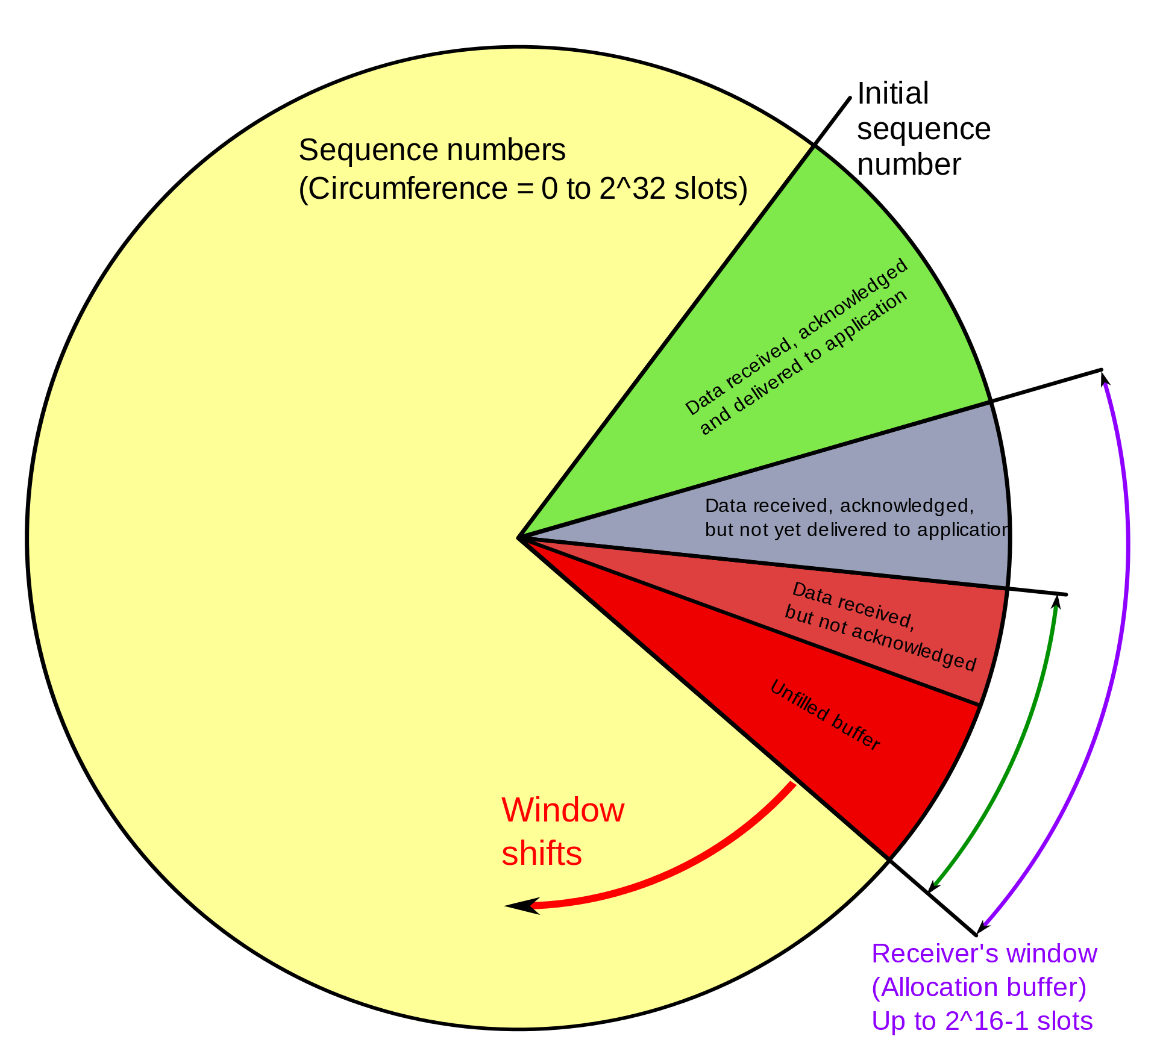
Receive, ACKed, sent to APP
Receive, ACKed, not sent to APP
Receive, not ACKed
Unused buffer
PC: https://en.wikipedia.org/wiki/Transmission_Control_Protocol

Slide 8
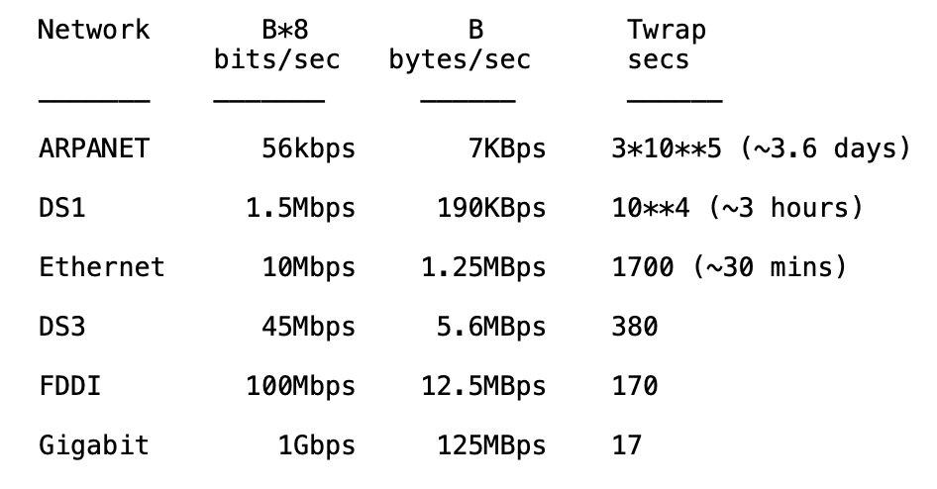
Wrap around is possible
REF: RFC 1323

Slide 9
Wrap around-aware sequence number comparison
(modulo arithmatic)
If A and B are sequence numbers,
A < B if 0 < (B - A) < 2**31,
computed in signed 32-bit arithmetic
Maximum segment lifetime (MSL, ~2 minutes) should be shorter than wrap-around-time, i.e., 2**31 / B > MSL (secs)
PAWS: Protect Against Wrapped Sequence Numbers
(RFC 1323) – Use sequence number and timestamps.
REF: RFC 1323

Slide 10
A few design decisions
  1. Unique packet identifiers: Why and how
  2. Duplicate packets: Why and how to eliminate
  3. Timeout: picking the ideal value

Slide 11
A few design decisions
  2. Duplicate packets: Why and how to eliminate
  - Receiver maintain the last in-sequence byte number in a variable, say rcv_seqnum
  - If the Receiver receives a packet with seq number less than or equal to rcv_seqnum

Slide 12
A few design decisions
  2. Duplicate packets: Why and how to eliminate
  - Receiver maintain the last in-sequence byte number in a variable, say rcv_seqnum
  - If the Receiver receives a packet with seq number less than or equal to rcv_seqnum
  >>It sends an ACK for that packet, and discards the packet
  - If the Receiver receives a packet with seq number (rcv_seqnum+1):

Slide 13
A few design decisions
  2. Duplicate packets: Why and how to eliminate
  - Receiver maintain the last in-sequence byte number in a variable, say rcv_seqnum
  - If the Receiver receives a packet with seq number less than or equal to rcv_seqnum
  >>It sends an ACK for that packet, and discards the packet
  - If the Receiver receives a packet with seq number (rcv_seqnum+1):
  >> It sends an ACK for that packet, and includes the packet to the application buffer

Slide 14
A few design decisions
  2. Duplicate packets: Why and how to eliminate
  - Receiver maintain the last in-sequence byte number in a variable, say rcv_seqnum
  - If the Receiver receives a packet with seq number less than or equal to rcv_seqnum
  >>It sends an ACK for that packet, and discards the packet
  - If the Receiver receives a packet with seq number (rcv_seqnum+1):
  >> It sends an ACK for that packet, and includes the packet to the application buffer
  - What if the receiver gets a packet with seq number greater than (rcv_seqnum+1) ?

Slide 15
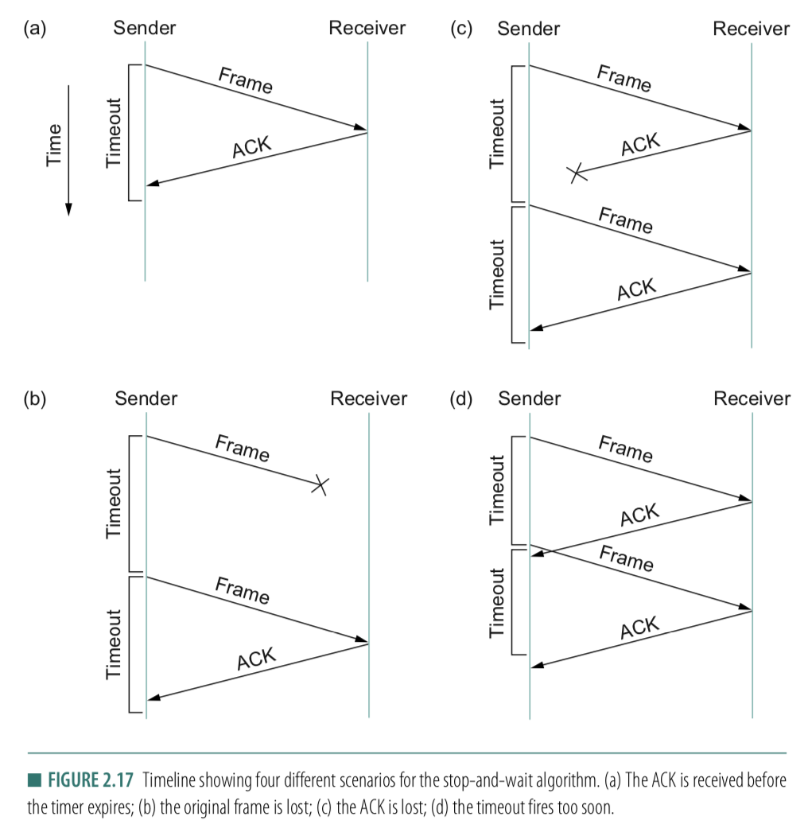
A few design decisions
  3. Timeout: picking the ideal value
  - What if the timeout is too small?
  - What if the timeout is too large?
  - Round-Trip time (RTT)

Slide 16
A few design decisions
  1. Unique packet identifiers: Why and how
  2. Duplicate packets: Why and how to eliminate
  3. Timeout: picking the ideal value

Slide 17
Reasons for Retransmission
Packet
Packet
Packet
Timeout
Timeout
ACK
Timeout
ACK
Packet
Packet
Packet
ACK
Timeout
Timeout
Timeout
ACK
ACK
Packet lost
ACK lost
DUPLICATE
PACKET
Early timeout
DUPLICATE
PACKETS
Notes:
Application may get duplicates in the case of early timeouts

Slide 18
How Long Should Sender Wait?
Sender sets a timeout to wait for an ACK
  Too short:
  >> wasted retransmissions
  Too long:
  >> excessive delays when packet lost

Slide 19
How Long Should Sender Wait?
Sender sets a timeout to wait for an ACK
  Too short:
  >> wasted retransmissions
  Too long:
  >> excessive delays when packet lost
TCP sets timeout as a function of the RTT
  Expect ACK to arrive after a “round-trip time”
  … plus a fudge factor to account for queuing
But, how does the sender know the RTT?

Slide 20
How Long Should Sender Wait?
Sender sets a timeout to wait for an ACK
  Too short:
  >> wasted retransmissions
  Too long:
  >> excessive delays when packet lost
TCP sets timeout as a function of the RTT
  Expect ACK to arrive after a “round-trip time”
  … plus a fudge factor to account for queuing
But, how does the sender know the RTT?
  Running average of delay to receive an ACK

Slide 21
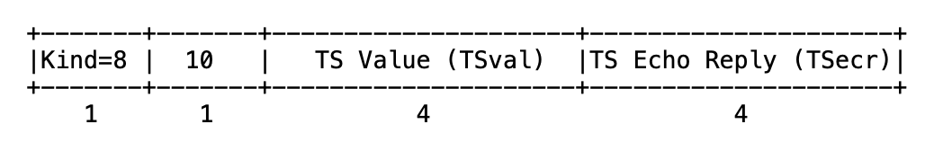
TCP timestamp

Slide 22
TCP timestamp
Sender’s current time

Slide 23
TCP Timestamp Option (10 bytes)
Sender’s current time
Copied timestamp from the packet
being acknowledged.
(valid only when the packet contains an ACK.
i.e., the ACK bit is set in TCP header).

Slide 24
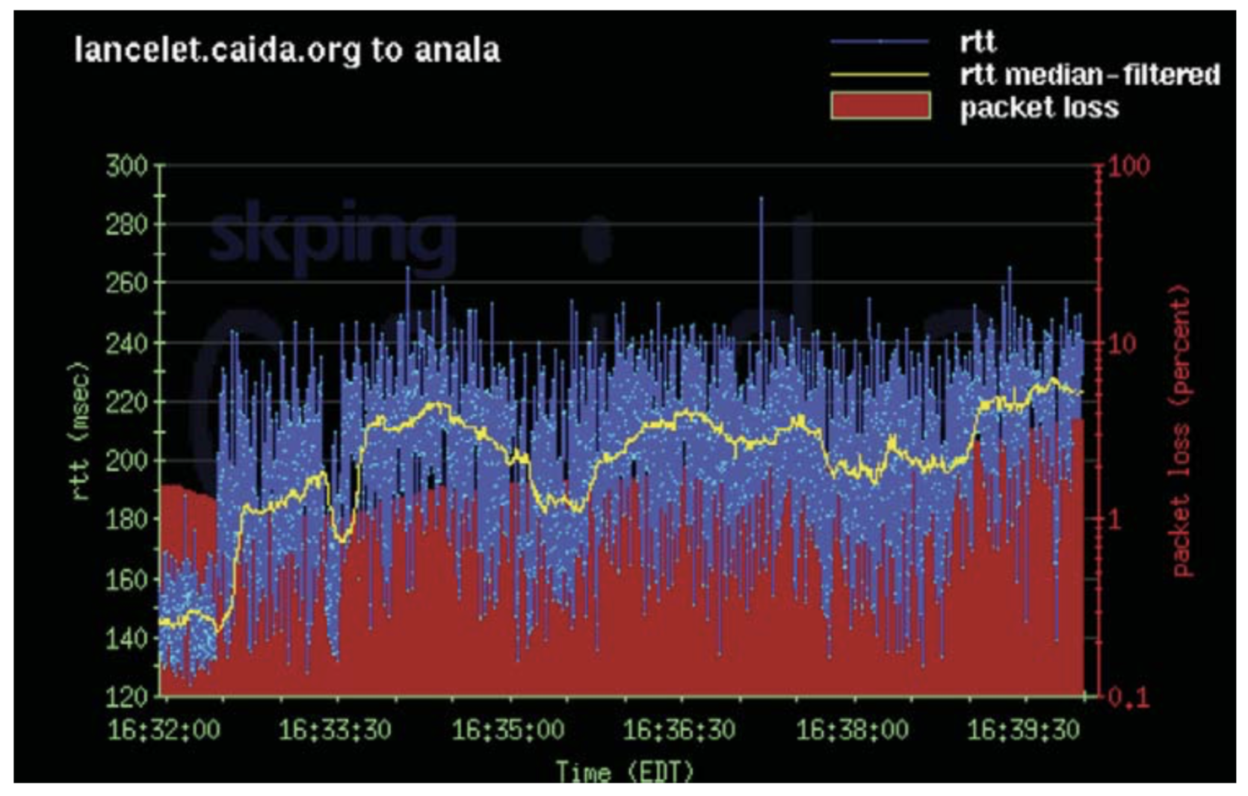
Example RTT Estimation

Slide 25
Reliable Delivery on a Lossy Channel With Bit Errors
TCP Flow control: Sliding Window Protocol

Slide 26
Motivation for Sliding Window
Stop-and-wait is inefficient
  Only one TCP segment is “in flight” at a time
  Especially bad for high “delay-bandwidth product”
bandwidth
delay

Slide 27
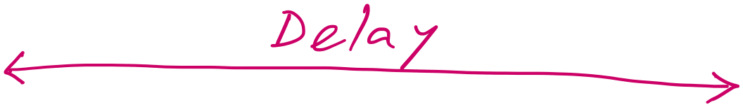
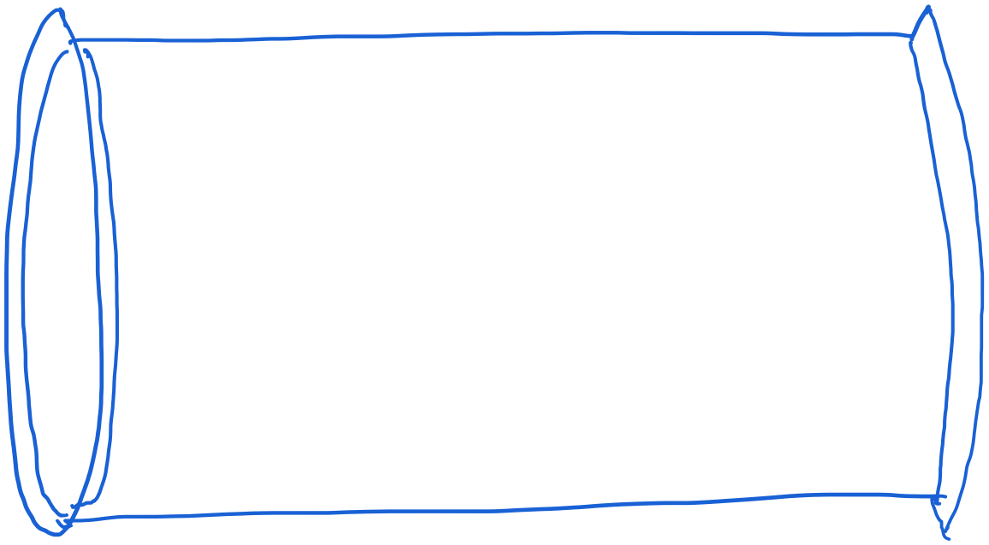
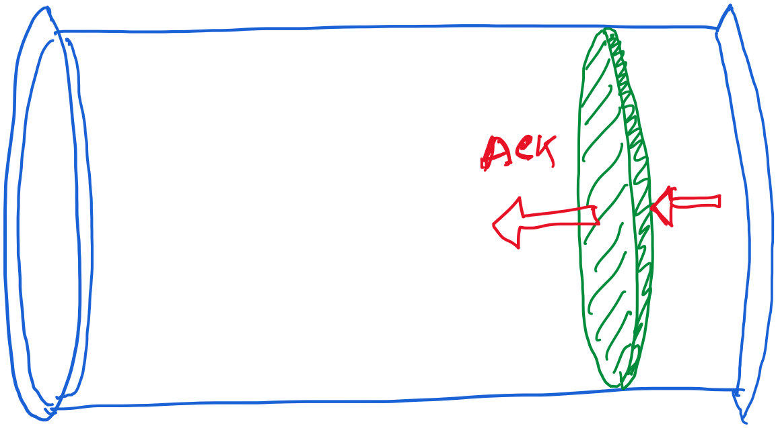
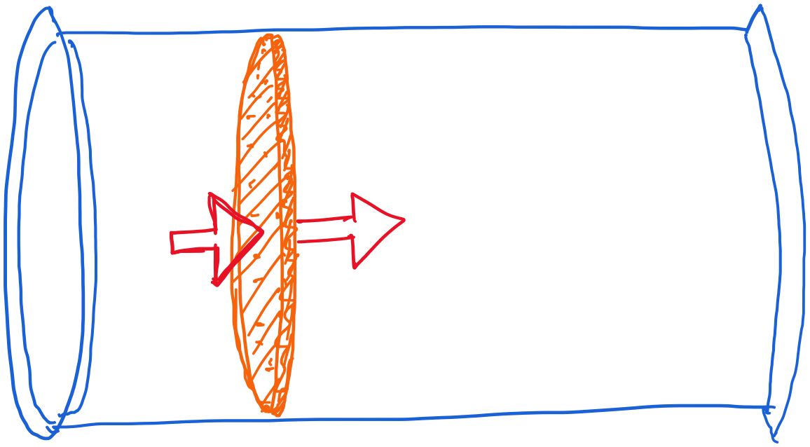
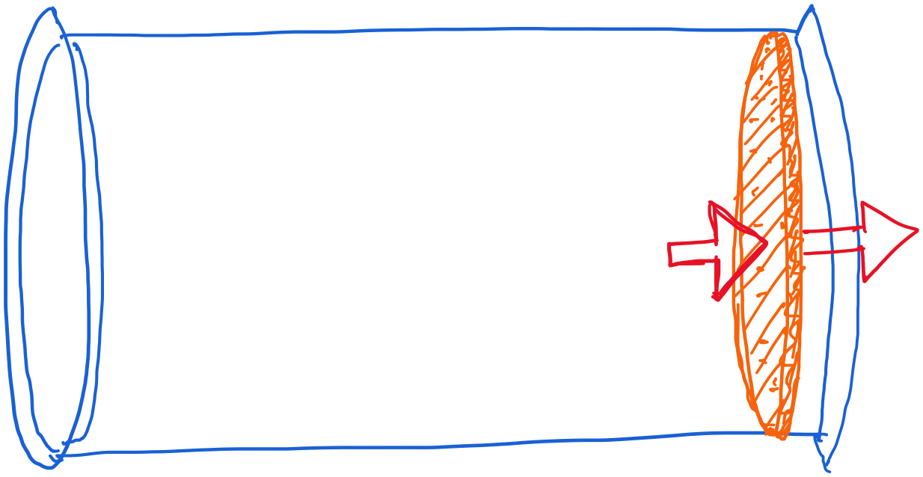
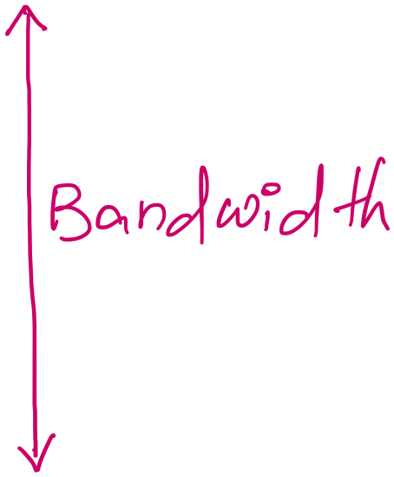
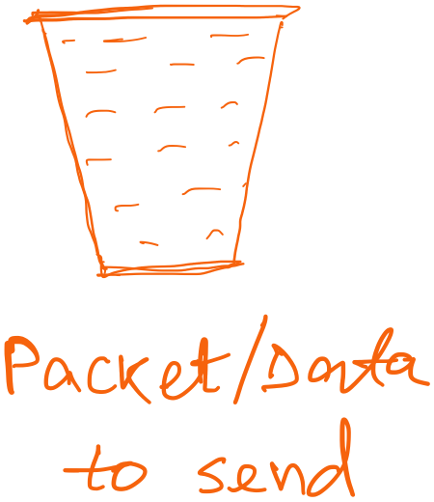
Revisiting “delay X bandwidth”

Slide 28
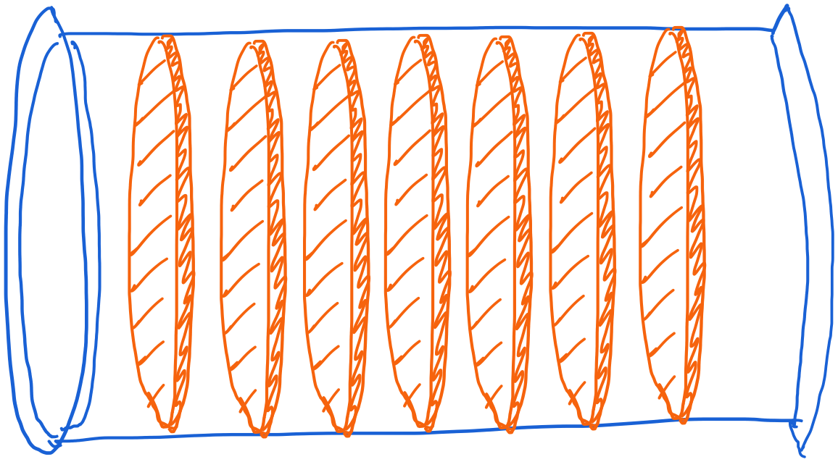
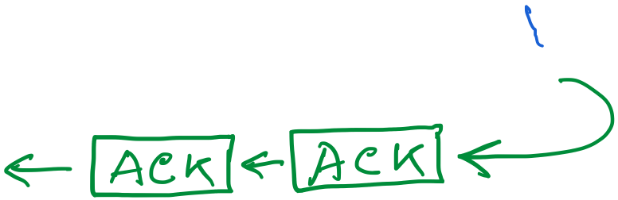
Revisiting “delay X bandwidth”

Slide 29
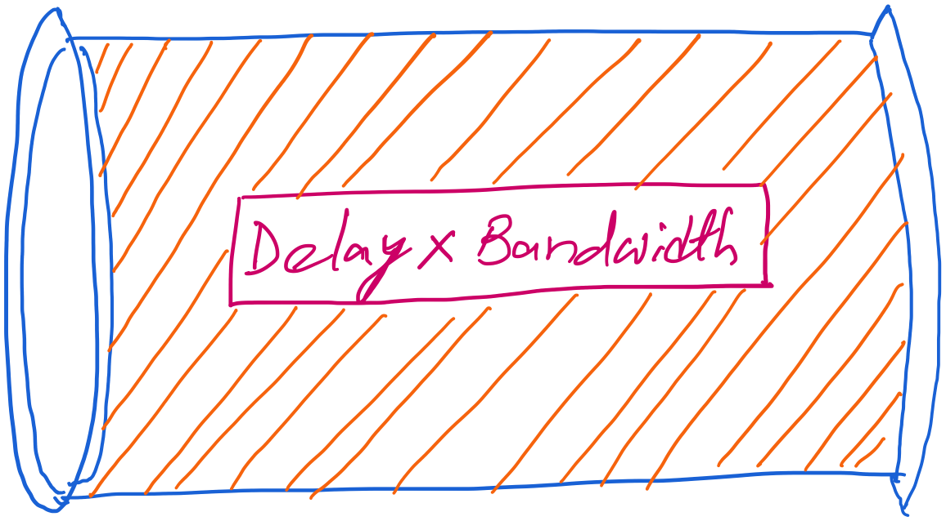
Revisiting “delay X bandwidth”

Slide 30
Revisiting “delay X bandwidth”
Consider two-way delay
or round-trip delay

Slide 31
Revisiting “delay X bandwidth”
Sender
Receiver
Packet
Round-trip delay
ACK
Time

Slide 32
stop-and-wait operation
sender
receiver
first packet bit transmitted, t = 0
last packet bit transmitted, t = L / R
first packet bit arrives
RTT
last packet bit arrives, send ACK
ACK arrives, send next
packet, t = RTT + L / R
Packet size = L bits
Network bandwidth = R bits-per-sec

Slide 33
Performance – an implementation of stop-and-wait
Stop-and-wait works, but performance stinks
ex: 1 Gbps link, 15 ms prop. delay, 8kbit (8000 bit) packet:
  U _{sender}: utilization – fraction of time sender busy sending
  1KB pkt every 30 msec -> 33kB/sec thruput over 1 Gbps link
  network protocol limits use of physical resources!

Slide 34
stop-and-wait operation
sender
receiver
first packet bit transmitted, t = 0
last packet bit transmitted, t = L / R
1kB packet per 30.008 msec
first packet bit arrives
RTT
last packet bit arrives, send ACK
ACK arrives, send next
packet, t = RTT + L / R
Packet size = L bits
Network bandwidth = R bits-per-sec

Slide 35
stop-and-wait operation
sender
receiver
first packet bit transmitted, t = 0
last packet bit transmitted, t = L / R
1kB packet per 30.008 msec
first packet bit arrives
RTT
last packet bit arrives, send ACK
~33KB/sec throughput over a 1GBPS link!!
ACK arrives, send next
packet, t = RTT + L / R
Packet size = L bits
Network bandwidth = R bits-per-sec

Slide 36
stop-and-wait operation
sender
receiver
first packet bit transmitted, t = 0
last packet bit transmitted, t = L / R
1kB packet per 30.008 msec
first packet bit arrives
RTT
last packet bit arrives, send ACK
~33KB/sec throughput over a 1GBPS link!!
ACK arrives, send next
packet, t = RTT + L / R
Network protocol limits the full utilization of physical resources.
Transport-layer vs Link-layer capacity gap
Packet size = L bits
Network bandwidth = R bits-per-sec

Slide 37
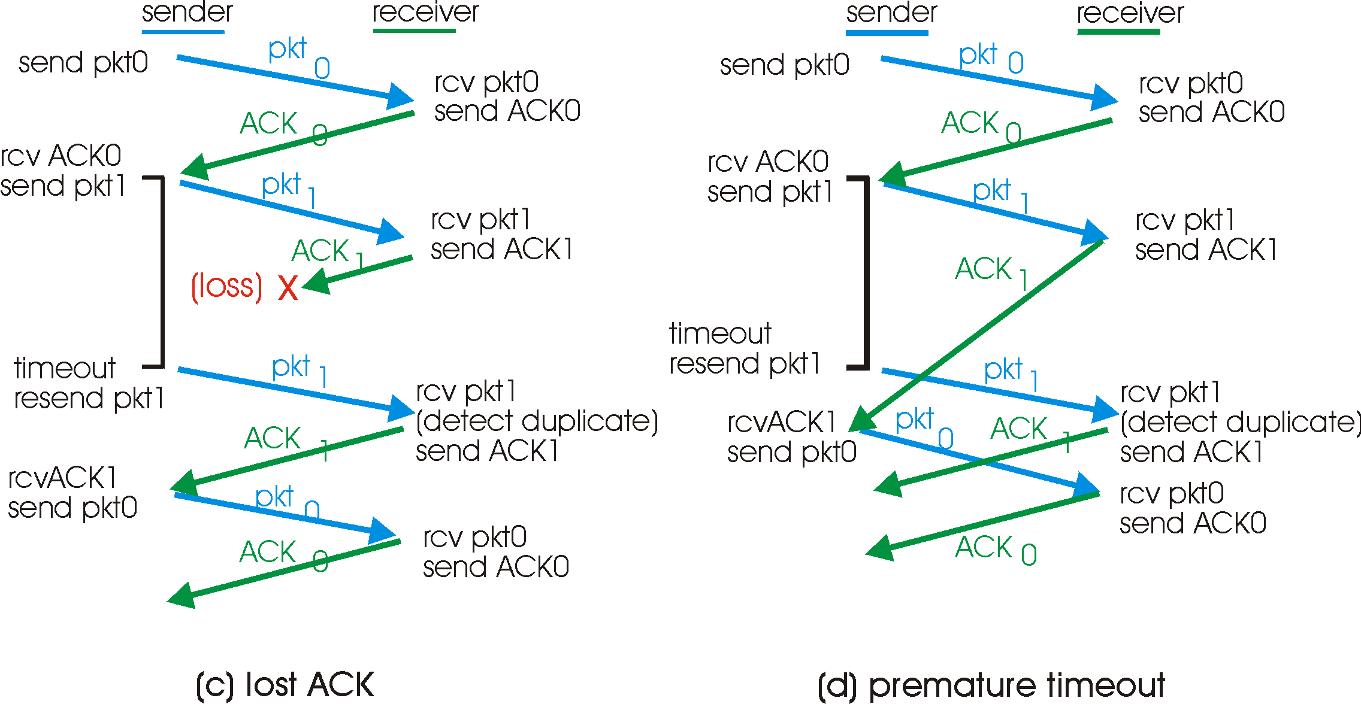
A problem in rdt3.0

Slide 38
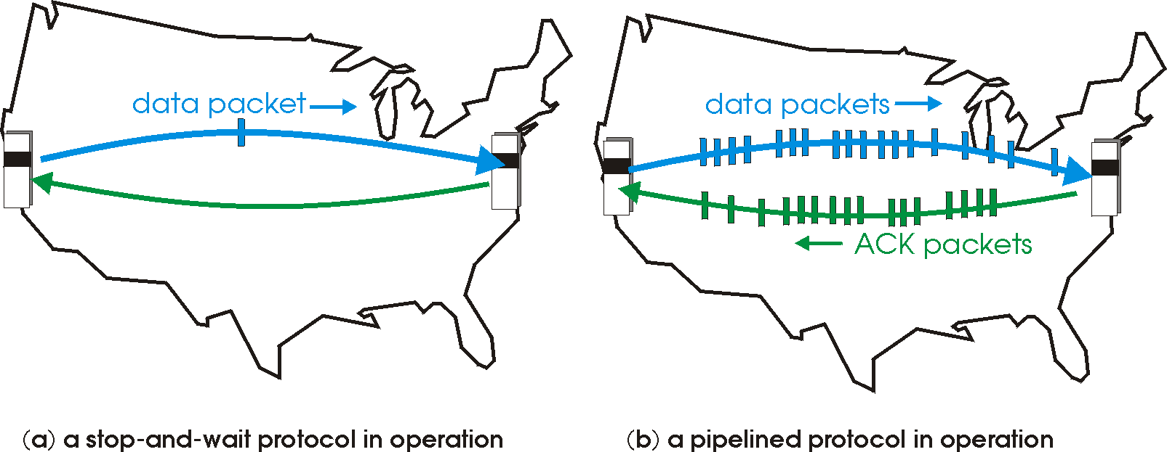
Pipelined protocols
Pipelining: sender allows multiple, “in-flight”, yet-to-be-acknowledged pkts
  range of sequence numbers must be increased
  buffering at sender and/or receiver
Two generic forms of pipelined protocols (or sliding window protocol) depending on the retransmission strategy: go-Back-N, selective repeat

Slide 39
Pipelining: increased utilization
sender
receiver
first packet bit transmitted, t = 0
last bit transmitted, t = L / R
first packet bit arrives
RTT
last packet bit arrives, send ACK
last bit of 2nd packet arrives, send ACK
last bit of 3rd packet arrives, send ACK
ACK arrives, send next
packet, t = RTT + L / R
Increase utilization
by a factor of 3!

Slide 40
Some Pipelining Protocols
Go-back-N: overview
sender: up to N unACKed pkts in pipeline
receiver: only sends cumulative ACKs
  doesn’t ACK pkt if there’s a gap
sender: has timer for oldest unACKed pkt
  if timer expires: retransmit all unACKed packets
Selective Repeat: overview
sender: up to N unACKed packets in pipeline
receiver: ACKs individual pkts
sender: maintains timer for each unACKed pkt
  if timer expires: retransmit only unACKed packet

Slide 41
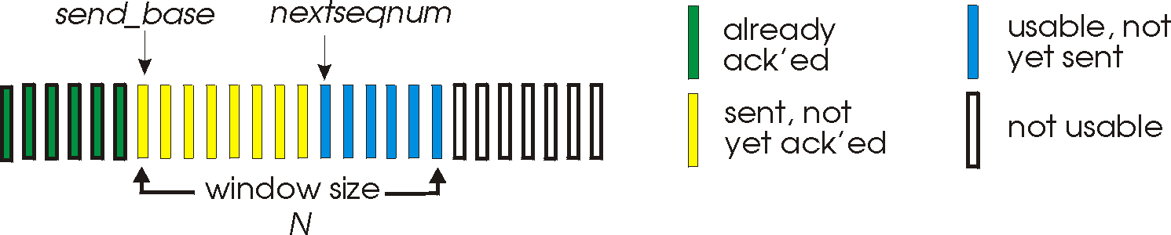
Go-Back-N
Sender:
k-bit seq # in pkt header
“window” of up to N, consecutive unACKed pkts allowed
ACK(n): ACKs all pkts up to, including seq # n - “cumulative ACK”
  may receive duplicate ACKs (see receiver)
timer for each in-flight pkt
timeout(n): retransmit pkt n and all higher seq # pkts in window

Slide 42
Revisiting “delay X bandwidth”
Sender
Receiver
Round-trip delay
Time

Slide 43
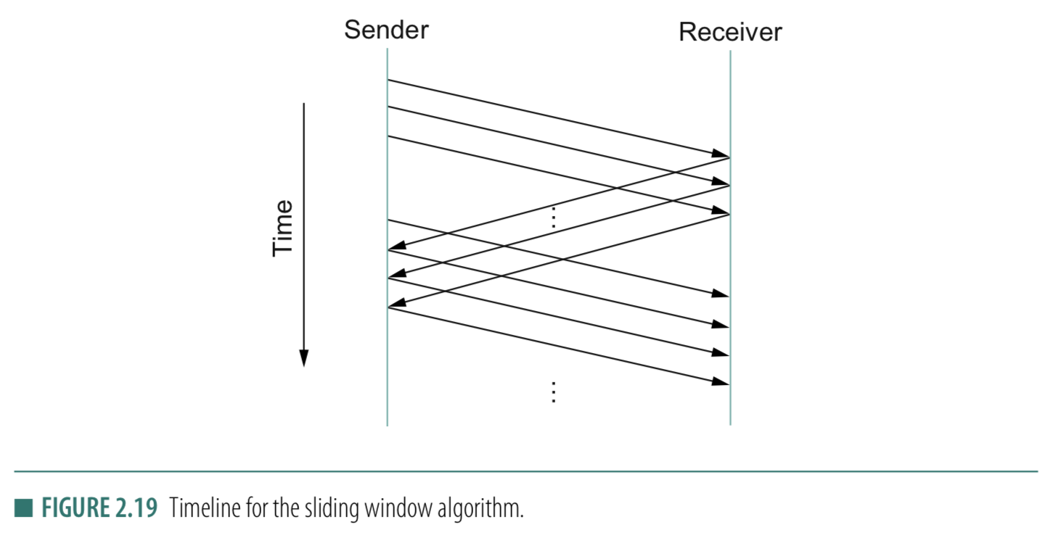
Stop-and-wait
Sliding Window
Sender
Receiver
Packet
Timeout
ACK
Time

Slide 44
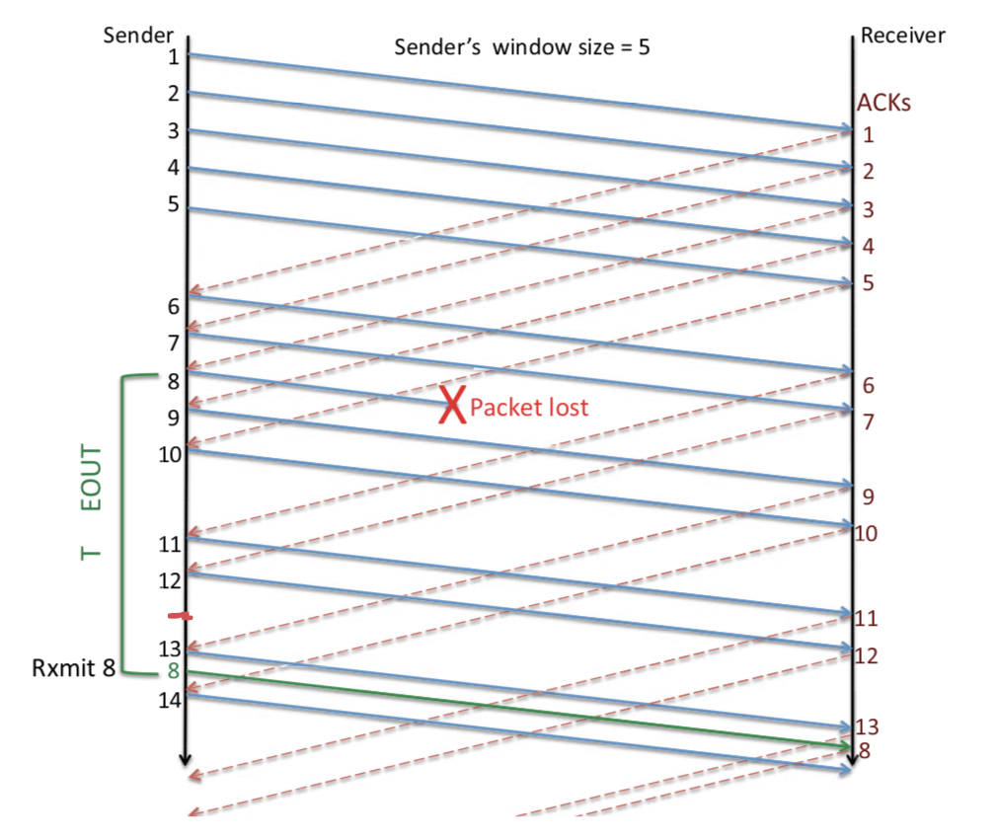
Sliding Window: Lost Packet/ACK

Slide 45
Sliding Window Protocol

Slide 46
Sliding Window: A series of packets to be sent reliably
Window = # pkt in flight
Pkt:1
Pkt:2
Pkt:3
Pkt:4
Pkt:5
Pkt:6
Pkt:7
Pkt:8
Sent
Sent
Sent

Slide 47
Sliding Window: A series of packets to be sent reliably
Window = # pkt in flight
Pkt:1
Pkt:2
Pkt:3
Pkt:4
Pkt:5
Pkt:6
Pkt:7
Pkt:8
Sent
Sent
Sent
ACK

Slide 48

Sliding Window: A series of packets to be sent reliably
Window = # pkt in flight
Pkt:1
Pkt:2
Pkt:3
Pkt:4
Pkt:5
Pkt:6
Pkt:7
Pkt:8
Sent
Sent
Packet 1 is delivered

Slide 49
Sliding Window: A series of packets to be sent reliably
Window = # pkt in flight
Pkt:1
Pkt:2
Pkt:3
Pkt:4
Pkt:5
Pkt:6
Pkt:7
Pkt:8
Sent
Sent
Packet 1 is delivered. Slide the window.

Slide 50
Sliding Window: A series of packets to be sent reliably
Window = # pkt in flight
Pkt:1
Pkt:2
Pkt:3
Pkt:4
Pkt:5
Pkt:6
Pkt:7
Pkt:8
Sent
Sent
Sent
Packet 1 is delivered. Slide the window.

Slide 51
Sliding Window: A series of packets to be sent reliably
Sender
Receiver
Time

Slide 52
Sliding Window: A series of packets to be sent reliably
Window = # pkt in flight
Pkt:1
Pkt:2
Pkt:3
Pkt:4
Pkt:5
Pkt:6
Pkt:7
Pkt:8
Sent
Sent
Sent
Packet 1 is delivered. Slide the window.

Slide 53
Sliding Window: A series of packets to be sent reliably
Should we advance the window in the following scenario?
Window = # pkt in flight
Pkt:1
Pkt:2
Pkt:3
Pkt:4
Pkt:5
Pkt:6
Pkt:7
Pkt:8
Sent
Sent
Sent
ACK

Slide 54
Sliding Window: A series of packets to be sent reliably
Sender
Receiver
Time

Slide 55
Sliding Window: A series of packets to be sent reliably
Should we advance the window in the following scenario?
Window = # pkt in flight
Pkt:1
Pkt:2
Pkt:3
Pkt:4
Pkt:5
Pkt:6
Pkt:7
Pkt:8
Sent
Sent
Sent
ACK

Slide 56
Sliding Window: A series of packets to be sent reliably
Should we advance the window in the following scenario?
Window = # pkt in flight
Pkt:1
Pkt:2
Pkt:3
Pkt:4
Pkt:5
Pkt:6
Pkt:7
Pkt:8
Sent
Sent
Sent
ACK
Note that the window size is not changed!

Slide 57
Sliding Window: A series of packets to be sent reliably
Window = # pkt in flight
Pkt:1
Pkt:2
Pkt:3
Pkt:4
Pkt:5
Pkt:6
Pkt:7
Pkt:8
Sent
Sent
Sent
Can you make sliding window behave like
stop-and-wait?

Slide 58
Sliding Window Protocol
(dealing packet loss)

Slide 59
Sliding Window: A series of packets to be sent reliably
Window = # pkt in flight
Pkt:1
Pkt:2
Pkt:3
Pkt:4
Pkt:5
Pkt:6
Pkt:7
Pkt:8
Sent
Sent
Sent

Slide 60
Sliding Window: A series of packets to be sent reliably
Window = # pkt in flight
Pkt:1
Pkt:2
Pkt:3
Pkt:4
Pkt:5
Pkt:6
Pkt:7
Pkt:8
Sent
Sent
Sent
Re-tx
Re-tx
Re-tx
(1) ARQ strategy 1: Retransmit all un-ACKed packets

Slide 61
Sliding Window: A series of packets to be sent reliably
(1) Go-back-N (Sender side)
Sender
Receiver
1
2
3
Timeout
X
1
2
3
Time

Slide 62
Sliding Window: A series of packets to be sent reliably
Window = # pkt in flight
Pkt:1
Pkt:2
Pkt:3
Pkt:4
Pkt:5
Pkt:6
Pkt:7
Pkt:8
Sent
Sent
Sent
Re-tx
(2) ARQ strategy 2: Retransmit only the lost packet
(2) Selective retransmit (Sender side)

Slide 63
Sliding Window: A series of packets to be sent reliably
(2) Selective retransmit
Sender
Receiver
1
2
3
Timeout
X
4
5
2
Time

Slide 64
Sliding Window: Lost Packet/ACK
Timeout

Slide 65
TCP Cumulative ACK strategy (receiver side)
Cumulative ACK:
ACK the largest in-sequence packet received.
What will be ACK sequence if the receive sequence
is: 5, 7, 8, 6 ?

Slide 66
TCP Cumulative ACK strategy (receiver side)
Cumulative ACK:
ACK the largest in-sequence packet received.
What will be ACK sequence if the receive sequence
is: 5, 7, 8, 6 ?
ACK: 6, 6, 6, 9

Slide 67
TCP Cumulative ACK strategy (receiver side)
(A more precise example)
Sender
Receiver
X

Slide 68
TCP Cumulative ACK strategy (receiver side)
(A more specific example)
Seq. # | 234118
ACK flag | N/A
ACK # | N/A
Data Len | 100 bytes
Sender
Receiver
234118
Seq. # | 234218
ACK flag | N/A
ACK # | N/A
Data Len | 50 bytes
234218
X
234268
Seq. # | 234268
ACK flag | N/A
ACK # | N/A
Data Len | 120 bytes
234388
Seq. # | 234388
ACK flag | N/A
ACK # | N/A
Data Len | 100 bytes

Slide 69
TCP Cumulative ACK strategy (receiver side)
(A more specific example)
Seq. # | 234118
ACK flag | N/A
ACK # | N/A
Data Len | 100 bytes
Sender
Receiver
234118
Seq. # | 234218
ACK flag | N/A
ACK # | N/A
Data Len | 50 bytes
234218
X
Timeout
234268
Seq. # | 234268
ACK flag | N/A
ACK # | N/A
Data Len | 120 bytes
234388
Seq. # | 234388
ACK flag | N/A
ACK # | N/A
Data Len | 100 bytes

Slide 70
TCP Cumulative ACK strategy (receiver side)
(A more specific example)
Seq. # | 234118
ACK flag | N/A
ACK # | N/A
Data Len | 100 bytes
Sender
Receiver
234118
Seq. # | 234218
ACK flag | N/A
ACK # | N/A
Data Len | 50 bytes
234218
X
234268
Seq. # | 234268
ACK flag | N/A
ACK # | N/A
Data Len | 120 bytes
234388
Seq. # | 234388
ACK flag | N/A
ACK # | N/A
Data Len | 100 bytes
234218

Slide 71
TCP Cumulative ACK strategy (receiver side)
(A more specific example)
Sender
Receiver
234118
Seq. # | 234118
Data Len | 100 bytes
234218
X
234268
Seq. # | 234268
Data Len | 120 bytes
234388
Seq. # | 234388
Data Len | 100 bytes
234218
Seq. # | 234218
Data Len | 50 bytes

Slide 72
TCP Cumulative ACK strategy (receiver side)
(A more specific example)
Sender
Receiver
ACKs
234118
Seq. # | 234118
Data Len | 100 bytes
ACK flag | 1
ACK #
234218
X
234268
Seq. # | 234268
Data Len | 120 bytes
ACK flag | 1
ACK #
234388
Seq. # | 234388
Data Len | 100 bytes
ACK flag | 1
ACK #
234218
Seq. # | 234218
Data Len | 50 bytes
ACK flag | 1
ACK #

Slide 73
TCP Cumulative ACK strategy (receiver side)
Sender buffer:
234118
234218
234268
234388
100 bytes
50 bytes
120 bytes
100 bytes
Receiver buffer:

Slide 74
TCP Cumulative ACK strategy (receiver side)
Sender buffer:
234118
234218
234268
234388
100 bytes
50 bytes
120 bytes
100 bytes
Receiver buffer:
234118
100 bytes

Slide 75
TCP Cumulative ACK strategy (receiver side)
Sender buffer:
234118
234218
234268
234388
100 bytes
50 bytes
120 bytes
100 bytes
Receiver buffer:
234118
100 bytes
234218

Slide 76
TCP Cumulative ACK strategy (receiver side)
Sender buffer:
234118
234218
234268
234388
100 bytes
50 bytes
120 bytes
100 bytes
Receiver buffer:
234118
234268
100 bytes
120 bytes
234218

Slide 77
TCP Cumulative ACK strategy (receiver side)
Sender buffer:
234118
234218
234268
234388
100 bytes
50 bytes
120 bytes
100 bytes
Receiver buffer:
234118
234268
234388
100 bytes
120 bytes
100 bytes
234218

Slide 78
TCP Cumulative ACK strategy (receiver side)
Sender buffer:
234118
234218
234268
234388
100 bytes
50 bytes
120 bytes
100 bytes
Receiver buffer:
234118
234218
234268
234388
100 bytes
50 bytes
120 bytes
100 bytes

Slide 79
TCP Cumulative ACK strategy (receiver side)
Sender buffer:
234118
234218
234268
234388
100 bytes
50 bytes
120 bytes
100 bytes
Receiver buffer:
234118
234218
234268
234388
100 bytes
50 bytes
120 bytes
100 bytes
234488

Slide 80
TCP Cumulative ACK strategy (receiver side)
Sender buffer:
234118
234218
234268
234388
100 bytes
50 bytes
120 bytes
100 bytes
Receiver buffer:
234118
234218
234268
234388
100 bytes
50 bytes
120 bytes
100 bytes

Slide 81
TCP Cumulative ACK strategy (receiver side)
(A more specific example)
Sender
Receiver
ACKs
234118
Seq. # | 234118
Data Len | 100 bytes
ACK flag | 1
ACK # | 234218
234218
X
234268
Seq. # | 234268
Data Len | 120 bytes
ACK flag | 1
ACK # | 234218
234388
Seq. # | 234388
Data Len | 100 bytes
ACK flag | 1
ACK # | 234218
234218
Seq. # | 234218
Data Len | 50 bytes
ACK flag | 1
ACK # | 234488

Slide 82
Flow Control:
TCP Sliding Window
Motivation: Maximum utilization of the resources without overwhelming the receiver.

Slide 83
Sliding Window
Receiver should have enough space to buffer/save the received data !!

Slide 84
Sliding Window: Implementation
Allow a larger amount of data “in flight” for better channel utilization, but should not exceed receiver’s capacity.
Sending process
Receiving process
TCP
TCP
Last byte written
Last byte read
Window
Next byte expected
Last byte ACKed
Last byte sent
Last byte received

Slide 85
Sliding Window: Implementation
Allow a larger amount of data “in flight”
  Allow sender to get ahead of the receiver
  … though not too far ahead
Sending process
Receiving process
TCP
TCP
Last byte written
Last byte read
Window
Next byte expected
Last byte ACKed
Last byte sent
Last byte received

Slide 86
Receiver Buffering: Flow control
Receive window size
  Amount that can be sent without acknowledgment
  Receiver must be able to store this amount of data
Receiver tells the sender the window
  Tells the sender the amount of free space left (i.e. sends an Advertised_Window size to the sender)

Slide 87
How to send the Advertised_Window size

Slide 88
Calculate Advertised_Window (Receiver side)
Receiving process
TCP
Last byte read
Next byte expected
Last byte received
AdvertisedWindow = MaxRcvBuffer – (bytes used)
AdvertisedWindow = MaxRcvBuffer –
((NextByteExpected-1) – LastByteRead)

Slide 89
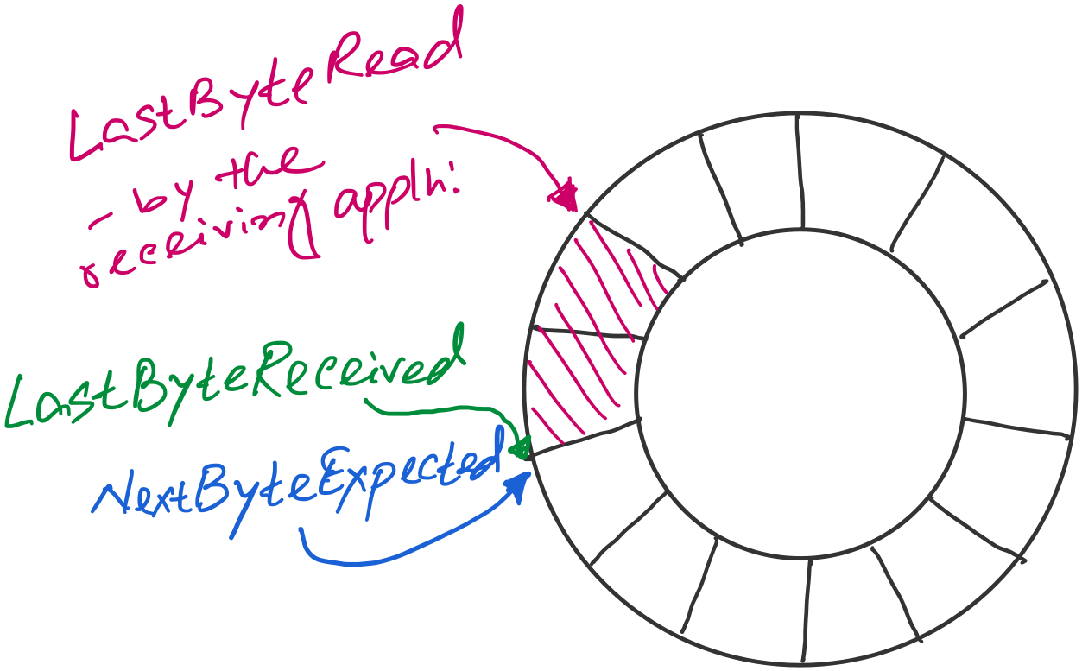
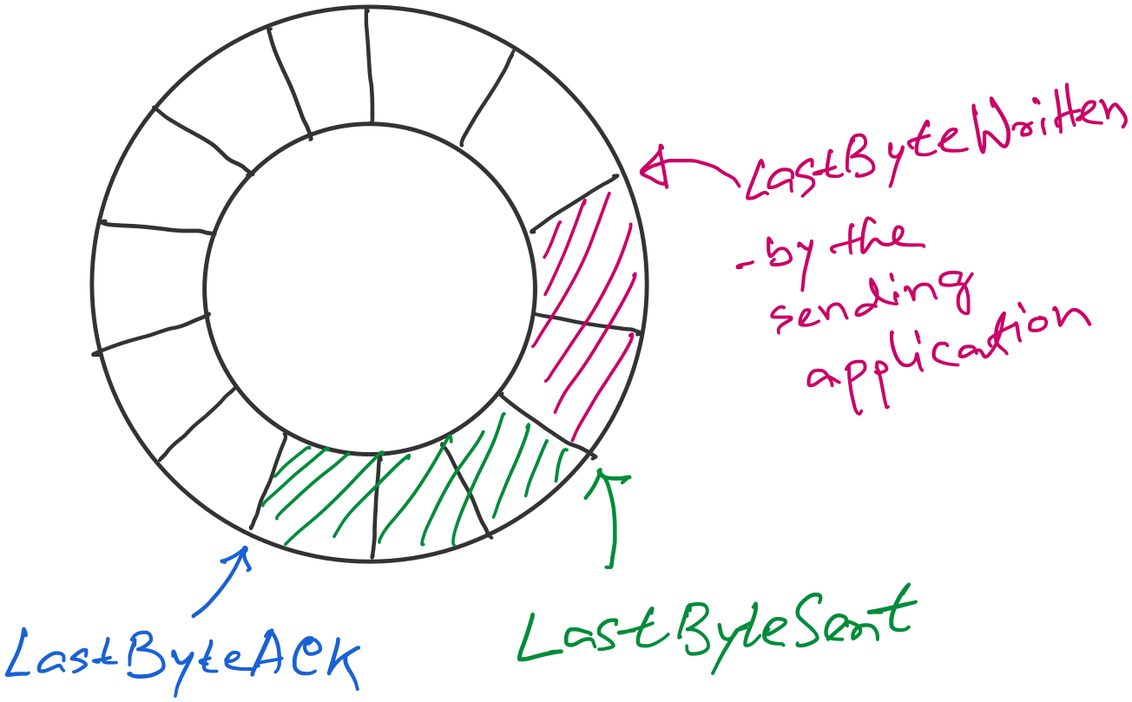
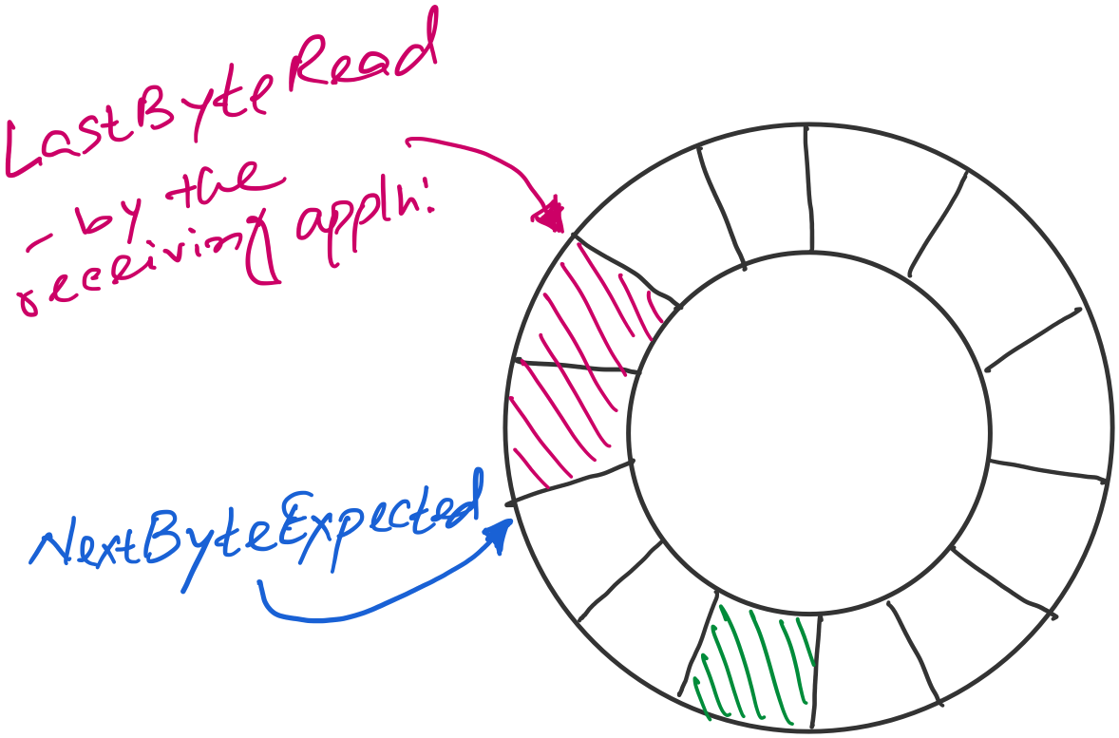

Sender buffer
Receiver buffer

Slide 90
Sender buffer
Receiver buffer
What if the AdvertisedWindow is zero?
>> Periodically send 1byte packets to break the deadlock. (uses the persist timer)
AdvertisedWindow = MaxRcvBuffer –
((NextByteExpected-1) – LastByteRead)
EffectiveWindow (calculated at the sender side)
= AdvertisedWindow - (LastByteSent – LastByteACKed)

Slide 91
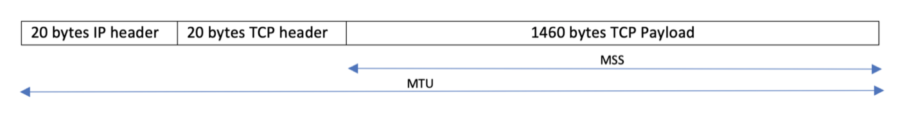
Considering Maximum Segment Size (MSS)
What if…
(1) Adv_window > MSS
(2) Adv_window < MSS

Slide 92
Sliding Window Protocol

Slide 93
Sliding Window: A series of packets to be sent reliably
Window = # pkt in flight
Pkt:1
Pkt:2
Pkt:3
Pkt:4
Pkt:5
Pkt:6
Pkt:7
Pkt:8
Sent
Sent
Sent

Slide 94
Sliding Window: A series of packets to be sent reliably
Window = # pkt in flight
Pkt:1
Pkt:2
Pkt:3
Pkt:4
Pkt:5
Pkt:6
Pkt:7
Pkt:8
Sent
Sent
Sent
ACK

Slide 95
Sliding Window: A series of packets to be sent reliably
Window = # pkt in flight
Pkt:1
Pkt:2
Pkt:3
Pkt:4
Pkt:5
Pkt:6
Pkt:7
Pkt:8
Sent
Sent
Packet 1 is delivered

Slide 96
Sliding Window: A series of packets to be sent reliably
Window = # pkt in flight
Pkt:1
Pkt:2
Pkt:3
Pkt:4
Pkt:5
Pkt:6
Pkt:7
Pkt:8
Sent
Sent
Packet 1 is delivered. Slide the window.

Slide 97
Sliding Window: A series of packets to be sent reliably
Window = # pkt in flight
Pkt:1
Pkt:2
Pkt:3
Pkt:4
Pkt:5
Pkt:6
Pkt:7
Pkt:8
Sent
Sent
Sent
Packet 1 is delivered. Slide the window.

Slide 98
Sliding Window: A series of packets to be sent reliably
Sender
Receiver
Time

