Slide 1

Computer Networks
CMSC 417 : Spring 2025
Topic: TCP Flow-control and Congestion-control
(Textbook chapter 5 & 6)
Nirupam Roy
Tu-Th 2:00-3:15pm
CSI 2117
March 31st, 2025

Slide 2

Sliding Window: A series of packets to be sent reliably
Window = # pkt in flight
Pkt:1
Pkt:2
Pkt:3
Pkt:4
Pkt:5
Pkt:6
Pkt:7
Pkt:8
Sent
Sent
Sent
Re-tx
(2) ARQ strategy 2: Retransmit only the lost packet
(2) Selective retransmit (Sender side)

Slide 3
Sliding Window: A series of packets to be sent reliably
(2) Selective retransmit
Sender
Receiver
1
2
3
Timeout
X
4
5
2
Time

Slide 4
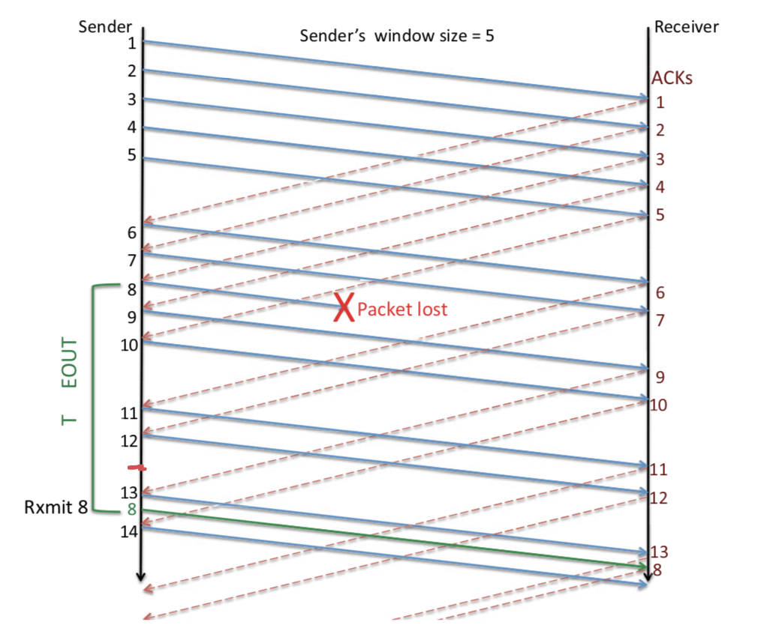
Sliding Window: Lost Packet/ACK
Timeout

Slide 5
TCP Cumulative ACK strategy (receiver side)
Cumulative ACK:
ACK the largest in-sequence packet received.
What will be ACK sequence if the receive sequence
is: 5, 7, 8, 6 ?

Slide 6
TCP Cumulative ACK strategy (receiver side)
Cumulative ACK:
ACK the largest in-sequence packet received.
What will be ACK sequence if the receive sequence
is: 5, 7, 8, 6 ?
ACK: 6, 6, 6, 9

Slide 7
TCP Cumulative ACK strategy (receiver side)
(A more precise example)
Sender
Receiver
X

Slide 8
TCP Cumulative ACK strategy (receiver side)
(A more specific example)
Seq. # | 234118
ACK flag | N/A
ACK # | N/A
Data Len | 100 bytes
Sender
Receiver
234118
Seq. # | 234218
ACK flag | N/A
ACK # | N/A
Data Len | 50 bytes
234218
X
234268
Seq. # | 234268
ACK flag | N/A
ACK # | N/A
Data Len | 120 bytes
234388
Seq. # | 234388
ACK flag | N/A
ACK # | N/A
Data Len | 100 bytes

Slide 9
TCP Cumulative ACK strategy (receiver side)
(A more specific example)
Seq. # | 234118
ACK flag | N/A
ACK # | N/A
Data Len | 100 bytes
Sender
Receiver
234118
Seq. # | 234218
ACK flag | N/A
ACK # | N/A
Data Len | 50 bytes
234218
X
Timeout
234268
Seq. # | 234268
ACK flag | N/A
ACK # | N/A
Data Len | 120 bytes
234388
Seq. # | 234388
ACK flag | N/A
ACK # | N/A
Data Len | 100 bytes

Slide 10
TCP Cumulative ACK strategy (receiver side)
(A more specific example)
Seq. # | 234118
ACK flag | N/A
ACK # | N/A
Data Len | 100 bytes
Sender
Receiver
234118
Seq. # | 234218
ACK flag | N/A
ACK # | N/A
Data Len | 50 bytes
234218
X
234268
Seq. # | 234268
ACK flag | N/A
ACK # | N/A
Data Len | 120 bytes
234388
Seq. # | 234388
ACK flag | N/A
ACK # | N/A
Data Len | 100 bytes
234218

Slide 11
TCP Cumulative ACK strategy (receiver side)
(A more specific example)
Sender
Receiver
234118
Seq. # | 234118
Data Len | 100 bytes
234218
X
234268
Seq. # | 234268
Data Len | 120 bytes
234388
Seq. # | 234388
Data Len | 100 bytes
234218
Seq. # | 234218
Data Len | 50 bytes

Slide 12
TCP Cumulative ACK strategy (receiver side)
(A more specific example)
Sender
Receiver
ACKs
234118
Seq. # | 234118
Data Len | 100 bytes
ACK flag | 1
ACK #
234218
X
234268
Seq. # | 234268
Data Len | 120 bytes
ACK flag | 1
ACK #
234388
Seq. # | 234388
Data Len | 100 bytes
ACK flag | 1
ACK #
234218
Seq. # | 234218
Data Len | 50 bytes
ACK flag | 1
ACK #

Slide 13
TCP Cumulative ACK strategy (receiver side)
Sender buffer:
234118
234218
234268
234388
100 bytes
50 bytes
120 bytes
100 bytes
Receiver buffer:

Slide 14
TCP Cumulative ACK strategy (receiver side)
Sender buffer:
234118
234218
234268
234388
100 bytes
50 bytes
120 bytes
100 bytes
Receiver buffer:
234118
100 bytes

Slide 15
TCP Cumulative ACK strategy (receiver side)
Sender buffer:
234118
234218
234268
234388
100 bytes
50 bytes
120 bytes
100 bytes
Receiver buffer:
234118
100 bytes
234218

Slide 16
TCP Cumulative ACK strategy (receiver side)
Sender buffer:
234118
234218
234268
234388
100 bytes
50 bytes
120 bytes
100 bytes
Receiver buffer:
234118
234268
100 bytes
120 bytes
234218

Slide 17
TCP Cumulative ACK strategy (receiver side)
Sender buffer:
234118
234218
234268
234388
100 bytes
50 bytes
120 bytes
100 bytes
Receiver buffer:
234118
234268
234388
100 bytes
120 bytes
100 bytes
234218

Slide 18
TCP Cumulative ACK strategy (receiver side)
Sender buffer:
234118
234218
234268
234388
100 bytes
50 bytes
120 bytes
100 bytes
Receiver buffer:
234118
234218
234268
234388
100 bytes
50 bytes
120 bytes
100 bytes

Slide 19
TCP Cumulative ACK strategy (receiver side)
Sender buffer:
234118
234218
234268
234388
100 bytes
50 bytes
120 bytes
100 bytes
Receiver buffer:
234118
234218
234268
234388
100 bytes
50 bytes
120 bytes
100 bytes
234488

Slide 20
TCP Cumulative ACK strategy (receiver side)
Sender buffer:
234118
234218
234268
234388
100 bytes
50 bytes
120 bytes
100 bytes
Receiver buffer:
234118
234218
234268
234388
100 bytes
50 bytes
120 bytes
100 bytes

Slide 21
TCP Cumulative ACK strategy (receiver side)
(A more specific example)
Sender
Receiver
ACKs
234118
Seq. # | 234118
Data Len | 100 bytes
ACK flag | 1
ACK # | 234218
234218
X
234268
Seq. # | 234268
Data Len | 120 bytes
ACK flag | 1
ACK # | 234218
234388
Seq. # | 234388
Data Len | 100 bytes
ACK flag | 1
ACK # | 234218
234218
Seq. # | 234218
Data Len | 50 bytes
ACK flag | 1
ACK # | 234488

Slide 22
Flow Control: TCP Sliding Window
Motivation: Maximum utilization of the resources without overwhelming the receiver.

Slide 23
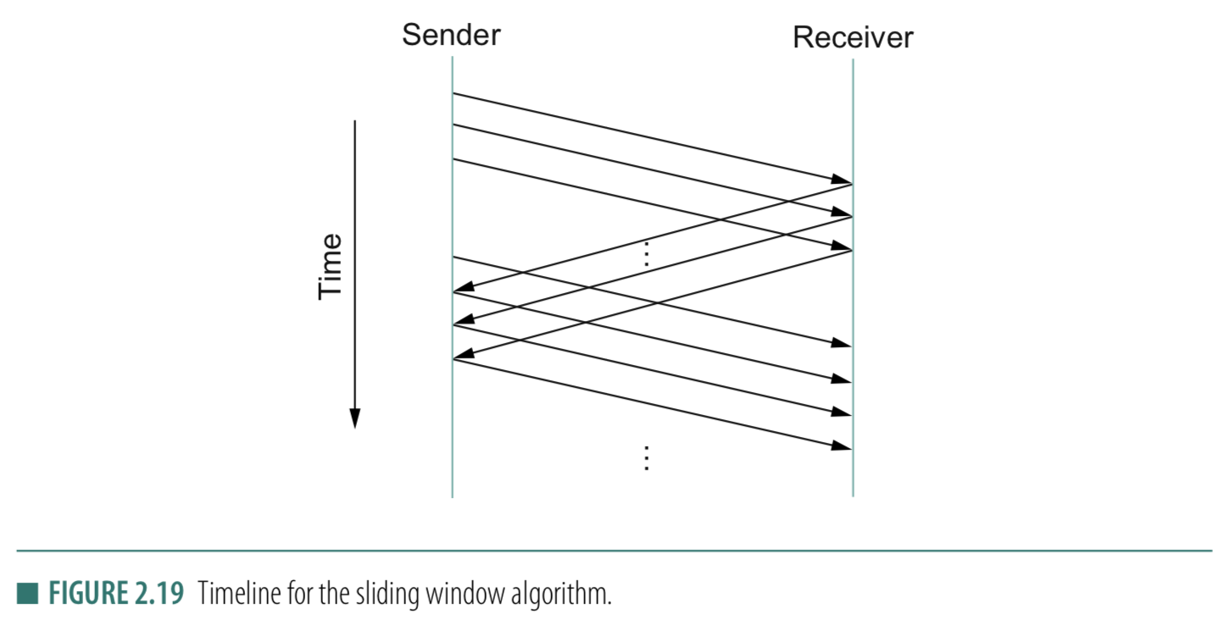
Sliding Window
Receiver should have enough space to buffer/save the received data !!

Slide 24
Sliding Window: Implementation
Allow a larger amount of data “in flight” for better channel utilization, but should not exceed receiver’s capacity.
Sending process
Receiving process
TCP
TCP
Last byte written
Last byte read
Window
Next byte expected
Last byte ACKed
Last byte sent
Last byte received

Slide 25
Sliding Window: Implementation
Allow a larger amount of data “in flight”
Allow sender to get ahead of the receiver
… though not too far ahead
Sending process
Receiving process
TCP
TCP
Last byte written
Last byte read
Window
Next byte expected
Last byte ACKed
Last byte sent
Last byte received

Slide 26
Receiver Buffering: Flow control
Receive window size
Amount that can be sent without acknowledgment
Receiver must be able to store this amount of data
Receiver tells the sender the window
Tells the sender the amount of free space left (i.e. sends an Advertised_Window size to the sender)

Slide 27
How to send the Advertised_Window size

Slide 28
Calculate Advertised_Window (Receiver side)
Receiving process
TCP
Last byte read
Next byte expected
Last byte received
AdvertisedWindow = MaxRcvBuffer – (bytes used)
AdvertisedWindow = MaxRcvBuffer –
((NextByteExpected-1) – LastByteRead)

Slide 29
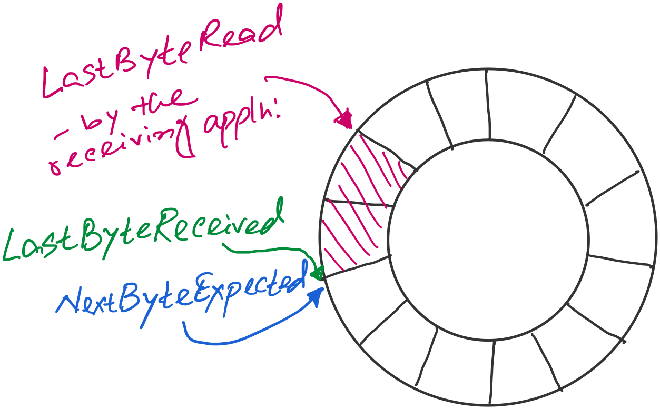
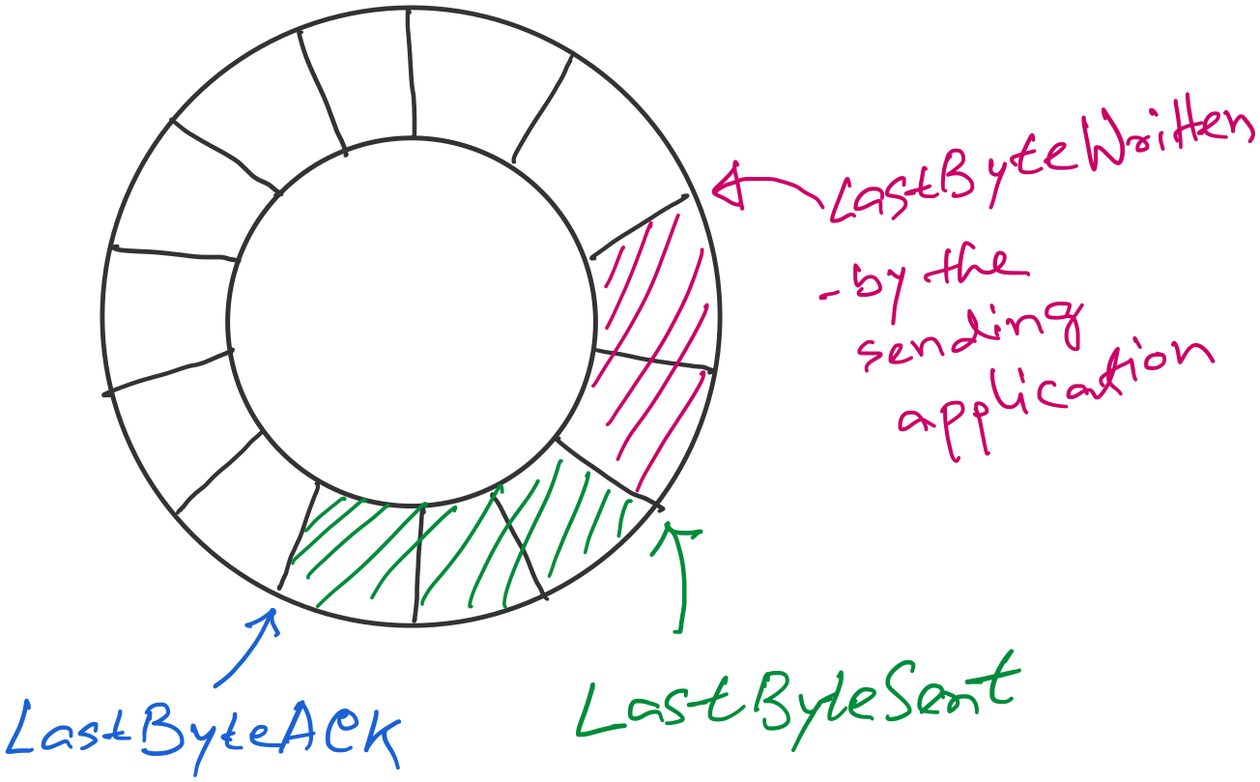
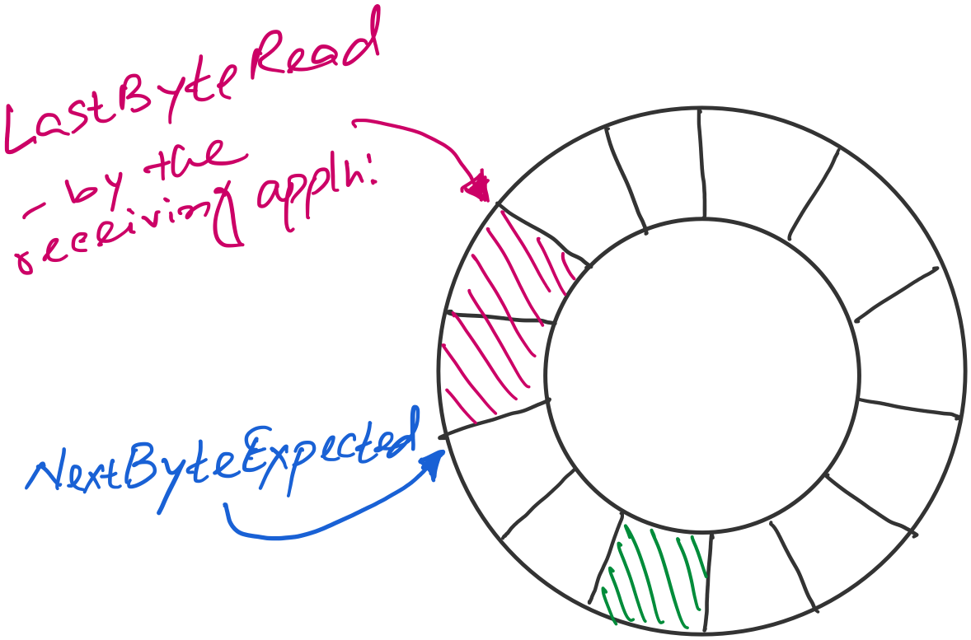
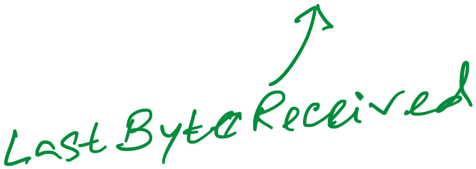
Sender buffer
Receiver buffer

Slide 30
Sender buffer
Receiver buffer
What if the AdvertisedWindow is zero?
>> Periodically send 1byte packets to break the deadlock. (uses the persist timer)
AdvertisedWindow = MaxRcvBuffer –
((NextByteExpected-1) – LastByteRead)
EffectiveWindow (calculated at the sender side)
= AdvertisedWindow - (LastByteSent – LastByteACKed)

Slide 31
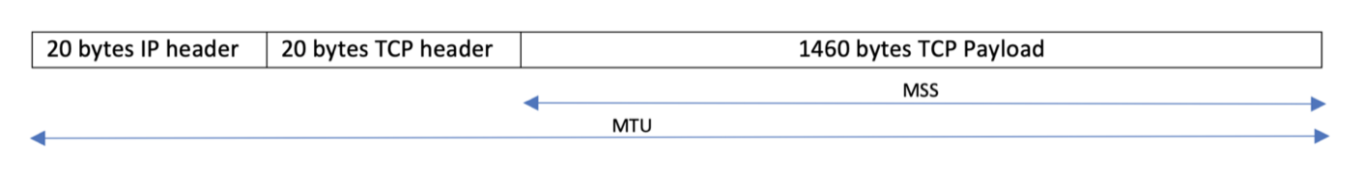
Considering Maximum Segment Size (MSS)
What if…
(1) Adv_window > MSS
(2) Adv_window < MSS

Slide 32
A few points of discussions on TCP flow control
Silly window syndrome
Nagle’s algorithm (self-clocking)
Karn-Partridge algorithm

Slide 33
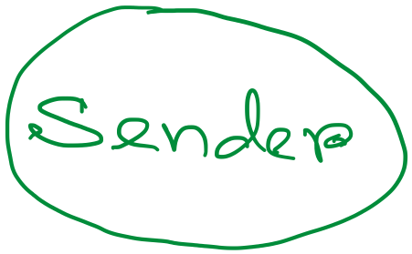
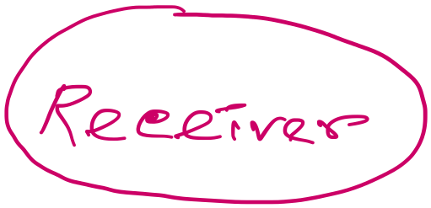
Silly-window syndrome
Host A
Byte 0
Byte 1
Byte 2
Byte 3
Byte 80
Data
ACK + Adv_Win
Byte 0
Byte 1
Byte 2
Byte 3
Byte 80
Host B

Slide 34
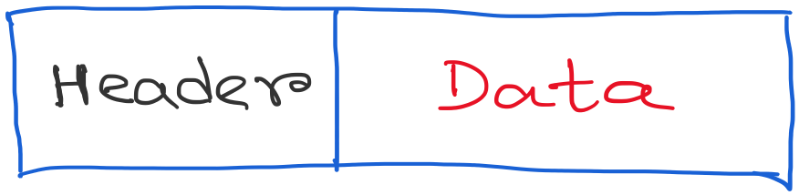
Silly window syndrome
What happens when the receiving application program consumes data slowly?
Leads to smaller advertised_window

Slide 35
Info: Maximum Segment Size (MSS)
What if…
(1) Adv_window > MSS
(2) Adv_window < MSS

Slide 36
Info 2: When TCP sends a “Segments”?
Host A
Byte 0
Byte 1
Byte 2
Byte 3
Byte 80
Segment sent when:
Segment full (Max Segment Size),
Not full, but times out, or
“Pushed” by application.
TCP Data
TCP Data
Host B
Byte 0
Byte 1
Byte 2
Byte 3
Byte 80

Slide 37
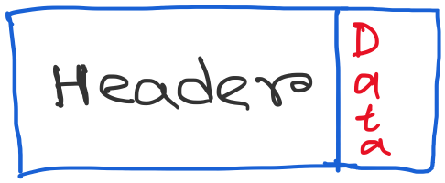
Silly window syndrome
Discussion: What can be the possible solutions?

Slide 38
Solution 1: Receiver side approach
(1) Delayed ACK (a receiver-side approach)

Slide 39
Solution 1: Receiver side approach
(1) Delayed ACK (a receiver-side approach)
- How much delay is good enough?

Slide 40
Solution 1: Receiver side approach
(1) Delayed ACK (a receiver-side approach)
- How much delay is good enough?
[RFC 1122] A TCP SHOULD implement a delayed ACK, but an
ACK should not be excessively delayed; in particular,
the delay MUST be less than 0.5 seconds, and in a stream
of full-sized segments there SHOULD be an ACK for at least
every second segment.
Typically, OSs are more conservative. Use 200ms of delay.

Slide 41
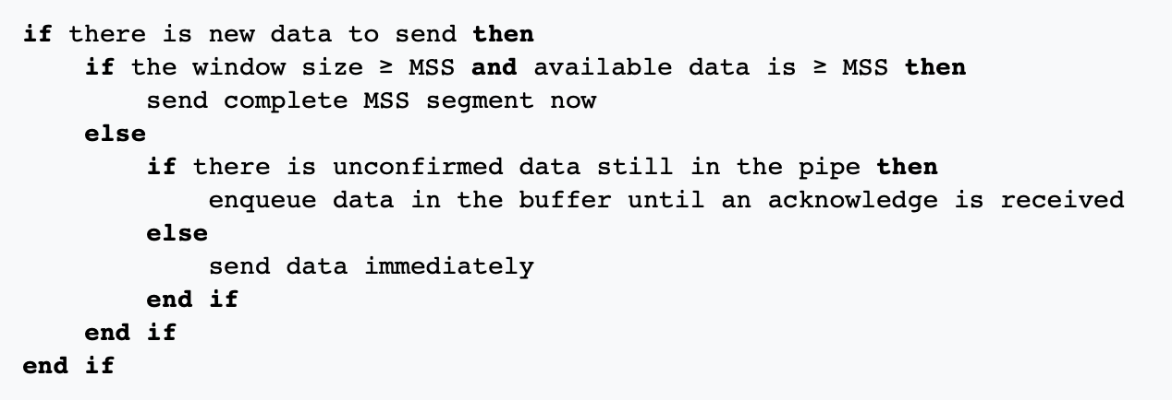
Solution 2: Sender side approach
(2) Nagle’s algorithm (a sender-side approach)

Slide 42
Solution 2: Sender side approach
Condition 0: Assumes there are some data to send. Otherwise, the sender will have to wait anyway.

Slide 43
Solution 2: Sender side approach
Condition 1: The system is capable of sending a full MSS.
Send immediately.

Slide 44
Solution 2: Sender side approach
Condition 2: Not enough data OR window size for a full MSS.
But some packets are in-flight (yet to receive ACK for).
Buffer the data and wait.

Slide 45
Solution 2: Sender side approach
Condition 3: No packet is in-flight (i.e., all ACKs are received).
Send immediately, no matter how small the packet is.

Slide 46
Solution 2: Sender side approach
(2) Nagle’s algorithm
Because some applications cannot afford such a delay for each write it does to a
TCP connection, the socket interface allows the application to turn off
Nagel’s algorithm by setting the TCP_NODELAY socket option.
TCP_QUICKACK option disables the Delayed Ack protocol.

Slide 47
What if sender and receiver simultaneously applies the Nagle’s algo. and delayed ack (TCP’s default setting) ?
[Ref] https://betterprogramming.pub/redis-internals-client-connects-to-redis-by-tcp-faf6ad1a7df5

Slide 48
What if sender and receiver simultaneously applies the Nagle’s algo. and delayed ack (TCP’s default setting) ?
Sender
Receiver
Packet-1
Nagle’s algo:
Buffered next packet
waiting for the ACK
for packet-1.
Delayed ACK:
Delayed the ACK
for packet-1.
Waiting for the next packet
to send the cumulative ACK
OR
the timeout to occur.
Time

Slide 49
What if sender and receiver simultaneously applies the Nagle’s algo. and delayed ack (TCP’s default setting) ?
Sender
Receiver
Packet-1
Nagle’s algo:
Buffered next packet
waiting for the ACK
for packet-1.
Delayed ACK:
Delayed the ACK
for packet-1.
Waiting for the next packet
to send the cumulative ACK
OR
the timeout to occur.
Time
Timeout after 500ms (default)

Slide 50
What if sender and receiver simultaneously applies the Nagle’s algo. and delayed ack (TCP’s default setting) ?
Sender
Receiver
Packet-1
Nagle’s algo:
Buffered next packet
waiting for the ACK
for packet-1.
Delayed ACK:
Delayed the ACK
for packet-1.
Waiting for the next packet
to send the cumulative ACK
OR
the timeout to occur.
ACK for 1
Time
Timeout after 500ms (default)

Slide 51
What if sender and receiver simultaneously applies the Nagle’s algo. and delayed ack (TCP’s default setting) ?
Sender
Receiver
Packet-1
Nagle’s algo:
Buffered next packet
waiting for the ACK
for packet-1.
Delayed ACK:
Delayed the ACK
for packet-1.
Waiting for the next packet
to send the cumulative ACK
OR
the timeout to occur.
ACK for 1
Time
Timeout after 500ms (default)
Packet-2

Slide 52
Timeout value calculation and its limitations

Slide 53
Calculating TCP timeout value: The original idea

Slide 54
Calculating TCP timeout value: The original idea
Smoothing factor (recommended between 0.8 -0.9)

Slide 55
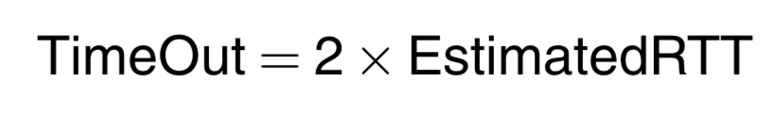
Calculating TCP timeout value: The original idea
Smoothing factor (recommended between 0.8 -0.9)

Slide 56
Calculating TCP timeout value: The original idea
Smoothing factor (recommended between 0.8 -0.9)
RTT estimation can be wrong

Slide 57
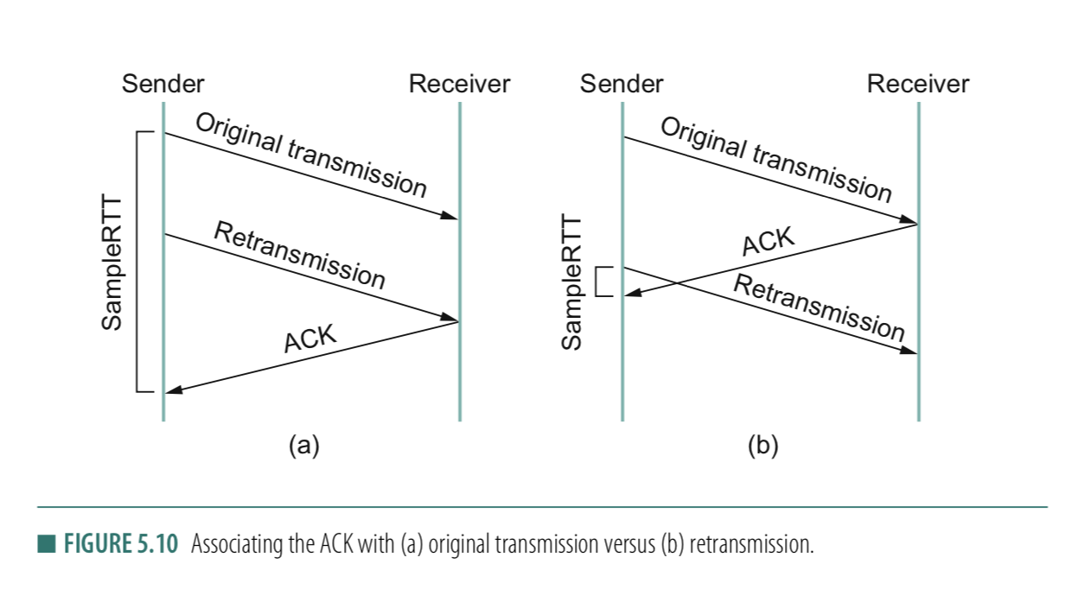
RTT estimation can be wrong

Slide 58
RTT estimation can be wrong

Slide 59
Solution: Karn/Partridge algorithm
Stop taking RTT samples when TCP retransmits
Start again after a regular transmission/reception
3) Each time TCP retransmits, set next timeout to be twice the last timeout value
Can rules #1 & #2 create issues?
Notes:
Answer (2) This simplistic implementation of Karn's algorithm can lead to problems as well. Consider what happens when TCP sends a segment after a sharp increase in delay. Using the prior round-trip time estimate, TCP computes a timeout and retransmits a segment. If TCP ignores the round-trip time of all retransmitted packets, the round trip estimate will never be updated, and TCP will continue retransmitting every segment, never adjusting to the increased delay.
[Ref] https://en.wikipedia.org/wiki/Karn%27s_algorithm

Slide 60
Summary of TCP learned so far

Slide 61
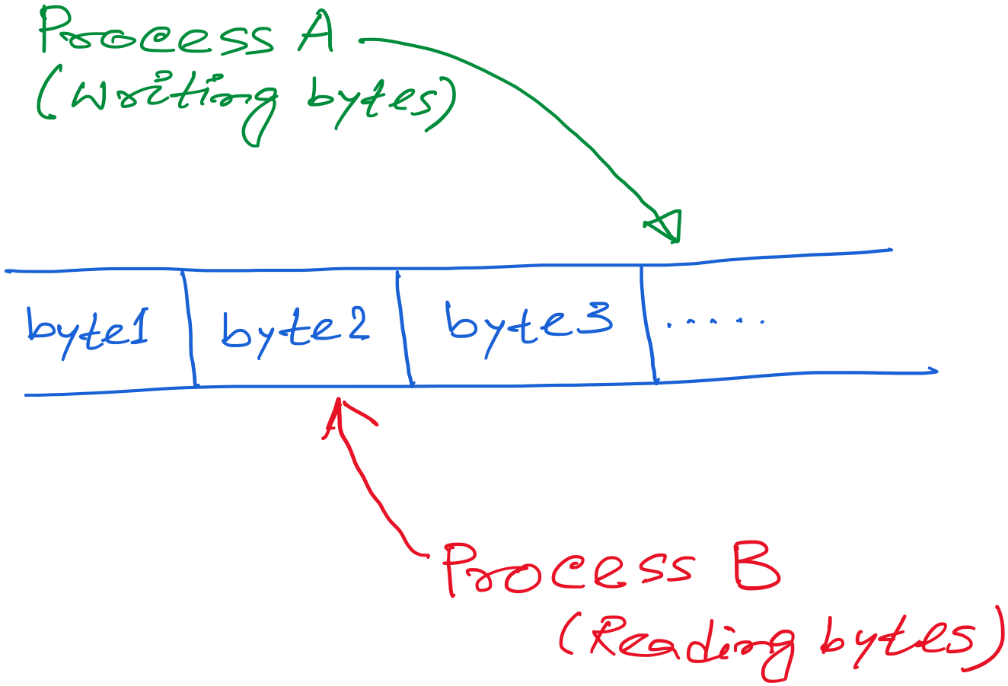
TCP: Abstraction of Reliable Bytes Stream

Slide 62
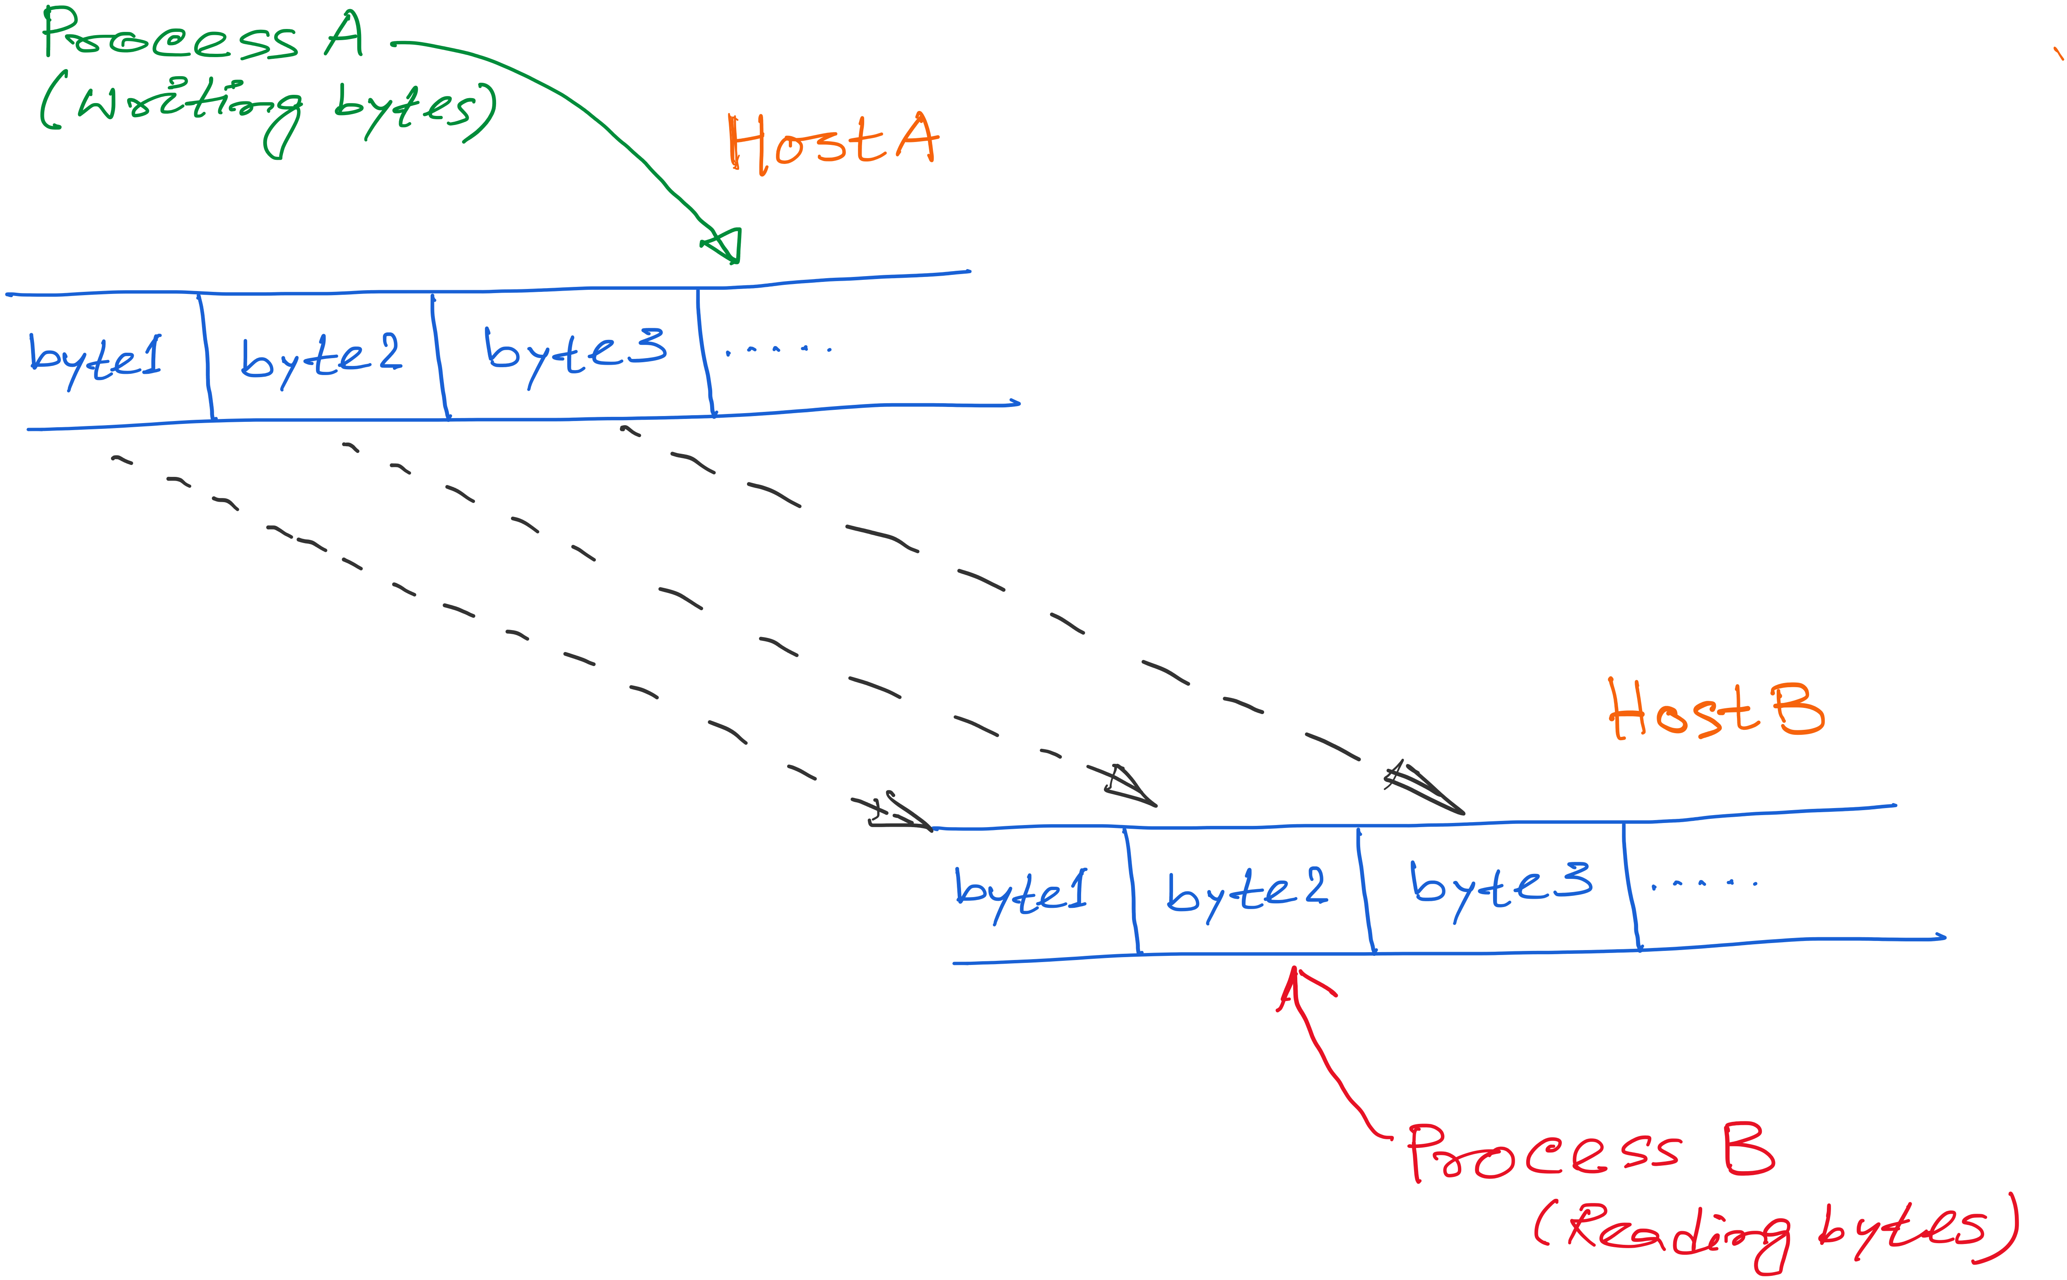
TCP: Abstraction of Reliable Bytes Stream

Slide 63
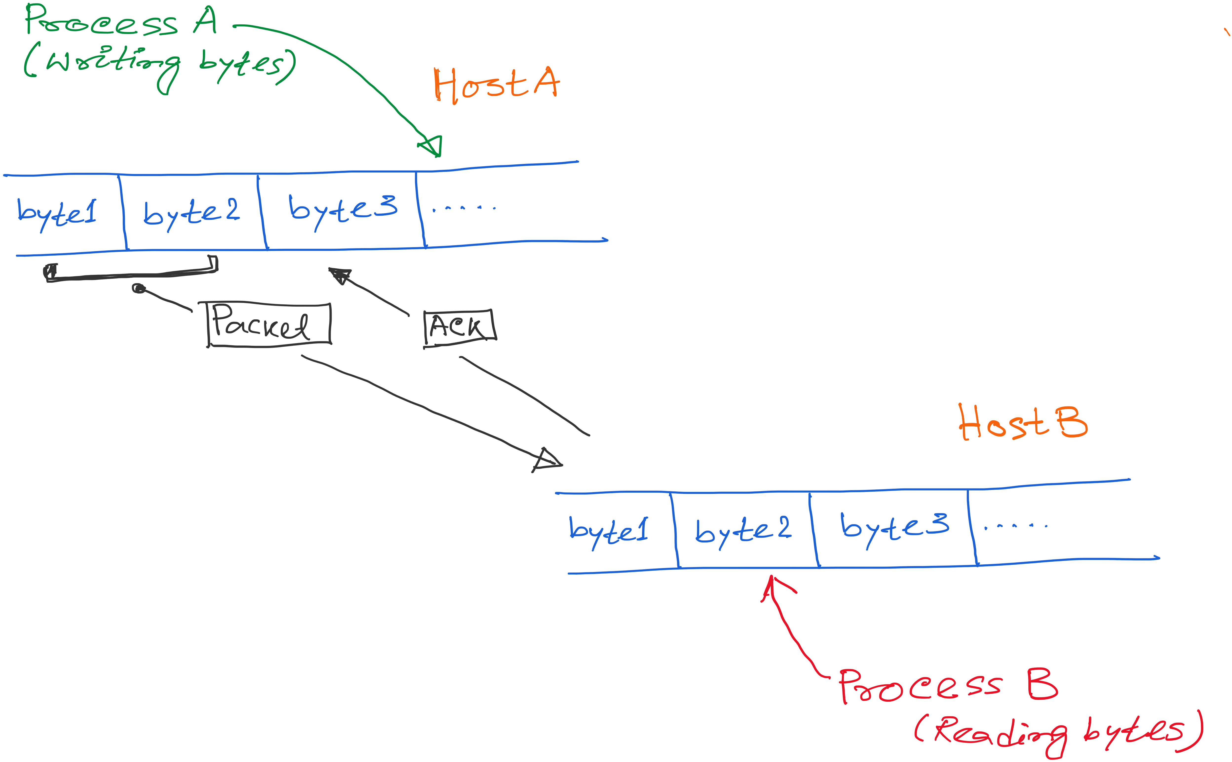
TCP: Abstraction of Reliable Bytes Stream

Slide 64
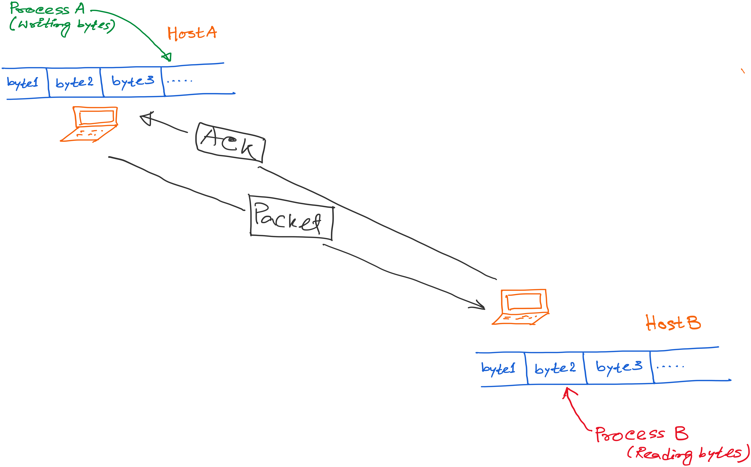
TCP: Abstraction of Reliable Bytes Stream

Slide 65
TCP: Abstraction of Reliable Bytes Stream
AdvertisedWindow
Flow control: Do not overwhelm the resources at the receiver

Slide 66
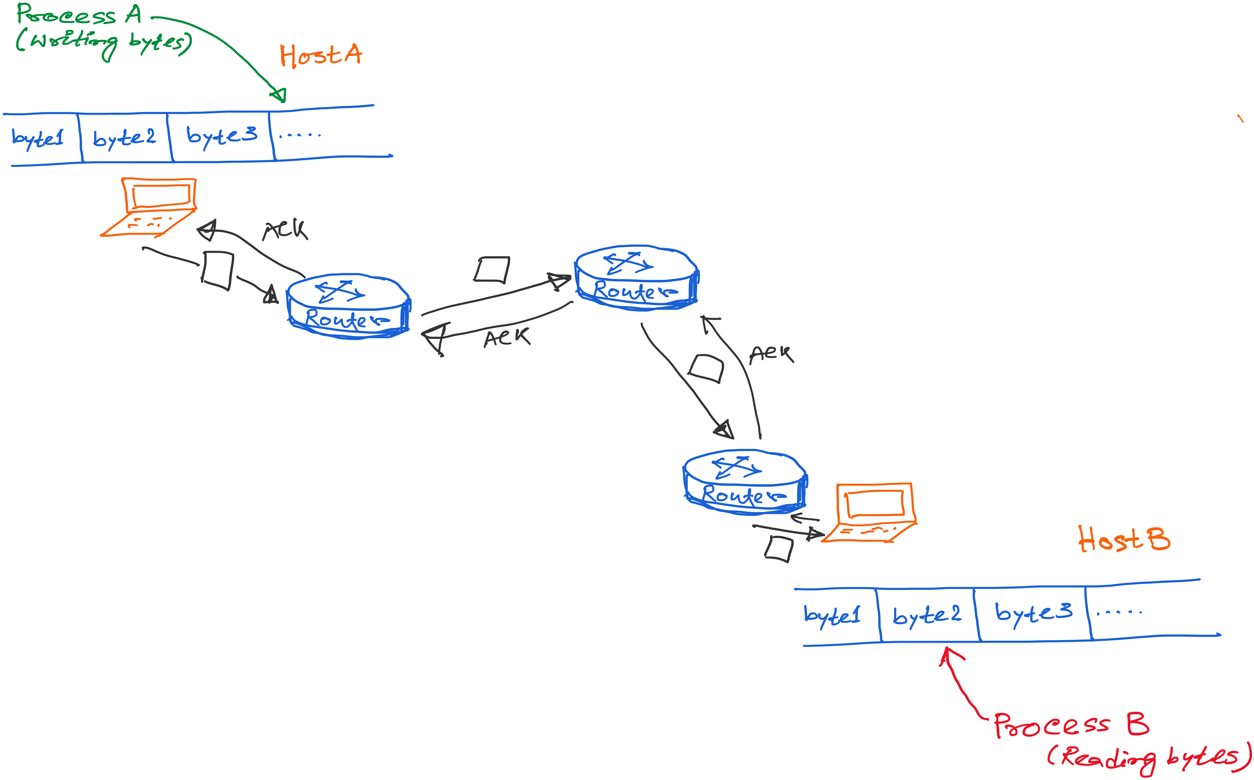
TCP: Abstraction of Reliable Bytes Stream

Slide 67
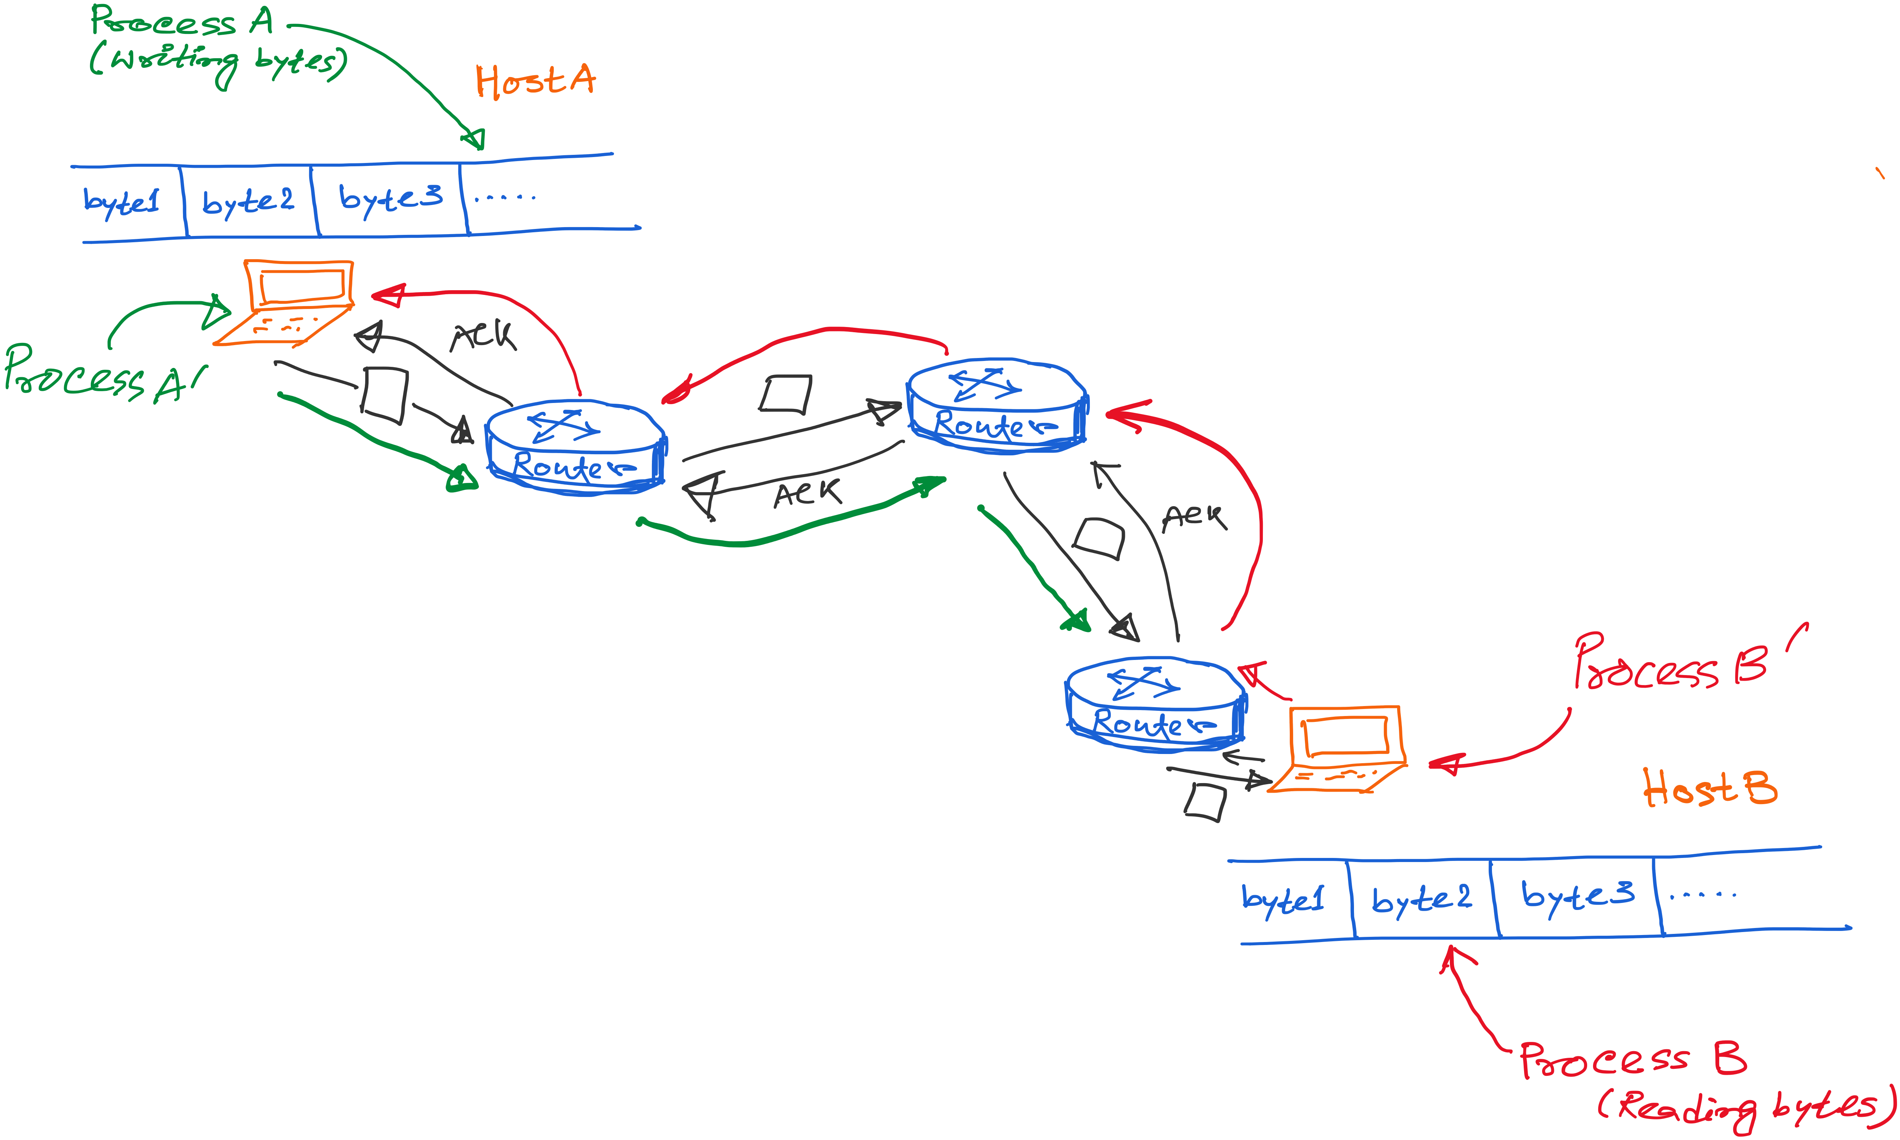
TCP: Abstraction of Reliable Bytes Stream
Notes:
Multiple processes running simulataneously.

Slide 68
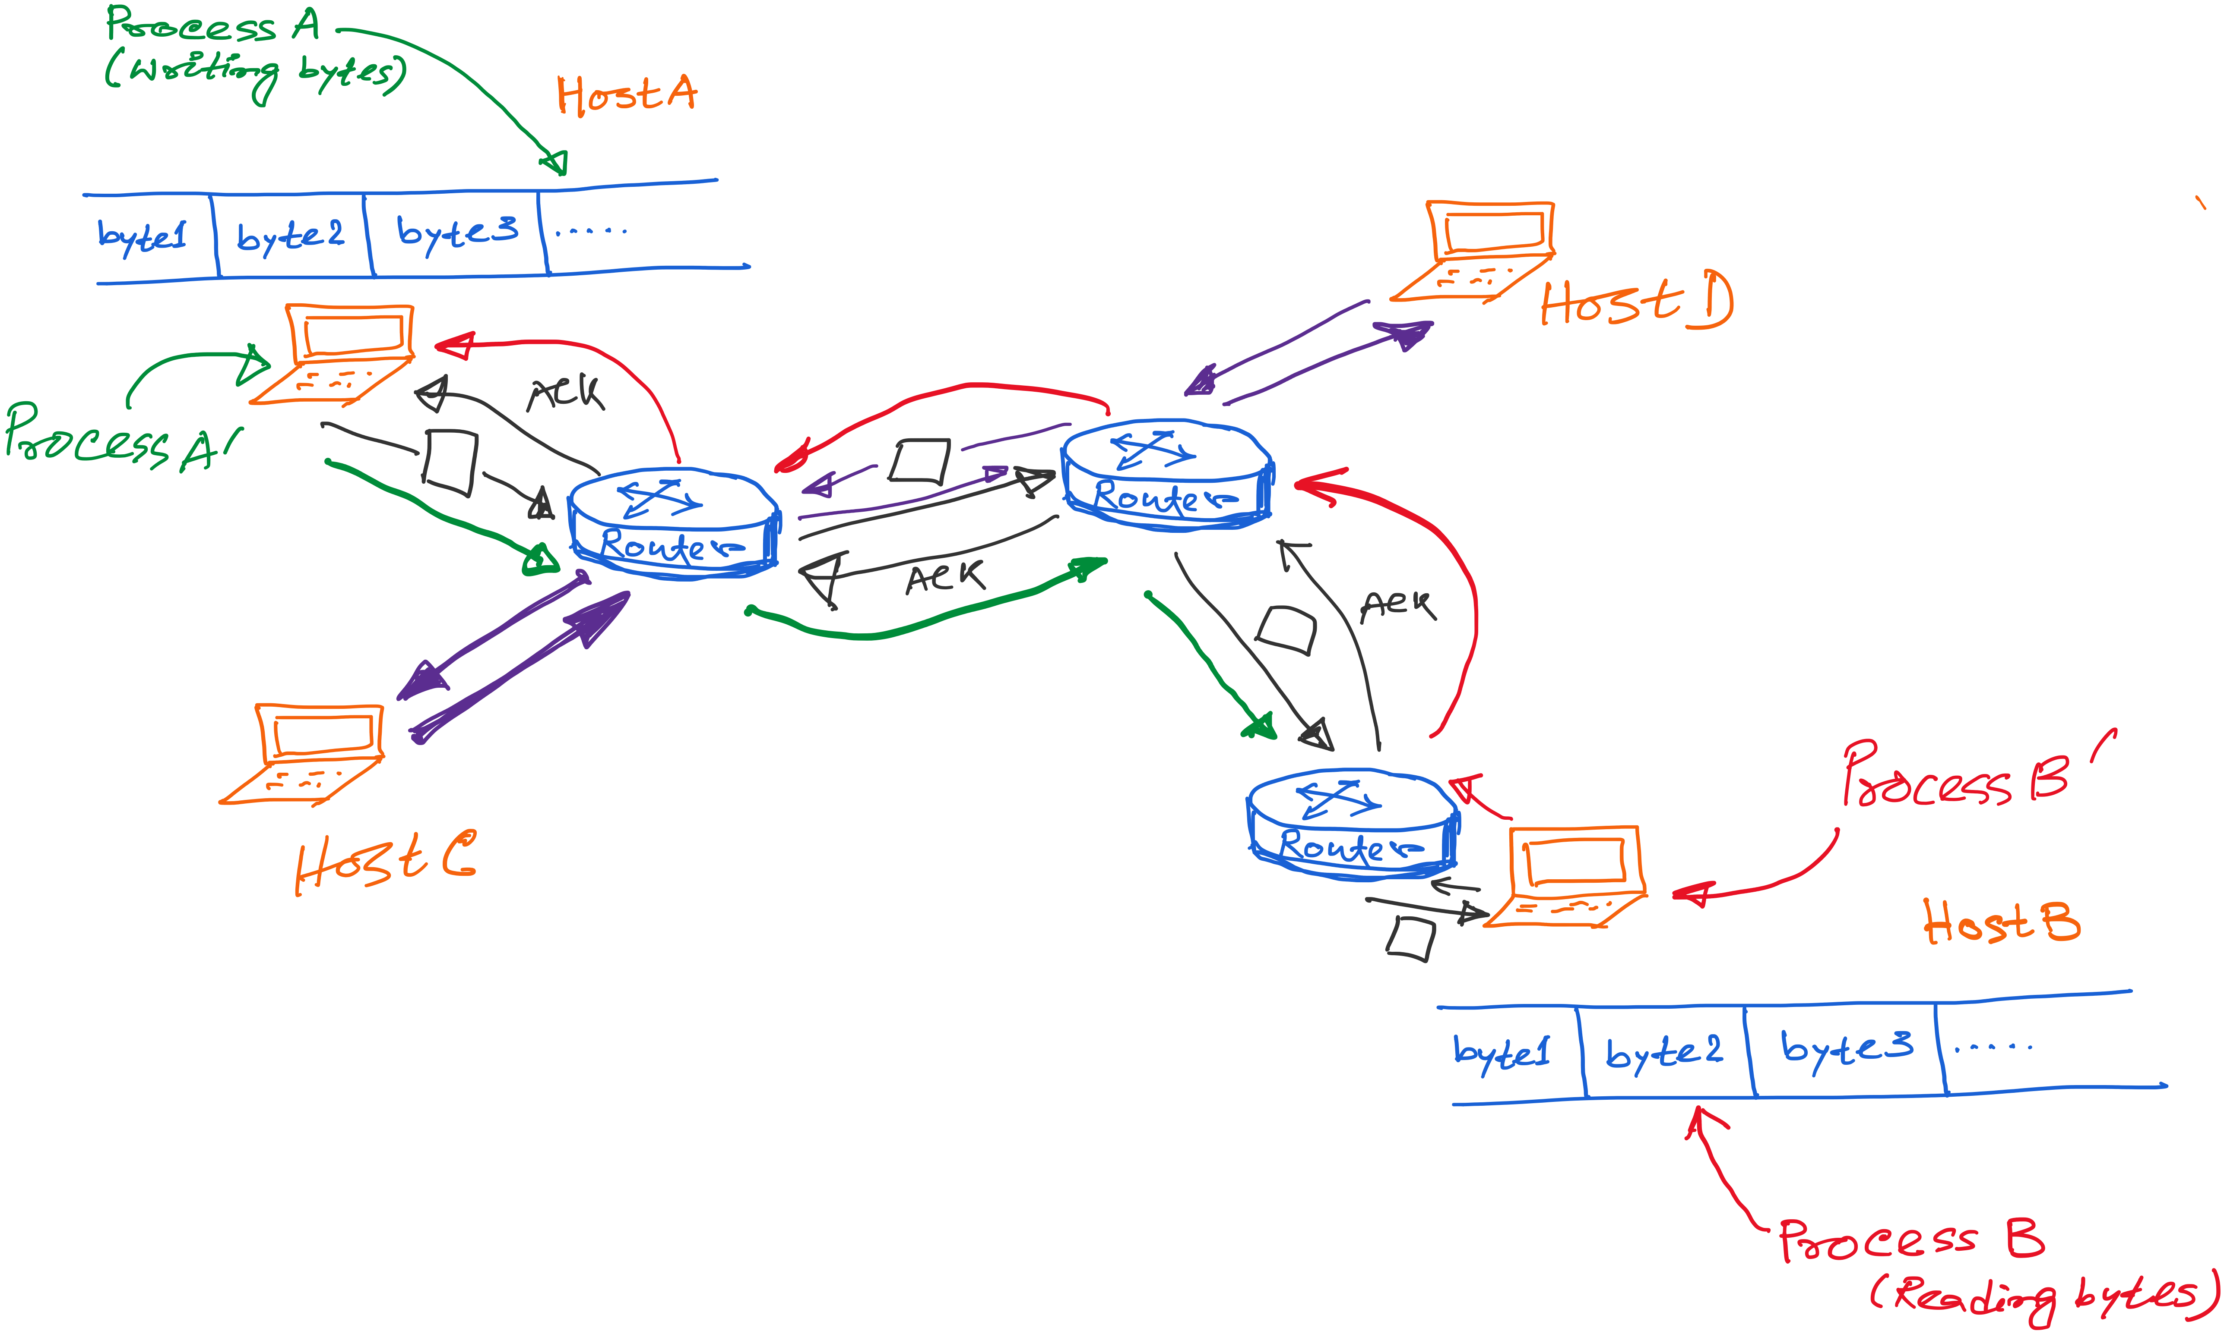
TCP: Abstraction of Reliable Bytes Stream

Slide 69
Summary of TCP learned so far

Slide 70
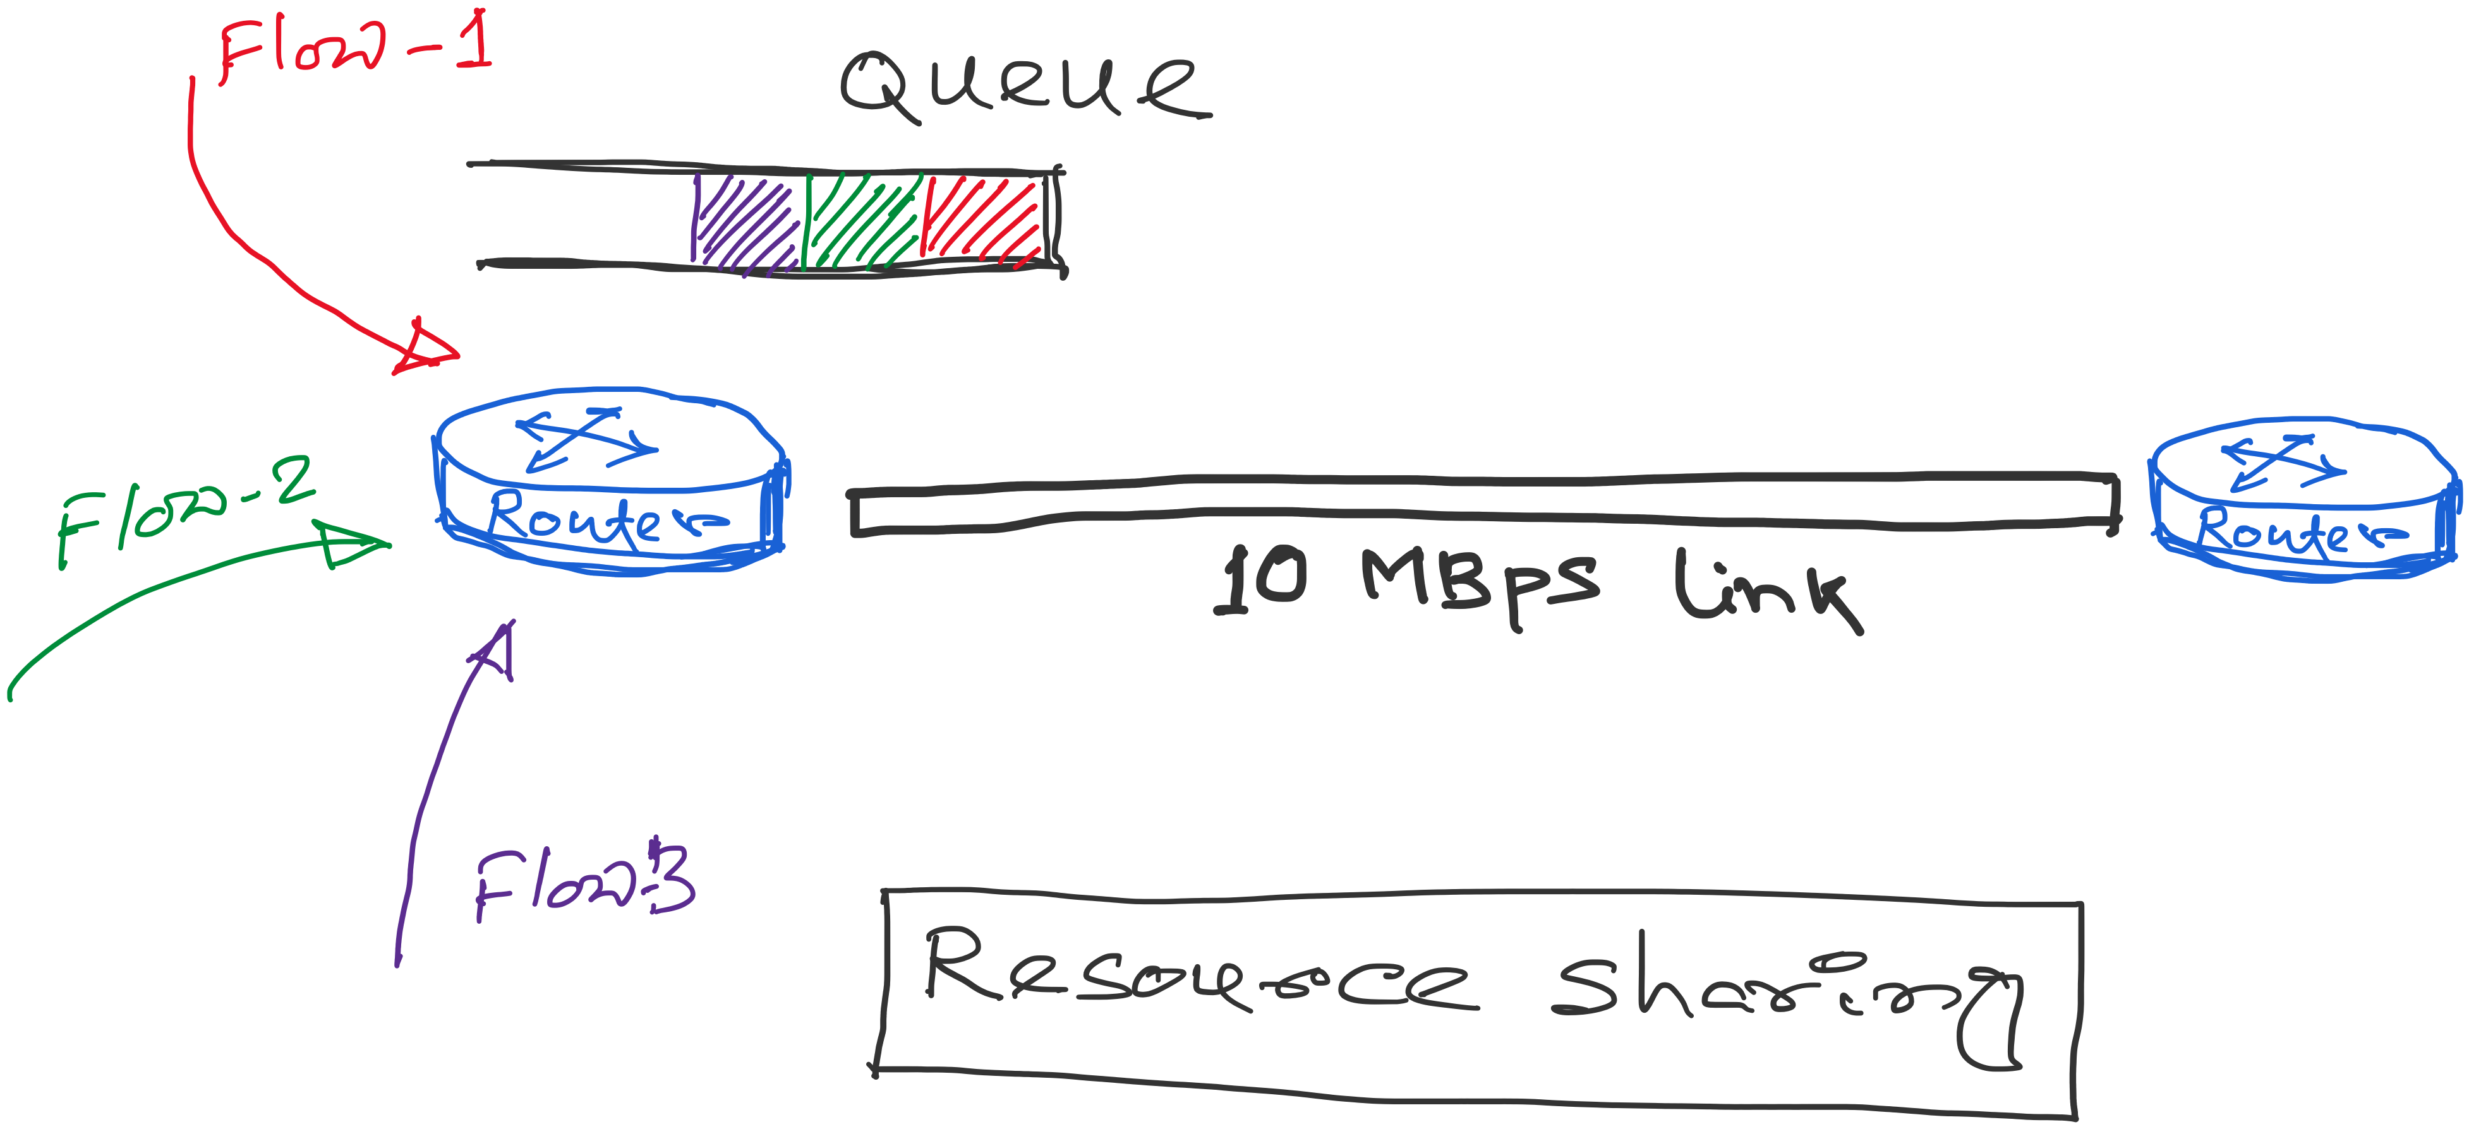
TCP: Abstraction of Reliable Bytes Stream
Flows contend for two resources:
1) Link bandwidth
2) Queue space

Slide 71
Congestion A network is considered congested if contention for resources leads toward queue build-ups and packet drops
Best-effort network does not “block” calls
So, they can easily become overloaded
Congestion == “Load higher than capacity”
Examples of congestion
Link layer: Ethernet frame collisions
Network layer: full IP packet buffers
Excess packets are simply dropped
And the sender can simply retransmit
queue

Slide 72
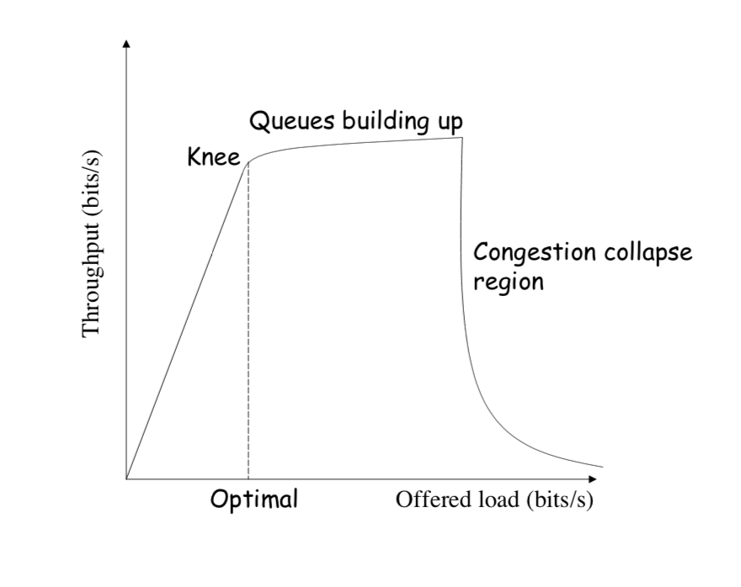
Throughput vs Load
Goodput: Application-level throughput.
Goodput
Notes:
Picture: https://ocw.mit.edu/courses/electrical-engineering-and-computer-science/6-829-computer-networks-fall-2002/lecture-notes/L8e2ecc.pdf

Slide 73
Throughput vs Load
Notes:
Picture: https://ocw.mit.edu/courses/electrical-engineering-and-computer-science/6-829-computer-networks-fall-2002/lecture-notes/L8e2ecc.pdf

Slide 74
Congestion Collapse
Notes:
Picture: https://ocw.mit.edu/courses/electrical-engineering-and-computer-science/6-829-computer-networks-fall-2002/lecture-notes/L8e2ecc.pdf

Slide 75
Congestion Collapse is real !!
Easily leads to congestion collapse
Senders retransmit the lost packets
Leading to even greater load
… and even more packet loss
Increase in load that results in a decrease in useful work done.

Slide 76
Detect and Respond to Congestion
?
What does the end host see?
What can the end host change?

Slide 77
Congestion in a Drop-Tail FIFO Queue
Access to the bandwidth: first-in first-out queue
Packets transmitted in the order they arrive
Access to the buffer space: drop-tail queuing
If the queue is full, drop the incoming packet
✗

Slide 78
How it Looks to the End Host
Delay: Packet experiences high delay
Loss: Packet gets dropped along path
✗

Slide 79
How it Looks to the End Host
Delay: Packet experiences high delay
Loss: Packet gets dropped along path
How does TCP sender learn this?
✗

Slide 80
How it Looks to the End Host
Delay: Packet experiences high delay
Loss: Packet gets dropped along path
How does TCP sender learn this?
Delay: Round-trip time estimate
Loss: Timeout and/or duplicate acknowledgments
✗

Slide 81
Detecting Congestion
Link layer
Carrier sense multiple access
Seeing your own frame collide with others
Network layer
Observing end-to-end performance
Packet delay or loss over the path

Slide 82
How TCP detects packet losses
(1) Duplicate ACKs
Packet# n is lost, but packets n+1, n+2, etc. are received and ACKs are sent.
(2) Timeout
Packet# n is lost and detected via a timeout

Slide 83
Responding to Congestion
Upon detecting congestion
Decrease the sending rate

Slide 84
Responding to Congestion
Upon detecting congestion
Decrease the sending rate
But, what if conditions change?
If more bandwidth becomes available,
… unfortunate to keep sending at a low rate

Slide 85
Responding to Congestion
Upon detecting congestion
Decrease the sending rate
But, what if conditions change?
If more bandwidth becomes available,
… unfortunate to keep sending at a low rate
Upon not detecting congestion
Increase sending rate, a little at a time
See if packets get through

Slide 86
TCP Congestion Control

Slide 87
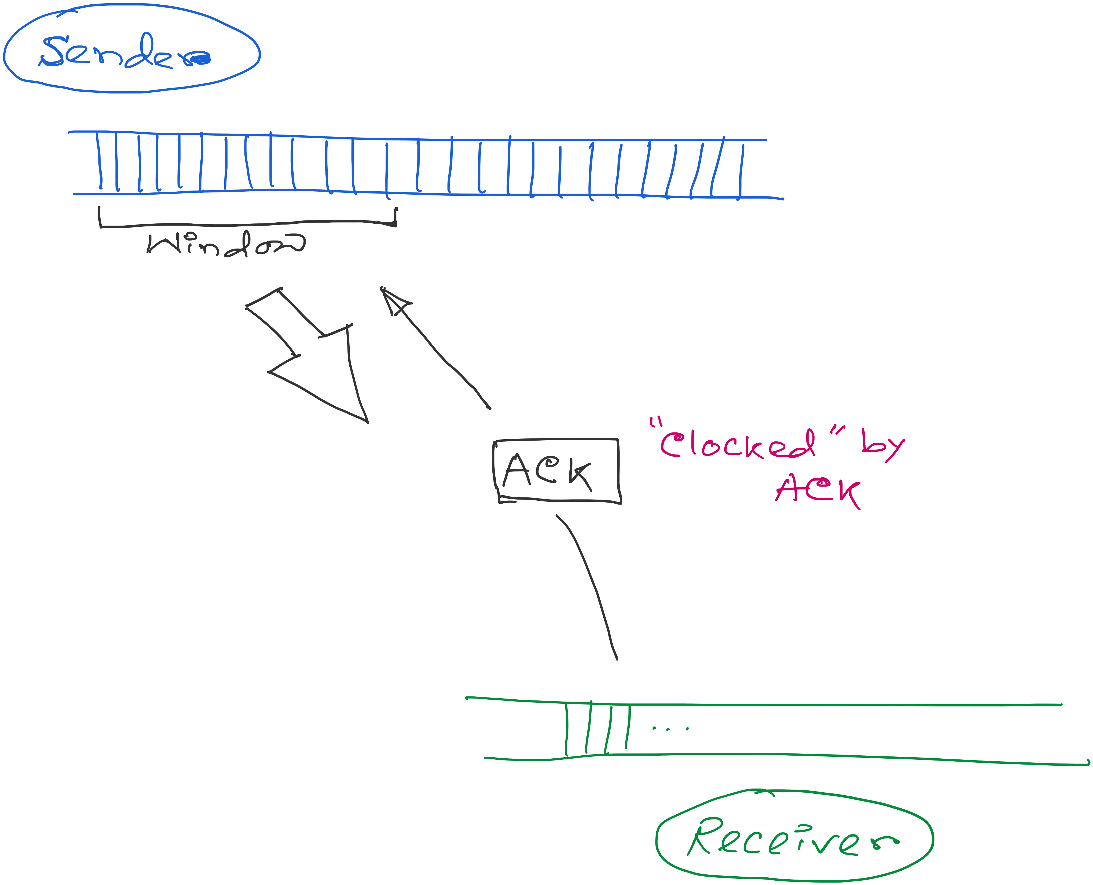
ACK works as the indicator and the window controls the flow.
Congestion_window: Calculated by the sender

Slide 88
ACK works as the indicator and the window controls the flow.
How to find the right window size?
When to change? How much?

Slide 89
TCP Congestion Control
Additive increase, multiplicative decrease (AIMD)
On packet loss, divide congestion window in half
On success for last window, increase window linearly
Loss
Window
halved
t

