Slide 1

Computer Networks
CMSC 417 : Spring 2025
Topic: TCP Congestion-control
(Textbook chapter 6)
Nirupam Roy
Tu-Th 2:00-3:15pm
CSI 2117
April 2nd, 2025

Slide 2
Summary of TCP learned so far

Slide 3
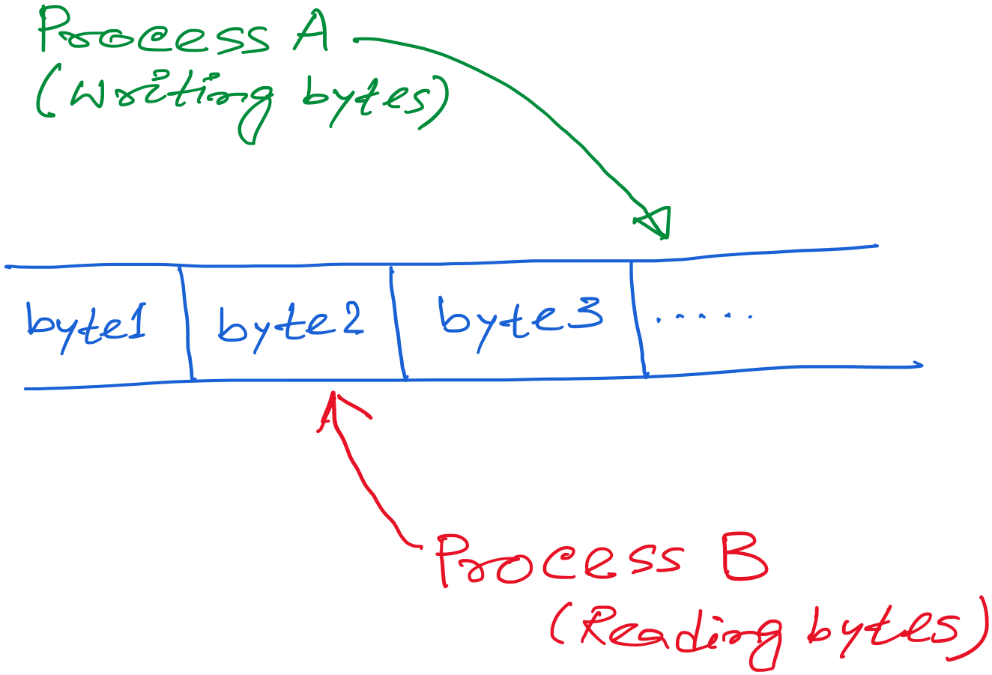
TCP: Abstraction of Reliable Bytes Stream

Slide 4
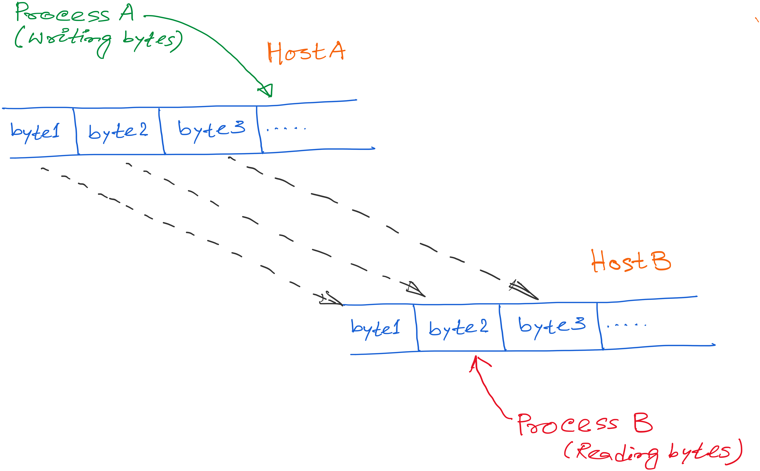
TCP: Abstraction of Reliable Bytes Stream

Slide 5
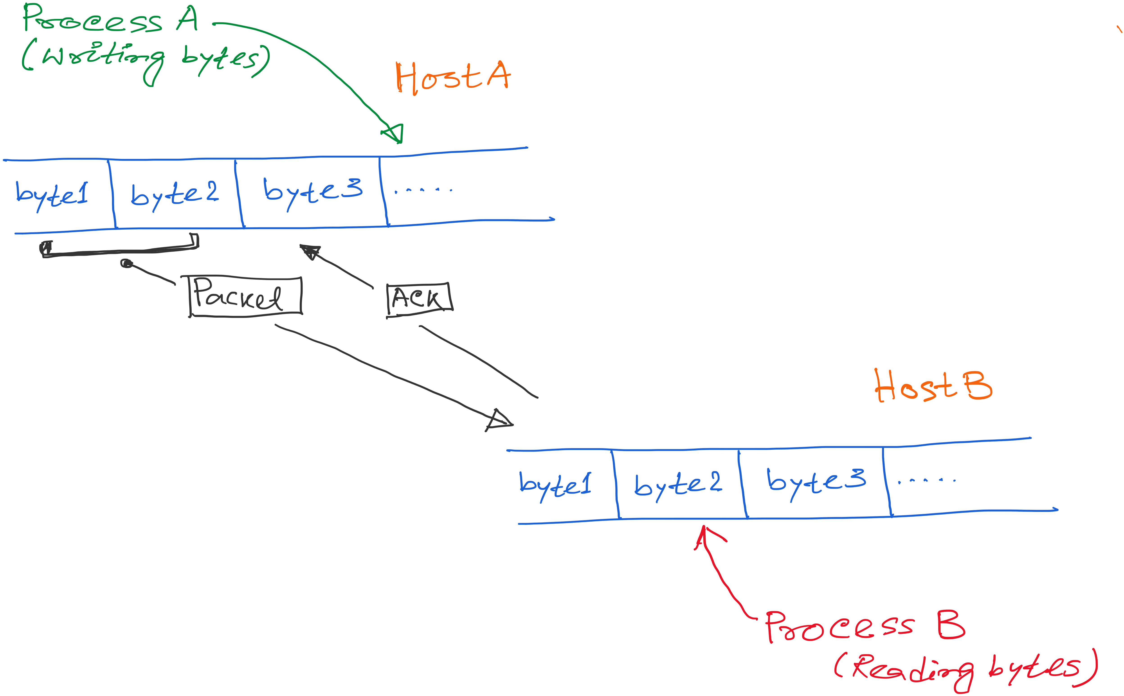
TCP: Abstraction of Reliable Bytes Stream

Slide 6
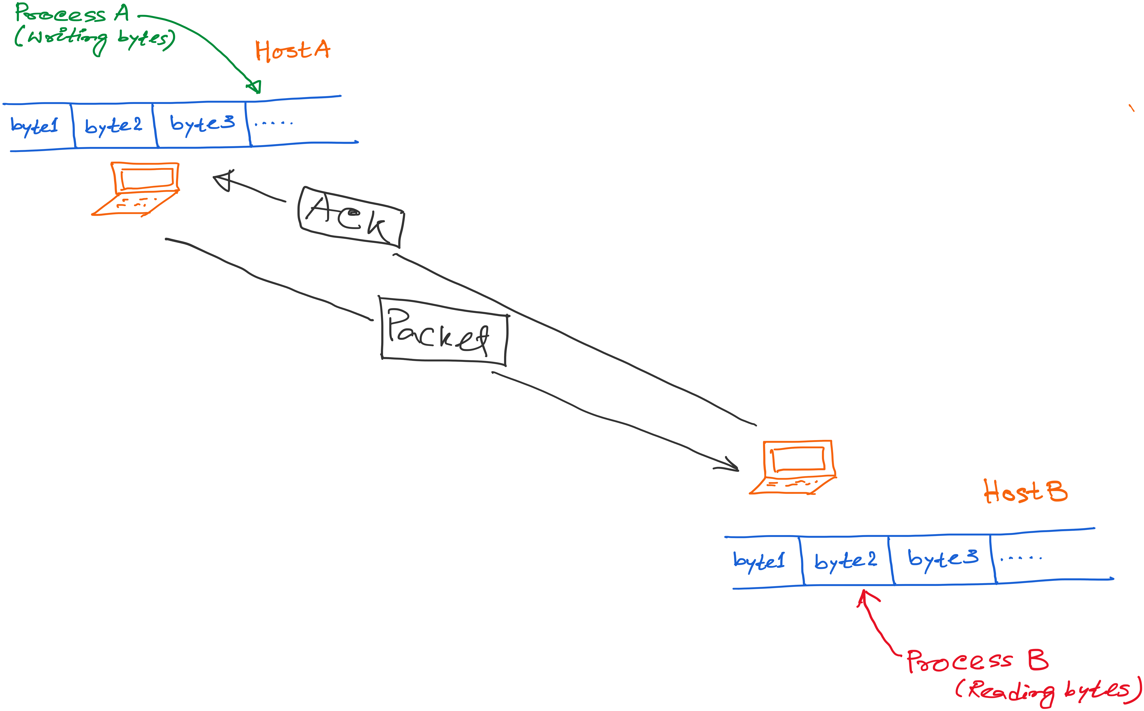
TCP: Abstraction of Reliable Bytes Stream

Slide 7
TCP: Abstraction of Reliable Bytes Stream
AdvertisedWindow
Flow control: Do not overwhelm the resources at the receiver

Slide 8
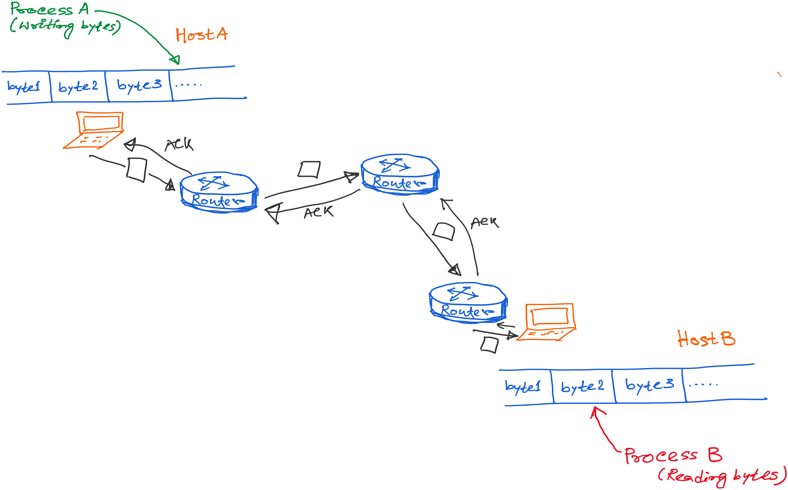
TCP: Abstraction of Reliable Bytes Stream

Slide 9
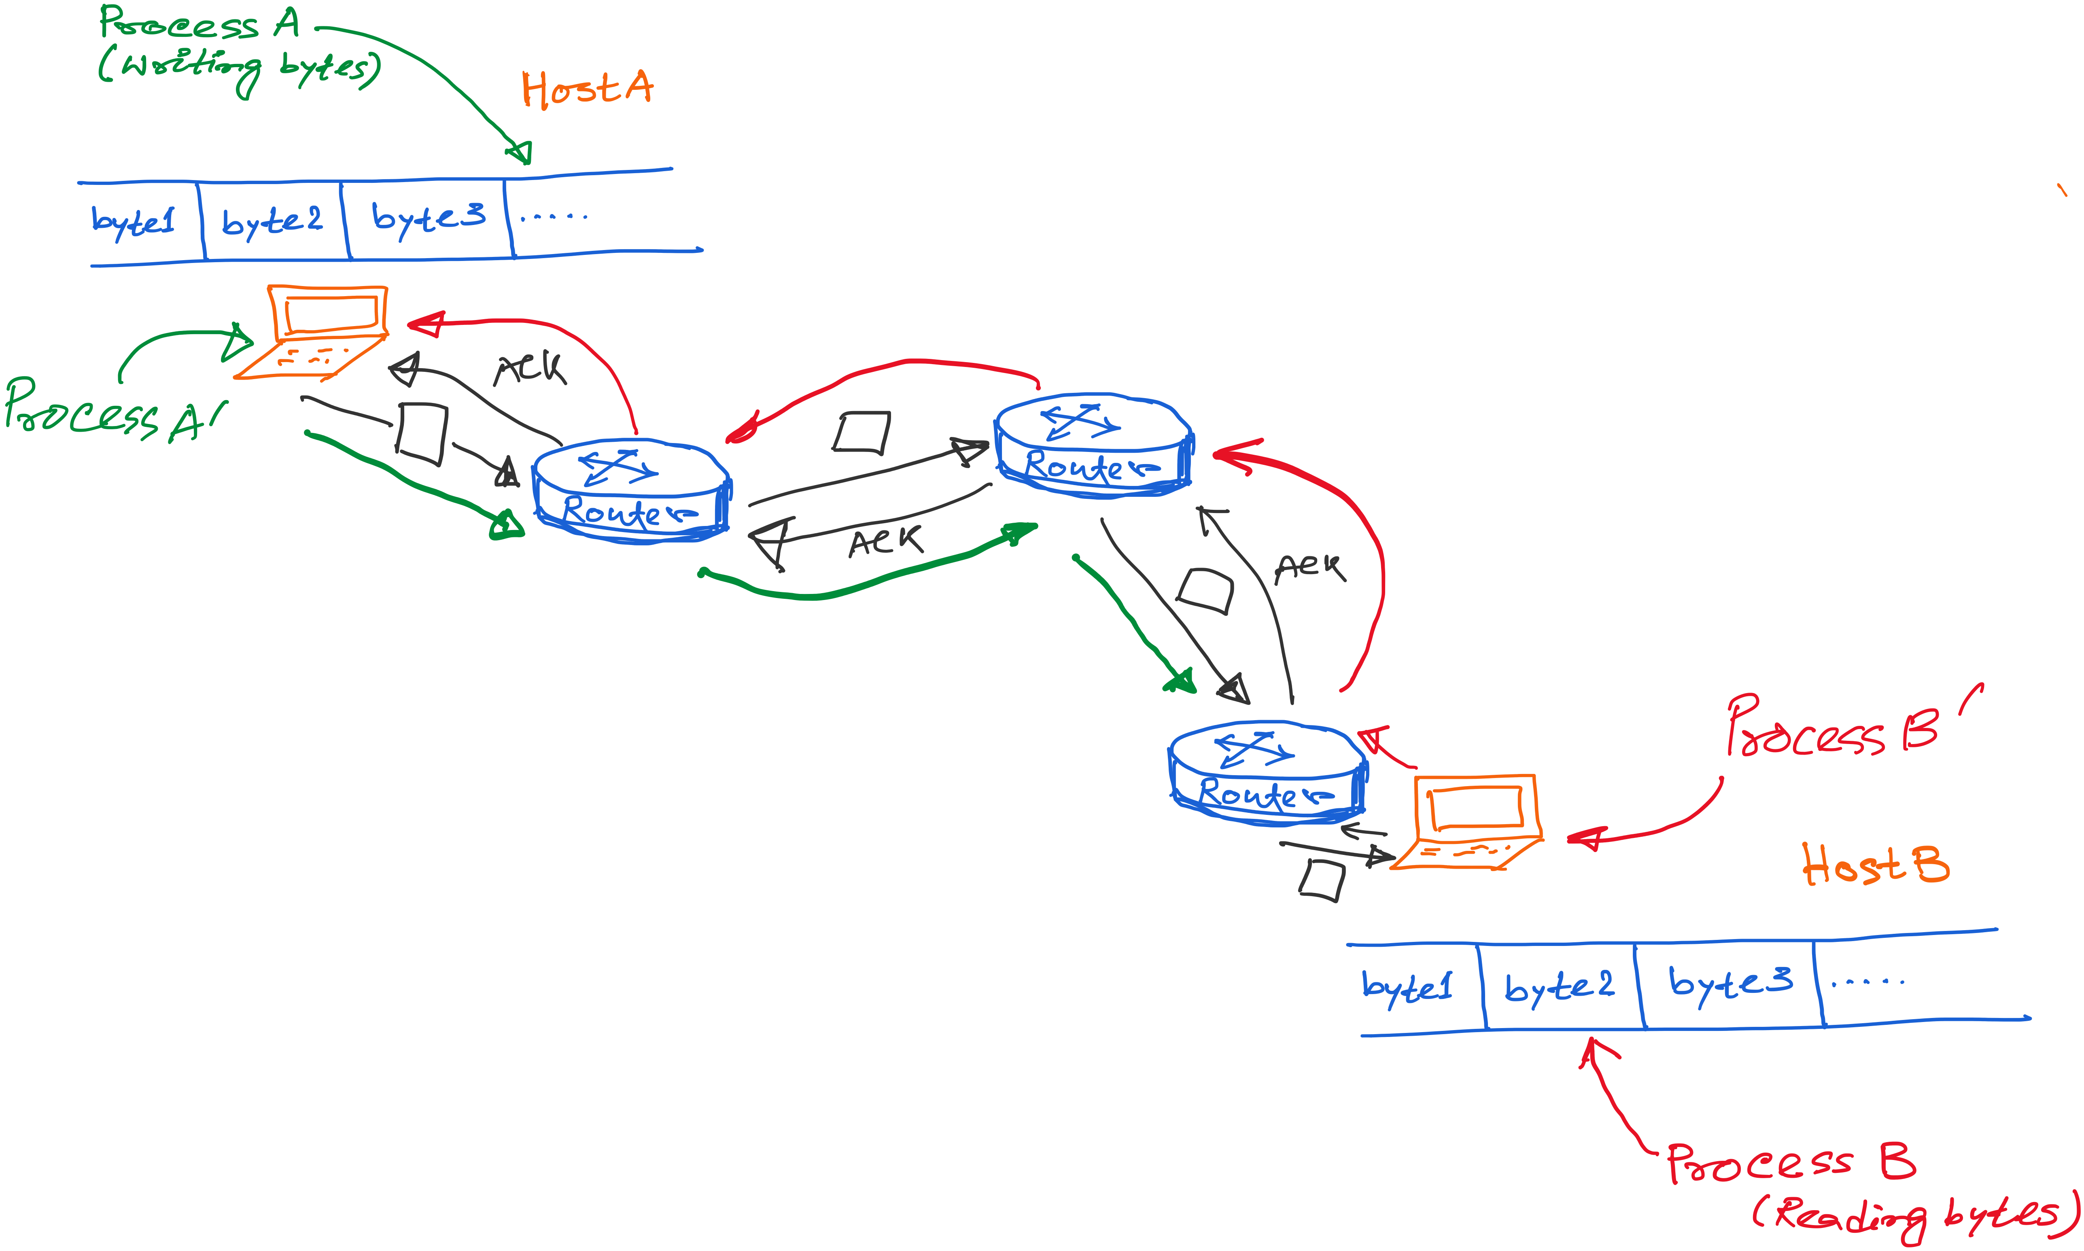
TCP: Abstraction of Reliable Bytes Stream
Notes:
Multiple processes running simulataneously.

Slide 10
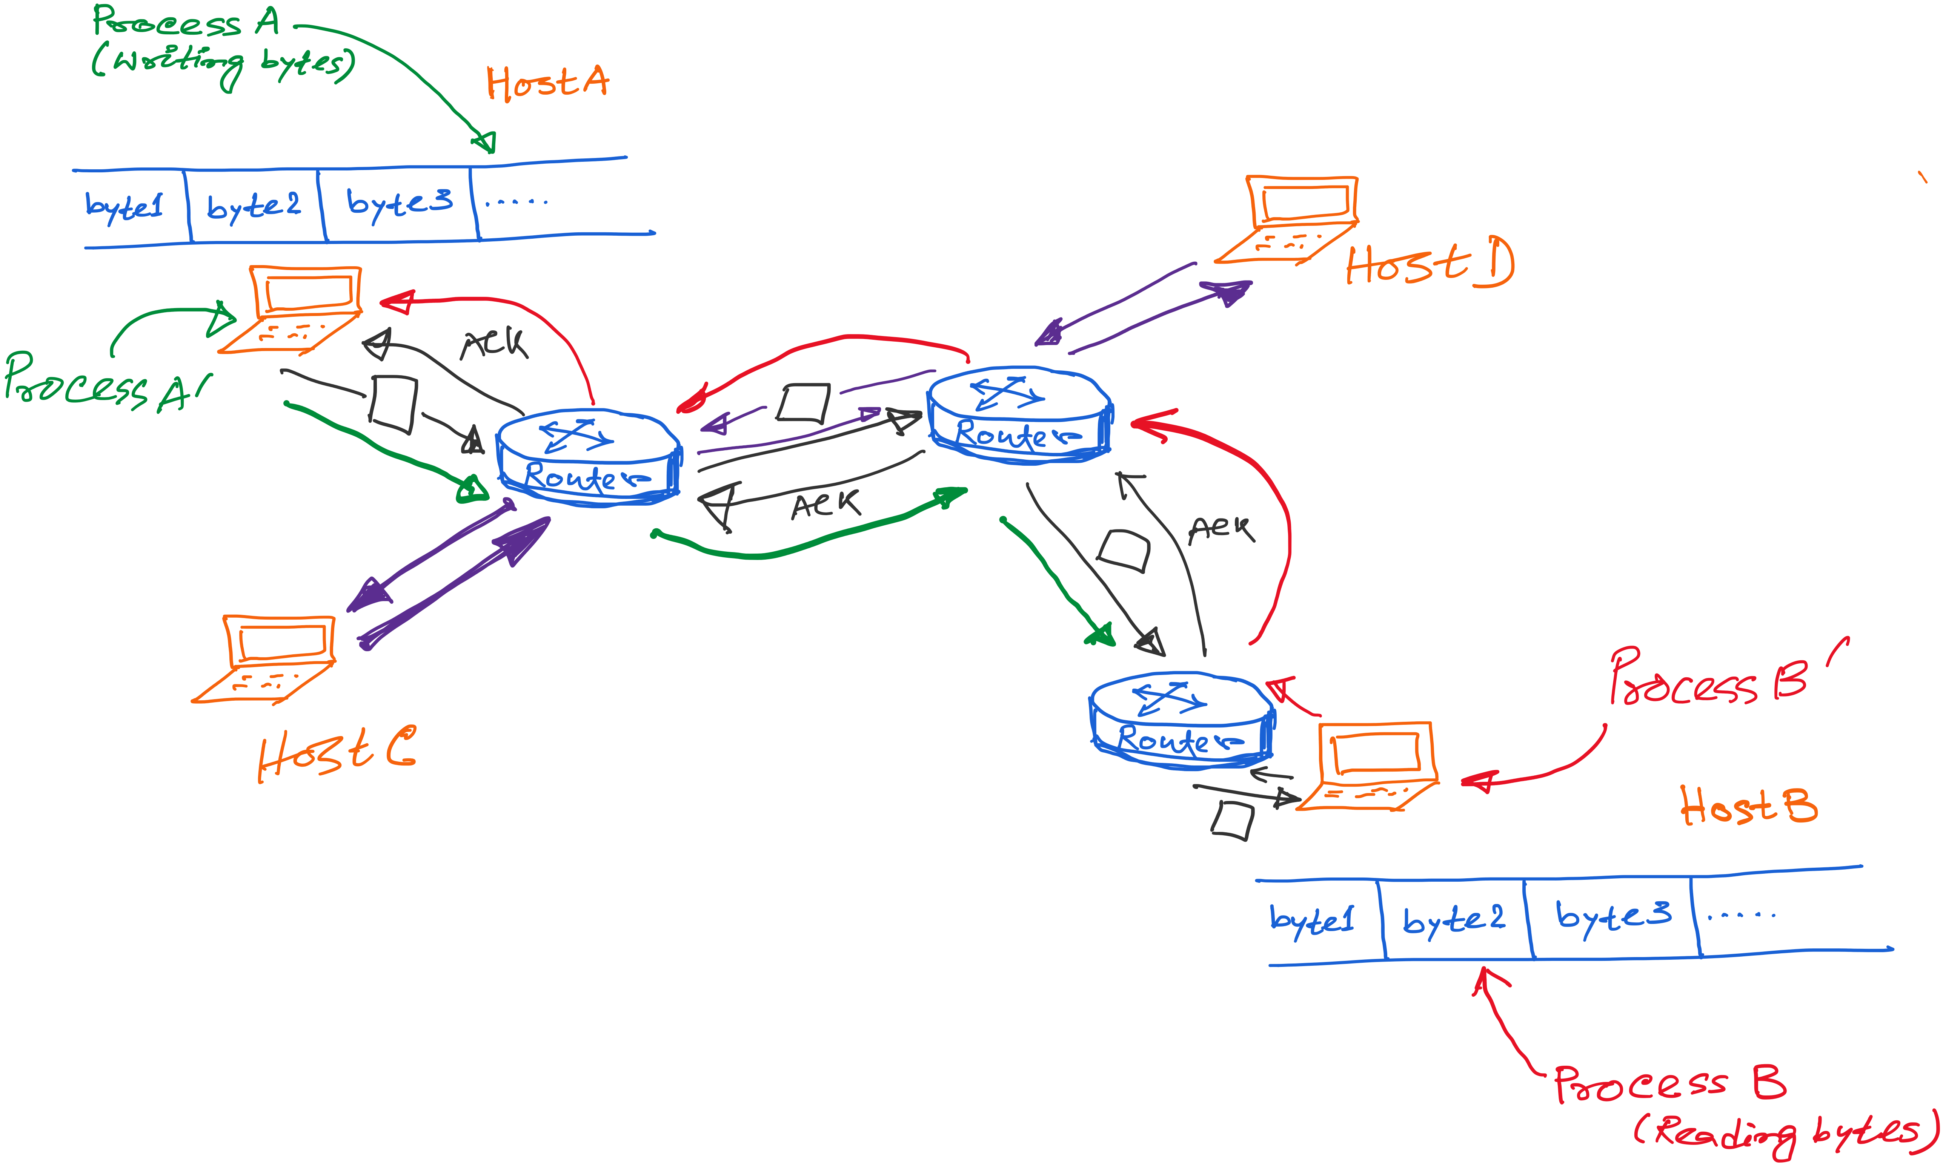
TCP: Abstraction of Reliable Bytes Stream

Slide 11
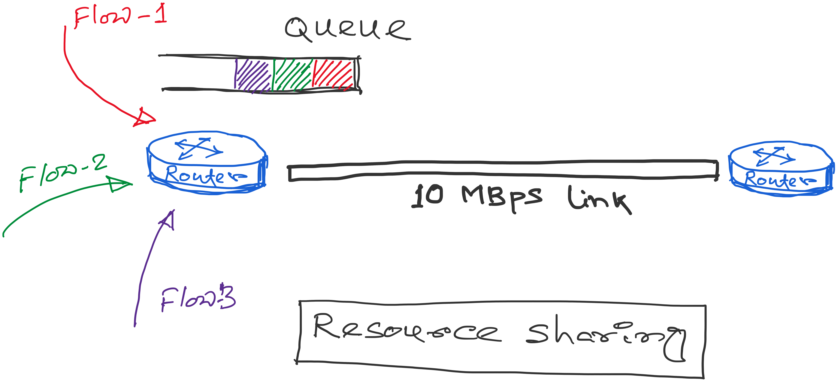
TCP: Abstraction of Reliable Bytes Stream
Flows contend for two resources:
1) Link bandwidth
2) Queue space

Slide 12
Congestion
A network is considered congested if contention for resources leads toward queue build-ups and packet drops
Best-effort network does not “block” calls
  So, they can easily become overloaded
  Congestion == “Load higher than capacity”
Examples of congestion
  Link layer: Ethernet frame collisions
  Network layer: full IP packet buffers
Excess packets are simply dropped
  And the sender can simply retransmit
queue

Slide 13
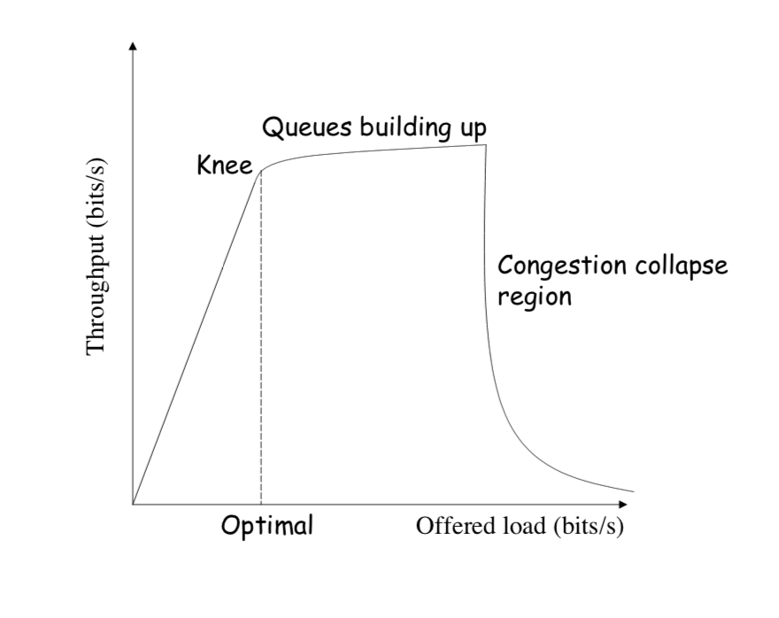
Throughput vs Load
Goodput: Application-level throughput.
Goodput
Notes:
Picture: https://ocw.mit.edu/courses/electrical-engineering-and-computer-science/6-829-computer-networks-fall-2002/lecture-notes/L8e2ecc.pdf

Slide 14
Throughput vs Load
Notes:
Picture: https://ocw.mit.edu/courses/electrical-engineering-and-computer-science/6-829-computer-networks-fall-2002/lecture-notes/L8e2ecc.pdf

Slide 15
Congestion Collapse
Notes:
Picture: https://ocw.mit.edu/courses/electrical-engineering-and-computer-science/6-829-computer-networks-fall-2002/lecture-notes/L8e2ecc.pdf

Slide 16
Congestion Collapse is real !!
Easily leads to congestion collapse
  Senders retransmit the lost packets
  Leading to even greater load
  … and even more packet loss
Increase in load that results in a decrease in useful work done.

Slide 17
Detect and Respond to Congestion
?
What does the end host see?
What can the end host change?

Slide 18
Congestion in a Drop-Tail FIFO Queue
Access to the bandwidth: first-in first-out queue
  Packets transmitted in the order they arrive
Access to the buffer space: drop-tail queuing
  If the queue is full, drop the incoming packet
✗

Slide 19
How it Looks to the End Host
Delay: Packet experiences high delay
Loss: Packet gets dropped along path
✗

Slide 20
How it Looks to the End Host
Delay: Packet experiences high delay
Loss: Packet gets dropped along path
How does TCP sender learn this?
✗

Slide 21
How it Looks to the End Host
Delay: Packet experiences high delay
Loss: Packet gets dropped along path
How does TCP sender learn this?
  Delay: Round-trip time estimate
  Loss: Timeout and/or duplicate acknowledgments
✗

Slide 22
Detecting Congestion
Link layer
  Carrier sense multiple access
  Seeing your own frame collide with others
Network layer
  Observing end-to-end performance
  Packet delay or loss over the path

Slide 23
How TCP detects packet losses
(1) Duplicate ACKs
  Packet# n is lost, but packets n+1, n+2, etc. are received and ACKs are sent.
(2) Timeout
  Packet# n is lost and detected via a timeout

Slide 24
Responding to Congestion
Upon detecting congestion
  Decrease the sending rate

Slide 25
Responding to Congestion
Upon detecting congestion
  Decrease the sending rate
But, what if conditions change?
  If more bandwidth becomes available,
  … unfortunate to keep sending at a low rate

Slide 26
Responding to Congestion
Upon detecting congestion
  Decrease the sending rate
But, what if conditions change?
  If more bandwidth becomes available,
  … unfortunate to keep sending at a low rate
Upon not detecting congestion
  Increase sending rate, a little at a time
  See if packets get through

Slide 27
TCP Congestion Control

Slide 28
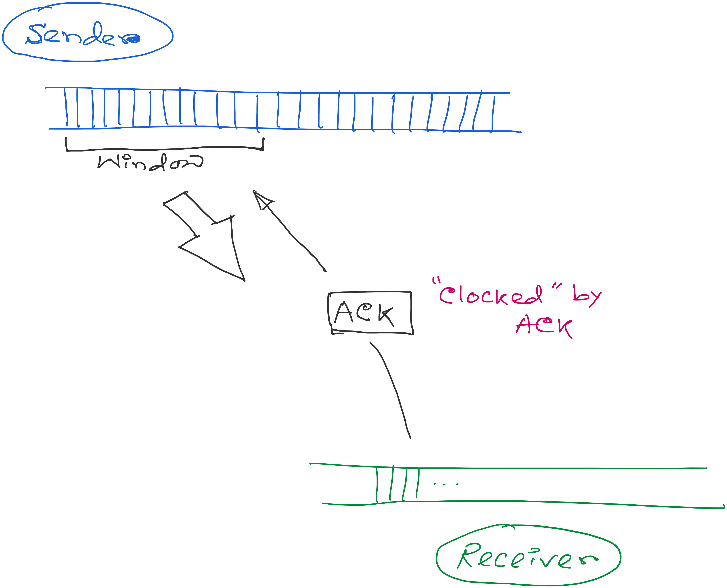
ACK works as the indicator and the window controls the flow.
Congestion_window: Calculated by the sender

Slide 29
ACK works as the indicator and the window controls the flow.
How to find the right window size?
When to change? How much?

Slide 30
TCP Congestion Control
Additive increase, multiplicative decrease (AIMD)
  On packet loss, divide congestion window in half
  On success for last window, increase window linearly
Loss
Window
halved
t

Slide 31
Why Exponential decrease?
Respond aggressively to bad news
  Congestion is (very) bad for everyone
  Need to react aggressively
Nice theoretical properties
  Makes efficient use of network resources

Slide 32
TCP Congestion Window
Each TCP sender maintains a congestion window
  Max number of bytes to have in transit (not yet ACK’d)
Adapting the congestion window
  Decrease upon losing a packet: backing off
  Increase upon success: optimistically exploring
  Always struggling to find right transfer rate
Tradeoff
  Pro: avoids needing explicit network feedback
  Con: continually under- and over-shoots “right” rate

Slide 33
Additive Increase, Multiplicative Decrease
How much to adapt?
  Additive increase: On success of last window of data, increase window by 1 Max Segment Size (MSS)
  Multiplicative decrease: On loss of packet, divide congestion window in half
Much quicker to slow than speed up!
  Over-sized windows (causing loss) are much worse than under-sized windows (causing lower thruput)
  AIMD: A necessary condition for stability of TCP

Slide 34
Leads to the TCP “Sawtooth”
Window
Loss
halved
t

Slide 35
Receiver/Advertised Window vs. Congestion Window
Flow control
  Keep a fast sender from overwhelming a slow receiver
Congestion control
  Keep a set of senders from overloading the network
Different concepts, but similar mechanisms
  TCP flow control: receiver window
  TCP congestion control: congestion window
  Sender TCP window =
  min { congestion window, receiver window }

Slide 36
Congestion control: Slow start

Slide 37
How Should a New Flow Start?
Start slow (a small CWND) to avoid overloading network
Window
Loss
halved
t

Slide 38
How Should a New Flow Start?
Start slow (a small CWND) to avoid overloading network
Window
Loss
halved
t
But, could take a long time to get started!

Slide 39
“Slow Start” Phase
Start with a small congestion window
  Initially, CWND is 1 MSS
  So, initial sending rate is MSS / RTT
Could be pretty wasteful
  Might be much less than actual bandwidth
  Linear increase takes a long time to accelerate
Slow-start phase (really “fast start”)
  Sender starts at a slow rate (hence the name)
  … but increases rate exponentially until the first loss

Slide 40
Slow Start in Action
Double CWND per round-trip time
1
2
4
8
Src
D
A
D
D
A
A
D
D
D
D
A
A
A
A
Dest

Slide 41
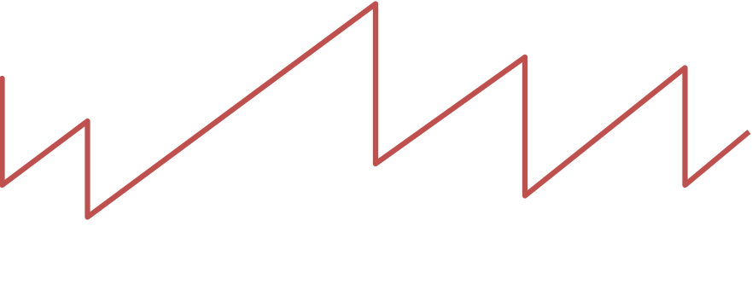
Slow Start and the TCP Sawtooth
Loss
Window
Linear “congestion avoidance” phase
halved
Exponential “slow start”
t
Why is this called “slow start”?
TCP originally had no congestion control
  Source would start by sending entire receiver window
  Led to congestion collapse!
  “Slow start” is, comparatively, slower

Slide 42
Response to the two types of losses

Slide 43
Response to the two types of losses
(1) Triple duplicate ACK (Fast retransmit)
  Packet n is lost, but packets n+1, n+2, etc. arrive
  Then, sender quickly resends packet n
  Do a multiplicative decrease and keep going

Slide 44
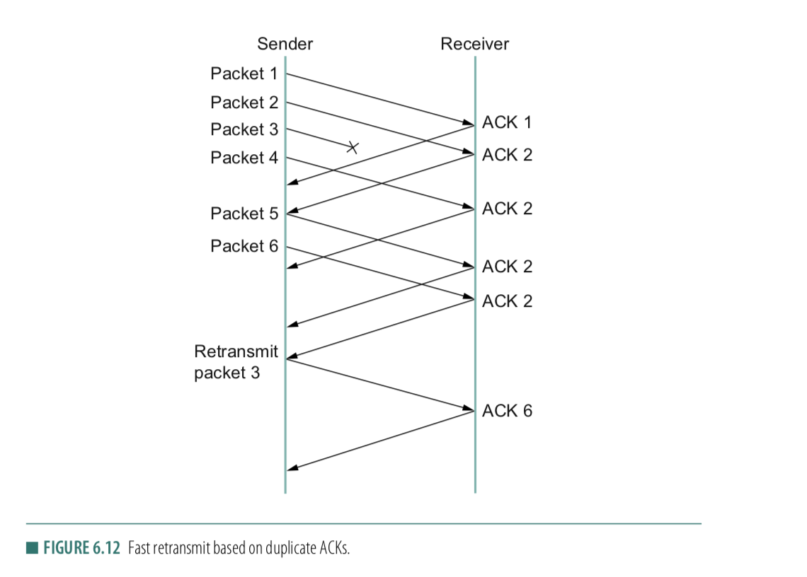
Fast retransmit
ACK for 2
1st Dup-ACK for 2
2nd Dup-ACK
3rd Dup-ACK

Slide 45
Congestion window during Fast retransmit
Window
Packet loss (3-dup ack, fast retransmit, multiplicative decrease)
t

Slide 46
Two Kinds of Loss in TCP
(1) Triple duplicate ACK (Fast retransmit)
  Packet n is lost, but packets n+1, n+2, etc. arrive
  Then, sender quickly resends packet n
  Do a multiplicative decrease and keep going
(2) Timeout (Repeat slow start – slow start restart)
  Packet n is lost and detected via a timeout
  Blasting entire CWND would cause another burst
  Better to start over with a low CWND

Slide 47
Repeating Slow Start After Timeout
(slow-start restart)
Window
timeout
Packet loss (3-dup ack, fast retransmit)
t
Slow start until reaching half of previous cwnd.
Slow-start restart: Go back to CWND of 1, but take advantage of knowing the previous value of CWND.

Slide 48
Repeating Slow Start After Idle Period
Suppose a TCP connection goes idle for a while
Eventually, the network conditions change
  Maybe many more flows are traversing the link
Dangerous to start transmitting at the old rate
  Previously-idle TCP sender might blast network
  … causing excessive congestion and packet loss
So, some TCP implementations repeat slow start
  Slow-start restart after an idle period

Slide 49
TCP congestion control
Conservation of packets:
If the connection is running at the available capacity (bandwidth) then a packet is not injected into the network unless a packet is taken out.
Notes:
[source: G.R.Wright and W.R.Stevens, TCP/IP Illustrated, Vol 2; J. Hoe, MSc Thesis, pp.22]
Tahoe (1988): slow start, congestion avoidance, fast retransmit
Reno (1990): fast recovery, TCP header prediction, SLIP header compression, routing table changes
4.4BSD (1993): multicasting, long fat pipe modifications

Slide 50
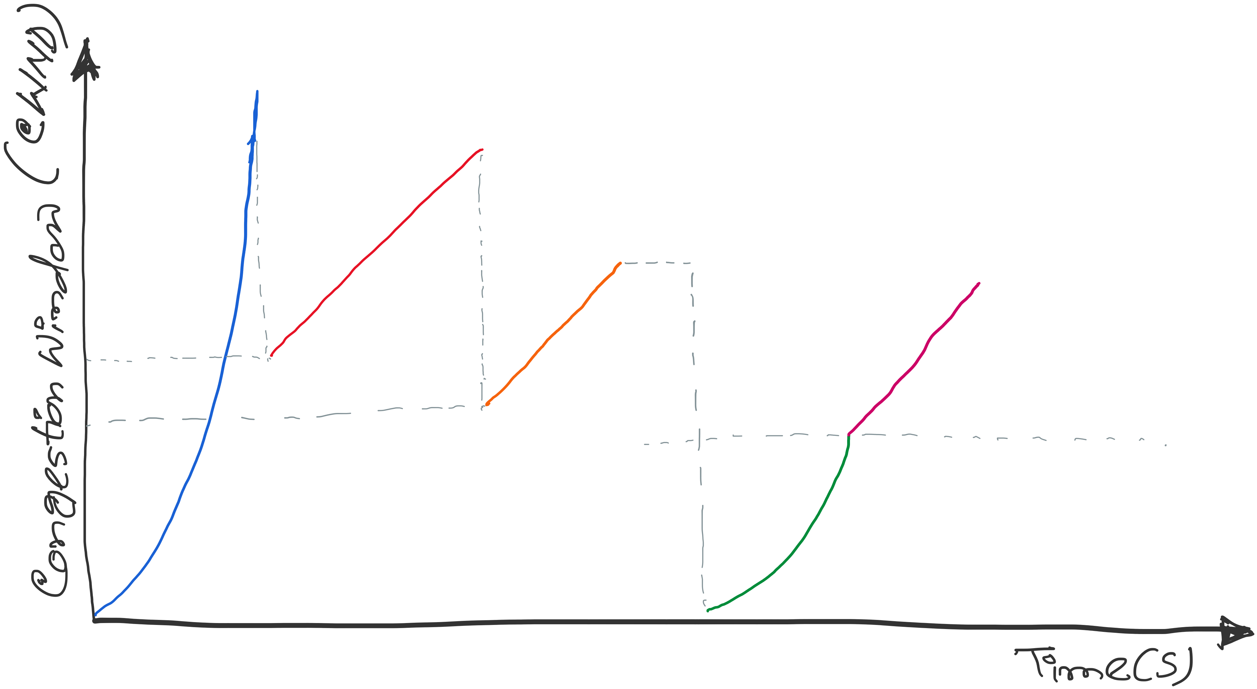
TCP congestion control: CWND graph
Notes:
[source: G.R.Wright and W.R.Stevens, TCP/IP Illustrated, Vol 2; J. Hoe, MSc Thesis, pp.22]
Tahoe (1988): slow start, congestion avoidance, fast retransmit
Reno (1990): fast recovery, TCP header prediction, SLIP header compression, routing table changes
4.4BSD (1993): multicasting, long fat pipe modifications

Slide 51
Implementation details
Update Time: Per RTT vs Per ACK

Slide 52
Implementation details
Update Time: Per RTT vs Per ACK
Double CWND per round-trip time
1
2
4
8
Src
D
A
D
D
A
A
D
D
D
D
A
A
A
A
Dest

Slide 53
Implementation details
Update Time: Per RTT vs Per ACK
Double CWND per round-trip time
Implemented as CWND = CWND + 1 (per ACK)
1
2
4
8
Src
D
A
D
D
A
A
D
D
D
D
A
A
A
A
Dest

Slide 54
Implementation details
Update Time: Per RTT vs Per ACK
Linear increase of CWND per round-trip time
Implemented as CWND = CWND + 1/CWND (per ACK)
1
2
3
4
Src
D
A
D
D
A
A
D
D
D
D
A
A
A
Dest

Slide 55
TCP congestion control: CWND graph
First packet loss (3-dup acks)
Congestion avoidance CWND = CWND + (1/CWND)
Packet loss
(3-dup acks)
CWND = CWND/2
Time out(no acks)
Congestion
avoidance
CWND =
CWND +
(1/CWND)
SSTHRES = CWND/2
CWND = CWND/2
Slow Start end
Slow start
Slow Start restart
CWND = 1
Notes:
[source: G.R.Wright and W.R.Stevens, TCP/IP Illustrated, Vol 2; J. Hoe, MSc Thesis, pp.22]
Tahoe (1988): slow start, congestion avoidance, fast retransmit
Reno (1990): fast recovery, TCP header prediction, SLIP header compression, routing table changes
4.4BSD (1993): multicasting, long fat pipe modifications

Slide 56
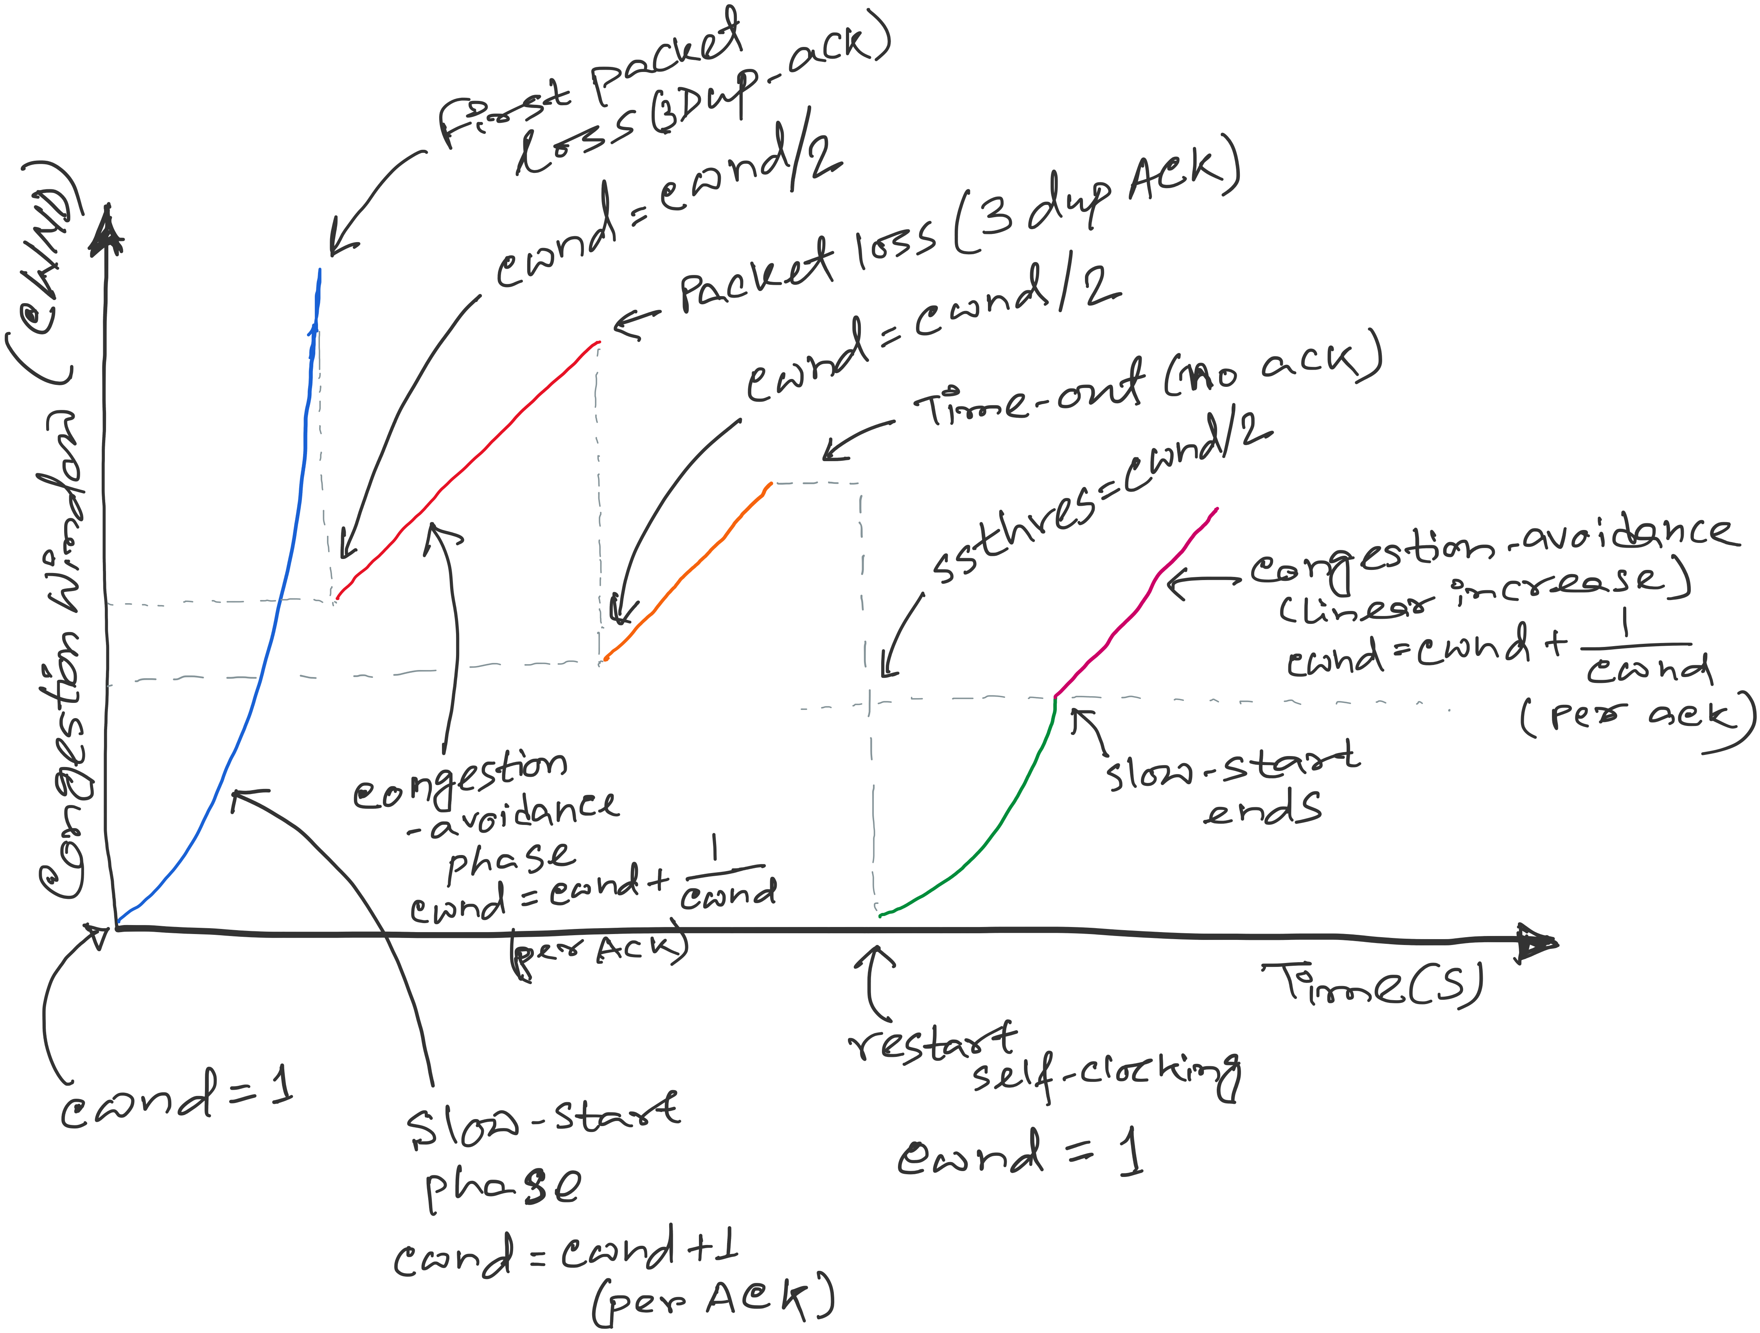
TCP congestion control
SSTHRES = Slow-start threshold
Notes:
[source: G.R.Wright and W.R.Stevens, TCP/IP Illustrated, Vol 2; J. Hoe, MSc Thesis, pp.22]
Tahoe (1988): slow start, congestion avoidance, fast retransmit
Reno (1990): fast recovery, TCP header prediction, SLIP header compression, routing table changes
4.4BSD (1993): multicasting, long fat pipe modifications

Slide 57
1. Development of Congestion Control over TCP versions
Copyright, 1996 © Dale Carnegie & Associates, In

Slide 58
TCP versions
TCP is not perfectly homogenous (200+)
4.2 BSD first widely available release of TCP/IP (1983)
Windows 95
4.3 BSD (1986)
Windows NT
4.3 BSD Tahoe (1988)
SunOS 4.1.3,4.1.4
4.3 BSD Reno (1990)
Solaris 2.3,2.4
IRIX
Linux 1.0
Digital OSF
HP/UX
4.4 BSD (1993)
Vegas (1994)
NewReno (1999)
.....
Notes:
[source: G.R.Wright and W.R.Stevens, TCP/IP Illustrated, Vol 2; J. Hoe, MSc Thesis, pp.22]
Tahoe (1988): slow start, congestion avoidance, fast retransmit
Reno (1990): fast recovery, TCP header prediction, SLIP header compression, routing table changes
4.4BSD (1993): multicasting, long fat pipe modifications

Slide 59
TCP Congestion Controls
Tahoe (Jacobson 1988)
  Slow Start
  Congestion Avoidance
  Fast Retransmit (FR)

Slide 60
TCP Tahoe (Jacobson 1988)
window
time
SS
CA
SS: Slow Start
CA: Congestion Avoidance

Slide 61
Slow Start in Tahoe
Start with cwnd = 1 (slow start)
On each successful ACK increment cwnd
cwnd ← cnwd + 1
Exponential growth of cwnd
each RTT: cwnd ← 2 x cwnd
Enter CA when cwnd >= ssthresh

Slide 62
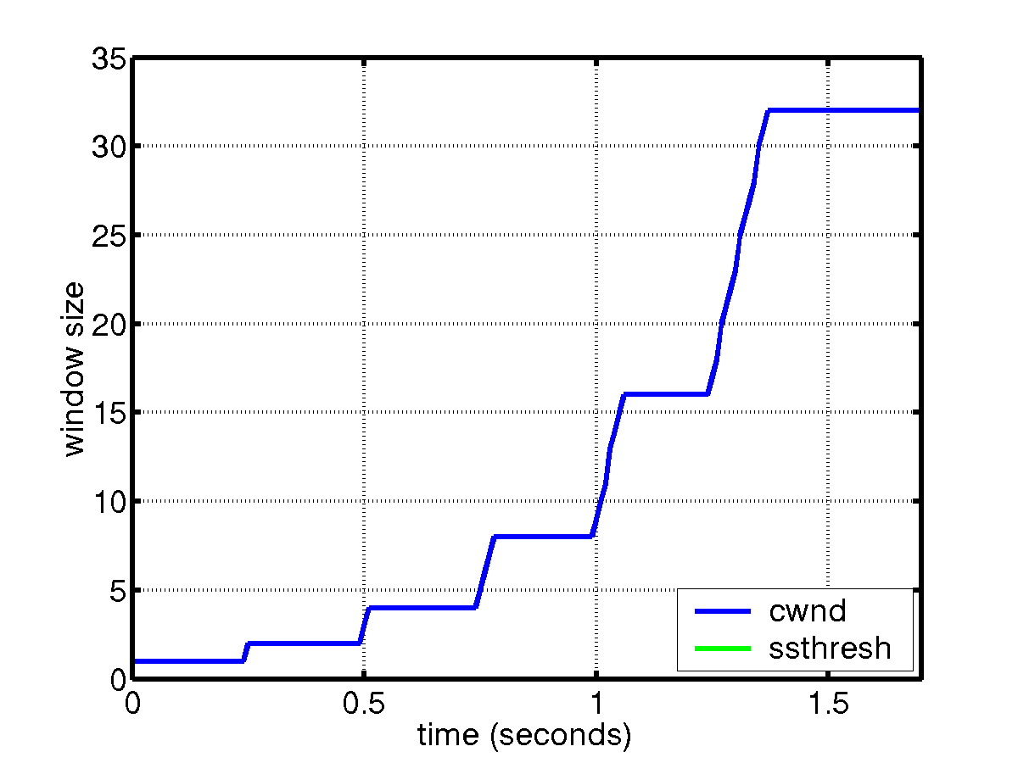
Slow Start
sender
receiver
cwnd
1
data packet
1 RTT
ACK
2
3
4
5
6
7
8
cwnd ← cwnd + 1 (for each ACK)

Slide 63
Congestion Avoidance
Starts when cwnd ≥ ssthresh
On each successful ACK: cwnd ← cwnd + 1/cwnd
Linear growth of cwnd
each RTT: cwnd ← cwnd + 1

Slide 64
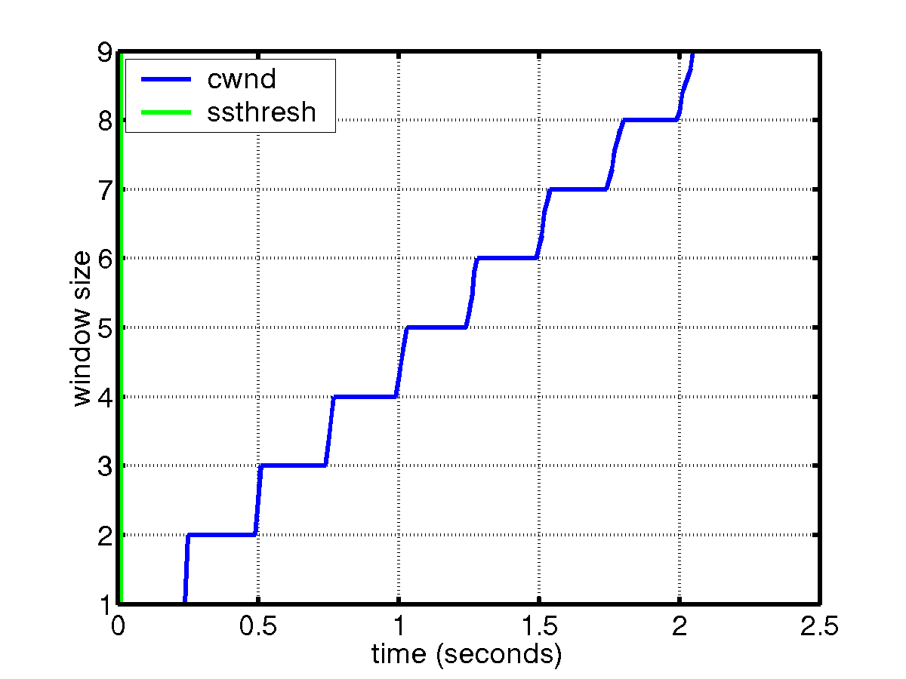
Congestion Avoidance
sender
receiver
cwnd
1
data packet
ACK
2
1 RTT
3
4
cwnd ← cwnd + 1 (for each “cwnd number of ACKS”)

Slide 65
Packet Loss
Assumption: loss indicates congestion
Packet loss detected by
  Retransmission TimeOuts (RTO timer)
  Duplicate ACKs (at least 3)
Packets
1
2
3
4
5
6
7
Acknowledgements
1
2
3
3
3
3

Slide 66
Fast Retransmit
Wait for a timeout is quite long
Immediately retransmits after 3 dupACKs without waiting for timeout
Adjusts ssthresh
flightsize = min(awnd, cwnd)
ssthresh ← max(flightsize/2, 2)
Enter Slow Start (cwnd = 1)

Slide 67
Summary: Tahoe
Basic ideas
  Gently probe network for spare capacity
  Drastically reduce rate on congestion
  Windowing: self-clocking
  Other functions: round trip time estimation, error recovery
for every ACK {
if (W < ssthresh) then W++ (SS)
else W += 1/W (CA)
}
for every loss {
ssthresh = W/2
W = 1
}

Slide 68
TCP Congestion Controls
Tahoe (Jacobson 1988)
  Slow Start
  Congestion Avoidance
  Fast Retransmit (FR)
Reno (Jacobson 1990)
  Fast Recovery

Slide 69
Tahoe’s CWND recovers slowly
window
time
SS
CA
SS: Slow Start
CA: Congestion Avoidance

Slide 70
TCP Reno
window
time
SS
CA
SS: Slow Start
CA: Congestion Avoidance
Fast retransmission/Fast recovery

Slide 71
TCP Reno
Notes:
[source: G.R.Wright and W.R.Stevens, TCP/IP Illustrated, Vol 2; J. Hoe, MSc Thesis, pp.22]
Tahoe (1988): slow start, congestion avoidance, fast retransmit
Reno (1990): fast recovery, TCP header prediction, SLIP header compression, routing table changes
4.4BSD (1993): multicasting, long fat pipe modifications

Slide 72
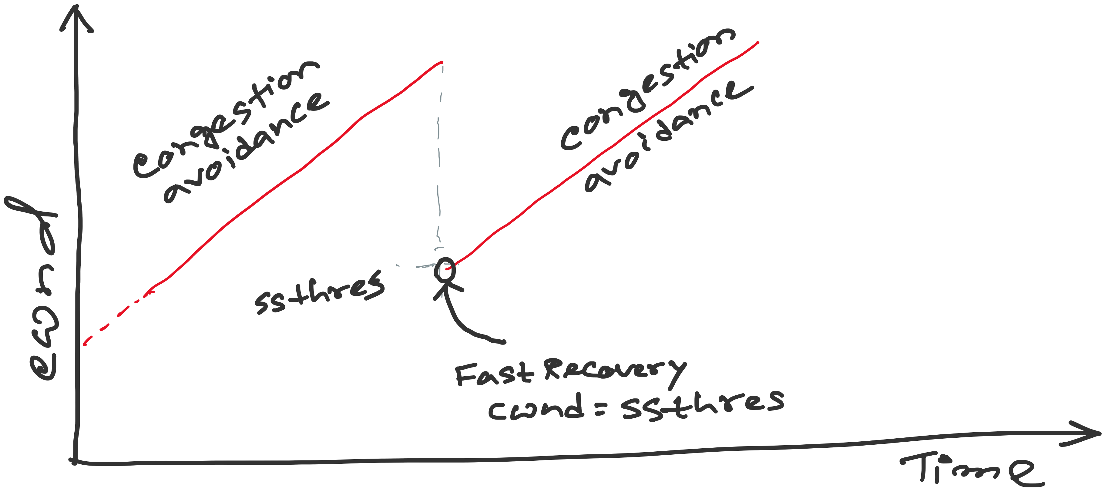
TCP Reno: details of Fast Recovery
Notes:
[source: G.R.Wright and W.R.Stevens, TCP/IP Illustrated, Vol 2; J. Hoe, MSc Thesis, pp.22]
Tahoe (1988): slow start, congestion avoidance, fast retransmit
Reno (1990): fast recovery, TCP header prediction, SLIP header compression, routing table changes
4.4BSD (1993): multicasting, long fat pipe modifications

Slide 73
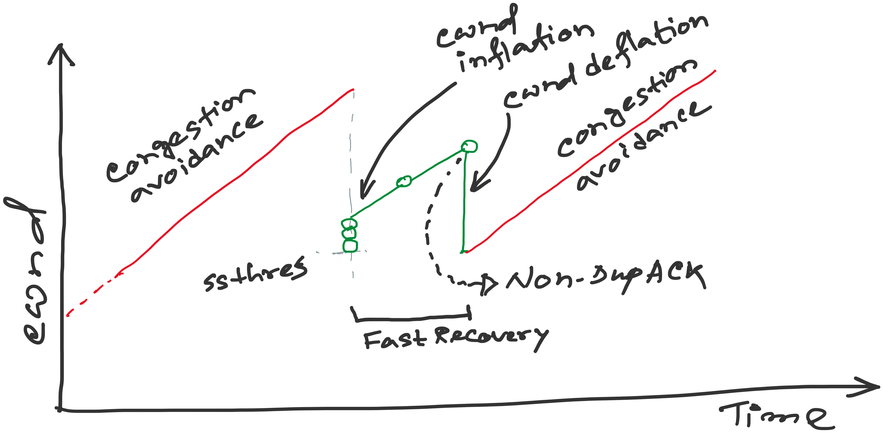
TCP Reno: details of Fast Recovery
Notes:
[source: G.R.Wright and W.R.Stevens, TCP/IP Illustrated, Vol 2; J. Hoe, MSc Thesis, pp.22]
Tahoe (1988): slow start, congestion avoidance, fast retransmit
Reno (1990): fast recovery, TCP header prediction, SLIP header compression, routing table changes
4.4BSD (1993): multicasting, long fat pipe modifications

Slide 74
TCP Reno
Notes:
[source: G.R.Wright and W.R.Stevens, TCP/IP Illustrated, Vol 2; J. Hoe, MSc Thesis, pp.22]
Tahoe (1988): slow start, congestion avoidance, fast retransmit
Reno (1990): fast recovery, TCP header prediction, SLIP header compression, routing table changes
4.4BSD (1993): multicasting, long fat pipe modifications

Slide 75
TCP Reno: details of Fast Recovery
Notes:
[source: G.R.Wright and W.R.Stevens, TCP/IP Illustrated, Vol 2; J. Hoe, MSc Thesis, pp.22]
Tahoe (1988): slow start, congestion avoidance, fast retransmit
Reno (1990): fast recovery, TCP header prediction, SLIP header compression, routing table changes
4.4BSD (1993): multicasting, long fat pipe modifications

Slide 76
TCP Reno: details of Fast Recovery
Notes:
[source: G.R.Wright and W.R.Stevens, TCP/IP Illustrated, Vol 2; J. Hoe, MSc Thesis, pp.22]
Tahoe (1988): slow start, congestion avoidance, fast retransmit
Reno (1990): fast recovery, TCP header prediction, SLIP header compression, routing table changes
4.4BSD (1993): multicasting, long fat pipe modifications

Slide 77
Fast Retransmit/Fast Recovery (FR/FR)
(will work on this example during lecture)
<Open>
6
CWND
6
STHRES
N/A
13
14
15
16
17
18
14
19
20
TX
X
RX
14
14
14
14
19
Notes:
After FR/FR, when CA is entered, cwnd is half of the window when lost was detected.
So the effect of lost is halving the window.
[Source: RFC 2581, Fall & Floyd, “Simulation based Comparison of Tahoe, Reno, and SACK TCP”]

Slide 78
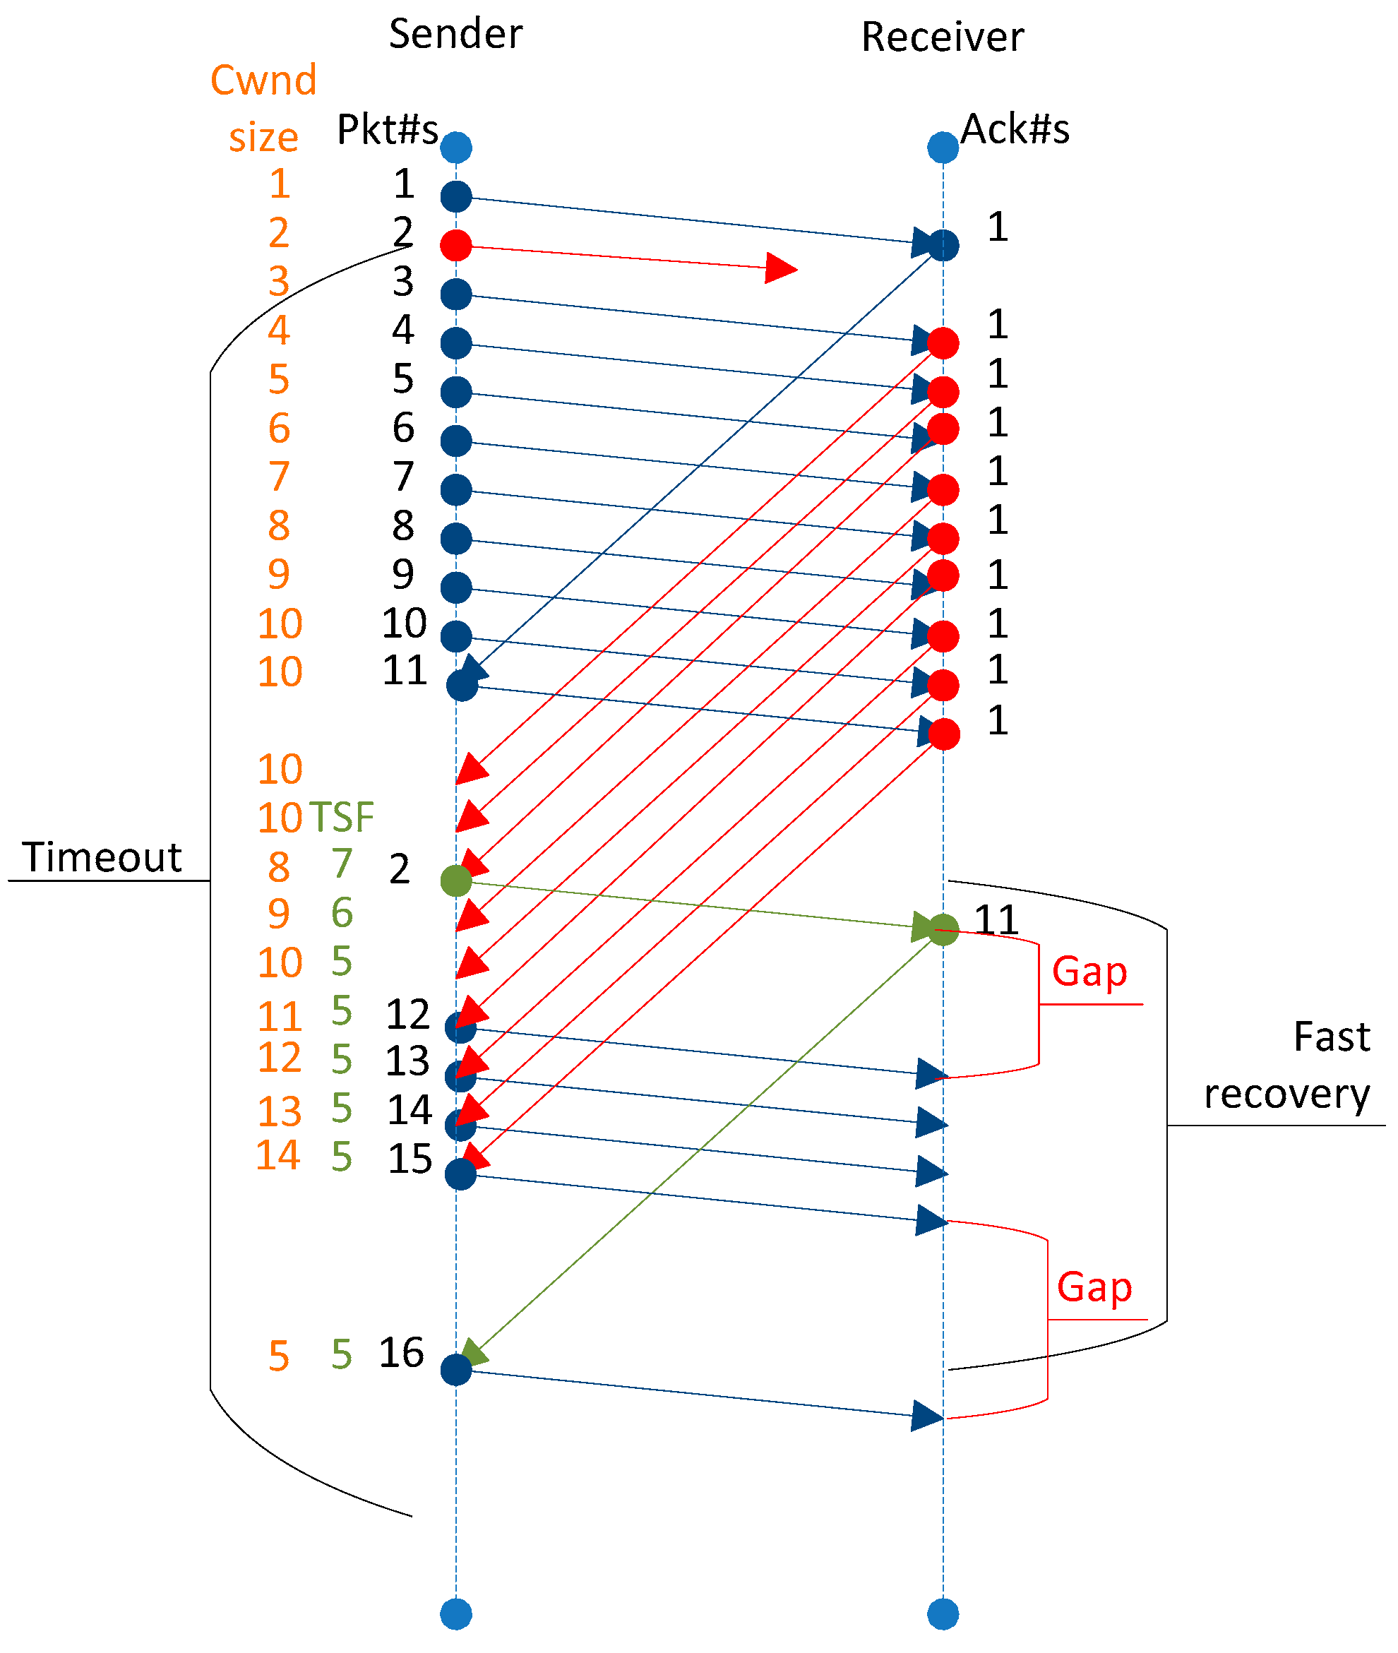
Fast Retransmit/Fast Recovery (FR/FR)
10
TSF = Segments in flight
[Ref] https://www.mdpi.com/2076-3417/9/21/4698
Notes:
After FR/FR, when CA is entered, cwnd is half of the window when lost was detected.
So the effect of lost is halving the window.
[Source: RFC 2581, Fall & Floyd, “Simulation based Comparison of Tahoe, Reno, and SACK TCP”]

Slide 79
Fast Retransmit/Fast Recovery (FR/FR)
Motivation: prevent `pipe’ from emptying after fast retransmit
Idea: each dupACK represents a packet having left the pipe (successfully received)
Enter FR/FR after 3 dupACKs
  Set ssthresh ← max(flightsize/2, 2)
  Retransmit lost packet
  Set cwnd ← ssthresh + ndup (window inflation)
  Wait till W=min(awnd, cwnd) is large enough; transmit new packet(s)
  On non-dup ACK (1 RTT later), set cwnd ← ssthresh (window deflation)
Enter CA
Notes:
After FR/FR, when CA is entered, cwnd is half of the window when lost was detected.
So the effect of lost is halving the window.
[Source: RFC 2581, Fall & Floyd, “Simulation based Comparison of Tahoe, Reno, and SACK TCP”]

Slide 80
Summary: Reno
Basic ideas
  Fast recovery avoids slow start
  dupACKs: fast retransmit + fast recovery
  Timeout: fast retransmit + slow start
dupACKs
congestion avoidance
FR/FR
timeout
slow start
retransmit

Slide 81
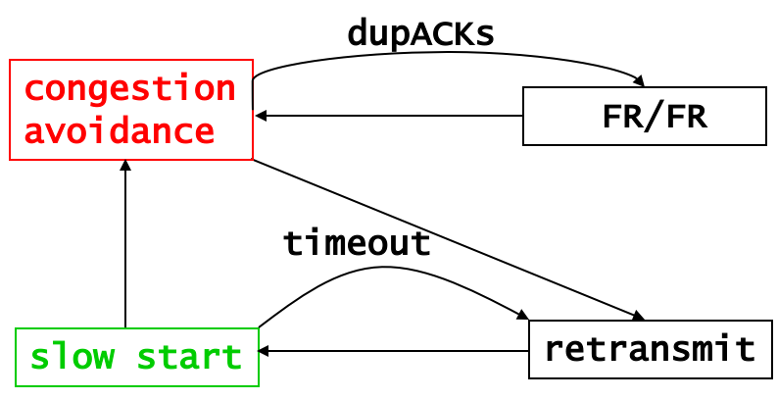
TCP congestion control: CWND graph
Notes:
[source: G.R.Wright and W.R.Stevens, TCP/IP Illustrated, Vol 2; J. Hoe, MSc Thesis, pp.22]
Tahoe (1988): slow start, congestion avoidance, fast retransmit
Reno (1990): fast recovery, TCP header prediction, SLIP header compression, routing table changes
4.4BSD (1993): multicasting, long fat pipe modifications

Slide 82
Problem with Reno
Reno retransmit at most 1 lost packet per RTT
  Pipe can be emptied during “Fast Retransmit/Fast Recovery” with multiple losses
Solution: TCP with Selective Acknowledgements (SACK) provides better estimate of packets in pipe
  SACK TCP option describes received packets
  On 3 dupACKs: retransmits, halves window, enters FR
  Updates pipe = packets in pipe
    Increment when lost or new packets sent
    Decrement when dupACK received
  Transmits a (lost or new) packet when pipe < cwnd
  Exit FR when all packets outstanding when FR was entered are acknowledged
Notes:
[Sources: M. Mathis, J. Mahdavi, S. Floyd and A. Romanow, “TCP Selective Acknowledgement Options”, RFC 2018, Oct. 1996
K. Fall and S. Floyd, “Simulation-based comparisons of Tahoe, Reno and SACK TCP”, Computer Communication Review, July 1996 ]

Slide 83
TCP Vegas (Brakmo & Peterson 1994)
window
time
SS
CA
Considers packet delay, not loss, as a hint for congestion
Reno with a new congestion avoidance algorithm
Converges (provided buffer is large) !

Slide 84
2. Router-assisted Congestion Control
Copyright, 1996 © Dale Carnegie & Associates, In

Slide 85
Congestion Control discussed so far
What can the end-points do to collectively to make good use of shared underlying resources?
link
name
?
?
session
path
address
Notes:
This week, we’ll talk about how to share resources. Today we’ll talk about what the end-points can do in a distributed fashion, from the edge of the network. On Wednesday, we’ll talk about what the lower-level elements can do.

Slide 86
Router-assisted Congestion Control
What can the individual links do to make
good use of shared underlying resources?
link
name
session
?
path
address
Notes:
This week, we’ll talk about how to share resources. Today we’ll talk about what the end-points can do in a distributed fashion, from the edge of the network. On Wednesday, we’ll talk about what the lower-level elements can do.

Slide 87
Router
Processor
control plane
data plane
Switching
Fabric
Line card
Line card
Line card
Line card
Line card
Line card

Slide 88
Line Cards (Interface Cards, Adaptors)
Packet handling
  Packet forwarding
  Buffer management
  Link scheduling
  Packet filtering
  Rate limiting
  Packet marking
  Measurement
to/from link
Receive
lookup
Transmit
to/from switch

Slide 89
Packet Switching and Forwarding
“4”
Link 1, ingress
Choose
Egress
Link 1, egress
Link 2
Link 2, ingress
Choose
Egress
Link 2, egress
R1
“4”
Link 1
Link 3
Link 3, ingress
Choose
Egress
Link 3, egress
Link 4
Link 4, ingress
Choose
Egress
Link 4, egress

Slide 90
Queue Management Issues
Scheduling discipline
  Which packet to send?
  Some notion of fairness? Priority?
Drop policy
  When should you discard a packet?
  Which packet to discard?
Goal: balance throughput and delay
  Huge buffers minimize drops, but add to queuing delay (thus higher RTT, longer slow start, …)

Slide 91
Queue Management 1: Drop Policy

Slide 92
FIFO Scheduling and Drop-Tail
Access to the bandwidth: first-in first-out queue
  Packets only differentiated when they arrive
Access to the buffer space: drop-tail queuing
  If the queue is full, drop the incoming packet
✗

Slide 93
Bursty Loss From Drop-Tail Queuing
TCP depends on packet loss
  Packet loss is indication of congestion
  TCP additive increase drives network into loss
Drop-tail leads to bursty loss
  Congested link: many packets encounter full queue
  Synchronization: many connections lose packets at once

Slide 94
Slow Feedback from Drop Tail
Feedback comes when buffer is completely full
  … even though the buffer has been filling for a while
Plus, the filling buffer is increasing RTT
  … making detection even slower
Better to give early feedback
  Get 1-2 connections to slow down before it’s too late!

Slide 95
Random Early Detection (RED)
Router notices that queue is getting full
  … and randomly drops packets to signal congestion
Packet drop probability
  Drop probability increases as queue length increases
  Else, set drop probability f(avg queue length)
Drop
Probability
0 1
Average Queue Length

Slide 96
Properties of RED
Drops packets before queue is full
  In the hope of reducing the rates of some flows
Drops packet in proportion to each flow’s rate
  High-rate flows selected more often
Drops are spaced out in time
  Helps desynchronize the TCP senders
Tolerant of burstiness in the traffic
  By basing the decisions on average queue length

Slide 97
Problems With RED
Hard to get tunable parameters just right
  How early to start dropping packets?
  What slope for increase in drop probability?
  What time scale for averaging queue length?
RED has mixed adoption in practice
  If parameters aren’t set right, RED doesn’t help
Many other variations in research community
  Names like “Blue” (self-tuning), “FRED”…

Slide 98
Feedback: From Loss to Notification
Early dropping of packets
  Good: gives early feedback
  Bad: has to drop the packet to give the feedback
Explicit Congestion Notification (ECN)
  Router marks the packet with an ECN bit
  Sending host interprets as a sign of congestion
  Requires participation of hosts and the routers

Slide 99
Queue Management 2: Link Scheduling

Slide 100

First-In First-Out Scheduling
First-in first-out scheduling
  Simple, but restrictive
Example: two kinds of traffic
  Voice over IP needs low delay
  E-mail is not that sensitive about delay
Voice traffic waits behind e-mail

Slide 101
Strict Priority
Multiple levels of priority
  Always transmit high-priority traffic, when present
Isolation for the high-priority traffic
  Almost like it has a dedicated link
  Except for (small) delay for packet transmission
But, lower priority traffic may starve ☹

Slide 102
Weighted Fair Scheduling
Weighted fair scheduling
  Assign each queue a fraction of the link bandwidth
  Rotate across queues on a small time scale
Work-conserving
  Send extra traffic from one queue if others are idle
50% red, 25% blue, 25% green

Slide 103
Implementation Trade-Offs
FIFO
  One queue, trivial scheduler
Strict priority
  One queue per priority level, simple scheduler
Weighted fair scheduling
  One queue per class, and more complex scheduler

Slide 104
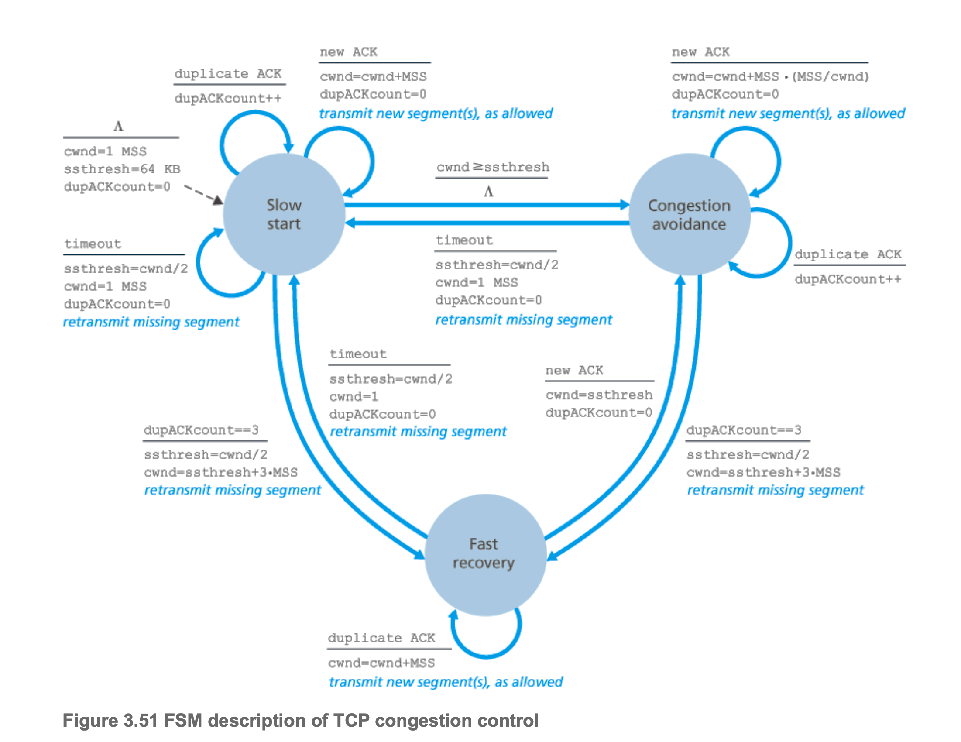
TCP Congestion Control

Slide 105
TCP Congestion Control
Should TCP increment CWND during Dup-ACKs?

Slide 106
Revisiting Dup ACKs (without Fast-Recovery)
<Open>
6
CWND
5
STHRES
N/A
13
14
15
16
17
18
14
19
20
21
TX
X
RX
14
14
14
14
14
19
Notes:
After FR/FR, when CA is entered, cwnd is half of the window when lost was detected.
So the effect of lost is halving the window.
[Source: RFC 2581, Fall & Floyd, “Simulation based Comparison of Tahoe, Reno, and SACK TCP”]

Slide 107
Revisiting Dup ACKs (without Fast-Recovery)
<Open>
6
CWND
5
STHRES
N/A
13
14
15
16
17
18
14
19
20
21
TX
X
X
RX
14
14
14
14
?
What if there are multiple losses in an RTT?
Notes:
After FR/FR, when CA is entered, cwnd is half of the window when lost was detected.
So the effect of lost is halving the window.
[Source: RFC 2581, Fall & Floyd, “Simulation based Comparison of Tahoe, Reno, and SACK TCP”]

Slide 108
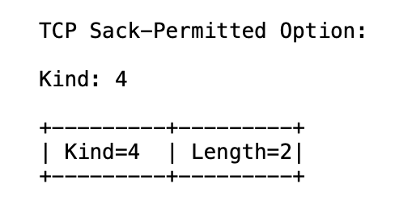
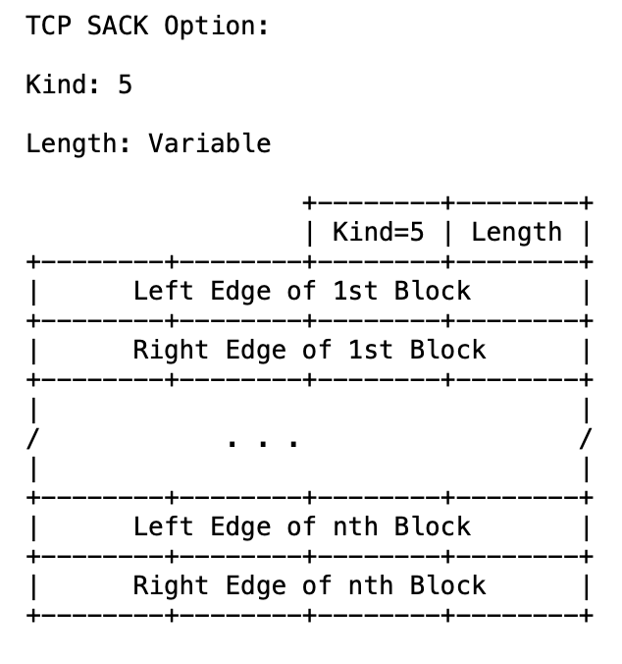
TCP Selective ACK (SACK): RFC 2018
https://www.rfc-editor.org/rfc/rfc2018

Slide 109
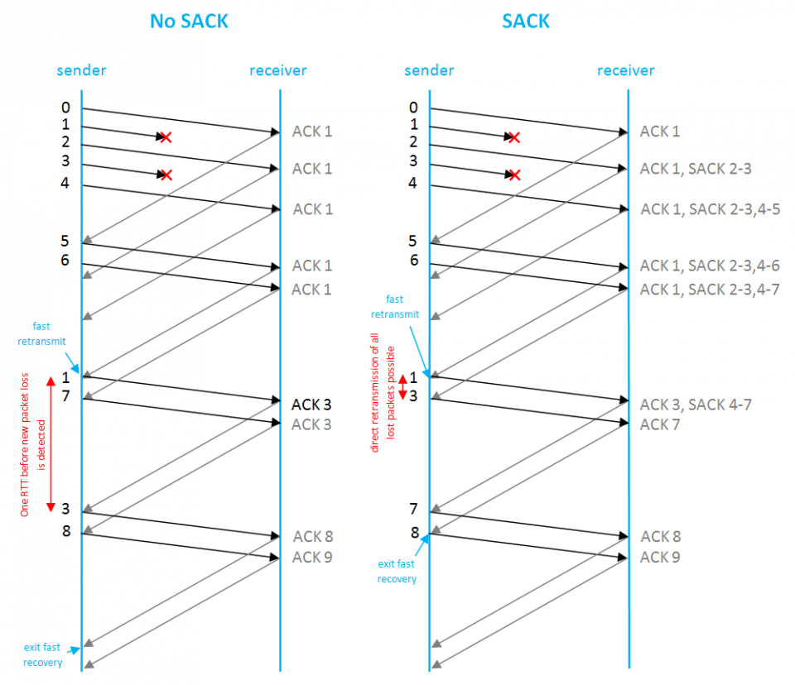
TCP Selective ACK (SACK): RFC 2018
[REF-1] https://www.rfc-editor.org/rfc/rfc2018
[REF-2] https://www.excentis.com/blog/measuring-throughput-effect-of-used-tcp-settings/

Slide 110
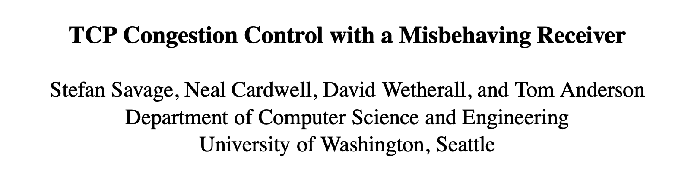
Slides courtesy: https://cseweb.ucsd.edu/classes/wi01/cse222/lectures/attack-18.pdf

