Slide 1

Computer Networks
CMSC 417 : Spring 2025
Topic: TCP Congestion-control
(Textbook chapter 6)
Nirupam Roy
Tu-Th 2:00-3:15pm
CSI 2117
April 9th, 2025

Slide 2
Development of Congestion Control over TCP versions
Copyright, 1996 © Dale Carnegie & Associates, In

Slide 3
TCP versions
TCP is not perfectly homogenous (200+)
4.2 BSD first widely available release of TCP/IP (1983)
Windows 95
4.3 BSD (1986)
Windows NT
4.3 BSD Tahoe (1988)
SunOS 4.1.3,4.1.4
4.3 BSD Reno (1990)
Solaris 2.3,2.4
IRIX
Linux 1.0
Digital OSF
HP/UX
4.4 BSD (1993)
Vegas (1994)
NewReno (1999)
.....
Notes:
[source: G.R.Wright and W.R.Stevens, TCP/IP Illustrated, Vol 2; J. Hoe, MSc Thesis, pp.22]
Tahoe (1988): slow start, congestion avoidance, fast retransmit
Reno (1990): fast recovery, TCP header prediction, SLIP header compression, routing table changes
4.4BSD (1993): multicasting, long fat pipe modifications
BSD stands for Berkeley Software Distribution, a family of Unix-like operating systems developed at the University of California, Berkeley. BSD is connected to TCP congestion control because several key TCP congestion control algorithms, like TCP Tahoe and TCP Reno, were first implemented in the 4.3BSD operating system.

Slide 4
TCP Congestion Controls
Tahoe (Jacobson 1988)
  Slow Start
  Congestion Avoidance
  Fast Retransmit (FR)

Slide 5
TCP Tahoe (Jacobson 1988)
window
time
SS
CA
SS: Slow Start
CA: Congestion Avoidance
Notes:
In TCP Tahoe, the initial value for ssthresh (slow start threshold) is 32 segments.

Slide 6
Slow Start in Tahoe
Start with cwnd = 1 (slow start)
On each successful ACK increment cwnd
cwnd ← cnwd + 1
Exponential growth of cwnd
each RTT: cwnd ← 2 x cwnd
Enter CA when cwnd >= ssthresh

Slide 7
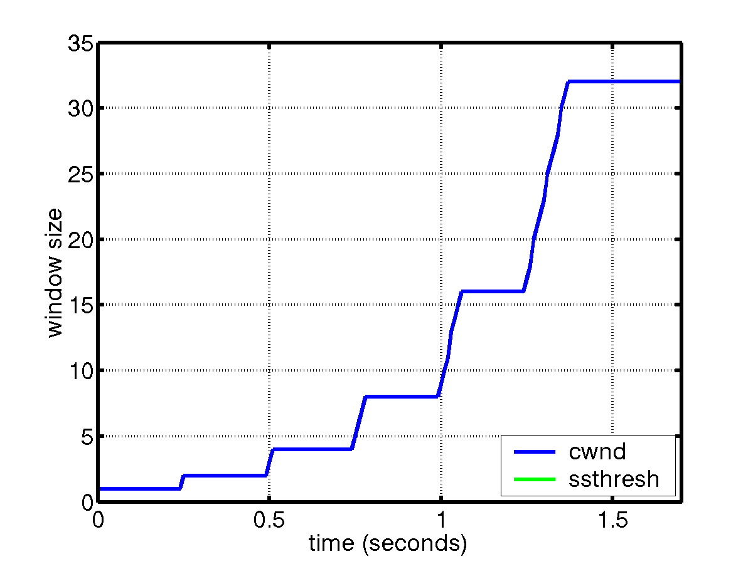
Slow Start
sender
receiver
cwnd
1
data packet
1 RTT
ACK
2
3
4
5
6
7
8
cwnd ← cwnd + 1 (for each ACK)

Slide 8
Congestion Avoidance
Starts when cwnd ≥ ssthresh
On each successful ACK: cwnd ← cwnd + 1/cwnd
Linear growth of cwnd
each RTT: cwnd ← cwnd + 1

Slide 9
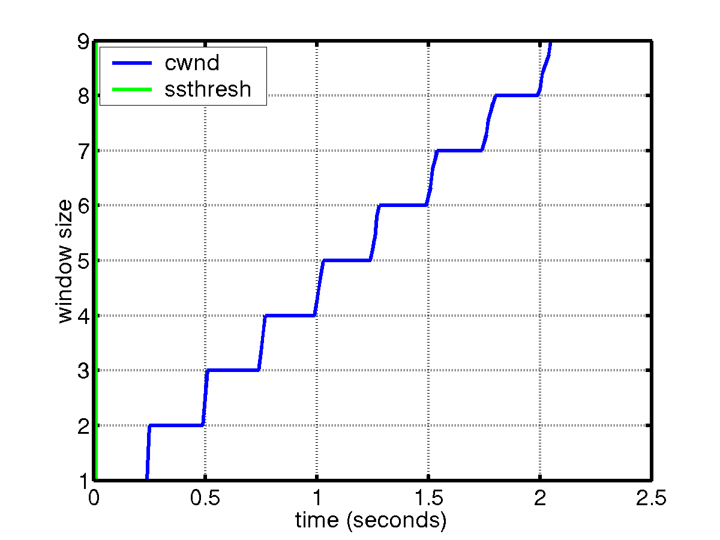
Congestion Avoidance
sender
receiver
cwnd
1
data packet
ACK
2
1 RTT
3
4
cwnd ← cwnd + 1 (for each “cwnd number of ACKS”)

Slide 10
Packet Loss
Assumption: loss indicates congestion
Packet loss detected by
  Retransmission TimeOuts (RTO timer)
  Duplicate ACKs (at least 3)
Packets
1
2
3
4
5
6
7
Acknowledgements
1
2
3
3
3
3

Slide 11
Fast Retransmit (Tahoe)
Wait for a timeout is quite long
Immediately retransmits after 3 dupACKs without waiting for timeout
Adjusts ssthresh
flightsize = min(awnd, cwnd)
ssthresh ← max(flightsize/2, 2)
Enter Slow Start (cwnd = 1)
Notes:
In TCP Tahoe, the initial value for ssthresh (slow start threshold) is 32 segments.

Slide 12
Summary: Tahoe
Basic ideas
  Gently probe network for spare capacity
  Drastically reduce rate on congestion
  Windowing: self-clocking
  Other functions: round trip time estimation, error recovery
for every ACK {
if (W < ssthresh) then W++ (SS)
else W += 1/W (CA)
}
for every loss {
ssthresh = W/2
W = 1
}
Notes:
In TCP Tahoe, the initial value for ssthresh (slow start threshold) is 32 segments.

Slide 13
TCP Congestion Controls
Tahoe (Jacobson 1988)
  Slow Start
  Congestion Avoidance
  Fast Retransmit (FR)
Reno (Jacobson 1990)
  Fast Recovery

Slide 14
Tahoe’s CWND recovers slowly
window
time
SS
CA
SS: Slow Start
CA: Congestion Avoidance

Slide 15
TCP Reno
window
time
SS
CA
SS: Slow Start
CA: Congestion Avoidance
Fast retransmission/Fast recovery

Slide 16
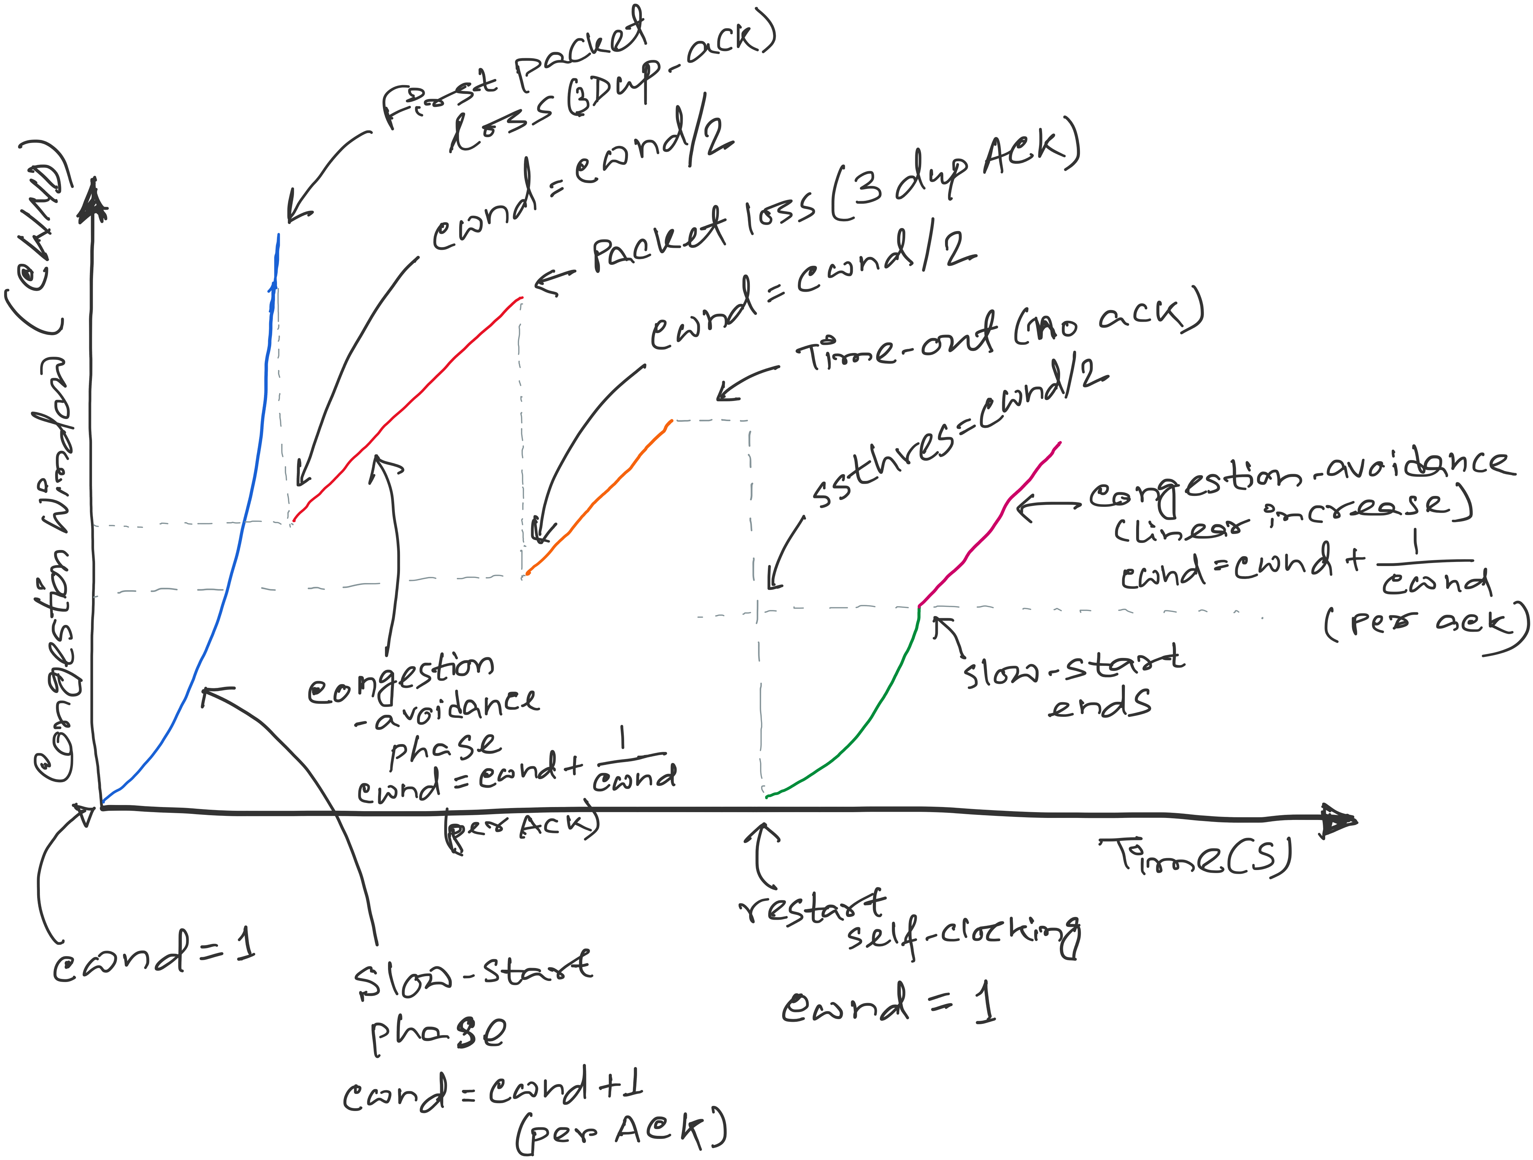
TCP Reno
Notes:
[source: G.R.Wright and W.R.Stevens, TCP/IP Illustrated, Vol 2; J. Hoe, MSc Thesis, pp.22]
Tahoe (1988): slow start, congestion avoidance, fast retransmit
Reno (1990): fast recovery, TCP header prediction, SLIP header compression, routing table changes
4.4BSD (1993): multicasting, long fat pipe modifications

Slide 17
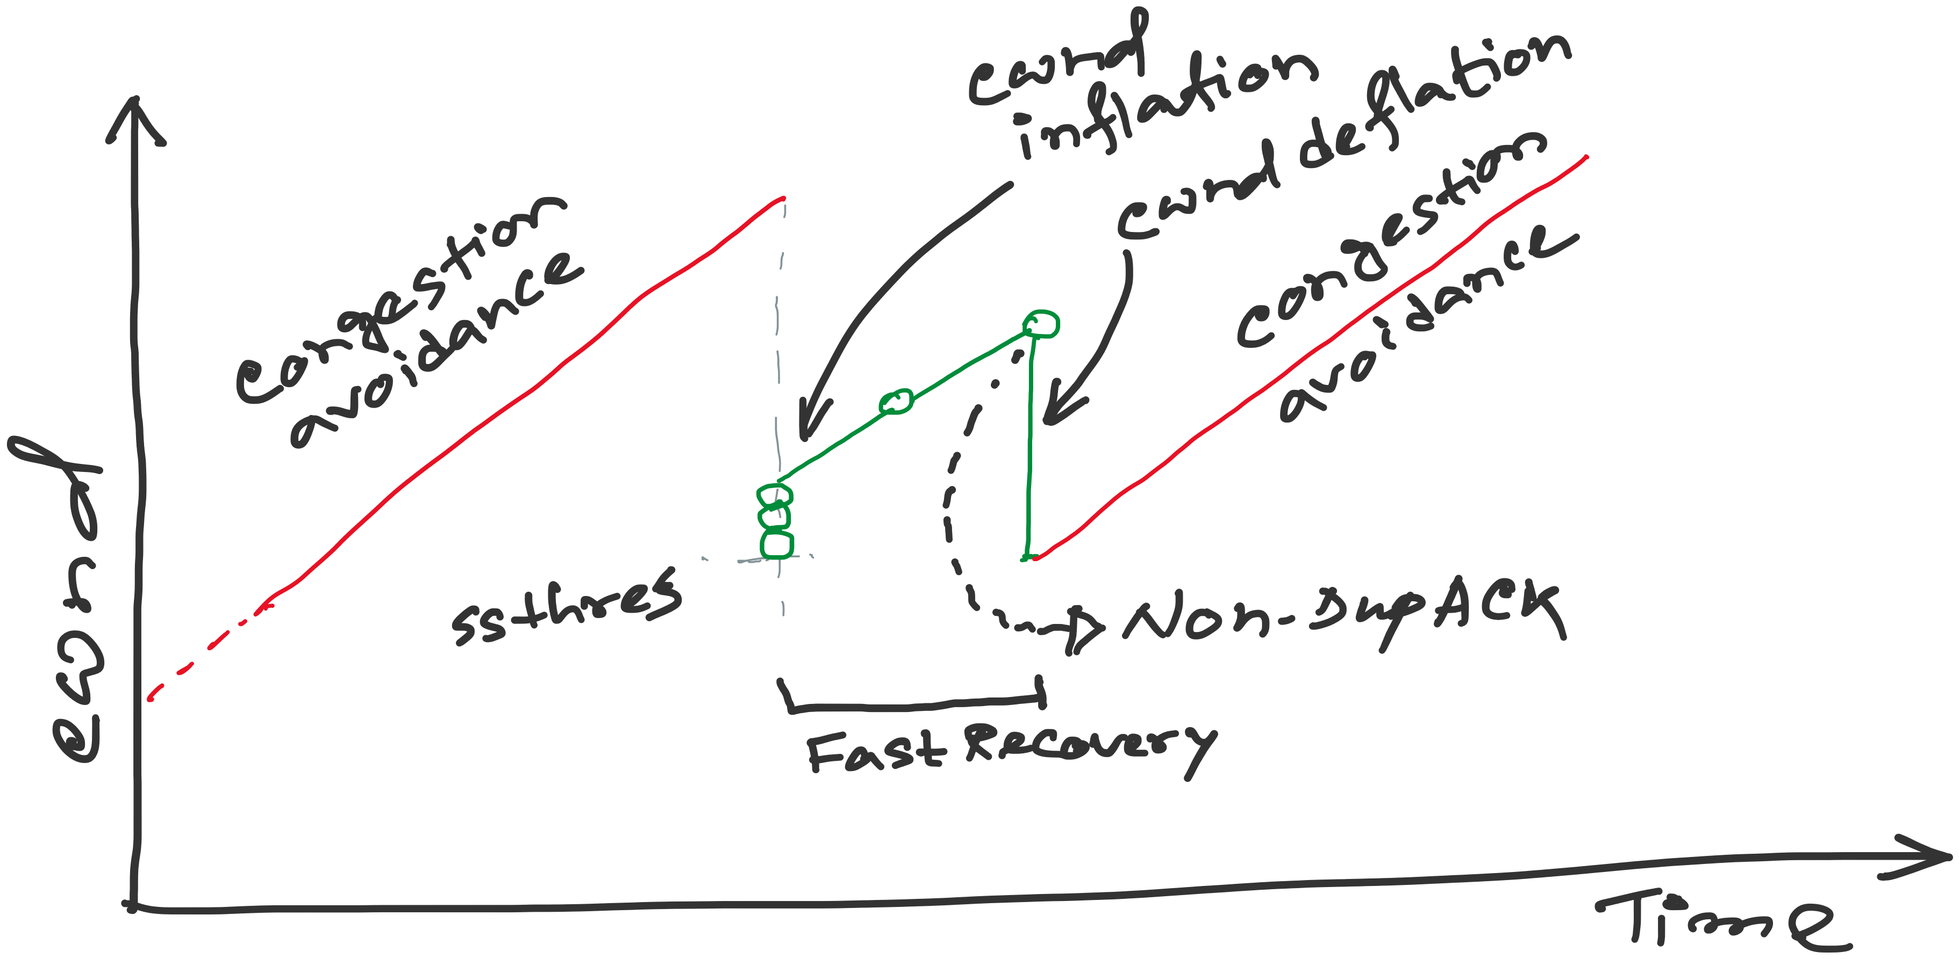
TCP Reno: details of Fast Recovery
Notes:
[source: G.R.Wright and W.R.Stevens, TCP/IP Illustrated, Vol 2; J. Hoe, MSc Thesis, pp.22]
Tahoe (1988): slow start, congestion avoidance, fast retransmit
Reno (1990): fast recovery, TCP header prediction, SLIP header compression, routing table changes
4.4BSD (1993): multicasting, long fat pipe modifications

Slide 18
TCP Reno
Notes:
[source: G.R.Wright and W.R.Stevens, TCP/IP Illustrated, Vol 2; J. Hoe, MSc Thesis, pp.22]
Tahoe (1988): slow start, congestion avoidance, fast retransmit
Reno (1990): fast recovery, TCP header prediction, SLIP header compression, routing table changes
4.4BSD (1993): multicasting, long fat pipe modifications

Slide 19
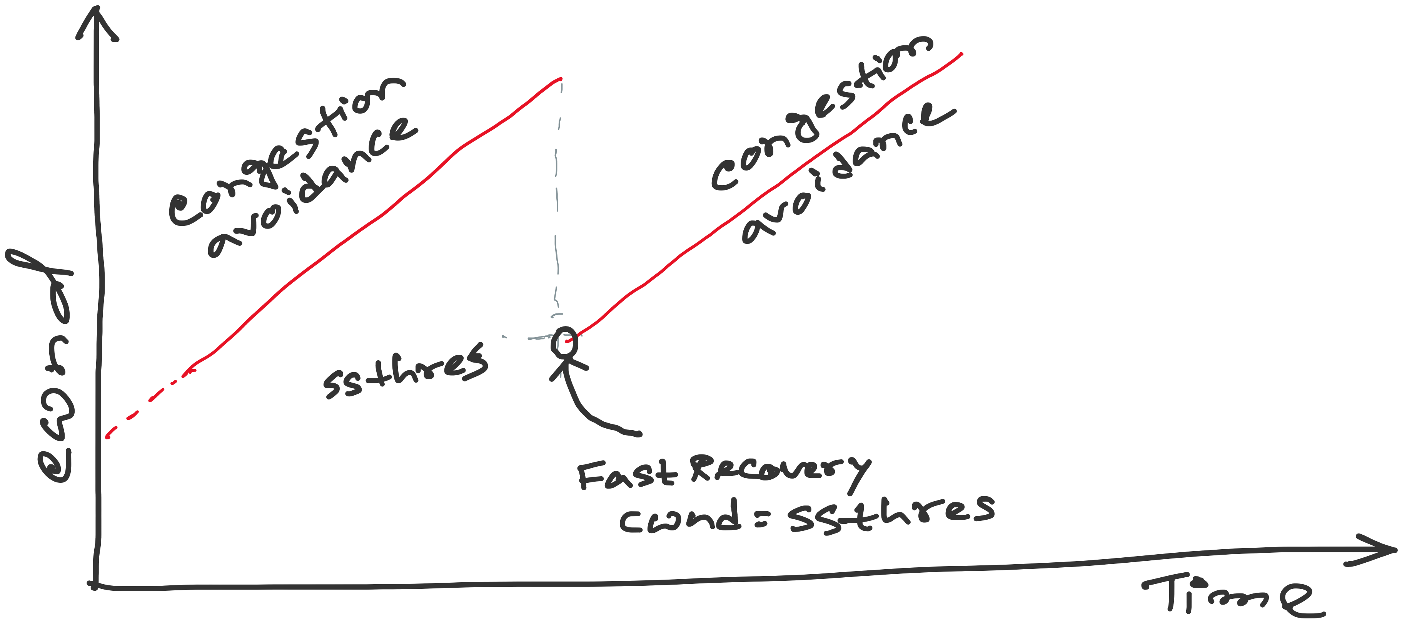
TCP Reno: details of Fast Recovery
Notes:
[source: G.R.Wright and W.R.Stevens, TCP/IP Illustrated, Vol 2; J. Hoe, MSc Thesis, pp.22]
Tahoe (1988): slow start, congestion avoidance, fast retransmit
Reno (1990): fast recovery, TCP header prediction, SLIP header compression, routing table changes
4.4BSD (1993): multicasting, long fat pipe modifications

Slide 20
TCP Reno: details of Fast Recovery
Notes:
[source: G.R.Wright and W.R.Stevens, TCP/IP Illustrated, Vol 2; J. Hoe, MSc Thesis, pp.22]
Tahoe (1988): slow start, congestion avoidance, fast retransmit
Reno (1990): fast recovery, TCP header prediction, SLIP header compression, routing table changes
4.4BSD (1993): multicasting, long fat pipe modifications

Slide 21
TCP Reno: details of Fast Recovery
Notes:
[source: G.R.Wright and W.R.Stevens, TCP/IP Illustrated, Vol 2; J. Hoe, MSc Thesis, pp.22]
Tahoe (1988): slow start, congestion avoidance, fast retransmit
Reno (1990): fast recovery, TCP header prediction, SLIP header compression, routing table changes
4.4BSD (1993): multicasting, long fat pipe modifications

Slide 22
EXAMPLE:
With Fast
Recovery
Sender
Receiver
CWND=1, UNACK=1
P=0, ACK=1
CWND=2, UNACK=1
CWND=2, UNACK=2
P=1, ACK=2
P=2, ACK=3
CWND=3, UNACK=2
CWND=4, UNACK=2
CWND=4, UNACK=3
P=3, ACK=4
CWND=4, UNACK=4
X
P=4, ACK=5
CWND=5, UNACK=4
P=6, ACK=5
CWND=6, UNACK=4
CWND=6, UNACK=5
P=7, ACK=5
CWND=6, UNACK=6, DuACK=1
P=8, ACK=5
CWND=6, UNACK=6, DuACK=2
P=9, ACK=5
SSTH=3, CWND=3+3, UNACK=6, DuACK=3
P=10, ACK=5
SSTH=3, CWND=3+4, UNACK=7, DuACK=4
SSTH=3, CWND=3+5, UNACK=8, DuACK=5
P=5, ACK=11
P=11, ACK=12
(New ACK) CWND=SSTH=3, UNACK=2
P=12, ACK=13

Slide 23
EXAMPLE:
Without Fast
Recovery
Sender
Receiver
CWND=1, UNACK=1
P=0, ACK=1
CWND=2, UNACK=1
CWND=2, UNACK=2
P=1, ACK=2
P=2, ACK=3
CWND=3, UNACK=2
CWND=4, UNACK=2
CWND=4, UNACK=3
P=3, ACK=4
CWND=4, UNACK=4
X
P=4, ACK=5
CWND=5, UNACK=4
P=6, ACK=5
CWND=6, UNACK=4
CWND=6, UNACK=5
P=7, ACK=5
CWND=6, UNACK=6, DuACK=1
P=8, ACK=5
CWND=6, UNACK=6, DuACK=2
P=9, ACK=5
SSTH=3, CWND=3, UNACK=6, DuACK=3
P=10, ACK=5
SSTH=3, CWND=3, UNACK=6, DuACK=4
SSTH=3, CWND=3, UNACK=6, DuACK=5
P=5, ACK=11
(New ACK) CWND=3+1/3, UNACK=1
P=11, ACK=12

Slide 24
Fast Retransmit/Fast Recovery (FR/FR)
(will work on this example during lecture)
<Open>
6
CWND
6
STHRES
N/A
13
14
15
16
17
18
14
19
20
TX
X
RX
14
14
14
14
19
Notes:
After FR/FR, when CA is entered, cwnd is half of the window when lost was detected.
So the effect of lost is halving the window.
[Source: RFC 2581, Fall & Floyd, “Simulation based Comparison of Tahoe, Reno, and SACK TCP”]

Slide 25
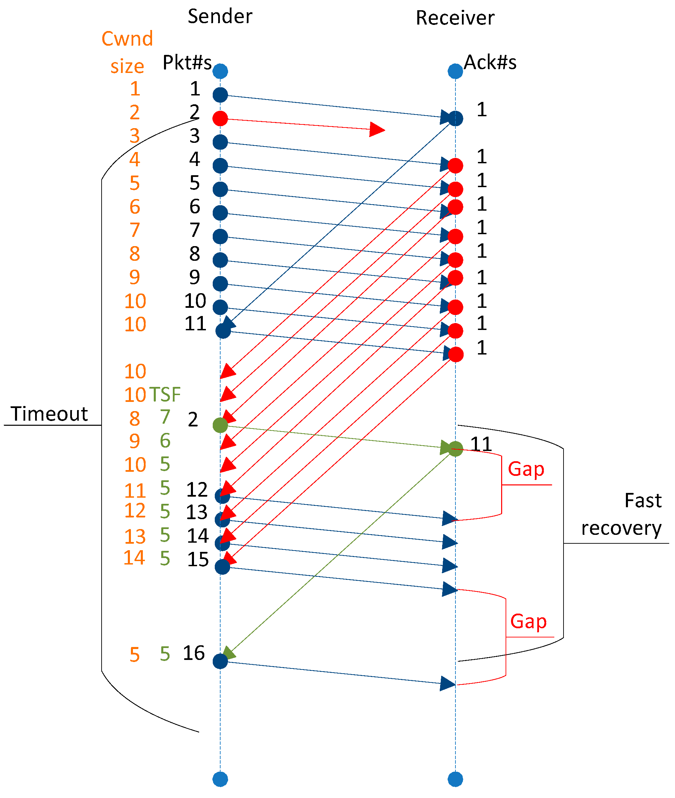
Fast Retransmit/Fast Recovery (FR/FR)
10
TSF = Segments in flight
[Ref] https://www.mdpi.com/2076-3417/9/21/4698
Notes:
After FR/FR, when CA is entered, cwnd is half of the window when lost was detected.
So the effect of lost is halving the window.
[Source: RFC 2581, Fall & Floyd, “Simulation based Comparison of Tahoe, Reno, and SACK TCP”]

Slide 26
Fast Retransmit/Fast Recovery (FR/FR)
Motivation: prevent `pipe’ from emptying after fast retransmit
Idea: each dupACK represents a packet having left the pipe (successfully received)
Enter FR/FR after 3 dupACKs
  Set ssthresh ← max(flightsize/2, 2)
  Retransmit lost packet
  Set cwnd ← ssthresh + ndup (window inflation)
  Wait till W=min(awnd, cwnd) is large enough; transmit new packet(s)
  On non-dup ACK (1 RTT later), set cwnd ← ssthresh (window deflation)
Enter CA
Notes:
After FR/FR, when CA is entered, cwnd is half of the window when lost was detected.
So the effect of lost is halving the window.
[Source: RFC 2581, Fall & Floyd, “Simulation based Comparison of Tahoe, Reno, and SACK TCP”]

Slide 27
Summary: Reno
Basic ideas
  Fast recovery avoids slow start
  dupACKs: fast retransmit + fast recovery
  Timeout: fast retransmit + slow start
dupACKs
congestion avoidance
FR/FR
timeout
slow start
retransmit

Slide 28
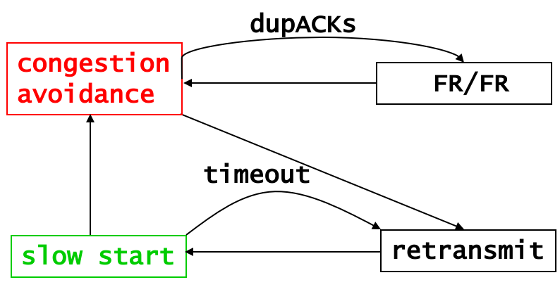
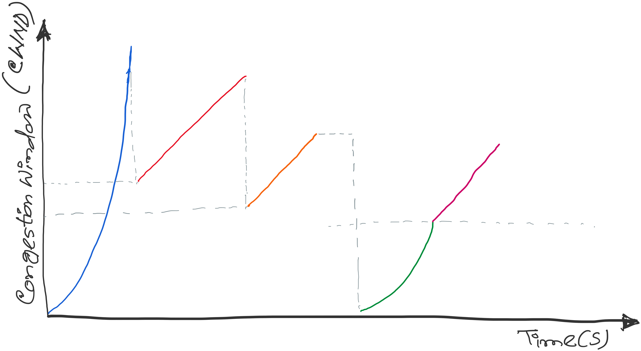
TCP congestion control: CWND graph
Notes:
[source: G.R.Wright and W.R.Stevens, TCP/IP Illustrated, Vol 2; J. Hoe, MSc Thesis, pp.22]
Tahoe (1988): slow start, congestion avoidance, fast retransmit
Reno (1990): fast recovery, TCP header prediction, SLIP header compression, routing table changes
4.4BSD (1993): multicasting, long fat pipe modifications

Slide 29
Problem with Reno
Reno retransmit at most 1 lost packet per RTT
  Pipe can be emptied during “Fast Retransmit/Fast Recovery” with multiple losses
Solution: TCP with Selective Acknowledgements (SACK) provides better estimate of packets in pipe
  SACK TCP option describes received packets
  On 3 dupACKs: retransmits, halves window, enters FR
  Updates pipe = packets in pipe
    Increment when lost or new packets sent
    Decrement when dupACK received
  Transmits a (lost or new) packet when pipe < cwnd
  Exit FR when all packets outstanding when FR was entered are acknowledged
Notes:
[Sources: M. Mathis, J. Mahdavi, S. Floyd and A. Romanow, “TCP Selective Acknowledgement Options”, RFC 2018, Oct. 1996
K. Fall and S. Floyd, “Simulation-based comparisons of Tahoe, Reno and SACK TCP”, Computer Communication Review, July 1996 ]

Slide 30
TCP Vegas (Brakmo & Peterson 1994)
window
time
SS
CA
Considers packet delay, not loss, as a hint for congestion
Reno with a new congestion avoidance algorithm
Converges (provided buffer is large) !

Slide 31
Router-assisted Congestion Control
Copyright, 1996 © Dale Carnegie & Associates, In

Slide 32
Congestion Control discussed so far
What can the end-points do to collectively to make good use of shared underlying resources?
link
name
?
?
session
path
address
Notes:
This week, we’ll talk about how to share resources. Today we’ll talk about what the end-points can do in a distributed fashion, from the edge of the network. On Wednesday, we’ll talk about what the lower-level elements can do.

Slide 33
Router-assisted Congestion Control
What can the individual links do to make
good use of shared underlying resources?
link
name
session
?
path
address
Notes:
This week, we’ll talk about how to share resources. Today we’ll talk about what the end-points can do in a distributed fashion, from the edge of the network. On Wednesday, we’ll talk about what the lower-level elements can do.

Slide 34
Router
Processor
control plane
data plane
Switching
Fabric
Line card
Line card
Line card
Line card
Line card
Line card

Slide 35
Line Cards (Interface Cards, Adaptors)
Packet handling
  Packet forwarding
  Buffer management
  Link scheduling
  Packet filtering
  Rate limiting
  Packet marking
  Measurement
to/from link
Receive
lookup
Transmit
to/from switch

Slide 36
Packet Switching and Forwarding
“4”
Link 1, ingress
Choose
Egress
Link 1, egress
Link 2
Link 2, ingress
Choose
Egress
Link 2, egress
R1
“4”
Link 1
Link 3
Link 3, ingress
Choose
Egress
Link 3, egress
Link 4
Link 4, ingress
Choose
Egress
Link 4, egress

Slide 37
Queue Management Issues
Scheduling discipline
  Which packet to send?
  Some notion of fairness? Priority?
Drop policy
  When should you discard a packet?
  Which packet to discard?
Goal: balance throughput and delay
  Huge buffers minimize drops, but add to queuing delay (thus higher RTT, longer slow start, …)

Slide 38
Queue Management 1: Drop Policy

Slide 39
FIFO Scheduling and Drop-Tail
Access to the bandwidth: first-in first-out queue
  Packets only differentiated when they arrive
Access to the buffer space: drop-tail queuing
  If the queue is full, drop the incoming packet
✗

Slide 40
Bursty Loss From Drop-Tail Queuing
TCP depends on packet loss
  Packet loss is indication of congestion
  TCP additive increase drives network into loss
Drop-tail leads to bursty loss
  Congested link: many packets encounter full queue
  Synchronization: many connections lose packets at once

Slide 41
Slow Feedback from Drop Tail
Feedback comes when buffer is completely full
  … even though the buffer has been filling for a while
Plus, the filling buffer is increasing RTT
  … making detection even slower
Better to give early feedback
  Get 1-2 connections to slow down before it’s too late!

Slide 42
Random Early Detection (RED)
Router notices that queue is getting full
  … and randomly drops packets to signal congestion
Packet drop probability
  Drop probability increases as queue length increases
  Else, set drop probability f(avg queue length)
Drop
Probability
0 1
Average Queue Length

Slide 43
Properties of RED
Drops packets before queue is full
  In the hope of reducing the rates of some flows
Drops packet in proportion to each flow’s rate
  High-rate flows selected more often
Drops are spaced out in time
  Helps desynchronize the TCP senders
Tolerant of burstiness in the traffic
  By basing the decisions on average queue length

Slide 44
Problems With RED
Hard to get tunable parameters just right
  How early to start dropping packets?
  What slope for increase in drop probability?
  What time scale for averaging queue length?
RED has mixed adoption in practice
  If parameters aren’t set right, RED doesn’t help
Many other variations in research community
  Names like “Blue” (self-tuning), “FRED”…

Slide 45
Feedback: From Loss to Notification
Early dropping of packets
  Good: gives early feedback
  Bad: has to drop the packet to give the feedback
Explicit Congestion Notification (ECN)
  Router marks the packet with an ECN bit, instead of dropping it.
  Receiver send this ECN info to the sender.
  Sending host interprets as a sign of congestion
  Requires participation of hosts and the routers
Notes:
17.6.2 Explicit Congestion Notification
Explicit congestion notification (ECN) is another feedback scheme that indicates congestion information by marking packets instead of dropping them. The destination of marked packets returns this congestion notification to the source. As a result, the source decreases its transmit rate. The implementation of ECN uses an ECN-specific field in the IP header with two bits—the ECN-capable Transport (ECT) bit and the Congestion Experienced (CE) bit.

Slide 46
Queue Management 2: Link Scheduling

Slide 47

First-In First-Out Scheduling
First-in first-out scheduling
  Simple, but restrictive
Example: two kinds of traffic
  Voice over IP needs low delay
  E-mail is not that sensitive about delay
Voice traffic waits behind e-mail

Slide 48
Strict Priority
Multiple levels of priority
  Always transmit high-priority traffic, when present
Isolation for the high-priority traffic
  Almost like it has a dedicated link
  Except for (small) delay for packet transmission
But, lower priority traffic may starve ☹

Slide 49
Weighted Fair Scheduling
Weighted fair scheduling
  Assign each queue a fraction of the link bandwidth
  Rotate across queues on a small time scale
Work-conserving
  Send extra traffic from one queue if others are idle
50% red, 25% blue, 25% green

Slide 50
Implementation Trade-Offs
FIFO
  One queue, trivial scheduler
Strict priority
  One queue per priority level, simple scheduler
Weighted fair scheduling
  One queue per class, and more complex scheduler

Slide 51
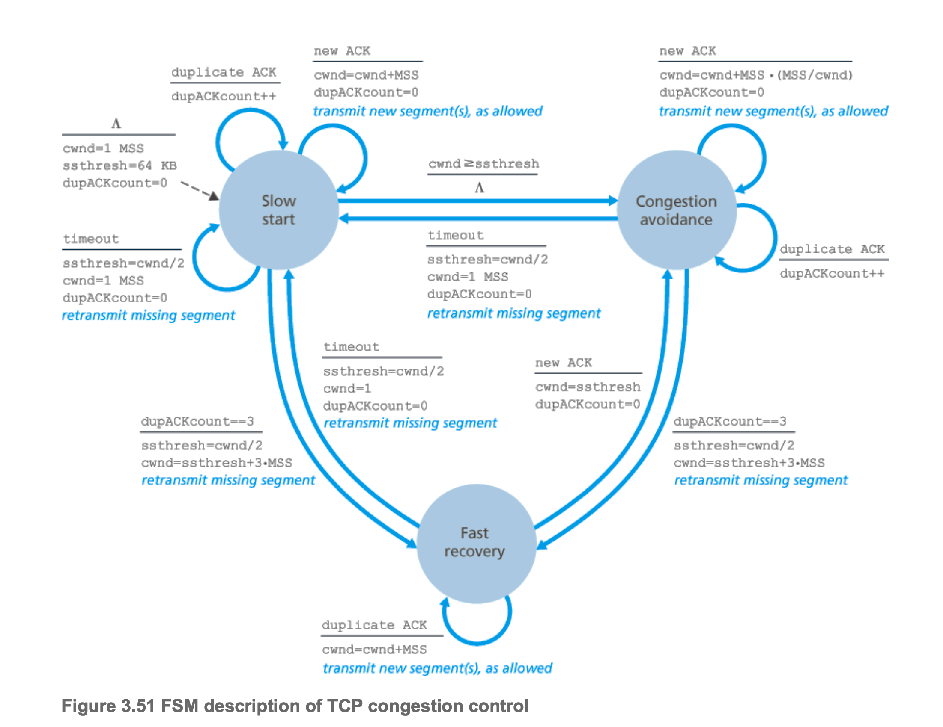
TCP Congestion Control

Slide 52
TCP Congestion Control
Should TCP increment CWND during Dup-ACKs?

Slide 53
Revisiting Dup ACKs (without Fast-Recovery)
<Open>
6
CWND
5
STHRES
N/A
13
14
15
16
17
18
14
19
20
21
TX
X
RX
14
14
14
14
14
19
Notes:
After FR/FR, when CA is entered, cwnd is half of the window when lost was detected.
So the effect of lost is halving the window.
[Source: RFC 2581, Fall & Floyd, “Simulation based Comparison of Tahoe, Reno, and SACK TCP”]

Slide 54
Revisiting Dup ACKs (without Fast-Recovery)
<Open>
6
CWND
5
STHRES
N/A
13
14
15
16
17
18
14
19
20
21
TX
X
X
RX
14
14
14
14
?
What if there are multiple losses in an RTT?
Notes:
After FR/FR, when CA is entered, cwnd is half of the window when lost was detected.
So the effect of lost is halving the window.
[Source: RFC 2581, Fall & Floyd, “Simulation based Comparison of Tahoe, Reno, and SACK TCP”]

Slide 55
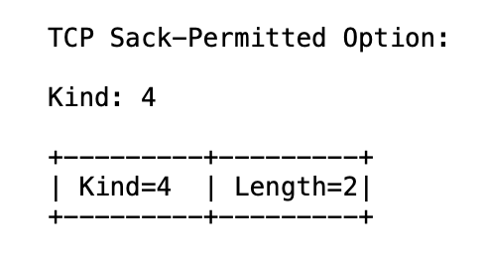
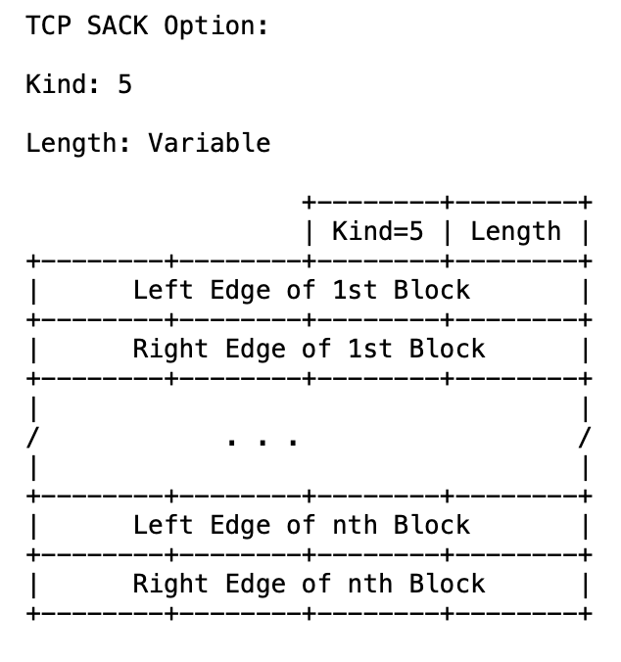
TCP Selective ACK (SACK): RFC 2018
https://www.rfc-editor.org/rfc/rfc2018

Slide 56
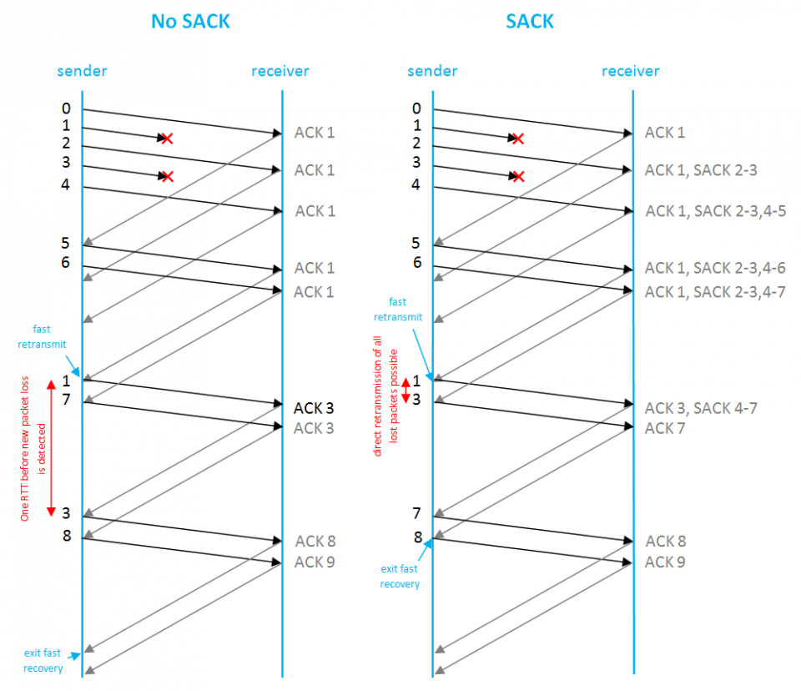
TCP Selective ACK (SACK): RFC 2018
[REF-1] https://www.rfc-editor.org/rfc/rfc2018
[REF-2] https://www.excentis.com/blog/measuring-throughput-effect-of-used-tcp-settings/

Slide 57
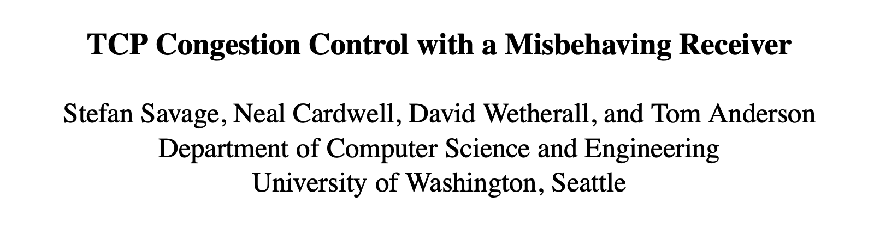
Slides courtesy: https://cseweb.ucsd.edu/classes/wi01/cse222/lectures/attack-18.pdf
Paper link: https://dl.acm.org/doi/10.1145/505696.505704

Slide 63
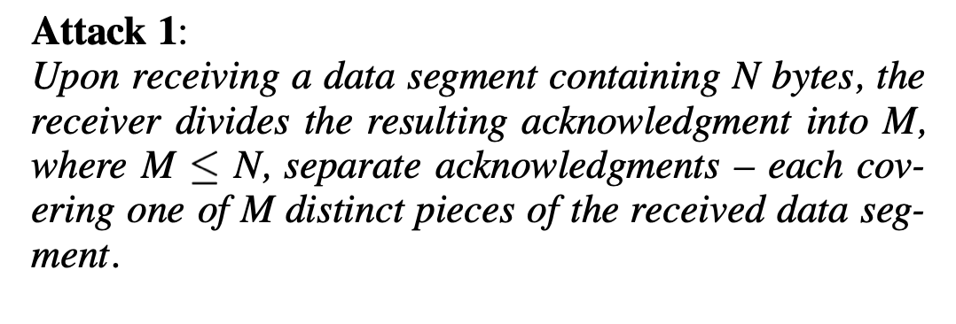

Slide 65
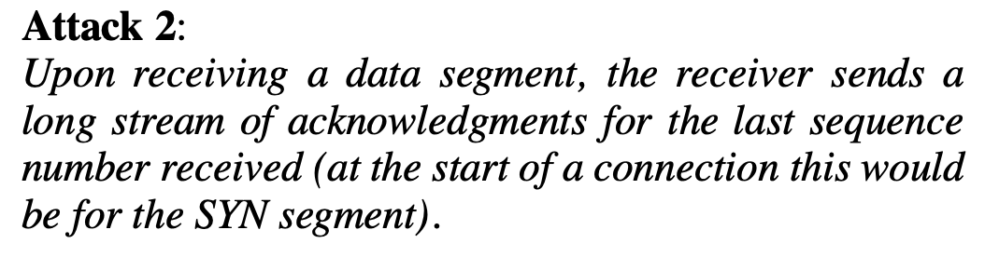

Slide 67
