Slide 1
Computer Networks
CMSC 417 : Spring 2024
Topic: Link layer
(Textbook chapter 2)
Nirupam Roy
Tu-Th 2:00-3:15pm
CSI 2117

Slide 3
Carrier Sense Multiple Access (CSMA)

Slide 4
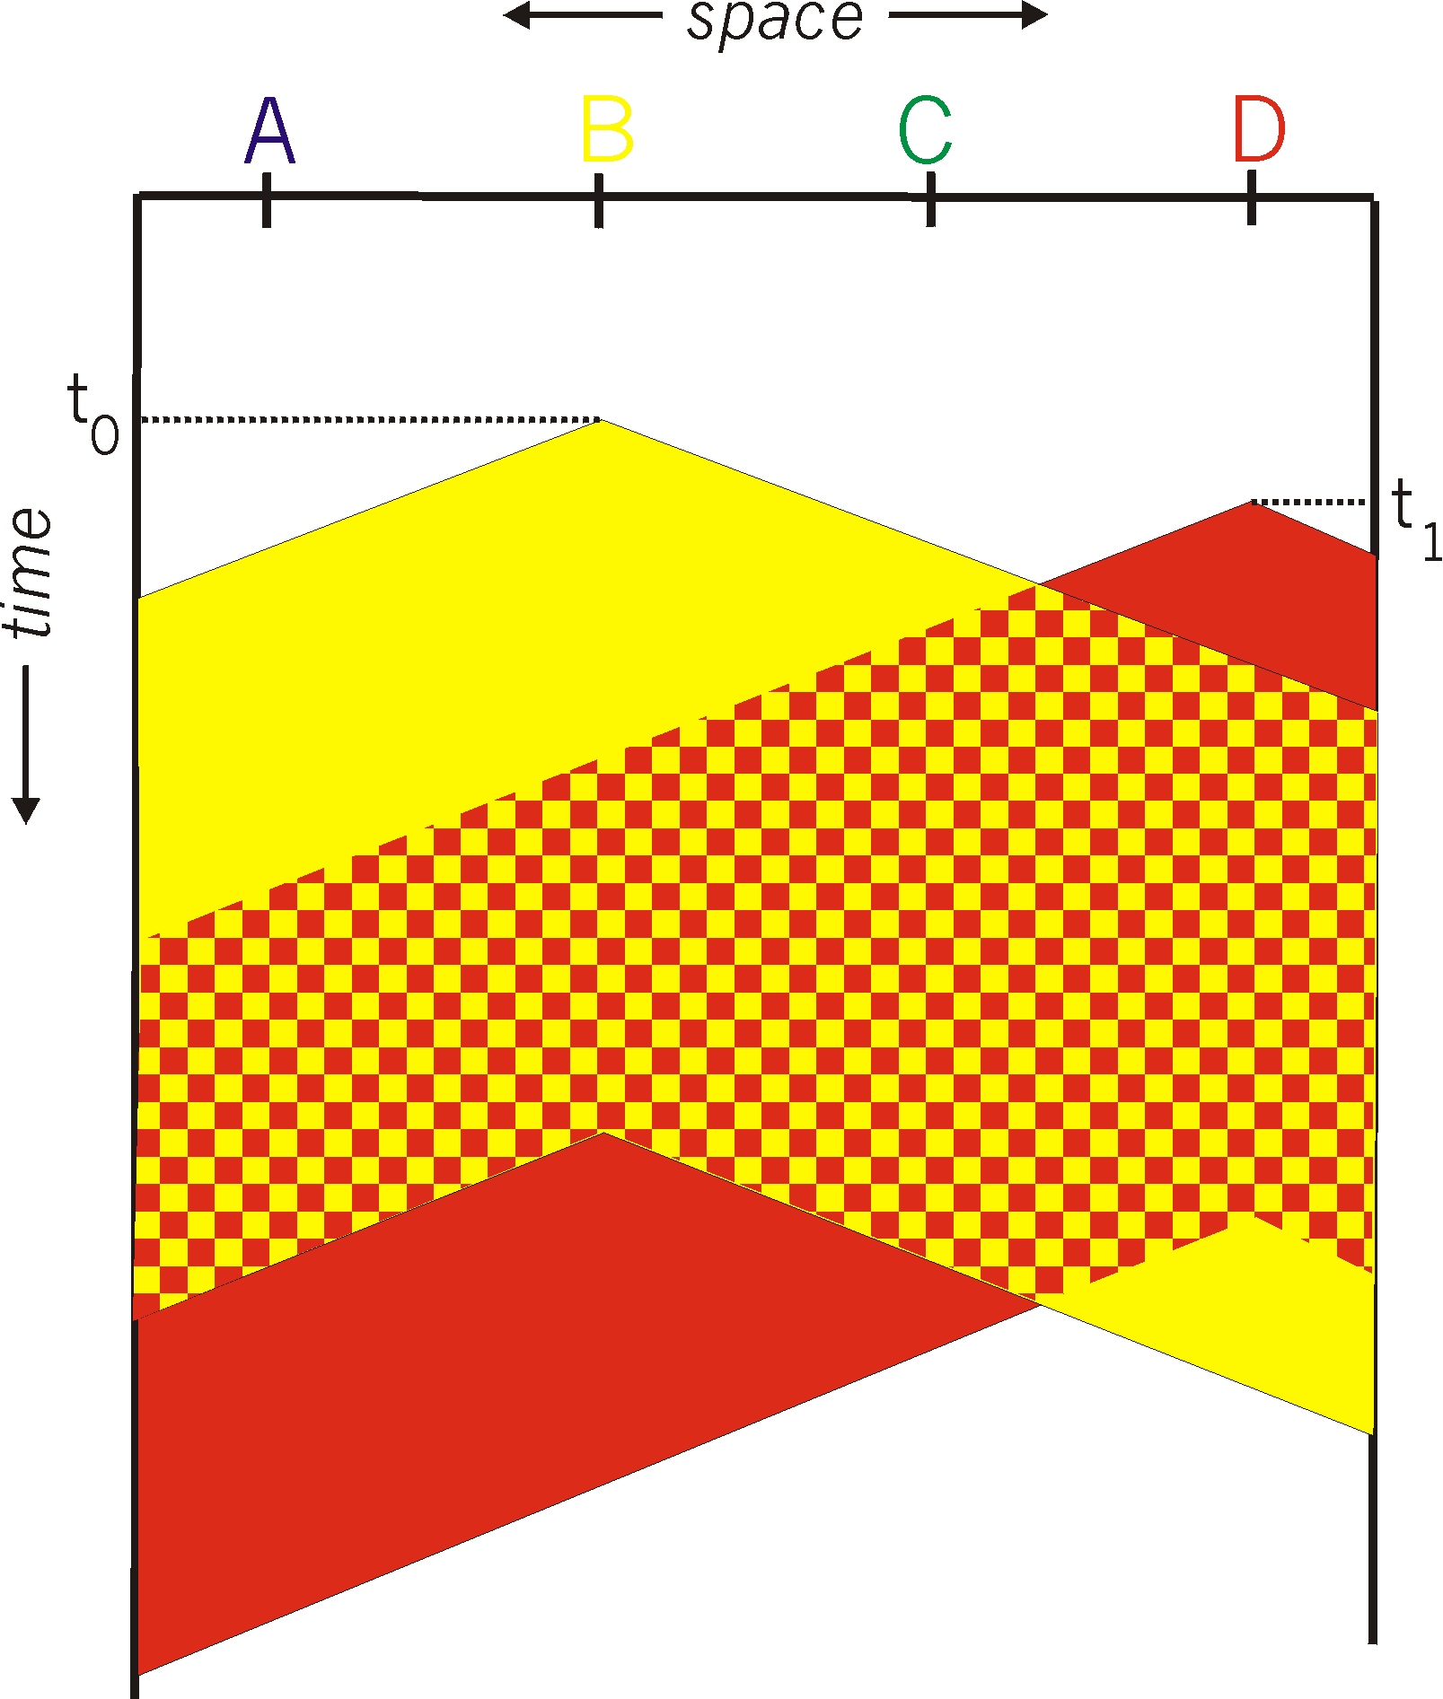
Carrier Sense Multiple Access (CSMA)
Listen for other senders
Then transmit your data
Collisions can still occur
Propagation delay
Wasted transmission

Slide 5
CSMA: The time-space graph of collision

Slide 6
CSMA: The time-space graph of collision

Slide 7
CSMA: The time-space graph of collision

Slide 8
CSMA: The time-space graph of collision
The time-space region of collision

Slide 9
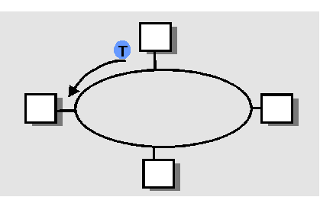
Comparing the Three Approaches
Divide the channel into pieces
In time
In frequency
Take turns
Pass a token for the right to transmit
Defer action
Let collisions happen
… and detect and recover from them
Carrier Sense Multiple Access

Slide 10
Comparing the Three Approaches
Channel partitioning
Efficient and fair at high load
Inefficient at low load
“Taking turns”
Eliminates empty slots without collisions
Vulnerable to failures (e.g. lost token)
Random access
Efficient at low load
Collision overhead at high load

Slide 11
Automatic Repeat request
Flow control
Not implemented in wired LAN (e.g. Ethernet)

Slide 12
Ethernet

Slide 13
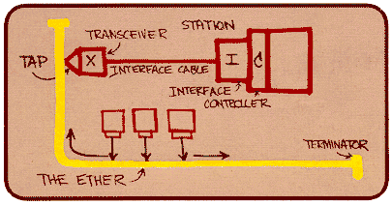
Ethernet
Dominant wired LAN technology
First widely used LAN technology
Kept up with speed race: 10 Mbps – 40 Gbps
Metcalfe’s
Ethernet
sketch

Slide 14
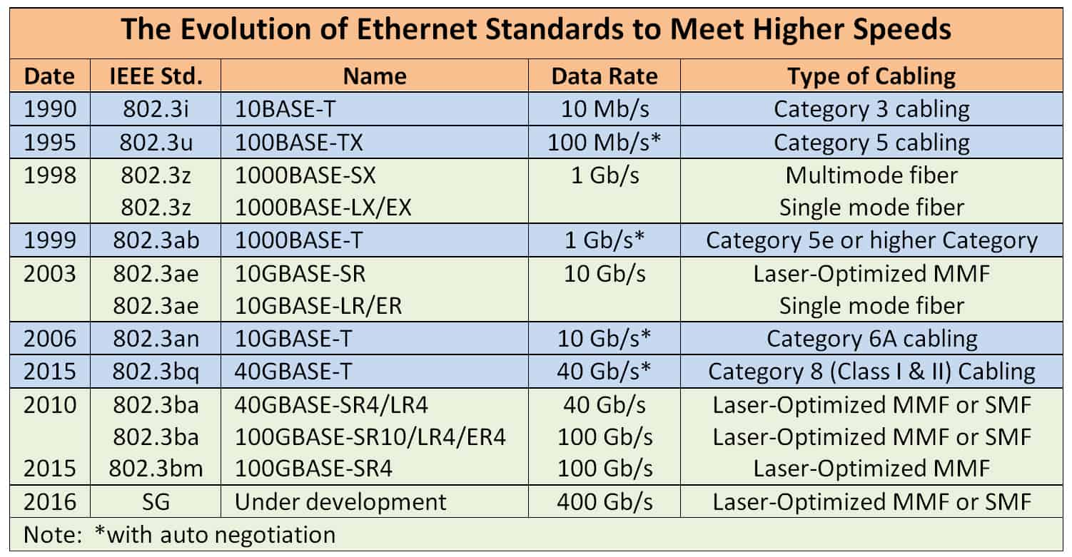

Slide 15
Ethernet Uses CSMA/CD
Carrier Sense: wait for link to be idle
Channel idle: start transmitting
Channel busy: wait until idle
A strategy is p-persistent if, after waiting for the line to clear, the sender sends with probability p≤1.
Collision Detection: listen while transmitting
No collision: transmission is complete
Collision: abort transmission, and send jam signal
Random Access: exponential back-off
After collision, wait random time before trying again
After m^{th} collision, choose K randomly from {0, …, 2^{m}-1}
… and wait for K*512 bit times before trying again

Slide 16
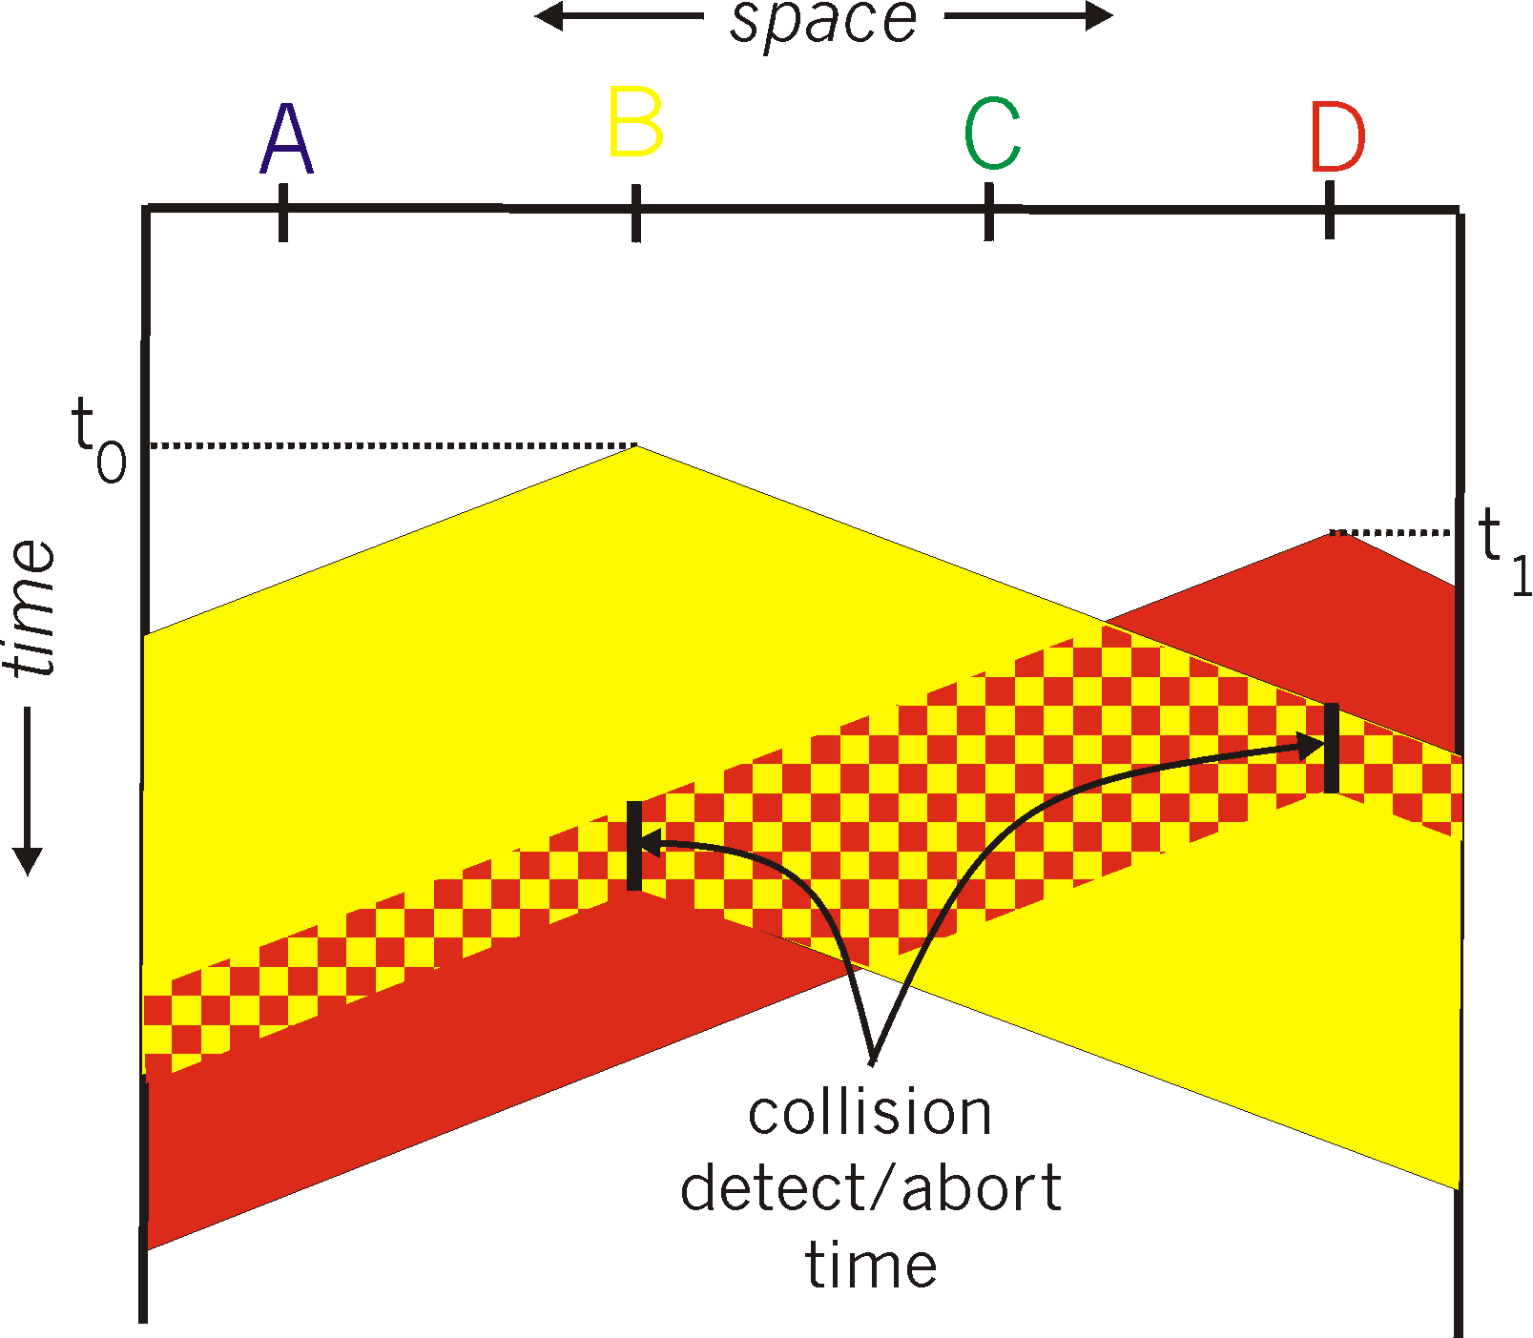
CSMA/CD Collision Detection
Detect collision
Abort transmission
Jam the link
Wait random time
Transmit again
Hard in wireless
Must receive data while transmitting

Slide 17
CSMA/CD Collision Detection
Without collision detection
With collision detection and abort

Slide 18
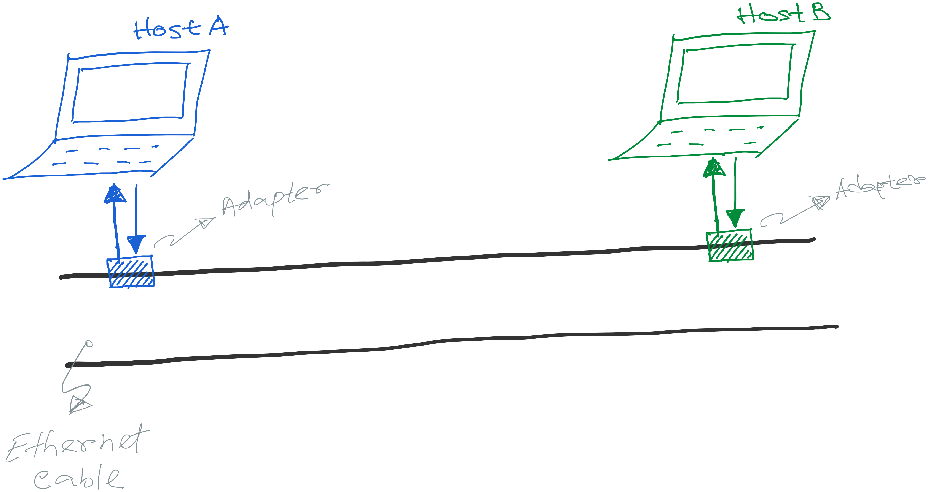
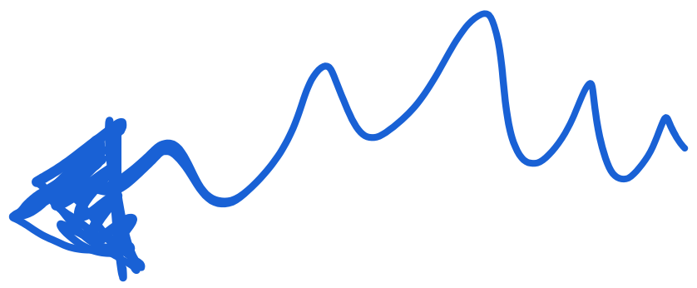

Slide 19
Collision does not happen like this. :-D

Slide 20
Collision happens when both packet overlaps at the receiver.

Slide 21
Preparing for the worst-case scenario of collision
Collision happens when both packet overlaps at the receiver.

Slide 22
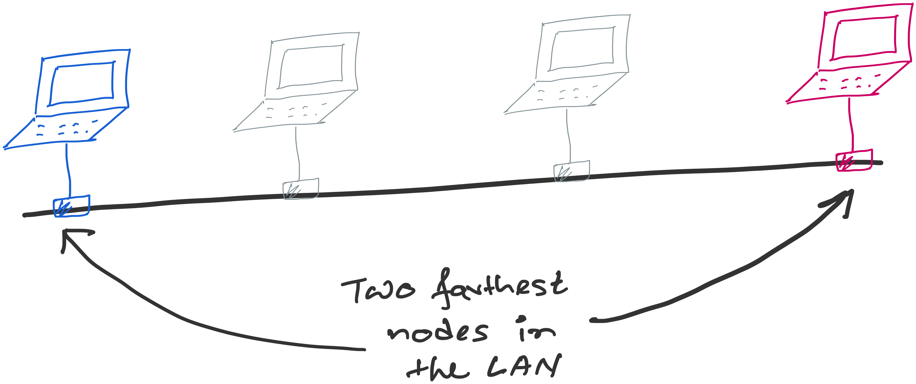
Preparing for the worst-case scenario of collision

Slide 23
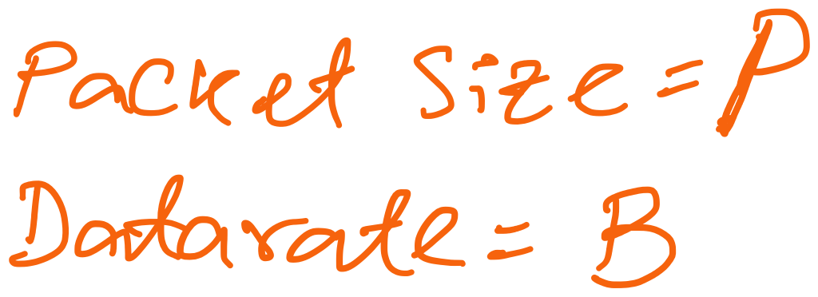
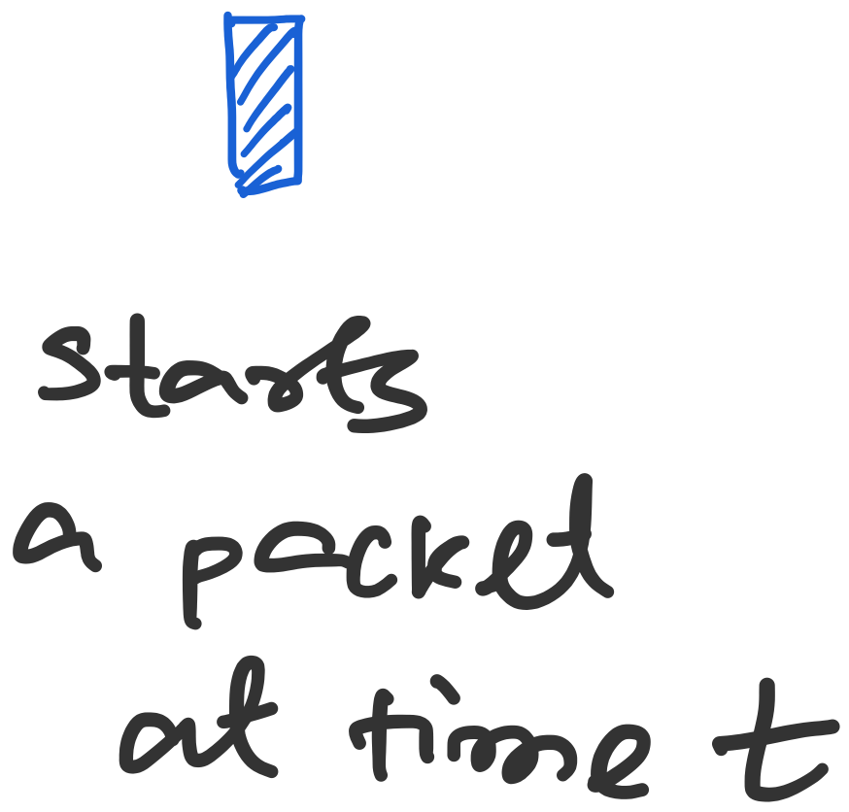
Preparing for the worst-case scenario of collision

Slide 24
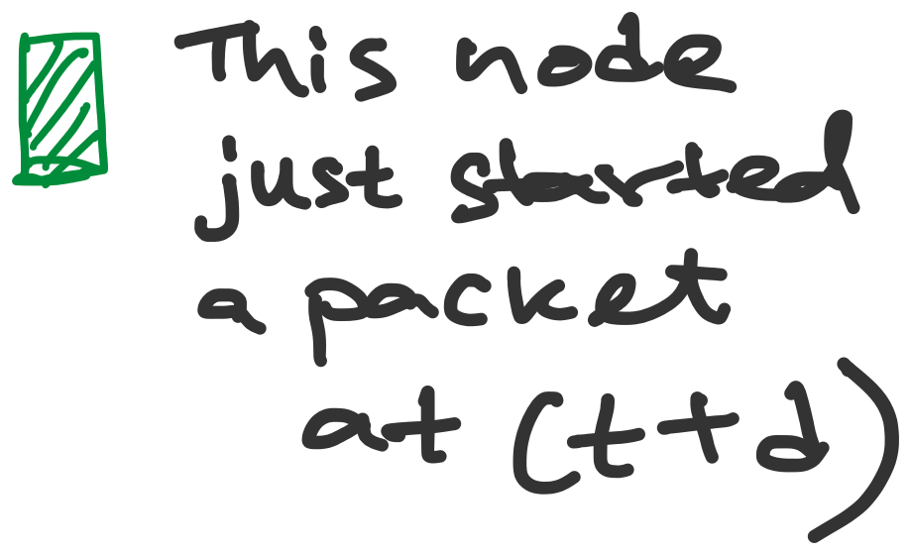
Preparing for the worst-case scenario of collision

Slide 25
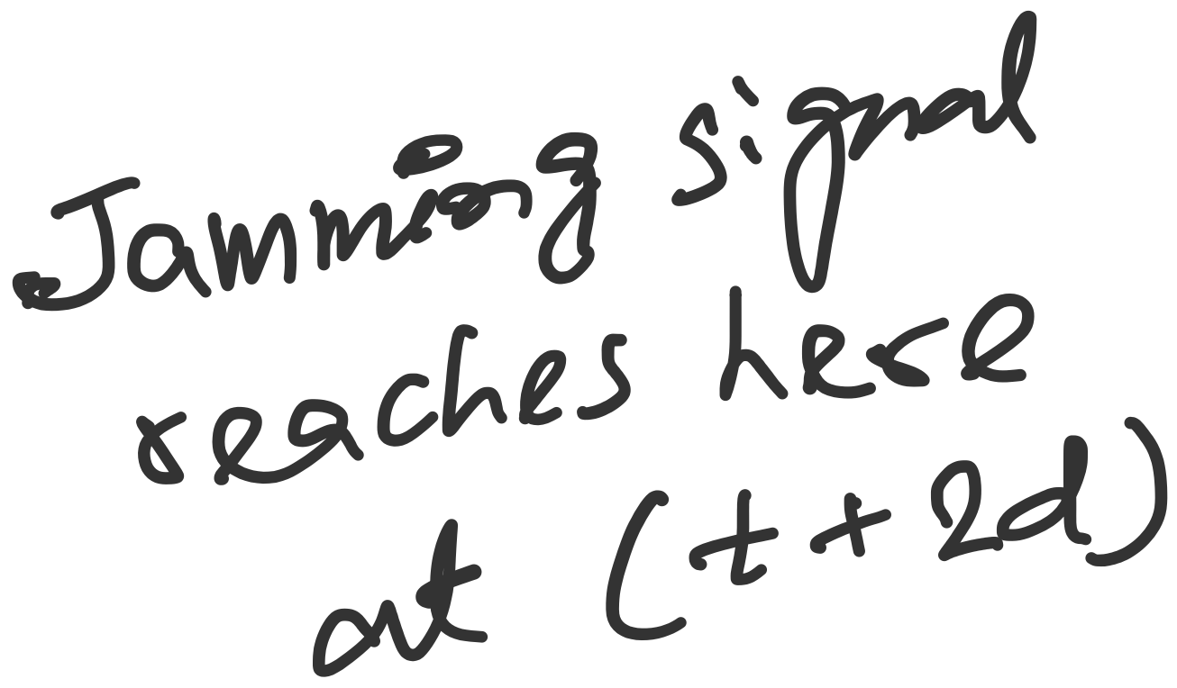
Preparing for the worst-case scenario of collision
The packet should be at least for 2d seconds long so that the sender can get the notification of the collision (through the jamming signal)

Slide 26
Preparing for the worst-case scenario of collision
Transmission time >= 2*propagation time
The packet should be at least for 2d seconds long so that the sender can get the notification of the collision (through the jamming signal)

Slide 27
Preparing for the worst-case scenario of collision
Formula for minimum packet size (P) or maximum length (L)

Slide 28
Two questions
1. Why does the receiver send jamming signal after
detecting collision?
2. In the worst-case collision scenario, why did we
consider collision with the first bit of the packet?
Is it possible to have collision in the middle or at
the end in this scenario.

Slide 29
Two questions
1. Why does the receiver send jamming signal after
detecting collision?
Host A
Host B
Host C

Slide 30
Two questions
1. Why does the receiver send jamming signal after
detecting collision?
Host A
Host B
Host C
Collision
Host C detects
collision

Slide 31
Two questions
1. Why does the receiver send jamming signal after
detecting collision?
Host A
Host B
Host C
Collision
Attenuation makes
the signal weak. This may lead to missed detection.

Slide 32
Two questions
1. Why does the receiver send jamming signal after
detecting collision?
Host A
Host B
Host C
Collision
Host B sends jamming signal to ensure collision
detection.

Slide 33
Two questions
2. In the worst-case collision scenario, why did we
consider collision with the first bit of the packet?
Is it possible to have collision in the middle or at
the end in this scenario.

Slide 34
Preparing for the worst-case scenario of collision

Slide 35
Two questions
2. In the worst-case collision scenario, why did we
consider collision with the first bit of the packet?
Is it possible to have collision in the middle or at
the end in this scenario.
Host A
Host B
Host C
Pkt: A
Pkt: B

Slide 36
Two questions
2. In the worst-case collision scenario, why did we
consider collision with the first bit of the packet?
Is it possible to have collision in the middle or at
the end in this scenario.
Host A
Host B
Host C
Pkt: A
Pkt: B
Collision

Slide 37
Two questions
2. In the worst-case collision scenario, why did we
consider collision with the first bit of the packet?
Is it possible to have collision in the middle or at
the end in this scenario.
Host A
Host B
Host C
Pkt: A
Pkt: B
Collision

Slide 38
Two questions
2. In the worst-case collision scenario, why did we
consider collision with the first bit of the packet?
Is it possible to have collision in the middle or at
the end in this scenario.
Host A
Host B
Host C
Pkt: A
Pkt: B
Collision
This situation is
not possible under our
assumptions.

Slide 39
Two questions
2. In the worst-case collision scenario, why did we
consider collision with the first bit of the packet?
Is it possible to have collision in the middle or at
the end in this scenario.
Host A
Host B
Host C
Pkt: B
Pkt: A
Pkt: A
Valid scenario.

Slide 40
Two questions
2. In the worst-case collision scenario, why did we
consider collision with the first bit of the packet?
Is it possible to have collision in the middle or at
the end in this scenario.
Host A
Host B
Host C
Pkt: B
Pkt: A
Pkt: A
Valid scenario.

Slide 41
Two questions
2. In the worst-case collision scenario, why did we
consider collision with the first bit of the packet?
Is it possible to have collision in the middle or at
the end in this scenario.
Host A
Host B
Host C
Pkt: B
Pkt: A
Pkt: A
Not a valid scenario:
Host B won’t start transmission
as the channel is busy.

Slide 42
Preparing for the worst-case scenario of collision

Slide 43
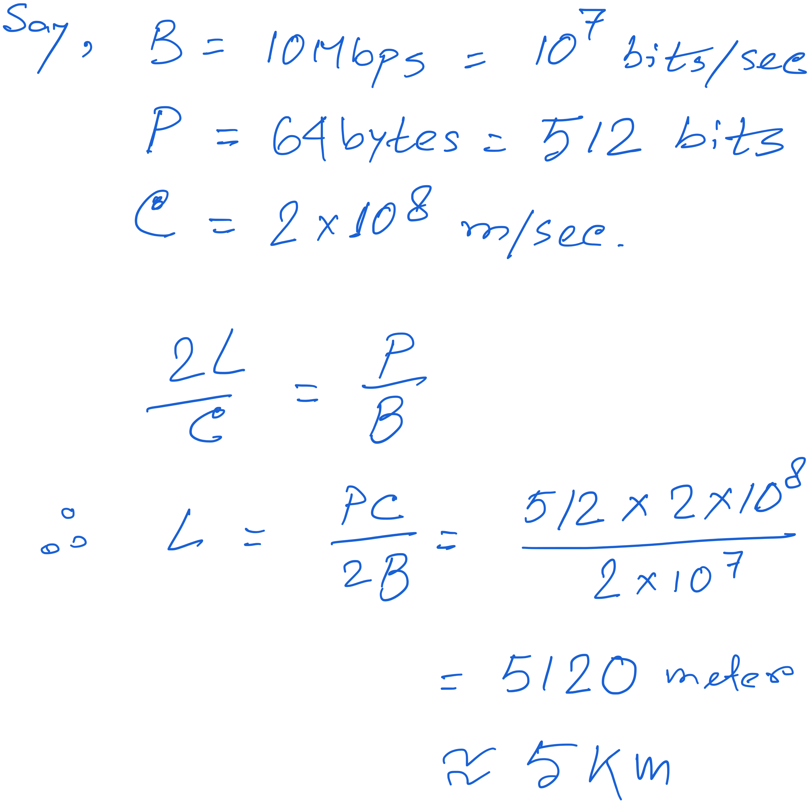

Slide 44
Preparing for the worst-case scenario of collision
Repeater
(3 us delay)
Repeater
(3 us delay)

Slide 45
Ethernet Frame Structure
Sending adapter encapsulates packet in frame
Preamble: synchronization
Seven bytes with pattern 10101010, followed by one byte with pattern 10101011
Used to synchronize receiver, sender clock rates

Slide 46
Ethernet Frame Structure
Addresses: source and destination MAC addresses
Adaptor passes frame to network-level protocol
If destination is local MAC address or broadcast address
Otherwise, adapter discards frame
Type: indicates the higher layer protocol
Usually IP
But also Novell IPX, AppleTalk, …
CRC: cyclic redundancy check
Checked at receiver
If error is detected, the frame is simply dropped

Slide 47
Unreliable, Connectionless Service
Connectionless
No handshaking between send and receive adapter
Unreliable
Receiving adapter doesn’t send ACKs or NACKs
Packets passed to network layer can have gaps
Gaps can be filled by transport protocol (e.g., TCP)
Otherwise, the application will see the gaps

Slide 48
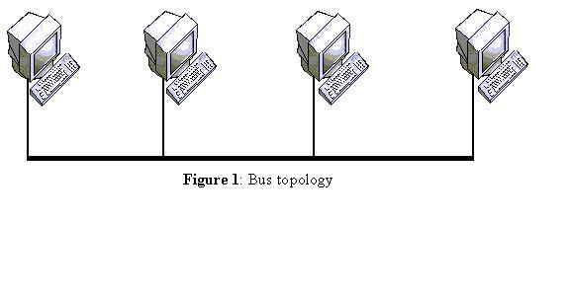
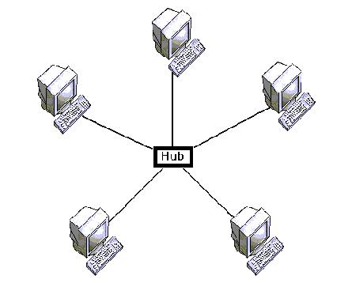
Star topology and collision-free Ethernet
Bus topology
Star topology

Slide 49
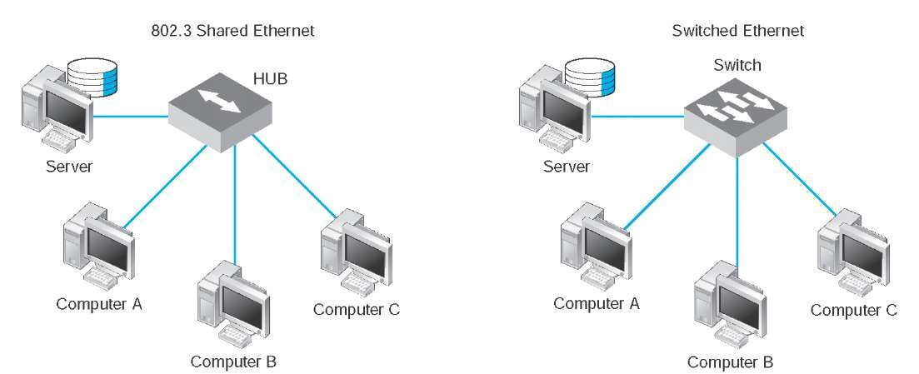
Star topology and collision-free Ethernet
Star topology with hub and switch

Slide 50
Repeaters, Hubs, Bridges and Switches

Slide 51
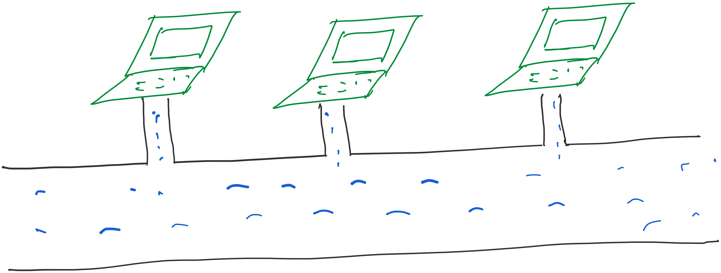
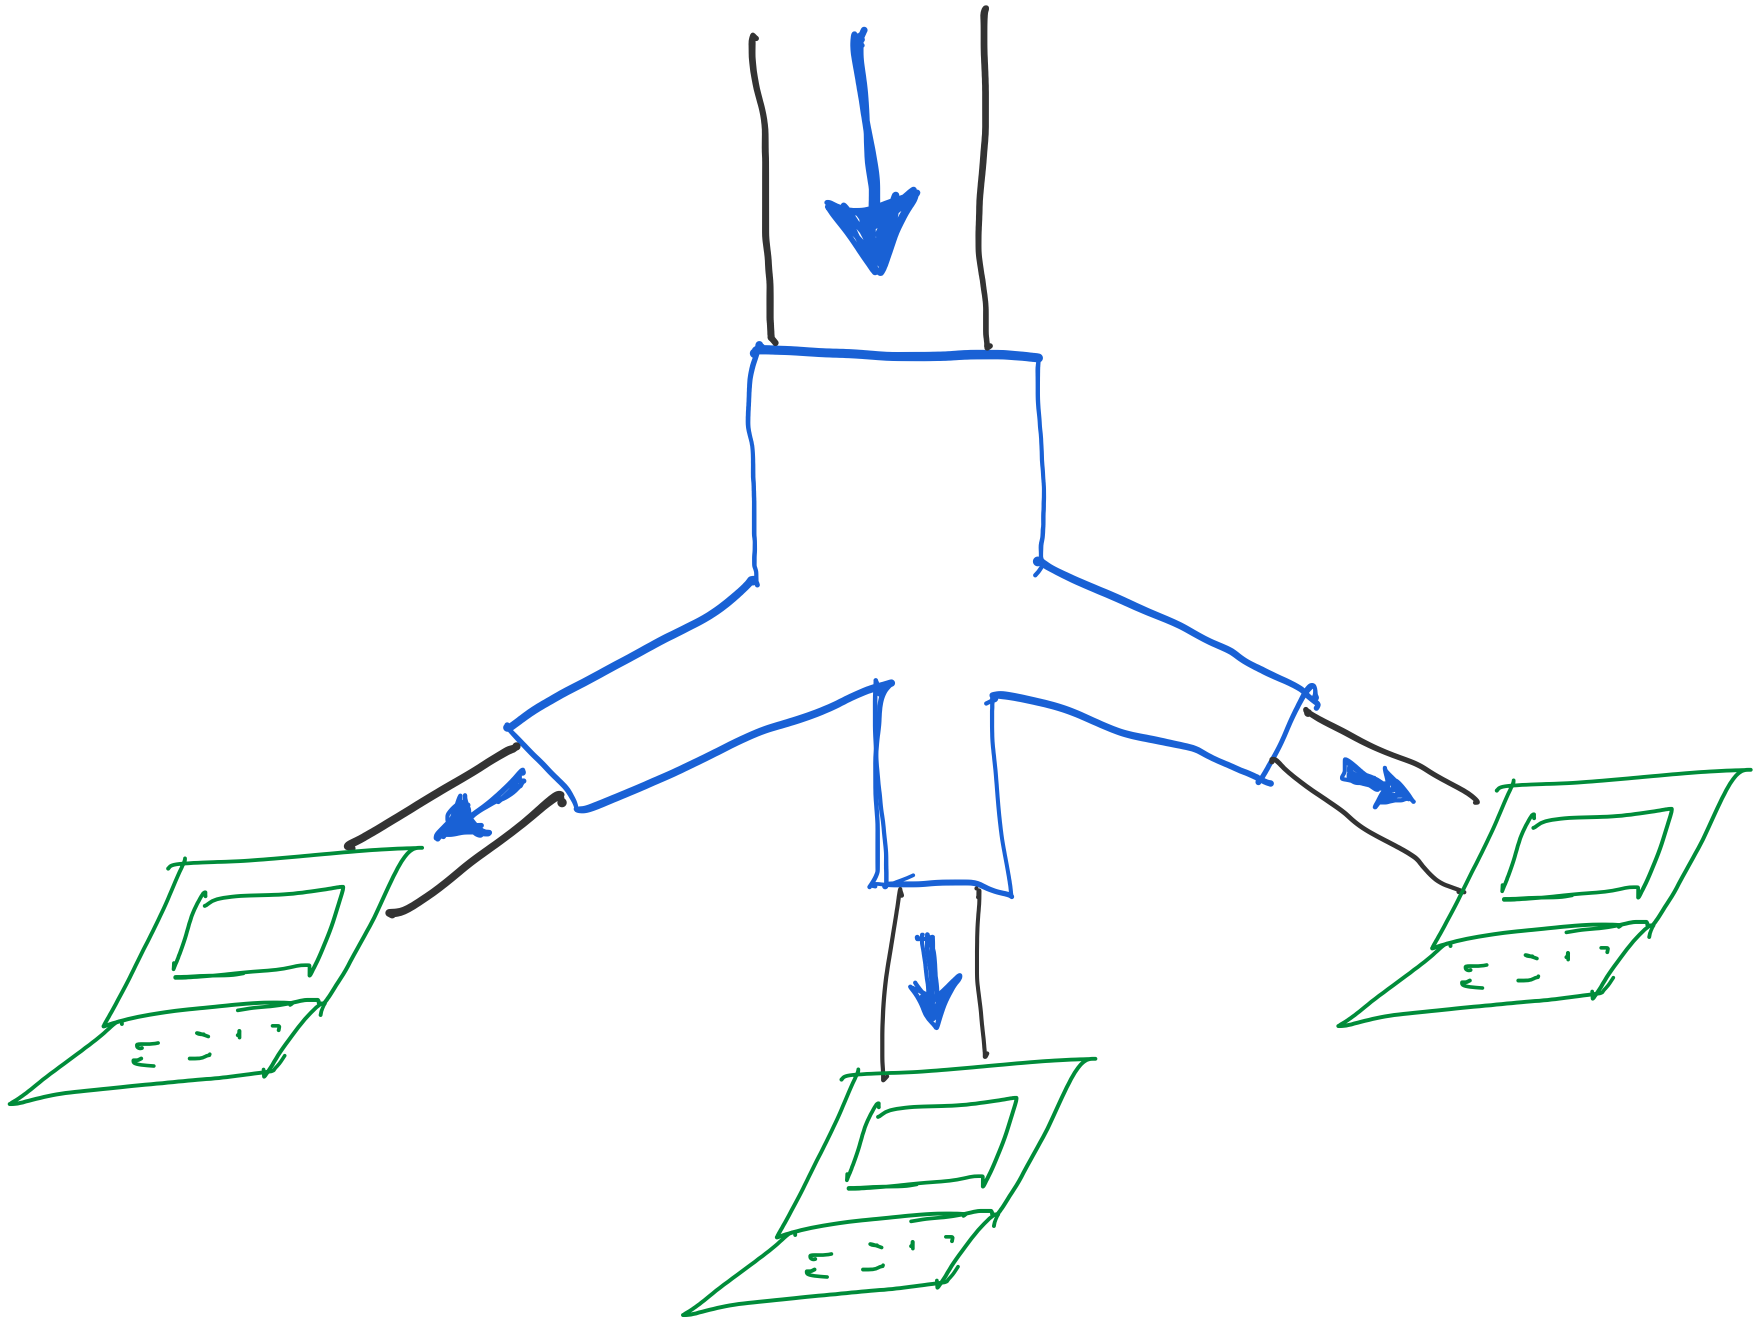
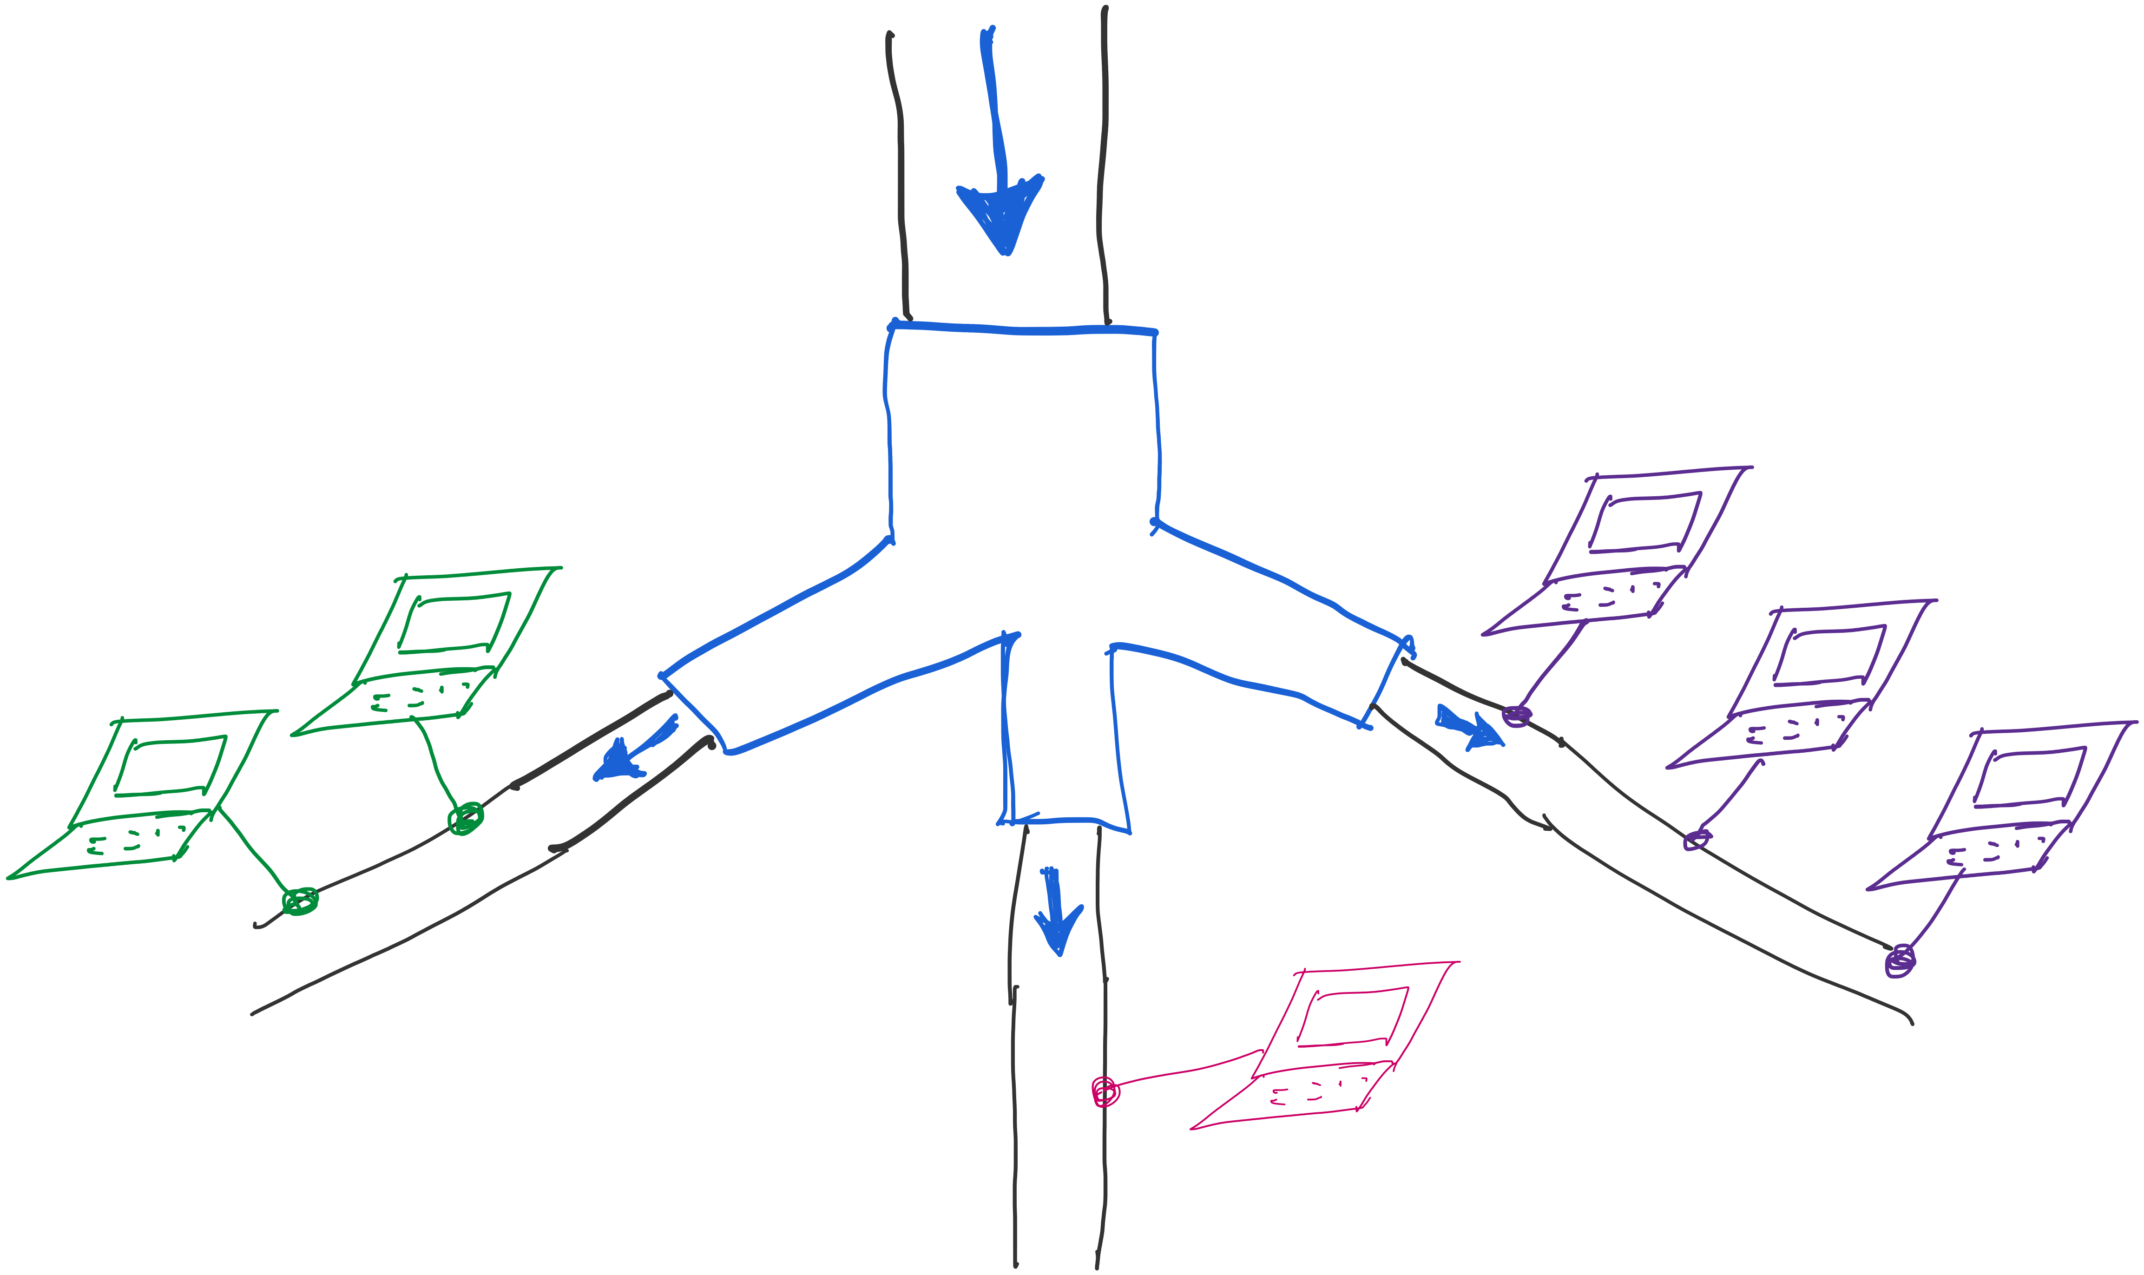

Slide 52
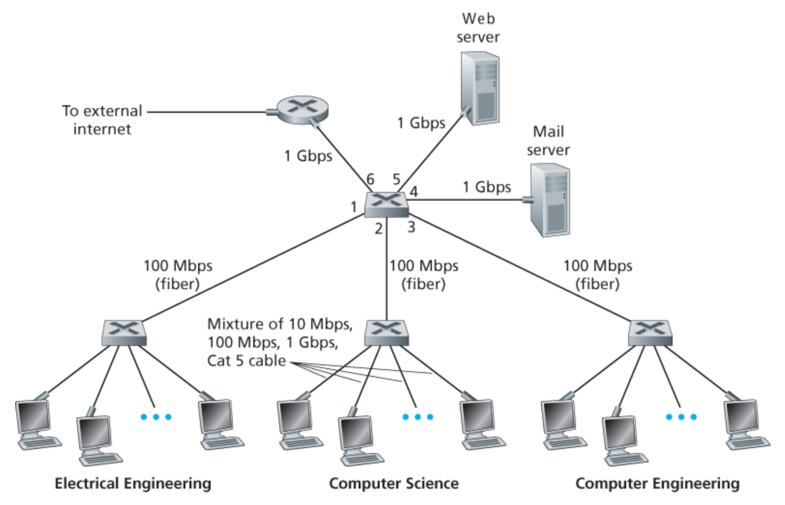

Slide 53
Physical Layer: Repeaters
Distance limitation in local-area networks
Electrical signal becomes weaker as it travels
Imposes a limit on the length of a LAN
Repeaters join LANs together
Analog electronic device
Continuously monitors electrical signals
Transmits an amplified copy

Slide 54
Physical Layer: Hubs
Joins multiple input lines electrically
Designed to hold multiple line cards
Do not necessarily amplify the signal
Very similar to repeaters
Also operates at the physical layer
hub
hub
hub
hub

Slide 55
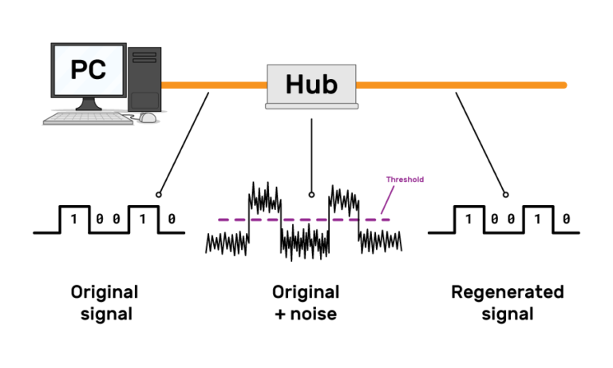
Physical Layer: Hubs

Slide 56
Limitations of Repeaters and Hubs
One large shared link
Each bit is sent everywhere
So, aggregate throughput is limited
Cannot support multiple LAN technologies
Does not buffer or interpret frames
Can’t interconnect between different rates/formats
Limitations on maximum nodes and distances
Shared medium imposes length limits
E.g., cannot go beyond 2500 meters on Ethernet

Slide 57
Link Layer: Bridges
Connects two or more LANs at the link layer
Extracts destination address from the frame
Looks up the destination in a table
Forwards the frame to the appropriate segment
Each segment can carry its own traffic
host
host
host
host
host
host
Bridge
host
host
host
host
host
host

Slide 58
Link Layer: Switches
Typically connects individual computers
A switch is essentially the same as a bridge
… though typically used to connect hosts
Supports concurrent communication
Host A can talk to C, while B talks to D
B
A
C
switch
D

Slide 59
Bridges/Switches: Traffic Isolation
Switch filters packets
Frame only forwarded to the necessary segments
Segments can support separate transmissions
switch/bridge
segment
hub
hub
hub
segment
segment

Slide 60
Advantages Over Hubs/Repeaters
Only forwards frames as needed
Avoid unnecessary load on segments
Wider geographic span
Separate segments allow longer distances
Improves privacy
Hosts can “snoop” traffic traversing their segment
… but not all the rest of the traffic
Can join segments using different technologies

Slide 61
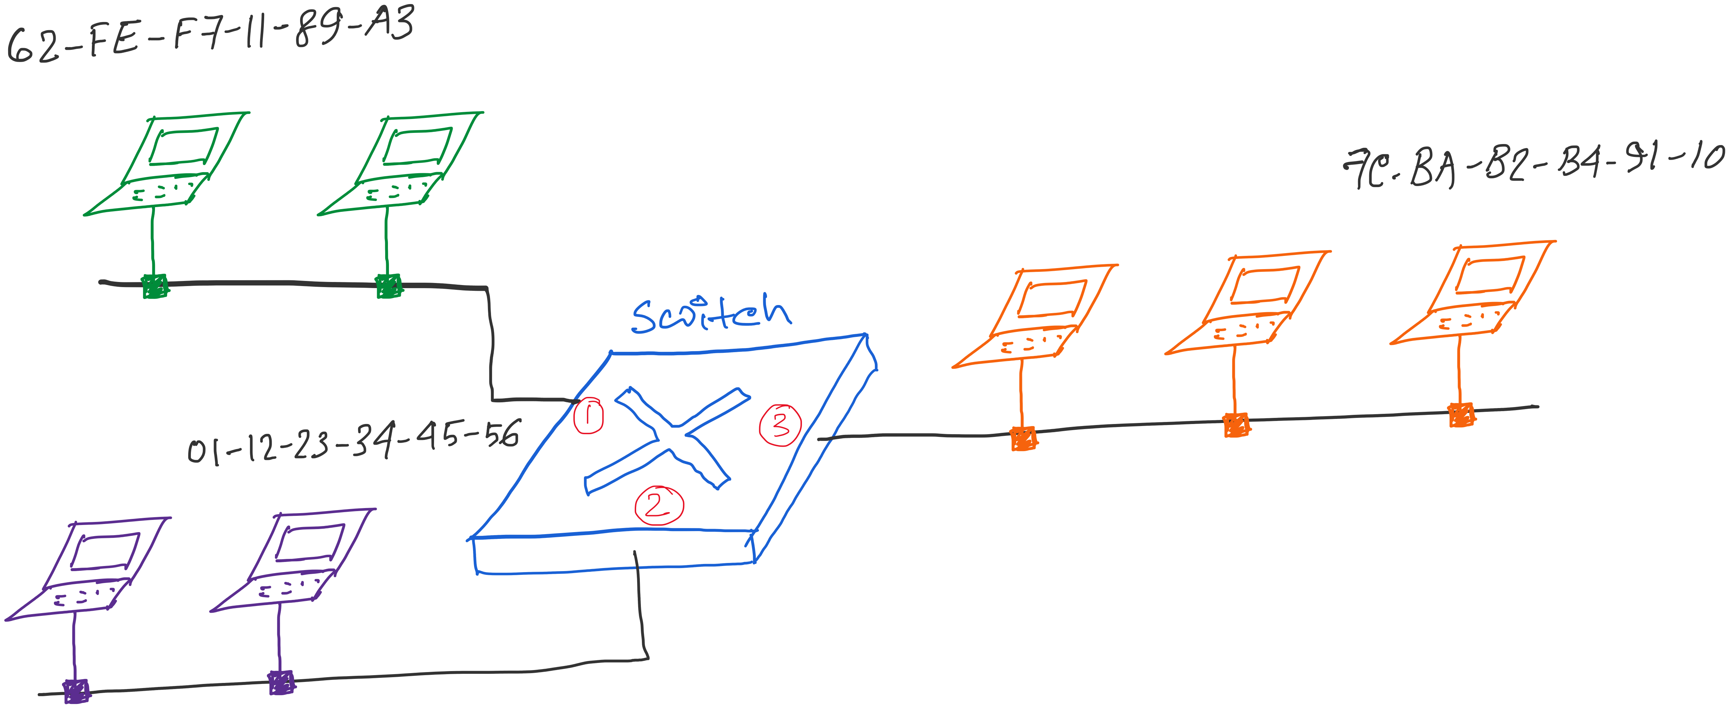
Traffic Isolation: Example
Switch table

Slide 62
Self Learning: Building the Table
When a frame arrives
Inspect the source MAC address
Associate the address with the incoming interface
Store the mapping in the switch table
Use a timer to eventually forget the mapping
B
A
C
Switch learns how to reach A.
D

Slide 63
Self Learning: Handling Misses
When frame arrives with unfamiliar destination
Forward the frame out all of the interfaces
… except for the one where the frame arrived
Hopefully, this case won’t happen very often!
B
When in doubt, shout!
A
C
D

Slide 64
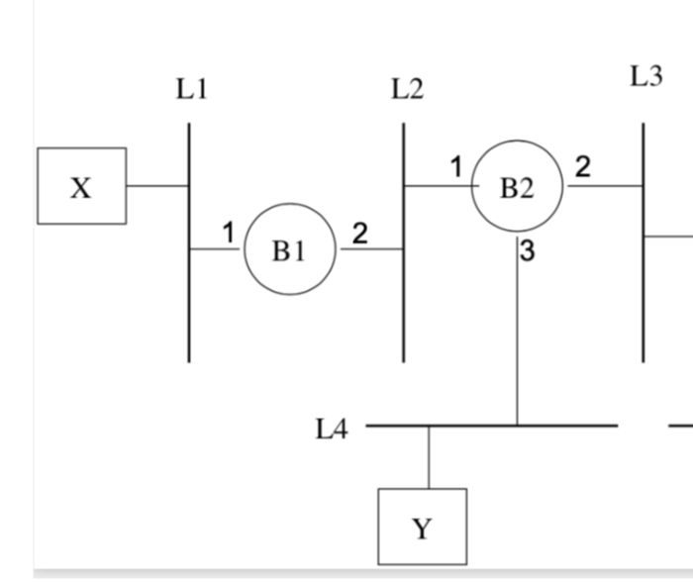
Exercise problems related to
learning-bridges/switches

Slide 65
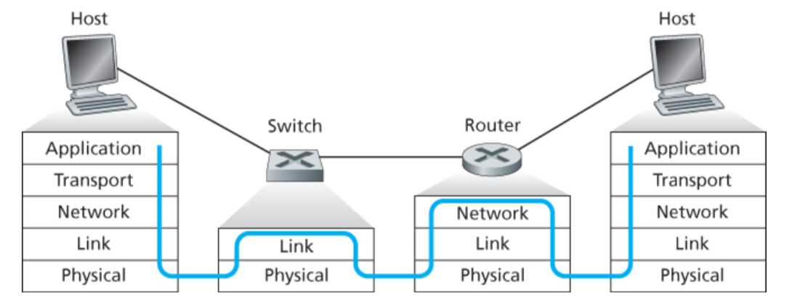
Switch vs Router

Slide 66
Summary: Multiple Layers
Different devices switch different things
Network layer: packets (routers)
Link layer: frames (bridges and switches)
Physical layer: electrical signals (repeaters and hubs)
Application
Transport
Frame header
Packet header
TCP header
User
data
Router
Bridge, switch
Repeater, hub

