Slide 1

Computer Networks
CMSC 417 : Spring 2025
Topic: Link layer
(Textbook chapter 2)
Nirupam Roy
Tu-Th 2:00-3:15pm
CSI 2117

Slide 2
Repeaters, Hubs, Bridges and Switches (cont…)

Slide 3
Link Layer: Bridges
Connects two or more LANs at the link layer
  Extracts destination address from the frame
  Looks up the destination in a table
  Forwards the frame to the appropriate segment
Each segment can carry its own traffic
host
host
host
host
host
host
Bridge
host
host
host
host
host
host

Slide 4
Link Layer: Switches
Typically connects individual computers
  A switch is essentially the same as a bridge
  … though typically used to connect hosts
Supports concurrent communication
  Host A can talk to C, while B talks to D
B
A
C
switch
D

Slide 5
Bridges/Switches: Traffic Isolation
Switch filters packets
  Frame only forwarded to the necessary segments
  Segments can support separate transmissions
switch/bridge
segment
hub
hub
hub
segment
segment

Slide 6
Advantages Over Hubs/Repeaters
Only forwards frames as needed
  Avoid unnecessary load on segments
Wider geographic span
  Separate segments allow longer distances
Improves privacy
  Hosts can “snoop” traffic traversing their segment
  … but not all the rest of the traffic
Can join segments using different technologies

Slide 7
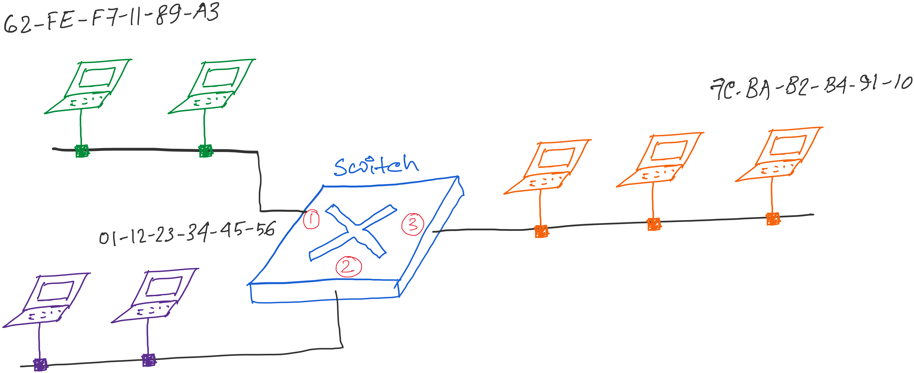
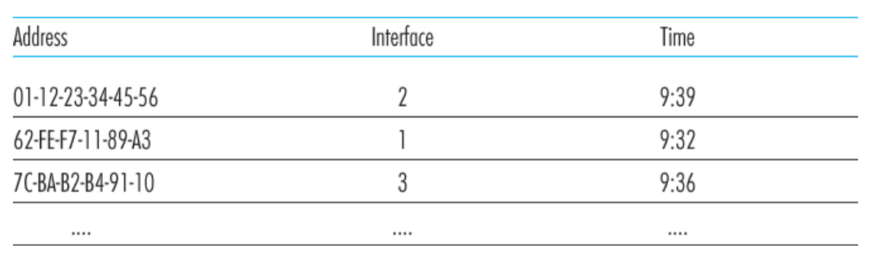
Traffic Isolation: Example
Switch table

Slide 8
Self Learning: Building the Table
When a frame arrives
  Inspect the source MAC address
  Associate the address with the incoming interface
  Store the mapping in the switch table
  Use a timer to eventually forget the mapping
B
A
C
Switch learns how to reach A.
D

Slide 9
Self Learning: Handling Misses
When frame arrives with unfamiliar destination
  Forward the frame out all of the interfaces
  … except for the one where the frame arrived
  Hopefully, this case won’t happen very often!
B
When in doubt, shout!
A
C
D

Slide 10
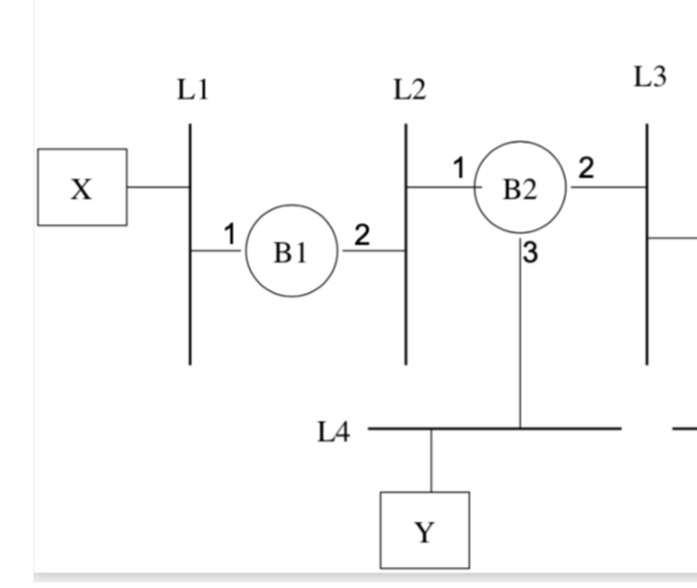
Exercise problems related to
learning-bridges/switches

Slide 11
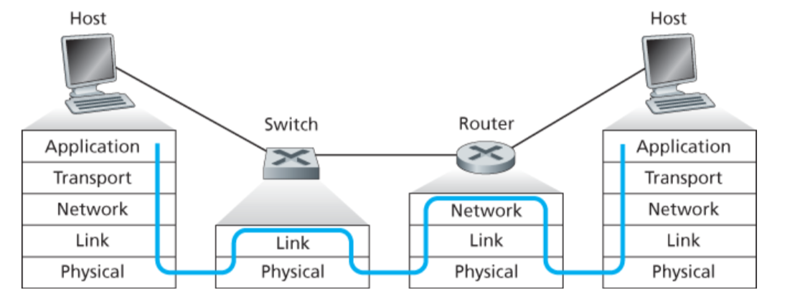
Switch vs Router

Slide 12
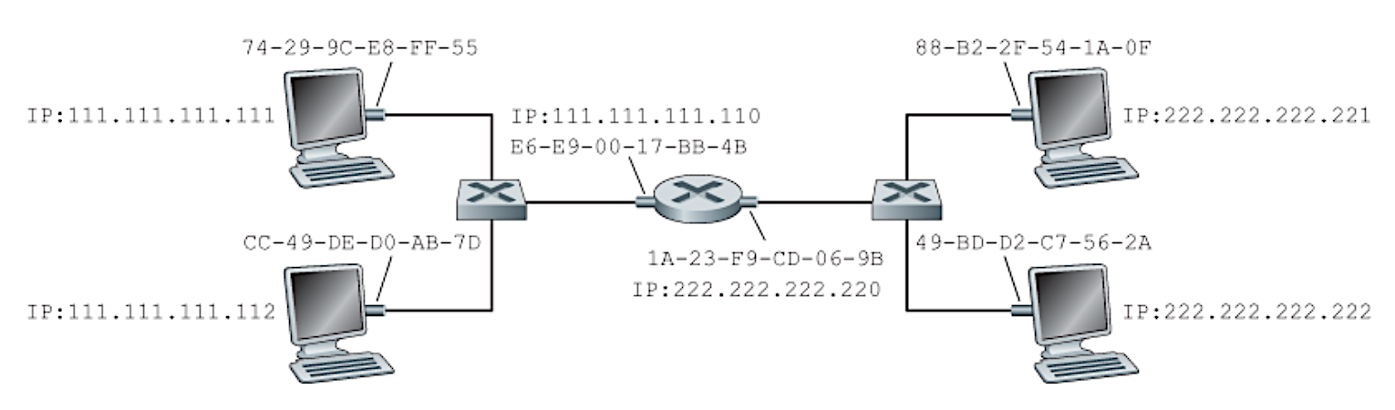
Problems related to learning-bridges/switches
and routers
Notes:
Figure: Computer Networking - A Top Down Approach, 7th edition, Figure 6.19

Slide 13
Summary: Multiple Layers
Different devices switch different things
  Network layer: packets (routers)
  Link layer: frames (bridges and switches)
  Physical layer: electrical signals (repeaters and hubs)
Application
Transport
Frame
header
Packet
header
TCP
header
User
data
Router
Bridge, switch
Repeater, hub

Slide 14

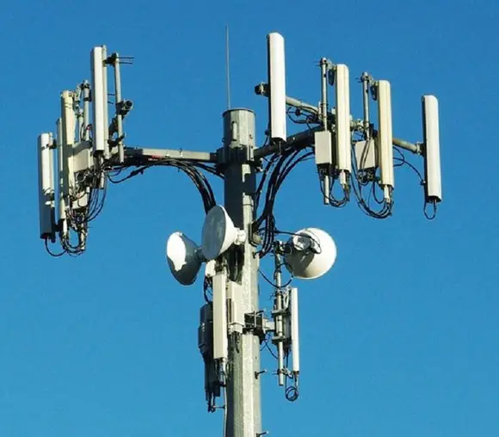
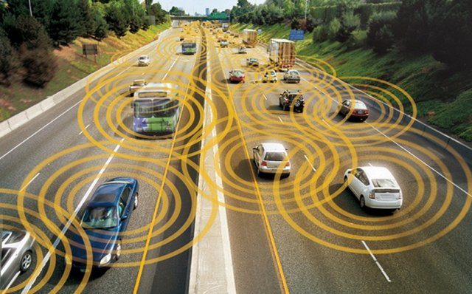
Wireless Networks

Slide 15
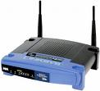

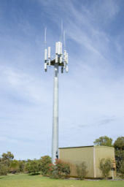

Widespread Deployment
Worldwide cellular subscribers
  1993: 34 million
  2005: more than 2 billion
  2009: more than 4 billion
  > landline subscribers
  2024: more than 9 billion
Wireless local area networks
  Wireless adapters built into laptops, tablets, & phones
  More than 220,000 known WiFi locations in 134 countries
  Probably many, many more (e.g., home networks, corporate networks, …)

Slide 16
Wireless Links

Slide 17
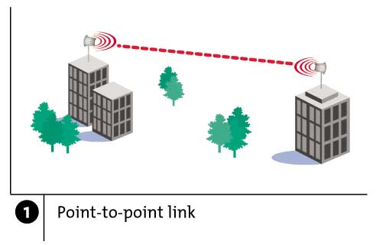
Wireless Links: High Bit Error Rate
Decreasing signal strength
  Disperses as it travels greater distance
  Attenuates as it passes through matter

Slide 18
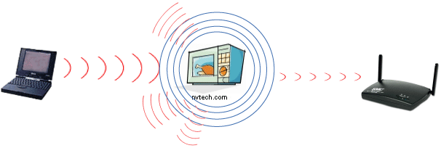
Wireless Links: High Bit Error Rate
Interference from other sources
  Radio sources in same frequency band
  E.g., 2.4 GHz wireless phone interferes with 802.11b wireless LAN
  Electromagnetic noise (e.g., microwave oven)

Slide 19
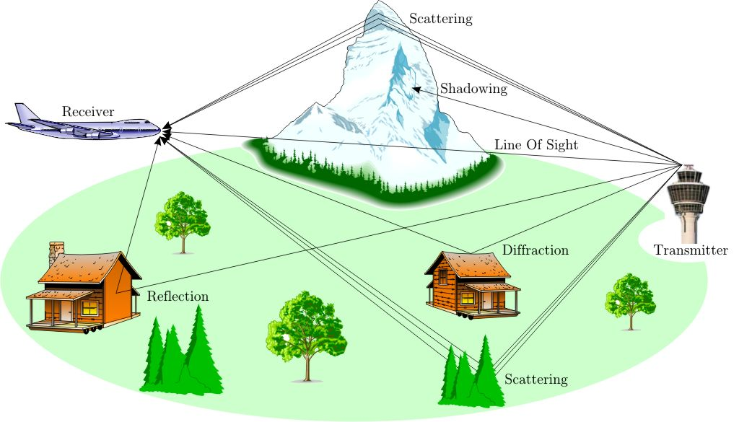
Wireless Links: High Bit Error Rate
Multi-path propagation
  Electromagnetic waves reflect off objects
  Taking many paths of different lengths
  Causing blurring of signal at the receiver
receiver
transmitter

Slide 20
Wireless Properties
Interference / bit errors
  More sources of corruption compared to wired
Multipath propagation
  Signal does not travel in a straight line
Broadcast medium
  All traffic to everyone
Power trade-offs
  Important for power constrained devices

Slide 21
Dealing With Bit Errors
Wireless vs. wired links
  Wired: most loss is due to congestion
  Wireless: higher, time-varying bit-error rate
Dealing with high bit-error rates
  Sender could increase transmission power
    Requires more energy (bad for battery-powered hosts)
    Creates more interference with other senders
  Stronger error detection and recovery
    More powerful error detection/correction codes
    Link-layer retransmission of corrupted frames

Slide 22
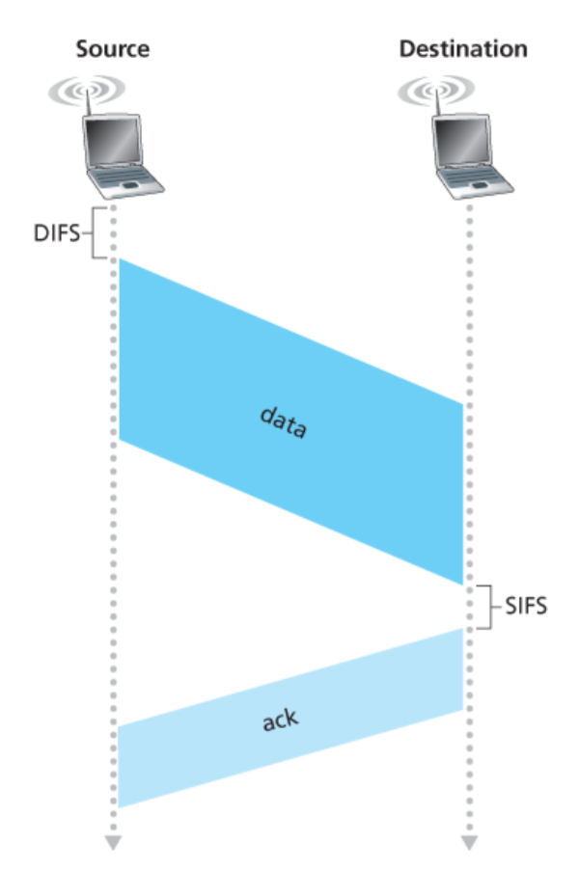
Link layer ACK

Slide 23
Wireless Links: Broadcast Limitations
Wired broadcast links
  E.g., Ethernet bridging, in wired LANs
  All nodes receive transmissions from all other nodes
Wireless broadcast: hidden terminal problem
C
A and B hear each other
B and C hear each other
But, A and C do not
So, A and C are unaware of their interference at B
B
A

Slide 24
Wireless Links: Broadcast Limitations
Wired broadcast links
  E.g., Ethernet bridging, in wired LANs
  All nodes receive transmissions from all other nodes
Wireless broadcast: fading over distance
A
B
C
A and B hear each other
B and C hear each other
But, A and C do not
So, A and C are unaware of their interference at B
A’s signal
strength
C’s signal
strength
space

Slide 25
Example Wireless Link Technologies
Data networks
  802.15.1 (Bluetooth): 2.1 Mbps – 10 m
  802.11a and g (WiFi): 54 Mbps – 100 m
  802.11n (WiFi): 200 Mbps – 100 m
  802.11be (WiFi, 2024): 46 Gbps (theoretical)
  802.16 (WiMax): 70 Mbps – 10 km
Cellular networks, outdoors
  2G: 56 Kbps
  3G: 384 Kbps
  3G enhanced (“4G”): 4 Mbps
  LTE
  5G

Slide 26
Example Wireless Link Technologies
Data networks
  802.15.1 (Bluetooth): 2.1 Mbps – 10 m
  802.11a and g (WiFi): 54 Mbps – 100 m
  802.11n (WiFi): 200 Mbps – 100 m
  802.11be (WiFi, 2024): 46 Gbps (theoretical)
  802.16 (WiMax): 70 Mbps – 10 km
Cellular networks, outdoors
  2G: 56 Kbps
  3G: 384 Kbps
  3G enhanced (“4G”): 4 Mbps
  LTE
  5G

Slide 27
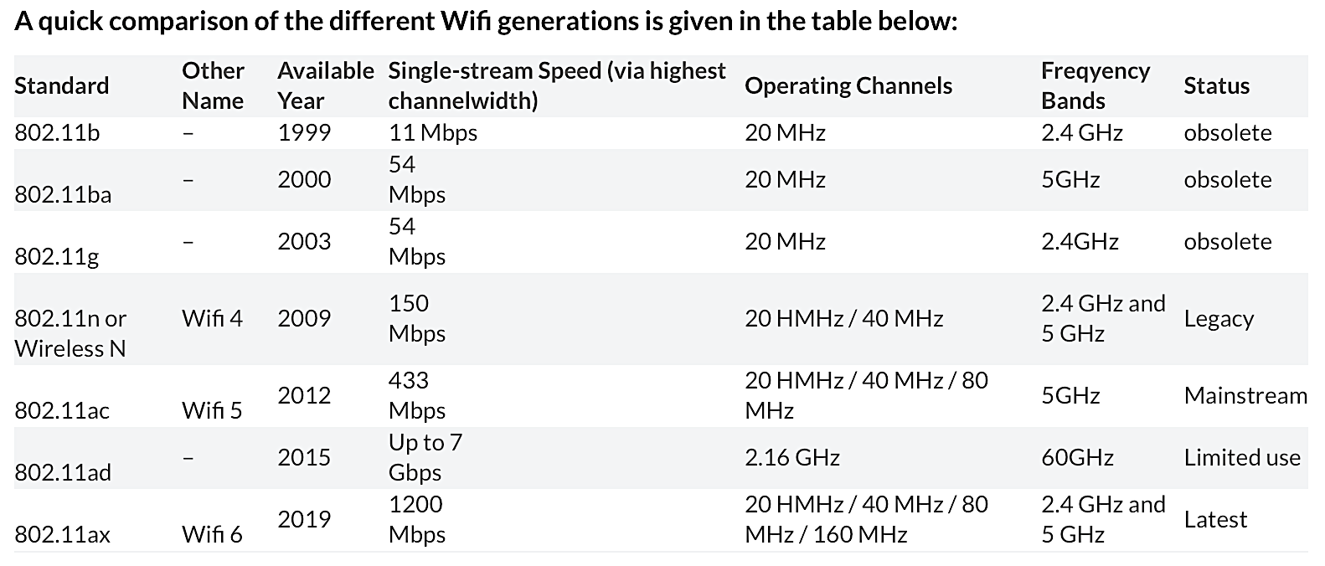
WiFi: IEEE 802.11 Wireless LANs

Slide 28
WiFi: IEEE 802.11 Wireless LANs
LAN Architecture
MAC protocol
Frame structure
Advanced features

Slide 29
WiFi: IEEE 802.11 Wireless LANs
LAN Architecture
MAC protocol
Frame structure
Advanced features

Slide 30
Wireless Network: Wireless Link
Wireless link
Typically used to connect mobile(s) to base station
Also used as backbone link
Multiple access protocol coordinates link access
network
infrastructure

Slide 31
Wireless Network: Wireless Hosts
Wireless host
Laptop, smartphone
Run applications
May be stationary (non-mobile) or mobile
network
infrastructure

Slide 32
Wireless Network: Base Station
Base station
Typically connected to wired network
Relay responsible for sending packets between wired network and wireless host(s) in its “area”
E.g., cell towers, 802.11 access points
network
infrastructure

Slide 33
Wireless Network: Infrastructure
Network infrastructure
Larger network with which a wireless host wants to communicate
Typically a wired network
Provides traditional network services
May not always exist
network
infrastructure

Slide 34
Infrastructure Mode (APs)
Infrastructure mode
Base station connects mobiles into wired network
Network provides services (addressing, routing, DNS)
Handoff: mobile changes base station providing connection to wired network
network
infrastructure

Slide 35
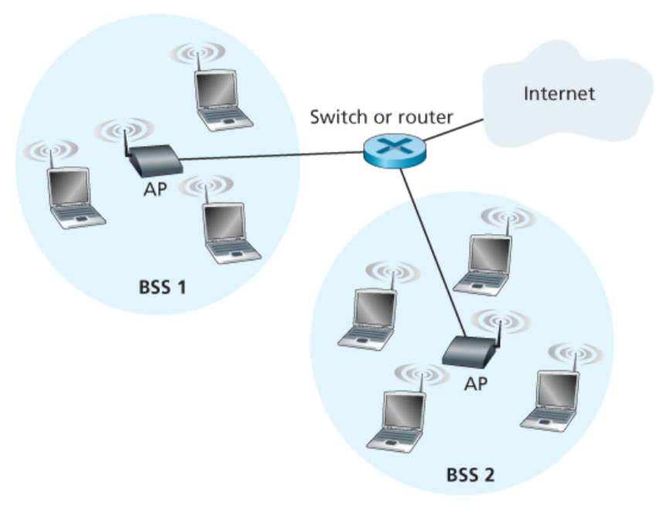
802.11 LAN Architecture
Access Point (AP)
  Base station that communicates with the wireless hosts
Basic Service Set (BSS)
  Coverage of one AP
  AP acts as the master
  Identified by a “network name” known as an SSID
SSID: Service Set Identifier
(1) Infrastructure wireless LAN

Slide 36
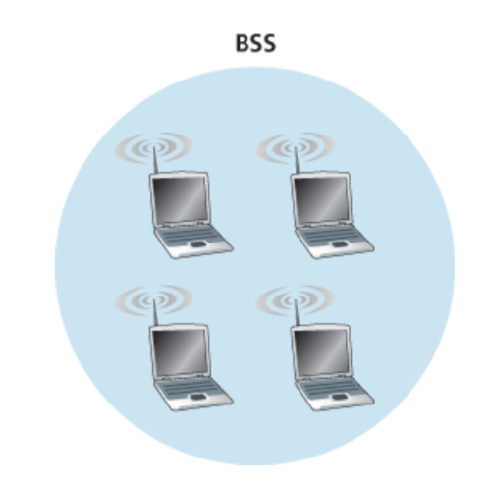
802.11 LAN Architecture
(2) Ad hoc wireless LAN

Slide 37
Channels and Association
network
infrastructure

Slide 38
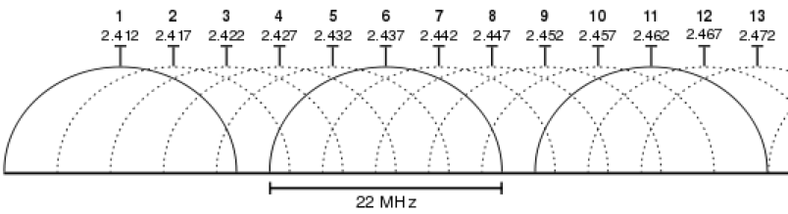
Channels and Association
Multiple channels at different frequencies
  Network administrator chooses frequency for AP
  Interference if channel is same as neighboring AP
Beacon frames from APs
Associate request from host
Association response from AP

Slide 39
Channels and Association
Multiple channels at different frequencies
  Network administrator chooses frequency for AP
  Interference if channel is same as neighboring AP
Access points send periodic beacon frames
  Containing AP’s name (SSID) and MAC address
  Host scans channels, listening for beacon frames
  Host selects an access point to associate with
Beacon frames from APs
Associate request from host
Association response from AP

Slide 40
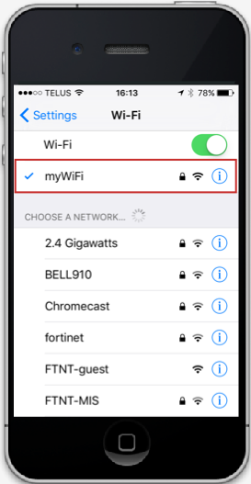
Channels and Association
Multiple channels at different frequencies
  Network administrator chooses frequency for AP
  Interference if channel is same as neighboring AP
Access points send periodic beacon frames
  Containing AP’s name (SSID) and MAC address
  Host scans channels, listening for beacon frames
  Host selects an access point to associate with
Beacon frames from APs
Associate request from host
Association response from AP

Slide 41
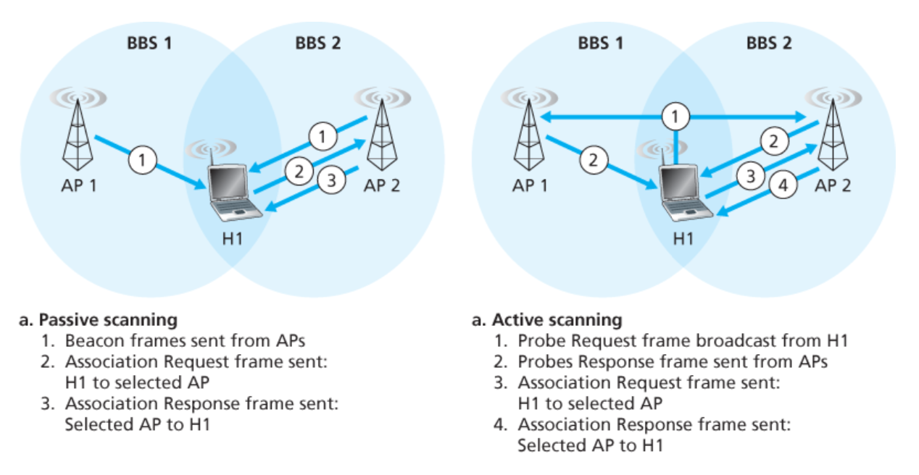
Scanning: Passive and active

Slide 42
Mobility Within the Same Subnet
H1 remains in same IP subnet
  IP address of the host can remain same
  Ongoing data transfers can continue uninterrupted
H1 recognizes the need to change
  H1 detects a weakening signal
  Starts scanning for stronger one
Changes APs with same SSID
  H1 disassociates from one
  And associates with other
Switch learns new location
  Self-learning mechanism
router
switch
BBS 1
AP 1
AP 2
H1
BBS 2

Slide 43
WiFi: IEEE 802.11 Wireless LANs
LAN Architecture
MAC protocol
Frame structure
Advanced features

Slide 44
CSMA: Carrier Sense, Multiple Access
Multiple access: channel is shared medium
  Station: wireless host or access point
  Multiple stations may want to transmit at same time
Carrier sense: sense channel before sending
  Station doesn’t send when channel is busy
  To prevent collisions with ongoing transfers
  But, detecting ongoing transfers isn’t always possible
A
B
C
C
A’s signal
strength
C’s signal
strength
B
A
space

Slide 45
CSMA/CA: Collision Avoidance (CA), Not Collision Detection (CD)
Collision detection in wired Ethernet
  Station listens while transmitting
  Detects collision with other transmission
  Aborts transmission and tries sending again

Slide 46
CSMA/CA: Collision Avoidance (CA), Not Collision Detection (CD)
Collision detection in wired Ethernet
  Station listens while transmitting
  Detects collision with other transmission
  Aborts transmission and tries sending again
Problem #1: cannot detect all collisions
  Hidden terminal problem
  Fading

Slide 47
CA: Collision Avoidance, Not Detection
Collision detection in wired Ethernet
  Station listens while transmitting
  Detects collision with other transmission
  Aborts transmission and tries sending again
Problem #1: cannot detect all collisions
  Hidden terminal problem
  Fading
Problem #2: Can not listen while sending
  Strength of received signal is much smaller
  Expensive to build hardware that detects collisions
So, 802.11 does collision avoidance, not detection

Slide 48
Hidden Terminal Problem
A
B
C
A and C can’t see each other, both send to B
Occurs since 802.11 relies on physical carrier sensing, which is susceptible to hidden terminal problem

Slide 49
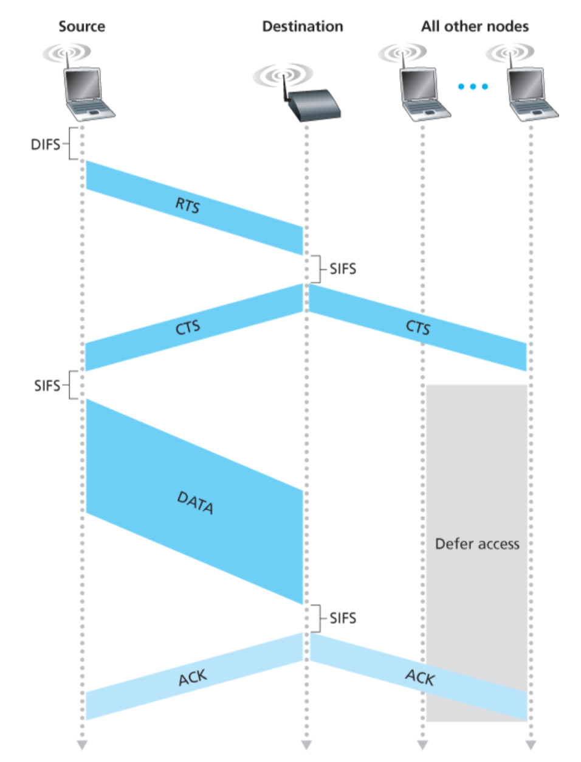
Virtual carrier sensing (RTS-CTS)
A
B
C
D

Slide 50
Virtual carrier sensing
First exchange control frames before transmitting data
  Sender issues “Request to Send” (RTS), incl. length of data
  Receiver responds with “Clear to Send” (CTS)
If sender sees CTS, transmits data (of specified length)
If other node sees CTS, will idle for specified period
If other node sees RTS but not CTS, free to send

Slide 51
Hidden Terminal Problem
A
B
C
A and C can’t see each other, both send to B
RTS/CTS can help
  Both A and C would send RTS that B would see first
  B only responds with one CTS (say, echo’ing A’s RTS)
  C detects that CTS doesn’t match and won’t send

Slide 52
Virtual carrier sensing (RTS-CTS)

Slide 53
Exposed Terminal Problem
A
B
C
D
B sending to A, C wants to send to D
As C receives B’s packets, carrier sense would prevent it from sending to D, even though wouldn’t interfere
RTS/CTS can help
  C hears RTS from B, but not CTS from A
  C knows it’s transmission will not interfere with A
  C is safe to transmit to D

Slide 54
Impact on Higher-Layer Protocols
Wireless and mobility change path properties
  Wireless: higher packet loss, not from congestion
  Mobility: transient disruptions, and changes in RTT
Logically, impact should be minimal …
  Best-effort service model remains unchanged
  TCP and UDP can (and do) run over wireless, mobile
But, performance definitely is affected
  TCP treats packet loss as a sign of congestion
  TCP tries to estimate the RTT to drive retransmissions
  TCP does not perform well under out-of-order packets
Internet not designed with these issues in mind

Slide 55
WiFi: IEEE 802.11 Wireless LANs
LAN Architecture
MAC protocol
Frame structure
Advanced features

Slide 56
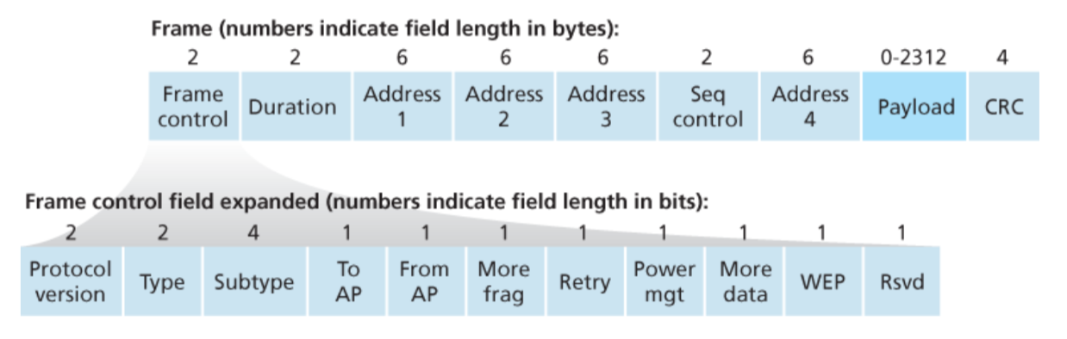
WiFi: IEEE 802.11 Frame

Slide 57
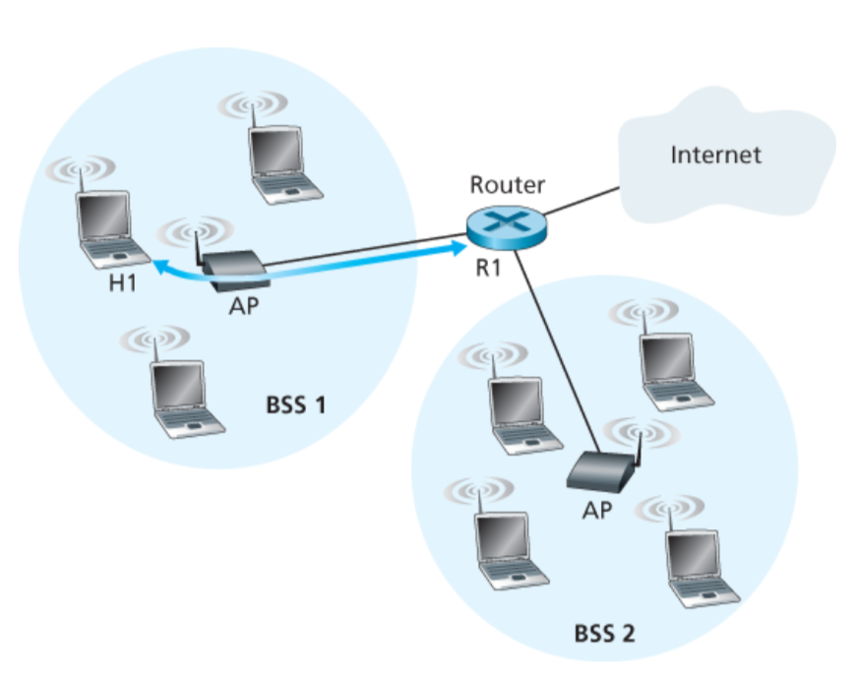
802.11 Frame: The secret of Address-3

Slide 58
802.11 Frame: The secret of Address-3
Case 1: Router R1 send data to host H1

Slide 59
802.11 Frame: The secret of Address-3
Case 1: Router R1 send data to host H1
(1) R1 knows H1’s IP addr, runs ARP to get the MAC addr.

Slide 60
802.11 Frame: The secret of Address-3
(2) R1 encapsulates the data in Ethernet frame.
Source addr: R1’s MAC addr
Dest. addr: H1’s MAC addr
Case 1: Router R1 send data to host H1

Slide 61
802.11 Frame: The secret of Address-3
Case 1: Router R1 send data to host H1
(3) AP converts the Ethernet (802.3) frame to WiFi frame (802.11).
Addr 1: H1’s MAC addr
Addr 2: AP’s MAC addr
Addr 3: R1’s MAC addr

Slide 62
802.11 Frame: The secret of Address-3
Case 1: Router R1 send data to host H1
(4) H1 can determine that the frame has come from R1 by checking Addr-3 field.

Slide 63
802.11 Frame: The secret of Address-3
Case 2: Host H1 responds by sending packet to Router R1

Slide 64
802.11 Frame: The secret of Address-3
Case 2: Host H1 responds by sending packet to Router R1
H1 creates a WiFi frame.
Addr 1: AP’s MAC addr
Addr 2: H1’s MAC addr
Addr 3: R1’s MAC addr

Slide 65
802.11 Frame: The secret of Address-3
Case 2: Host H1 responds by sending packet to Router R1
(2) AP can determine that the frame should be forwarded to R1 by checking Addr-3 field.

Slide 66
802.11 Frame: The secret of Address-3
Case 2: Host H1 responds by sending packet to Router R1
(3) AP converts the WiFi (802.11) frame to Ethernet frame (802.3).
Source addr : H1’s MAC addr
Dest. addr : R1’s MAC addr

Slide 67
WiFi: IEEE 802.11 Wireless LANs
LAN Architecture
MAC protocol
Frame structure
Advanced features

Slide 68
WiFi: Advanced features
1) Rate adaptation
2) Power management

Slide 69
Mobility in Wide-area
Wireless Networks (Cellular)

Slide 70


Components of cellular network architecture
MSC
connects cells to wired tel. net.
manages call setup
handles mobility
cell
covers geographical region
base station (BS) analogous to 802.11 AP
mobile users attach to network through BS
air-interface: physical and link layer protocol between mobile and BS
Mobile
Switching
Center
Public telephone
network
Mobile
Switching
Center
wired network

Slide 71
Cellular networks: the first hop
Two techniques for sharing mobile-to-BS radio spectrum
combined FDMA/TDMA: divide spectrum in frequency channels, divide each channel into time slots
CDMA: code division multiple access
time slots
frequency
bands

Slide 72
Picture1: https://www.brandsynario.com/the-evolution-of-gs-generation-networks/
Notes:
Picture from: https://www.brandsynario.com/the-evolution-of-gs-generation-networks/

Slide 73
Picture1: https://www.brandsynario.com/the-evolution-of-gs-generation-networks/
Picture2: http://kaaale.blogspot.com/2019/02/the-evolution-of-cellular-mobile.html
Notes:
Picture from: https://www.brandsynario.com/the-evolution-of-gs-generation-networks/

Slide 74
What is mobility?
spectrum of mobility, from the network perspective:
no mobility
high mobility
mobile wireless user,
using same access
point
mobile user, connecting/ disconnecting from network using DHCP.
mobile user, passing through multiple access point while maintaining ongoing connections (like cell phone)

Slide 75




Mobility: vocabulary
home network: permanent “home” of mobile
(e.g., 128.119.40/24)
home agent: entity that will perform mobility functions on behalf of mobile, when mobile is remote
wide area network
permanent address: address in home network, can always be used to reach mobile
e.g., 128.119.40.186

Slide 76
Mobility: more vocabulary
permanent address: remains constant (e.g., 128.119.40.186)
visited network: network in which mobile currently resides (e.g., 79.129.13/24)
care-of-address: address in visited network.
(e.g., 79,129.13.2)
wide area network
foreign agent: entity in visited network that performs mobility functions on behalf of mobile.
correspondent: wants to communicate with mobile

Slide 77
Mobility: approaches
let routing handle it: routers advertise permanent address of mobile-nodes-in-residence via usual routing table exchange.
  routing tables indicate where each mobile located
  no changes to end-systems
let end-systems handle it:
  indirect routing: communication from correspondent to mobile goes through home agent, then forwarded to remote
  direct routing: correspondent gets foreign address of mobile, sends directly to mobile

Slide 78
Mobility: approaches
let routing handle it: routers advertise permanent address of mobile-nodes-in-residence via usual routing table exchange.
  routing tables indicate where each mobile located
  no changes to end-systems
let end-systems handle it:
  indirect routing: communication from correspondent to mobile goes through home agent, then forwarded to remote
  direct routing: correspondent gets foreign address of mobile, sends directly to mobile
not
scalable
to millions of
mobiles

Slide 79
Mobility: registration
visited network
home network
1
2
wide area network
mobile contacts foreign agent on entering visited network
foreign agent contacts home agent home: “this mobile is resident in my network”
end result:
foreign agent knows about mobile
home agent knows location of mobile

Slide 80

Mobility via indirect routing
foreign agent receives packets, forwards to mobile
home agent intercepts packets, forwards to foreign agent
visited
network
home
network
3
wide area network
2
1
correspondent addresses packets using home address of mobile

Slide 81
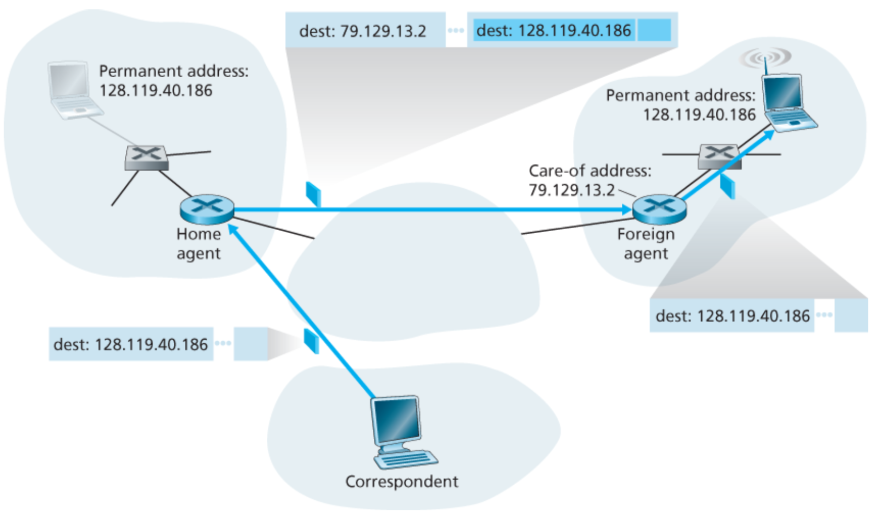
Packet encapsulation

Slide 82
Mobility via indirect routing
foreign agent receives packets, forwards to mobile
home agent intercepts packets, forwards to foreign agent
visited
network
home
network
3
wide area network
2
1
correspondent addresses packets using home address of mobile
4
mobile replies directly to correspondent

Slide 83



Indirect Routing: comments
mobile uses two addresses:
  permanent address: used by correspondent (hence mobile location is transparent to correspondent)
  care-of-address: used by home agent to forward datagrams to mobile
foreign agent functions may be done by mobile itself
triangle routing: correspondent-home-network-mobile
  inefficient when
  correspondent, mobile
  are in same network

Slide 84


Mobility via direct routing
foreign agent receives packets, forwards to mobile
correspondent forwards to foreign agent
visited
network
home
network
3
1
2
4
correspondent requests, receives foreign address of mobile
mobile replies directly to correspondent

Slide 85
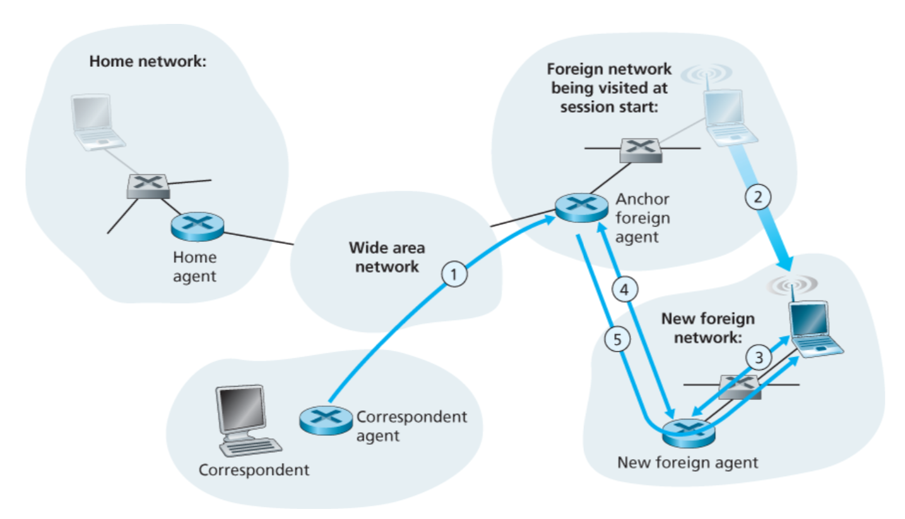
Mobility through multiple foreign networks

