Slide 1

Computer Networks
CMSC 417 : Spring 2025
Topic: Wireless Link layer & Chord Protocol
(Textbook chapter 2 & the research paper)
Nirupam Roy
Tu-Th 2:00-3:15pm
CSI 2117

Slide 2
Exposed Terminal Problem
A
B
C
D
B sending to A, C wants to send to D
As C receives B’s packets, carrier sense would prevent it from sending to D, even though wouldn’t interfere
RTS/CTS can help
  C hears RTS from B, but not CTS from A
  C knows it’s transmission will not interfere with A
  C is safe to transmit to D

Slide 3
Impact on Higher-Layer Protocols
Wireless and mobility change path properties
  Wireless: higher packet loss, not from congestion
  Mobility: transient disruptions, and changes in RTT
Logically, impact should be minimal …
  Best-effort service model remains unchanged
  TCP and UDP can (and do) run over wireless, mobile
But, performance definitely is affected
  TCP treats packet loss as a sign of congestion
  TCP tries to estimate the RTT to drive retransmissions
  TCP does not perform well under out-of-order packets
Internet not designed with these issues in mind

Slide 4
WiFi: IEEE 802.11 Wireless LANs
LAN Architecture
MAC protocol
Frame structure
Advanced features

Slide 5
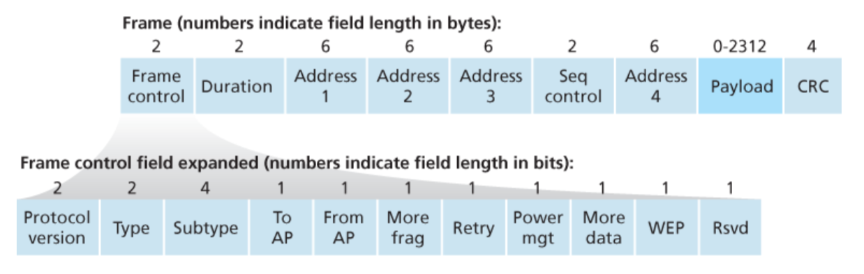
WiFi: IEEE 802.11 Frame
Notes:
Address 4 in an 802.11 Wi-Fi packet header is primarily used when an AP (Access Point) forwards a frame to another AP over a wireless link

Slide 6
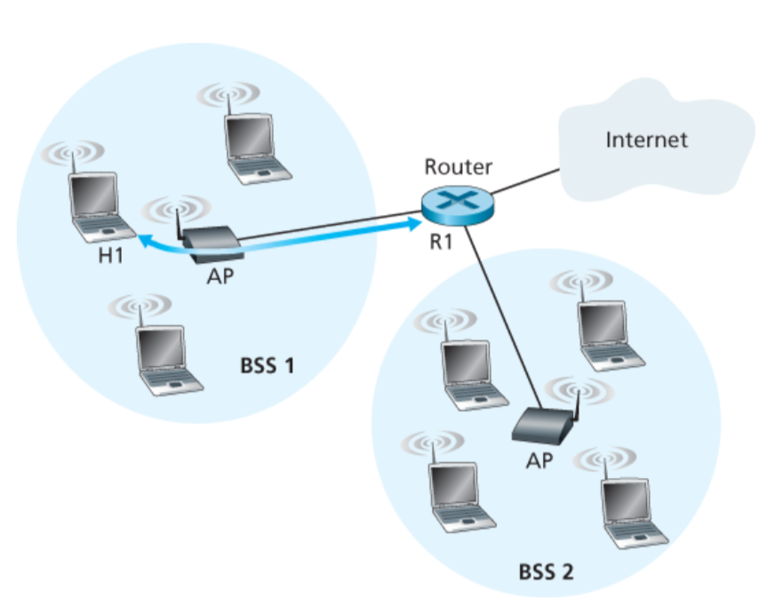
802.11 Frame: The secret of Address-3

Slide 7
802.11 Frame: The secret of Address-3
Case 1: Router R1 send data to host H1

Slide 8
802.11 Frame: The secret of Address-3
Case 1: Router R1 send data to host H1
(1) R1 knows H1’s IP addr, runs ARP to get the MAC addr.

Slide 9
802.11 Frame: The secret of Address-3
(2) R1 encapsulates the data in Ethernet frame.
Source addr: R1’s MAC addr
Dest. addr: H1’s MAC addr
Case 1: Router R1 send data to host H1

Slide 10
802.11 Frame: The secret of Address-3
Case 1: Router R1 send data to host H1
(3) AP converts the Ethernet (802.3) frame to WiFi frame (802.11).
Addr 1: H1’s MAC addr
Addr 2: AP’s MAC addr
Addr 3: R1’s MAC addr

Slide 11
802.11 Frame: The secret of Address-3
Case 1: Router R1 send data to host H1
(4) H1 can determine that the frame has come from R1 by checking Addr-3 field.

Slide 12
802.11 Frame: The secret of Address-3
Case 2: Host H1 responds by sending packet to Router R1

Slide 13
802.11 Frame: The secret of Address-3
Case 2: Host H1 responds by sending packet to Router R1
H1 creates a WiFi frame.
Addr 1: AP’s MAC addr
Addr 2: H1’s MAC addr
Addr 3: R1’s MAC addr

Slide 14
802.11 Frame: The secret of Address-3
Case 2: Host H1 responds by sending packet to Router R1
(2) AP can determine that the frame should be forwarded to R1 by checking Addr-3 field.

Slide 15
802.11 Frame: The secret of Address-3
Case 2: Host H1 responds by sending packet to Router R1
(3) AP converts the WiFi (802.11) frame to Ethernet frame (802.3).
Source addr : H1’s MAC addr
Dest. addr : R1’s MAC addr

Slide 16
WiFi: IEEE 802.11 Wireless LANs
LAN Architecture
MAC protocol
Frame structure
Advanced features

Slide 17
WiFi: Advanced features
1) Rate adaptation
2) Power management

Slide 18
Mobility in Wide-area
Wireless Networks (Cellular)

Slide 19


Components of cellular network architecture
MSC
connects cells to wired tel. net.
manages call setup
handles mobility
cell
covers geographical region
base station (BS) analogous to 802.11 AP
mobile users attach to network through BS
air-interface: physical and link layer protocol between mobile and BS
Mobile
Switching
Center
Public telephone
network
Mobile
Switching
Center
wired network

Slide 20
Cellular networks: the first hop
Two techniques for sharing mobile-to-BS radio spectrum
combined FDMA/TDMA: divide spectrum in frequency channels, divide each channel into time slots
CDMA: code division multiple access
time slots
frequency
bands

Slide 21
Picture1: https://www.brandsynario.com/the-evolution-of-gs-generation-networks/
Notes:
Picture from: https://www.brandsynario.com/the-evolution-of-gs-generation-networks/

Slide 22
Picture1: https://www.brandsynario.com/the-evolution-of-gs-generation-networks/
Picture2: http://kaaale.blogspot.com/2019/02/the-evolution-of-cellular-mobile.html
Notes:
Picture from: https://www.brandsynario.com/the-evolution-of-gs-generation-networks/

Slide 23
What is mobility?
spectrum of mobility, from the network perspective:
no mobility
high mobility
mobile wireless user,
using same access
point
mobile user, connecting/ disconnecting from network using DHCP.
mobile user, passing through multiple access point while maintaining ongoing connections (like cell phone)

Slide 24




Mobility: vocabulary
home network: permanent “home” of mobile
(e.g., 128.119.40/24)
home agent: entity that will perform mobility functions on behalf of mobile, when mobile is remote
wide area network
permanent address: address in home network, can always be used to reach mobile
e.g., 128.119.40.186

Slide 25
Mobility: more vocabulary
permanent address: remains constant (e.g., 128.119.40.186)
visited network: network in which mobile currently resides (e.g., 79.129.13/24)
care-of-address: address in visited network.
(e.g., 79,129.13.2)
wide area network
foreign agent: entity in visited network that performs mobility functions on behalf of mobile.
correspondent: wants to communicate with mobile

Slide 26
Mobility: approaches
let routing handle it: routers advertise permanent address of mobile-nodes-in-residence via usual routing table exchange.
  routing tables indicate where each mobile located
  no changes to end-systems
let end-systems handle it:
  indirect routing: communication from correspondent to mobile goes through home agent, then forwarded to remote
  direct routing: correspondent gets foreign address of mobile, sends directly to mobile

Slide 27
Mobility: approaches
let routing handle it: routers advertise permanent address of mobile-nodes-in-residence via usual routing table exchange.
  routing tables indicate where each mobile located
  no changes to end-systems
let end-systems handle it:
  indirect routing: communication from correspondent to mobile goes through home agent, then forwarded to remote
  direct routing: correspondent gets foreign address of mobile, sends directly to mobile
not
scalable
to millions of
mobiles

Slide 28
Mobility: registration
visited network
home network
1
2
wide area network
mobile contacts foreign agent on entering visited network
foreign agent contacts home agent home: “this mobile is resident in my network”
end result:
foreign agent knows about mobile
home agent knows location of mobile

Slide 29

Mobility via indirect routing
foreign agent receives packets, forwards to mobile
home agent intercepts packets, forwards to foreign agent
visited
network
home
network
3
wide area network
2
1
correspondent addresses packets using home address of mobile

Slide 30
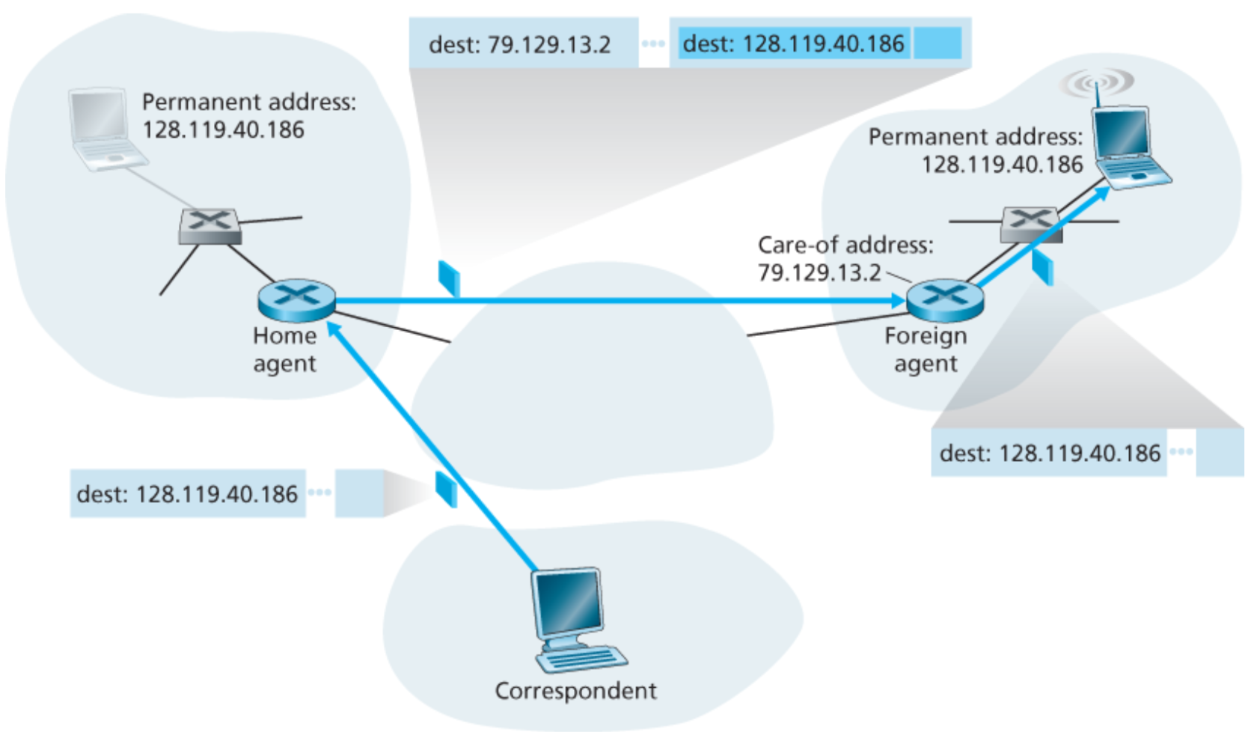
Packet encapsulation

Slide 31
Mobility via indirect routing
foreign agent receives packets, forwards to mobile
home agent intercepts packets, forwards to foreign agent
visited
network
home
network
3
wide area network
2
1
correspondent addresses packets using home address of mobile
4
mobile replies directly to correspondent

Slide 32



Indirect Routing: comments
mobile uses two addresses:
  permanent address: used by correspondent (hence mobile location is transparent to correspondent)
  care-of-address: used by home agent to forward datagrams to mobile
foreign agent functions may be done by mobile itself
triangle routing: correspondent-home-network-mobile
  inefficient when
  correspondent, mobile
  are in same network

Slide 33


Mobility via direct routing
foreign agent receives packets, forwards to mobile
correspondent forwards to foreign agent
visited
network
home
network
3
1
2
4
correspondent requests, receives foreign address of mobile
mobile replies directly to correspondent

Slide 34
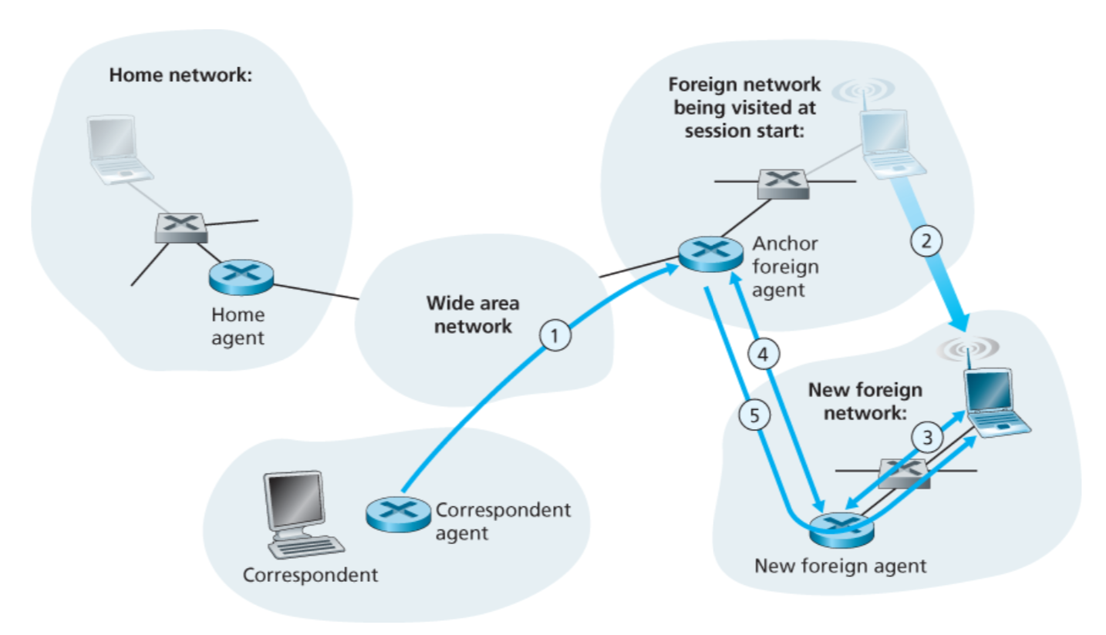
Mobility through multiple foreign networks

Slide 35
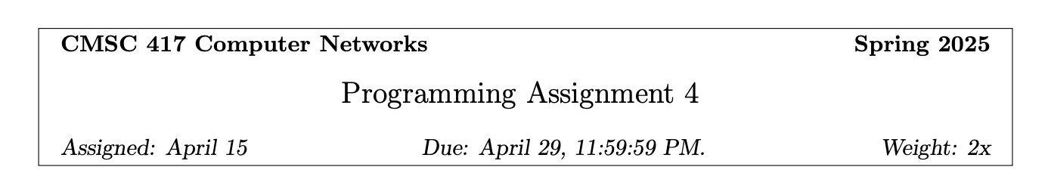
Work in a group of two.

Slide 36
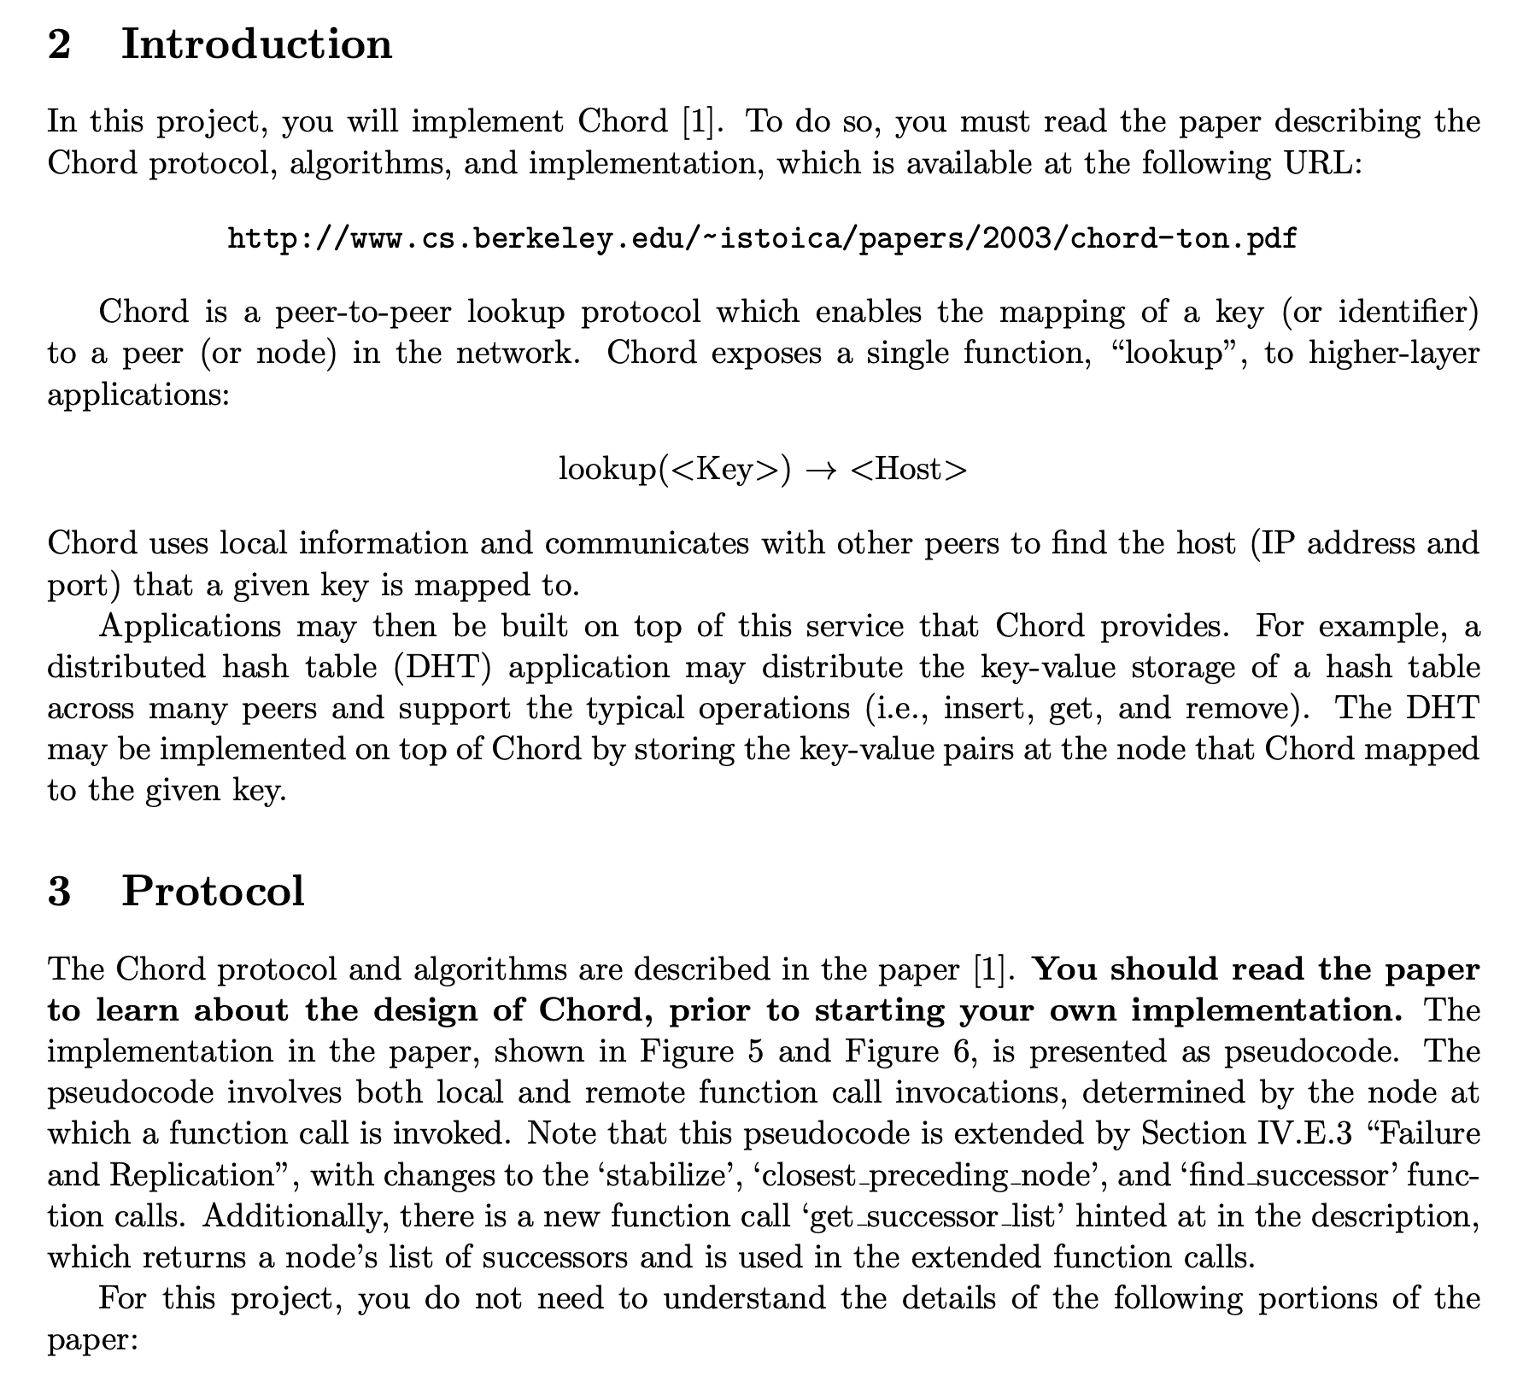

Slide 37
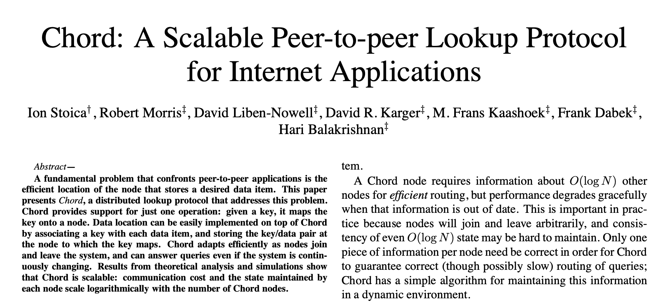

Slide 38
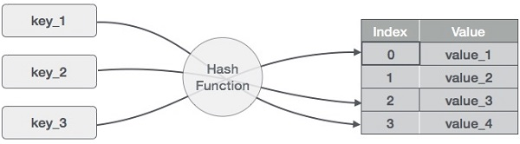
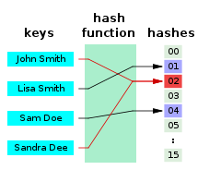
Hashing, Hash Table
A hash function is any function that can be used to map data of arbitrary size to fixed-size values, though there are some hash functions that support variable length output.
Picture: https://www.tutorialspoint.com/data_structures_algorithms/hash_data_structure.htm

Slide 39
Hashing, Hash Table
Can we imagine it as a circular data-structure?
Picture: https://www.tutorialspoint.com/data_structures_algorithms/hash_data_structure.htm

Slide 40
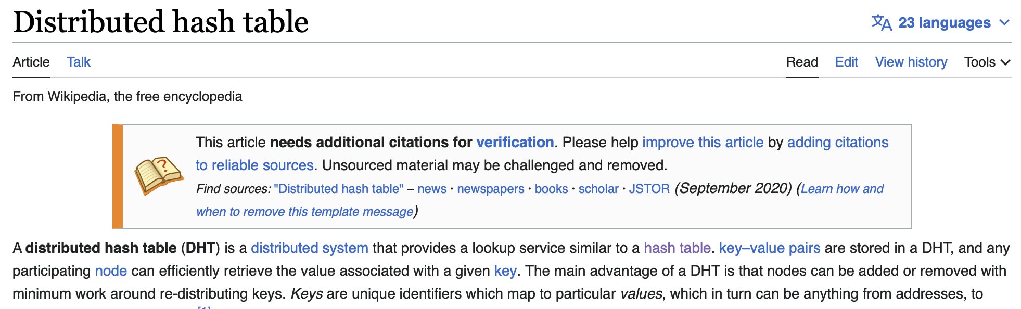
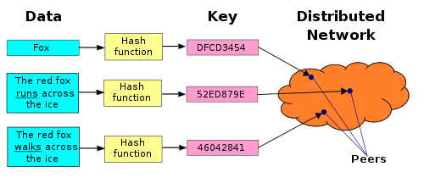
Distributed Hash Table

Slide 41
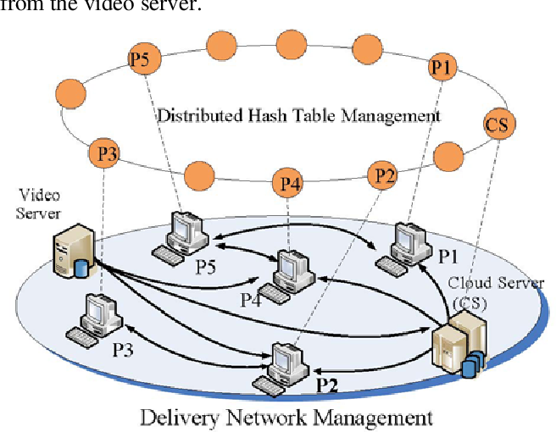
An overlay network
Pic: https://www.semanticscholar.org/paper/Cloud-Assisted-Live-Video-Streaming-over-DHT-Lim-Choi/3152fe80a5c964548c18673f1e8a9d2a7dff3368

Slide 42
Chord: A distributed lookup protocol
Node_IP + Key mapping
Successor

Slide 43
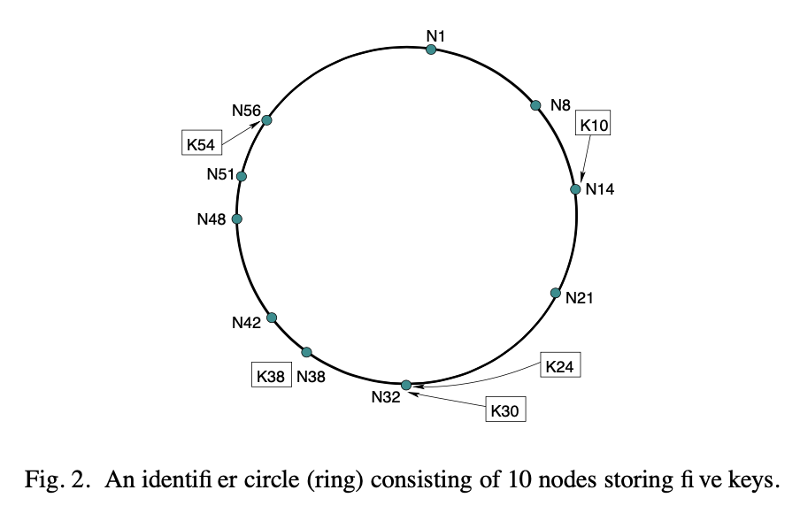

Slide 44
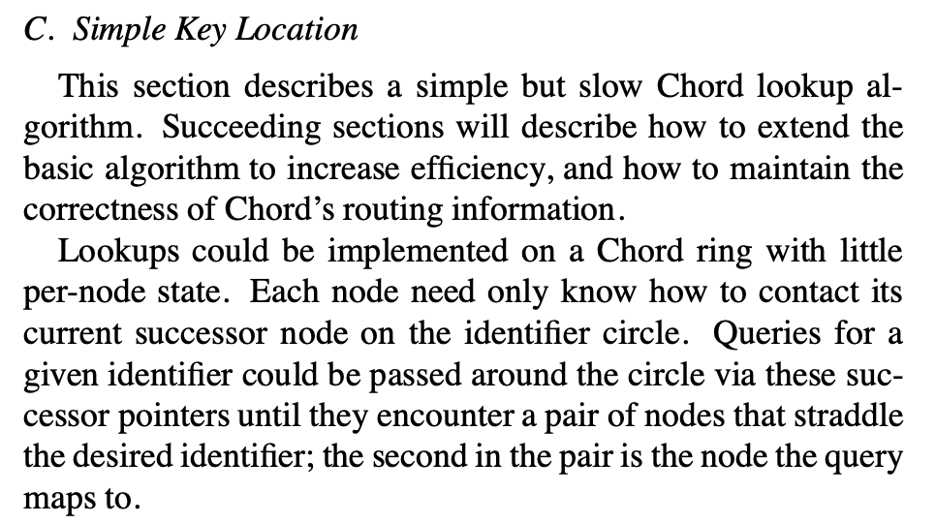
Not-Chord

Slide 45
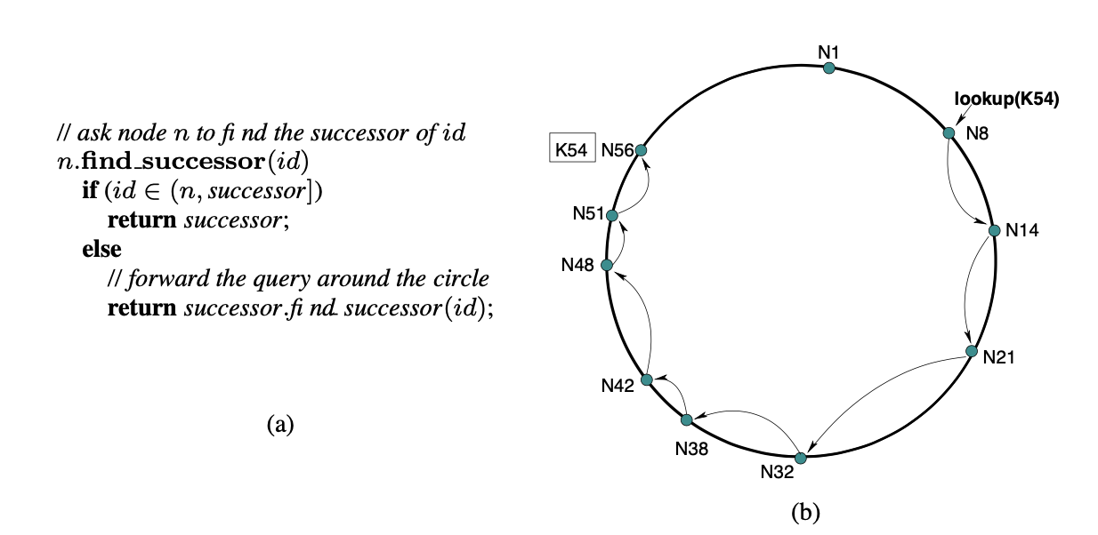
Not-Chord: Simple Key Lookup (Fig. 3)

Slide 46
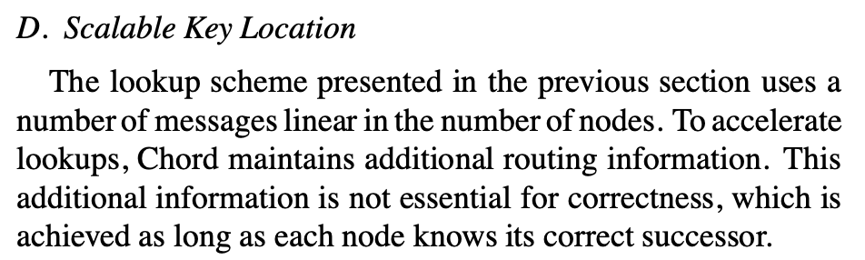
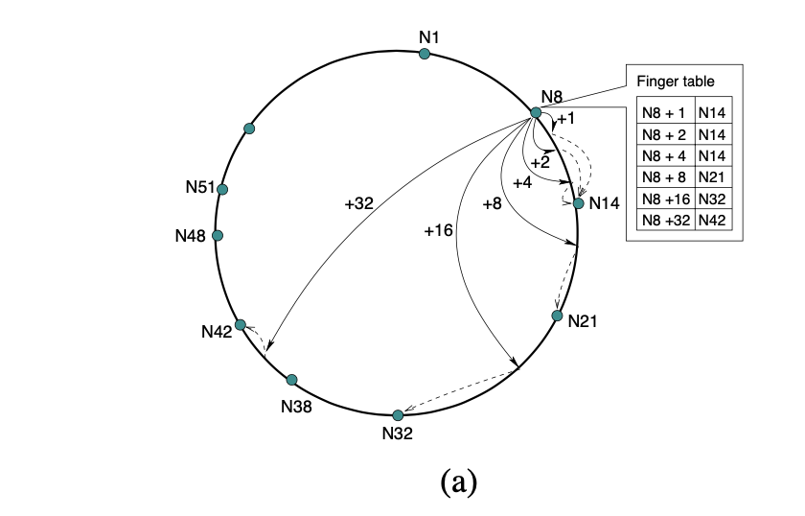
Chord: Scalable Key Lookup (Fig. 4)

Slide 47
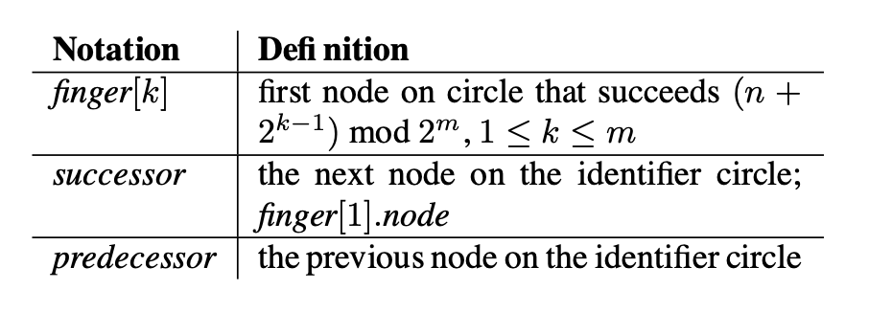
Chord: Scalable Key Lookup

Slide 48
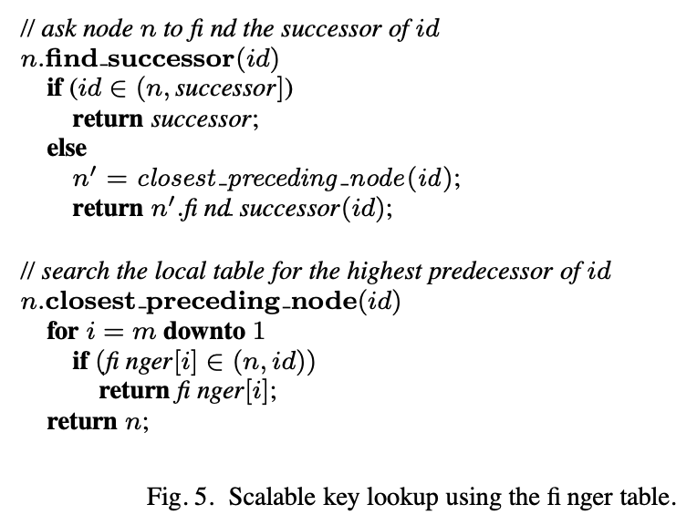
Chord: Scalable Key Lookup

Slide 49
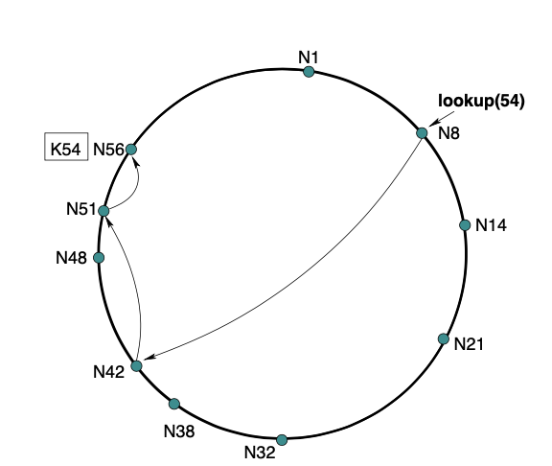
Chord: Scalable Key Lookup (Fig. 4)

Slide 50
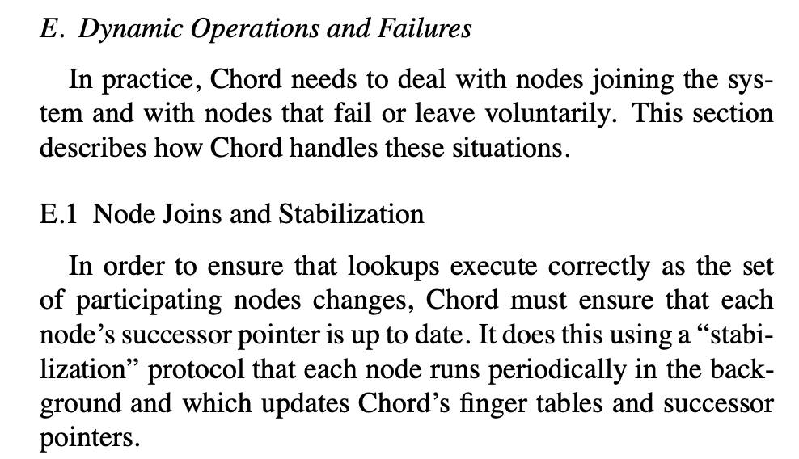
Addition, Deletion of nodes

Slide 51
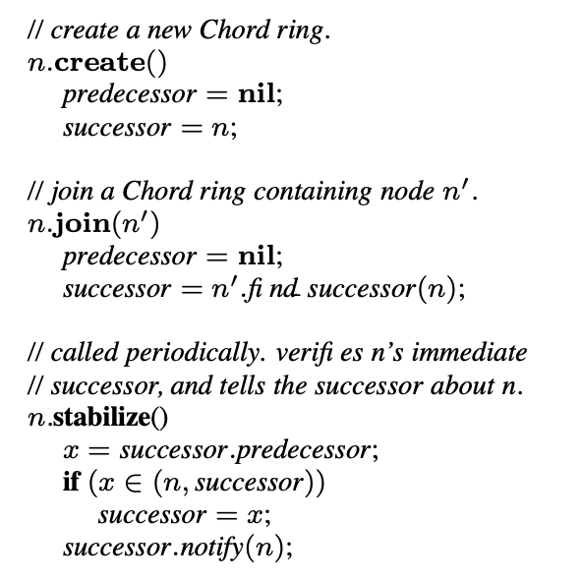
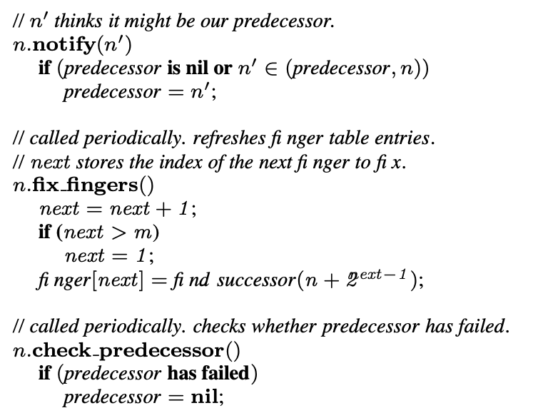
Stabilization (Fig. 6)

Slide 52
Failures, Successor-list

