Slide 1

Computer Networks
CMSC 417 : Spring 2025
Topic: BGP & Application Layer
(Textbook chapter 4 & 9)
Nirupam Roy
M-W 2:00-3:15pm
CSI 2117
May 5th, 2025

Slide 2
Route Selection Summary
Highest Local Preference
Enforce relationships
Shortest ASPATH
Lowest MED
i-BGP < e-BGP
traffic engineering
Lowest IGP cost
to BGP egress
Lowest router ID
Throw up hands and
break ties

Slide 3
Hot Potato Routing: Go for the Closest Egress Point
192.44.78.0/24
egress 1
egress 2
IGP distances
56
15
This Router has two BGP routes to 192.44.78.0/24.
Hot potato: get traffic off of your network as
Soon as possible. Go for egress 1!

Slide 4
Getting Burned by the Hot Potato
2865
Heavy
Content
Web Farm
High bandwidth
Provider backbone
17
SFO
NYC
Low bandwidth
customer backbone
56
15
San Diego
Many customers want
their provider to
carry the bits!
tiny http request
huge http reply

Slide 5
Cold Potato Routing with MEDs
(Multi-Exit Discriminator Attribute)
Prefer lower
MED values
2865
Heavy
Content
Web Farm
17
192.44.78.0/24
MED = 15
192.44.78.0/24
MED = 56
56
15
192.44.78.0/24
This means that MEDs must be considered BEFORE
IGP distance!
Note1 : some providers will not listen to MEDs
Note2 : MEDs need not be tied to IGP distance

Slide 6
BGP Attacks/Misconfiguration

Slide 7

Prefix Hijacking
Originating someone else’s prefix
  What fraction of the Internet believes it?
4
3
5
2
7
6
1
12.34.0.0/16
12.34.0.0/16

Slide 8
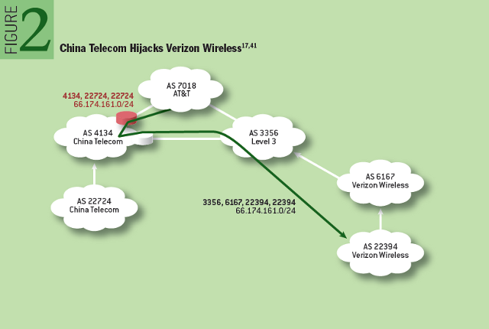
Prefix highjack
http://queue.acm.org/detail.cfm?id=2668966

Slide 9
Sub-Prefix Hijacking
4
3
5
2
7
6
1
12.34.0.0/16
12.34.158.0/24
Originating a more-specific prefix
  Every AS picks the bogus route for that prefix
  Traffic follows the longest matching prefix

Slide 10
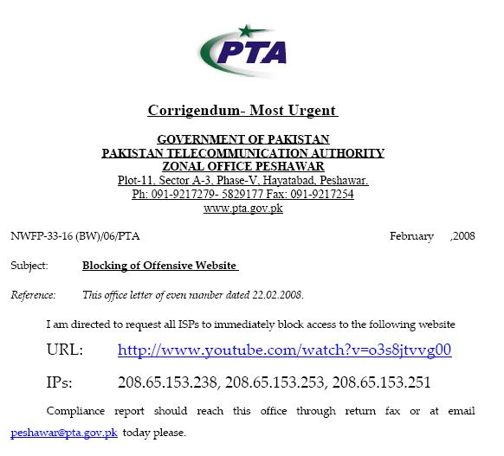
Sub-prefix hijack
  February 2008 : Pakistan Telecom hijacks YouTube
“The Internet”
Pakistan
Telecom
YouTube
I’m YouTube:
IP 208.65.153.0 / 22
Multinet
Pakistan
Telnor
Pakistan
Aga Khan
University
Notes:
-level of autonomous systems
-e.g., YouTube, AT&T, pakistan telecom
-routing is done on IP addresses, so when someone wants to go to YouTube they get YouTube’s IP address and YouTube announces to the world that they have the ip address and traffic is forwarded towards them. So here multinet would route to it’s provider pakistan telecom that then forwards the traffic on to youtube.
-these networks chosen for a specific reason which is that there was an incident in february 2008 pakistan telecom actually high jacked traffic going to youtube (misconfiguration).
-they announced to the world that they’re youtube and traffic destined to youtube was routed to them
-youtube was unavailable for a couple of hours as operators phone each other to figure out what was going on.

Slide 11
Sub-prefix hijack
  Here’s what should have happened….
“The Internet”
Hijack + drop packets going to YouTube
X
Pakistan
Telecom
YouTube
I’m YouTube:
IP 208.65.153.0 / 22
Multinet
Pakistan
Telnor
Pakistan
Aga Khan
University
  Block your own customers.

Slide 12
Sub-prefix hijack
  But here’s what Pakistan ended up doing…
“The Internet”
No, I’m YouTube!
IP 208.65.153.0 / 24
Pakistan
Telecom
YouTube
I’m YouTube:
IP 208.65.153.0 / 22
Multinet
Pakistan
Telnor
Pakistan
Aga Khan
University
Notes:
Our works focuses on attacks of this flavor..

Slide 13
Bogus AS Paths to Hide Hijacking
Adds AS hop(s) at the end of the path
  E.g., turns “701 88” into “701 88 3”
Motivations
  Evade detection for a bogus route
  E.g., by adding the legitimate AS to the end
Hard to tell that the AS path is bogus…
  Even if other ASes filter based on prefix ownership
701
3
18.0.0.0/8
88
18.0.0.0/8

Slide 14
Path-Shortening Attacks
Remove ASes from the AS path
  E.g., turn “701 3715 88” into “701 88”
Motivations
  Make the AS path look shorter than it is
  Attract sources that normally try to avoid AS 3715
  Help AS 88 look like it is closer to the Internet’s core
Who can tell that this AS path is a lie?
  Maybe AS 88 *does* connect to AS 701 directly
701
3715
88
?

Slide 15
Attacks that Add a Bogus AS Hop
701
Add ASes to the path
  E.g., turn “701 88” into “701 3715 88”
Motivations
  Trigger loop detection in AS 3715
    Denial-of-service attack on AS 3715
    Or, blocking unwanted traffic coming from AS 3715!
  Make your AS look like is has richer connectivity
Who can tell the AS path is a lie?
  AS 3715 could, if it could see the route
  AS 88 could, but would it really care as long as it received data traffic meant for it?
88

Slide 16
Violating “Consistent Export” to Peers
Peers require consistent export
  Prefix advertised at all peering points
  Prefix advertised with same AS path length
Reasons for violating the policy
  Trick neighbor into “cold potato”
  Configuration mistake
Main defense
  Analyzing BGP updates
  … or data traffic
  … for signs of inconsistency
dest
Bad AS
BGP
data
src

Slide 17
Other Attacks
Attacks on BGP sessions
  Confidentiality of BGP messages
  Denial-of-service on BGP session
  Inserting, deleting, modifying, or replaying messages
Resource exhaustion attacks
  Too many IP prefixes (e.g., BGP “512K Day”)
  Too many BGP update messages
Data-plane attacks
  Announce one BGP routes, but use another

Slide 18
Solution Techniques
Protective filtering
  Know your neighbors
Anomaly detection
  Suspect the unexpected
Checking against registries
  Establish ground truth for prefix origination
Signing and verifying
  Prevent bogus AS PATHs
Data-plane verification
  Ensure the path is actually followed

Slide 19
Computer Networks
CMSC 417 : Spring 2025
Topic: Application Layer Protocols
(Textbook chapter 9)
Nirupam Roy
M-W 2:00-3:15pm
CSI 2117

Slide 20


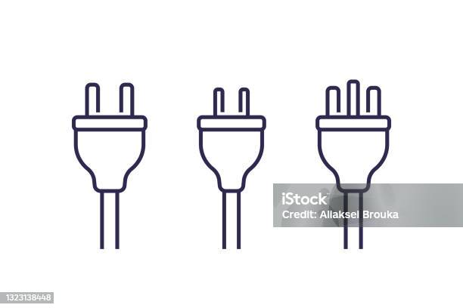
Applications
Internet as a Platform
Process to process: Transport layer
Network to network: Network layer
Device to device: Link/Physical layer

Slide 21
Applications
How do we address a host?
Internet as a Platform
Process to process: Transport layer
How did we address a host?
Network to network: Network layer
Device to device: Link/Physical layer

Slide 22
Applications
How do we address a host?
URLs, Email IDs
Internet as a Platform
Process to process: Transport layer
How did we address a host?
Network to network: Network layer
IP addresses
Device to device: Link/Physical layer

Slide 23

Applications (World wide web)
https://www.cs.umd.edu
Webserver
HTTP protocol responses
Internet as a Platform
Process to process: Transport layer
How did we address a host?
Network to network: Network layer
IP addresses
Device to device: Link/Physical layer

Slide 24
We need a database on the Internet
for
Human readable domain name → IP address mapping
Questions:
(1) Centralized or distributed?
(2) Hierarchical or flat?
(3) At the application layer or at a lower layer?

Slide 25
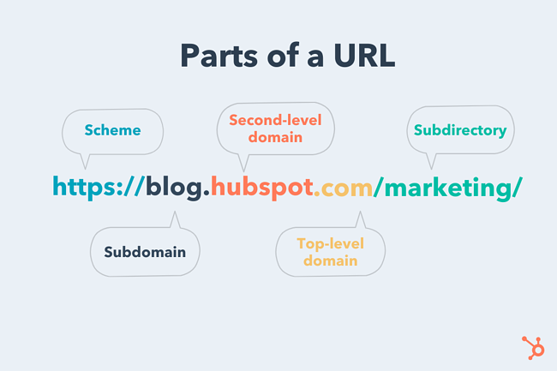
PC: https://blog.hubspot.com/marketing/parts-url

Slide 26
Anatomy of a domain name
https://www.cs.umd.edu
https://www.ece.umd.edu
ftp://ftp.example.com/Batch_File
nirupam@cs.umd.edu

Slide 27
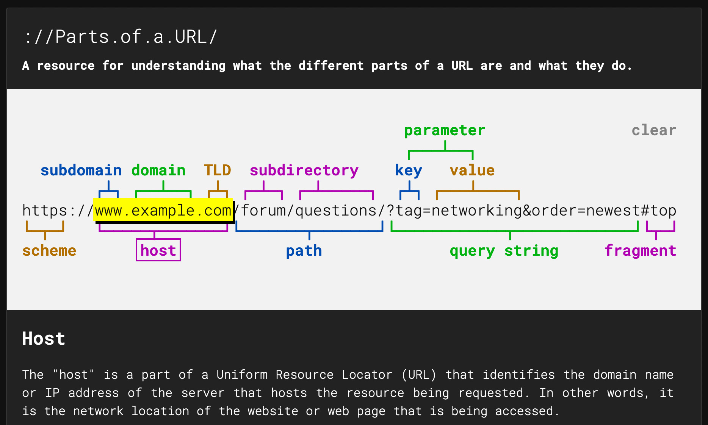
Anatomy of a domain name
https://www.cs.umd.edu
https://www.ece.umd.edu
ftp://ftp.example.com/Batch_File
nirupam@cs.umd.edu
[Picture] https://strategylab.ca/parts-of-a-url/

Slide 28
DNS: domain name system
people: many identifiers:
  SSN, name, passport #
Internet hosts, routers:
  IP address (32 bit) - used for addressing datagrams
  “name”, e.g., www.yahoo.com - used by humans
Q: how to map between IP address and name, and vice versa ?
Domain Name System:
distributed database implemented in hierarchy of many name servers
application-layer protocol: hosts, name servers communicate to resolve names (address/name translation)
  note: core Internet function, implemented as application-layer protocol
  complexity at network’s “edge”

Slide 29
DNS: a distributed, hierarchical database
Root DNS Servers
…
…
com DNS servers
org DNS servers
edu DNS servers
yahoo.com
DNS servers
pbs.org
DNS servers
poly.edu
DNS servers
umass.edu
DNS servers
amazon.com
DNS servers
client wants IP for www.amazon.com; 1st approximation:
client queries root server to find com DNS server
client queries .com DNS server to get amazon.com DNS server
client queries amazon.com DNS server to get IP address for www.amazon.com

Slide 30
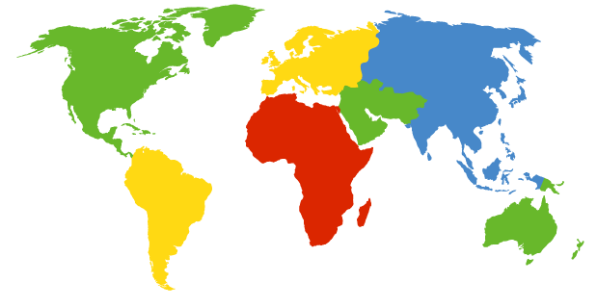
DNS: Root Name Servers
Contacted by local name server that cannot resolve name
Root name server:
  Contacts authoritative name server if name mapping not known
  Gets mapping
  Returns mapping to local name server
c. Cogent, Herndon, VA (5 other sites)
d. U Maryland College Park, MD
h. ARL Aberdeen, MD
j. Verisign, Dulles VA (69 other sites )
k. RIPE London (17 other sites)
i. Netnod, Stockholm (37 other sites)
e. NASA Mt View, CA
f. Internet Software C.
Palo Alto, CA (and 48 other sites)
m. WIDE Tokyo
(5 other sites)
13 logical root name “servers” worldwide
each “server” replicated many times
(BGP Anycast / GSLB)
a. Verisign, Los Angeles CA
(5 other sites)
b. USC-ISI Marina del Rey, CA
l. ICANN Los Angeles, CA
(41 other sites)
g. US DoD Columbus, OH (5 other sites)

Slide 31
TLD, Authoritative DNS Servers
Top-level domain (TLD) servers:
  responsible for com, org, net, edu, aero, jobs, museums, and all top-level country domains, e.g.: uk, fr, ca, jp
  Network Solutions maintains servers for .com TLD
  Educause for .edu TLD
Authoritative DNS servers:
Organization’s own DNS server(s), providing authoritative hostname to IP mappings for organization’s named hosts
  can be maintained by organization or service provider

Slide 32
Local DNS name server
does not strictly belong to hierarchy
each ISP (residential ISP, company, university) has one
  also called “default name server”
when host makes DNS query, query is sent to its local DNS server
  has local cache of recent name-to-address translation pairs (but may be out of date!)
  acts as proxy, forwards query into hierarchy

Slide 33

DNS name resolution example
root DNS server
2
host at cs.stanford.edu wants IP address for cs.umd.edu
3
TLD DNS server
4
5
iterated query:
contacted server replies with name of server to contact
“I don’t know this name, but ask this server”
local DNS server
dns.stanford.edu
7
6
1
8
authoritative DNS server
dns.cs.umd.edu
requesting host
cs.stanford.edu
cs.umd.edu

Slide 34
DNS name
resolution example
root DNS server
2
3
recursive query:
puts burden of name resolution on contacted name server
heavy load at upper levels of hierarchy?
7
6
TLD DNS
server
local DNS server
dns.stanford.edu
5
4
1
8
authoritative DNS server
dns.cs.umd.edu
requesting host
cs.stanford.edu
cs.umd.edu

Slide 35
DNS: caching, updating records
once (any) name server learns mapping, it caches mapping
  cache entries timeout (disappear) after some time (TTL)
  TLD servers typically cached in local name servers
    thus root name servers not often visited
cached entries may be out-of-date (best effort name-to-address translation!)
  if name host changes IP address, may not be known Internet-wide until all TTLs expire
update/notify mechanisms proposed IETF standard
  RFC 2136

Slide 36
DNS: services, structure
DNS services
hostname to IP address translation
host aliasing
  canonical, alias names
mail server aliasing
load distribution
  replicated Web servers: many IP addresses correspond to one name
why not centralize DNS?
single point of failure
traffic volume
distant centralized database
maintenance
A: doesn‘t scale!

Slide 37
DNS records
DNS: distributed database storing resource records (RR)
RR format: (name, value, type, ttl)
type=A
  name is hostname
  value is IP address
type=CNAME
  name is alias name for some “canonical” (the real) name
  www.ibm.com is really
  servereast.backup2.ibm.com
  value is canonical name
type=NS
  name is domain (e.g., foo.com)
  value is hostname of authoritative name server for this domain
type=MX
  value is name of mail server associated with name

Slide 38
DNS protocol, messages
query and reply messages, both with same message format
2 bytes
2 bytes
message header
identification: 16 bit # for query, reply to query uses same #
flags:
  query or reply
  recursion desired
  recursion available
  reply is authoritative
identification
flags
# questions
# answer RRs
# authority RRs
# additional RRs
questions (variable # of questions)
answers (variable # of RRs)
authority (variable # of RRs)
additional info (variable # of RRs)

Slide 39
DNS protocol, messages
2 bytes
2 bytes
identification
flags
# questions
# answer RRs
# authority RRs
# additional RRs
name, type fields
for a query
questions (variable # of questions)
RRs in response
to query
answers (variable # of RRs)
records for
authoritative servers
authority (variable # of RRs)
additional “helpful”
info that may be used
additional info (variable # of RRs)
Notes:
Does DNS use TCP or UDP? Why?

Slide 40
Inserting records into DNS
example: new startup “Network Utopia”
register name networkuptopia.com at DNS registrar (e.g., Network Solutions)
  provide names, IP addresses of authoritative name server (primary and secondary)
  registrar inserts two RRs into .com TLD server:
  (networkutopia.com, dns1.networkutopia.com, NS)
  (dns1.networkutopia.com, 212.212.212.1, A)
create authoritative server type A record for www.networkuptopia.com; type NS record for networkutopia.com

Slide 41
HTTP
(Hyper-Text Transfer Protocol)

Slide 42
Web and HTTP
First, a review…
web page consists of objects
object can be HTML file, JPEG image, Java applet, audio file,…
web page consists of base HTML-file which includes several referenced objects
each object is addressable by a URL, e.g.,
www.someschool.edu/someDept/pic.gif
host name
path name

Slide 43

HTTP overview
HTTP: hypertext transfer protocol
Web’s application layer protocol
client/server model
  client: browser that requests, receives, (using HTTP protocol) and “displays” Web objects
  server: Web server sends (using HTTP protocol) objects in response to requests
HTTP request
PC running
Firefox browser
HTTP response
HTTP request
server
running
Apache Web
server
HTTP response
iPhone running
Safari browser

Slide 44
HTTP overview
Uses TCP:
client initiates TCP connection (creates socket) to server, port 80
server accepts TCP connection from client
HTTP messages (application-layer protocol messages) exchanged between browser (HTTP client) and Web server (HTTP server)
TCP connection closed
HTTP is “stateless”
server maintains no information about past client requests
aside
protocols that maintain “state” are complex!
past history (state) must be maintained
if server/client crashes, their views of “state” may be inconsistent, must be reconciled

Slide 45
HTTP connections
non-persistent HTTP
at most one object sent over TCP connection
  connection then closed
downloading multiple objects required multiple connections
persistent HTTP
multiple objects can be sent over single TCP connection between client, server

Slide 46
Non-persistent HTTP
(contains text, references to 10 jpeg images)
suppose user enters URL:
www.someSchool.edu/someDepartment/home.index
1a. HTTP client initiates TCP connection to HTTP server (process) at www.someSchool.edu on port 80
1b. HTTP server at host www.someSchool.edu waiting for TCP connection at port 80. “accepts” connection, notifying client
2. HTTP client sends HTTP request message (containing URL) into TCP connection socket. Message indicates that client wants object someDepartment/home.index
time
3. HTTP server receives request message, forms response message containing requested object, and sends message into its socket
5. HTTP client receives response message containing html file, displays html. Parsing html file, finds 10 referenced jpeg objects
4. HTTP server closes TCP connection.
6. Steps 1-5 repeated for each of 10 jpeg objects

Slide 47
Non-persistent HTTP: response time
RTT (Round Trip Time): time for a small packet to travel from client to server and back
HTTP response time:
one RTT to initiate TCP connection
one RTT for HTTP request and first few bytes of HTTP response to return
file transmission time
non-persistent HTTP response time
  = 2RTT+ file transmission time
initiate TCP
connection
RTT
request
file
RTT
time to
transmit
file
file
received
time
time

Slide 48
Persistent HTTP
Persistent HTTP:
server leaves connection open after sending response
subsequent HTTP messages between same client/server sent over open connection
client sends requests as soon as it encounters a referenced object
as little as one RTT for all the referenced objects
initiate TCP
connection
RTT
request
file
RTT
request
new file
time
time
Notes:
Breakdown of layering

Slide 49
Other optimizations
Pipelining
  Send several requests at once
initiate TCP
connection
RTT
request
file
RTT
request
new files
time
time

Slide 50
Other optimizations
Pipelining
  Send several requests at once
HTTP/2
  Push resources
initiate TCP
connection
RTT
request
file
RTT
send
file
push
objects
time
time

Slide 51
Other optimizations
Pipelining
  Send several requests at once
HTTP/2
  Push resources
QUIC
  Eliminate first RTT
initiate QUIC
connection
request
file
RTT
send
file
push
objects
time
time

Slide 52
HTTP request message
two types of HTTP messages: request, response
HTTP request message:
  ASCII (human-readable format)
carriage return character
request line
(GET, POST,
HEAD commands)
line-feed character
GET /index.html HTTP/1.1\r\n
Host: www-net.cs.umass.edu\r\n
User-Agent: Firefox/3.6.10\r\n
Accept: text/html,application/xhtml+xml\r\n
Accept-Language: en-us,en;q=0.5\r\n
Accept-Encoding: gzip,deflate\r\n
Accept-Charset: ISO-8859-1,utf-8;q=0.7\r\n
Keep-Alive: 115\r\n
Connection: keep-alive\r\n
\r\n
header
lines
carriage return,
line feed at start
of line indicates
end of header lines

Slide 53
HTTP request message: general format
method
sp
URL
sp
version
cr
lf
request
line
header field name
:
value
cr
lf
~
~
header
lines
~
~
header field name
:
value
cr
lf
cr
lf
~
entity body
~
body
~
~

Slide 54
Uploading form input
POST method:
web page often includes form input
input is uploaded to server in entity body
URL method:
uses GET method
input is uploaded in URL field of request line:
www.somesite.com/animalsearch?monkeys&banana

Slide 55
Method types
HTTP/1.0:
GET
POST
HEAD
  asks server to leave requested object out of response
HTTP/1.1:
GET, POST, HEAD
PUT
  uploads file in entity body to path specified in URL field
DELETE
  deletes file specified in the URL field

Slide 56
HTTP response message
status line
(protocol
status code
status phrase)
HTTP/1.1 200 OK\r\n
Date: Sun, 26 Sep 2010 20:09:20 GMT\r\n
Server: Apache/2.0.52 (CentOS)\r\n
Last-Modified: Tue, 30 Oct 2007 17:00:02 GMT\r\n
ETag: "17dc6-a5c-bf716880"\r\n
Accept-Ranges: bytes\r\n
Content-Length: 2652\r\n
Keep-Alive: timeout=10, max=100\r\n
Connection: Keep-Alive\r\n
Content-Type: text/html; charset=ISO-8859-1\r\n
\r\n
data data data data data ...
header
lines
data, e.g.,
requested
HTML file

Slide 57
HTTP response status codes
status code appears in 1st line in server-to-client response message.
some sample codes:
200 OK
  request succeeded, requested object later in this msg
301 Moved Permanently
  requested object moved, new location specified later in this msg (Location:)
400 Bad Request
  request msg not understood by server
404 Not Found
  requested document not found on this server
505 HTTP Version Not Supported
Notes:
cats

Slide 58
Trying out HTTP (client side) for yourself
1. Telnet to your favorite Web server:
telnet gaia.cs.umass.edu 80
opens TCP connection to port 80
(default HTTP server port)
at gaia.cs.umass. edu.
anything typed in will be sent
to port 80 at gaia.cs.umass.edu
2. type in a GET HTTP request:
GET /kurose_ross/interactive/index.php HTTP/1.1
Host: gaia.cs.umass.edu
by typing this in (hit carriage
return twice), you send
this minimal (but complete)
GET request to HTTP server
3. look at response message sent by HTTP server!
(or use Wireshark to look at captured HTTP request/response)

Slide 59
Trying out HTTP (client side) for yourself
1. Telnet to your favorite Web server:
telnet gaia.cs.umass.edu 80
opens TCP connection to port 80
(default HTTP server port)
at gaia.cs.umass. edu.
anything typed in will be sent
to port 80 at gaia.cs.umass.edu
2. type in a GET HTTP request:
GET /kurose_ross/interactive/index.php HTTP/1.1
Host: gaia.cs.umass.edu
by typing this in (hit carriage
return twice), you send
this minimal (but complete)
GET request to HTTP server
3. look at response message sent by HTTP server!
(or use Wireshark to look at captured HTTP request/response)

Slide 60
User-server state: cookies
Many Web sites use cookies
four components:
  1) Cookie header line of HTTP response message
  2) Cookie header line in next HTTP request message
  3) Cookie file kept on user’s host, managed by user’s browser
  4) Back-end database at Website
example:
Susan always access Internet from PC
visits specific e-commerce site for first time
when initial HTTP requests arrives at site, site creates:
  unique ID
  entry in backend database for ID

Slide 61
Cookies: keeping “state” (cont.)
client
server
ebay 8734
usual http request msg
Amazon server
creates ID
1678 for user
cookie file
usual http response
set-cookie: 1678
backend
database
create
entry
ebay 8734
amazon 1678
usual http request msg
cookie: 1678
cookie-
specific
action
access
usual http response msg
one week later:
access
ebay 8734
amazon 1678
usual http request msg
cookie: 1678
cookie-
specific
action
usual http response msg

Slide 62
Cookies (continued)
aside
what cookies can be used for:
authorization
shopping carts
recommendations
user session state (Web e-mail)
cookies and privacy:
cookies permit sites to learn a lot about you
you may supply name and e-mail to sites
how to keep “state”:
protocol endpoints: maintain state at sender/receiver over multiple transactions
cookies: http messages carry state
Notes:
tracking

Slide 63

Web caches (proxy server)
goal: satisfy client request without involving origin server
user sets browser: Web accesses via cache
browser sends all HTTP requests to cache
  object in cache: cache returns object
  else cache requests object from origin server, then returns object to client
proxy
server
HTTP request
HTTP request
client
origin
server
HTTP response
HTTP response
HTTP request
HTTP response
client
origin
server

Slide 64
More about Web caching
cache acts as both client and server
  server for original requesting client
  client to origin server
typically cache is installed by ISP (university, company, residential ISP)
why Web caching?
reduce response time for client request
reduce traffic on an institution’s access link
Internet dense with caches: enables “poor” content providers to effectively deliver content
Notes:
proxy

Slide 65
Outline
  Principles of network applications
  Web and HTTP
  Electronic Mail (SMTP, POP3, IMAP)
  DNS

Slide 66
Electronic mail
outgoing
message queue
user mailbox
Three major components:
user agents
mail servers
SMTP: Simple Mail Transfer Protocol
User Agent
a.k.a. “mail reader”
composing, editing, reading mail messages
e.g., Outlook, Thunderbird, iPhone mail client
outgoing, incoming messages stored on server
user
agent
mail
server
user
agent
SMTP
mail
server
user
agent
SMTP
SMTP
user
agent
mail
server
user
agent
user
agent

Slide 67
Electronic Mail: Mail Servers
outgoing
message queue
user mailbox
Mail Servers:
mailbox contains incoming messages for user
message queue of outgoing (to be sent) mail messages
SMTP protocol between mail servers to send email messages
  client: sending mail server
  “server”: receiving mail server
user
agent
mail
server
user
agent
SMTP
mail
server
user
agent
SMTP
SMTP
user
agent
mail
server
user
agent
user
agent

Slide 68
Electronic Mail: SMTP [RFC 2821]
uses TCP to reliably transfer email message from client to server, port 25
direct transfer: sending server to receiving server
three phases of transfer
  handshaking (greeting)
  transfer of messages
  closure
command/response interaction (like HTTP)
  commands: ASCII text
  response: status code and phrase
messages must be in 7-bit ASCII

Slide 69
Scenario: Alice sends message to Bob
1) Alice uses UA to compose message “to” bob@someschool.edu
2) Alice’s UA sends message to her mail server; message placed in message queue
3) client side of SMTP opens TCP connection with Bob’s mail server
4) SMTP client sends Alice’s message over the TCP connection
5) Bob’s mail server places the message in Bob’s mailbox
6) Bob invokes his user agent to read message
user
agent
mail
server
user
agent
1
mail
server
2
3
6
4
Alice’s mail server
5
Bob’s mail server

Slide 70
Sample SMTP interaction
S: 220 hamburger.edu
C: HELO crepes.fr
S: 250 Hello crepes.fr, pleased to meet you
C: MAIL FROM: <alice@crepes.fr>
S: 250 alice@crepes.fr... Sender ok
C: RCPT TO: <bob@hamburger.edu>
S: 250 bob@hamburger.edu ... Recipient ok
C: DATA
S: 354 Enter mail, end with "." on a line by itself
C: Do you like ketchup?
C: How about pickles?
C: .
S: 250 Message accepted for delivery
C: QUIT
S: 221 hamburger.edu closing connection
Notes:
Note: no authentication

Slide 71
SMTP: final words
SMTP uses persistent connections
SMTP requires message (header & body) to be in 7-bit ASCII
SMTP server uses CRLF.CRLF to determine end of message
comparison with HTTP:
HTTP: pull
SMTP: push
both have ASCII command/response interaction, status codes
HTTP: each object encapsulated in its own response message
SMTP: multiple objects sent in multipart message
Notes:
Question: what happens in an email with a single dot on a line?

Slide 72
Mail message format
SMTP: protocol for exchanging email messages
RFC 822: standard for text message format:
header lines, e.g.,
  To:
  From:
  Subject:
  different from SMTP MAIL FROM, RCPT TO: commands!
Body: the “message”
  ASCII characters only
header
blank
line
body

Slide 73
Mail access protocols
user
agent
mail access
protocol
user
agent
SMTP
SMTP
(e.g., POP,
IMAP)
Sender’s mail
server
Receiver’s mail
server
SMTP: delivery/storage to receiver’s server
mail access protocol: retrieval from server
  POP: Post Office Protocol [RFC 1939]: authorization, download
  IMAP: Internet Mail Access Protocol [RFC 1730]: more features, including manipulation of stored messages on server
  HTTP: gmail, Hotmail, Yahoo! Mail, etc.

Slide 74
Outline
  Principles of network applications
  Web and HTTP
  Electronic Mail (SMTP, POP3, IMAP)
  DNS

Slide 77
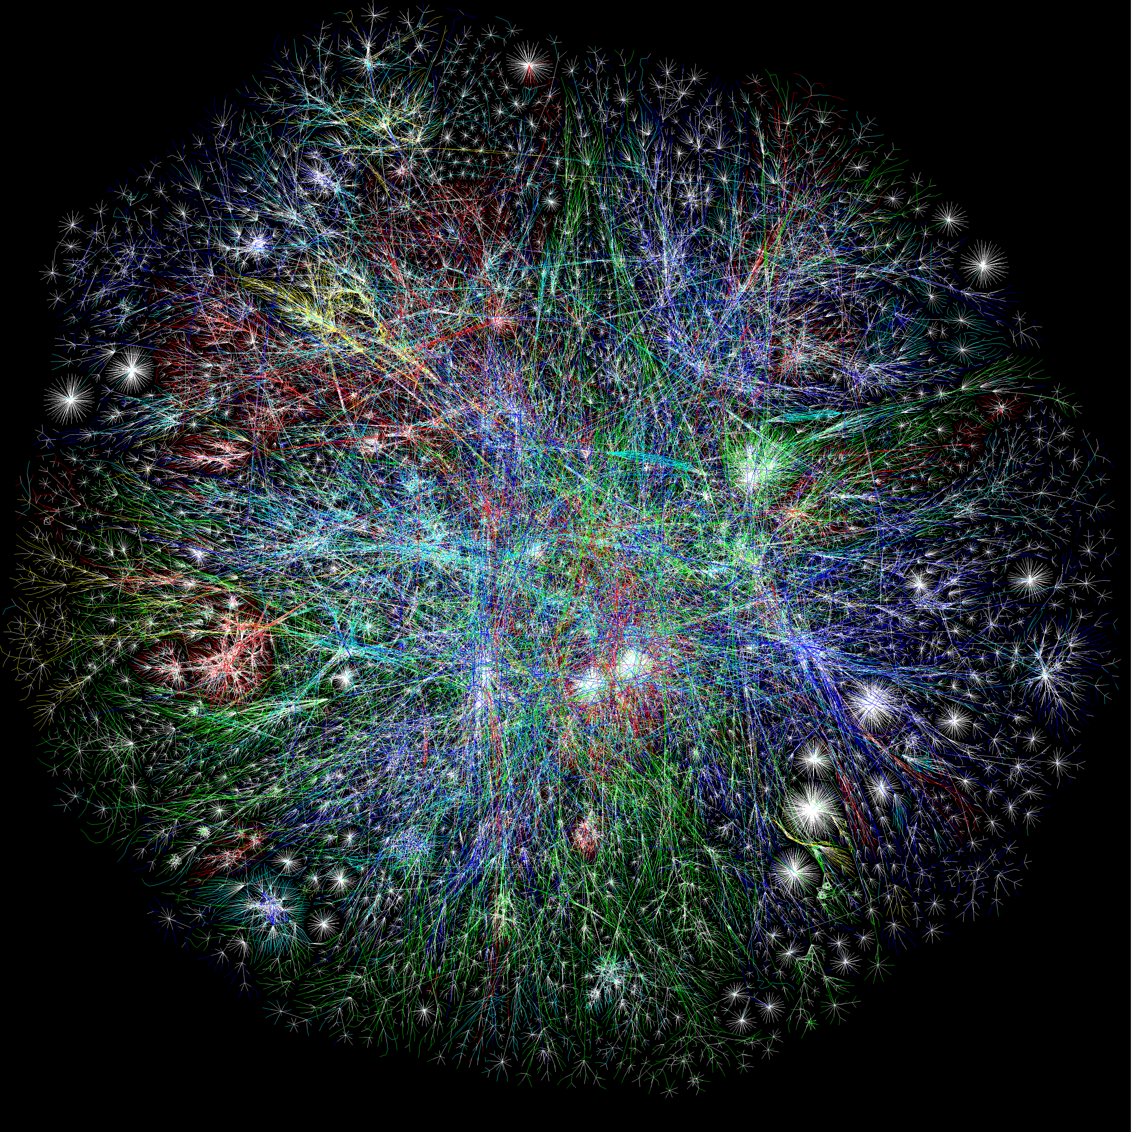
MOOCs
Online Content
Search Engines
Notes:
So building networks is hard
But unfortunately, computer networks are becoming increasingly critical to our daily lives
You know all the standard uses of computers…
Social networking
Gaming
But there’s a lot you may not thinki about
Financial sector – trillions of dollars –
Critical infrastructures – power grid, water delibvery systems – now all managed and operated with IP networks
911 communication services
…
Remote medicine
Brakes of your car
Power grid and critical infrastructure
Financial and trading networks – move billions of dollars per day over computer netowrks
Computer networks are no longer just for fun and games
People’s lives every day depend on the availability and functioning of computer netowrks
Makign it very important that we build them well, and protect them from adversaries,

Slide 78
MOOCs
Online Content
Search Engines
Notes:
So building networks is hard
But unfortunately, computer networks are becoming increasingly critical to our daily lives
You know all the standard uses of computers…
Social networking
Gaming
But there’s a lot you may not thinki about
Financial sector – trillions of dollars –
Critical infrastructures – power grid, water delibvery systems – now all managed and operated with IP networks
911 communication services
…
Remote medicine
Brakes of your car
Power grid and critical infrastructure
Financial and trading networks – move billions of dollars per day over computer netowrks
Computer networks are no longer just for fun and games
People’s lives every day depend on the availability and functioning of computer netowrks
Makign it very important that we build them well, and protect them from adversaries,

Slide 79

What’s the Internet?
Notes:
Associate press: an Internet vs the Internet

