Slide 1

Computer Networks
CMSC 417 : Spring 2025
Topic: Application Layer Protocols
(Textbook chapter 9)
Nirupam Roy
M-W 2:00-3:15pm
CSI 2117
May 12th, 2025

Slide 2
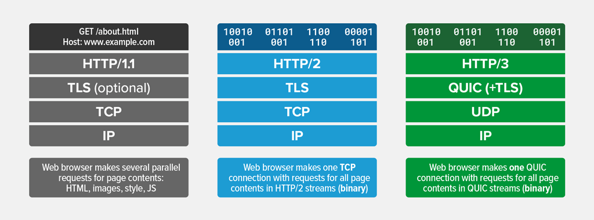
QUIC: Quick UDP Internet Connections A new transport layer protocol for web

Slide 3
HTTP/0.9
The one-line protocol
HTTP/1.0
Added extensibility
Initial version. Simple.
One-line request
Only the GET method works
Server sends HTML files
Status code included, helped
application caching and failure
management.
Metadata sent over HTTP header,
Helped extensibility.
Documents other than HTML files
can be sent.
HTTP/2.0
Performance
HTTP/1.1
Standardization
Connection reuse.
Pipeline
Content negotiation—Language,
encoding etc.
Binary protocol, not text
Multiplexed: Multiple requests
(streams) over the same
connection.
Header compression
Notes:
[Ref] https://developer.mozilla.org/en-US/docs/Web/HTTP/Guides/Evolution_of_HTTP

Slide 4
Transport layer (TCP) limitation for HTTP/2.0 streaming
Head-of-Line Blocking (HOLB): HTTP/2.0 resolves application layer
HOLB through multiplexing, but transport layer HOLB persists.
If a packet for a particular stream is lost or delayed (head-of-line), it can
block all other streams using that same TCP connection
TCP resolves order before sending to application layer.
HTTP/2.0
Performance
Binary protocol, not text
Multiplexed: Multiple requests
(streams) over the same
connection.
Header compression
Notes:
[Ref] https://developer.mozilla.org/en-US/docs/Web/HTTP/Guides/Evolution_of_HTTP

Slide 5
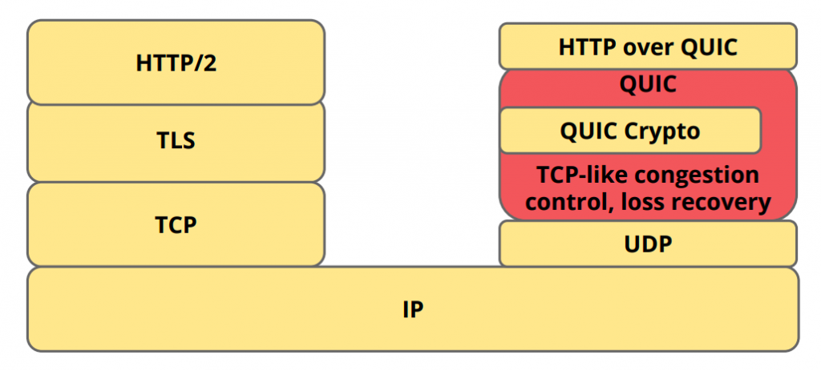
QUIC: A cross-layer approach
(+TLS 1.3)
QUIC can exist by itself, HTTP/3 can’t exist without QUIC.
Notes:
Image ref: https://medium.com/codavel-blog/quic-vs-tcp-tls-and-why-quic-is-not-the-next-big-thing-d4ef59143efd
[Ref] https://javascript-conference.com/blog/quic-and-http-3-the-next-step-in-web-performance/
QUIC is a general-purpose transport layer network protocol initially designed by Jim Roskind at Google. It was first implemented and deployed in 2012 and was publicly announced in 2013 as experimentation broadened.
[Ref] https://blog.apnic.net/2022/11/03/comparing-tcp-and-quic/
It is a grossly inaccurate simplification, but at its simplest level, QUIC is simply TCP encapsulated and encrypted in a User Datagram Protocol (UDP) payload. To the external network, QUIC has the appearance of a bidirectional UDP packet sequence where the UDP payload is concealed. To the endpoints, QUIC can be used as a reliable full duplex data flow protocol. Even at this level, QUIC has a number of advantages over TCP.

Slide 6
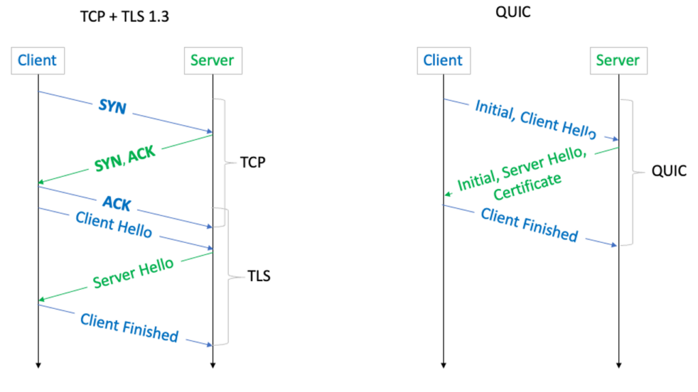
QUIC: A cross-layer approach
Notes:
Image ref: https://blog.apnic.net/2022/11/03/comparing-tcp-and-quic/

Slide 7
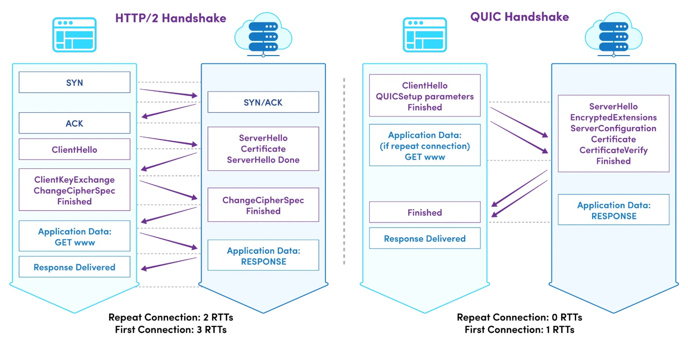
QUIC: Expedited secure handshake

Slide 8
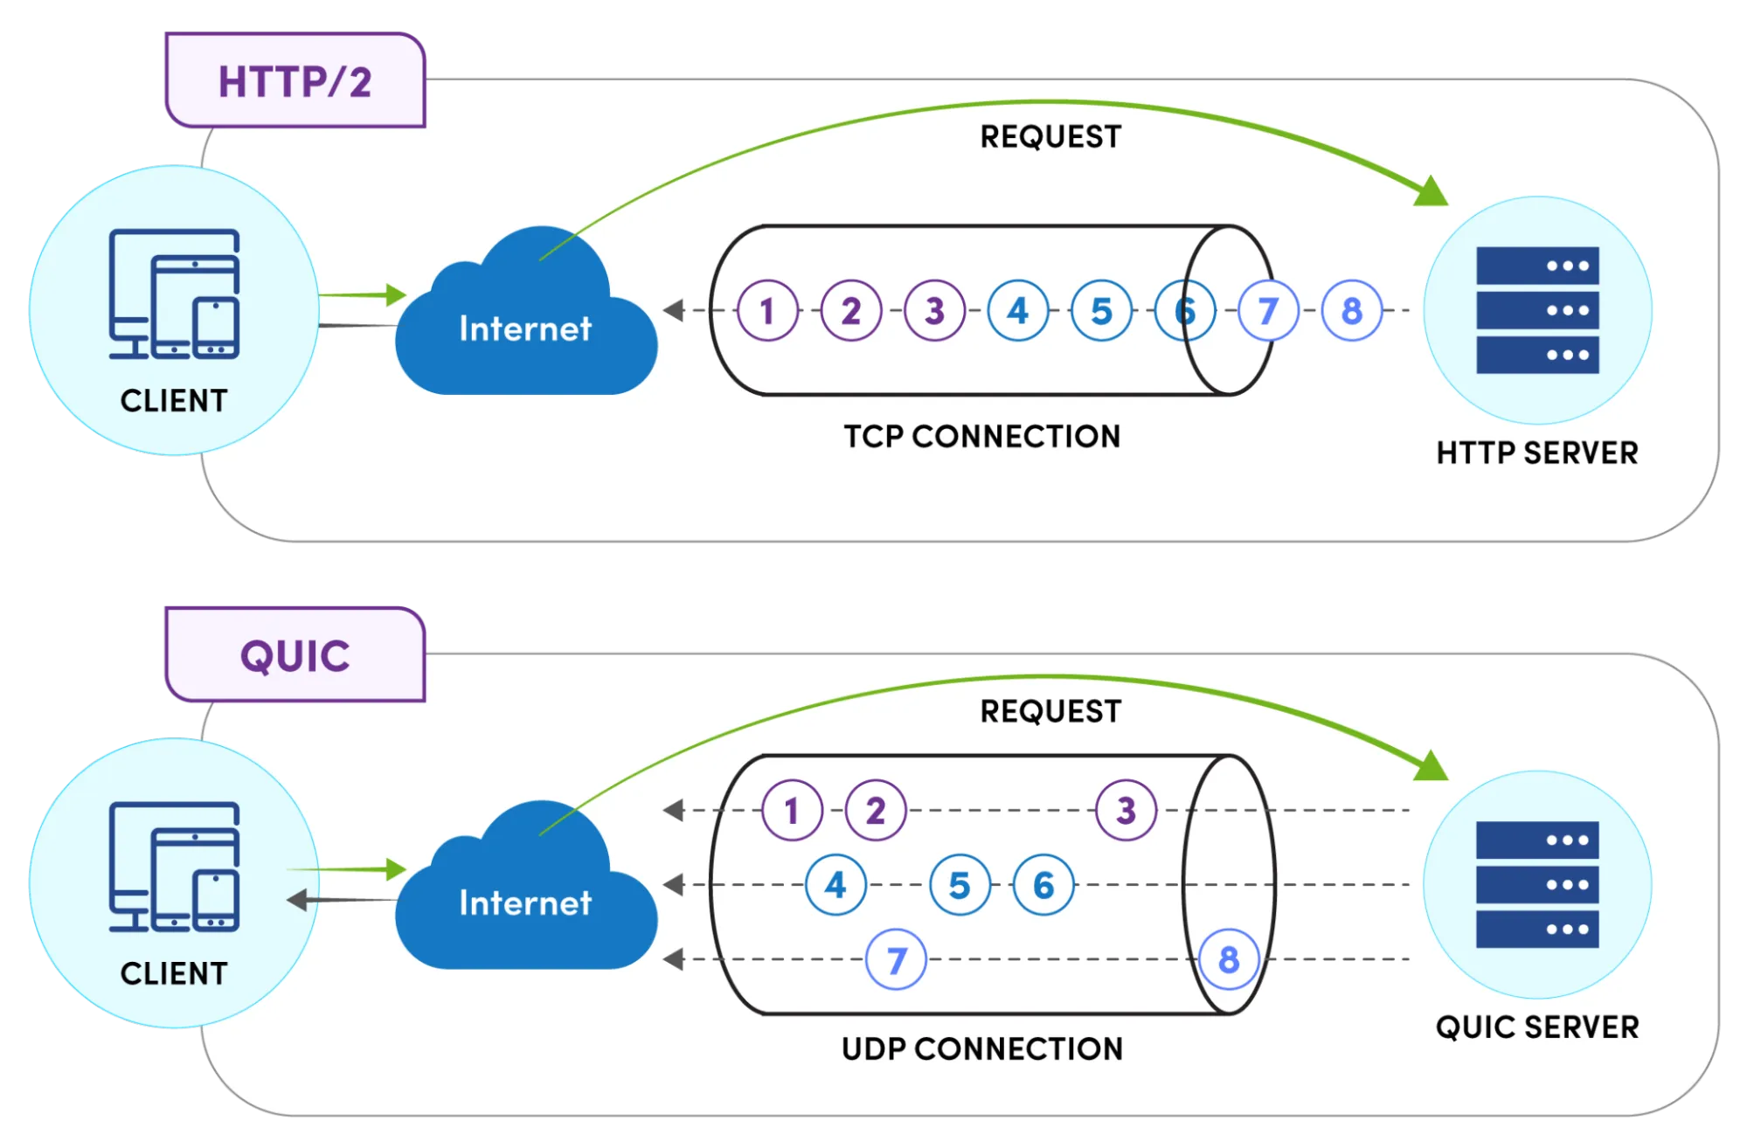
QUIC: Stream multiplexing
Notes:
[Ref] https://www.catchpoint.com/http3-vs-http2

Slide 9
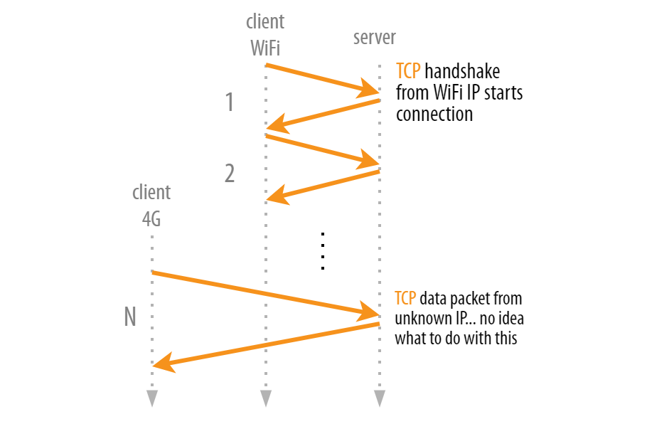
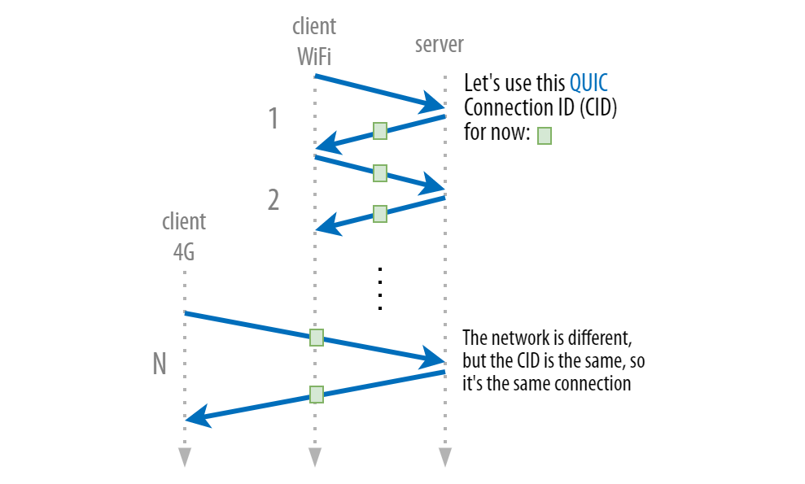
QUIC: A cross-layer approach
Seamless migration between multiple <IP, port>
Notes:
Image ref:
https://pulse.internetsociety.org/blog/how-quic-helps-you-seamlessly-connect-to-different-networks

Slide 10


Web caches (proxy server)
goal: satisfy client request without involving origin server
user sets browser: Web accesses via cache
browser sends all HTTP requests to cache
  object in cache: cache returns object
  else cache requests object from origin server, then returns object to client
proxy
server
HTTP request
HTTP request
client
origin
server
HTTP response
HTTP response
HTTP request
HTTP response
client
origin
server

Slide 11
More about Web caching
cache acts as both client and server
  server for original requesting client
  client to origin server
typically cache is installed by ISP (university, company, residential ISP)
why Web caching?
reduce response time for client request
reduce traffic on an institution’s access link
Internet dense with caches: enables “poor” content providers to effectively deliver content
Notes:
proxy

Slide 12
Electronic Mail

Slide 13
Electronic mail
outgoing
message queue
user mailbox
Three major components:
user agents
mail servers
SMTP: Simple Mail Transfer Protocol
User Agent
a.k.a. “mail reader”
composing, editing, reading mail messages
e.g., Outlook, Thunderbird, iPhone mail client
outgoing, incoming messages stored on server
user
agent
mail
server
user
agent
SMTP
mail
server
user
agent
SMTP
SMTP
user
agent
mail
server
user
agent
user
agent

Slide 14
Electronic Mail: Mail Servers
outgoing
message queue
user mailbox
Mail Servers:
mailbox contains incoming messages for user
message queue of outgoing (to be sent) mail messages
SMTP protocol between mail servers to send email messages
  client: sending mail server
  “server”: receiving mail server
user
agent
mail
server
user
agent
SMTP
mail
server
user
agent
SMTP
SMTP
user
agent
mail
server
user
agent
user
agent

Slide 15
Electronic Mail: SMTP [RFC 2821]
uses TCP to reliably transfer email message from client to server, port 25
direct transfer: sending server to receiving server
three phases of transfer
  handshaking (greeting)
  transfer of messages
  closure
command/response interaction (like HTTP)
  commands: ASCII text
  response: status code and phrase
messages must be in 7-bit ASCII
Notes:
New addition for security: STARTTLS or SMTPS
STARTTLS (Security Handshake)
STARTTLS is the most common way to secure SMTP today.
It upgrades a plaintext connection to an encrypted one using TLS (Transport Layer Security).
Here's the handshake flow:
Client connects to SMTP server (usually on port 587).
Server responds with supported features (via EHLO command).
If STARTTLS is supported, the client issues a STARTTLS command.
TLS handshake happens (just like in HTTPS).
Once encrypted, the SMTP session (authentication and email sending) proceeds.

Slide 16
Scenario: Alice sends message to Bob
1) Alice uses UA to compose message “to” bob@someschool.edu
2) Alice’s UA sends message to her mail server; message placed in message queue
3) client side of SMTP opens TCP connection with Bob’s mail server
4) SMTP client sends Alice’s message over the TCP connection
5) Bob’s mail server places the message in Bob’s mailbox
6) Bob invokes his user agent to read message
user
agent
mail
server
user
agent
1
mail
server
2
3
6
4
Alice’s mail server
5
Bob’s mail server

Slide 17
Sample SMTP interaction
S: 220 hamburger.edu
C: HELO crepes.fr
S: 250 Hello crepes.fr, pleased to meet you
C: MAIL FROM: <alice@crepes.fr>
S: 250 alice@crepes.fr... Sender ok
C: RCPT TO: <bob@hamburger.edu>
S: 250 bob@hamburger.edu ... Recipient ok
C: DATA
S: 354 Enter mail, end with "." on a line by itself
C: Do you like ketchup?
C: How about pickles?
C: .
S: 250 Message accepted for delivery
C: QUIT
S: 221 hamburger.edu closing connection
Notes:
Note: no authentication

Slide 18
SMTP: final words
SMTP uses persistent connections
SMTP requires message (header & body) to be in 7-bit ASCII
SMTP server uses CRLF.CRLF to determine end of message
comparison with HTTP:
HTTP: pull
SMTP: push
both have ASCII command/response interaction, status codes
HTTP: each object encapsulated in its own response message
SMTP: multiple objects sent in multipart message
Notes:
Question: what happens in an email with a single dot on a line?

Slide 19
Mail message format
SMTP: protocol for exchanging email messages
RFC 822: standard for text message format:
header lines, e.g.,
  To:
  From:
  Subject:
  different from SMTP MAIL FROM, RCPT TO: commands!
Body: the “message”
  ASCII characters only
header
blank
line
body

Slide 20
Mail access protocols
user
agent
mail access
protocol
user
agent
SMTP
SMTP
(e.g., POP,
IMAP)
Sender’s mail
server
Receiver’s mail
server
SMTP: delivery/storage to receiver’s server
mail access protocol: retrieval from server
  POP: Post Office Protocol [RFC 1939]: authorization, download
  IMAP: Internet Mail Access Protocol [RFC 1730]: more features, including manipulation of stored messages on server
  HTTP: gmail, Hotmail, Yahoo! Mail, etc.

Slide 23
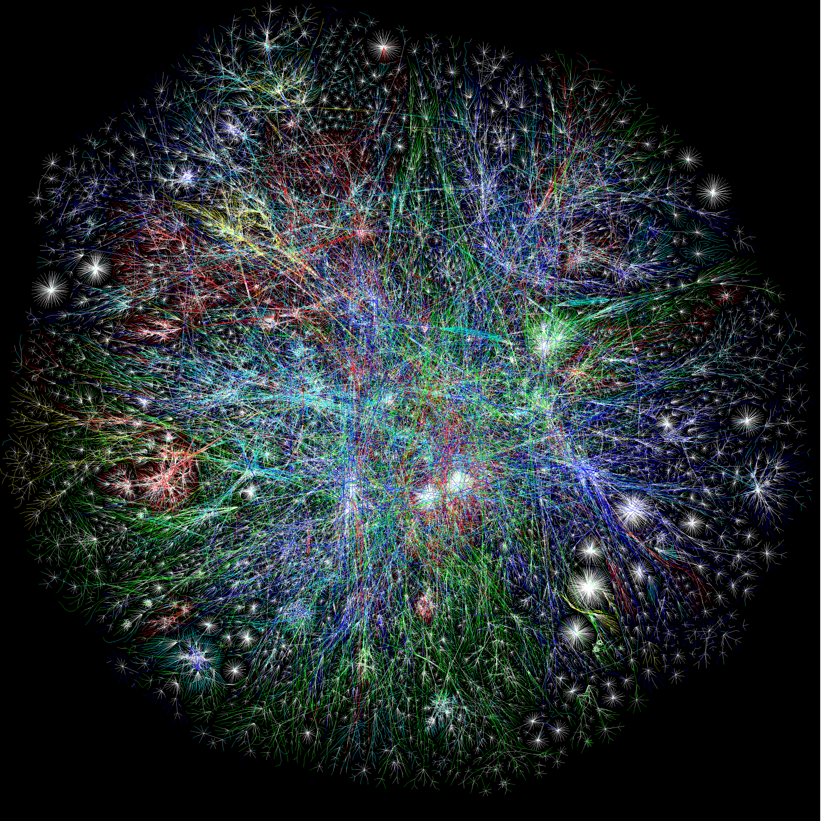
MOOCs
Online Content
Search Engines
Notes:
So building networks is hard
But unfortunately, computer networks are becoming increasingly critical to our daily lives
You know all the standard uses of computers…
Social networking
Gaming
But there’s a lot you may not thinki about
Financial sector – trillions of dollars –
Critical infrastructures – power grid, water delibvery systems – now all managed and operated with IP networks
911 communication services
…
Remote medicine
Brakes of your car
Power grid and critical infrastructure
Financial and trading networks – move billions of dollars per day over computer netowrks
Computer networks are no longer just for fun and games
People’s lives every day depend on the availability and functioning of computer netowrks
Makign it very important that we build them well, and protect them from adversaries,

Slide 24
MOOCs
Online Content
Search Engines
Notes:
So building networks is hard
But unfortunately, computer networks are becoming increasingly critical to our daily lives
You know all the standard uses of computers…
Social networking
Gaming
But there’s a lot you may not thinki about
Financial sector – trillions of dollars –
Critical infrastructures – power grid, water delibvery systems – now all managed and operated with IP networks
911 communication services
…
Remote medicine
Brakes of your car
Power grid and critical infrastructure
Financial and trading networks – move billions of dollars per day over computer netowrks
Computer networks are no longer just for fun and games
People’s lives every day depend on the availability and functioning of computer netowrks
Makign it very important that we build them well, and protect them from adversaries,

Slide 25

What’s the Internet?
Notes:
Associate press: an Internet vs the Internet

