Slide 1

CMSC 417: Computer Networks
Spring 2025
Topic: Overview of networks Part-2
(Textbook chapter 1)
Nirupam Roy
Tu-Th 2:00-3:15pm
CSI 2117
Jan 29th, 2025

Slide 2
Our Goal:
Get “feel” and terminology
More depth, detail later in course
Approach:
  Use Internet as example

Slide 3
Roadmap
  What is the Internet?
  Network edge
  Network core
  Delay, Loss, Throughput in networks
  Protocol layers, service models

Slide 4
What is the Internet ?

Slide 5
internet == The network of networks

Slide 6
internet == The network of networks
The Internet?

Slide 7
Abstraction
MOOCs
Online Content
Search Engines
Notes:
So building networks is hard
But unfortunately, computer networks are becoming increasingly critical to our daily lives
You know all the standard uses of computers…
Social networking
Gaming
But there’s a lot you may not thinki about
Financial sector – trillions of dollars –
Critical infrastructures – power grid, water delibvery systems – now all managed and operated with IP networks
911 communication services
…
Remote medicine
Brakes of your car
Power grid and critical infrastructure
Financial and trading networks – move billions of dollars per day over computer netowrks
Computer networks are no longer just for fun and games
People’s lives every day depend on the availability and functioning of computer netowrks
Makign it very important that we build them well, and protect them from adversaries,

Slide 8




















What’s the Internet: Components View
Billions of connected computing devices:
  hosts = end systems
  running network apps
PC
mobile network
server
global ISP
wireless
laptop
smartphone
home
network
Communication links
  fiber, copper, radio, satellite
  transmission rate: bandwidth
regional ISP
wireless
links
wired
links
Packet switches: forward packets (chunks of data)
  routers and switches
router
institutional
network
Notes:
8

Slide 9
What’s the Internet: Protocols View
Internet: “network of networks”
  Interconnected ISPs
Protocols control sending, receiving of messages
  e.g., TCP, IP, HTTP, Skype, 802.11
Internet standards
  RFC: Request for comments
  IETF: Internet Engineering Task Force
  (also ISO, IEEE)
mobile network
global ISP
home
network
regional ISP
institutional
network
Notes:
Associate press: an Internet vs the Internet

Slide 10
What’s a protocol?
Human protocols:
“what’s the time?”
“I have a question”
introductions
… specific messages sent
… specific actions taken when messages received, or other events
Network protocols:
Machines rather than humans
All communication activity in Internet governed by protocols
Protocols define format, order of messages sent and received among network entities, and actions taken on message transmission, receipt

Slide 11

What’s a protocol?
A human protocol and a computer network protocol:
client
server
Hi
TCP connection
request
Hi
TCP connection
response
Got the
time?
Get http://www.awl.com/kurose-ross
2:00
<file>
time

Slide 12
What’s the Internet: A Service View
Infrastructure that provides services to applications:
  Web, VoIP, email, games, e-commerce, social nets, …
Provides programming interface to apps
  hooks that allow sending and receiving app programs to “connect” to Internet
  provides service options, analogous to postal service
mobile network
global ISP
home
network
regional ISP
institutional
network

Slide 13
How to connect computers in a network?
Circuit-Switching / Packet-Switching

Slide 14
Point-to-point connection

Slide 16
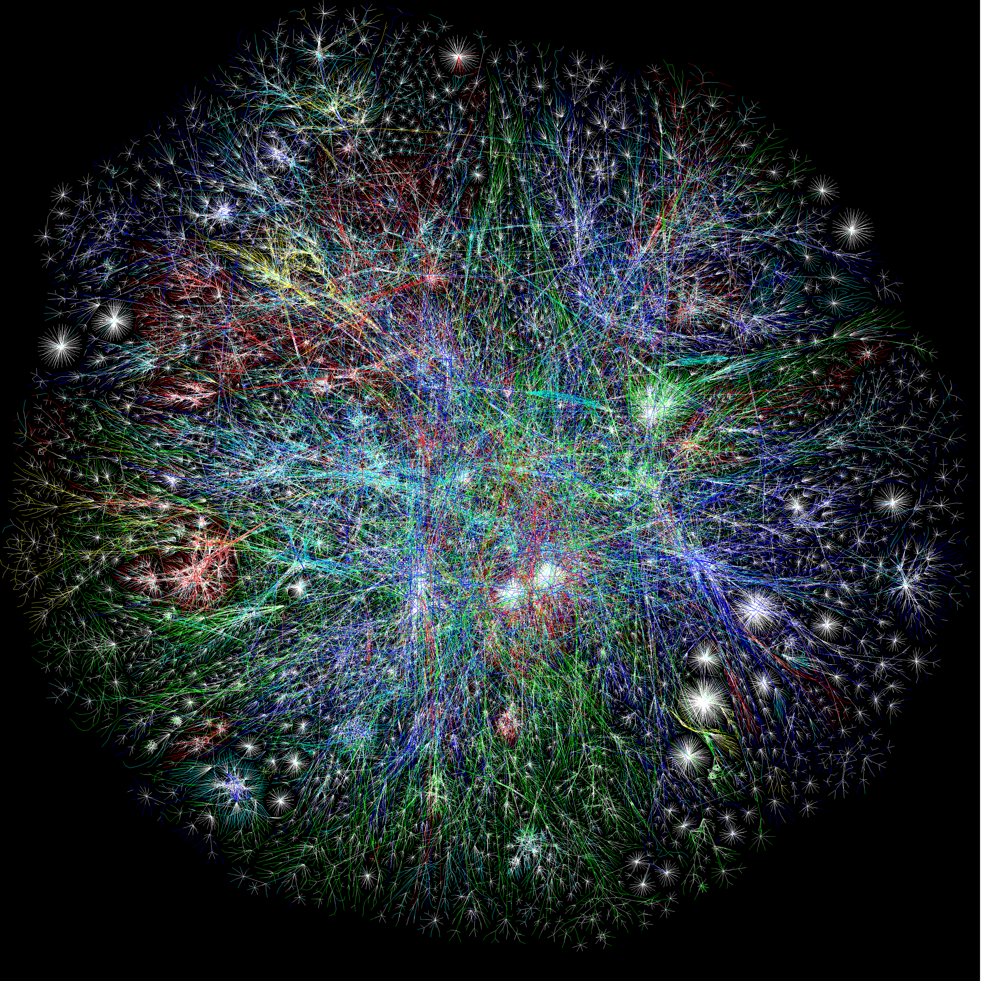
MOOCs
Online Content
Search Engines
Notes:
So building networks is hard
But unfortunately, computer networks are becoming increasingly critical to our daily lives
You know all the standard uses of computers…
Social networking
Gaming
But there’s a lot you may not thinki about
Financial sector – trillions of dollars –
Critical infrastructures – power grid, water delibvery systems – now all managed and operated with IP networks
911 communication services
…
Remote medicine
Brakes of your car
Power grid and critical infrastructure
Financial and trading networks – move billions of dollars per day over computer netowrks
Computer networks are no longer just for fun and games
People’s lives every day depend on the availability and functioning of computer netowrks
Makign it very important that we build them well, and protect them from adversaries,

Slide 17
All pair Point-to-point connection
Notes:
It is a viable solution (for small networks, like home networks, access networks—ethernet, USB hub that is also a network by its own merits…it addresses protocols etc.). Only question is that is this connection topology suitable for the Internet?

Slide 18
Is this scalable?
All pair Point-to-point connection

Slide 19
Shared channel
Multiple access

Slide 20
Shared channel
How to direct the flow of data at these points?
Multiple access

Slide 21
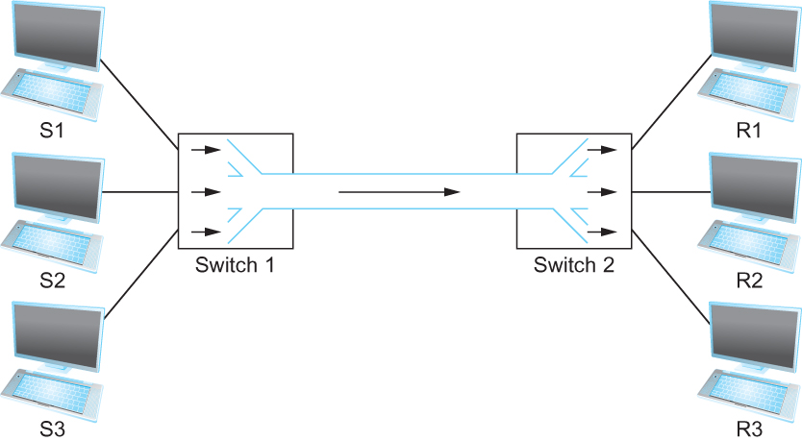
Multiplexing multiple logical flows over a single physical link
Switching

Slide 22
Circuit Switching
end-end resources allocated to, reserved for “call” between source & destination:
in diagram, each link has four circuits.
  call gets 2nd circuit in top link and 1st circuit in right link.
dedicated resources: no sharing
  circuit-like (guaranteed) performance
commonly used in traditional telephone networks

Slide 23
Circuit Switching: Telephone (voice)

Slide 24

Circuit Switching: Telephone (data)

Slide 25
Circuit Switching
end-end resources allocated to, reserved for “call” between source & destination:
in diagram, each link has four circuits.
  call gets 2nd circuit in top link and 1st circuit in right link.
dedicated resources: no sharing
  circuit-like (guaranteed) performance
commonly used in traditional telephone networks
Circuit segment idle if there is not enough data

Slide 26
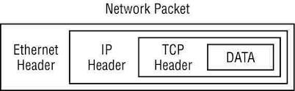

Packet Switching: What is a packet
(packet/datagram/frame)

Slide 27
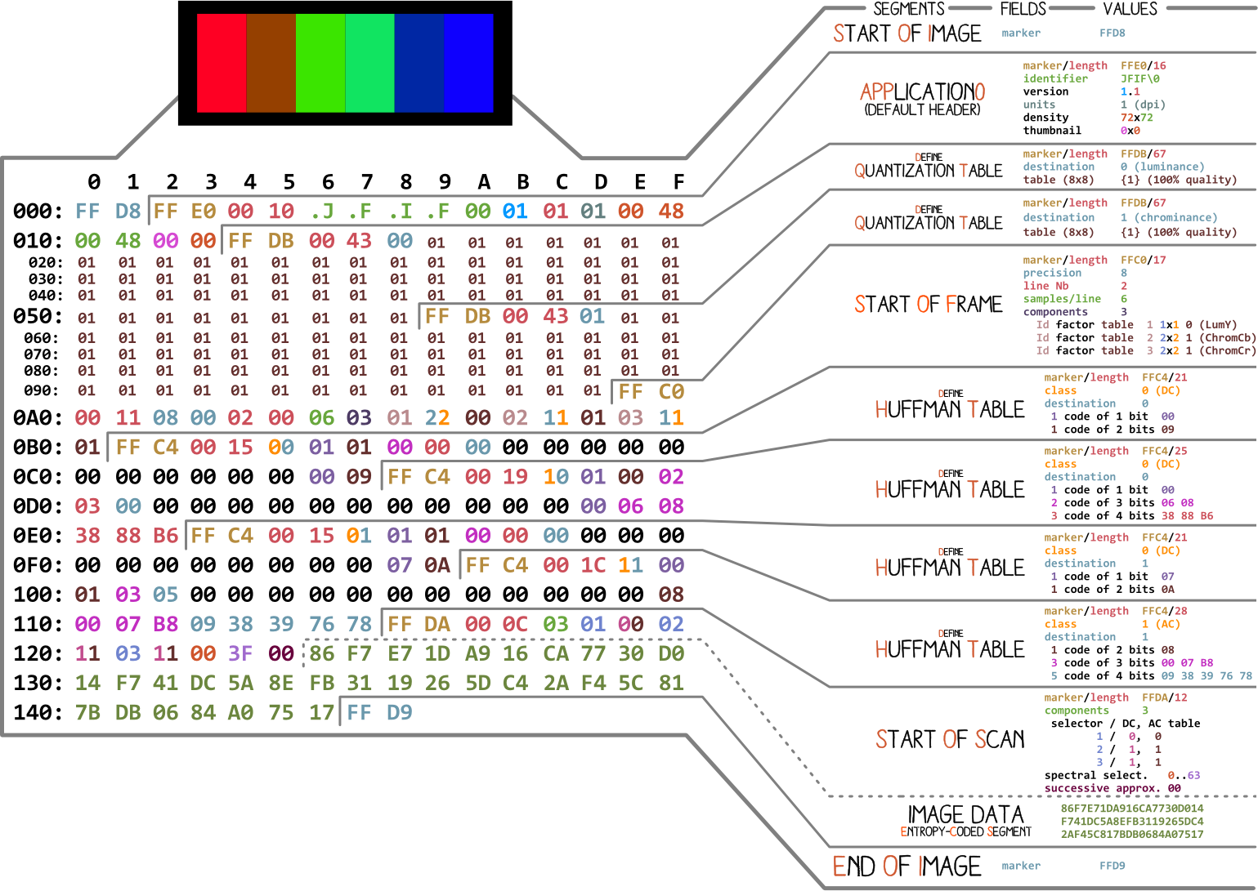
Data packets: A format for organizing data
Analogy: JPEG file format

Slide 28
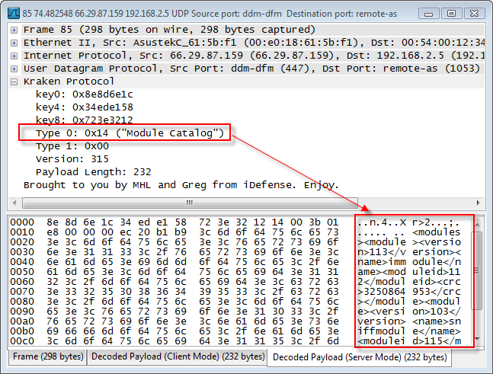
Packet Switching: What is a packet
(packet/datagram/frame)

Slide 29
Packet Switching
R = 100 Mb/s
C
A
D
R = 1.5 Mb/s
B
E
queue of packets
waiting for output link

Slide 30
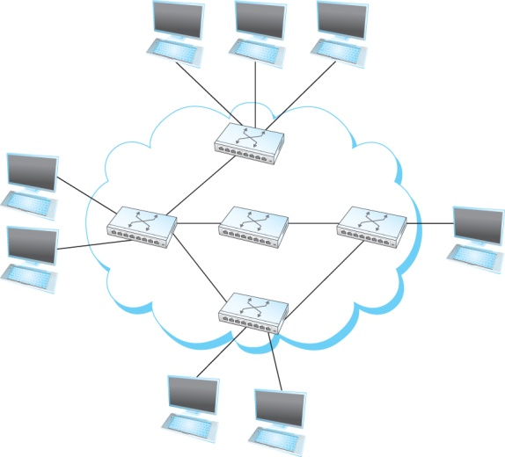
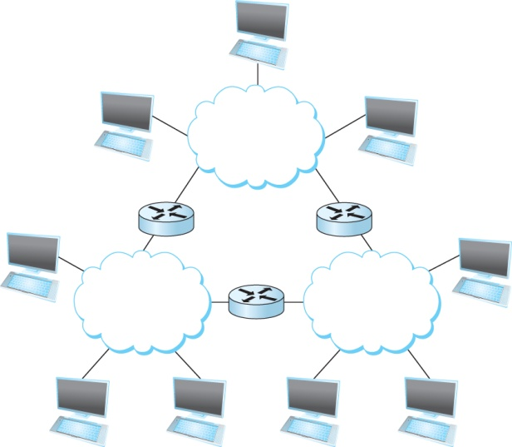
Switch vs Router
Switches
Routers

Slide 31

What’s the Internet?
Notes:
Associate press: an Internet vs the Internet

Slide 32
Chapter 1: Roadmap
  What is the Internet?
  Network edge
  Network core
  Delay, Loss, Throughput in networks
  Protocol layers, service models
  History

Slide 33
Network Edge
Notes:
So building networks is hard
But unfortunately, computer networks are becoming increasingly critical to our daily lives
You know all the standard uses of computers…
Social networking
Gaming
But there’s a lot you may not thinki about
Financial sector – trillions of dollars –
Critical infrastructures – power grid, water delibvery systems – now all managed and operated with IP networks
911 communication services
…
Remote medicine
Brakes of your car
Power grid and critical infrastructure
Financial and trading networks – move billions of dollars per day over computer netowrks
Computer networks are no longer just for fun and games
People’s lives every day depend on the availability and functioning of computer netowrks
Makign it very important that we build them well, and protect them from adversaries,

Slide 34
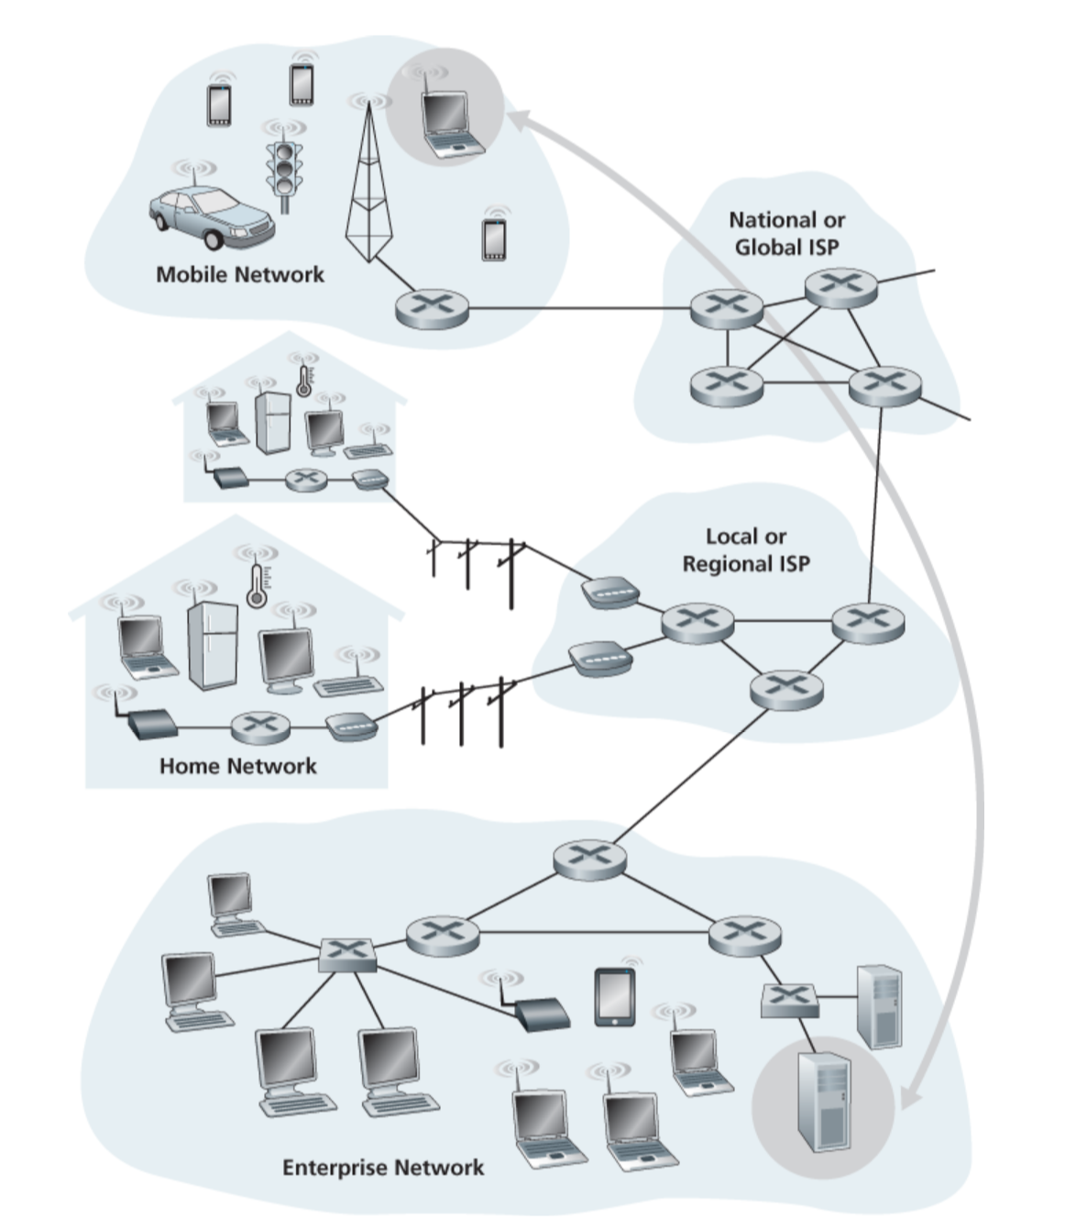
Network Edge

Slide 35
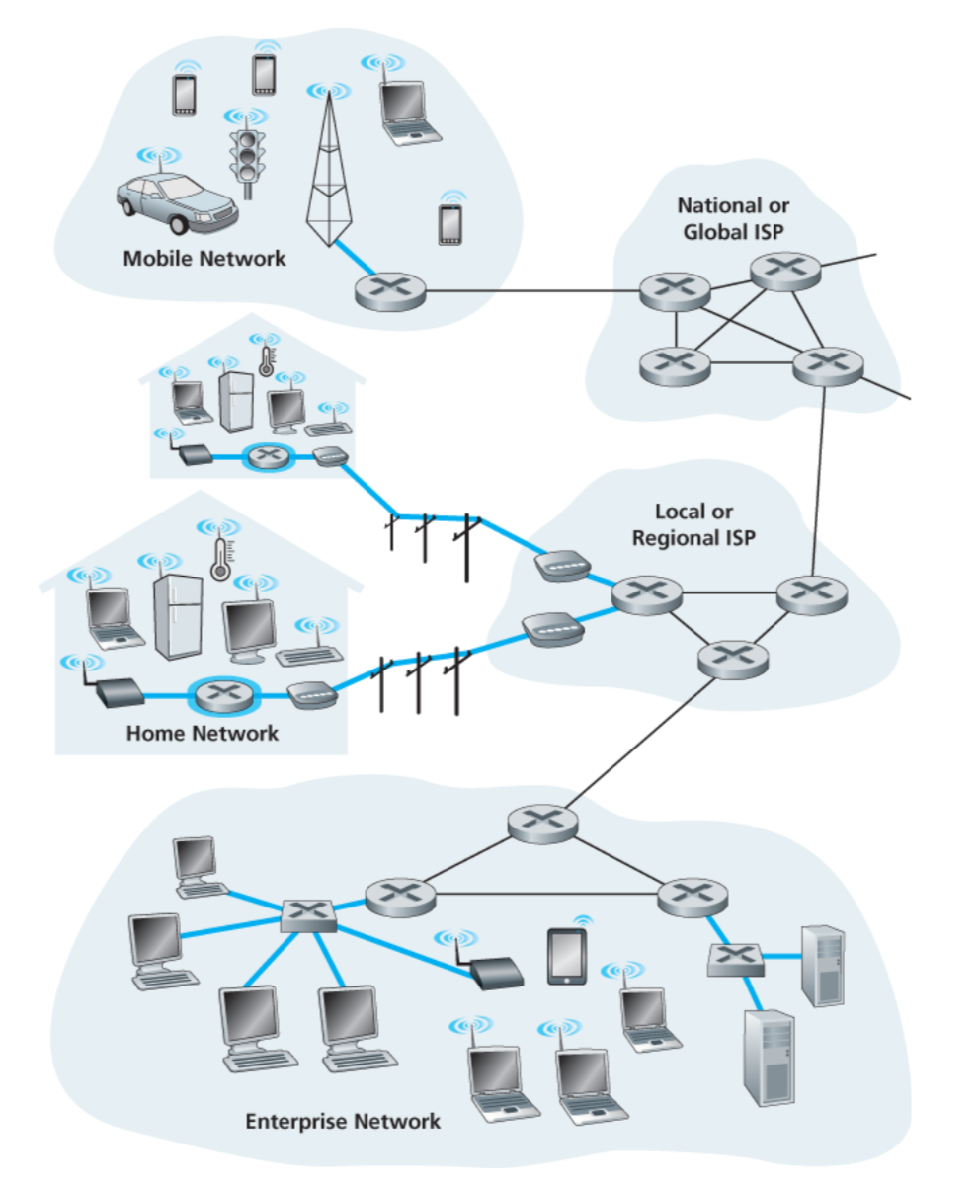
A closer look at network structure:
Network edge:
  hosts: clients and servers
  servers often in data centers
  access networks, physical media: wired, wireless communication links

Slide 36





Access Network: Home Network
wireless
devices
to/from headend or central office
often combined
in single box
cable or DSL modem
(DSL=Digital Subscriber Line)
wireless access
point
router, firewall
wired Ethernet

Slide 37
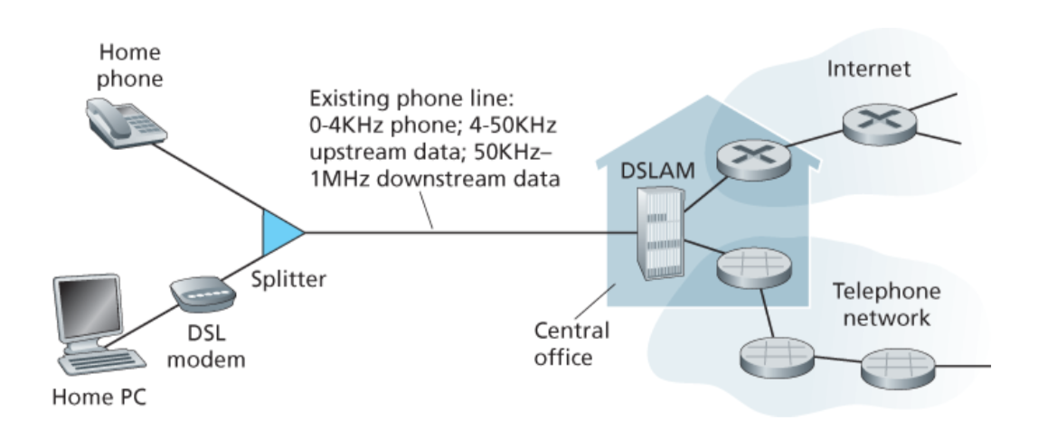
Access Network: Home Network

Slide 38









Enterprise Access Networks (Ethernet)
institutional link to
ISP (Internet)
institutional router
Ethernet
switch
institutional mail,
web servers
Typically used in companies, universities, etc.
  10 Mbps, 100Mbps, 1Gbps, 10Gbps transmission rates
  Today, end systems typically connect into Ethernet switch

Slide 39








Wireless Access Networks
Shared wireless access network connects end system to router
  via base station aka “access point”
Wide-area wireless access
  provided by telco (cellular) operator, 10’s km
  between 1 and 10 Mbps
  3G, 4G: LTE, 5G,…
Wireless LANs:
  within building (100 ft.)
  802.11b/g/n (WiFi): 11, 54, 450 Mbps transmission rate
to Internet
to Internet

Slide 40
Chapter 1: Roadmap
  What is the Internet?
  Network edge
  Network core
  Delay, Loss, Throughput in networks
  Protocol layers, service models
  History

Slide 41
Network Core
MOOCs
Online Content
Search Engines
Notes:
So building networks is hard
But unfortunately, computer networks are becoming increasingly critical to our daily lives
You know all the standard uses of computers…
Social networking
Gaming
But there’s a lot you may not thinki about
Financial sector – trillions of dollars –
Critical infrastructures – power grid, water delibvery systems – now all managed and operated with IP networks
911 communication services
…
Remote medicine
Brakes of your car
Power grid and critical infrastructure
Financial and trading networks – move billions of dollars per day over computer netowrks
Computer networks are no longer just for fun and games
People’s lives every day depend on the availability and functioning of computer netowrks
Makign it very important that we build them well, and protect them from adversaries,

Slide 42









The Network Core
Mesh of interconnected routers
Packet-switching:
  forward packets from one router to the next, across links on path from source to destination
  each packet transmitted at full link capacity

Slide 43
Two key network-core functions
routing: determines source-destination route taken by packets
  routing algorithms
forwarding: move packets from router’s input to appropriate router output
routing algorithm
local forwarding table
header value
output link
0100
0101
0111
1001
3
2
2
1
1
3
2
0111
destination address in arriving
packet’s header

Slide 44
Why is routing challenging?
1
3
2
No central control in a distributed system.

Slide 45



Packet-switching: Store-and-Forward
L bits
per packet
source
3
2
1
R bps
R bps
destination
takes L/R seconds to transmit (push out) L-bit packet into link at R bps
store and forward: entire packet must arrive at router before it can be transmitted on next link
one-hop numerical example:
L = 7.5 Mbits
R = 1.5 Mbps
one-hop transmission delay = 5 sec
end-end delay = 2L/R (assuming zero propagation delay)
more on delay shortly …

Slide 46
Organization of the
“Network of networks”

Slide 47
Internet Structure: Network of Networks
End systems connect to Internet via access ISPs (Internet Service Providers)
  residential, company and university ISPs
Access ISPs in turn must be interconnected.
  so that any two hosts can send packets to each other
Resulting network of networks is very complex
  evolution was driven by economics and national policies
Let’s take a stepwise approach to describe current Internet structure

Slide 48
Internet Structure: Network of Networks
Question: given millions of access ISPs, how to connect them together?
…
…
access
net
access
net
access
net
access
net
access
net
access
net
access
net
…
…
access
net
access
net
access
net
access
net
access
net
access
net
…
access
net
access
net
…
access
net

Slide 49
Internet Structure: Network of Networks
Option: connect each access ISP to every other access ISP?
…
…
access
net
access
net
access
net
access
net
access
net
…
…
access
net
access
net
…
connecting each access ISP to each other directly doesn’t scale: O(N²) connections.
…
…
access
net
access
net
…
access
net
access
net
access
net
…
access
net
…
access
net
access
net
…
access
net

Slide 50
Internet Structure: Network of Networks
Option: connect each access ISP to one global transit ISP?
Customer and provider ISPs have economic agreement.
…
…
access
net
access
net
access
net
access
net
access
net
access
net
access
net
…
…
global
ISP
access
net
access
net
access
net
access
net
access
net
access
net
…
access
net
access
net
…
access
net

Slide 51
Internet Structure: Network of Networks
But if one global ISP is viable business, there will be competitors ….
…
…
access
net
access
net
access
net
access
net
access
net
access
net
ISP A
access
net
…
…
access
net
ISP B
access
net
ISP C
access
net
access
net
access
net
access
net
…
access
net
access
net
…
access
net

Slide 52
Internet Structure: Network of Networks
But if one global ISP is viable business, there will be competitors …. which must be interconnected
Internet exchange point
…
…
access
net
access
net
access
net
access
net
access
net
IXP
access
net
access
net
ISP A
…
…
access
net
IXP
ISP B
access
net
ISP C
access
net
access
net
peering link
access
net
access
net
…
access
net
access
net
…
access
net

Slide 53
Internet Structure: Network of Networks
… and regional networks may arise to connect access nets to ISPs
…
…
access
net
access
net
access
net
access
net
access
net
IXP
access
net
access
net
ISP A
…
…
regional net
access
net
IXP
ISP B
access
net
ISP C
access
net
access
net
access
net
regional net
access
net
…
access
net
access
net
…
access
net

Slide 54
Internet Structure: Network of Networks
… and content provider networks (e.g., Google, Microsoft, Akamai) may run their own network, to bring services, content close to end users
…
…
access
net
access
net
access
net
access
net
access
net
IXP
access
net
access
net
ISP A
…
…
Content provider/distribution network
regional net
access
net
IXP
ISP B
access
net
ISP C
access
net
access
net
access
net
regional net
access
net
…
access
net
access
net
…
access
net

Slide 55
Internet Structure: Network of Networks
Tier 1 ISP
Tier 1 ISP
Google
IXP
IXP
IXP
Regional ISP
Regional ISP
access
ISP
access
ISP
access
ISP
access
ISP
access
ISP
access
ISP
access
ISP
access
ISP
at center: small # of well-connected large networks
  “tier-1” commercial ISPs (e.g., Level 3, Sprint, AT&T, NTT), national & international coverage
  content provider/distribution network (e.g., Google, Akamai): private network that connects it data centers to Internet, often bypassing tier-1, regional ISPs

Slide 56
Chapter 1: Roadmap
  What is the Internet?
  Network edge
  Network core
  Delay, Loss, Throughput in networks
  Protocol layers, service models
  History

Slide 57
How do loss and delay occur?
packets queue in router buffers
packet arrival rate to link (temporarily) exceeds output link capacity
packets queue, wait for turn
packet being transmitted (delay)
A
B
packets queueing (delay)
free (available) buffers: arriving packets
dropped (loss) if no free buffers

Slide 58
Thank you

