Slide 1

CMSC 417: Computer Networks
Spring 2025
Topic: Overview of networks (cont…)
(Textbook chapter 1)
& Internetworking
(Textbook chapter 3)
Nirupam Roy
Tu-Th 2:00-3:15pm
CSI 2117
Feb 3rd, 2025

Slide 2
Chapter 1: Roadmap
What is the Internet?
Network edge
Network core
Delay, Loss, Throughput in networks
Protocol layers, service models
History

Slide 3

How do loss and delay occur?
packets queue in router buffers
packet arrival rate to link (temporarily) exceeds output link capacity
packets queue, wait for turn
packet being transmitted (delay)
A
B
packets queueing (delay)
free (available) buffers: arriving packets
dropped (loss) if no free buffers

Slide 4
Four sources of packet delay
transmission
A
propagation
B
nodal
processing
queueing
d_{total} = d_{proc} + d_{queue} + d_{trans} + d_{prop}
d_{proc}: nodal processing
check bit errors
determine output link
typically < msec
d_{queue}: queueing delay
time waiting at output link for transmission
depends on congestion level of router

Slide 5
Four sources of packet delay
transmission
A
propagation
B
nodal
processing
queueing
d_{total} = d_{proc} + d_{queue} + d_{trans} + d_{prop}
d_{trans}: transmission delay:
L: packet length (bits)
R: link bandwidth (bps)
d_{trans} = L/R
d_{prop}: propagation delay:
d: length of physical link
v: propagation speed
d_{prop} = d/v
d_{trans} and d_{prop}
very different
Notes:
5

Slide 6
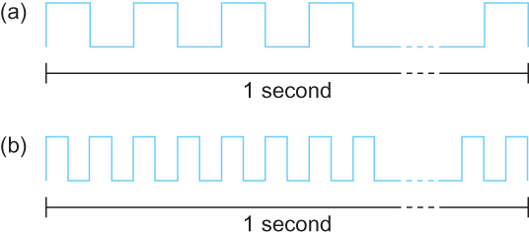
Bandwidth
Bits transmitted at a particular bandwidth can be regarded as having some width:
(a) bits transmitted at 1Mbps (each bit 1 μs wide);
(b) bits transmitted at 2Mbps (each bit 0.5 μs wide).

Slide 7
Throughput
throughput: rate (bits/time unit) at which bits transferred between sender/receiver
instantaneous: rate at given point in time
average: rate over longer period of time
server, with
file of F bits
to send to client
link capacity
R_{s} bits/sec
link capacity
R_{c} bits/sec
server sends bits
(fluid) into pipe
pipe that can carry
fluid at rate
R_{s} bits/sec)
pipe that can carry
fluid at rate
R_{c} bits/sec)

Slide 8
Throughput
R_{s} < R_{c} What is average end-end throughput?
R_{s} bits/sec
R_{c} bits/sec
R_{s} > R_{c} What is average end-end throughput?
R_{s} bits/sec
R_{c} bits/sec
bottleneck link
link on end-end path that constrains end-end throughput

Slide 9
Throughput: Internet scenario
per-connection end-end throughput: min(R_{c},R_{s},R/10)
in practice: R_{c} or R_{s} is often bottleneck
R_{s}
R_{s}
R_{s}
R
R_{c}
R_{c}
R_{c}
10 connections (fairly) share backbone bottleneck link R bits/sec

Slide 10
Packet Loss
queue (aka buffer) preceding link in buffer has finite capacity
packet arriving to full queue dropped (aka lost)
lost packet may be retransmitted by previous node, by source end system, or not at all
buffer
(waiting area)
A
packet being transmitted
B
packet arriving to
full buffer is lost

Slide 11
Chapter 1: Roadmap (cont…)
What is the Internet?
Network edge
Network core
Delay, Loss, Throughput in networks
Protocol layers, service models

Slide 12
Protocol “Layers”
Networks are complex,
with many “pieces”:
hosts
routers
links of various media
applications
protocols
hardware, software
Question:
is there any hope of organizing structure of network?
…. or at least our discussion of networks?

Slide 13
Layering of airline functionality
ticket (purchase)
baggage (check)
gates (load)
runway (takeoff)
airplane routing
ticket (complain)
baggage (claim
gates (unload)
runway (land)
airplane routing
ticket
baggage
gate
takeoff/landing
airplane routing
airplane routing
airplane routing
departure
airport
intermediate air-traffic
control centers
arrival
airport
layers: each layer implements a service
via its own internal-layer actions
relying on services provided by layer below

Slide 14
Why layering?
dealing with complex systems:
explicit structure allows identification, relationship of complex system’s pieces
layered reference model for discussion
modularization eases maintenance, updating of system
change of implementation of layer’s service transparent to rest of system
e.g., change in gate procedure doesn’t affect rest of system
Can layering be harmful? Give an example.

Slide 15
Internet protocol stack
application: supporting network applications
FTP, SMTP, HTTP
transport: process-process data transfer
TCP, UDP
network: routing of packets from source to destination
IP, routing protocols
link: data transfer between neighboring network elements
Ethernet, 802.11 (WiFi), PPP
physical: bits “on the wire”
application
transport
network
link
physical

Slide 16
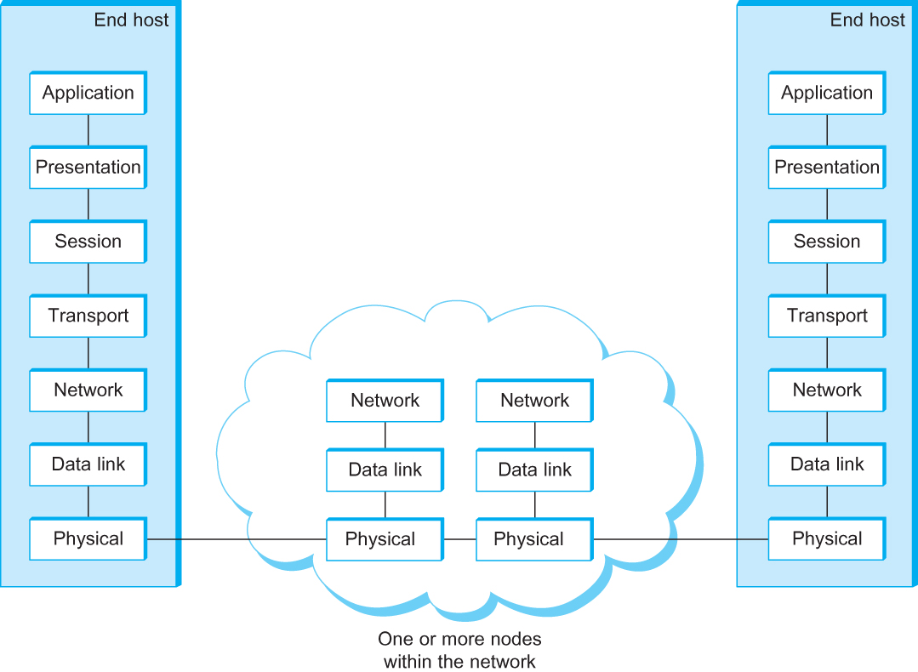
OSI Architecture
The OSI 7-layer Model
OSI – Open Systems Interconnection
(by International Organization for Standardization, ISO)

Slide 17
Description of Layers
Physical Layer
Handles the transmission of raw bits over a communication link
Data Link Layer
Collects a stream of bits into a larger aggregate called a frame
Network adaptor along with device driver in OS implement the protocol in this layer
Frames are actually delivered to hosts
Network Layer
Handles routing among nodes within a packet-switched network
Unit of data exchanged between nodes in this layer is called a packet
The lower three layers are implemented on all network nodes

Slide 18
Description of Layers
Transport Layer
Implements a process-to-process channel
Unit of data exchanges in this layer is called a message
Session Layer
Provides a name space that is used to tie together the potentially different transport streams that are part of a single application.
Presentation Layer
Concerned about the format of data exchanged between peers (data formats, data encryption)
Application Layer
Standardize common type of exchanges
The transport layer and the higher layers typically run only on end-hosts and not on the intermediate switches and routers

Slide 19
Encapsulation
source
message
M
application
transport
network
link
physical
segment
H_{t}
M
H_{t}
datagram
H_{n}
H_{n}
H_{t}
M
frame
H_{l}
H_{n}
H_{t}
M
link
physical
switch
destination
H_{n}
H_{t}
M
network
link
physical
M
application
transport
network
link
physical
H_{l}
H_{n}
H_{t}
M
H_{n}
H_{t}
M
H_{t}
M
H_{n}
H_{t}
M
H_{l}
H_{n}
H_{t}
M
router

Slide 20
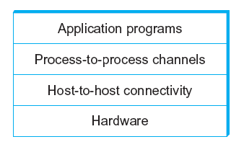
Network Architecture
Example of a layered network system

Slide 21
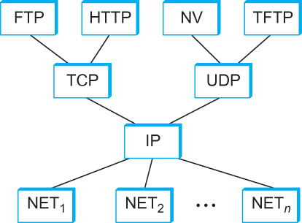
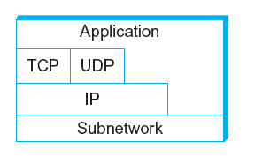
Internet Architecture
Alternative view of the Internet architecture. The “Network” layer shown here is sometimes referred to as the “sub-network” or “link” layer.
Internet Protocol Graph

Slide 22
This course: Top-Down or Bottom-up?
3
2
1
4

Slide 23
Internetworking

Slide 24
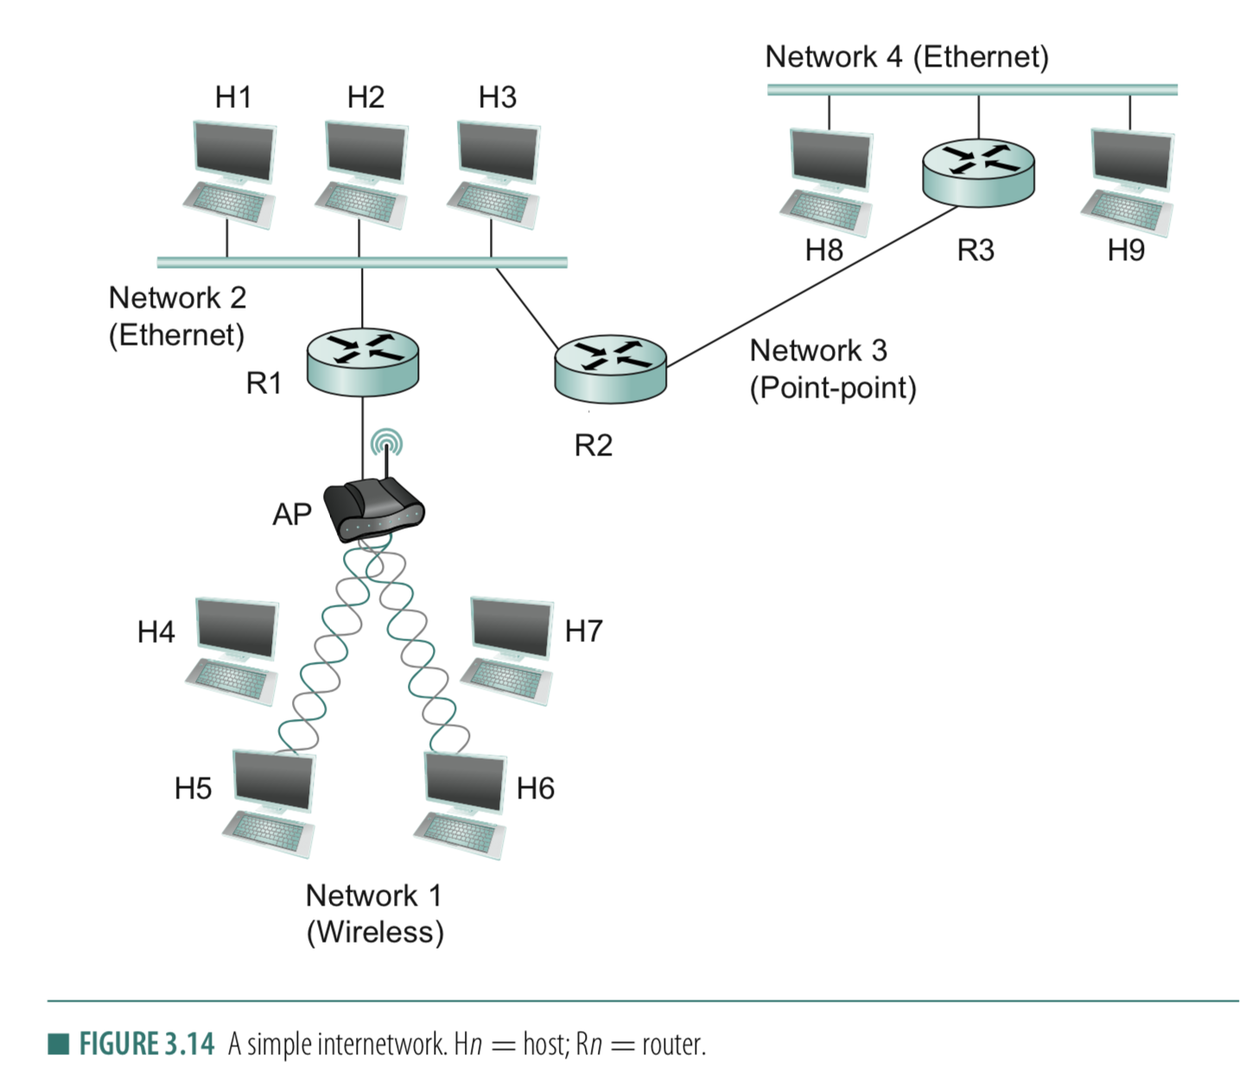
Connection between hosts
1. Addressing
– Unique identifier for global addressing
– Link name for neighbors
2. Forwarding
-- Switching packets between links
3. Routing
-- Determining paths between hosts

Slide 25
Internet Structure: Network of Networks
But if one global ISP is viable business, there will be competitors ….
…
Routers
access
net
access
net
…
access
net
access
net
access
net
access
net
ISP A
access
net
…
…
access
net
ISP B
access
net
ISP C
access
net
access
net
access
net
access
net
…
access
net
access
net
…
access
net

Slide 26
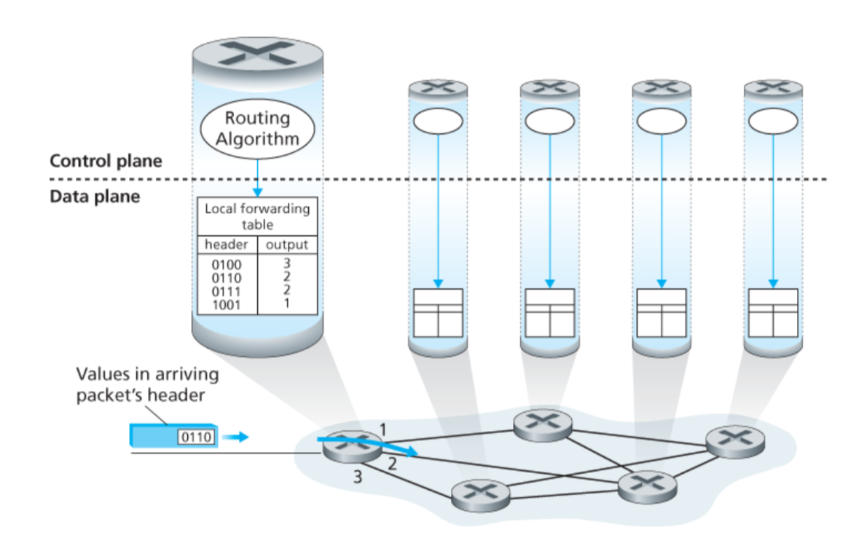
Connection between hosts

Slide 27
Connection between hosts
Using network to maintain network.
Behaves like Applications. Uses TCP/UDP packets

Slide 28
Connection between hosts
1. Addressing
– Unique identifier for global addressing
– Link name for neighbors
2. Forwarding
-- Switching packets between links
3. Routing
-- Determining paths between hosts

Slide 29
Routing protocols
Routing protocol goal: determine “good” paths (equivalently, routes), from sending hosts to receiving host, through network of routers
path: sequence of routers packets will traverse in going from given initial source host to given final destination host
“good”: least “cost”, “fastest”, “least congested”

Slide 30
Graph abstraction of the network
5
v
3
w
2
5
u
2
1
z
3
1
2
x
y
1
graph: G = (N,E)
N = set of routers = { u, v, w, x, y, z }
E = set of links ={ (u,v), (u,x), (v,x), (v,w), (x,w), (x,y), (w,y), (w,z), (y,z) }
aside: graph abstraction is useful in other network contexts, e.g.,
P2P, where N is set of peers and E is set of TCP connections

Slide 31
Graph abstraction: costs
5
c(x,x’) = cost of link (x,x’)
e.g., c(w,z) = 5
cost could always be 1, or
inversely related to bandwidth,
or related to congestion
v
3
w
2
5
u
2
1
z
3
1
2
x
y
1
cost of path (x₁, x₂, x₃,…, x_{p}) = c(x₁,x₂) + c(x₂,x₃) + … + c(x_{p-1},x_{p})
key question: what is the least-cost path between u and z ?
routing algorithm: algorithm that finds that least cost path

Slide 32
Routing
For a simple network, we can calculate all shortest paths and load them into some nonvolatile storage on each node.
Such a static approach has several shortcomings
It does not deal with node or link failures
It does not consider the addition of new nodes or links
It implies that edge costs cannot change
What is the solution?
Need a distributed and dynamic protocol
Two main classes of protocols
Distance Vector
Link State

Slide 33
Distance Vector Routing

Slide 34
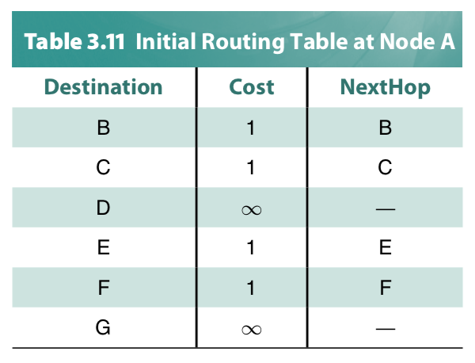
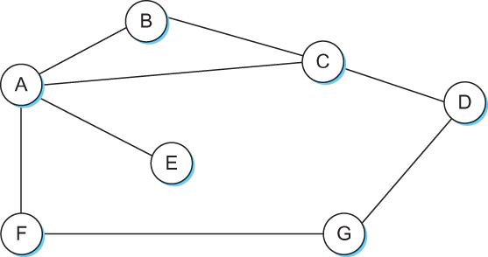
Distance Vector
Each node constructs a one-dimensional array (a vector) containing the “distances” (costs) to all other nodes and distributes that vector to its immediate neighbors
Starting assumption is that each node knows the cost of the link to each of its directly connected neighbors

Slide 35
Distance Vector Routing protocol
Advertise:
A router transmits its distance vector to each of its neighbors in a
routing packet.
2. Each router receives and saves the most recently received
distance vector from each of its neighbors.
3. Update:
A router recalculates its distance vector when:
It receives a distance vector from a neighbor containing
different information than before.
b) It discovers that a link to a neighbor has gone down
(or the cost has changed).

Slide 36
Thank you

