Slide 1

CMSC 417: Computer Networks
Spring 2025
Topic: Internetworking
(Textbook chapter 3)
Nirupam Roy
Tu-Th 2:00-3:15pm
CSI 2117
Feb 10th, 2025

Slide 2
“Count-to-infinity” problem: Another scenario
1
1
1
1
A
X
B
C
D
E
Small number for infinity
Triggered update and hold time
Avoiding loop while advertising

Slide 3
Count-to-infinity Problem: Solutions-1
Use some relatively small number as an approximation of infinity
For instance, in the Routing Information Protocol (RIP)—that implements DV routing-- the maximum number of hops is typically set to 15 with 16 hops considered as infinity. If a network destination is more than 15 hops away, it is considered unreachable.

Slide 4
Count-to-infinity Problem: Solutions-2
Technique to improve the time to stabilize routing is called
split horizon
  When a node sends a routing update to its neighbors, it does not send those routes it learned from each neighbor back to that neighbor
  For example, if Z has the route (X, 5, Y) in its table, then it knows it must have learned this route from Y, and so whenever Z sends a routing update to Y, it does not include the route (X, 5) in that update

Slide 5
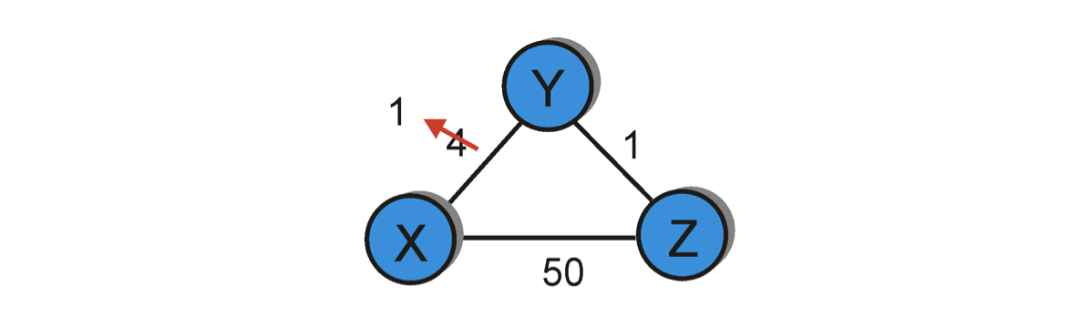
Distance vector: link cost “increases”
Bellman-Ford algo.
considers two routes from the
saved advertisements.
<X, 60, X> -- direct link
<X, 5, Z> + d_{Z}(X) – Cost 6 link via Z
60
Case: Split horizon
Dest | Cost | Hop
X | 4 | X
Y | 0 | Y
Z | 1 | Z
Dest | Cost | Hop
X | 6 | Z
Y | 0 | Y
Z | 1 | Z
Dest | Cost | Hop
X | 6 | Z
Y | 0 | Y
Z | 1 | Z
Dest | Cost | Hop
X | 8 | X
Y | 0 | Y
Z | 1 | Z
node Y
Dest | Cost | Hop
X | 5 | Y
Y | 1 | Y
Z | 0 | Z
Dest | Cost | Hop
X | 5 | Y
Y | 1 | Y
Z | 0 | Z
Dest | Cost | Hop
X | 7 | Y
Y | 1 | Y
Z | 0 | Z
Dest | Cost | Hop
X | 7 | Y
Y | 1 | Y
Z | 0 | Z
node Z
T1
T2
T3
T4
Cost change

Slide 6
Count-to-infinity Problem: Solutions-3
In a stronger version of split horizon, called split horizon with poison reverse
  B actually sends that back route to A, but it puts negative information in the route to ensure that A will not eventually use B to get to E
  For example, B sends the route (E, ∞) to A

Slide 7
Distance vector: link cost “increases”
Bellman-Ford algo.
considers two routes from the
saved advertisements.
<X, 60, X> -- direct link
<X, ♾, Z> + d_{Z}(X) – Cost 6 link via Z
60
Case: Split horizon
with poisoned reverse
Dest | Cost | Hop
X | 4 | X
Y | 0 | Y
Z | 1 | Z
Dest | Cost | Hop
X | 6 | Z
Y | 0 | Y
Z | 1 | Z
Dest | Cost | Hop
X | 6 | Z
Y | 0 | Y
Z | 1 | Z
Dest | Cost | Hop
X | 8 | X
Y | 0 | Y
Z | 1 | Z
node Y
Dest | Cost | Hop
X | 5 | Y
Y | 1 | Y
Z | 0 | Z
Dest | Cost | Hop
X | 5 | Y
Y | 1 | Y
Z | 0 | Z
Dest | Cost | Hop
X | 7 | Y
Y | 1 | Y
Z | 0 | Z
Dest | Cost | Hop
X | 7 | Y
Y | 1 | Y
Z | 0 | Z
node Z
T1
T2
T3
T4
Cost change

Slide 8

An example where split-horizon is not enough
DV format: <Destination, Path-cost, NextHop>
C
<A, 2, B>
Example: Let’s consider the routes
from (C to A) and (D to A).
1
A
B
1
1
1
<A, 2, B>
D
Event 1: Converged state

Slide 9
An example where split-horizon is not enough
DV format: <Destination, Path-cost, NextHop>
C
<A, 2, B>
1
X
A
B
1
1
X
X
X
1
<A, 2, B>
D
Event 2: Router B failed, i.e., both links (B,C) and (B,D) are down simultaneously.

Slide 10
An example where split-horizon is not enough
DV format: <Destination, Path-cost, NextHop>
C
<A, 2, B>
<A, 3, D>
Case A:
No split-horizon.
No poison reverse.
1
X
A
B
1
1
X
<A, 2, B>
X
1
<A, 4, C>
D
Event 3:
C updates the route from its old database (which contains an advertisement from D) to <A,3,D>.
C shares this route to D.
D updates its route with this recent advertisement from C.
D’s current route becomes <A,4,C>. D shares this route back to C and this starts the “count to infinity”.

Slide 11
An example where split-horizon is not enough
DV format: <Destination, Path-cost, NextHop>
C
<A, 2, B>
<A, 3, D>
Case B:
With split-horizon.
No poison reverse.
1
X
A
B
1
1
X
<A, 2, B>
X
1
<A, 3, C>
D
Event 3:
C updates the route from its old database (which contains an old advertisement from D) to <A,3,D>.
(Note that D’s old route <A,2,B> was not learnt from C, so it shared it with C even when split-horizon is applied.)
C DOES NOT advertise this route (i.e., <A,3,D>) to D due to the Split-horizon rule.
D also updates the route from its old database (which contains an old advertisement from C) to <A,3,C>.
D DOES NOT advertise this route to C due to the Split-horizon rule.
This prevents count to infinity, but does not stop routing loop as both C and D’s routes depend on each other.
In practical implementations, routers will time-out old database to eventually get rid of this inconsistency.

Slide 12
An example where split-horizon is not enough
DV format: <Destination, Path-cost, NextHop>
C
<A, 2, B>
<A, 3, D>
Case C:
With poison reverse.
(this means Split-horizon
with poisoned reverse)
1
X
A
B
1
1
X
<A, 2, B>
X
1
<No route to A>
D
Event 3:
C updates the route from its old database (which contains an old advertisement from D) to <A,3,D>.
C advertises the poisoned route <A, inf., D> to D due to Poisoned-reverse rule.
This advertisement from C changes D’s database indicating “cost to reach A via C is inf.”
D finds no path to A. D considers A unreachable (correct behavior). D may send this <A,inf,D> to C.
This prevents count to infinity, as well as prevents the routing loop.

Slide 13
Distance vector: Poisoned reverse
Does poison reverse solve the general count-to-infinity problem?
It does not. It may be possible that loops involving three or more nodes (rather than simply two immediately neighboring nodes, as we shown in last example) will not be detected by the poison reverse technique.

Slide 14
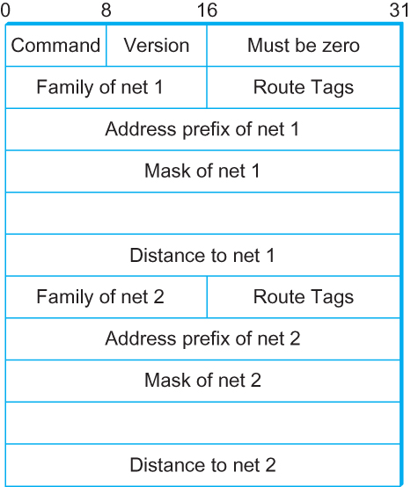
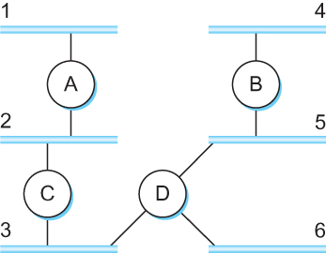
DV Implementation: Routing Information Protocol (RIP)
  Example Network
  running RIP RIPv2 Packet Format

Slide 15
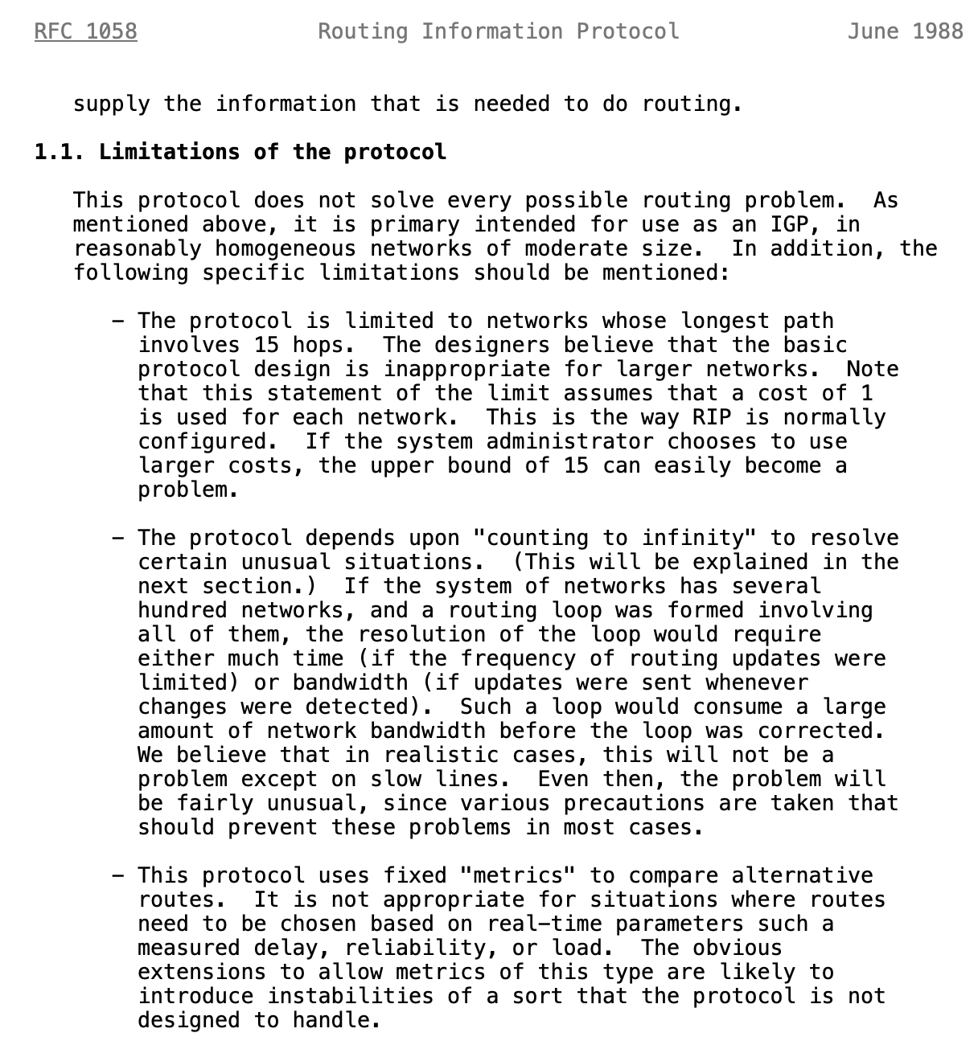
Limitations of DV routing
Small network assumption
Possibility of
routing loops
Static and
pre-determined
link costs
Notes:
What is RFC: https://www.techtarget.com/whatis/definition/Request-for-Comments-RFC

Slide 16
What is RFC?
Request for Comments (RFC):
A peer reviewed publication in a series from the
principal technical development and standards-setting
bodies for the Internet, most prominently
the Internet Engineering Task Force (IETF).
[ref] https://www.ietf.org/standards/rfcs/
How to Read an RFC: https://www.ietf.org/blog/how-read-rfc/

Slide 17
Routing by rumor
Consistent
view of topology
Link State Routing

Slide 18
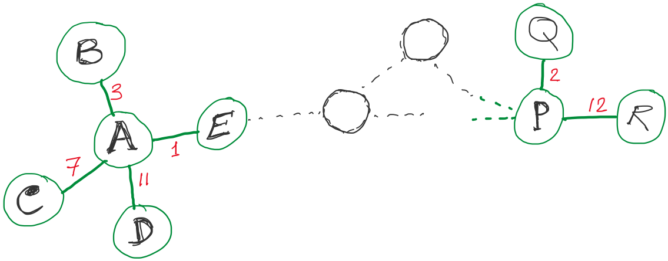
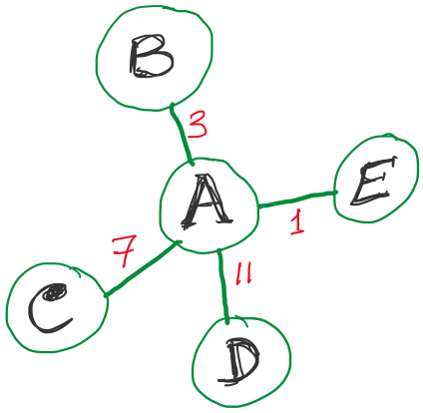
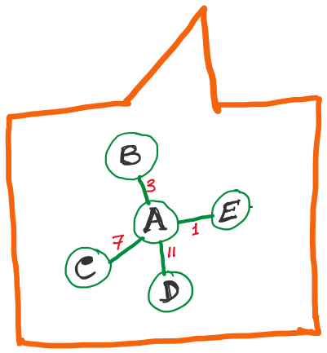
Link State Routing
Strategy:
Send to all nodes (not just neighbors) information about neighbors (not connection to all nodes).
All nodes will know the link-state information of all other nodes

Slide 19
Link State Routing
Strategy:
Send to all nodes (not just neighbors) information about neighbors (not connection to all nodes).
All nodes will know the link-state information of all other nodes

Slide 20
Link State Routing
Strategy:
Send to all nodes (not just neighbors) information about neighbors (not connection to all nodes).
Link State Packet (LSP):
  The ID of the node that created the LSP
  (2) Costs of links to each directly connected neighbor
  (3) A sequence number (SEQNO)
  [To distinguish a newer LSP from the old ones]
  [Smaller number == older LSP]
  (4) A Time-To-Live (TTL) for this packet
  [To make sure old information is eventually removed
  from the network]
What is the unit of the “Time-to-Live”?

Slide 21
Link State Routing
Strategy:
Send to all nodes (not just neighbors) information about neighbors (not connection to all nodes).
Link State Packet (LSP):
  The ID of the node that created the LSP
  (2) Costs of links to each directly connected neighbor
  (3) A sequence number (SEQNO)
  [To distinguish a newer LSP from the old ones]
  [Smaller number == older LSP]
  (4) A Time-To-Live (TTL) for this packet
  [To make sure old information is eventually removed
  from the network]
What is the unit of the “Time-to-Live”?

Slide 22
Thank you

