Slide 1
CMSC 417: Computer Networks
Spring 2025
Topic: Internetworking (LS routing + IP)
(Textbook chapter 3)
Nirupam Roy
Tu-Th 2:00-3:15pm
CSI 2117
Feb 17th, 2025

Slide 2
Routing by rumor
Consistent
view of topology
Link State Routing

Slide 3
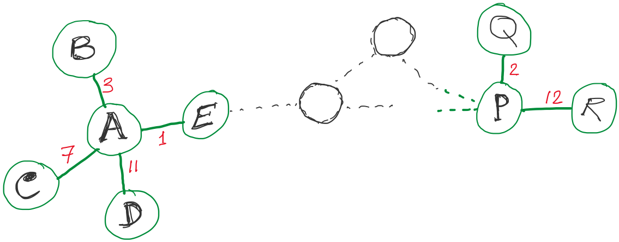
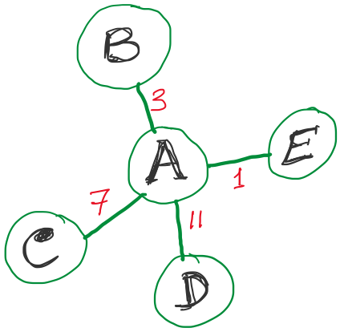
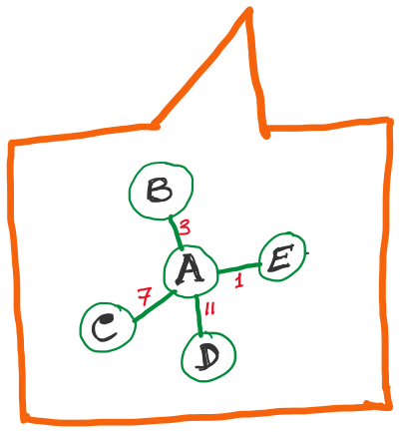
Link State Routing
Strategy:
Send to all nodes (not just neighbors) information about neighbors (not connection to all nodes).
All nodes will know the link-state information of all other nodes

Slide 4
Link State Routing
Strategy:
Send to all nodes (not just neighbors) information about neighbors (not connection to all nodes).
Link State Packet (LSP):
The ID of the node that created the LSP
(2) Costs of links to each directly connected neighbor
(3) A sequence number (SEQNO)
[To distinguish a newer LSP from the old ones]
[Smaller number == older LSP]
(4) A Time-To-Live (TTL) for this packet
[To make sure old information is eventually removed
from the network]
What is the unit of the “Time-to-Live”?

Slide 5
Link State Routing
(1) Reliable flooding
[Makes sure all nodes in the network get a copy of LSP from all other nodes]
(2) Route calculation
(Dijkstra’s shortest path algorithm)
[Calculates the shortest path from each node to all other nodes and the corresponding next-hop]

Slide 6
Link State Routing: Reliable flooding
Goals:
0) Ensure all nodes get LSPs from all other
Flood in minimum time
Minimize total routing traffic
Store most recent LSP from each node
Forward LSP to all nodes but one that sent it
Generate new LSP periodically; increment SEQNO
Start SEQNO at 0 when reboot
Decrement TTL before flooding it to neighbors.
Also age the stored LSP (decrement TTL)
Discard when TTL=0.

Slide 7
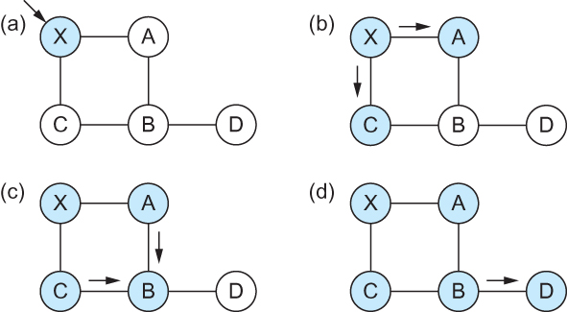
Link State
Gets two identical copies of LSP.
Accepts the one arrived first
Reliable Flooding
Flooding of link-state packets. (a) LSP arrives at node X; (b) X floods LSP to A and C; (c) A and C flood LSP to B (but not X); (d) flooding is complete

Slide 8
Link State
Reliable Flooding
Flooding of link-state packets. (a) LSP arrives at node X; (b) X floods LSP to A and C; (c) A and C flood LSP to B (but not X); (d) flooding is complete
This copy is not added to database.
But will ‘B’ flood it?
If B receives this LSP from A first, will B send the second copy received from C to A?

Slide 9
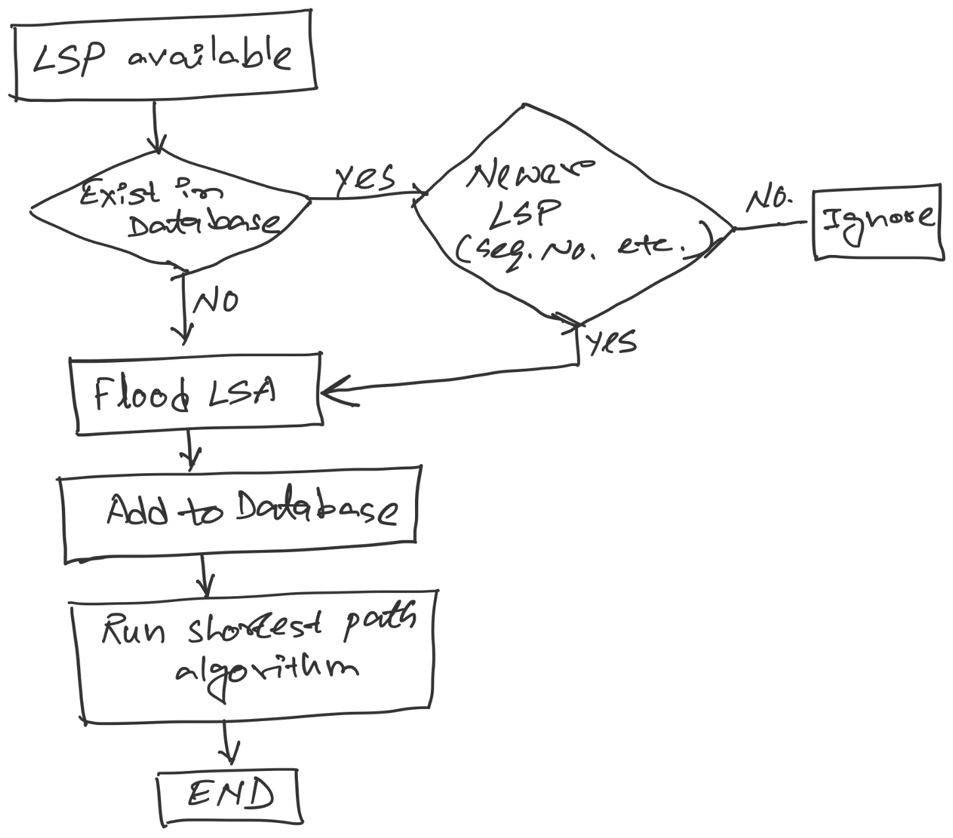
LSP processing

Slide 10
LSP processing flow
LSP available
Is it
a newer LSP?
(seq. #)
Exists in
Database?
Yes
No
Ignore
No
Yes
Flood LSP
Add to database
Run shortest path
algorithm
End

Slide 11
Consider this network:
B
D
19
4
A
11
13
15
7
5
C
E
After flooding every node will have the following information:
Each node has complete knowledge of the network topology
B
B
D
19
A
11
15
B
D
4
7
C
C
5
E
13
Apply shortest path algorithm to find routes
E
D
B
D
19
4
13
A
C
5
E

Slide 12
Consider this network:
B
D
19
4
A
11
13
15
7
5
C
E

Slide 13
Consider this network:
B
D
19
4
A
11
13
15
7
5
C
E
After flooding every node will have the following information:
B
B
D
19
A
11
15
B
D
A
4
7
C
C
5
E
7
15
13
E
D
C
B
D
19
4
13
11
C
5
A
E
C

Slide 14
Consider this network:
B
D
19
4
A
11
13
15
7
5
C
E
After flooding every node will have the following information:
Each node has complete knowledge of the network topology
B
B
D
19
A
11
15
B
D
A
4
7
C
C
5
E
7
15
13
Apply shortest path algorithm to find routes
E
D
C
B
D
19
4
13
11
C
5
A
E
C

Slide 15
Shortest Path Routing
Dijkstra’s Algorithm - Assume non-negative link weights
N: set of nodes in the graph
l((i, j): the non-negative cost associated with the edge between nodes i, j ∈N and l(i, j) = ∝ if no edge connects i and j
Let s ∈N be the starting node which executes the algorithm to find shortest paths to all other nodes in N
Two variables used by the algorithm
M: set of nodes incorporated so far by the algorithm
C(n) : the cost of the path from s to each node n
The algorithm
M = {s}
For each n in N – {s}
C(n) = l(s, n)
while ( N ≠ M)
M = M ∪ {w} such that C(w) is the minimum
for all w in (N-M)
For each n in (N-M)
C(n) = MIN (C(n), C(w) + l(w, n))

Slide 16
Shortest Path Routing
In practice, each switch computes its routing table directly from the LSP’s it has collected using a realization of Dijkstra’s algorithm called the forward search algorithm
Specifically, each switch maintains two lists, known as Tentative and Confirmed
Each of these lists contains a set of entries of the form (Destination, Cost, NextHop)

Slide 17
Consider this network:
B
D
19
4
A
11
13
15
7
5
C
E
After flooding every node will have the following information:
B
B
D
19
A
11
15
B
D
A
4
7
C
C
5
E
7
15
13
E
D
C
B
D
19
4
13
11
C
5
A
E
C

Slide 18
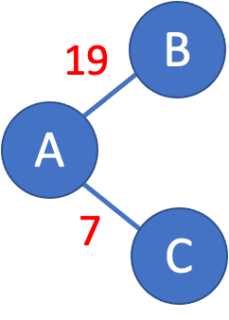
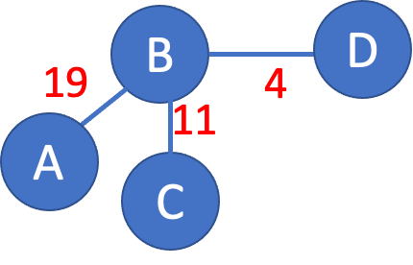
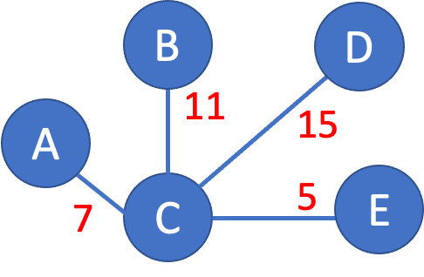
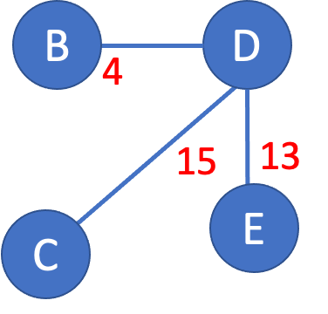
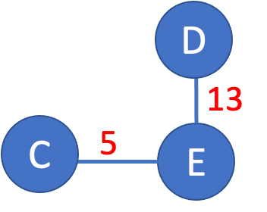
>

Slide 19
>
19
B
A
7
C

Slide 20
>
19
B
A
7
C

Slide 21
>
19
B
Unvisited nodes
A
Confirmed nodes
7
C
Tentative nodes

Slide 22
>
19
B
Unvisited nodes
A
Confirmed nodes
7
C
Tentative nodes

Slide 23
>
19
B
A
7
C
‘Confirm’ the lowest cost nodes
from the list of ‘tentative’ nodes.

Slide 24
>
B
B
D
19
A
11
15
A
7
C
X
C
5
E
7
‘Confirm’ the lowest cost nodes
from the list of ‘tentative’ nodes.
… and find out this newly ‘confirmed’
node’s LSP (i.e., C’s LSP).
X
= Ignore the confirmed nodes

Slide 25
>
B
B
D
19
A
11
15
Update costs
A
By adding the cost
to reach ‘C’.
7
C
X
C
5
E
7

Slide 26
>
B
B
D
19
A
18
22
Costs updated
A
7
C
X
C
12
E
7

Slide 27
>
Join with minimum link costs
D
B
B
D
A
18
22
18
Costs updated
22
A
7
C
12
E
X
C
12
E
7
Note that B’s link is updated.

Slide 28
>
D
B
A
18
22
7
C
12
E

Slide 29
>
D
D
B
13
A
18
22
C
5
E
7
C
12
E
‘Confirm’ the lowest cost nodes
from the list of ‘tentative’ nodes.
… and find out this newly ‘confirmed’
node’s LSP.

Slide 30
>
D
D
B
X
13
18
22
25
A
C
5
E
7
C
12
E
No addition to the topology as the links are already at minimum costs.

Slide 31
>
18
D
B
D
B
19
4
A
18
22
A
11
X
C
7
C
12
E
X
‘Confirm’ the lowest cost nodes
from the list of ‘tentative’ nodes.
… and find out this newly ‘confirmed’
node’s LSP (this time B’s LSP).

Slide 32
>
18
D
B
D
B
19
4
A
18
22
11
22
A
X
C
7
C
12
E
X
No addition to the topology as the links are already at minimum costs.

Slide 33
>
D
X
B
B
D
4
A
18
22
X
15
C
13
7
C
12
E
E
X
‘Confirm’ the lowest cost nodes
from the list of ‘tentative’ nodes.
… and find out this newly ‘confirmed’
node’s LSP (this time D’s LSP).
No addition to the topology as the links are already at minimum costs.

Slide 34
B
D
19
4
A
11
13
15
7
5
C
E
D
B
A
18
22
7
C
12
E

Slide 35
Shortest Path Routing
Dijkstra’s Algorithm
M = {s}
For each n in N – {s}
C(n) = l(s, n)
while ( N ≠ M)
M = M ∪ {w} such that C(w) is the minimum
for all w in (N-M)
For each n in (N-M)
C(n) = MIN (C(n), C(w) + l(w, n))
Confirmed list
Newly added member to the confirmed list
Tentative list

Slide 36
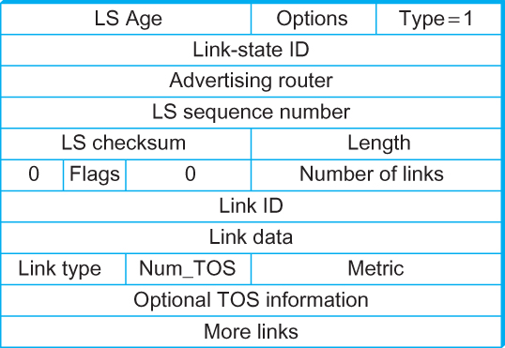
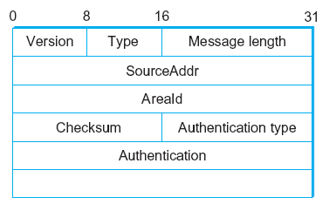
Open Shortest Path First (OSPF)
OSPF Header Format OSPF Link State Advertisement
OSPF runs over IPv4 and IPv6 (does not use a transport protocol such
as UDP or TCP).
It encapsulates its data directly in IP packets with protocol number 89.

Slide 37
Comparison of LS and DV algorithms
message complexity
LS: with n nodes, E links, O(nE) msgs sent
DV: exchange between neighbors only
convergence time varies
speed of convergence
LS: O(n²) algorithm requires O(nE) msgs
may have oscillations
DV: convergence time varies
may be routing loops
count-to-infinity problem
robustness: what happens if router malfunctions?
LS:
node can advertise incorrect link cost
each node computes only its own table
DV:
DV node can advertise incorrect path cost
each node’s table used by others
error propagate thru network

Slide 38
 | Distance Vector routing | Link State routing
Convergence time/Latency |  | ✅
Robustness to Loop |  | ✅
Processing overhead | ✅
Bandwidth requirement (for control plane) | ✅
Scalability (and robustness to complex topology and changes) |  | ✅

Slide 39
Internet Protocol

Slide 40
The Internet network layer
host, router network layer functions:
transport layer: TCP, UDP
routing protocols
path selection
RIP, OSPF, BGP
IP protocol
addressing conventions
datagram format
packet handling conventions
network
layer
forwarding
table
ICMP protocol
error reporting
router “signaling”
link layer
physical layer

Slide 41
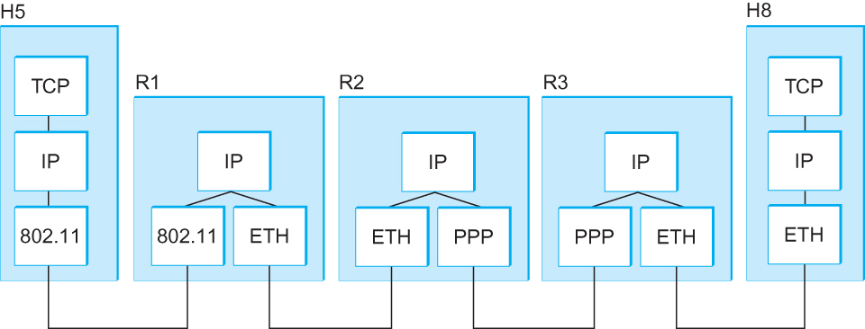
Internetworking
What is IP
IP stands for Internet Protocol
Key tool used today to build scalable, heterogeneous internetworks
It runs on all the nodes in a collection of networks and defines the infrastructure that allows these nodes and networks to function as a single logical internetwork
A simple internetwork showing the protocol layers

Slide 42
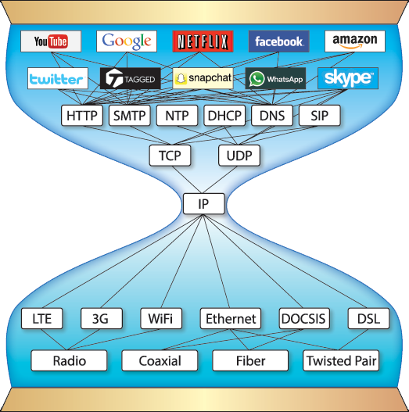
Pic courtesy: https://www.are.na/block/881873

Slide 43
IP Service Model
Packet Delivery Model
Connectionless model for data delivery
Best-effort delivery (unreliable service)
packets are lost
packets are delivered out of order
duplicate copies of a packet are delivered
packets can be delayed for a long time
Global Addressing Scheme
Provides a way to identify all hosts in the network

Slide 44
IP datagram format (i.e., Packet format)
32 bits
ver
head.
len
type of
service
length
flgs
fragment
offset
16-bit identifier
Variable size header.
(20 bytes default
without options)
time to
live
upper
layer
header
checksum
32 bit source IP address
32 bit destination IP address
options (if any)
data
(variable length,
typically a TCP
or UDP segment)
Variable size data.
Data size =
(Datagram Len – Header Len)

Slide 45
IP datagram format
IP protocol version number
(4 bits)
32 bits
total datagram
length (bytes)
header length
in # of 4-bytes (4 bits)
head.
len
type of
service
ver
length
for
fragmentation/
reassembly
“type” of data
(real-time, non-real-time etc.)
fragment
offset
16-bit identifier
flgs
time to
live
upper
layer
header
checksum
max number remaining hops
(decremented at each router)
Why header only?
32 bit source IP address
32 bit destination IP address
upper layer protocol
to deliver payload to
options (if any)
e.g. timestamp,
record route
taken, specify
list of routers
to visit, Min-MTU
discovery
data
(variable length,
typically a TCP
or UDP segment)

Slide 46
Thank you

