Slide 1

CMSC 417: Computer Networks
Spring 2025
Topic: Internetworking: Addresses, Subnets, CIDR, DHCP
(Textbook chapter 3)
Nirupam Roy
Tu-Th 2:00-3:15pm
CSI 2117
Feb 24th, 2025

Slide 2
IP Fragmentation-Reassembly: Q&A
1. The packet “Identifier”
2. Does fragmentation and reassembly set a new limit on the total
packet size? Is it consistent with “packet length” header field?
3. Fragmentation of fragmentation
4. Assembly of mixed fragmentation of different size
(possibly from different paths)
RFC 791, page 24: https://www.rfc-editor.org/rfc/rfc791

Slide 3
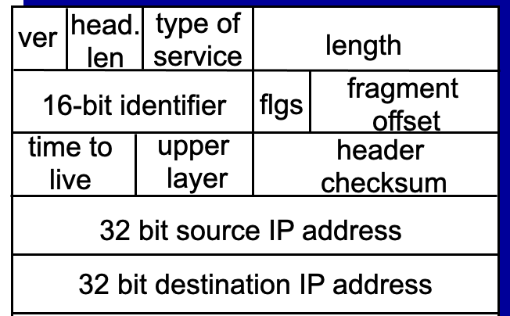
1. The packet “Identifier”
What can violate the uniqueness of the “identifier”?
In IPv4, the Identification (ID) field is a 16-bit value that is unique for every datagram for a given source address, destination address, and protocol, such that it does not repeat within the maximum datagram lifetime (MDL) [RFC791] [RFC1122]. As currently specified, all datagrams between a source and destination of a given protocol must have unique IPv4 ID values over a period of this MDL, which is typically interpreted as two minutes and is related to the
recommended reassembly timeout [RFC1122]. This uniqueness is currently specified as for all datagrams, regardless of fragmentation settings.

Slide 4
2. Does fragmentation and reassembly set a new limit on the total
packet size? Is it consistent with “packet length” header field?

Slide 5
3. Fragmentation of fragmentation
How “More Fragments (MF)” flag is decided?
How “fragment offset” is calculated?

Slide 6
4. Assembly of mixed fragmentation of different size
(possibly from different paths)
“Fragment offsets” always represent the absolute position of a data-fragment relative to the original (unfragmented) packet.
The last fragment decides the total data size in the reassembly process.
Reassembly fails only if there are missing data before the timer goes off.
(Recommended initial value for the time is 15 seconds)

Slide 7
Network Addresses

Slide 8
IP Address (IPv4)
A unique 32-bit number
Identifies an interface (on a host, on a router, …)
Represented in dotted-quad notation
12
34
158
5
00001100
00100010
10011110
00000101
12:34:158:5

Slide 9
Grouping Related Hosts
The Internet is an “inter-network”
  Used to connect networks together, not hosts
  Need to address a network (i.e., group of hosts)
host
host
...
host
host
host
...
host
LAN 1
LAN 2
router
router
router
WAN
WAN
LAN = Local Area Network
WAN = Wide Area Network
Notes:
Hint: IP routing tries to find the network. Once the packet reaches to the router physically connected to the destination network, it can forward the packet using link-layer delivery method. Routing/forwarding tables only cares about the address of that physical network.

Slide 10
Scalability Challenge
Suppose hosts had arbitrary addresses
  Then every router would need a lot of information
  …to know how to direct packets toward every host
1.2.3.4
5.6.7.8
2.4.6.8
1.2.3.5
5.6.7.9
2.4.6.9
host
host
...
host
host
host
...
host
LAN 1
LAN 2
router
router
router
WAN
WAN
1.2.3.4
1.2.3.5
forwarding table

Slide 11
Hierarchical Addressing: IP Prefixes
Network and host portions (left and right)
12
34
158
5
00001100
00100010
10011110
00000101
Network (24 bits)
Host (8 bits)
(N bits)
(32-N bits)

Slide 12
Hierarchical Addressing in U.S. Mail
Addressing in the U.S. mail
  Zip code: 08540
  Building: 35 Olden Street
  Room in building: 306
  Name of occupant: Jennifer Rexford
Forwarding the U.S. mail
  Deliver to the post office in the zip code
  Assign to mailman covering the building
  Drop letter into mailbox for building/room
  Give letter to the appropriate person
???

Slide 13
Easy to Add New Hosts
No need to update the routers
  E.g., adding a new host 5.6.7.213 on the right
  Doesn’t require adding a new forwarding-table entry
1.2.3.4
1.2.3.7
1.2.3.156
5.6.7.8
5.6.7.9
5.6.7.212
host
host
...
host
host
host
...
host
LAN 1
LAN 2
router
router
router
host
WAN
WAN
5.6.7.213
1.2.3.0/24
5.6.7.0/24
forwarding table

Slide 14
Hierarchical Addressing: IP Prefixes
Network and host portions (left and right)
12
34
158
5
00001100
00100010
10011110
00000101
Network (24 bits)
Host (8 bits)
(N bits)
(32-N bits)

Slide 15
Hierarchical Addressing: IP Prefixes
Network and host portions (left and right)
12
34
158
5
00001100
00100010
10011110
00000101
Network (24 bits)
Host (8 bits)
(N bits)
(32-N bits)
N = ?

Slide 16
“Classes” of networks
The sizes of networks can be different
1.2.3.4
1.2.3.7
1.2.3.156
5.6.7.8
5.6.7.9
host
host
...
host
host
host
LAN 1
LAN 2
router
router
router
WAN
WAN
Large networks (many hosts)
Fewer such networks exist
Small networks (fewer hosts)
Many such networks exist
1.2.3.0/24
5.6.7.0/24
forwarding table

Slide 17
Class-full addressing

Slide 18
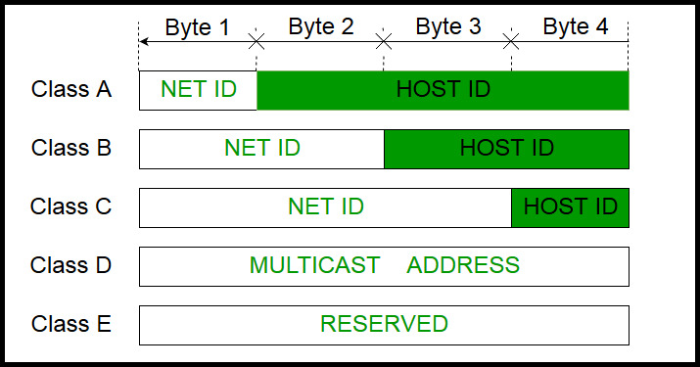
How can you tell network class from the IP address?
Picture courtesy: https://www.geeksforgeeks.org/introduction-of-classful-ip-addressing/

Slide 19
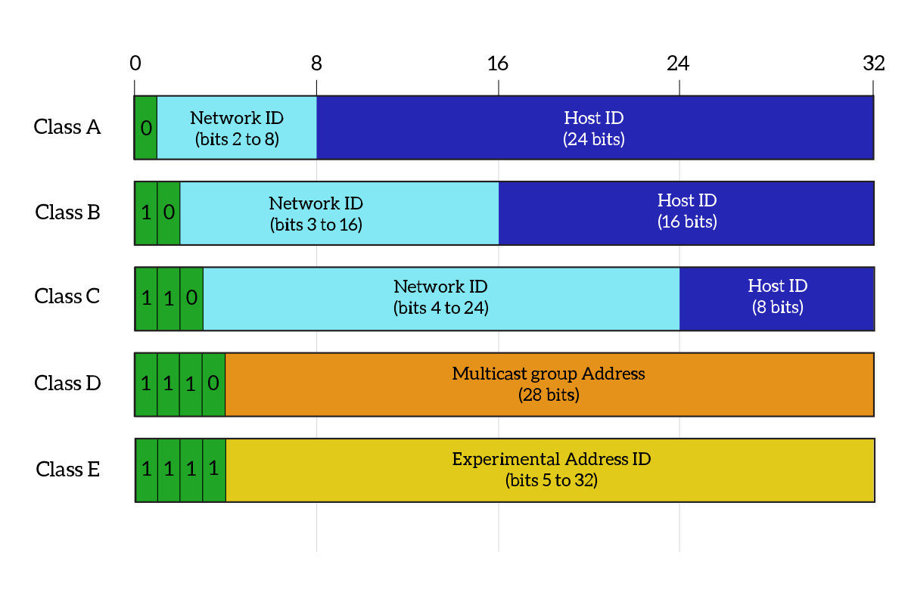
What percentage of addresses and allocated to each class?
Picture courtesy: https://www.ictshore.com/free-ccna-course/network-layer-ipv4-addressing/attachment/1013-05-classful_addressing/

Slide 20
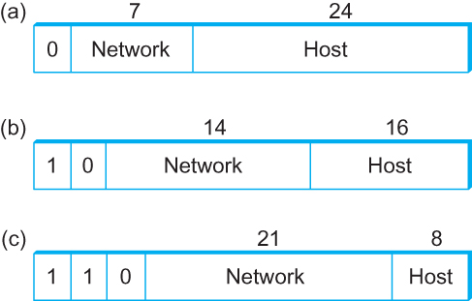
Global Addresses
Properties
  globally unique
  hierarchical: network + host
  4 Billion IP address, half are A type, ¼ is B type, and 1/8 is C type
Format
Dot notation
  10.3.2.4
  128.96.33.81
  192.12.69.77

Slide 21
Let’s assume we have 4-bit address (instead of 32 bit)
0000
0001
0010
0011
0100
0101
0110
0111
1000
1001
1010
1011
1100
1101
1110
1111
Class A (Half of all possible addresses)
Class B (1/4 of all possible addresses)
Class C (1/8 of all possible addresses)

Slide 22
Let’s assume we have 4-bit address (instead of 32 bit)
0000
0001
0010
0011
0100
0101
0110
0111
Class A (Half of all possible addresses)
Say, 1 bit for network part = 2 different networks
Say, 2 bits for host part = 4 hosts per network

Slide 23
Global Addresses
Properties
  globally unique
  hierarchical: network + host
  4 Billion IP address, half are A type, ¼ is B type, and 1/8 is C type
Format
Dot notation
  10.3.2.4
  128.96.33.81
  192.12.69.77

Slide 24
Classful Addressing
In the olden days, only fixed allocation sizes
  Class A: 0*
    Very large /8 blocks (e.g., MIT has 18.0.0.0/8)
    There can be 126 different class A networks (0 and 127 values are reserved) and (2²⁴-2) different hosts (2 values are reserved)
  Class B: 10*
    Large /16 blocks (e.g,. Princeton has 128.112.0.0/16)
  Class C: 110*
    Small /24 blocks (e.g., AT&T Labs has 192.20.225.0/24)
    2²¹ different networks possible, 254 hosts (255 is reserved for broadcast and 0 is reserved)
  Class D: 1110* for multicast groups
  Class E: 11110* reserved for future use
This is why folks use dotted-quad notation!

Slide 25
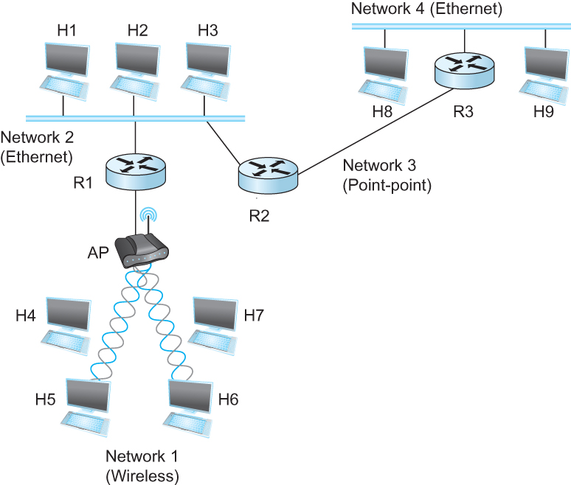
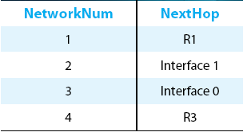
IP Datagram Forwarding
Strategy
  every datagram contains destination's address
  if directly connected to destination network, then forward to host
  if not directly connected to destination network, then forward to some router
  forwarding table maps network number into next hop
  each host has a default router
  each router maintains a forwarding table
Example (router R2)

Slide 26

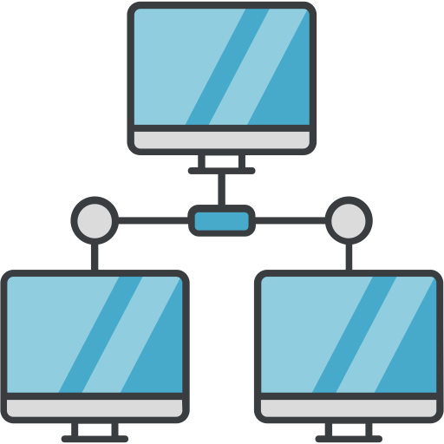
IP Datagram Forwarding
Forwarding table at R2
R2
I-0
I-1
R3
R1

Slide 27
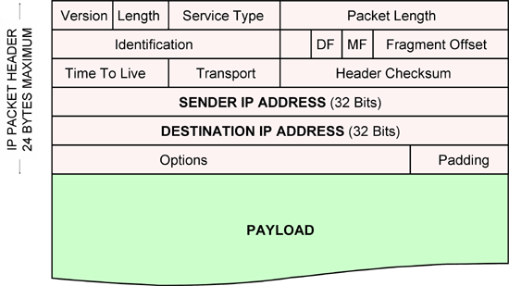
IP Datagram Forwarding
Forwarding table at R2
R2
I-0
I-1
R3
R1
IP data packet (datagram)

Slide 28
IP Datagram Forwarding
Forwarding table at R2
R2
I-0
I-1
R3
R1
Algorithm
if (NetworkNum of destination = NetworkNum of one of my interfaces) then
deliver packet to destination over that interface
else
if (NetworkNum of destination is in my forwarding table) then
deliver packet to NextHop router
else
deliver packet to default router
First: find the NetworkNum. How?

Slide 29
IP Datagram Forwarding
Algorithm
if (NetworkNum of destination = NetworkNum of one of my interfaces) then
deliver packet to destination over that interface
else
if (NetworkNum of destination is in my forwarding table) then
deliver packet to NextHop router
else
deliver packet to default router
For a host with only one interface and only a default router in its forwarding table, this simplifies to
if (NetworkNum of destination = my NetworkNum)then
deliver packet to destination directly
else
deliver packet to default router

Slide 30
Obtaining a Block of Addresses
Internet Corporation for Assigned Names and Numbers (ICANN)
  Allocates large blocks to Regional Internet Registries
Regional Internet Registries (RIRs)
  E.g., ARIN (American Registry for Internet Numbers)
  Allocates to ISPs and large institutions
Internet Service Providers (ISPs)
  Allocate address blocks to their customers
  Who may, in turn, allocate to their customers…

Slide 31
Obtaining a Block of Addresses
Your organization: XYZ
Maximum # of hosts is estimated to be 10 millions.
What class of IP address will you request for?
Maximum # of hosts is estimated to be 64K ?
Maximum # of hosts is estimated to be 250?
Maximum # of hosts is estimated to be 100?
Maximum # of hosts is estimated to be 20?
Maximum # of hosts is estimated to be 300?
Maximum # of hosts is estimated to be 66K?
Notes:
Class A can have 16 millions (16777214 = 2^24-2)
Class B can have 65K (65534 = 2^16 - 2)
Class C can have 254 (2^8-2)

Slide 32
Problems with the classes of addresses
Wastage of addresses
Bigger tables to look up at routers

Slide 33
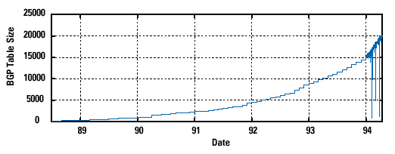
Pre-CIDR (1988-1994): Steep Growth
Growth faster than improvements in equipment capability

Slide 34
Subnetting

Slide 35


The ISP provided the network address space: 223.1.1.X
ISP
Router
223.1.1.1
223.1.1.2
223.1.1.3
223.1.1.4
223.1.1.5
223.1.1.6

Slide 36
The ISP provided the network address space: 223.1.1.X
ISP
223.1.2.X
Router
223.1.3.X
223.1.1.1
223.1.1.2
223.1.1.3
223.1.1.4
223.1.1.5
223.1.1.6

Slide 37
The ISP provided the network address space: 223.1.1.X
Router
Two separate networks are needed. How can we assign addresses to these “sub” networks?

Slide 38
Thank you

