Slide 1
Computer Networks
CMSC 417 : Spring 2025
Topic: Internetworking: CIDR, DHCP, NAT, ARP
(Textbook chapter 3)
Nirupam Roy
Tu-Th 2:00-3:15pm
CSI 2117
Feb 26th, 2025

Slide 2
Announcement: Yibo is a new TA for 417

Slide 3
Subnetting

Slide 4
The ISP provided the network address space: 223.1.1.X
ISP
Router
223.1.1.1
223.1.1.2
223.1.1.3
223.1.1.4
223.1.1.5
223.1.1.6

Slide 5
The ISP provided the network address space: 223.1.1.X
ISP
223.1.2.X
Router
223.1.3.X
223.1.1.1
223.1.1.2
223.1.1.3
223.1.1.4
223.1.1.5
223.1.1.6

Slide 6
The ISP provided the network address space: 223.1.1.X
Router
Two separate networks are needed. How can we assign addresses to these “sub” networks?

Slide 7
The ISP provided the network address space: 223.1.1.X
Router

Slide 8
The ISP provided the network address space: 223.1.1.X
Router
Use subnetting

Slide 9
The ISP provided the network address space: 223.1.1.X
11011111.00000001.00000001.XXXXXXX
Router
Use part of the host bits to identify separate subnets.

Slide 10
The ISP provided the network address space: 223.1.1.X
11011111.00000001.00000001.XXXXXXX
Router
Use part of the host bits to identify separate subnets.
11011111.00000001.00000001.0XXXXXX
11011111.00000001.00000001.1XXXXXX
Subnet mask = 11111111. 11111111. 11111111.10000000

Slide 11
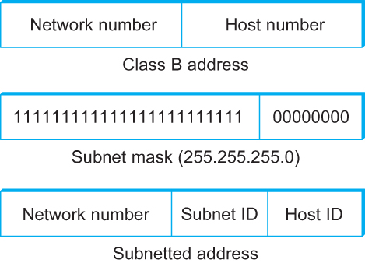
Subnetting
Add another level to address/routing hierarchy: subnet
Subnet masks define variable partition of host part of class A and B addresses
Subnets visible only within site
“Bitwise and”

Slide 12
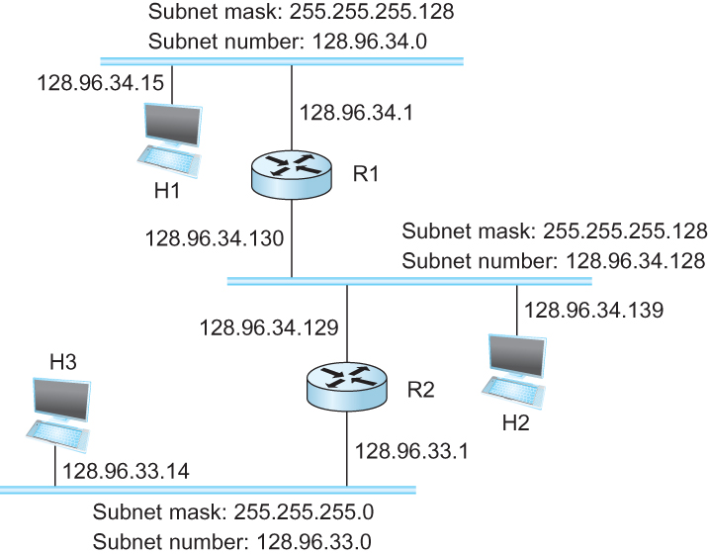
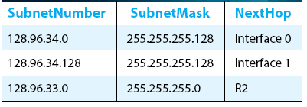
Subnetting
Forwarding Table at Router R1

Slide 13
Subnetting
Forwarding Table at Router R1
Forwarding Algorithm
D = destination IP address
for each entry < SubnetNum, SubnetMask, NextHop>
D1 = SubnetMask & D
if D1 = SubnetNum
if NextHop is an interface
deliver datagram directly to destination
else
deliver datagram to NextHop (a router)

Slide 14
Subnetting
Notes
Would use a default router if nothing matches
Not necessary for all ones in subnet mask to be contiguous
Can put multiple subnets on one physical network
Subnets not visible from the rest of the Internet

Slide 15
Subnets “toy” example

Slide 16
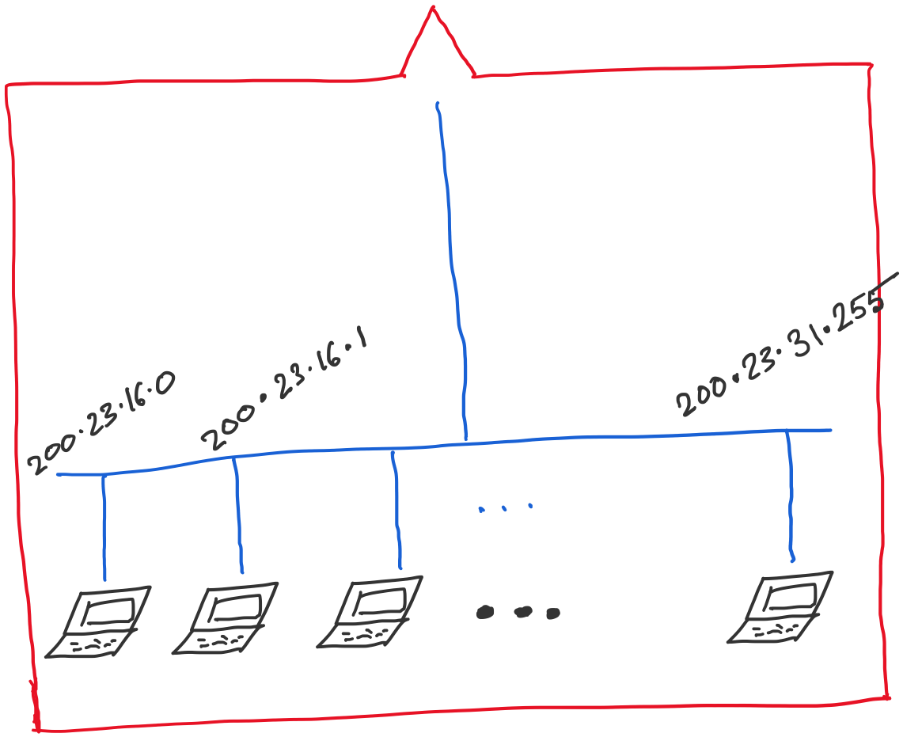
Address space assigned to you:

Slide 17
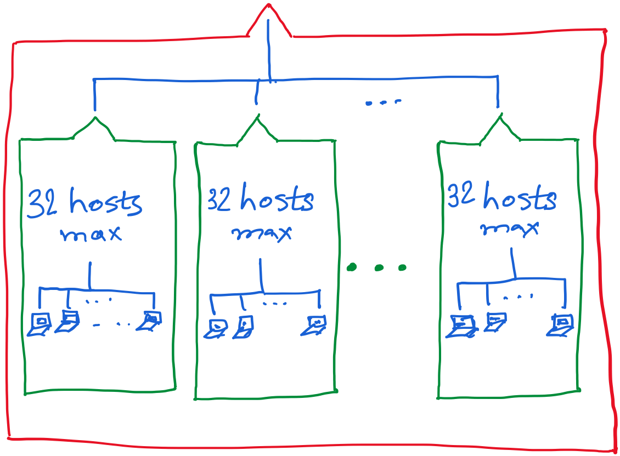
30 hosts max.
22 hosts max.
18 hosts max.

Slide 20
Announcements
In-class Midterm-1 exam: March 3rd.
Syllabus: Until “Subnetting”.

Slide 21
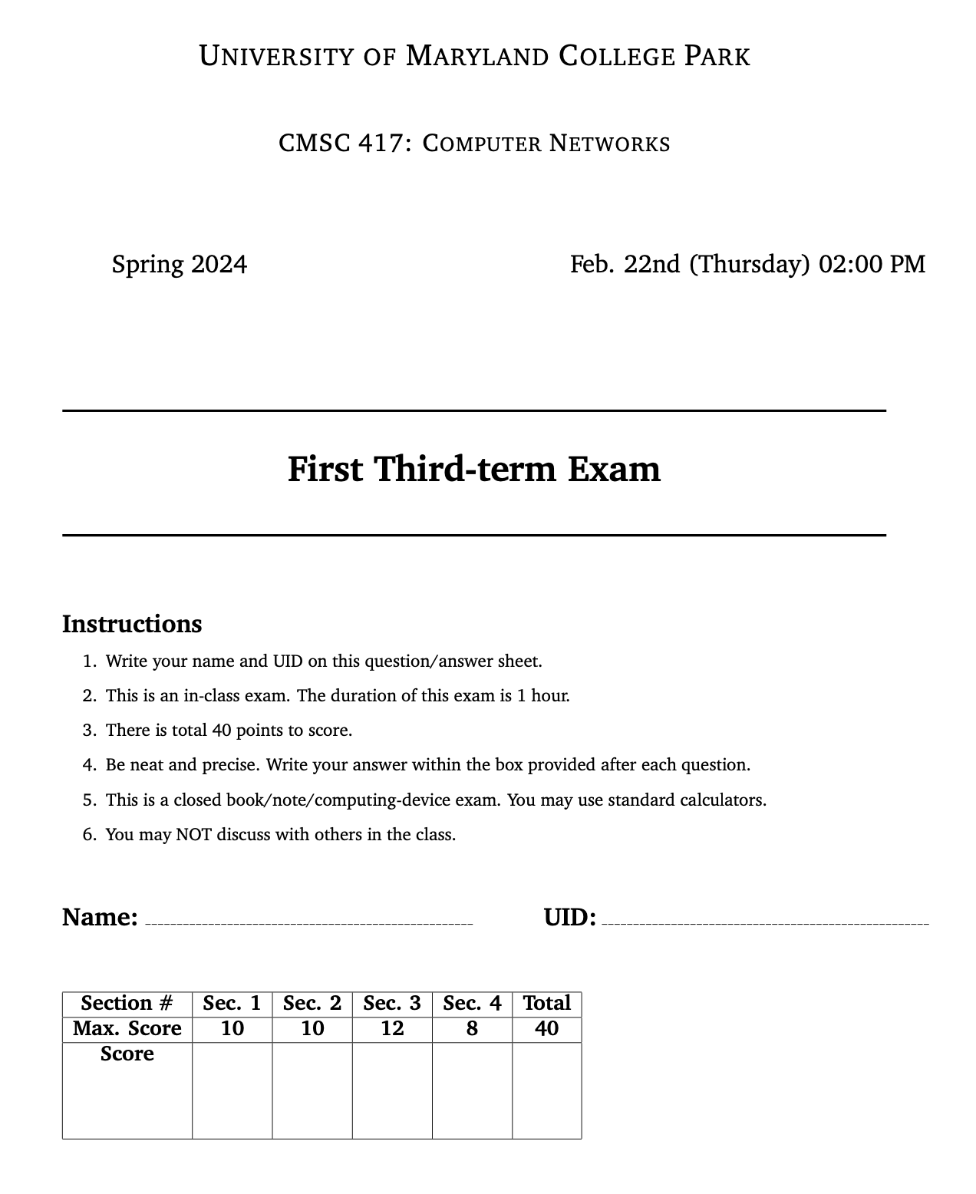
It is the question format from the last year for reference. Expect changes.

Slide 22
It is the question format from the last year for reference. Expect changes.

Slide 23
It is the question format from the last year for reference. Expect changes.

Slide 24
Class-less Interdomain Routing (CIDR)
Generalizes the ideas of subnetting

Slide 25
Lessons learned from subnetting
Forwarding tab.
Forwarding tab.
223.1.1.0
223.1.1.0
223.1.2.0
223.1.2.0
223.1.1.0
223.1.3.0
223.1.3.0
ISP
223.1.2.0
223.1.3.0

Slide 26
Lessons learned from subnetting
Forwarding tab.
Forwarding tab.
223.1.1.0
223.1.1.0
223.1.2.0
223.1.2.0
223.1.1.128
223.1.1.0
223.1.3.0
223.1.3.0
223.1.1.192
ISP
223.1.2.0
223.1.3.0

Slide 27
Lessons learned from subnetting
Forwarding tab.
Forwarding tab.
223.1.1.0
223.1.1.0
223.1.2.0
223.1.2.0
223.1.1.128
223.1.1.0
223.1.3.0
223.1.3.0
223.1.1.192
ISP
Lesson 1:
Address classes are not needed. Mask can define the number of bits for the network part.
Lesson 2:
Network hierarchies can be hidden from the outside world.
Network addresses can be aggregated/summarized/combined
223.1.2.0
223.1.3.0

Slide 28
CIDR: Classless address

Slide 29
IP addressing: CIDR
CIDR: Classless InterDomain Routing
Network portion of address of arbitrary length
address format: a.b.c.d/x, where x is # bits in subnet portion of address
subnet
part
host
part
11001000 00010111 00010000 00000000
200.23.16.0/23
200.23.16.0–200.23.17.255
This X bit network part is often called Prefix or Network-prefix

Slide 30
IP addressing: CIDR
CIDR: Classless InterDomain Routing
subnet portion of address of arbitrary length
address format: a.b.c.d/x, where x is # bits in subnet portion of address
forwarding table
4.0.0.0/8
4.83.128.0/17
201.10.0.0/21
201.10.6.0/23
126.255.103.0/24

Slide 31
CIDR: Super-netting/ Route aggregation

Slide 32
Lessons learned from subnetting
Forwarding tab.
Forwarding tab.
223.1.1.0/24
223.1.1.0/24
223.1.2.0/24
223.1.2.0/24
223.1.1.0
223.1.3.0/24
223.1.3.0/24
ISP
223.1.0.0/16
223.1.2.0
223.1.3.0

Slide 33
Lessons learned from subnetting
Forwarding tab.
Forwarding tab.
223.1.1.0/24
223.1.0.0/16
223.1.2.0/24
223.1.1.0
223.1.3.0/24
ISP
223.1.0.0/16
223.1.2.0
223.1.3.0

Slide 34
Thank you

Slide 37
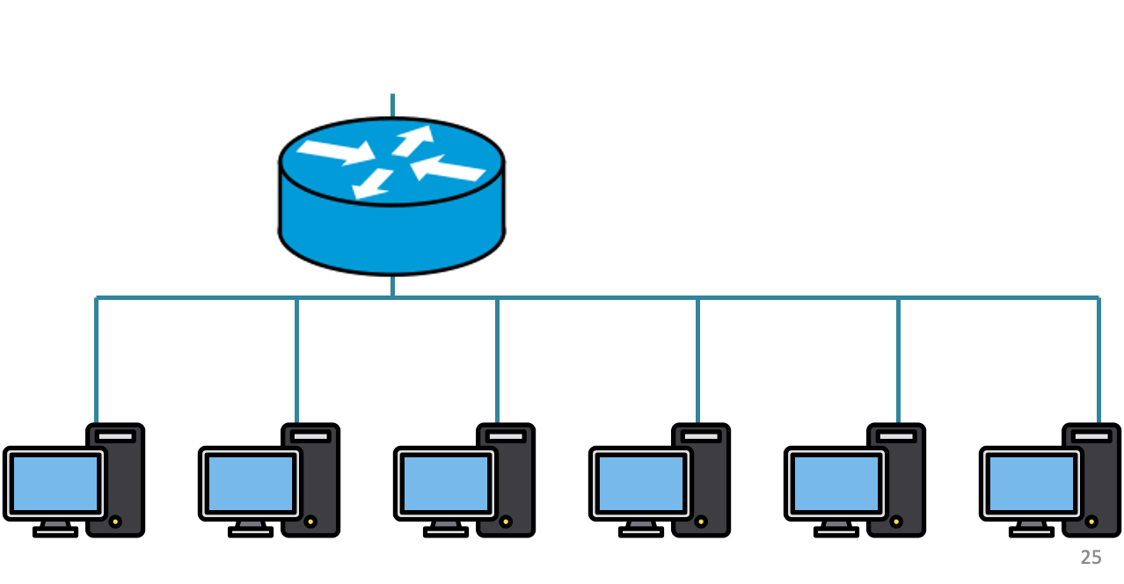
200.20.1.0/24
200.20.2.0/24
200.20.0.0/24

Slide 38
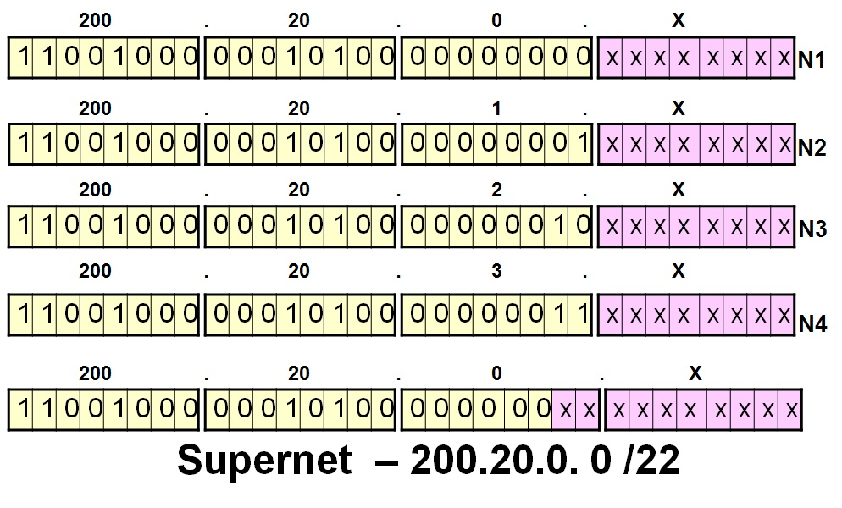
200.20.1.0/24
200.20.2.0/24
200.20.0.0/24

Slide 39
Route aggregation
200.20.1.0/24
200.20.2.0/24
200.20.0.0/24

Slide 40
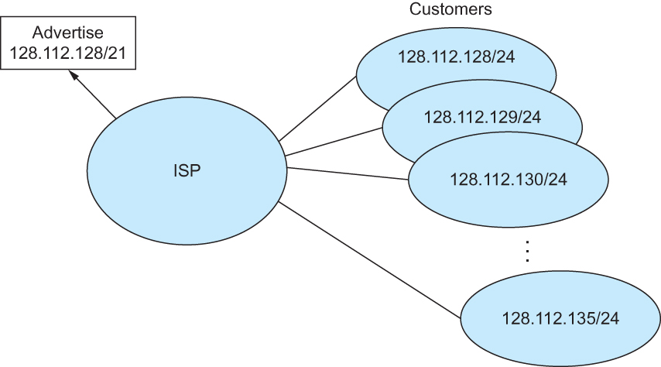
Route aggregation with CIDR

Slide 41
Classless Inter-Domain Routing (CIDR)
Use two 32-bit numbers to represent a network.
Network number = IP address + Mask
IP Address : 12.4.0.0 IP Mask: 255.254.0.0
Address
00001100
00000100
00000000
00000000
Mask
11111111
11111110
00000000
00000000
Network Prefix
for hosts
Written as 12.4.0.0/15

Slide 42
Hierarchical Address Allocation
Hierarchy is key to scalability
Address allocated in contiguous chunks (prefixes)
Today, the Internet has about 400,000 prefixes
12.0.0.0/16
12.1.0.0/16
:
:
:
12.3.0.0/24
12.2.0.0/16
12.3.1.0/24
12.3.0.0/16
:
:
:
:
:
12.0.0.0/8
12.3.254.0/24
12.253.0.0/19
12.253.32.0/19
:
:
12.254.0.0/16
12.253.160.0/19

Slide 43
Separate Forwarding Entry Per Prefix
Prefix-based forwarding
Map the destination address to matching prefix
Forward to the outgoing interface
1.2.3.4
1.2.3.7
1.2.3.156
5.6.7.8
5.6.7.9
5.6.7.212
host
host
...
host
host
host
...
host
LAN 1
LAN
router
router
router
WAN
WAN
1.2.3.0/24
5.6.7.0/24
forwarding table

Slide 44
CIDR Makes Packet Forwarding Harder
201.10.0.0/21
Provider 1
201.10.0.0/22
201.10.4.0/24
201.10.5.0/24
201.10.6.0/23

Slide 45
CIDR Makes Packet Forwarding Harder
201.10.0.0/21
Provider 1
Provider 2
Multi-homing
201.10.0.0/22
201.10.4.0/24
201.10.5.0/24
201.10.6.0/23

Slide 46
CIDR Makes Packet Forwarding Harder
Forwarding tab.
201.10.0.0/21
Provider 1
Provider 2
Multi-homing
201.10.0.0/22
201.10.4.0/24
201.10.5.0/24
201.10.6.0/23

Slide 47
CIDR Makes Packet Forwarding Harder
Forwarding tab.
201.10.0.0/21
201.10.6.0/23
201.10.0.0/21
Provider 1
Provider 2
Multi-homing
201.10.0.0/22
201.10.4.0/24
201.10.5.0/24
201.10.6.0/23

Slide 48
CIDR Makes Packet Forwarding Harder
Forwarding table
201.10.0.0/21
11001001.00001010.00000000.00000000/21
201.10.6.0/23
11001001.00001010.00000110.00000000/23
A packet with dest. Addr.: 201.10.6.17
11001001.00001010.00000110.00010001

Slide 49
CIDR Makes Packet Forwarding Harder
Forwarding table may have many matches
E.g., entries for 201.10.0.0/21 and 201.10.6.0/23
The IP address 201.10.6.17 would match both!
201.10.0.0/21
Provider 1
Provider 2
201.10.0.0/22
201.10.4.0/24
201.10.5.0/24
201.10.6.0/23

Slide 50
Longest Prefix Match Forwarding
Destination-based forwarding
Packet has a destination address
Router identifies longest-matching prefix
Cute algorithmic problem: very fast lookups
forwarding table
4.0.0.0/8
4.83.128.0/17
201.10.0.0/21
201.10.6.0/23
126.255.103.0/24
destination
201.10.6.17
outgoing link

Slide 51
Getting an IP address: DHCP Protocol

Slide 52
IP addresses: how to get one?
Q: How does a host get its IP address?
hard-coded by system admin in a file
Windows: control-panel->network->configuration->tcp/ip->properties
UNIX: /etc/…
DHCP: Dynamic Host Configuration Protocol: dynamically get address from a server
“plug-and-play”

Slide 53
DHCP: Dynamic Host Configuration Protocol
goal: allow host to dynamically obtain its IP address from network server when it joins network
can renew its lease on address in use
allows reuse of addresses (only hold address while connected/“on”)
support for mobile users who want to join network

Slide 54
DHCP: Dynamic Host Configuration Protocol
DHCP overview:
host broadcasts “DHCP discover” msg
DHCP server responds with “DHCP offer” msg
host requests IP address: “DHCP request” msg
DHCP server sends address: “DHCP ack” msg

Slide 55
DHCP client-server scenario
DHCP
server
223.1.1.0/24
223.1.1.1
223.1.2.1
223.1.1.2
arriving DHCP
client needs
address in this
network
223.1.1.4
223.1.2.9
223.1.3.27
223.1.2.2
223.1.1.3
223.1.2.0/24
223.1.3.1
223.1.3.2
223.1.3.0/24

Slide 56
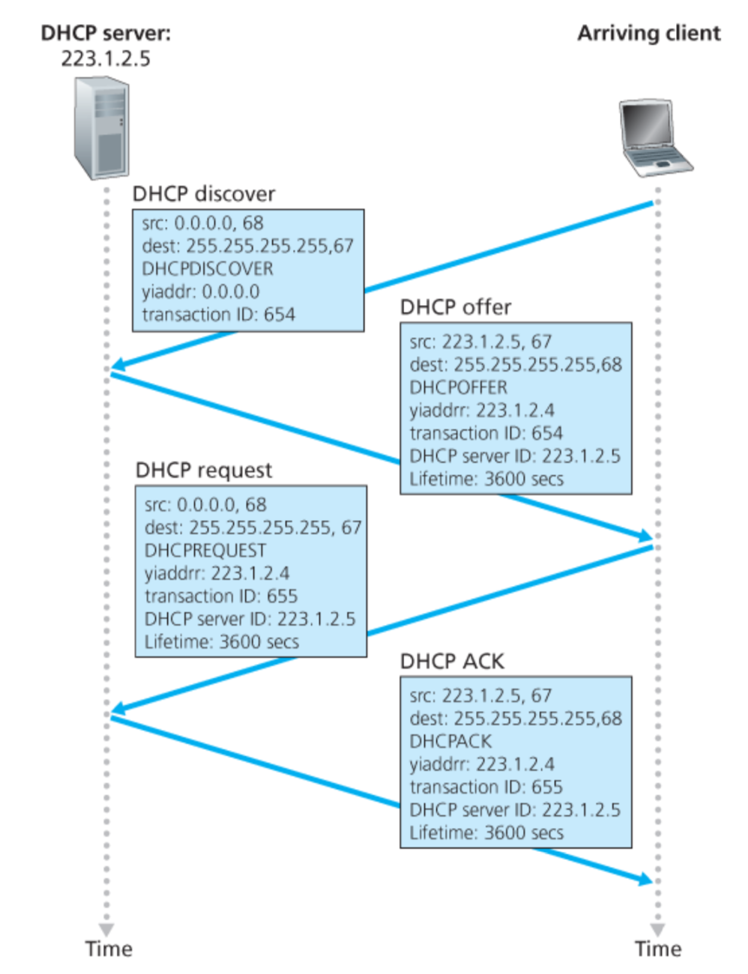
Broadcast: is there a DHCP server out there?

Slide 57
A note on the “broadcast address”

Slide 58
inet 10.104.216.101 ➔ 00001010.01101000.11011000.01100101
netmask ff:ff:f0:00 ➔ 11111111.11111111.11110000.00000000
broadcast 10.104.223.255 ➔
00001010.01101000.11011111.11111111

Slide 59
Broadcast: is there a DHCP server out there?
Which protocol would you use to exchange these DHCP protocol messages?

Slide 60
Broadcast: is there a DHCP server out there?
Broadcast: I’m a DHCP server! Here’s an IP address you can use
Broadcast: OK. I’ll take that IP address!
Broadcast: OK. You’ve got that IP address!

Slide 61
Broadcast: is there a DHCP server out there?
Broadcast: I’m a DHCP server! Here’s an IP address you can use
Broadcast: OK. I’ll take that IP address!
Broadcast: OK. You’ve got that IP address!

Slide 62
Broadcast: is there a DHCP server out there?
Broadcast: I’m a DHCP server! Here’s an IP address you can use
Broadcast: OK. I’ll take that IP address!
Broadcast: OK. You’ve got that IP address!

Slide 63
Broadcast: is there a DHCP server out there?
Broadcast: I’m a DHCP server! Here’s an IP address you can use
Broadcast: OK. I’ll take that IP address!
Broadcast: OK. You’ve got that IP address!

Slide 64
Broadcast: is there a DHCP server out there?
Broadcast: I’m a DHCP server! Here’s an IP address you can use
Broadcast: OK. I’ll take that IP address!
Broadcast: OK. You’ve got that IP address!

Slide 65
Broadcast: is there a DHCP server out there?
Broadcast: I’m a DHCP server! Here’s an IP address you can use
Broadcast: OK. I’ll take that IP address!
Broadcast: OK. You’ve got that IP address!

Slide 66
Broadcast: is there a DHCP server out there?
Broadcast: I’m a DHCP server! Here’s an IP address you can use
Broadcast: OK. I’ll take that IP address!
Broadcast: OK. You’ve got that IP address!

Slide 67
Broadcast: is there a DHCP server out there?
Broadcast: I’m a DHCP server! Here’s an IP address you can use
Broadcast: OK. I’ll take that IP address!
Broadcast: OK. You’ve got that IP address!

Slide 68
Broadcast: is there a DHCP server out there?
Broadcast: I’m a DHCP server! Here’s an IP address you can use
Broadcast: OK. I’ll take that IP address!
Broadcast: OK. You’ve got that IP address!

Slide 69
Broadcast: is there a DHCP server out there?
Broadcast: I’m a DHCP server! Here’s an IP address you can use
Broadcast: OK. I’ll take that IP address!
Broadcast: OK. You’ve got that IP address!

Slide 70
Broadcast: is there a DHCP server out there?
Broadcast: I’m a DHCP server! Here’s an IP address you can use
Broadcast: OK. I’ll take that IP address!
Broadcast: OK. You’ve got that IP address!

Slide 71
Broadcast: is there a DHCP server out there?
Broadcast: I’m a DHCP server! Here’s an IP address you can use
Broadcast: OK. I’ll take that IP address!
Broadcast: OK. You’ve got that IP address!

Slide 72
Broadcast: is there a DHCP server out there?
Broadcast: I’m a DHCP server! Here’s an IP address you can use
Broadcast: OK. I’ll take that IP address!
Broadcast: OK. You’ve got that IP address!

Slide 73
Broadcast: is there a DHCP server out there?
Broadcast: I’m a DHCP server! Here’s an IP address you can use
Broadcast: OK. I’ll take that IP address!
Broadcast: OK. You’ve got that IP address!

Slide 74
Broadcast: is there a DHCP server out there?
Broadcast: I’m a DHCP server! Here’s an IP address you can use
Broadcast: OK. I’ll take that IP address!
Broadcast: OK. You’ve got that IP address!

Slide 75
Broadcast: is there a DHCP server out there?
Broadcast: I’m a DHCP server! Here’s an IP address you can use
Broadcast: OK. I’ll take that IP address!
Broadcast: OK. You’ve got that IP address!

