Slide 1
CMSC 818G Some Project Ideas

Slide 2
Projects
Building Analytics
Breathing Analytics
Breathing to Speech
Ayurvedic Patients Dataset
Personal Digital Assistant
Mu Sigma

Slide 3
1. Building Analytics – Iribe Center
Dataset
15-minute reading
Drawings
BIM files
…
Energy Efficiency
Comfort Index
AR visualization and use

Slide 4
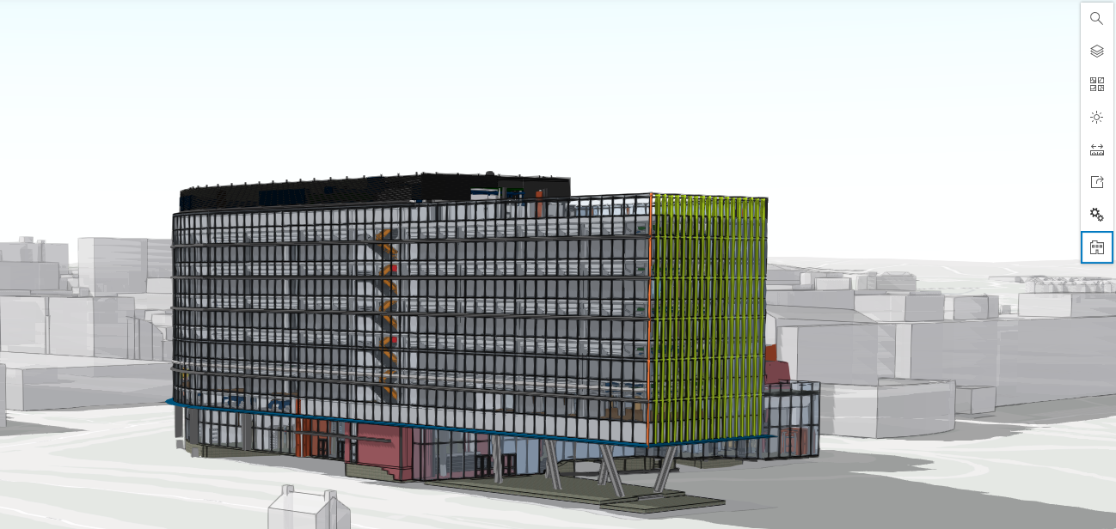
Building Analytics

Slide 5
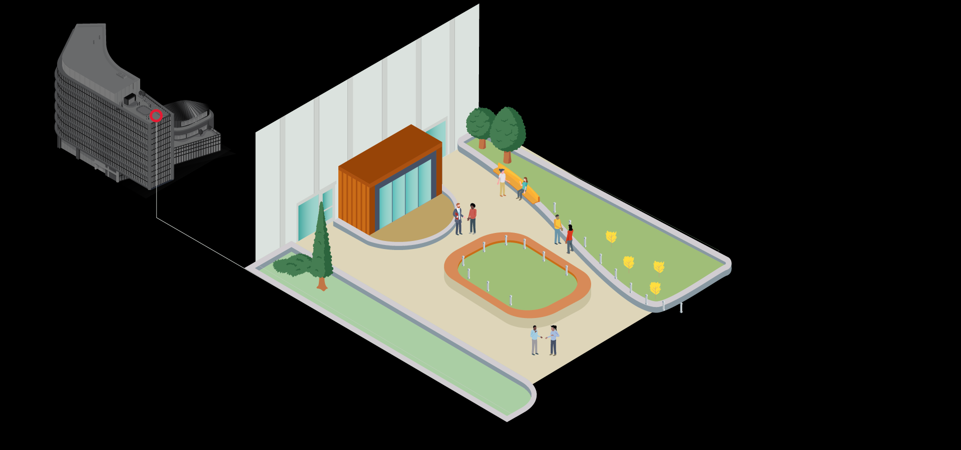
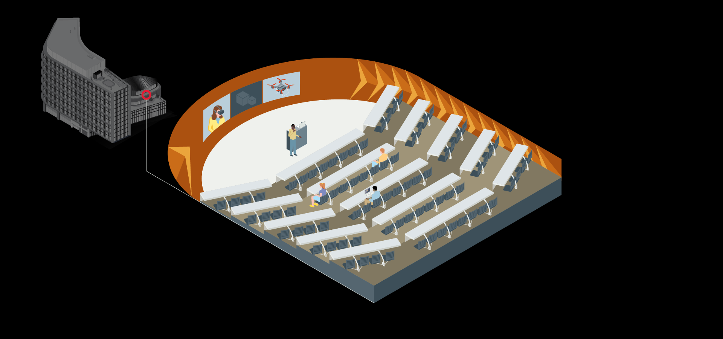
Iribe Center for Computer Science and Engineering
Operational since April 2019
215,600 Gross SQ. FT
298 Seat Auditorium
658 Seats of Instruction Space
Rooftop Park
Garden Terrace
Seminar Rooms
Over 200 Office Rooms

Slide 6
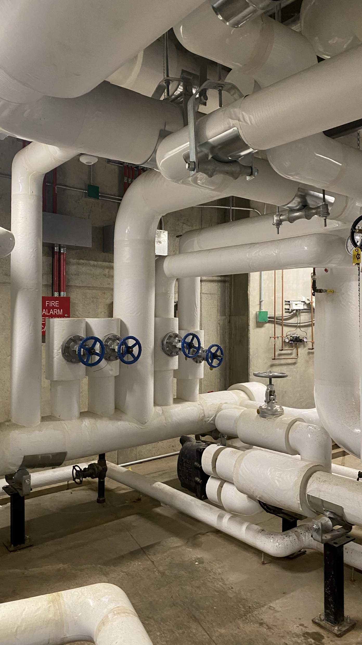
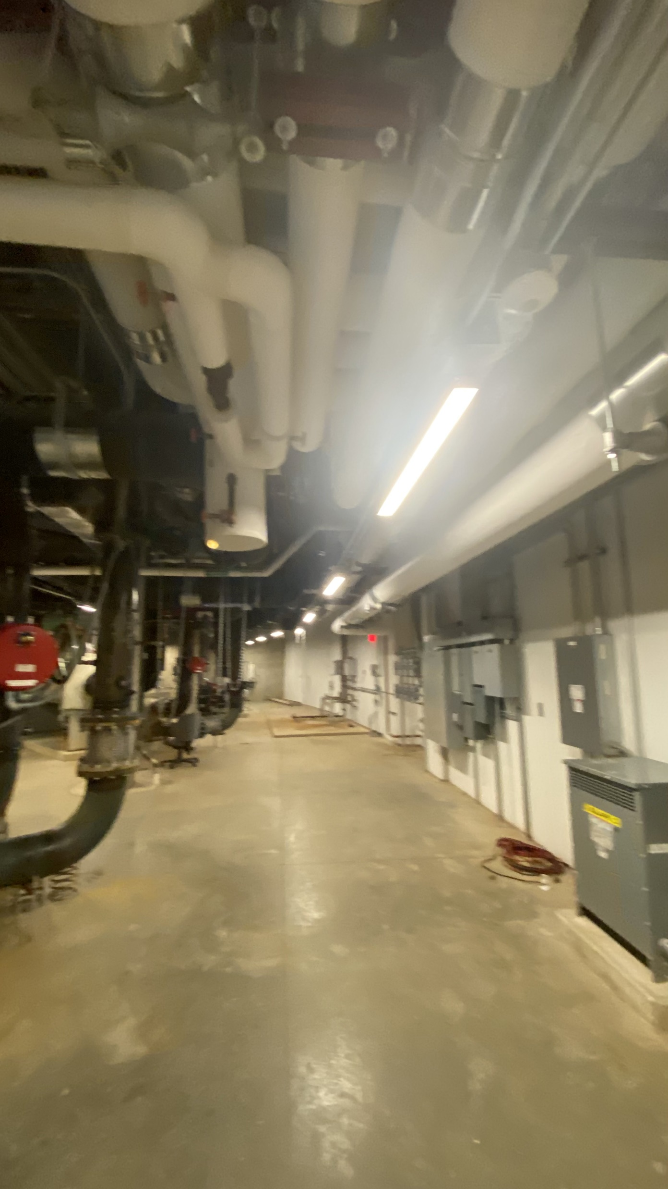
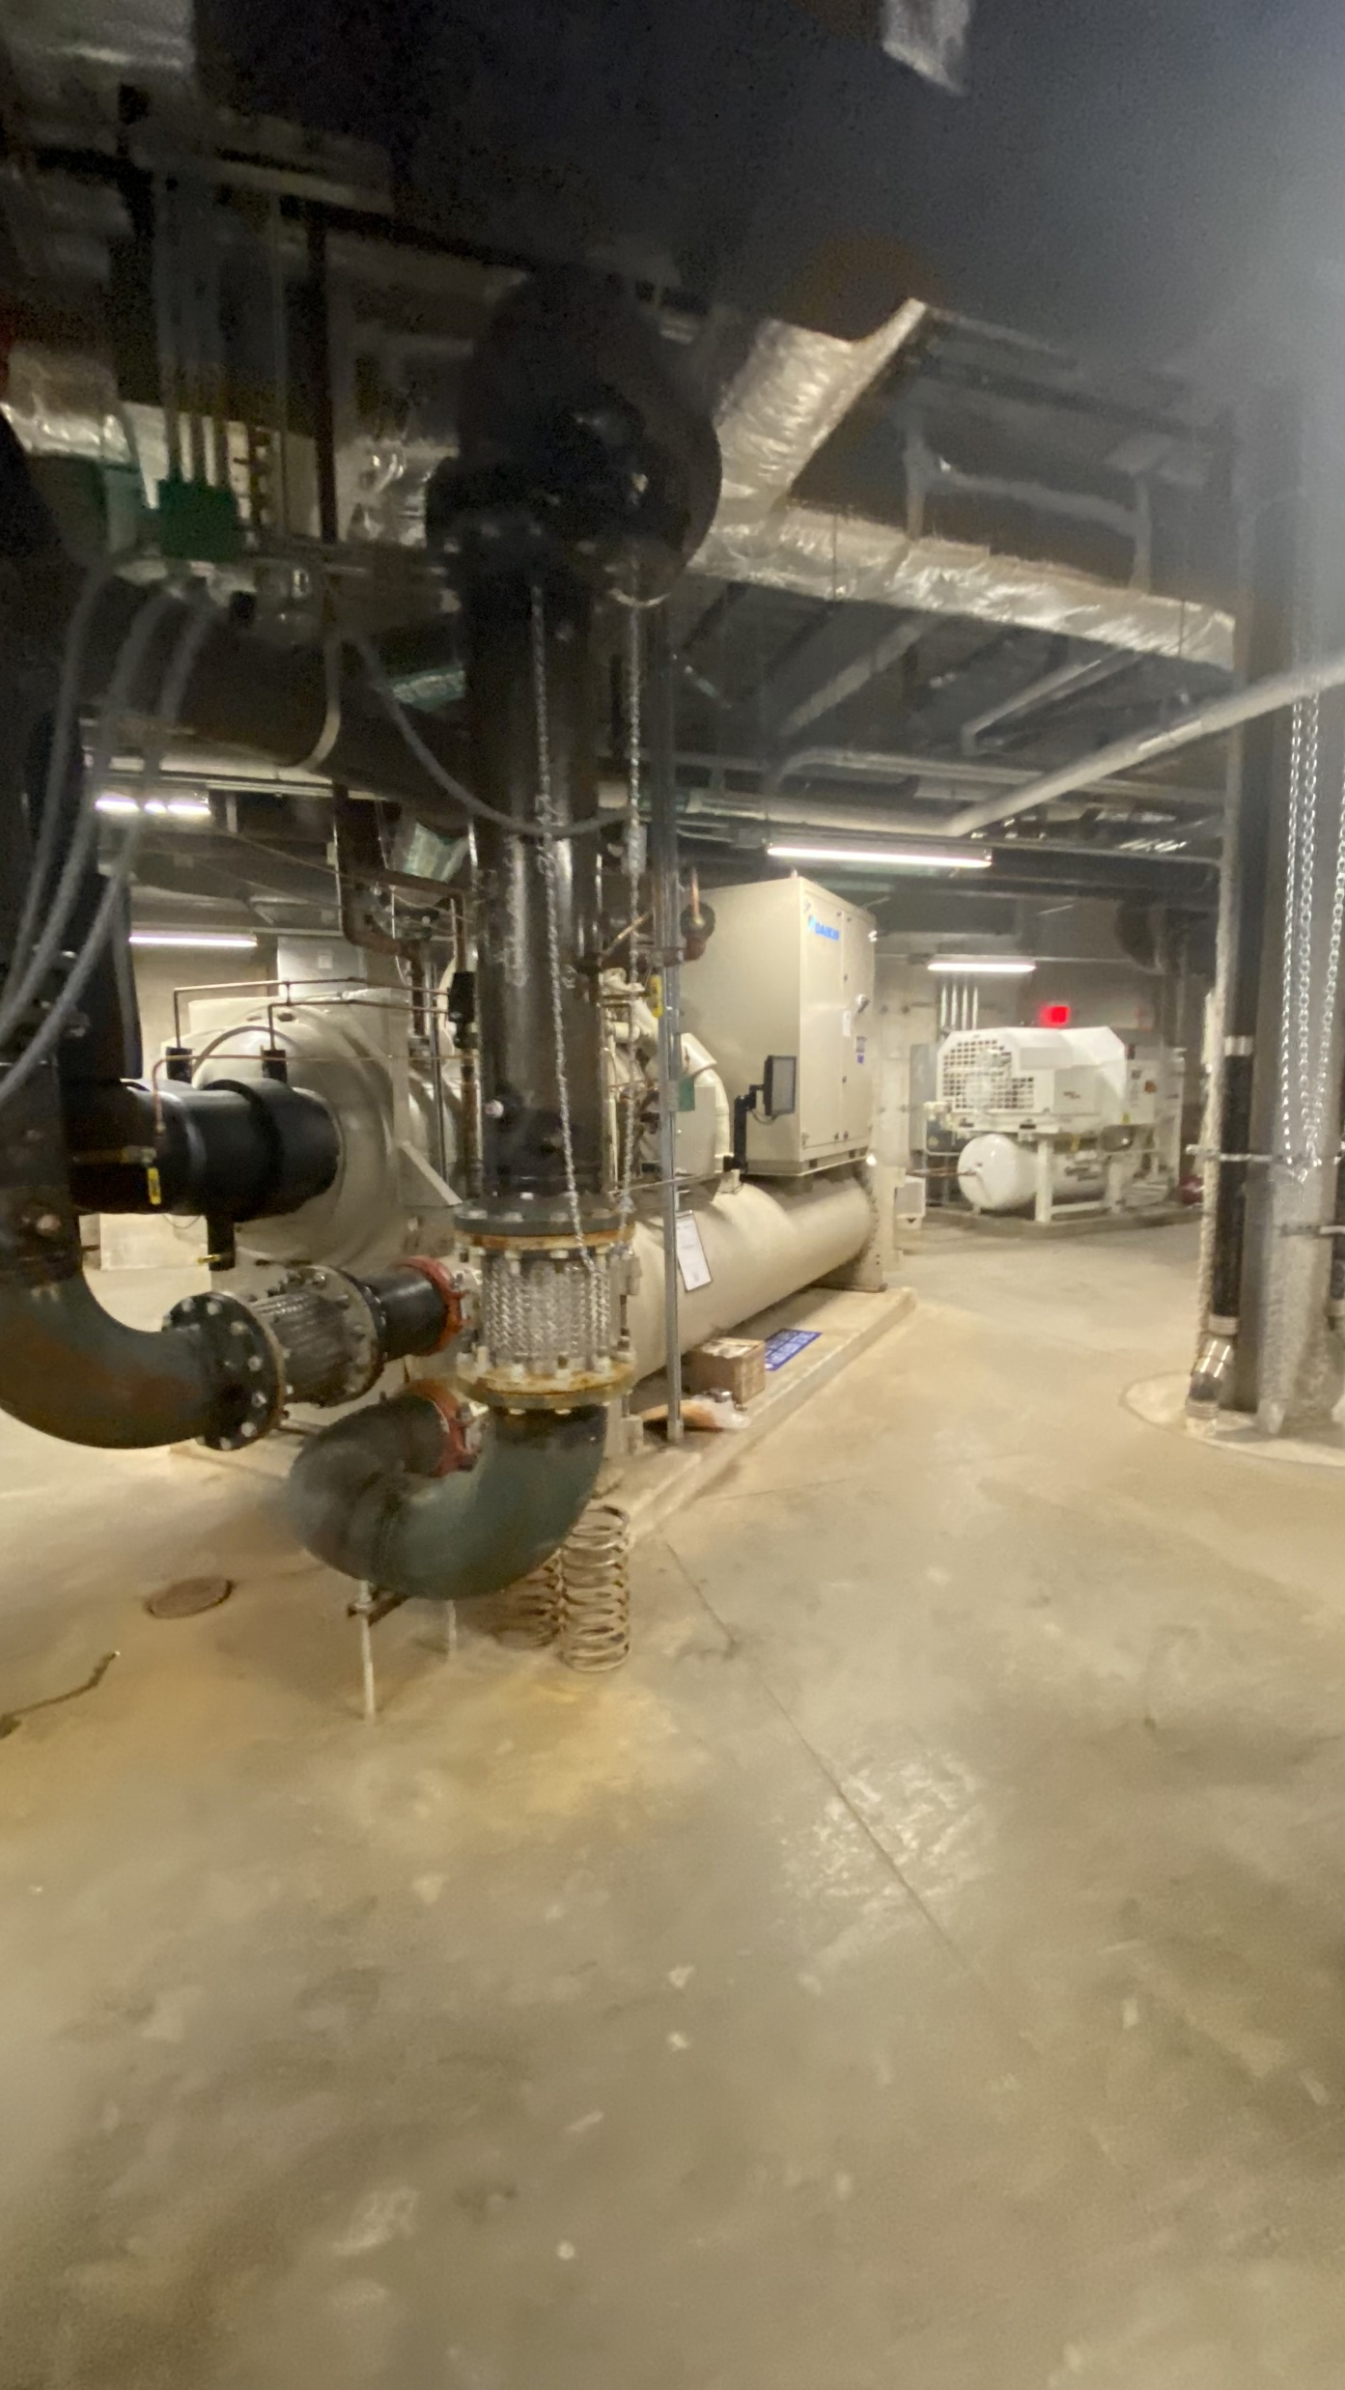
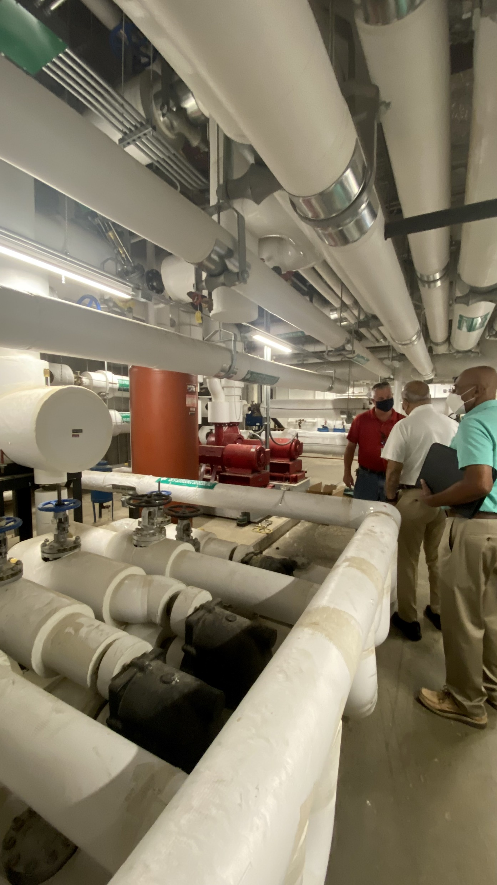
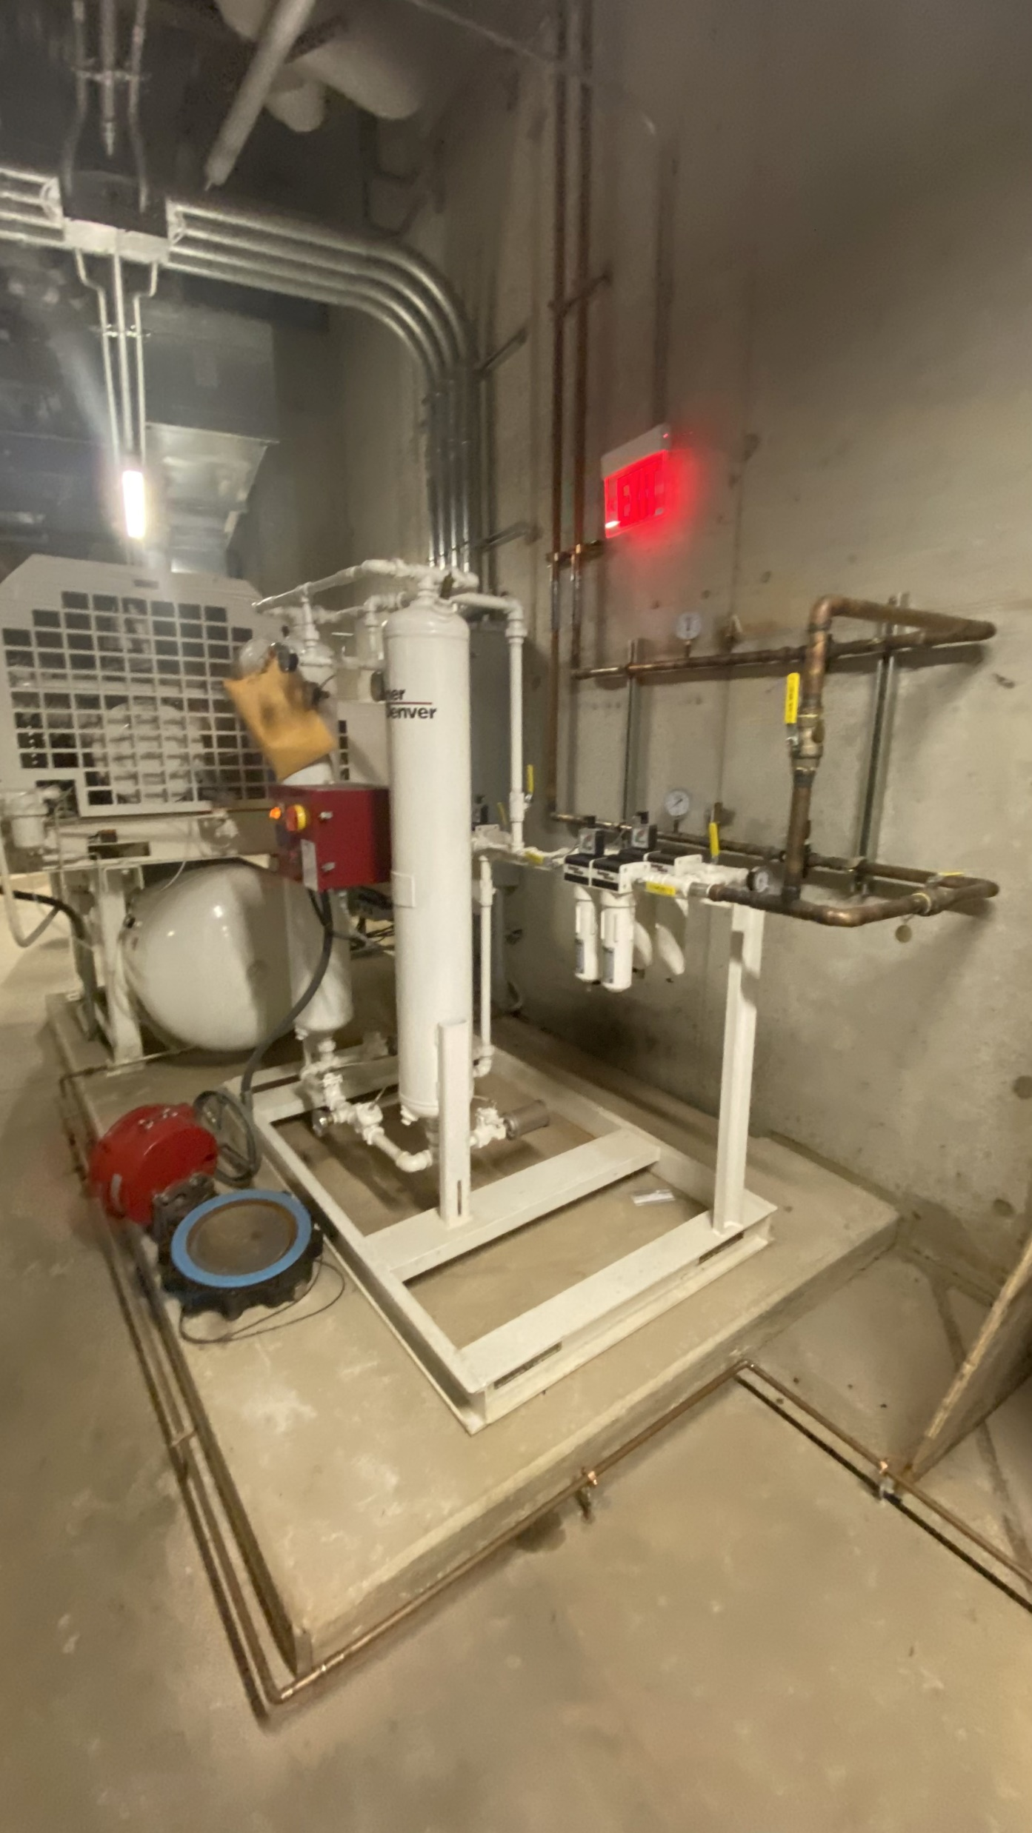
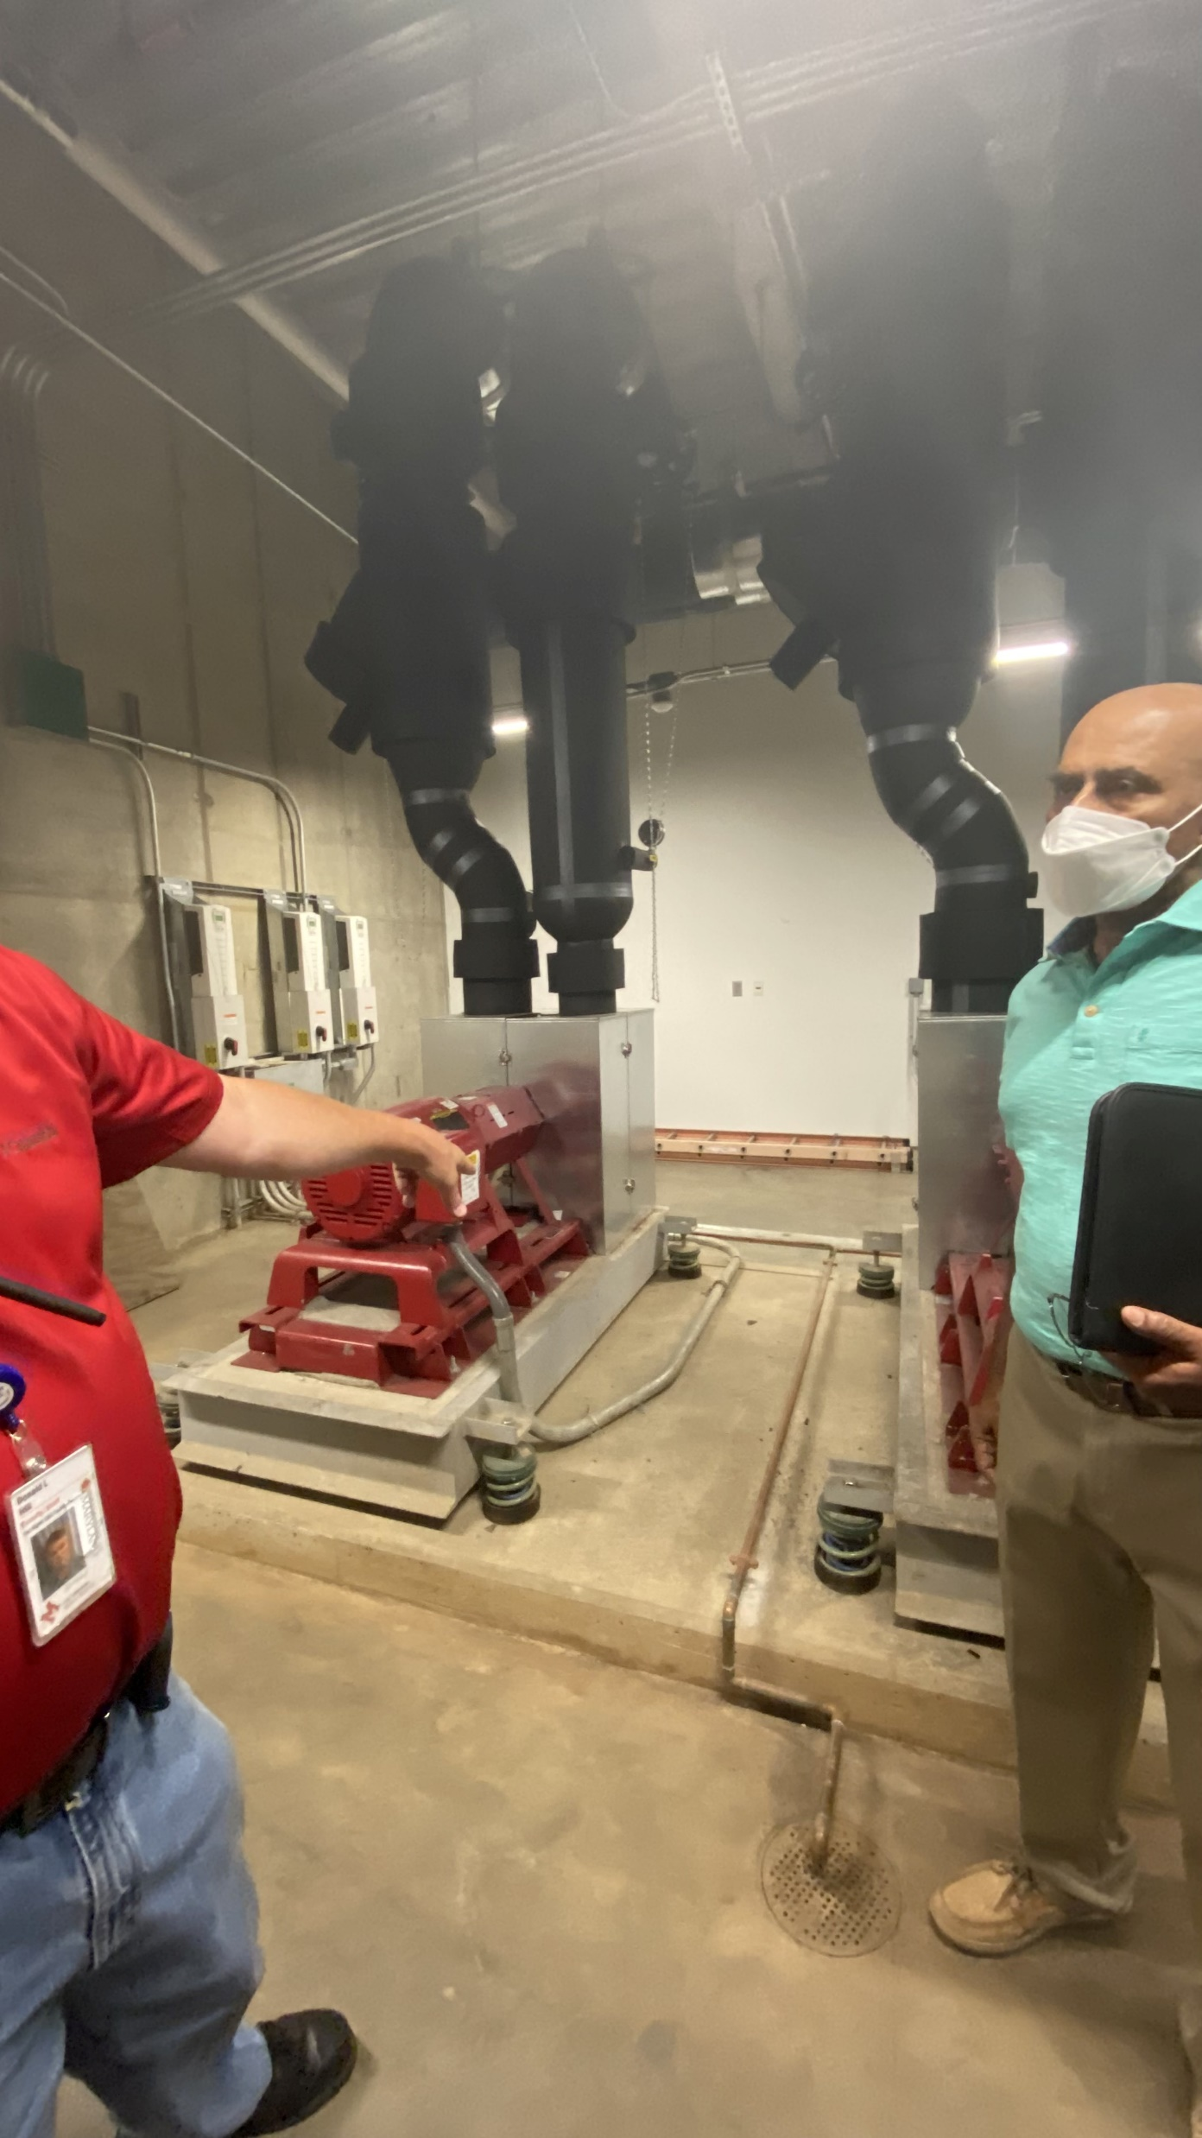
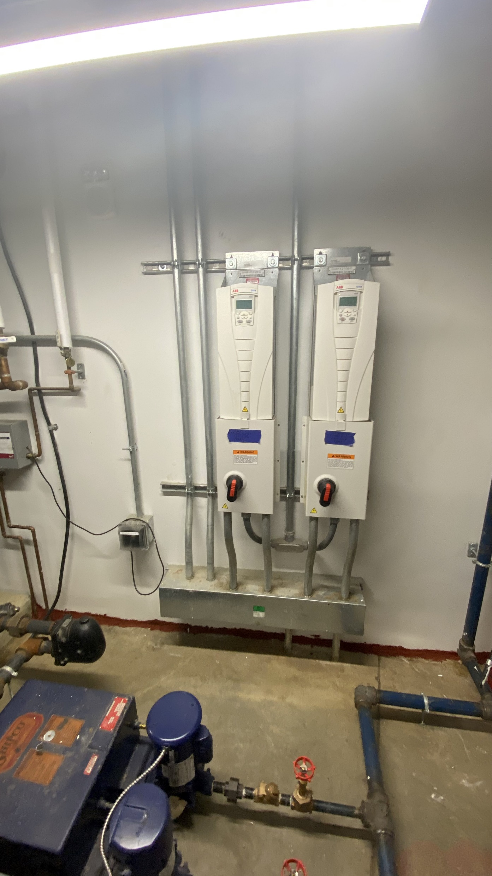
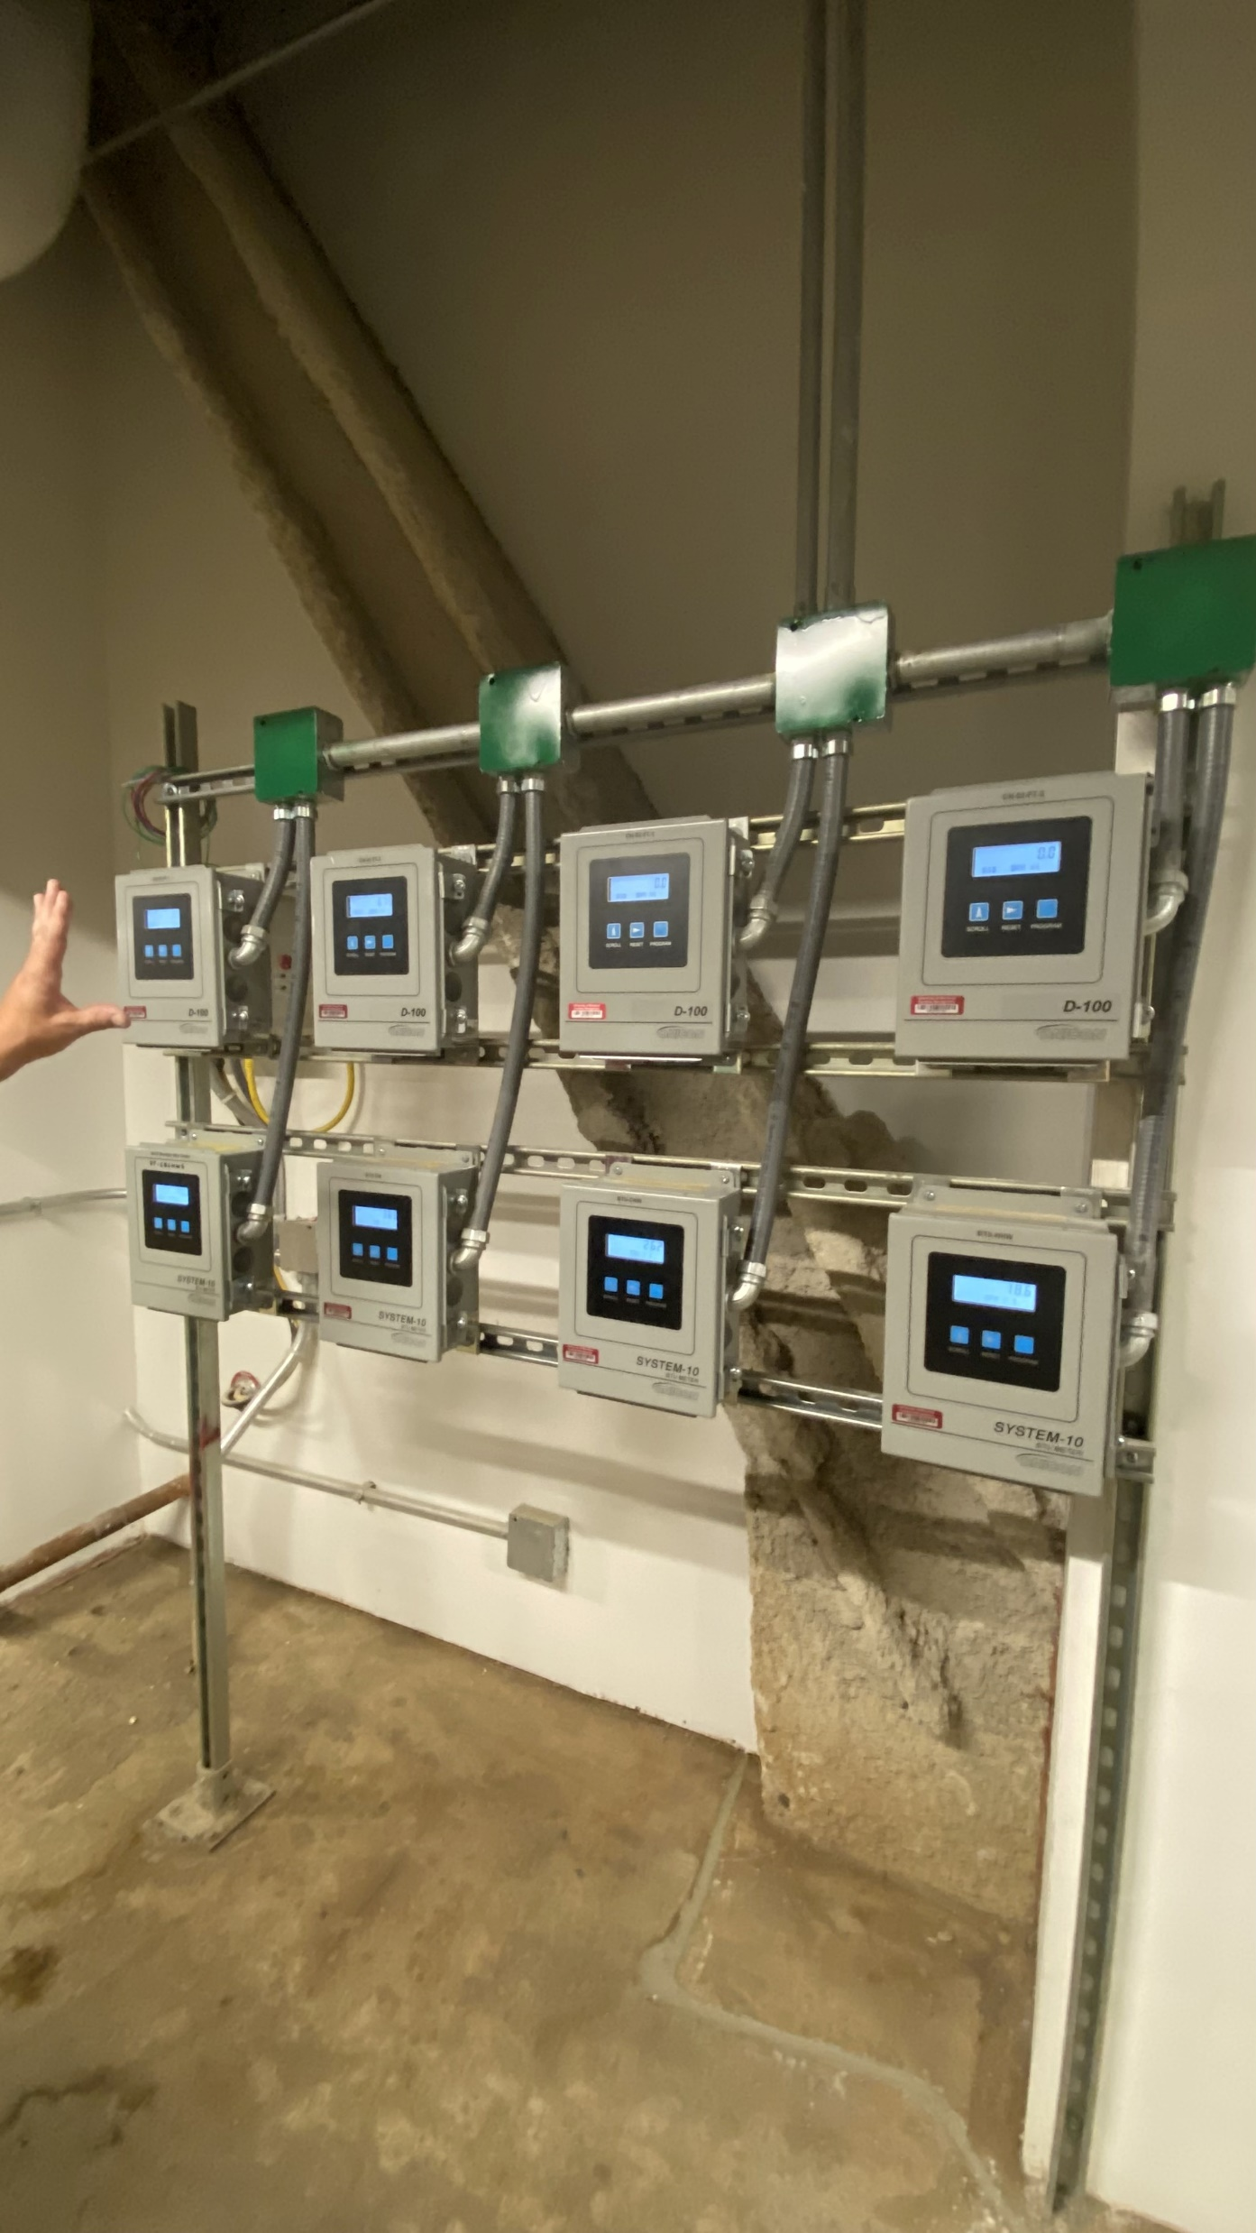
Building Operations
Well Instrumented Building
7 Air Handling Units
326 VAV units
6068 sensors
466 Different Types of Sensors
Space Temperature
Space Humidity
CO2 Level
Discharge Temp
Air Flow
…
Reading every 15 minutes
Data Accessible
Courtesy Facilities at UMD
Building plans
Air distribution and control layout
Information about
Generators
Chillers
Heaters
Control points

Slide 7
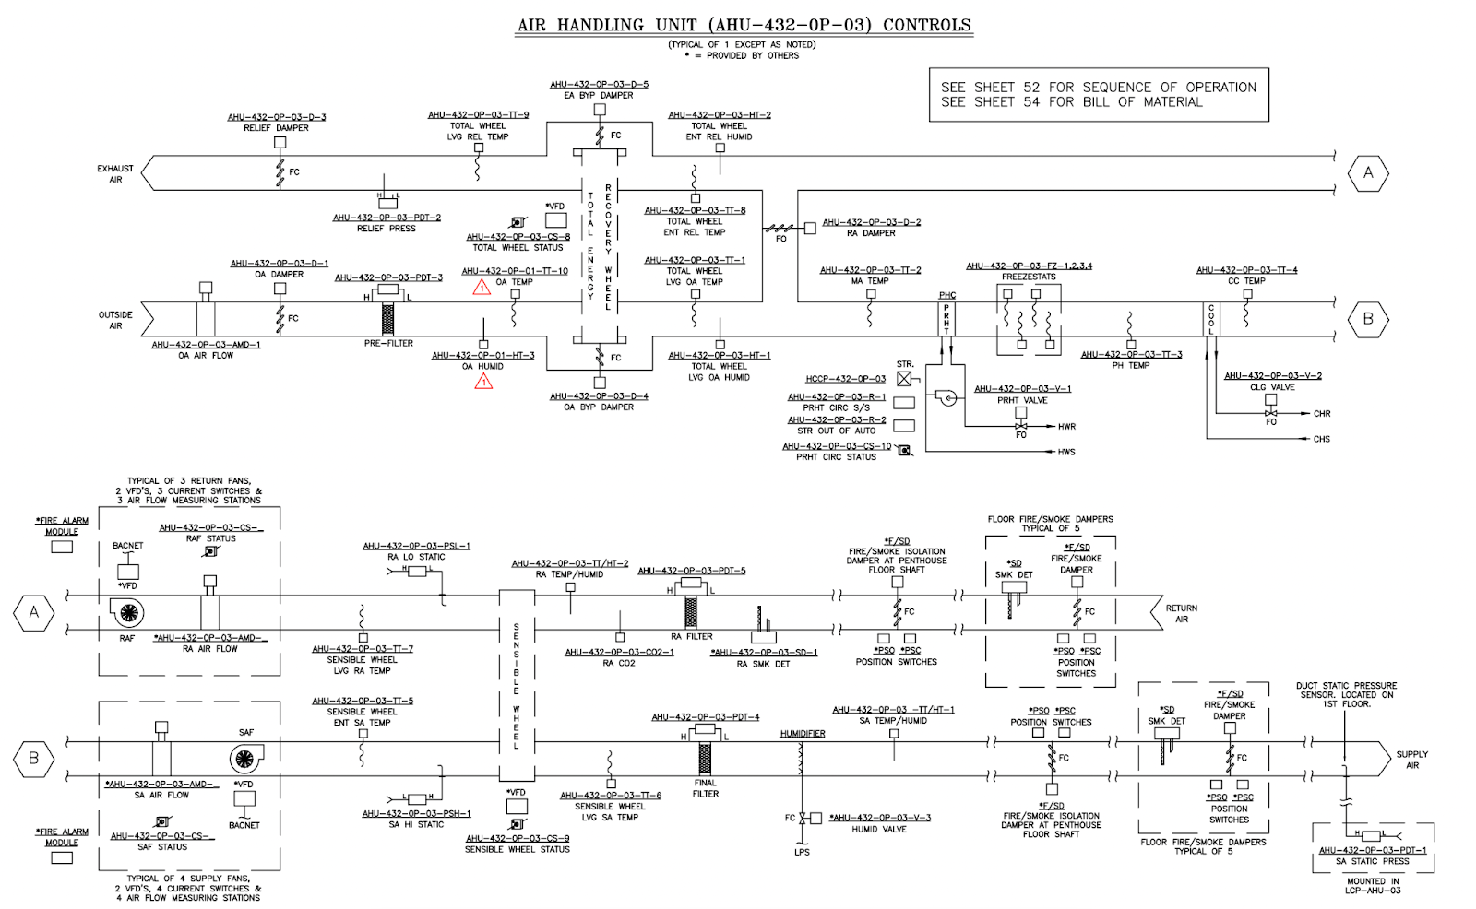

Slide 8
Data Set
6068 sensors
Every 15 Minutes
Since Feb 2019 to January 31, 2025
2177 Days
1,268,163,456 readings
Near Real-time
Updated every 15 minutes

Slide 9
Sensors
Room (VAV)
ActFlow and Actflow SP
CO2 Sensor
Chill Beam signal
Damper
Dew Point
Effective SP
Reheat Valve
Humidity
Space temp
Occupancy – Det, CMD, Status
AHU
SA and RA temp
Ma Temp
OA Temp and Flow
Ra CO2
SA Fans – Flow and speed
SA Humidity
Total Ra Fan Flow
Total Sa Fan Flow
…

Slide 10
Data from 2120 and AHU3
 | ActFlow | ActFlowSP | ChlBeamVlvSig | CO2Sensor | DamperOvr | DewPoint | DischargeTemp | EffectSP | ReheatVlvSig | SpaceHumidity | SpaceTemp | SaTemp | SaHumidity | RaTemp | OaTemp | OaHumidity | RaCo2
 | 2120 | 2120 | 2120 | 2120 | 2120 | 2120 | 2120 | 2120 | 2120 | 2120 | 2120 | AHU_03 | AHU_03 | AHU_03 | AHU_03 | AHU_03 | AHU_03
Timamp | Value (cfm) | Value (cfm) | Value (%) | Value (ppm) | Value (%) | Value (°F) | Value (°F) | Value (°F) | Value (%) | Value (%RH) | Value (°F) | Value (°F) | Value (%RH) | Value (°F) | Value (°F) | Value (%RH) | Value (ppm)
CI-Weight |  |  |  |  |  |  |  |  |  | 50 | 0.5
CI- Ref |  |  |  |  |  |  |  |  |  | 40% | 72
5/15/2019 0:00 | 0 | 0 | 0.00% | 614 | 0.00% | 44.4 | 72.8 | 85 | 0.00% | 38.10% | 73.3 | 65.7 | 54.20% | 68.9 | 60.1 | 60.00% | 425
5/15/2019 0:15 | 0 | 0 | 0.00% | 644 | 0.00% | 44.5 | 72.9 | 85 | 0.00% | 38.20% | 73.3 | 65.8 | 54.10% | 68.7 | 60 | 59.50% | 424
5/15/2019 0:30 | 5.5 | 0 | 0.00% | 665 | 0.00% | 44.5 | 73 | 85 | 0.00% | 38.20% | 73.3 | 65.8 | 54.00% | 68.6 | 59.7 | 57.50% | 427
5/15/2019 0:45 | 0 | 0 | 0.00% | 681 | 0.00% | 44.6 | 73 | 85 | 0.00% | 38.30% | 73.3 | 65.9 | 54.00% | 68.5 | 61.3 | 59.20% | 423
5/15/2019 1:00 | 5.6 | 0 | 0.00% | 676 | 0.00% | 44.7 | 73.1 | 85 | 0.00% | 38.40% | 73.4 | 65.9 | 54.00% | 68.4 | 63.6 | 56.60% | 426
Have access to all sensors

Slide 11
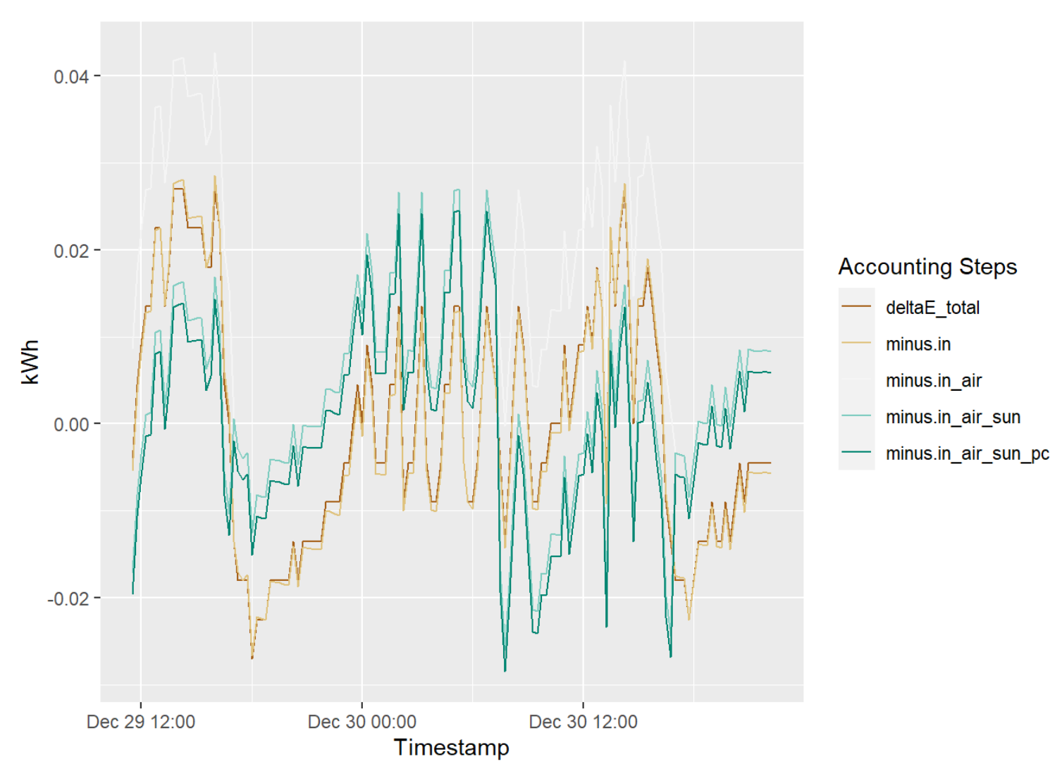
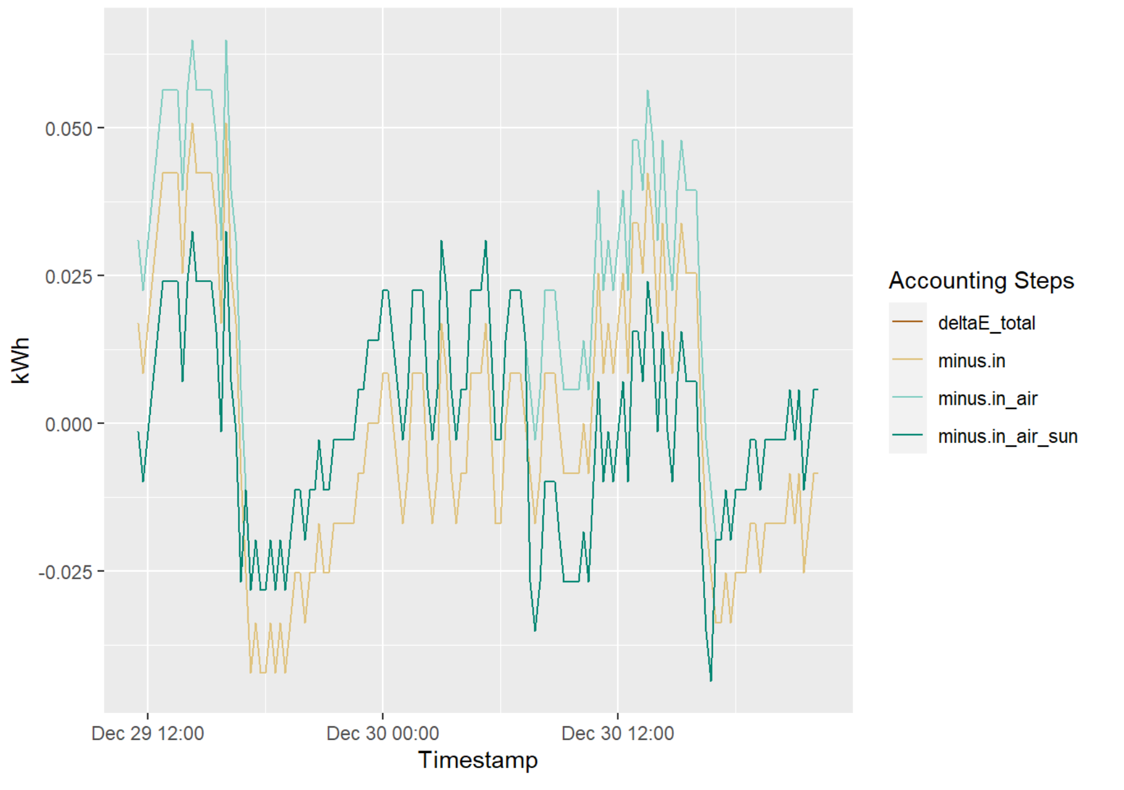
Energy Usage
Room 2116
Room 2120
Room 2107

Slide 12
People Presence and CO2

Slide 13
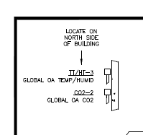
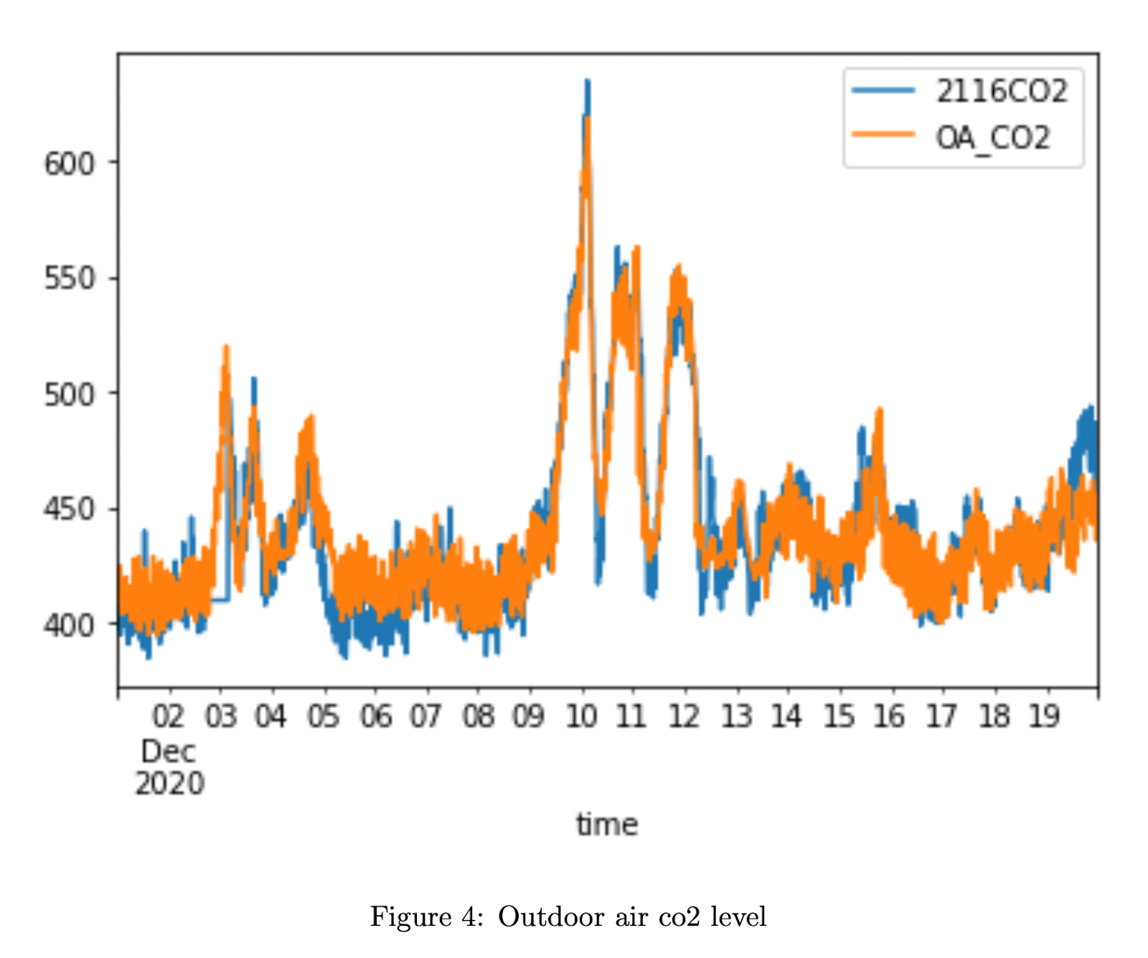
Indoor (2116) and Outdoor CO2

Slide 14
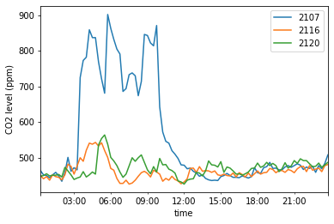
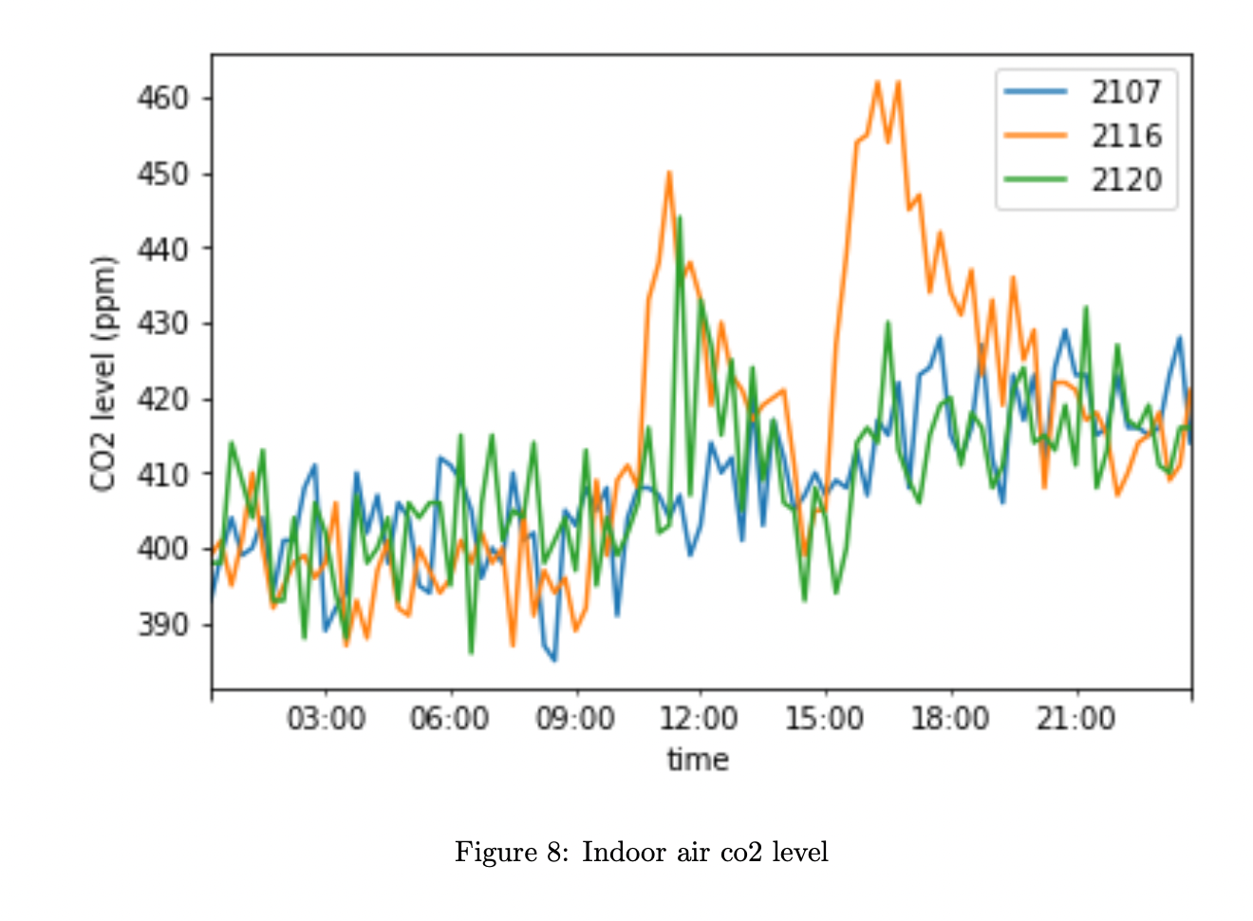
CO2 levels in 2107,2116,2120
December 25, 2020
September 17, 2019 (Tuesday)

Slide 15
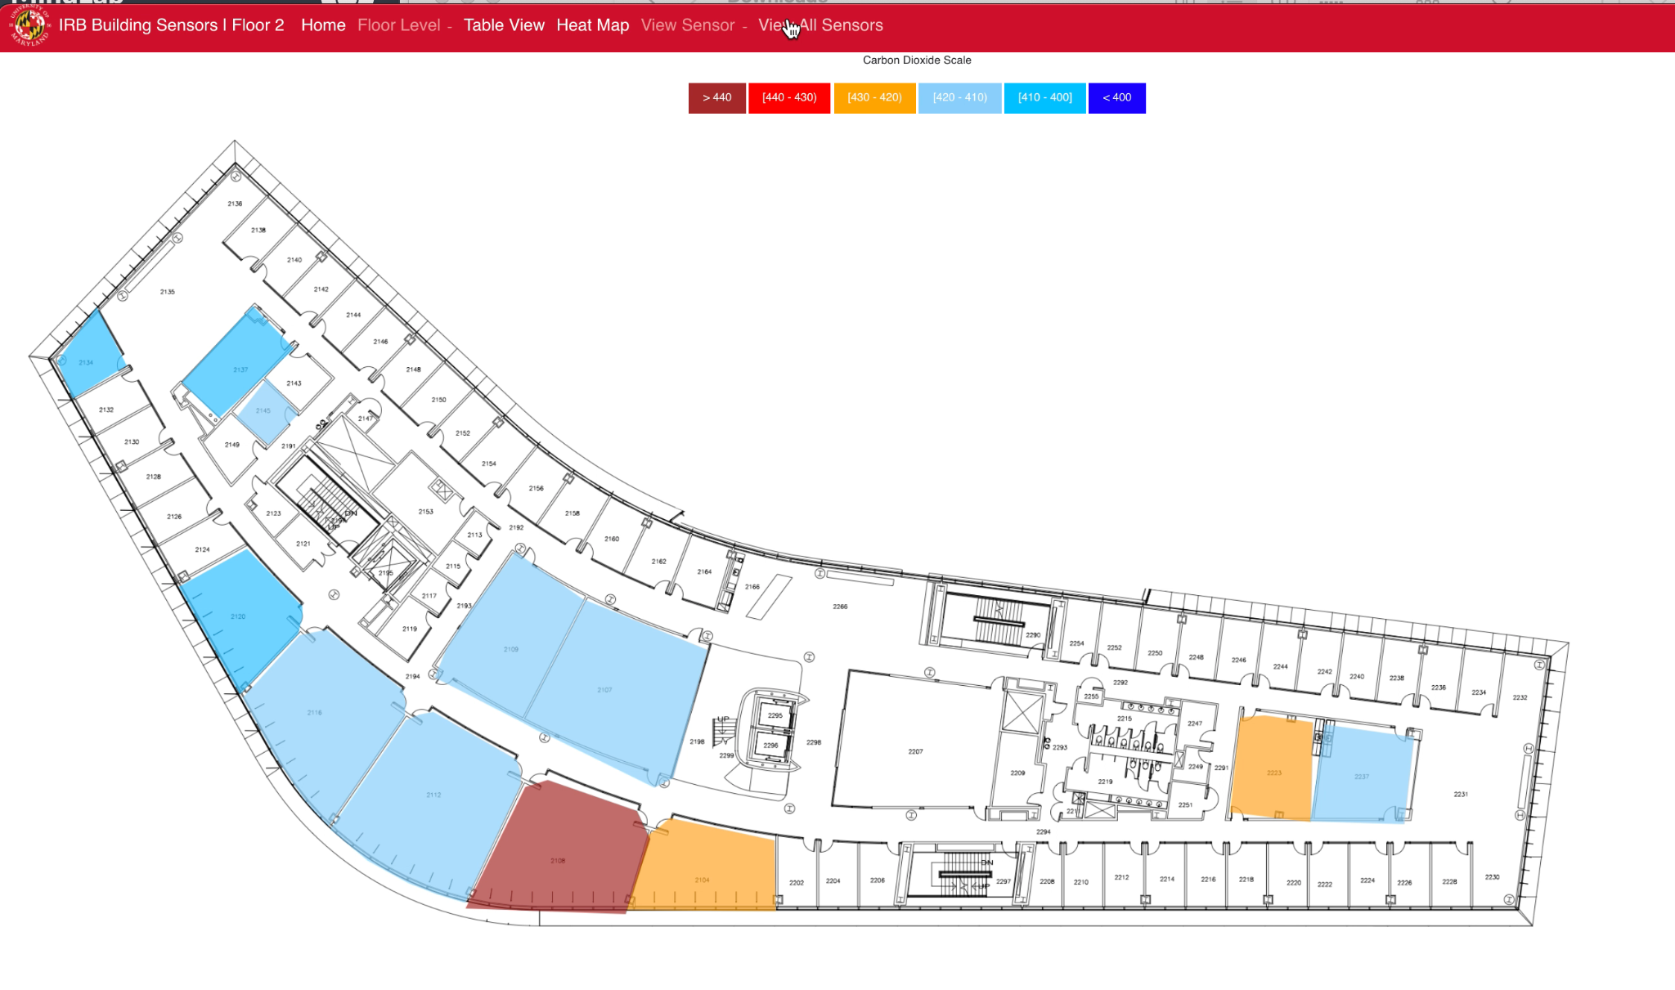
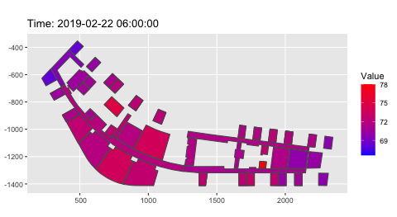
Interactive web app to show Temperature on a given floor.

Slide 16
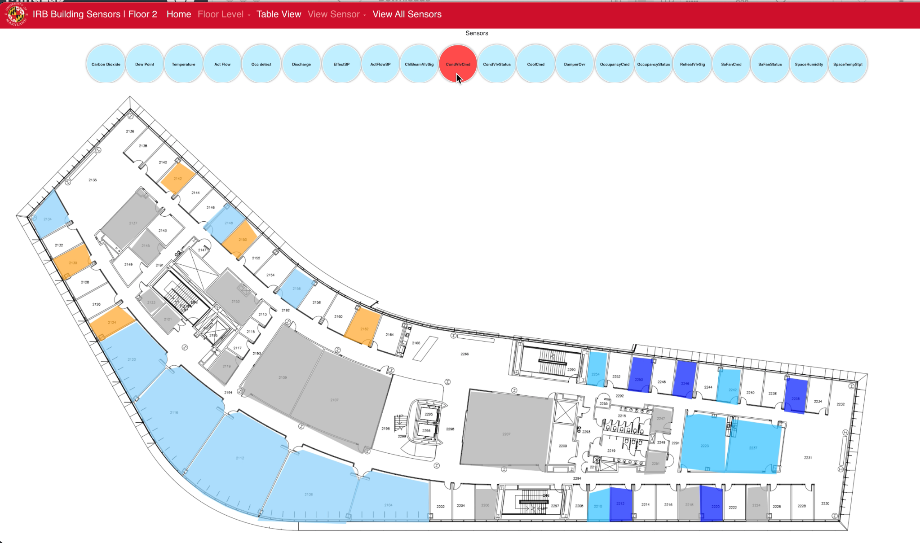
Choose from a multitude of other sensors to view data for a given day and time.

Slide 17
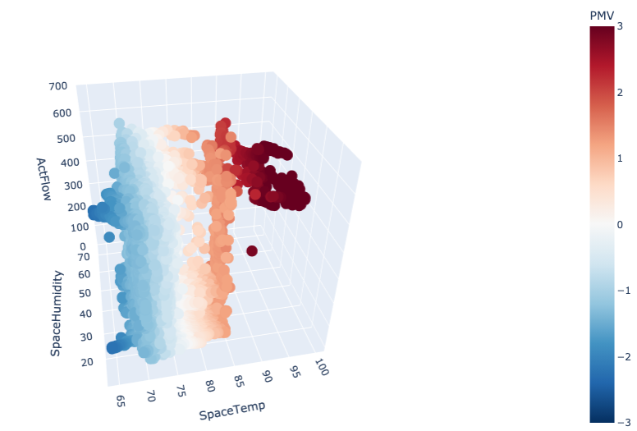
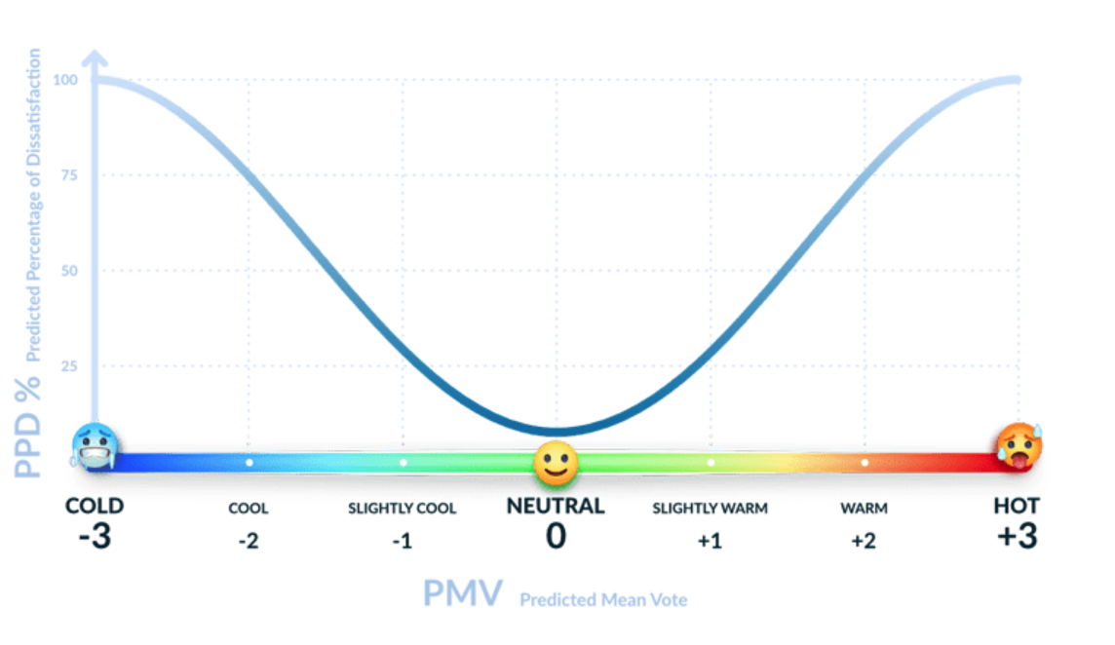
Comfort Index- 2120

Slide 18
2. Breathing Analytics
Breathing is the only autonomous process that we have conscious control over.
Talking
Breathing is affected by any physical or mental afflictions
Dataset
24/7 breathing data for months from about 100 subjects
25 samples per second of breathing
Accelerometer readings
Infection – flu virus
Controlled Dataset
Using our own sensor
Under controlled conditions.
Steps
Noise cleanup
Segmentation into individual breaths
Classification of breaths
Identification of ailments

Slide 19
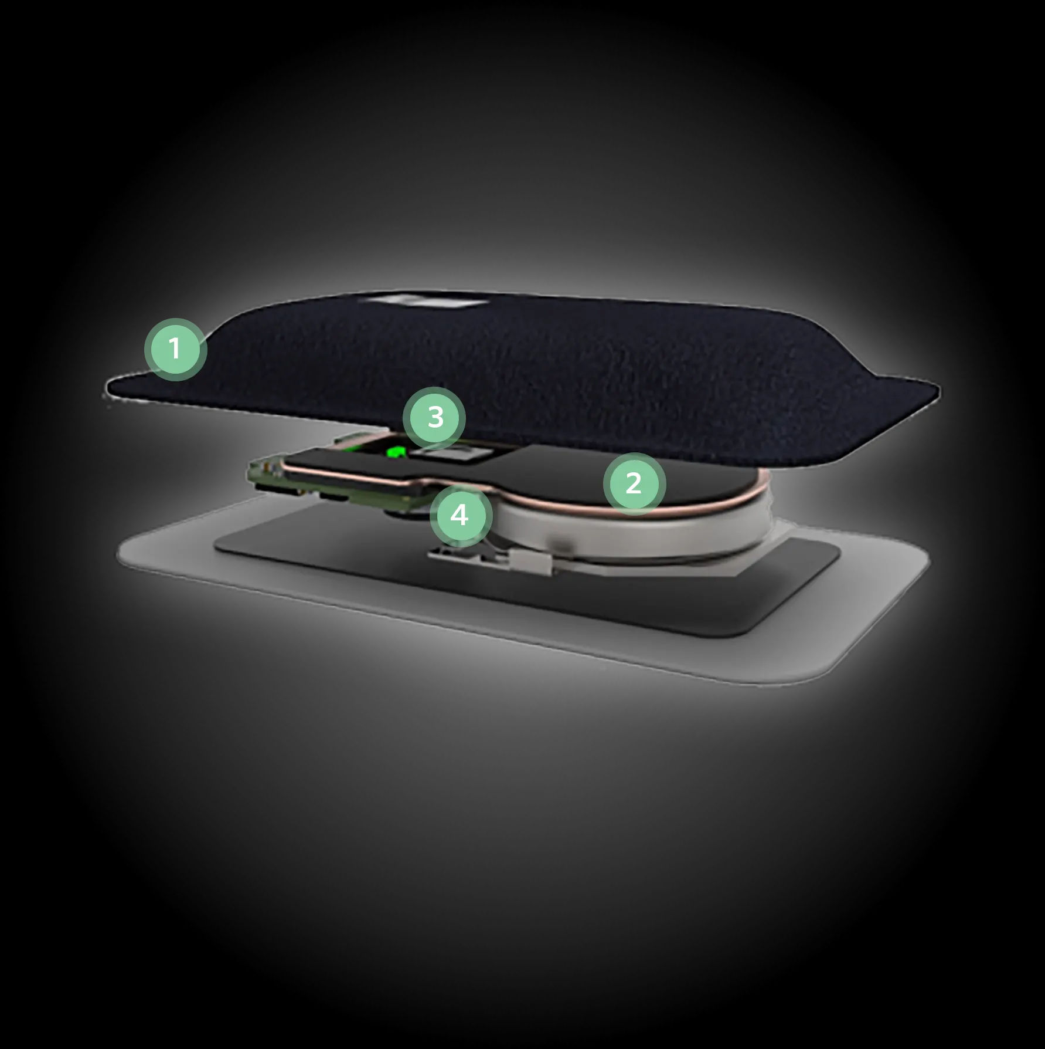
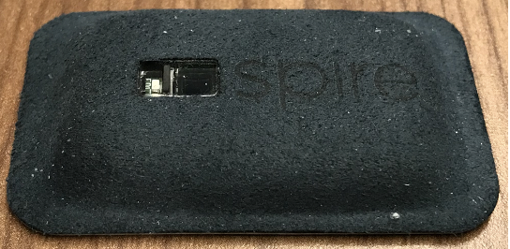
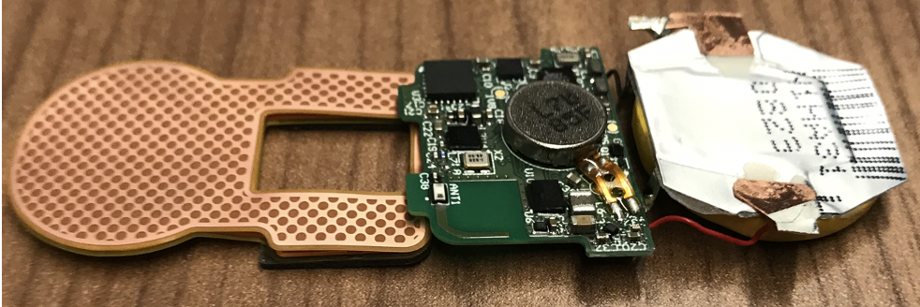
Spire Tag
Sensors
Breathing Force Sensor
PPG
3 Axis Accelerometer
We have concentrated on the analysis of breathing patterns and anomalies

Slide 20
Tag Raw Data
ID TAG Time TimeZone Force X Y Z PPG
319656 64F7DB2440F0644C 2019-05-13 15:48:00.015625 America/New_York 436994560 -1564 -8200 1588 10936
319656 64F7DB2440F0644C 2019-05-13 15:48:00.054688 America/New_York 437027328 -1356 -8224 1680 10928
319656 64F7DB2440F0644C 2019-05-13 15:48:00.09375 America/New_York 437371392 -1308 -8132 1728 10920
319656 64F7DB2440F0644C 2019-05-13 15:48:00.136719 America/New_York 437813760 -1380 -7980 1748 10920
319656 64F7DB2440F0644C 2019-05-13 15:48:00.175781 America/New_York 437977600 -1480 -7864 1696 10912
319656 64F7DB2440F0644C 2019-05-13 15:48:00.214844 America/New_York 437789184 -1492 -7760 1564 10904
319656 64F7DB2440F0644C 2019-05-13 15:48:00.253906 America/New_York 437608960 -1716 -7752 1484 10904
319656 64F7DB2440F0644C 2019-05-13 15:48:00.296875 America/New_York 437436928 -1692 -7904 1600 10888
319656 64F7DB2440F0644C 2019-05-13 15:48:00.335938 America/New_York 437371392 -1376 -7972 1588 10888
319656 64F7DB2440F0644C 2019-05-13 15:48:00.375 America/New_York 437305856 -1340 -8116 1568 10872
319656 64F7DB2440F0644C 2019-05-13 15:48:00.414062 America/New_York 437363200 -1324 -8148 1512 10864
319656 64F7DB2440F0644C 2019-05-13 15:48:00.457031 America/New_York 437404160 -1280 -8276 1500
319656 64F7DB2440F0644C 2019-05-13 15:48:00.496094 America/New_York 437387776 -1660 -8272 1376
319656 64F7DB2440F0644C 2019-05-13 15:48:00.535156 America/New_York 437101056 -1596 -8064 1792
319656 64F7DB2440F0644C 2019-05-13 15:48:00.574219 America/New_York 437256704 -1444 -8188 1624
319656 64F7DB2440F0644C 2019-05-13 15:48:00.617188 America/New_York 437314048 -1420 -8104 1696
319656 64F7DB2440F0644C 2019-05-13 15:48:00.65625 America/New_York 437699072 -1552 -8128 1732
Reported measurements are relative values
Breathing Force data is continuous when the subject is using the tag
Sampling rate is 25/second (40 ms)
PPG data is not collected continuously

Slide 21
Breath Data
Some observations About Breathing
Patterns change rather rapidly
One must work with raw data
Patterns vary from individual to individual
Must make separate models for each individual
Spire Tag
The way it records breathing, the baseline gets affected by
Change in posture
Moving
There is a significant difference in readings depending on where the tag is mounted
Waist – under the belt
On the waist like in underwear – where
Back strap

Slide 22
Full day plot

Slide 23
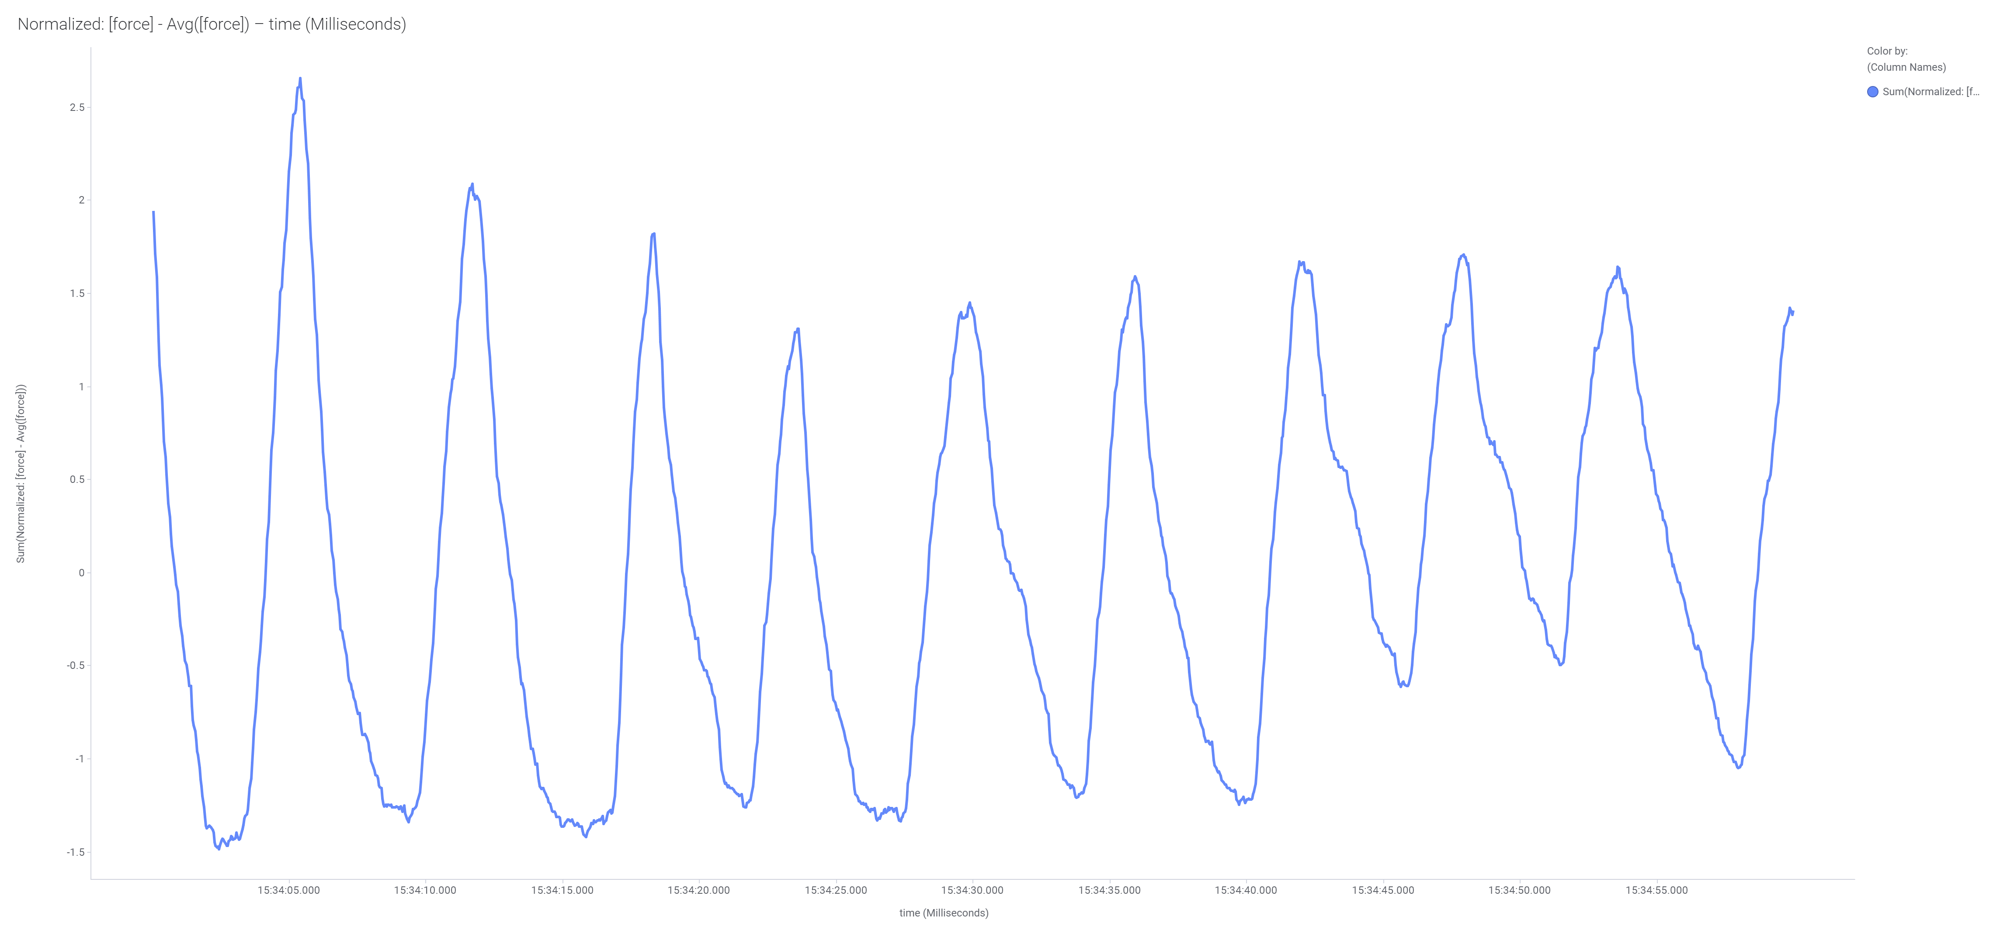
Normal Breathing July 15, 2019

Slide 24
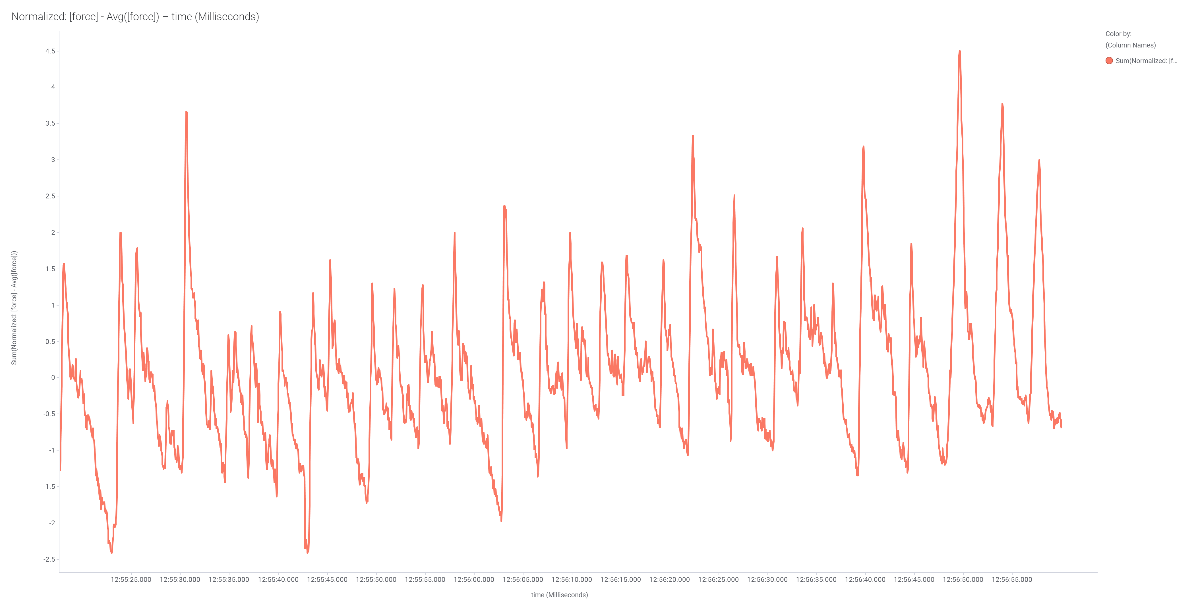
Talking July 15, 2019

Slide 25
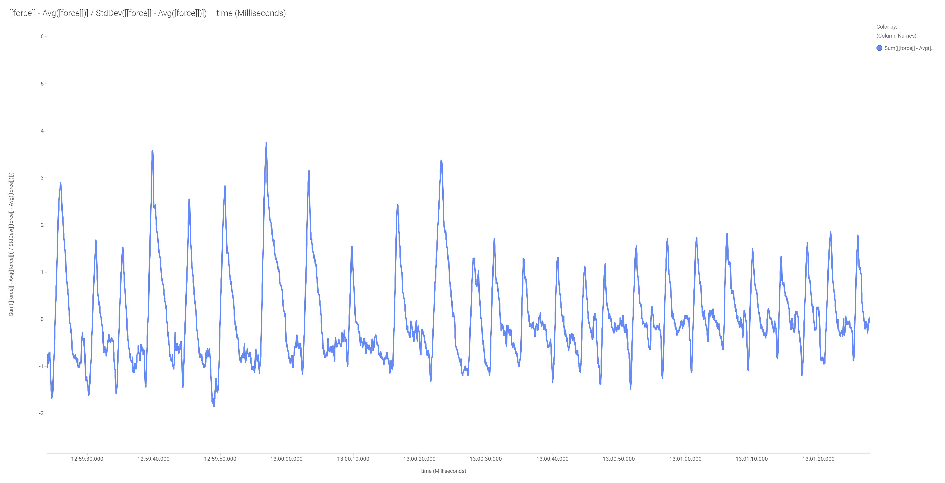
Humming July 15, 2019

Slide 26
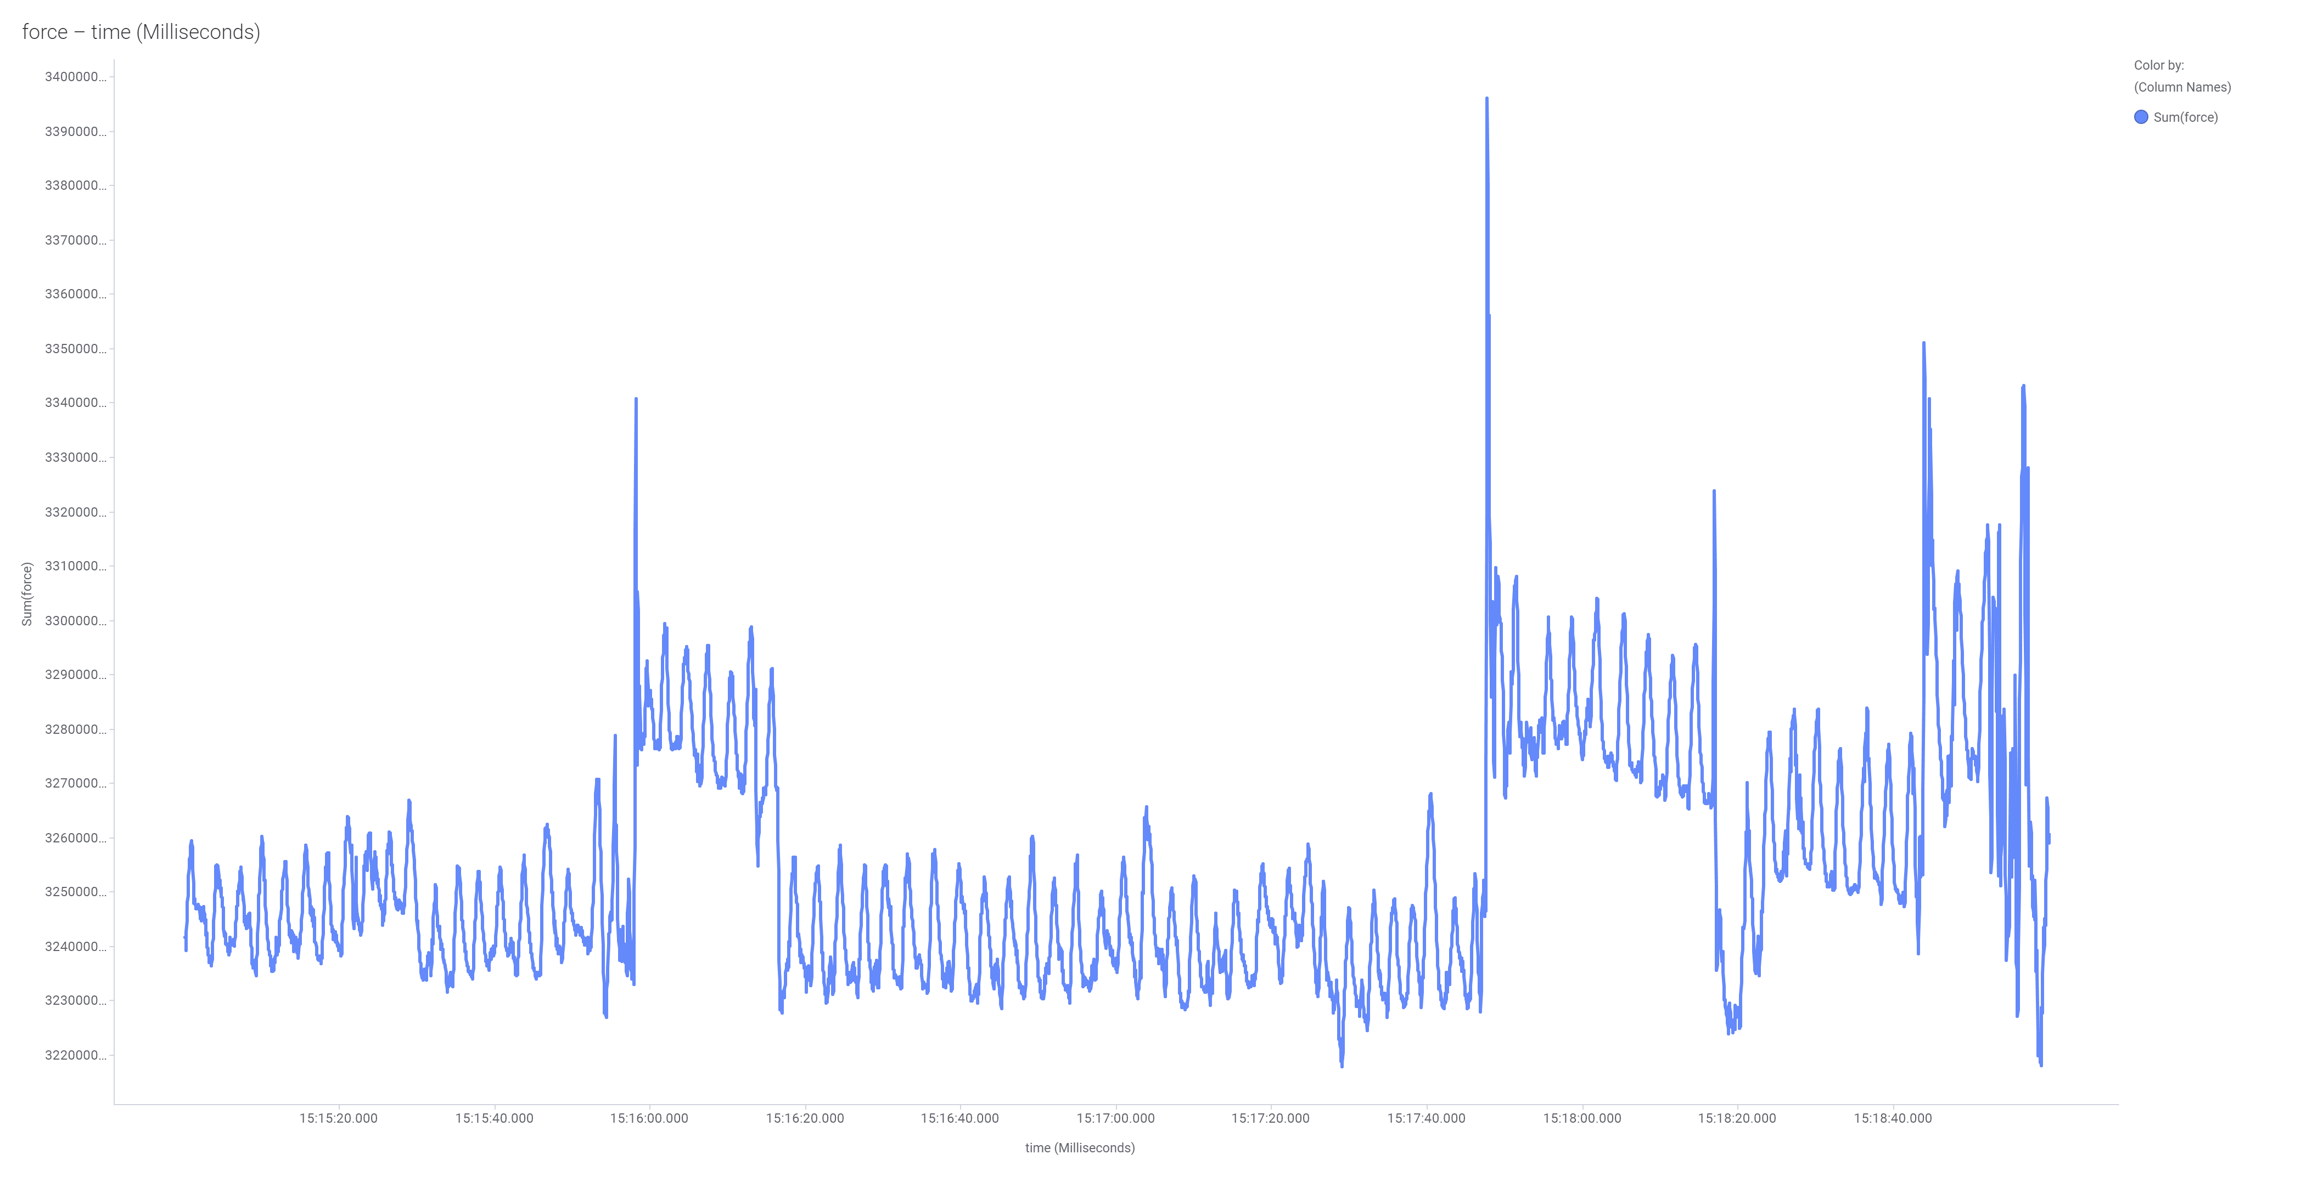
Sneezing July 17, 2019

Slide 27
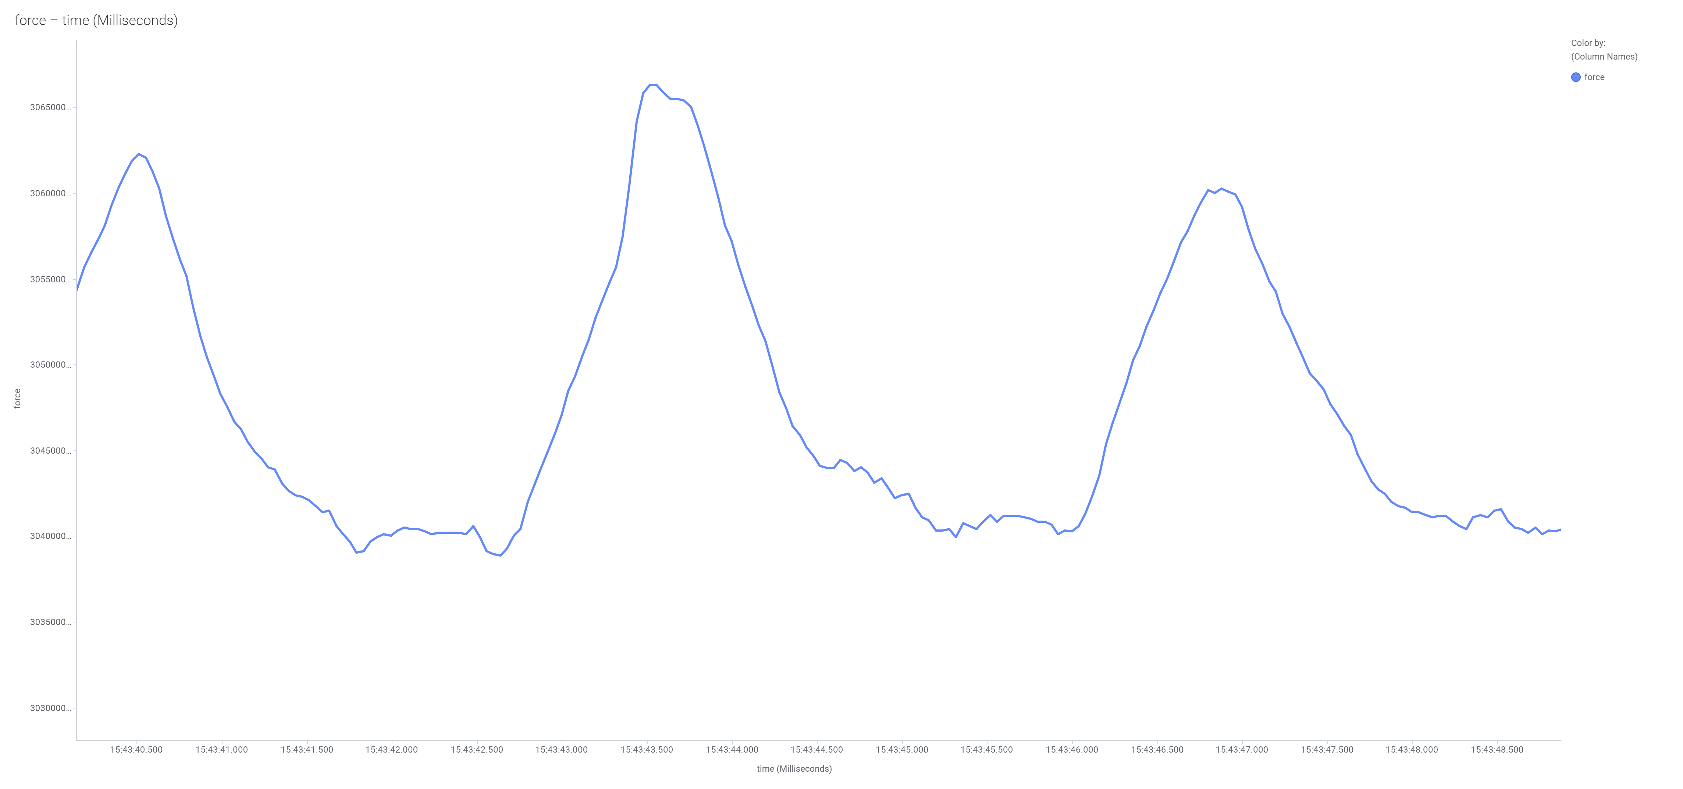
Phases of a Breath
Range
Inhale
Exhale

Slide 28
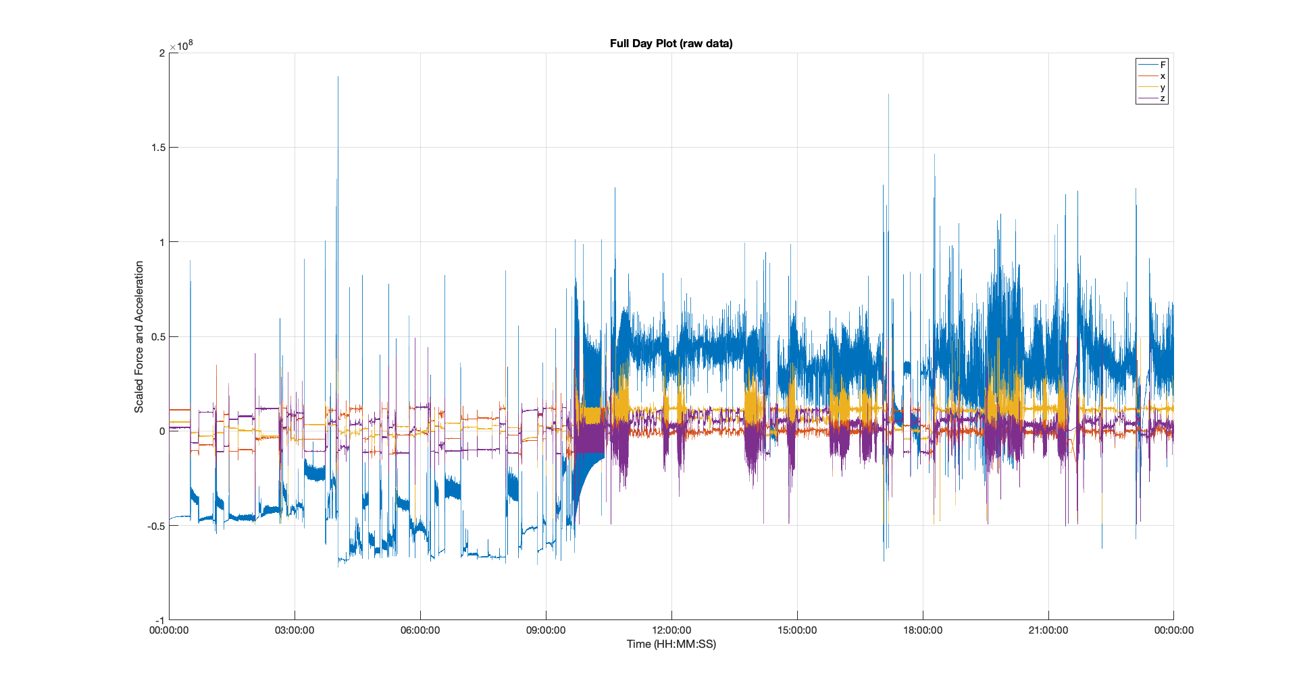
Accelerometer

Slide 29
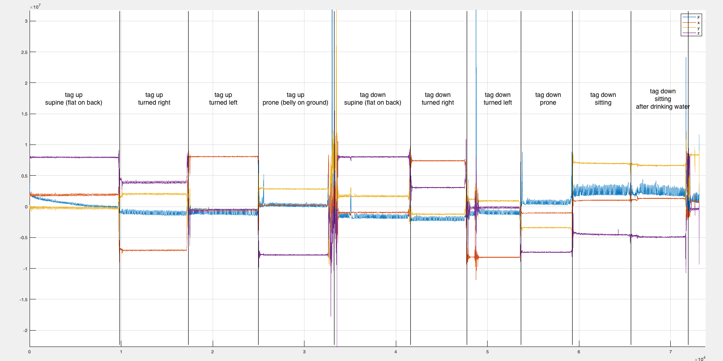
Lay Positions Rotation

Slide 30
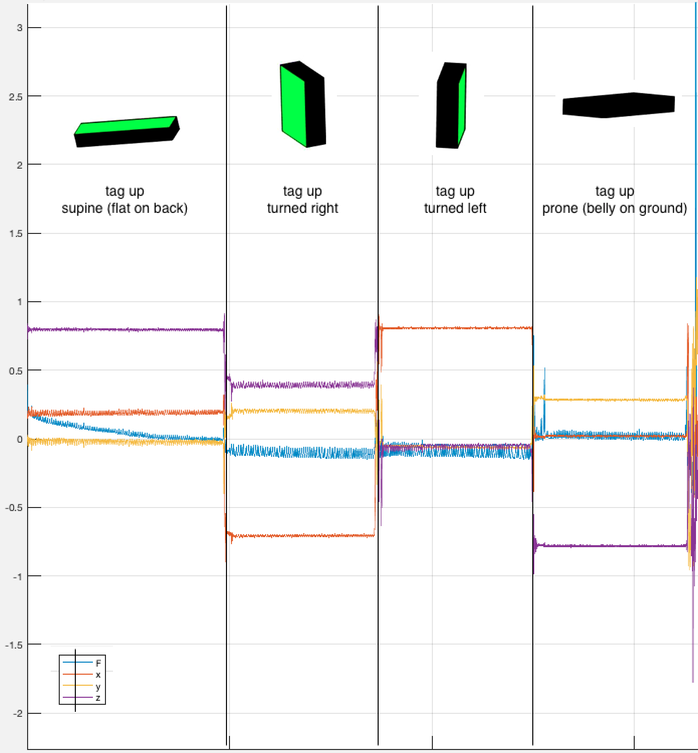
Turning in bed

Slide 31
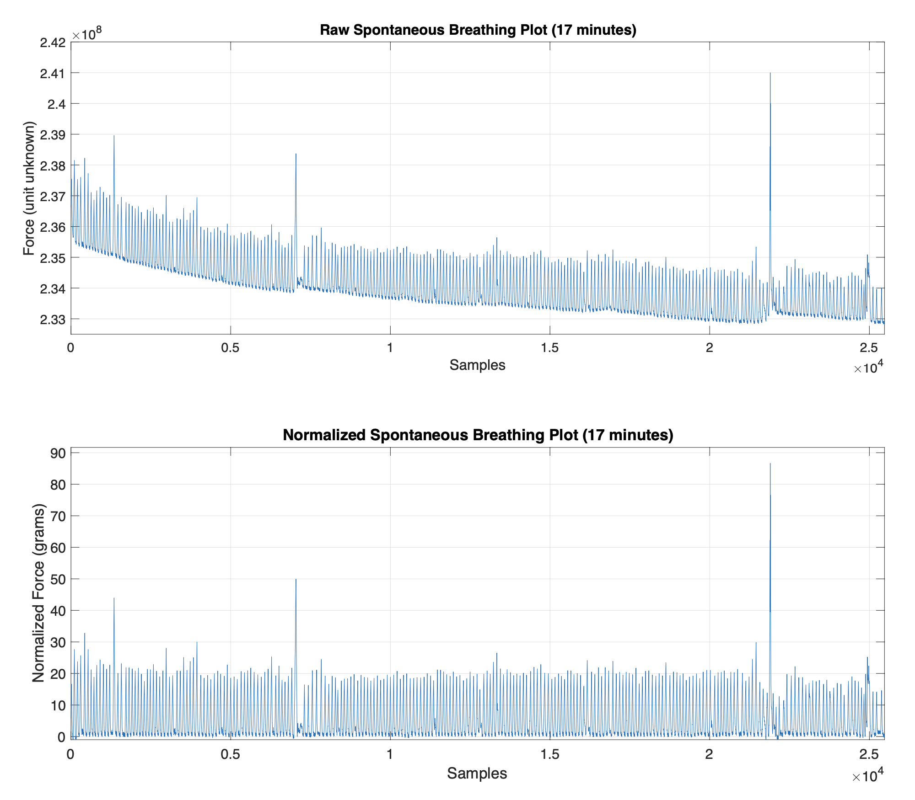
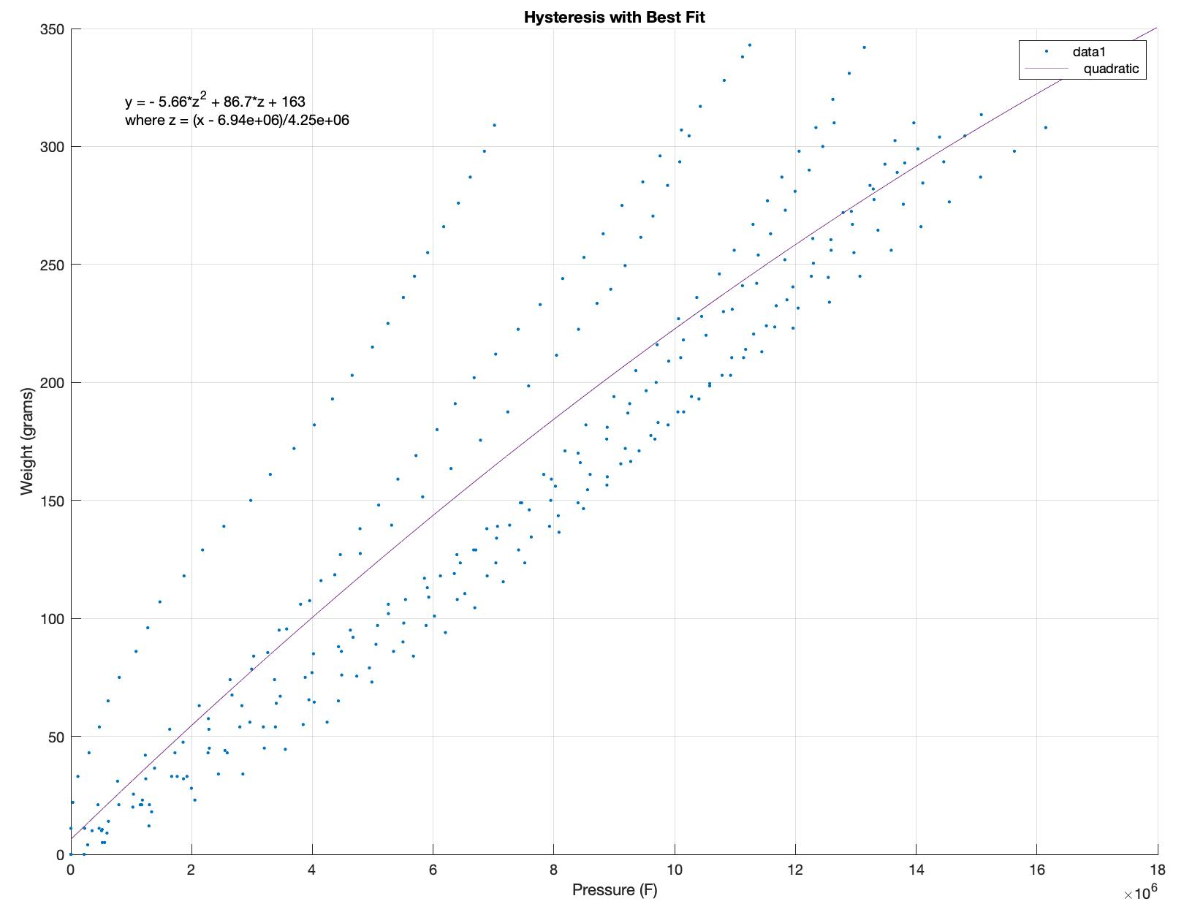
Normalization
Hysteresis measurement and
scale normalization of breath segment

Slide 32
Posture Change segmentation for a Flu participant – indication of restlessness

Slide 33
Breath Segmentation

Slide 34
Typical breaths

Slide 35
3. Breathing to Speech
Can you infer speech from breathing pattern
Detection of vowels and consonants
Inferring what was said
LLM?
Detecting ailments from speech

Slide 36
4. Ayurvedic Healing
Ayurveda is an ancient system of medicine that originated in India over 3,000 years ago.
It focuses on balancing the body's three doshas—Vata (air & space), Pitta (fire & water), and Kapha (earth & water)—to maintain health and prevent disease.
Ayurveda emphasizes natural healing through diet, herbal remedies, yoga, meditation, detoxification, and lifestyle practices.
It is a holistic approach that considers physical, mental, and spiritual well-being.

Slide 37
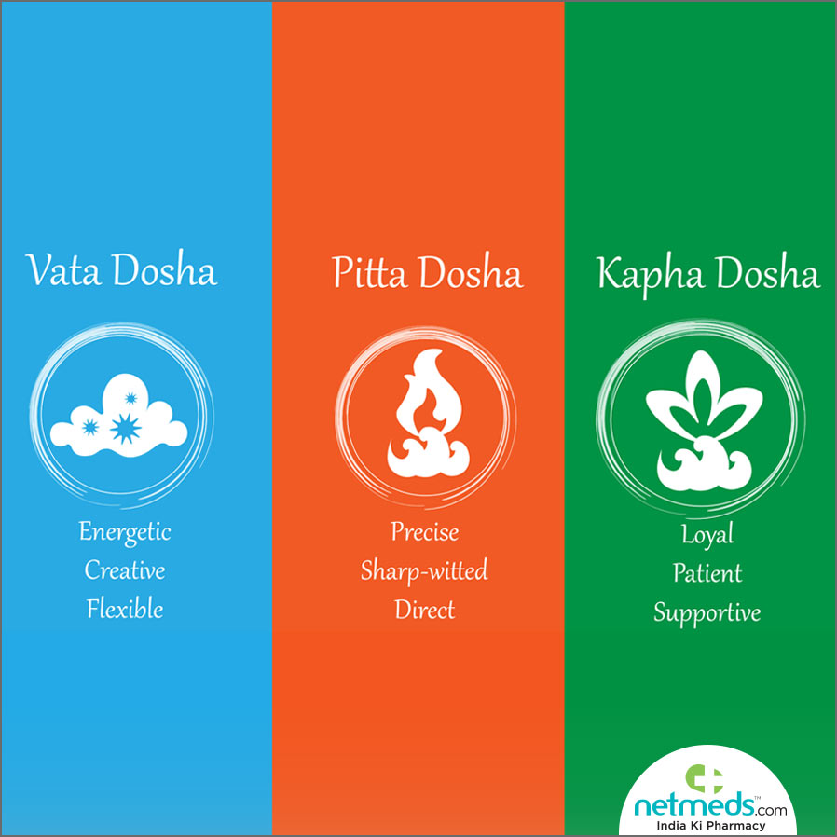

Slide 38
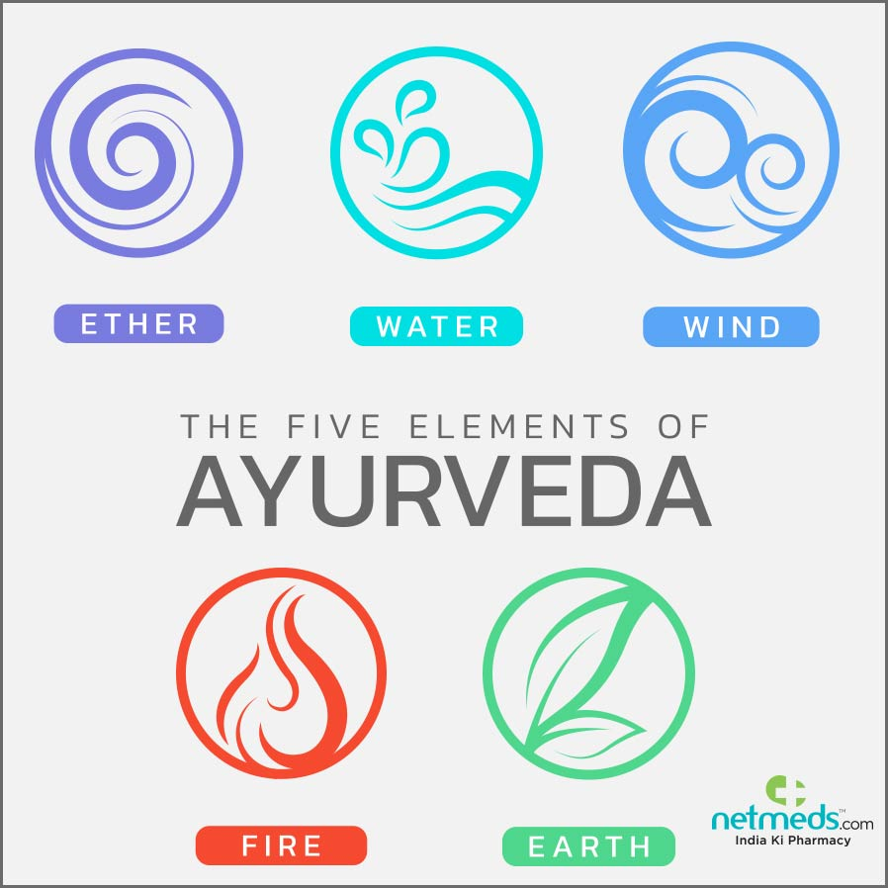

Slide 39
Ayurvedic Patients Dataset
From an Ayurvedic Hospital in Coimbatore
15 years of detailed patient records
About 1.2 million records
Data Analytics and Machine Learning.

Slide 40
5. Personal Digital Assistant
Functions
A system that knows (all) about me
Keeps track of my actions and interactions
Projects I am involved in
Friends I have
My likes and dislikes
Supports me in pointing out what I may have overlooked in a situation
When authorized, takes actions on my behalf
Input Sources
Phone
Watch
Sensors
..
Modes of operation
Online vs Offline
Cloud based vs edge based
Using LLMs
Interactions
Audio
Gestures
Visual
…

Slide 41
6. Mu Sigma
In a world of rising complexity, a NEW approach to problem solving is needed to scale and systematize better decision-making.

Slide 45
Solution Design

Slide 46
PreFabs & Accelerators

