Slide 1
Physically based simulation of Tornadoes
Akash Bapat

Slide 2
Outline
Subproblems
Genesis
Rendering
Navier-Stokes equation
Single fluid model
Two fluid model
Reynold average NS equations
Genesis

Slide 3
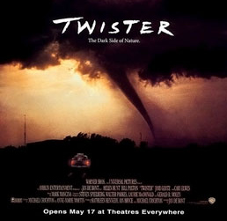
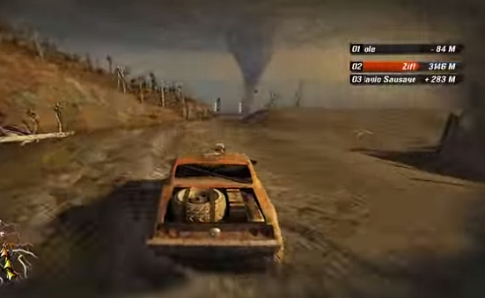
Motivation
Movies
Games
Meteorology

Slide 4
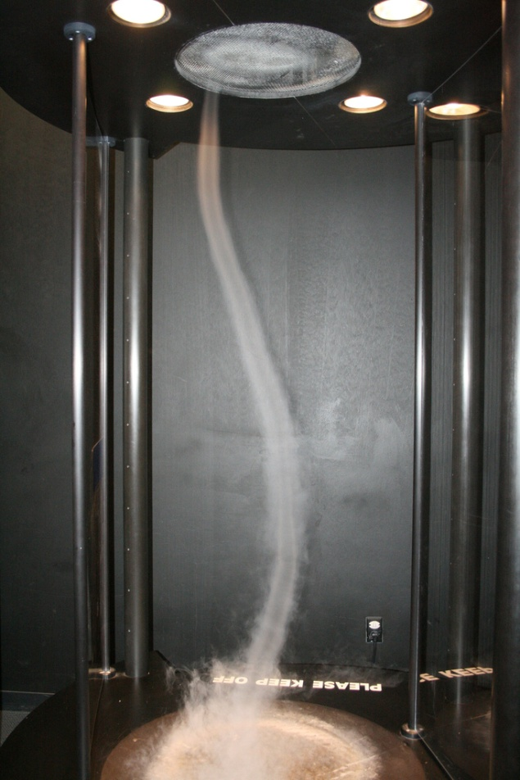
Pioneer Work
Photogrammetry
Aerial and local surveys
Tornado chasing
Tornado Vortex Chamber
Notes:
https://c2.staticflickr.com/6/5032/6940119950_b70709504d_b.jpg

Slide 5
Tornado and genesis
Tornado scale simulation (Nolan and Farell,1999)
This studies the interaction between the vortex and ground.
Investigates damage
Thunderstorm scale simulation
Tornado genesis can be studied using this approach
Starts from cloud simulation
Not completely understood

Slide 6
Tornado scale simulation
What happens after tornado hits the ground?

Slide 7
Navier - Stokes equation
Newton’s second law,
ma = F
Newton’s second law for fluids
Incompressibility

Slide 8
Navier Stokes equation
Advection: How the fluid pushes itself around
Diffusion : This describes how fluid motion is damped
f : external force

Slide 9
Single fluid model
Debris is simulated by introducing new particles at each time step
Two fluid model
Debris and vapor are simulated as fluid.
These two fluids interact via force F_{d}
Two fluid model + reynold average NS equations
Shear stress term is additional in NS equations

Slide 10
Boundary conditions terminology
Boundary conditions
No slip
Fluid is at rest, ie u=0
Free slip
No fluid penetrates the boundary
Inflow condition
Value of velocity is given explicitly
Outflow condition
The velocity doesn’t change in direction normal to boundary

Slide 11
No slip
https://www.youtube.com/watch?v=cUTkqZeiMow

Slide 12
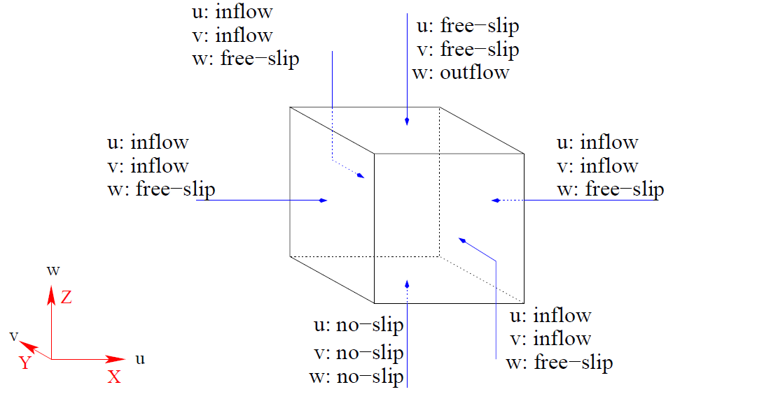
1.Ding et al

Slide 13
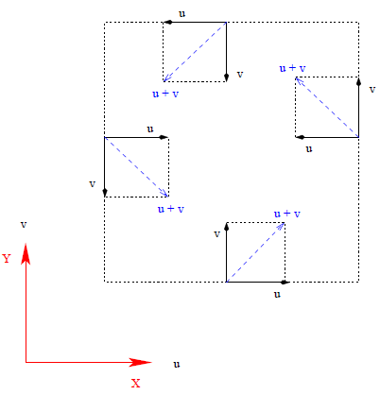
Coriolis effect
Top view: Tornado is in northern hemisphere
Notes:
This is at the boundary, https://www.youtube.com/watch?v=i2mec3vgeaI

Slide 14
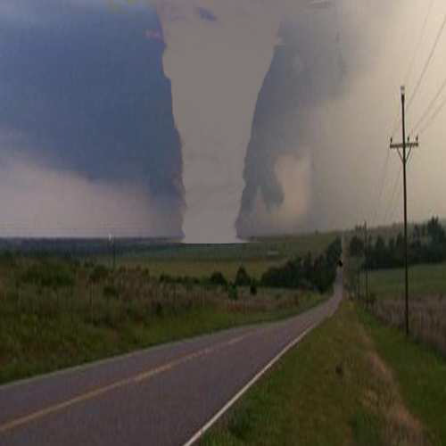
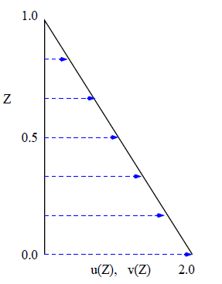
Shape of tornado and vertical profile
Boundary profile
Funnel shape simulated tornado

Slide 15
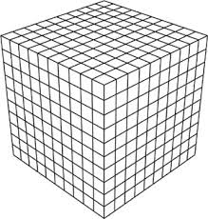
Staggered grid
For a grid cell in 3D
P is at cell center
U at center of right plane
V at center of back plane
W at center of top plane
FDM is used for solving equations
Notes:
Finite difference method

Slide 16
Debris
Debris particles
Special particles are introduced at each time step
Debris particles have velocity, position, lifetime and mass as attributes
Lifetime- a particle dies when it is outside boundaries
Centrifugal force and gravity acts on them

Slide 17
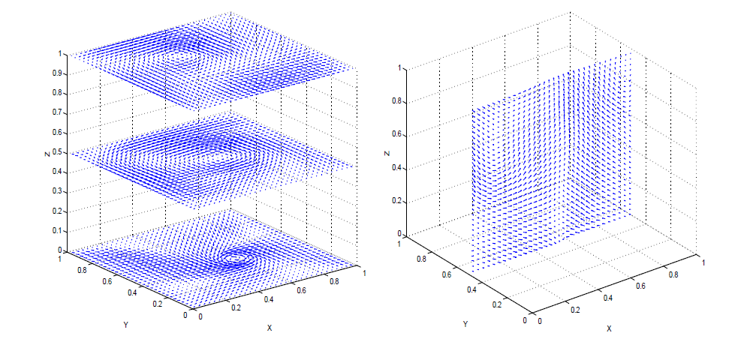
Results

Slide 18
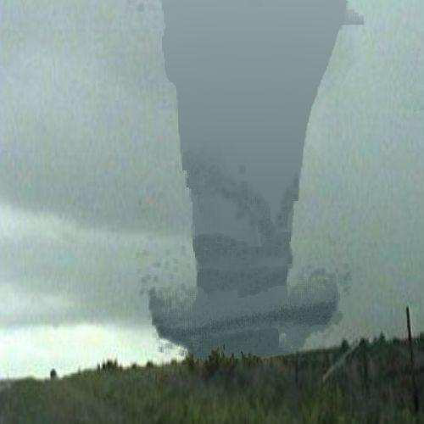
Arrow tornado
Real
Simulated
Notes:
Function of density

Slide 19
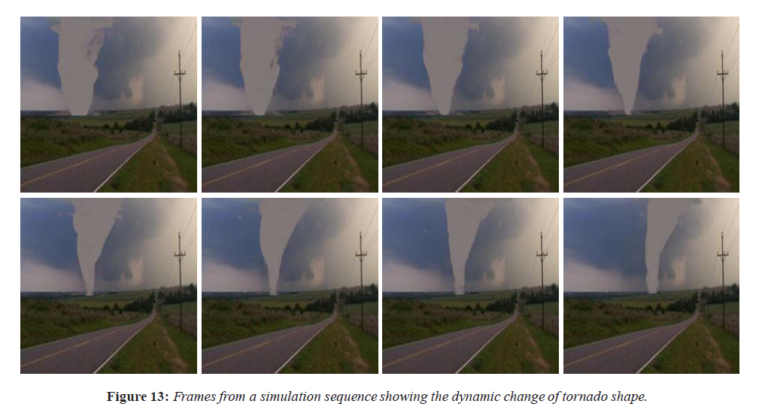
Dynamic changes

Slide 20
2. Physically based modelling and animation of tornado –Liu Shi-guang et al
Two Fluid model
Tornado is composed of vapor and debris.
The vapor is considered as primary fluid.
The rotating debris is the secondary.
Both are incompressible.
Tornado vapor | Debris
∇⋅u=0 | ∇⋅u_{d} =0
∂u/∂t=−(u⋅∇)u−∇p−F_{d} | ∂u_{d}/∂t=−(u_{d}⋅∇)u_{d}−∇p_{d}+F_{d}+ F_{G}
Notes:
m and d are mass and diameter of each spherical particles in secondary fluid, Fd is interaction between two fluids

Slide 21
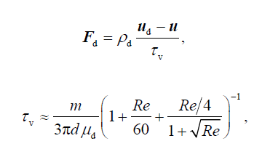
Interaction force
Re – reynolds number
µ_{d} is viscosity
d is diameter

Slide 22
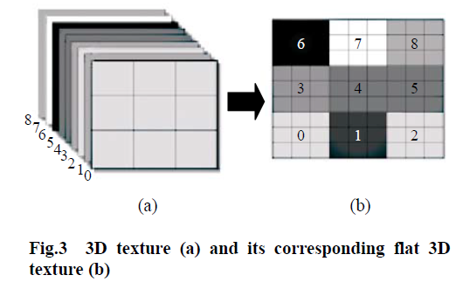
Solver on GPU ~15fps
Advection
Diffusion
Force
Pressure
State fields like u & p are stored as textures in GPU

Slide 23
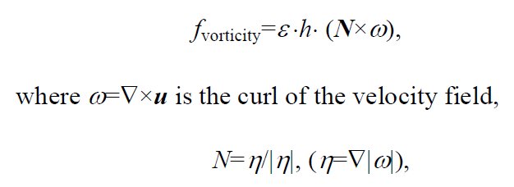
Vorticity confinement
This was introduced by Steinhoff & Underhil (1994) to compensate for numerical dissipation
Interpolation during semi-lagrangian approach tends to smooth sharp changes.
This aims to reintroduces those sharp changes.
h : spatial step , ε : control

Slide 24
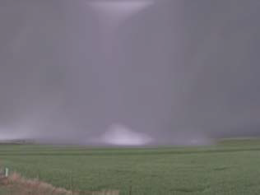
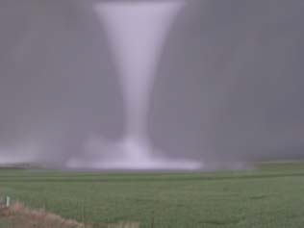
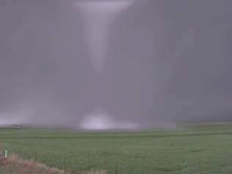
Results
Birth
Mature
Decay

Slide 25
3.RATFM- Reynold Average TFM
Real time on GPU!
Able to simulate damage to surrounding objects
Reynold –average NS equation better simulate turbulent flows
Extra terms
C_{k}=0.4 ,Von Karman constant
ρ = density of air
υ = viscosity

Slide 26
RATFM

Slide 27
RATFM- video

Slide 28
TFM

Slide 29
Large object representation
Large objects eg house, are modeled as connected voxels
A graph is constructed where each node is a voxel
Edge represents pressure yield limit
Fragments:
Each fragment is represented by its bounding box
R : radius vector from center of tornado
r: distance of voxel to center of fragment
P(t) : pressure at time t
A : projected surface area of bounding box

Slide 30
Interaction with large objects

Slide 31
Genesis- the leading idea
Strong updraft during a thunderstorm
Wind shear
Gulf of mexico and rocky mountains

Slide 32
Data driven approach :Visualization
Simulation with initial conditions seeded with real data from Manchester
SIGGRAPH ‘05
https://www.youtube.com/watch?v=EgumU0Ns1YI
Talk 3B.3 at the Severe Local Storms Conference, 2014
https://www.youtube.com/watch?v=1JC79gzZykU

Slide 33
Questions ?

Slide 34
References
Liu, Shiguang, et al. "Real time simulation of a tornado." The Visual Computer23.8 (2007): 559-567.
Ding, Xiangyang. "Physically-based Simulation of Tornadoes." (2005).
Liu, Shi-guang, et al. "Physically based modeling and animation of tornado."Journal of Zhejiang University SCIENCE A 7.7 (2006): 1099-1106.
http://www.sciencedirect.com/science/article/pii/S1524070308000064 –RATFM demo
Visualization of an F3 Tornado Within a Simulated Supercell Thunderstorm

Slide 35
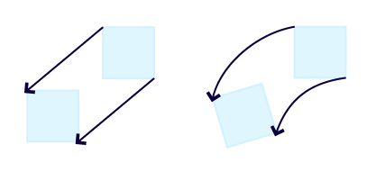
Vorticity
Zero vorticity
Non-zero vorticity
Vorticity describes local spinning

