Slide 1
Collision Detection for Deformable Models

Slide 2
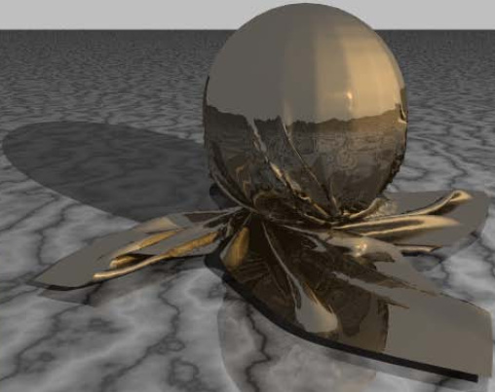
Collision Detection for Deformable Models
Bounding Volume Test
Culling Techniques
6 VF
15 cubic Equations
Triangle Test
9 EE
Notes:
To do collision detection, people usually use the pipeline like this.
Given a scene, for example, including a piece of cloth, a ground, and a solid ball, a hierarchical structure such as BVTT is built.
In this tree, each non-leaf node stands for a bounding volume overlapping test, and each leaf node stands for an triangle intersection test, assuming all the objects are represented by a set of triangles.
To test whether two triangle will intersect with each other during a delta T time, people need to perform 6 vertex-face intersection tests and 9 edge-edge intersection tests. These tests will finally reduce to solving 15 cubic equations.
Most of the cubic equations do not have real solutions, because the triangles will not intersect during the delta T time.
Since solving cubic equations is time consuming, people are trying to do such non-overlapping triangles tests without solving cubic equations.

Slide 3
High-Level Culling
Culling Techniques
Low-Level Culling
Notes:
Such techniques are usually called culling techniques.
The culling methods used in the process of traversal the hierarchical structure are called high-level culling.
On the other hand, the culling methods used in the process of triangle tests are called low-level culling.
In my presentation, I will introduce a group of culling techniques.

Slide 4
Culling Techniques
High-Level Culling
  Front-Based Decomposition
Low-level Culling
  Orphan Set
  Representative Triangles
  Non-penetration Filter
Notes:
For high-level, it has front-based decomposition. And for low-level, it has the following three techniques.
To make it easy to understand, we begin with the easiest one. I will first talk about Orphan Set.

Slide 5
Orphan Set
Interactive Continuous Collision Detection between Deformable Models using Connectivity-Based Culling
Notes:
Let’s begin with an observation.

Slide 6
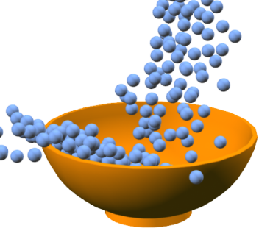
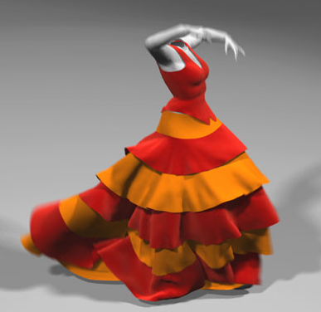
DIFFERENCE ?
Intra-intersection
Rigid
Deformable
Notes:
Imagine a scene of rigid bodies and a scene of deformable models, what is the biggest difference?
You may think that is intra-intersection. A deformable model can intersect with itself but a rigid body cannot.
But, is intra-intersection more complicated than a regular intersection?
The answer is no.
In fact, the mesh which represents the deformable model provides so much connection information. This information can be used to accelerate the collision detection.
The concept of Orphan Set is proposed based on this observation.

Slide 7
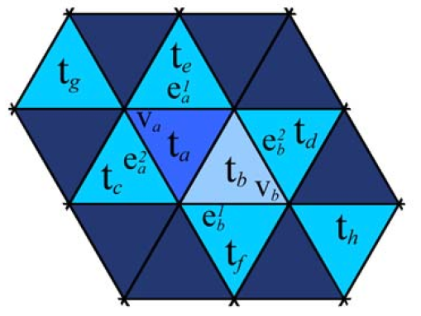
New Way
Traditional Way
15
6: vertex - face
9: edge - edge
Notes:
Let’s see an example.
If we want to test whether the two triangle ta and tb will intersect during a delta T time, the traditional way will solve 15 cubic equations, where 6 for vertex-face tests and 9 for edge-edge tests.
Such method is inefficient, and should be replaced by a new way.

Slide 8
New Way
Observation
4
(V_{a}, t_{b})
(V_{b}, t_{a})
(e_{a}¹, e_{b}¹)
(e_{a}², e_{b}²)
Notes:
Because ta and tb are neighbors, only 4 tests are necessary.
They are: (Va, Tb), (Vb, Ta), (ea1, eb1), (ea2, eb2).
Now, because the collision detection between adjacent triangles are more easier than the non-adjacent triangles, the whole collision detection process is divided into 2 steps.
The first step checks the non-adjacent triangles, and the second step checks the adjacent triangles.
So the second step will take this advantage.

Slide 9
New Way
Non-adjacent Test
Adjacent Test
Another Observation
Notes:
The first step checks the non-adjacent triangles, and the second step checks the adjacent triangles.
So the second step will take this advantage. But, is that all?
Here is another Observation.
During the non-adjacent test, when we test (tg, tb), (va tb) is tested at the same time.
Similarly, when we test (ta, th), (va, ta) is tested at the same time.
When we test (te, tf), (ea1, eb1) is tested at the same time.
When we test (tc, td), (ea2, eb2) is tested at the same time.
So, in this example if non-adjacent test is performed first, all the tests in the adjacent step can be avoid.
However, not all the adjacent steps can be avoid.

Slide 10
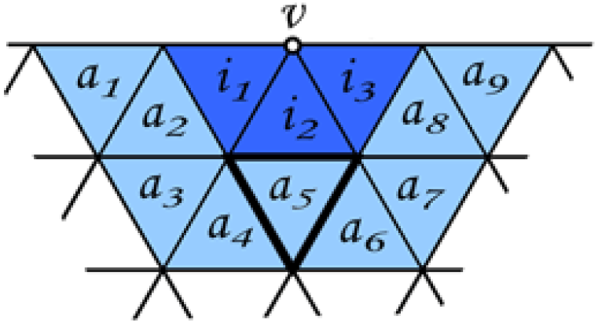
Notes:
For example, the test (v, a5) will never be performed in the non-adjacent step. Because all the triangles including vertex v are the neighbors of a5.

Slide 11
can be tested in non-adjacent step
Adjacent Elementary Pairs
New Way
cannot be tested in non-adjacent step
Non-adjacent Test
Orphan Set
Orphan Test
Notes:
So, we classify the adjacent elementary pairs into two groups: can be tested in non-adjacent step, and cannot be.
And those cannot be tested in non-adjacent are called orphan set.
Now, the new way to do collision detection is first perform non-adjacent test and than perform orphan test.
For a triangle mesh, the orphan set is fixed and can be pre-computed.
But I am not going to explain how to compute the orphan set, because there is another more powerful techniques which replace the orphan set.

Slide 12
Representative-Triangles
Fast Collision Detection for Deformable Models using Representative-Triangles
Notes:
This technique is called representative-traingles.

Slide 13
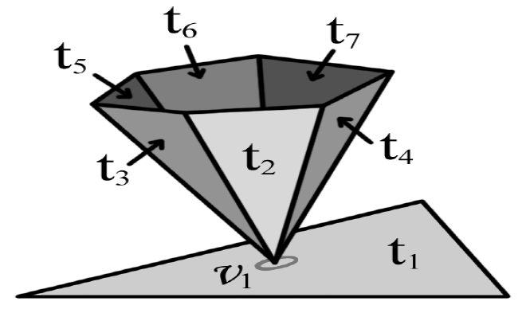
Motivation
Notes:
What is the motivation?
Look at this example.
The vertex v1 contact with the triangle t1.
So the traditional way will test (v1, t1) 6 times. And since the upper six triangles are not the neighbors of t1 (in fact, they even don’t in the same mesh), using orphan set will not avoid those duplicate elementary tests.

Slide 14
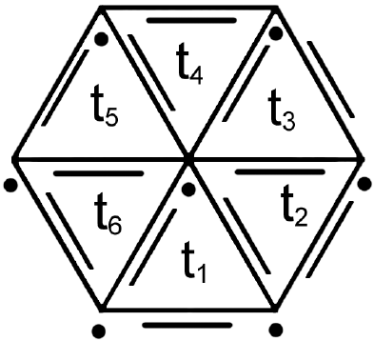
Representative-Triangles
Notes:
To solve this problem, people proposed representative-triangles.
In representative-triangles.
Each element is assigned to one triangle.
For example, the middle point is assigned to the triangle t1. And this point will only be tested when the triangle t1 is tested.
Using representative-triangles, each elementary test will perform no more than once.

Slide 15
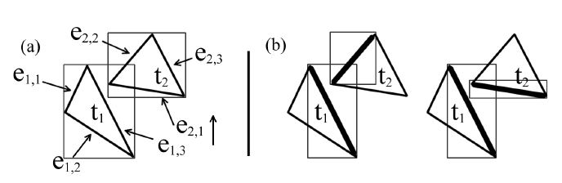
Motivation
Notes:
And here is another advantage of representative triangle.
In the left figure, the bounding volumes of the two triangles are overlapping. So 15 elementary tests are needed to do further check.
But in fact, if we use the bounding volumes of the edge, only 2 elementary tests are needed to do further check.

Slide 16
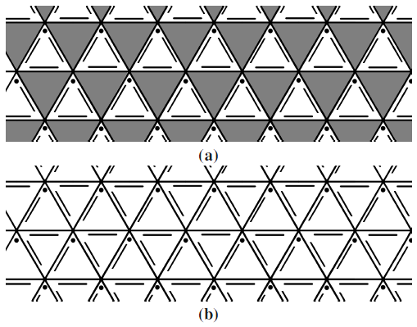
Representative-Triangles
How to assign?
Notes:
So, a representative triangle will also remember the bounding volumes of the assigned elements
But, how to assign the elements? Is there an optimal assignment?
Of course, different assignment will lead to different computations. But it is proved that, there is no global optimal assignment. And a greedy method is good enough to assign the elements.

Slide 17
Non-Penetration Filter
Fast Continuous Collision Detection using Deforming Non-Penetration Filters
Notes:
Now we talk about non-penetration filter.
This technique bases on another observation.

Slide 18
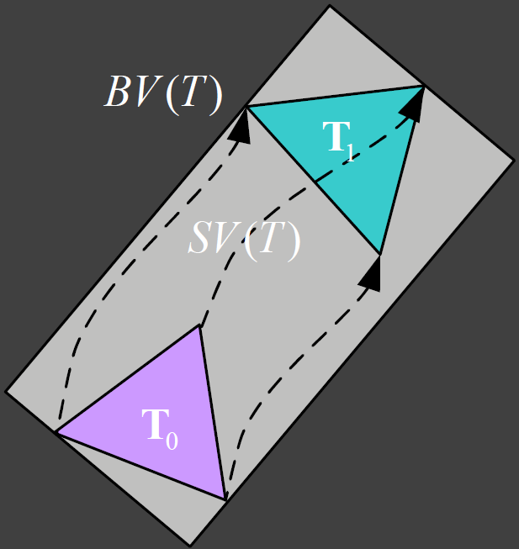
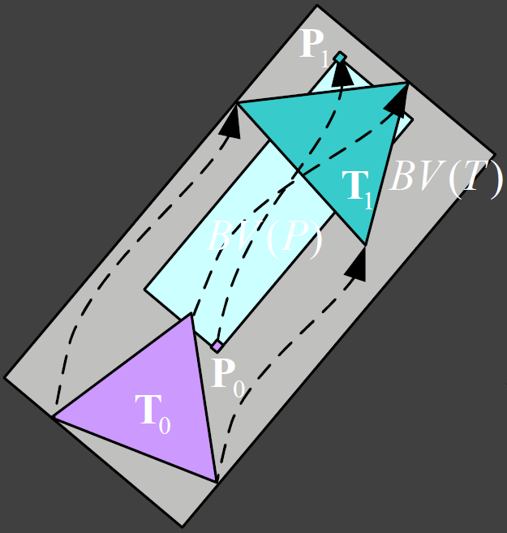
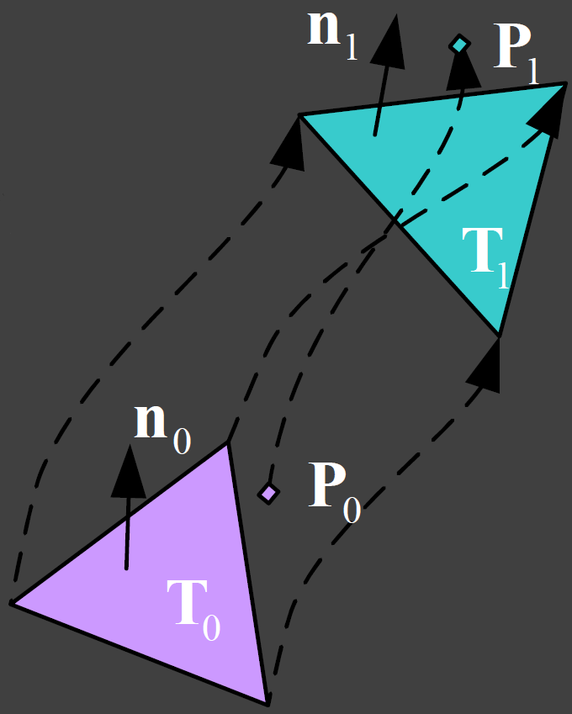
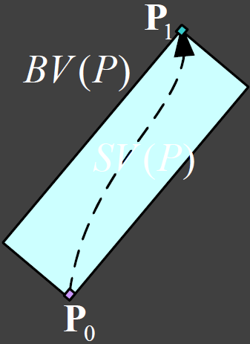
Notes:
Look at this figure. At time t0, the triangle is at lower position, and at time t1, the triangle moves to the higher position.
When doing collision detection, people usually use a big bounding volume to cover the both positions.
Now, there is a bounding volume of a moving vertex.
Such bounding volumes are too conservative to do collision detection. And too many cubic equations are going to be solved to check whether during the time delta T, the vertex penetrate the triangle.
But there is a much easier way to do this test. This technique is called non-penetration filter.

Slide 19
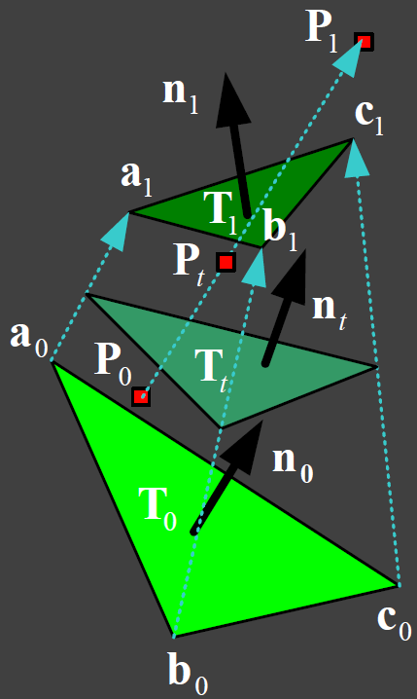
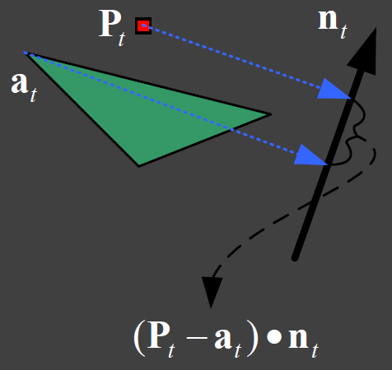
Non-Penetration Filter
Notes:
Assume the normal of the triangle changes from n0 to n1, and nt is the normal at any time point.
We project the vertex a and p to the normal nt, the projected distance can be denoted like this.
If during the time delta T the projected distance is never equal to zero. The vertex and the triangle do not intersect.
To get this distance also needs much mathematical computation, however, the computation is much lighter than solving cubic equations.
Because I only want to show the basic conception, I am not going to talk about the mathematical details right here.
If you are interested in, you can find them in the reference papers.

Slide 20
Culling Techniques
Low-level Culling
  Orphan Set
  Representative Triangles
  Non-penetration Filter
High-Level Culling
  Front-Based Decomposition
Notes:
Now I have talked about all the three low-level culling techniques. Next I will introduce a high-level culling method.

Slide 21
Front-Based Decomposition
MCCD: Multi-Core Collision Detection between Deformable Models using Front-Based Decomposition

Slide 22
BVH
BVTT
BVTT Front
Notes:
First we need to remember three names.

Slide 23
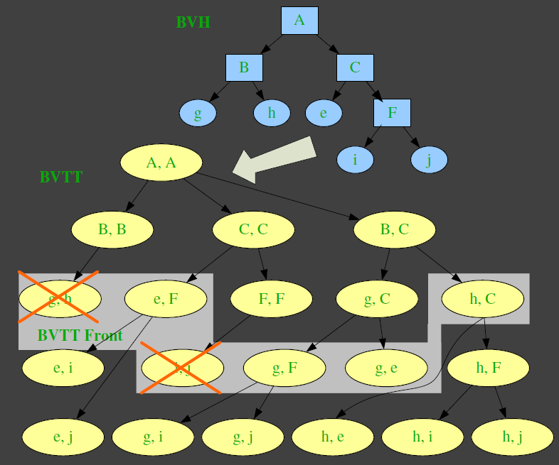
Bounding Volume Test Tree
BVTT Front
Notes:
BVH, bounding volume hierarchy, has been introduced in this class.
BVTT ,is a bounding volume test tree, which is build base on the BVH.
BVTT represents the traversal process in BVH.
Each node in the BVTT represents a single overlap test between a pair of bounding volumes (BVs) or represents a self-collision test within one bounding volume.
As a result, the BVTT is no longer a binary tree. Some internal nodes could have three children nodes.
BVTT Front: A front of the BVTT is a set of internal and leaf nodes, where the traversal terminates while performing a collision query during a given time instance.

Slide 24
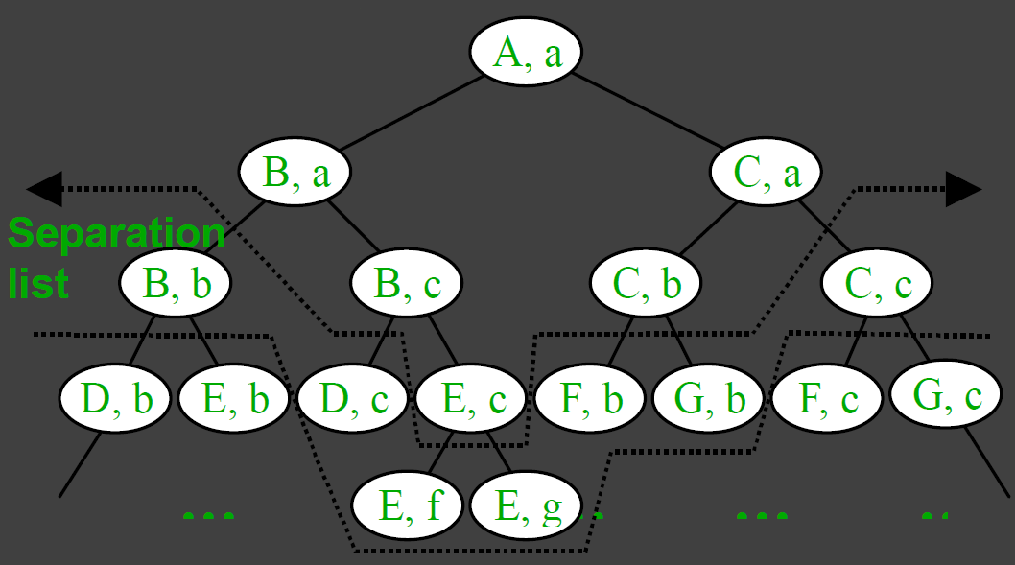
Basic idea of FBD: Incremental 3D Collision Detection with Hierarchical Data Structures
Notes:
The basic idea of FBD is first introduced in the paper “Incremental 3D Collision Detection with Hierarchical Data Structures”.
When traversal the BVTT, if a node do not overlap, no further traversal down to its subtree is necessary.
Therefore, for each collision query, we can draw a line that cuts the tree into two parts.
The nodes above the cut overlap, but the nodes below the cut do not.
We call the set of nodes right below this cut a separation list.
Each node in the list is called a separation node.
A key observation on this separation list is that when objects do not jump very far between two frames, most of the separation list remains unchanged or only changes locally.
By keeping track of this separation list, we hope to reduce the number nodes that need to be traversed.
We use the list from the previous query as a starting point to generate the separation list for the current query.
If coherence between two frames exists, then only a small portion of the list needs be updated at each time.
To maintain such list, sometimes the separation node will go down, sometimes the separation node will go up, and sometimes it stays the same.
For going down, it’s faster than traversal from the root. But for going up is hard to say, because we don’t know how up it will go.
We can predict the motion of the separation list by examining the number of nodes in the separation list.
If the size increases, we predict that the objects are getting closer to each other, and we will keep on using this growing list to generate the next separation list.
On the other hand, whenever the list stop growing (i.e., its number of nodes does not change in two consecutive frame), we predict that they are moving away from each other, and the separation list will be rebuilt.
With this strategy, we do not examine the parent nodes of the current list in any cases.
In the case going down, we save n nodes of traversals (where n is the total number of nodes above the list).
In the cases going up and staying the same, , we may not save or waste any nodes.
Note that, the separation list here is the BVTT front.

Slide 25
Front-Based Decomposition
Front-Based Decomposition
Notes:
Now we have known what is the Front (Separate List), but what “Decomposition” stands for?
Since the nodes of a BVTT front are updated independently, it is easy to execute them in parallel on multiple cores.

Slide 26
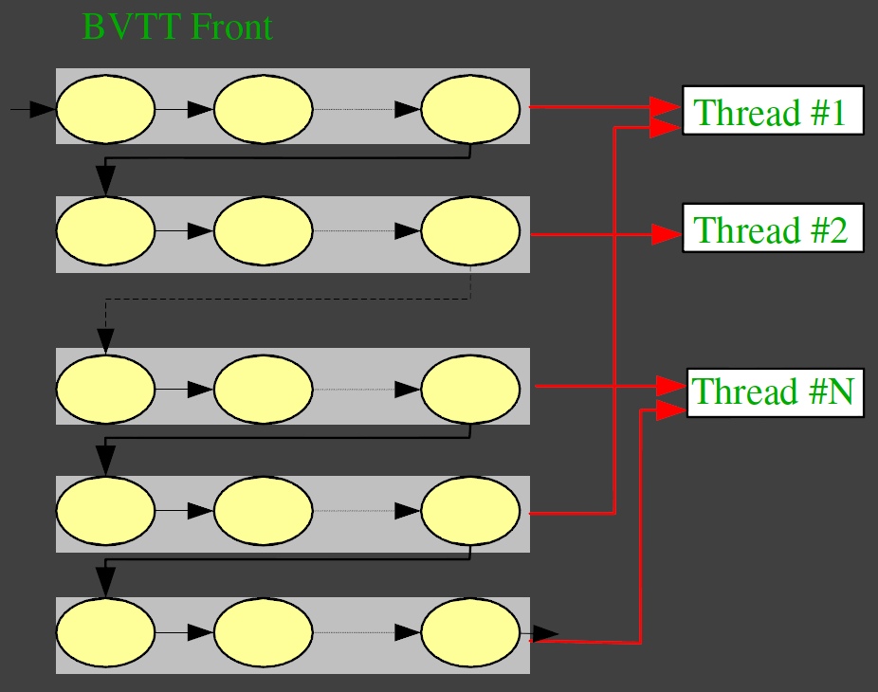
Notes:
To achieve high performance, we need to fully utilize all the available computing units.
By using FDB, the task of collision detection is broken into a set of front node updating sub-tasks, which can be executed independently.
As shown in this Figure, all the nodes of the BVTT front are organized as blocks and manage the threads using dynamic load balancing.
When a thread finishes the computation on its block, a new block is assigned to the thread and thereby keeps the thread busy.

Slide 27
Culling Techniques
Low-level Culling
  Orphan Set
  Representative Triangles
  Non-penetration Filter
High-Level Culling
  Front-Based Decomposition
Notes:
Now I have talked about all the three low-level culling techniques. Next I will introduce a high-level culling method.

Slide 28
Thank you!

