Slide 1
Dynamics in Networked Simulation
Giuseppe Di Natale

Slide 2
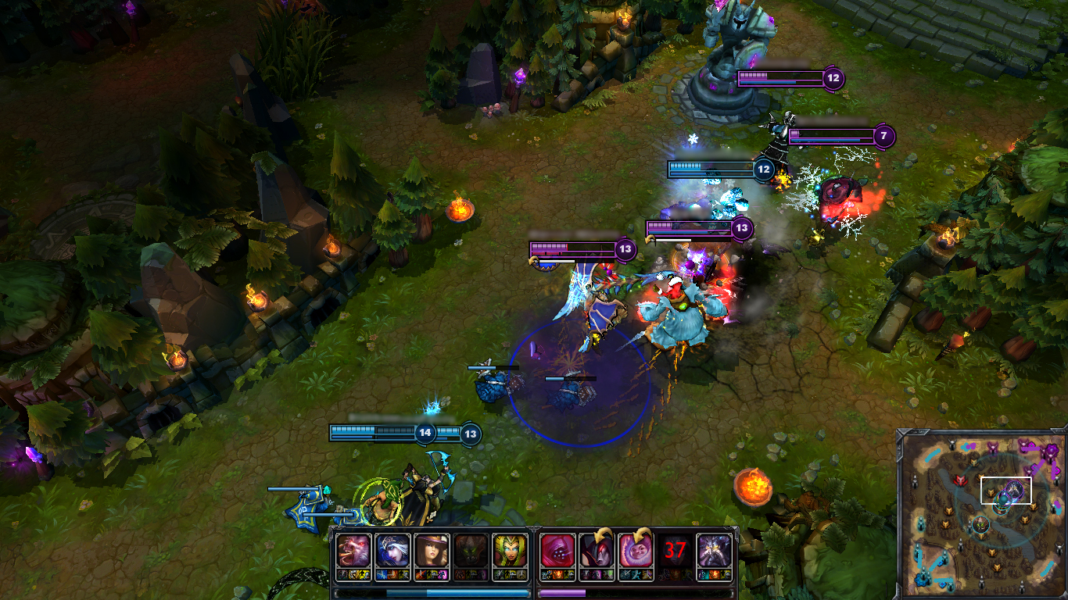
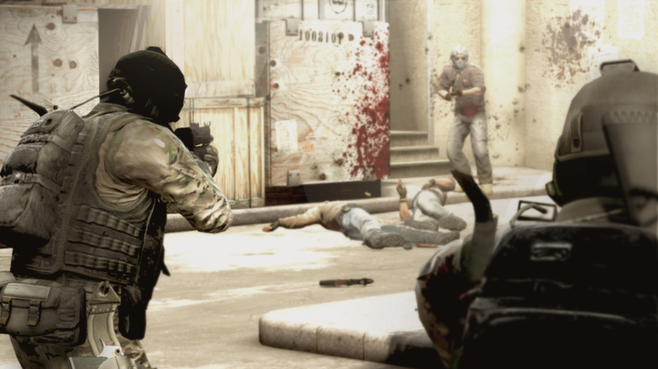
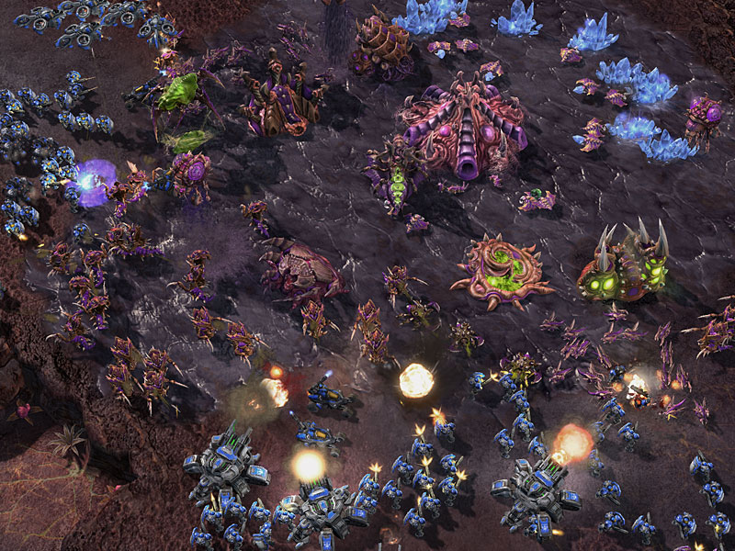
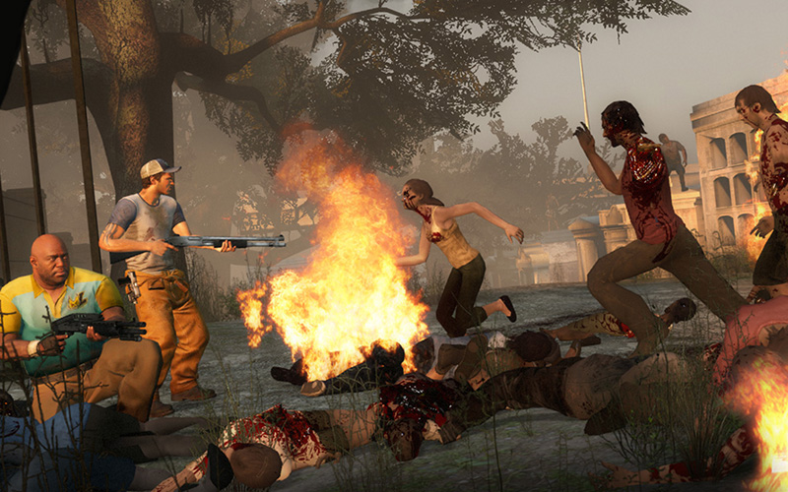
Motivation
Multiplayer games
Training Simulators (flight training, air traffic control, etc.)
League of Legends
CS: GO
Starcraft II
Left 4 Dead 2

Slide 3
Important Terms
Latency – Amount of time it takes packet to go from source to destination
Bandwidth – The rate at which data can be sent over a network
Game – refers to the simulation
Players – Participants providing input at the client side in a running simulation
Consistency – Refers to all participants having (approximately) the same state
Entity – Object of the world which hold some form of state (i.e. bullet with a velocity and current position)
World – Collection of entities representing the state of the world
Server – Machine which contains the “ground truth” for the state of the world
Client – Endpoint machine which is accepting player input

Slide 4
Goals
All clients have a copy of the world, so it is important to maintain consistency across all these copies
For highly interactive simulations, make interaction with world appear instantaneously while minimally impacting consistency of state

Slide 5
Early Games
Usually played on LANs
Peer to Peer (P2P) Mesh topology
Primarily games were Real Time Strategy (RTS)
Age of Empires
Starcraft

Slide 6
P2P Lockstep
Game has an initial state that all players begin with
Game is viewed as a “series of turns”
Turn is usually a fixed period of time where all game updates/changes are collected (i.e. 200ms)
At turns end, all players execute all received commands/updates
Rinse and repeat

Slide 7
P2P Lockstep
Client3
Commands
Commands
Commands
Client4
Client1
Commands
Commands
Commands
Client2

Slide 8
P2P Lockstep
Limitations
Not suitable for highly interactive games (i.e. First Person Shooters)
Difficult to determine if the game is entirely deterministic
Initial state is required
Late joining is possible, but difficult since its hard to get a good initial state for the new comer
Final Notes
Some variant of this model is still in use today for various RTS games such as Starcraft II
Again, not suitable for highly interactive games over the internet

Slide 9
Client/Server – Round 1
As mentioned, P2P Lockstep is not suitable for highly interactive games
Solution: we need a central authority (the server) that will maintain the “ground truth”
All player actions (i.e. key presses, mouse moves, etc.) are sent to the server
Client’s copy of the world only updated based on the information received from the server

Slide 10
Client/Server – Round 1
Client2
Commands
Client1
Client 3
State Updates
Commands
Commands
Server
State Updates
State Updates

Slide 11
Client/Server – Round 1
If an entity is only updated when the server reports a change, players would be seeing choppiness due to the time for information to travel to and from the server
Solution: Do some form of smoothing/interpolation to make updates appear smooth to the player

Slide 12
Client/Server – Round 1
Model supports players joining midway through a simulation
Clients simply generate all the entities and then start updating based on what is received from the server
Larger number of players can be supported
Each player uses less bandwidth to send updates
Limitations
Players will “feel” the latency between them and the server
Symptom of having to send actions to server then wait for a state update in return
This works out to be a good first try

Slide 13
Client/Server – Round 2
How can we make the game “feel” right for players?
Generally, the solution is two fold
Lag Compensation – attempt to normalize server-side state for each player
Client-side movement prediction – client is less “dumb” and has at least some knowledge about how the world updates

Slide 14
Client/Server – Lag Compensation
Method of normalizing state of the world per player server-side
At a high level, server takes a step back in time to the exact time a player’s action is performed
High level algorithm:
Prior to processing the player’s command
Compute latency for the client
Find the world update sent to the client that was received before the new command was issued
Move all other players affected by the update backwards in time to where they were at the time the new player command was issued
Execute the command
Move all players back to their correct/current positions

Slide 15
Client/Server – Lag Compensation
Limitations
There are a few extreme cases which will feel unnatural to a player
Example: A player with high latency is firing at a player with lower latency
Low latency player has rounded a corner and is out of sight of the high latency player in their copy of the world
High latency player is seeing things in the past, they have line of sight on the low latency player and fire at the player in their copy of the world
Once the high latency player’s commands hit the server, the world on the server is sent backwards and the hits are recorded against the low latency player
Low latency player receives updates from server regarding loss of health, it now appears the high latency player is shooting around corners
Fortunately, this case is rare. Most common cases are both players see and fire at each other or one player is running perpendicular to the view direction of the other player.

Slide 16
Client/Server – Lag Compensation
Generally, lag compensation makes the game feel right most of the time
Actions feel natural
Example: When player is firing a weapon, they no longer need to lead the target to compensate for latency in the network
Occasional negative does not outweigh the positives

Slide 17
Client/Server – Client-side Prediction
Clients are no longer “dumb”, but are not in full control of the state of the game. The server is still present as the authority.
Clients still send commands to the server, but instead they also store these time stamped commands locally
Using the last state acknowledged by the server, clients proceed to update its state according to the players action
If the server comes back with a different state, the client’s state is corrected and the local simulation then uses the cache of unacknowledged commands to update from the new correct state onward

Slide 18
Fully Distributed Interactive Simulation
So far we have discussed methods which primarily involve a central authority which is viewed as the “ground truth”
P2P Lockstep was distributed in some sense, but wasn’t suitable for interactive gameplay
So how do we obtain a distributed interactive simulation?

Slide 19
Dead Reckoning
Form of replicated computing
P2P network topology
All clients participating in the simulation end up simulating all objects in the world to some degree
All clients must agree on the methods used to model all objects
Extrapolation is used heavily to keep the world seemingly interactive
Concept of entity ownership
Client who spawns the entity has ownership of it

Slide 20
Dead Reckoning
Entity creation and maintenance
Client decides to create an entity
Client notifies all other clients in the simulation of entity creation and which predefined model to use to extrapolate its state over time
Owner simulates both the actual state and the extrapolated state of the owned entity
If the owner determines that the estimation of the entity’s state is outside of some agreed upon error threshold, it will issue an update to all other clients

Slide 21
Dead Reckoning
Entity Updating
All clients update the entities they do not own with a coarse approximation
Upon receiving an update from the owner of the entity (remember, the owner simulates both the actual and approximate states)
Update the state of the entity to what the owner specified
Begin approximating from the new current state
Again, what about the apparent choppiness when updates occur?
Smoothing/Interpolation comes into play here.

Slide 22
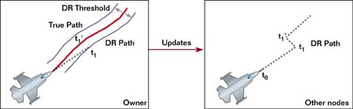
Dead Reckoning
Example is a plane flying, the model used by remote nodes is the standard kinematic equation
P = P_{r} + v_{r} (t_{current} – t_{update}) + ½ a_{r} (t_{current} – t_{update})²
Example: Owner controlled plane and what it looks like to remote nodes. [5]

Slide 23
Dead Reckoning
Limitations
In extreme cases, corrections (even with smoothing) can be jarring
Consider the case where remote clients determine a ball has made it down a hill, where the owner determines that in actuality, the ball didn’t make it over the hill
Correcting this scenario is visually costly
Notion of physics consistency cost
What about physically enabled objects in the environment?

Slide 24
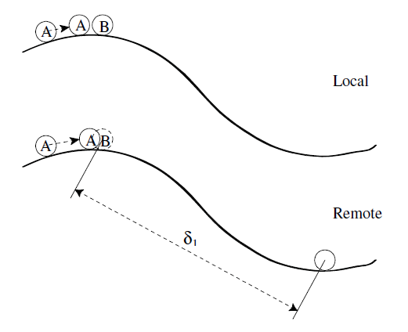
Dead Reckoning
Issue: The physical consistency of the remote clients and the client who owns the entity that collided
Example of high physics consistency cost. [1]

Slide 25
Physically Aware Dead Reckoning
No longer is ownership of an entity tied to the client that created it
Dynamic Authority/Ownership
Clients are responsible for what is local to them
If a player is beginning an interaction with a physically enabled object, they assume ownership of that object
Collisions between other clients and physically enabled objects are ignored locally.
Those objects are only updated based on update messages from other clients

Slide 26
Physically Aware Dead Reckoning
When to update state?
Only at the start of a collision?
Not enough, what if the player moves their controlled entity during the collision, remote entities won’t have an accurate view
Need to update, at the very least, at both the start and the end of the collision
Other option, update each frame
Creates too many update packets and clutters the network
How about a hybrid?
Can periodically send updates during a collision, but not at every frame

Slide 27
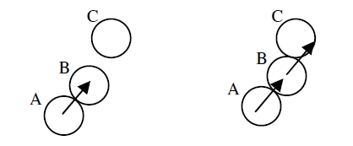
Physically Aware Dead Reckoning
A method of updating objects by proxy is also necessary
This covers the cases where the player affects an object and that object collides with another object
Recursively figure out which objects are being impacted by the entity the player is controlling
Example of ownership by proxy [7]

Slide 28
Adaptive Dead Reckoning
Do some look ahead to determine if collisions will occur in the near future
Naively, each iteration of the simulation, simulate the next few steps into the future
If a collision is likely to occur, the simulation can reduce the error tolerance accordingly, this will cause more frequent updates to occur
If collisions are not going to happen, then it is presumed safe to increase the error tolerance, thus reducing the number of update messages

Slide 29
Questions?

Slide 30
References
http://ieeexplore.ieee.org/xpl/articleDetails.jsp?arnumber=6621148
https://developer.valvesoftware.com/wiki/Latency_Compensating_Methods_in_Client/Server_In-game_Protocol_Design_and_Optimization
http://gafferongames.com/networking-for-game-programmers/what-every-programmer-needs-to-know-about-game-networking/
http://www.gamasutra.com/view/feature/3094/1500_archers_on_a_288_network_.php
http://www.gamasutra.com/view/feature/131638/dead_reckoning_latency_hiding_for_.php
http://www.hindawi.com/journals/ijcgt/2014/138596/
http://eprints.maynoothuniversity.ie/3985/1/PW_Thesis_MScEng.pdf

