Slide 1
Soft Tissue Simulation
Presented by Shan Yang
alexyang@cs.unc.edu

Slide 2
Outline
Background
Constraints for soft tissue simulation
Deformable tissue models
Estimation of soft tissue elastic parameters

Slide 3
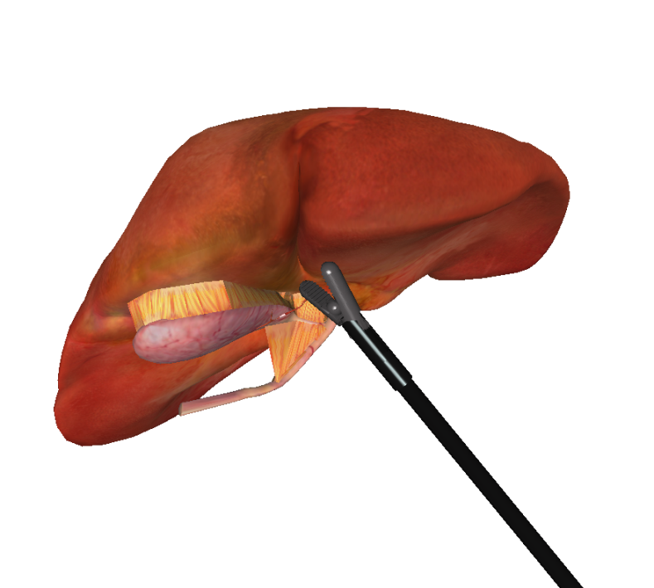
Background
Three generations of medical simulators^{[1]}:
  Anatomy
    Emersion of 3D anatomical data set
    Only considers geometrical nature
  Physics
    Simulate physical interaction of each anatomical structure
  Physiology
    Takes the function of human tissue into account
[1]Delingette, H. (1998). "Toward realistic soft-tissue modeling in medical simulation." Proceedings of the IEEE 86(3): 512-523.

Slide 4
Constraints for Soft Tissue Modeling
Biomedical Model
  How to assess the accuracy of the deformation of Soft Tissue?
Interaction with rigid or soft bodies
  How to do collision detection?
  How to compute contact forces?
Real-time deformation
  Latency
  Computation Time
[1]Delingette, H. (1998). "Toward realistic soft-tissue modeling in medical simulation." Proceedings of the IEEE 86(3): 512-523.

Slide 5
Deformable Tissue Model-Geometry
Decision based on two factors:
  Computer efficiency
  Physical accuracy
Surface Model
Volumetric Model
[1]Delingette, H. (1998). "Toward realistic soft-tissue modeling in medical simulation." Proceedings of the IEEE 86(3): 512-523.

Slide 6
Deformable Tissue Model-Geometry
Surface Model
  Only simulate the surface behavior of the soft tissue
  Advantages:
    Efficient
    Suitable for modeling cavernous tissues
  Limitations:
    may give physically invalid deformations
  Application:
    Vessel simulation
[1]Delingette, H. (1998). "Toward realistic soft-tissue modeling in medical simulation." Proceedings of the IEEE 86(3): 512-523.
[8]Brown, Joel, et al. "A microsurgery simulation system." Medical Image Computing and Computer-Assisted Intervention–MICCAI
2001. Springer Berlin/Heidelberg, 2001.

Slide 7
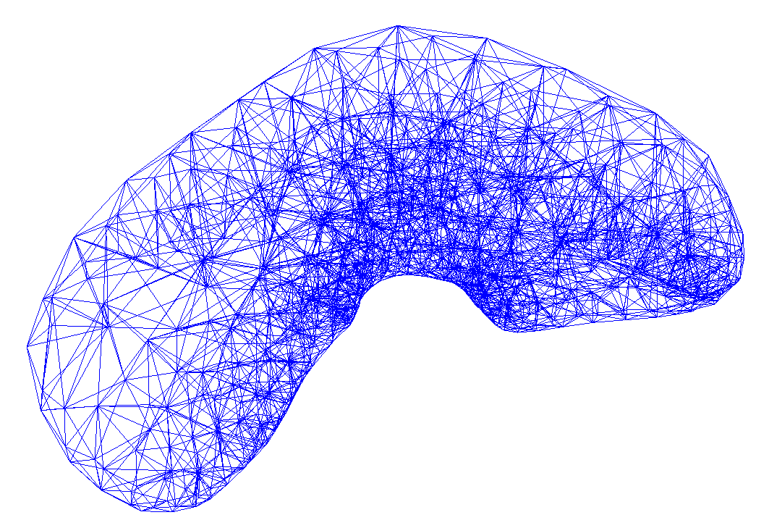
Deformable Tissue Model-Geometry
Volumetric Model
  Simulate the surface and the internal part of the soft tissue
  Advantages:
    Give more precise physical representation of soft tissue
  Limitations:
    May not be efficient for some model
  Application:
    Organs: liver, prostate, gallbladder
[1]Delingette, H. (1998). "Toward realistic soft-tissue modeling in medical simulation." Proceedings of the IEEE 86(3): 512-523.

Slide 8
Deformable Tissue Model-Physics Model
Mass-Spring system
  Simplest computationally, but does not allow accurate modeling of material properties
Boundary element method
  Only the object boundary is considered
  Although the resulting system is one dimension less than FEM, it is still very dense
  But the internal behavior, such as non-homogeneous material properties cannot be modeled
Finite difference method
  Takes the middle road between mass-spring system and FEM
  The differential operator is approximated by algebraic difference operators
  FDM achieves efficiency when the geometry of the problem is regular, but discretization becomes extremely dense when approximating the boundary of an irregular object
Finite element method
  Superior to FDM when handling geometric approximation
  Uses exact differential operators that apply only on subspaces of those solution fields
  Computationally very heavy

Slide 9
Deformable Tissue Model-Physics Model
Linear Model
Nonlinear Model
  Advantages:
    Efficient, Give satisfactory visual result
  Limitations:
    Inaccurate for large deformation
  Example:
    Mass Spring Model
    Linear Finite Element Model
  Advantages:
    Accurate even in large deformation
  Limitation:
    Inefficient
  Example:
    Nonlinear Finite Element Model

Slide 10
Physics Model-Linear Mass Spring Model
Energy Analysis
  For a curve, the energy function is :
  Where a is displacement under the material coordinate, ε is the energy for the curve
  α β γ are the amount of resistance of the curve to stretching, bending and twisting
  s, κ, τ are the stretching, bending and twisting deformation amount
[2]Terzopoulos, D., J. Platt, et al. (1987). Elastically deformable models.
Proceedings of the 14th annual conference on Computer graphics and interactive techniques, ACM: 205-214.

Slide 11
Physics Model-Linear Mass Spring Model
Discretization:
  partial differential derivative equation
  Continuous mass, damping and material property
  Discretize mass matrix, damping matrix and material property
  a system of linked ordinary differential equations
[2]Terzopoulos, D., J. Platt, et al. (1987). Elastically deformable models.
Proceedings of the 14th annual conference on Computer graphics and interactive techniques, ACM: 205-214.

Slide 12
Continuous energy function
Discretization
Deformation simulation

Slide 13
Discretization How?

Slide 14
Physics Model-Linear Mass Spring Model
The first derivative of ε(energy) over r(displacement) is the elastic force e(r) :
  Where α_{ij} and β_{ij} are continuous function describing the elastic properties of the material of a 2 dimensional object, a_{i} and a_{j} is the displacement under 2d material coordinate
We first need to discretize the continuous material function α and β
Then discretize the elastic force function
[2]Terzopoulos, D., J. Platt, et al. (1987). Elastically deformable models.
Proceedings of the 14th annual conference on Computer graphics and interactive techniques, ACM: 205-214.

Slide 15
Physics Model-Linear Mass Spring Model
Given a grid function u[m,n]
  Basic idea: use the difference function to approximate the derivative function
  Using the grid function the elastic force function can be discretized into:
  Where p and q are the discretized material function ( recall α_{ij} and β_{ij} in:
[2]Terzopoulos, D., J. Platt, et al. (1987). Elastically deformable models.
Proceedings of the 14th annual conference on Computer graphics and interactive techniques, ACM: 205-214.

Slide 16
Physics Model-Linear Mass Spring Model
Finally the elastic force equation is discretized:
  Where e is the elastic force, K is the stiffness matrix and r is the deformation
[2]Terzopoulos, D., J. Platt, et al. (1987). Elastically deformable models.
Proceedings of the 14th annual conference on Computer graphics and interactive techniques, ACM: 205-214.

Slide 17
Continuous energy function
Discretization
Deformation simulation

Slide 18
Physics Model-Linear Mass Spring Model
Dynamics
  Use the discretized elastic force equation:
  We can transform the continuous motion function:
[2]Terzopoulos, D., J. Platt, et al. (1987). Elastically deformable models.
Proceedings of the 14th annual conference on Computer graphics and interactive techniques, ACM: 205-214.

Slide 19
Mass points, Springs
Triangles? Tetrahedron?
Deformable body

Slide 20
Physics Model-Tetrahedral Mass Spring
Medical Image ( CT, MRI )
Tetrahedralization ( use tetgen,netgen )
Tetrahedral Mesh
Surface Triangle Mesh ( ITK snap )
Add mass points and springs
[5] Selle A, Lentine M, Fedkiw R. “A mass spring model for hair simulation”

Slide 21
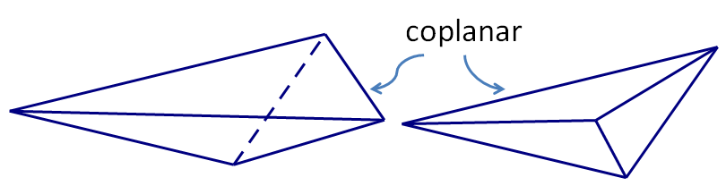
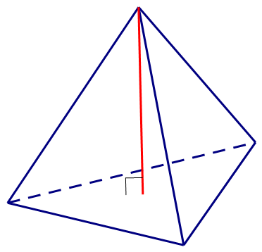
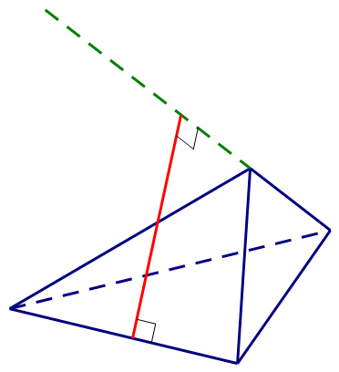
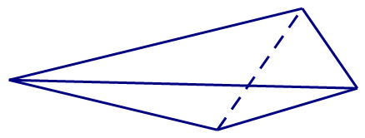
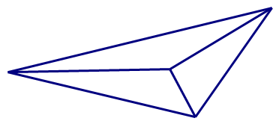
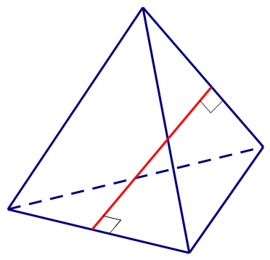
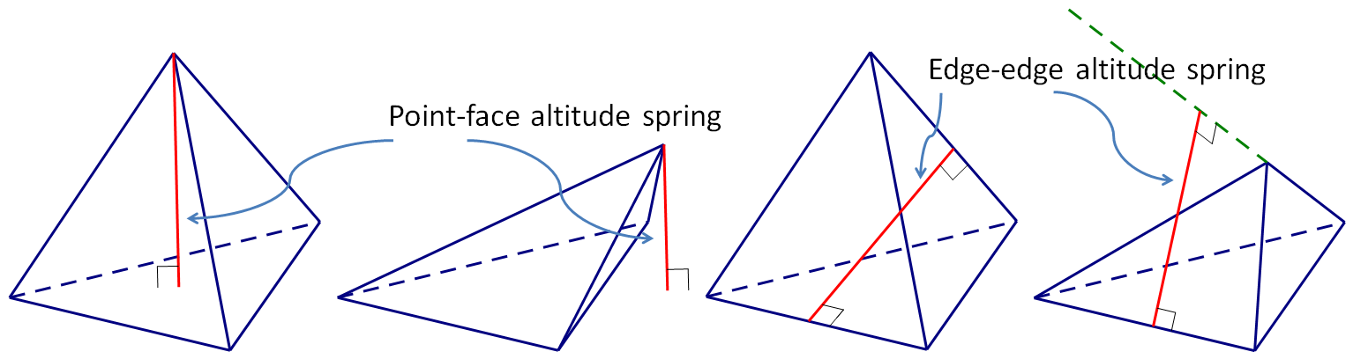
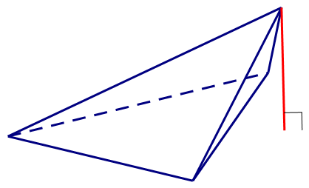
Physics Model-Tetrahedral Mass Spring
Tetrahedral Degenerate
Point-face, Edge-edge altitude spring
Use altitude spring that has the positive barycenter weight
coplanar
Edge-edge altitude spring
Point-face altitude spring
[5] Selle A, Lentine M, Fedkiw R. “A mass spring model for hair simulation”

Slide 22
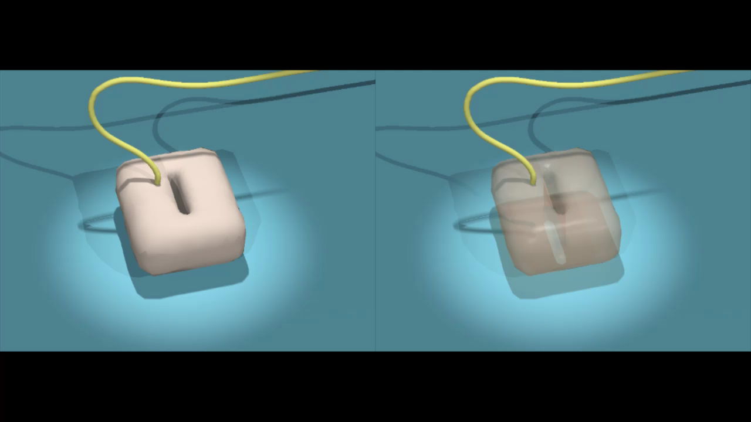
Simple Tetrahedral Mass Spring Demo – buried virtual suturing

Slide 23
Mass points and springs
More accurate model?
Linear Finite Element model

Slide 24
Physics Model-Linear Finite Element Model
Energy Analysis
  Continuous strain energy:
    Where ε is the strain vector, σ is the stress vector
    ε: ε = Bu
[3]Bro-Nielsen, M.; , "Finite element modeling in surgery simulation," Proceedings of the IEEE , vol.86, no.3, pp.490-503, Mar 1998
doi: 10.1109/5.662874

Slide 25
Physics Model-Linear Finite Element Model
Energy Analysis
  Through Hooke’s Law:
  Where ε is the strain vector, σ is the stress vector
  C is the material matrix, for a homogenous and isotropic material:
  Where λ and μ are material parameters
[3]Bro-Nielsen, M.; , "Finite element modeling in surgery simulation," Proceedings of the IEEE , vol.86, no.3, pp.490-503, Mar 1998
doi: 10.1109/5.662874

Slide 26
Physics Model-Linear Finite Element Model
Energy Analysis
  The total energy E(u), u is the displacement vector:
    Recall:
      ε = Bu, ,
    strain energy energy generated by external forces
    Where f is the external forces
[3]Bro-Nielsen, M.; , "Finite element modeling in surgery simulation," Proceedings of the IEEE , vol.86, no.3, pp.490-503, Mar 1998
doi: 10.1109/5.662874

Slide 27
Continuous energy function
Discretization
Evaluate deformation

Slide 28
Finite element (triangle, tetrahedron) example

Slide 29
Physics Model-Linear Finite Element Model
Discretization
  We discretize the domain Ω into a number of finite element (tetrahedrons)
  The corresponding element displacement vector:
  We can estimate the u(x) using
[3]Bro-Nielsen, M.; , "Finite element modeling in surgery simulation," Proceedings of the IEEE , vol.86, no.3, pp.490-503, Mar 1998
doi: 10.1109/5.662874

Slide 30
Physics Model-Linear Finite Element Model
Discretization
  Using linear interpolation is:
  where L_{i} is nature coordinates of the tetrahedron
  Where V is the volume of the tetrahedron and a, b, c, d is:
[3]Bro-Nielsen, M.; , "Finite element modeling in surgery simulation," Proceedings of the IEEE , vol.86, no.3, pp.490-503, Mar 1998
doi: 10.1109/5.662874

Slide 31
Physics Model-Linear Finite Element Model
Discretization
[3]Bro-Nielsen, M.; , "Finite element modeling in surgery simulation," Proceedings of the IEEE , vol.86, no.3, pp.490-503, Mar 1998
doi: 10.1109/5.662874

Slide 32
Physics Model-Linear Finite Element Model
How to solve the deformation function?
The solution to the deformation problem is found where the total energy of the system assumes its minimum value
For each element:
For the entire model:
[3]Bro-Nielsen, M.; , "Finite element modeling in surgery simulation," Proceedings of the IEEE , vol.86, no.3, pp.490-503, Mar 1998
doi: 10.1109/5.662874

Slide 33
Physics Model-Linear Finite Element Model
Dynamics
Where M is the mass matrix, D is the damping matrix, K is the stiffness matrix
f is the external force vector

Slide 34
Physics Model
Soft tissue is not homogenous isotropic material
Non linear deformation
Non linear physics model

Slide 35
Physics Model-Nonlinear Finite Element
Nonlinear hyperelastic material model:
  Mooney-Rivlin Model
    More accurate than neo-hookean model for large deformation
  Neo-Hookean Model
    does not predict that increase in modulus at large strains and is typically accurate only for strains less than 20%^{[9]}
Nonlinear geometric changes:
  Linear model: non linear model:
[4]Wu, X., Downes, M. S., Goktekin, T. and Tendick, F. (2001),
Adaptive Nonlinear Finite Elements for Deformable Body Simulation Using Dynamic Progressive Meshes.
Computer Graphics Forum, 20: 349–358. doi: 10.1111/1467-8659.00527
[9]Gent, A. N., ed., 2001, Engineering with rubber, Carl Hanser Verlag, Munich.

Slide 36
Physics Model-Nonlinear Finite Element
According to the principle of Virtual Work equation:
  Where Φ is the strain energy and W is the energy generated by external force f
  C is the right Cauchy-Green tensor
    gives us the square of local change in distances due to deformation ( from wiki )
  Trace of a matrix ( from wiki ):
Mooney-Rivlin Model:
[4]Wu, X., Downes, M. S., Goktekin, T. and Tendick, F. (2001),
Adaptive Nonlinear Finite Elements for Deformable Body Simulation Using Dynamic Progressive Meshes.
Computer Graphics Forum, 20: 349–358. doi: 10.1111/1467-8659.00527

Slide 37
Physics Model-Nonlinear Finite Element
Discretize:
Recall:
To get , using the chain rule
[4]Wu, X., Downes, M. S., Goktekin, T. and Tendick, F. (2001),
Adaptive Nonlinear Finite Elements for Deformable Body Simulation Using Dynamic Progressive Meshes.
Computer Graphics Forum, 20: 349–358. doi: 10.1111/1467-8659.00527

Slide 38
Physics Model-Nonlinear Finite Element
  The external virtual work of each element comes from its inertia force, damping force, body force and surface traction force:
    Where W_{I} is the work of inertia force, W_{D} is the work of damping force, W_{B} is the work body force and W_{T} is the work of surface traction force
Recall our problem:
[4]Wu, X., Downes, M. S., Goktekin, T. and Tendick, F. (2001),
Adaptive Nonlinear Finite Elements for Deformable Body Simulation Using Dynamic Progressive Meshes.
Computer Graphics Forum, 20: 349–358. doi: 10.1111/1467-8659.00527

Slide 39
How to get the material parameters of the soft tissue?

Slide 40
Estimation of soft tissue elastic parameters
The forward problem
  To study the solution of the inverse problem
  Generate the domain behavior using methods like FEM
    Such as the displacement vector
  Generate boundary condition given the material parameters by solving the inverse problem
[5]Van Houten, E. E. W., et al. "An overlapping subzone technique for MR-based elastic property reconstruction."
Magnetic resonance in medicine 42.4 (1999): 779-786.
[6] Van Houten, Elijah EW, et al. "Three‐dimensional subzone‐based reconstruction algorithm for MR elastography."
Magnetic resonance in Medicine 45.5 (2001): 827-837.

Slide 41
Estimation of soft tissue elastic parameters
The inverse problem
  A constrained optimization task
  Objective is to minimize the difference between a set of measured displacement fields and those computed by a model description
    A typical 2D objective function:
[5]Van Houten, E. E. W., et al. "An overlapping subzone technique for MR-based elastic property reconstruction."
Magnetic resonance in medicine 42.4 (1999): 779-786.
[6] Van Houten, Elijah EW, et al. "Three‐dimensional subzone‐based reconstruction algorithm for MR elastography."
Magnetic resonance in Medicine 45.5 (2001): 827-837.
[7]Lee, H., et al. "Simulation-Based Joint Estimation of Body Deformation and Elasticity Parameters for Medical Image Analysis.” (2012): 1-1.

Slide 42
Questions?
Thank you!

