Slide 1
Interactive Auditory Display
Ming C. Lin
Department of Computer Science
University of Maryland at College Park
lin@cs.umd.edu
http://gamma.cs.umd.edu/Sound

Slide 2
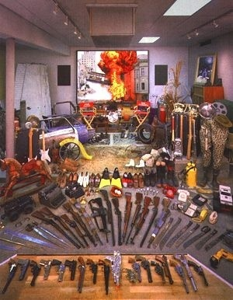
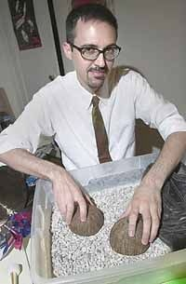
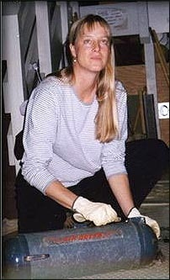
How can it be done?
Foley artists manually make and record the sound from the real-world interaction
Lucasfilm Foley Artist

Slide 3
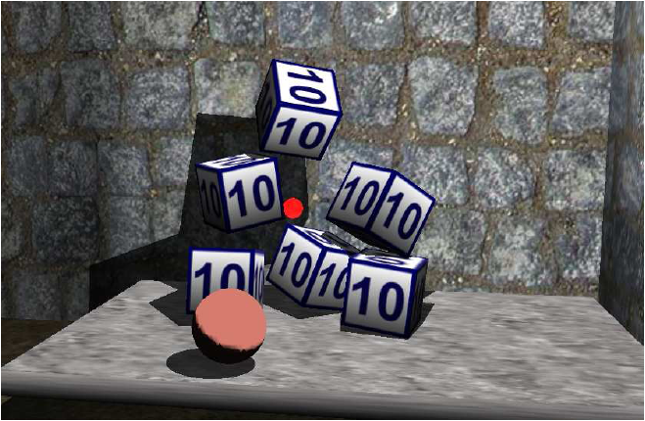
How about Computer Simulation?
Physical simulation drives visual simulation
Sound rendering can also be automatically generated via 3D physical interaction

Slide 4
Sound Rendering: An Overview
Scientific Visualization
Specular Reflection
Acoustic Geometry
-- surface simplification
Scattering
Late Reverberation
Diffraction
Personalized HRTFs
for 3D sound
Acoustic Material
-- absorption coefficient
-- scattering coefficient
Refraction
Doppler Effect
Digital Signal Processing
Source Modeling
-- area source
-- emitting characteristics
-- sound signal
Attenuation
Interpolation for
Dynamic Scenes
Interference
Modeling
Propagation
3D Audio
Rendering

Slide 5
Modeling
Acoustic vs. Graphics
Low geometric detail vs. High geometric detail
Acoustic Geometry
-- surface simplification
Acoustic Material
-- absorption coefficient
-- scattering coefficient
Source Modeling
-- area source
-- emitting characteristics
-- sound signal
Modeling
Notes:
5

Slide 6
Propagation
Acoustic vs. Graphics
343 m/s vs. 300,000,000 m/s
20 to 20K Hz vs. RGB
17m to 17cm vs. 700 to 400 nm
Specular Reflection
Scattering
Diffraction
Refraction
Doppler Effect
Attenuation
Interference
Propagation
Notes:
6

Slide 7
3D Audio Rendering
Acoustic vs. Graphics
Compute intensive DSP vs. addition of colors
44.1 KHz vs. 30 Hz
Psychoacoustics vs. Visual psychophysics
Late Reverberation
Personalized HRTFs
for 3D sound
Digital Signal Processing
Interpolation for
Dynamic Scenes
3D Audio
Rendering
Notes:
7

Slide 8
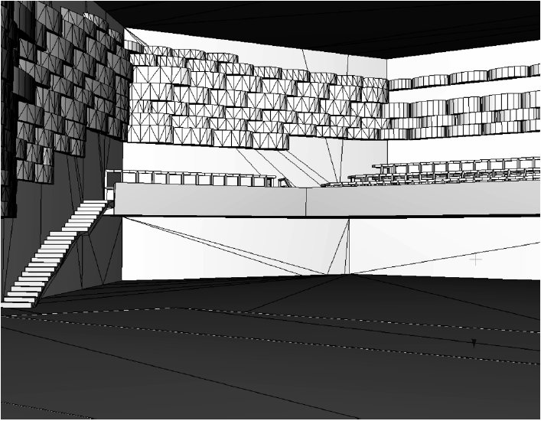
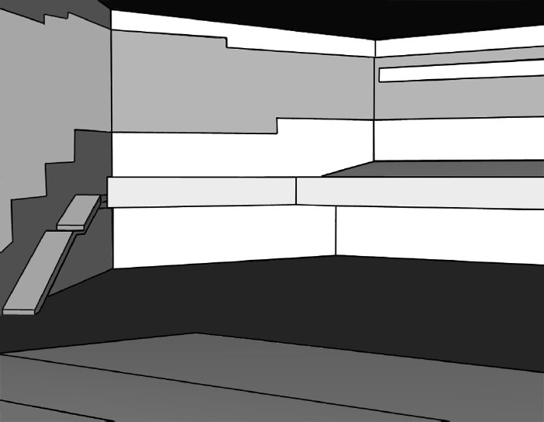
Modeling Acoustic Geometry
[Vorländer,2007]
Visual Geometry
Acoustic Geometry
Notes:
8

Slide 9
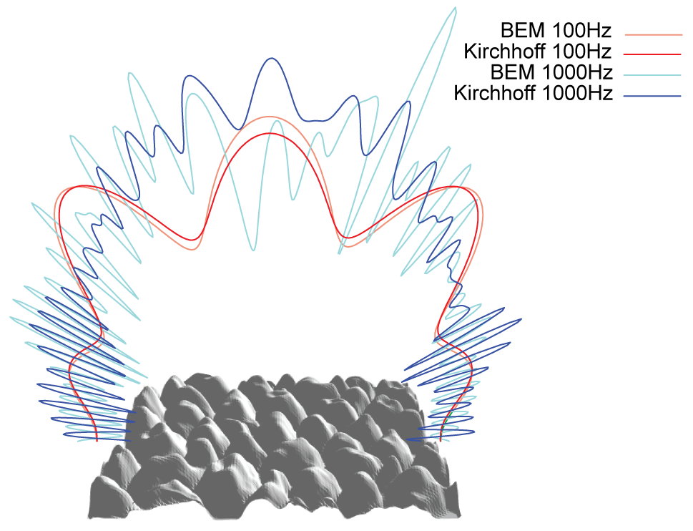
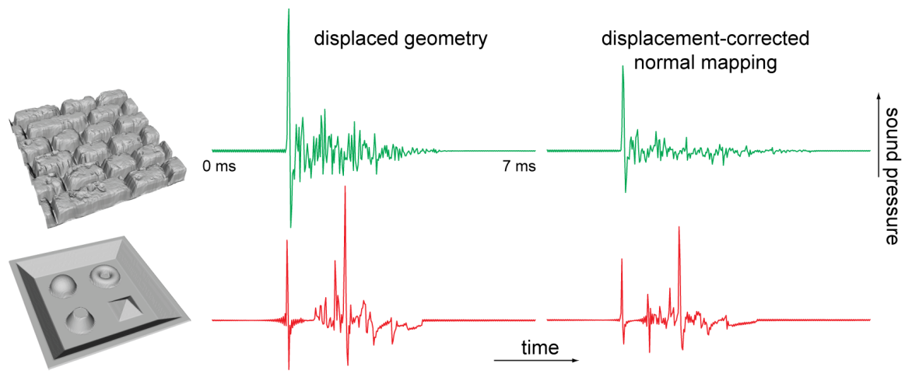
Modeling Sound Material
[Embrechts,2001] [Christensen,2005] [Tsingos,2007]
Notes:
9

Slide 10
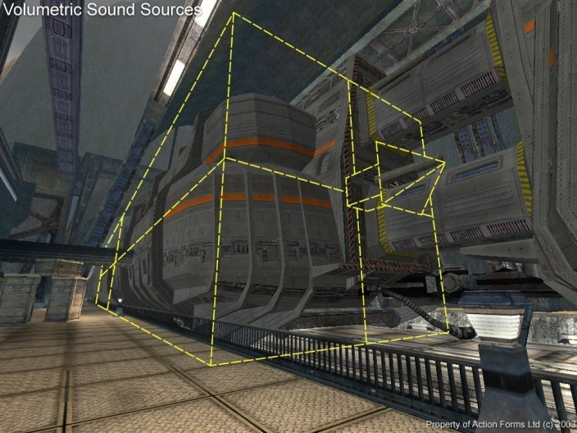

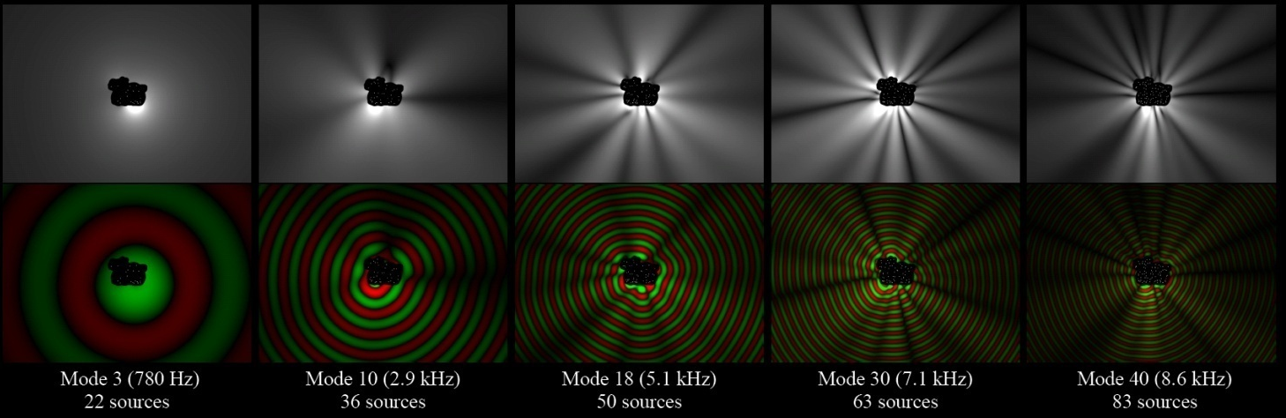
Modeling Sound Source
Volumetric Sound Source
Directional Sound Source
Complex Vibration Source
Notes:
10

Slide 11
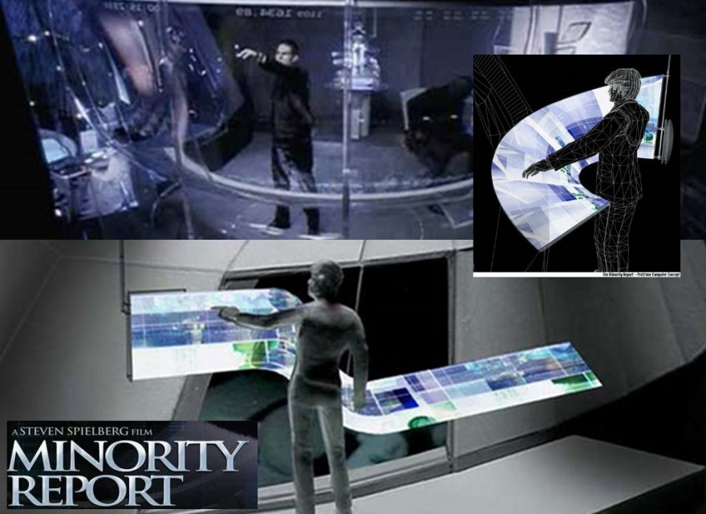
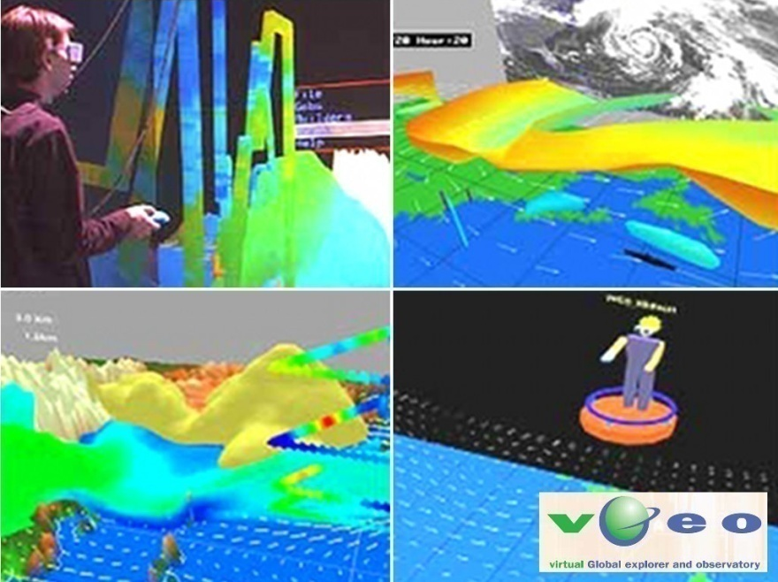
Applications
Advanced Interfaces
Multi-sensory Visualization
Minority Report (2002)
Multi-variate Data Visualization
Notes:
11

Slide 12
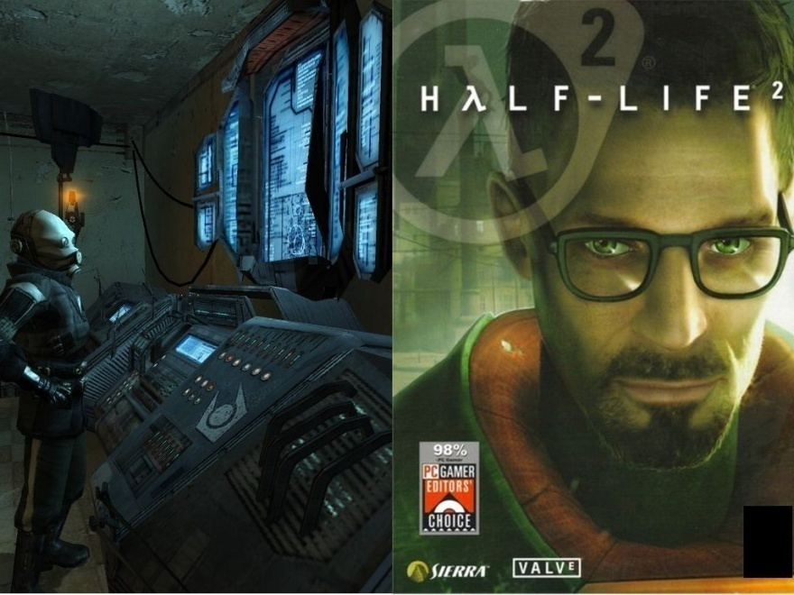
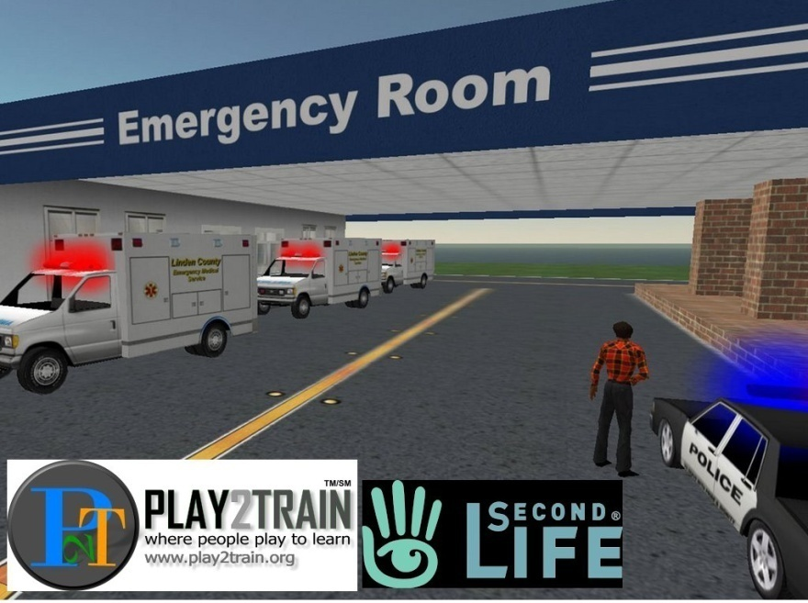
Applications
Games
VR Training
Game (Half-Life 2)
Medical Personnel Training
Notes:
12

Slide 13
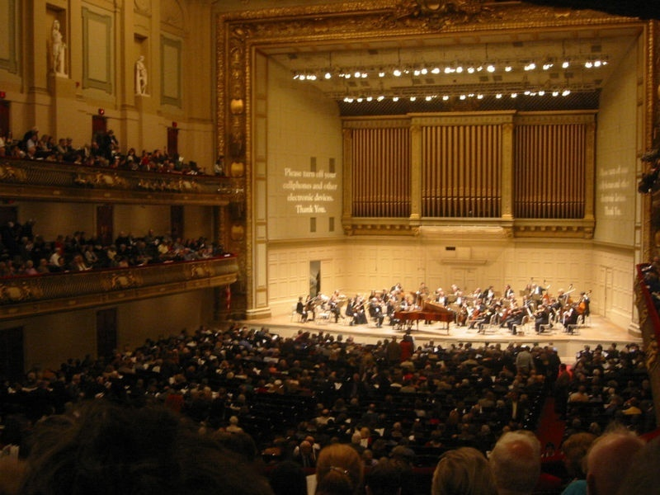
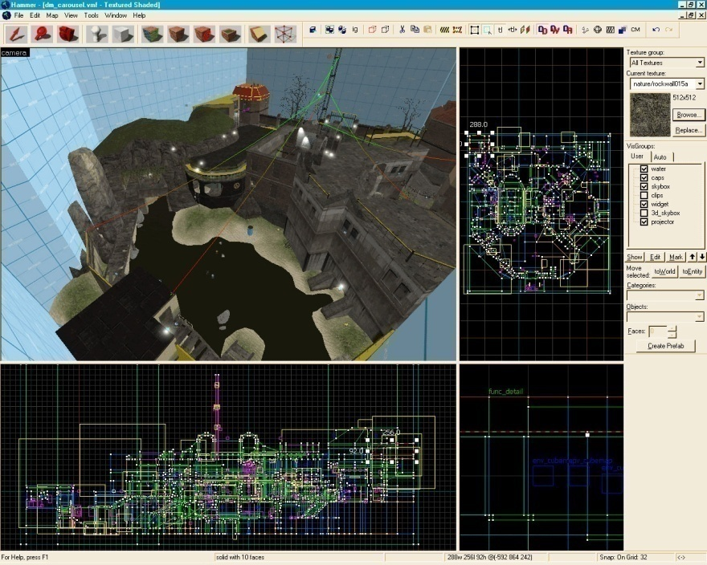
Applications
Acoustic Prototyping
Symphony Hall, Boston
Level Editor, Half Life
Notes:
13

Slide 14
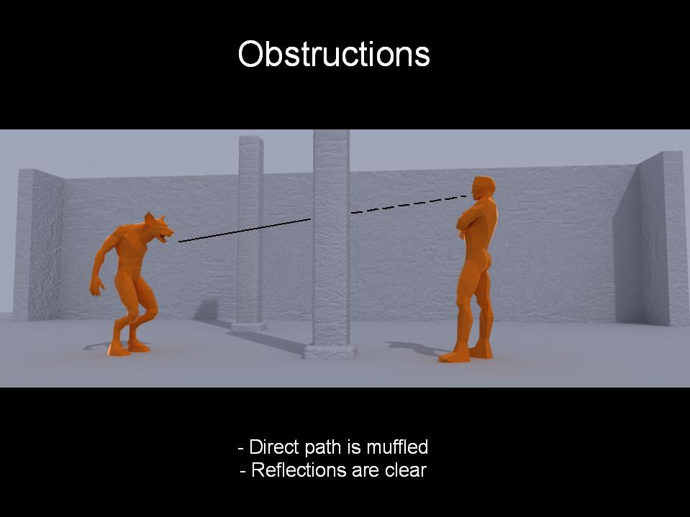
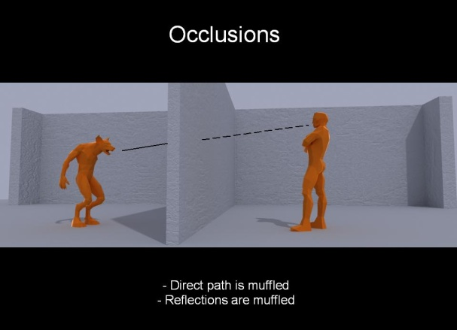
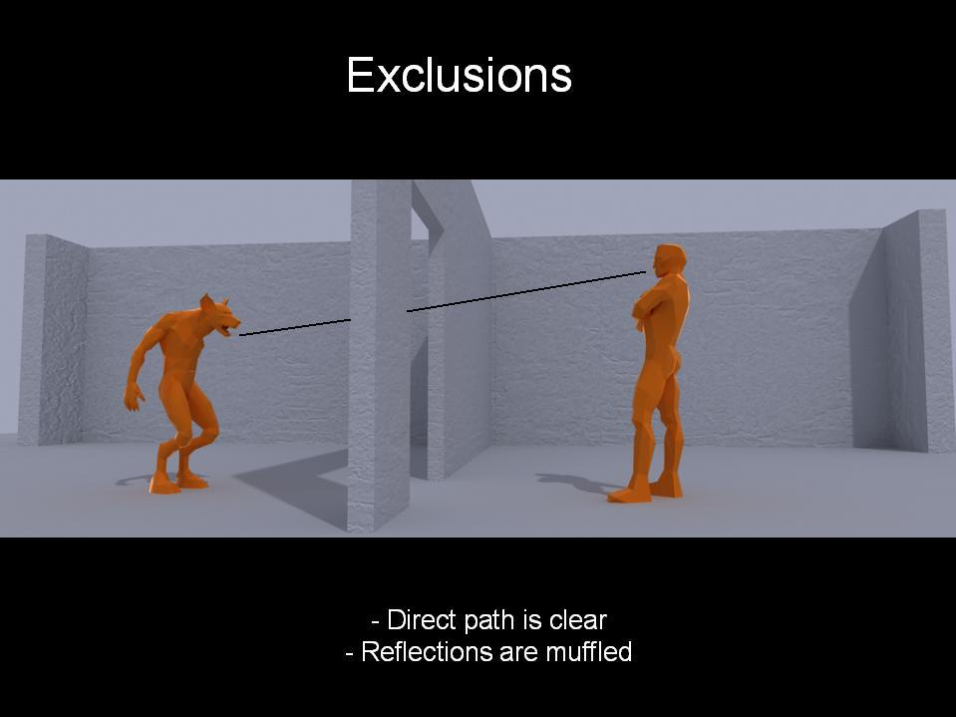
Sound Propagation in Games
Strict time budget for audio simulations
Games are dynamic Moving sound sources Moving listeners Moving scene geometry
Trade-off speed with the accuracy of the simulation
Static environment effects (assigned to regions in the scene)
Notes:
14

Slide 15
3D Audio Rendering
Main Components
3D Audio and HRTF
Artifact free rendering for dynamic scenes
Handling many sound sources
Notes:
15

Slide 16
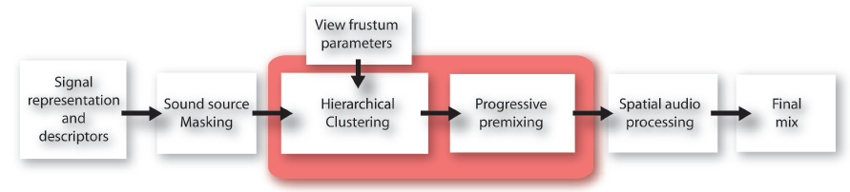
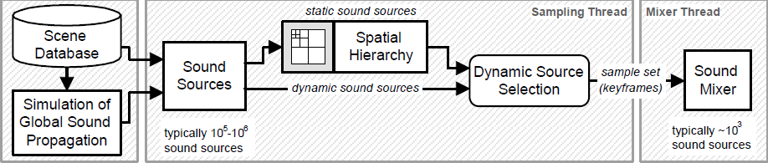
3D Audio Rendering
Perceptual Audio Rendering [Moeck,2007]
Multi-Resolution Sound Rendering [Wand,2004]
Notes:
16

Slide 17

Overview of Sound Simulation
The complete pipeline for sound simulation
Sound Synthesis
Sound Propagation
Sound Rendering

Slide 18

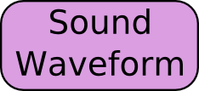
Overview of Sound Simulation
Sound Synthesis

Slide 19
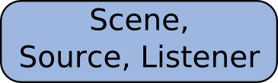
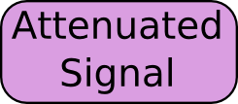
Overview of Sound Simulation
Sound Propagation

Slide 20
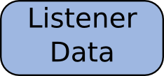
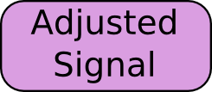
Overview of Sound Simulation
Sound Rendering

Slide 21
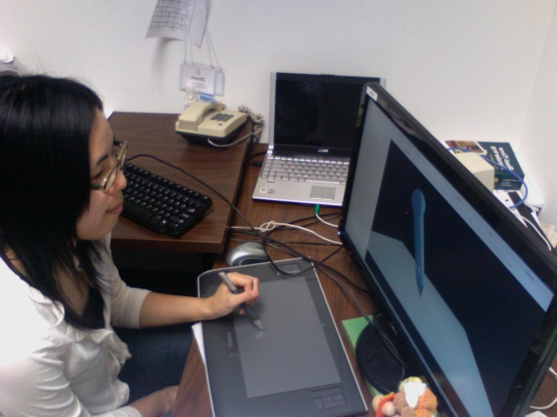
Our System Set-up
Tablet Support
User Interface

Slide 22
Main Results
An interactive and flexible work flow for sound synthesis
User control over material parameters
Intuitive interaction and real-time auditory feedback for easy testing and prototyping
No event synchronization issue:
users with little or no foley experience can start sound design and creation quickly
Easy integration with game engines

Slide 23
Main Results [Ren et al; VR 2010]
A new frictional contact model for sound synthesis
Fast, allows real-time interaction
Simulates frictional interactions at different levels:
Macro shape
Meso bumpiness
Micro roughness
Better matches their virtually-simulated visual counterparts

Slide 24
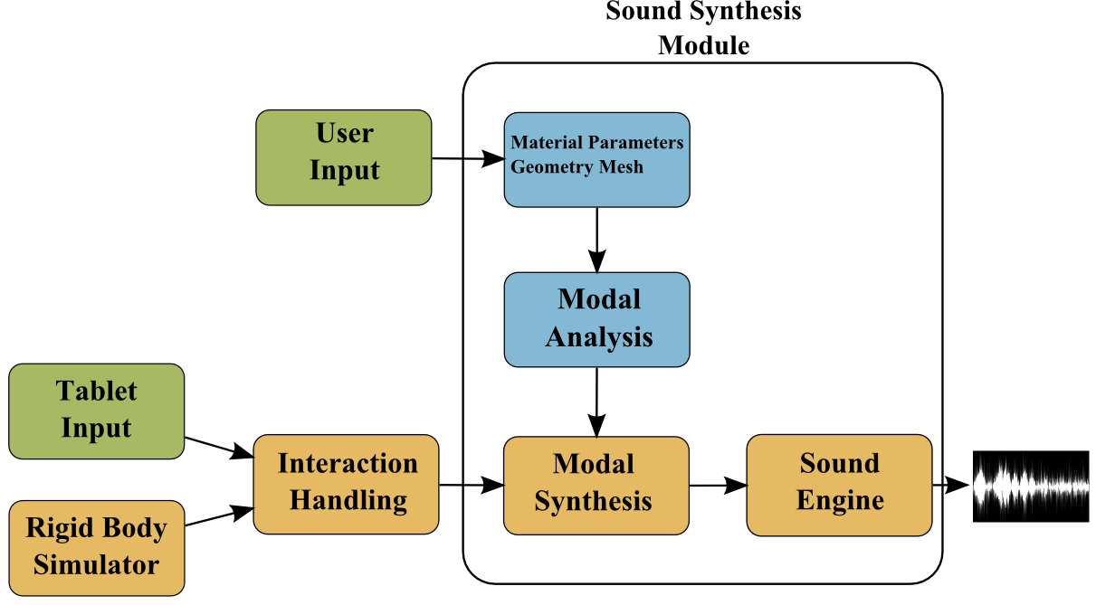
System Overview

Slide 25
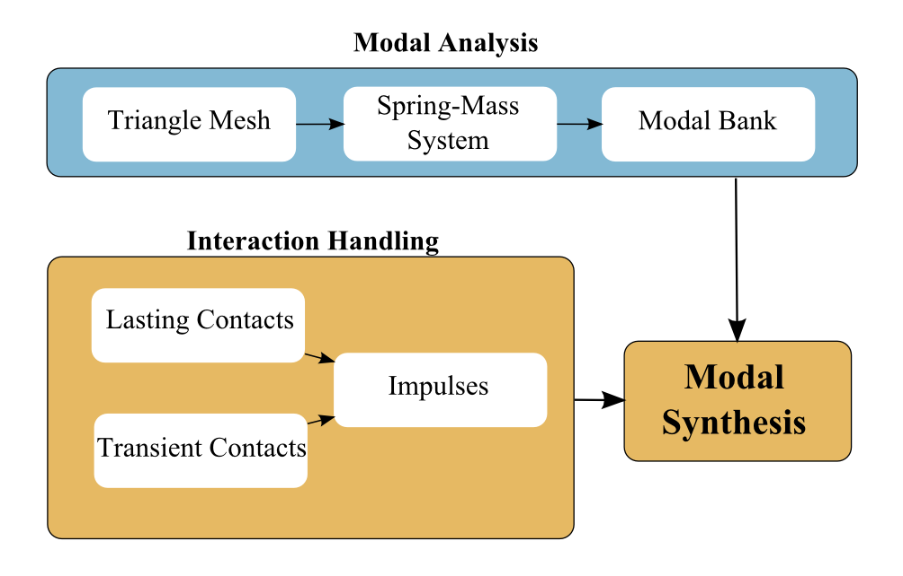
System Overview
Sound synthesis module
Modal Analysis: Raghuvanshi & Lin (I3D 2006)
Impulse response

Slide 26
System Overview
Interaction handling module
State detection: lasting and transient contacts
Converting interactions into impulses

Slide 27
Modal Analysis
Deformation modeling
Vibration of surface generates sound
Sound sampling rate: 44100 Hz
Impossible to calculate the displacement of the surface at sampling rate
Represent the vibration pattern by a bank of damped oscillators (modes)
Standard technique for real-time sound synthesis

Slide 28
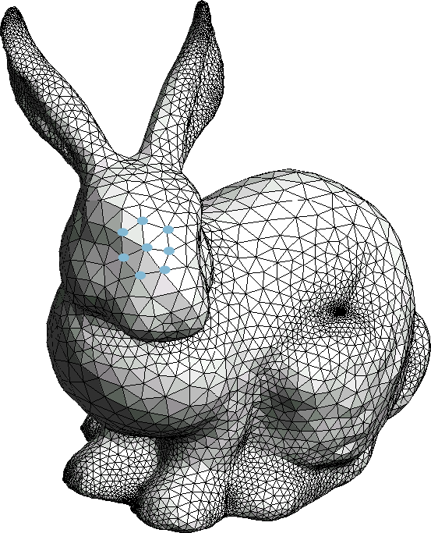
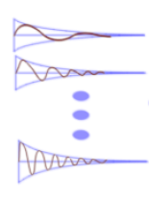
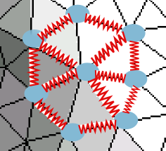
Modal Analysis
Discretization
An input triangle mesh → a spring-mass system
A spring-mass system → a set of decoupled modes
Notes:
Refer to previous work

Slide 29
Modal Analysis
The spring-mass system set-up
Each vertex is considered as a mass particle
Each edge is considered as a damped spring

Slide 30
Modal Analysis
Coupled spring-mass system to a set of decoupled modes

Slide 31
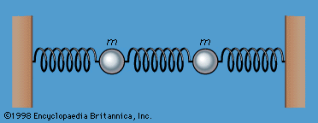


Modal Analysis
A discretized physics system
We use spring-mass system
Small displacement, so consider it linear
Stiffness
Damping
Mass
Stiffness
Damping
Mass

Slide 32


Modal Analysis
Solve the Ordinary Differential Equation (ODE)
Rayleigh damping
And diagonalizing
Now, solve this ODE instead

Slide 33

Modal Analysis
Solve the ODE
Substitute (z are the modes)
Now, solve this ODE instead

Slide 34


Modal Analysis
General solution
External excitation defines the initial conditions

Slide 35
Modal Analysis
Assumptions
In most graphics applications, only surface representations of geometries are given
A surface representation is used in modal Analysis
Synthesized sound appears to be “hallow”

Slide 36
Modal Analysis Summary
An input triangle mesh →
A spring-mass system →
A set of decoupled modes

Slide 37
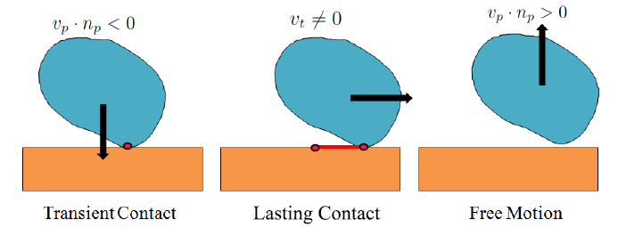
State Detection

Slide 38
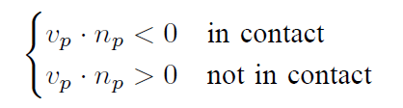
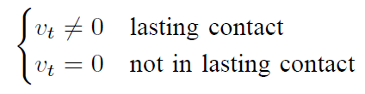
State Detection
Distinguishing between lasting and transient contacts
In contacts?
In lasting contacts?

Slide 39
Interaction Handling
Lasting contacts → a sequence of impulses
Transient contacts → a single impulse
Notes:
New slides to explain the object interaction to contact to impulse ()

Slide 40
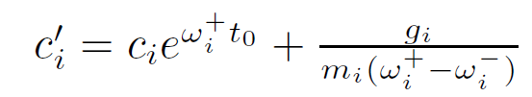
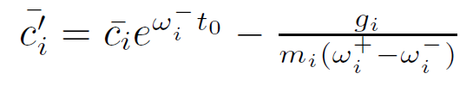
Impulse Response
Dirac Delta function as impulse excitation
General solution
with initial condition given by the impulse,
we have:
Notes:
37-39 link them smoothly

Slide 41
Impulse Response

Slide 42
Handling Lasting Contacts
i.e. Frictional contacts
How to add the sequence of impulses?
The model has to be fast and simple, because…

Slide 43
Handling Lasting Contacts
Update Rate: 100Hz
Update Rate: 44100Hz

Slide 44
Handling Lasting Contacts
The interaction simulation has to be stepped at the audio sampling rate: 44100 Hz
The update rate of a typical real-time physics simulator: on the order of 100’s Hz
Not enough simulation is provided by the physics engine
An customized interaction model for sound synthesis

Slide 45
Our Solution
Decompose the interaction into difference levels
Different update rates at different levels
Combined results offer a good approximation

Slide 46
Our Solution
Three levels of simulation
Macro level: simulating the interactions on the overall surface shape
Meso level: simulating the interactions on the surface material bumpiness
Micro level: simulating the interactions on the surface material roughness

Slide 47
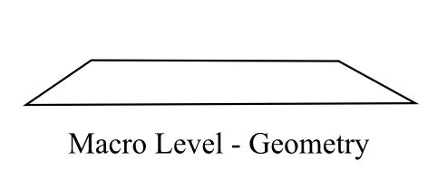
Three-level Simulation
Macro level: Geometry information
Update rate: 100’s Hz
Update rate does not need to be high
The geometry information is from the input triangle mesh, and contacts are reported by collision detection in the physics engine.

Slide 48
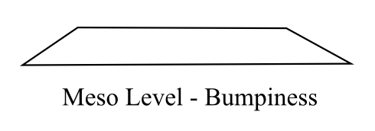
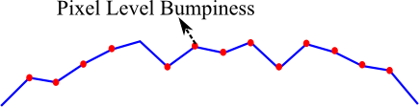

Three-level Simulation
Meso level: Bumpiness
Bump mapping is ubiquitous in real-time graphics rendering
Bump maps are visible to users but transparent to physics simulation

Slide 49
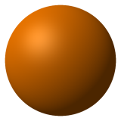
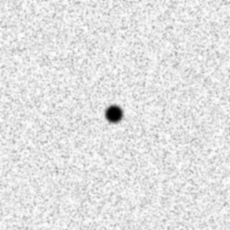
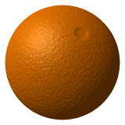
What Is Bump Mapping?
Perturb vertex normals for shading
No geometry details
+ =
Image Courtesy to Wikipedia

Slide 50
Three-level Simulation
Meso level simulation
Makes sure visual and auditory cues are consistent
Attends to surface bumpiness details
Update rate:
Event queue: 100’s Hz
Event processor: 44100 Hz

Slide 51
Three-level Simulation
Meso level simulation details (1)
Event queue is update at 100’s Hz.
Linear velocity and position information from the physics simulator.
An event handler traverse back one time step to collect all “bumping” events in last time step

Slide 52
Three-level Simulation
Meso level simulation details (2)
Events from last time step are made up in this time at audio rate resolution. Latency: 10ms.
200ms latency tolerance (Bonneel et al. 08)
Event
Queue
1 step in physics simulation
Event
Processor
Live demo of only meso-level simulation enabled and both macro and meso-level simulation enabled

Slide 53
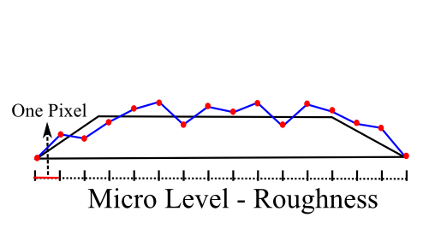
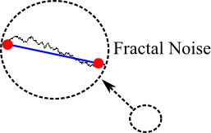
Three-level Simulation
Micro level simulation: Van den Doel et al. 01
Fractal noise is used to simulate the micro-level interaction
Live demo of only micro-level simulation enabled
And both micro, meso, and macro-level simulation enabled

Slide 54
Three-level Simulation
Advantages:
Fast and simple. Makes real-time sound synthesis driven by complex interaction possible.
Captures the richness of sound varying at three levels of resolution
Visual and auditory feedbacks are consistent

Slide 55
System Implementation
Tablet support
Material manipulation
Users are allowed to change material parameters
Testing “new materials” right away
Material blending: linear interpolation
Integration with physics & game engines
Physics engine: Open Dynamics Engine (ODE)
Graphics rendering engine: Open Source 3D Rendering Engine (OGRE)

Slide 56
Video Demonstration
Video

Slide 57
Sounding Liquids [Moss et al. 2009]
Work in physics and engineering literature since 1917
Sound generated by resonating bubbles
Physically-based Models for Liquid Sounds (van den Doel, 2005)
Spherical bubble model
No fluid simulator coupling
Hand tune bubble profile

Slide 58
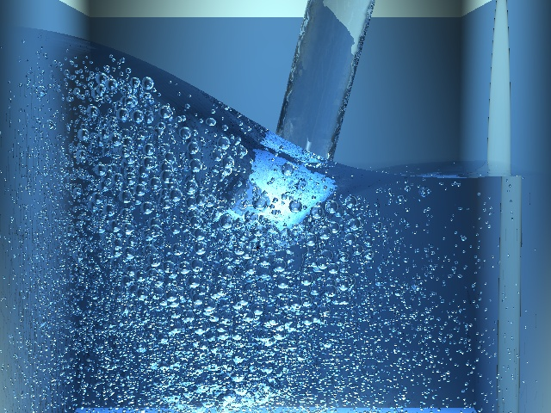
Background (Fluid)
Grid-based methods
Accurate to grid resolution
Bubbles can be smaller
Slow
Can be two-phase

Slide 59
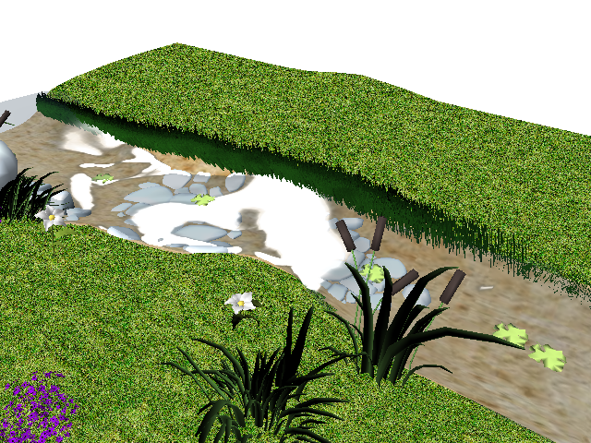
Background (Fluid)
Shallow Water Equations
Simulate water surface
No breaking waves
Real time
One phase
Explicit bubbles

Slide 60
Overview
Generate sound from existing fluid simulation
Model sound generated by bubbles
Apply model to two types of fluid simulators
Particle-Grid-based
Extract bubbles
Process spherical and non-spherical bubbles
Generate sound
Shallow Water Equations
Processes surface
Curvature and velocity
Select bubble from distribution
Generate sound

Slide 61
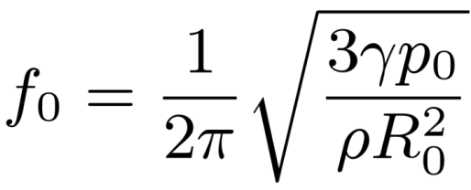
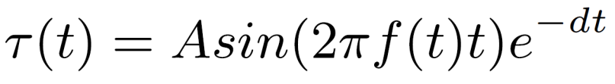

Mathematical Formulations
R₀
R₀
☒R
Spherical Bubbles
Non-spherical bubbles
Decompose into a spherical harmonics

Slide 62



Without
Spherical Harmonics
With
Spherical Harmonics
Notes:
A grayed out image of each bubble, it becomes ungrayed as the sound is played.

Slide 63

System Overview

Slide 64





Summary
Simple, automatic sound synthesis
Applied to two fluid simulators
Interactive, shallow water
High-quality, grid based

Slide 65
Video Demonstration
Video

Slide 66
Acknowledgements
Army Research Office
Carolina Development Foundation
Intel Corporation
National Science Foundation
RDECOM

