Slide 1
Intro to Fluid Simulation (I)

Slide 2
Disclaimer
There are some equations. However, I promise that, if you stay with me, you’ll completely understand the basics of fluids and how they behave. Also, the equations aren’t that bad once you get to know them!

Slide 3
Goals
You will:
Know some important properties of fluids
See different ways to think about fluids
Understand the equations governing their behavior
Realize the benefits of breaking down a complicated equation into its constituent parts

Slide 4
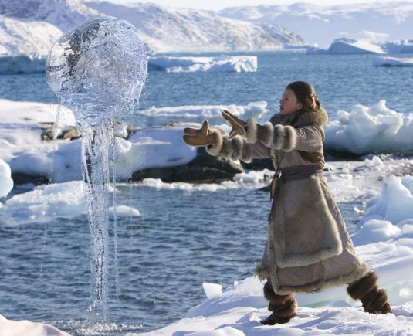
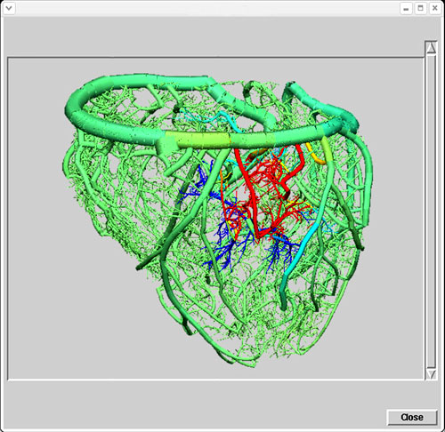
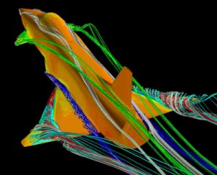

Why Simulate Fluids?
Games
Movies
Research
Development

Slide 5
What is a Fluid?
Fluids have:
  Velocity (u)
  Density (ρ)
  Pressure (p, force per area)
  Viscosity (v, resistance to flow, “friction”)
  Body forces (g), including gravity

Slide 6
Two Frames of Reference (I)
Grid-based
  “Eulerian”
  Solves for change in quantities over time at specific points
Particle-based
  “Lagrangian”
  Tracks individual particles with specific values as they move through a continuum

Slide 7
Two Frames of Reference (II)
Connect the two via the “Material Derivative”
Suppose we have particles (Lagrangian!) with positions x and velocities u
Each particle also has a generic value, q
q(t,x) gives us the value of q at time t for the particle at position x (Eulerian!)
The question is how fast is q changing for that particle?

Slide 8



Two Frames of Reference (III)
Take the derivative of q (with the Chain Rule):
Correct for how much of that change is due just to differences in the fluid flowing past
How fast q is changing at a fixed point in space
The material derivative!

Slide 9





Two Frames of Reference (IV)
u = c
x = 0 ➔ T(x) = freezing
T(x) = 10x
x = 10 ➔ T(x) = boiling
Assume T of each particle is constant, they just move around.
Advection in the Lagrangian viewpoint:
Expanding the material derivative to move to an
Eulerian viewpoint:
Even though Lagrangian derivative is 0, the Eulerian derivative depends on the wind speed:

Slide 10
Navier-stokes equations
Allright, we know what fluids are and how to think about them.
Let’s talk about

Slide 11
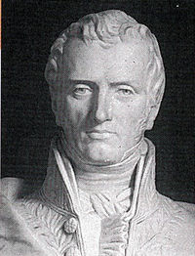
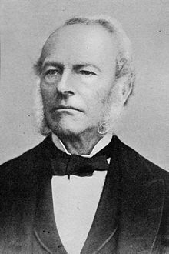


The Foundation of Fluid Solvers
Navier-Stokes equations!
Recall:
  Velocity, density, pressure, body forces, viscosity
  u ρ p g v

Slide 12
Quick Vector Calc Refresher
Three important differential operators:
  Gradient (∇)
  Divergence (∇∙)
  Curl (∇×)

Slide 13

Gradient (∇)
Gives vector of spatial derivatives of function
When applied to a vector valued function, results in the Jacobian matrix

Slide 14

Divergence (∇∙)
Only applies to vector fields, measures convergence/divergence of vectors at a point
Think of it as the dot product between the gradient operator and the vector field

Slide 15
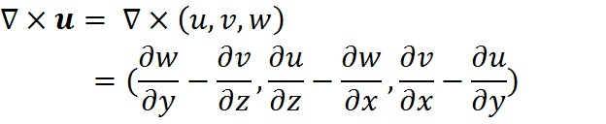
Curl (∇×)
Measures how much a vector field rotates around a point.
Again, think of it as the cross product of the gradient operator and the vector field.

Slide 16
…Back to Navier-Stokes
Two different equations
  Momentum equation:
  Incompressibility condition:

Slide 17

Momentum Equation
It’s really just f=ma!
Consider a “particle” of water…
  Mass, m
  Volume, V
  Velocity, u
The acceleration can be written as:
d
Lagrangian viewpoint
Material derivative

Slide 18

Momentum Equation
So, Newton’s second law becomes
What are the forces?
  Gravity (mg), pressure (p), viscosity (μ)

Slide 19
Gravity (and Other Body Forces)
Gravity, of course, acts uniformly across the continuum
What doesn’t?
  Wind
  Buoyancy
  Anything else that may be artistically relevant
All these are represented by the “g” term
Handling them in simulation is force-dependent

Slide 20

Pressure Forces
In a liquid, high pressure regions push on lower pressure regions.
Net force on the particle is what matters.
  The negative gradient of pressure gives the imbalance
  Integrated over the volume of the particle, this gives the pressure force
    Simple approximation is to multiply by the volume, V

Slide 21


Viscosity Forces
Intuitively, this is a force that tries to average the velocity of nearby particles
The differential operator that measures the difference of a value from the neighborhood’s average is the Laplacian:
Integrating this over the volume gives the force.
Here, we’ll use the “dynamic viscosity coefficient”, μ

Slide 22


Newton’s 2nd Continued
Putting together all these forces gives:
➔
Take the limit as the particles go to infinity with infinitesimal size, after dividing by the volume:

Slide 23


Newton’s 2nd ➔ Momentum Equation
Divide by the density and rearrange:
Substitute the kinematic (acceleration, not force) viscosity as v = μ/ρ:
Replace the material derivative, and we’re there!:

Slide 24
Momentum Equation Recap
Viscosity
Pressure
Change caused by flow
Change experienced
by “particle”
Gravity
Advection

Slide 25
Understanding Navier-Stokes
We’ve seen that the momentum equation is simply F=ma
Incompressibility Condition

Slide 26
The Incompressibility Condition (I)
Literally: “The divergence of the velocity is 0.”
Conceptually: “The velocity of fluid into a region is the same as the velocity of fluid out of a region.”
A step further: “The volume of the fluid is constant”

Slide 27
The Incompressibility Condition (II)
What causes fluid to move from one area to another in a non-uniform manner?
  (Hint: not gravity.)
  (Another hint: incomPRESSibility condition.)
  Pressure!
The pressure in the fluid is whatever is needed to keep the velocity divergence-free.
We’ll have to look back to the momentum equation for a moment…

Slide 28



The Incompressibility Condition (III)
Take the divergence of both sides:
Change the order of differentiation in the first term:
This first term will be 0 after the IC is enforced, so rearrange to yield an equation for pressure:

Slide 29
The Truth About Viscosity in Animation
In most cases, it’s not really necessary.
  Exceptions: molasses, honey, tiny drops of water
Even without the viscosity term, numerical errors will occur that can be interpreted as viscosity.
  Simpler to compute with visually plausible results? Count me in!
So-called “inviscid” fluids are what most simulations simulate.

Slide 30
Boundary Conditions
Intra-homogeneous fluid interactions – done!
What about where the fluid meets another material?
Lots of variations, but let’s examine two common cases:
  Solid walls
  Free surfaces

Slide 31




Solid Walls
Fluid doesn’t flow into or out of walls.
“No-stick” velocity:
  Normal component is 0
  Or, if the wall is moving, the normal component of the wall’s velocity
“No-slip” velocity (simple viscosity):
  No velocity
  Or, if the wall is moving, the wall’s velocity is the fluid’s velocity

Slide 32
Free Surfaces
Water next to air, for example
  Air is 700 times lighter than water (read: insignificant)
  The incompressibility condition doesn’t control the velocity
  Since we’re not enforcing anything about pressure, we get to choose
  Constant! Zero!
    (The difference in pressure matters, zero is just a handy constant.)

Slide 33
Overview of numerical simulation
We’ve examined the equations. Let’s move on to the…

Slide 34
Splitting
N-S is pretty complicated, even now that we know what it all means.
By “splitting” it, we can solve it much more cleanly.
Let’s see what this means…

Slide 35




Splitting (II)
A toy example:
Sure, we know the answer ( ), but let’s split it anyway using Euler’s method:
This didn’t really buy us anything, huh. Let’s look at something slightly more complicated…

Slide 36



Splitting (III)
Split:
So what? Pretend f(q) and g(q) aren’t simple Euler steps, but are best solved by separate complicated algorithms.
Divide and conquer!

Slide 37



Splitting (IV)
So, we apply this to N-S:
  Advection
  Body forces
  Pressure/incompressibility

Slide 38





Basic Fluid Algorithm
In: Initial divergence-free velocity field,
For time step n = 0, 1, 2, …
  Pick a time step
  Solve the advection step for , find
  Solve the body forces for , find
  Solve the pressure for , find
Out: Next divergence-free velocity field

Slide 39
Fluid simulation
I’ll be happy to tackle any questions before Mingsong continues our discussion of

Slide 40
References
Robert Bridson and Matthias Müller-Fischer’s SIGGRAPH 2007 course on fluid simulation, with the notes and presentations found here: http://www.cs.ubc.ca/~rbridson/fluidsimulation/

