Slide 1
Controlling Non-smooth Dynamic System

Slide 2

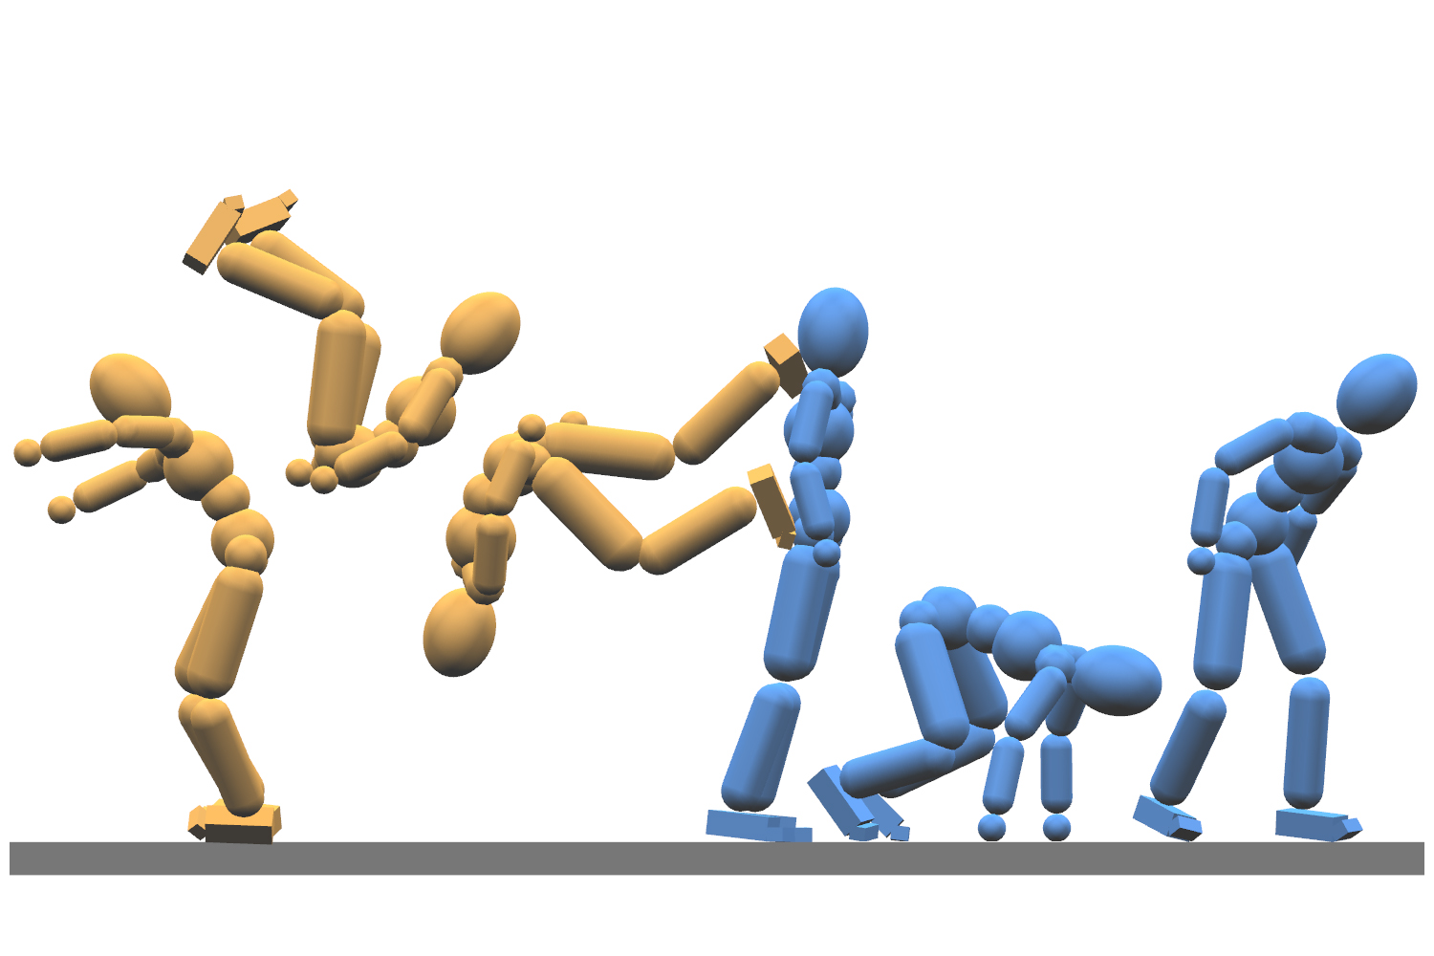
c
Background & Motivation
Section divider here

Slide 3
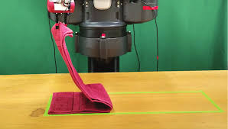
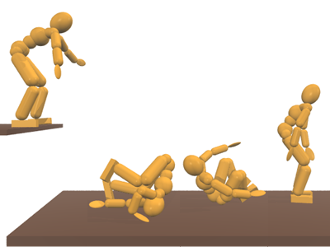
Motivation
Applications
Character Locomotion for humanoids, animals
Robotic Manipulation of strings, cloths
Simulation is easy and fast. Control is difficult

Slide 4
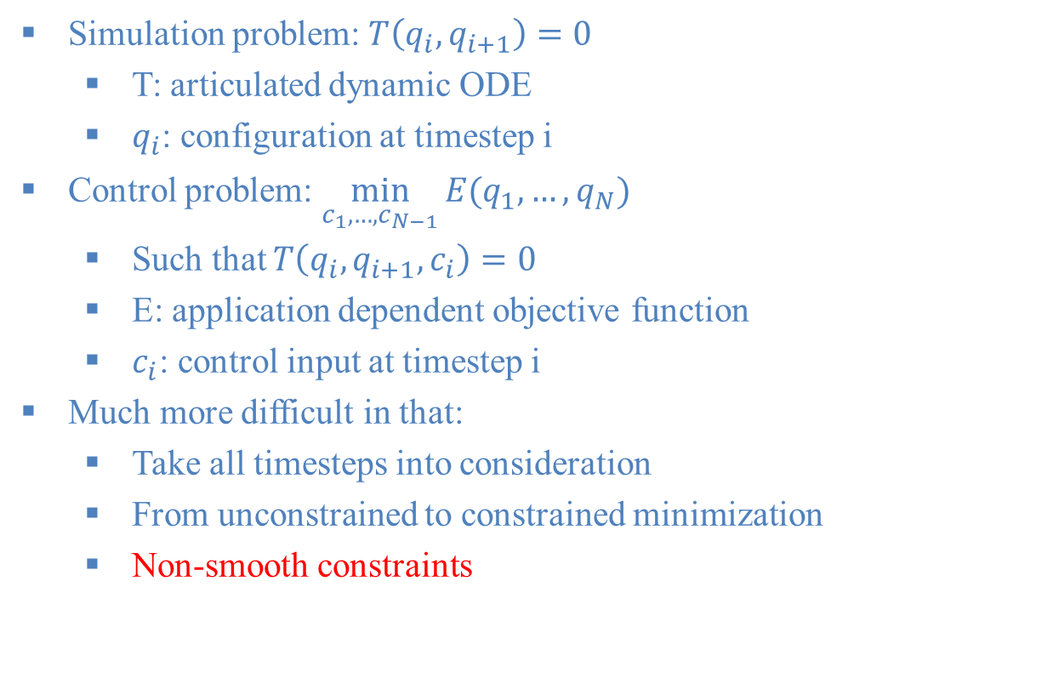
From Simulation to Control
Simulation problem: $T\left(q_{i}, q_{i+1}\right)=0$
T: articulated dynamic ODE
$q_{i}$: configuration at timestep i
Control problem: $\min_{c_{1},…,c_{N−1}}{E(q_{1}, …,q_{N})}$
Such that $T\left(q_{i}, q_{i+1},c_{i}\right)=0$
E: application dependent objective function
$c_{i}$: control input at timestep i
Much more difficult in that:
Take all timesteps into consideration
From unconstrained to constrained minimization
Non-smooth constraints

Slide 5
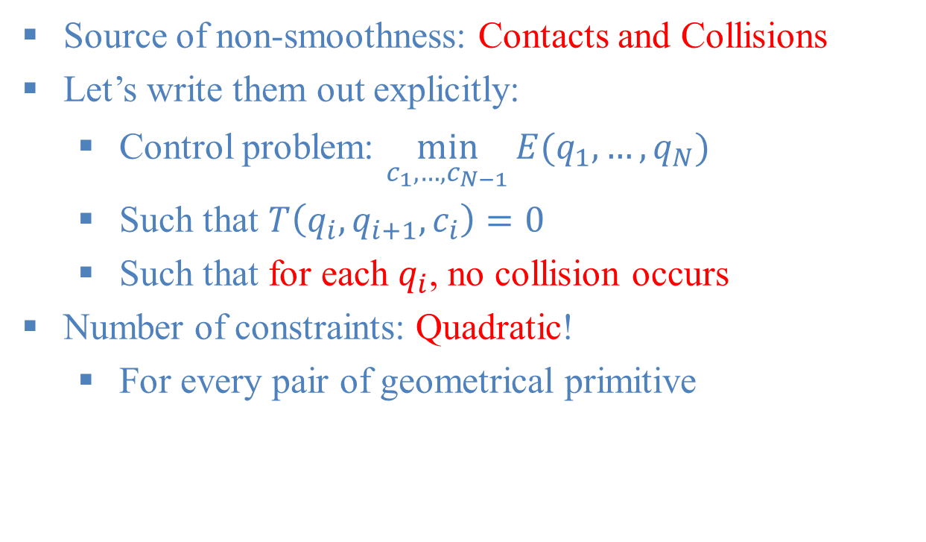
Challenge in Control: Non-smoothness
Source of non-smoothness: Contacts and Collisions
Let’s write them out explicitly:
Control problem: $\min_{c_{1},…,c_{N−1}}{E(q_{1}, …,q_{N})}$
Such that $T\left(q_{i}, q_{i+1},c_{i}\right)=0$
Such that for each $q_{i}$, no collision occurs
Number of constraints: Quadratic!
For every pair of geometrical primitive

Slide 6
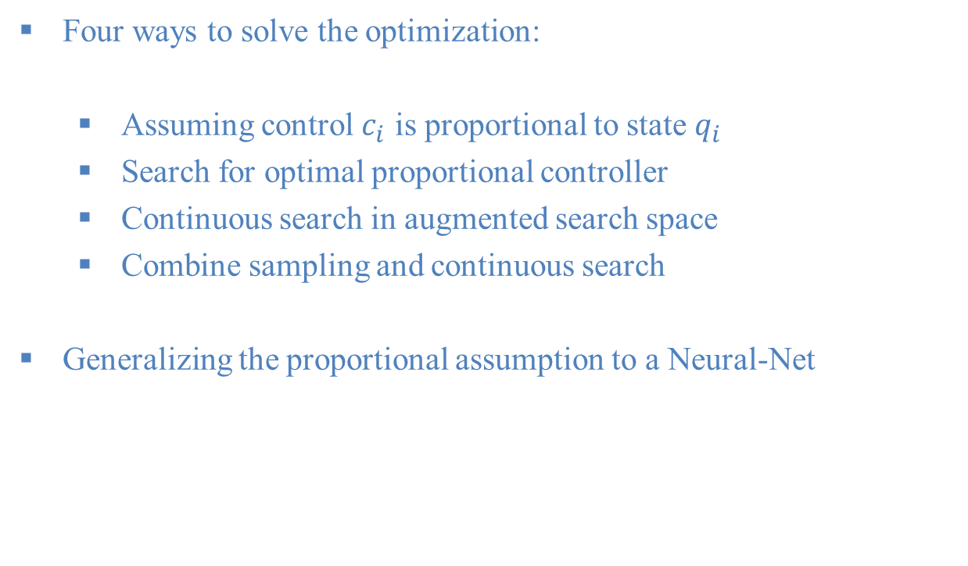
Outline of the Talk
Four ways to solve the optimization:
Assuming control $c_{i}$ is proportional to state $q_{i}$
Search for optimal proportional controller
Continuous search in augmented search space
Combine sampling and continuous search
Generalizing the proportional assumption to a Neural-Net

Slide 7
c
Simple Proportional Controller
Section divider here

Slide 8
Application
Conventional motion capture:
Capture an animated human skeleton
Physical motion capture:
Capture the contact points/forces needed to achieve the animation

Slide 9
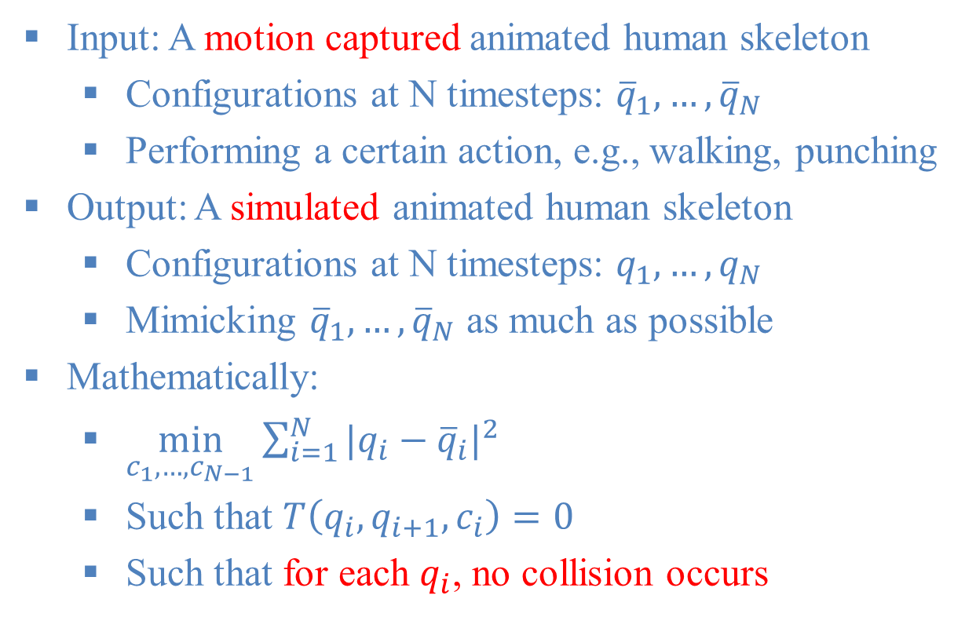
Problem Setup
Input: A motion captured animated human skeleton
Configurations at N timesteps: ${\overline{q}}_{1}, …,{\overline{q}}_{N}$
Performing a certain action, e.g., walking, punching
Output: A simulated animated human skeleton
Configurations at N timesteps: $q_{1}, …,q_{N}$
Mimicking ${\overline{q}}_{1}, …,{\overline{q}}_{N}$ as much as possible
Mathematically:
$\min_{c_{1},…,c_{N−1}}{\sum_{i=1}^{N}{{|q_{i}−{\overline{q}}_{i}|}^{2}}}$
Such that $T\left(q_{i}, q_{i+1},c_{i}\right)=0$
Such that for each $q_{i}$, no collision occurs

Slide 10
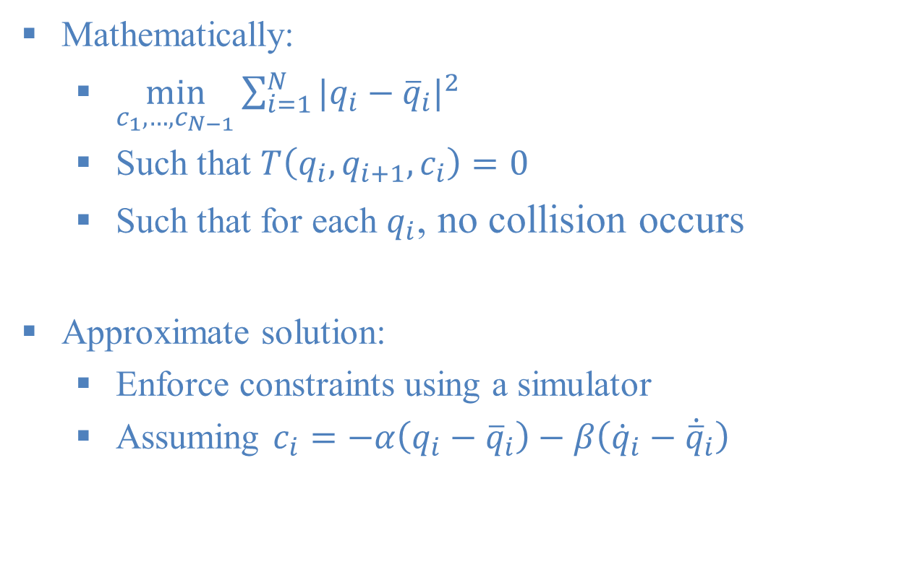
Formulation of PD Servo
Mathematically:
$\min_{c_{1},…,c_{N−1}}{\sum_{i=1}^{N}{{|q_{i}−{\overline{q}}_{i}|}^{2}}}$
Such that $T\left(q_{i}, q_{i+1},c_{i}\right)=0$
Such that for each $q_{i}$, no collision occurs
Approximate solution:
Enforce constraints using a simulator
Assuming $c_{i}=−α\left(q_{i}−{\overline{q}}_{i}\right)−β\left({\dot{q}}_{i}−{\dot{\overline{q}}}_{i}\right)$

Slide 11
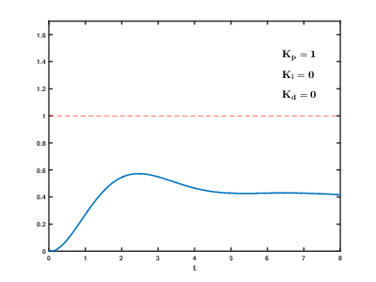
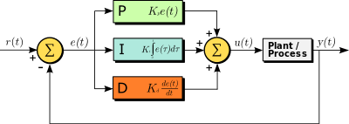

Principle of PD Servo
Assuming $c_{i}=−α_{i}\left(q_{i}−{\overline{q}}_{i}\right)−β_{i}\left({\dot{q}}_{i}−{\dot{\overline{q}}}_{i}\right)$
Position Error
Velocity Error

Slide 12
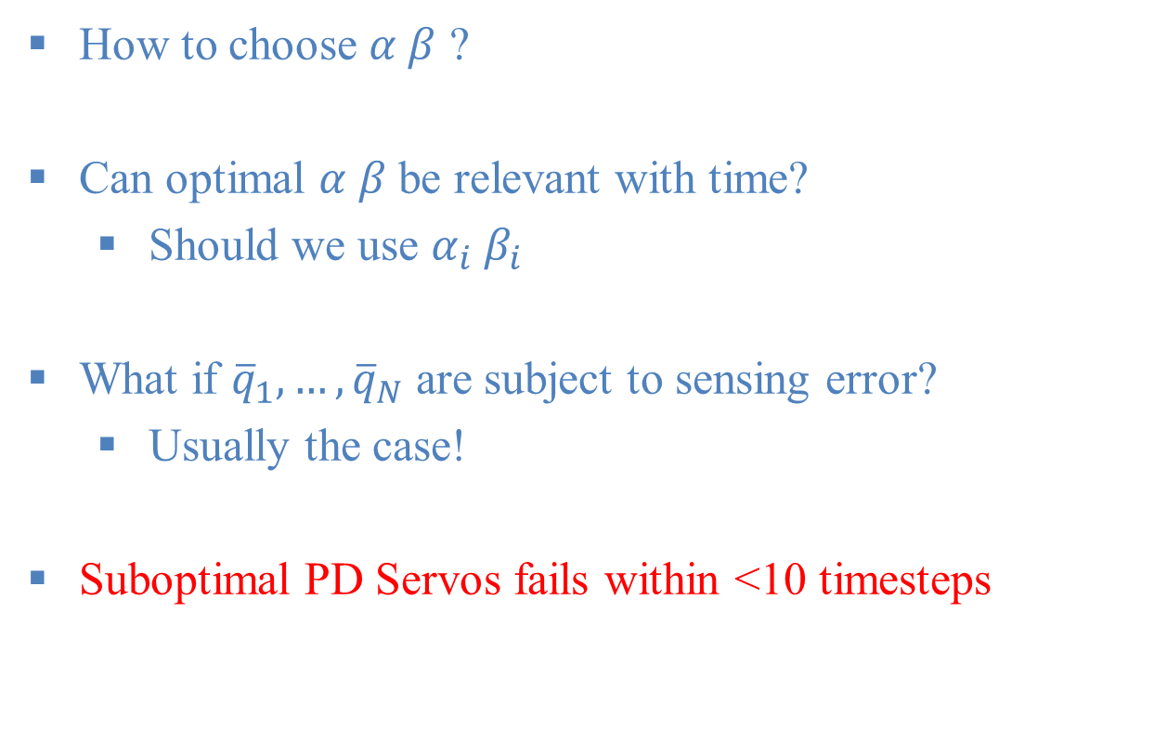
Limitation
How to choose $α β$ ?
Can optimal $α β$ be relevant with time?
Should we use $α_{i} β_{i}$
What if ${\overline{q}}_{1}, …,{\overline{q}}_{N}$ are subject to sensing error?
Usually the case!
Suboptimal PD Servos fails within <10 timesteps

Slide 13
c
Searching for Optimal Controller
Section divider here

Slide 14
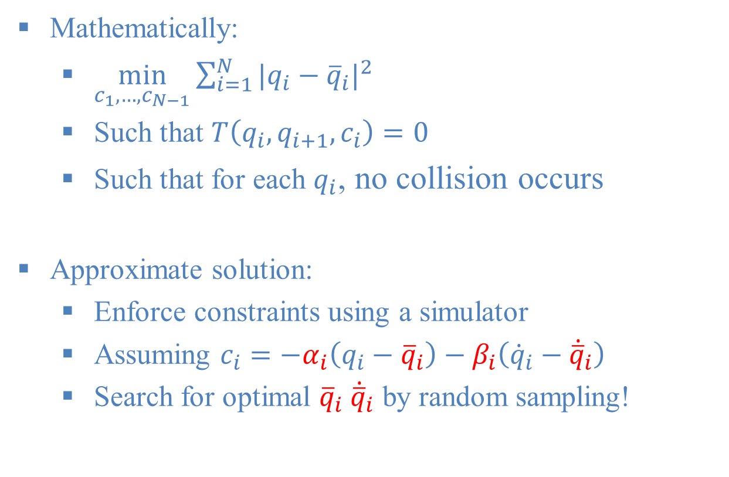
Formulation of PD Servo
Mathematically:
$\min_{c_{1},…,c_{N−1}}{\sum_{i=1}^{N}{{|q_{i}−{\overline{q}}_{i}|}^{2}}}$
Such that $T\left(q_{i}, q_{i+1},c_{i}\right)=0$
Such that for each $q_{i}$, no collision occurs
Approximate solution:
Enforce constraints using a simulator
Assuming $c_{i}=−α_{i}\left(q_{i}−{\overline{q}}_{i}\right)−β_{i}\left({\dot{q}}_{i}−{\dot{\overline{q}}}_{i}\right)$
Search for optimal ${\overline{q}}_{i} {\dot{\overline{q}}}_{i}$ by random sampling!

Slide 15
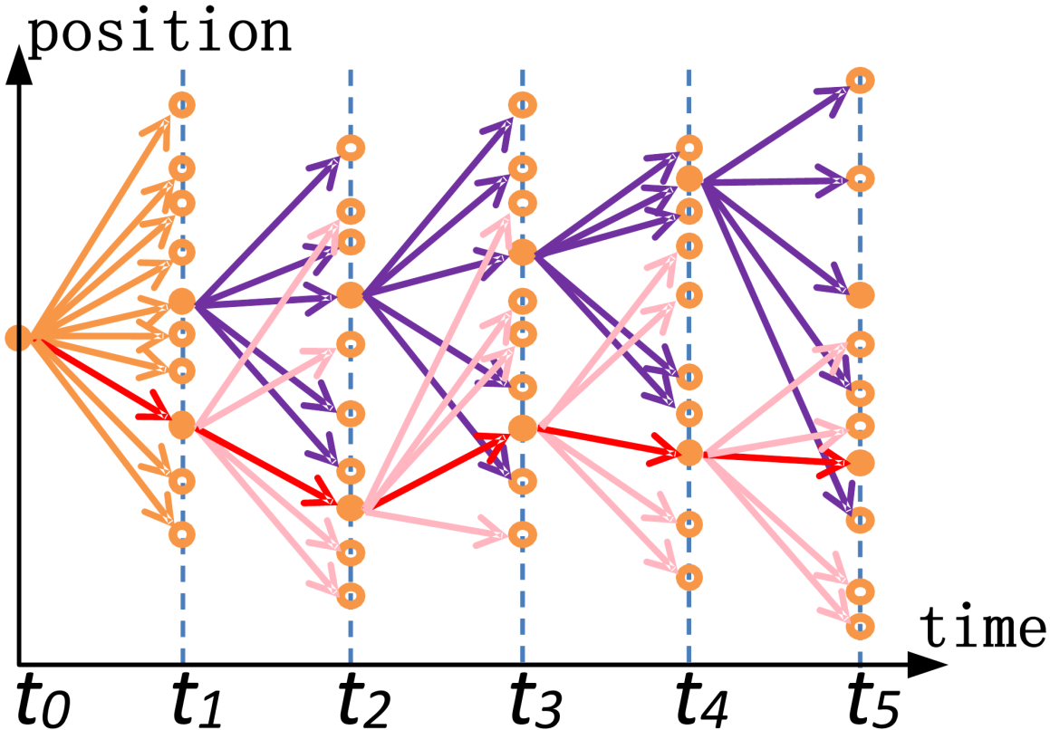

The Sampling Algorithm
Approximate solution:
$c_{i}=−α_{i}\left(q_{i}−{\overline{q}}_{i}\right)−β_{i}\left({\dot{q}}_{i}−{\dot{\overline{q}}}_{i}\right)$
Search for optimal ${\overline{q}}_{i} {\dot{\overline{q}}}_{i}$ by random sampling!
Step 1: randomly perturb to get K samples of ${\overline{q}}_{i} {\dot{\overline{q}}}_{i}$
Step 2: retain only N good ${\overline{q}}_{i} {\dot{\overline{q}}}_{i}$
K=10, N=2 here
K=1400, N=200
in practice

Slide 16
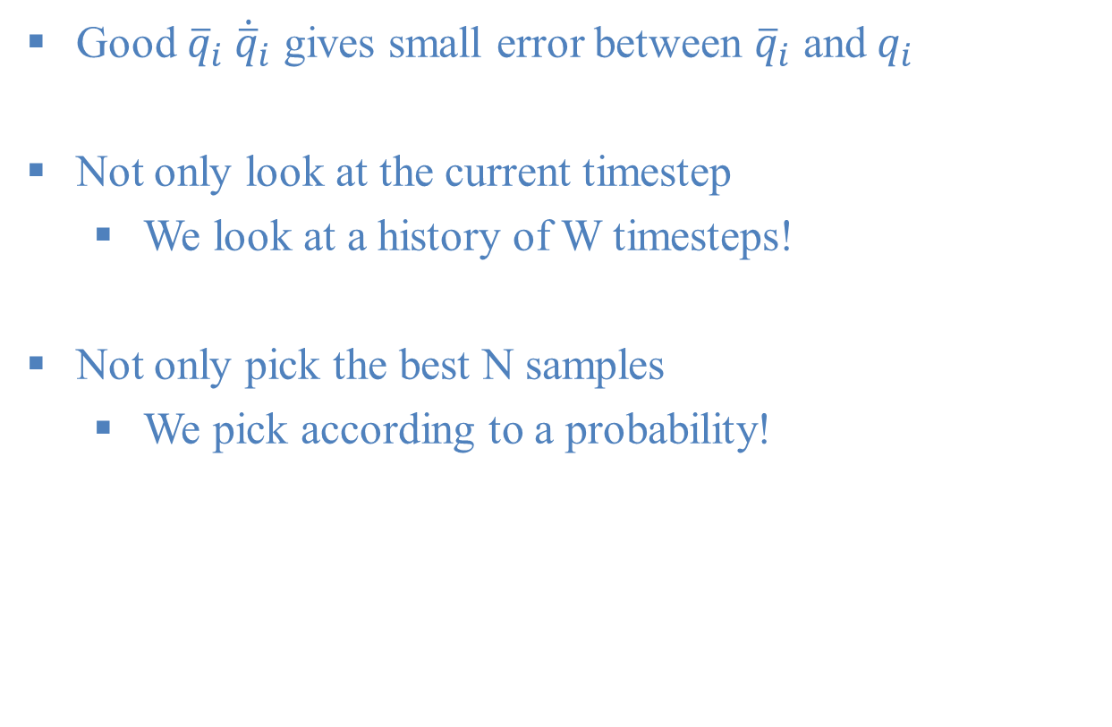
What is a Good Sample?
Good ${\overline{q}}_{i} {\dot{\overline{q}}}_{i}$ gives small error between ${\overline{q}}_{i}$ and$q_{i}$
Not only look at the current timestep
We look at a history of W timesteps!
Not only pick the best N samples
We pick according to a probability!

Slide 17
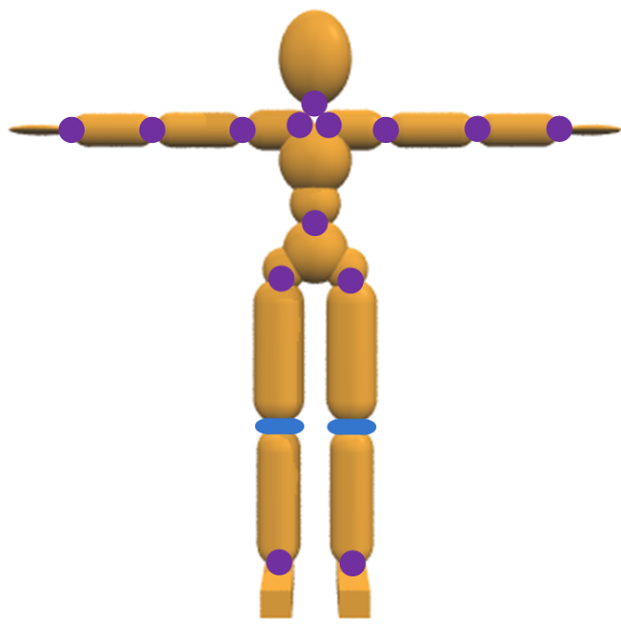

Good Sample Selection
Define a cost function $E$:
$E=\sum_{i−W}^{i}{E_{Joint}+E_{End}+E_{COM}(q_{i})}$
Joint angles should match by $E_{Joint}$:
$|Joint\left(q_{i}\right)−Joint({\overline{q}}_{i})|$
End-effector should match by $E_{End}$:
$|End\left(q_{i}\right)−End({\overline{q}}_{i})|$
Center-of-mass should match by $E_{COM}$:
$|COM\left(q_{i}\right)−COM({\overline{q}}_{i})|$
From the $K$ samples, select $N$ with probability: $\frac{e^{−E}}{Z}$
$Z$ is a normalization factor

Slide 18
Sampling-based Contact-Rich Motion Control

Slide 19
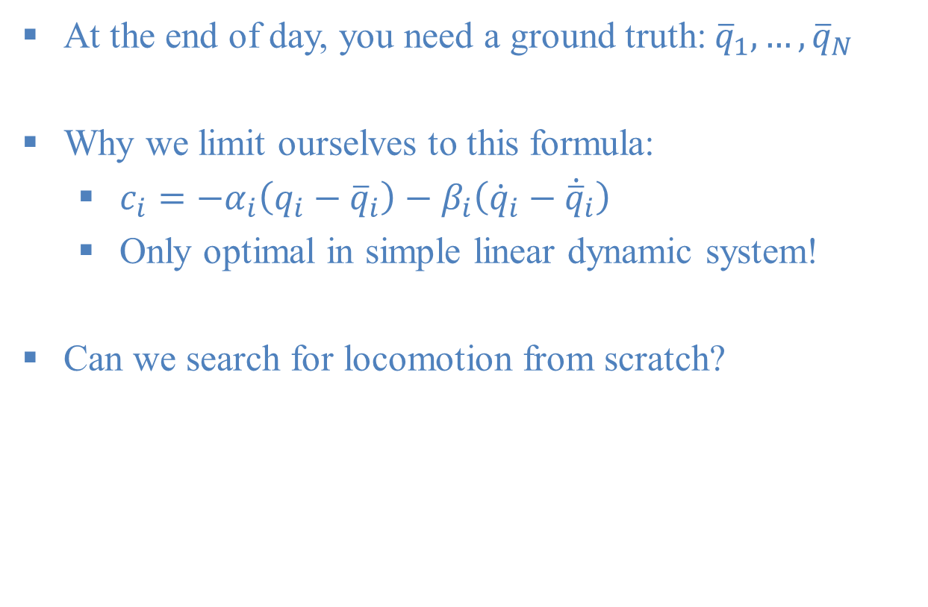
Limitation
At the end of day, you need a ground truth: ${\overline{q}}_{1}, …,{\overline{q}}_{N}$
Why we limit ourselves to this formula:
$c_{i}=−α_{i}\left(q_{i}−{\overline{q}}_{i}\right)−β_{i}\left({\dot{q}}_{i}−{\dot{\overline{q}}}_{i}\right)$
Only optimal in simple linear dynamic system!
Can we search for locomotion from scratch?

Slide 20
c
Continuous Searching
Section divider here

Slide 21
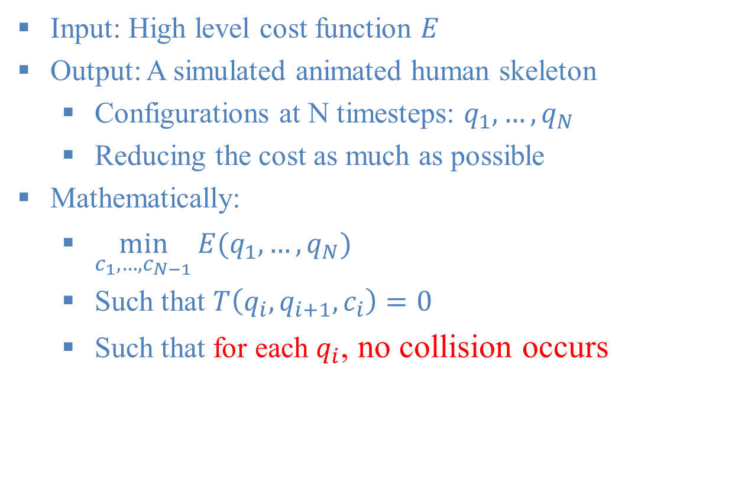


Problem Setup
Input: High level cost function $E$
Output: A simulated animated human skeleton
Configurations at N timesteps: $q_{1}, …,q_{N}$
Reducing the cost as much as possible
Mathematically:
$\min_{c_{1},…,c_{N−1}}{E(q_{1}, …,q_{N})}$
Such that $T\left(q_{i}, q_{i+1},c_{i}\right)=0$
Such that for each $q_{i}$, no collision occurs
T: articulated dynamic ODE
$q_{i}$: configuration at timestep i
E: application dependent objective function
$c_{i}$: control input at timestep i

Slide 22
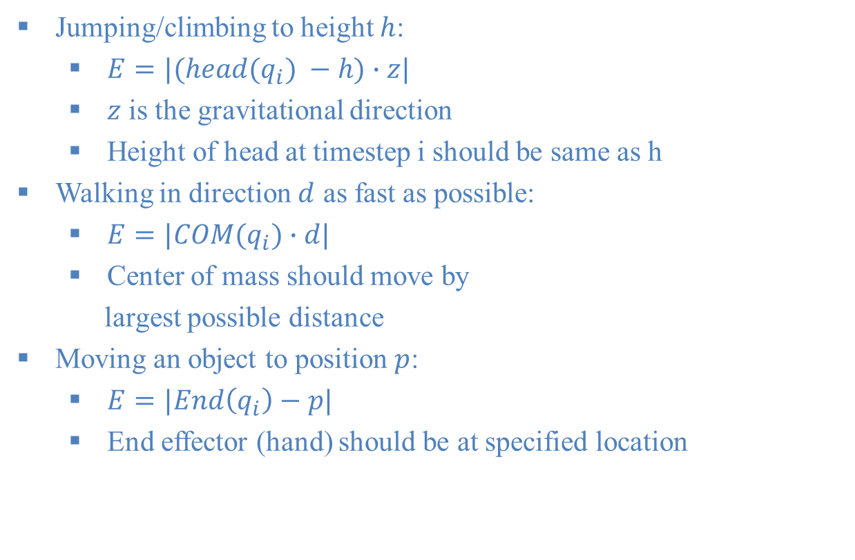
Exemplary Objective Function
Jumping/climbing to height $h$:
$E=|(head(q_{i}) −h)∙z|$
$z$ is the gravitational direction
Height of head at timestep i should be same as h
Walking in direction $d$ as fast as possible:
$E=|COM(q_{i})∙d|$
Center of mass should move by
largest possible distance
Moving an object to position $p$:
$E=|End\left(q_{i}\right)−p|$
End effector (hand) should be at specified location

Slide 23
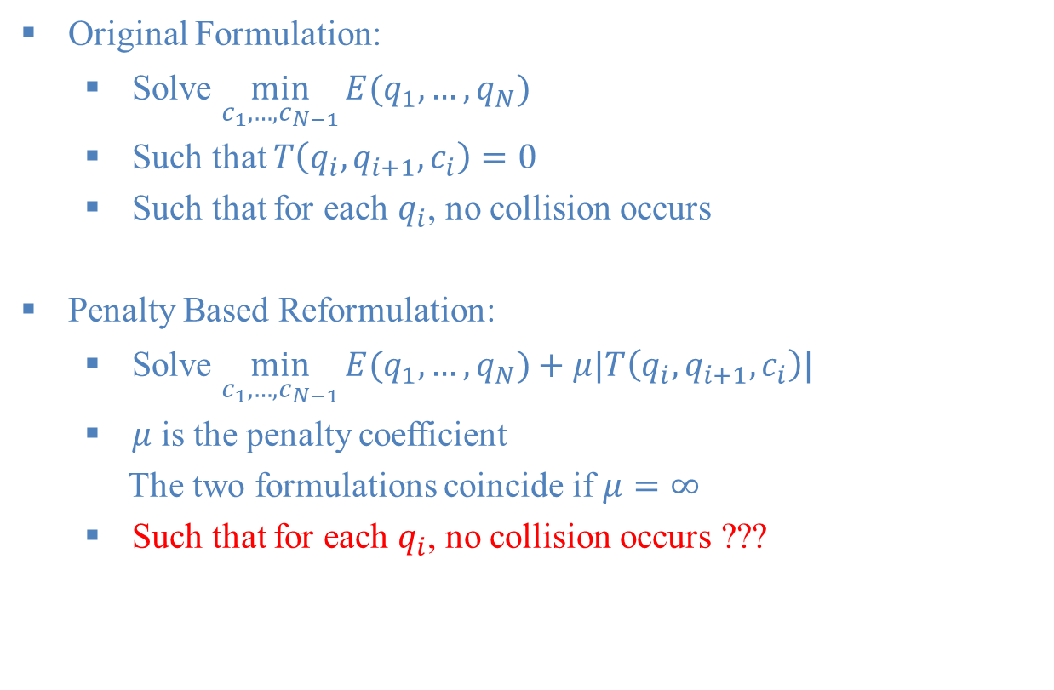
Penalty Based Reformulation
Original Formulation:
Solve $\min_{c_{1},…,c_{N−1}}{E(q_{1}, …,q_{N})}$
Such that $T\left(q_{i}, q_{i+1},c_{i}\right)=0$
Such that for each $q_{i}$, no collision occurs
Penalty Based Reformulation:
Solve $\min_{c_{1},…,c_{N−1}}{E(q_{1}, …,q_{N})}+μ|T\left(q_{i}, q_{i+1},c_{i}\right)|$
$μ$ is the penalty coefficient
The two formulations coincide if $μ=∞$
Such that for each $q_{i}$, no collision occurs ???

Slide 24
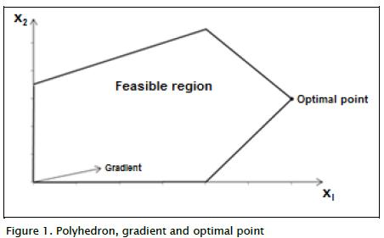



Contacts as Penalty: Challenges
The two formulations coincide if $μ=∞$ but:
Unilateral constraints: $0$ inside, $∞$ outside
Computers don’t handle $∞$, there are no gradient!
$$∞$$
$$0$$

Slide 25
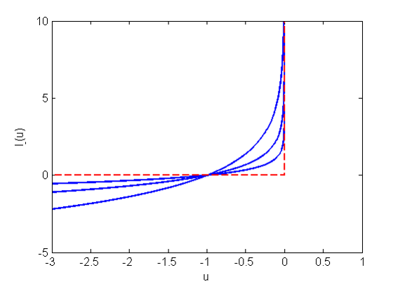
Contacts as Penalty: Interior Point Method
Replace the red line with the blue line
Stop the robot before reaching the red line

Slide 26
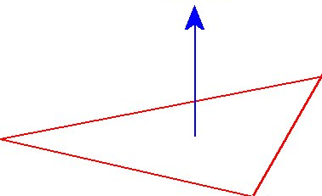




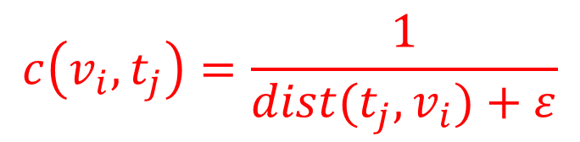
The Algorithm
Penalty Based Reformulation:
Solve $\min_{c_{1},…,c_{N−1}}{E(q_{1}, …,q_{N})}+μ|T\left(q_{i}, q_{i+1},c_{i}\right)|$+$E_{C}$
$E_{C}=\sum_{v_{i}, t_{j}}{c(v_{i}, t_{j})}\left[\left|v_{i}∙n\left(t_{j},v_{i}\right)\right|+\left|{\dot{v}}_{i}∙n\left(t_{j},v_{i}\right)\right|\right]$
Number of constraints: Quadratic!
Efficient culling using hierarchy
$$v_{i}$$
$$c\left(v_{i}, t_{j}\right)=\frac{1}{dist(t_{j},v_{i})+ε}$$
$$n\left(t_{j},v_{i}\right)$$
$$t_{j}$$

Slide 27



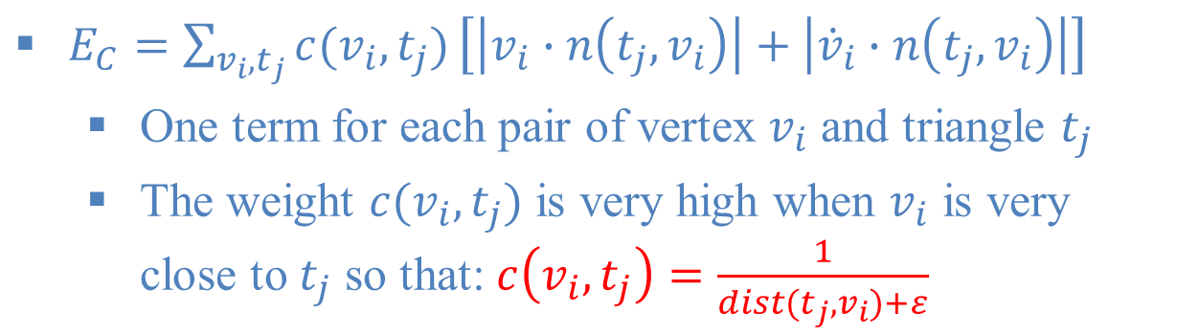
The Algorithm
Position Error
Velocity Error
$E_{C}=\sum_{v_{i}, t_{j}}{c(v_{i}, t_{j})}\left[\left|v_{i}∙n\left(t_{j},v_{i}\right)\right|+\left|{\dot{v}}_{i}∙n\left(t_{j},v_{i}\right)\right|\right]$
One term for each pair of vertex $v_{i}$ and triangle $t_{j}$
The weight $c(v_{i}, t_{j})$ is very high when $v_{i}$ is very close to $t_{j}$ so that: $c\left(v_{i}, t_{j}\right)=\frac{1}{dist(t_{j},v_{i})+ε}$
$$v_{i}$$
$$dist\left(t_{j},v_{i}\right)=|n\left(t_{j},v_{i}\right)|$$
$$t_{j}$$

Slide 28
Discovery of Complex Behaviors through Contact-Invariant Optimization

Slide 29
Limitation
A continuous search is always local search
The results are good for simple boundary
Can we do global search with local refinement?

Slide 30
c
Combining Two Searching Methods
Section divider here

Slide 31
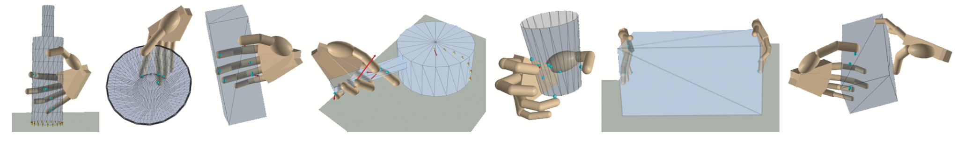
Application
Conventional Motion Capture:
Resolution high enough for the manipulated body
Resolution too low to capture hand
Recover hand animation by optimization!

Slide 32
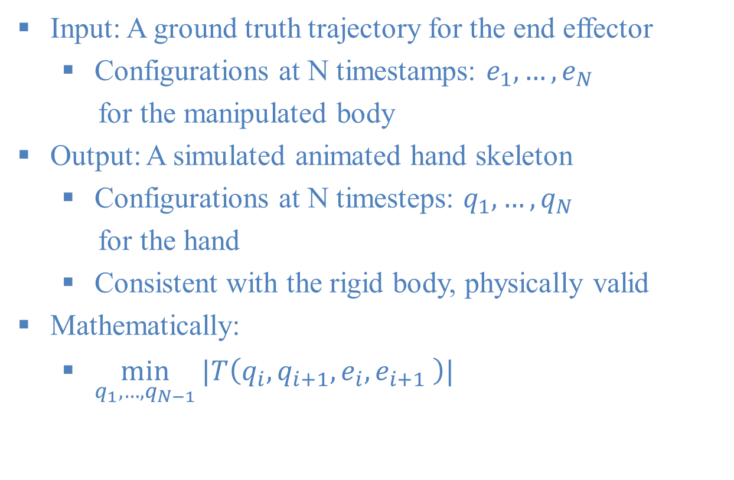

Problem Setup
Input: A ground truth trajectory for the end effector
Configurations at N timestamps: $e_{1}, …,e_{N}$
for the manipulated body
Output: A simulated animated hand skeleton
Configurations at N timesteps: $q_{1}, …,q_{N}$
for the hand
Consistent with the rigid body, physically valid
Mathematically:
$\min_{q_{1},…,q_{N−1}}{|T\left(q_{i}, q_{i+1},e_{i}, e_{i+1} \right)|}$
T: articulated dynamic ODE
$q_{i}$: configuration at timestep i

Slide 33
Hand Manipulation: Challenge
Mathematically same:
Can be solved using sampling/continuous-opt.
Challenge for optimization based methods:
Lots of local minima
Challenge for sampling based methods:
Smooth/jitter-free animations

Slide 34
Search+Optimization Algorithm
Depth first search, Depth=timestep index
Searching for contact points
Optimization for dynamics / smoothness

Slide 35
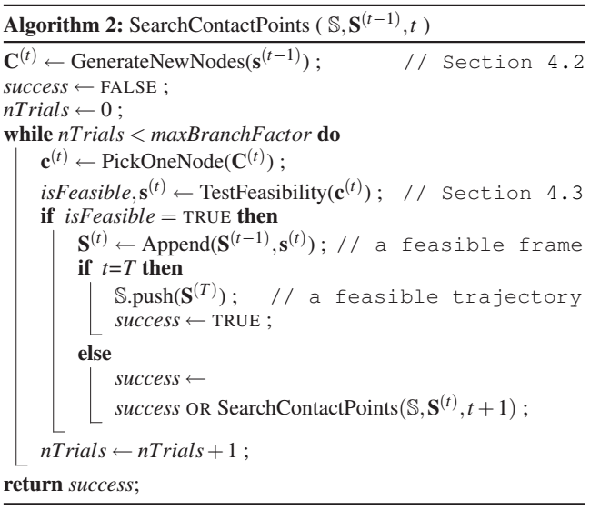
Searching+Optimization Algorithm
Depth first search
Depth=timestep index

Slide 36
Searching+Optimization Algorithm
Generate a set of
contact point sets
Check if this set is dynamically correct using optimization
Recursive for
next timestep

Slide 37
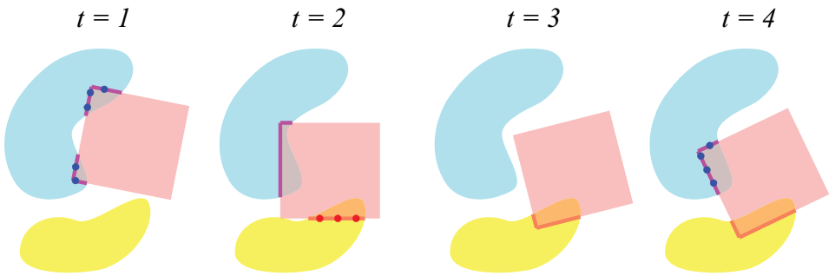
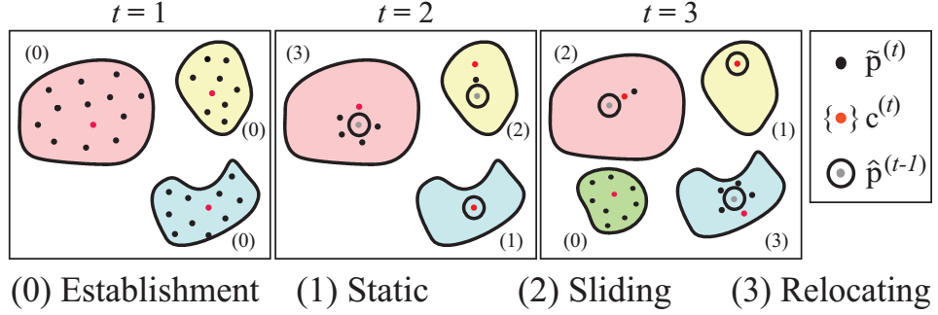
Generating Random Contact Points
Initialization using reachable set
Update contact points across frames

Slide 38
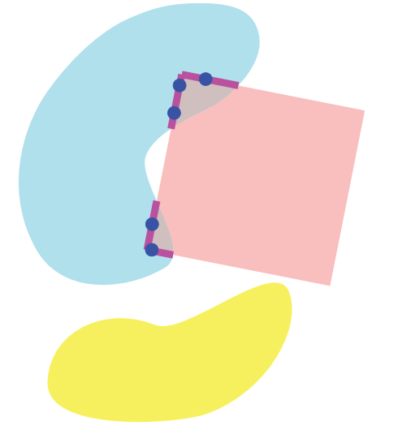
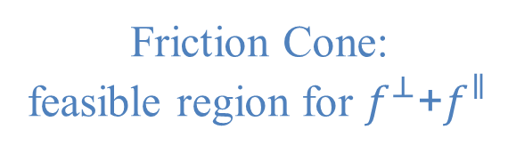


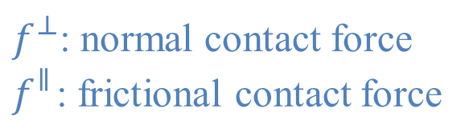
Generating Random Contact Points
Update contact points across frames
Friction Cone:
feasible region for $f_{}^{⊥}$+$f_{}^{∥}$
$f_{}^{⊥}$: normal contact force
$f_{}^{∥}$: frictional contact force
$$f_{}^{⊥}$$
$$f_{}^{∥}$$

Slide 39
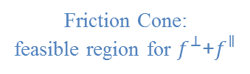


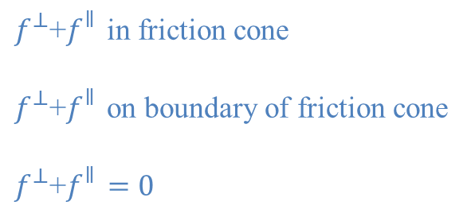

Generating New Contact Samples
$$f_{}^{∥}$$
$f_{}^{⊥}$+$f_{}^{∥}$ in friction cone
$f_{}^{⊥}$+$f_{}^{∥}$ on boundary of friction cone
$f_{}^{⊥}$+$f_{}^{∥}=0$
Friction Cone:
feasible region for $f_{}^{⊥}$+$f_{}^{∥}$
$$f_{}^{⊥}$$
$$f_{}^{∥}$$

Slide 40
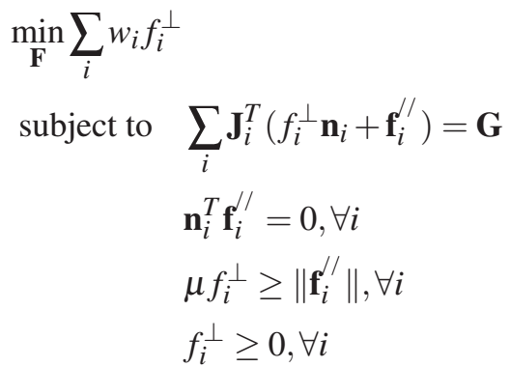


Checking for Dynamic Correctness
Solving the optimization
Contact forces in frictional cone
Consistent with $e_{1}, …,e_{N}$ for the manipulated body
Prefer smaller forces
$f_{}^{⊥}$: normal contact force
$f_{}^{∥}$: frictional contact force
$n_{i}^{}$: contact normal
$w_{i}^{}=1$ for all $i$ in this paper
$μ$: frictional coefficient
$G$: generalized mass matrix
$J$: generalized external force

Slide 41
Synthesis of Detailed Hand Manipulations Using Contact Sampling

Slide 42
c
Generalizing to Neural-Net
Section divider here

Slide 43
Let’s Recall PD-Servo
Mathematically:
$\min_{c_{1},…,c_{N−1}}{\sum_{i=1}^{N}{{|q_{i}−{\overline{q}}_{i}|}^{2}}}$
Such that $T\left(q_{i}, q_{i+1},c_{i}\right)=0$
Such that for each $q_{i}$, no collision occurs
Approximate solution:
Enforce constraints using a simulator
Assuming $c_{i}=−α\left(q_{i}−{\overline{q}}_{i}\right)−β\left({\dot{q}}_{i}−{\dot{\overline{q}}}_{i}\right)$

Slide 44
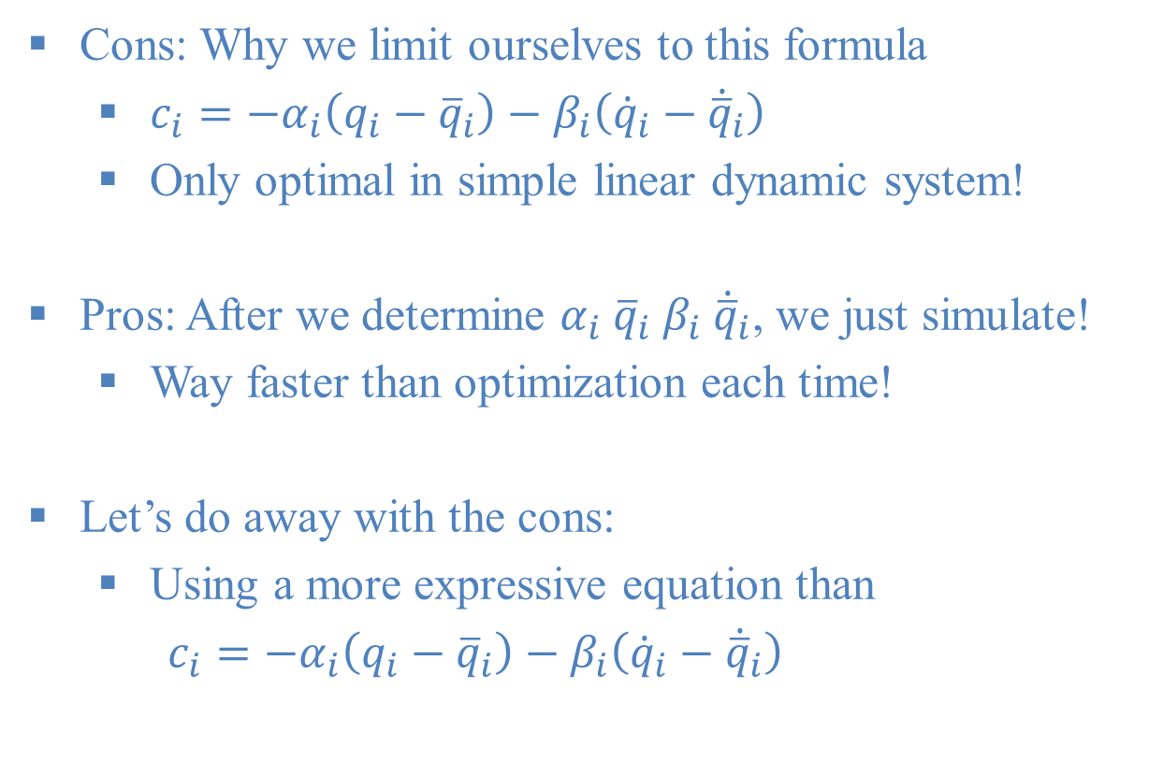
Is PD-Servo That Bad?
Cons: Why we limit ourselves to this formula
$c_{i}=−α_{i}\left(q_{i}−{\overline{q}}_{i}\right)−β_{i}\left({\dot{q}}_{i}−{\dot{\overline{q}}}_{i}\right)$
Only optimal in simple linear dynamic system!
Pros: After we determine $α_{i} {\overline{q}}_{i} β_{i} {\dot{\overline{q}}}_{i}$, we just simulate!
Way faster than optimization each time!
Let’s do away with the cons:
Using a more expressive equation than
$c_{i}=−α_{i}\left(q_{i}−{\overline{q}}_{i}\right)−β_{i}\left({\dot{q}}_{i}−{\dot{\overline{q}}}_{i}\right)$

Slide 45
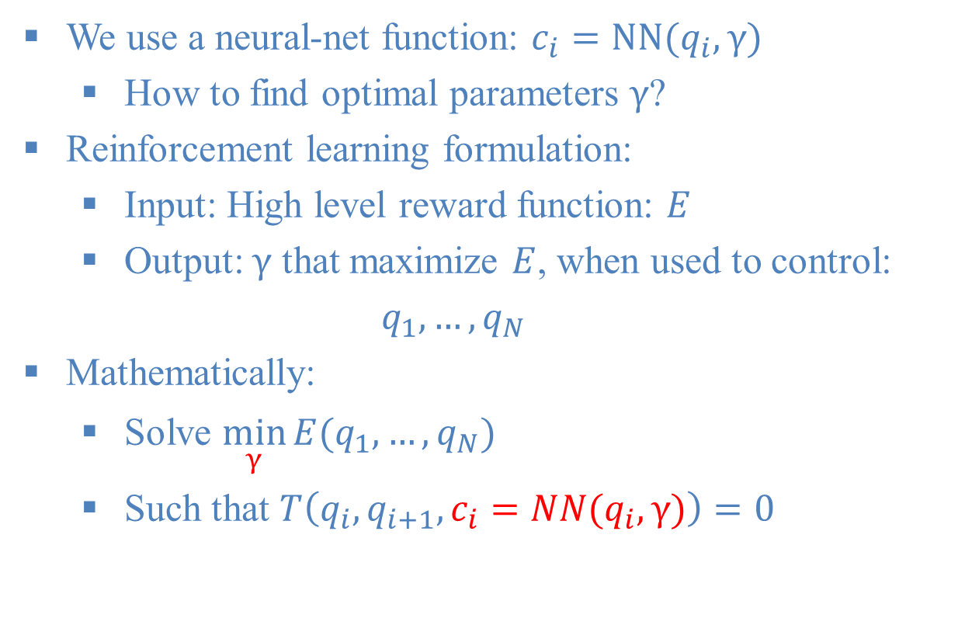
Neural-Net Controller
We use a neural-net function: $c_{i}=NN(q_{i},γ)$
How to find optimal parameters $γ$?
Reinforcement learning formulation:
Input: High level reward function: $E$
Output: $γ$ that maximize $E$, when used to control:
$q_{1}, …,q_{N}$
Mathematically:
Solve $\min_{γ}{E(q_{1}, …,q_{N})}$
Such that $T\left(q_{i}, q_{i+1},c_{i}=NN(q_{i},γ)\right)=0$

Slide 46
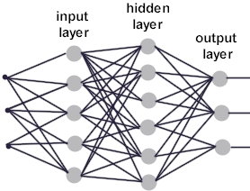







Neural-Net Controller
We use a neural-net function: $c_{i}=NN(q_{i},γ)$
$$q_{i}^{1}$$
$$c_{i}^{1}$$
$$q_{i}^{2}$$
$$c_{i}^{2}$$
$$q_{i}^{3}$$
$$c_{i}^{3}$$

Slide 47
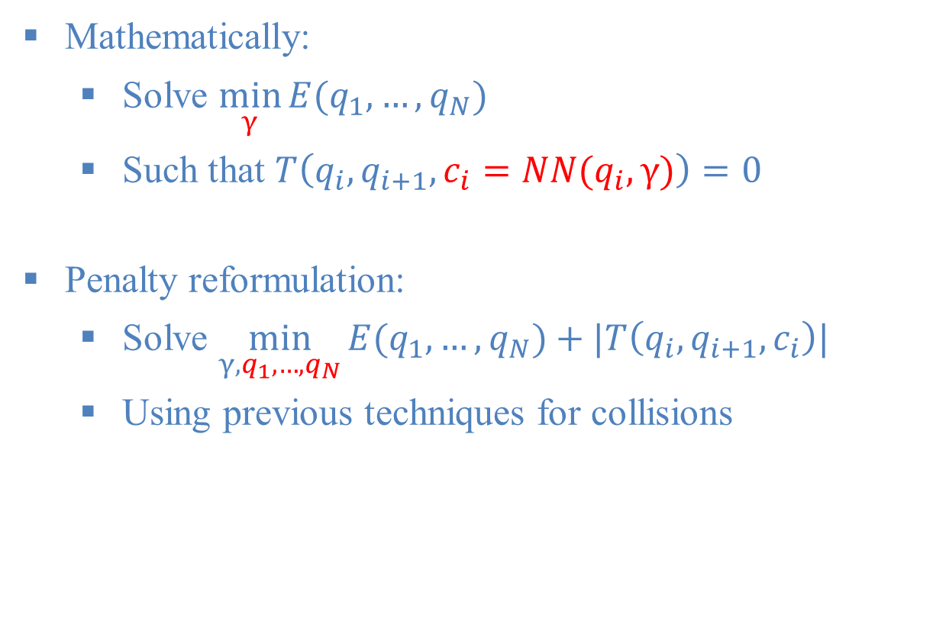
Penalty Based Reformulation
Mathematically:
Solve $\min_{γ}{E(q_{1}, …,q_{N})}$
Such that $T\left(q_{i}, q_{i+1},c_{i}=NN(q_{i},γ)\right)=0$
Penalty reformulation:
Solve $\min_{γ,q_{1}, …,q_{N}}{E(q_{1}, …,q_{N})}+|T\left(q_{i}, q_{i+1},c_{i}\right)|$
Using previous techniques for collisions

Slide 48
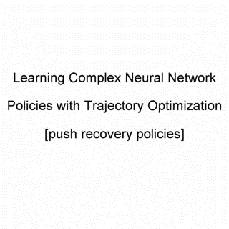
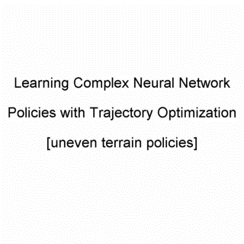

Results

Slide 49
c
Thank You & Questions?
Section divider here

