Slide 1
Disclaimer
The following slides reuse materials from SIGGRAPH 2001 Course Notes on Physically-based Modeling (copyright ♥ 2001 by David Baraff at Pixar).
M. C. Lin

Slide 2
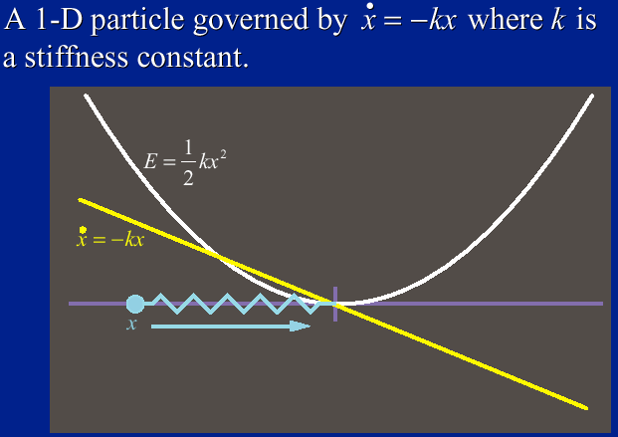
An Example
M. C. Lin

Slide 3


An Example
The left side of the ODE:
Finite difference discretization:
M. C. Lin

Slide 4

Explicit Euler’s Method
The left side of the ODE:
Finite difference discretization:
Euler’s method:
M. C. Lin

Slide 5
Explicit Euler’s Method
Euler’s method:
How to choose: ?
Is it stable? Why?
M. C. Lin

Slide 6
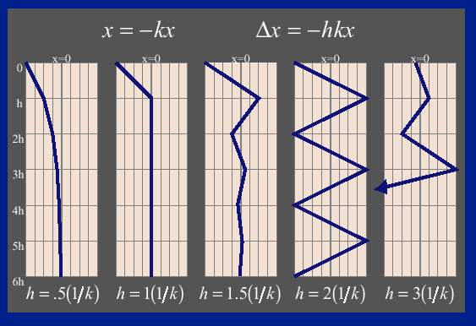
Speed Limitation of Euler’s Method
M. C. Lin

Slide 7



Explicit Euler’s Method
Euler’s method:
Convergence analysis:
M. C. Lin

Slide 8


Explicit Euler’s Method
Convergence analysis:
Convergence condition (CFL):
M. C. Lin

Slide 9
Determining Step Size
Explicit Integration
Too big, unstable!
Too small, too slow
Adaptive, maybe
Ultimately the constants decide!
Implicit Methods
Taking large steps when possible
M. C. Lin

Slide 10


Explicit Euler’s Method
Euler’s method:
Backward Euler’s method:
M. C. Lin

Slide 11


Backward Euler’s Method
Backward Euler’s method:
Convergence analysis:
Stable!
M. C. Lin

Slide 12
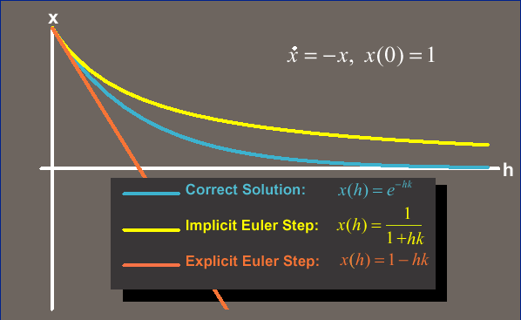
One Step: Implicit vs. Explicit
M. C. Lin

Slide 13
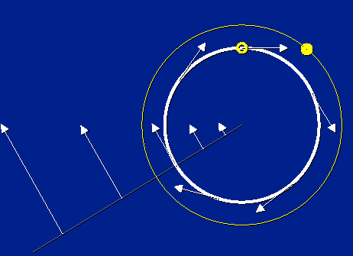
Explicit Integration
M. C. Lin

Slide 14
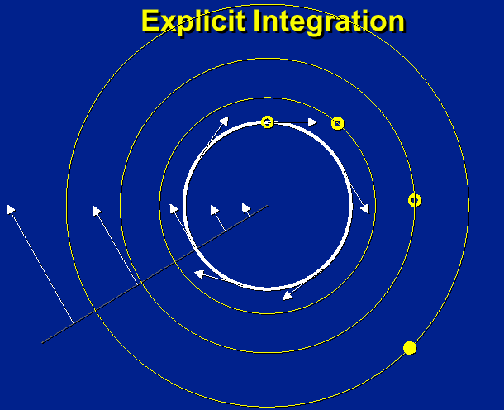
Problems
M. C. Lin

Slide 15
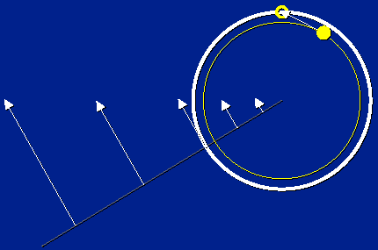
Implicit Integration
M. C. Lin

Slide 16
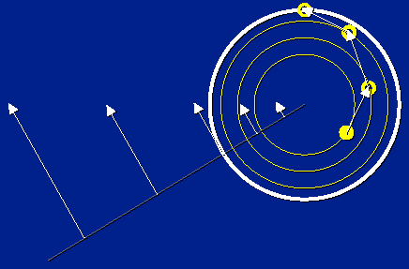
Implicit Integration
M. C. Lin

Slide 17
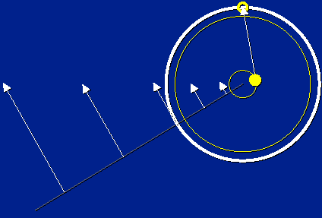
Implicit Integration
M. C. Lin

Slide 18

Explicit Euler’s Method
Convergence condition (CFL):
k indicate the stiffness of the ODE
M. C. Lin

Slide 19
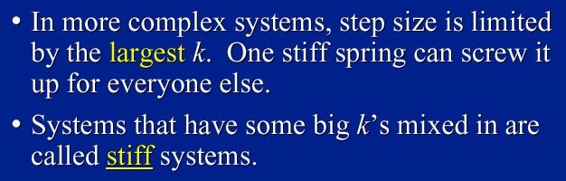
Stiff Equations
M. C. Lin

Slide 20
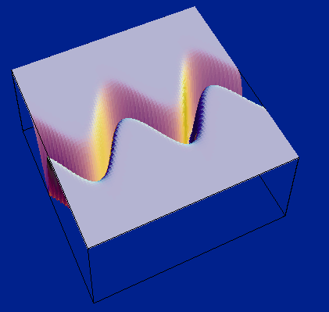
A Stiff Energy Landscape
M. C. Lin

Slide 21
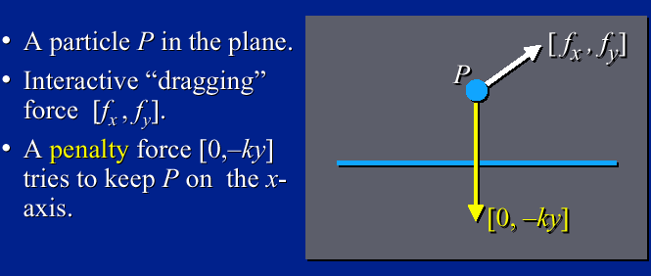
Example: Particle-on-line
M. C. Lin

Slide 22
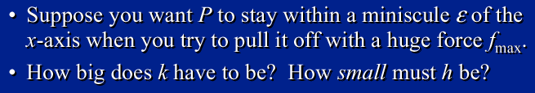
Example: Particle-on-line
M. C. Lin

Slide 23
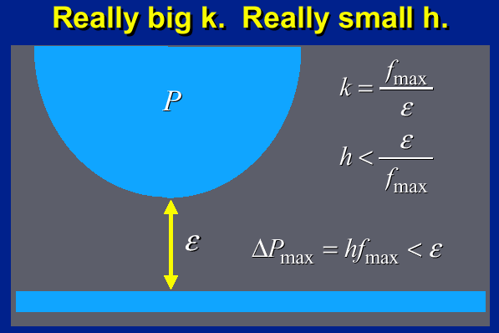
Example: Particle-on-line
M. C. Lin

Slide 24
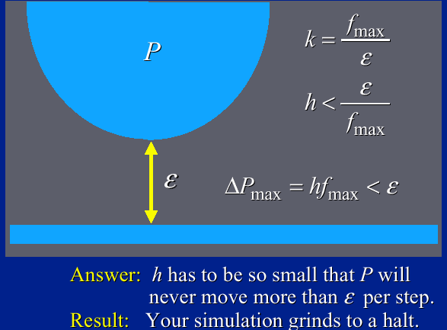
Example: Particle-on-line
M. C. Lin

Slide 25


Explicit vs. Implicit Euler Method
vs.
M. C. Lin

Slide 26
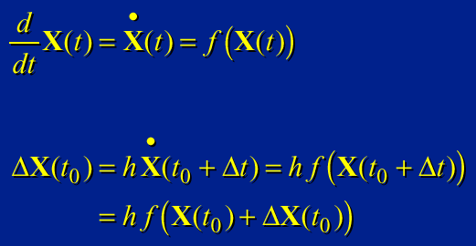
Large Systems
M. C. Lin

Slide 27
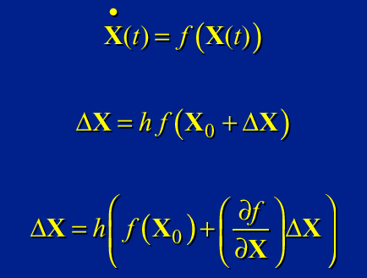

Linearized Implicit Integration
M. C. Lin

Slide 28
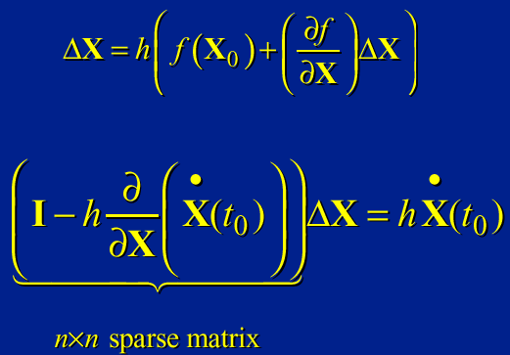
Single-Step Implicit Euler Method
M. C. Lin

Slide 29


Backward Euler’s Method
Backward Euler’s method:
Linearize:
How to solve this linear system?
M. C. Lin

Slide 30
Solving Large Linear Systems
Matrix structure reflects force-coupling:
(i , j)th entry exists iff f_{i} depends on X_{j}
Conjugate gradient a good first choice
M. C. Lin

Slide 31
Linear Solvers
How to solve the linear system:
Two classes:
Non iterative solvers: GE (Gauss Elimination), QR
Iterative solvers
Basic iterative method (Stationary)
Jacobi, Gauss-Seidel, SOR, Weighted-Jacobi
Krylov subspace method
CG (Conjugate Gradient)
M. C. Lin

Slide 32



Linear Solvers
How to solve the linear system:
Basic iterative solvers:
Jacobi:
Gauss-Seidel:
M. C. Lin

Slide 33

Linear Solvers
How to solve the linear system:
Krylov subspace methods:
Approximate solution from the Krylov subspace:
Popular choice of c = b
M. C. Lin

