Slide 1
Discovering Physical Parameters From Sound

Slide 2


Forward vs Inverse
In forward problems, we have the model parameters m and want the resulting data d:
Inverse problems are the other way around:
Notes:
The topics in this talk are generally seen as inverse problems related to sound. This is a brief introduction to what “inverse” means in this case.
Give examples of m and d, maybe for particle simulators? Rigid body?

Slide 3
Forward vs Inverse
The function f is not always easily invertible.
Can you tell how an object at rest reached that state?
If you see an object flying, can you determine where it was launched from?

Slide 4
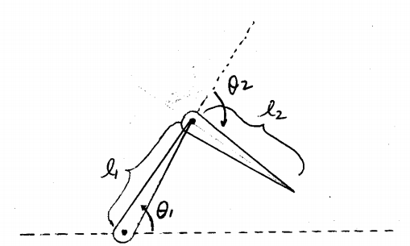
Inverse Position Problem
(Kinematics)
d is the position of the end effector,
m is the set of intermediate joint parameters.
Some parameters are known in both problems, e.g. limb and joint properties, obstacles.
Solved by iterative optimization over state space.
Notes:
Limb properties are things like dimensions and constraints.
Just looking at how inverse kinematics is an inverse problem so we can get a better idea of what inverse sound problems might look like.

Slide 5
Inverse Sound Problems
d is the sound itself, as a signal or in some other form.
m is some physical property that played a role in creating the sound.
Synthesis: geometry, material, contact details
Propagation: environment geometry and material, medium, directionality, other sources
How do we “undo” the process of synthesizing and propagating sound?
Sample over parameter space, repeat forward problem.
Notes:
Contact details would be the contact points on each object, duration, forces, timing, deformations.

Slide 6
Topics
Sound Classification
Ambient sounds
General sounds
Sound Source Separation
Monaural separation by signal processing
Binaural separation by azimuth determination
Synchronizing rigid-body motion to sound
Notes:
Specifically explain what physical properties each of these topics identifies.
Mention that I’m going to try to talk about the physically based approaches to really fit with the class, but that it won’t all be physical.

Slide 7
Sound Classification
Sound classification for environment sound.
Hearing aids should function differently depending on surrounding sound.
Sound classification for individual sounds.
Given a short sound, tell if it’s applause, piano music, a creaky door, a car crash, etc
Notes:
Analogous to object recognition in vision.
If someone with a hearing aid is working in a nearly silent office, they probably want to amplify most noises to be able to hear knocking, footsteps, neighbor down the hall going home for the night. If they walk to a noisy restaurant for lunch, the hearing aid should instead try to reduce the volume of noises. If they’re having a conversation with a friend, could a classifier recognize that and try to amplify just the dialogue?

Slide 8

Classifying Ambient Sounds
Büchler et al. 2005, “Sound classification in hearing aids inspired by auditory scene analysis”
Created a general framework for extracting features and classifying ambient sound as “clean speech”, “speech in noise”, “noise”, and “music”.
Notes:
Talk very briefly about the flowchart here before moving on.

Slide 9
Extracting Features
Features are heuristic properties of the data (the wave).
Loudness as root mean square of the wave.
Tonality as the ratio of harmonic (having a clear frequency peak) to inharmonic segments.
The features of the data are usually placed together in a vector to represent the data to the rest of the algorithm.
Similar sounds will have similar feature vectors.
Reduces dimensionality and reorganizes the data into easily understandable components.
Notes:
RMS is square root of the arithmetic mean of the squares of the values. Doesn’t make sense to use the arithmetic mean of the amplitudes or use just the highest point.
Instead of using the raw wave data, we use the feature vector.
Different features may be useful for different problems. Tonality is great for telling if sound is music or just noise, but it wouldn’t be very helpful if you’re doing speech recognition or music genre classification. Pick the right ones for the job.

Slide 10
Classifying Ambient Sounds
Some extracted features are amplitude modulation, spectral center of gravity, and tonality, but more are used.
A number of different classifiers were tested; the authors found Hidden Markov Models to be the most effective.
Notes:
These features describe qualities of the waveform itself: amplitude, duration, area, variance, etc. The equations to compute the features would take a long time to explain. I don’t think it’s worth the time to go through the math, but I can try to explain what the general idea is.
Ask if people know about HMM’s since they get used a lot here. I’m guessing the answer will be no.

Slide 11
HMM Detour
A Hidden Markov Model has a set of states which transition to each other with fixed probabilities each step.
Each state has a fixed probability distribution of observations.
All probabilities are known; what’s “hidden” is the state at any point in time.
Each step involves an observation and a hidden state transition.
Use one HMM for each classification.
Train each HMM using the Baum-Welch Algorithm.
Iterative refinement of probabilities given samples.
Notes:
Draw the usual HMM diagram on the board, say something like “We’re given this series of readings, which states were we most likely to have gone through?”

Slide 12

Viterbi Algorithm
y_{t}: Observation at time t.
a_{x,k}: Probability of transitioning from state x to state k.
V_{t,k}: Probability of most likely state at time t, ending on observation k.
π_{k}: Probability of starting in state k.
Given y₁-y_{t}, finds the most likely series of state transitions to produce that series of observations.
For classifying a series of observations, compare likelihood of seeing y₁-y_{t} on each model.
Notes:
From the found series of state transitions, it is easy to find the probability of that actually happening

Slide 13
General Sound Classification
Wold et al. 1996, “Content-based classification, search, and retrieval of audio”
Again identifies acoustical features (in this case, loudness, pitch, bandwidth, and harmonicity).
The system is trained by providing a set of sounds to represent each category.
Notes:
Categories can be things like “dog barks” or “young male laugh”, or more something like “scratchiness” or a subjective feature like “shimmering”.
This was, I believe, the first very successful approach (another used neural networks, but that made it hard to tell what was going on internally).

Slide 14
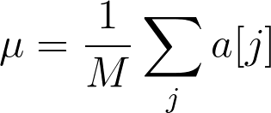
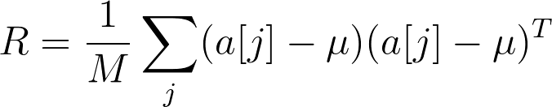

General Sound Classification
For each category of M feature vectors [a₁, a_{j}], compute the mean vector μ and covariance matrix R:
Given a query sound b, compare against each category:
Notes:
In the equation for R, this the outer product.
The category with the lowest D is the most similar category.

Slide 15
General Sound Classification
Each sound can be evaluated against each category, making complex queries possible.
Classify a query sound into the closest category.
Create and compare against categories of perceptual qualities.
Scratchy, shimmery, ominous sounds.
Find the 5 sounds which best fit into some category.
Can segment and identify longer sounds by checking for sudden large changes in features.
Notes:
Example for segmenting is a piece of music ending, and the audience starts to applaud.

Slide 16
Sound Source Separation
“Cocktail party problem”
Monaural signal processing approach.
Binaural (stereo) spatial approach.
Notes:
Analogous to image segmentation in vision.

Slide 17
Separation by Signal Processing
Modern methods rely on representing signals as linear combinations of basis vectors.
In sound separation, non-negative matrix factorization (NMF) has been particularly popular [Lee, Seung 1999].
Particularly nice because if our vectors are amplitudes. It doesn’t make physical sense to talk about negative amplitudes.
Notes:
IMPORTANT: Go over this on the board. People aren’t going to know what matrix factorizations and PCA are.
We are given m data vectors of length n. Usually m >> n. We want to determine the best basis for representation of these points to aid in analysis, recognition, etc. Give exampel of plane in 3d space?
Draw a nxm matrix V, explain that the rows are features and the columns are given examples.
V can be \approx factorized into nxo matrix W and oxm matrix H. The columns of W are the new basis vectors, and matrix H contains the mapping of each input vector to your new basis.
o is customizable based on time and space requirements.
There are a number of ways to go about this, PCA requires basis to be orthogonal, NMF requires that all input data be non-negative, but results in non-negative W and H.
NMF is useful for its sparsity (but don’t go into details there), but also useful when negative values just don’t make sense in the real world.
If all else fails, pull up the next slide.

Slide 18
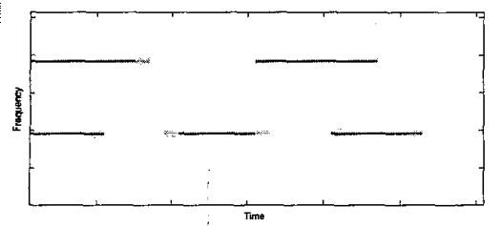
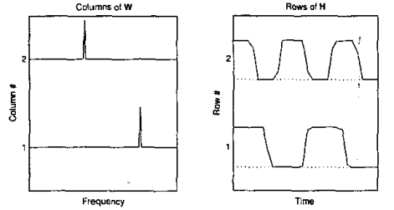
Transcription by Signal Processing
[Smaragdis, Brown 2003]
Notes:
The top is matrix V, the magnitude spectrogram for sound if we just have two sine waves turning on and off. Computed by doing a windowed DFT. Describe all of that.
The bottom two are depictions of W and H.
This is with o=2. If we tried o=3, we’d find that the third row of H had nearly no amplitude, and therefore only two signals here.
Already seeing separation ability!
Original paper used this technique for automatic transcription of a single instrument, with o = range of notes played.
Each note gets a basis vector in W, H describes when it’s played and at what amplitudes.

Slide 19
Modern Improvements
Added cost functions to the iterative non-negative matrix factorization process [Virtanen 2007].
“Reconstruction error term” to help low-energy (quiet) sources get separated.
“Temporal continuity criterion” to help separate sources with overlapping frequencies.
“Sparseness objective” aims to keep H sparse.
User interactivity; display spectrogram and allow the user to draw on it to tell the solver to prefer one source in particular for that frequency and time.
Notes:
NMF still used as the basis for many modern approaches, but there’s been improvements.
Previously, if there were both loud and quiet sounds, the quiet ones were less likely to get separated properly.
Draw magnitude spectrogram as a box with lines starting outside and going through to the other side, show two possible separations.
If you have sources with overlapping frequency ranges, we want to encourage NMF to see them as separate and not as one big one with a little bit of error added in reproducing the other.

Slide 20
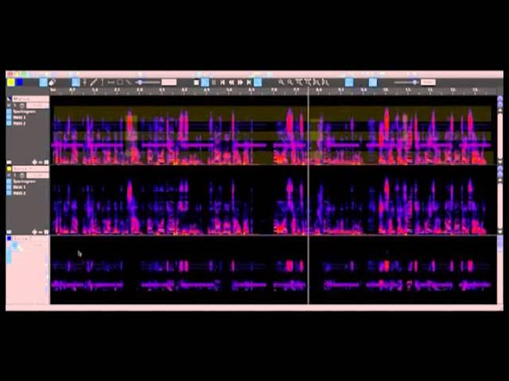
Notes:
Play video from ~1 min to ~4 min.

Slide 21
Separation Examples
ISSE: http://isse.sourceforge.net/
Video from last slide
ADX TRAX: http://www.audionamix.com/
Inception: http://vimeo.com/76916703

Slide 22
Separation by Binaural Localization
If we have binaural sound, we can take a more physically based approach.
Use interaural time differences (ITDs) and interaural level differences (ILDs) as cues for the azimuth of each source.
Can incorporate HRTFs for higher accuracy.

Slide 23
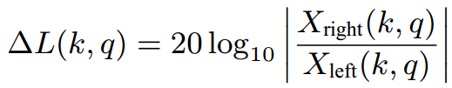


Binaural Sound Separation
Viste, Evangelista 2004, “Binaural Source Localization”
Perform a windowed DFT on each ear’s sound to get spectrograms X_{right} and X_{left}.
Notes:
I think this paper was the first to incorporate HRTF’s. There have been more advanced models in the 10 years since then, but this conveys the general idea.
May want to rewrite equations a little using “ITD”, “t”, “f”
delta L is the estimated ILD in dB at time k and frequency q.
delta P_p is the estimated phase difference between ears.
I believe arg means the angle between the given complex value and the positive real axis.
p indexes the locations where the phase difference is the same, with p=0 being the one closest to zero azimuth.
L is the width of the DFT window.

Slide 24
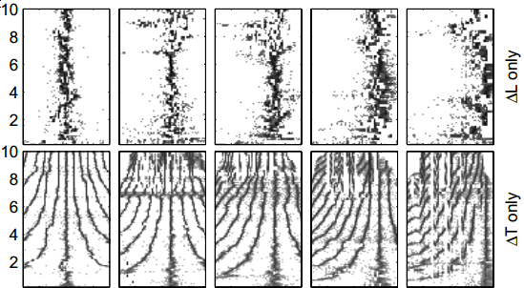
Estimating Azimuth
The ITD and ILD each query individually against the HRTF for an azimuth estimation.
Choose p to select the 𝚫Tp azimuth closest to the one provided by 𝚫L:
Notes:
In images, azimuth is the x axis, frequency is y axis, dots filled in on likely positions.
Azimuth estimation from delta L is inaccurate, azimuth estimation from delta T is ambiguous, combine them to get the best answer.

Slide 25
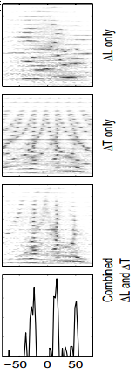
Localization and Separation
With multiple sources, look at a histogram of azimuth estimations.
Each high peak is likely its own source.
Separate by assigning each time/frequency to the closest source.
Notes:
Images are again azimuth estimations with frequency on the y axis.

Slide 26
Inverse-Foley Animation
Given the sound of a dropped object bouncing (possibly multiple times) off a flat surface and rigid-body properties of that object, produce a plausible motion path the object could have taken to produce that sound.
Notes:
“We know this object made this sound, here’s a path it could have taken to make it”

Slide 27
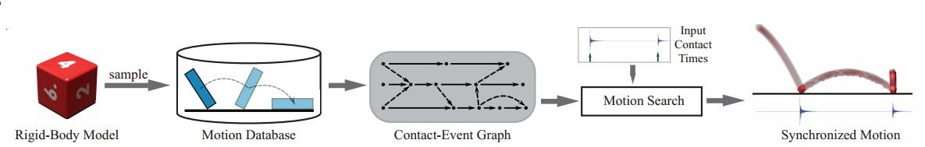
Inverse-Foley Animation
Sound is marked by hand with contact times.
Create database of contacts.
Randomly sample position, orientation, linear and angular velocities.
Place object in contact with ground, allow rigid-body simulator to resolve.
Integrate forwards to find more contacts.
Notes:
The random samples aren’t necessarily uniform. They only select downwards velocities, and weight it so more straight down ones are picked. They weight it to pick low angular velocities.
Integrate forward until rest. Also integrate backwards to determine the ballistic motion of the object before the collision.

Slide 28
Inverse-Foley Animation
Create Contact-Event Graph.
Each node is a contact; each edge is a possible transition (bounce).
Edges are weighted by plausibility.
Notes:
Motion isn’t actually a graph. At our scale, there’s never two ways that an object can bounce given the exact same circumstances.
However, we can’t sample the entire motion space, so we need to approximate. We’re only trying to make something that looks real, so close is fine.
If two contacts are similar, we can try to measure how different they are, and weigh the edges appropriately.

Slide 29
Edge Weights
Post-contact velocity
Orientation error
Time-warp synchronization
Target event sounds and contact forces
Spurious energy gains
Terminal nodes
Additional features (absolute position and orientation constraints) can be added by creating or modifying terms.
Notes:
Product of multiple terms, not sum. If one aspect of it is really implausible, the whole thing is bad.
Maybe draw on board. The difference between out and in velocities should be in a certain range. Too far out from there and it gets bad.
If the object needs to rotate during the contact (orientations are different), there’s a cost.
If the time spent flying is too long or too short to match the sounds, they can speed it up or slow it down up to about 30%.
We also want the collisions to be ones which could create the sounds. This term is largely found by comparing force amplitudes.
We want the object to lose energy over time. Spurious energy gains term adds a high cost to any transition which adds net energy.
Terminal nodes means we don’t want to go to a sink node (rest state) if there’s still more sound contacts to match, and we don’t want to go to an intermediate (non-rest) node if there’s no more sound contacts.
Given these, search graph for best solution! Paper goes into details about techniques and optimizations, but not needed here.

Slide 30
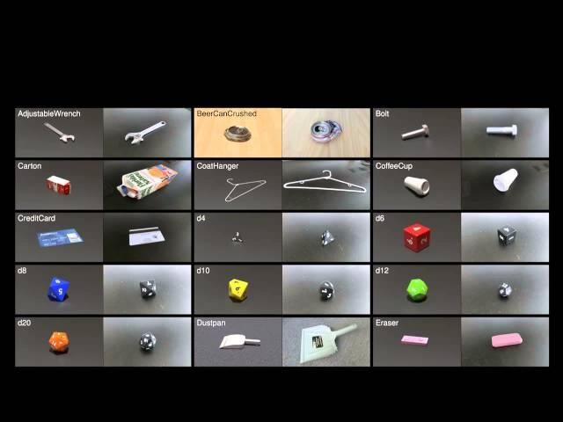
Notes:
Play from 1:20 to 4:15

Slide 31
Summary
Sound Classification
Ambient sounds
General sounds
Sound Source Separation
Monaural separation by signal processing
Binaural separation by azimuth determination
Synchronizing rigid-body motion to sound
Notes:
Again, all different ways of answering the question of what made some input sound.

Slide 32
References
Christian Greuel ; Mark T. Bolas ; Niko Bolas and Ian E. McDowall. "Sculpting 3D worlds with music: advanced texturing techniques", Proc. SPIE2653, Stereoscopic Displays and Virtual Reality Systems III, 306 (April 10, 1996); doi:10.1117/12.237453; http://dx.doi.org/10.1117/12.237453
Marc Cardle, Loic Barthe, Stephen Brooks, Peter Robinson. “Music-Driven Motion Editing: Local Motion Transformations Guided By Music”, In Proceedings of Eurographics UK, 2002
Michael Büchler, Silvia Allegro, Stefan Launer, and Norbert Dillier. 2005. Sound classification in hearing aids inspired by auditory scene analysis. EURASIP J. Appl. Signal Process. 2005 (January 2005), 2991-3002. DOI=10.1155/ASP.2005.2991 http://dx.doi.org/10.1155/ASP.2005.2991
Wold, E.; Blum, T.; Keislar, D.; Wheaten, J., "Content-based classification, search, and retrieval of audio," MultiMedia, IEEE , vol.3, no.3, pp.27,36, Fall 1996, doi: 10.1109/93.556537
Lee, Daniel D.; Seung, H. Sebastian, “Learning the parts of objects by non-negative matrix factorization,” Nature, vol. 401, October 1999, http://dx.doi.org/10.1038/44565
Smaragdis, P.; Brown, J.C., "Non-negative matrix factorization for polyphonic music transcription," Applications of Signal Processing to Audio and Acoustics, 2003 IEEE Workshop on. , vol., no., pp.177,180, 19-22 Oct. 2003, doi: 10.1109/ASPAA.2003.1285860
All images are from these referenced papers or Ming Lin’s lecture slides.
Virtanen, T., "Monaural Sound Source Separation by Nonnegative Matrix Factorization With Temporal Continuity and Sparseness Criteria," Audio, Speech, and Language Processing, IEEE Transactions on , vol.15, no.3, pp.1066,1074, March 2007, doi: 10.1109/TASL.2006.885253
Viste, Harald; Evangelista, Gianpaolo. “Binaural Source Localization”. Proc. 7th International Conference on Digital Audio Effects (DAFx-04), invited paper, p. 145-150. 2004
Timothy R. Langlois and Doug L. James. Inverse-Foley Animation: Synchronizing rigid-body motions to sound, ACM Transactions on Graphics (SIGGRAPH 2014). 33(4), August, 2014.

Slide 33
Thank you!

Slide 34
MIDI Files
A large and powerful communication protocol designed with music in mind.
MIDI controllers send note information to a connected computer or output device.
Music is stored as a series of events.
Notes:
If you’ve ever played with an electronic keyboard with instruments like “Orchestra hit”, “Seashore”, and “Gunshot”, and has a “percussion” instrument with one object on each key, it’s probably following the General MIDI 1 standard.
MIDI events like turning a note on or off, choosing an instrument, adding lyrics, show control.

Slide 35
MIDI Parsing
Given a MIDI file, we can easily extract events.
Can we use the events to affect a physical system?
We could visually reproduce a keyboard with keys being pressed, but that’s not very interesting.

Slide 36
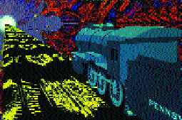
Reinterpreting MIDI Events
Greuel et al. 1996, “Sculpting 3D worlds with music: advanced texturing techniques”.
Each MIDI “note” is a visual transformation to an object.
Movement
Animation
Color
Notes:
I wish I could show a video of what this looked like, but all I could find were a few stills.

Slide 37
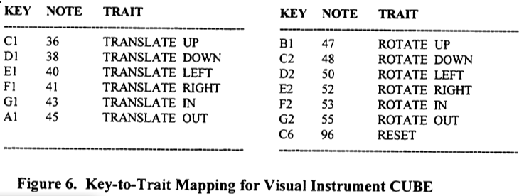
Reinterpreting MIDI Events
More of a music visualizer or music video than determining model parameters.
Notes:
Instead of instruments, notes play on objects like the CUBE.

Slide 38
Motion Path Editing
Animators often need to synchronize motion with audio beats and events.
Cardle et al. 2002, “Music-Driven Motion Editing: Local Motion Transformations Guided By Music”
Takes as input both a MIDI and corresponding audio signal and extracts features from both.
Chords, repeated patterns, beat and tempo, note density, etc

Slide 39
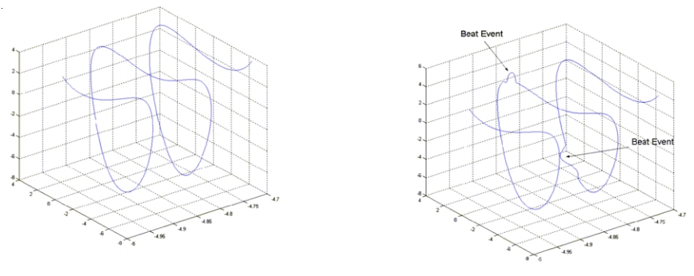
Motion Path Editing
For example, an animator could specify a short perturbation to be blended in with each beat event.
Notes:
The only other example they game was adding some Perlin noise to alternating stretches of the motion path depending on the beat.

Slide 40
Using a Genetic Algorithm to Reduce Number of Features
Not sure if I should talk about this (leaning towards no), leaving this slide incomplete for now. It does tie in well with the previous paper, though.
http://ieeexplore.ieee.org/xpls/abs_all.jsp?arnumber=4317557

