Slide 1
Quadcopter Kineodynamics and motion planning
Niti Madhugiri

Slide 2
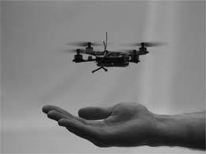
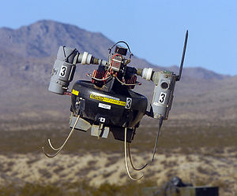
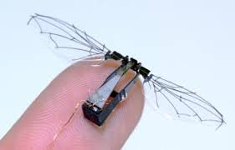
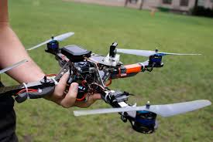
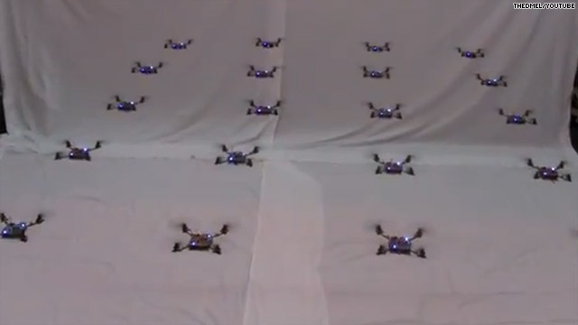
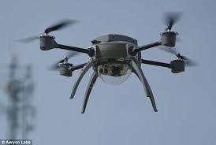
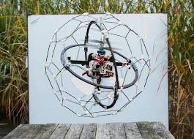
Autonomous Micro-Aerial Vehicles: the advent of drones …

Slide 3
Characteristics of MAVs
2 types : wings, rotors
small size, light weight (<5kg)
low altitude
more degrees of freedom (full ~6DOF used)
more randomness in trajectories than pre-planned
small flight duration (<5hrs)

Slide 4
Possible uses
search operations in danger prone regions
spying
target tracking
surveillance and monitoring
security
visualization and analysis of inaccessible environments
science experiments

Slide 5
Quadcopter Kineodynamics
Quadrotor state variables:
Inertial position
Velocities in body frame
Orientation
Angular velocities

Slide 6
Quadcopter kinematics
Rotation matrix
Transformation from inertial frame
to body frame

Slide 7
Quadcopter dynamics
Newton’s laws in inertial frames
Velocity as a combination of linear
and angular component
Moment of Inertia

Slide 8
Quadcopter kineodynamics

Slide 9
Forces and moments
Thrust
Drag
Gravity

Slide 10
Quadcopter kineodynamic equations

Slide 11
State of the art and future plans for MAVs
US Air force plans for MAVs
Flying bots at Upenn

Slide 12
Engineering challenges
kinematic and dynamic constraints
load constraints
stability constraints, fragile nature
real-time system design challenges
power source and flight duration/range
navigation challenges at low altitudes and random trajectories

Slide 13
Autonomous navigation
Sense and avoid obstacles : static and dynamic obstacles
Preplanned trajectories may not work
GPS useless indoors and at small resolutions
Aircraft needs to “see” and “plan” in real-time
Sensing the surroundings: cameras, depth cameras, SONAR etc

Slide 14
Path planning for MAVs
6 degrees of freedom : 3D path planning
Kineodynamic constraints to be considered while path planning
Safety zone considerations to be accounted
Account for fragile nature of MAVs: environment tolerance
Manage sensor noise, uncertainties, and delays → still make it real-time

Slide 15
Extending the local path planning to 3D
3D RVO
S-airplane model

Slide 16
Navigating multiple Simple Airplanes in 3D workspace
Goal: Collision free navigation of multiple flying bots in 3D workspace amongst dynamic obstacles
Simple car : 2d, varying speed, max steering angle
Simple airplane: 3d, extend the simple car model to varying altitude, without the reverse gear

Slide 17
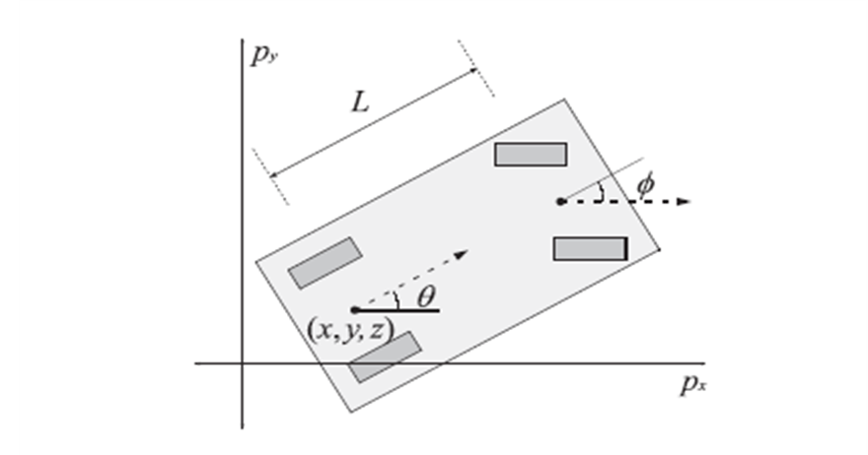
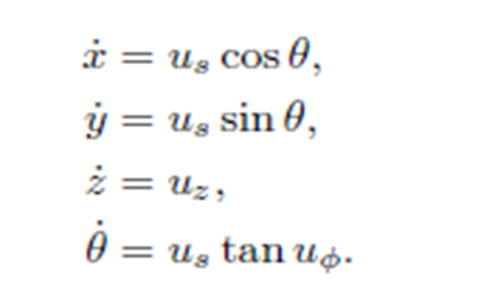
Kinematic constraints for s-airplane
4D configuration space: {x,y,z,θ}
Constraints on U and Φ (min,max)

Slide 18
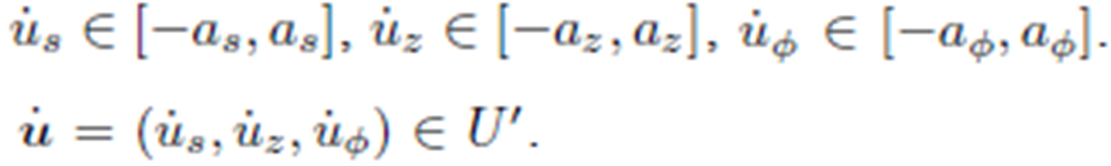
Dynamic constraints for s-airplane
V’ - accelerations permitted by U’
Reduced constraints and pre-computed trajectories
Reciprocity factor and preferred velocity

Slide 19
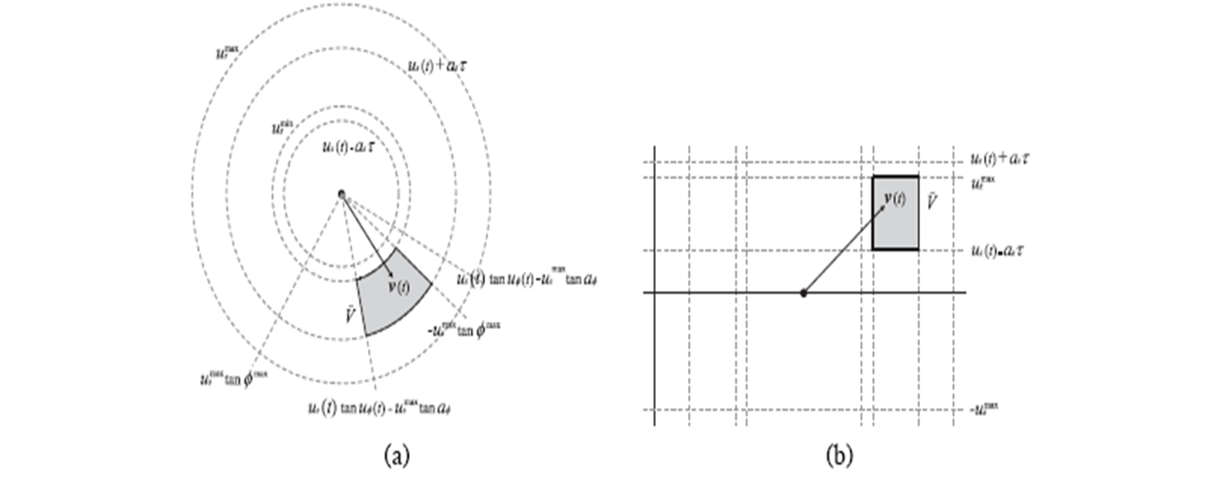
Reduced constraints
Window of time: τ to t+τ

Slide 20
Pre-computed trajectories
Each curve in the pre-computed trajectories corresponds to the path taken when s-airplane performs action u for time τ
The set is populated by uniform sampling the range of valid values
Change in velocity calculated for each curve
Pre-computed 105 curves

Slide 21
Reciprocity factor
Variable reciprocity: Higher responsibility for collision avoidance to a s-airplane having fewer constraints in choosing a velocity
Reciprocity factor α ϵ [0,1]

Slide 22
Local collision avoidance
Velocity Obstacles (VO)
ORCA (Optimal Reciprocal Collision Avoidance) extended to 3D

Slide 23
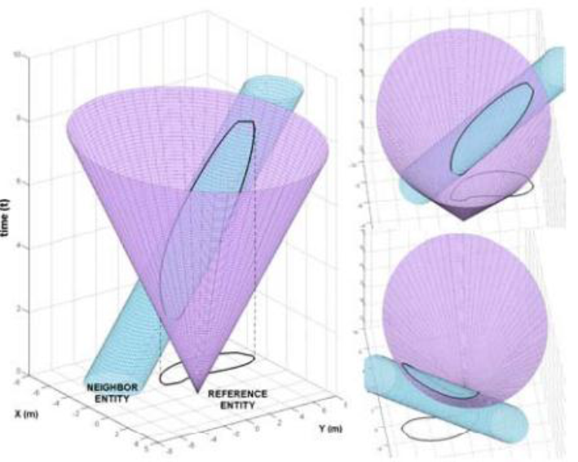
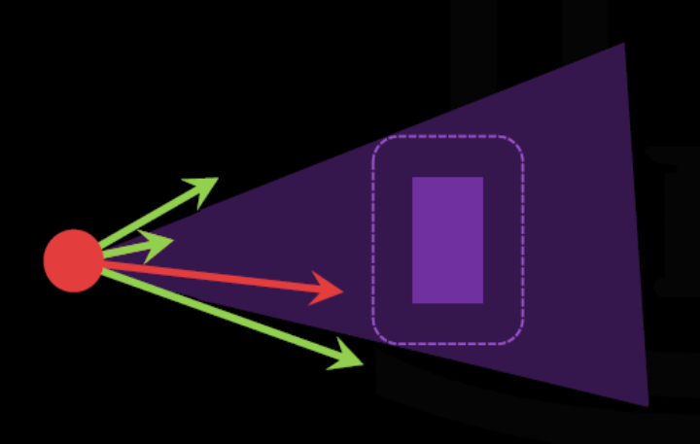
Velocity space , Velocity Obstacles
Velocity space: Defined by possible velocities
Velocity obstacles: set of velocities leading to an inevitable collision

Slide 24
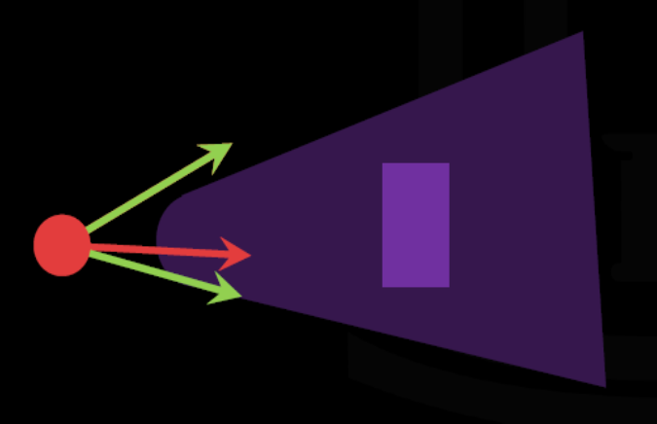
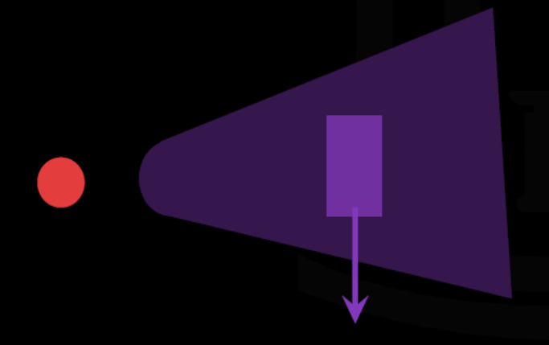
Velocity obstacles
Navigate by selecting best velocity outside obstacle
Velocity obstacle for moving objects is translated by that objects velocity

Slide 25
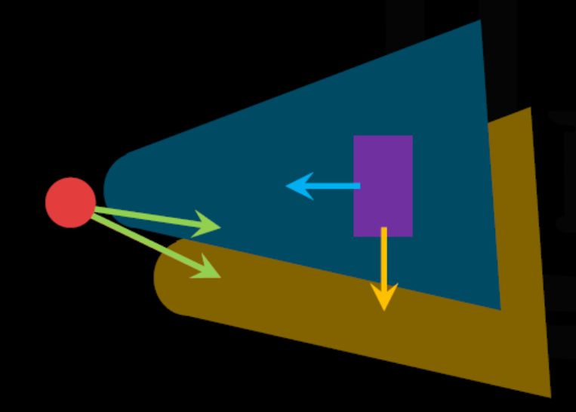
Predicting responsive obstacles
Reciprocal Velocity Obstacles (RVO): Assume that each agent is responsive and will take an equal share in avoiding collision

Slide 26
RVO
Assumes that it accurately predicts the other agent’s future velocity
If the other agent has constraints preventing it from taking the expected velocity, this assumption is broken
Solution: ORCA

Slide 27
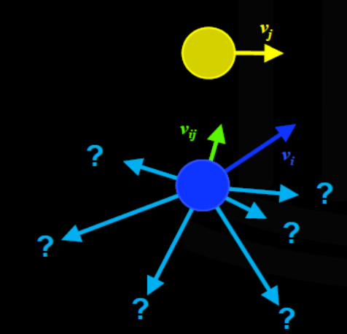
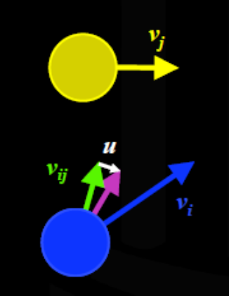
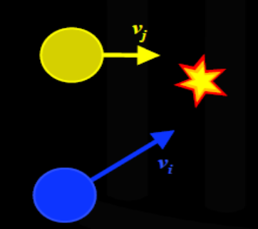
Optimal Reciprocal Collision Avoidance
Identify a collision given relative velocity and position
Find alternate collision free velocities
Choose the velocity that requires smallest change to the current

Slide 28
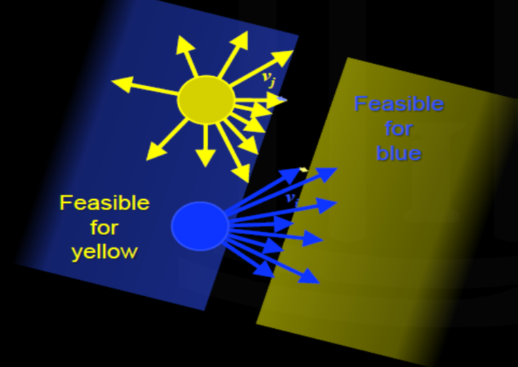
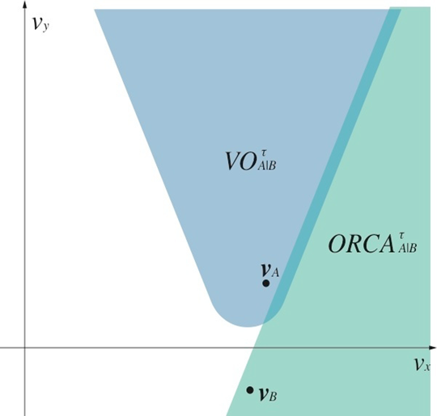
ORCA
Share the displacement equally between 2 agents
The change in velocity is enforced by a half-plane constraint

Slide 29
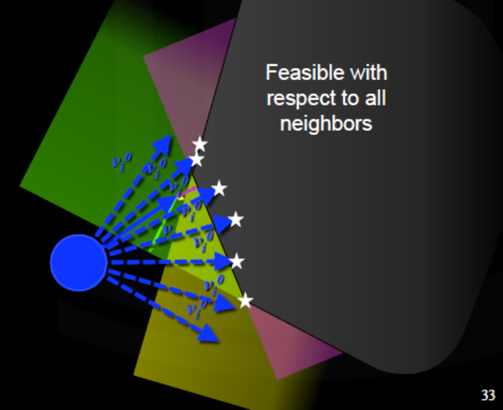
ORCA
Multiple neighbors form multiple simultaneous constraints
Choose the nearest feasible velocity

Slide 30
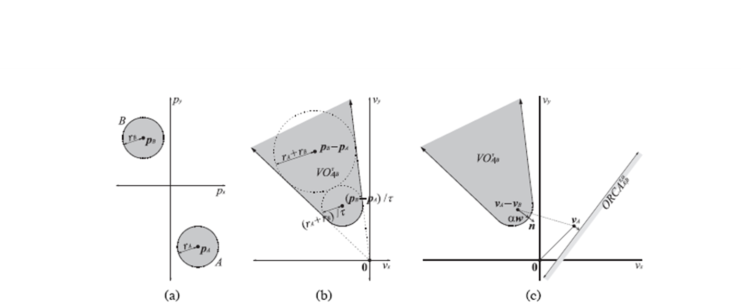

ORCA
Smooth trajectories, avoiding oscillations
Variable reciprocity:

Slide 31
ORCA video
2D ORCA

Slide 32
Overview
Compute curves
Sense position, velocity, orientation
Calculate VO
Calculate V’
Calculate reciprocity factor
Calculate ORCA
Calculate preferred velocity
Select v in V’
Curve with highest ranked v

Slide 33
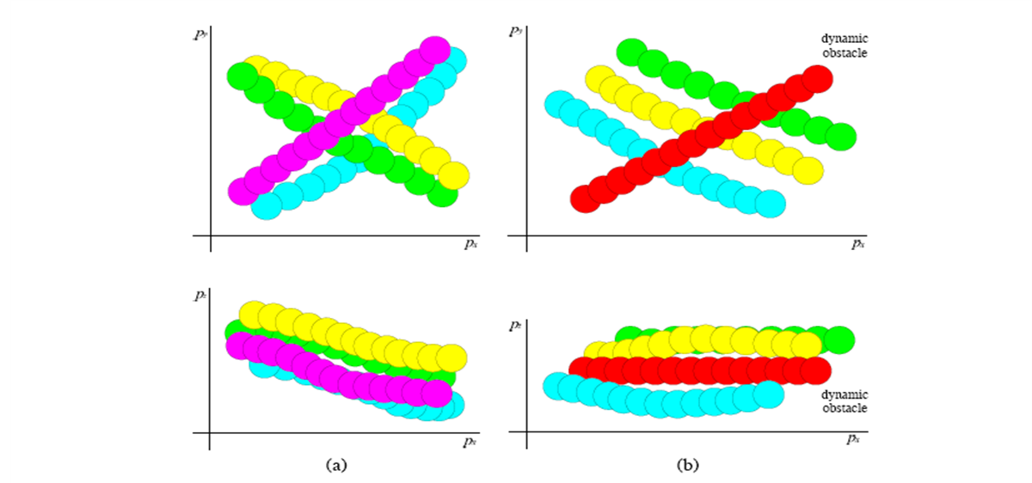
Results
Scenario:
Sphere and Dynamic obstacles

Slide 34
Limitations and future scope
Ignores roll and pitch
Sufficient for simulation but need to consider factors like environment, drag, etc. in real world
Assumption about perfect sensing
Static obstacles and global planner need to be added

Slide 35
Recent updates
Dealing with sensor noise, uncertainties for real physical quadcopter motion planning
Extended Kalman filters
LQG obstacles

Slide 36
Thank you !!!

