Slide 1
Rigid Body Dynamics

Slide 2
Disclaimer
The content and structure of this lecture borrows heavily from the course notes at http://www.pixar.com/companyinfo/research/pbm2001/pdf/notesg.pdf
Refer to course notes for derivations and implementation specifics

Slide 3
Approaches
Constraint-based Dynamics
Impulse-based Dynamics
Penalty-based Dynamics
Position-based Dynamics
Etc.

Slide 4
Approaches
Constraint-based Dynamics
Impulse-based Dynamics
Penalty-based Dynamics
Position-based Dynamics
Etc.

Slide 5
Unconstrained
No collision detection
Only consider motion of bodies under external forces
Constrained
Bodies are solid
Prevent interpenetration
Collision detection & contact forces

Slide 6
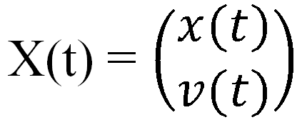
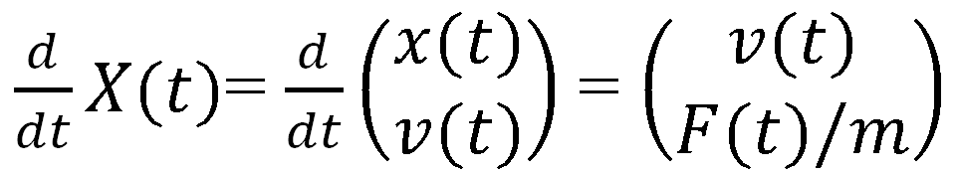
Recall: Particle motion
Position x(t), linear velocity v(t)
Linear acceleration a(t), mass m, net force F(t) = ma(t)
State vector:

Slide 7
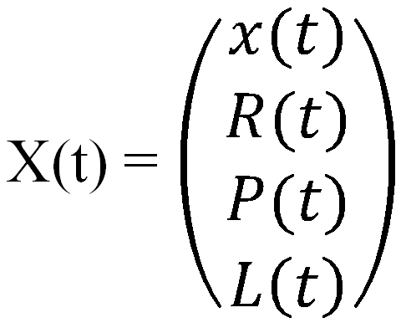
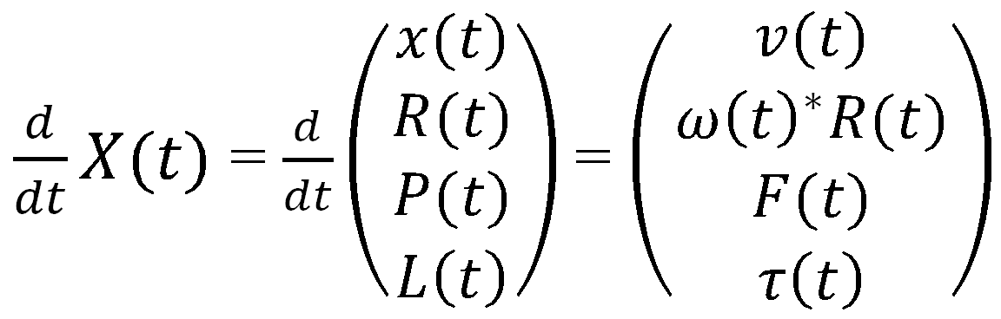
Particle → Rigid body
State vector:

Slide 8
Rigid body definitions
x(t) = translation vector
R = 3 × 3 rotation matrix
Body space
  Fixed definition of body
  Origin is center of mass (COM)
World space location p(t) of point p₀:
  p(t) = Rp₀ + x(t)
COM in world space is x(t)

Slide 9
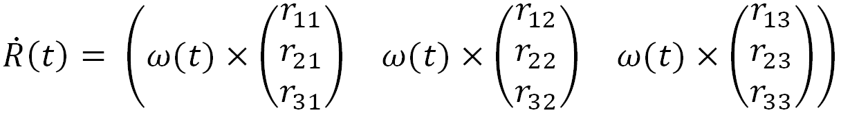
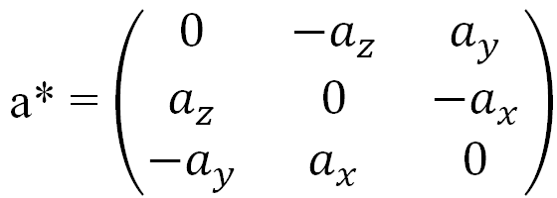
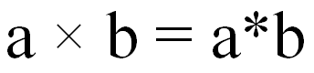
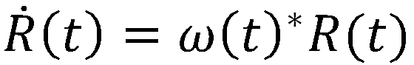
Angular velocity
Spin vector ω(t)
  Direction: axis of rotation
  Magnitude: |ω(t)| = speed of rotation (rev/time)
Columns of R transform x,y,z-axes in body space
Let r_{ij} = element of R at row i, column j. So change in R:
For 3-vector a, define →
So

Slide 10
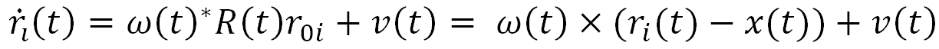
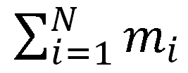
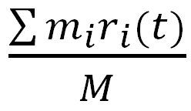
Discretize body into particles
Particles 1 to N
r_{0i} = position of particle i in body space
Position of particle i at time t:
  r_{i}(t) = R(t)r_{0i} + x(t)
Velocity of particle i at time t:
m_{i} = mass of particle i
Total mass M =
COM in world space:

Slide 11
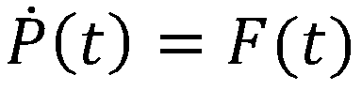
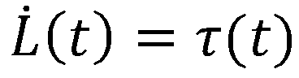
Force, torque & momentum
Total external forces acting on particle i: F_{i}(t)
Sum of forces acting on all particles: F(t)
Torque on particle i: τ_{i}(t) = (r_{i}(t) – x(t)) × F_{i}(t)
Linear velocity: v(t)
Linear momentum: P(t) = Mv(t)
Change in linear momentum:
Angular momentum L(t)
  Define inertia tensor I(t)
  L(t) = I(t)ω(t)
  Change in angular momentum:

Slide 12
Complete rigid body model
State vector:

Slide 13
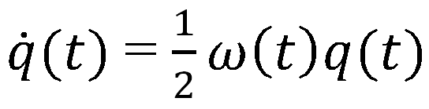
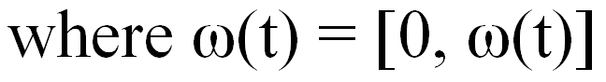
Quaternions
4-element unit vector describing rotation
Avoid degeneracies in R
s + v_{x}i + v_{y}j + v_{z}k = [s, v]
[s₁, v₁][s₂, v₂] = [s₁s₂ – v₁ • v₂, s₁v₂ + s₂v₁ + v₁ × v₂]
  Rotates by [s₂, v₂], then by [s₁, v₁]
Rotation by θ radians about unit axis u:
  [cos(θ/2), sin(θ/2) u]

Slide 14
Rigid collisions/contacts
No deformation – instantaneous forces
2 types:
  Colliding contact
    Immediate change in velocity
    Velocity no longer continuous
  Resting contact
    Zero velocities
    Prevent interpenetration with contact forces

Slide 15
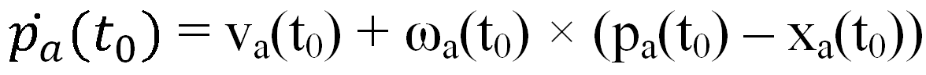
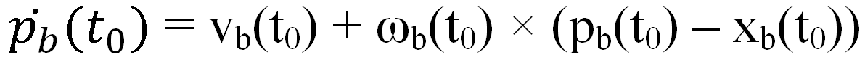
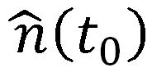
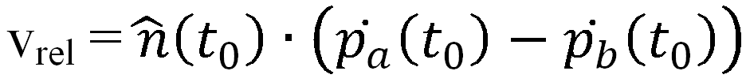
Colliding contact
Vertex/face, edge/edge (not collinear)
Assume vertex on A colliding with face on B at point p
Point on A at time t₀: p_{a}(t₀) = p
Velocity of point on A:
Velocity of point on B:
Unit vector normal to surface of collision:
Relative velocity of points:

Slide 16
Impulses
Impulse vector J
  Apply a force F over a small time step ∆t
  J = F∆t as F → ∞, ∆t → 0
  Change in linear momentum: ∆P = J
  Change in linear velocity (net mass M): ∆v = J/M
Impulse torque on point p: τ_{impulse} = (p – x(t)) × J = ∆L
  (∆L = change in angular momentum)
Apply impulse at point of collision
Assuming bodies are frictionless, direction =
J = j for some (very, very messy) scalar j

Slide 17
Approaches
Constraint-based Dynamics
Impulse-based Dynamics
Penalty-based Dynamics
Position-based Dynamics
Etc.

Slide 18
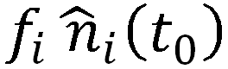
Resting contact
Most difficult problem
n contact points, each with v_{rel} < ϵ (some tolerance ϵ)
Each point experiences normal force
  Unknown scalar f_{i}
Forces influence each other – must be computed simultaneously

Slide 19
Resting contact (Constraint-based)
3 rules for forces:
  Prevent interpenetration
  Repulsive
  Go to zero as bodies separate
Requirements
  Distance function between points / edges ≥ 0
  f_{i}’s ≥ 0
  Product of point acceleration and force = 0
Result: acceleration of collision point =
linear combination of forces plus a constant
Solve n-by-n matrix with quadratic programming (QP)

