Slide 1

CMSC 417: Computer Networks
Spring 2026
Topic: DHCP, NAT, ARP, ICMP, VPN, IPv6
(Textbook chapter 3)
Nirupam Roy
M-W 2:00-3:15pm
CSI 2117
March 9th, 2026

Slide 2
DHCP: more than IP addresses
DHCP can return more than just allocated IP address on subnet:
address of first-hop router for client
name and IP address of DNS sever
network mask (indicating network versus host portion of address)

Slide 3
Dynamic Host Configuration Protocol (DHCP)
DHCP server is responsible for providing configuration information to hosts
DHCP server maintains a pool of available addresses
There is at least one DHCP server for an administrative domain (a server or a relay agent per subnet)

Slide 4
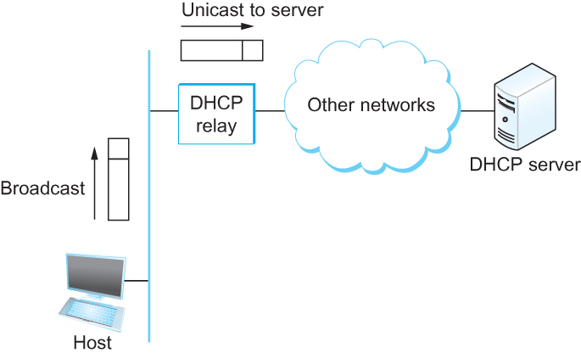
DHCP relay
Newly booted or attached host sends DHCPDISCOVER message to a special IP address (255.255.255.255)
DHCP relay agent unicasts the message to DHCP server and waits for the response

Slide 5
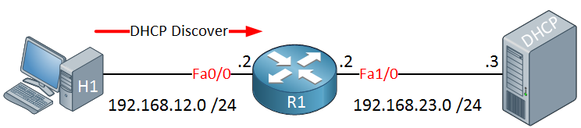




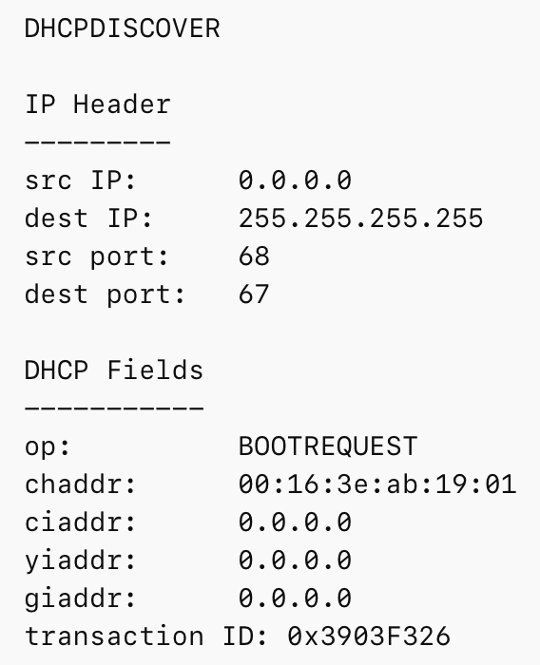
DHCP protocol steps with the “Relay agent”
Step: 1

Slide 6
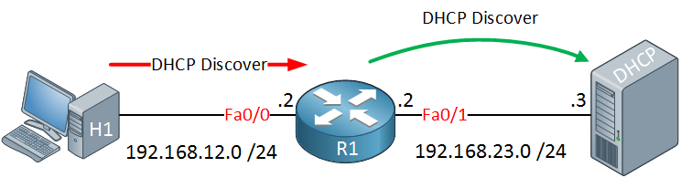
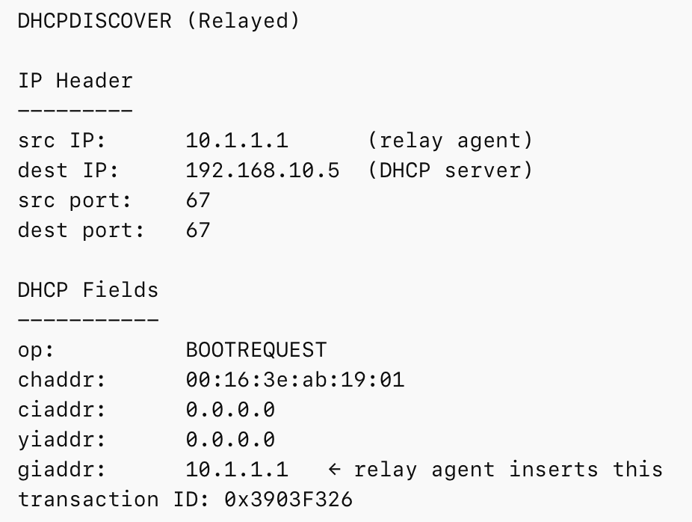
DHCP protocol steps with the “Relay agent”
Step: 2

Slide 7
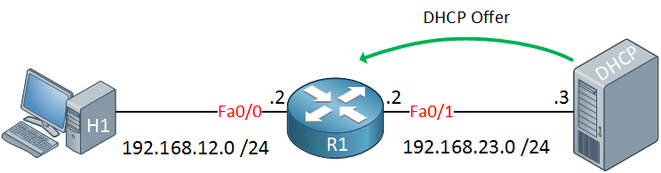
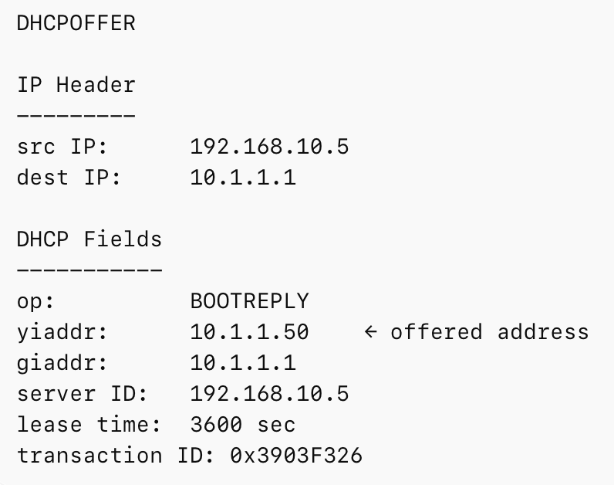
DHCP protocol steps with the “Relay agent”
Step: 3

Slide 8
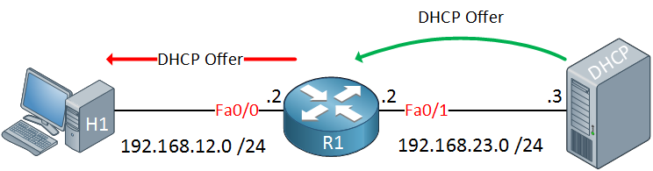
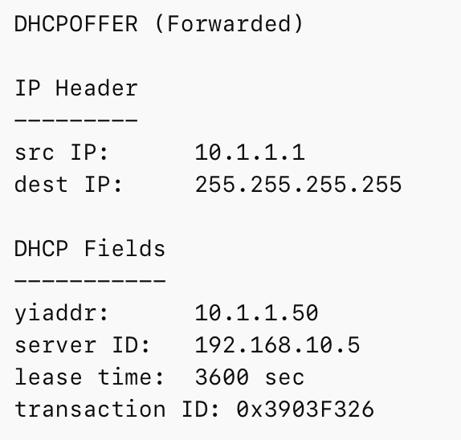
DHCP protocol steps with the “Relay agent”
Step: 4

Slide 9

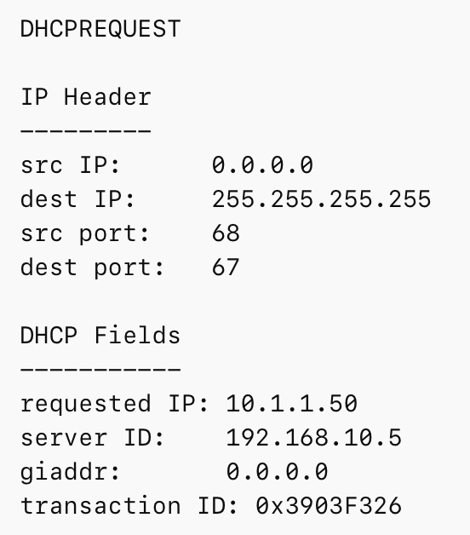
DHCP protocol steps with the “Relay agent”
Step: 5

Slide 10
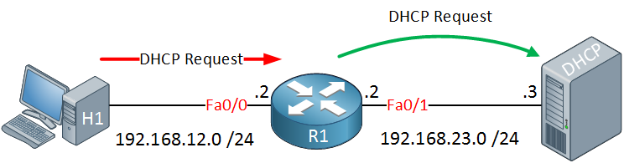
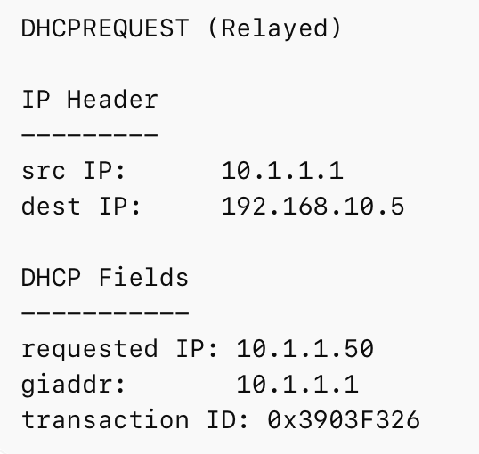
DHCP protocol steps with the “Relay agent”
Step: 6

Slide 11
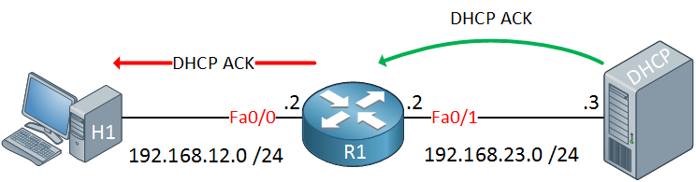
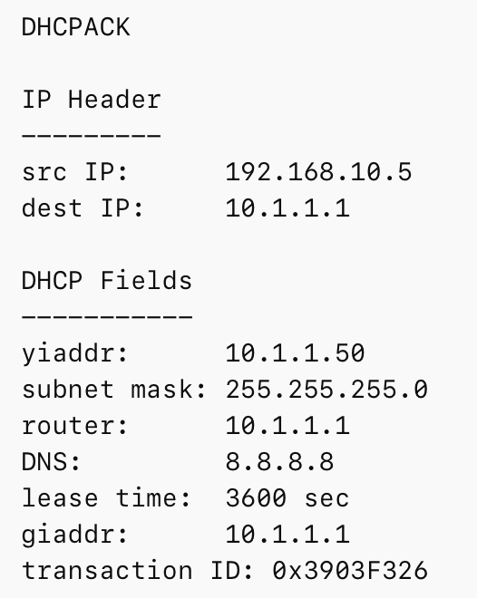
DHCP protocol steps with the “Relay agent”
Step: 7 & 8
Relay then forwards it to the client.

Slide 12
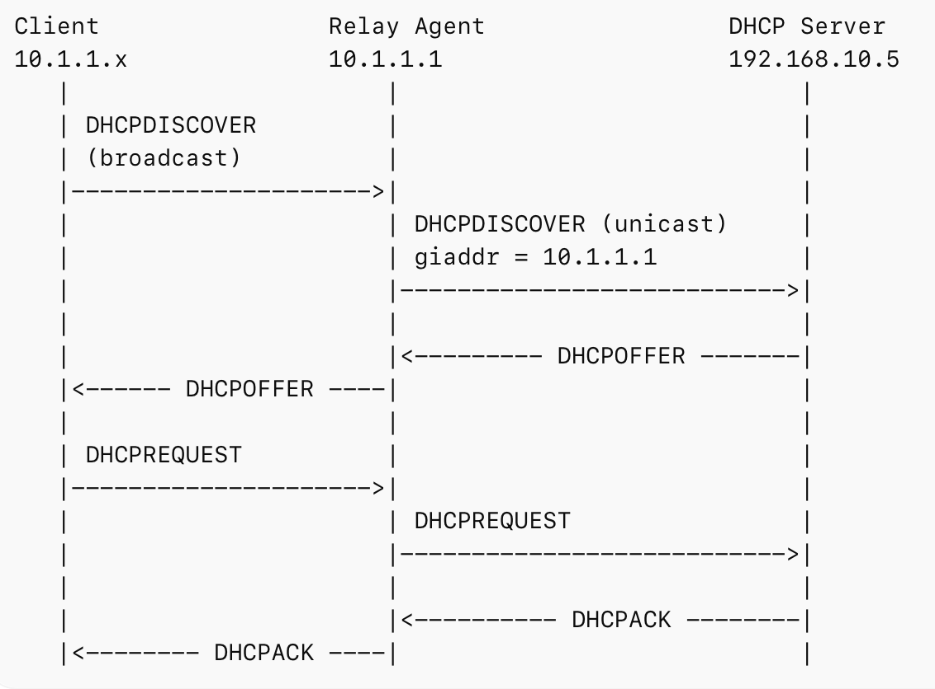

Slide 13
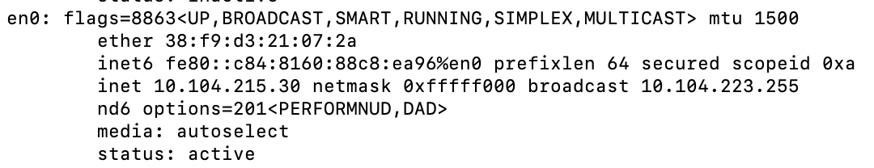
Check your IP addresses
ifconfig (linux/mac) / ipconfig (windows)

Slide 14
Check your IP addresses
(ifconfig/ipconfig)

Slide 15
Private Address Space & NAT

Slide 16
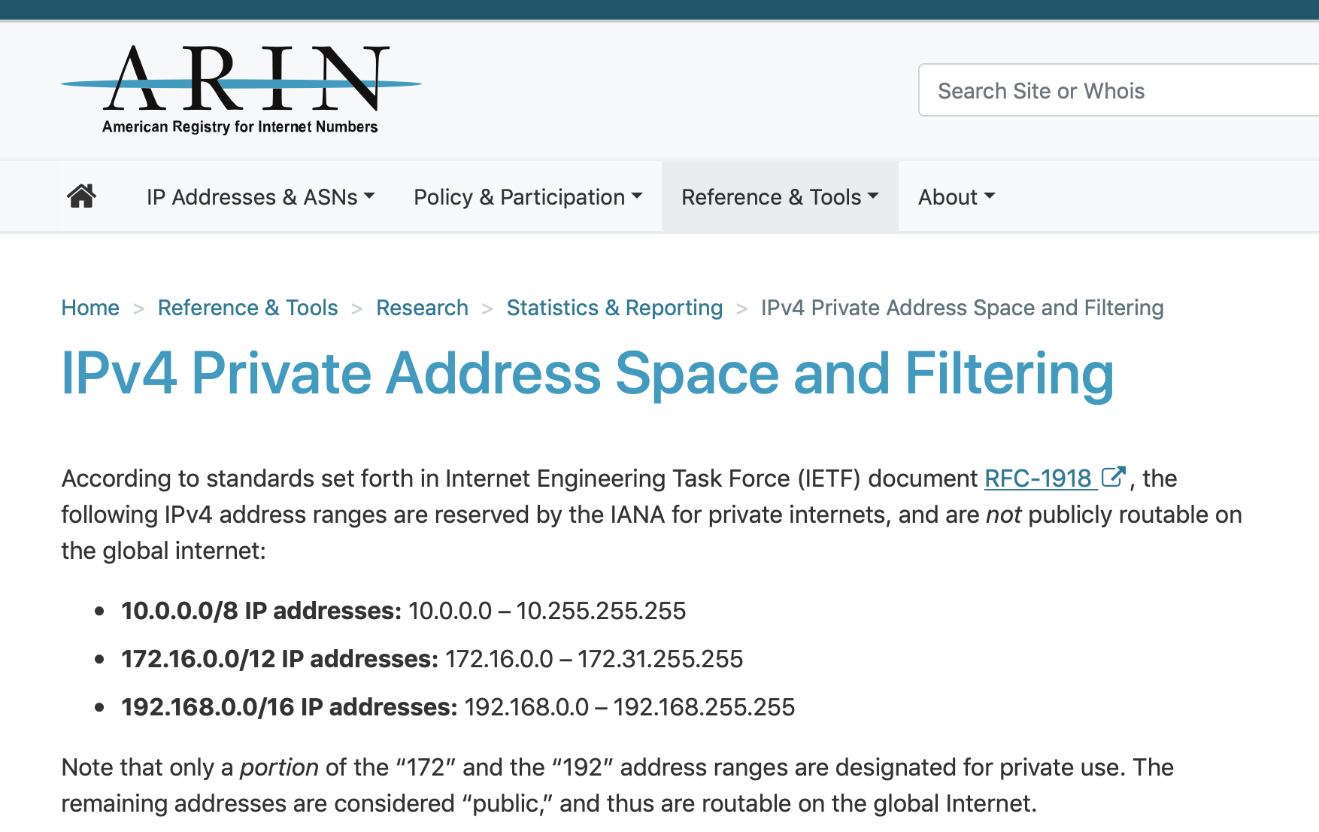

Slide 17

NAT: network address translation
rest of
Internet
local network
(e.g., home network)
10.0.0.0/24
10.0.0.1
10.0.0.4
10.0.0.2
138.76.29.7
10.0.0.3
all datagrams leaving local
network have same single source NAT IP address: 138.76.29.7,different source port numbers
datagrams with source or
destination in this network
have 10.0.0.0/24 address for
source, destination (as usual)

Slide 18

What is a Port number?
Computer 1
Computer 2
211
716
456
Process - 1
Process - 1
1001
263
2039
Process - 2
Process - 2
IP addr-1
IP addr-2
Process - n
Process - n
16-bit integers
called ‘port numbers’
Notes:
An internet port number can be as large as 65,535. This is because port numbers are 16-bit integers, meaning they can represent values from 0 to 65,535.
Key points about port numbers:
Range:
0 - 65,535
Well-known ports:
Ports from 0 to 1023 are considered "well-known" and are assigned to commonly used services like HTTP (port 80).
Registered ports:
Ports from 1024 to 49151 are registered ports that can be used by applications to identify specific services.
Dynamic ports:
Ports from 49152 to 65,535 are considered "dynamic" or "ephemeral" and are used for temporary connections by applications.

Slide 19
NAT: network address translation
NAT translation table
WAN side addr LAN side addr
2: NAT router
changes datagram
source addr from
10.0.0.1, 3345 to
138.76.29.7, 5001,
updates table
1: host 10.0.0.1
sends datagram to
128.119.40.186, 80
138.76.29.7, 5001 10.0.0.1, 3345
…… ……
S: 10.0.0.1, 3345
D: 128.119.40.186, 80
10.0.0.1
1
2
S: 138.76.29.7, 5001
D: 128.119.40.186, 80
10.0.0.4
10.0.0.2
138.76.29.7
S: 128.119.40.186, 80
D: 10.0.0.1, 3345
4
S: 128.119.40.186, 80
D: 138.76.29.7, 5001
3
10.0.0.3
4: NAT router
changes datagram
dest addr from
138.76.29.7, 5001 to 10.0.0.1, 3345
3: reply arrives
dest. address:
138.76.29.7, 5001

Slide 20
NAT: network address translation
motivation: local network uses just one IP address as far as outside world is concerned:
range of addresses not needed from ISP: just one IP address for all devices
can change addresses of devices in local network without notifying outside world
can change ISP without changing addresses of devices in local network
devices inside local net not explicitly addressable, visible by outside world (a security plus)

Slide 21
NAT: network address translation
implementation: NAT router must:
outgoing datagrams: replace (source IP address, port #) of every outgoing datagram to (NAT IP address, new port #)
. . . remote clients/servers will respond using (NAT IP address, new port #) as destination addr
remember (in NAT translation table) every (source IP address, port #) to (NAT IP address, new port #) translation pair
incoming datagrams: replace (NAT IP address, new port #) in dest fields of every incoming datagram with corresponding (source IP address, port #) stored in NAT table

Slide 22
NAT: network address translation
implementation: NAT router must:
outgoing datagrams: replace (source IP address, port #) of every outgoing datagram to (NAT IP address, new port #)
. . . remote clients/servers will respond using (NAT IP address, new port #) as destination addr
remember (in NAT translation table) every (source IP address, port #) to (NAT IP address, new port #) translation pair
incoming datagrams: replace (NAT IP address, new port #) in dest fields of every incoming datagram with corresponding (source IP address, port #) stored in NAT table

Slide 23
NAT: network address translation
16-bit port-number field:
Over 60,000 simultaneous connections with a single LAN-side address!
NAT challenges:
violates end-to-end argument
NAT possibility must be taken into account by app designers, e.g., P2P applications
NAT traversal: what if client wants to connect to server behind NAT?

Slide 24
Network-specific address (IP address) vs LAN-specific address (HW address)

Slide 25


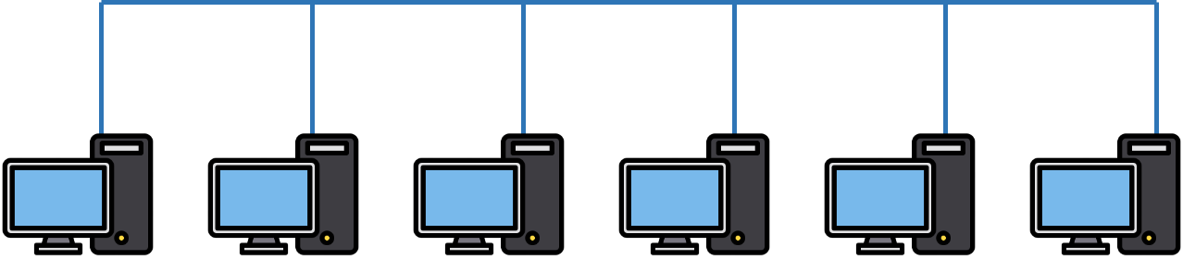

Two perspectives of addresses:
(1)Network-to-network & (2)machine-to-machine
Destination
Router
Source

Slide 26
application
transport
network
link
physical
Router
Source

Slide 27
network
link
physical
application
transport
network
link
physical
Router
Source

Slide 28
network
link
physical
Router
Hierarchical address for addressing networks
(IP address)

Slide 29
network
link
physical
application
transport
network
link
physical
Router
Source

Slide 30
Flat address for addressing machines at the link-layer
(MAC address)
network
link
physical
application
transport
network
link
physical
Router
Source

Slide 31
Address Resolution Protocol (ARP)

Slide 32
MAC addresses and ARP
32-bit IP address:
network-layer address for interface
used for layer 3 (network layer) forwarding
MAC (or LAN or physical or Ethernet) address:
function: used “locally” to get frame from one interface to another physically-connected interface (same network, in IP-addressing sense)
48 bit MAC address (for most LANs) burned in NIC ROM, also sometimes software settable
e.g.: 1A-2F-BB-76-09-AD
hexadecimal (base 16) notation
(each “numeral” represents 4 bits)

Slide 33
MAC addresses and ARP
each adapter on LAN has unique LAN addr. or MAC addr.
1A-2F-BB-76-09-AD
LAN
(wired or
wireless)
adapter
71-65-F7-2B-08-53
58-23-D7-FA-20-B0
0C-C4-11-6F-E3-98

Slide 34
MAC addresses (more)
MAC address allocation administered by IEEE
manufacturer buys portion of MAC address space (to assure uniqueness)
analogy:
MAC address: like Social Security Number
IP address: like postal address
MAC flat address ➜ portability
can move LAN card from one LAN to another
IP hierarchical address not portable
address depends on IP subnet to which node is attached

Slide 35


ARP: address resolution protocol
Question: how to determine
interface’s MAC address, knowing its IP address?
ARP table: each IP node (host, router) on LAN has table
IP/MAC address mappings for some LAN nodes:
< IP address; MAC address; TTL>
TTL (Time To Live): time after which address mapping will be forgotten (typically 20 min)
137.196.7.78
1A-2F-BB-76-09-AD
137.196.7.23
137.196.7.14
LAN
71-65-F7-2B-08-53
58-23-D7-FA-20-B0
0C-C4-11-6F-E3-98
137.196.7.88

Slide 36
ARP protocol: same LAN
A wants to send datagram to B
B’s MAC address not in A’s ARP table.
A broadcasts ARP query packet, containing B's IP address
destination MAC address = FF-FF-FF-FF-FF-FF
all nodes on LAN receive ARP query
B receives ARP packet, replies to A with its (B's) MAC address
frame sent to A’s MAC address (unicast)
A caches (saves) IP-to-MAC address pair in its ARP table until information becomes old (times out)
soft state: information that times out (goes away) unless refreshed
ARP is “plug-and-play”:
nodes create their ARP tables without intervention from net administrator
Notes:
3. Do Other Nodes See the ARP Reply?
Normally no, because:
Ethernet switches forward unicast frames only to the destination port
Other hosts do not receive the frame
So they cannot overhear the ARP reply. (Power saving Idea).

Slide 37
Address Translation Protocol (ARP)
Map IP addresses into physical addresses
destination host
next hop router
Techniques
encode physical address in host part of IP address
table-based
ARP (Address Resolution Protocol)
table of IP to physical address bindings
broadcast request if IP address not in table
target machine responds with its physical address
table entries are discarded if not refreshed
Query message include the physical address of the sending host. Why?

Slide 38
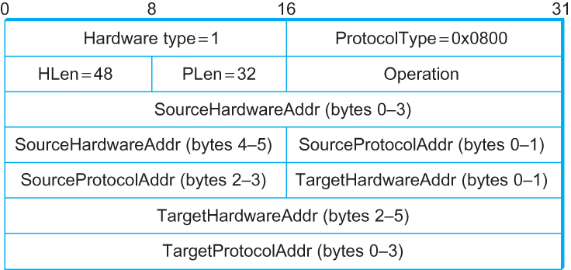
ARP Packet Format
HardwareType: type of physical network (e.g., Ethernet)
ProtocolType: type of higher layer protocol (e.g., IP)
HLEN & PLEN: length of physical and protocol addresses
Operation: request or response
Source/Target Physical/Protocol addresses

Slide 39
Internet Control Message Protocol (ICMP)

Slide 40
Internet Control Message Protocol (ICMP)
Defines a collection of error messages that are sent back to the source host.
E.g., ICMP messages are sent whenever a router or host is unable to process an IP datagram successfully
Destination host unreachable due to link /node failure
Reassembly process failed
TTL had reached 0 (so datagrams don't cycle forever)
IP header checksum failed
ICMP-Redirect
From router to a source host
With a better route information

Slide 41
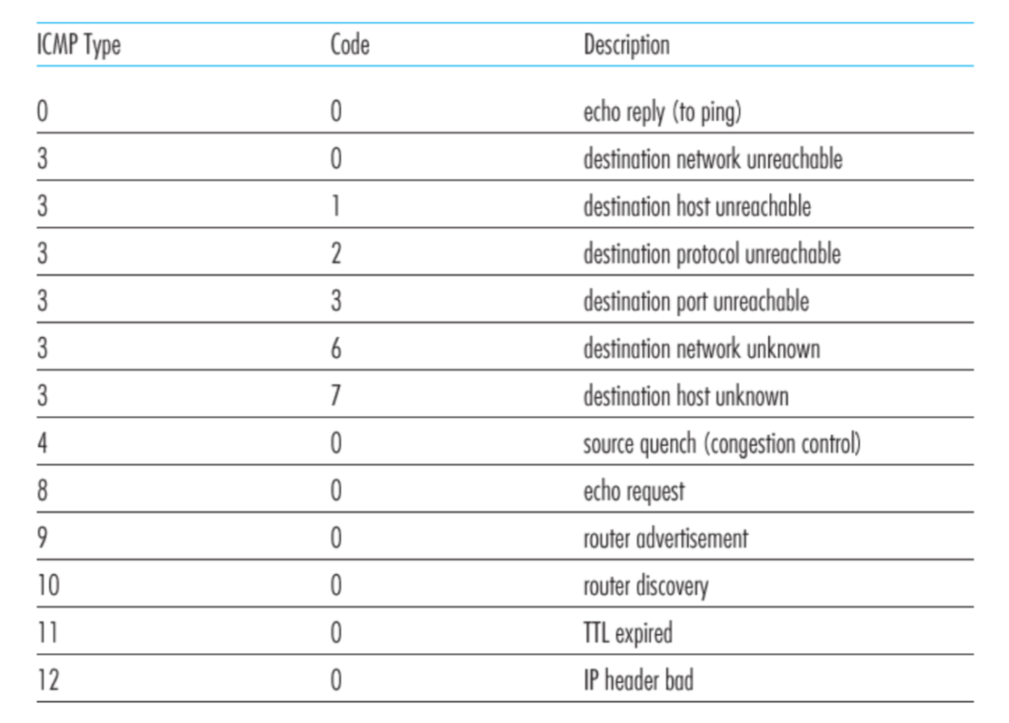
ICMP message types

Slide 42
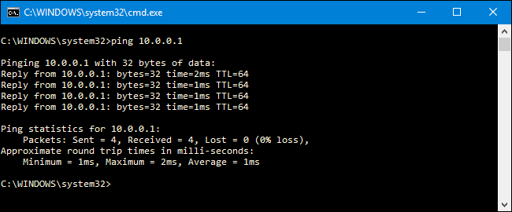
Ping example
Notes:
The output often shows something like:
64 bytes from 8.8.8.8: icmp_seq=1 ttl=115 time=12.3 ms
The TTL=115 means:
When the ICMP Echo Reply reached your machine, the packet still had TTL = 115 remaining.
Typical Initial TTL Values for Ping Requests
Operating SystemInitial TTLL
inux64
macOS64
Windows128
Cisco routers255
BSD systems64

Slide 43
Traceroute : An unintuitive application using ICMP

Slide 44
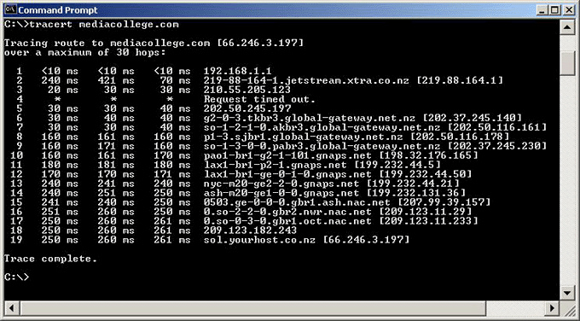
Traceroute example

Slide 45
Traceroute : An unintuitive application

Slide 46
Virtual Networks and Tunnels

Slide 47


Untrusted/Shared network
Gateway A
Gateway B
IP Header
Data
Trusted network (Site A)
Trusted network (Site B)

Slide 48
Untrusted/Shared network
Gateway A
Gateway B
Virtual Tunnel
IP Header
Data
Trusted network (Site A)
Trusted network (Site B)

Slide 49
New IP Header Source: Gateway-A Dest: Gateway-B
Encapsulation
IP Header
Data
Untrusted/Shared network
Gateway A
Gateway B
Virtual Tunnel
IP Header
Data
Trusted network (Site A)
Trusted network (Site B)

Slide 50
New IP Header Source: Gateway-A Dest: Gateway-B
Decapsulation
New IP Header Source: Gateway-A Dest: Gateway-B
IP Header
Data
IP Header
Data
Untrusted/Shared network
Gateway A
Gateway B
Virtual Tunnel
IP Header
Data
Trusted network (Site A)
Trusted network (Site B)

Slide 51
Untrusted/Shared network
Gateway A
Gateway B
Virtual Tunnel
IP Header
Data
IP Header
Data
Trusted network (Site A)
Trusted network (Site B)

Slide 52

New IP Header Source: Gateway-A Dest: Gateway-A
New IP Header Source: Gateway-A Dest: Gateway-A
Encryption/Decryption
IP Header
Data
IP Header
Data
Untrusted/Shared network
Gateway A
Gateway B
Virtual Tunnel
IP Header
Data
Trusted network (Site A)
Trusted network (Site B)

Slide 53
Untrusted/Shared network
Gateway A
Gateway B
Virtual Tunnel
Virtual Private Network
(VPN)
Trusted network (Site A)
Trusted network (Site B)

Slide 54
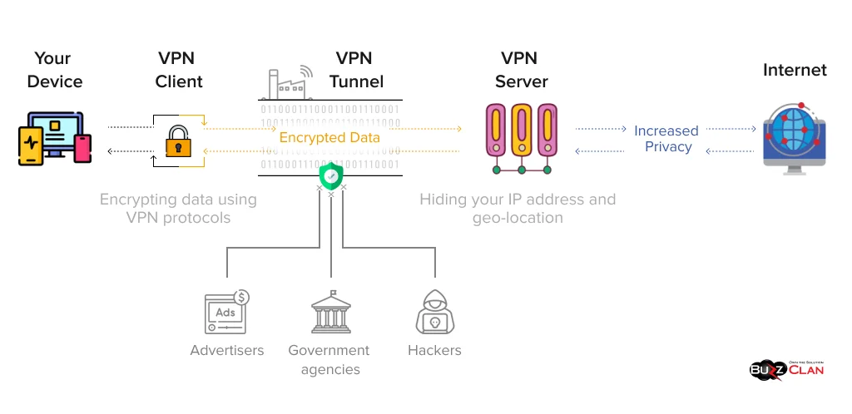
Picture: https://buzzclan.com/cyber-security/how-does-a-vpn-work/

Slide 55
Why do we need virtual networks or tunnels?
1. Security
2. Special capabilities between routers (e.g., multicast)
3. Supporting heterogeneity

Slide 56
Why do we need virtual networks or tunnels?
1. Security
2. Special capabilities between routers (e.g., multicast)
3. Supporting heterogeneity
Disadvantages:
1. Increases packet length
a) Wastage of bandwidth
b) More processing
c) Fragmentation
2. Increases management cost

Slide 57
IPv6
1) Address and packet format
2) Unicast, Multicast, Anycast addressing
3) IPV4 and IPV6 coexistence

Slide 58
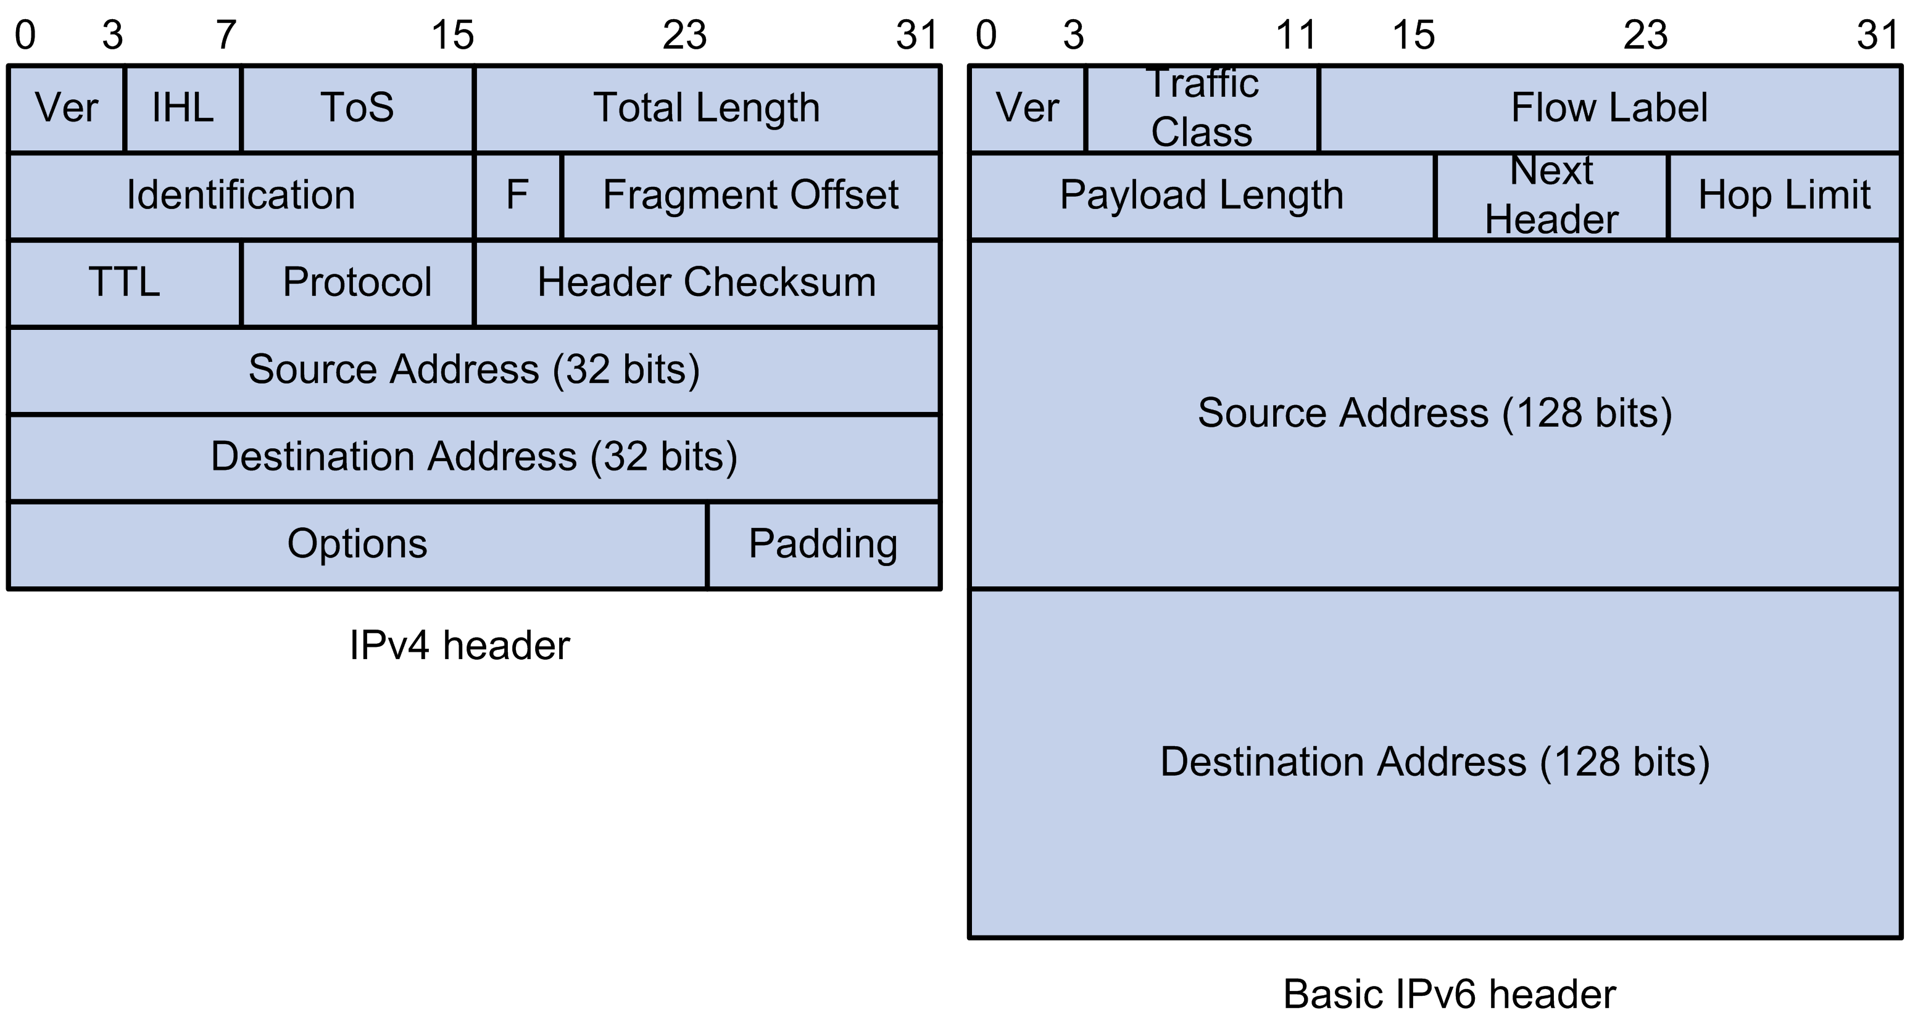
IPv6: Address and packet format
Pic courtesy: https://techhub.hpe.com

Slide 59
IPv6: Address and packet format
Q 1. Why is there no header checksum?
Q 2. Why is there no fragmenting related option?
Q 3. Is 128-bit IP address big enough?
Pic courtesy: https://techhub.hpe.com
Notes:
IPv6 provides for a maximum of 3.4×10^38 (340 trillion trillion trillion) unique IP addresses, or about 47 octillion unique addresses for every person on the planet.
For comparison: One light-year is about 6 trillion miles (9 trillion km)
Q1: Does not provide much quality of service when the delivery policy itself is unreliable,
Q2: Pushing the responsibility to the edge. With increasing traffic fragmentation is computation costly.

Slide 60
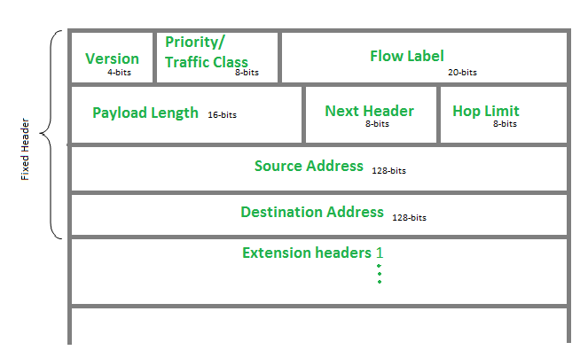
Notes:
Fragmentations are possible in IPV6, but only at source. And in that case an extension header will be defined.

Slide 61
IPv6: Address and packet format
Q 1. Why is there no header checksum?
Q 2. Why is there no fragmenting related option?
Q 3. Is 128-bit IP address big enough?
Pic courtesy: https://techhub.hpe.com
Notes:
IPv6 provides for a maximum of 3.4×10^38 (340 trillion trillion trillion) unique IP addresses, or about 47 octillion unique addresses for every person on the planet.
For comparison: One light-year is about 6 trillion miles (9 trillion km)
Q1: Does not provide much quality of service when the delivery policy itself is unreliable,
Q2: Pushing the responsibility to the edge. With increasing traffic fragmentation is computation costly.

Slide 62
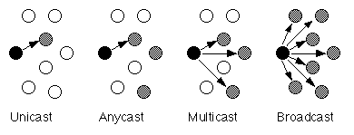
Unicast, Multicast, Anycast, Broadcast

Slide 63
Unicast, Multicast, Anycast, Broadcast
IPv4
IPv4
IPv4

Slide 64
Unicast, Multicast, Anycast, Broadcast
IPv4
IPv4
IPv4
IPv6
IPv6
IPv6

Slide 65
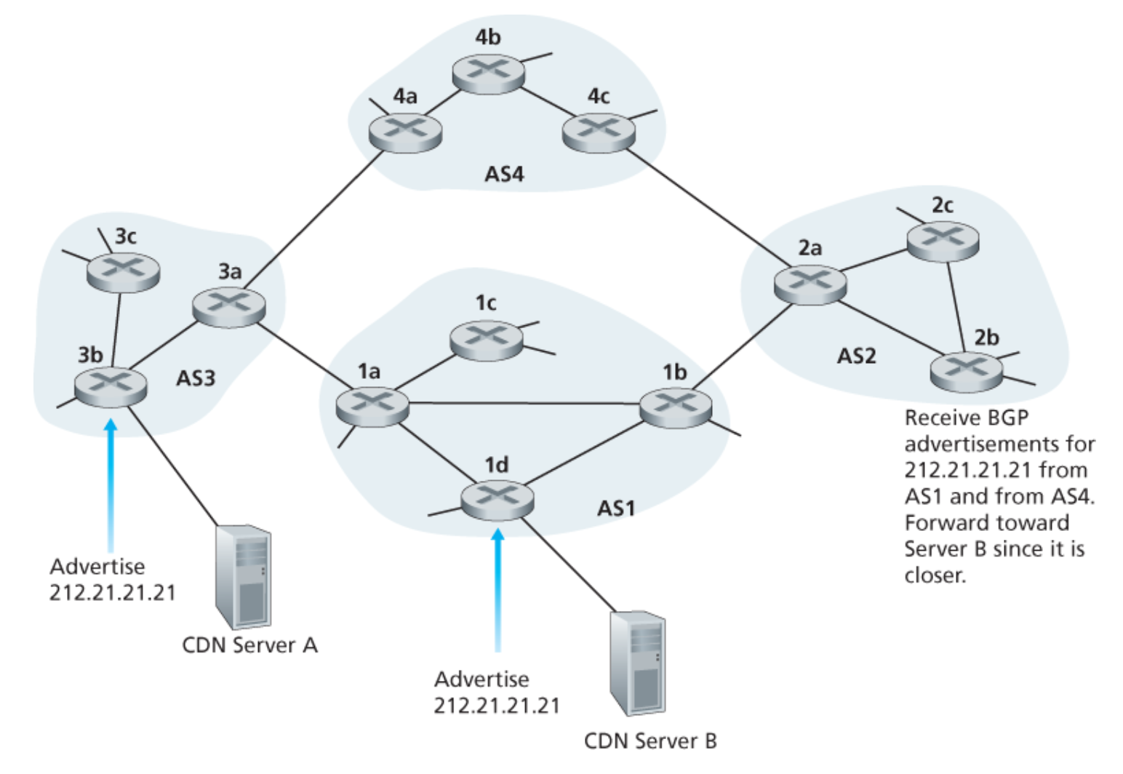
Unicast, Multicast, Anycast, Broadcast
IP: Anycast example

Slide 66
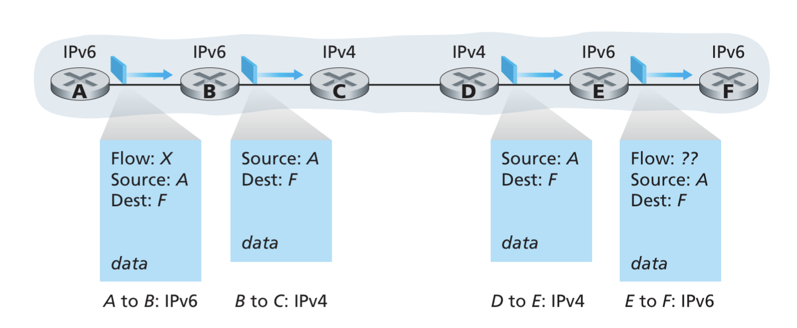
IPv4 and IPv6 Co-existence

Slide 67
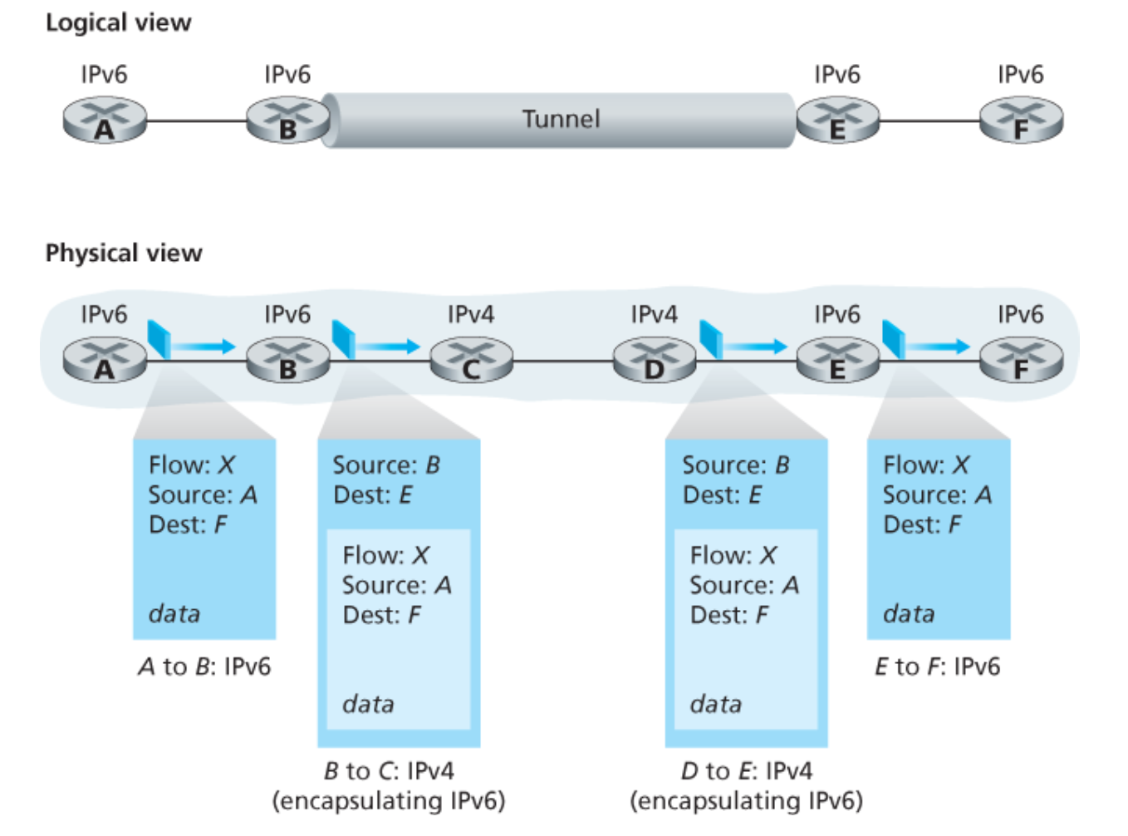
IPv4 and IPv6 Co-existence

