Slide 1

CMSC 417: Computer Networks
Spring 2026
Topic: ICMP, VPN, IPv6
(Textbook chapter 3)
Nirupam Roy
M-W 2:00-3:15pm
CSI 2117
March 9th, 2026

Slide 2



ARP: address resolution protocol
Question: how to determine
interface’s MAC address, knowing its IP address?
ARP table: each IP node (host, router) on LAN has table
  IP/MAC address mappings for some LAN nodes:
< IP address; MAC address; TTL>
  TTL (Time To Live): time after which address mapping will be forgotten (typically 20 min)
137.196.7.78
1A-2F-BB-76-09-AD
137.196.7.23
137.196.7.14
LAN
71-65-F7-2B-08-53
58-23-D7-FA-20-B0
0C-C4-11-6F-E3-98
137.196.7.88

Slide 3
ARP protocol: same LAN
A wants to send datagram to B
  B’s MAC address not in A’s ARP table.
A broadcasts ARP query packet, containing B's IP address
  destination MAC address = FF-FF-FF-FF-FF-FF
  all nodes on LAN receive ARP query
B receives ARP packet, replies to A with its (B's) MAC address
  frame sent to A’s MAC address (unicast)
A caches (saves) IP-to-MAC address pair in its ARP table until information becomes old (times out)
  soft state: information that times out (goes away) unless refreshed
ARP is “plug-and-play”:
  nodes create their ARP tables without intervention from net administrator
Notes:
3. Do Other Nodes See the ARP Reply?
Normally no, because:
Ethernet switches forward unicast frames only to the destination port
Other hosts do not receive the frame
So they cannot overhear the ARP reply. (Power saving Idea).

Slide 4
Address Translation Protocol (ARP)
Map IP addresses into physical addresses
  destination host
  next hop router
Techniques
  encode physical address in host part of IP address
  table-based
ARP (Address Resolution Protocol)
  table of IP to physical address bindings
  broadcast request if IP address not in table
  target machine responds with its physical address
  table entries are discarded if not refreshed
  Query message include the physical address of the sending host. Why?

Slide 5
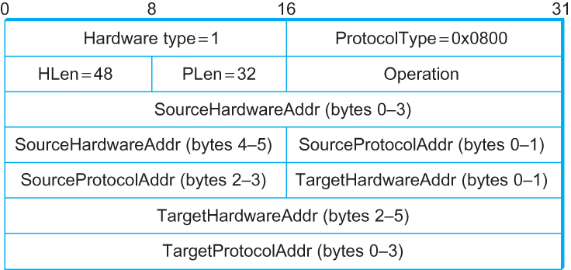
ARP Packet Format
  HardwareType: type of physical network (e.g., Ethernet)
  ProtocolType: type of higher layer protocol (e.g., IP)
  HLEN & PLEN: length of physical and protocol addresses
  Operation: request or response
  Source/Target Physical/Protocol addresses

Slide 6
Internet Control Message Protocol (ICMP)

Slide 7
Internet Control Message Protocol (ICMP)
Defines a collection of error messages that are sent back to the source host.
E.g., ICMP messages are sent whenever a router or host is unable to process an IP datagram successfully
  Destination host unreachable due to link /node failure
  Reassembly process failed
  TTL had reached 0 (so datagrams don't cycle forever)
  IP header checksum failed
ICMP-Redirect
  From router to a source host
  With a better route information

Slide 8
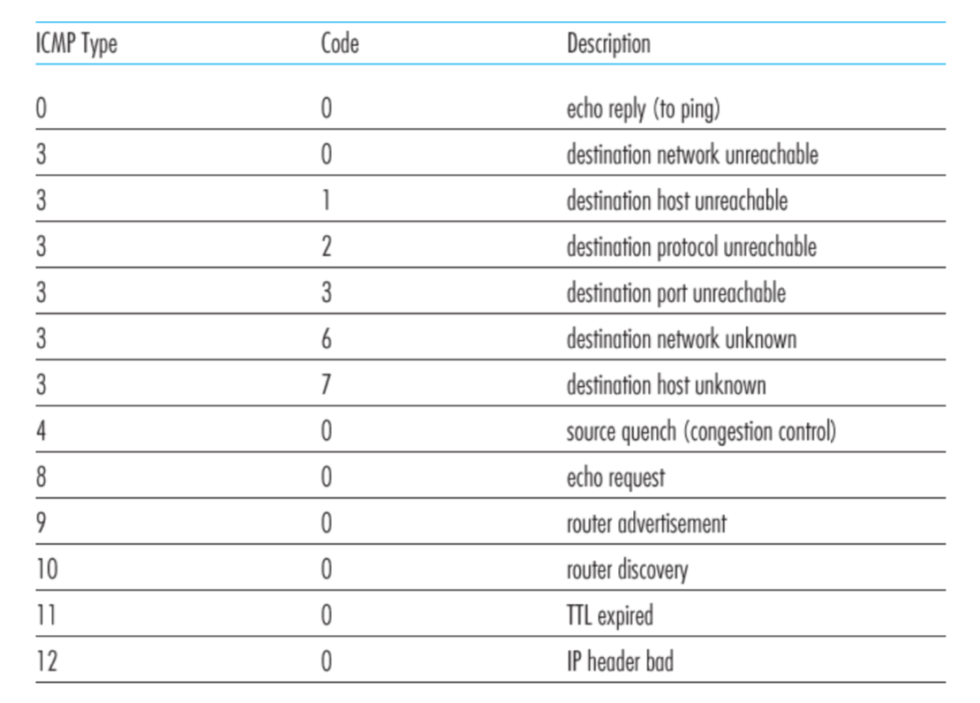
ICMP message types

Slide 9
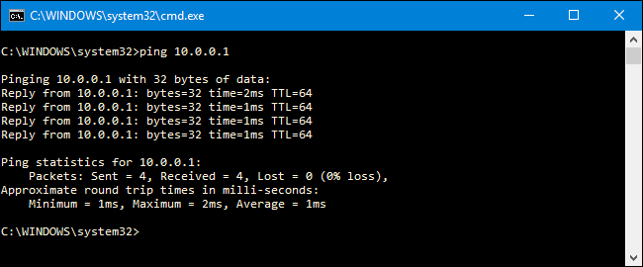
Ping example
Notes:
The output often shows something like:
64 bytes from 8.8.8.8: icmp_seq=1 ttl=115 time=12.3 ms
The TTL=115 means:
When the ICMP Echo Reply reached your machine, the packet still had TTL = 115 remaining.
Typical Initial TTL Values for Ping Requests
Operating SystemInitial TTLL
inux64
macOS64
Windows128
Cisco routers255
BSD systems64

Slide 10
Traceroute : An unintuitive application using ICMP

Slide 11
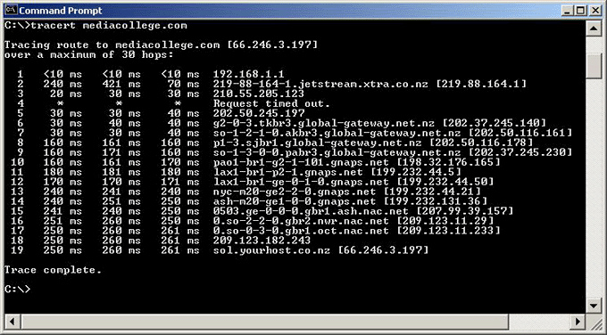
Traceroute example

Slide 12
Traceroute : An unintuitive application

Slide 13
Virtual Networks and Tunnels

Slide 14



Untrusted/Shared network
Gateway A
Gateway B
IP Header
Data
Trusted network (Site A)
Trusted network (Site B)

Slide 15
Untrusted/Shared network
Gateway A
Gateway B
Virtual Tunnel
IP Header
Data
Trusted network (Site A)
Trusted network (Site B)

Slide 16
New IP Header Source: Gateway-A Dest: Gateway-B
Encapsulation
IP Header
Data
Untrusted/Shared network
Gateway A
Gateway B
Virtual Tunnel
IP Header
Data
Trusted network (Site A)
Trusted network (Site B)

Slide 17
New IP Header Source: Gateway-A Dest: Gateway-B
Decapsulation
New IP Header Source: Gateway-A Dest: Gateway-B
IP Header
Data
IP Header
Data
Untrusted/Shared network
Gateway A
Gateway B
Virtual Tunnel
IP Header
Data
Trusted network (Site A)
Trusted network (Site B)

Slide 18
Untrusted/Shared network
Gateway A
Gateway B
Virtual Tunnel
IP Header
Data
IP Header
Data
Trusted network (Site A)
Trusted network (Site B)

Slide 19

New IP Header Source: Gateway-A Dest: Gateway-A
New IP Header Source: Gateway-A Dest: Gateway-A
Encryption/Decryption
IP Header
Data
IP Header
Data
Untrusted/Shared network
Gateway A
Gateway B
Virtual Tunnel
IP Header
Data
Trusted network (Site A)
Trusted network (Site B)

Slide 20
Untrusted/Shared network
Gateway A
Gateway B
Virtual Tunnel
Virtual Private Network
(VPN)
Trusted network (Site A)
Trusted network (Site B)

Slide 21
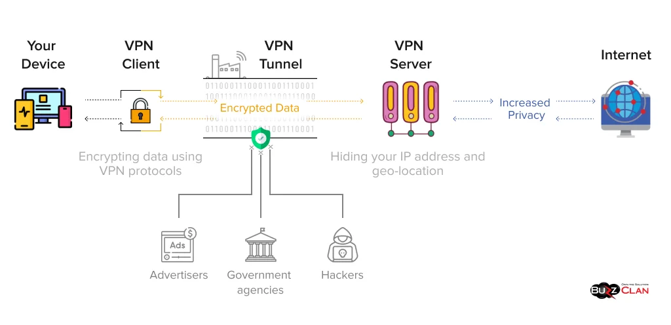
Picture: https://buzzclan.com/cyber-security/how-does-a-vpn-work/

Slide 22
Three Major Types of VPNs
Remote Access VPN – Allows individual users to securely connect to a private network from a remote location using the internet (commonly used by employees working from home).
Site-to-Site VPN – Connects entire networks at different locations (e.g., branch offices) through secure tunnels over the internet.
Client-to-Site VPN (SSL/IPsec) – A client device uses VPN software to establish an encrypted connection to a company’s VPN gateway.

Slide 23
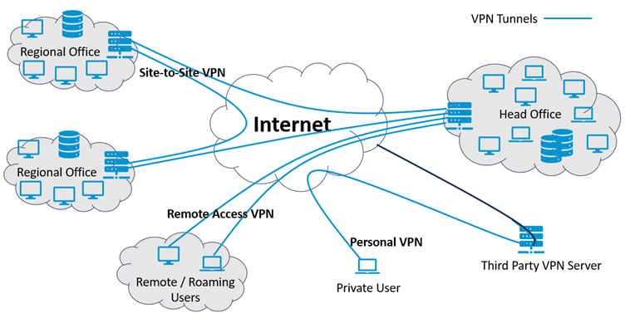
Pic ref: https://www.siretta.com/2024/02/virtual-private-network/

Slide 24
Why do we need virtual networks or tunnels?
1. Security
2. Special capabilities between routers (e.g., multicast)
3. Supporting heterogeneity

Slide 25
Why do we need virtual networks or tunnels?
1. Security
2. Special capabilities between routers (e.g., multicast)
3. Supporting heterogeneity
Disadvantages:
1. Increases packet length
a) Wastage of bandwidth
b) More processing
c) Fragmentation
2. Increases management cost

Slide 26
IPv6
1) Address and packet format
2) Unicast, Multicast, Anycast addressing
3) IPV4 and IPV6 coexistence

Slide 27
IPv6: Address
Classless addressing/routing (similar to CIDR)
Notation: x:x:x:x:x:x:x:x (x = 16-bit hex number)
  contiguous 0s are compressed: 47CD::A456:0124
  IPv6 compatible IPv4 address: ::128.42.1.87
Address assignment
  provider-based
  geographic
Notes:
IPv4-compatible IPv6 addresses were an early IPv6 transition mechanism designed to allow IPv6 hosts to communicate over IPv4 infrastructure using automatic tunneling. These addresses embedded an IPv4 address inside an IPv6 address so that IPv6 packets could be transported through IPv4 networks.
However, this mechanism is now deprecated and is no longer used in modern IPv6 deployments.

Slide 28
IPv6: Address
47CD:1234:4422:AC02:0022:1234:A456:0124
47CD:0000:0000:0000:0000:0000:A456:0124
47CD::A456:0124

Slide 29
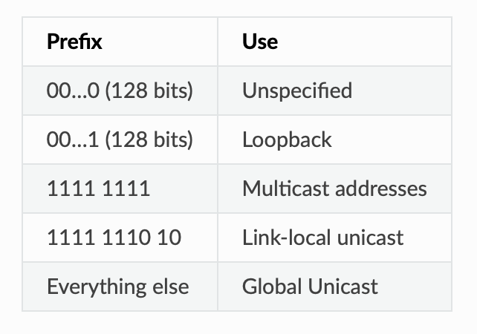
IPv6: Scopes of Addresses

Slide 30
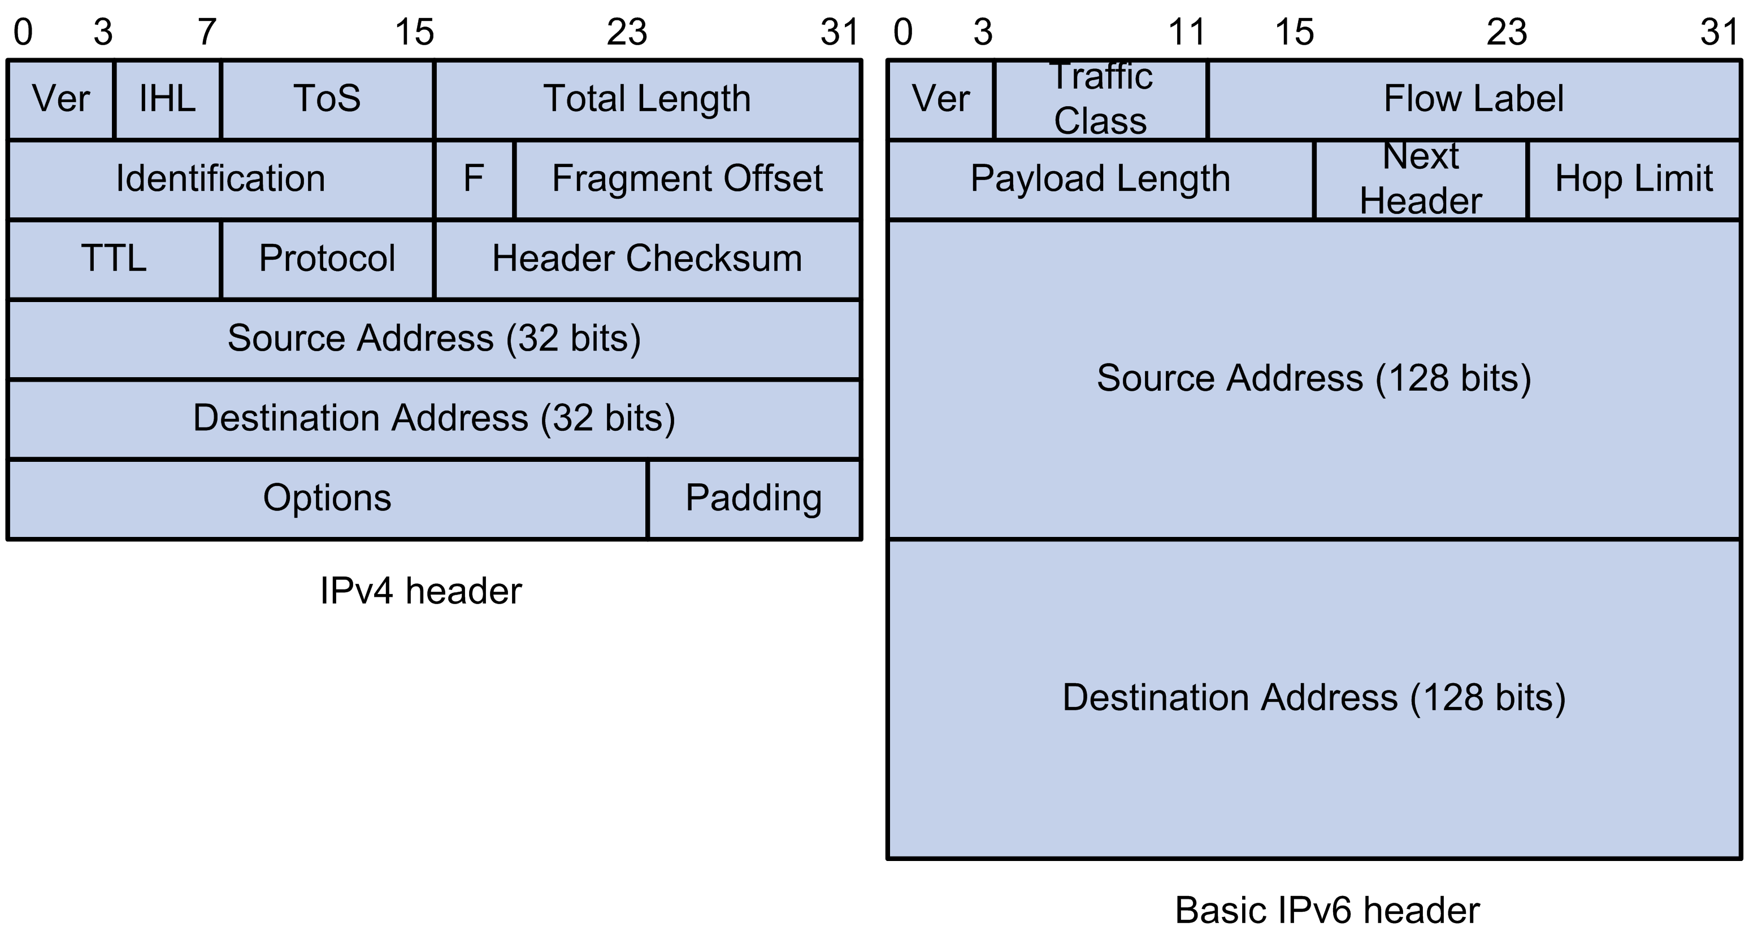
IPv6: Address and packet format
Pic courtesy: https://techhub.hpe.com

Slide 31
IPv6: Address and packet format
Q 1. Why is there no header checksum?
Q 2. Why is there no fragmenting related option?
Q 3. Is 128-bit IP address big enough?
Pic courtesy: https://techhub.hpe.com
Notes:
IPv6 provides for a maximum of 3.4×10^38 (340 trillion trillion trillion) unique IP addresses, or about 47 octillion unique addresses for every person on the planet.
For comparison: One light-year is about 6 trillion miles (9 trillion km)
Q1: Does not provide much quality of service when the delivery policy itself is unreliable,
Q2: Pushing the responsibility to the edge. With increasing traffic fragmentation is computation costly.
fragmentation is now handled as an optional header, which means that the fragmentation-related fields of IPv4 are not included in the IPv6 header.

Slide 32
IPv6: IP packet Fragmentation
Fragmentation in IPv4 (for comparison)
A router receives a packet larger than the MTU of the next link.
The router fragments the packet into smaller pieces.
Each fragment travels independently.
The destination host reassembles them.
This means routers perform fragmentation, which increases router processing overhead.
IPv6 Design Decision
IPv6 eliminates router fragmentation.
Instead:
Routers never fragment packets
If a packet is too large, the router drops it
The router sends an ICMPv6 Packet Too Big message
The sender adjusts the packet size
This mechanism is called: Path MTU Discovery (PMTUD)

Slide 33
IPv6: IP packet Fragmentation
Path MTU Discovery (PMTUD)
The sender discovers the smallest MTU along the path.
Step-by-step
Sender transmits a packet.
Router finds packet larger than its MTU.
Router drops the packet.
Router sends:
ICMPv6: Packet Too Big
Message includes the MTU of the link.
Sender reduces packet size.
Sender retransmits.

Slide 34
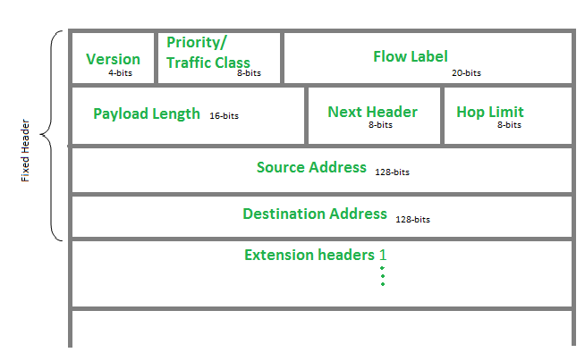
IPv6: IP packet Fragmentation
Fragmentation is done only by the source host using a Fragment Extension Header.
Notes:
Fragmentations are possible in IPV6, but only at source. And in that case an extension header will be defined.

Slide 35
IPv6: IP packet Fragmentation
IPv6 Fragment Extension Header
The Fragment Header contains:
Field | Purpose
Fragment Offset | Position of fragment
M flag | More fragments indicator
Identification | Used for reassembly

Slide 36
IPv6: IP packet Fragmentation
Why IPv6 Removed Router Fragmentation?
Three main reasons:
1. Router performance
Routers operate in hardware and fragmentation is expensive.
2. Simpler routers
Edge hosts handle fragmentation instead.
3. Security
Fragmentation can enable evasion attacks on Firewalls and IDS (Intrusion Detection Systems).

Slide 37
IPv6: IP packet Fragmentation
Evasion Attack
Security systems typically inspect packets to detect attacks. However, if an attacker splits the packet into fragments, the security device may:
inspect fragments individually, or
fail to reassemble them correctly
Meanwhile, the destination host reassembles them differently, revealing the malicious payload.

Slide 38
IPv6: IP packet Fragmentation
Splitting Malicious Payload Across Fragments
An attacker splits a malicious signature across fragments so that the IDS cannot detect it.
Example attack payload:
GET /cmd.exe
Fragments sent:
Fragment 1
GET /cm
Fragment 2
d.exe
If the IDS inspects fragments separately:
Fragment 1 → benign
Fragment 2 → benign
But the destination host reassembles:
GET /cmd.exe
This was historically used to bypass signature-based IDS systems.

Slide 39
IPv6: Address and packet format
Q 1. Why is there no header checksum?
Q 2. Why is there no fragmenting related option?
Q 3. Is 128-bit IP address big enough?
Pic courtesy: https://techhub.hpe.com
Notes:
IPv6 provides for a maximum of 3.4×10^38 (340 trillion trillion trillion) unique IP addresses, or about 47 octillion unique addresses for every person on the planet.
For comparison: One light-year is about 6 trillion miles (9 trillion km)
Q1: Does not provide much quality of service when the delivery policy itself is unreliable,
Q2: Pushing the responsibility to the edge. With increasing traffic fragmentation is computation costly.

Slide 40
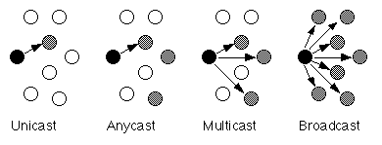
Unicast, Multicast, Anycast, Broadcast

Slide 41
Unicast, Multicast, Anycast, Broadcast
IPv4
IPv4
IPv4

Slide 42
Unicast, Multicast, Anycast, Broadcast
IPv4
IPv4
IPv4
IPv6
IPv6
IPv6

Slide 43
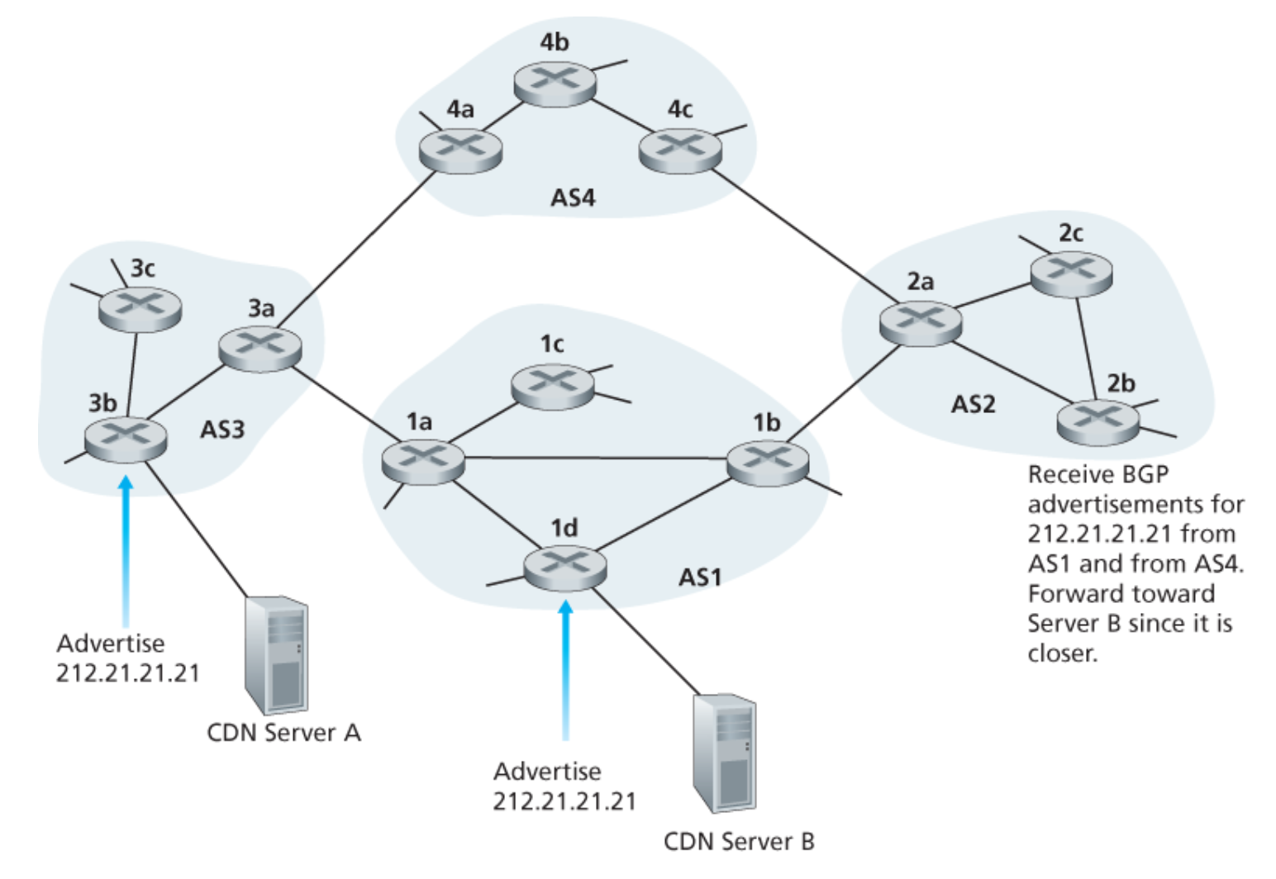
Unicast, Multicast, Anycast, Broadcast
IP: Anycast example

Slide 44
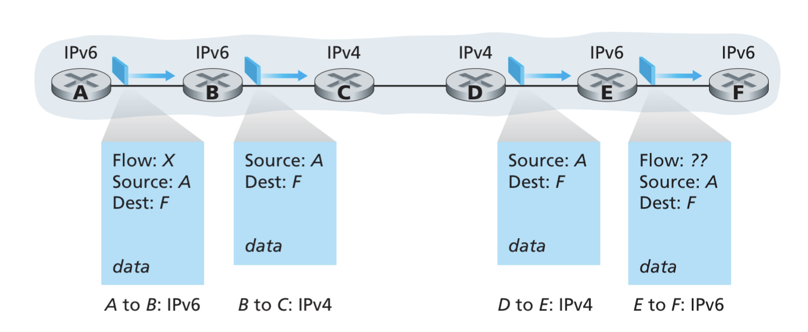
IPv4 and IPv6 Co-existence

Slide 45
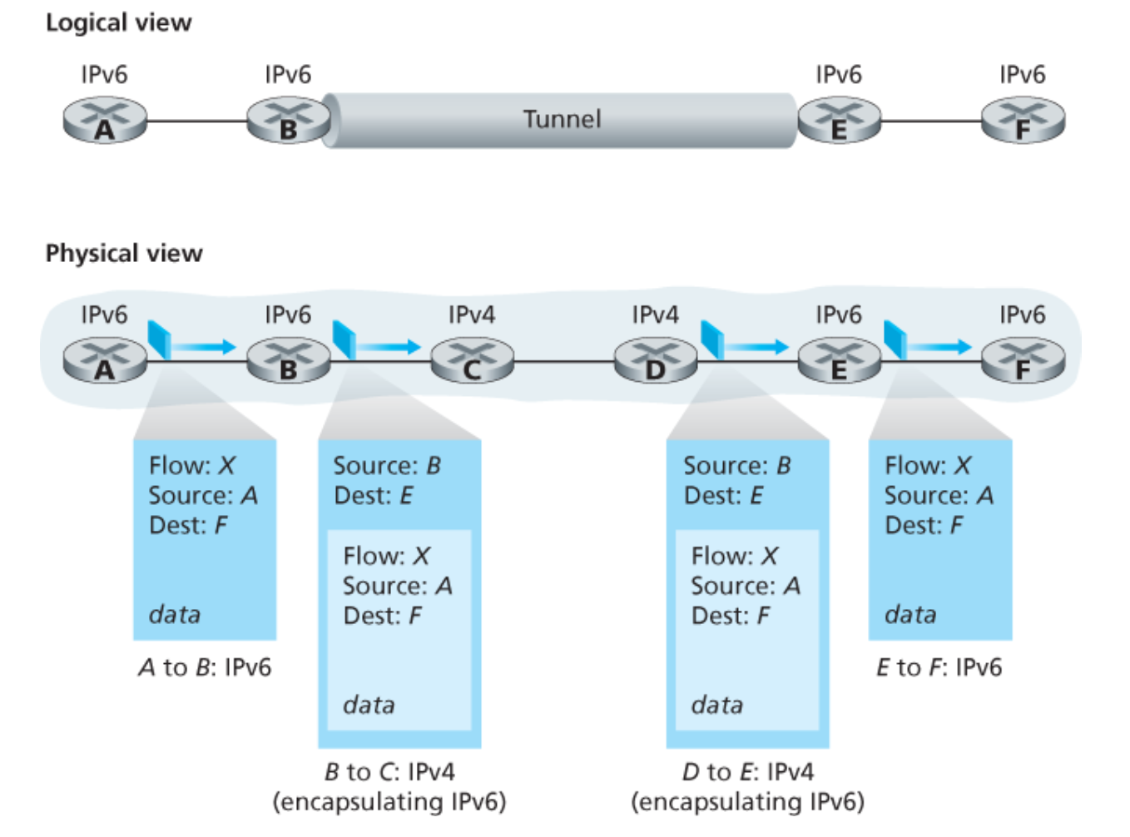
IPv4 and IPv6 Co-existence

Slide 46
Computer Networks
CMSC 417 : Spring 2025
Topic:
Transport Layer Protocols (UDP, TCP)
(Textbook chapter 5)
Nirupam Roy
Tu-Th 2:00-3:15pm
CSI 2117
March 12th, 2025

Slide 47
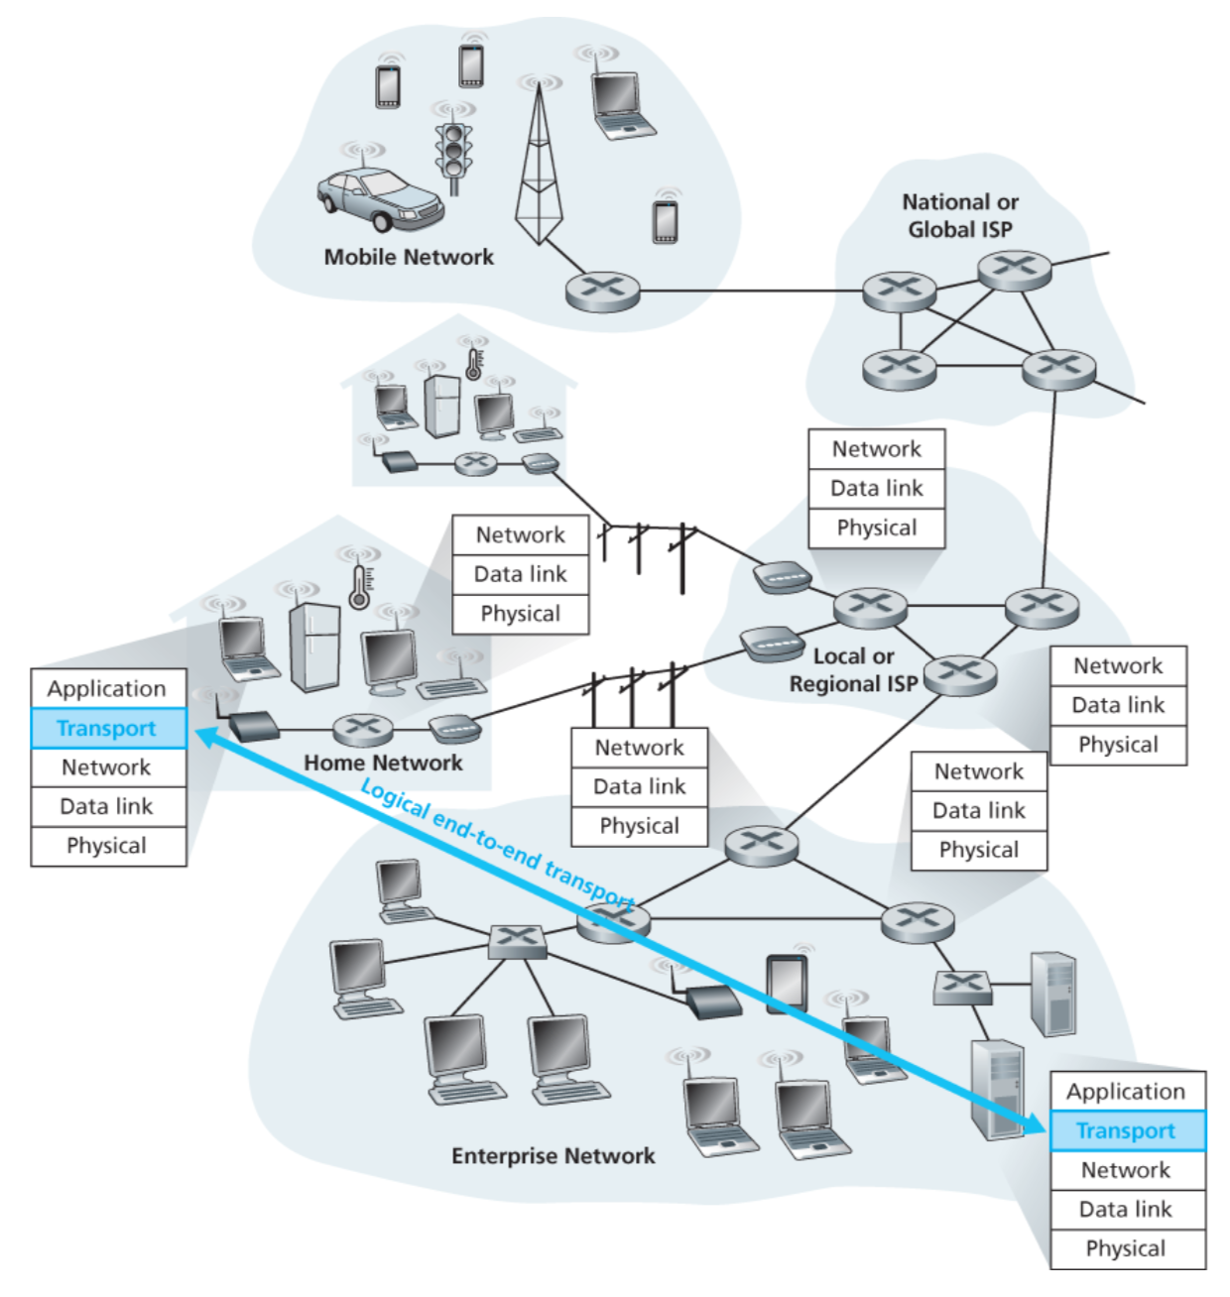

Slide 48
Transport layer: From the lens of two perspectives
(1) Abstraction of clients. (machines/networks/processes)
(2) Abstraction of services.

Slide 49
(1) Abstraction of clients

Slide 50
Network layer abstraction
128.2.0.0/16
200.30.0.0/16
16.20.0.0/20
Network 1
Network 3
Network 2

Slide 51
Network layer abstraction
128.2.0.0/16
200.30.0.0/16
16.20.0.0/20
Network 1
Network 3
Network 2

Slide 52
Network layer abstraction
Network layer services
128.2.0.0/16
200.30.0.0/16
16.20.0.0/20
Network 1
Network 3
Network 2

Slide 53
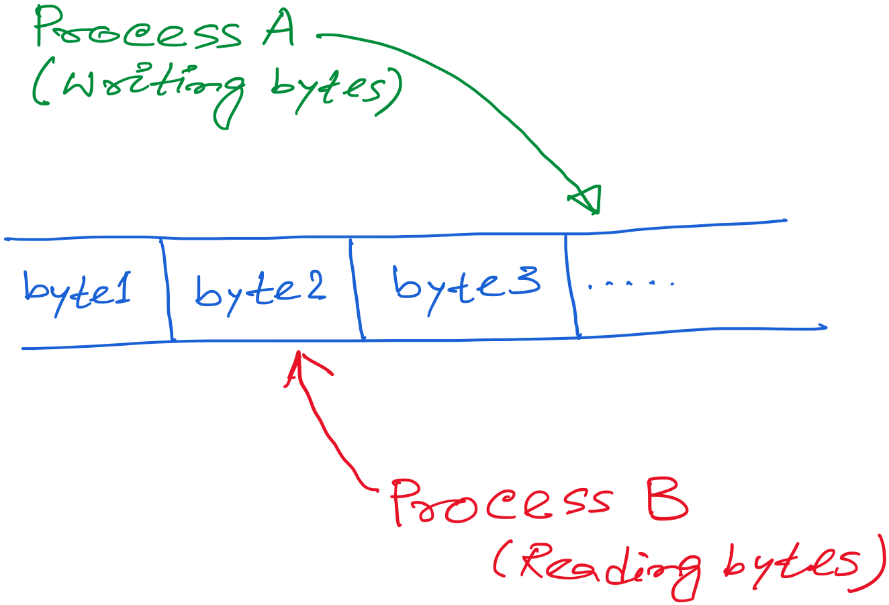
Transport layer abstraction

Slide 54
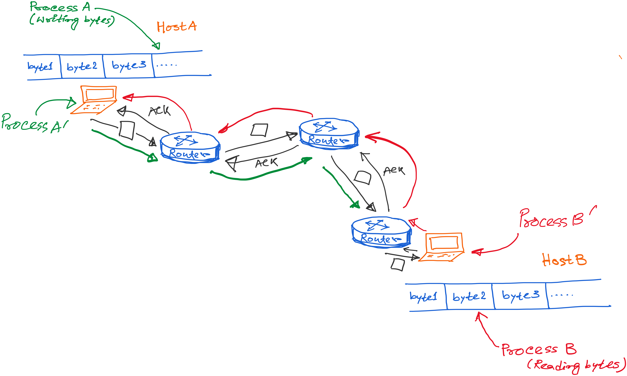
Transport layer abstraction
Transport layer services

Slide 55
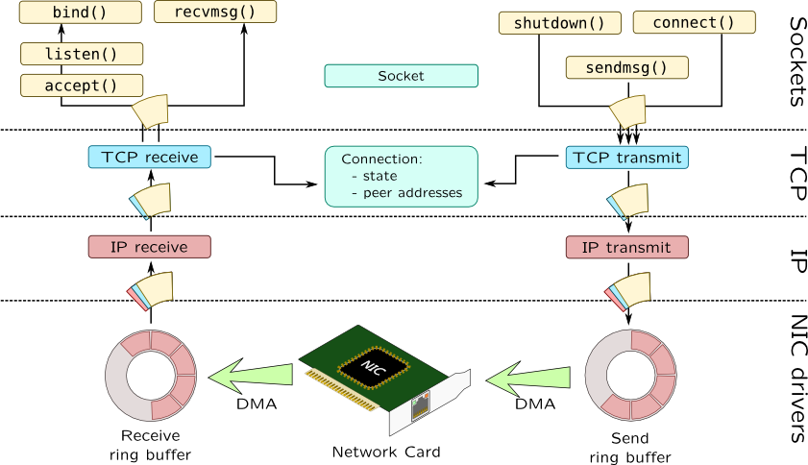

Slide 56
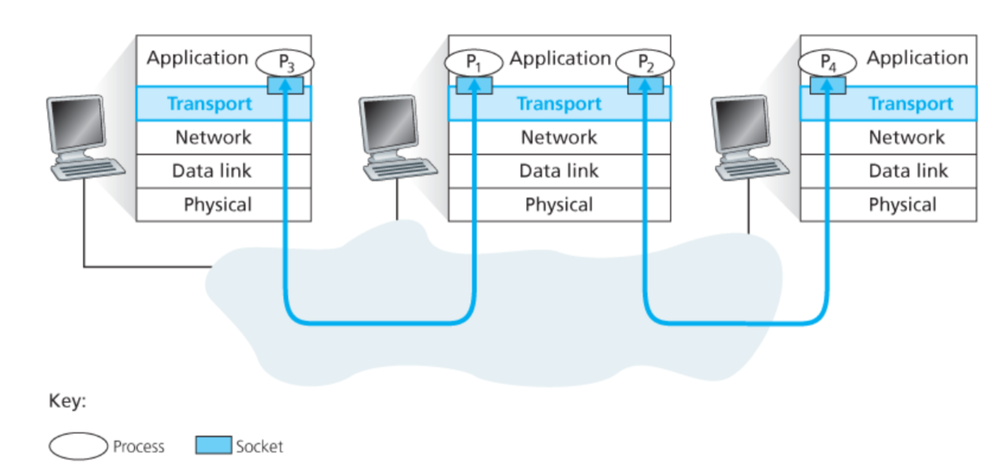
Connection between processes

Slide 57
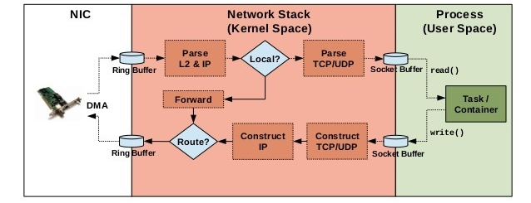
Implementation of networking algorithms

Slide 58
Transport Protocols
Logical communication between processes
  Sender divides a message into segments
  Receiver reassembles segments into message
Transport services
  (De)multiplexing packets
  Detecting corrupted data
  Optionally: reliable delivery, flow control, …

Slide 59
Two Basic Transport Features
Demultiplexing: port numbers
Error detection: checksums
Server host 128.2.194.242
Service request for
128.2.194.242:80
(i.e., the Web server)
Client host
Web server
(port 80)
Client
OS
Echo server
(port 7)
IP
payload
detect corruption

Slide 60
Multiplexing/demultiplexing
Demultiplexing at rcv host:
Multiplexing at send host:
delivering received segments
to correct socket
Data headers helps flows
from multiple sockets to use
common the network channel,
Info in header later helps
Demultiplexing.
= socket
= process
application
application
application
P4
P3
P1
P2
P1
transport
transport
transport
network
network
network
link
link
link
physical
physical
physical
host 1
host 2
host 3

Slide 61
How demultiplexing works
1) host receives IP datagrams
  each datagram has source IP address, destination IP address
  each datagram carries 1 transport-layer segment
  each segment has source, destination port number
2) host uses IP addresses & port numbers to direct segment to appropriate socket
32 bits
source port #
dest port #
other header fields
application
data
(message)
TCP/UDP segment format

Slide 62
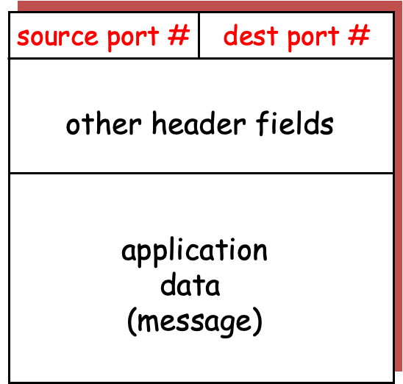
application
application
P3
P1
P2
P1
transport
transport
network
network
link
link
physical
physical
host 1
host 2

Slide 63
application
application
P3
P1
P2
P1
transport
transport
network
network
link
link
physical
physical
host 1
host 2

Slide 64
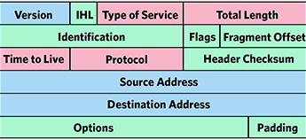
application
application
P3
P1
P2
P1
transport
transport
network
network
link
link
physical
physical
host 1
host 2

Slide 65
application
application
P3
P1
P2
P1
transport
transport
network
network
link
link
physical
physical
host 1
host 2

Slide 66
application
application
P3
P1
P2
P1
transport
transport
network
network
link
link
physical
physical
host 1
host 2

Slide 67
Connection-less mux/demux:
- User Datagram Protocol (UDP)
Connection-oriented mux/demux:
- Transmission Control Protocol (TCP)

Slide 68
Connectionless demultiplexing
When host receives UDP segment:
  checks destination port number in segment
  directs UDP segment to socket with that port number
IP datagrams with different source IP addresses and/or source port numbers directed to same socket
Create sockets with port numbers:
DatagramSocket mySocket1 = new DatagramSocket(99111);
DatagramSocket mySocket2 = new DatagramSocket(99222);
UDP socket identified by two-tuple:
(dest IP address, dest port number)

Slide 69
Connectionless demux (cont)
DatagramSocket serverSocket = new DatagramSocket(6428);
P2
P1
P3
P1
SP: 6428
SP: 6428
DP: 9157
DP: 5775
SP: 9157
SP: 5775
client
IP: A
DP: 6428
server
IP: C
DP: 6428
Client
IP:B
SP provides “return address”

