Slide 1

CMSC 417: Computer Networks
Spring 2026
Topic: IPv6
(Textbook chapter 3)
Nirupam Roy
M-W 2:00-3:15pm
CSI 2117
March 9th, 2026

Slide 2
IPv6
1) Address and packet format
2) Unicast, Multicast, Anycast addressing
3) IPV4 and IPV6 coexistence

Slide 3
IPv6: Address
Classless addressing/routing (similar to CIDR)
Notation: x:x:x:x:x:x:x:x (x = 16-bit hex number)
contiguous 0s are compressed: 47CD::A456:0124
IPv6 compatible IPv4 address: ::128.42.1.87
Address assignment
provider-based
geographic
Notes:
IPv4-compatible IPv6 addresses were an early IPv6 transition mechanism designed to allow IPv6 hosts to communicate over IPv4 infrastructure using automatic tunneling. These addresses embedded an IPv4 address inside an IPv6 address so that IPv6 packets could be transported through IPv4 networks.
However, this mechanism is now deprecated and is no longer used in modern IPv6 deployments.

Slide 4
IPv6: Address
47CD:1234:4422:AC02:0022:1234:A456:0124
47CD:0000:0000:0000:0000:0000:A456:0124
47CD::A456:0124

Slide 5
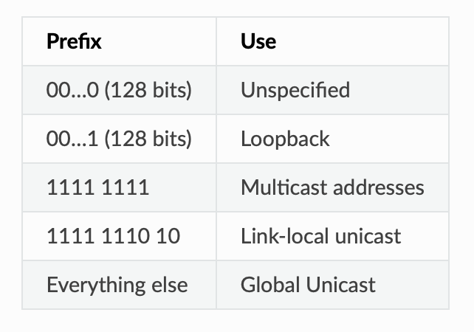
IPv6: Scopes of Addresses
FF00::/8
FE80::/10
FC00::/7
Unique Local Scope (similar to private address)

Slide 6
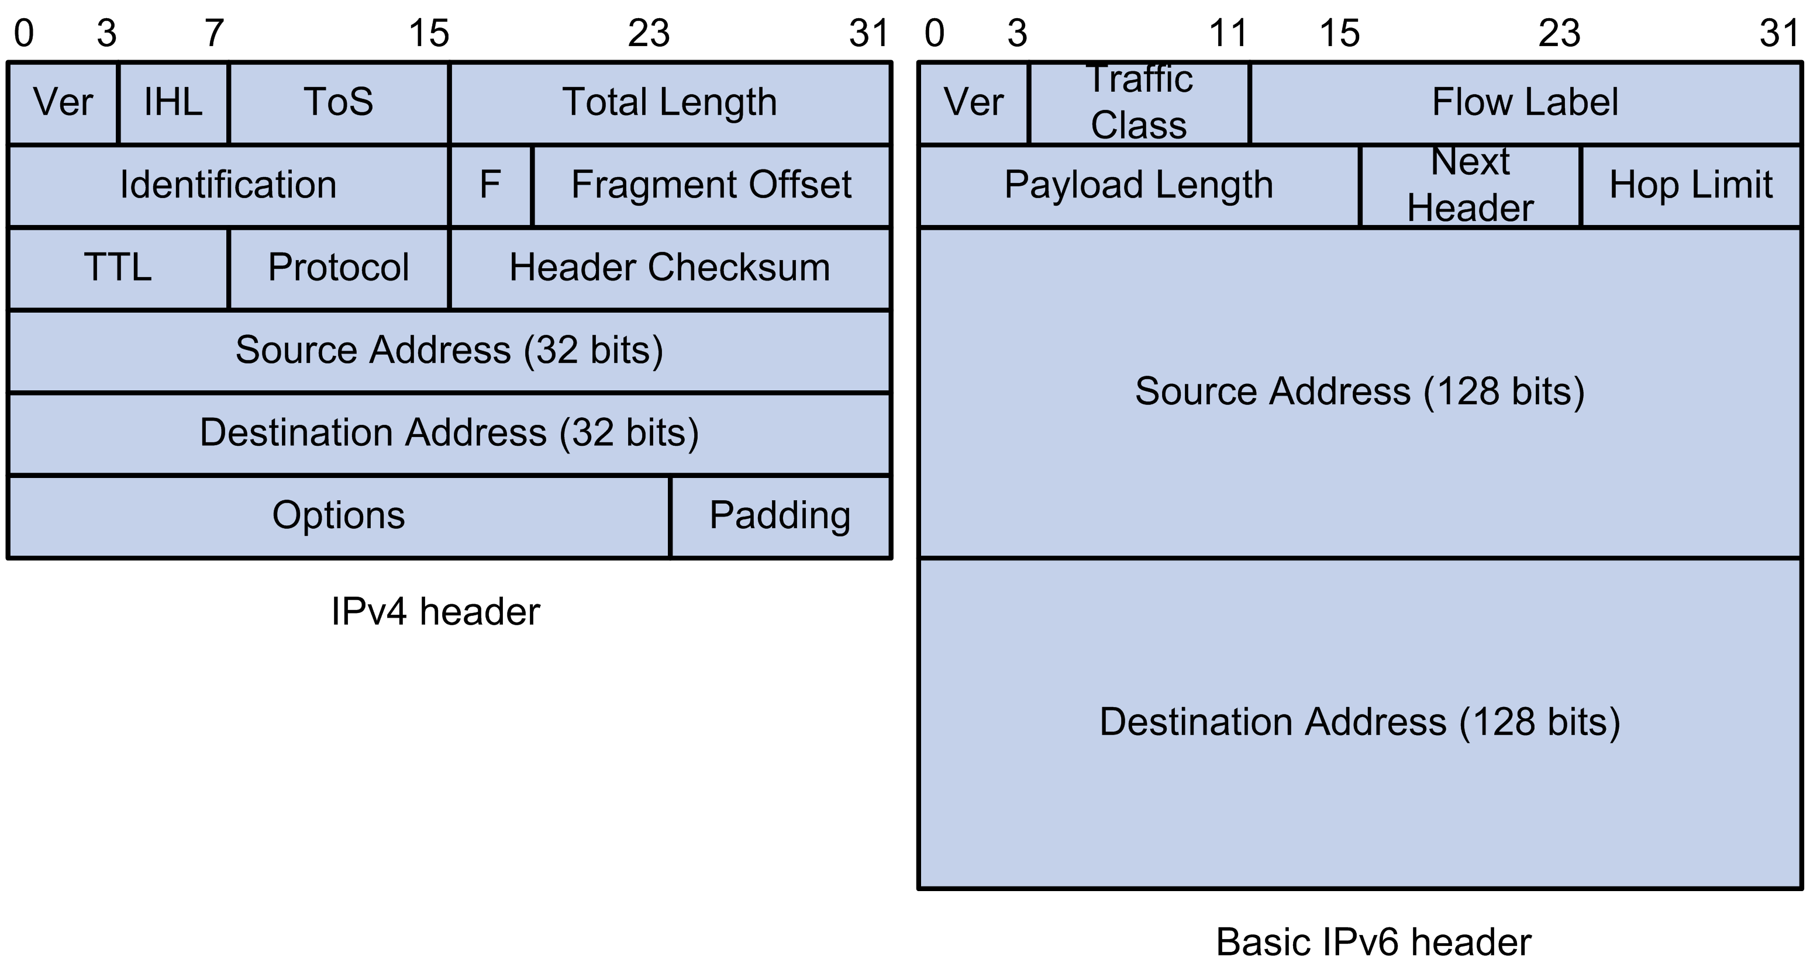
IPv6: Address and packet format
Pic courtesy: https://techhub.hpe.com

Slide 7
IPv6: Address and packet format
Q 1. Why is there no header checksum?
Q 2. Why is there no fragmenting related option?
Q 3. Is 128-bit IP address big enough?
Pic courtesy: https://techhub.hpe.com
Notes:
IPv6 provides for a maximum of 3.4×10^38 (340 trillion trillion trillion) unique IP addresses, or about 47 octillion unique addresses for every person on the planet.
For comparison: One light-year is about 6 trillion miles (9 trillion km)
Q1: Does not provide much quality of service when the delivery policy itself is unreliable,
Q2: Pushing the responsibility to the edge. With increasing traffic fragmentation is computation costly.
fragmentation is now handled as an optional header, which means that the fragmentation-related fields of IPv4 are not included in the IPv6 header.

Slide 8
IPv6: IP packet Fragmentation
Fragmentation in IPv4 (for comparison)
A router receives a packet larger than the MTU of the next link.
The router fragments the packet into smaller pieces.
Each fragment travels independently.
The destination host reassembles them.
This means routers perform fragmentation, which increases router processing overhead.
IPv6 Design Decision
IPv6 eliminates router fragmentation.
Instead:
Routers never fragment packets
If a packet is too large, the router drops it
The router sends an ICMPv6 Packet Too Big message
The sender adjusts the packet size
This mechanism is called: Path MTU Discovery (PMTUD)

Slide 9
IPv6: IP packet Fragmentation
Path MTU Discovery (PMTUD)
The sender discovers the smallest MTU along the path.
Step-by-step
Sender transmits a packet.
Router finds packet larger than its MTU.
Router drops the packet.
Router sends:
ICMPv6: Packet Too Big
Message includes the MTU of the link.
Sender reduces packet size.
Sender retransmits.

Slide 10
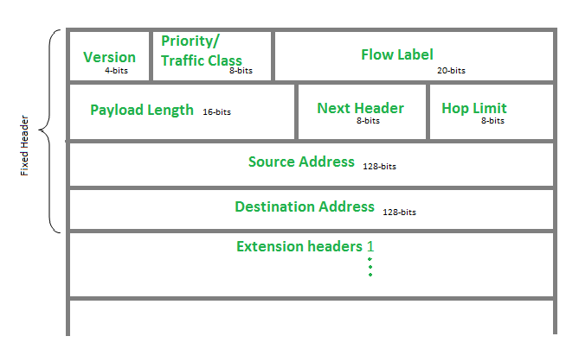
IPv6: IP packet Fragmentation
Fragmentation is done only by the source host using a Fragment Extension Header.
Notes:
Fragmentations are possible in IPV6, but only at source. And in that case an extension header will be defined.

Slide 11
IPv6: IP packet Fragmentation
IPv6 Fragment Extension Header
The Fragment Header contains:
Field | Purpose
Fragment Offset | Position of fragment
M flag | More fragments indicator
Identification | Used for reassembly

Slide 12
IPv6: IP packet Fragmentation
Why IPv6 Removed Router Fragmentation?
Three main reasons:
1. Router performance
Routers operate in hardware and fragmentation is expensive.
2. Simpler routers
Edge hosts handle fragmentation instead.
3. Security
Fragmentation can enable evasion attacks on Firewalls and IDS (Intrusion Detection Systems).

Slide 13
IPv6: IP packet Fragmentation
Evasion Attack
Security systems typically inspect packets to detect attacks. However, if an attacker splits the packet into fragments, the security device may:
inspect fragments individually, or
fail to reassemble them correctly
Meanwhile, the destination host reassembles them differently, revealing the malicious payload.

Slide 14
IPv6: IP packet Fragmentation
Splitting Malicious Payload Across Fragments
An attacker splits a malicious signature across fragments so that the IDS cannot detect it.
Example attack payload:
GET /cmd.exe
Fragments sent:
Fragment 1
GET /cm
Fragment 2
d.exe
If the IDS inspects fragments separately:
Fragment 1 → benign Fragment 2 → benign
But the destination host reassembles:
GET /cmd.exe
This was historically used to bypass signature-based IDS systems.

Slide 15
IPv6: Address and packet format
Q 1. Why is there no header checksum?
Q 2. Why is there no fragmenting related option?
Q 3. Is 128-bit IP address big enough?
Pic courtesy: https://techhub.hpe.com
Notes:
IPv6 provides for a maximum of 3.4×10^38 (340 trillion trillion trillion) unique IP addresses, or about 47 octillion unique addresses for every person on the planet.
For comparison: One light-year is about 6 trillion miles (9 trillion km)
Q1: Does not provide much quality of service when the delivery policy itself is unreliable,
Q2: Pushing the responsibility to the edge. With increasing traffic fragmentation is computation costly.

Slide 16
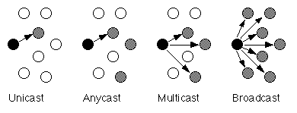
Unicast, Multicast, Anycast, Broadcast

Slide 17
Unicast, Multicast, Anycast, Broadcast
IPv4
IPv4
IPv4

Slide 18
Unicast, Multicast, Anycast, Broadcast
IPv4
IPv4
IPv4
IPv6
IPv6
IPv6
Notes:
The two main broadcast address types in IPv4 are the
Limited Broadcast address (
255.255
.
255.255
) and the Directed Broadcast address (e.g.,
192.168
.
1.255
).

Slide 19
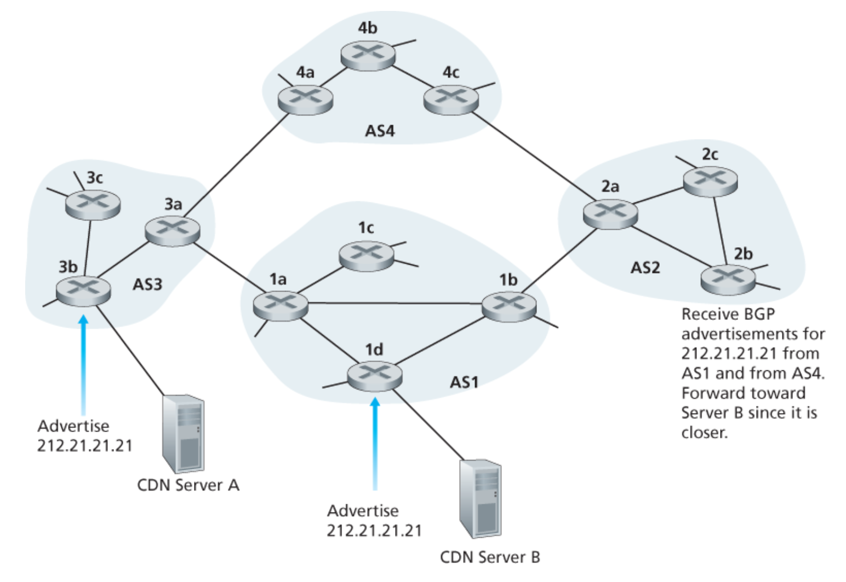
Anycast
IP: Anycast example

Slide 20

Anycast: Is this a new concept?
Anycast effectively existed as a routing pattern even in IPv4; IPv6 formalized it as a first-class architectural concept.
a:b:x:x

Slide 21
Anycast: Is this a new concept?
“Anycast” was possible as a routing pattern even in IPv4; IPv6 formalized it as a first-class architectural concept.
a:b:x:x
a:b:x:x

Slide 22
Multicast
A multicast group exists
Interested nodes join the multicast group
On the local link, switches/NICs learn who is interested
The sender creates a packet addressed to the multicast group
On a single link, all members of that group receive it.
If the multicast is beyond one link, routers
forward it selectively

Slide 23
Multicast: How the groups are formed
1. Predefined (Well-Known) Multicast Groups
Some groups are built into the IPv6 architecture.
Examples
ff02::1 → all-nodes
ff02::2 → all-routers
👉 These groups:
are defined by standards
every relevant node automatically joins them

Slide 24
Multicast: How the groups are formed
2. Dynamically Joined Multicast Groups (Application-driven)
These are the multicast groups created and used by applications.
Examples:
streaming
conferencing
distributed systems

Slide 25
Multicast: How the groups are formed
3. Algorithmically Derived Groups
Some multicast groups are created deterministically from unicast addresses.
How they “form”
Every node:
computes its own multicast group
automatically joins it
No signaling, no coordination
Example: Solicited-node multicast

Slide 26
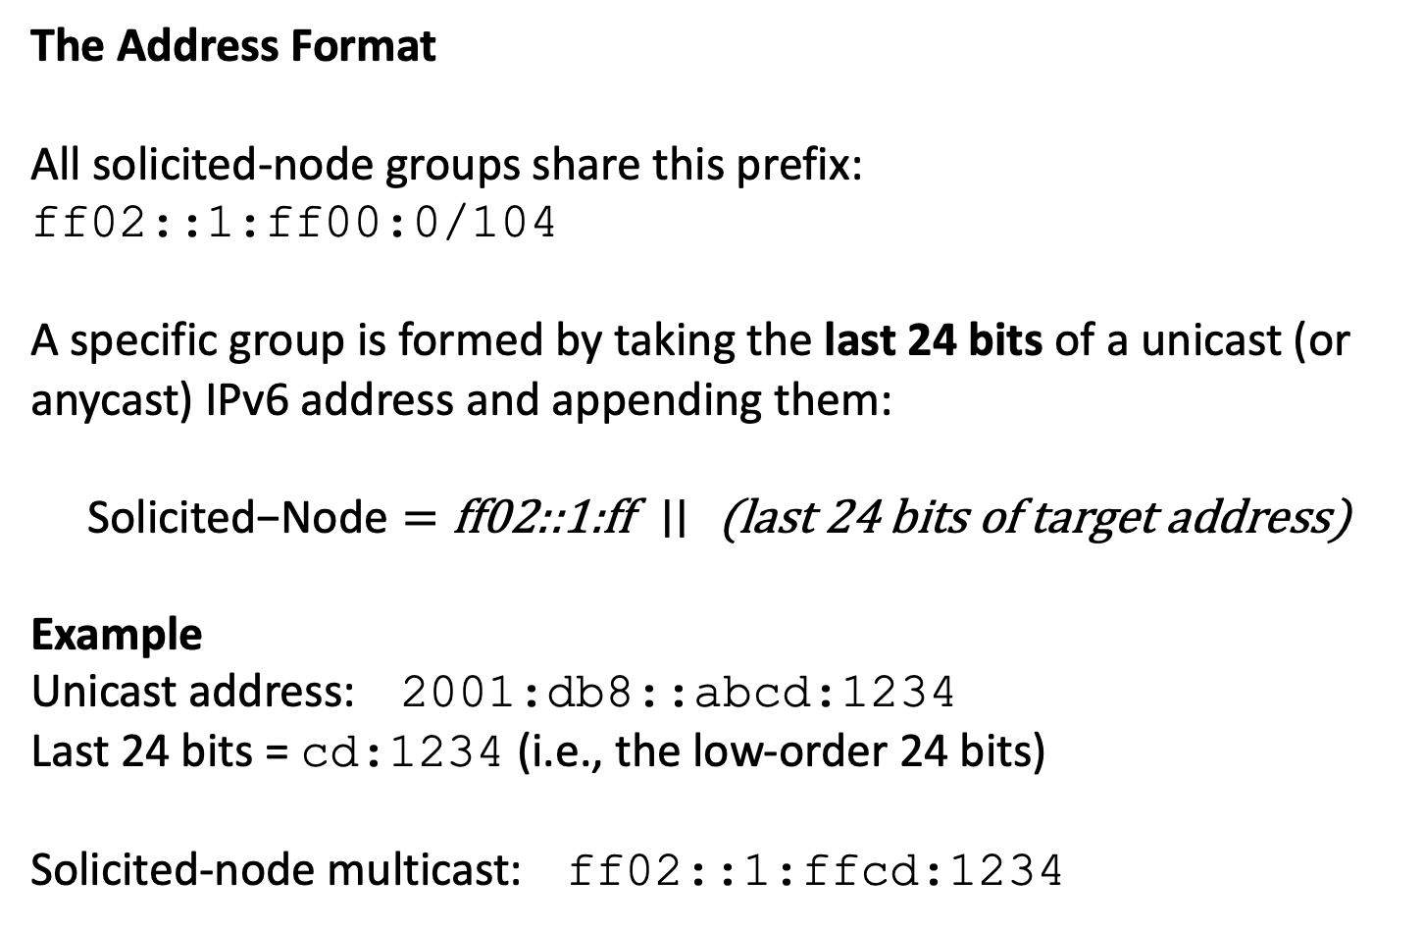
IPV6 Multicast: Solicited-Node Multicast
The Address Format
All solicited-node groups share this prefix:
ff02::1:ff00:0/104
A specific group is formed by taking the last 24 bits of a unicast (or anycast) IPv6 address and appending them:
$$\text{Solicited}\text{−}\text{Node}=\text{ff}\text{02::1:}\text{ff} ∣∣\text{ (}\text{last}\text{ 24 }\text{bits} \text{of} \text{target} \text{address}\text{)}$$
Example
Unicast address: 2001:db8::abcd:1234
Last 24 bits = cd:1234 (i.e., the low-order 24 bits)
Solicited-node multicast: ff02::1:ffcd:1234

Slide 27
IPV6 Neighbor Discovery Protocol (NDP)
What NDP Replaces (from IPv4)
IPv6 collapses multiple IPv4 mechanisms into one protocol:
ARP → address resolution
ICMP Router Discovery → router discovery
ICMP Redirect → route optimization
👉 NDP is a unified control-plane protocol over ICMPv6
Runs Over ICMPv6 (Architectural Placement)
NDP messages are ICMPv6 types
Uses multicast, not broadcast
👉 Important shift:
IPv4: broadcast-heavy
IPv6: multicast + scoped communication

Slide 28
IPV6 Neighbor Discovery Protocol (NDP)
Key Functions of NDP
(a) Address Resolution
Map IPv6 → MAC address
Equivalent of ARP
How:
Neighbor Solicitation (NS) → “Who has this IP?”
Neighbor Advertisement (NA) → “I do”
(b) Router Discovery
Hosts discover routers on the link
How:
Router Solicitation (RS) → “Any routers here?”
Router Advertisement (RA) → “Yes, here is prefix + config”

Slide 29
IPV6 Neighbor Discovery Protocol (NDP)
(c) Prefix Discovery
Learn:
network prefix
subnet information
From:
Router Advertisement (RA) messages
(d) Duplicate Address Detection (DAD)
Ensure an address is unique before use
How:
Host sends NS for its own address
If no reply → safe

Slide 30
IPV6 Neighbor Discovery Protocol (NDP)
(e) Neighbor Unreachability Detection (NUD)
Detect if a neighbor is still alive
Mechanism:
Track reachability via:
traffic
probes (NS/NA)

Slide 31
IPV6 Stateless Address Autoconfiguration (SLAAC)
It is the IPv6 mechanism by which a host can:
create its own IPv6 address,
learn the subnet prefix,
learn the default router,
without needing a DHCP server for address assignment.

Slide 32
IPV6 Stateless Address Autoconfiguration (SLAAC)
Step 1: The host comes online
When a device connects to an IPv6-enabled network, it first enables IPv6 on its interface.
At this point, it does not yet know:
the subnet prefix
the default router
whether it should use SLAAC or DHCPv6
So it starts with only local mechanisms.

Slide 33
IPV6 Stateless Address Autoconfiguration (SLAAC)
Step 2: The host creates a link-local address
Before anything else, the host creates a link-local IPv6 address.
This always uses the prefix: fe80::/64
The remaining 64 bits are created locally by the host, using either:
EUI-64 from the MAC address, or
a randomly generated interface identifier, or
a stable privacy-preserving identifier
Example:
fe80::a1b2:c3d4:e5f6:7890
This address works only on the local link.
It is important because IPv6 control protocols, including Neighbor Discovery, use link-local addresses.

Slide 34
IPV6 Stateless Address Autoconfiguration (SLAAC)
Step 3: The host performs Duplicate Address Detection for the link-local address
Before using even the link-local address, the host must check whether some other node is already using it.
It does this through Duplicate Address Detection (DAD).
The host sends a Neighbor Solicitation (NS) for its own tentative address.
If nobody responds, the address is unique and can be used.
If someone responds with a Neighbor Advertisement (NA), there is a conflict and the address cannot be used.
After successful DAD, the host can use its link-local address.

Slide 35
IPV6 Stateless Address Autoconfiguration (SLAAC)
Step 4: The host discovers routers
Now the host needs to learn:
whether routers are present
what network prefix to use
what default gateway to use
whether SLAAC is allowed
It does this using Neighbor Discovery Protocol (NDP).
The host may send a Router Solicitation (RS) to:
ff02::2 (all-routers multicast)
This is basically asking:
“Are there any routers on this link? Please send configuration information.”
Even if the host does not send RS, routers may periodically send advertisements anyway.

Slide 36
IPV6 Stateless Address Autoconfiguration (SLAAC)
Step 5: The router sends a Router Advertisement
A router replies with a Router Advertisement (RA).
The RA is the key message for SLAAC.
It contains information such as:
the network prefix, for example 2001:db8:abcd:1::/64
the prefix length
the default gateway information
lifetime values
flags indicating whether SLAAC and/or DHCPv6 should be used

Slide 37
IPV6 Stateless Address Autoconfiguration (SLAAC)
Step 6: The host checks the RA flags
The important RA flags include:
A flag: Autonomous address-configuration flag
if set, the prefix can be used for SLAAC
M flag: Managed flag
if set, use DHCPv6 for address assignment
O flag: Other configuration flag
if set, use DHCPv6 for other info such as DNS, while the address may still be formed through SLAAC
For pure SLAAC, the important condition is that the prefix is advertised with the A flag set.

Slide 38
IPV6 Stateless Address Autoconfiguration (SLAAC)
Step 7: The host forms its global unicast address
Now the host has:
the network prefix from the router
its own interface identifier
It combines them to form a full IPv6 address.
Example:
prefix from RA: 2001:db8:abcd:1::/64
host-generated interface ID: a1b2:c3d4:e5f6:7890
Resulting address:
2001:db8:abcd:1:a1b2:c3d4:e5f6:7890
This is the host’s global unicast address.

Slide 39
IPV6 Stateless Address Autoconfiguration (SLAAC)
Step 8: The host performs DAD again for the new global address
The host must again verify uniqueness.
It runs Duplicate Address Detection for the newly formed global address:
sends NS for that tentative address
waits to see if anyone objects
If no response comes back, the address is considered unique and becomes usable.

Slide 40
IPV6 Stateless Address Autoconfiguration (SLAAC)
Step 9: The host installs the default router information
From the RA, the host also learns which router should be used as the default gateway.
This means the host can now:
communicate on the local link directly
send off-link traffic to the router
So after this step, the host has:
a link-local address
a global unicast address
a default router
Now it is fully operational on the IPv6 network.
The host may configure additional addresses
In practice, a host may create more than one IPv6 address on the same interface. Example: one stable address and one temporary privacy address.
This is common in modern systems to reduce long-term tracking.

Slide 41
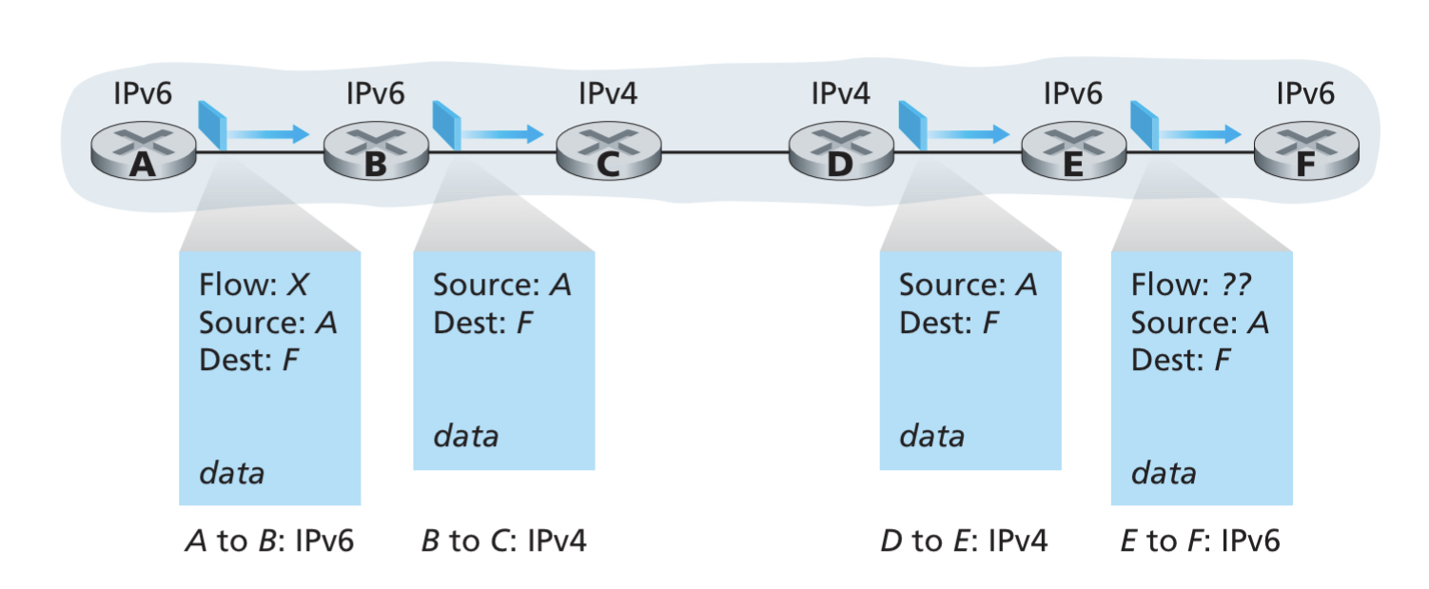
IPv4 and IPv6 Co-existence

Slide 42
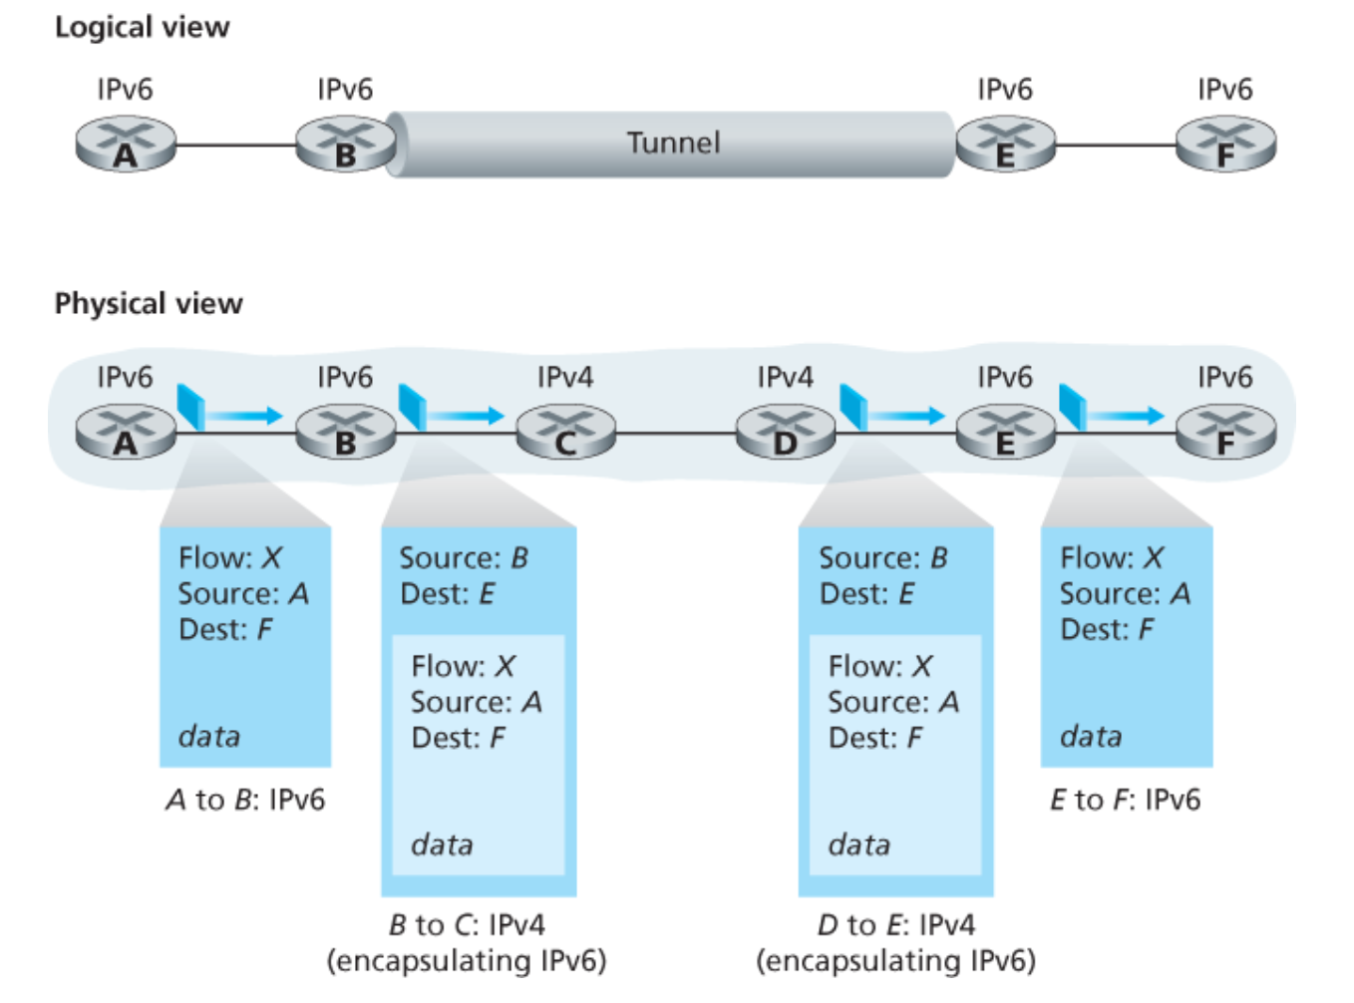
IPv4 and IPv6 Co-existence

Slide 43
Computer Networks
CMSC 417 : Spring 2026
Topic:
Transport Layer Protocols (UDP, TCP)
(Textbook chapter 5)
Nirupam Roy
M-W 2:00-3:15pm
CSI 2117
March 23th, 2026

Slide 44
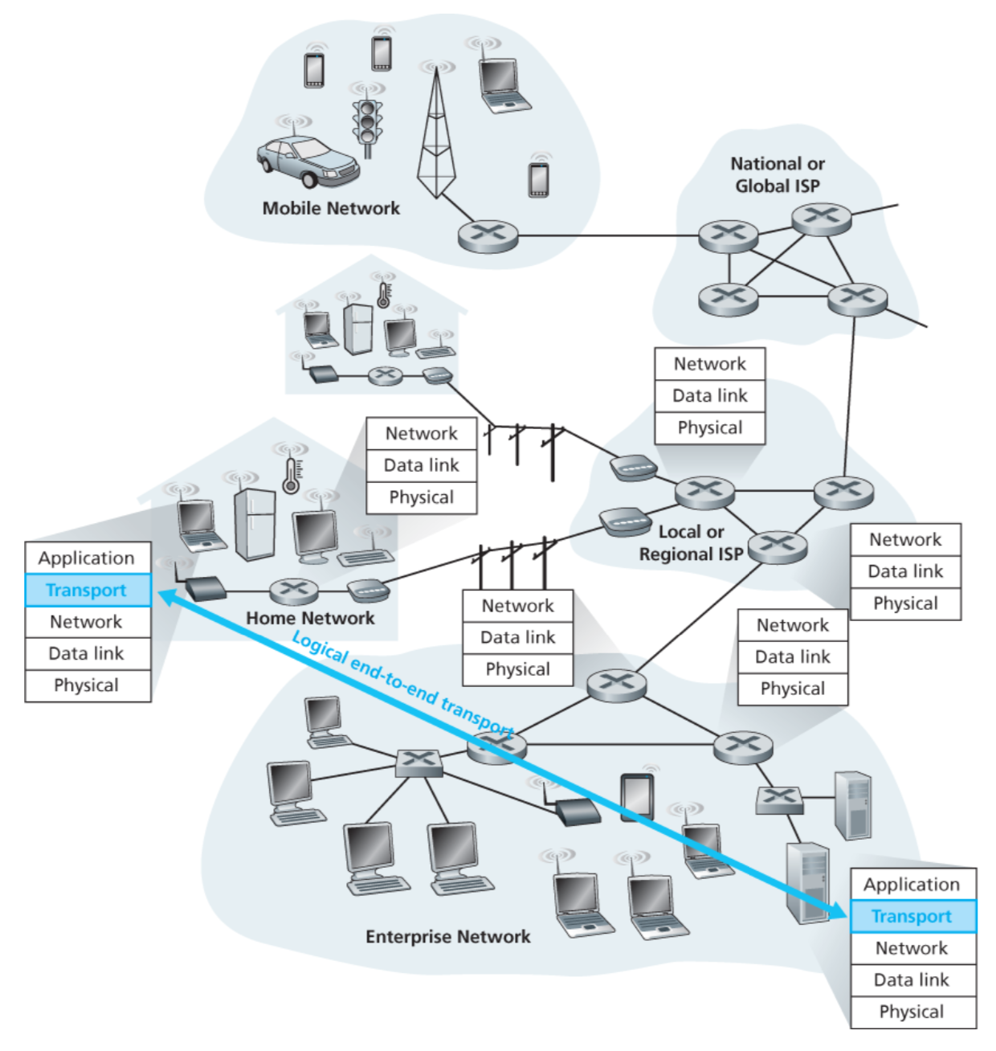

Slide 45
Transport layer: From the lens of two perspectives
(1) Abstraction of clients. (machines/networks/processes)
(2) Abstraction of services.

Slide 46
(1) Abstraction of clients

Slide 47



Network layer abstraction
128.2.0.0/16
200.30.0.0/16
16.20.0.0/20
Network 1
Network 3
Network 2

Slide 48
Network layer abstraction
128.2.0.0/16
200.30.0.0/16
16.20.0.0/20
Network 1
Network 3
Network 2

Slide 49
Network layer abstraction
Network layer services
128.2.0.0/16
200.30.0.0/16
16.20.0.0/20
Network 1
Network 3
Network 2

Slide 50
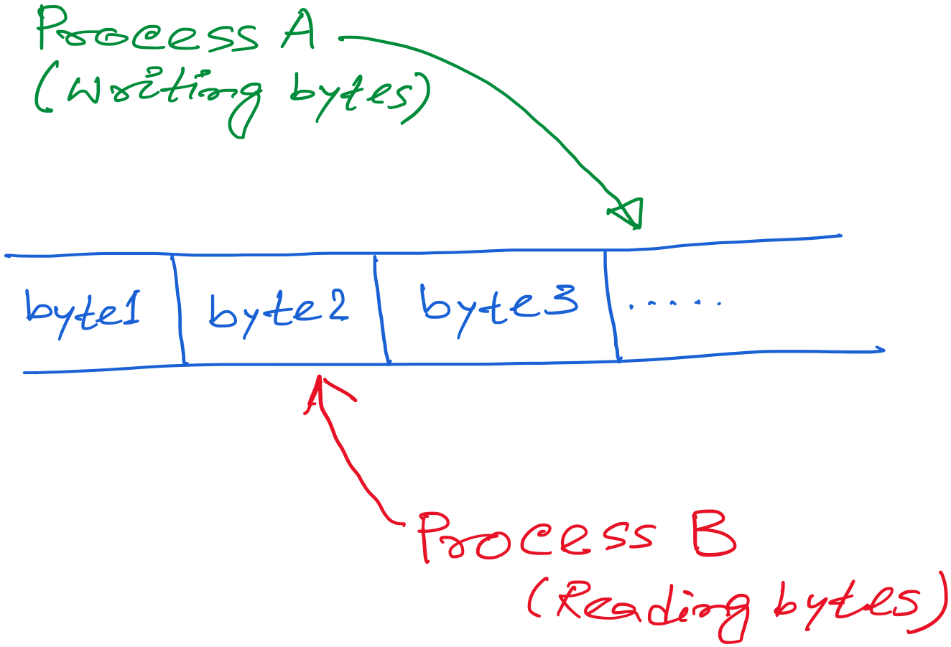
Transport layer abstraction

Slide 51
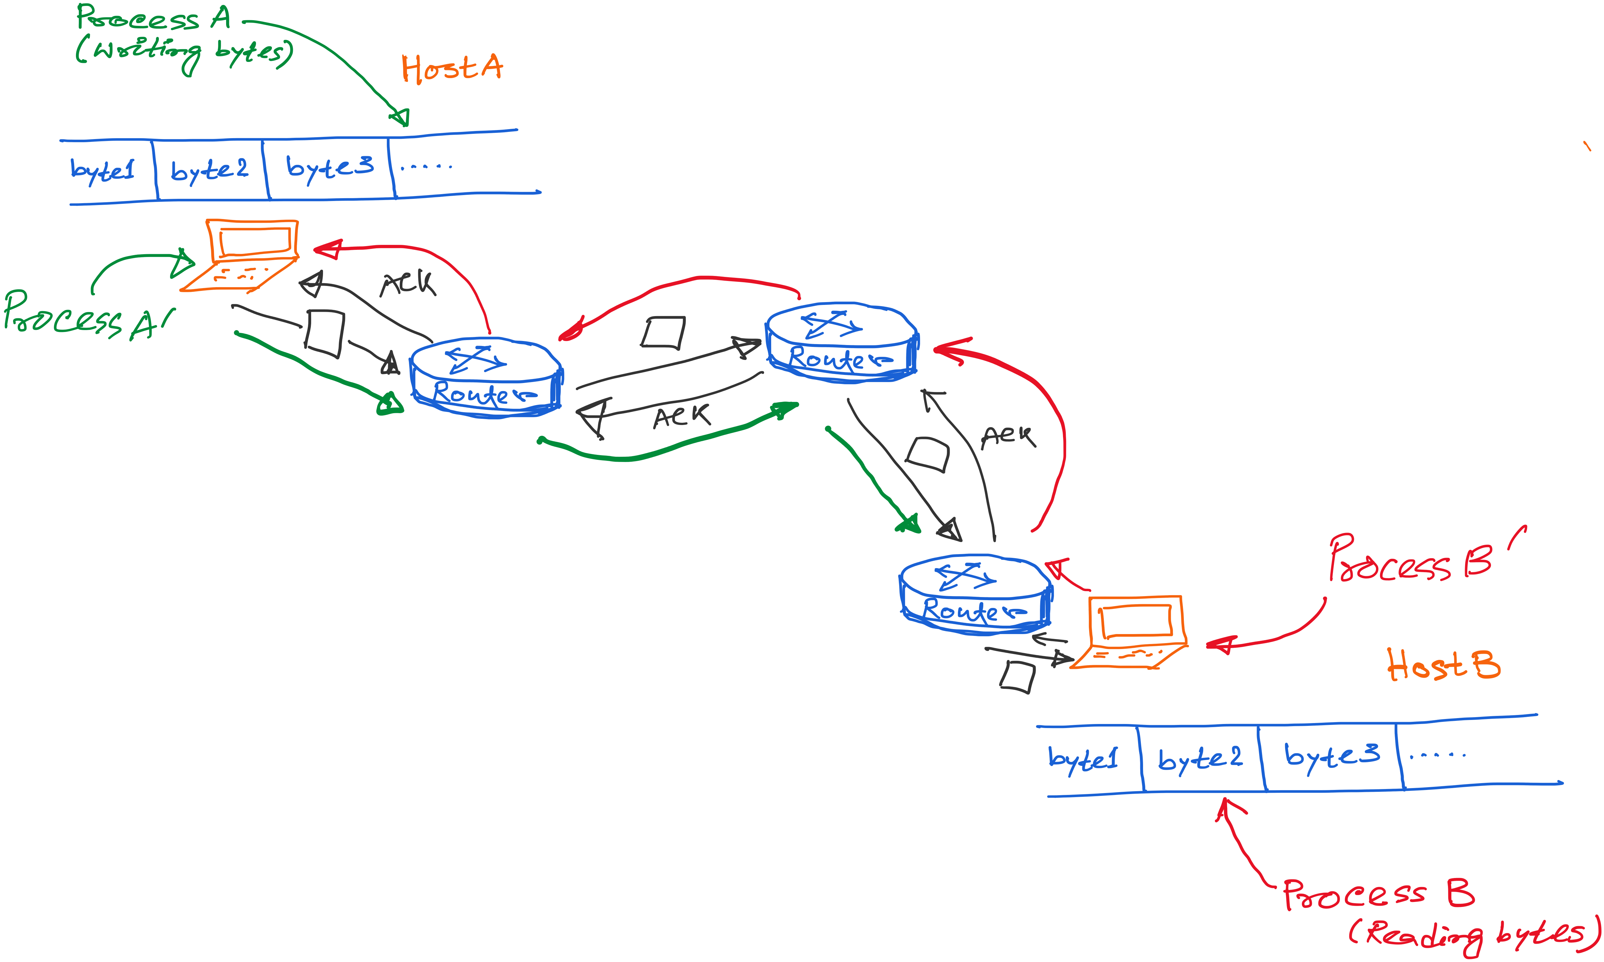
Transport layer abstraction
Transport layer services

Slide 52
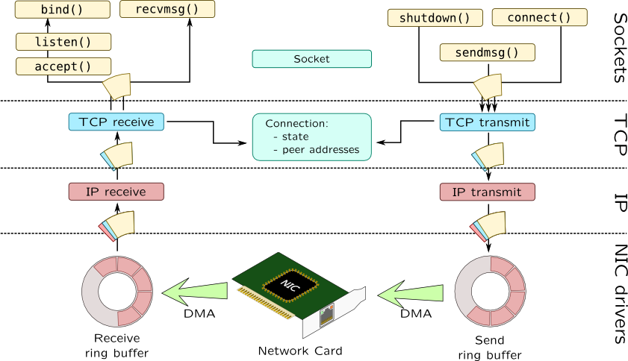

Slide 53
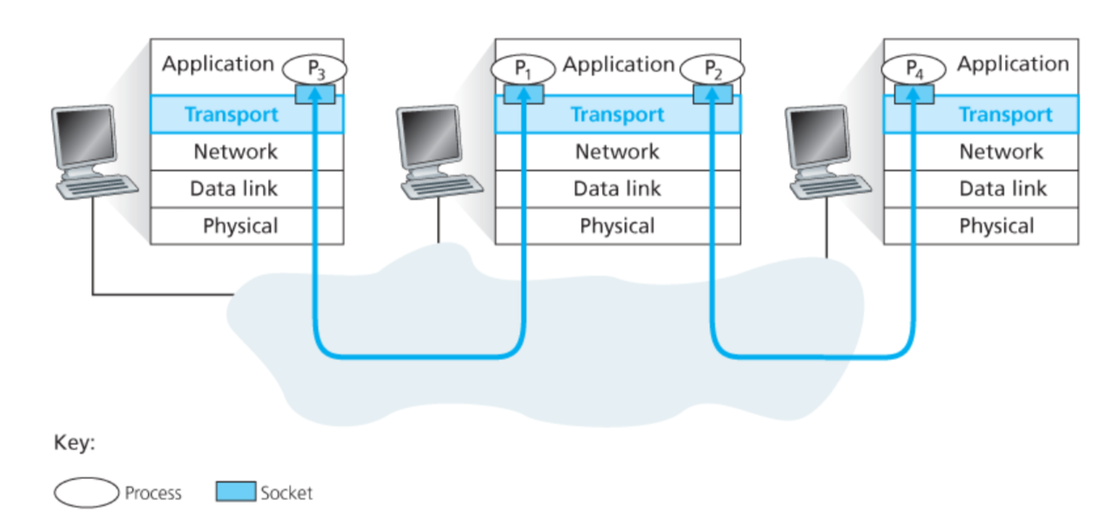
Connection between processes

Slide 54
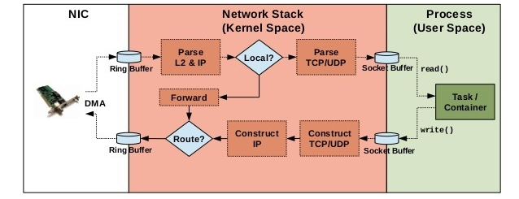
Implementation of networking algorithms

Slide 55
Transport Protocols
Logical communication between processes
Sender divides a message into segments
Receiver reassembles segments into message
Transport services
(De)multiplexing packets
Detecting corrupted data
Optionally: reliable delivery, flow control, …

Slide 56
Two Basic Transport Features
Demultiplexing: port numbers
Error detection: checksums
Server host 128.2.194.242
Service request for
128.2.194.242:80
(i.e., the Web server)
Client host
Web server
(port 80)
Client
OS
Echo server
(port 7)
IP
payload
detect corruption

Slide 57
Multiplexing/demultiplexing
Demultiplexing at rcv host:
Multiplexing at send host:
delivering received segments
to correct socket
Data headers helps flows
from multiple sockets to use
common the network channel,
Info in header later helps
Demultiplexing.
= socket
= process
application
application
application
P4
P3
P1
P2
P1
transport
transport
transport
network
network
network
link
link
link
physical
physical
physical
host 1
host 2
host 3

Slide 58
How demultiplexing works
1) host receives IP datagrams
each datagram has source IP address, destination IP address
each datagram carries 1 transport-layer segment
each segment has source, destination port number
2) host uses IP addresses & port numbers to direct segment to appropriate socket
32 bits
source port #
dest port #
other header fields
application
data
(message)
TCP/UDP segment format

Slide 59
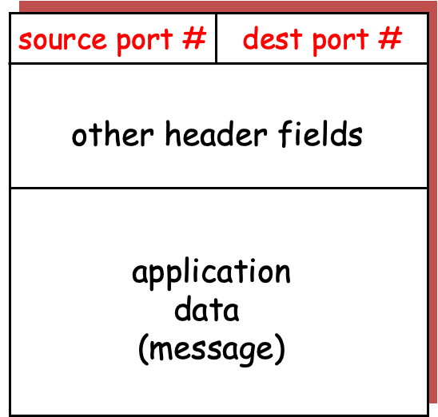
application
application
P3
P1
P2
P1
transport
transport
network
network
link
link
physical
physical
host 1
host 2

Slide 60
application
application
P3
P1
P2
P1
transport
transport
network
network
link
link
physical
physical
host 1
host 2

Slide 61
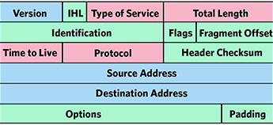
application
application
P3
P1
P2
P1
transport
transport
network
network
link
link
physical
physical
host 1
host 2

Slide 62
application
application
P3
P1
P2
P1
transport
transport
network
network
link
link
physical
physical
host 1
host 2

Slide 63
application
application
P3
P1
P2
P1
transport
transport
network
network
link
link
physical
physical
host 1
host 2

Slide 64
Connection-less mux/demux:
- User Datagram Protocol (UDP)
Connection-oriented mux/demux:
- Transmission Control Protocol (TCP)

Slide 65
Connectionless demultiplexing
When host receives UDP segment:
checks destination port number in segment
directs UDP segment to socket with that port number
IP datagrams with different source IP addresses and/or source port numbers directed to same socket
Create sockets with port numbers:
DatagramSocket mySocket1 = new DatagramSocket(99111);
DatagramSocket mySocket2 = new DatagramSocket(99222);
UDP socket identified by two-tuple:
(dest IP address, dest port number)

Slide 66
Connectionless demux (cont)
DatagramSocket serverSocket = new DatagramSocket(6428);
P2
P1
P3
P1
SP: 6428
SP: 6428
DP: 9157
DP: 5775
SP: 9157
SP: 5775
client
IP: A
DP: 6428
server
IP: C
DP: 6428
Client
IP:B
SP provides “return address”

