Slide 1

Computer Networks
CMSC 417 : Spring 2026
Topic:
Transport Layer Protocols (UDP, TCP)
(Textbook chapter 5)
Nirupam Roy
M-W 2:00-3:15pm
CSI 2117
March 25th, 2026

Slide 2
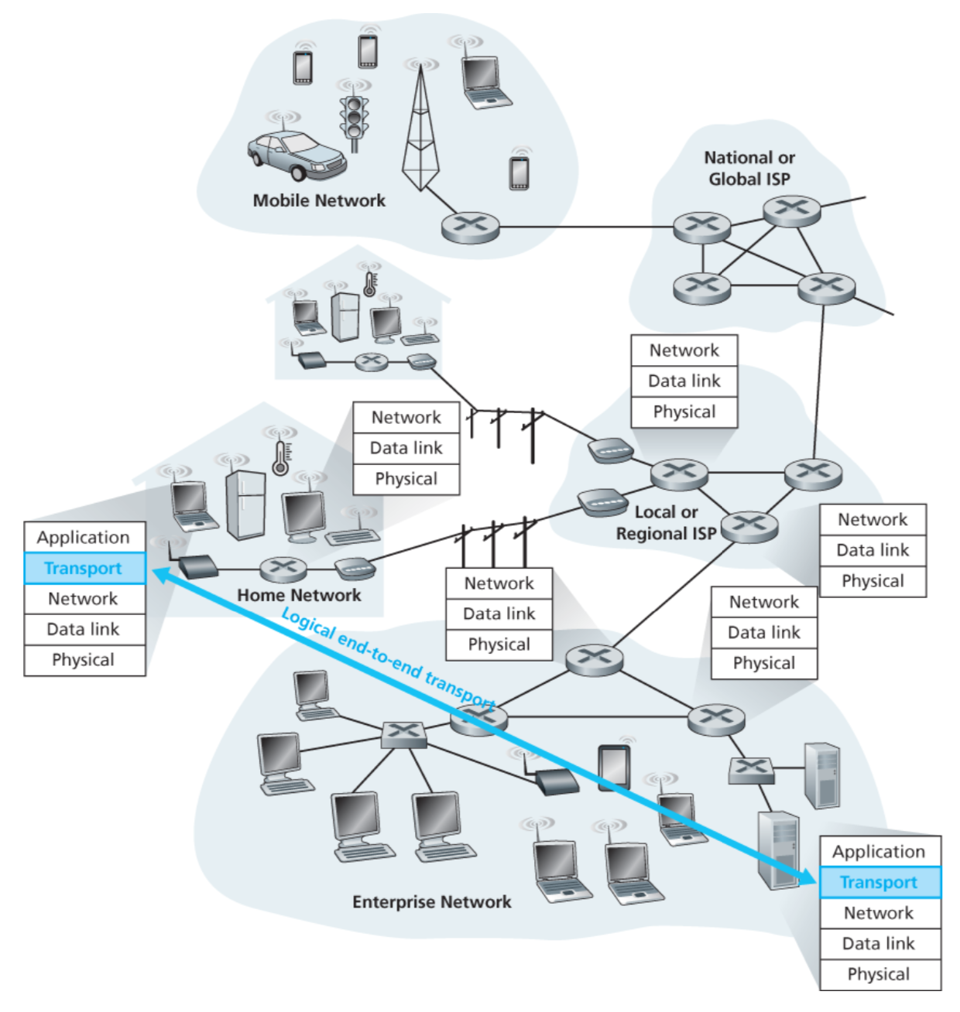

Slide 3
Transport layer: From the lens of two perspectives
(1) Abstraction of clients. (machines/networks/processes)
(2) Abstraction of services.

Slide 4
(1) Abstraction of clients

Slide 5
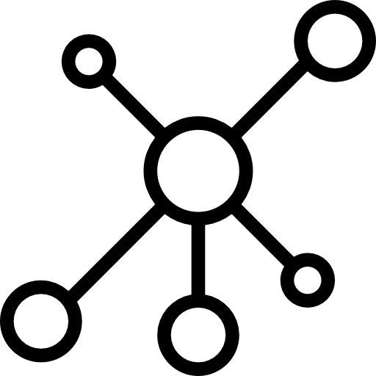
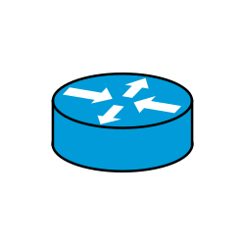

Network layer abstraction
128.2.0.0/16
200.30.0.0/16
16.20.0.0/20
Network 1
Network 3
Network 2

Slide 6
Network layer abstraction
128.2.0.0/16
200.30.0.0/16
16.20.0.0/20
Network 1
Network 3
Network 2

Slide 7
Network layer abstraction
Network layer services
128.2.0.0/16
200.30.0.0/16
16.20.0.0/20
Network 1
Network 3
Network 2

Slide 8
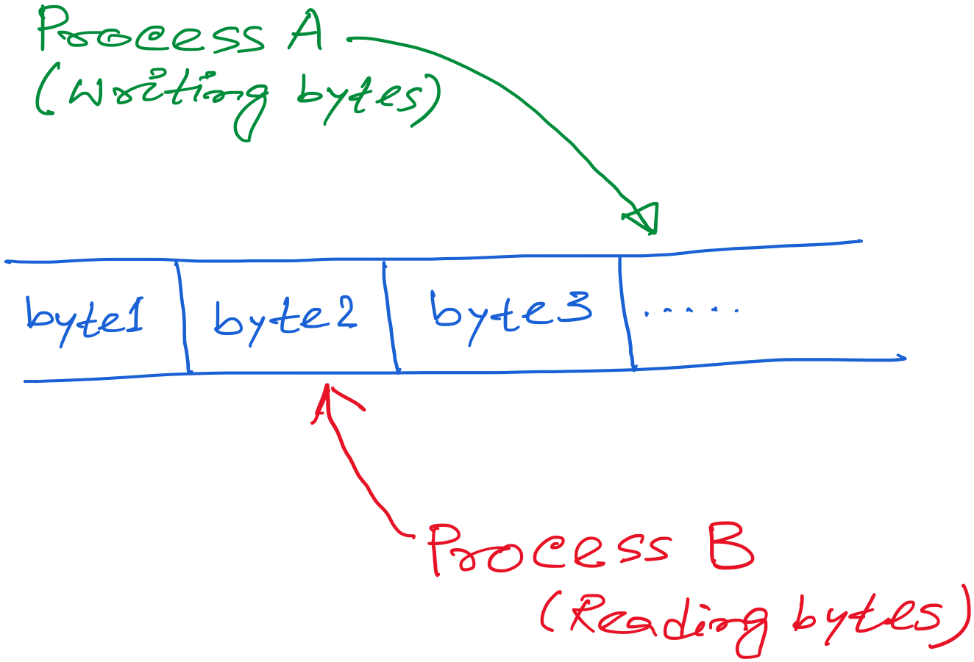
Transport layer abstraction

Slide 9
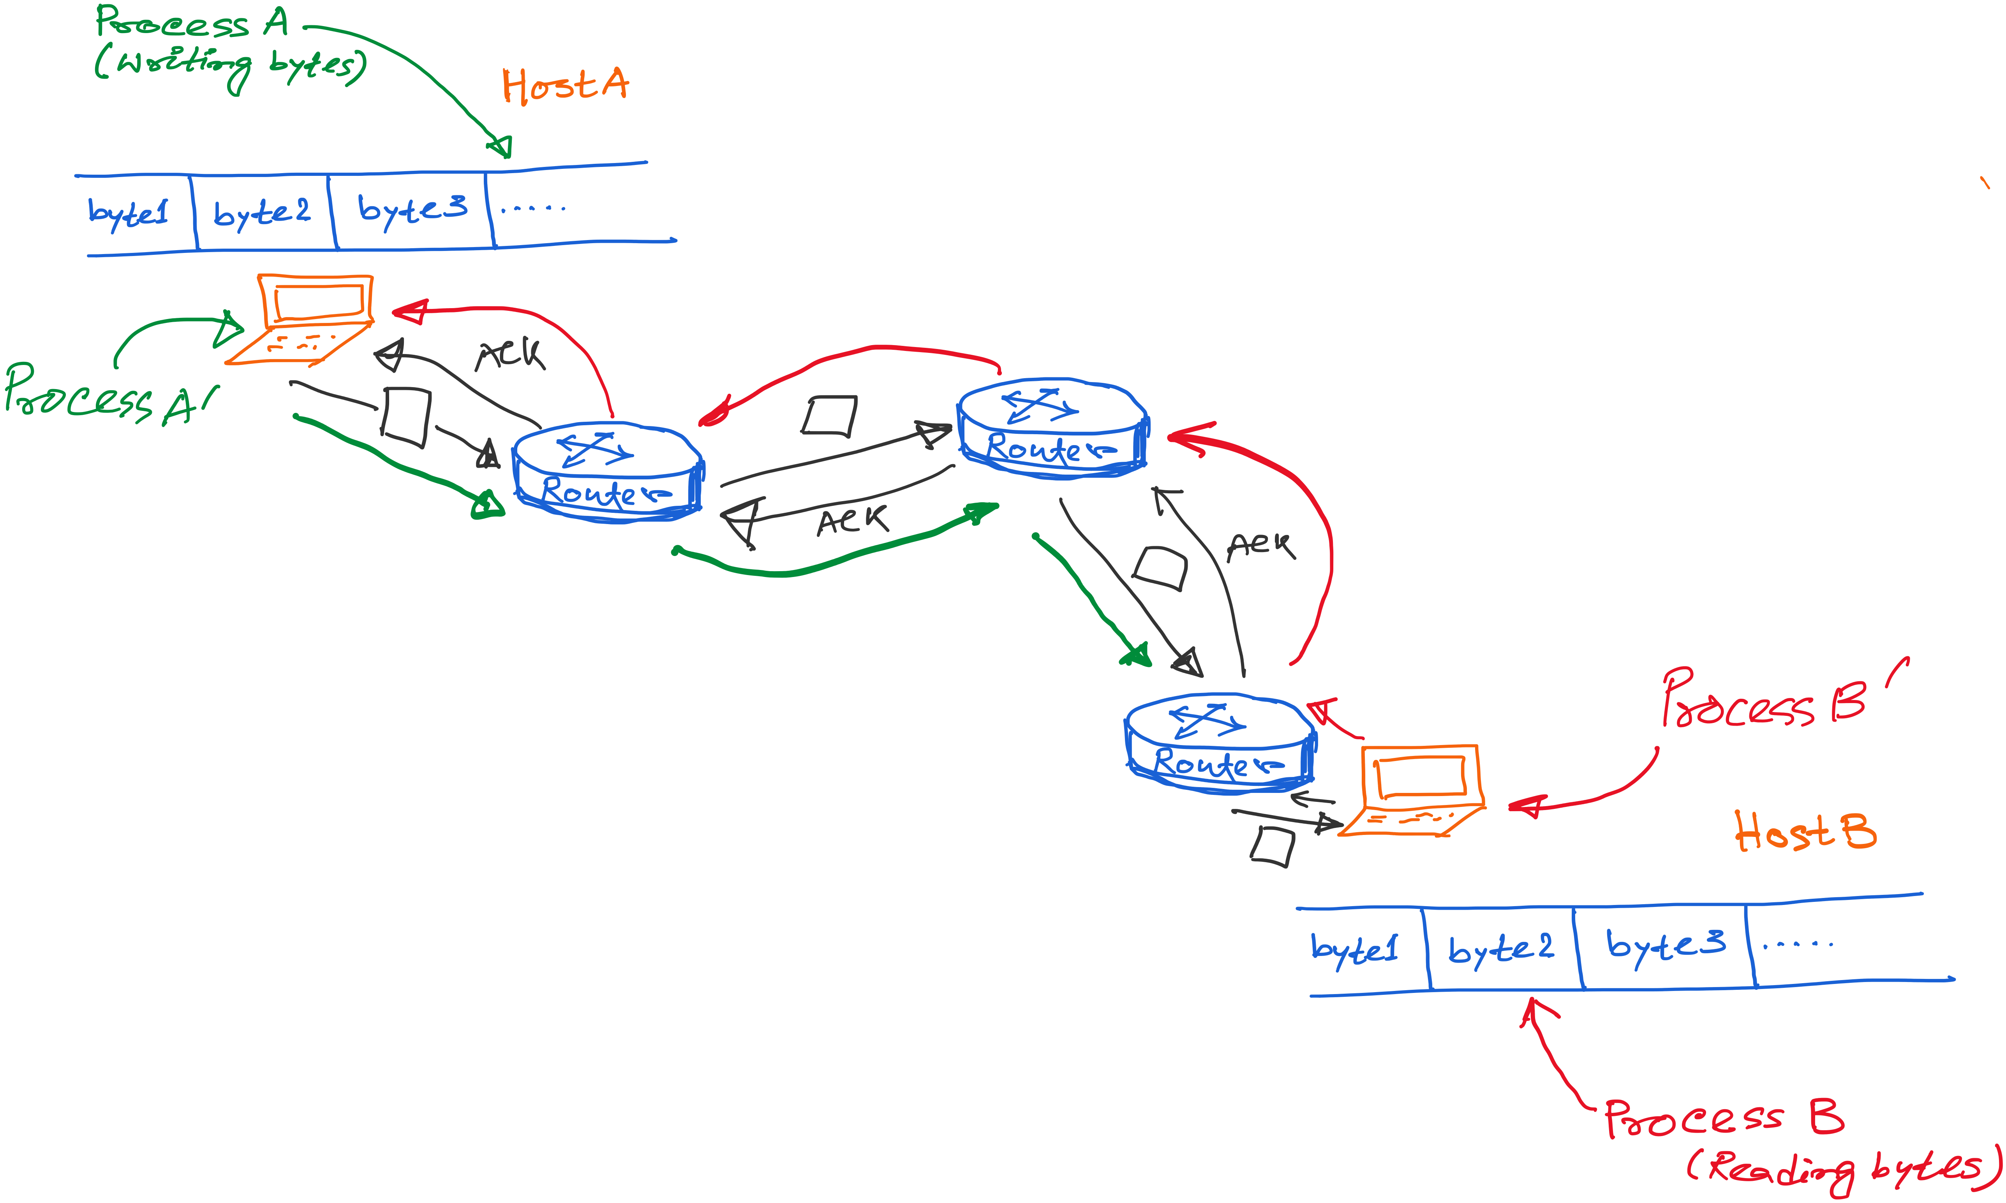
Transport layer abstraction
Transport layer services

Slide 10
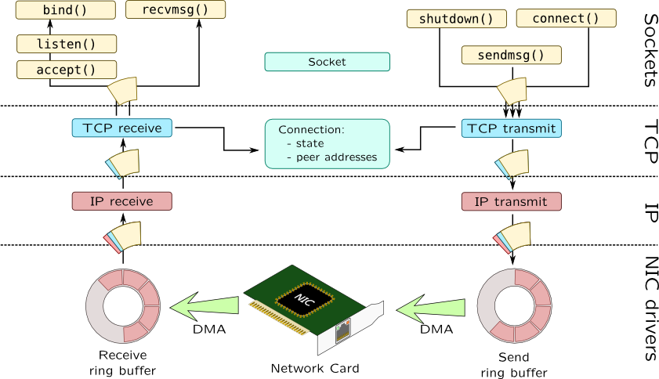

Slide 11
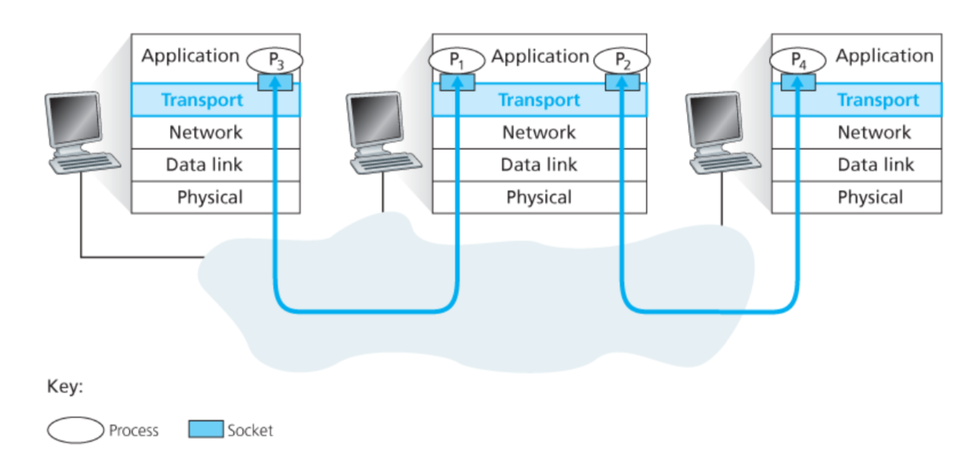
Connection between processes

Slide 12
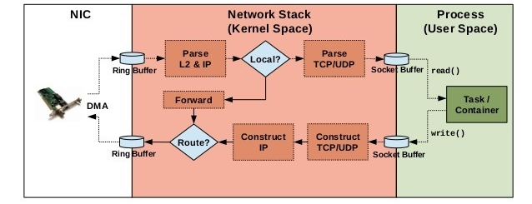
Implementation of networking algorithms

Slide 13
Transport Protocols
Logical communication between processes
Sender divides a message into segments
Receiver reassembles segments into message
Transport services
(De)multiplexing packets
Detecting corrupted data
Optionally: reliable delivery, flow control, …

Slide 14
Two Basic Transport Features
Demultiplexing: port numbers
Error detection: checksums
Server host 128.2.194.242
Service request for
128.2.194.242:80
(i.e., the Web server)
Client host
Web server
(port 80)
Client
OS
Echo server
(port 7)
IP
payload
detect corruption

Slide 15
Multiplexing/demultiplexing
Demultiplexing at rcv host:
Multiplexing at send host:
delivering received segments
to correct socket
Data headers helps flows
from multiple sockets to use
common the network channel,
Info in header later helps
Demultiplexing.
= socket
= process
application
application
application
P4
P3
P1
P2
P1
transport
transport
transport
network
network
network
link
link
link
physical
physical
physical
host 1
host 2
host 3

Slide 16
How demultiplexing works
1) host receives IP datagrams
each datagram has source IP address, destination IP address
each datagram carries 1 transport-layer segment
each segment has source, destination port number
2) host uses IP addresses & port numbers to direct segment to appropriate socket
32 bits
source port #
dest port #
other header fields
application
data
(message)
TCP/UDP segment format

Slide 17
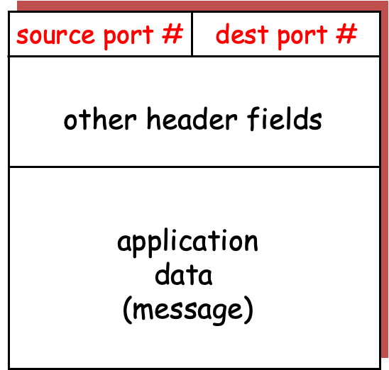
application
application
P3
P1
P2
P1
transport
transport
network
network
link
link
physical
physical
host 1
host 2

Slide 18
application
application
P3
P1
P2
P1
transport
transport
network
network
link
link
physical
physical
host 1
host 2

Slide 19
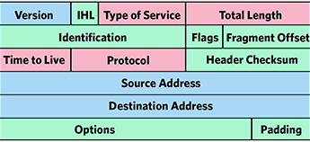
application
application
P3
P1
P2
P1
transport
transport
network
network
link
link
physical
physical
host 1
host 2

Slide 20
application
application
P3
P1
P2
P1
transport
transport
network
network
link
link
physical
physical
host 1
host 2

Slide 21
application
application
P3
P1
P2
P1
transport
transport
network
network
link
link
physical
physical
host 1
host 2

Slide 22
Connection-less mux/demux:
- User Datagram Protocol (UDP)
Connection-oriented mux/demux:
- Transmission Control Protocol (TCP)

Slide 23
Connectionless demultiplexing
When host receives UDP segment:
checks destination port number in segment
directs UDP segment to socket with that port number
IP datagrams with different source IP addresses and/or source port numbers directed to same socket
Create sockets with port numbers:
DatagramSocket mySocket1 = new DatagramSocket(99111);
DatagramSocket mySocket2 = new DatagramSocket(99222);
UDP socket identified by two-tuple:
(dest IP address, dest port number)
Notes:
Why port+IP for demultiplexing, why not port only: A host can have multiple IP addresses (e.g., multiple interfaces, IPv4 + IPv6, virtual interfaces).

Slide 24
Connectionless demux (cont)
DatagramSocket serverSocket = new DatagramSocket(6428);
P2
P1
P3
P1
SP: 6428
SP: 6428
DP: 9157
DP: 5775
SP: 9157
SP: 5775
client
IP: A
DP: 6428
server
IP: C
DP: 6428
Client
IP:B
SP provides “return address”

Slide 25
Connection-oriented demux
TCP socket identified by 4-tuple:
source IP address
source port number
dest IP address
dest port number
recv host uses all four values to direct segment to appropriate socket
Server host may support many simultaneous TCP sockets:
each socket identified by its own 4-tuple
Web servers have different sockets for each connecting client
non-persistent HTTP will have different socket for each request

Slide 26
Connection-oriented demux (cont)
= socket
= process
P1
P4
P5
P6
P2
P1
P3
SP: 5775
DP: 80
S-IP: B
D-IP:C
SP: 9157
SP: 9157
client
IP: A
DP: 80
server
IP: C
DP: 80
Client
IP:B
S-IP: A
S-IP: B
D-IP:C
D-IP:C

Slide 27
Connection-oriented demux: Threaded Web Server
= socket
= process
P1
P4
P2
P1
P3
SP: 5775
DP: 80
S-IP: B
D-IP:C
SP: 9157
SP: 9157
client
IP: A
DP: 80
server
IP: C
DP: 80
Client
IP:B
S-IP: A
S-IP: B
D-IP:C
D-IP:C

Slide 28
(2) Abstraction of services

Slide 29
IP Protocol Stack: Key Abstractions
Application
Applications
Transport
Streams of data
Messages
Network
Best-effort global packet delivery
Best-effort local packet delivery
Link
Transport layer is where we “pay the piper”
Provide applications with good abstractions
Without support or feedback from the network

Slide 30
End-to-end Protocols
(UDP, TCP)

Slide 31
End-to-end Protocols
Common properties that a transport protocol can be expected to provide
Guarantees message delivery
Delivers messages in the same order they were sent
Delivers at most one copy of each message
Supports arbitrarily large messages
Supports synchronization between the sender and the receiver
Allows the receiver to apply flow control to the sender
Supports multiple application processes (Mux/DeMux)

Slide 32
End-to-end Protocols
Typical limitations of the network on which transport protocol will operate
Drop messages/Packet loss
Reorder messages/Out of order delivery
Deliver duplicate copies of a given message
Limit messages to some finite size
Deliver messages after an arbitrarily long delay

Slide 33
User Datagram Protocol (UDP)

Slide 34
UDP: User Datagram Protocol [RFC 768]
Bare minimum Internet transport protocol
“best effort” service, UDP segments may be:
lost
delivered out of order to app
connectionless:
no handshaking between UDP sender, receiver
each UDP segment handled independently of others

Slide 35
User Datagram Protocol (UDP)
Datagram messaging service
Demultiplexing: port numbers
Detecting corruption: checksum
Lightweight communication between processes
Send and receive messages
Avoid overhead of any ordered, reliable delivery
SRC port
DST port
length
checksum
DATA

Slide 36
UDP: more
often used for streaming multimedia apps
loss tolerant
rate sensitive
other UDP uses
DNS
SNMP
reliable transfer over UDP: add reliability at application layer
application-specific error recovery!
32 bits
Length, in
bytes of UDP
segment,
including
header
source port #
dest port #
length
checksum
Application
data
(message)
UDP segment format

Slide 37
UDP checksum
Goal: detect “errors” (e.g., flipped bits) in transmitted segment
Sender:
treat segment contents as sequence of 16-bit integers
checksum: addition (1’s complement sum) of segment contents
sender puts checksum value into UDP checksum field
Receiver:
compute checksum of received segment
check if computed checksum equals checksum field value:
NO - error detected
YES - no error detected.
Is UDP service == IP service ??

Slide 38
Recall encapsulation

Slide 39
Advantages of UDP
Fine-grain control
UDP sends as soon as the application writes
No connection set-up delay
UDP sends without establishing a connection
No connection state
No buffers, parameters, sequence #s, etc.
Small header overhead
UDP header is only eight-bytes long

Slide 40
Popular Applications That Use UDP
Multimedia streaming
Retransmitting packets is not always worthwhile
E.g., phone calls, video conferencing, gaming, IPTV
Simple query-response protocols
Overhead of connection establishment is overkill
E.g., Domain Name System (DNS), DHCP, etc.
“Address for www.cnn.com?”
“12.3.4.15”

Slide 41
How to introduce reliability in transport?

Slide 42
What are the expectations from a reliable packet delivery system?
Guaranteed delivery
Ordered delivery
At-most one copy of the message
(any or all of the above)

Slide 43
What are the features of the underlying ‘best effort’ network?
Packet loss
Out of order delivery
Multiple copies
Delay variations
A non-zero probability of packet delivery

Slide 44
Transmission Control Protocol (TCP)

Slide 45
TCP “Segments”
Host A
Byte 1
Byte 2
Byte 3
Byte 80
Segment sent when:
Segment full (Max Segment Size),
Not full, but times out, or
“Pushed” by application.
TCP Data
TCP Data
Host B
Byte 1
Byte 2
Byte 3
Byte 80

Slide 46
Sequence Number
Host A
ISN (initial sequence number)
Byte 81
Sequence number =
ISN+ # of the 1st byte the segment
TCP Data
TCP Data
Host B

Slide 47
Sequence Number
Host A
ISN (initial sequence number)
Byte 81
Sequence number =
ISN+ # of the 1st byte the segment
TCP Data
TCP Data
Host B
How are acknowledgements identified?

Slide 48
TCP Header

Slide 49
Acknowledgement Number
Host A
ISN (initial sequence number)
Byte 81
Sequence number =
ISN+ # of the 1st byte the segment
TCP Data
ACK number ==
Next expected Seq number
TCP Data
Host B

Slide 50
Starting and Ending a Connection: TCP Handshakes (Three-Way Handshake)

Slide 51
Establishing a TCP Connection
A
B
SYN
SYN ACK
Each host tells its ISN to the other host.
ACK
Data
Data
Three-way handshake to establish connection
Host A sends a SYN (open) to the host B
Host B returns a SYN acknowledgment (SYN ACK)
Host A sends an ACK to acknowledge the SYN ACK

Slide 52
TCP Header
32 bits
Source port
Destination port
Sequence number
Flags:
SYN
FIN
RST
PSH
URG
ACK
Acknowledgment
HdrLen
0
Flags
Advertised window
Checksum
Urgent pointer
Options (variable)
Data

Slide 53
TCP Header
Notes:
The TCP Header Length (also known as Data Offset) is a 4-bit field in the TCP header, which defines the size of the TCP header in 32-bit (4-byte) words.
How It Works
The 4-bit field allows values from 0 to 15.
Each unit in this field represents 4 bytes (32 bits).
The minimum TCP header size is 20 bytes (when the field is 5, meaning 5 × 4 = 20 bytes).
The maximum TCP header size is 60 bytes (when the field is 15, meaning 15 × 4 = 60 bytes).

Slide 56
Step 1: A’s Initial SYN Packet
A’s port
B’s port
A’s Initial Sequence Number
Flags:
SYN
FIN
RST
PSH
URG
ACK
Acknowledgment
20
Flags
Advertised window
0
Checksum
Urgent pointer
Options (variable)
A tells B it wants to open a connection…

Slide 59
Step 2: B’s SYN-ACK Packet
B’s port
A’s port
B’s Initial Sequence Number
Flags:
SYN
FIN
RST
PSH
URG
ACK
A’s ISN plus 1
20
Flags
Advertised window
0
Checksum
Urgent pointer
Options (variable)
B tells A it accepts, and is ready to hear the next byte…
… upon receiving this packet, A can start sending data

Slide 62
Step 3: A’s ACK of the SYN-ACK
A’s port
B’s port
Sequence number
Flags:
SYN
FIN
RST
PSH
URG
ACK
B’s ISN plus 1
20
Flags
Advertised window
0
Checksum
Urgent pointer
Options (variable)
A tells B it is okay to start sending
… upon receiving this packet, B can start sending data

Slide 64
What is really happening?
Exchange of ISNs
(a) Alice --> Bob SYNchronize with my Initial Sequence Number of X
(b) Alice <-- Bob I received your syn, I ACKnowledge that I am ready for [X+1]
(c) Alice <-- Bob SYNchronize with my Initial Sequence Number of Y
(d) Alice --> Bob I received your syn, I ACKnowledge that I am ready for [Y+1]
Piggybacking information
(a) Alice --> Bob : SYN
(b) Alice <-- Bob : SYN+ACK
(c) Alice --> Bob : ACK
Can data piggyback on 3-way handshake packets?
Notes:
TCP is a bi-directional communication protocol, which means either end ought to be able to send data reliably. Both parties need to establish an ISN, and both parties need to acknowledge the other's ISN.
Piggyback: Data can piggyback on the TCP three-way handshake, a technique often called "TCP Fast Open" (TFO).

Slide 65
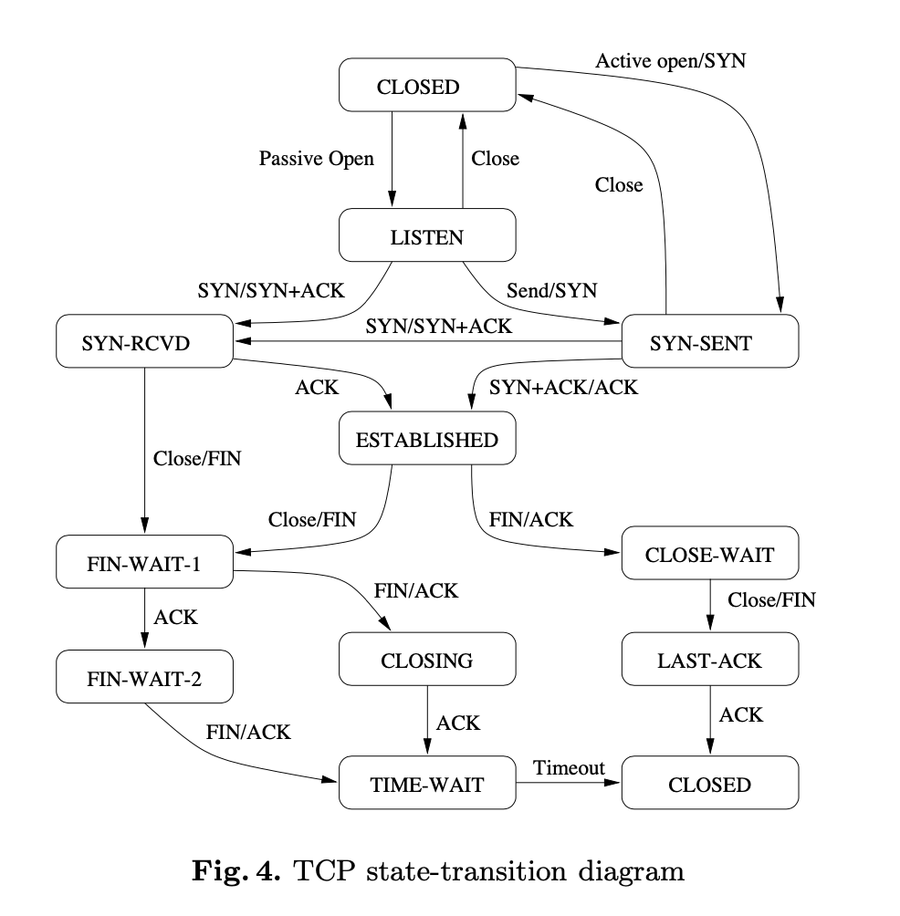
[Ref] Efficient Reachability Analysis of Hierarchical Reactive Machines

Slide 66
What if the SYN Packet Gets Lost?
Suppose the SYN packet gets lost
Packet is lost inside the network, or
Server rejects the packet (e.g., listen queue is full)
Eventually, no SYN-ACK arrives
Sender sets a timer and wait for the SYN-ACK
… and retransmits the SYN if needed
How should the TCP sender set the timer?
Sender has no idea how far away the receiver is
Some TCPs use a default of 3 or 6 seconds

Slide 67
SYN Loss and Web Downloads
User clicks on a hypertext link
Browser creates a socket and does a “connect”
The “connect” triggers the OS to transmit a SYN
If the SYN is lost…
The 3-6 seconds of delay is very long
The impatient user may click “reload”
User triggers an “abort” of the “connect”
Browser “connects” on a new socket
Essentially, forces a fast send of a new SYN!

Slide 68
Tearing Down the Connection
B
ACK
SYN
SYN ACK
Data
ACK
FIN
ACK
FIN
ACK
A
time
Closing (each end of) the connection
Finish (FIN) to close and receive remaining bytes
And other host sends a FIN ACK to acknowledge

Slide 69
Tearing Down the Connection
B
ACK
SYN
SYN ACK
Data
ACK
FIN
ACK
FIN
ACK
A
time
Closing (each end of) the connection
Finish (FIN) to close and receive remaining bytes
And other host sends a FIN ACK to acknowledge
Reset (RST) to close and not receive remaining bytes

Slide 70
Sending/Receiving the FIN Packet
Sending a FIN: close()
Process is done sending data via the socket
Process invokes “close()” to close the socket
Once TCP has sent all the outstanding bytes…
… then TCP sends a FIN
Receiving a FIN: EOF
Process is reading data from the socket
Eventually, the attempt to read returns an EOF

Slide 71
TCP Header: PSH and URG flags
Notes:
The TCP PSH (Push) flag is a control flag used to indicate that the receiving device should deliver the data to the receiving application as soon as possible, rather than buffering it.

Slide 72
TCP Header: PSH and URG flags
Notes:
The URG (Urgent) flag is another control flag in TCP, which is used to indicate that some data in the packet is urgent and requires immediate attention. However, unlike the PSH flag, the URG flag is rarely used in modern applications.
Example Scenario:
In Telnet or SSH, if a user presses Ctrl+C, the OS should immediately terminate a running command. The key press is sent with the URG flag and processed ahead of buffered data.
TCP header includes:
Urgent Pointer (offset)
When URG is set:
Urgent pointer marks a position in the byte stream:
urgent data ends at sequence number = current seq + urgent pointer
Receiver behavior:
Notify application that urgent data is present
Application can read urgent data separately (e.g., via MSG_OOB in sockets)
Example use case (classic)
Terminal interrupt signal (e.g., Ctrl+C)
Immediate control messages in a stream

Slide 73
Reliable Delivery on a Lossy Channel With Bit Errors

Slide 74
Challenges of Reliable Data Transfer
Over a perfectly reliable channel
Easy: sender sends, and receiver receives
Over a channel with bit errors
Receiver detects errors and requests retransmission
Over a lossy channel with bit errors
Some data are missing, and others corrupted
Receiver cannot always detect loss
Over a channel that may reorder packets
Receiver cannot distinguish loss from out-of-order

Slide 75
Retransmission hints
Acknowledgments from receiver
Positive: “okay” or “uh huh” or “ACK”
Negative: “please repeat that” or “NACK”
Retransmission by the sender
After not receiving an “ACK”
After receiving a “NACK”
Timeout by the sender (“stop and wait”)
Don’t wait forever without some acknowledgment

Slide 76
TCP Support for Reliable Delivery
Detect bit errors: checksum
Used to detect corrupted data at the receiver
…leading the receiver to drop the packet
Detect missing data: sequence number
Used to detect a gap in the stream of bytes
... and for putting the data back in order
Recover from lost data: retransmission
Sender retransmits lost or corrupted data
Two main ways to detect lost packets

Slide 77
TCP Acknowledgments
Host A
ISN (initial sequence number)
Sequence number = ISN+1st byte
TCP Data
ACK sequence number = next expected byte
TCP Data
Host B

Slide 78
Automatic Repeat reQuest (ARQ)
ACK and timeouts
Receiver sends ACK when it receives packet
Sender waits for ACK and times out
Simplest ARQ protocol
Stop and wait
Send a packet, stop and wait until ACK arrives
Sender
Receiver
Packet
Timeout
ACK
Time

Slide 79
Automatic Repeat reQuest (ARQ)
We will discuss two variations
1. Stop and Wait
2. Sliding window

Slide 80
Reliable Delivery on a Lossy Channel With Bit Errors
Stop-and-Wait Protocol

Slide 81
Sender
Receiver
Packet
Timeout
ACK
Time

Slide 82
A few design decisions
1. Unique packet identifiers: Why and how
2. Duplicate packets: Why and how to eliminate
3. Timeout: picking the ideal value

Slide 83
A few design decisions
1. Unique packet identifiers: Why and how
2. Duplicate packets: Why and how to eliminate
3. Timeout: picking the ideal value

Slide 84
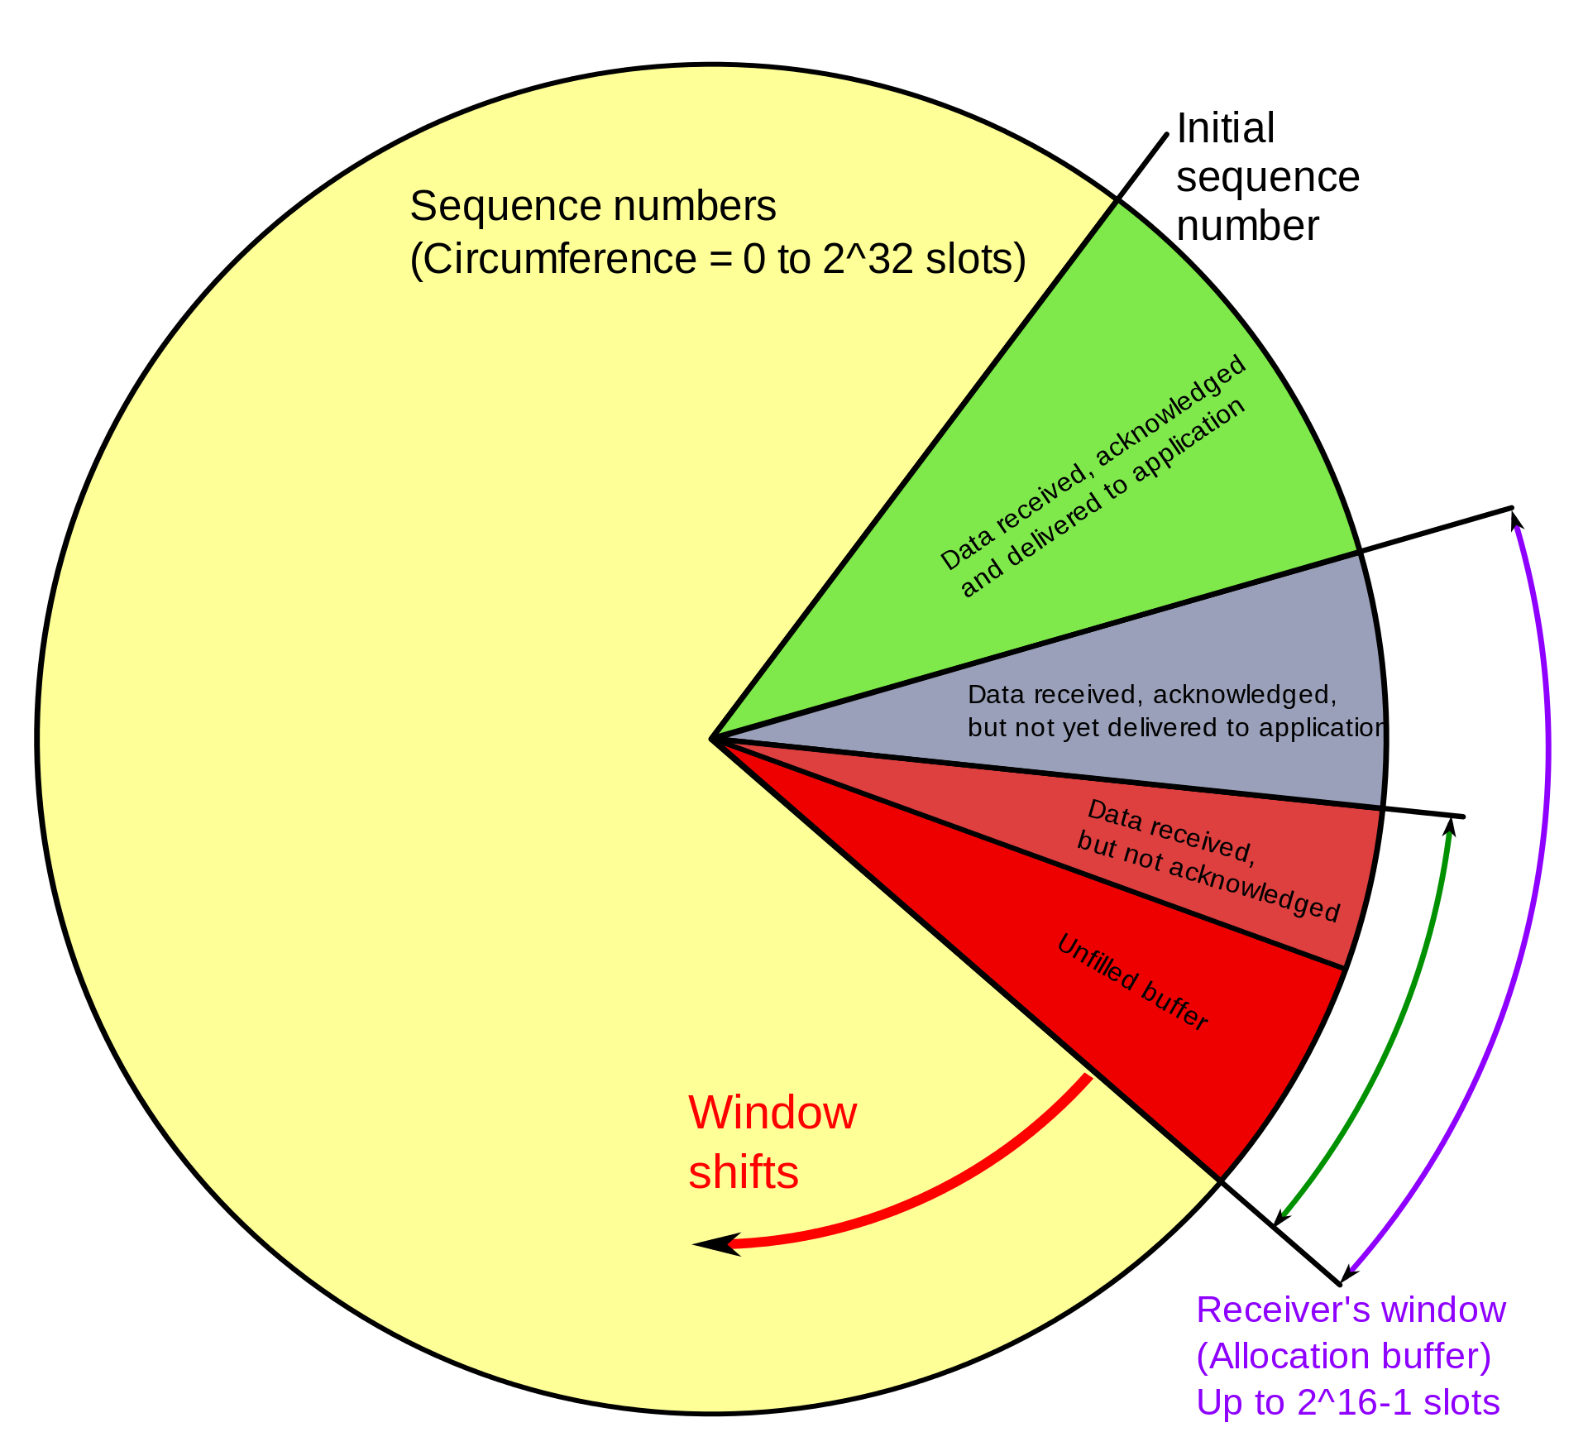
PC: https://en.wikipedia.org/wiki/Transmission_Control_Protocol

Slide 85
Thank you

