Slide 1

Computer Networks
CMSC 417 : Spring 2026
Topic:
Transport Layer Protocols: ARQ, Flow-control
(Textbook chapter 5)
Nirupam Roy
M-W 2:00-3:15pm
CSI 2117
March 30th, 2026

Slide 2
TCP Acknowledgments
Host A
ISN (initial sequence number)
Sequence number = ISN+1st byte
TCP Data
ACK sequence number = next expected byte
TCP Data
Host B

Slide 3
Byte numbering is 0-based
Sequence number = ISN + offset
But:
- FIN also consumes 1
- SYN consumes 1 → shifts starting point
Assume:
ISN = 1000
Step 1: SYN
SYN segment: seq = 1000
(no data, but consumes 1 sequence number)
Step 2: First data segment (say 100 bytes)
First byte offset = 0 (relative to data stream after SYN)
Sequence number = 1001

Slide 4
TCP Header: PSH and URG flags
Notes:
The TCP PSH (Push) flag is a control flag used to indicate that the receiving device should deliver the data to the receiving application as soon as possible, rather than buffering it.

Slide 5
TCP Header: PSH and URG flags
Notes:
The URG (Urgent) flag is another control flag in TCP, which is used to indicate that some data in the packet is urgent and requires immediate attention. However, unlike the PSH flag, the URG flag is rarely used in modern applications.
Example Scenario:
In Telnet or SSH, if a user presses Ctrl+C, the OS should immediately terminate a running command. The key press is sent with the URG flag and processed ahead of buffered data.
TCP header includes:
Urgent Pointer (offset)
When URG is set:
Urgent pointer marks a position in the byte stream:
urgent data ends at sequence number = current seq + urgent pointer
Receiver behavior:
Notify application that urgent data is present
Application can read urgent data separately (e.g., via MSG_OOB in sockets)
Example use case (classic)
Terminal interrupt signal (e.g., Ctrl+C)
Immediate control messages in a stream

Slide 6
Reliable Delivery on a Lossy Channel With Bit Errors

Slide 7
Challenges of Reliable Data Transfer
Over a perfectly reliable channel
  Easy: sender sends, and receiver receives
Over a channel with bit errors
  Receiver detects errors and requests retransmission
Over a lossy channel with bit errors
  Some data are missing, and others corrupted
  Receiver cannot always detect loss
Over a channel that may reorder packets
  Receiver cannot distinguish loss from out-of-order

Slide 8
Retransmission hints
Acknowledgments from receiver
  Positive: “okay” or “uh huh” or “ACK”
  Negative: “please repeat that” or “NACK”
Retransmission by the sender
  After not receiving an “ACK”
  After receiving a “NACK”
Timeout by the sender (“stop and wait”)
  Don’t wait forever without some acknowledgment

Slide 9
TCP Support for Reliable Delivery
Detect bit errors: checksum
  Used to detect corrupted data at the receiver
  …leading the receiver to drop the packet
Detect missing data: sequence number
  Used to detect a gap in the stream of bytes
  ... and for putting the data back in order
Recover from lost data: retransmission
  Sender retransmits lost or corrupted data
  Two main ways to detect lost packets

Slide 10
TCP Acknowledgments
Host A
ISN (initial sequence number)
Sequence number = ISN+1st byte
TCP Data
ACK sequence number = next expected byte
TCP Data
Host B

Slide 11
Automatic Repeat reQuest (ARQ)
ACK and timeouts
  Receiver sends ACK when
  it receives packet
  Sender waits for ACK
  and times out
Simplest ARQ protocol
  Stop and wait
  Send a packet, stop and wait until ACK arrives
Sender
Receiver
Packet
Timeout
ACK
Time

Slide 12
Automatic Repeat reQuest (ARQ)
We will discuss two variations
  1. Stop and Wait
  2. Sliding window

Slide 13
Reliable Delivery on a Lossy Channel With Bit Errors
Stop-and-Wait Protocol

Slide 14
Sender
Receiver
Packet
Timeout
ACK
Time

Slide 15
A few design decisions
  1. Unique packet identifiers: Why and how
  2. Duplicate packets: Why and how to eliminate
  3. Timeout: picking the ideal value

Slide 16
A few design decisions
  1. Unique packet identifiers: Why and how
  2. Duplicate packets: Why and how to eliminate
  3. Timeout: picking the ideal value

Slide 17
Processing of incoming packets
Host A
ISN (initial sequence number)
Byte 81
TCP Data
TCP Data
Host B
Receive, ACKed, sent to APP
Receive, ACKed, not sent to APP
Receive, not ACKed
Unused buffer

Slide 18
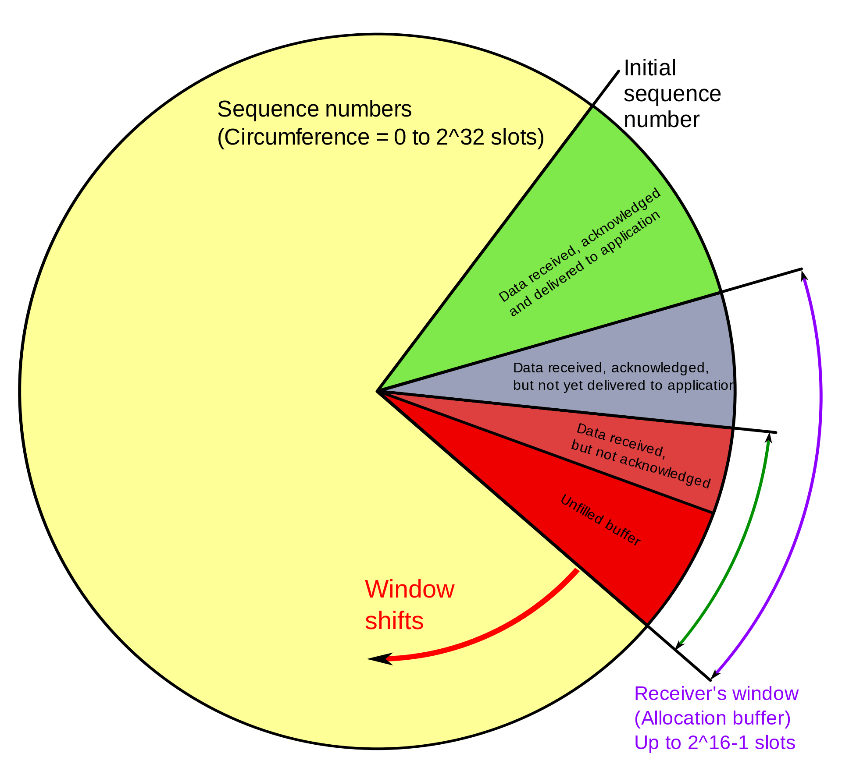
Receive, ACKed, sent to APP
Receive, ACKed, not sent to APP
Receive, not ACKed
Unused buffer
PC: https://en.wikipedia.org/wiki/Transmission_Control_Protocol

Slide 19
What is “wrap around” of TCP sequence numbers?
In TCP, every byte is assigned a 32-bit sequence number.
That means the sequence number space is finite:
Range: 0 → (2³² − 1)
After reaching the maximum, it wraps back to 0 (modulo 2³²)
This is called sequence number wrap around.

Slide 20
Why is wrap around a problem?
TCP relies on sequence numbers to:
- Detect duplicates
- Ensure ordering
- Identify new vs old data
If wraparound happens too quickly, an old packet still in the network could:
- Reappear after wraparound
- Be mistaken as new data (same sequence number)

Slide 21
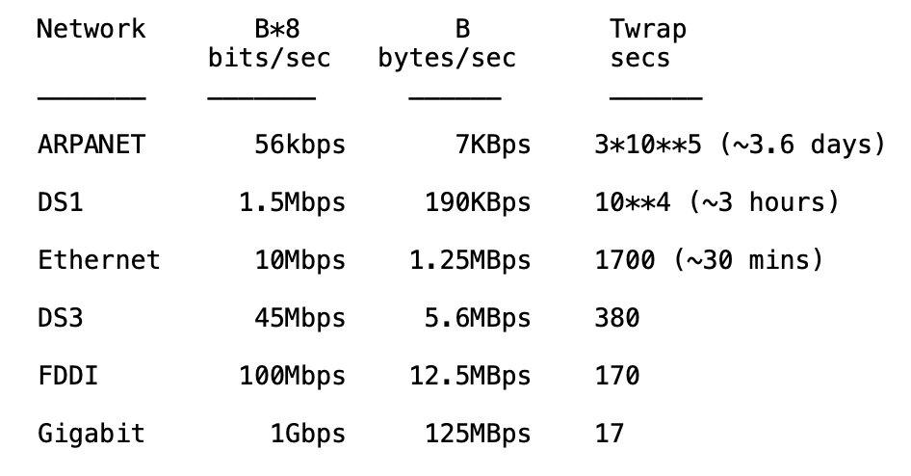
Wrap around is possible
REF: RFC 1323

Slide 22
Why does it happen faster in high-speed networks?
Wraparound time depends on data rate:
Wraparound time = 2³² bytes / data rate (bytes/sec)

Slide 23
Wrap around-aware sequence number comparison
(modulo arithmatic)
If A and B are sequence numbers,
A < B if 0 < (B - A) < 2**31,
computed in signed 32-bit arithmetic
Maximum segment lifetime (MSL, ~2 minutes) should be shorter than wrap-around-time, i.e., 2**31 / B > MSL (secs)
PAWS: Protect Against Wrapped Sequence Numbers
(RFC 1323) – Use sequence number and timestamps.
REF: RFC 1323
Notes:
TCP reliability depends upon the existence of a bound on the lifetime of a segment: the "Maximum Segment Lifetime" or MSL. An MSL is generally required by any reliable transport protocol, since every sequence number field must be finite, and therefore any sequence number may eventually be reused. In the Internet protocol suite, the MSL bound is enforced by an IP-layer mechanism, the "Time-to-Live" or TTL field.

Slide 24
A few design decisions
  1. Unique packet identifiers: Why and how
  2. Duplicate packets: Why and how to eliminate
  3. Timeout: picking the ideal value

Slide 25
A few design decisions
  2. Duplicate packets: Why and how to eliminate
  - Receiver maintain the last in-sequence byte number in a variable, say rcv_seqnum
  - If the Receiver receives a packet with seq number less than or equal to rcv_seqnum

Slide 26
A few design decisions
  2. Duplicate packets: Why and how to eliminate
  - Receiver maintain the last in-sequence byte number in a variable, say rcv_seqnum
  - If the Receiver receives a packet with seq number less than or equal to rcv_seqnum
  >>It sends an ACK for that packet, and discards the packet
  - If the Receiver receives a packet with seq number (rcv_seqnum+1):

Slide 27
A few design decisions
  2. Duplicate packets: Why and how to eliminate
  - Receiver maintain the last in-sequence byte number in a variable, say rcv_seqnum
  - If the Receiver receives a packet with seq number less than or equal to rcv_seqnum
  >>It sends an ACK for that packet, and discards the packet
  - If the Receiver receives a packet with seq number (rcv_seqnum+1):
  >> It sends an ACK for that packet, and includes the packet to the application buffer

Slide 28
A few design decisions
  2. Duplicate packets: Why and how to eliminate
  - Receiver maintain the last in-sequence byte number in a variable, say rcv_seqnum
  - If the Receiver receives a packet with seq number less than or equal to rcv_seqnum
  >>It sends an ACK for that packet, and discards the packet
  - If the Receiver receives a packet with seq number (rcv_seqnum+1):
  >> It sends an ACK for that packet, and includes the packet to the application buffer
  - What if the receiver gets a packet with seq number greater than (rcv_seqnum+1) ?

Slide 29
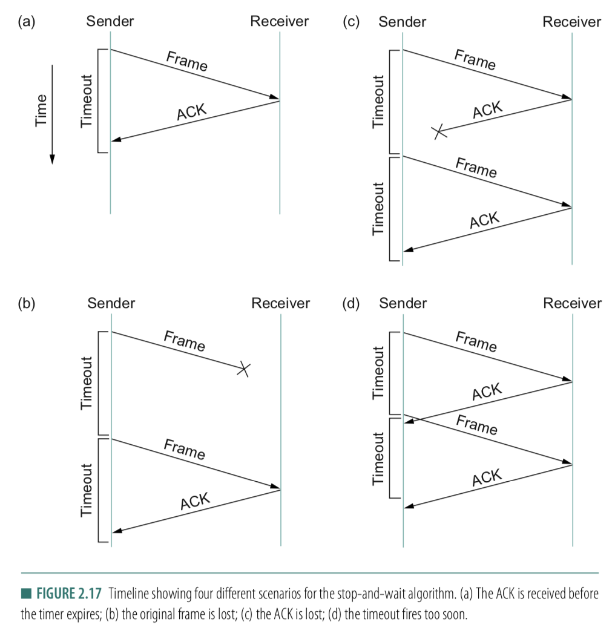
A few design decisions
  3. Timeout: picking the ideal value
  - What if the timeout is too small?
  - What if the timeout is too large?
  - Round-Trip time (RTT)

Slide 30
A few design decisions
  1. Unique packet identifiers: Why and how
  2. Duplicate packets: Why and how to eliminate
  3. Timeout: picking the ideal value

Slide 31
Reasons for Retransmission
Packet
Packet
Packet
Timeout
Timeout
ACK
Timeout
ACK
Packet
Packet
Packet
ACK
Timeout
Timeout
Timeout
ACK
ACK
Packet lost
ACK lost
DUPLICATE
PACKET
Early timeout
DUPLICATE
PACKETS
Notes:
Application may get duplicates in the case of early timeouts

Slide 32
How Long Should Sender Wait?
Sender sets a timeout to wait for an ACK
  Too short:
  >> wasted retransmissions
  Too long:
  >> excessive delays when packet lost

Slide 33
How Long Should Sender Wait?
Sender sets a timeout to wait for an ACK
  Too short:
  >> wasted retransmissions
  Too long:
  >> excessive delays when packet lost
TCP sets timeout as a function of the RTT
  Expect ACK to arrive after a “round-trip time”
  … plus a fudge factor to account for queuing
But, how does the sender know the RTT?

Slide 34
How Long Should Sender Wait?
Sender sets a timeout to wait for an ACK
  Too short:
  >> wasted retransmissions
  Too long:
  >> excessive delays when packet lost
TCP sets timeout as a function of the RTT
  Expect ACK to arrive after a “round-trip time”
  … plus a fudge factor to account for queuing
But, how does the sender know the RTT?
  Running average of delay to receive an ACK

Slide 35
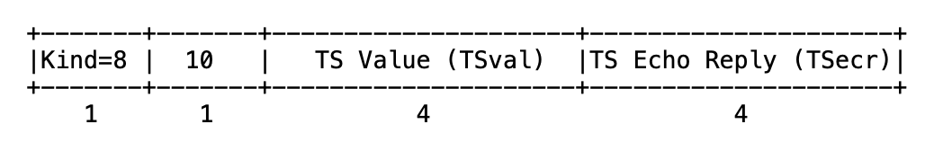
TCP timestamp

Slide 36
TCP timestamp
Sender’s current time

Slide 37
TCP Timestamp Option (10 bytes)
Sender’s current time
Copied timestamp from the packet
being acknowledged.
(valid only when the packet contains an ACK.
i.e., the ACK bit is set in TCP header).

Slide 38
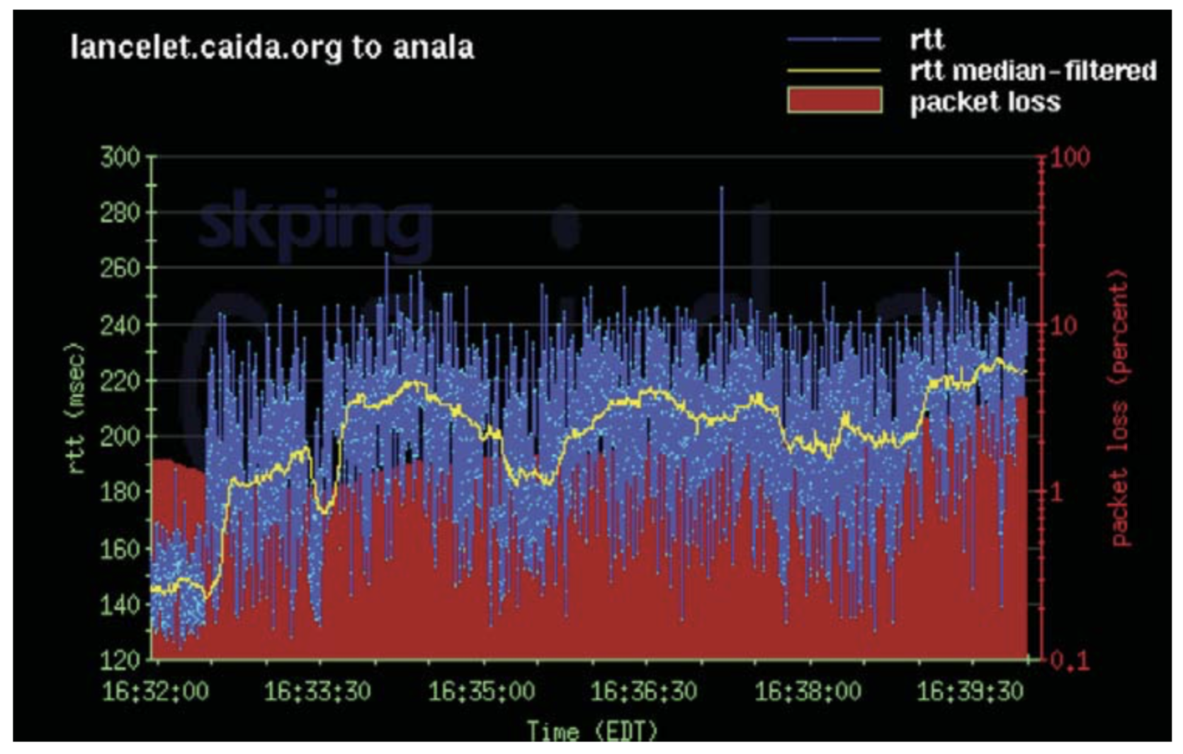
Example RTT Estimation

Slide 39
Reliable Delivery on a Lossy Channel With Bit Errors
TCP Flow control: Sliding Window Protocol

Slide 40
Motivation for Sliding Window
Stop-and-wait is inefficient
  Only one TCP segment is “in flight” at a time
  Especially bad for high “delay-bandwidth product”
bandwidth
delay

Slide 41
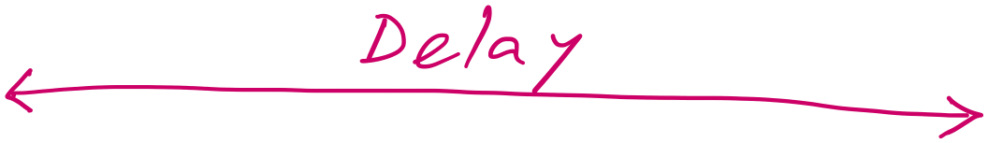
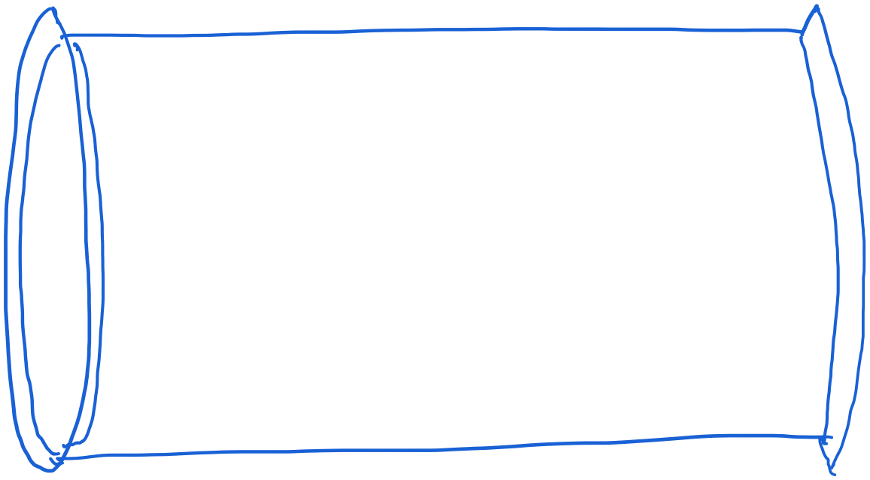
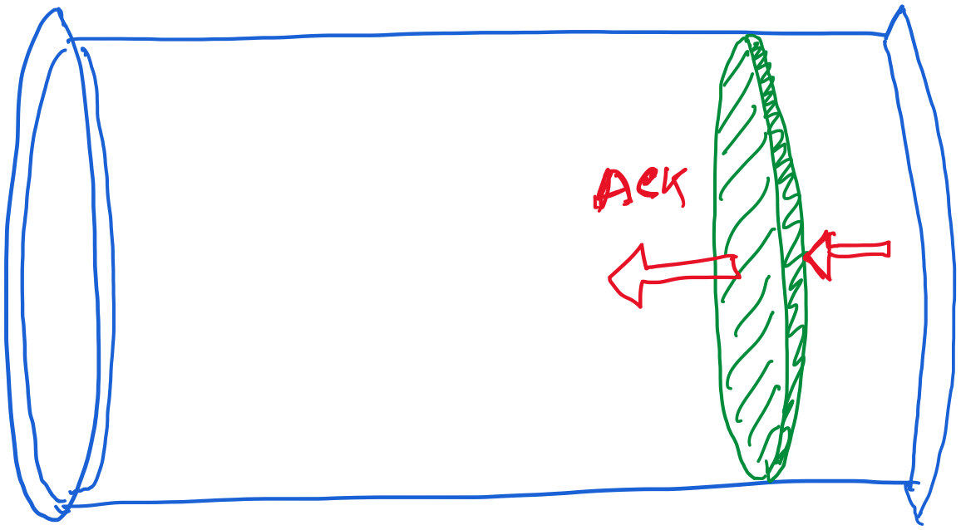
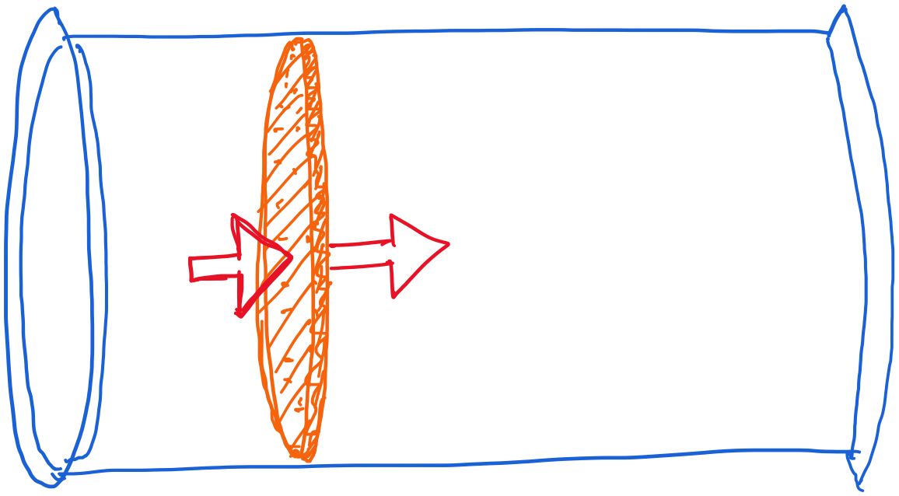
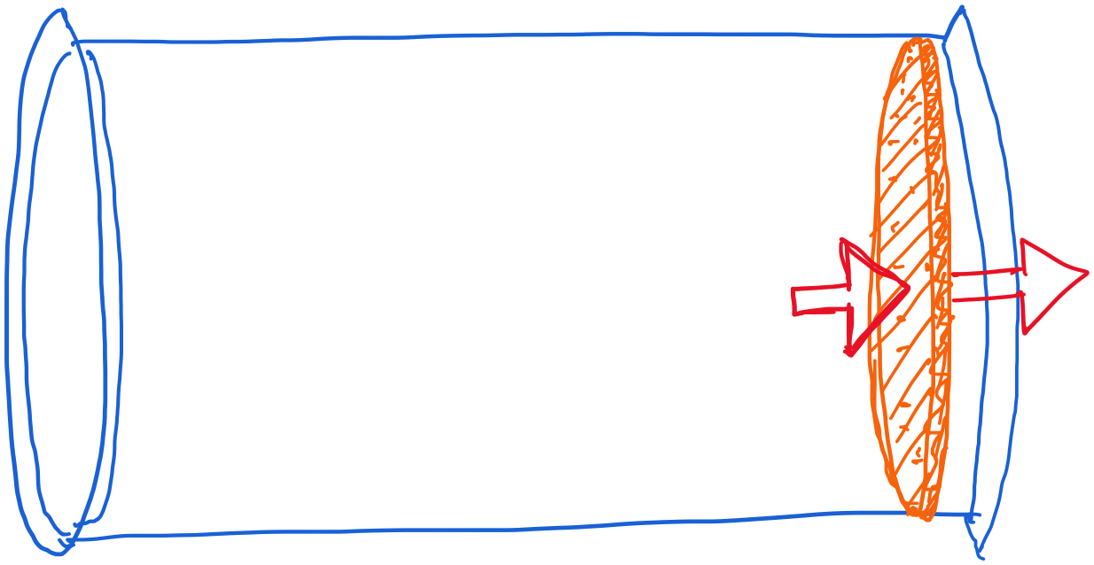
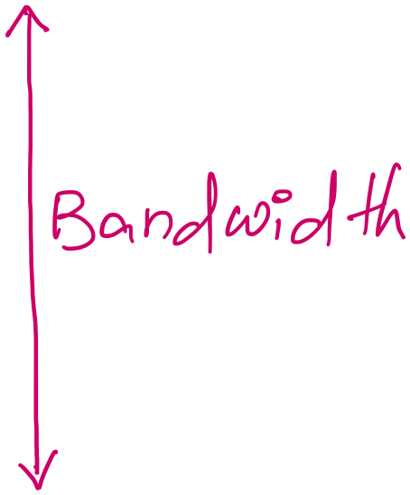
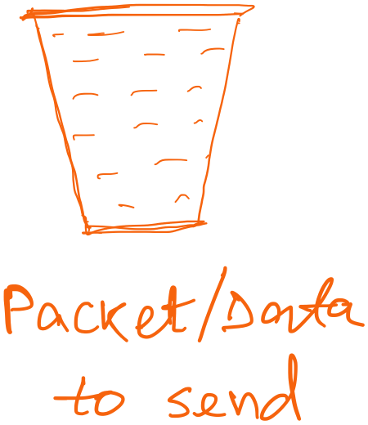
Revisiting “delay X bandwidth”

Slide 42
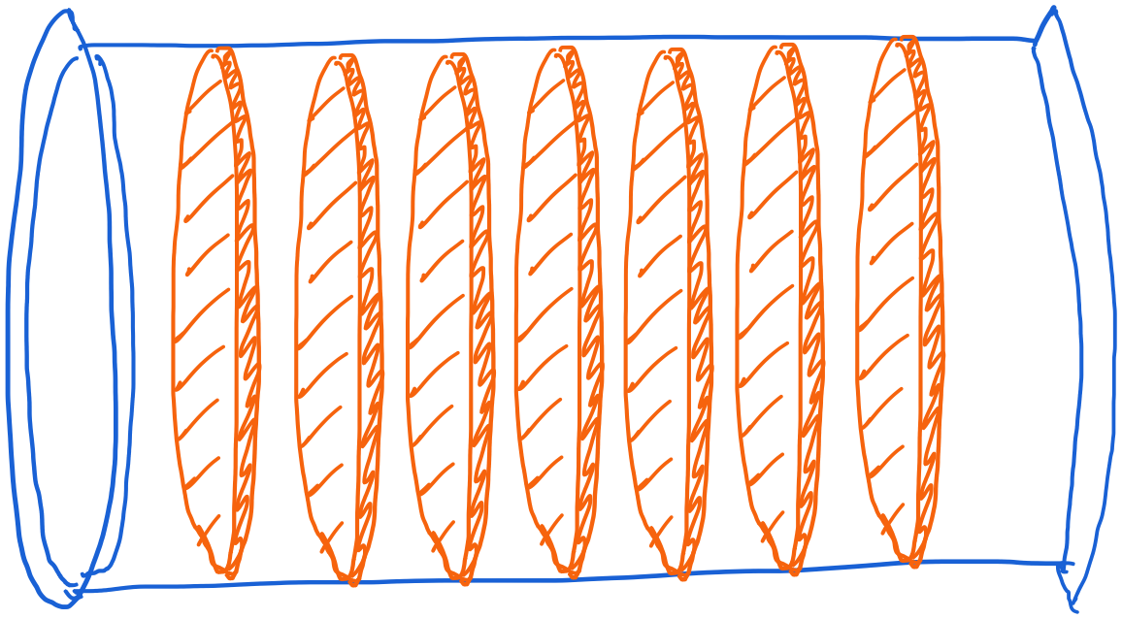
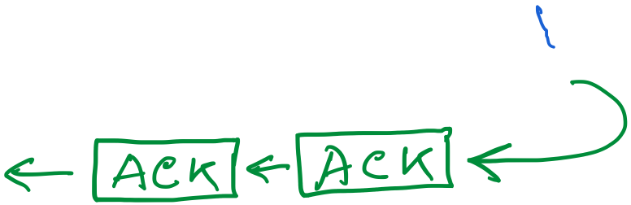
Revisiting “delay X bandwidth”

Slide 43
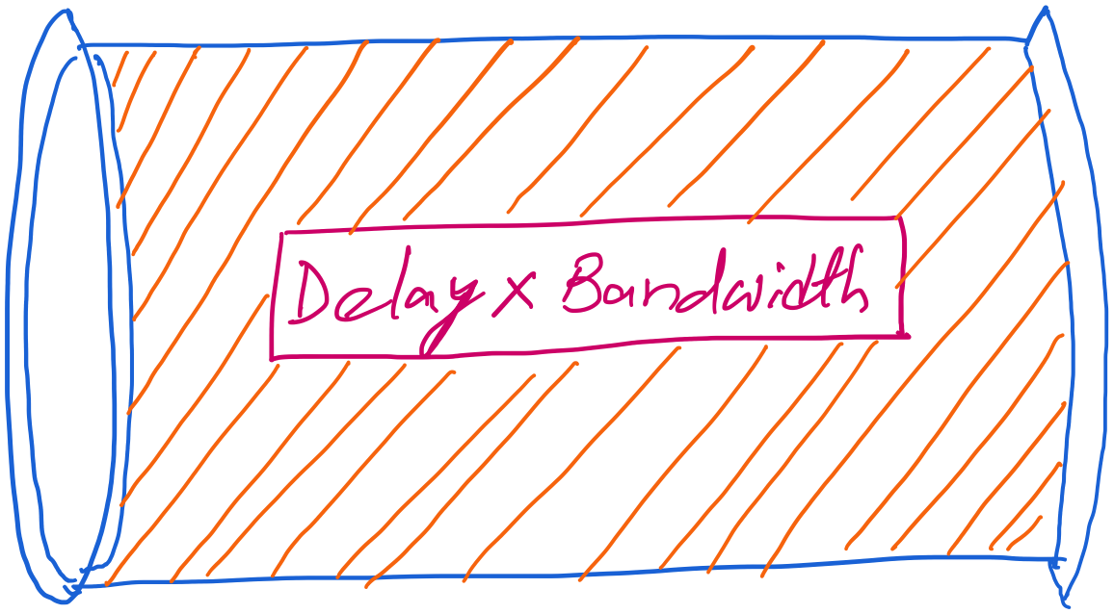
Revisiting “delay X bandwidth”

Slide 44
Revisiting “delay X bandwidth”
Consider two-way delay
or round-trip delay

Slide 45
Revisiting “delay X bandwidth”
Sender
Receiver
Packet
Round-trip delay
ACK
Time

Slide 46
stop-and-wait operation
sender
receiver
first packet bit transmitted, t = 0
last packet bit transmitted, t = L / R
first packet bit arrives
RTT
last packet bit arrives, send ACK
ACK arrives, send next
packet, t = RTT + L / R
Packet size = L bits
Network bandwidth = R bits-per-sec

Slide 47
Performance – an implementation of stop-and-wait
Stop-and-wait works, but performance stinks
ex: 1 Gbps link, 15 ms prop. delay, 8kbit (8000 bit) packet:
  U _{sender}: utilization – fraction of time sender busy sending
  1KB pkt every 30 msec -> 33kB/sec thruput over 1 Gbps link
  network protocol limits use of physical resources!

Slide 48
stop-and-wait operation
sender
receiver
first packet bit transmitted, t = 0
last packet bit transmitted, t = L / R
1kB packet per 30.008 msec
first packet bit arrives
RTT
last packet bit arrives, send ACK
ACK arrives, send next
packet, t = RTT + L / R
Packet size = L bits
Network bandwidth = R bits-per-sec

Slide 49
stop-and-wait operation
sender
receiver
first packet bit transmitted, t = 0
last packet bit transmitted, t = L / R
1kB packet per 30.008 msec
first packet bit arrives
RTT
last packet bit arrives, send ACK
~33KB/sec throughput over a 1GBPS link!!
ACK arrives, send next
packet, t = RTT + L / R
Packet size = L bits
Network bandwidth = R bits-per-sec

Slide 50
stop-and-wait operation
sender
receiver
first packet bit transmitted, t = 0
last packet bit transmitted, t = L / R
1kB packet per 30.008 msec
first packet bit arrives
RTT
last packet bit arrives, send ACK
~33KB/sec throughput over a 1GBPS link!!
ACK arrives, send next
packet, t = RTT + L / R
Network protocol limits the full utilization of physical resources.
Transport-layer vs Link-layer capacity gap
Packet size = L bits
Network bandwidth = R bits-per-sec

Slide 51
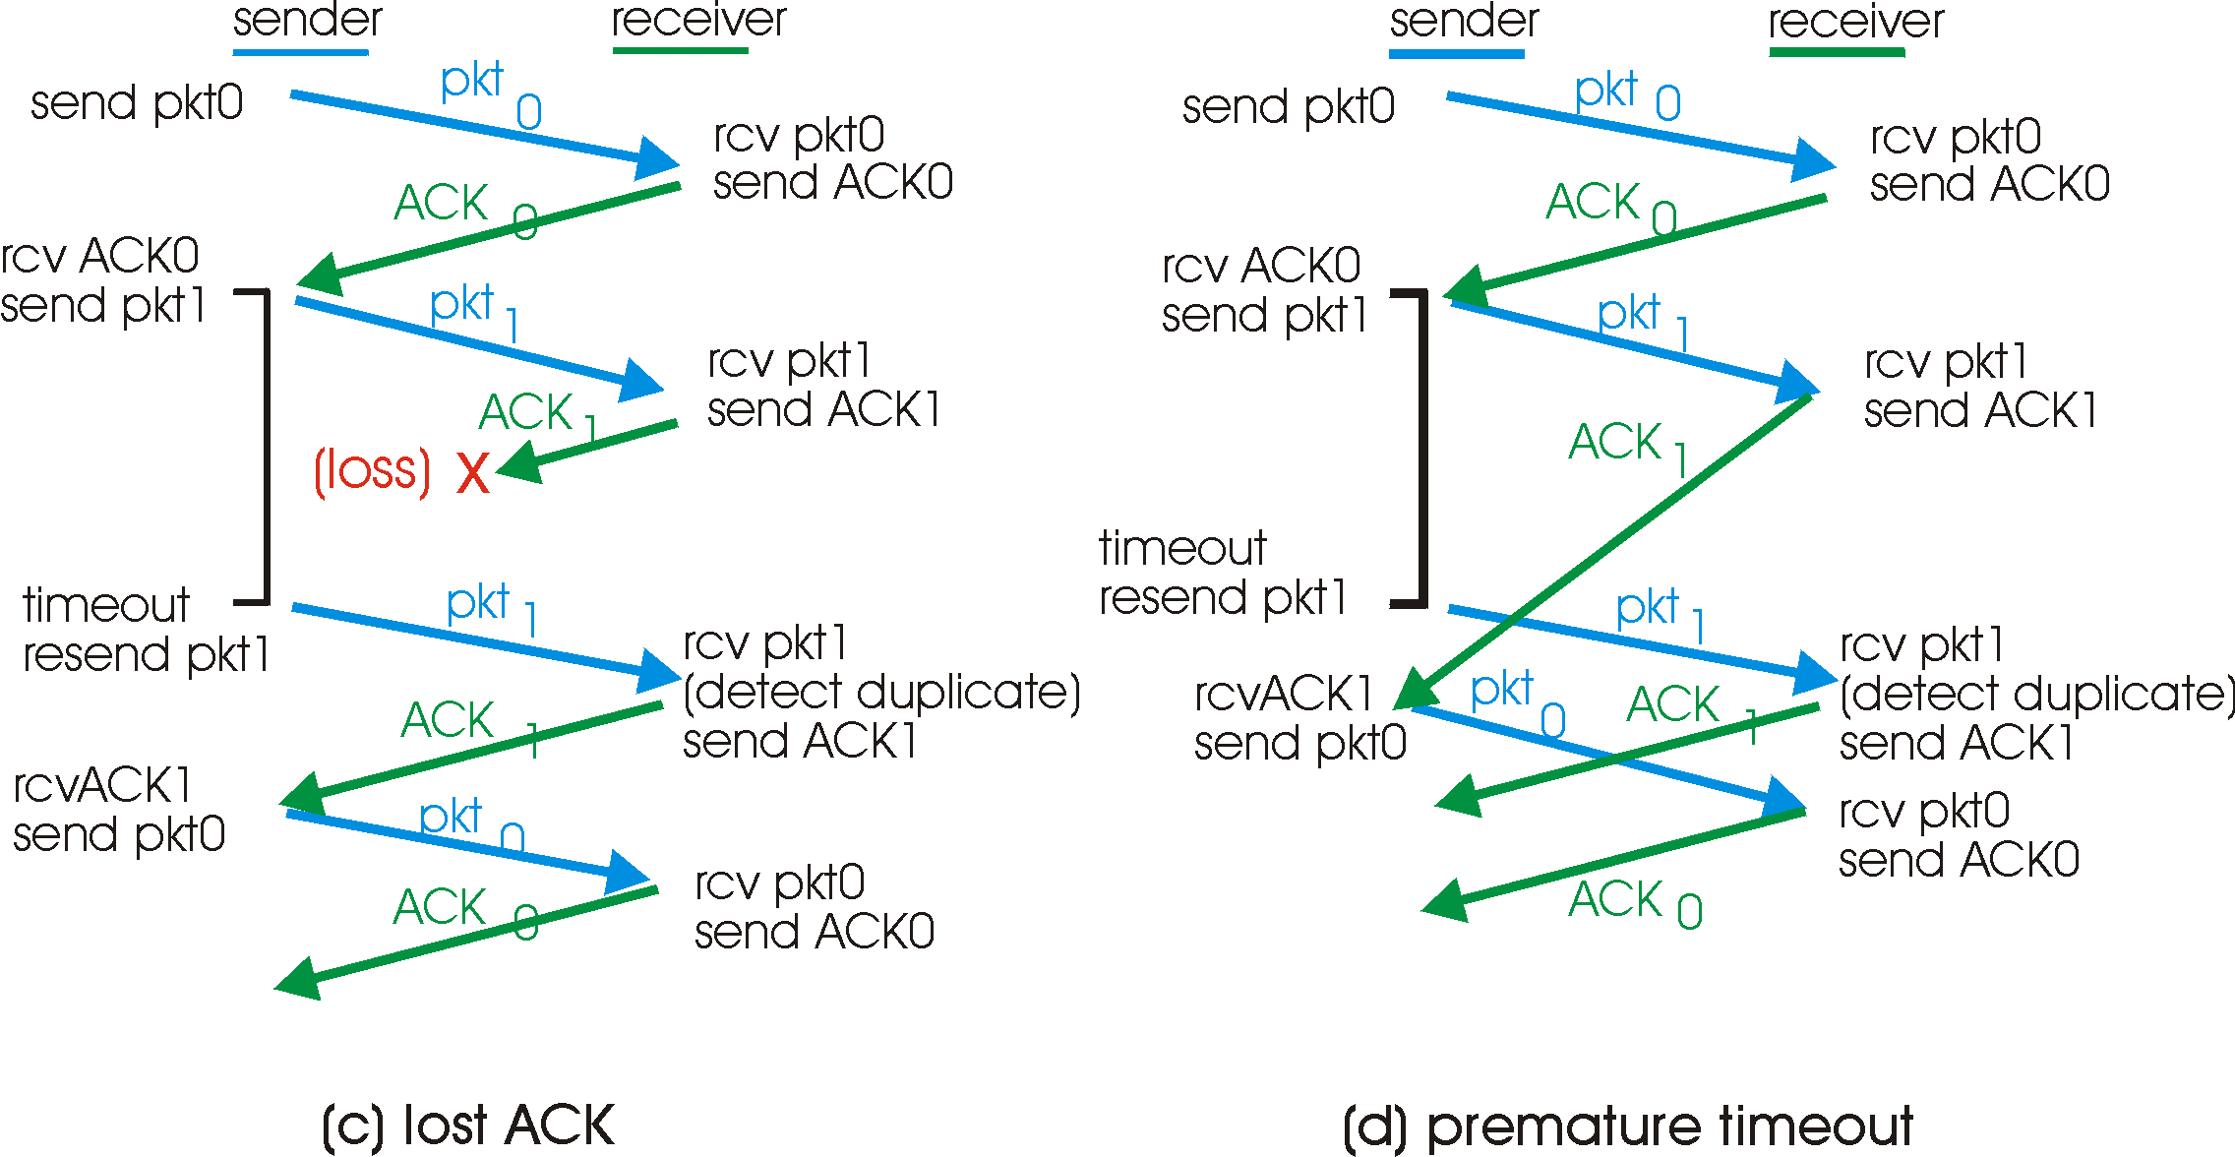
A problem in rdt3.0

Slide 52
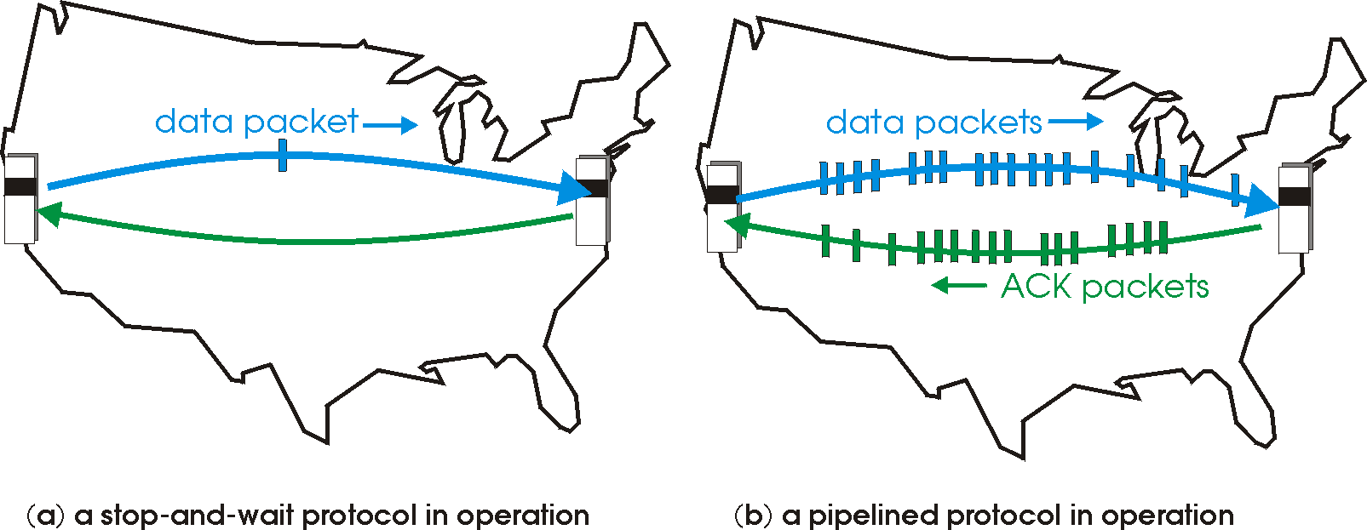
Pipelined/Sliding-window protocols
Pipelining: sender allows multiple, “in-flight”, yet-to-be-acknowledged pkts
  range of sequence numbers must be increased
  buffering at sender and/or receiver
Two generic forms of pipelined protocols (or sliding window protocol) depending on the retransmission strategy: go-Back-N, selective repeat

Slide 53
Pipelining: increased utilization
sender
receiver
first packet bit transmitted, t = 0
last bit transmitted, t = L / R
first packet bit arrives
RTT
last packet bit arrives, send ACK
last bit of 2nd packet arrives, send ACK
last bit of 3rd packet arrives, send ACK
ACK arrives, send next
packet, t = RTT + L / R
Increase utilization
by a factor of 3!

Slide 54
Some Pipelining Protocols
Go-back-N: overview
sender: up to N unACKed pkts in pipeline
receiver: only sends cumulative ACKs
  doesn’t ACK pkt if there’s a gap
sender: has timer for oldest unACKed pkt
  if timer expires: retransmit all unACKed packets
Selective Repeat: overview
sender: up to N unACKed packets in pipeline
receiver: ACKs individual pkts
sender: maintains timer for each unACKed pkt
  if timer expires: retransmit only unACKed packet

Slide 55
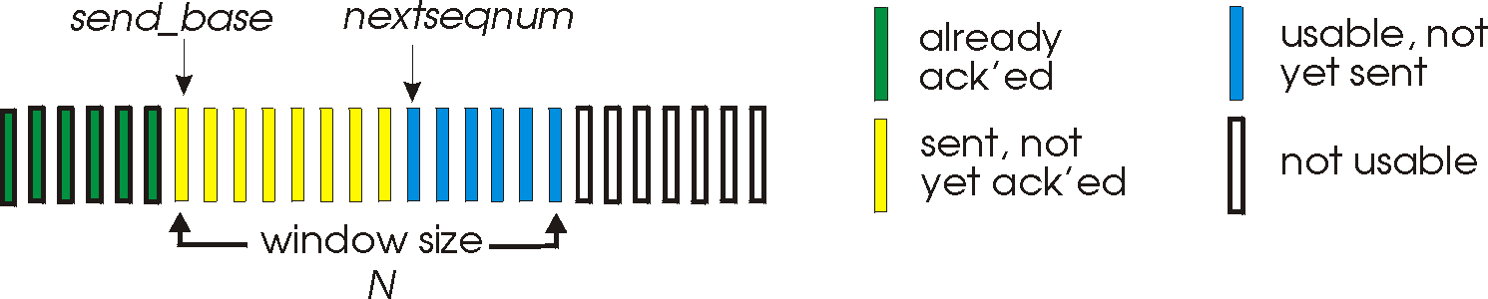
Go-Back-N
Sender:
k-bit seq # in pkt header
“window” of up to N, consecutive unACKed pkts allowed
ACK(n): ACKs all pkts up to, including seq # n - “cumulative ACK”
  may receive duplicate ACKs (see receiver)
timer for each in-flight pkt
timeout(n): retransmit pkt n and all higher seq # pkts in window

Slide 56
Revisiting “delay X bandwidth”
Sender
Receiver
Round-trip delay
Time

Slide 57
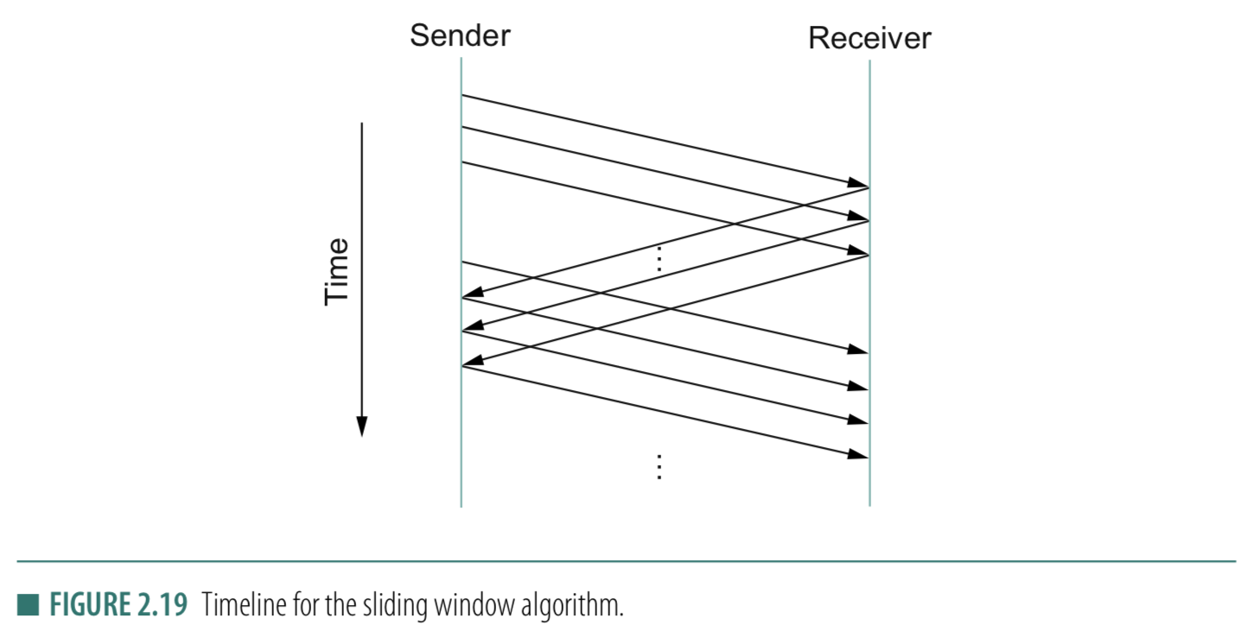
Stop-and-wait
Sliding Window
Sender
Receiver
Packet
Timeout
ACK
Time

Slide 58
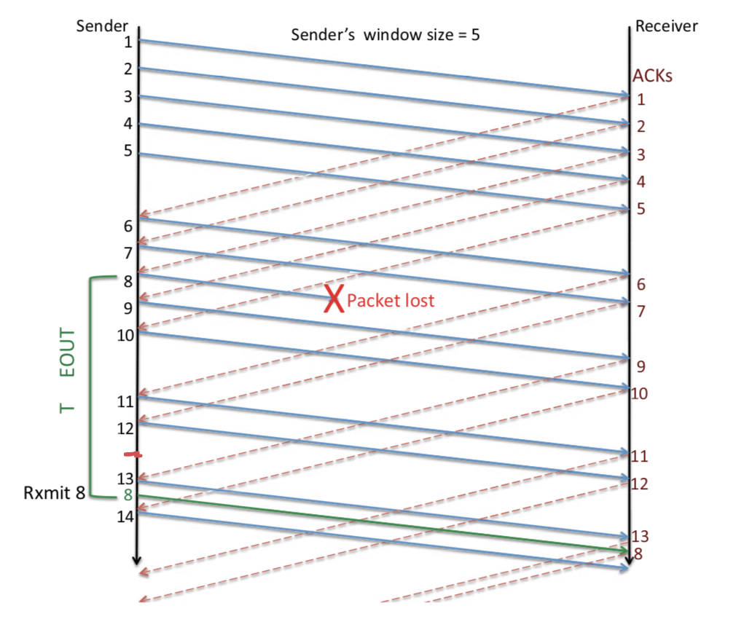
Sliding Window: Lost Packet/ACK

Slide 59
Sliding Window Protocol

Slide 60
Sliding Window: A series of packets to be sent reliably
Window = # pkt in flight
Pkt:1
Pkt:2
Pkt:3
Pkt:4
Pkt:5
Pkt:6
Pkt:7
Pkt:8
Sent
Sent
Sent

Slide 61
Sliding Window: A series of packets to be sent reliably
Window = # pkt in flight
Pkt:1
Pkt:2
Pkt:3
Pkt:4
Pkt:5
Pkt:6
Pkt:7
Pkt:8
Sent
Sent
Sent
ACK

Slide 62

Sliding Window: A series of packets to be sent reliably
Window = # pkt in flight
Pkt:1
Pkt:2
Pkt:3
Pkt:4
Pkt:5
Pkt:6
Pkt:7
Pkt:8
Sent
Sent
Packet 1 is delivered

Slide 63
Sliding Window: A series of packets to be sent reliably
Window = # pkt in flight
Pkt:1
Pkt:2
Pkt:3
Pkt:4
Pkt:5
Pkt:6
Pkt:7
Pkt:8
Sent
Sent
Packet 1 is delivered. Slide the window.

Slide 64
Sliding Window: A series of packets to be sent reliably
Window = # pkt in flight
Pkt:1
Pkt:2
Pkt:3
Pkt:4
Pkt:5
Pkt:6
Pkt:7
Pkt:8
Sent
Sent
Sent
Packet 1 is delivered. Slide the window.

Slide 65
Sliding Window: A series of packets to be sent reliably
Sender
Receiver
Time

Slide 66
Sliding Window: A series of packets to be sent reliably
Window = # pkt in flight
Pkt:1
Pkt:2
Pkt:3
Pkt:4
Pkt:5
Pkt:6
Pkt:7
Pkt:8
Sent
Sent
Sent
Packet 1 is delivered. Slide the window.

Slide 67
Sliding Window: A series of packets to be sent reliably
Should we advance the window in the following scenario?
Window = # pkt in flight
Pkt:1
Pkt:2
Pkt:3
Pkt:4
Pkt:5
Pkt:6
Pkt:7
Pkt:8
Sent
Sent
Sent
ACK

Slide 68
Sliding Window: A series of packets to be sent reliably
Sender
Receiver
Time

Slide 69
Sliding Window: A series of packets to be sent reliably
Should we advance the window in the following scenario?
Window = # pkt in flight
Pkt:1
Pkt:2
Pkt:3
Pkt:4
Pkt:5
Pkt:6
Pkt:7
Pkt:8
Sent
Sent
Sent
ACK

Slide 70
Sliding Window: A series of packets to be sent reliably
Should we advance the window in the following scenario?
Window = # pkt in flight
Pkt:1
Pkt:2
Pkt:3
Pkt:4
Pkt:5
Pkt:6
Pkt:7
Pkt:8
Sent
Sent
Sent
ACK
Note that the window size is not changed!

Slide 71
Sliding Window: A series of packets to be sent reliably
Window = # pkt in flight
Pkt:1
Pkt:2
Pkt:3
Pkt:4
Pkt:5
Pkt:6
Pkt:7
Pkt:8
Sent
Sent
Sent
Can you make sliding window behave like
stop-and-wait?

Slide 72
Sliding Window Protocol
(dealing packet loss)

Slide 73
Sliding Window: A series of packets to be sent reliably
Window = # pkt in flight
Pkt:1
Pkt:2
Pkt:3
Pkt:4
Pkt:5
Pkt:6
Pkt:7
Pkt:8
Sent
Sent
Sent

Slide 74
Sliding Window: A series of packets to be sent reliably
Window = # pkt in flight
Pkt:1
Pkt:2
Pkt:3
Pkt:4
Pkt:5
Pkt:6
Pkt:7
Pkt:8
Sent
Sent
Sent
Re-tx
Re-tx
Re-tx
(1) ARQ strategy 1: Retransmit all un-ACKed packets

Slide 75
Sliding Window: A series of packets to be sent reliably
(1) Go-back-N (Sender side)
Sender
Receiver
1
2
3
Timeout
X
1
2
3
Time

Slide 76
Sliding Window: A series of packets to be sent reliably
Window = # pkt in flight
Pkt:1
Pkt:2
Pkt:3
Pkt:4
Pkt:5
Pkt:6
Pkt:7
Pkt:8
Sent
Sent
Sent
Re-tx
(2) ARQ strategy 2: Retransmit only the lost packet
(2) Selective retransmit (Sender side)

Slide 77
Sliding Window: A series of packets to be sent reliably
(2) Selective retransmit
Sender
Receiver
1
2
3
Timeout
X
4
5
2
Time

Slide 78
Sliding Window: Lost Packet/ACK
Timeout

Slide 79
TCP Cumulative ACK strategy (receiver side)
Cumulative ACK:
ACK the largest in-sequence packet received.
What will be ACK sequence if the receive sequence
is: 5, 7, 8, 6 ?

Slide 80
TCP Cumulative ACK strategy (receiver side)
Cumulative ACK:
ACK the largest in-sequence packet received.
What will be ACK sequence if the receive sequence
is: 5, 7, 8, 6 ?
ACK: 6, 6, 6, 9

Slide 81
TCP Cumulative ACK strategy (receiver side)
(An example)
Sender
Receiver
X

Slide 82
TCP Cumulative ACK strategy (receiver side)
(An example)
Seq. # | 234118
ACK flag | N/A
ACK # | N/A
Data Len | 100 bytes
Sender
Receiver
234118
Seq. # | 234218
ACK flag | N/A
ACK # | N/A
Data Len | 50 bytes
234218
X
234268
Seq. # | 234268
ACK flag | N/A
ACK # | N/A
Data Len | 120 bytes
234388
Seq. # | 234388
ACK flag | N/A
ACK # | N/A
Data Len | 100 bytes

Slide 83
TCP Cumulative ACK strategy (receiver side)
(An example)
Seq. # | 234118
ACK flag | N/A
ACK # | N/A
Data Len | 100 bytes
Sender
Receiver
234118
Seq. # | 234218
ACK flag | N/A
ACK # | N/A
Data Len | 50 bytes
234218
X
Timeout
234268
Seq. # | 234268
ACK flag | N/A
ACK # | N/A
Data Len | 120 bytes
234388
Seq. # | 234388
ACK flag | N/A
ACK # | N/A
Data Len | 100 bytes

Slide 84
TCP Cumulative ACK strategy (receiver side)
(An example)
Seq. # | 234118
ACK flag | N/A
ACK # | N/A
Data Len | 100 bytes
Sender
Receiver
234118
Seq. # | 234218
ACK flag | N/A
ACK # | N/A
Data Len | 50 bytes
234218
X
234268
Seq. # | 234268
ACK flag | N/A
ACK # | N/A
Data Len | 120 bytes
234388
Seq. # | 234388
ACK flag | N/A
ACK # | N/A
Data Len | 100 bytes
234218

Slide 85
TCP Cumulative ACK strategy (receiver side)
(An example)
Sender
Receiver
234118
Seq. # | 234118
Data Len | 100 bytes
234218
X
234268
Seq. # | 234268
Data Len | 120 bytes
234388
Seq. # | 234388
Data Len | 100 bytes
234218
Seq. # | 234218
Data Len | 50 bytes

Slide 86
TCP Cumulative ACK strategy (receiver side)
(An example)
Sender
Receiver
ACKs
234118
Seq. # | 234118
Data Len | 100 bytes
ACK flag | 1
ACK #
234218
X
234268
Seq. # | 234268
Data Len | 120 bytes
ACK flag | 1
ACK #
234388
Seq. # | 234388
Data Len | 100 bytes
ACK flag | 1
ACK #
234218
Seq. # | 234218
Data Len | 50 bytes
ACK flag | 1
ACK #

Slide 87
TCP Cumulative ACK strategy (receiver side)
Sender buffer:
234118
234218
234268
234388
100 bytes
50 bytes
120 bytes
100 bytes
Receiver buffer:

Slide 88
TCP Cumulative ACK strategy (receiver side)
Sender buffer:
234118
234218
234268
234388
100 bytes
50 bytes
120 bytes
100 bytes
Receiver buffer:
234118
100 bytes

Slide 89
TCP Cumulative ACK strategy (receiver side)
Sender buffer:
234118
234218
234268
234388
100 bytes
50 bytes
120 bytes
100 bytes
Receiver buffer:
234118
100 bytes
234218

Slide 90
TCP Cumulative ACK strategy (receiver side)
Sender buffer:
234118
234218
234268
234388
100 bytes
50 bytes
120 bytes
100 bytes
Receiver buffer:
234118
234268
100 bytes
120 bytes
234218

Slide 91
TCP Cumulative ACK strategy (receiver side)
Sender buffer:
234118
234218
234268
234388
100 bytes
50 bytes
120 bytes
100 bytes
Receiver buffer:
234118
234268
234388
100 bytes
120 bytes
100 bytes
234218

Slide 92
TCP Cumulative ACK strategy (receiver side)
Sender buffer:
234118
234218
234268
234388
100 bytes
50 bytes
120 bytes
100 bytes
Receiver buffer:
234118
234218
234268
234388
100 bytes
50 bytes
120 bytes
100 bytes

Slide 93
TCP Cumulative ACK strategy (receiver side)
Sender buffer:
234118
234218
234268
234388
100 bytes
50 bytes
120 bytes
100 bytes
Receiver buffer:
234118
234218
234268
234388
100 bytes
50 bytes
120 bytes
100 bytes
234488

Slide 94
TCP Cumulative ACK strategy (receiver side)
Sender buffer:
234118
234218
234268
234388
100 bytes
50 bytes
120 bytes
100 bytes
Receiver buffer:
234118
234218
234268
234388
100 bytes
50 bytes
120 bytes
100 bytes

Slide 95
TCP Cumulative ACK strategy (receiver side)
(An example)
Sender
Receiver
ACKs
234118
Seq. # | 234118
Data Len | 100 bytes
ACK flag | 1
ACK # | 234218
234218
X
234268
Seq. # | 234268
Data Len | 120 bytes
ACK flag | 1
ACK # | 234218
234388
Seq. # | 234388
Data Len | 100 bytes
ACK flag | 1
ACK # | 234218
234218
Seq. # | 234218
Data Len | 50 bytes
ACK flag | 1
ACK # | 234488

Slide 96
Flow Control:
TCP Sliding Window
Motivation: Maximum utilization of the resources without overwhelming the receiver.

Slide 97
Sliding Window
Receiver should have enough space to buffer/save the received data !!

Slide 98
Sliding Window: Implementation
Allow a larger amount of data “in flight” for better channel utilization, but should not exceed receiver’s capacity.
Sending process
Receiving process
TCP
TCP
Last byte written
Last byte read
Window
Next byte expected
Last byte ACKed
Last byte sent
Last byte received

Slide 99
Sliding Window: Implementation
Allow a larger amount of data “in flight”
  Allow sender to get ahead of the receiver
  … though not too far ahead
Sending process
Receiving process
TCP
TCP
Last byte written
Last byte read
Window
Next byte expected
Last byte ACKed
Last byte sent
Last byte received

Slide 100
Receiver Buffering: Flow control
Receive window size
  Amount that can be sent without acknowledgment
  Receiver must be able to store this amount of data
Receiver tells the sender the window
  Tells the sender the amount of free space left (i.e. sends an Advertised_Window size to the sender)

Slide 101
How to send the Advertised_Window size

Slide 102
Calculate Advertised_Window (Receiver side)
Receiving process
TCP
Last byte read
Next byte expected
Last byte received
AdvertisedWindow = MaxRcvBuffer – (bytes used)
AdvertisedWindow = MaxRcvBuffer –
((NextByteExpected-1) – LastByteRead)

Slide 103
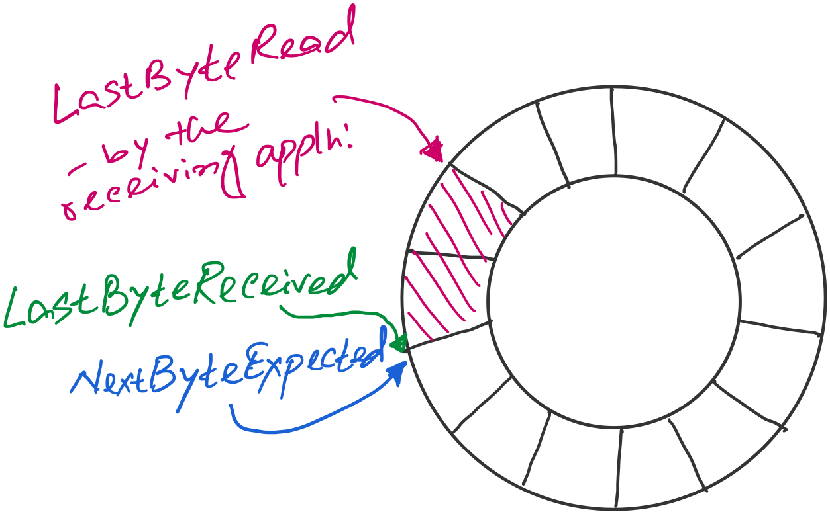
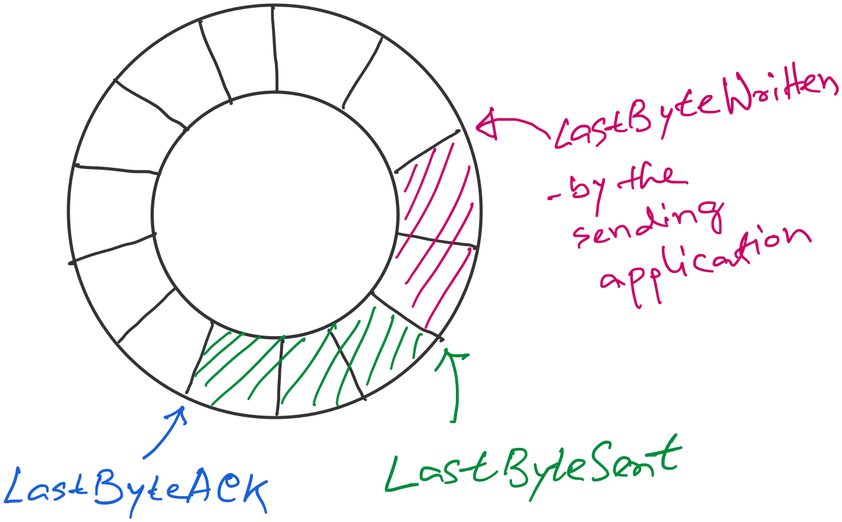
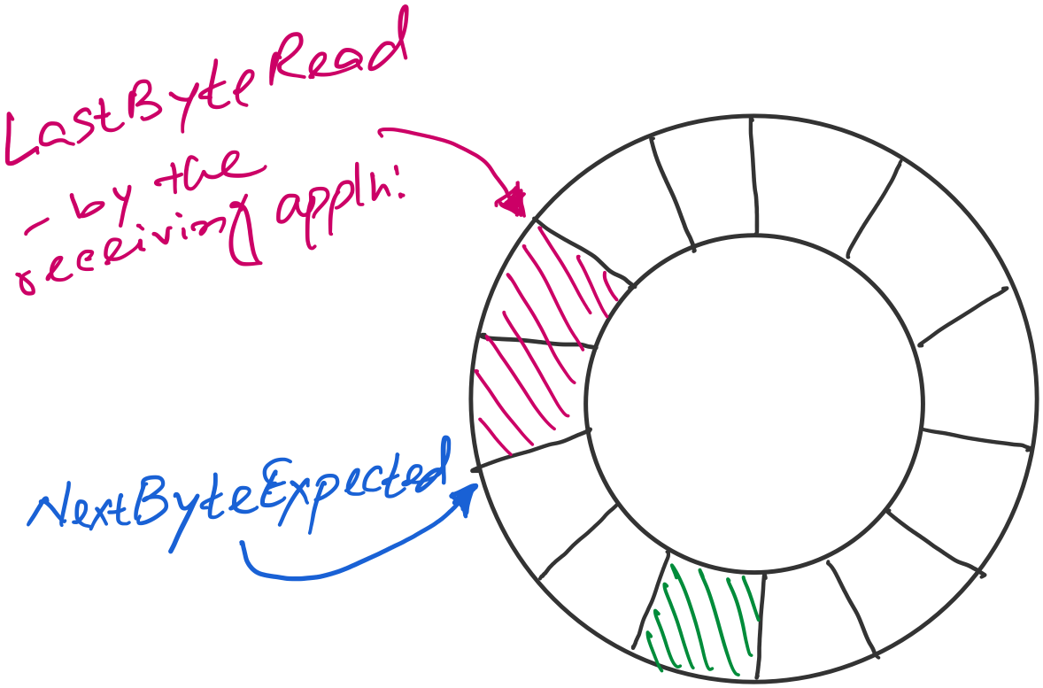
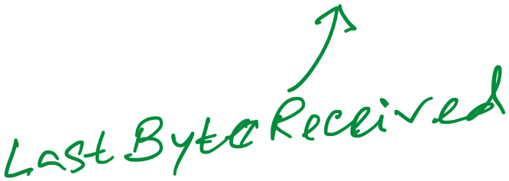
Sender buffer
Receiver buffer

Slide 104
Sender buffer
Receiver buffer
What if the AdvertisedWindow is zero?
>> Periodically send 1byte packets to break the deadlock. (uses the persist timer)
AdvertisedWindow = MaxRcvBuffer –
((NextByteExpected-1) – LastByteRead)
EffectiveWindow (calculated at the sender side)
= AdvertisedWindow - (LastByteSent – LastByteACKed)

Slide 105
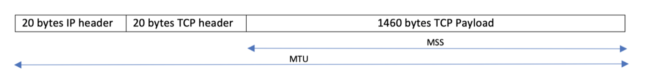
Considering Maximum Segment Size (MSS)
What if…
(1) Adv_window > MSS
(2) Adv_window < MSS

Slide 106
A few points of discussions on TCP flow control
Silly window syndrome
Nagle’s algorithm (self-clocking)
Karn-Partridge algorithm

Slide 107

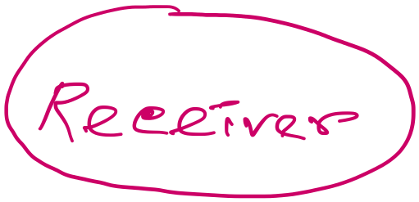
Silly-window syndrome
Host A
Byte 1
Byte 2
Byte 3
Byte 80
Data
ACK + Adv_Win
Byte 1
Byte 2
Byte 3
Byte 80
Host B

Slide 108

Silly window syndrome
What happens when the receiving application program consumes data slowly?
Leads to smaller advertised_window

Slide 109
Info: Maximum Segment Size (MSS)
What if…
(1) Adv_window > MSS
(2) Adv_window < MSS

Slide 110
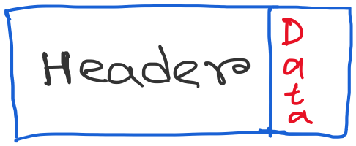
Silly window syndrome
Discussion: What can be the possible solutions?

Slide 111
Solution 1: Receiver side approach
(1) Delayed ACK (a receiver-side approach)

Slide 112
Solution 1: Receiver side approach
(1) Delayed ACK (a receiver-side approach)
- How much delay is good enough?

Slide 113
Solution 1: Receiver side approach
(1) Delayed ACK (a receiver-side approach)
- How much delay is good enough?
[RFC 1122] A TCP SHOULD implement a delayed ACK, but an
ACK should not be excessively delayed; in particular,
the delay MUST be less than 0.5 seconds, and in a stream
of full-sized segments there SHOULD be an ACK for at least
every second segment.
Typically, OSs are more conservative. Use 200ms of delay.

Slide 114
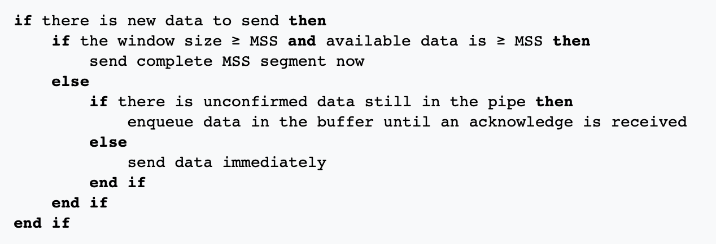
Solution 2: Sender side approach
(2) Nagle’s algorithm (a sender-side approach)

Slide 115
Solution 2: Sender side approach
Condition 0: Assumes there are some data to send. Otherwise, the sender will have to wait anyway.

Slide 116
Solution 2: Sender side approach
Condition 1: The system is capable of sending a full MSS.
Send immediately.

Slide 117
Solution 2: Sender side approach
Condition 2: Not enough data OR window size for a full MSS.
But some packets are in-flight (yet to receive ACK for).
Buffer the data and wait.

Slide 118
Solution 2: Sender side approach
Condition 3: No packet is in-flight (i.e., all ACKs are received).
Send immediately, no matter how small the packet is.

Slide 119
Solution 2: Sender side approach
(2) Nagle’s algorithm
Because some applications cannot afford such a delay for each write it does to a
TCP connection, the socket interface allows the application to turn off
Nagel’s algorithm by setting the TCP_NODELAY socket option.
TCP_QUICKACK option disables the Delayed Ack protocol.

Slide 120
What if sender and receiver simultaneously applies the Nagle’s algo. and delayed ack (TCP’s default setting) ?
[Ref] https://betterprogramming.pub/redis-internals-client-connects-to-redis-by-tcp-faf6ad1a7df5

Slide 121
What if sender and receiver simultaneously applies the Nagle’s algo. and delayed ack (TCP’s default setting) ?
Sender
Receiver
Packet-1
Nagle’s algo:
Buffered next packet
waiting for the ACK
for packet-1.
Delayed ACK:
Delayed the ACK
for packet-1.
Waiting for the next packet
to send the cumulative ACK
OR
the timeout to occur.
Time

Slide 122
What if sender and receiver simultaneously applies the Nagle’s algo. and delayed ack (TCP’s default setting) ?
Sender
Receiver
Packet-1
Nagle’s algo:
Buffered next packet
waiting for the ACK
for packet-1.
Delayed ACK:
Delayed the ACK
for packet-1.
Waiting for the next packet
to send the cumulative ACK
OR
the timeout to occur.
Time
Timeout after 500ms (default)

Slide 123
What if sender and receiver simultaneously applies the Nagle’s algo. and delayed ack (TCP’s default setting) ?
Sender
Receiver
Packet-1
Nagle’s algo:
Buffered next packet
waiting for the ACK
for packet-1.
Delayed ACK:
Delayed the ACK
for packet-1.
Waiting for the next packet
to send the cumulative ACK
OR
the timeout to occur.
ACK for 1
Time
Timeout after 500ms (default)

Slide 124
What if sender and receiver simultaneously applies the Nagle’s algo. and delayed ack (TCP’s default setting) ?
Sender
Receiver
Packet-1
Nagle’s algo:
Buffered next packet
waiting for the ACK
for packet-1.
Delayed ACK:
Delayed the ACK
for packet-1.
Waiting for the next packet
to send the cumulative ACK
OR
the timeout to occur.
ACK for 1
Time
Timeout after 500ms (default)
Packet-2
Notes:
When Nagle's algorithm and delayed acknowledgment (delayed ACK) are used together, they can create a "deadlock" scenario, leading to delays and reduced throughput, especially for applications requiring immediate data transmission.

Slide 125
Sender-side Timeout value calculation and its limitations

Slide 126
Calculating TCP timeout value: The original idea

Slide 127
Calculating TCP timeout value: The original idea
Smoothing factor (recommended between 0.8 -0.9)

Slide 128
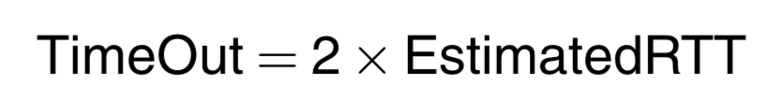
Calculating TCP timeout value: The original idea
Smoothing factor (recommended between 0.8 -0.9)

Slide 129
Calculating TCP timeout value: The original idea
Smoothing factor (recommended between 0.8 -0.9)
RTT estimation can be wrong

Slide 130
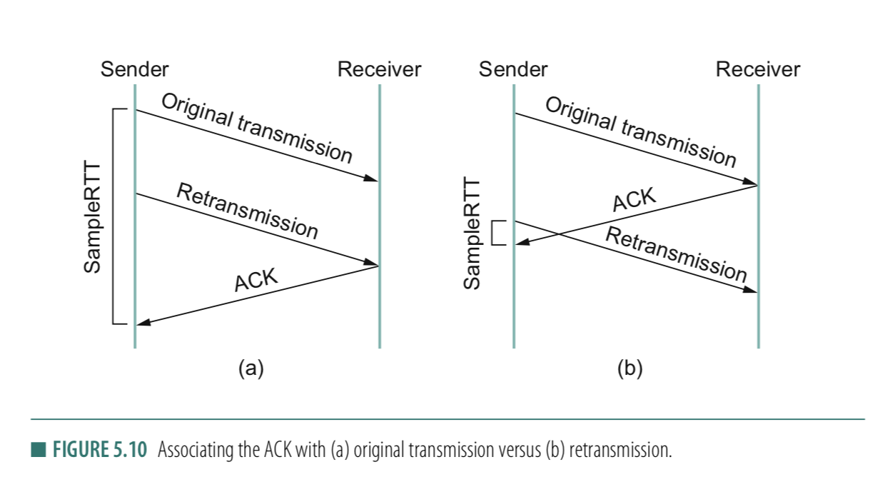
RTT estimation can be wrong

Slide 131
RTT estimation can be wrong

Slide 132
Solution: Karn/Partridge algorithm
Stop taking RTT samples when TCP retransmits
Start again after a regular transmission/reception
3) Each time TCP retransmits, set next timeout to be twice the last timeout value
Can rules #1 & #2 create issues?
Notes:
Answer (2) This simplistic implementation of Karn's algorithm can lead to problems as well. Consider what happens when TCP sends a segment after a sharp increase in delay. Using the prior round-trip time estimate, TCP computes a timeout and retransmits a segment. If TCP ignores the round-trip time of all retransmitted packets, the round trip estimate will never be updated, and TCP will continue retransmitting every segment, never adjusting to the increased delay.
[Ref] https://en.wikipedia.org/wiki/Karn%27s_algorithm

Slide 133
Thank you

