Slide 1

Computer Networks
CMSC 417 : Spring 2026
Topic:
Transport Layer Protocols: ARQ, Flow-control
(Textbook chapter 5)
Nirupam Roy
M-W 2:00-3:15pm
CSI 2117
April 1st, 2026

Slide 2
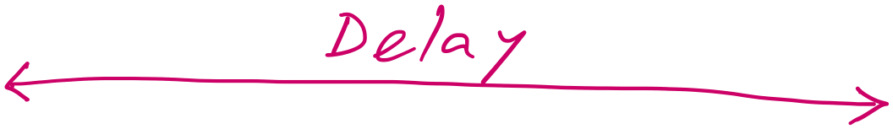
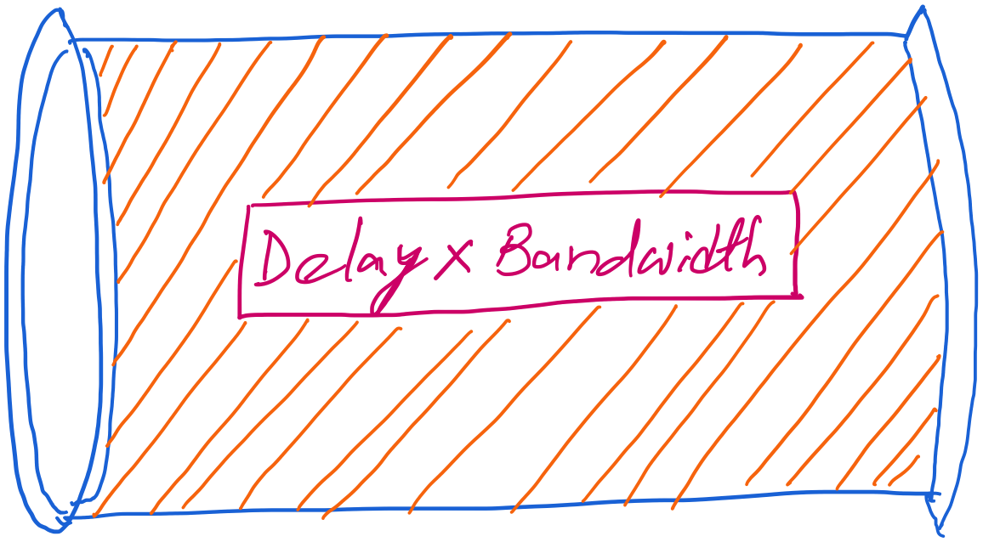
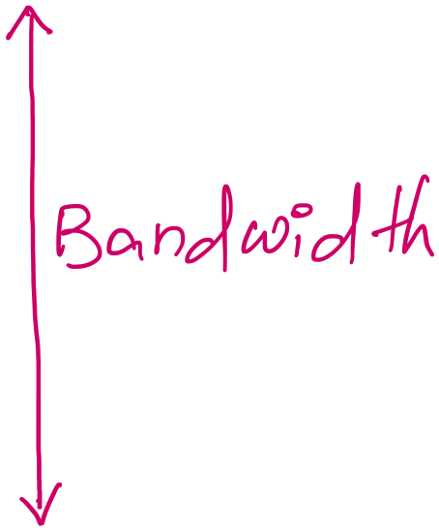
Revisiting “delay X bandwidth”
Consider two-way delay
or round-trip delay

Slide 3
stop-and-wait operation
sender
receiver
first packet bit transmitted, t = 0
last packet bit transmitted, t = L / R
first packet bit arrives
RTT
last packet bit arrives, send ACK
ACK arrives, send next
packet, t = RTT + L / R
Packet size = L bits
Network bandwidth = R bits-per-sec

Slide 4
stop-and-wait operation
sender
receiver
first packet bit transmitted, t = 0
last packet bit transmitted, t = L / R
1kB packet per 30.008 msec
first packet bit arrives
RTT
last packet bit arrives, send ACK
~33KB/sec throughput over a 1GBPS link!!
ACK arrives, send next
packet, t = RTT + L / R
Network protocol limits the full utilization of physical resources.
Transport-layer vs Link-layer capacity gap
Packet size = L bits
Network bandwidth = R bits-per-sec

Slide 5
Pipelining: increased utilization
sender
receiver
first packet bit transmitted, t = 0
last bit transmitted, t = L / R
first packet bit arrives
RTT
last packet bit arrives, send ACK
last bit of 2nd packet arrives, send ACK
last bit of 3rd packet arrives, send ACK
ACK arrives, send next
packet, t = RTT + L / R
Increase utilization
by a factor of 3!

Slide 6
Revisiting “delay X bandwidth”
Sender
Receiver
Round-trip delay
Time

Slide 7
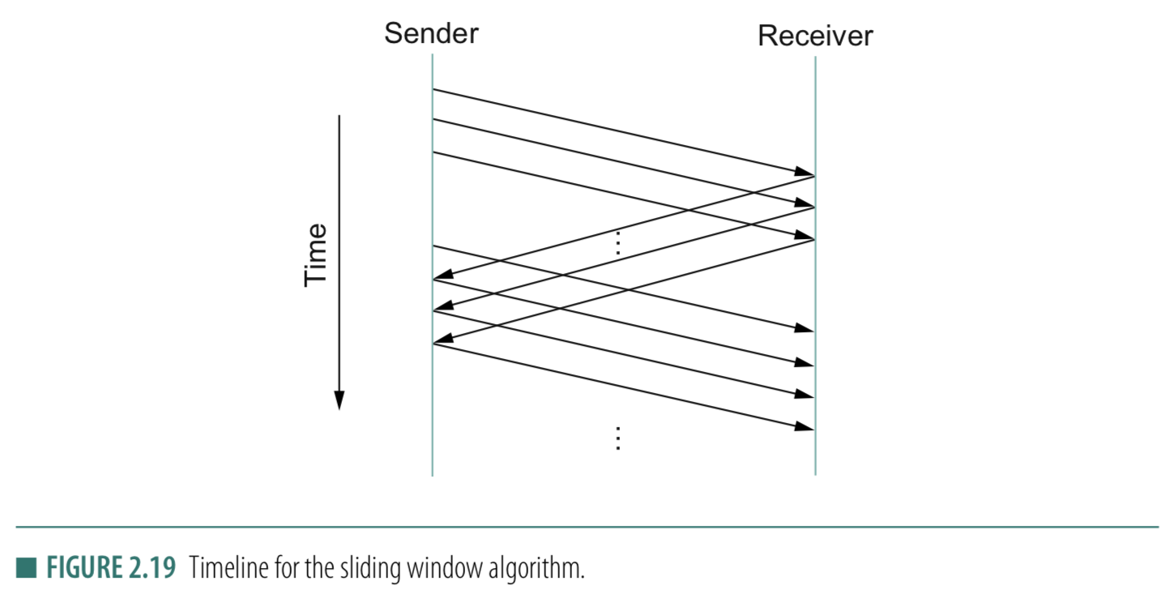
Stop-and-wait
Sliding Window
Sender
Receiver
Packet
Timeout
ACK
Time

Slide 8
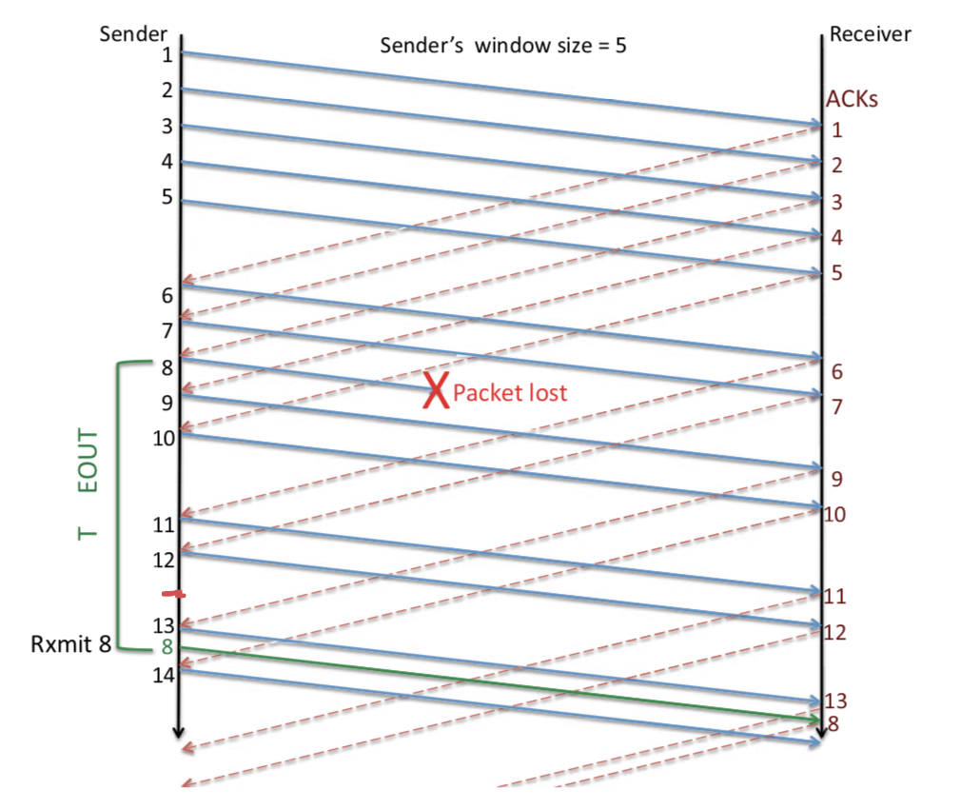
Sliding Window: Lost Packet/ACK

Slide 9
Sliding Window Protocol

Slide 10
Sliding Window: A series of packets to be sent reliably
Window = # pkt in flight
Pkt:1
Pkt:2
Pkt:3
Pkt:4
Pkt:5
Pkt:6
Pkt:7
Pkt:8
Sent
Sent
Sent

Slide 11
Sliding Window: A series of packets to be sent reliably
Window = # pkt in flight
Pkt:1
Pkt:2
Pkt:3
Pkt:4
Pkt:5
Pkt:6
Pkt:7
Pkt:8
Sent
Sent
Sent
ACK

Slide 12

Sliding Window: A series of packets to be sent reliably
Window = # pkt in flight
Pkt:1
Pkt:2
Pkt:3
Pkt:4
Pkt:5
Pkt:6
Pkt:7
Pkt:8
Sent
Sent
Packet 1 is delivered

Slide 13
Sliding Window: A series of packets to be sent reliably
Window = # pkt in flight
Pkt:1
Pkt:2
Pkt:3
Pkt:4
Pkt:5
Pkt:6
Pkt:7
Pkt:8
Sent
Sent
Packet 1 is delivered. Slide the window.

Slide 14
Sliding Window: A series of packets to be sent reliably
Window = # pkt in flight
Pkt:1
Pkt:2
Pkt:3
Pkt:4
Pkt:5
Pkt:6
Pkt:7
Pkt:8
Sent
Sent
Sent
Packet 1 is delivered. Slide the window.

Slide 15
Sliding Window: A series of packets to be sent reliably
Sender
Receiver
Time

Slide 16
Sliding Window: A series of packets to be sent reliably
Window = # pkt in flight
Pkt:1
Pkt:2
Pkt:3
Pkt:4
Pkt:5
Pkt:6
Pkt:7
Pkt:8
Sent
Sent
Sent
Packet 1 is delivered. Slide the window.

Slide 17
Sliding Window: A series of packets to be sent reliably
Should we advance the window in the following scenario?
Window = # pkt in flight
Pkt:1
Pkt:2
Pkt:3
Pkt:4
Pkt:5
Pkt:6
Pkt:7
Pkt:8
Sent
Sent
Sent
ACK

Slide 18
Sliding Window: A series of packets to be sent reliably
Sender
Receiver
Time

Slide 19
Sliding Window: A series of packets to be sent reliably
Should we advance the window in the following scenario?
Window = # pkt in flight
Pkt:1
Pkt:2
Pkt:3
Pkt:4
Pkt:5
Pkt:6
Pkt:7
Pkt:8
Sent
Sent
Sent
ACK

Slide 20
Sliding Window: A series of packets to be sent reliably
Should we advance the window in the following scenario?
Window = # pkt in flight
Pkt:1
Pkt:2
Pkt:3
Pkt:4
Pkt:5
Pkt:6
Pkt:7
Pkt:8
Sent
Sent
Sent
ACK
Note that the window size is not changed!

Slide 21
Sliding Window: A series of packets to be sent reliably
Window = # pkt in flight
Pkt:1
Pkt:2
Pkt:3
Pkt:4
Pkt:5
Pkt:6
Pkt:7
Pkt:8
Sent
Sent
Sent
Can you make sliding window behave like
stop-and-wait?

Slide 22
Sliding Window Protocol
(dealing packet loss)

Slide 23
Sliding Window: A series of packets to be sent reliably
Window = # pkt in flight
Pkt:1
Pkt:2
Pkt:3
Pkt:4
Pkt:5
Pkt:6
Pkt:7
Pkt:8
Sent
Sent
Sent

Slide 24
Sliding Window: A series of packets to be sent reliably
Window = # pkt in flight
Pkt:1
Pkt:2
Pkt:3
Pkt:4
Pkt:5
Pkt:6
Pkt:7
Pkt:8
Sent
Sent
Sent
Re-tx
Re-tx
Re-tx
(1) ARQ strategy 1: Retransmit all un-ACKed packets

Slide 25
Sliding Window: A series of packets to be sent reliably
(1) Go-back-N (Sender side)
Sender
Receiver
1
2
3
Timeout
X
1
2
3
Time
Why sender retransmitted all packet in a window?
(1) Bursty losses
(2) Assumes receiver discarded out-of-order packets.

Slide 26
Sliding Window: A series of packets to be sent reliably
Window = # pkt in flight
Pkt:1
Pkt:2
Pkt:3
Pkt:4
Pkt:5
Pkt:6
Pkt:7
Pkt:8
Sent
Sent
Sent
Re-tx
(2) ARQ strategy 2: Retransmit only the lost packet
(2) Selective retransmit (Sender side)

Slide 27
Sliding Window: A series of packets to be sent reliably
(2) Selective retransmit
Sender
Receiver
1
2
3
Timeout
X
4
5
2
Time

Slide 28
Sliding Window: Lost Packet/ACK
Timeout

Slide 29
Which ARQ strategy does modern TCP implement?
TCP does not strictly implement either pure Go-Back-N (GBN) or pure Selective Repeat (SR)
—it is a hybrid, but in modern implementations it behaves much closer to Selective Repeat ARQ.

Slide 30
TCP Cumulative ACK strategy (receiver side)
Cumulative ACK:
ACK the largest in-sequence packet received.
What will be ACK sequence if the receive sequence
is: 5, 7, 8, 6 ?

Slide 31
TCP Cumulative ACK strategy (receiver side)
Cumulative ACK:
ACK the largest in-sequence packet received.
What will be ACK sequence if the receive sequence
is: 5, 7, 8, 6 ?
ACK: 6, 6, 6, 9

Slide 32
TCP Cumulative ACK strategy (receiver side)
(An example)
Sender
Receiver
X

Slide 33
TCP Cumulative ACK strategy (receiver side)
(An example)
Seq. # | 234118
ACK flag | N/A
ACK # | N/A
Data Len | 100 bytes
Sender
Receiver
234118
Seq. # | 234218
ACK flag | N/A
ACK # | N/A
Data Len | 50 bytes
234218
X
234268
Seq. # | 234268
ACK flag | N/A
ACK # | N/A
Data Len | 120 bytes
234388
Seq. # | 234388
ACK flag | N/A
ACK # | N/A
Data Len | 100 bytes

Slide 34
TCP Cumulative ACK strategy (receiver side)
(An example)
Seq. # | 234118
ACK flag | N/A
ACK # | N/A
Data Len | 100 bytes
Sender
Receiver
234118
Seq. # | 234218
ACK flag | N/A
ACK # | N/A
Data Len | 50 bytes
234218
X
Timeout
234268
Seq. # | 234268
ACK flag | N/A
ACK # | N/A
Data Len | 120 bytes
234388
Seq. # | 234388
ACK flag | N/A
ACK # | N/A
Data Len | 100 bytes

Slide 35
TCP Cumulative ACK strategy (receiver side)
(An example)
Seq. # | 234118
ACK flag | N/A
ACK # | N/A
Data Len | 100 bytes
Sender
Receiver
234118
Seq. # | 234218
ACK flag | N/A
ACK # | N/A
Data Len | 50 bytes
234218
X
234268
Seq. # | 234268
ACK flag | N/A
ACK # | N/A
Data Len | 120 bytes
234388
Seq. # | 234388
ACK flag | N/A
ACK # | N/A
Data Len | 100 bytes
234218

Slide 36
TCP Cumulative ACK strategy (receiver side)
(An example)
Sender
Receiver
234118
Seq. # | 234118
Data Len | 100 bytes
234218
X
234268
Seq. # | 234268
Data Len | 120 bytes
234388
Seq. # | 234388
Data Len | 100 bytes
234218
Seq. # | 234218
Data Len | 50 bytes

Slide 37
TCP Cumulative ACK strategy (receiver side)
(An example)
Sender
Receiver
ACKs
234118
Seq. # | 234118
Data Len | 100 bytes
ACK flag | 1
ACK #
234218
X
234268
Seq. # | 234268
Data Len | 120 bytes
ACK flag | 1
ACK #
234388
Seq. # | 234388
Data Len | 100 bytes
ACK flag | 1
ACK #
234218
Seq. # | 234218
Data Len | 50 bytes
ACK flag | 1
ACK #

Slide 38
TCP Cumulative ACK strategy (receiver side)
Sender buffer:
234118
234218
234268
234388
100 bytes
50 bytes
120 bytes
100 bytes
Receiver buffer:

Slide 39
TCP Cumulative ACK strategy (receiver side)
Sender buffer:
234118
234218
234268
234388
100 bytes
50 bytes
120 bytes
100 bytes
Receiver buffer:
234118
100 bytes

Slide 40
TCP Cumulative ACK strategy (receiver side)
Sender buffer:
234118
234218
234268
234388
100 bytes
50 bytes
120 bytes
100 bytes
Receiver buffer:
234118
100 bytes
234218

Slide 41
TCP Cumulative ACK strategy (receiver side)
Sender buffer:
234118
234218
234268
234388
100 bytes
50 bytes
120 bytes
100 bytes
Receiver buffer:
234118
234268
100 bytes
120 bytes
234218

Slide 42
TCP Cumulative ACK strategy (receiver side)
Sender buffer:
234118
234218
234268
234388
100 bytes
50 bytes
120 bytes
100 bytes
Receiver buffer:
234118
234268
234388
100 bytes
120 bytes
100 bytes
234218

Slide 43
TCP Cumulative ACK strategy (receiver side)
Sender buffer:
234118
234218
234268
234388
100 bytes
50 bytes
120 bytes
100 bytes
Receiver buffer:
234118
234218
234268
234388
100 bytes
50 bytes
120 bytes
100 bytes

Slide 44
TCP Cumulative ACK strategy (receiver side)
Sender buffer:
234118
234218
234268
234388
100 bytes
50 bytes
120 bytes
100 bytes
Receiver buffer:
234118
234218
234268
234388
100 bytes
50 bytes
120 bytes
100 bytes
234488

Slide 45
TCP Cumulative ACK strategy (receiver side)
Sender buffer:
234118
234218
234268
234388
100 bytes
50 bytes
120 bytes
100 bytes
Receiver buffer:
234118
234218
234268
234388
100 bytes
50 bytes
120 bytes
100 bytes

Slide 46
TCP Cumulative ACK strategy (receiver side)
(An example)
Sender
Receiver
ACKs
234118
Seq. # | 234118
Data Len | 100 bytes
ACK flag | 1
ACK # | 234218
234218
X
234268
Seq. # | 234268
Data Len | 120 bytes
ACK flag | 1
ACK # | 234218
234388
Seq. # | 234388
Data Len | 100 bytes
ACK flag | 1
ACK # | 234218
234218
Seq. # | 234218
Data Len | 50 bytes
ACK flag | 1
ACK # | 234488

Slide 47
Flow Control: TCP Sliding Window
Motivation: Maximum utilization of the resources without overwhelming the receiver.

Slide 48
Sliding Window
Receiver should have enough space to buffer/save the received data !!

Slide 49
Sliding Window: Implementation
Allow a larger amount of data “in flight” for better channel utilization, but should not exceed receiver’s capacity.
Sending process
Receiving process
TCP
TCP
Last byte written
Last byte read
Window
Next byte expected
Last byte ACKed
Last byte sent
Last byte received

Slide 50
Sliding Window: Implementation
Allow a larger amount of data “in flight”
Allow sender to get ahead of the receiver
… though not too far ahead
Sending process
Receiving process
TCP
TCP
Last byte written
Last byte read
Window
Next byte expected
Last byte ACKed
Last byte sent
Last byte received

Slide 51
Receiver Buffering: Flow control
Receive window size
Amount that can be sent without acknowledgment
Receiver must be able to store this amount of data
Receiver tells the sender the window
Tells the sender the amount of free space left (i.e. sends an Advertised_Window size to the sender)

Slide 52
How to send the Advertised_Window size

Slide 53
Calculate Advertised_Window (Receiver side)
Receiving process
TCP
Last byte read
Next byte expected
Last byte received
AdvertisedWindow = MaxRcvBuffer – (bytes used)
AdvertisedWindow = MaxRcvBuffer –
((NextByteExpected-1) – LastByteRead)

Slide 54
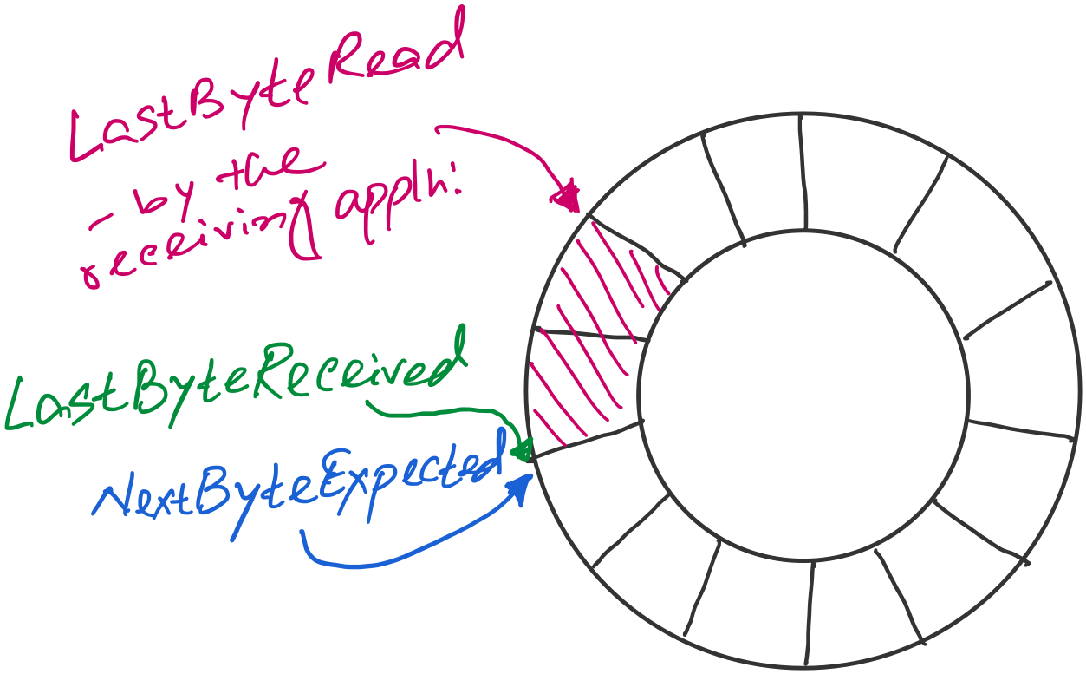
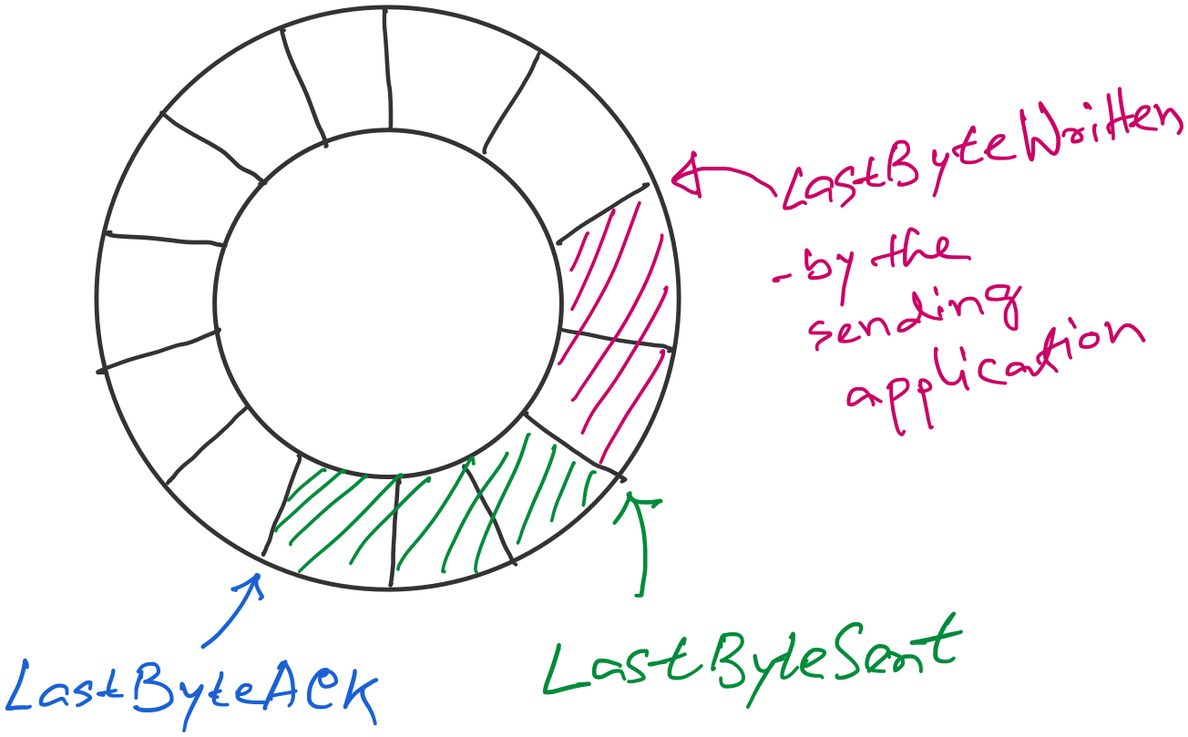
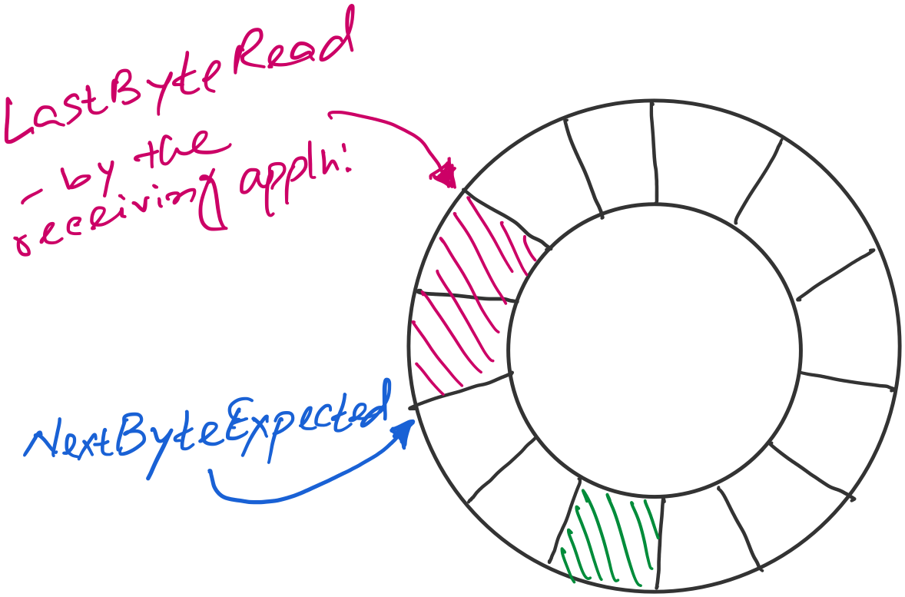
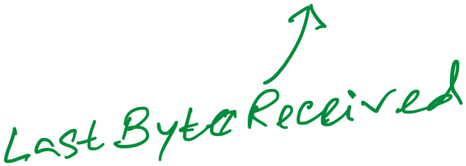
Sender buffer
Receiver buffer

Slide 55
Sender buffer
Receiver buffer
What if the AdvertisedWindow is zero?
>> Periodically send 1byte packets to break the deadlock. (uses the persist timer)
AdvertisedWindow = MaxRcvBuffer –
((NextByteExpected-1) – LastByteRead)
EffectiveWindow (calculated at the sender side)
= AdvertisedWindow - (LastByteSent – LastByteACKed)

Slide 56
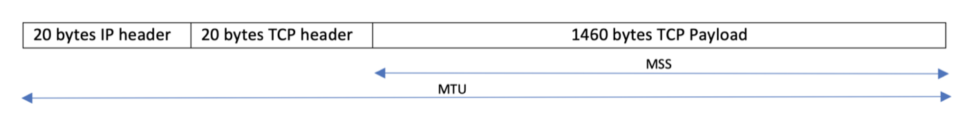
Considering Maximum Segment Size (MSS)
MSS = MTU − (IP header + TCP header)
What if…
(1) Adv_window > MSS
(2) Adv_window < MSS
Window vs segment size are different dimensions
rwnd or Adv_window (Advertised Window): total bytes
allowed in flight
MSS: maximum bytes per segment
They are not competing limits; they apply at different levels.

Slide 57
A few points of discussions on TCP flow control
Silly window syndrome
Nagle’s algorithm (self-clocking)
Karn-Partridge algorithm

Slide 58
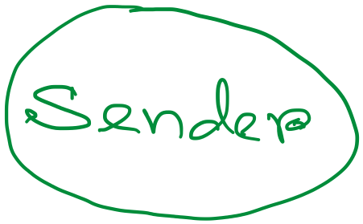
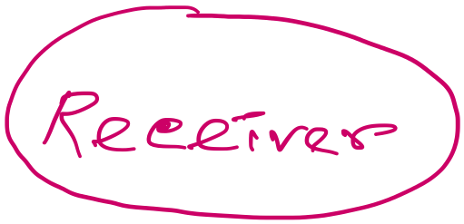
Silly-window syndrome
Host A
Byte 1
Byte 2
Byte 3
Byte 80
Data
ACK + Adv_Win
Byte 1
Byte 2
Byte 3
Byte 80
Host B

Slide 59

Silly window syndrome
What happens when the receiving application program consumes data slowly?
Leads to smaller advertised_window

Slide 60
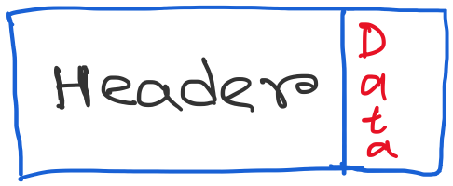
Silly window syndrome
Discussion: What can be the possible solutions?

Slide 61
Solution 1: Receiver side approach
(1) Delayed ACK (a receiver-side approach)

Slide 62
Solution 1: Receiver side approach
(1) Delayed ACK (a receiver-side approach)
- How much delay is good enough?

Slide 63
Solution 1: Receiver side approach
(1) Delayed ACK (a receiver-side approach)
- How much delay is good enough?
[RFC 1122] A TCP SHOULD implement a delayed ACK, but an
ACK should not be excessively delayed; in particular,
the delay MUST be less than 0.5 seconds, and in a stream
of full-sized segments there SHOULD be an ACK for at least
every second segment.
Typically, OSs are more conservative. Use 200ms of delay.

Slide 64
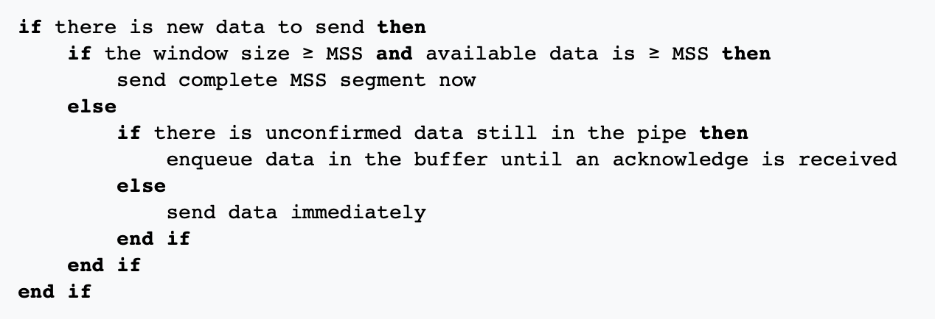
Solution 2: Sender side approach
(2) Nagle’s algorithm (a sender-side approach)

Slide 65
Solution 2: Sender side approach
Condition 0: Assumes there are some data to send. Otherwise, the sender will have to wait anyway.

Slide 66
Solution 2: Sender side approach
Condition 1: The system is capable of sending a full MSS.
Send immediately.

Slide 67
Solution 2: Sender side approach
Condition 2: Not enough data OR window size for a full MSS.
But some packets are in-flight (yet to receive ACK for).
Buffer the data and wait.

Slide 68
Solution 2: Sender side approach
Condition 3: No packet is in-flight (i.e., all ACKs are received).
Send immediately, no matter how small the packet is.

Slide 69
Solution 2: Sender side approach
(2) Nagle’s algorithm
Because some applications cannot afford such a delay for each write it does to a
TCP connection, the socket interface allows the application to turn off
Nagel’s algorithm by setting the TCP_NODELAY socket option.
TCP_QUICKACK option disables the Delayed Ack protocol.

Slide 70
What if sender and receiver simultaneously applies the Nagle’s algo. and delayed ack (TCP’s default setting) ?
[Ref] https://betterprogramming.pub/redis-internals-client-connects-to-redis-by-tcp-faf6ad1a7df5

Slide 71
What if sender and receiver simultaneously applies the Nagle’s algo. and delayed ack (TCP’s default setting) ?
Sender
Receiver
Packet-1
Nagle’s algo:
Buffered next packet
waiting for the ACK
for packet-1.
Delayed ACK:
Delayed the ACK
for packet-1.
Waiting for the next packet
to send the cumulative ACK
OR
the timeout to occur.
Time

Slide 72
What if sender and receiver simultaneously applies the Nagle’s algo. and delayed ack (TCP’s default setting) ?
Sender
Receiver
Packet-1
Nagle’s algo:
Buffered next packet
waiting for the ACK
for packet-1.
Delayed ACK:
Delayed the ACK
for packet-1.
Waiting for the next packet
to send the cumulative ACK
OR
the timeout to occur.
Time
Timeout after 500ms (default)

Slide 73
What if sender and receiver simultaneously applies the Nagle’s algo. and delayed ack (TCP’s default setting) ?
Sender
Receiver
Packet-1
Nagle’s algo:
Buffered next packet
waiting for the ACK
for packet-1.
Delayed ACK:
Delayed the ACK
for packet-1.
Waiting for the next packet
to send the cumulative ACK
OR
the timeout to occur.
ACK for 1
Time
Timeout after 500ms (default)

Slide 74
What if sender and receiver simultaneously applies the Nagle’s algo. and delayed ack (TCP’s default setting) ?
Sender
Receiver
Packet-1
Nagle’s algo:
Buffered next packet
waiting for the ACK
for packet-1.
Delayed ACK:
Delayed the ACK
for packet-1.
Waiting for the next packet
to send the cumulative ACK
OR
the timeout to occur.
ACK for 1
Time
Timeout after 500ms (default)
Packet-2
Notes:
When Nagle's algorithm and delayed acknowledgment (delayed ACK) are used together, they can create a "deadlock" scenario, leading to delays and reduced throughput, especially for applications requiring immediate data transmission.

Slide 75
Sender-side Timeout value calculation and its limitations

Slide 76
Calculating TCP timeout value: The original idea

Slide 77
Calculating TCP timeout value: The original idea
Smoothing factor (recommended between 0.8 -0.9)

Slide 78
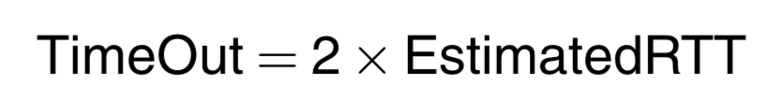
Calculating TCP timeout value: The original idea
Smoothing factor (recommended between 0.8 -0.9)

Slide 79
Calculating TCP timeout value: The original idea
Smoothing factor (recommended between 0.8 -0.9)
RTT estimation can be wrong

Slide 80
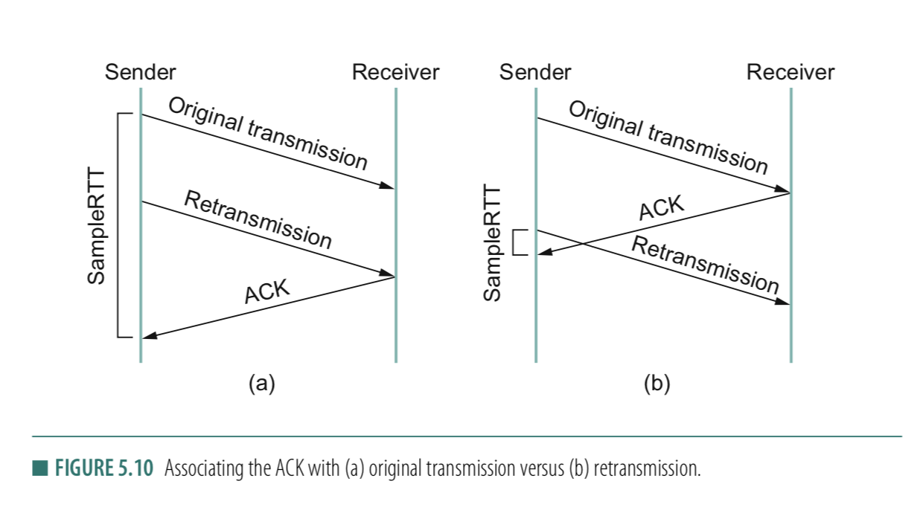
RTT estimation can be wrong

Slide 81
RTT estimation can be wrong

Slide 82
Solution: Karn/Partridge algorithm
Stop taking RTT samples when TCP retransmits
Start again after a regular transmission/reception
3) Each time TCP retransmits, set next timeout to be twice the last timeout value
Can rules #1 & #2 create issues?
Notes:
Answer (2) This simplistic implementation of Karn's algorithm can lead to problems as well. Consider what happens when TCP sends a segment after a sharp increase in delay. Using the prior round-trip time estimate, TCP computes a timeout and retransmits a segment. If TCP ignores the round-trip time of all retransmitted packets, the round trip estimate will never be updated, and TCP will continue retransmitting every segment, never adjusting to the increased delay.
[Ref] https://en.wikipedia.org/wiki/Karn%27s_algorithm

Slide 83
Thank you

