Slide 1

Computer Networks
CMSC 417 : Spring 2026
Topic:
Transport Layer Protocols:
Flow-control & Congestion Control
(Textbook chapters 5 & 6)
Nirupam Roy
M-W 2:00-3:15pm
CSI 2117
April 6th, 2026

Slide 2
A few points of discussions on TCP flow control
Silly window syndrome
Nagle’s algorithm (self-clocking)
Karn-Partridge algorithm

Slide 3
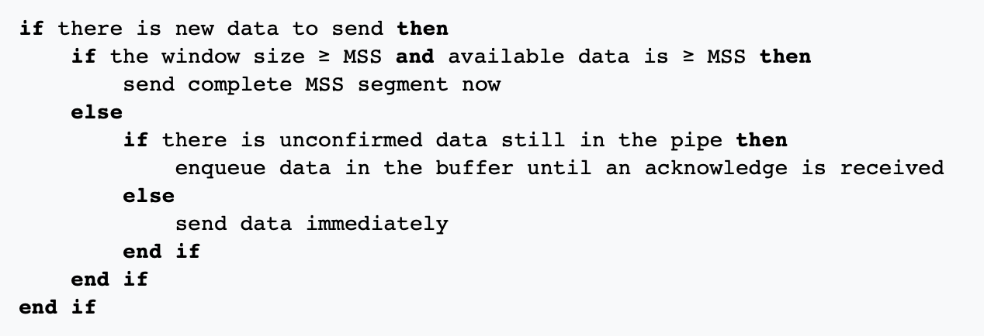
Solution 2: Sender side approach
(2) Nagle’s algorithm
Because some applications cannot afford such a delay for each write it does to a
TCP connection, the socket interface allows the application to turn off
Nagel’s algorithm by setting the TCP_NODELAY socket option.
TCP_QUICKACK option disables the Delayed Ack protocol.

Slide 4
Solution 2: Sender side approach
(2) Nagle’s algorithm
Send small data immediately only if no unacknowledged data is in flight; otherwise, buffer until an ACK arrives or
enough data accumulates (≈ MSS).
Because some applications cannot afford such a delay for each write it does to a
TCP connection, the socket interface allows the application to turn off
Nagel’s algorithm by setting the TCP_NODELAY socket option.
TCP_QUICKACK option disables the Delayed Ack protocol.

Slide 5
What if sender and receiver simultaneously applies the Nagle’s algo. and delayed ack (TCP’s default setting) ?
[Ref] https://betterprogramming.pub/redis-internals-client-connects-to-redis-by-tcp-faf6ad1a7df5

Slide 6
What if sender and receiver simultaneously applies the Nagle’s algo. and delayed ack (TCP’s default setting) ?
Sender
Receiver
Packet-1
Nagle’s algo:
Buffered next packet
waiting for the ACK
for packet-1.
Delayed ACK:
Delayed the ACK
for packet-1.
Waiting for the next packet
to send the cumulative ACK
OR
the timeout to occur.
Time

Slide 7
What if sender and receiver simultaneously applies the Nagle’s algo. and delayed ack (TCP’s default setting) ?
Sender
Receiver
Packet-1
Nagle’s algo:
Buffered next packet
waiting for the ACK
for packet-1.
Delayed ACK:
Delayed the ACK
for packet-1.
Waiting for the next packet
to send the cumulative ACK
OR
the timeout to occur.
Time
Timeout after 500ms (default)

Slide 8
What if sender and receiver simultaneously applies the Nagle’s algo. and delayed ack (TCP’s default setting) ?
Sender
Receiver
Packet-1
Nagle’s algo:
Buffered next packet
waiting for the ACK
for packet-1.
Delayed ACK:
Delayed the ACK
for packet-1.
Waiting for the next packet
to send the cumulative ACK
OR
the timeout to occur.
ACK for 1
Time
Timeout after 500ms (default)

Slide 9
What if sender and receiver simultaneously applies the Nagle’s algo. and delayed ack (TCP’s default setting) ?
Sender
Receiver
Packet-1
Nagle’s algo:
Buffered next packet
waiting for the ACK
for packet-1.
Delayed ACK:
Delayed the ACK
for packet-1.
Waiting for the next packet
to send the cumulative ACK
OR
the timeout to occur.
ACK for 1
Time
Timeout after 500ms (default)
Packet-2
Notes:
When Nagle's algorithm and delayed acknowledgment (delayed ACK) are used together, they can create a "deadlock" scenario, leading to delays and reduced throughput, especially for applications requiring immediate data transmission.

Slide 10
Sender-side Timeout value calculation and its limitations

Slide 11
Calculating TCP timeout value: The original idea

Slide 12
Calculating TCP timeout value: The original idea
Smoothing factor (recommended between 0.8 -0.9)

Slide 13
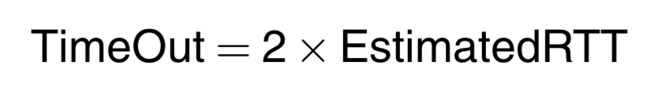
Calculating TCP timeout value: The original idea
Smoothing factor (recommended between 0.8 -0.9)

Slide 14
Calculating TCP timeout value: The original idea
Smoothing factor (recommended between 0.8 -0.9)
RTT estimation can be wrong

Slide 15
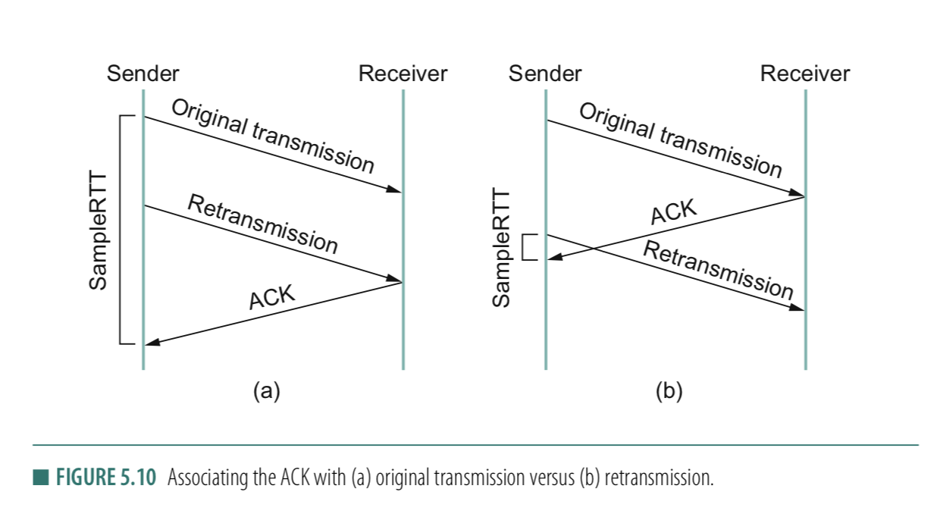
RTT estimation can be wrong
Notes:
TCP ACKs are cumulative and carry no transmission identifier. They only say:
“I have received all bytes up to sequence number X.”
Now consider a segment with sequence number S:
You send segment S at time t₀.
It is delayed (not necessarily lost).
You timeout and retransmit S at time t₁.
The receiver eventually sends an ACK for S.
When that ACK arrives, you cannot tell:
Did it acknowledge the original transmission (t₀)?
Or the retransmission (t₁)?
Both lead to the same ACK value.

Slide 16
RTT estimation can be wrong
Could this issue be solved by checking Sequence # and ACK # ?
Notes:
TCP ACKs are cumulative and carry no transmission identifier. They only say:
“I have received all bytes up to sequence number X.”
Now consider a segment with sequence number S:
You send segment S at time t₀.
It is delayed (not necessarily lost).
You timeout and retransmit S at time t₁.
The receiver eventually sends an ACK for S.
When that ACK arrives, you cannot tell:
Did it acknowledge the original transmission (t₀)?
Or the retransmission (t₁)?
Both lead to the same ACK value.

Slide 17
RTT estimation can be wrong

Slide 18
Solution: Karn/Partridge algorithm
Stop taking RTT samples when TCP retransmits
Start again after a regular transmission/reception
3) Each time TCP retransmits, set next timeout to be twice the last timeout value
Can rules #1 & #2 create issues?
Notes:
Answer (2) This simplistic implementation of Karn's algorithm can lead to problems as well. Consider what happens when TCP sends a segment after a sharp increase in delay. Using the prior round-trip time estimate, TCP computes a timeout and retransmits a segment. If TCP ignores the round-trip time of all retransmitted packets, the round trip estimate will never be updated, and TCP will continue retransmitting every segment, never adjusting to the increased delay.
[Ref] https://en.wikipedia.org/wiki/Karn%27s_algorithm
How modern TCP partially “fixes” this
With the TCP Timestamp option (RFC 7323):
Sender includes a timestamp in each segment
Receiver echoes it back in the ACK
Now you can measure RTT for each transmission instance, eliminating ambiguity.

Slide 19
Summary of TCP learned so far

Slide 20
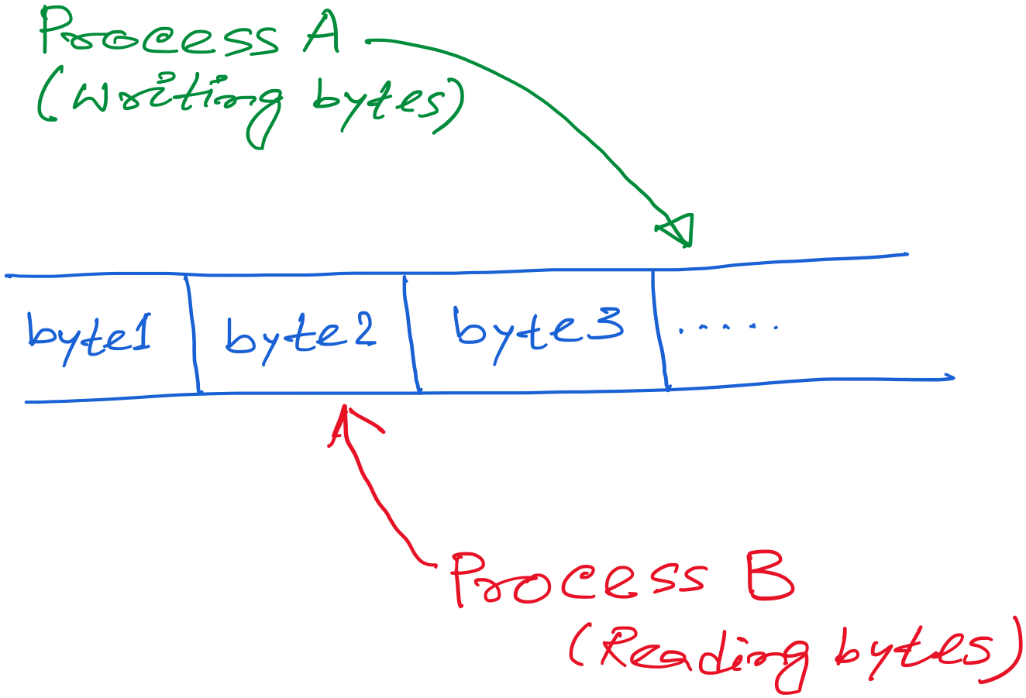
TCP: Abstraction of Reliable Bytes Stream

Slide 21
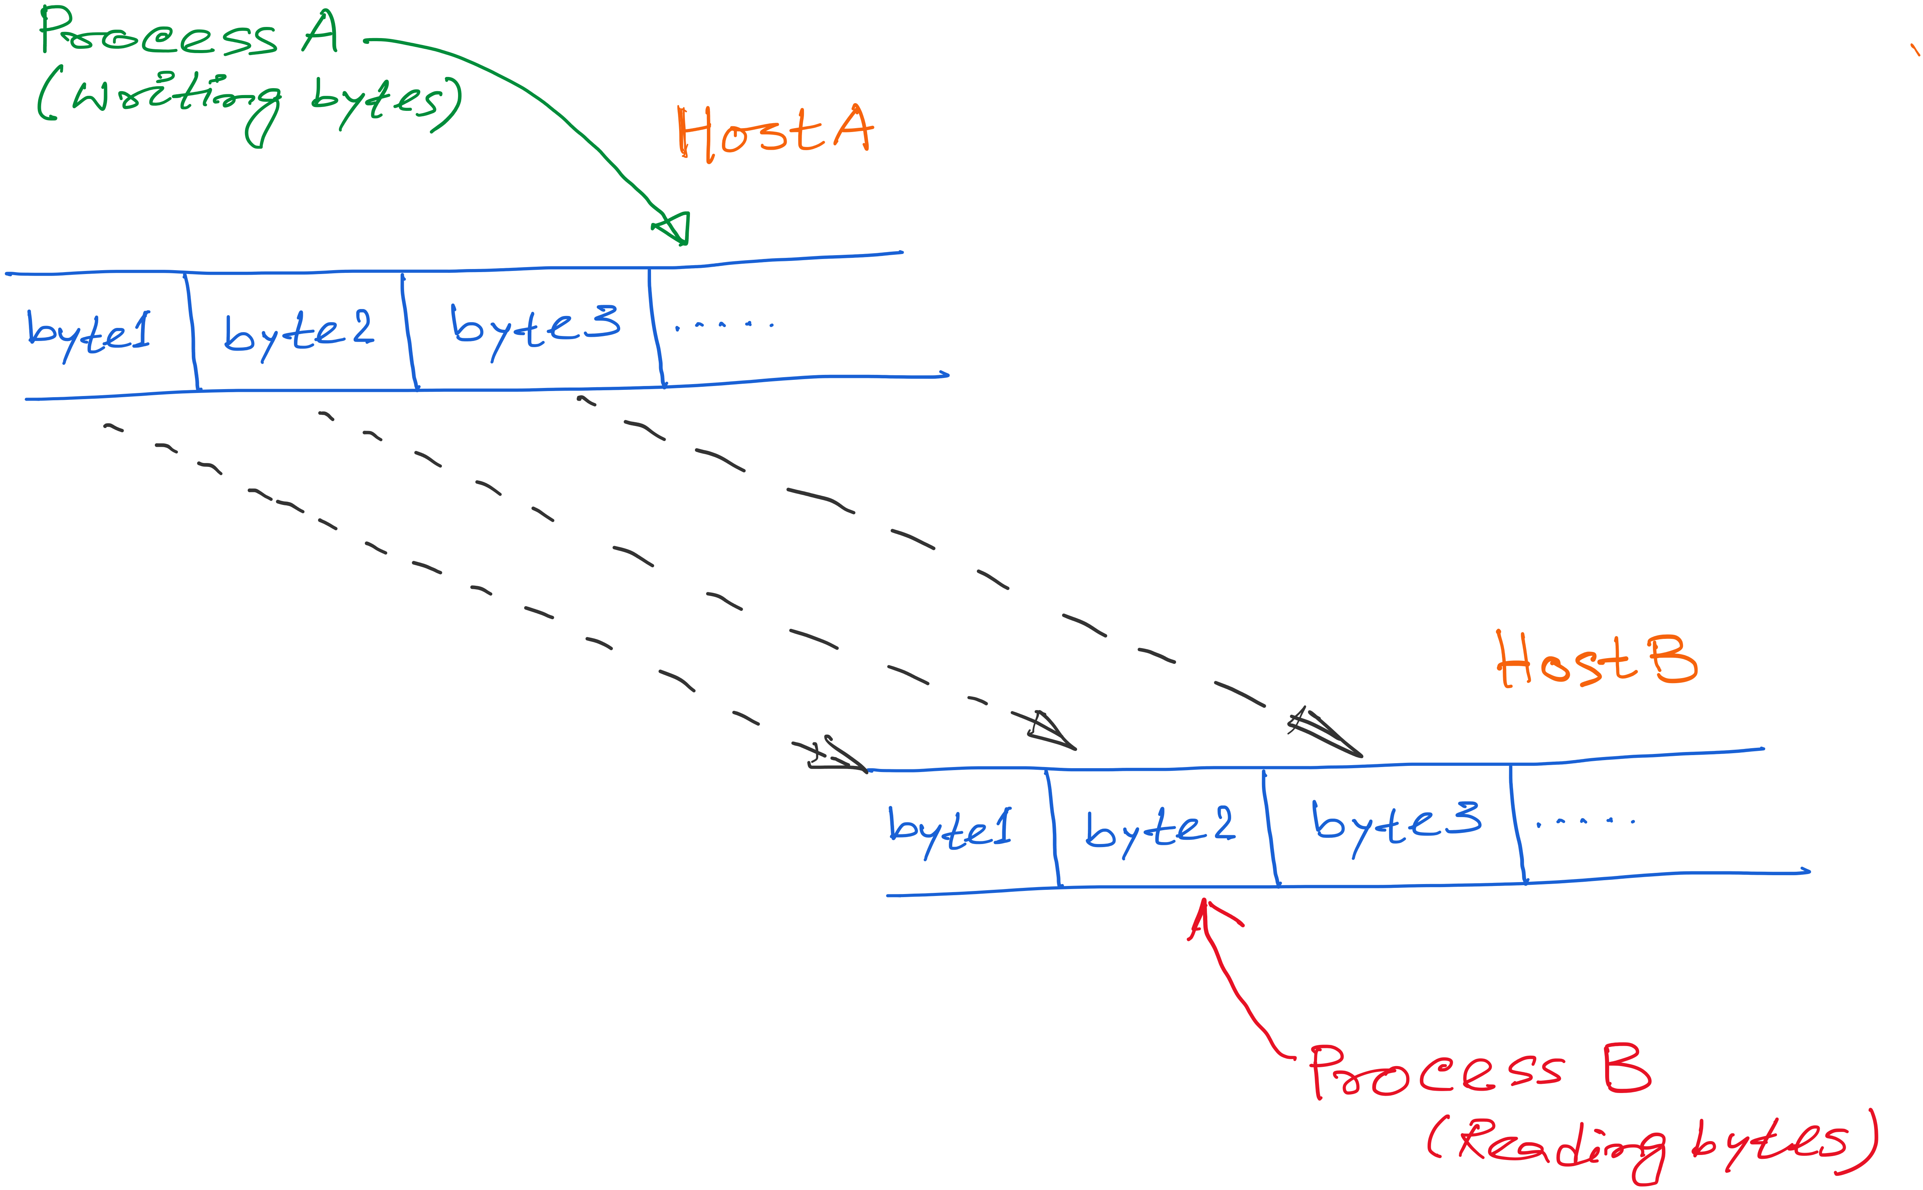
TCP: Abstraction of Reliable Bytes Stream

Slide 22
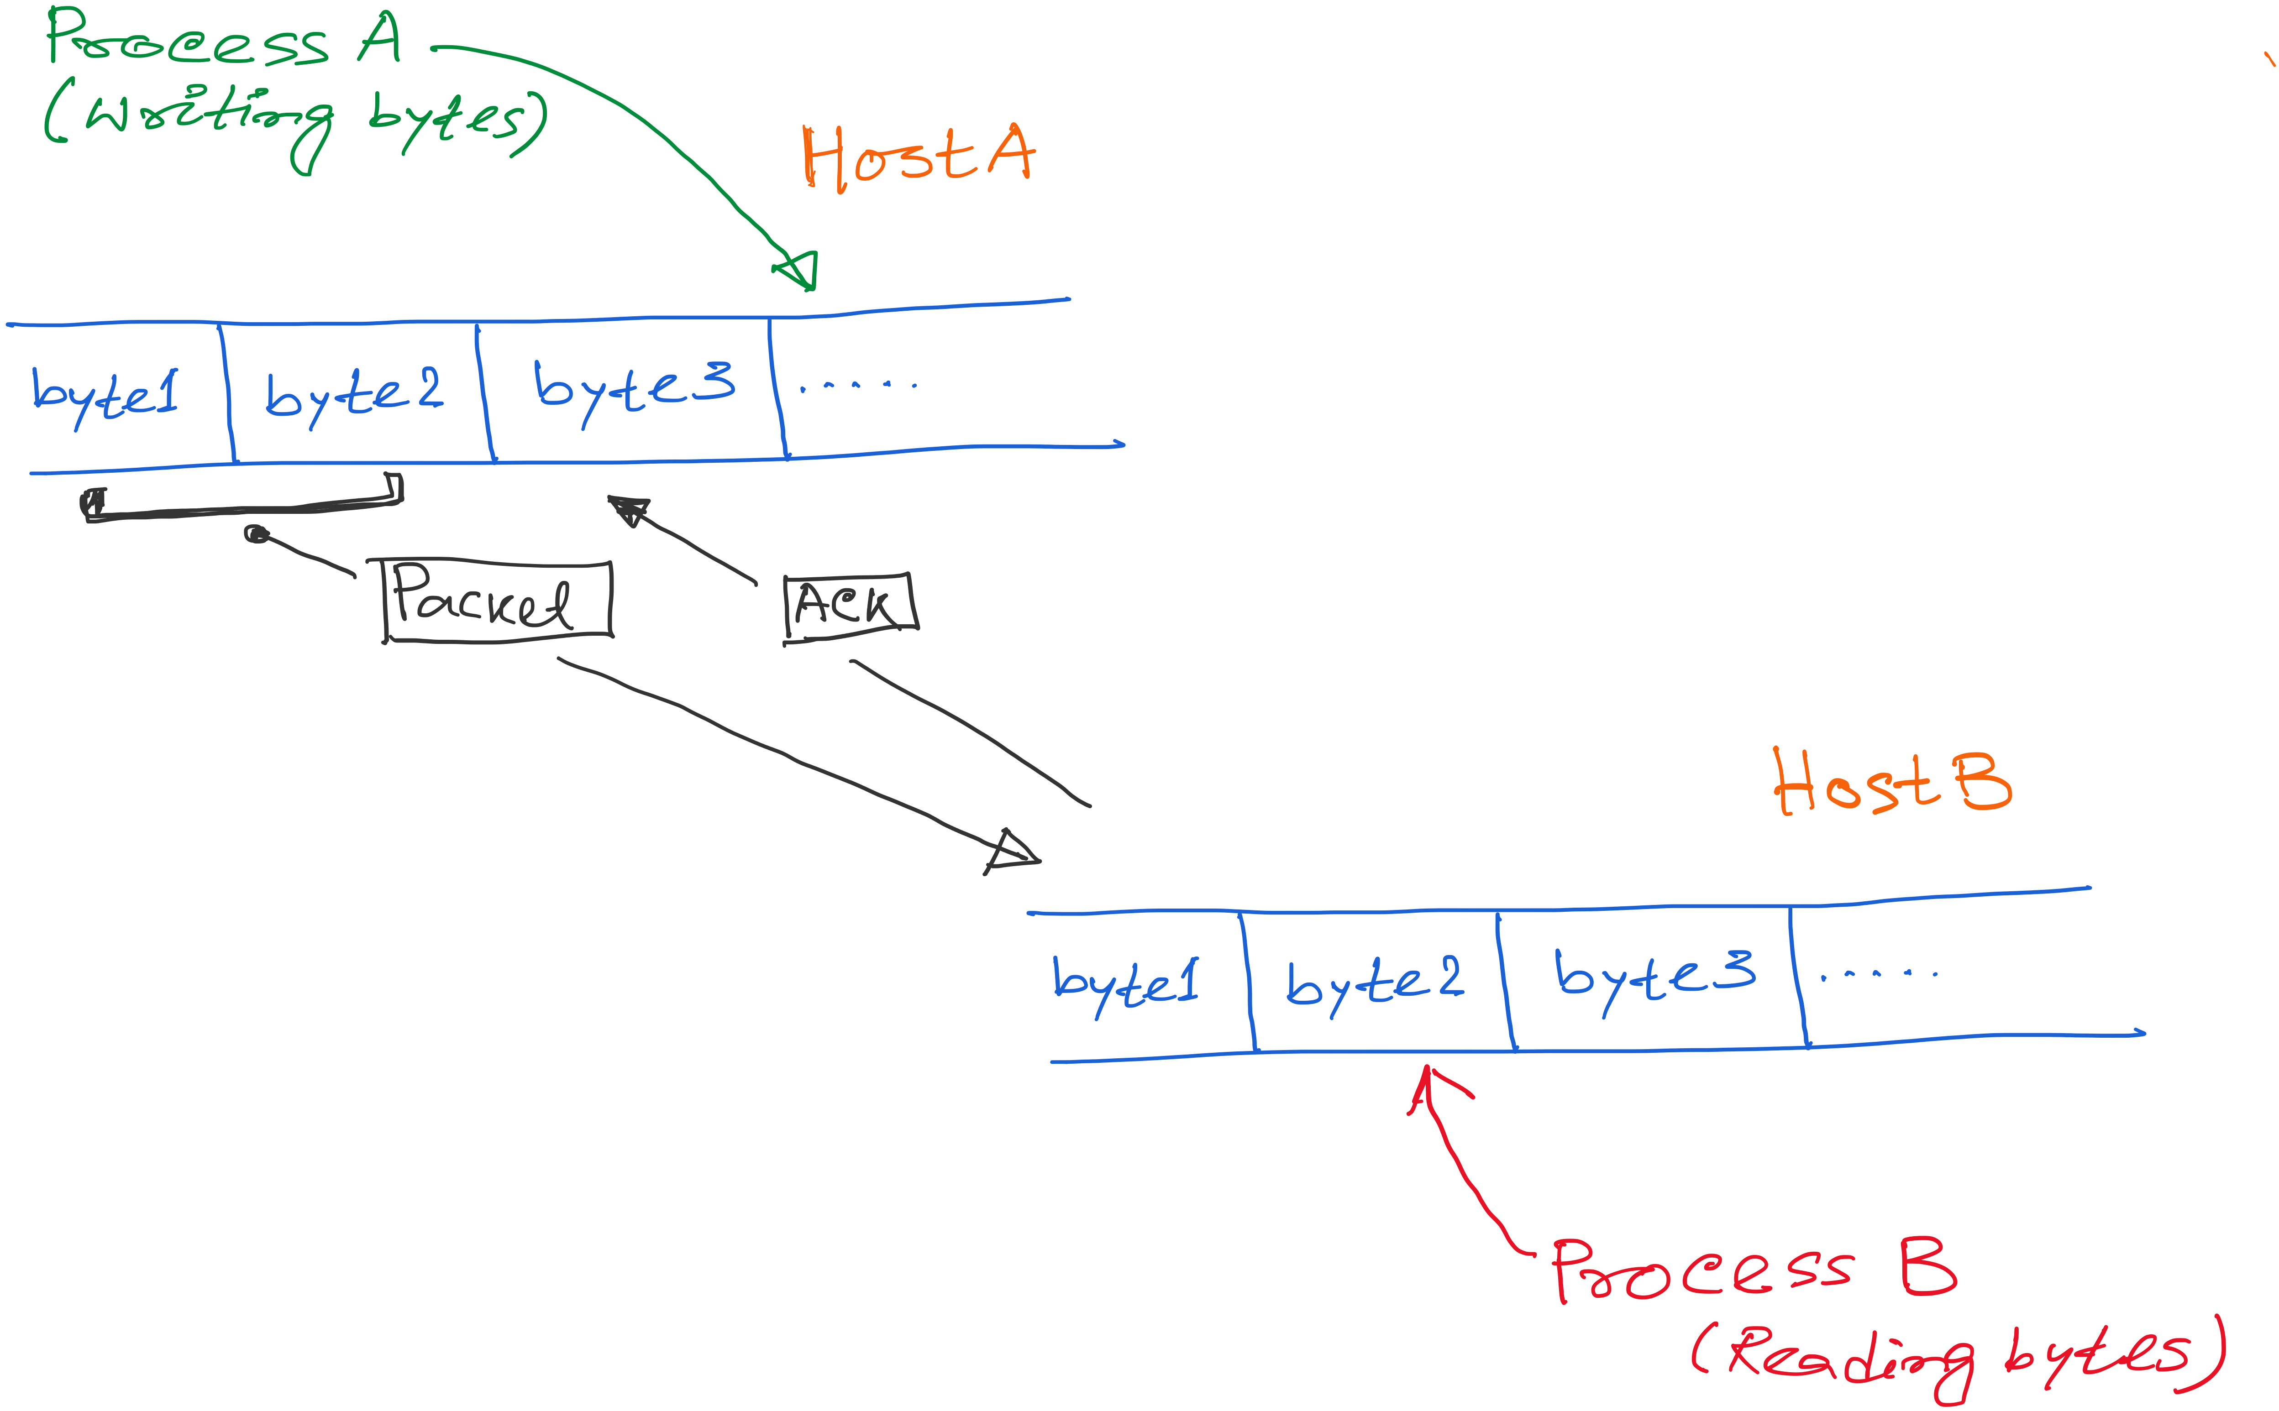
TCP: Abstraction of Reliable Bytes Stream

Slide 23
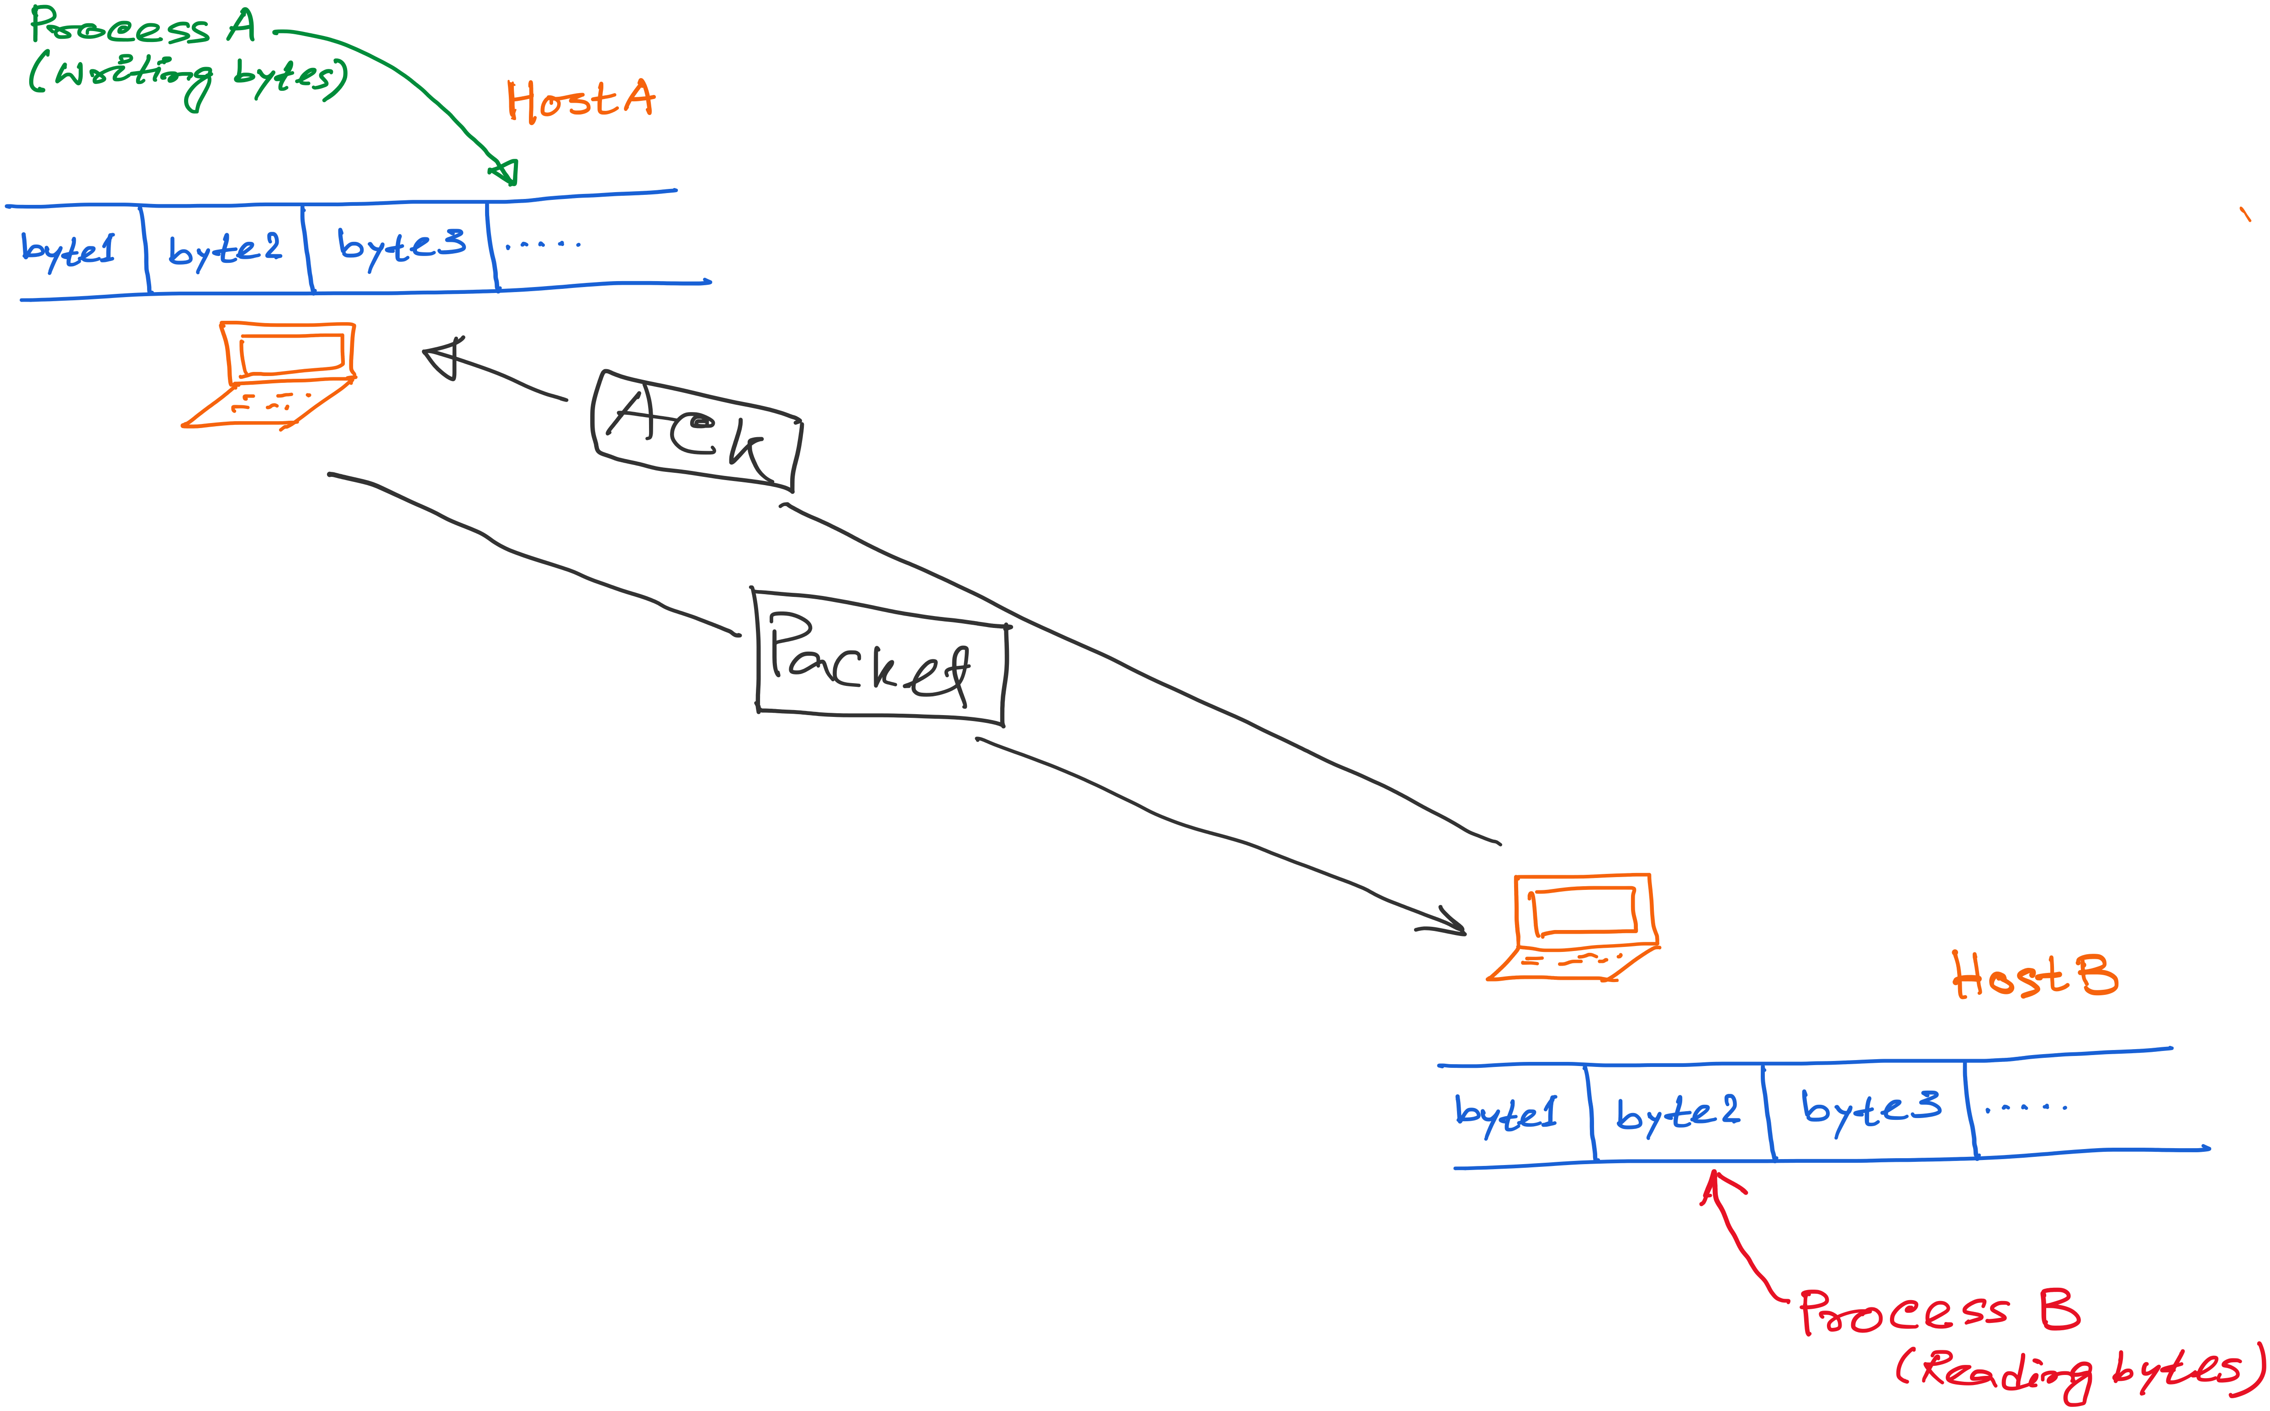
TCP: Abstraction of Reliable Bytes Stream

Slide 24
TCP: Abstraction of Reliable Bytes Stream
AdvertisedWindow
Flow control: Do not overwhelm the resources at the receiver

Slide 25
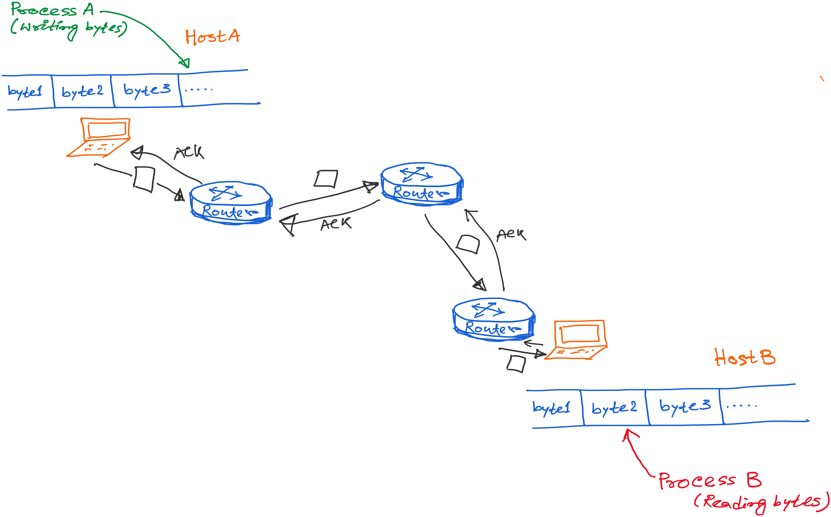
TCP: Abstraction of Reliable Bytes Stream

Slide 26
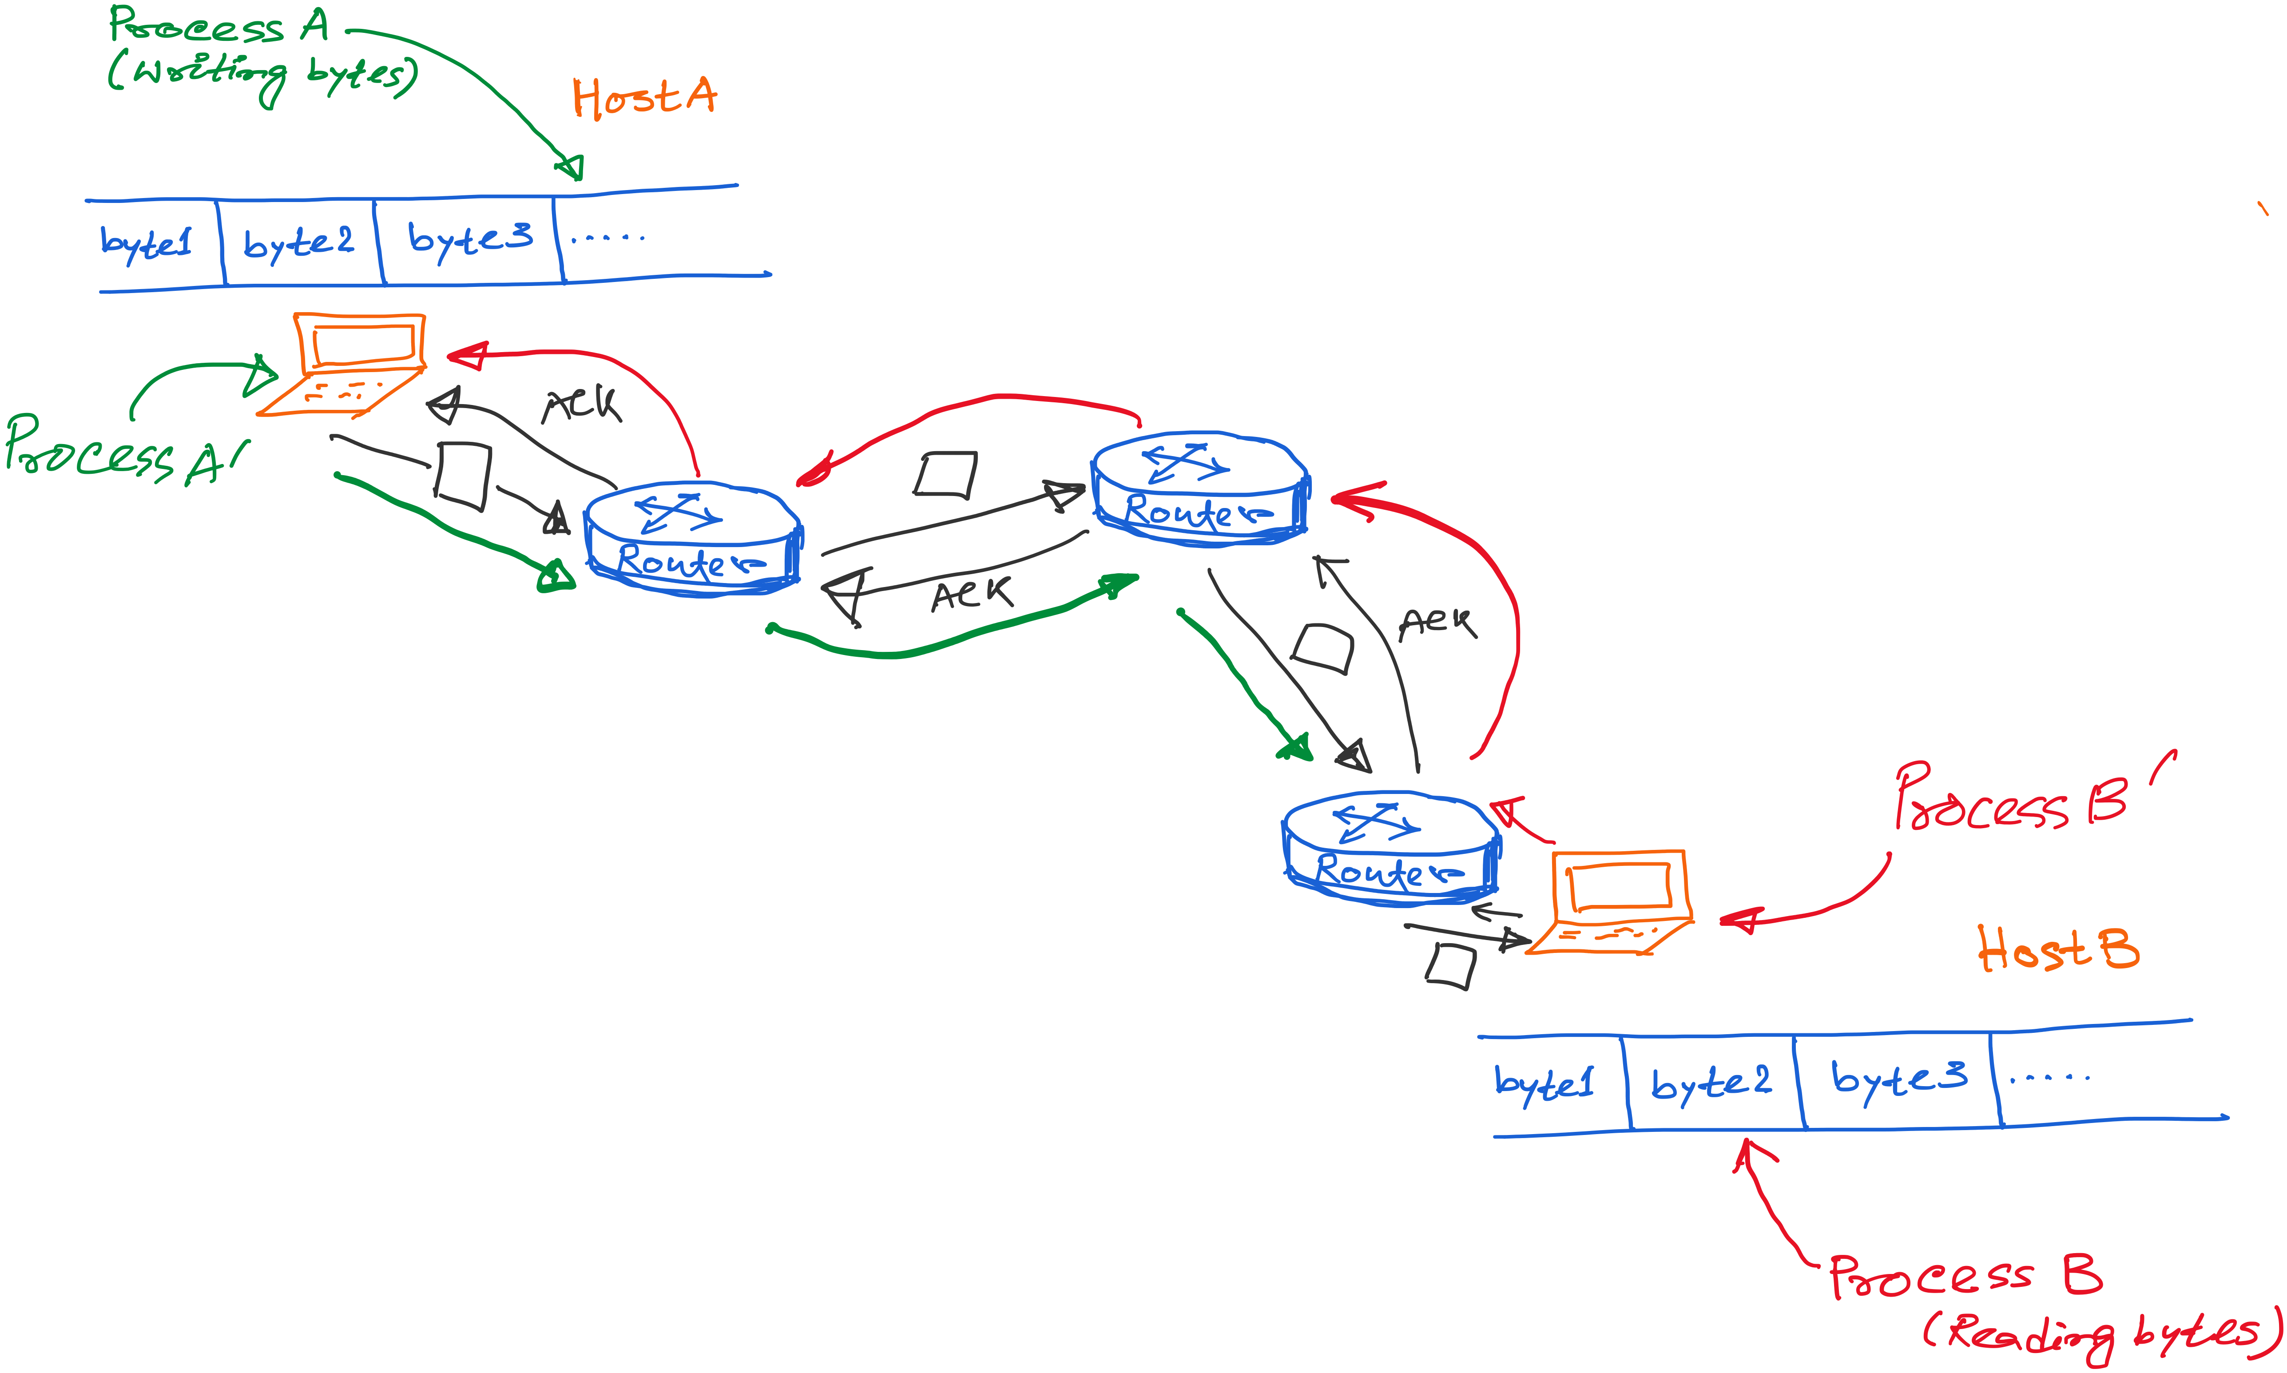
TCP: Abstraction of Reliable Bytes Stream
Notes:
Multiple processes running simulataneously.

Slide 27
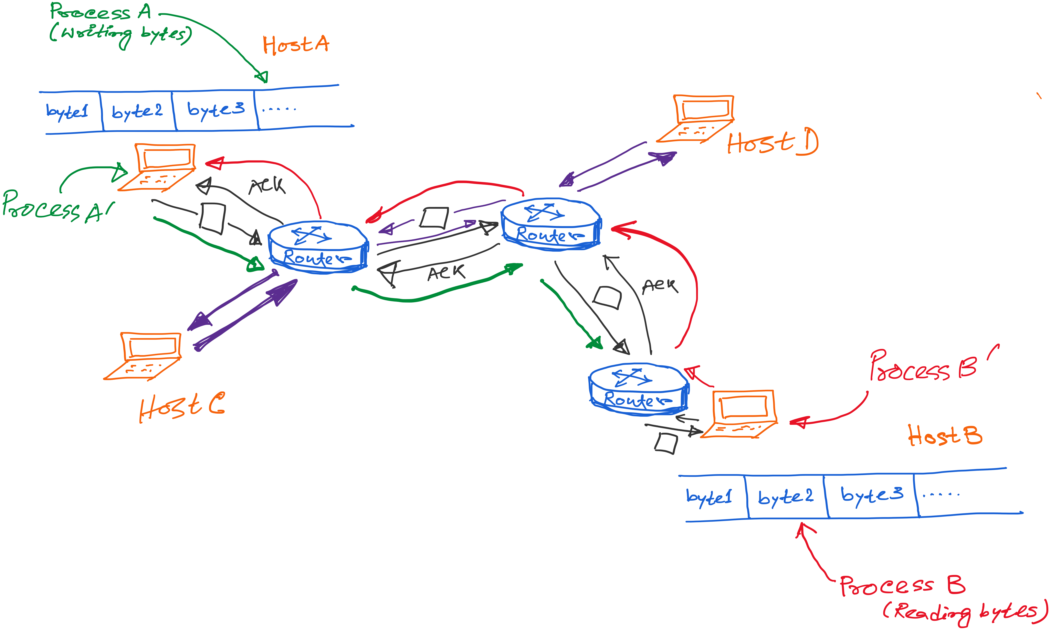
TCP: Abstraction of Reliable Bytes Stream

Slide 28
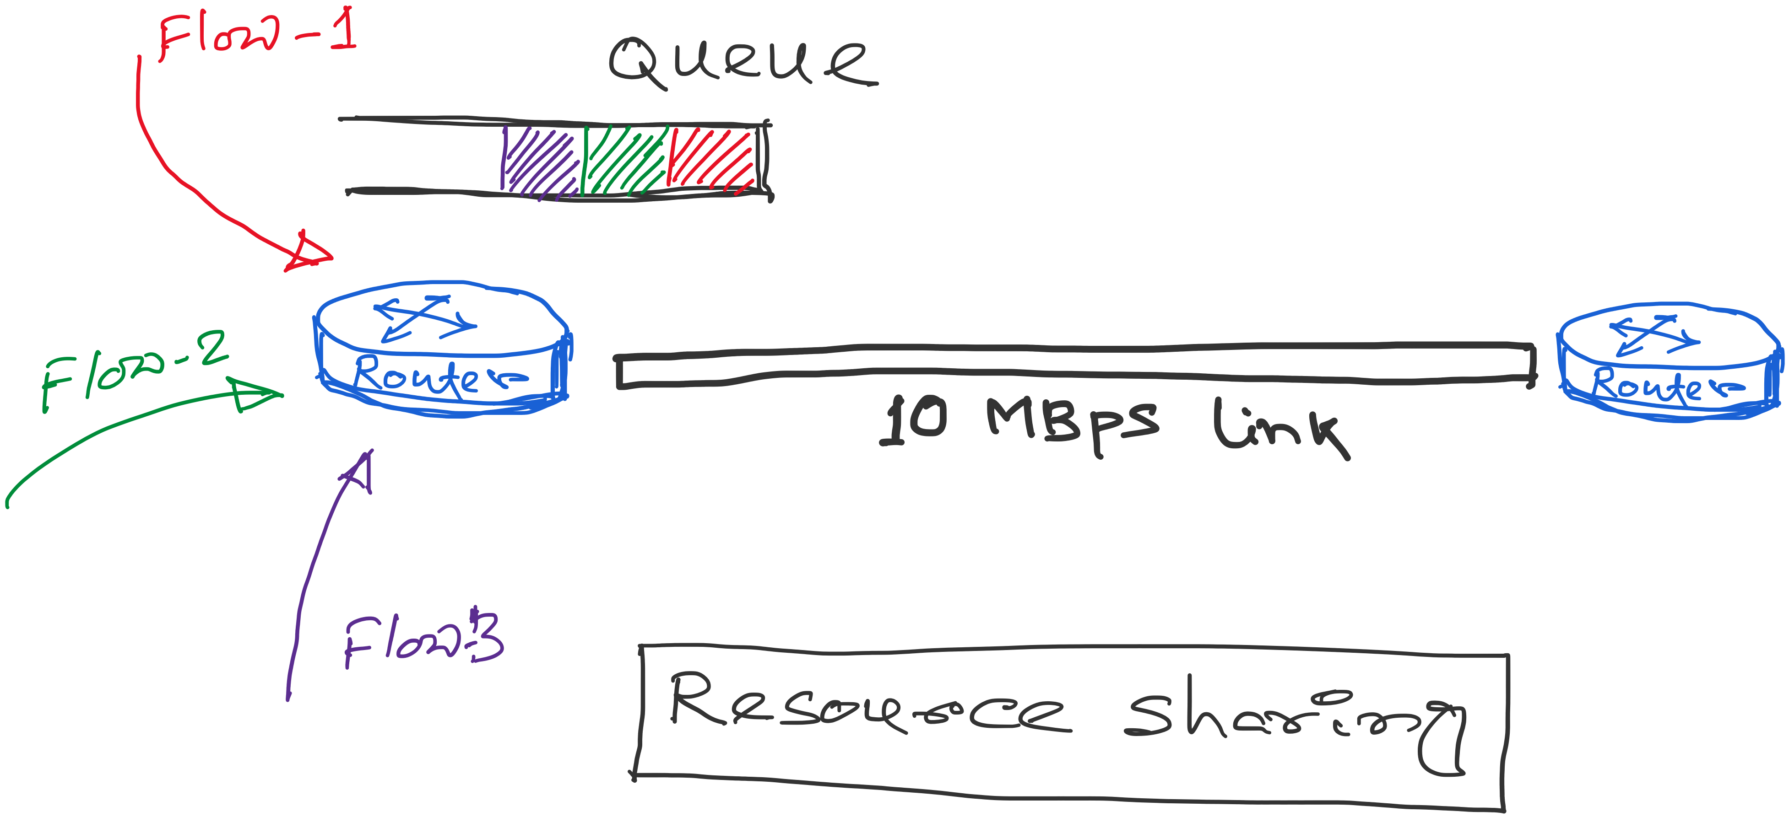
TCP: Abstraction of Reliable Bytes Stream
Flows contend for two resources:
1) Link bandwidth
2) Queue space

Slide 29
Congestion
A network is considered congested if contention for resources leads toward queue build-ups and packet drops
Best-effort network does not “block” calls
  So, they can easily become overloaded
  Congestion == “Load higher than capacity”
Examples of congestion
  Link layer: Ethernet frame collisions
  Network layer: full IP packet buffers
Excess packets are simply dropped
  And the sender can simply retransmit
queue

Slide 30
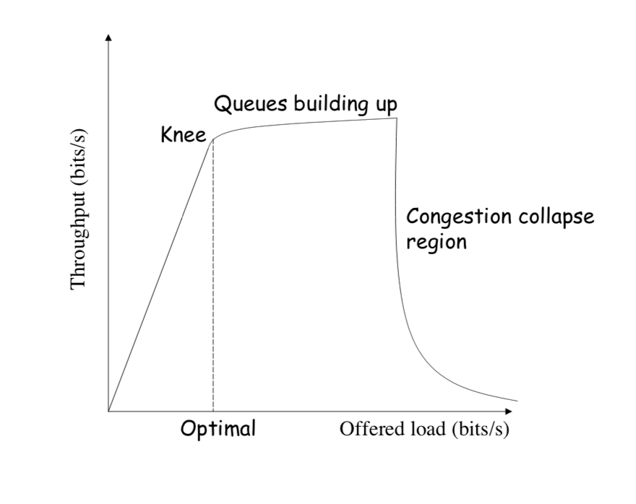
Throughput vs Load
Goodput: Application-level throughput.
Goodput
Notes:
Picture: https://ocw.mit.edu/courses/electrical-engineering-and-computer-science/6-829-computer-networks-fall-2002/lecture-notes/L8e2ecc.pdf

Slide 31
Throughput vs Load
Notes:
Picture: https://ocw.mit.edu/courses/electrical-engineering-and-computer-science/6-829-computer-networks-fall-2002/lecture-notes/L8e2ecc.pdf

Slide 32
Congestion Collapse
Notes:
Picture: https://ocw.mit.edu/courses/electrical-engineering-and-computer-science/6-829-computer-networks-fall-2002/lecture-notes/L8e2ecc.pdf

Slide 33
Congestion Collapse is real !!
Easily leads to congestion collapse
  Senders retransmit the lost packets
  Leading to even greater load
  … and even more packet loss
Increase in load that results in a decrease in useful work done.

Slide 34
Detect and Respond to Congestion
?
What does the end host see?
What can the end host change?

Slide 35
Congestion in a Drop-Tail FIFO Queue
Access to the bandwidth: first-in first-out queue
  Packets transmitted in the order they arrive
Access to the buffer space: drop-tail queuing
  If the queue is full, drop the incoming packet
✗

Slide 36
How it Looks to the End Host
Delay: Packet experiences high delay
Loss: Packet gets dropped along path
✗

Slide 37
How it Looks to the End Host
Delay: Packet experiences high delay
Loss: Packet gets dropped along path
How does TCP sender learn this?
✗

Slide 38
How it Looks to the End Host
Delay: Packet experiences high delay
Loss: Packet gets dropped along path
How does TCP sender learn this?
  Delay: Round-trip time estimate
  Loss: Timeout and/or duplicate acknowledgments
✗

Slide 39
Detecting Congestion
Link layer
  Carrier sense multiple access
  Seeing your own frame collide with others
Network layer
  Observing end-to-end performance
  Packet delay or loss over the path

Slide 40
How TCP detects packet losses
(1) Duplicate ACKs
  Packet# n is lost, but packets n+1, n+2, etc. are received and ACKs are sent.
(2) Timeout
  Packet# n is lost and detected via a timeout

Slide 41
Responding to Congestion
Upon detecting congestion
  Decrease the sending rate

Slide 42
Responding to Congestion
Upon detecting congestion
  Decrease the sending rate
But, what if conditions change?
  If more bandwidth becomes available,
  … unfortunate to keep sending at a low rate

Slide 43
Responding to Congestion
Upon detecting congestion
  Decrease the sending rate
But, what if conditions change?
  If more bandwidth becomes available,
  … unfortunate to keep sending at a low rate
Upon not detecting congestion
  Increase sending rate, a little at a time
  See if packets get through

Slide 44
TCP Congestion Control

Slide 45
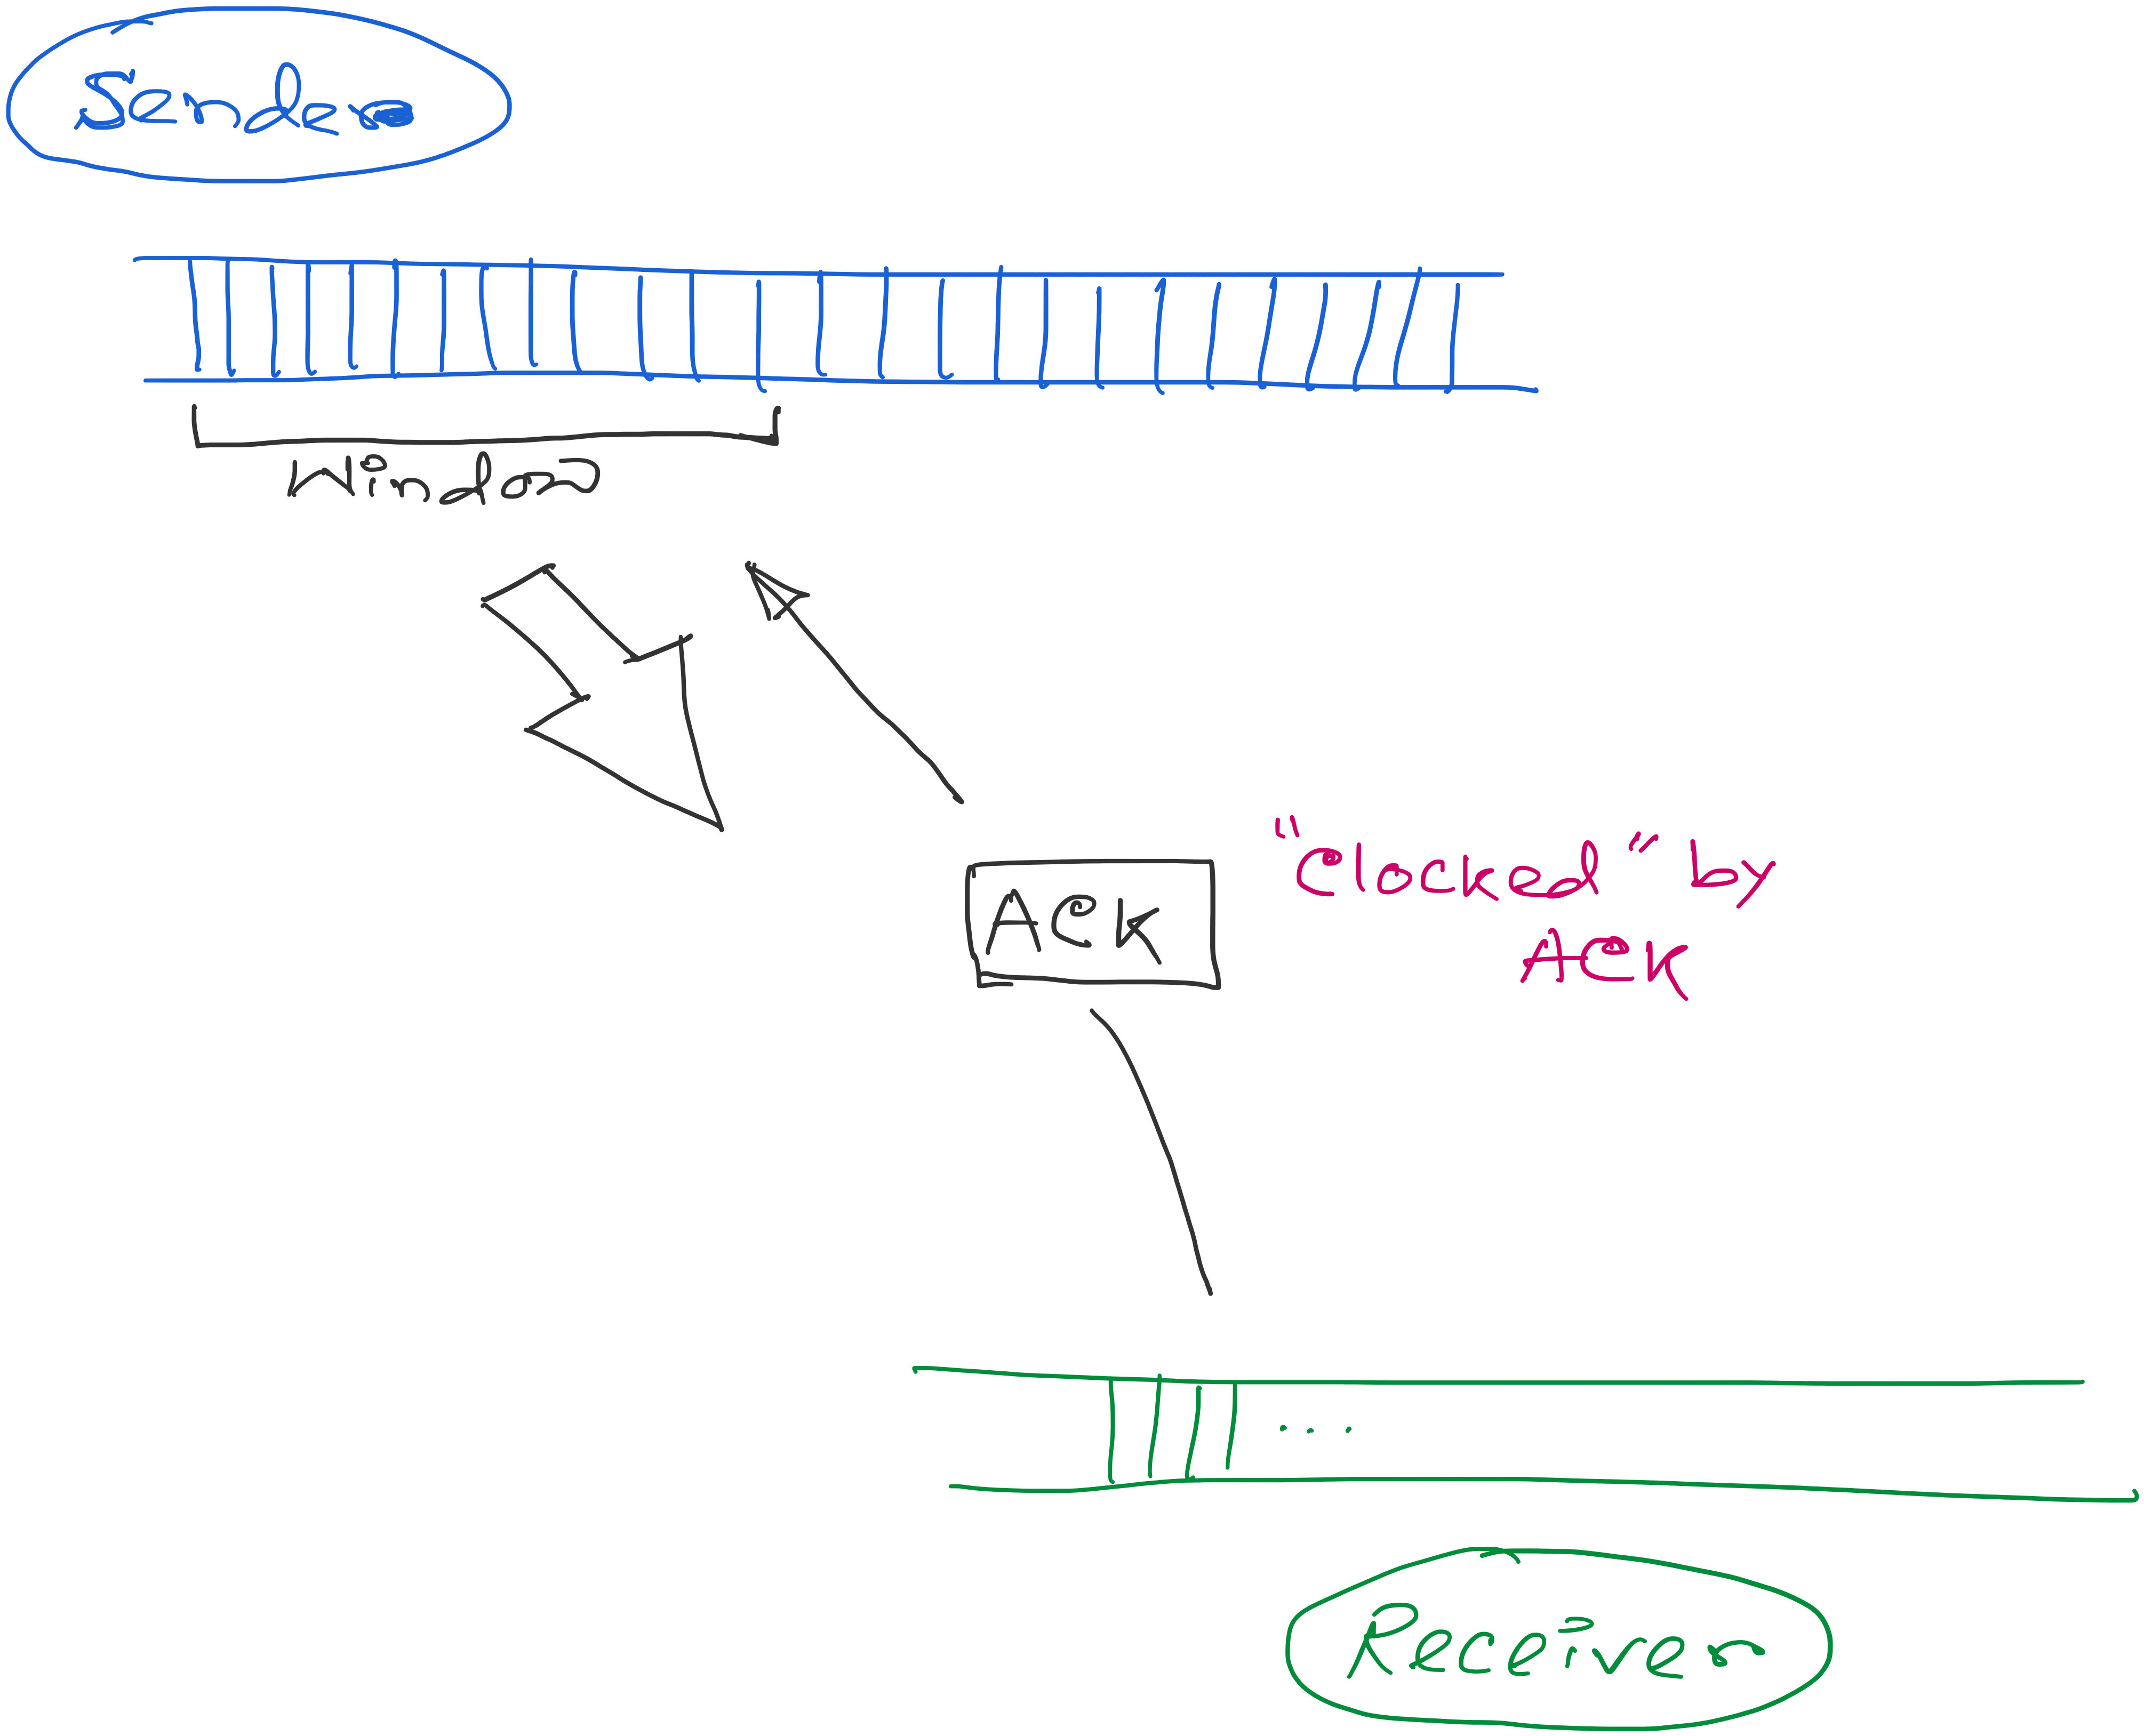
ACK works as the indicator and the window controls the flow.
Congestion_window: Calculated by the sender

Slide 46
ACK works as the indicator and the window controls the flow.
How to find the right window size?
When to change? How much?

Slide 47
TCP Congestion Window
Each TCP sender maintains a congestion window
  Max number of bytes to have in transit (not yet ACK’d)
Adapting the congestion window
  Decrease upon losing a packet: backing off
  Increase upon success: optimistically exploring
  Always struggling to find right transfer rate
Tradeoff
  Pro: avoids needing explicit network feedback
  Con: continually under- and over-shoots “right” rate

Slide 48
Additive Increase, Multiplicative Decrease
How much to adapt?
  Additive increase: On success of last window of data, increase window by 1 Max Segment Size (MSS)
  Multiplicative decrease: On loss of packet, divide congestion window in half
Much quicker to slow than speed up!
  Over-sized windows (causing loss) are much worse than under-sized windows (causing lower thruput)
  AIMD: A necessary condition for stability of TCP

Slide 49
Leads to the TCP “Sawtooth”
Window
Loss
halved
t

Slide 50
TCP Congestion Control: TCP “Sawtooth”
Additive increase, multiplicative decrease (AIMD)
  On packet loss, divide congestion window in half
  On success for last window, increase window linearly
Loss
Window
halved
t

Slide 51
Why Exponential decrease?
Respond aggressively to bad news
  Congestion is (very) bad for everyone
  Need to react aggressively
Nice theoretical properties
  Makes efficient use of network resources

Slide 52
Receiver/Advertised Window vs. Congestion Window
Flow control
  Keep a fast sender from overwhelming a slow receiver
Congestion control
  Keep a set of senders from overloading the network
Different concepts, but similar mechanisms
  TCP flow control: receiver window
  TCP congestion control: congestion window
  Sender TCP window =
  min { congestion window, receiver window }

Slide 53
Congestion control: Slow start

Slide 54
How Should a New Flow Start?
Start slow (a small CWND) to avoid overloading network
Window
Loss
halved
t

Slide 55
How Should a New Flow Start?
Start slow (a small CWND) to avoid overloading network
Window
Loss
halved
t
But, could take a long time to get started!

Slide 56
“Slow Start” Phase
Start with a small congestion window
  Initially, CWND is 1 MSS
  So, initial sending rate is MSS / RTT
Could be pretty wasteful
  Might be much less than actual bandwidth
  Linear increase takes a long time to accelerate
Slow-start phase (really “fast start”)
  Sender starts at a slow rate (hence the name)
  … but increases rate exponentially until the first loss

Slide 57
Slow Start in Action
Double CWND per round-trip time
1
2
4
8
Src
D
A
D
D
A
A
D
D
D
D
A
A
A
A
Dest

Slide 58
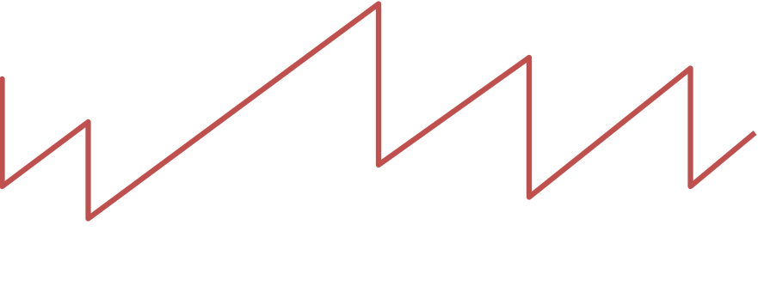
Slow Start and the TCP Sawtooth
Loss
Window
Linear “congestion avoidance” phase
halved
Exponential “slow start”
t
Why is this called “slow start”?
TCP originally had no congestion control
  Source would start by sending entire receiver window
  Led to congestion collapse!
  “Slow start” is, comparatively, slower

Slide 59
Response to the two types of losses

Slide 60
Response to the two types of losses
(1) Triple duplicate ACK (Fast retransmit)
  Packet n is lost, but packets n+1, n+2, etc. arrive
  Then, sender quickly resends packet n
  Do a multiplicative decrease and keep going

Slide 61
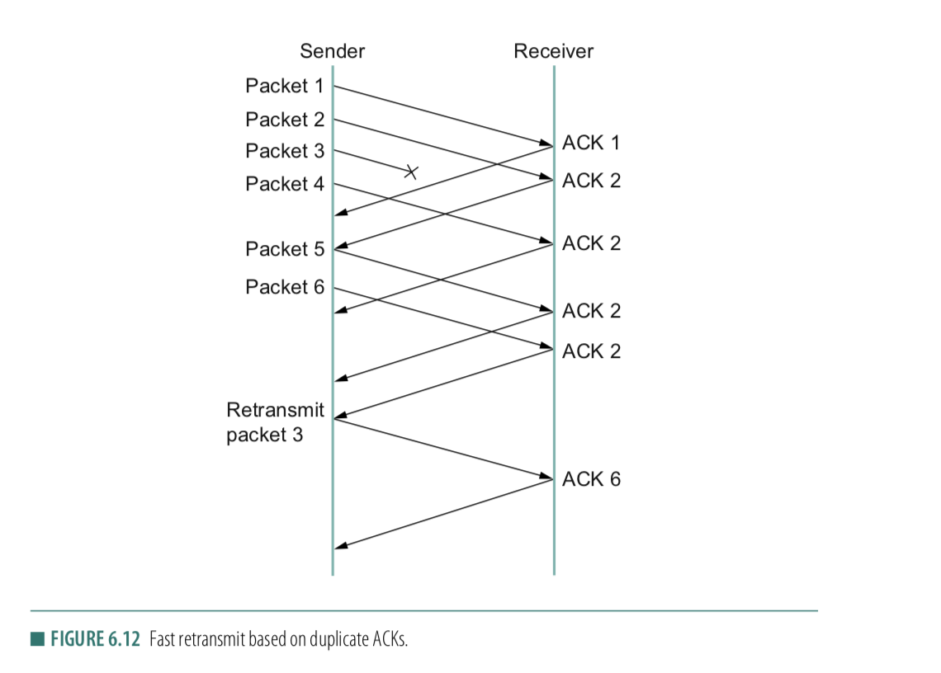
Fast retransmit
ACK for 2
1st Dup-ACK for 2
2nd Dup-ACK
3rd Dup-ACK

Slide 62
Congestion window during Fast retransmit
Window
Packet loss (3-dup ack, fast retransmit, multiplicative decrease)
t

Slide 63
Two Kinds of Loss in TCP
(1) Triple duplicate ACK (Fast retransmit)
  Packet n is lost, but packets n+1, n+2, etc. arrive
  Then, sender quickly resends packet n
  Do a multiplicative decrease and keep going
(2) Timeout (Repeat slow start – slow start restart)
  Packet n is lost and detected via a timeout
  Blasting entire CWND would cause another burst
  Better to start over with a low CWND

Slide 64
Repeating Slow Start After Timeout
(slow-start restart)
Window
timeout
Packet loss (3-dup ack, fast retransmit)
t
Slow start until reaching half of previous cwnd.
Slow-start restart: Go back to CWND of 1, but take advantage of knowing the previous value of CWND.

Slide 65
Repeating Slow Start After Idle Period
Suppose a TCP connection goes idle for a while
Eventually, the network conditions change
  Maybe many more flows are traversing the link
Dangerous to start transmitting at the old rate
  Previously-idle TCP sender might blast network
  … causing excessive congestion and packet loss
So, some TCP implementations repeat slow start
  Slow-start restart after an idle period

Slide 66
TCP congestion control
Conservation of packets:
If the connection is running at the available capacity (bandwidth) then a packet is not injected into the network unless a packet is taken out.
Notes:
[source: G.R.Wright and W.R.Stevens, TCP/IP Illustrated, Vol 2; J. Hoe, MSc Thesis, pp.22]
Tahoe (1988): slow start, congestion avoidance, fast retransmit
Reno (1990): fast recovery, TCP header prediction, SLIP header compression, routing table changes
4.4BSD (1993): multicasting, long fat pipe modifications

Slide 67
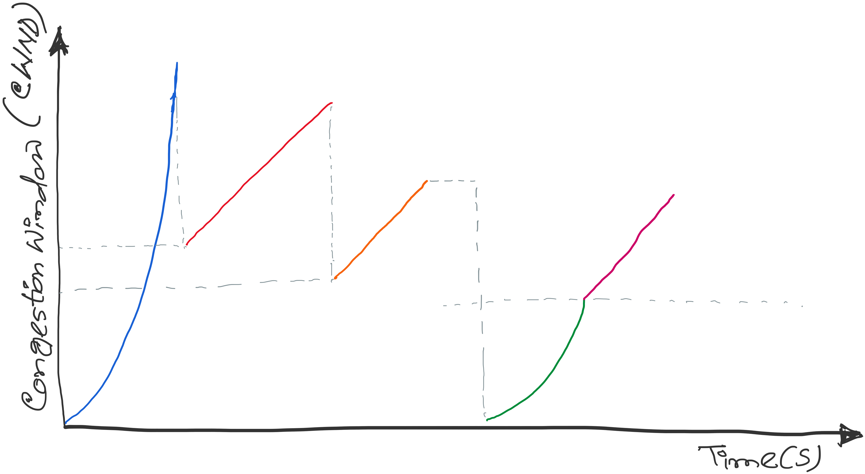
TCP congestion control: CWND graph
Notes:
[source: G.R.Wright and W.R.Stevens, TCP/IP Illustrated, Vol 2; J. Hoe, MSc Thesis, pp.22]
Tahoe (1988): slow start, congestion avoidance, fast retransmit
Reno (1990): fast recovery, TCP header prediction, SLIP header compression, routing table changes
4.4BSD (1993): multicasting, long fat pipe modifications

Slide 68
Implementation details
Update Time: Per RTT vs Per ACK

Slide 69
Implementation details
Update Time: Per RTT vs Per ACK
Double CWND per round-trip time
1
2
4
8
Src
D
A
D
D
A
A
D
D
D
D
A
A
A
A
Dest

Slide 70
Implementation details
Update Time: Per RTT vs Per ACK
Double CWND per round-trip time
Implemented as CWND = CWND + 1 (per ACK)
1
2
4
8
Src
D
A
D
D
A
A
D
D
D
D
A
A
A
A
Dest

Slide 71
Implementation details
Update Time: Per RTT vs Per ACK
Linear increase of CWND per round-trip time
Implemented as CWND = CWND + 1/CWND (per ACK)
1
2
3
4
Src
D
A
D
D
A
A
D
D
D
D
A
A
A
Dest

Slide 72
TCP congestion control: CWND graph
First packet loss (3-dup acks)
Congestion avoidance CWND = CWND + (1/CWND)
Packet loss
(3-dup acks)
CWND = CWND/2
Time out(no acks)
Congestion
avoidance
CWND =
CWND +
(1/CWND)
SSTHRES = CWND/2
CWND = CWND/2
Slow Start end
Slow start
Slow Start restart
CWND = 1
Notes:
[source: G.R.Wright and W.R.Stevens, TCP/IP Illustrated, Vol 2; J. Hoe, MSc Thesis, pp.22]
Tahoe (1988): slow start, congestion avoidance, fast retransmit
Reno (1990): fast recovery, TCP header prediction, SLIP header compression, routing table changes
4.4BSD (1993): multicasting, long fat pipe modifications

Slide 73
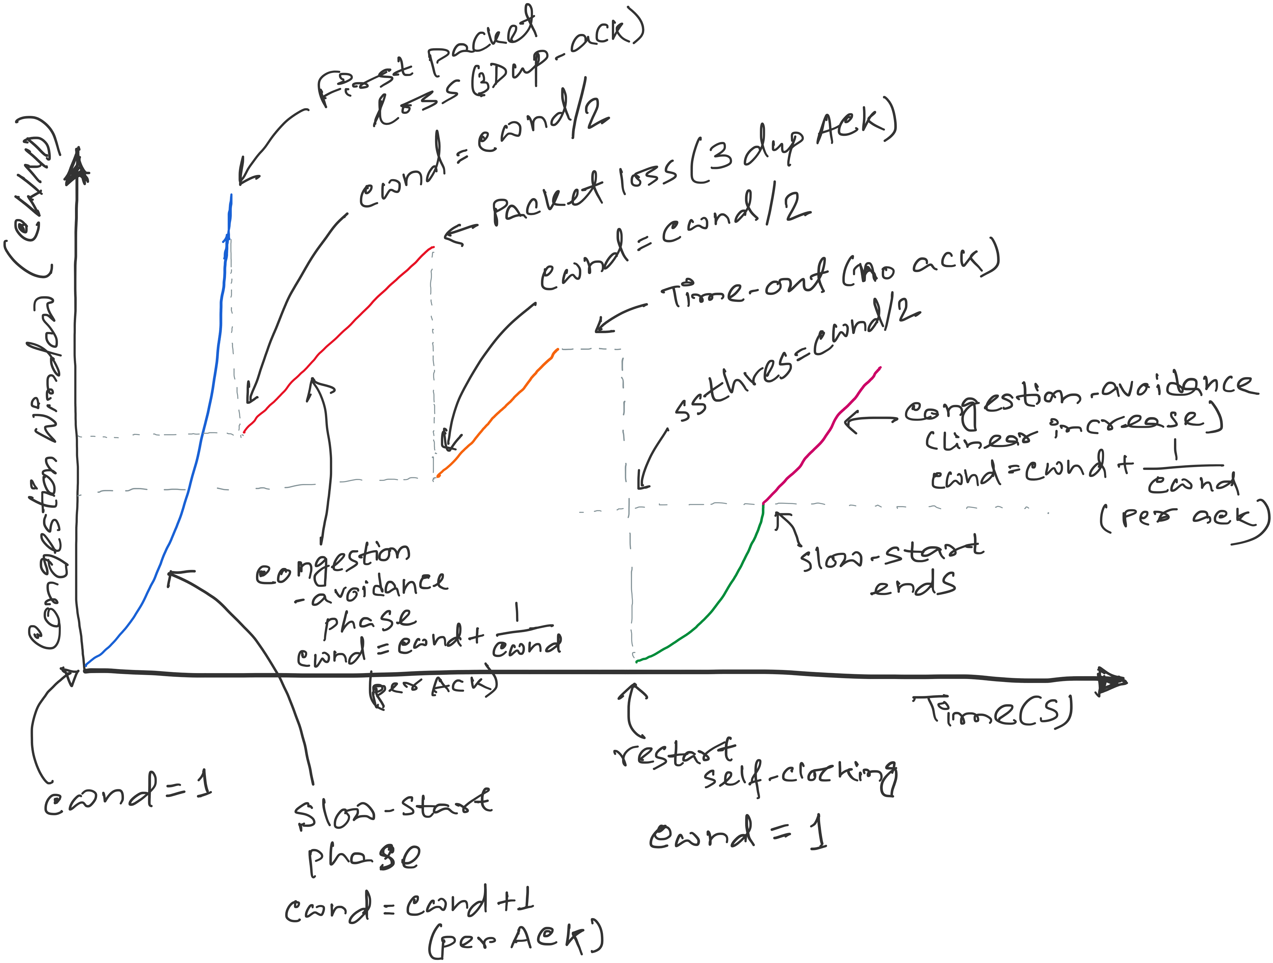
TCP congestion control
SSTHRES = Slow-start threshold
Notes:
[source: G.R.Wright and W.R.Stevens, TCP/IP Illustrated, Vol 2; J. Hoe, MSc Thesis, pp.22]
Tahoe (1988): slow start, congestion avoidance, fast retransmit
Reno (1990): fast recovery, TCP header prediction, SLIP header compression, routing table changes
4.4BSD (1993): multicasting, long fat pipe modifications

Slide 74
Development of Congestion Control over TCP versions
Copyright, 1996 © Dale Carnegie & Associates, In

Slide 75
TCP versions
TCP is not perfectly homogenous (200+)
4.2 BSD first widely available release of TCP/IP (1983)
Windows 95
4.3 BSD (1986)
Windows NT
4.3 BSD Tahoe (1988)
SunOS 4.1.3,4.1.4
4.3 BSD Reno (1990)
Solaris 2.3,2.4
IRIX
Linux 1.0
Digital OSF
HP/UX
4.4 BSD (1993)
Vegas (1994)
NewReno (1999)
.....
Notes:
[source: G.R.Wright and W.R.Stevens, TCP/IP Illustrated, Vol 2; J. Hoe, MSc Thesis, pp.22]
Tahoe (1988): slow start, congestion avoidance, fast retransmit
Reno (1990): fast recovery, TCP header prediction, SLIP header compression, routing table changes
4.4BSD (1993): multicasting, long fat pipe modifications
BSD stands for Berkeley Software Distribution, a family of Unix-like operating systems developed at the University of California, Berkeley. BSD is connected to TCP congestion control because several key TCP congestion control algorithms, like TCP Tahoe and TCP Reno, were first implemented in the 4.3BSD operating system.

Slide 76
TCP Congestion Controls
Tahoe (Jacobson 1988)
  Slow Start
  Congestion Avoidance
  Fast Retransmit (FR)

Slide 77
TCP Tahoe (Jacobson 1988)
window
time
SS
CA
SS: Slow Start
CA: Congestion Avoidance
Notes:
In TCP Tahoe, the initial value for ssthresh (slow start threshold) is 32 segments.

Slide 78
Slow Start in Tahoe
Start with cwnd = 1 (slow start)
On each successful ACK increment cwnd
cwnd ← cnwd + 1
Exponential growth of cwnd
each RTT: cwnd ← 2 x cwnd
Enter CA when cwnd >= ssthresh

Slide 79
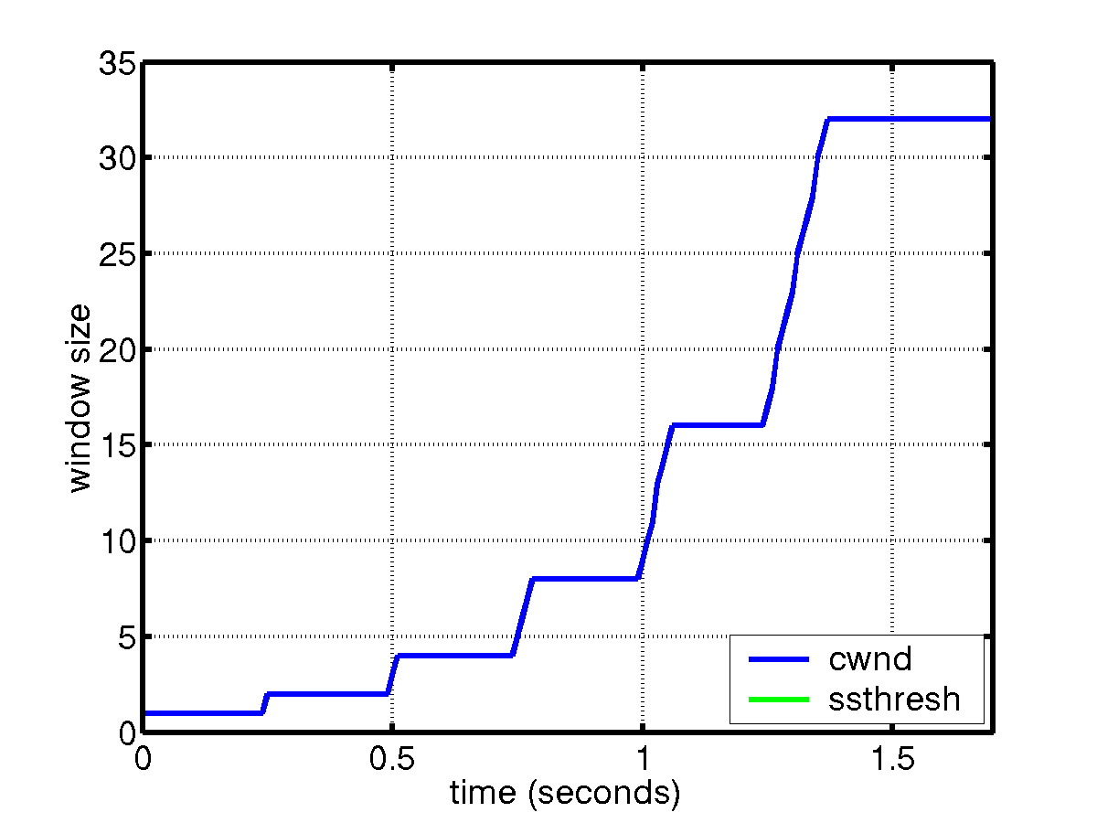
Slow Start
sender
receiver
cwnd
1
data packet
1 RTT
ACK
2
3
4
5
6
7
8
cwnd ← cwnd + 1 (for each ACK)

Slide 80
Congestion Avoidance
Starts when cwnd ≥ ssthresh
On each successful ACK: cwnd ← cwnd + 1/cwnd
Linear growth of cwnd
each RTT: cwnd ← cwnd + 1

Slide 81
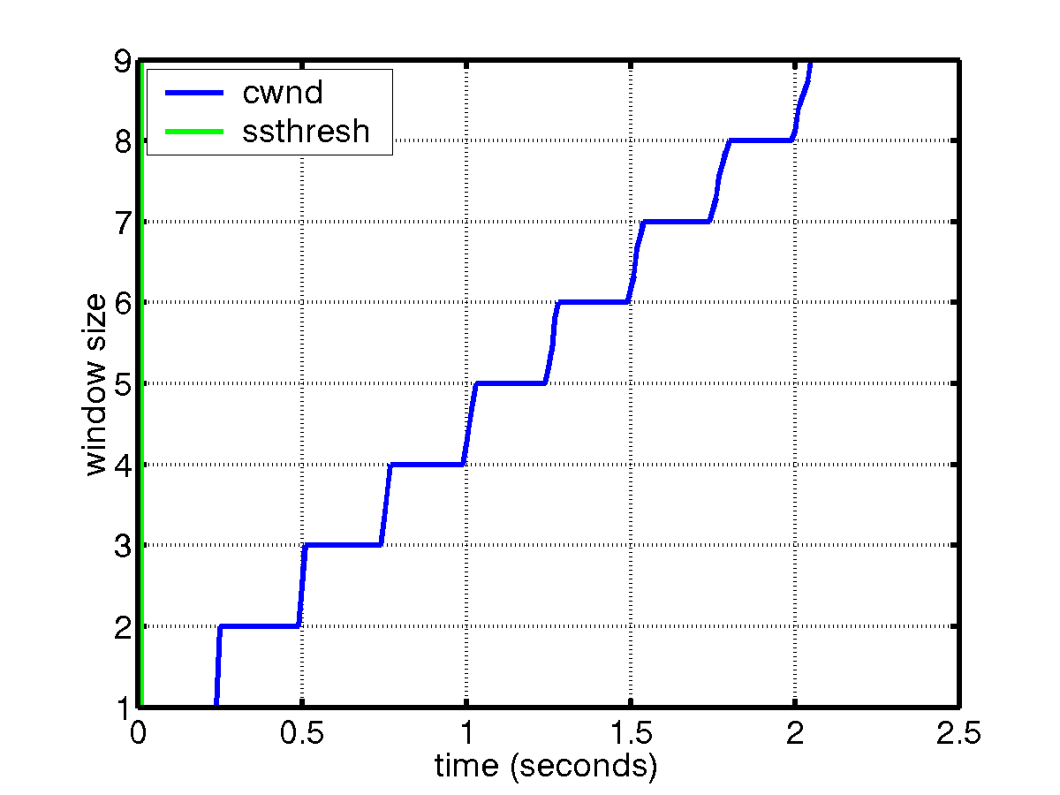
Congestion Avoidance
sender
receiver
cwnd
1
data packet
ACK
2
1 RTT
3
4
cwnd ← cwnd + 1 (for each “cwnd number of ACKS”)

Slide 82
Packet Loss
Assumption: loss indicates congestion
Packet loss detected by
  Retransmission TimeOuts (RTO timer)
  Duplicate ACKs (at least 3)
Packets
1
2
3
4
5
6
7
Acknowledgements
1
2
3
3
3
3

Slide 83
Fast Retransmit (Tahoe)
Wait for a timeout is quite long
Immediately retransmits after 3 dupACKs without waiting for timeout
Adjusts ssthresh
flightsize = min(awnd, cwnd)
ssthresh ← max(flightsize/2, 2)
Enter Slow Start (cwnd = 1)
Notes:
In TCP Tahoe, the initial value for ssthresh (slow start threshold) is 32 segments.

Slide 84
Summary: Tahoe
Basic ideas
  Gently probe network for spare capacity
  Drastically reduce rate on congestion
  Windowing: self-clocking
  Other functions: round trip time estimation, error recovery
for every ACK {
if (W < ssthresh) then W++ (SS)
else W += 1/W (CA)
}
for every loss {
ssthresh = W/2
W = 1
}
Notes:
In TCP Tahoe, the initial value for ssthresh (slow start threshold) is 32 segments.

Slide 85
TCP Congestion Controls
Tahoe (Jacobson 1988)
  Slow Start
  Congestion Avoidance
  Fast Retransmit (FR)
Reno (Jacobson 1990)
  Fast Recovery

Slide 86
Tahoe’s CWND recovers slowly
window
time
SS
CA
SS: Slow Start
CA: Congestion Avoidance

Slide 87
TCP Reno
window
time
SS
CA
SS: Slow Start
CA: Congestion Avoidance
Fast retransmission/Fast recovery

Slide 88
TCP Reno
Notes:
[source: G.R.Wright and W.R.Stevens, TCP/IP Illustrated, Vol 2; J. Hoe, MSc Thesis, pp.22]
Tahoe (1988): slow start, congestion avoidance, fast retransmit
Reno (1990): fast recovery, TCP header prediction, SLIP header compression, routing table changes
4.4BSD (1993): multicasting, long fat pipe modifications

Slide 89
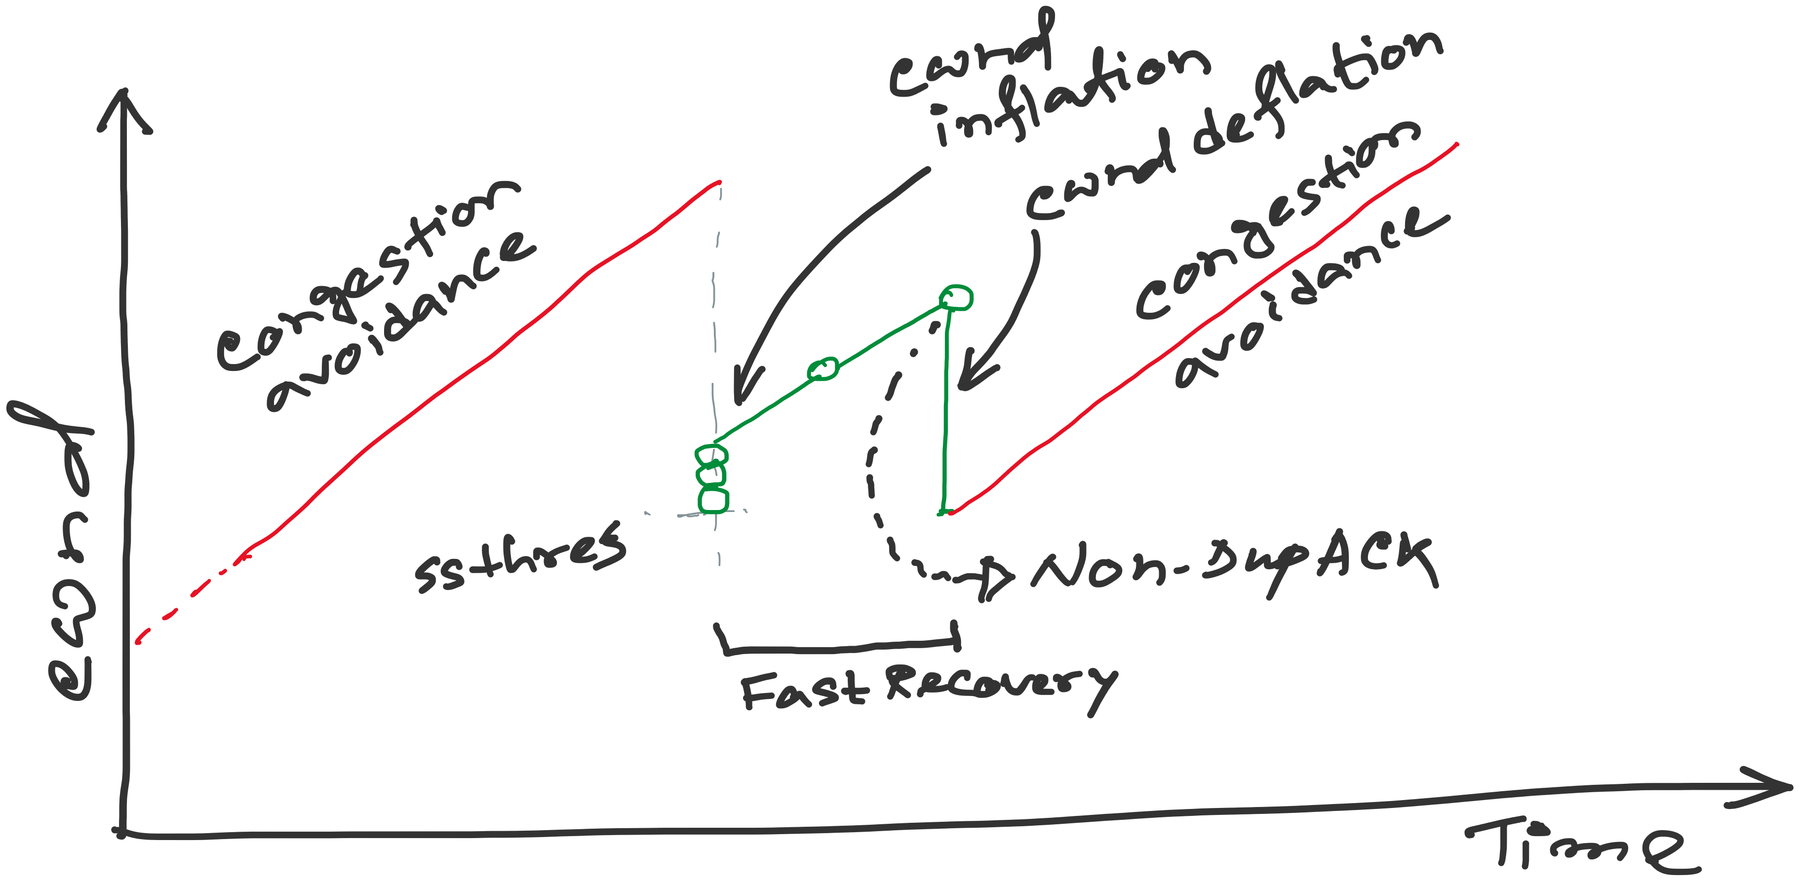
TCP Reno: details of Fast Recovery
Notes:
[source: G.R.Wright and W.R.Stevens, TCP/IP Illustrated, Vol 2; J. Hoe, MSc Thesis, pp.22]
Tahoe (1988): slow start, congestion avoidance, fast retransmit
Reno (1990): fast recovery, TCP header prediction, SLIP header compression, routing table changes
4.4BSD (1993): multicasting, long fat pipe modifications

Slide 90
TCP Reno
Notes:
[source: G.R.Wright and W.R.Stevens, TCP/IP Illustrated, Vol 2; J. Hoe, MSc Thesis, pp.22]
Tahoe (1988): slow start, congestion avoidance, fast retransmit
Reno (1990): fast recovery, TCP header prediction, SLIP header compression, routing table changes
4.4BSD (1993): multicasting, long fat pipe modifications

Slide 91
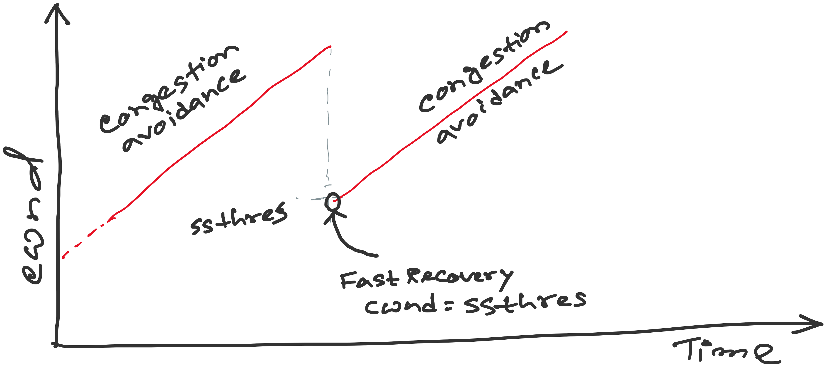
TCP Reno: details of Fast Recovery
Notes:
[source: G.R.Wright and W.R.Stevens, TCP/IP Illustrated, Vol 2; J. Hoe, MSc Thesis, pp.22]
Tahoe (1988): slow start, congestion avoidance, fast retransmit
Reno (1990): fast recovery, TCP header prediction, SLIP header compression, routing table changes
4.4BSD (1993): multicasting, long fat pipe modifications

Slide 92
TCP Reno: details of Fast Recovery
Notes:
[source: G.R.Wright and W.R.Stevens, TCP/IP Illustrated, Vol 2; J. Hoe, MSc Thesis, pp.22]
Tahoe (1988): slow start, congestion avoidance, fast retransmit
Reno (1990): fast recovery, TCP header prediction, SLIP header compression, routing table changes
4.4BSD (1993): multicasting, long fat pipe modifications

Slide 93
TCP Reno: details of Fast Recovery
Notes:
[source: G.R.Wright and W.R.Stevens, TCP/IP Illustrated, Vol 2; J. Hoe, MSc Thesis, pp.22]
Tahoe (1988): slow start, congestion avoidance, fast retransmit
Reno (1990): fast recovery, TCP header prediction, SLIP header compression, routing table changes
4.4BSD (1993): multicasting, long fat pipe modifications

Slide 94
EXAMPLE:
With Fast
Recovery
Sender
Receiver
CWND=1, UNACK=1
P=0, ACK=1
CWND=2, UNACK=1
CWND=2, UNACK=2
P=1, ACK=2
P=2, ACK=3
CWND=3, UNACK=2
CWND=4, UNACK=2
CWND=4, UNACK=3
P=3, ACK=4
CWND=4, UNACK=4
X
P=4, ACK=5
CWND=5, UNACK=4
P=6, ACK=5
CWND=6, UNACK=4
CWND=6, UNACK=5
P=7, ACK=5
CWND=6, UNACK=6, DuACK=1
P=8, ACK=5
CWND=6, UNACK=6, DuACK=2
P=9, ACK=5
SSTH=3, CWND=3+3, UNACK=6, DuACK=3
P=10, ACK=5
SSTH=3, CWND=3+4, UNACK=7, DuACK=4
SSTH=3, CWND=3+5, UNACK=8, DuACK=5
P=5, ACK=11
P=11, ACK=12
(New ACK) CWND=SSTH=3, UNACK=2
P=12, ACK=13

Slide 95
EXAMPLE:
Without Fast
Recovery
Sender
Receiver
CWND=1, UNACK=1
P=0, ACK=1
CWND=2, UNACK=1
CWND=2, UNACK=2
P=1, ACK=2
P=2, ACK=3
CWND=3, UNACK=2
CWND=4, UNACK=2
CWND=4, UNACK=3
P=3, ACK=4
CWND=4, UNACK=4
X
P=4, ACK=5
CWND=5, UNACK=4
P=6, ACK=5
CWND=6, UNACK=4
CWND=6, UNACK=5
P=7, ACK=5
CWND=6, UNACK=6, DuACK=1
P=8, ACK=5
CWND=6, UNACK=6, DuACK=2
P=9, ACK=5
SSTH=3, CWND=3, UNACK=6, DuACK=3
P=10, ACK=5
SSTH=3, CWND=3, UNACK=6, DuACK=4
SSTH=3, CWND=3, UNACK=6, DuACK=5
P=5, ACK=11
(New ACK) CWND=3+1/3, UNACK=1
P=11, ACK=12

Slide 96
Fast Retransmit/Fast Recovery (FR/FR)
(will work on this example during lecture)
<Open>
6
CWND
6
STHRES
N/A
13
14
15
16
17
18
14
19
20
TX
X
RX
14
14
14
14
19
Notes:
After FR/FR, when CA is entered, cwnd is half of the window when lost was detected.
So the effect of lost is halving the window.
[Source: RFC 2581, Fall & Floyd, “Simulation based Comparison of Tahoe, Reno, and SACK TCP”]

Slide 97
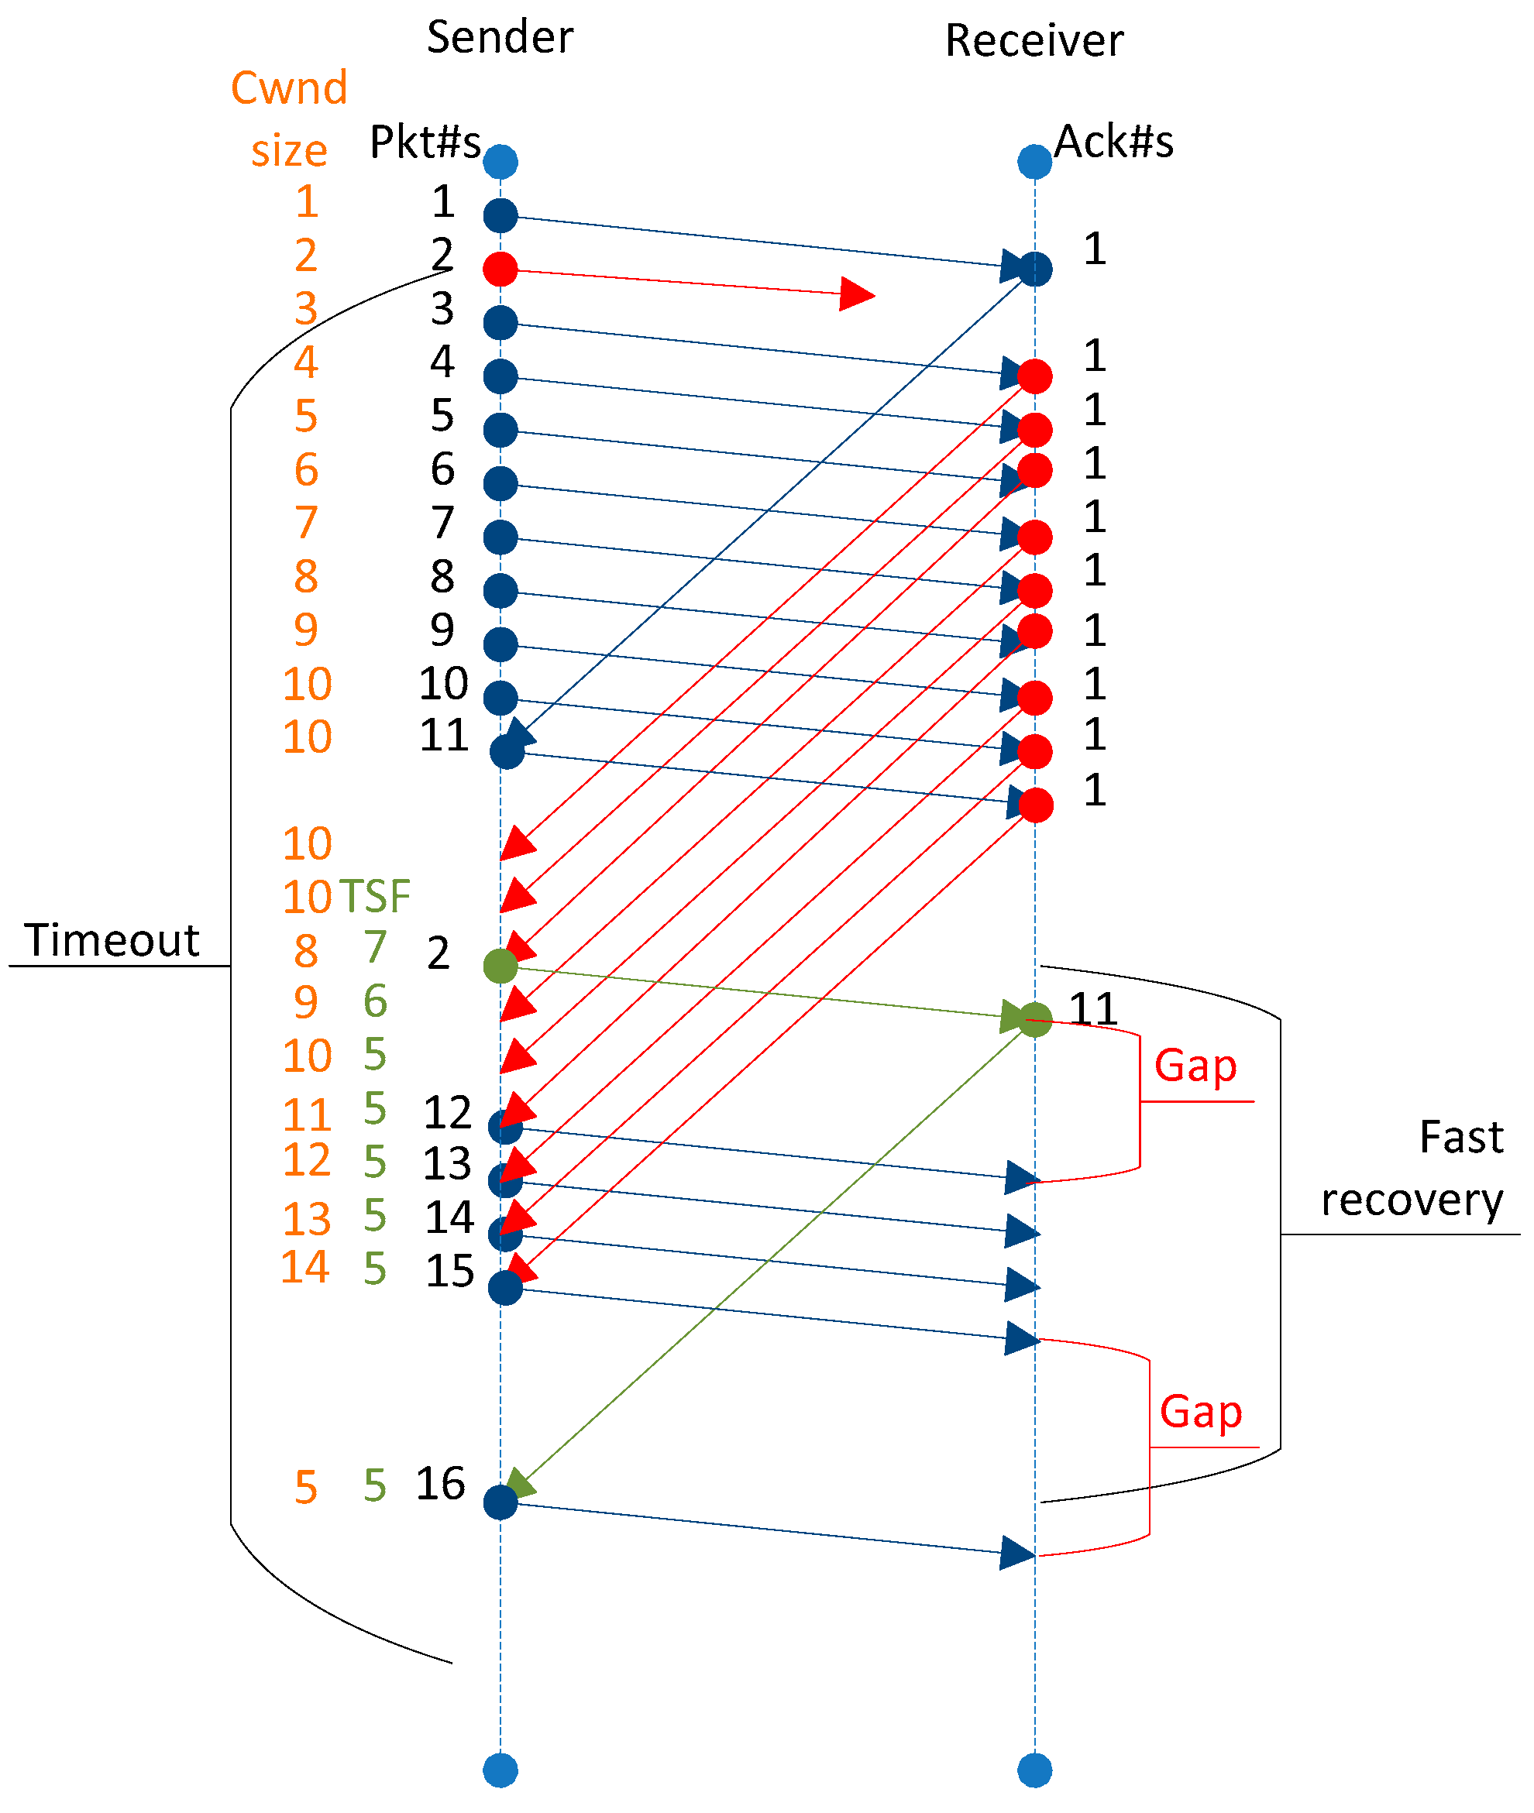
Fast Retransmit/Fast Recovery (FR/FR)
10
TSF = Segments in flight
[Ref] https://www.mdpi.com/2076-3417/9/21/4698
Notes:
After FR/FR, when CA is entered, cwnd is half of the window when lost was detected.
So the effect of lost is halving the window.
[Source: RFC 2581, Fall & Floyd, “Simulation based Comparison of Tahoe, Reno, and SACK TCP”]

Slide 98
Fast Retransmit/Fast Recovery (FR/FR)
Motivation: prevent `pipe’ from emptying after fast retransmit
Idea: each dupACK represents a packet having left the pipe (successfully received)
Enter FR/FR after 3 dupACKs
  Set ssthresh ← max(flightsize/2, 2)
  Retransmit lost packet
  Set cwnd ← ssthresh + ndup (window inflation)
  Wait till W=min(awnd, cwnd) is large enough; transmit new packet(s)
  On non-dup ACK (1 RTT later), set cwnd ← ssthresh (window deflation)
Enter CA
Notes:
After FR/FR, when CA is entered, cwnd is half of the window when lost was detected.
So the effect of lost is halving the window.
[Source: RFC 2581, Fall & Floyd, “Simulation based Comparison of Tahoe, Reno, and SACK TCP”]

Slide 99
Summary: Reno
Basic ideas
  Fast recovery avoids slow start
  dupACKs: fast retransmit + fast recovery
  Timeout: fast retransmit + slow start
dupACKs
congestion avoidance
FR/FR
timeout
slow start
retransmit

Slide 100
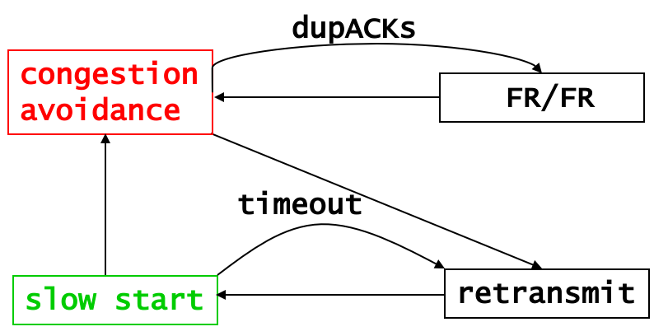
TCP congestion control: CWND graph
Notes:
[source: G.R.Wright and W.R.Stevens, TCP/IP Illustrated, Vol 2; J. Hoe, MSc Thesis, pp.22]
Tahoe (1988): slow start, congestion avoidance, fast retransmit
Reno (1990): fast recovery, TCP header prediction, SLIP header compression, routing table changes
4.4BSD (1993): multicasting, long fat pipe modifications

Slide 101
Problem with Reno
Reno retransmit at most 1 lost packet per RTT
  Pipe can be emptied during “Fast Retransmit/Fast Recovery” with multiple losses
Solution: TCP with Selective Acknowledgements (SACK) provides better estimate of packets in pipe
  SACK TCP option describes received packets
  On 3 dupACKs: retransmits, halves window, enters FR
  Updates pipe = packets in pipe
    Increment when lost or new packets sent
    Decrement when dupACK received
  Transmits a (lost or new) packet when pipe < cwnd
  Exit FR when all packets outstanding when FR was entered are acknowledged
Notes:
[Sources: M. Mathis, J. Mahdavi, S. Floyd and A. Romanow, “TCP Selective Acknowledgement Options”, RFC 2018, Oct. 1996
K. Fall and S. Floyd, “Simulation-based comparisons of Tahoe, Reno and SACK TCP”, Computer Communication Review, July 1996 ]

Slide 102
TCP Vegas (Brakmo & Peterson 1994)
window
time
SS
CA
Considers packet delay, not loss, as a hint for congestion
Reno with a new congestion avoidance algorithm
Converges (provided buffer is large) !

Slide 103
Router-assisted Congestion Control
Copyright, 1996 © Dale Carnegie & Associates, In

Slide 104
Congestion Control discussed so far
What can the end-points do to collectively to make good use of shared underlying resources?
link
name
?
?
session
path
address
Notes:
This week, we’ll talk about how to share resources. Today we’ll talk about what the end-points can do in a distributed fashion, from the edge of the network. On Wednesday, we’ll talk about what the lower-level elements can do.

Slide 105
Router-assisted Congestion Control
What can the individual links do to make
good use of shared underlying resources?
link
name
session
?
path
address
Notes:
This week, we’ll talk about how to share resources. Today we’ll talk about what the end-points can do in a distributed fashion, from the edge of the network. On Wednesday, we’ll talk about what the lower-level elements can do.

Slide 106
Router
Processor
control plane
data plane
Switching
Fabric
Line card
Line card
Line card
Line card
Line card
Line card

Slide 107
Line Cards (Interface Cards, Adaptors)
Packet handling
  Packet forwarding
  Buffer management
  Link scheduling
  Packet filtering
  Rate limiting
  Packet marking
  Measurement
to/from link
Receive
lookup
Transmit
to/from switch

Slide 108
Packet Switching and Forwarding
“4”
Link 1, ingress
Choose
Egress
Link 1, egress
Link 2
Link 2, ingress
Choose
Egress
Link 2, egress
R1
“4”
Link 1
Link 3
Link 3, ingress
Choose
Egress
Link 3, egress
Link 4
Link 4, ingress
Choose
Egress
Link 4, egress

Slide 109
Queue Management Issues
Scheduling discipline
  Which packet to send?
  Some notion of fairness? Priority?
Drop policy
  When should you discard a packet?
  Which packet to discard?
Goal: balance throughput and delay
  Huge buffers minimize drops, but add to queuing delay (thus higher RTT, longer slow start, …)

Slide 110
Queue Management 1: Drop Policy

Slide 111
FIFO Scheduling and Drop-Tail
Access to the bandwidth: first-in first-out queue
  Packets only differentiated when they arrive
Access to the buffer space: drop-tail queuing
  If the queue is full, drop the incoming packet
✗

Slide 112
Bursty Loss From Drop-Tail Queuing
TCP depends on packet loss
  Packet loss is indication of congestion
  TCP additive increase drives network into loss
Drop-tail leads to bursty loss
  Congested link: many packets encounter full queue
  Synchronization: many connections lose packets at once

Slide 113
Slow Feedback from Drop Tail
Feedback comes when buffer is completely full
  … even though the buffer has been filling for a while
Plus, the filling buffer is increasing RTT
  … making detection even slower
Better to give early feedback
  Get 1-2 connections to slow down before it’s too late!

Slide 114
Random Early Detection (RED)
Router notices that queue is getting full
  … and randomly drops packets to signal congestion
Packet drop probability
  Drop probability increases as queue length increases
  Else, set drop probability f(avg queue length)
Drop
Probability
0 1
Average Queue Length

Slide 115
Properties of RED
Drops packets before queue is full
  In the hope of reducing the rates of some flows
Drops packet in proportion to each flow’s rate
  High-rate flows selected more often
Drops are spaced out in time
  Helps desynchronize the TCP senders
Tolerant of burstiness in the traffic
  By basing the decisions on average queue length

Slide 116
Problems With RED
Hard to get tunable parameters just right
  How early to start dropping packets?
  What slope for increase in drop probability?
  What time scale for averaging queue length?
RED has mixed adoption in practice
  If parameters aren’t set right, RED doesn’t help
Many other variations in research community
  Names like “Blue” (self-tuning), “FRED”…

Slide 117
Feedback: From Loss to Notification
Early dropping of packets
  Good: gives early feedback
  Bad: has to drop the packet to give the feedback
Explicit Congestion Notification (ECN)
  Router marks the packet with an ECN bit, instead of dropping it.
  Receiver send this ECN info to the sender.
  Sending host interprets as a sign of congestion
  Requires participation of hosts and the routers
Notes:
17.6.2 Explicit Congestion Notification
Explicit congestion notification (ECN) is another feedback scheme that indicates congestion information by marking packets instead of dropping them. The destination of marked packets returns this congestion notification to the source. As a result, the source decreases its transmit rate. The implementation of ECN uses an ECN-specific field in the IP header with two bits—the ECN-capable Transport (ECT) bit and the Congestion Experienced (CE) bit.

Slide 118
Queue Management 2: Link Scheduling

Slide 119

First-In First-Out Scheduling
First-in first-out scheduling
  Simple, but restrictive
Example: two kinds of traffic
  Voice over IP needs low delay
  E-mail is not that sensitive about delay
Voice traffic waits behind e-mail

Slide 120
Strict Priority
Multiple levels of priority
  Always transmit high-priority traffic, when present
Isolation for the high-priority traffic
  Almost like it has a dedicated link
  Except for (small) delay for packet transmission
But, lower priority traffic may starve ☹

Slide 121
Weighted Fair Scheduling
Weighted fair scheduling
  Assign each queue a fraction of the link bandwidth
  Rotate across queues on a small time scale
Work-conserving
  Send extra traffic from one queue if others are idle
50% red, 25% blue, 25% green

Slide 122
Implementation Trade-Offs
FIFO
  One queue, trivial scheduler
Strict priority
  One queue per priority level, simple scheduler
Weighted fair scheduling
  One queue per class, and more complex scheduler

Slide 123
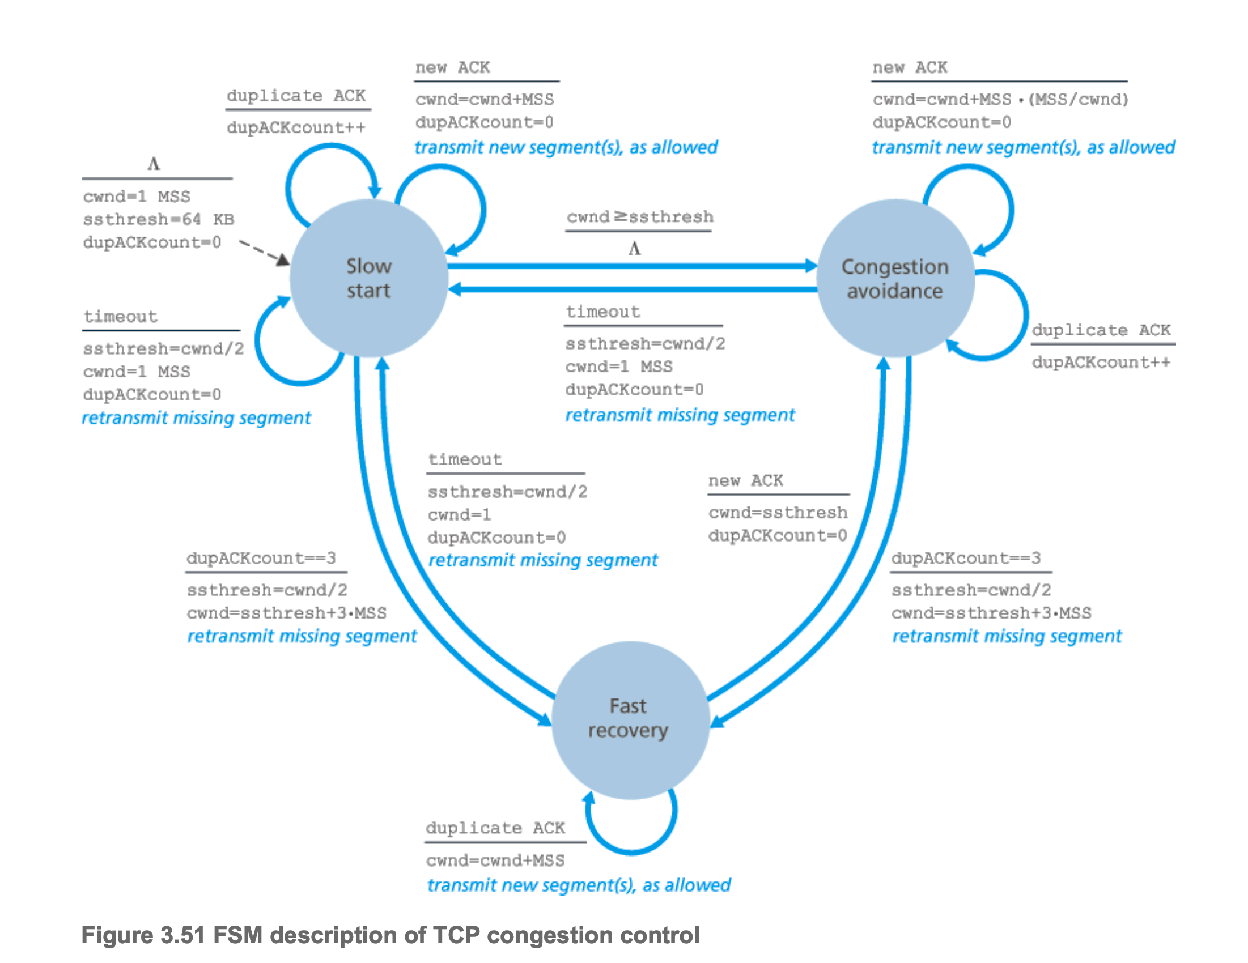
TCP Congestion Control

Slide 124
TCP Congestion Control
Should TCP increment CWND during Dup-ACKs?

Slide 125
Revisiting Dup ACKs (without Fast-Recovery)
<Open>
6
CWND
5
STHRES
N/A
13
14
15
16
17
18
14
19
20
21
TX
X
RX
14
14
14
14
14
19
Notes:
After FR/FR, when CA is entered, cwnd is half of the window when lost was detected.
So the effect of lost is halving the window.
[Source: RFC 2581, Fall & Floyd, “Simulation based Comparison of Tahoe, Reno, and SACK TCP”]

Slide 126
Revisiting Dup ACKs (without Fast-Recovery)
<Open>
6
CWND
5
STHRES
N/A
13
14
15
16
17
18
14
19
20
21
TX
X
X
RX
14
14
14
14
?
What if there are multiple losses in an RTT?
Notes:
After FR/FR, when CA is entered, cwnd is half of the window when lost was detected.
So the effect of lost is halving the window.
[Source: RFC 2581, Fall & Floyd, “Simulation based Comparison of Tahoe, Reno, and SACK TCP”]

Slide 127
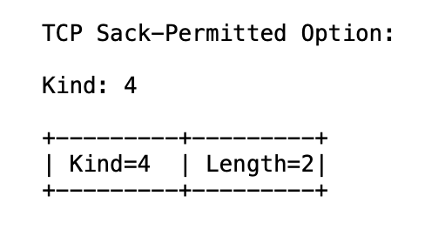
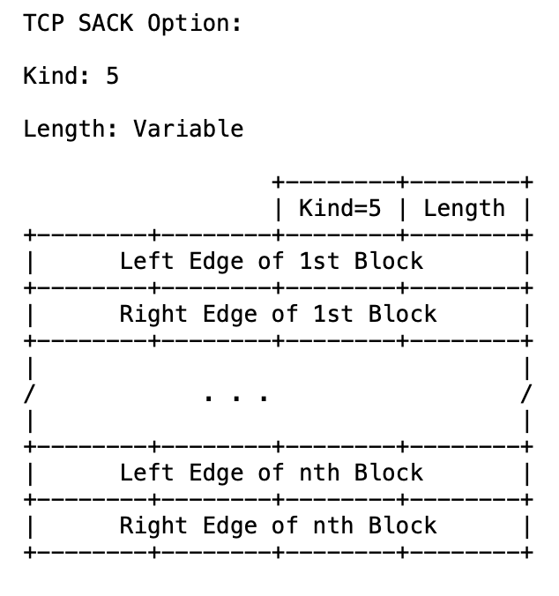
TCP Selective ACK (SACK): RFC 2018
https://www.rfc-editor.org/rfc/rfc2018

Slide 128
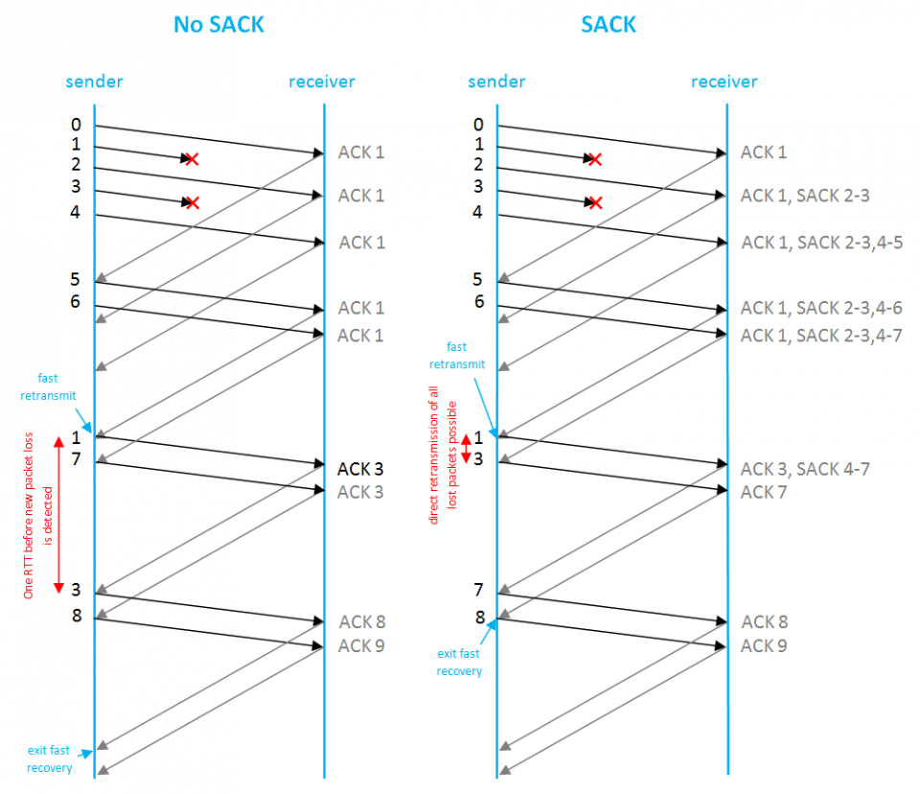
TCP Selective ACK (SACK): RFC 2018
[REF-1] https://www.rfc-editor.org/rfc/rfc2018
[REF-2] https://www.excentis.com/blog/measuring-throughput-effect-of-used-tcp-settings/

Slide 129
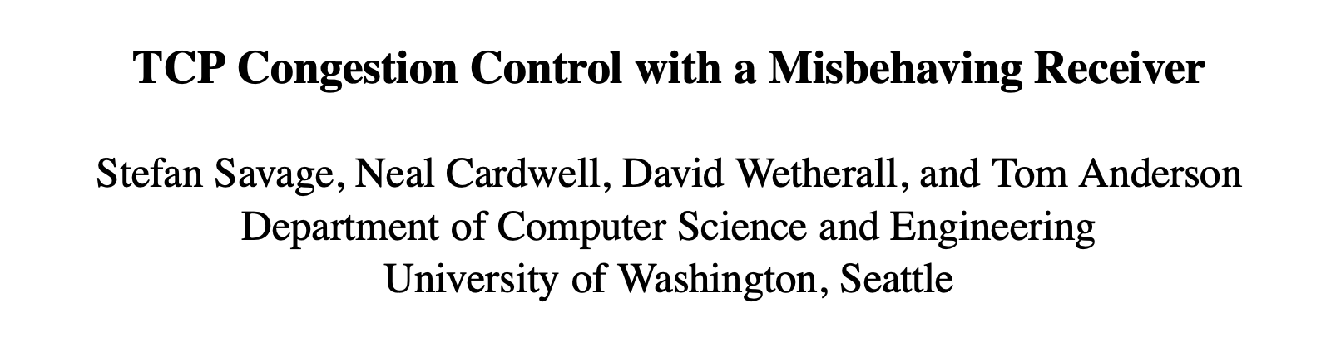
Slides courtesy: https://cseweb.ucsd.edu/classes/wi01/cse222/lectures/attack-18.pdf
Paper link: https://dl.acm.org/doi/10.1145/505696.505704

Slide 130
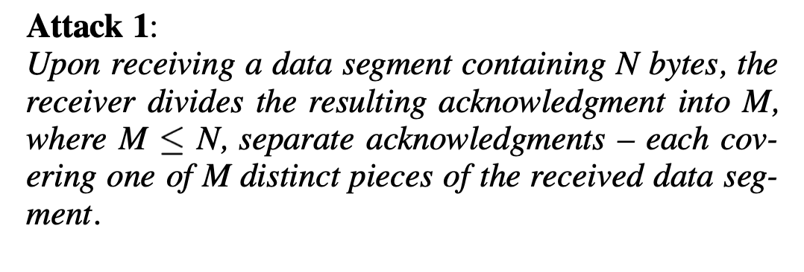

Slide 131
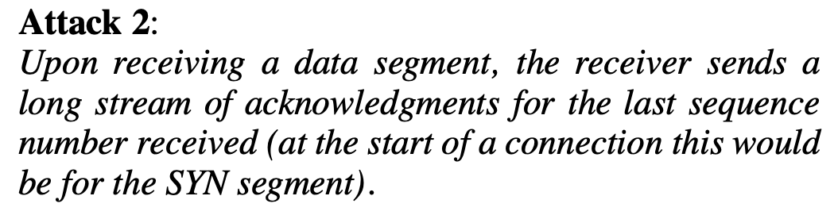

Slide 133
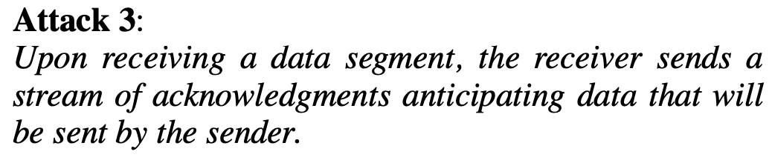

Slide 137
Today’s TCP versions

Slide 138
Today’s TCP versions
Linux kernel
2.6.13 (2005) → TCP BIC (default)
2.6.19 (2006) to 6.7+ (2024) → TCP CUBIC (default)
Mac OS-X
OS-X Mountain Lion (2012) → TCP New Reno
OS-X Mavericks (2023) to Sonoma (2023) → TCP CUBIC
Windows
Windows 8 (2013) → Compound TCP (CTCP)
Windows 10.1709 (2017)→ TCP CUBIC
Windows 11 (2021)→ TCP CUBIC

Slide 139
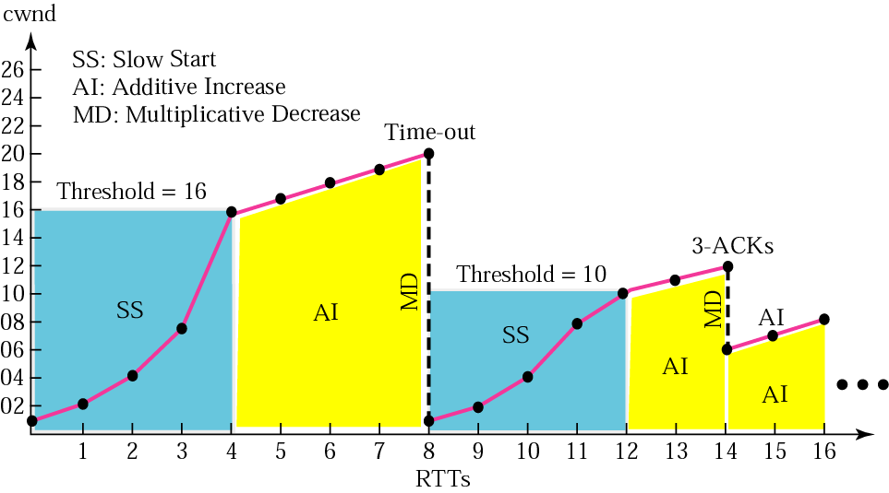
TCP BIC: Issues with Reno
BIC/CUBIC slides are adopted from: Injong Rhee, Lisong Xu, Ahmed El-Hassany, Qian HE, Bob Kinicki
Notes:
Slides adopted from: Injong Rhee, Lisong Xu, Ahmed El-Hassany

Slide 140
Response Function of TCP
Response function of TCP is the average throughput of a TCP connection in terms of the packet loss probability, the packet size, and the round-trip time.
Response Function of TCP is :
  R : Average Throughput
  MSS: Packet Size
  RTT: Round-Trip Time
  P : Packet Loss Probability
J. Padhye, V. Firoio, D. Towsley, J. Kurose, "Modeling TCP Throughput: a Simple Model and its Empirical Validation", Proceedings of SIGCOMM 98
Notes:
Usually, we study the performance of TCP using its response function, which is defined as the average throughput of TCP in terms of packet loss probability.
Here is the response function of TCP. In this function, MSS is the packet size, RTT is the round trip time, and p is the packet loss probability. From this function, we can see that the throughput of TCP depends on the packet size, the round-trip time, and the packet loss probability. In order to increase the throughput of TCP, we can either increase the packet size, or decrease the round trip time, or decrease the packet loss probability. Usually for a TCP connection, the packet size and round-trip time are fixed. Therefore, the throughput of a TCP connection mainly depends on the packet loss probability.

Slide 141

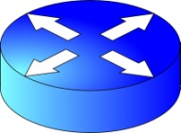
TCP BIC: Issues with Reno – RTT unfairness
y₁ ms
z₁ ms
x ms
y₂ ms
z₂ ms
y₁ + x + z₁ >> y₂ + x + z₂

Slide 142
Why BIC (Response Function of TCP)
10Gbps requires a packet loss rate of 10⁻¹⁰, or correspondingly a link bit error rate of at most 10⁻¹⁴, which is an unrealistic (or at least hard) requirement for current networks
Using Log-Log scale, Assuming 1250-Byte packet size, and 100ms RTT
Notes:
In this figure, we show how the throughput changes as we vary the packet loss probability. Note that the figure is shown in log-log scale. We can see that as the packet loss probability decreases, the TCP throughput increases. Assume the packet size is 1000 Bytes, and the RTT is 100ms, then TCP achieves the 10Gbps throughput when the packet loss probability is around 10-10.which corresponds to a link BER of 10-14. which is an unrealistic requirement for current networks. That is, in the current networks, it is impossible for TCP to achieve 10Gbps throughput.

Slide 143
A Search Problem
A Search Problem
  BIC consider the increase part of congestion avoidance as a search problem, in which a connection looks for the available bandwidth by comparing its current throughput with the available bandwidth, and adjusting cwnd accordingly.
Q: How to compare R with A?
  R = current throughput
  = cwnd/RTT
  A = available bandwidth
A: Check for packet losses
  No packet loss: R <= A
  Packet losses : R > A
How does standard TCP find the available bandwidth?
Linear search
  while (no packet loss){
  cwnd++;
  }

Slide 144
Linear Search
Available Bandwidth

Slide 145
TCP BIC: Issues with Reno
TCP slowly increases its congestion window (cwnd) for every RTT.
TCP reduces cwnd by half at a lost event.

Slide 146
TCP BIC
“Binary Increase Congestion Control (BIC) for Fast Long-Distance Networks”, Lisong Xu, Khaled Harfoush, and Injong Rhee, IEEE INFOCOM 2004

Slide 147
TCP BIC: The algorithm
BIC - Binary search
  while (Wmin <= Wmax){
  inc = (Wmin+Wmax)/2 - cwnd;
  if (inc > Smax)
  inc = Smax;
  else if (inc < Smin)
  inc = Smin;
  cwnd = cwnd + inc;
  if (no packet losses)
  Wmin = cwnd;
  else
  break;
  }
Wmax: Max Window
Wmin: Min Window
Smax: Max Increment
Smin: Min Increment

Slide 148
TCP BIC: The algorithm
If cwnd < low_window, normal TCP:
  ACK received
    cwnd = cwnd + 1
  Enter recovery
    cwnd = cwnd * 0.5
Else, BIC

Slide 149
BIC Algorithm
ACK received
  If cwnd < Wmax
    cwnd += (Wmax – cwnd) / 2
  Else
    cwnd += cwnd - Wmax
Recovery
  If cwnd < Wmax
    Wmax = cwnd * (1 – ß / 2)
  Else
    Wmax = cwnd
  cwnd *= 1 - ß
Smin <= cwnd
&&
cwnd <=Smax

Slide 150
BIC with no lost
Smin
Smax

Slide 151
Binary Search with Smax and Smin
Available Bandwidth
Wmax
Smin
Smax
Wmin

Slide 152
Setting Smax
Response Function of BIC on high-speed networks
Bandwidth scalability
Bandwidth scalability of BIC depends only on Smax
RTT Fairness of BIC on high-speed networks is the same as that of AIMD

Slide 153
Setting Smin
Response Function of BIC on low-speed networks
TCP-friendliness of BIC depends only on Smin
TCP friendliness

Slide 154
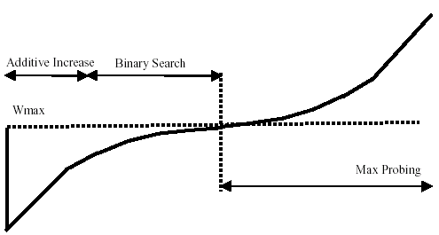
In Summary BIC function
BIC overall performs very well in evaluation of advanced TCP stacks on
fast long-distance production.
BIC (also HSTCP & STCP) growth function can be still aggressive for TCP
especially under short RTTs or low speed networks.

Slide 155
In Summary BIC function
Make window size growth function independent from RTT.
Use the elapsed real-time since the last loss event.
Goals
  TCP friendly
  RTT fair
  Co-existing flows with different RTTs are treated fairly
  Efficient use of available bandwidth

Slide 156
TCP CUBIC: Why CUBIC?
Window control of BIC is so complex!
BIC’s growth function can still be too aggressive for TCP, especially under short RTT or low speed networks.
BIC still has room for improving TCP-friendliness and RTT-fairness!
156

Slide 157
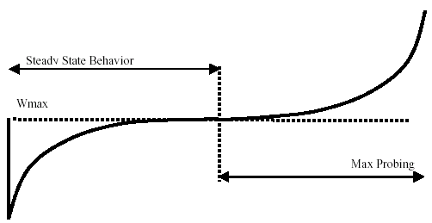


The CUBIC function
accelerate
slow down
accelerate
where C is a scaling factor, t is the elapsed time from the last window reduction, and β is a constant multiplication decrease factor

Slide 158
TCP CUBIC: The algorithm
ACK received
  C is a scaling factor
  t is the elapsed time from the last window reduction
  Wmax is the window size just before the last window reduction
  K is updated at the time of last lost event
Recovery
  Update K with:
  Update Wmax with:
  β is a constant multiplication decrease factor
Notes:
The CUBIC function (simplified):
cwnd(t)=C⋅(t−K)3+Wmaxcwnd(t)=C⋅(t−K)3+Wmax​Where:
t: Time since last congestion event
K: Time at which the function reaches Wma
C: Scaling constant (aggressiveness)
Wmax​: Last maximum congestion window
As t gets close to K, (t−K)3 approaches zero, and the function flattens near WmaxWmax​.

Slide 159
TCP CUBIC: The algorithm
ACK received
  C is a scaling factor
  t is the elapsed time from the last window reduction
  Wmax is the window size just before the last window reduction
  K is updated at the time of last lost event
Recovery
  Update K with:
  Update Wmax with:
  β is a constant multiplication decrease factor
cwnd cannot be less than
as to keep the growth rate the same as standard TCP in short RTT networks.

Slide 160
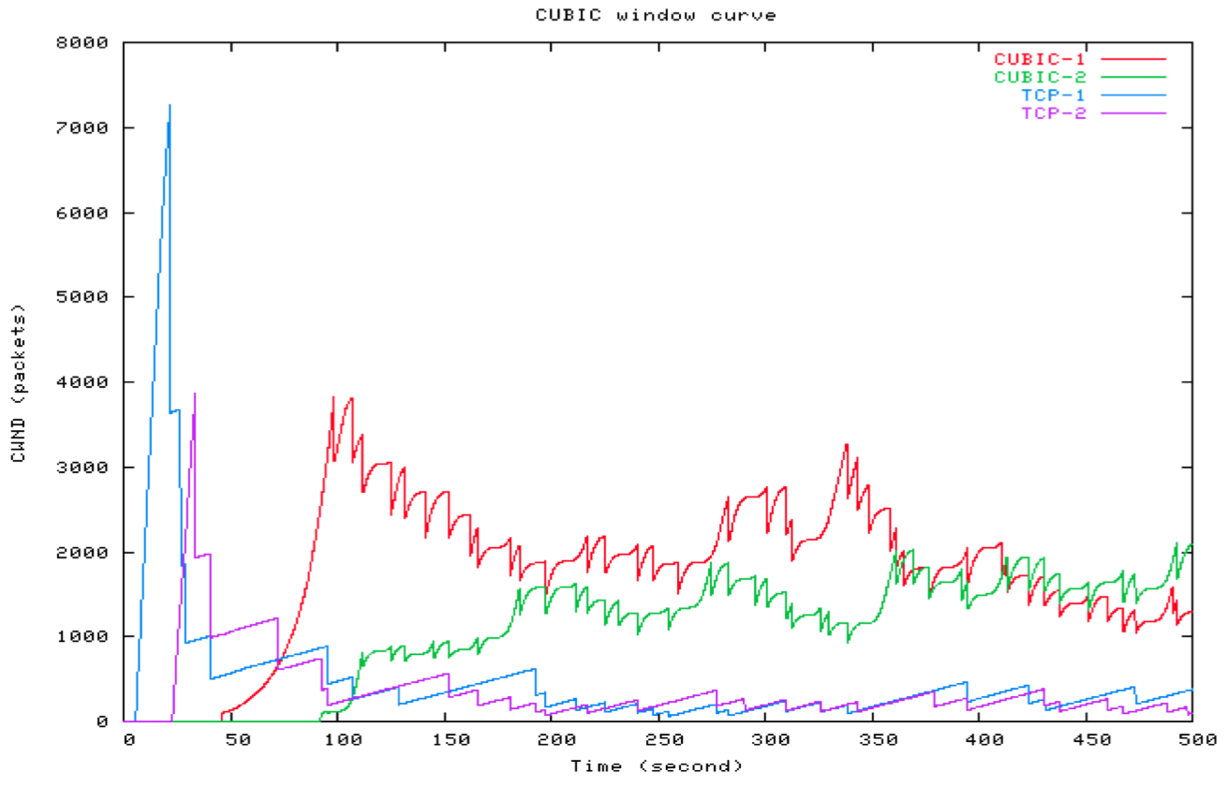
CUBIC window curves with competing flows (NS simulation in a network with 500Mbps and 100ms RTT), C = 0.4, β = 0.8.

Slide 161
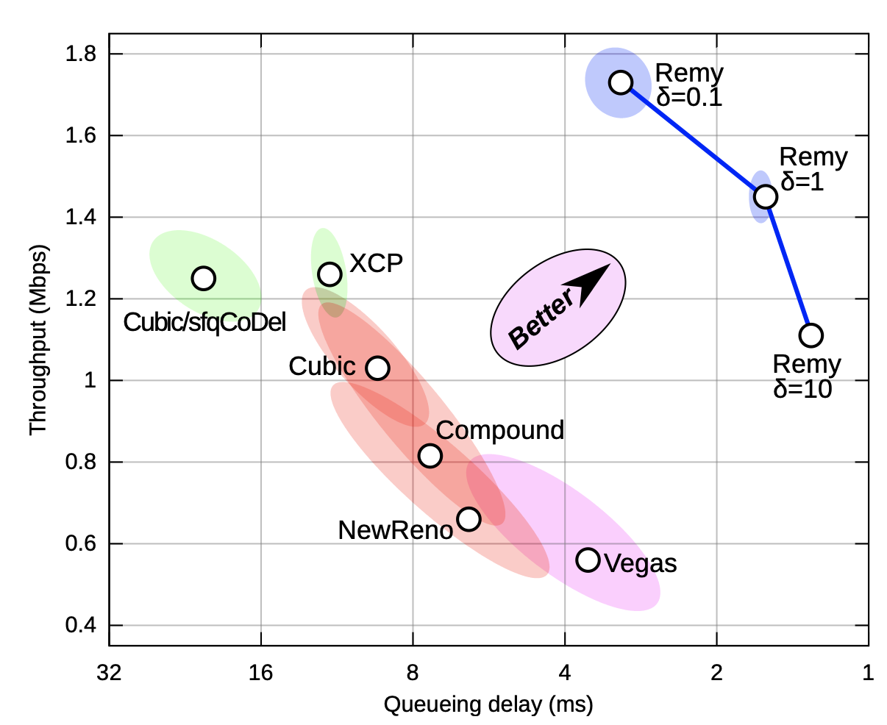
TCP ex Machina: Remy
Link to the paper: https://web.mit.edu/remy/TCPexMachina.pdf

