Slide 1

Computer Networks
CMSC 417 : Spring 2026
Topic:
Transport Layer Protocols: Congestion Control
(Textbook chapter 6)
Nirupam Roy
M-W 2:00-3:15pm
CSI 2117
April 8th, 2026

Slide 2
TCP Congestion Control

Slide 3
TCP Congestion Control: TCP “Sawtooth”
Additive increase, multiplicative decrease (AIMD)
  On packet loss, divide congestion window in half
  On success for last window, increase window linearly
Loss
Window
halved
t

Slide 4
Congestion control: Slow start

Slide 5
How Should a New Flow Start?
Start slow (a small CWND) to avoid overloading network
Window
Loss
halved
t

Slide 6
How Should a New Flow Start?
Start slow (a small CWND) to avoid overloading network
Window
Loss
halved
t
But, could take a long time to get started!

Slide 7
“Slow Start” Phase
Start with a small congestion window
  Initially, CWND is 1 MSS
  So, initial sending rate is MSS / RTT
Could be pretty wasteful
  Might be much less than actual bandwidth
  Linear increase takes a long time to accelerate
Slow-start phase (really “fast start”)
  Sender starts at a slow rate (hence the name)
  … but increases rate exponentially until the first loss

Slide 8
Slow Start in Action
Double CWND per round-trip time
1
2
4
8
Src
D
A
D
D
A
A
D
D
D
D
A
A
A
A
Dest

Slide 9
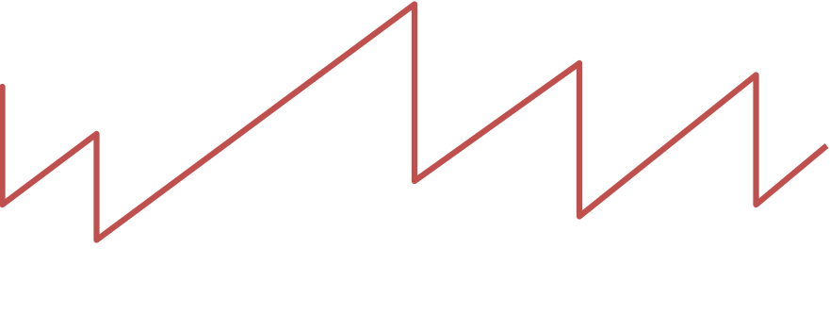
Slow Start and the TCP Sawtooth
Loss
Window
Linear “congestion avoidance” phase
halved
Exponential “slow start”
t
Why is this called “slow start”?
TCP originally had no congestion control
  Source would start by sending entire receiver window
  Led to congestion collapse!
  “Slow start” is, comparatively, slower

Slide 10
Response to the two types of losses

Slide 11
Response to the two types of losses
(1) Triple duplicate ACK (Fast retransmit)
  Packet n is lost, but packets n+1, n+2, etc. arrive
  Then, sender quickly resends packet n
  Do a multiplicative decrease and keep going

Slide 12
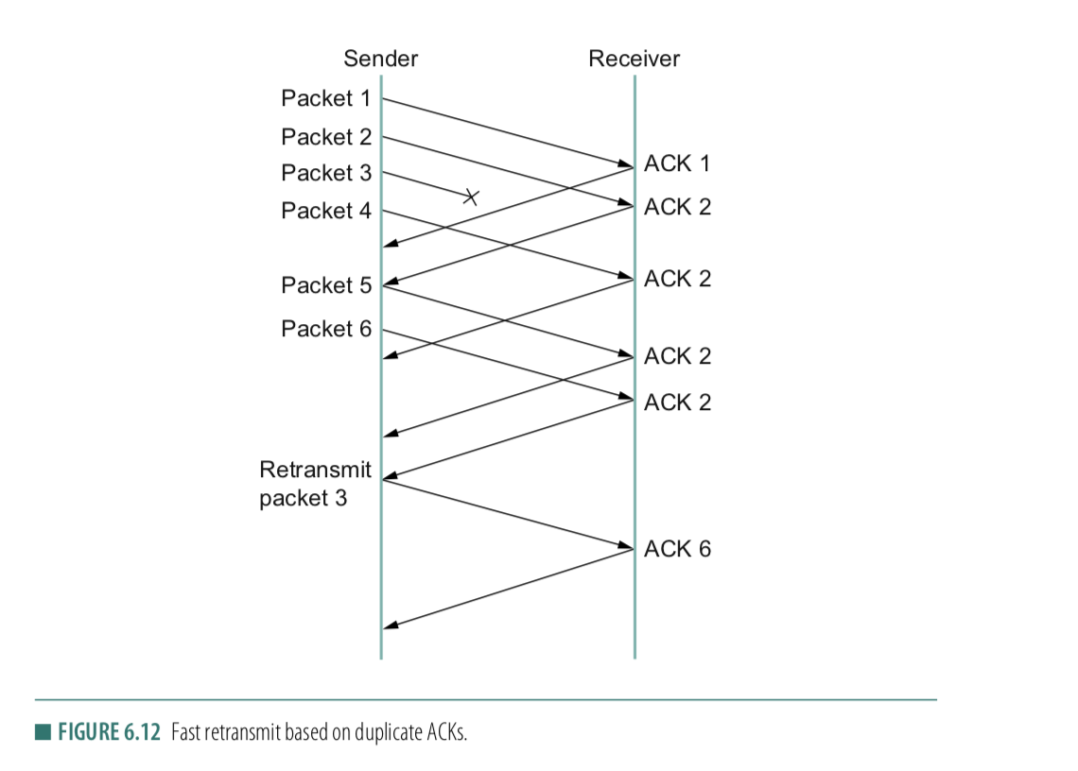
Fast retransmit
ACK for 2
1st Dup-ACK for 2
2nd Dup-ACK
3rd Dup-ACK

Slide 13
Congestion window during Fast retransmit
Window
Packet loss (3-dup ack, fast retransmit, multiplicative decrease)
t

Slide 14
Two Kinds of Loss in TCP
(1) Triple duplicate ACK (Fast retransmit)
  Packet n is lost, but packets n+1, n+2, etc. arrive
  Then, sender quickly resends packet n
  Do a multiplicative decrease and keep going
(2) Timeout (Repeat slow start – slow start restart)
  Packet n is lost and detected via a timeout
  Blasting entire CWND would cause another burst
  Better to start over with a low CWND

Slide 15
Repeating Slow Start After Timeout
(slow-start restart)
Window
timeout
Packet loss (3-dup ack, fast retransmit)
t
Slow start until reaching half of previous cwnd.
Slow-start restart: Go back to CWND of 1, but take advantage of knowing the previous value of CWND.

Slide 16
Repeating Slow Start After Idle Period
Suppose a TCP connection goes idle for a while
Eventually, the network conditions change
  Maybe many more flows are traversing the link
Dangerous to start transmitting at the old rate
  Previously-idle TCP sender might blast network
  … causing excessive congestion and packet loss
So, some TCP implementations repeat slow start
  Slow-start restart after an idle period

Slide 17
TCP congestion control
Conservation of packets:
If the connection is running at the available capacity (bandwidth) then a packet is not injected into the network unless a packet is taken out.
Notes:
[source: G.R.Wright and W.R.Stevens, TCP/IP Illustrated, Vol 2; J. Hoe, MSc Thesis, pp.22]
Tahoe (1988): slow start, congestion avoidance, fast retransmit
Reno (1990): fast recovery, TCP header prediction, SLIP header compression, routing table changes
4.4BSD (1993): multicasting, long fat pipe modifications

Slide 18
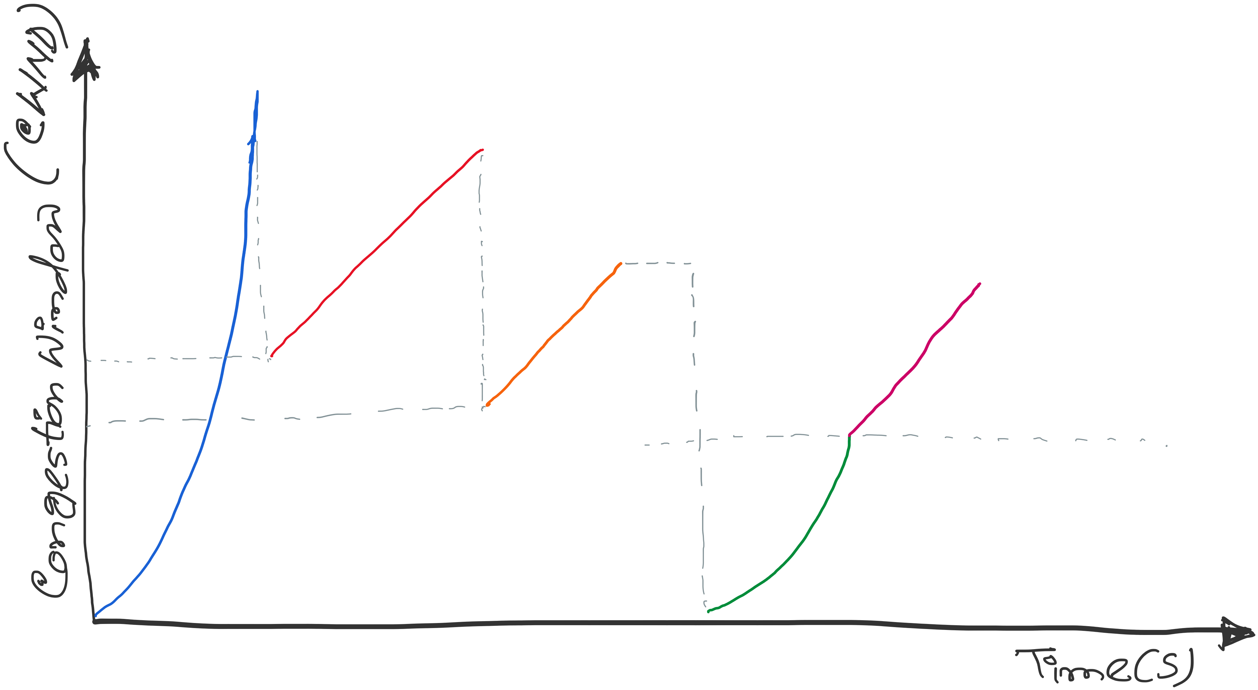
TCP congestion control: CWND graph
Notes:
[source: G.R.Wright and W.R.Stevens, TCP/IP Illustrated, Vol 2; J. Hoe, MSc Thesis, pp.22]
Tahoe (1988): slow start, congestion avoidance, fast retransmit
Reno (1990): fast recovery, TCP header prediction, SLIP header compression, routing table changes
4.4BSD (1993): multicasting, long fat pipe modifications

Slide 19
Implementation details
Update Time: Per RTT vs Per ACK

Slide 20
Implementation details
Update Time: Per RTT vs Per ACK
Double CWND per round-trip time
1
2
4
8
Src
D
A
D
D
A
A
D
D
D
D
A
A
A
A
Dest

Slide 21
Implementation details
Update Time: Per RTT vs Per ACK
Double CWND per round-trip time
Implemented as CWND = CWND + 1 (per ACK)
1
2
4
8
Src
D
A
D
D
A
A
D
D
D
D
A
A
A
A
Dest

Slide 22
Implementation details
Update Time: Per RTT vs Per ACK
Linear increase of CWND per round-trip time
Implemented as CWND = CWND + 1/CWND (per ACK)
1
2
3
4
Src
D
A
D
D
A
A
D
D
D
D
A
A
A
Dest

Slide 23
TCP congestion control: CWND graph
First packet loss (3-dup acks)
Congestion avoidance CWND = CWND + (1/CWND)
Packet loss
(3-dup acks)
CWND = CWND/2
Time out(no acks)
Congestion
avoidance
CWND =
CWND +
(1/CWND)
SSTHRES = CWND/2
CWND = CWND/2
Slow Start end
Slow start
Slow Start restart
CWND = 1
Notes:
[source: G.R.Wright and W.R.Stevens, TCP/IP Illustrated, Vol 2; J. Hoe, MSc Thesis, pp.22]
Tahoe (1988): slow start, congestion avoidance, fast retransmit
Reno (1990): fast recovery, TCP header prediction, SLIP header compression, routing table changes
4.4BSD (1993): multicasting, long fat pipe modifications

Slide 24
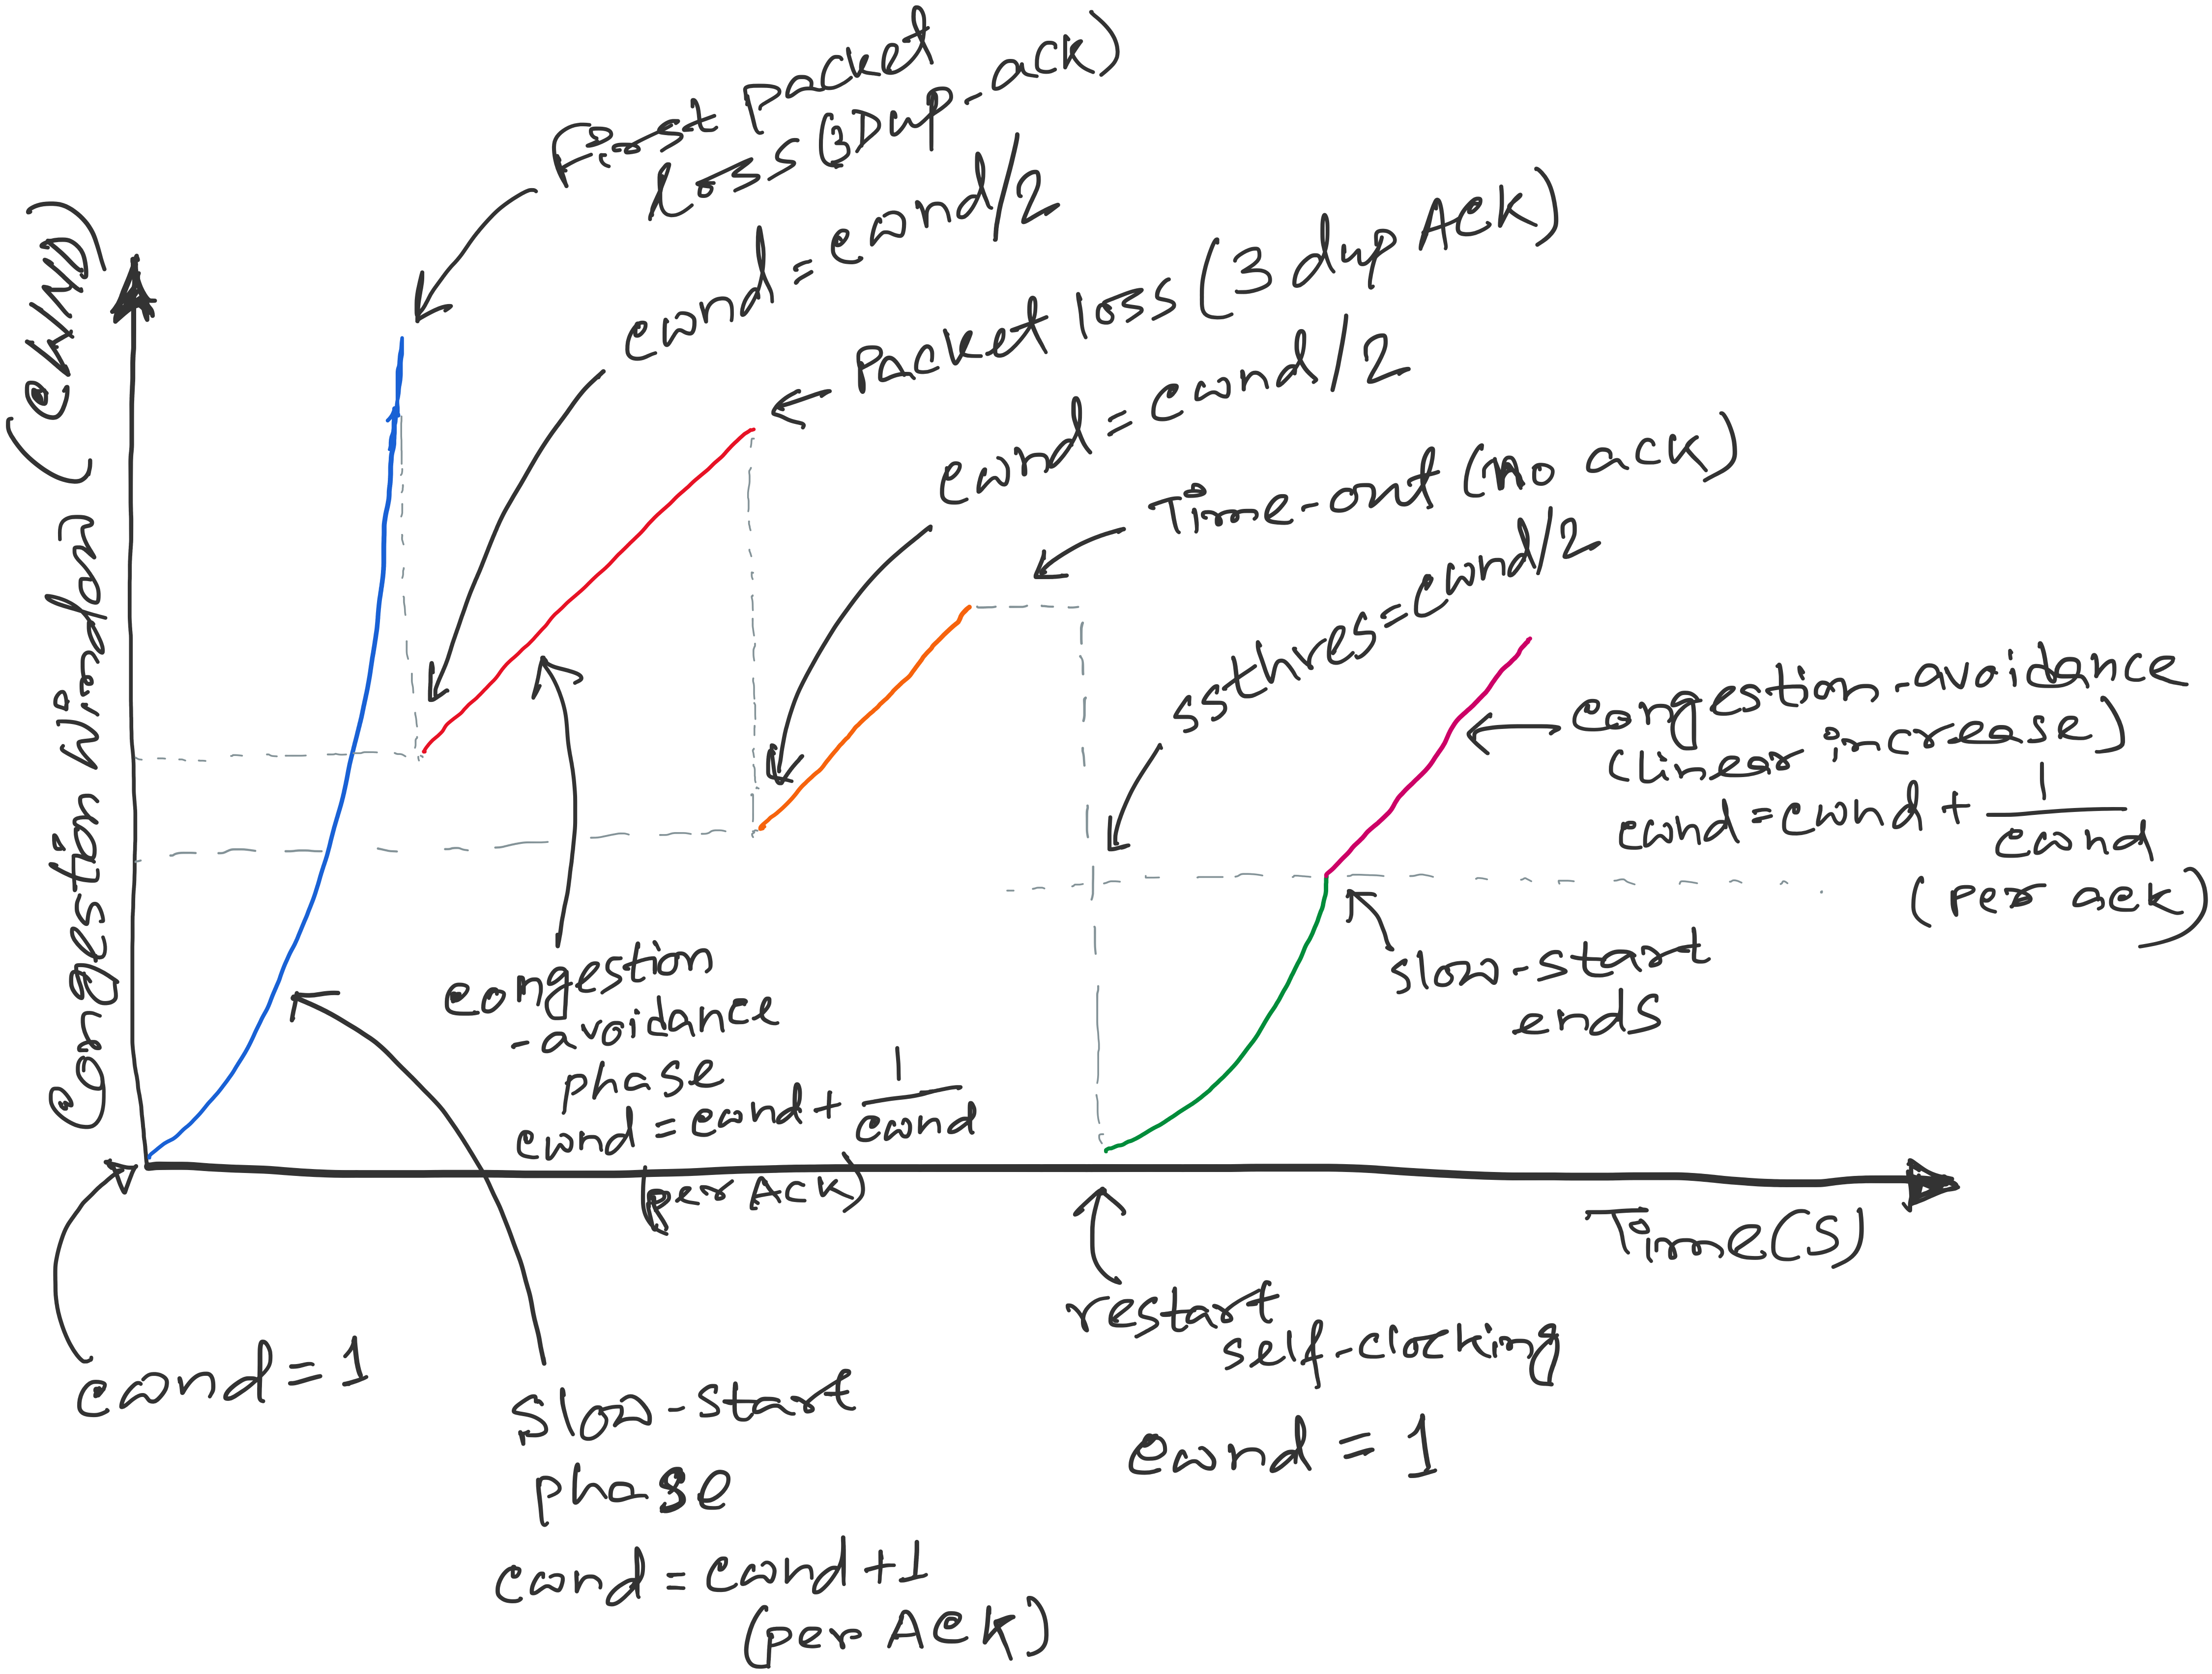
TCP congestion control
SSTHRES = Slow-start threshold
Notes:
[source: G.R.Wright and W.R.Stevens, TCP/IP Illustrated, Vol 2; J. Hoe, MSc Thesis, pp.22]
Tahoe (1988): slow start, congestion avoidance, fast retransmit
Reno (1990): fast recovery, TCP header prediction, SLIP header compression, routing table changes
4.4BSD (1993): multicasting, long fat pipe modifications

Slide 25
Revisiting a topic in a new context
A few design decisions
  1. Unique packet identifiers: Why and how
  2. Duplicate packets: Why and how to eliminate
  3. Timeout: picking the ideal value

Slide 26
Revisiting a topic in a new context
A few design decisions
  1. Unique packet identifiers: Why and how
  2. Duplicate packets: Why and how to eliminate
  3. Timeout: picking the ideal value

Slide 27
Processing of incoming packets
Revisiting a topic in a new context
Host A
ISN (initial sequence number)
Byte 81
TCP Data
TCP Data
Host B
Receive, ACKed, sent to APP
Receive, ACKed, not sent to APP
Receive, not ACKed
Unused buffer

Slide 28
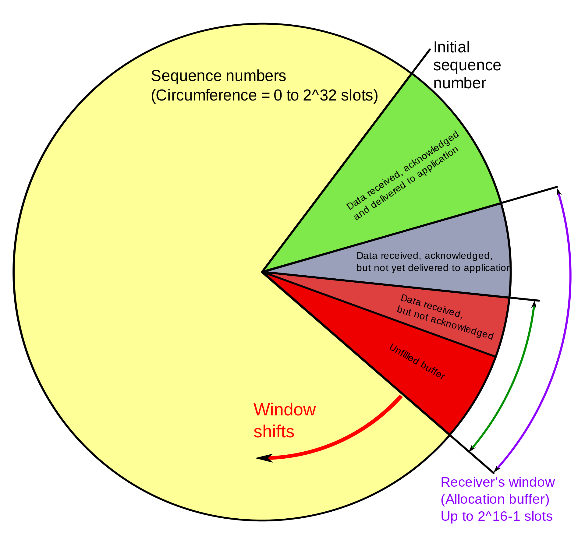
Revisiting a topic in a new context
Receive, ACKed, sent to APP
Receive, ACKed, not sent to APP
Receive, not ACKed
Unused buffer
PC: https://en.wikipedia.org/wiki/Transmission_Control_Protocol

Slide 29
Revisiting a topic in a new context
Receive, ACKed, sent to APP
Does the 16-bit Receiver window (advertised window) protect from wrap around?
Receive, ACKed, not sent to APP
Receive, not ACKed
Unused buffer
PC: https://en.wikipedia.org/wiki/Transmission_Control_Protocol

Slide 30
Receiver window (advertised window) scaling
1. Negotiation (during 3-way handshake)
Each side independently advertises a scale factor S:
Sent in SYN (and SYN-ACK)
Range: S∈[0,14]
This option is only exchanged during connection setup.
2. Interpretation Rule
The 16-bit advertised window is interpreted as:
Calculated Window=Advertised Window×2^{S}
The value in the TCP header remains 16 bits.
3. Example
Advertised window field = 40,000
Scale factor S=3
Calculated rwnd=40,000×2³=320,000 bytes

Slide 31
Revisiting a topic in a new context
What is “wrap around” of TCP sequence numbers?
In TCP, every byte is assigned a 32-bit sequence number.
That means the sequence number space is finite:
Range: 0 → (2³² − 1)
After reaching the maximum, it wraps back to 0 (modulo 2³²)
This is called sequence number wrap around.

Slide 32
Revisiting a topic in a new context
Why is wrap around a problem?
TCP relies on sequence numbers to:
- Detect duplicates
- Ensure ordering
- Identify new vs old data
If wraparound happens too quickly, an old packet still in the network or a “delayed packet” could:
- Reappear after wraparound
- Be mistaken as new data (same sequence number)

Slide 33
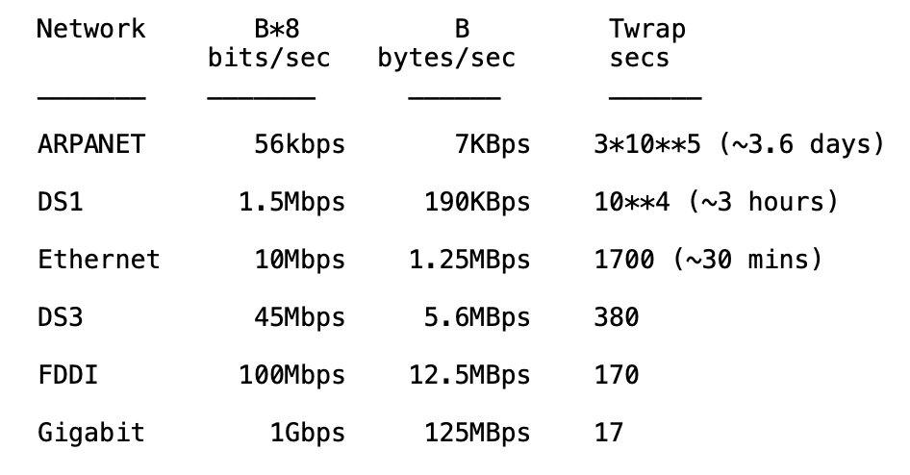
Revisiting a topic in a new context
Wrap around is possible
REF: RFC 1323

Slide 34
Revisiting a topic in a new context
Why does it happen faster in high-speed networks?
Wraparound time depends on data rate:
Wraparound time = 2³² bytes / data rate (bytes/sec)

Slide 35
Wrap around-aware sequence number comparison
(modulo arithmatic)
If A and B are sequence numbers,
A < B if 0 < (B - A) < 2**31,
computed in signed 32-bit arithmetic
Effective window rule: Effective window < 2³¹
Maximum segment lifetime (MSL, ~2 minutes) should be shorter than wrap-around-time, i.e., 2**31 / B > MSL (secs)
PAWS: Protect Against Wrapped Sequence Numbers
(RFC 1323) – Use sequence number and timestamps.
REF: RFC 1323
Notes:
TCP reliability depends upon the existence of a bound on the lifetime of a segment: the "Maximum Segment Lifetime" or MSL. An MSL is generally required by any reliable transport protocol, since every sequence number field must be finite, and therefore any sequence number may eventually be reused. In the Internet protocol suite, the MSL bound is enforced by an IP-layer mechanism, the "Time-to-Live" or TTL field.

Slide 36
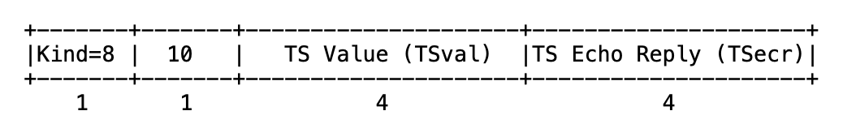
TCP timestamp

Slide 37
TCP timestamp
Sender’s current time
Notes:
Timestamp Wrap-Around Periods
The time it takes for a timestamp to wrap depends on the clock frequency of the sender, which RFC 7323 recommends be between 1 ms and 1 second per tick:
www.exploresecurity.com +2
At 1 ms ticks: The 32-bit timestamp wraps in approximately 49.7 days (and the sign bit wraps in 24.8 days).
At 1 second ticks: The timestamp would take 136 years to wrap.
IETF | Internet Engineering Task Force +2

Slide 38
TCP Timestamp Option (10 bytes)
Sender’s current time
Copied timestamp from the packet
being acknowledged.
(valid only when the packet contains an ACK.
i.e., the ACK bit is set in TCP header).

Slide 39
How PAWS Works:
Timestamp Echoing: Each TCP segment includes a TSval (Timestamp Value) from the sender. The receiver tracks the most recent valid timestamp received (TS.Recent).
Monotonicity Requirement: The algorithm assumes that every new segment sent will have a timestamp value greater than or equal to the previous one.
The Comparison: When a new segment arrives, PAWS compares its timestamp (SEG.TSval) against TS.Recent:
  If SEG.TSval < TS.Recent: The packet is treated as an "old duplicate" from a previous lap of the sequence numbers and is discarded.
  If SEG.TSval ≥ TS.Recent: The packet is considered current and is processed normally.

Slide 40
Revisiting a topic in a new context
A few design decisions
  1. Unique packet identifiers: Why and how
  2. Duplicate packets: Why and how to eliminate
  3. Timeout: picking the ideal value

Slide 41
A few design decisions
  2. Duplicate packets: Why and how to eliminate
  - Receiver maintain the last in-sequence byte number in a variable, say rcv_seqnum
  - If the Receiver receives a packet with seq number less than or equal to rcv_seqnum
  >>It sends an ACK for that packet, and discards the packet
  - If the Receiver receives a packet with seq number (rcv_seqnum+1):
  >> It sends an ACK for that packet, and includes the packet to the application buffer

Slide 42
A few design decisions
  2. Duplicate packets: Why and how to eliminate
  - Receiver maintain the last in-sequence byte number in a variable, say rcv_seqnum
  - If the Receiver receives a packet with seq number less than or equal to rcv_seqnum
  >>It sends an ACK for that packet, and discards the packet
  - If the Receiver receives a packet with seq number (rcv_seqnum+1):
  >> It sends an ACK for that packet, and includes the packet to the application buffer
  - What if the receiver gets a packet with seq number greater than (rcv_seqnum+1) ?

Slide 43
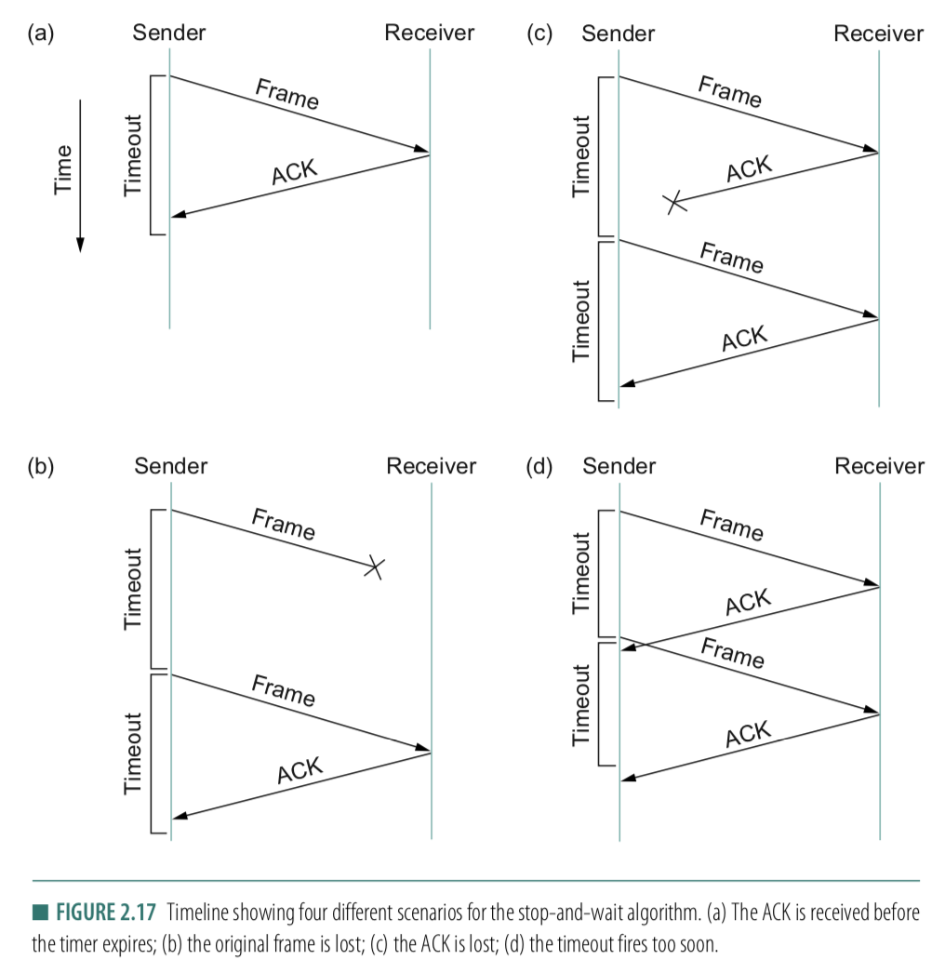
A few design decisions
  3. Timeout: picking the ideal value
  - What if the timeout is too small?
  - What if the timeout is too large?
  - Round-Trip time (RTT)

Slide 44
Revisiting a topic in a new context
A few design decisions
  1. Unique packet identifiers: Why and how
  2. Duplicate packets: Why and how to eliminate
  3. Timeout: picking the ideal value

Slide 45
Reasons for Retransmission
Packet
Packet
Packet
Timeout
Timeout
ACK
Timeout
ACK
Packet
Packet
Packet
ACK
Timeout
Timeout
Timeout
ACK
ACK
Packet lost
ACK lost
DUPLICATE
PACKET
Early timeout
DUPLICATE
PACKETS
Notes:
Application may get duplicates in the case of early timeouts

Slide 46
How Long Should Sender Wait?
Sender sets a timeout to wait for an ACK
  Too short:
  >> wasted retransmissions
  Too long:
  >> excessive delays when packet lost
TCP sets timeout as a function of the RTT
  Expect ACK to arrive after a “round-trip time”
  … plus a fudge factor to account for queuing
But, how does the sender know the RTT?
  Running average of delay to receive an ACK

Slide 47
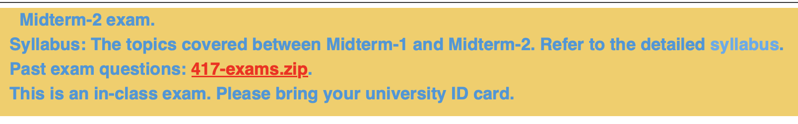
Midterm-2 this Monday (April 13th)

Slide 48
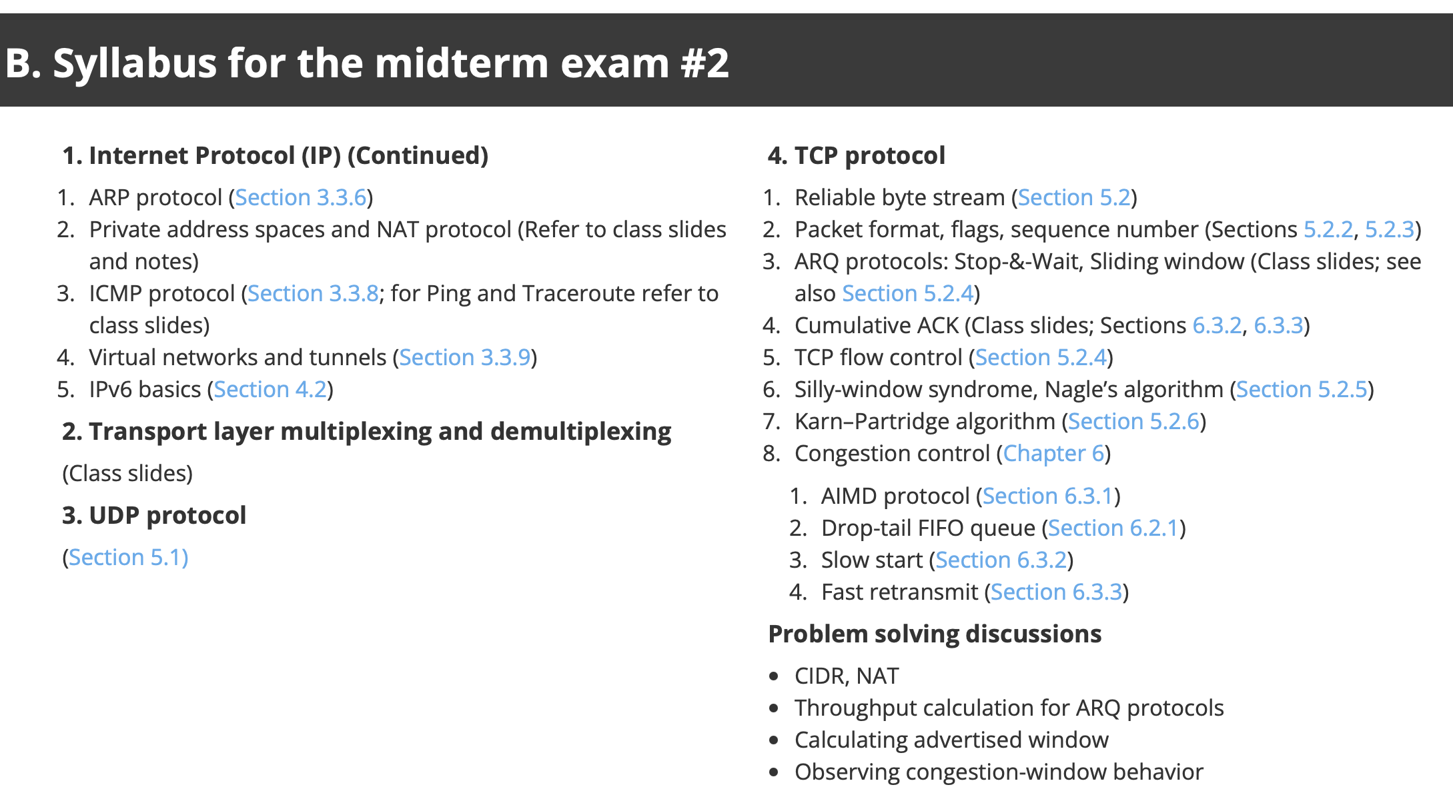
Midterm-2 this Monday (April 13th)

Slide 49
Problem-solving type questions: Recap

Slide 66
TCP congestion control: CWND graph
First packet loss (3-dup acks)
Congestion avoidance CWND = CWND + (1/CWND)
Packet loss
(3-dup acks)
CWND = CWND/2
Time out(no acks)
Congestion
avoidance
CWND =
CWND +
(1/CWND)
SSTHRES = CWND/2
CWND = CWND/2
Slow Start end
Slow start
Slow Start restart
CWND = 1
Notes:
[source: G.R.Wright and W.R.Stevens, TCP/IP Illustrated, Vol 2; J. Hoe, MSc Thesis, pp.22]
Tahoe (1988): slow start, congestion avoidance, fast retransmit
Reno (1990): fast recovery, TCP header prediction, SLIP header compression, routing table changes
4.4BSD (1993): multicasting, long fat pipe modifications

Slide 67
Thank you

