Slide 1

Computer Networks
CMSC 417 : Spring 2026
Topic:
Transport Layer Protocols:
Chord Protocol
&
Congestion Control (Textbook chapter 6)
Nirupam Roy
M-W 2:00-3:15pm
CSI 2117
April 15th, 2026

Slide 2
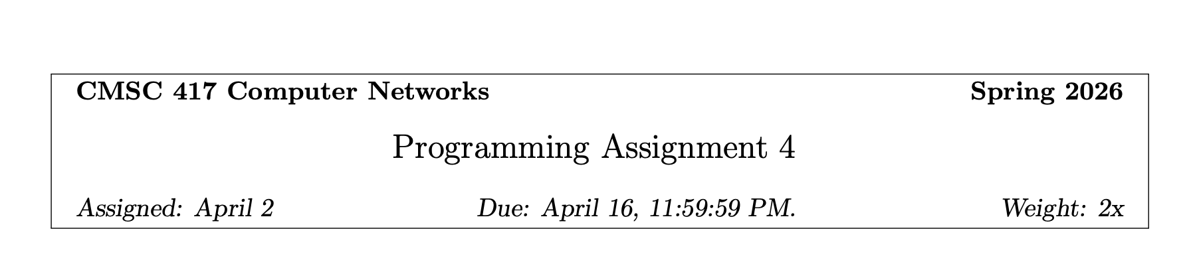
Work in a group of two.

Slide 3
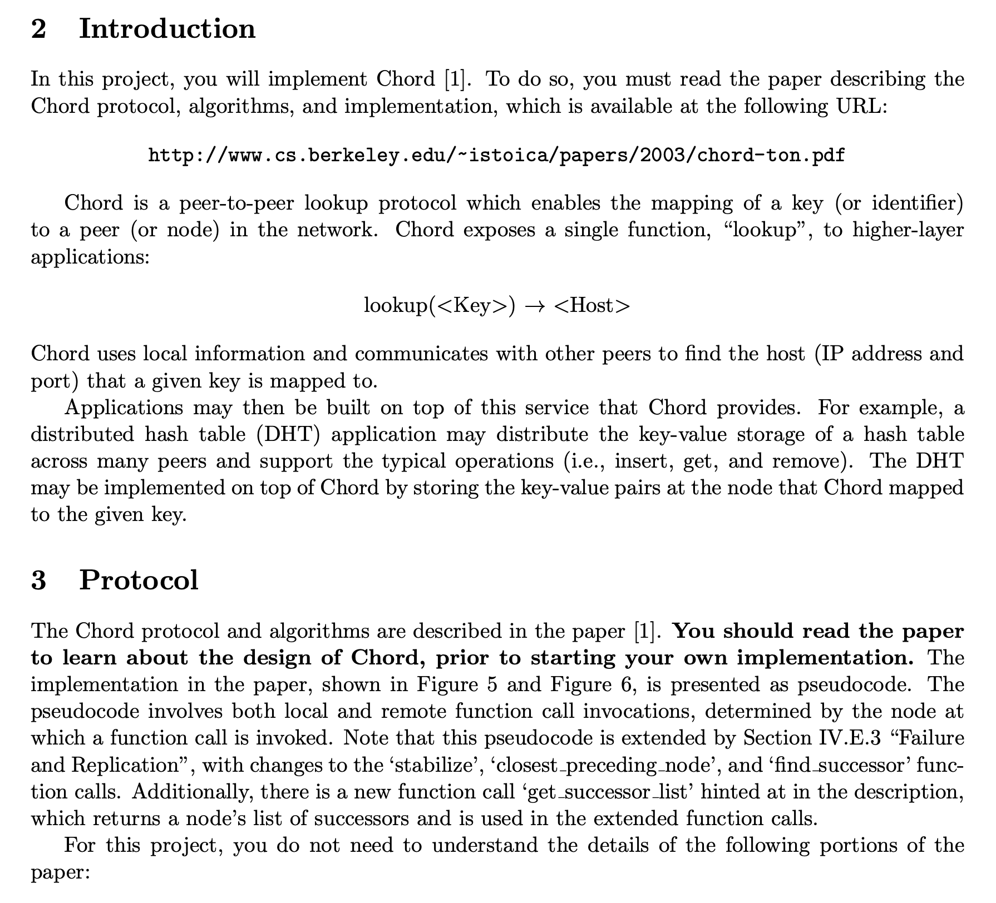

Slide 4
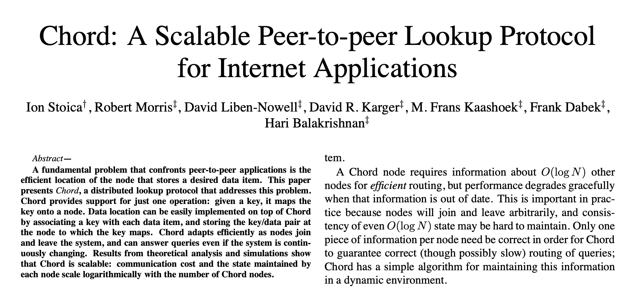

Slide 5
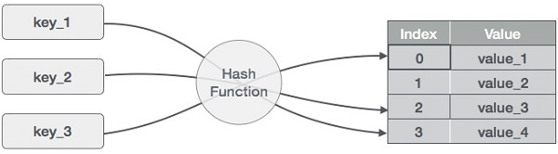
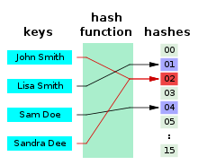
Hashing, Hash Table
A hash function is any function that can be used to map data of arbitrary size to fixed-size values, though there are some hash functions that support variable length output.
Picture: https://www.tutorialspoint.com/data_structures_algorithms/hash_data_structure.htm

Slide 6
Hashing, Hash Table
Can we imagine it as a circular data-structure?
Picture: https://www.tutorialspoint.com/data_structures_algorithms/hash_data_structure.htm

Slide 7
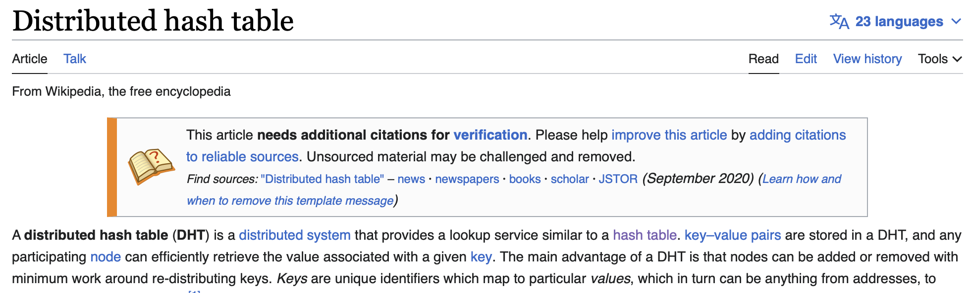
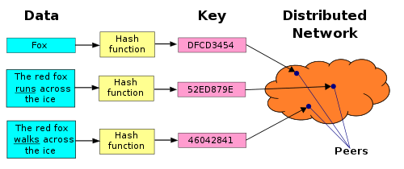
Distributed Hash Table

Slide 8
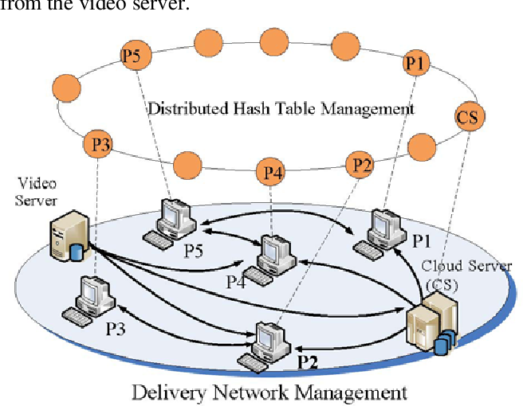
An overlay network
Pic: https://www.semanticscholar.org/paper/Cloud-Assisted-Live-Video-Streaming-over-DHT-Lim-Choi/3152fe80a5c964548c18673f1e8a9d2a7dff3368

Slide 9
Chord: A distributed lookup protocol
Node_IP + Key mapping
Successor

Slide 10
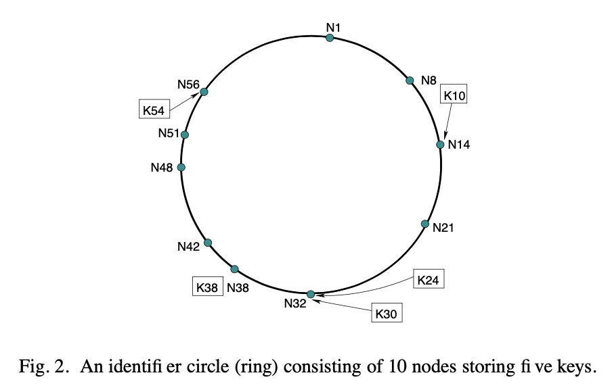

Slide 11
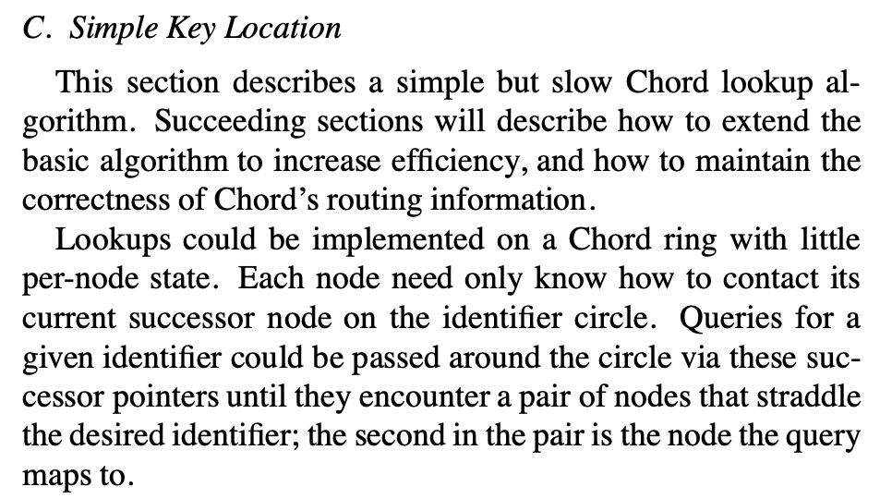
Not-Chord

Slide 12
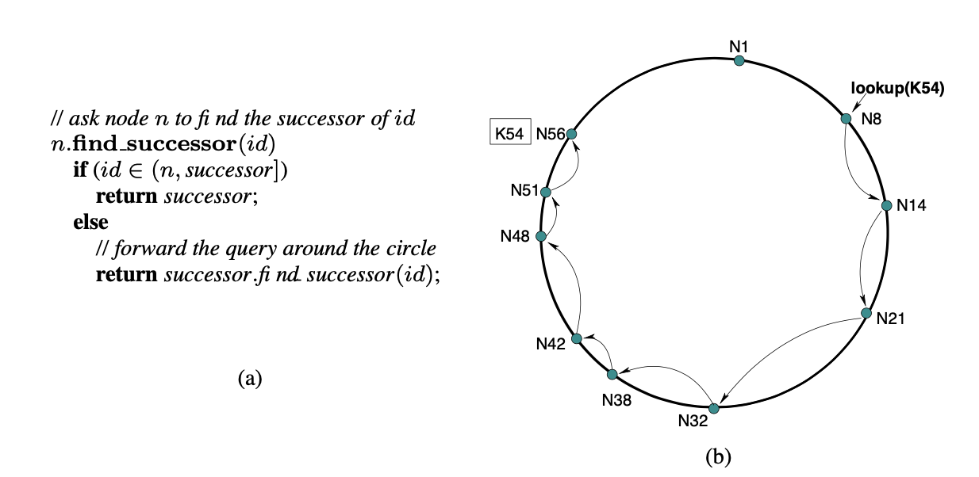
Not-Chord: Simple Key Lookup (Fig. 3)

Slide 13
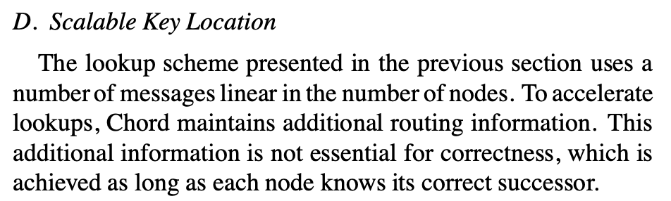
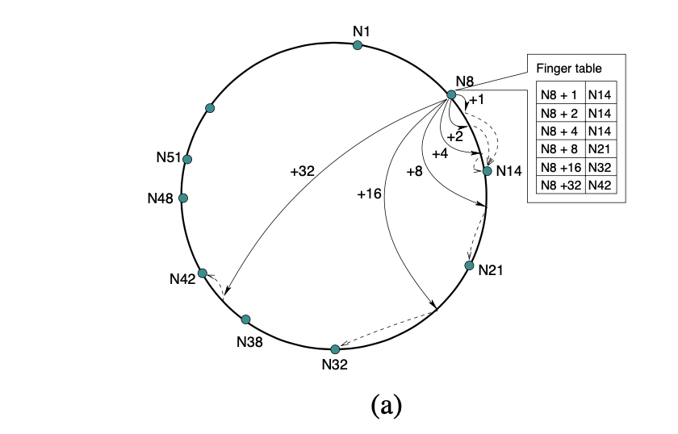
Chord: Scalable Key Lookup (Fig. 4)

Slide 14
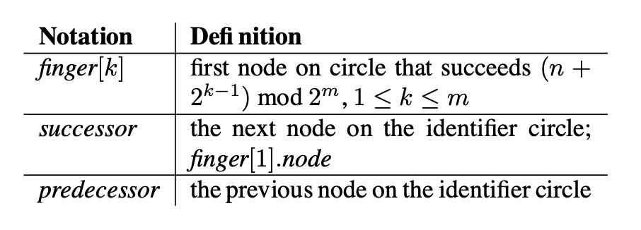
Chord: Scalable Key Lookup

Slide 15
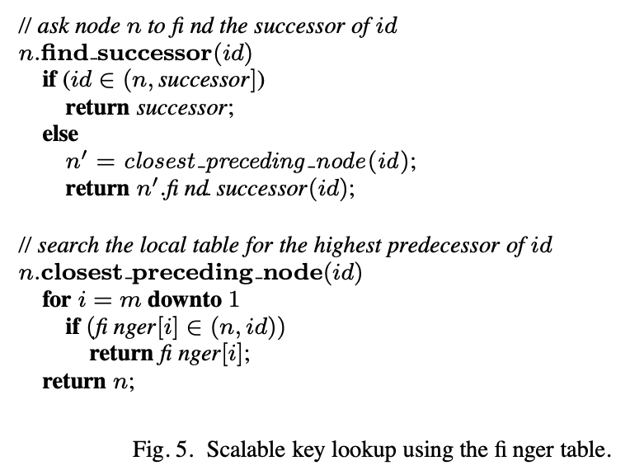
Chord: Scalable Key Lookup

Slide 16
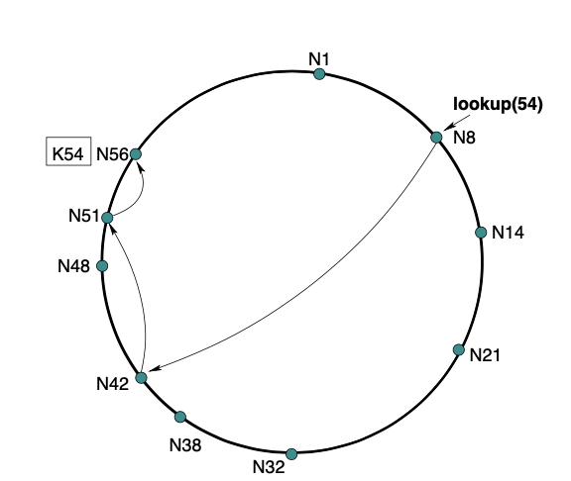
Chord: Scalable Key Lookup (Fig. 4)

Slide 17
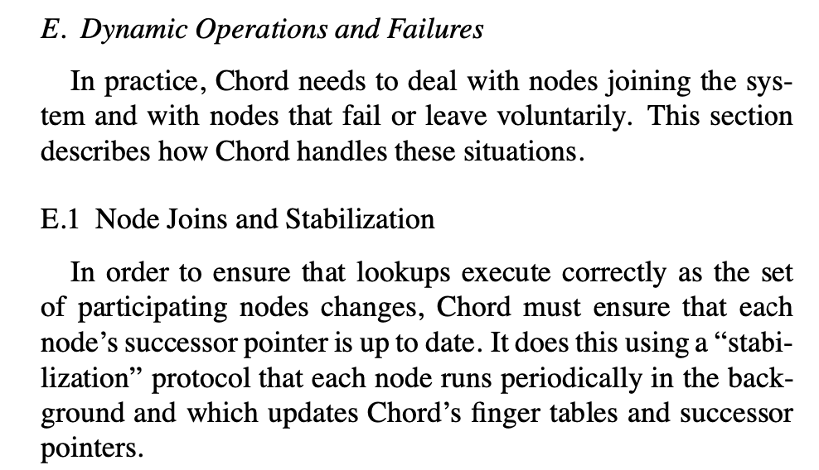
Addition, Deletion of nodes

Slide 18
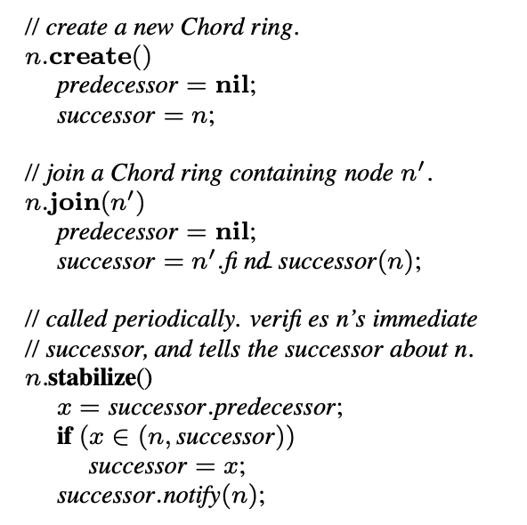
Stabilization (Fig. 6)

Slide 19
Stabilization (Fig. 6)

Slide 20
Stabilization (Fig. 6)

Slide 21
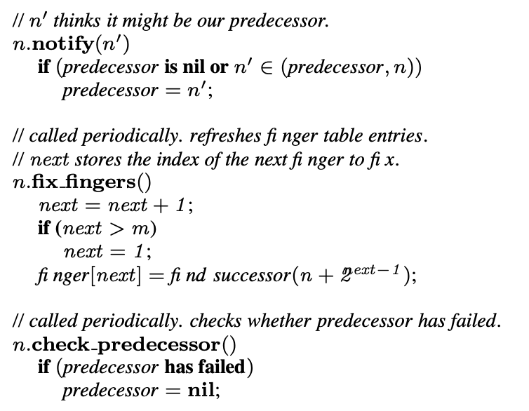
Stabilization (Fig. 6)

Slide 22
Stabilization (Fig. 6)

Slide 23
Stabilization (Fig. 6)

Slide 24
Stabilization (Fig. 6)

