Slide 1

Computer Networks
CMSC 417 : Spring 2026
Topic: Link layer
(Textbook chapter 2)
Nirupam Roy
M-W 2:00-3:15pm
CSI 2117

Slide 2
Protocol Layers
Notes:
Picture Courtesy : https://microchipdeveloper.com/tcpip:tcp-ip-five-layer-model

Slide 3
Link = Medium + Adapters

Slide 4
Adaptors Communicating
packet
link layer protocol
packet
frame
frame
sending
node
adapter
adapter
receiving
node
Sending side
  Encapsulates packet
  in a frame
  Adds error checking bits, flow control, etc.
Receiving side
  Looks for errors, flow control, etc.
  Extracts datagram and passes to receiving node

Slide 5
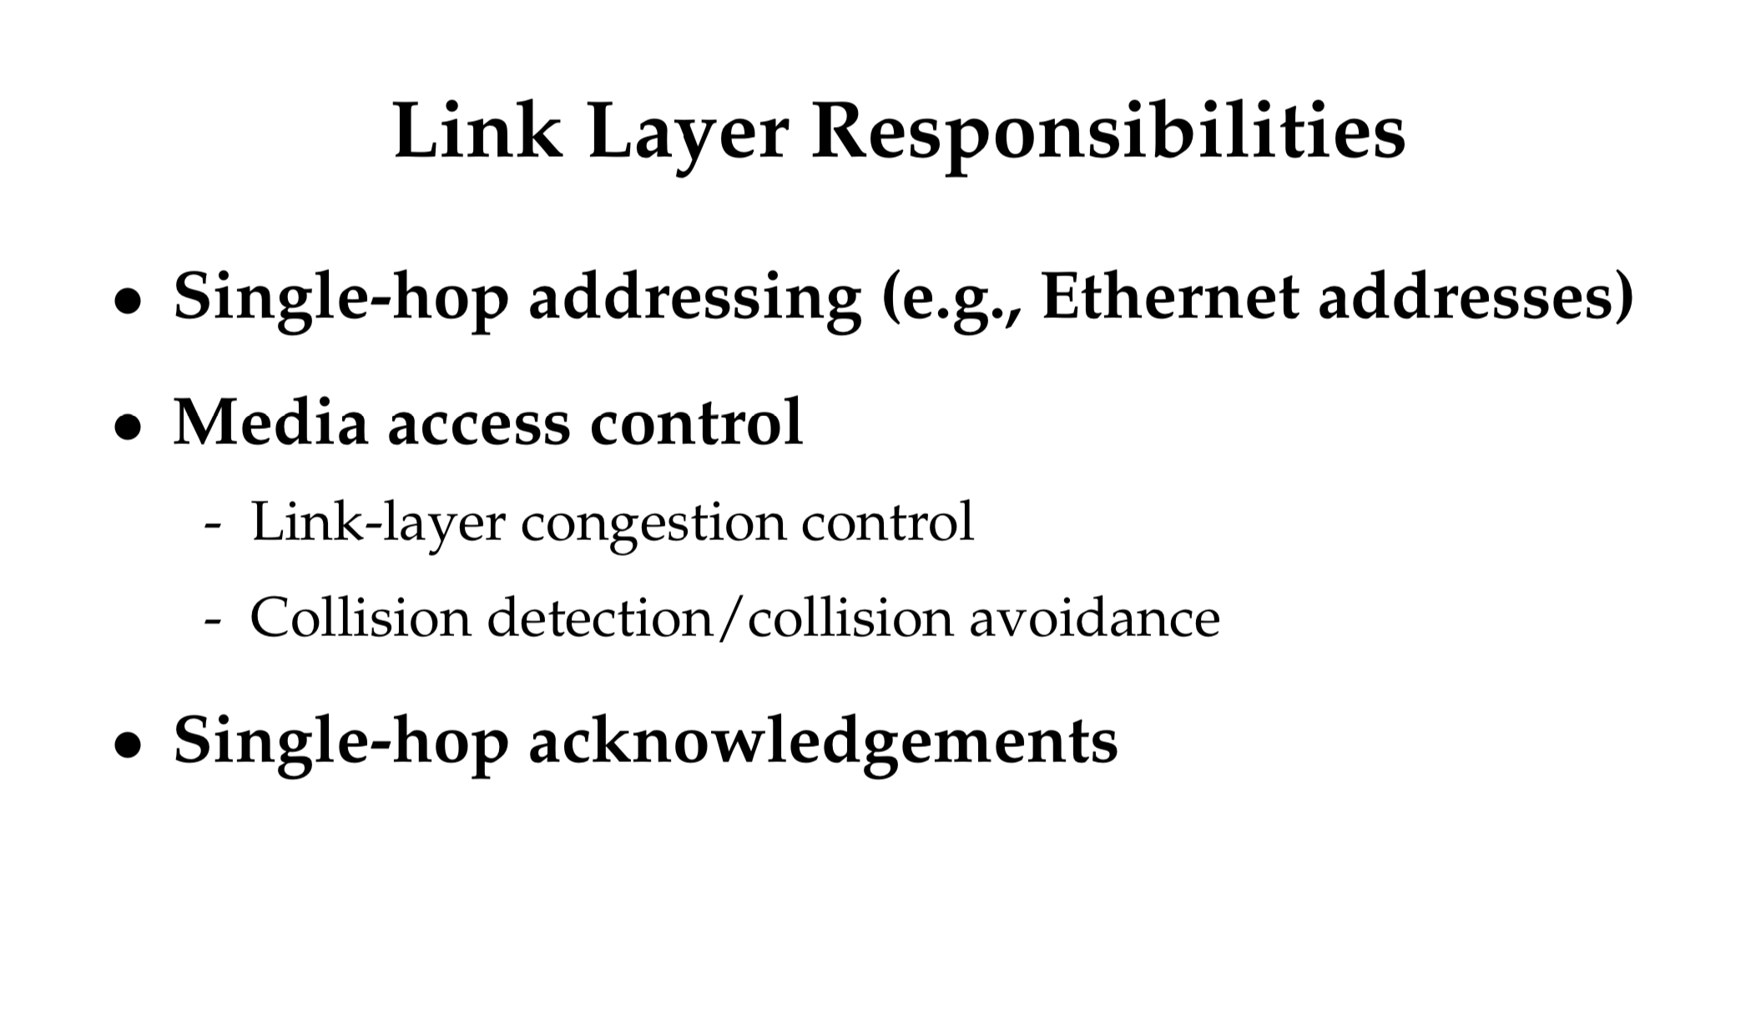

Slide 7
Link Layer Addresses (Recap)
(Discussed earlier in the context of ARP)

Slide 8
MAC addresses
MAC (or LAN or physical or Ethernet) address:
  function: used “locally” to get frame from one interface to another physically-connected interface (same network, in IP-addressing sense)
  48 bit MAC address (for most LANs) burned in NIC ROM, also sometimes software settable
  e.g.: 1A-2F-BB-76-09-AD
hexadecimal (base 16) notation
(each “numeral” represents 4 bits)

Slide 9
ARP protocol
A wants to send datagram to B
  B’s MAC address not in A’s ARP table.
A broadcasts ARP query packet, containing B's IP address
  destination MAC address = FF-FF-FF-FF-FF-FF
  all nodes on LAN receive ARP query
B receives ARP packet, replies to A with its (B's) MAC address
  frame sent to A’s MAC address (unicast)
A caches (saves) IP-to-MAC address pair in its ARP table until information becomes old (times out)
  soft state: information that times out (goes away) unless refreshed
ARP is “plug-and-play”:
  nodes create their ARP tables without intervention from net administrator

Slide 10

As an Aside: Promiscuous Mode
Normal adapter: receives frames sent to
  The local MAC address
  Broadcast address FF-FF-FF-FF-FF-FF
Promiscuous mode
  Receive everything, independent of destination MAC
Useful for packet sniffing
  Network monitoring
  E.g., wireshark, tcpdump

Slide 11
Why Not Just Use IP Addresses?
Links can support any network protocol
  Not just for IP (e.g., IPX, Appletalk, X.25, …)
  Different addresses on different kinds of links
An adapter may move to a new location
  So, cannot simply assign a static IP address
  Instead, must reconfigure the adapter’s IP address
Must identify the adapter during bootstrap
  Need to talk to the adapter to assign it an IP address

Slide 13
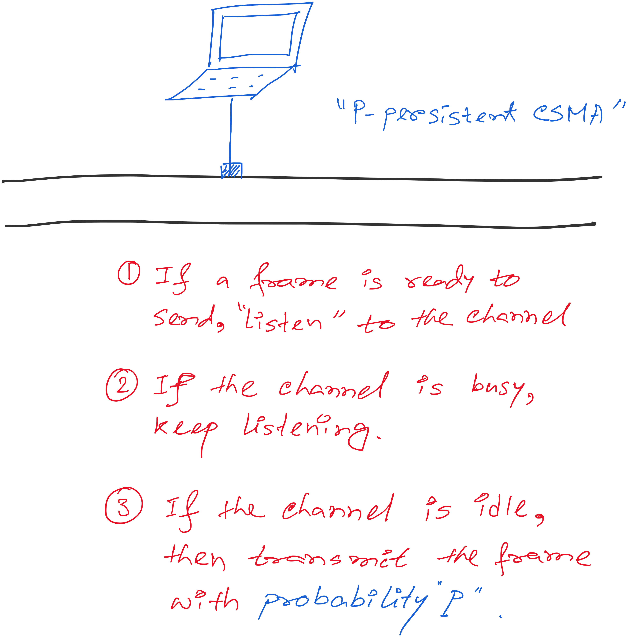
Carrier Sense Multiple Access (CSMA)

Slide 14
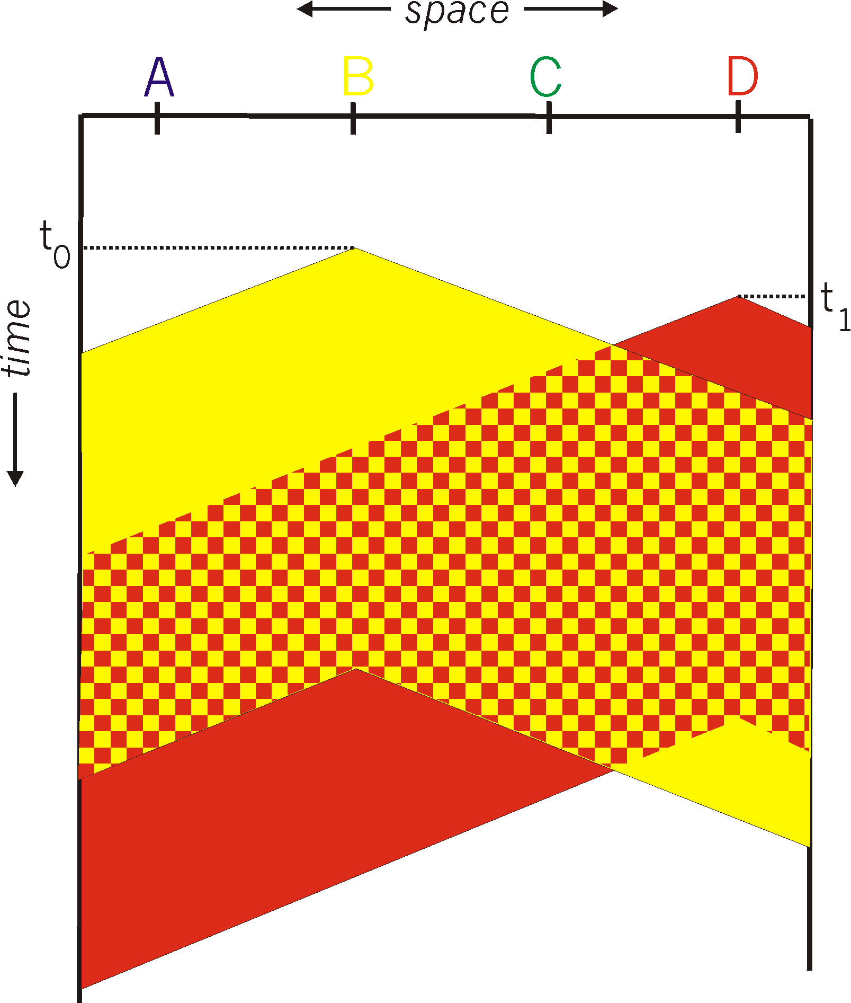
Carrier Sense Multiple Access (CSMA)
Listen for other senders
  Then transmit your data
Collisions can still occur
  Propagation delay
  Wasted transmission

Slide 15
CSMA: The time-space graph of collision

Slide 16
CSMA: The time-space graph of collision

Slide 17
CSMA: The time-space graph of collision

Slide 18
CSMA: The time-space graph of collision
The time-space region of collision

Slide 19

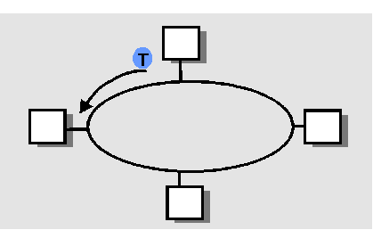
Comparing the Three Approaches
Divide the channel into pieces
  In time
  In frequency
Take turns
  Pass a token for the
  right to transmit
Defer action
  Let collisions happen
  … and detect and recover from them
Carrier Sense Multiple Access

Slide 20
Comparing the Three Approaches
Channel partitioning
  Efficient and fair at high load
  Inefficient at low load
“Taking turns”
  Eliminates empty slots without collisions
  Vulnerable to failures (e.g. lost token)
Random access
  Efficient at low load
  Collision overhead at high load

Slide 21
Automatic Repeat request
Flow control
Not implemented in wired LAN (e.g. Ethernet)

Slide 22
Ethernet

Slide 23
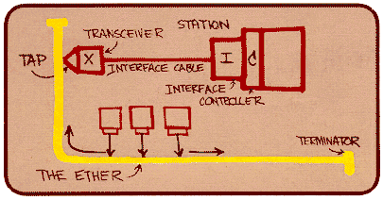
Ethernet
Dominant wired LAN technology
First widely used LAN technology
Kept up with speed race: 10 Mbps – 40 Gbps
Metcalfe’s
Ethernet
sketch
Notes:
Bob Metcalfe, co-inventor of Ethernet, was awarded the ACM A.M. Turing Award, often called the "Nobel Prize of Computing," in 2022 for his work on Ethernet.

Slide 24
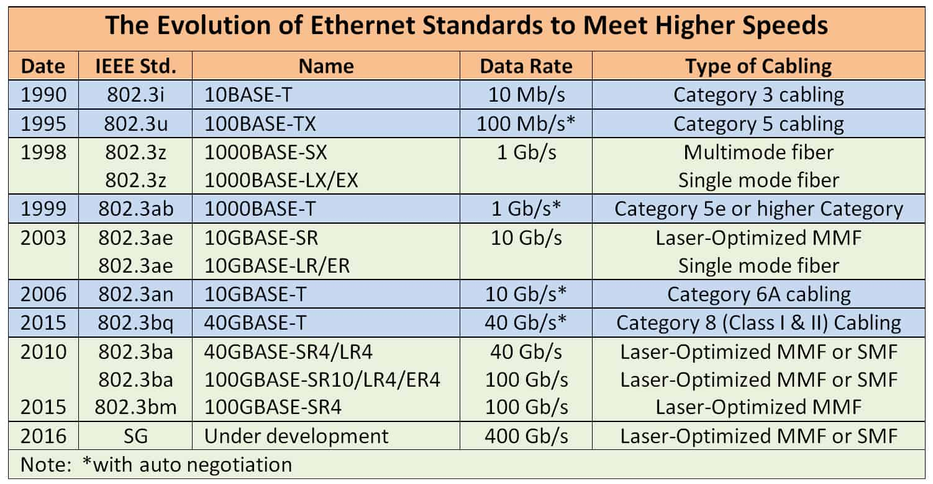
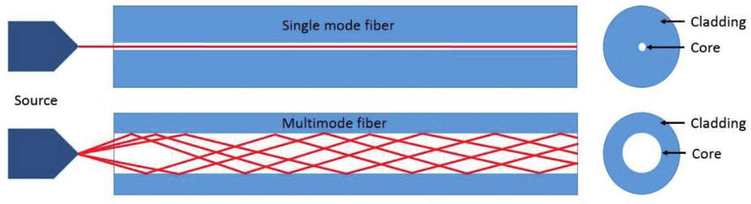
Notes:
1976:
Metcalfe and Boggs published a paper on Ethernet, describing its distributed packet-switching for LANs, according to IEEE Standards Association.
1979:
Metcalfe co-founded 3Com to commercialize Ethernet technology,.
1980:
The first Ethernet standard was released, and the IEEE began developing standards for local area networking, according to IEEE Spectrum.
1983:
The IEEE published the 802.3 Ethernet standard, solidifying Ethernet's position as a major LAN technology, according to IEEE.
1985:
Ethernet was officially adopted by the IEEE as the new industry standard, surpassing Token Ring.
1990s:
Ethernet's widespread adoption in businesses and homes led to the development of faster versions, including Fast Ethernet (100 Mbps).
2000s:
Gigabit Ethernet (1 Gbps) and later 10 Gigabit Ethernet (10 Gbps) became common, according to IEEE Standards Association.
2010s and beyond:
Further advancements in Ethernet technology, including 25 GbE, 40 GbE, and 100 GbE, continued to drive performance improvements and enable new applications, according to TechTarget.

Slide 25
Ethernet Uses CSMA/CD
Carrier Sense: wait for link to be idle
  Channel idle: start transmitting
  Channel busy: wait until idle
  A strategy is p-persistent if, after waiting for the line to clear, the sender sends with probability p≤1.
Collision Detection: listen while transmitting
  No collision: transmission is complete
  Collision: abort transmission, and send jam signal
Random Access: exponential back-off
  After collision, wait random time before trying again
  After m^{th} collision, choose K randomly from {0, …, 2^{m}-1}
  … and wait for K*512 bit times before trying again

Slide 26
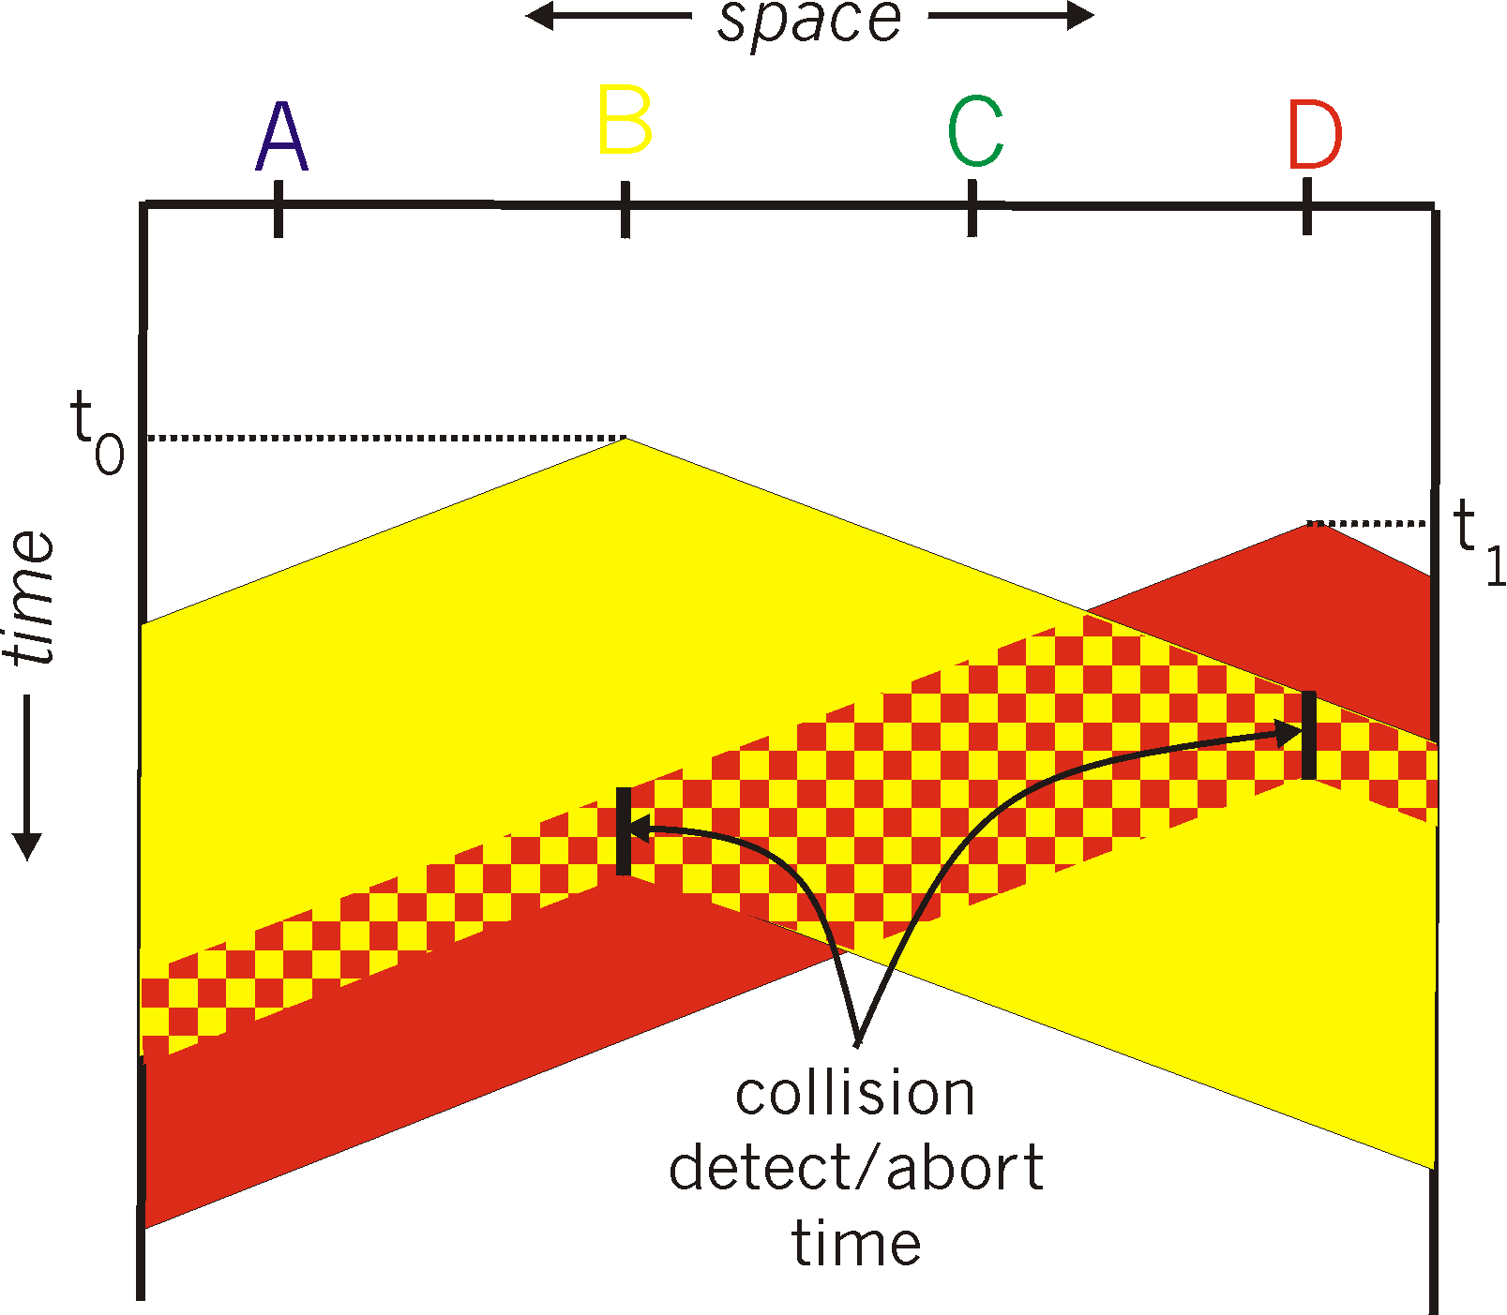
CSMA/CD Collision Detection
Detect collision
  Abort transmission
  Jam the link
Wait random time
  Transmit again
Hard in wireless
  Must receive data
  while transmitting

Slide 27
CSMA/CD Collision Detection
Without collision detection
With collision detection and abort

Slide 28
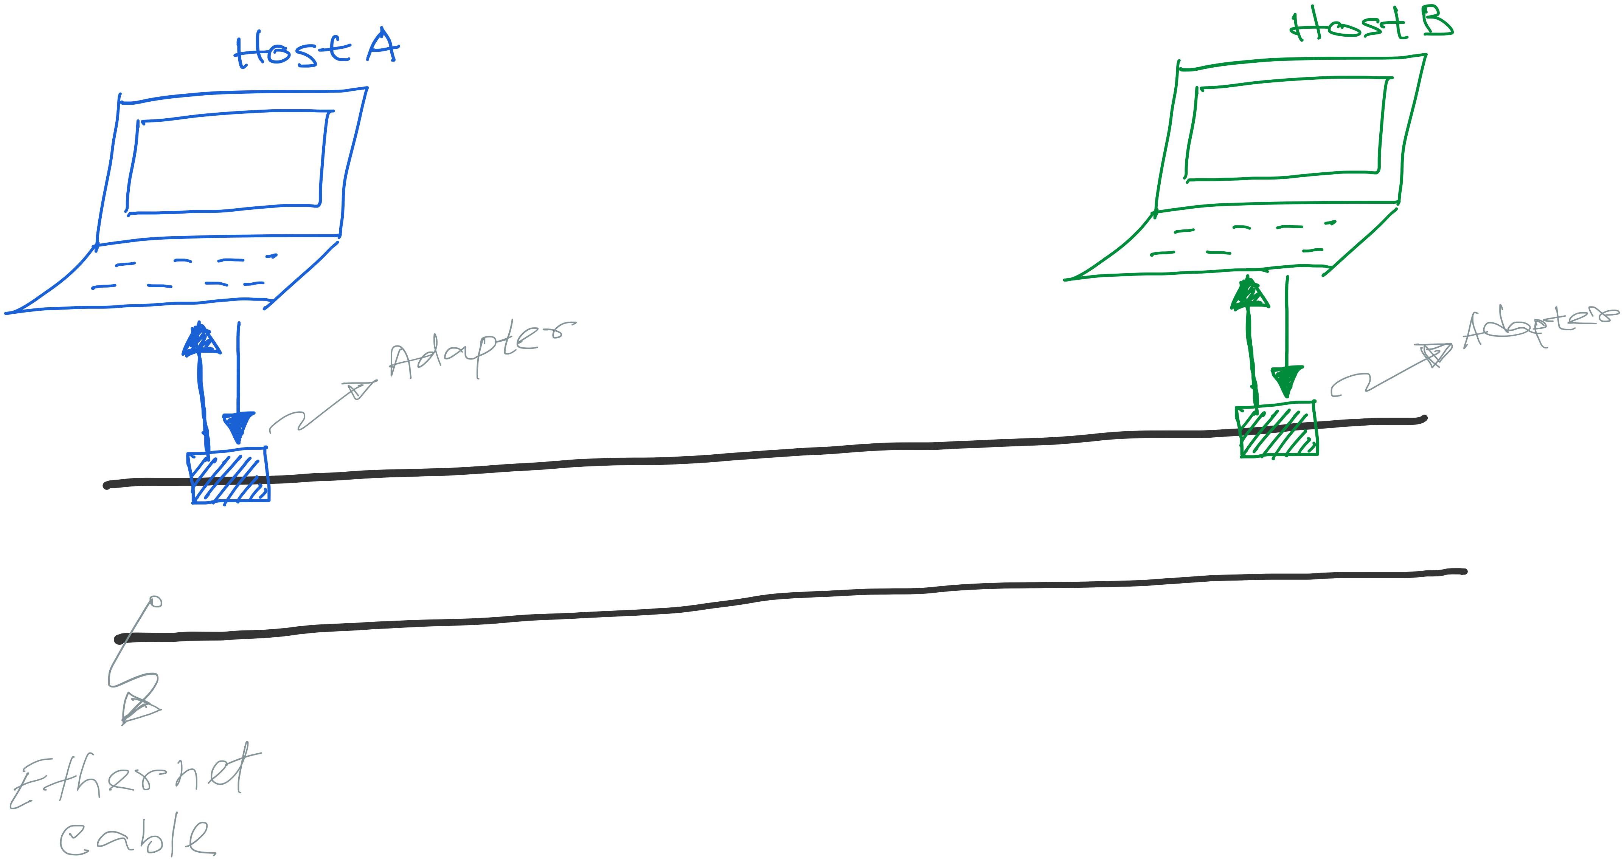
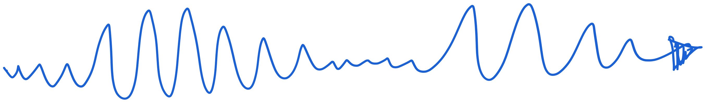
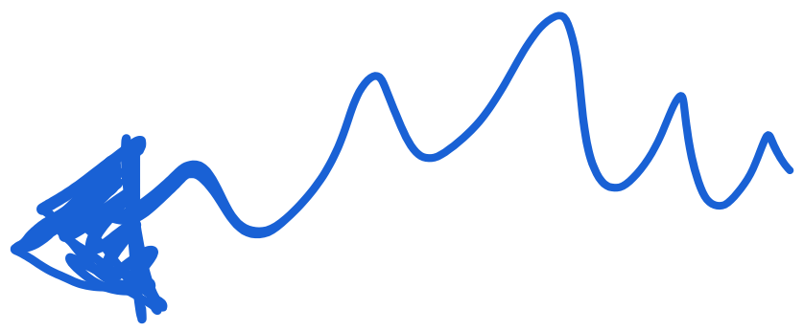


Slide 29

Collision does not happen like this. :-D

Slide 30
Collision happens when both packet overlaps at the receiver.

Slide 31
Preparing for the worst-case scenario of collision
Collision happens when both packet overlaps at the receiver.
Notes:
Note that Sender(s) can detect the collision ➔ By checking if the transmitted data matches with what is listened simultaneously.

Slide 32
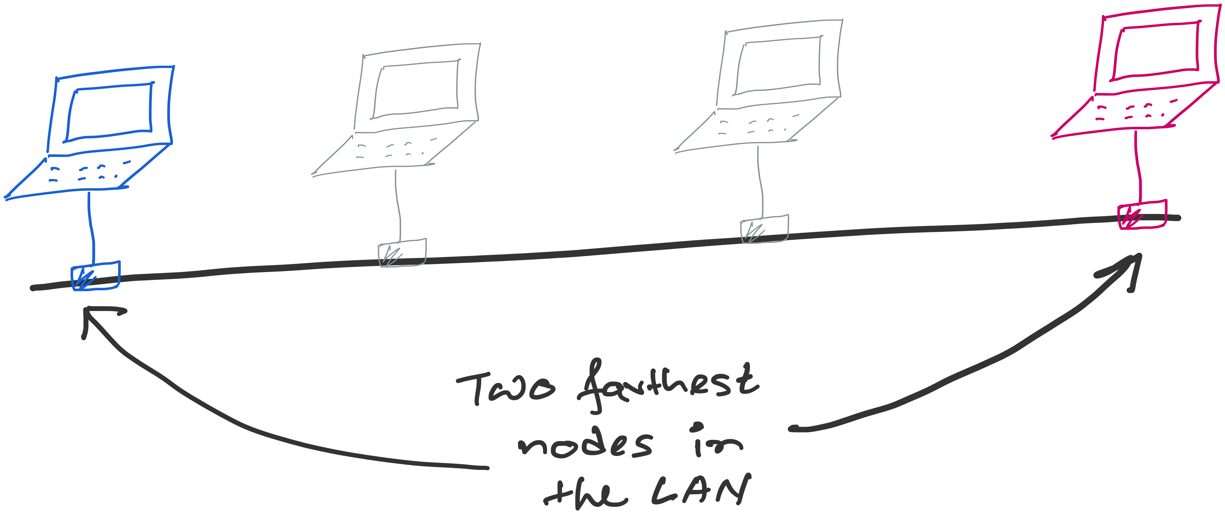
Preparing for the worst-case scenario of collision

Slide 33
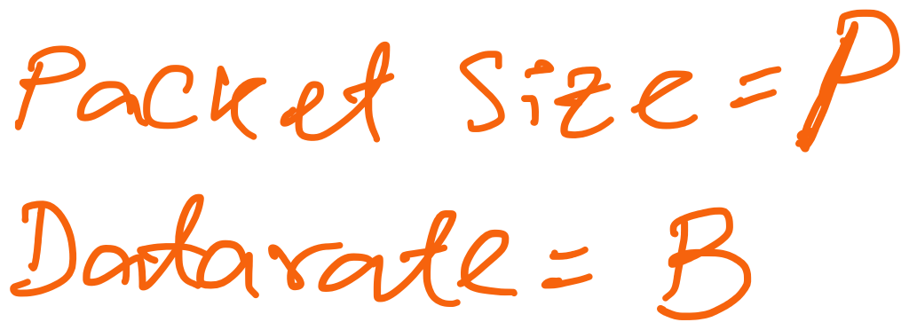
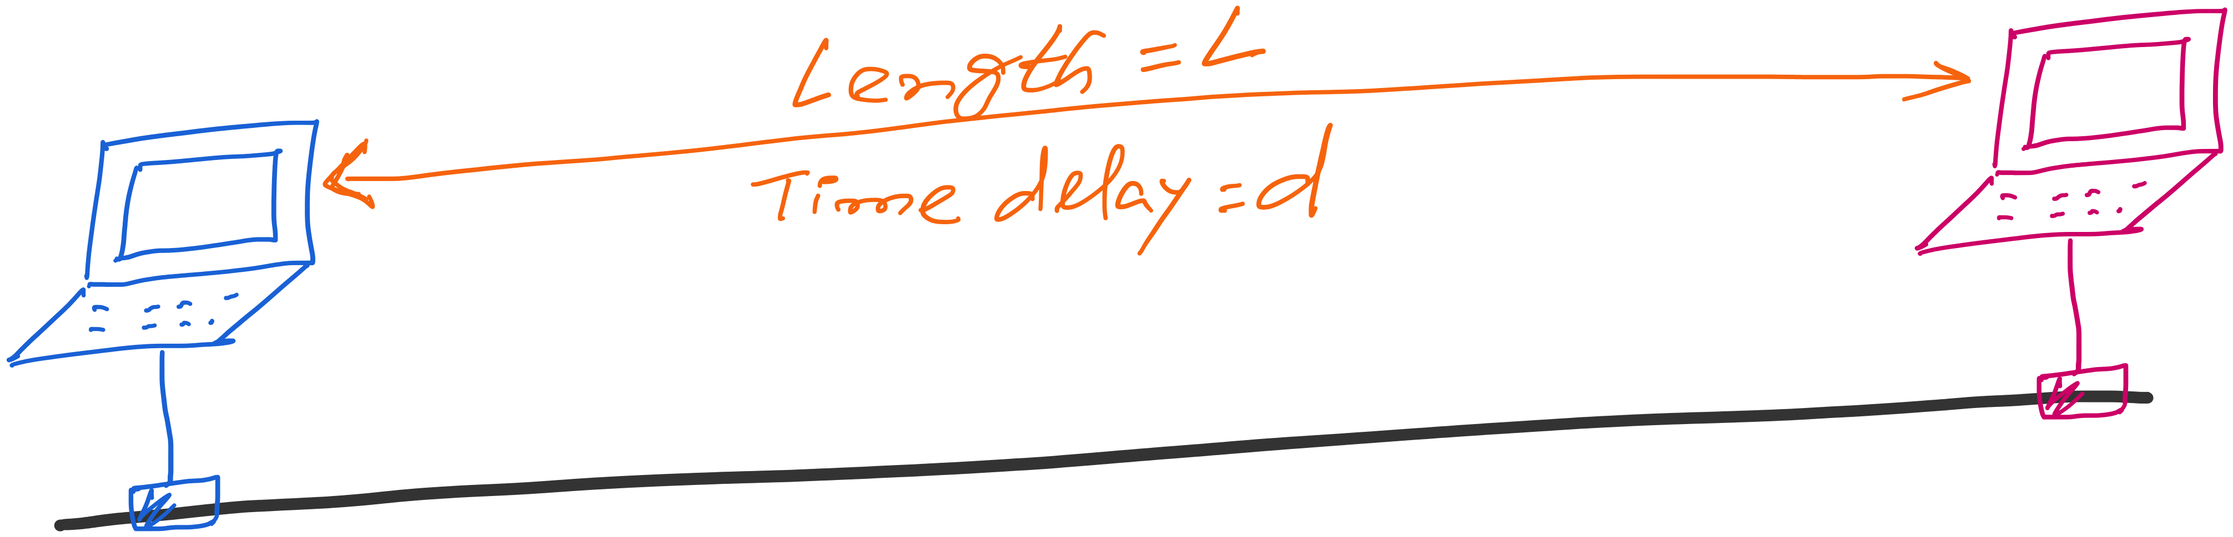
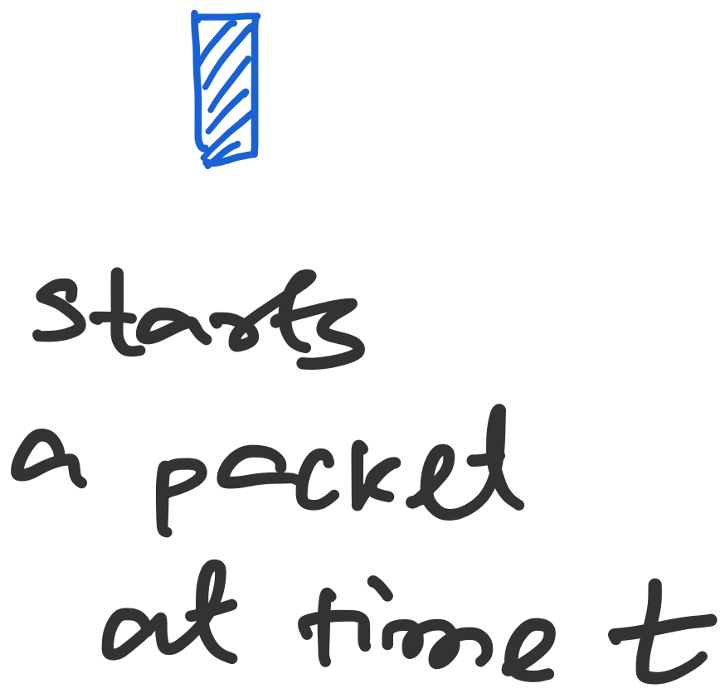
Preparing for the worst-case scenario of collision

Slide 34
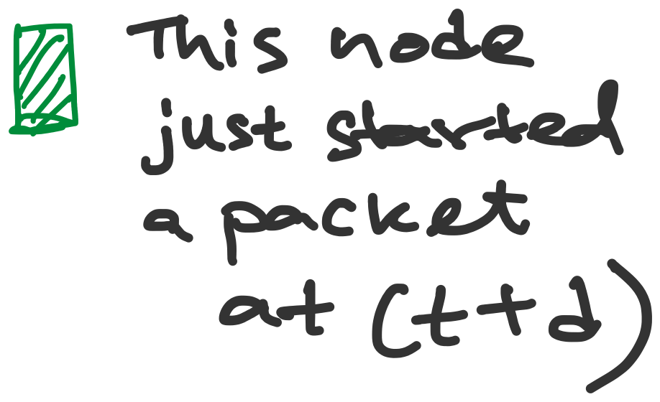
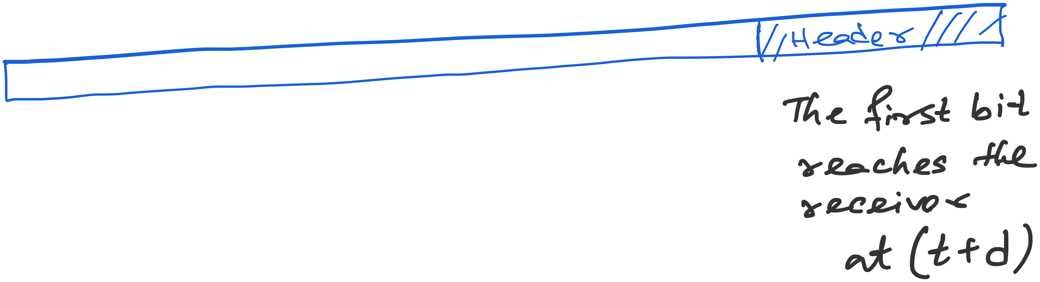
Preparing for the worst-case scenario of collision

Slide 35

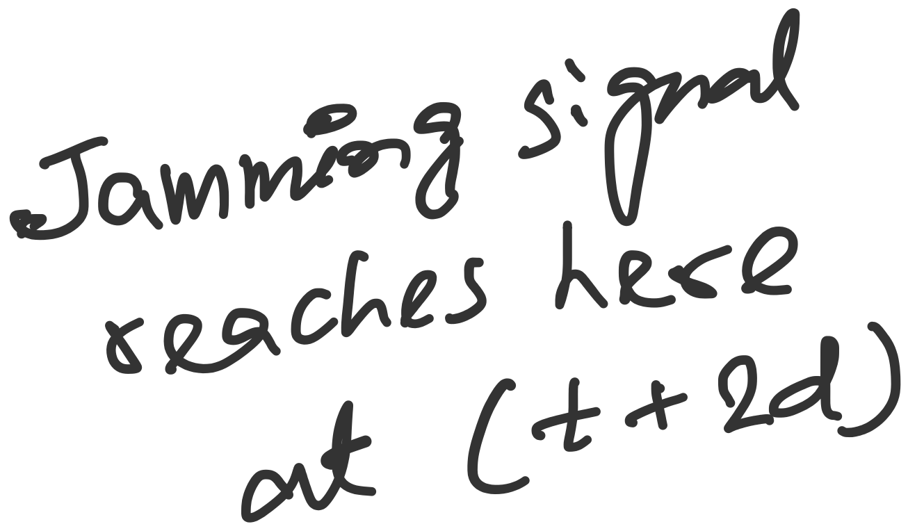
Preparing for the worst-case scenario of collision
The packet should be at least for 2d seconds long so that the sender can get the notification of the collision (through the jamming signal)

Slide 36
Preparing for the worst-case scenario of collision
Transmission time >= 2*propagation time
The packet should be at least for 2d seconds long so that the sender can get the notification of the collision (through the jamming signal)

Slide 37
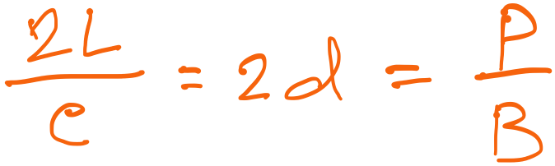
Preparing for the worst-case scenario of collision
Formula for minimum packet size (P) or maximum length (L)

Slide 38
Two questions
1. Why does the receiver send jamming signal after
detecting collision?
2. In the worst-case collision scenario, why did we
consider collision with the first bit of the packet?
Is it possible to have collision in the middle or at
the end in this scenario.

Slide 39


Two questions
1. Why does the receiver send jamming signal after
detecting collision?
Host A
Host B
Host C

Slide 40
Two questions
1. Why does the receiver send jamming signal after
detecting collision?
Host A
Host B
Host C
Collision
Host C detects
collision

Slide 41
Two questions
1. Why does the receiver send jamming signal after
detecting collision?
Host A
Host B
Host C
Collision
Attenuation makes
the signal weak. This may lead to missed detection.

Slide 42
Two questions
1. Why does the receiver send jamming signal after
detecting collision?
Host A
Host B
Host C
Collision
Host B sends jamming signal to ensure collision
detection.

Slide 43
Two questions
2. In the worst-case collision scenario, why did we
consider collision with the first bit of the packet?
Is it possible to have collision in the middle or at
the end in this scenario.

Slide 44
Preparing for the worst-case scenario of collision

Slide 45
Two questions
2. In the worst-case collision scenario, why did we
consider collision with the first bit of the packet?
Is it possible to have collision in the middle or at
the end in this scenario.
Host A
Host B
Host C
Pkt: A
Pkt: B

Slide 46
Two questions
2. In the worst-case collision scenario, why did we
consider collision with the first bit of the packet?
Is it possible to have collision in the middle or at
the end in this scenario.
Host A
Host B
Host C
Pkt: A
Pkt: B
Collision

Slide 47
Two questions
2. In the worst-case collision scenario, why did we
consider collision with the first bit of the packet?
Is it possible to have collision in the middle or at
the end in this scenario.
Host A
Host B
Host C
Pkt: A
Pkt: B
Collision

Slide 48
Two questions
2. In the worst-case collision scenario, why did we
consider collision with the first bit of the packet?
Is it possible to have collision in the middle or at
the end in this scenario.
Host A
Host B
Host C
Pkt: A
Pkt: B
Collision
This situation is
not possible under our
assumptions.

Slide 49
Two questions
2. In the worst-case collision scenario, why did we
consider collision with the first bit of the packet?
Is it possible to have collision in the middle or at
the end in this scenario.
Host A
Host B
Host C
Pkt: B
Pkt: A
Pkt: A
Valid scenario.

Slide 50
Two questions
2. In the worst-case collision scenario, why did we
consider collision with the first bit of the packet?
Is it possible to have collision in the middle or at
the end in this scenario.
Host A
Host B
Host C
Pkt: B
Pkt: A
Pkt: A
Valid scenario.

Slide 51
Two questions
2. In the worst-case collision scenario, why did we
consider collision with the first bit of the packet?
Is it possible to have collision in the middle or at
the end in this scenario.
Host A
Host B
Host C
Pkt: B
Pkt: A
Pkt: A
Not a valid scenario:
Host B won’t start transmission
as the channel is busy.

Slide 52
Preparing for the worst-case scenario of collision

Slide 53
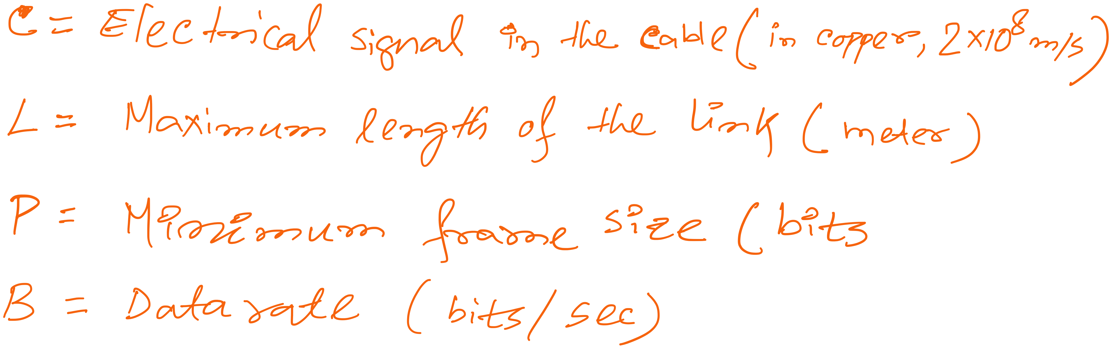
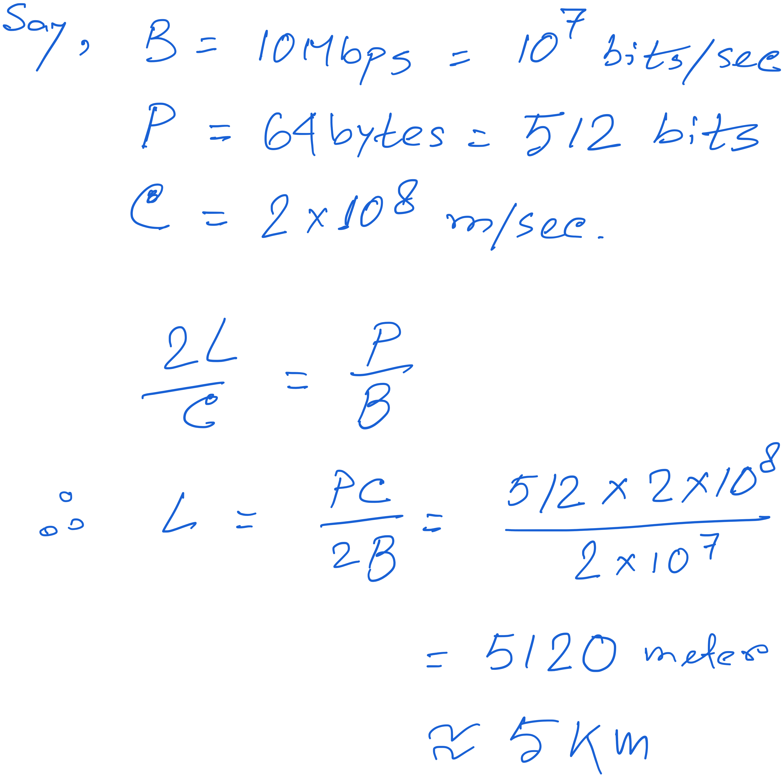
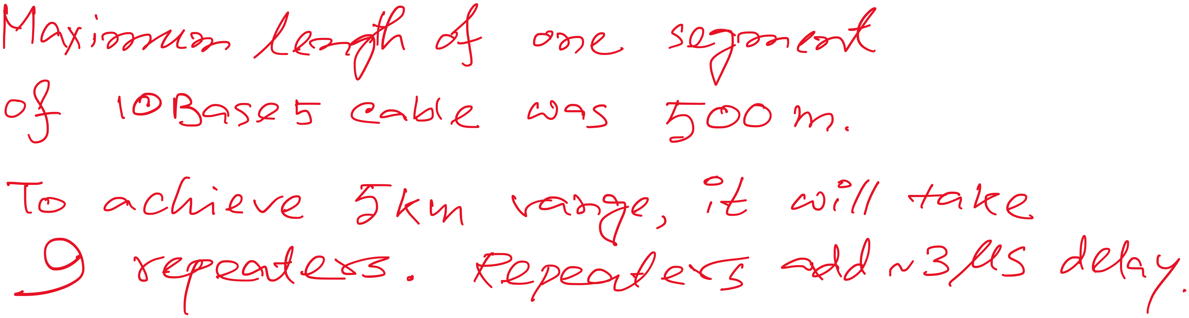

Slide 54
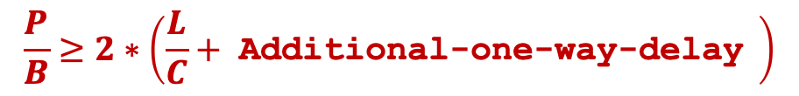
Preparing for the worst-case scenario of collision
Repeater
(3 us delay)
Repeater
(3 us delay)

Slide 55

Ethernet Frame Structure
Sending adapter encapsulates packet in frame
Preamble: synchronization
  Seven bytes with pattern 10101010, followed by one byte with pattern 10101011
  Used to synchronize receiver, sender clock rates

Slide 56
Ethernet Frame Structure
Addresses: source and destination MAC addresses
  Adaptor passes frame to network-level protocol
    If destination is local MAC address or broadcast address
  Otherwise, adapter discards frame
Type: indicates the higher layer protocol
  Usually IP
  But also Novell IPX, AppleTalk, …
CRC: cyclic redundancy check
  Checked at receiver
  If error is detected, the frame is simply dropped

Slide 57
Unreliable, Connectionless Service
Connectionless
  No handshaking between send and receive adapter
Unreliable
  Receiving adapter doesn’t send ACKs or NACKs
  Packets passed to network layer can have gaps
  Gaps can be filled by transport protocol (e.g., TCP)
  Otherwise, the application will see the gaps

Slide 58
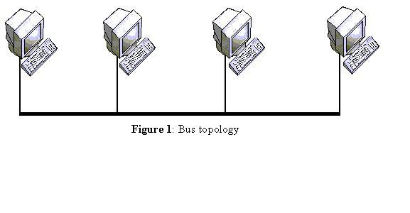
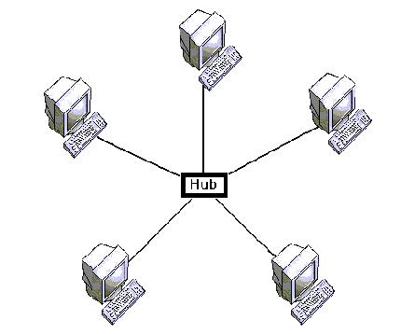
Star topology and collision-free Ethernet
Bus topology
Star topology

Slide 59
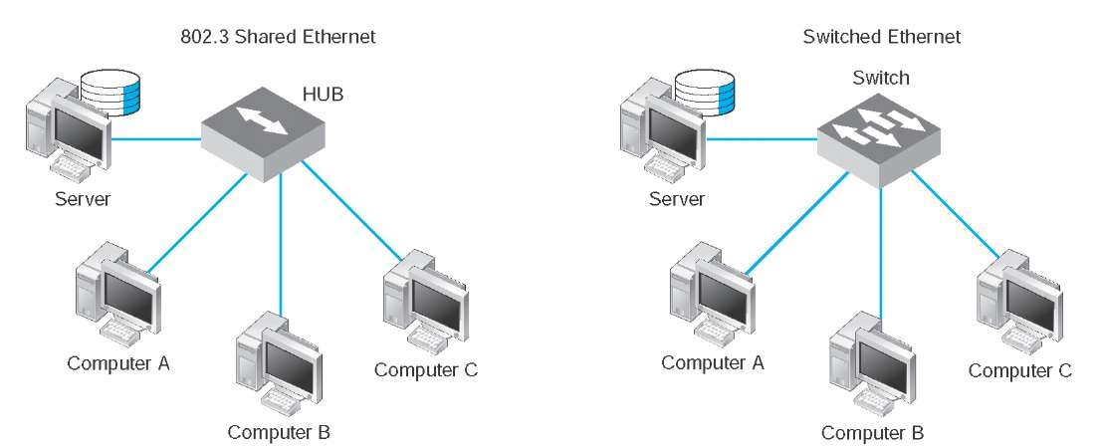
Star topology and collision-free Ethernet
Star topology with hub and switch

Slide 60
Repeaters, Hubs, Bridges and Switches

Slide 61
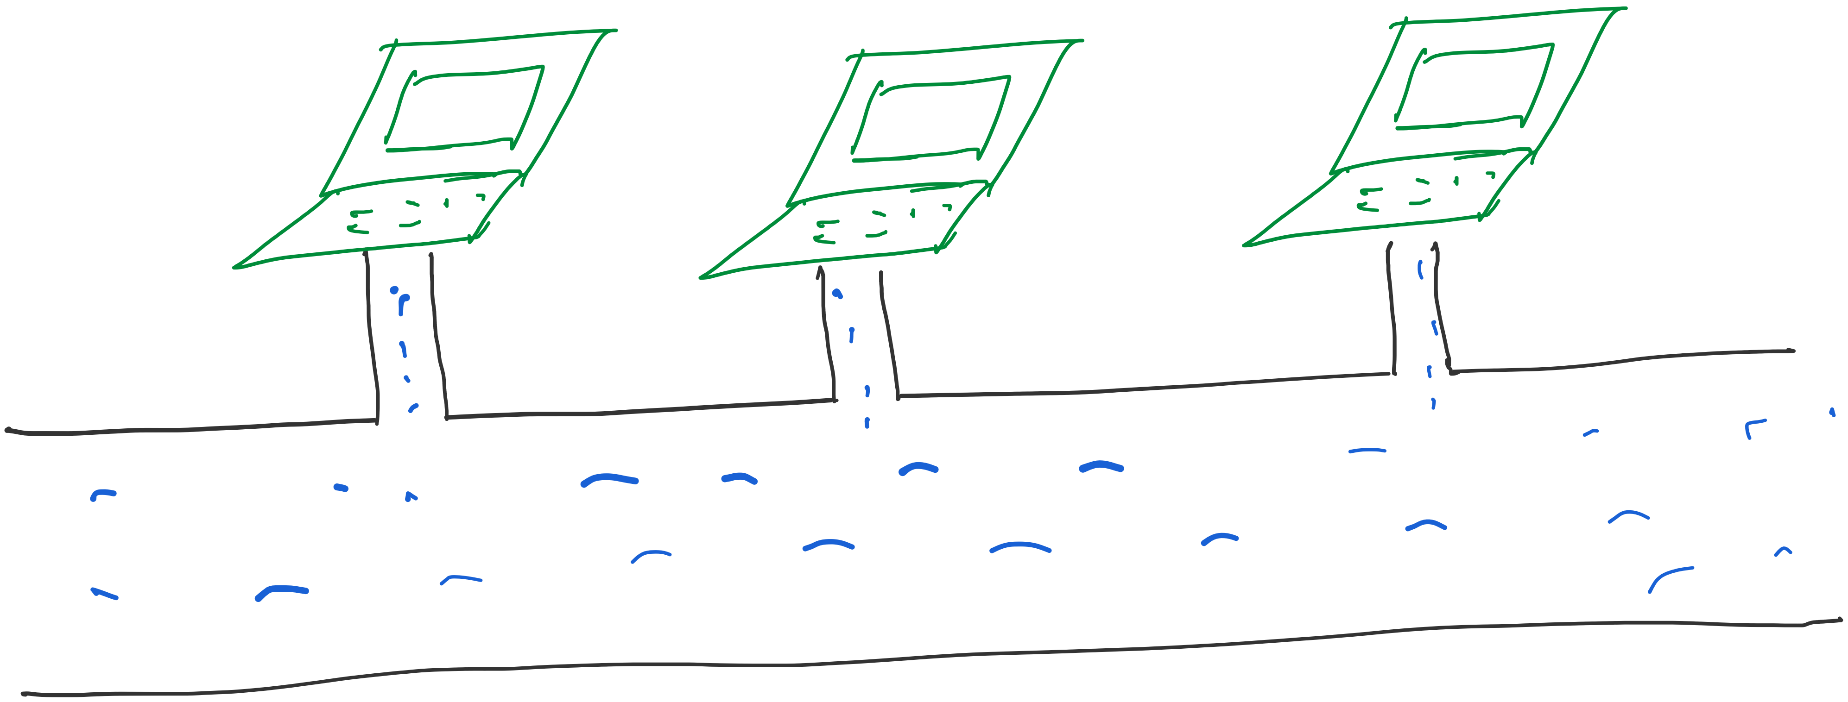
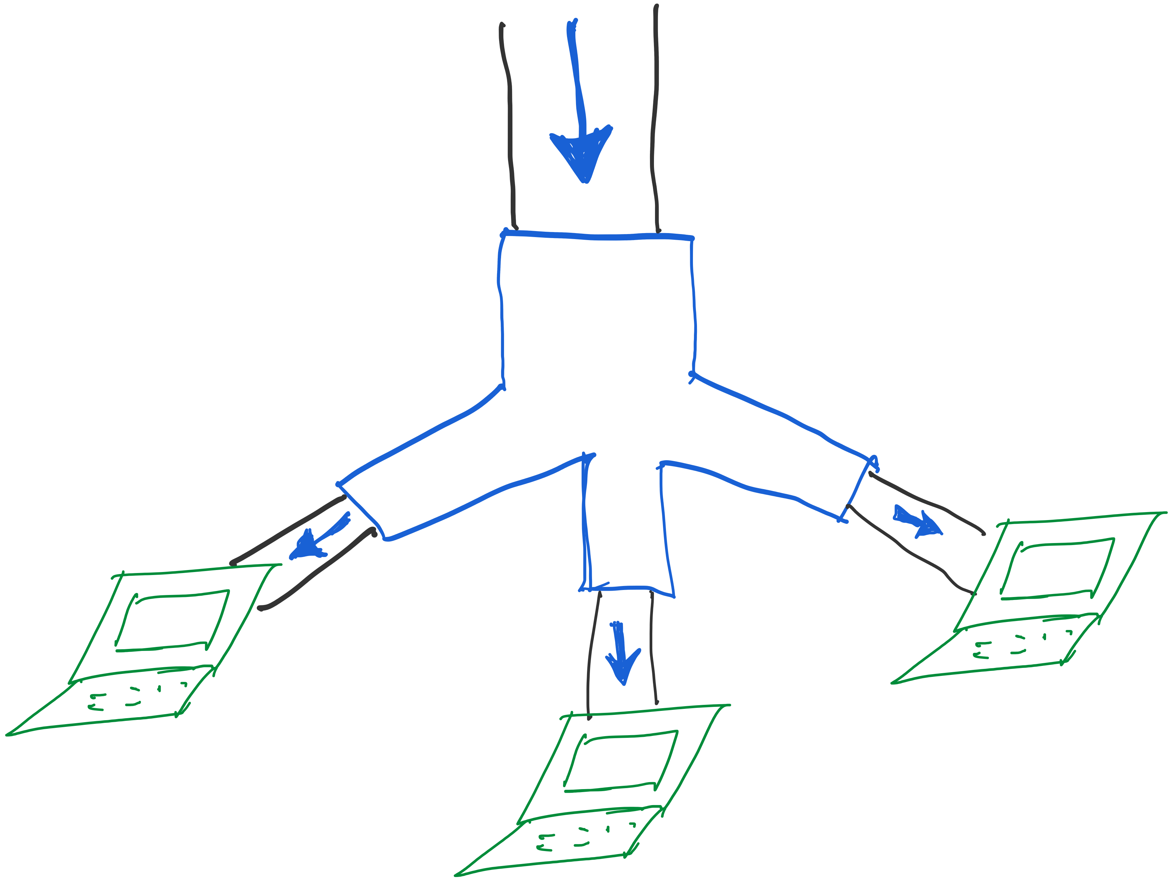
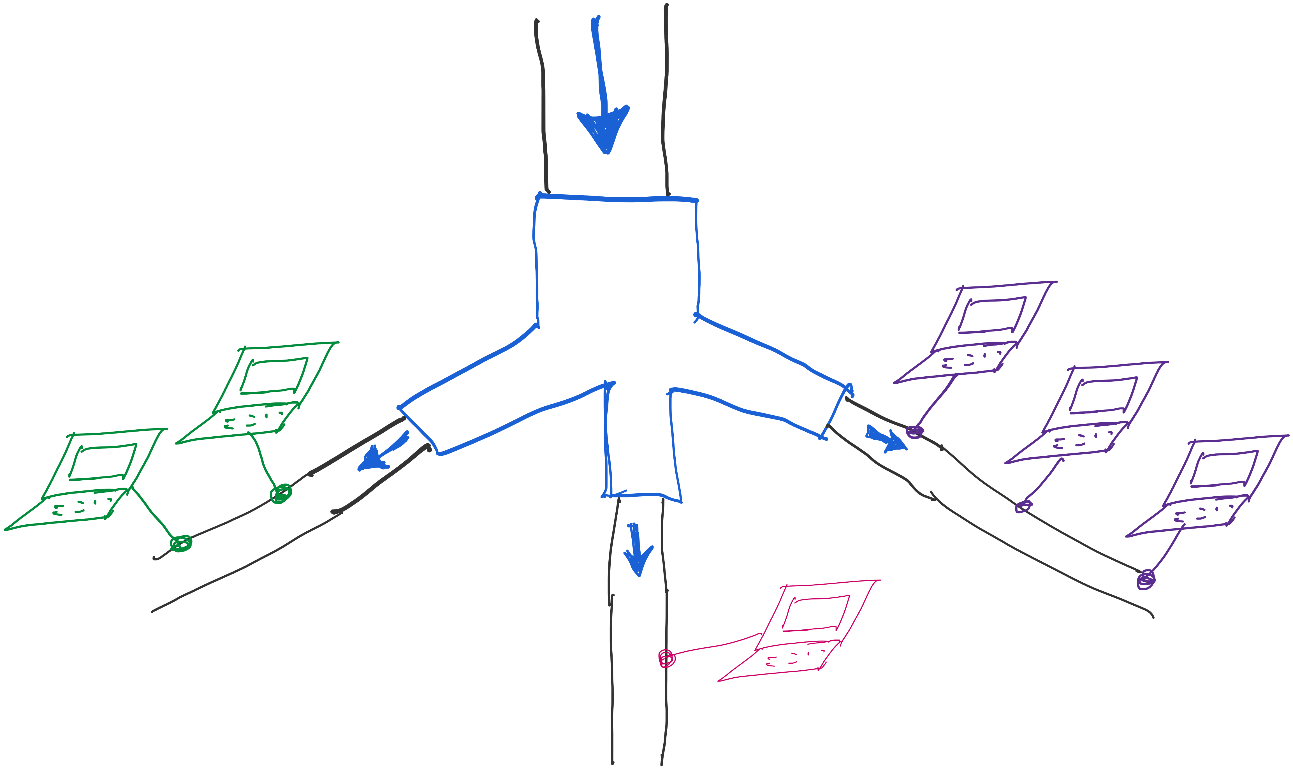

Slide 62
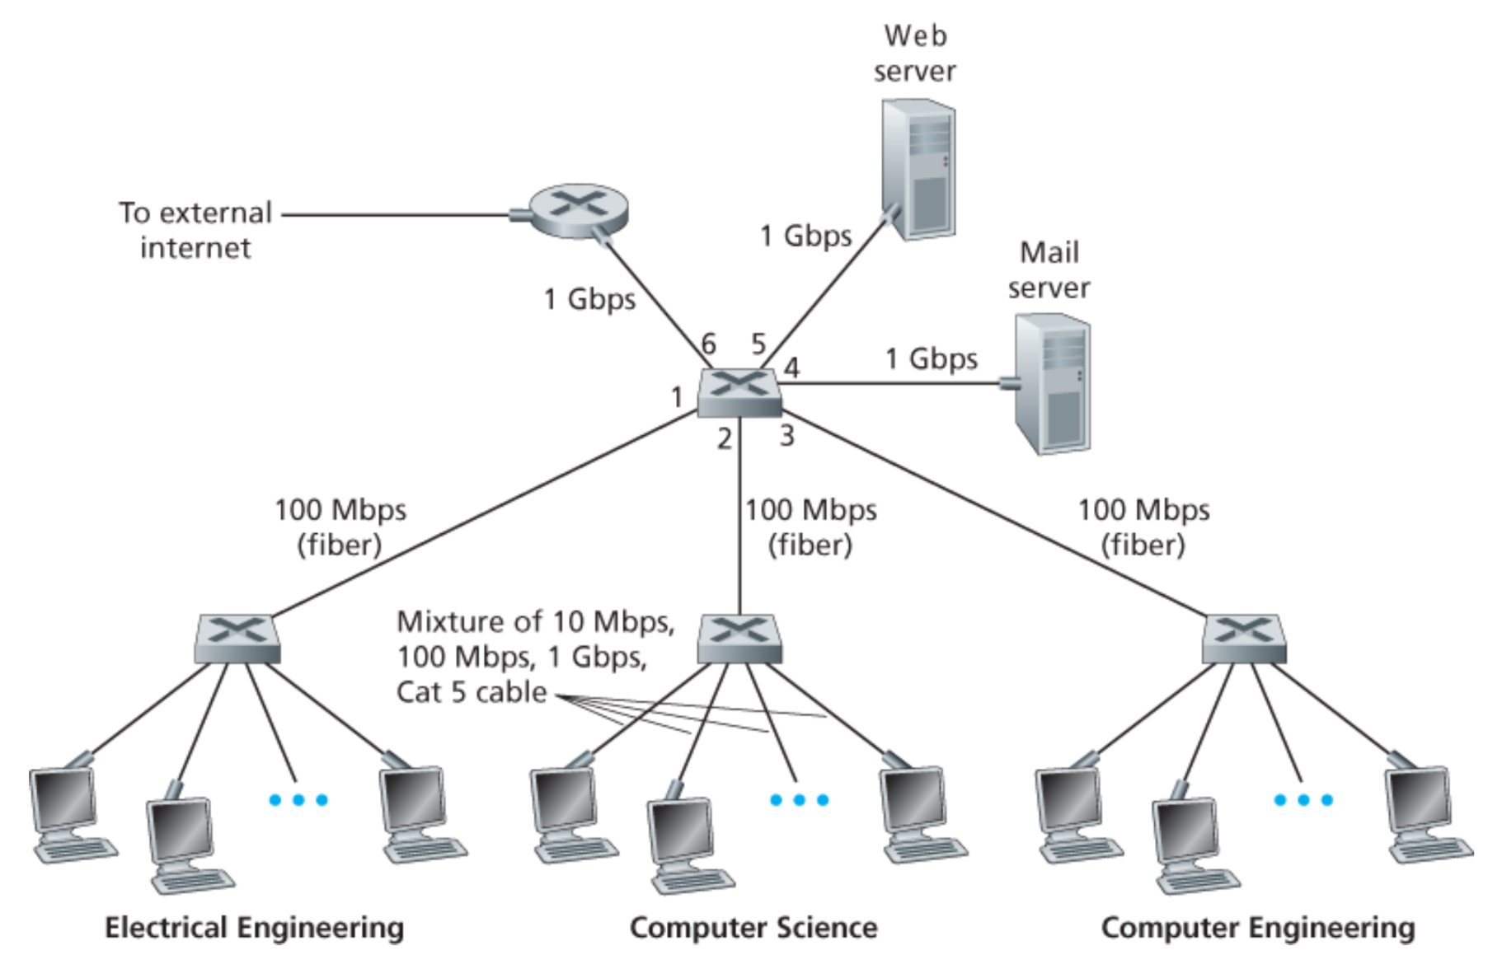

Slide 63
Physical Layer: Repeaters
Distance limitation in local-area networks
  Electrical signal becomes weaker as it travels
  Imposes a limit on the length of a LAN
Repeaters join LANs together
  Analog electronic device
  Continuously monitors electrical signals
  Transmits an amplified copy

Slide 64
Physical Layer: Hubs
Joins multiple input lines electrically
  Designed to hold multiple line cards
  Do not necessarily amplify the signal
Very similar to repeaters
  Also operates at the physical layer
hub
hub
hub
hub

Slide 65
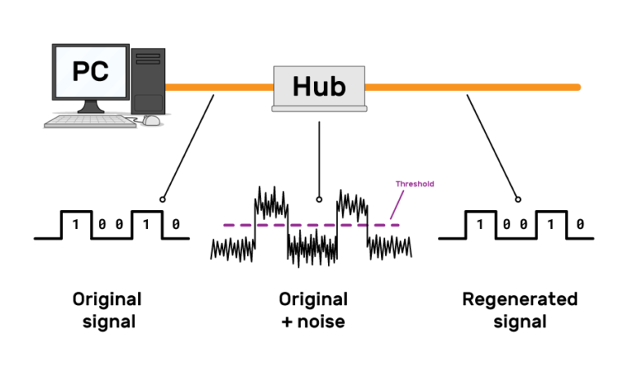
Physical Layer: Hubs

Slide 66
Limitations of Repeaters and Hubs
One large shared link
  Each bit is sent everywhere
  So, aggregate throughput is limited
Cannot support multiple LAN technologies
  Does not buffer or interpret frames
  Can’t interconnect between different rates/formats
Limitations on maximum nodes and distances
  Shared medium imposes length limits
  E.g., cannot go beyond 2500 meters on Ethernet

Slide 67
Link Layer: Bridges
Connects two or more LANs at the link layer
  Extracts destination address from the frame
  Looks up the destination in a table
  Forwards the frame to the appropriate segment
Each segment can carry its own traffic
host
host
host
host
host
host
Bridge
host
host
host
host
host
host

Slide 68
Link Layer: Switches
Typically connects individual computers
  A switch is essentially the same as a bridge
  … though typically used to connect hosts
Supports concurrent communication
  Host A can talk to C, while B talks to D
B
A
C
switch
D

Slide 69
Bridges/Switches: Traffic Isolation
Switch filters packets
  Frame only forwarded to the necessary segments
  Segments can support separate transmissions
switch/bridge
segment
hub
hub
hub
segment
segment

Slide 70
Advantages Over Hubs/Repeaters
Only forwards frames as needed
  Avoid unnecessary load on segments
Wider geographic span
  Separate segments allow longer distances
Improves privacy
  Hosts can “snoop” traffic traversing their segment
  … but not all the rest of the traffic
Can join segments using different technologies

Slide 71
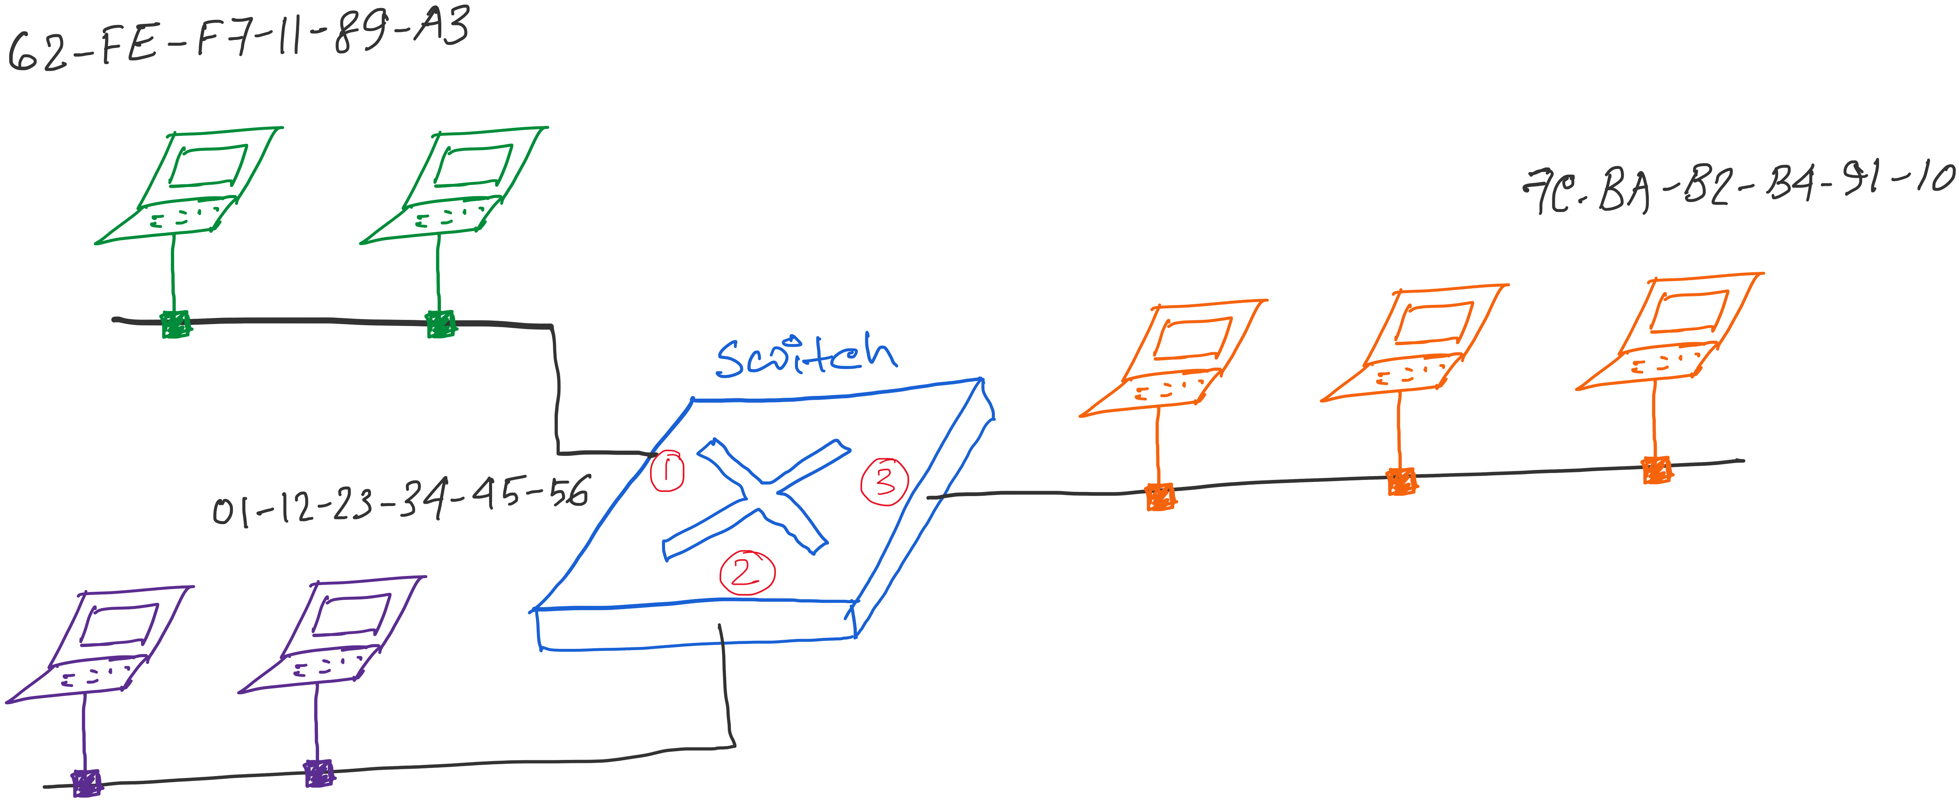
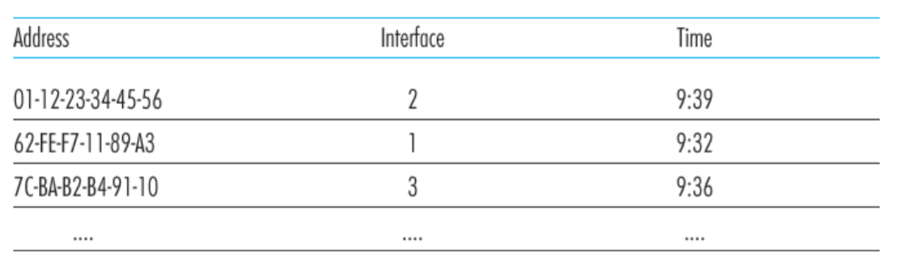
Traffic Isolation: Example
Switch table

Slide 72
Self Learning: Building the Table
When a frame arrives
  Inspect the source MAC address
  Associate the address with the incoming interface
  Store the mapping in the switch table
  Use a timer to eventually forget the mapping
B
A
C
Switch learns how to reach A.
D

Slide 73
Self Learning: Handling Misses
When frame arrives with unfamiliar destination
  Forward the frame out all of the interfaces
  … except for the one where the frame arrived
  Hopefully, this case won’t happen very often!
B
When in doubt, shout!
A
C
D

Slide 74
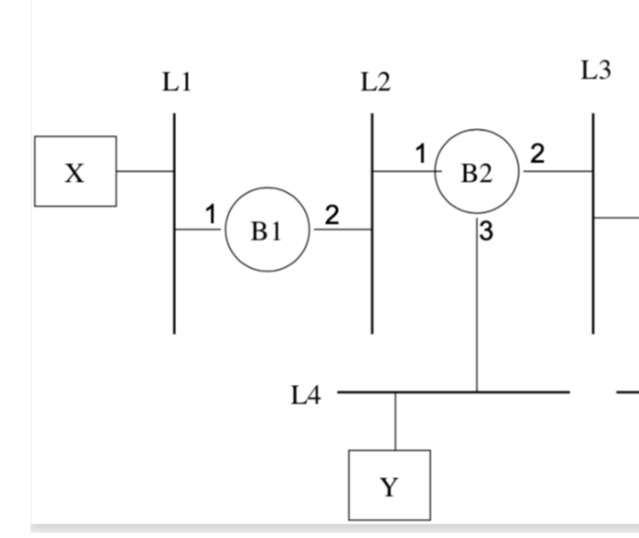
Exercise problems related to
learning-bridges/switches

Slide 75
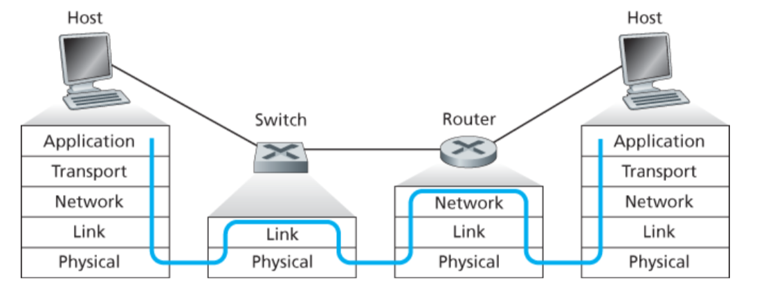
Switch vs Router

Slide 76
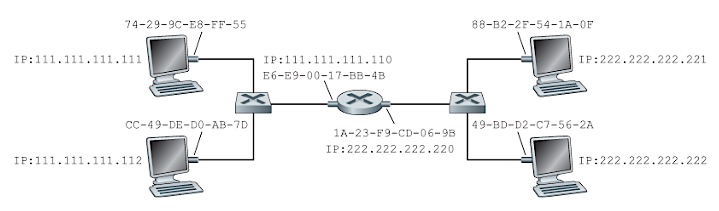
Problems related to learning-bridges/switches
and routers
Notes:
Figure: Computer Networking - A Top Down Approach, 7th edition, Figure 6.19

Slide 77
Summary: Multiple Layers
Different devices switch different things
  Network layer: packets (routers)
  Link layer: frames (bridges and switches)
  Physical layer: electrical signals (repeaters and hubs)
Application
Transport
Frame
header
Packet
header
TCP
header
User
data
Router
Bridge, switch
Repeater, hub

