Slide 1

Computer Networks
CMSC 417 : Spring 2026
Topic: Inter-domain Routing (BGP)
(Textbook chapter 2)
Nirupam Roy
M-W 2:00-3:15pm
CSI 2117

Slide 2
Join EGP with IGP For Connectivity
135.207.0.0/16
Next Hop = 192.0.2.1
135.207.0.0/16
10.10.10.10
AS 1
AS 2
192.0.2.1
192.0.2.0/30
Forwarding Table
destination
next hop
192.0.2.0/30
10.10.10.10
+
Forwarding Table
destination
next hop
EGP
135.207.0.0/16
10.10.10.10
destination
next hop
192.0.2.0/30
10.10.10.10
135.207.0.0/16
192.0.2.1

Slide 3
A dive into the BGP policies

Slide 4
Nontransit vs. Transit ASes
Internet Service
providers (often)
have transit
networks
ISP 2
ISP 1
NET A
Nontransit AS
might be a corporate
or campus network.
Could be a “content
provider”
Traffic NEVER
flows from ISP 1
through NET A to ISP 2
(At least not intentionally!)
IP traffic

Slide 5
Selective Transit
NET B
NET C
NET A provides transit
between NET B and NET C
and between NET D
and NET C
NET A DOES NOT
provide transit
Between NET D
and NET B
NET A
NET D
IP traffic
Most transit networks transit in a selective manner…

Slide 6
Customers and Providers
provider
provider
customer
IP traffic
customer
Customer pays provider for access to the Internet

Slide 7
Customers Don’t Always Need BGP
provider
Nail up routes 192.0.2.0/24
pointing to customer
Nail up default routes 0.0.0.0/0
pointing to provider.
customer
192.0.2.0/24
Static routing is the most common way of connecting an
autonomous routing domain to the Internet.
This helps explain why BGP is a mystery to many …

Slide 8
Customer-Provider Hierarchy
provider
customer
IP traffic

Slide 9
The Peering Relationship
Peers provide transit between
their respective customers
Peers do not provide transit
between peers
Peers (often) do not exchange $$$
peer
peer
provider
customer
traffic
allowed
traffic NOT
allowed

Slide 10
Peering Provides Shortcuts
Peering also allows connectivity between
the customers of “Tier 1” providers.
peer
peer
provider
customer

Slide 11
BGP-4
BGP = Border Gateway Protocol
Is a Policy-Based routing protocol
Is the de facto EGP of today’s global Internet
Relatively simple protocol, but configuration is complex and the entire world can see, and be impacted by, your mistakes.
1989 : BGP-1 [RFC 1105]
  Replacement for EGP (1984, RFC 904)
1990 : BGP-2 [RFC 1163]
1991 : BGP-3 [RFC 1267]
1995 : BGP-4 [RFC 1771]
  Support for Classless Interdomain Routing (CIDR)

Slide 12
BGP Operations (Simplified)
Establish session on
TCP port 179
AS1
BGP session
Exchange all
active routes
AS2
While connection
is ALIVE exchange
route UPDATE messages
Exchange incremental
updates

Slide 13
Four Types of BGP Messages
Open : Establish a peering session.
Keep Alive : Handshake at regular intervals.
Notification : Shuts down a peering session.
Update : Announcing new routes or withdrawing previously announced routes.
announcement
=
prefix + attributes values

Slide 14
BGP Attributes
Value Code Reference
----- --------------------------------- ---------
1 ORIGIN [RFC1771]
2 AS_PATH [RFC1771]
3 NEXT_HOP [RFC1771]
4 MULTI_EXIT_DISC [RFC1771]
5 LOCAL_PREF [RFC1771]
6 ATOMIC_AGGREGATE [RFC1771]
7 AGGREGATOR [RFC1771]
8 COMMUNITY [RFC1997]
9 ORIGINATOR_ID [RFC2796]
10 CLUSTER_LIST [RFC2796]
11 DPA [Chen]
12 ADVERTISER [RFC1863]
13 RCID_PATH / CLUSTER_ID [RFC1863]
14 MP_REACH_NLRI [RFC2283]
15 MP_UNREACH_NLRI [RFC2283]
16 EXTENDED COMMUNITIES [Rosen]
...
255 reserved for development
Most important attributes
Not all attributes
need to be present in
every announcement
From IANA: http://www.iana.org/assignments/bgp-parameters
Notes:
In BGP, the treat-as-withdraw path attribute is used to effectively rescind a path, meaning it removes a prefix from the BGP routing table if a specific path attribute is matched.

Slide 15
Attributes are Used to Select Best Routes
192.0.2.0/24
pick me!
192.0.2.0/24
pick me!
192.0.2.0/24
pick me!
Given multiple
routes to the same
prefix, a BGP speaker
must pick at most
one best route
(Note: it could reject
them all!)
192.0.2.0/24
pick me!

Slide 16
BGP Next Hop Attribute
12.125.133.90
12.127.0.121
AS 7018
AT&T
AS 6431
AS 12654
AT&T Research
RIPE NCC
RIS project
135.207.0.0/16
Next Hop = 12.125.133.90
135.207.0.0/16
Next Hop = 12.127.0.121
Every time a route announcement crosses an AS boundary, the Next Hop attribute is changed to the IP address of the border router that announced the route.

Slide 17
Join EGP with IGP For Connectivity
135.207.0.0/16
Next Hop = 192.0.2.1
135.207.0.0/16
10.10.10.10
AS 1
AS 2
192.0.2.1
192.0.2.0/30
Forwarding Table
destination
next hop
192.0.2.0/30
10.10.10.10
+
Forwarding Table
destination
next hop
EGP
135.207.0.0/16
10.10.10.10
destination
next hop
192.0.2.0/30
10.10.10.10
135.207.0.0/16
192.0.2.1

Slide 18
Implementing Customer/Provider and Peer/Peer relationships
Two parts:
Enforce transit relationships
  Outbound route filtering
Enforce order of route preference
  provider < peer < customer

Slide 19
Import Routes
provider route
peer route
customer route
From
provider
From
provider
AS-219
From
peer
From
peer
From
customer
From
customer

Slide 20
Import Routes
provider route
peer route
customer route
From
provider
From
provider
From
peer
From
peer
From
customer
From
customer

Slide 21
Export Routes
provider route
provider route
peer route
peer route
customer route
customer route
ISP route
?
?
To
provider
From
provider
To
peer
To
peer
?
?
To
customer
To
customer
?
?

Slide 22
Export Routes
provider route
provider route
peer route
peer route
customer route
customer route
ISP route
To
provider
From
provider
To
peer
To
peer
To
customer
To
customer

Slide 23
Export Routes
provider route
provider route
peer route
peer route
customer route
customer route
ISP route
To
provider
From
provider
To
peer
To
peer
To
customer
To
customer
filters
block

Slide 24
Export Routes
provider route
provider route
peer route
peer route
customer route
customer route
ISP route
To
provider
From
provider
To
peer
To
peer
To
customer
To
customer
filters
block

Slide 25
How Can Routes be Colored?
BGP Communities!
A community value is 32 bits
Used for signalling
within and between
ASes
By convention,
first 16 bits is
ASN indicating
who is giving it
an interpretation
community
number
Very powerful
BECAUSE it
has no (predefined) meaning
Community Attribute = a list of community values.
(So one route can belong to multiple communities)
Two reserved communities
  no_export = 0xFFFFFF01: don’t export out of AS
RFC 1997 (August 1996)
no_advertise 0xFFFFFF02: don’t pass to BGP neighbors

Slide 26
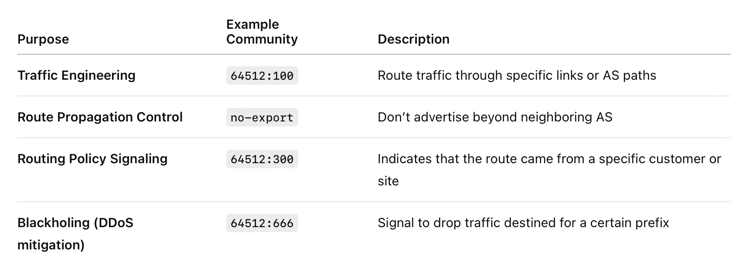
BGP Communities examples
Notes:
no-exportDon’t advertise this route to external (eBGP) peers.no-advertiseDon’t advertise this route to any peers (iBGP or eBGP).local-ASDon’t advertise this route outside the local AS, even within confederations.

Slide 27
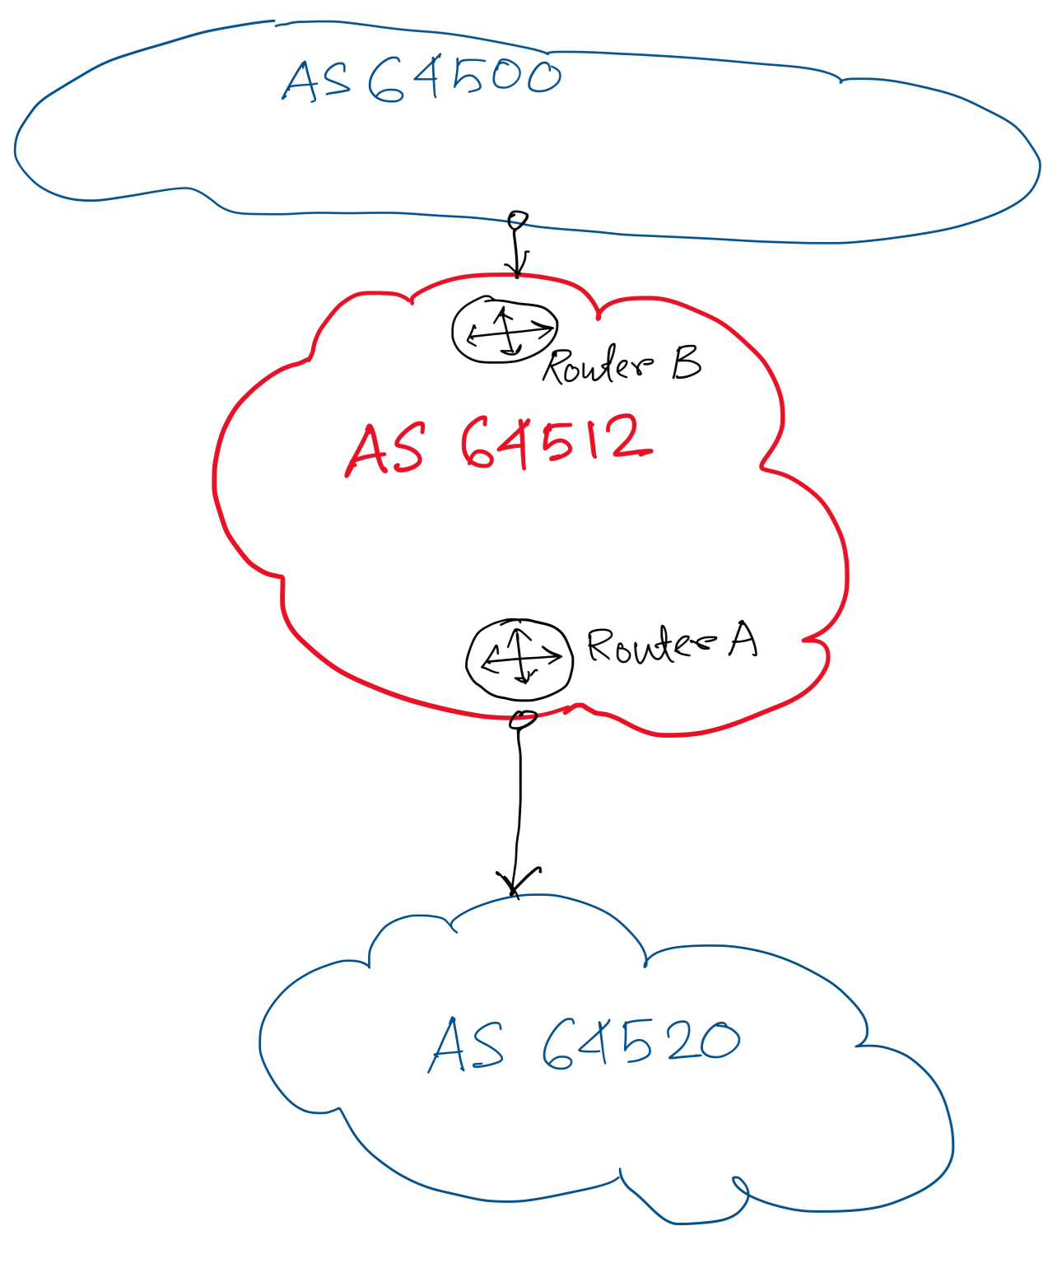
Tag customer routes with 64512:100.
Instruct Router B to only advertise routes with 64512:100.

Slide 28
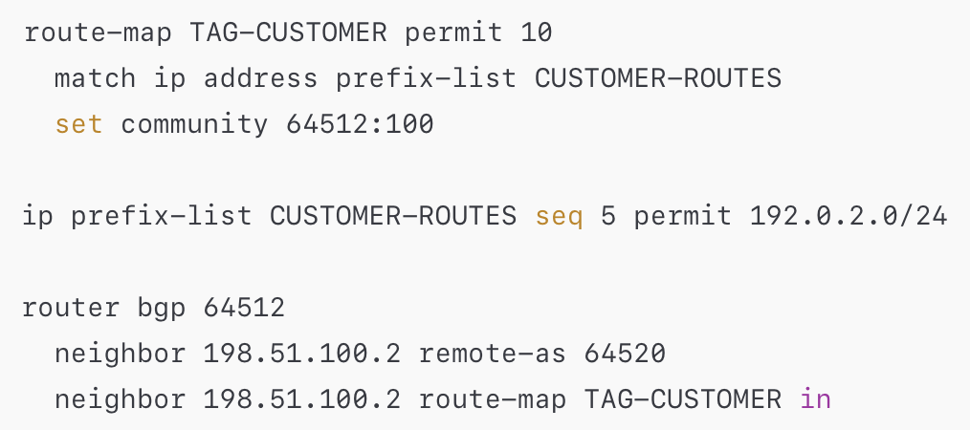
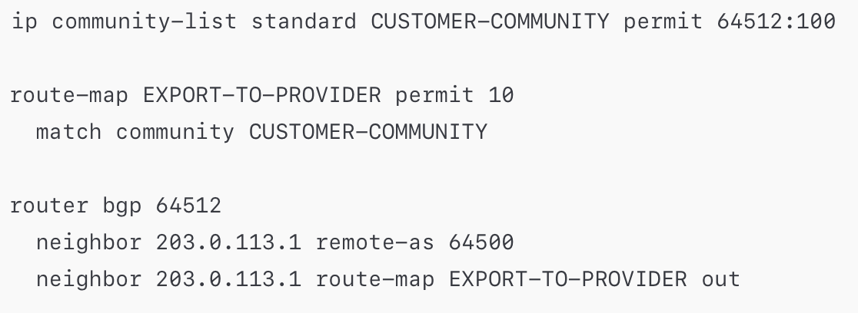
Tag customer routes with 64512:100. (on Router A)
Instruct Router B to only advertise routes with 64512:100.

Slide 29
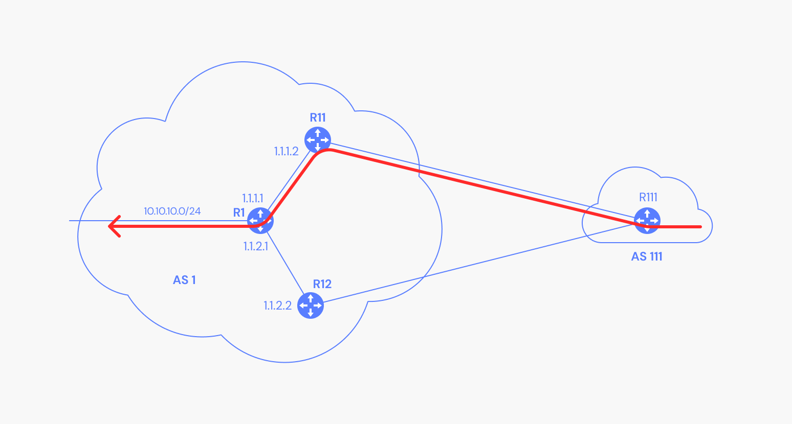
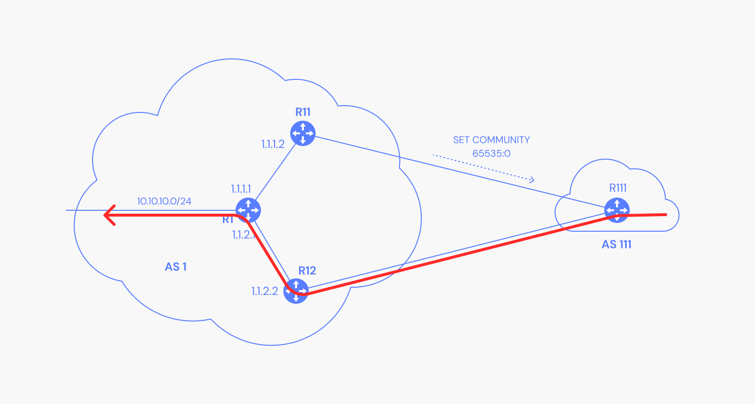
BGP Community attribute: Example

Slide 30
Tweak Tweak Tweak
For inbound traffic
  Filter outbound routes
  Tweak attributes on outbound routes in the hope of influencing your neighbor’s best route selection
For outbound traffic
  Filter inbound routes
  Tweak attributes on inbound routes to influence best route selection
outbound
routes
inbound
traffic
outbound
traffic
inbound
routes
In general, an AS has more
control over outbound traffic

Slide 31
BGP route selection
router may learn about more than one route to destination AS, selects route based on:
  local preference value attribute: policy decision
  shortest AS-PATH
  closest NEXT-HOP router: hot potato routing
  additional criteria

Slide 32
Route Selection Summary
Highest Local Preference
Enforce relationships
Shortest ASPATH
Lowest MED
i-BGP < e-BGP
traffic engineering
Lowest IGP cost
to BGP egress
Lowest router ID
Throw up hands and
break ties

Slide 33
Hot Potato Routing
AS3
3b
AS1
1b
3a
3c
1a
1c
AS2
2b
3d
X
1d
112
152
AS3,X
AS1,AS3,X
2a
263
2c
201
OSPF link weights
2d
2d learns (via iBGP) it can route to X via 2a or 2c
hot potato routing: choose local gateway that has least intra-domain cost (e.g., 2d chooses 2a, even though more AS hops to X): don’t worry about inter-domain cost!

Slide 34
Back to Frank …
peer
peer
Local preference only used in iBGP
provider
customer
AS 4
local pref = 80
AS 3
local pref = 90
local pref = 100
AS 2
AS 1
Higher Local
preference values
are more preferred
13.13.0.0/16

Slide 35
Implementing Backup Links with Local Preference (Outbound Traffic)
AS 1
primary link
backup link
Set Local Pref = 100
for all routes from AS 1
Set Local Pref = 50
for all routes from AS 1
AS 65000
Forces outbound traffic to take primary link, unless link is down.

Slide 36
Multihomed Backups
(Outbound Traffic)
AS 1
AS 3
provider
provider
primary link
backup link
Set Local Pref = 100
for all routes from AS 1
Set Local Pref = 50
for all routes from AS 3
AS 2
Forces outbound traffic to take primary link, unless link is down.

Slide 37
ASPATH Attribute
AS 1129
135.207.0.0/16
AS Path = 1755 1239 7018 6341
Global Access
AS 1755
135.207.0.0/16
AS Path = 1239 7018 6341
135.207.0.0/16
AS Path = 1129 1755 1239 7018 6341
Ebone
AS 12654
AS 1239
135.207.0.0/16
AS Path = 7018 6341
RIPE NCC
RIS project
Sprint
AS7018
135.207.0.0/16
AS Path = 3549 7018 6341
135.207.0.0/16
AS Path = 6341
AT&T
AS 6341
AS 3549
135.207.0.0/16
AS Path = 7018 6341
AT&T Research
Global Crossing
135.207.0.0/16
Prefix Originated

Slide 38
Interdomain Loop Prevention
AS 7018
BGP at AS YYY will never accept a route with ASPATH containing YYY.
Don’t Accept!
12.22.0.0/16
ASPATH = 1 333 7018 877
AS 1

Slide 39
Traffic Often Follows ASPATH
135.207.0.0/16
ASPATH = 3 2 1
AS 1
AS 2
AS 3
AS 4
135.207.0.0/16
IP Packet
Dest =
135.207.44.66

Slide 40
… But It Might Not
AS 2 filters all
subnets with masks
longer than /24
135.207.0.0/16
ASPATH = 1
135.207.0.0/16
ASPATH = 3 2 1
135.207.44.0/25
ASPATH = 5
AS 1
AS 2
AS 3
AS 4
135.207.0.0/16
IP Packet
Dest =
135.207.44.66
From AS 4, it
may look like this
packet will take
path 3 2 1, but it
actually takes
path 3 2 5
AS 5
135.207.44.0/25
Notes:
This slide shows that in Border Gateway Protocol, the advertised path (control plane) may differ from the actual packet path (data plane) due to prefix filtering and longest-prefix match. AS2 filters out the more specific /25 route, so AS4 only sees the aggregate /16 and believes traffic will go via AS1. However, since the destination belongs to the more specific /25 owned by AS5, routers that know this route will forward packets using it, causing the actual path to deviate (going via AS5 instead of AS1).

Slide 41
Shorter Doesn’t Always Mean Shorter
Mr. BGP says that
path 4 1 is better
than path 3 2 1
In fairness:
could you do
this “right” and
still scale?
Exporting internal
state would
dramatically
increase global
instability and
amount of routing
state
Duh!
AS 4
AS 3
AS 2
AS 1

Slide 42
Shedding Inbound Traffic with ASPATH Padding Hack
AS 1
provider
192.0.2.0/24
ASPATH = 2
192.0.2.0/24
ASPATH = 2 2 2
primary
backup
Padding will (usually)
force inbound
traffic from AS 1
to take primary link
customer
192.0.2.0/24
AS 2

Slide 43
Padding May Not Shut Off All Traffic
AS 1
AS 3
provider
provider
192.0.2.0/24
ASPATH = 2
192.0.2.0/24
ASPATH = 2 2 2 2 2 2 2 2 2 2 2 2 2 2
primary
backup
AS 3 will send
traffic on “backup”
link because it prefers
customer routes and local
preference is considered
before ASPATH length!
Padding in this way is often
used as a form of load
balancing
customer
192.0.2.0/24
AS 2

Slide 44
COMMUNITY Attribute to the Rescue!
AS 3: normal
customer local
pref is 100,
peer local pref is 90
AS 1
AS 3
provider
provider
192.0.2.0/24
ASPATH = 2
192.0.2.0/24
ASPATH = 2
COMMUNITY = 3:70
primary
backup
Customer import policy at AS 3:
If 3:90 in COMMUNITY then
set local preference to 90
If 3:80 in COMMUNITY then
set local preference to 80
If 3:70 in COMMUNITY then
set local preference to 70
customer
192.0.2.0/24
AS 2

Slide 45
Hot Potato Routing: Go for the Closest Egress Point
192.44.78.0/24
egress 1
egress 2
IGP distances
56
15
This Router has two BGP routes to 192.44.78.0/24.
Hot potato: get traffic off of your network as
Soon as possible. Go for egress 1!

Slide 46
Getting Burned by the Hot Potato
2865
Heavy
Content
Web Farm
High bandwidth
Provider backbone
17
SFO
NYC
Low bandwidth
customer backbone
56
15
San Diego
Many customers want
their provider to
carry the bits!
tiny http request
huge http reply

Slide 47
Cold Potato Routing with MEDs
(Multi-Exit Discriminator Attribute)
Prefer lower
MED values
2865
Heavy
Content
Web Farm
17
192.44.78.0/24
MED = 15
192.44.78.0/24
MED = 56
56
15
192.44.78.0/24
This means that MEDs must be considered BEFORE
IGP distance!
Note1 : some providers will not listen to MEDs
Note2 : MEDs need not be tied to IGP distance

Slide 48
Route Selection Summary
Highest Local Preference
Enforce relationships
Shortest ASPATH
Lowest MED
i-BGP < e-BGP
traffic engineering
Lowest IGP cost
to BGP egress
Lowest router ID
Throw up hands and
break ties

Slide 49
BGP Attacks/Misconfiguration

Slide 50

Prefix Hijacking
Originating someone else’s prefix
  What fraction of the Internet believes it?
4
3
5
2
7
6
1
12.34.0.0/16
12.34.0.0/16

Slide 51
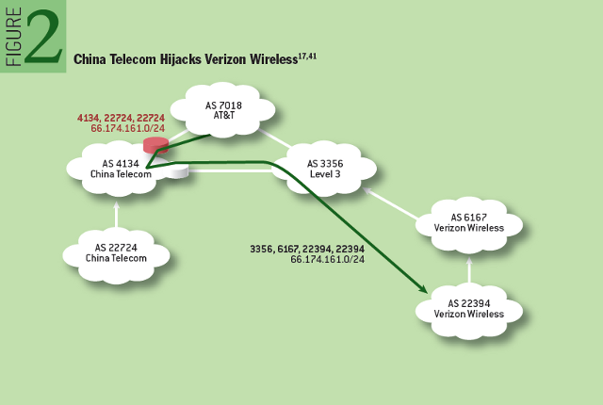
Prefix highjack
http://queue.acm.org/detail.cfm?id=2668966

Slide 52
Sub-Prefix Hijacking
4
3
5
2
7
6
1
12.34.0.0/16
12.34.158.0/24
Originating a more-specific prefix
  Every AS picks the bogus route for that prefix
  Traffic follows the longest matching prefix

Slide 53
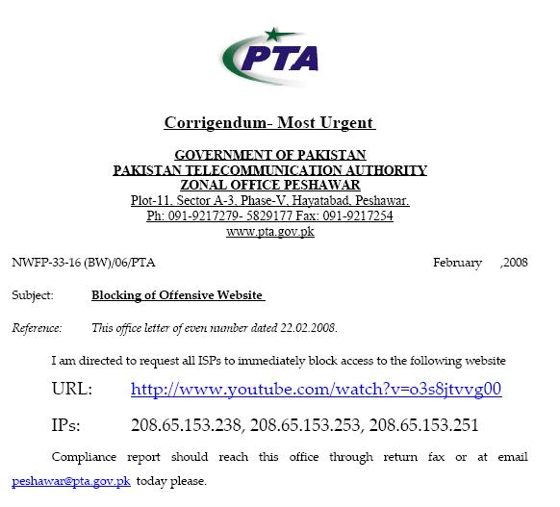
Sub-prefix hijack
  February 2008 : Pakistan Telecom hijacks YouTube
“The Internet”
Pakistan
Telecom
YouTube
I’m YouTube:
IP 208.65.153.0 / 22
Multinet
Pakistan
Telnor
Pakistan
Aga Khan
University
Notes:
-level of autonomous systems
-e.g., YouTube, AT&T, pakistan telecom
-routing is done on IP addresses, so when someone wants to go to YouTube they get YouTube’s IP address and YouTube announces to the world that they have the ip address and traffic is forwarded towards them. So here multinet would route to it’s provider pakistan telecom that then forwards the traffic on to youtube.
-these networks chosen for a specific reason which is that there was an incident in february 2008 pakistan telecom actually high jacked traffic going to youtube (misconfiguration).
-they announced to the world that they’re youtube and traffic destined to youtube was routed to them
-youtube was unavailable for a couple of hours as operators phone each other to figure out what was going on.

Slide 54
Sub-prefix hijack
  Here’s what should have happened….
“The Internet”
Hijack + drop packets going to YouTube
X
Pakistan
Telecom
YouTube
I’m YouTube:
IP 208.65.153.0 / 22
Multinet
Pakistan
Telnor
Pakistan
Aga Khan
University
  Block your own customers.

Slide 55
Sub-prefix hijack
  But here’s what Pakistan ended up doing…
“The Internet”
No, I’m YouTube!
IP 208.65.153.0 / 24
Pakistan
Telecom
YouTube
I’m YouTube:
IP 208.65.153.0 / 22
Multinet
Pakistan
Telnor
Pakistan
Aga Khan
University
Notes:
Our works focuses on attacks of this flavor..

Slide 56
Bogus AS Paths to Hide Hijacking
Adds AS hop(s) at the end of the path
  E.g., turns “701 88” into “701 88 3”
Motivations
  Evade detection for a bogus route
  E.g., by adding the legitimate AS to the end
Hard to tell that the AS path is bogus…
  Even if other ASes filter based on prefix ownership
701
3
18.0.0.0/8
88
18.0.0.0/8

Slide 57
Path-Shortening Attacks
Remove ASes from the AS path
  E.g., turn “701 3715 88” into “701 88”
Motivations
  Make the AS path look shorter than it is
  Attract sources that normally try to avoid AS 3715
  Help AS 88 look like it is closer to the Internet’s core
Who can tell that this AS path is a lie?
  Maybe AS 88 *does* connect to AS 701 directly
701
3715
88
?

Slide 58
Attacks that Add a Bogus AS Hop
701
Add ASes to the path
  E.g., turn “701 88” into “701 3715 88”
Motivations
  Trigger loop detection in AS 3715
    Denial-of-service attack on AS 3715
    Or, blocking unwanted traffic coming from AS 3715!
  Make your AS look like is has richer connectivity
Who can tell the AS path is a lie?
  AS 3715 could, if it could see the route
  AS 88 could, but would it really care as long as it received data traffic meant for it?
88

Slide 59
Violating “Consistent Export” to Peers
Peers require consistent export
  Prefix advertised at all peering points
  Prefix advertised with same AS path length
Reasons for violating the policy
  Trick neighbor into “cold potato”
  Configuration mistake
Main defense
  Analyzing BGP updates
  … or data traffic
  … for signs of inconsistency
dest
Bad AS
BGP
data
src

Slide 60
Other Attacks
Attacks on BGP sessions
  Confidentiality of BGP messages
  Denial-of-service on BGP session
  Inserting, deleting, modifying, or replaying messages
Resource exhaustion attacks
  Too many IP prefixes (e.g., BGP “512K Day”)
  Too many BGP update messages
Data-plane attacks
  Announce one BGP routes, but use another

Slide 61
Solution Techniques
Protective filtering
  Know your neighbors
Anomaly detection
  Suspect the unexpected
Checking against registries
  Establish ground truth for prefix origination
Signing and verifying
  Prevent bogus AS PATHs
Data-plane verification
  Ensure the path is actually followed

Slide 62
Computer Networks
CMSC 417 : Spring 2026
Topic: Application Layer Protocols
(Textbook chapter 9)
Nirupam Roy
M-W 2:00-3:15pm
CSI 2117

Slide 63


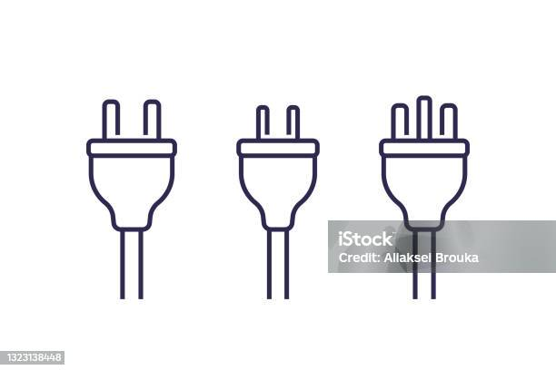
Applications
Internet as a Platform
Process to process: Transport layer
Network to network: Network layer
Device to device: Link/Physical layer

Slide 64
Applications
How do we address a host?
Internet as a Platform
Process to process: Transport layer
How did we address a host?
Network to network: Network layer
Device to device: Link/Physical layer

Slide 65
Applications
How do we address a host?
URLs, Email IDs
Internet as a Platform
Process to process: Transport layer
How did we address a host?
Network to network: Network layer
IP addresses
Device to device: Link/Physical layer

Slide 66

Applications (World wide web)
https://www.cs.umd.edu
Webserver
HTTP protocol responses
Internet as a Platform
Process to process: Transport layer
How did we address a host?
Network to network: Network layer
IP addresses
Device to device: Link/Physical layer

Slide 67
We need a database on the Internet
for
Human readable domain name → IP address mapping
Questions:
(1) Centralized or distributed?
(2) Hierarchical or flat?
(3) At the application layer or at a lower layer?

Slide 68
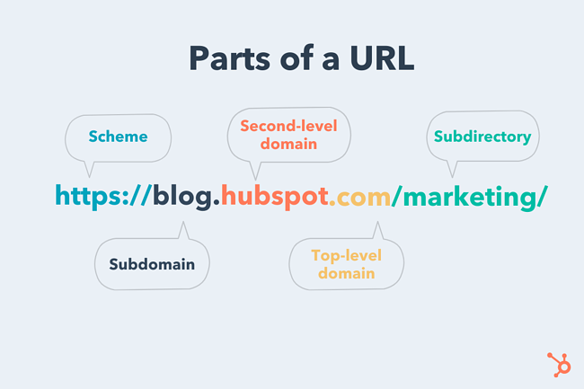
PC: https://blog.hubspot.com/marketing/parts-url

Slide 69
Anatomy of a domain name
https://www.cs.umd.edu
https://www.ece.umd.edu
ftp://ftp.example.com/Batch_File
nirupam@cs.umd.edu

Slide 70
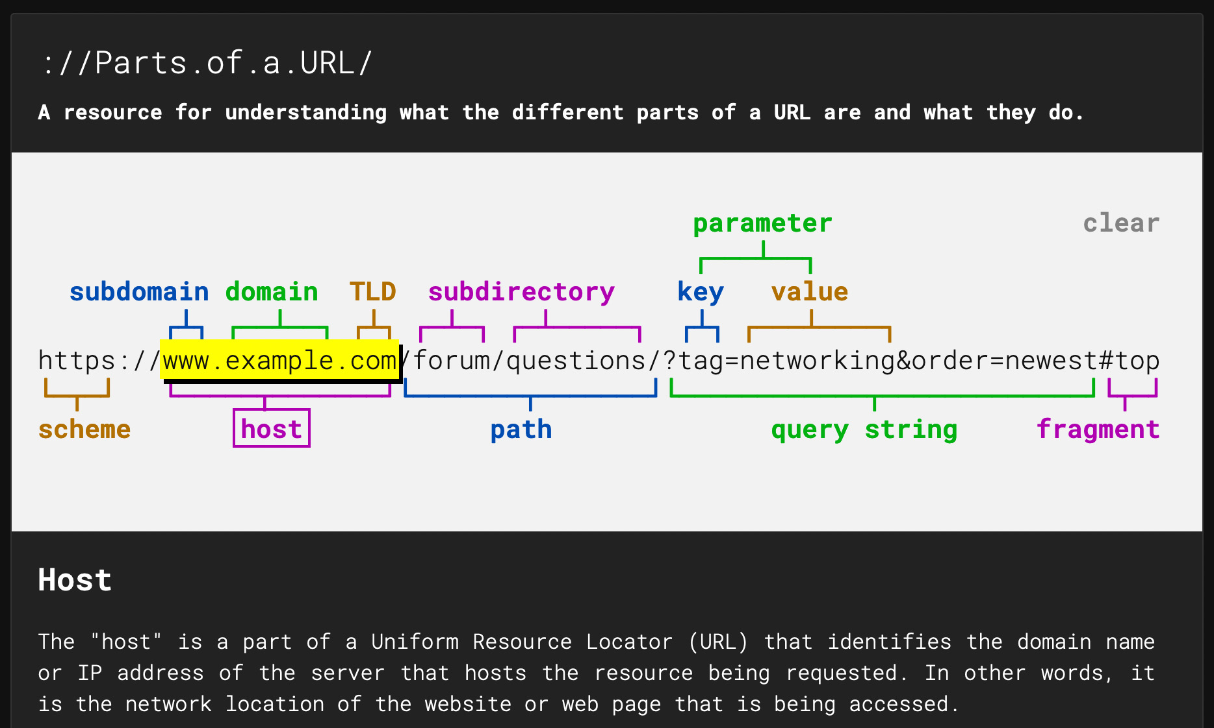
Anatomy of a domain name
https://www.cs.umd.edu
https://www.ece.umd.edu
ftp://ftp.example.com/Batch_File
nirupam@cs.umd.edu
[Picture] https://strategylab.ca/parts-of-a-url/

Slide 71
DNS: domain name system
people: many identifiers:
  SSN, name, passport #
Internet hosts, routers:
  IP address (32 bit) - used for addressing datagrams
  “name”, e.g., www.yahoo.com - used by humans
Q: how to map between IP address and name, and vice versa ?
Domain Name System:
distributed database implemented in hierarchy of many name servers
application-layer protocol: hosts, name servers communicate to resolve names (address/name translation)
  note: core Internet function, implemented as application-layer protocol
  complexity at network’s “edge”

Slide 72
DNS: a distributed, hierarchical database
Root DNS Servers
…
…
com DNS servers
org DNS servers
edu DNS servers
yahoo.com
DNS servers
pbs.org
DNS servers
poly.edu
DNS servers
umass.edu
DNS servers
amazon.com
DNS servers
client wants IP for www.amazon.com; 1st approximation:
client queries root server to find com DNS server
client queries .com DNS server to get amazon.com DNS server
client queries amazon.com DNS server to get IP address for www.amazon.com

Slide 73
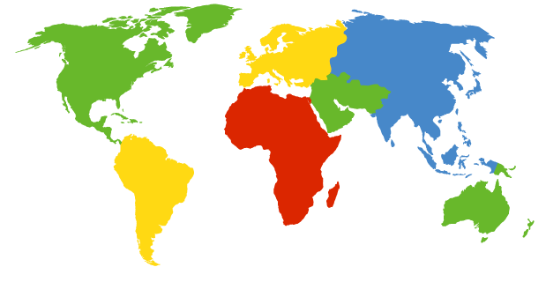
DNS: Root Name Servers
Contacted by local name server that cannot resolve name
Root name server:
  Contacts authoritative name server if name mapping not known
  Gets mapping
  Returns mapping to local name server
c. Cogent, Herndon, VA (5 other sites)
d. U Maryland College Park, MD
h. ARL Aberdeen, MD
j. Verisign, Dulles VA (69 other sites )
k. RIPE London (17 other sites)
i. Netnod, Stockholm (37 other sites)
e. NASA Mt View, CA
f. Internet Software C.
Palo Alto, CA (and 48 other sites)
m. WIDE Tokyo
(5 other sites)
13 logical root name “servers” worldwide
each “server” replicated many times
(BGP Anycast / GSLB)
a. Verisign, Los Angeles CA
(5 other sites)
b. USC-ISI Marina del Rey, CA
l. ICANN Los Angeles, CA
(41 other sites)
g. US DoD Columbus, OH (5 other sites)

Slide 74
TLD, Authoritative DNS Servers
Top-level domain (TLD) servers:
  responsible for com, org, net, edu, aero, jobs, museums, and all top-level country domains, e.g.: uk, fr, ca, jp
  Network Solutions maintains servers for .com TLD
  Educause for .edu TLD
Authoritative DNS servers:
Organization’s own DNS server(s), providing authoritative hostname to IP mappings for organization’s named hosts
  can be maintained by organization or service provider

Slide 75
Local DNS name server
does not strictly belong to hierarchy
each ISP (residential ISP, company, university) has one
  also called “default name server”
when host makes DNS query, query is sent to its local DNS server
  has local cache of recent name-to-address translation pairs (but may be out of date!)
  acts as proxy, forwards query into hierarchy

Slide 76

DNS name resolution example
root DNS server
2
host at cs.stanford.edu wants IP address for cs.umd.edu
3
TLD DNS server
4
5
iterated query:
contacted server replies with name of server to contact
“I don’t know this name, but ask this server”
local DNS server
dns.stanford.edu
7
6
1
8
authoritative DNS server
dns.cs.umd.edu
requesting host
cs.stanford.edu
cs.umd.edu

Slide 77
DNS name
resolution example
root DNS server
2
3
recursive query:
puts burden of name resolution on contacted name server
heavy load at upper levels of hierarchy?
7
6
TLD DNS
server
local DNS server
dns.stanford.edu
5
4
1
8
authoritative DNS server
dns.cs.umd.edu
requesting host
cs.stanford.edu
cs.umd.edu

Slide 78
DNS: caching, updating records
once (any) name server learns mapping, it caches mapping
  cache entries timeout (disappear) after some time (TTL)
  TLD servers typically cached in local name servers
    thus root name servers not often visited
cached entries may be out-of-date (best effort name-to-address translation!)
  if name host changes IP address, may not be known Internet-wide until all TTLs expire
update/notify mechanisms proposed IETF standard
  RFC 2136

Slide 79
DNS: services, structure
DNS services
hostname to IP address translation
host aliasing
  canonical, alias names
mail server aliasing
load distribution
  replicated Web servers: many IP addresses correspond to one name
why not centralize DNS?
single point of failure
traffic volume
distant centralized database
maintenance
Centralize DNS doesn‘t scale!

Slide 80
DNS records
DNS: distributed database storing resource records (RR)
RR format: (name, value, type, ttl)
type=A
  name is hostname
  value is IP address
type=CNAME
  name is alias name for some “canonical” (the real) name
  www.ibm.com is really
  servereast.backup2.ibm.com
  value is canonical name
type=NS
  name is domain (e.g., foo.com)
  value is hostname of authoritative name server for this domain
type=MX
  value is name of mail server associated with name

Slide 81
DNS protocol, messages
query and reply messages, both with same message format
2 bytes
2 bytes
message header
identification: 16 bit # for query, reply to query uses same #
flags:
  query or reply
  recursion desired
  recursion available
  reply is authoritative
identification
flags
# questions
# answer RRs
# authority RRs
# additional RRs
questions (variable # of questions)
answers (variable # of RRs)
authority (variable # of RRs)
additional info (variable # of RRs)

Slide 82
DNS protocol, messages
2 bytes
2 bytes
identification
flags
# questions
# answer RRs
# authority RRs
# additional RRs
name, type fields
for a query
questions (variable # of questions)
RRs in response
to query
answers (variable # of RRs)
records for
authoritative servers
authority (variable # of RRs)
additional “helpful”
info that may be used
additional info (variable # of RRs)
Notes:
Does DNS use TCP or UDP? Why?

Slide 83
Inserting records into DNS
example: new startup “Network Utopia”
register name networkuptopia.com at DNS registrar (e.g., Network Solutions)
  provide names, IP addresses of authoritative name server (primary and secondary)
  registrar inserts two RRs into .com TLD server:
  (networkutopia.com, dns1.networkutopia.com, NS)
  (dns1.networkutopia.com, 212.212.212.1, A)
create authoritative server type A record for www.networkuptopia.com; type NS record for networkutopia.com

Slide 84
HTTP
(Hyper-Text Transfer Protocol)

Slide 85
Web and HTTP
First, a review…
web page consists of objects
object can be HTML file, JPEG image, Java applet, audio file,…
web page consists of base HTML-file which includes several referenced objects
each object is addressable by a URL, e.g.,
www.someschool.edu/someDept/pic.gif
host name
path name

Slide 86

HTTP overview
HTTP: hypertext transfer protocol
Web’s application layer protocol
client/server model
  client: browser that requests, receives, (using HTTP protocol) and “displays” Web objects
  server: Web server sends (using HTTP protocol) objects in response to requests
HTTP request
PC running
Firefox browser
HTTP response
HTTP request
server
running
Apache Web
server
HTTP response
iPhone running
Safari browser

Slide 87
HTTP overview
Uses TCP:
client initiates TCP connection (creates socket) to server, port 80
server accepts TCP connection from client
HTTP messages (application-layer protocol messages) exchanged between browser (HTTP client) and Web server (HTTP server)
TCP connection closed
HTTP is “stateless”
server maintains no information about past client requests
aside
protocols that maintain “state” are complex!
past history (state) must be maintained
if server/client crashes, their views of “state” may be inconsistent, must be reconciled

Slide 88
HTTP connections
non-persistent HTTP
at most one object sent over TCP connection
  connection then closed
downloading multiple objects required multiple connections
persistent HTTP
multiple objects can be sent over single TCP connection between client, server

Slide 89
Non-persistent HTTP
(contains text, references to 10 jpeg images)
suppose user enters URL:
www.someSchool.edu/someDepartment/home.index
1a. HTTP client initiates TCP connection to HTTP server (process) at www.someSchool.edu on port 80
1b. HTTP server at host www.someSchool.edu waiting for TCP connection at port 80. “accepts” connection, notifying client
2. HTTP client sends HTTP request message (containing URL) into TCP connection socket. Message indicates that client wants object someDepartment/home.index
time
3. HTTP server receives request message, forms response message containing requested object, and sends message into its socket
5. HTTP client receives response message containing html file, displays html. Parsing html file, finds 10 referenced jpeg objects
4. HTTP server closes TCP connection.
6. Steps 1-5 repeated for each of 10 jpeg objects

Slide 90
Non-persistent HTTP: response time
RTT (Round Trip Time): time for a small packet to travel from client to server and back
HTTP response time:
one RTT to initiate TCP connection
one RTT for HTTP request and first few bytes of HTTP response to return
file transmission time
non-persistent HTTP response time
  = 2RTT+ file transmission time
initiate TCP
connection
RTT
request
file
RTT
time to
transmit
file
file
received
time
time

Slide 91
Persistent HTTP
Persistent HTTP:
server leaves connection open after sending response
subsequent HTTP messages between same client/server sent over open connection
client sends requests as soon as it encounters a referenced object
as little as one RTT for all the referenced objects
initiate TCP
connection
RTT
request
file
RTT
request
new file
time
time
Notes:
Breakdown of layering

Slide 92
Other optimizations
Pipelining
  Send several requests at once
initiate TCP
connection
RTT
request
file
RTT
request
new files
time
time

Slide 93
Other optimizations
Pipelining
  Send several requests at once
HTTP/2
  Push resources
initiate TCP
connection
RTT
request
file
RTT
send
file
push
objects
time
time

Slide 94
Other optimizations
Pipelining
  Send several requests at once
HTTP/2
  Push resources
QUIC
  Eliminate first RTT
initiate QUIC
connection
request
file
RTT
send
file
push
objects
time
time

Slide 95
HTTP request message
two types of HTTP messages: request, response
HTTP request message:
  ASCII (human-readable format)
carriage return character
request line
(GET, POST,
HEAD commands)
line-feed character
GET /index.html HTTP/1.1\r\n
Host: www-net.cs.umass.edu\r\n
User-Agent: Firefox/3.6.10\r\n
Accept: text/html,application/xhtml+xml\r\n
Accept-Language: en-us,en;q=0.5\r\n
Accept-Encoding: gzip,deflate\r\n
Accept-Charset: ISO-8859-1,utf-8;q=0.7\r\n
Keep-Alive: 115\r\n
Connection: keep-alive\r\n
\r\n
header
lines
carriage return,
line feed at start
of line indicates
end of header lines

Slide 96
HTTP request message: general format
method
sp
URL
sp
version
cr
lf
request
line
header field name
:
value
cr
lf
~
~
header
lines
~
~
header field name
:
value
cr
lf
cr
lf
~
entity body
~
body
~
~

Slide 97
Uploading form input
POST method:
web page often includes form input
input is uploaded to server in entity body
URL method:
uses GET method
input is uploaded in URL field of request line:
www.somesite.com/animalsearch?monkeys&banana

Slide 98
Method types
HTTP/1.0:
GET
POST
HEAD
  asks server to leave requested object out of response
HTTP/1.1:
GET, POST, HEAD
PUT
  uploads file in entity body to path specified in URL field
DELETE
  deletes file specified in the URL field

Slide 99
HTTP response message
status line
(protocol
status code
status phrase)
HTTP/1.1 200 OK\r\n
Date: Sun, 26 Sep 2010 20:09:20 GMT\r\n
Server: Apache/2.0.52 (CentOS)\r\n
Last-Modified: Tue, 30 Oct 2007 17:00:02 GMT\r\n
ETag: "17dc6-a5c-bf716880"\r\n
Accept-Ranges: bytes\r\n
Content-Length: 2652\r\n
Keep-Alive: timeout=10, max=100\r\n
Connection: Keep-Alive\r\n
Content-Type: text/html; charset=ISO-8859-1\r\n
\r\n
data data data data data ...
header
lines
data, e.g.,
requested
HTML file

Slide 100
HTTP response status codes
status code appears in 1st line in server-to-client response message.
some sample codes:
200 OK
  request succeeded, requested object later in this msg
301 Moved Permanently
  requested object moved, new location specified later in this msg (Location:)
400 Bad Request
  request msg not understood by server
404 Not Found
  requested document not found on this server
505 HTTP Version Not Supported
Notes:
cats

Slide 101
Trying out HTTP (client side) for yourself
1. Telnet to your favorite Web server:
telnet gaia.cs.umass.edu 80
opens TCP connection to port 80
(default HTTP server port)
at gaia.cs.umass. edu.
anything typed in will be sent
to port 80 at gaia.cs.umass.edu
2. type in a GET HTTP request:
GET /kurose_ross/interactive/index.php HTTP/1.1
Host: gaia.cs.umass.edu
by typing this in (hit carriage
return twice), you send
this minimal (but complete)
GET request to HTTP server
3. look at response message sent by HTTP server!
(or use Wireshark to look at captured HTTP request/response)

Slide 102
Trying out HTTP (client side) for yourself
1. Telnet to your favorite Web server:
telnet gaia.cs.umass.edu 80
opens TCP connection to port 80
(default HTTP server port)
at gaia.cs.umass. edu.
anything typed in will be sent
to port 80 at gaia.cs.umass.edu
2. type in a GET HTTP request:
GET /kurose_ross/interactive/index.php HTTP/1.1
Host: gaia.cs.umass.edu
by typing this in (hit carriage
return twice), you send
this minimal (but complete)
GET request to HTTP server
3. look at response message sent by HTTP server!
(or use Wireshark to look at captured HTTP request/response)

Slide 103
User-server state: cookies
Many Web sites use cookies
four components:
  1) Cookie header line of HTTP response message
  2) Cookie header line in next HTTP request message
  3) Cookie file kept on user’s host, managed by user’s browser
  4) Back-end database at Website
example:
Susan always access Internet from PC
visits specific e-commerce site for first time
when initial HTTP requests arrives at site, site creates:
  unique ID
  entry in backend database for ID

Slide 104
Cookies: keeping “state” (cont.)
client
server
ebay 8734
usual http request msg
Amazon server
creates ID
1678 for user
cookie file
usual http response
set-cookie: 1678
backend
database
create
entry
ebay 8734
amazon 1678
usual http request msg
cookie: 1678
cookie-
specific
action
access
usual http response msg
one week later:
access
ebay 8734
amazon 1678
usual http request msg
cookie: 1678
cookie-
specific
action
usual http response msg

Slide 105
Cookies (continued)
aside
what cookies can be used for:
authorization
shopping carts
recommendations
user session state (Web e-mail)
cookies and privacy:
cookies permit sites to learn a lot about you
you may supply name and e-mail to sites
how to keep “state”:
protocol endpoints: maintain state at sender/receiver over multiple transactions
cookies: http messages carry state
Notes:
tracking

Slide 106
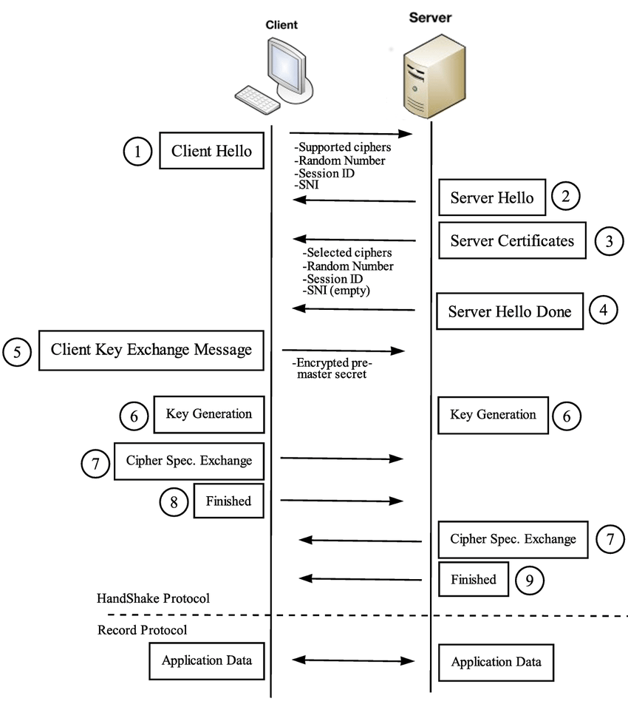
HTTPS: TLS handshake
Notes:
Image refs:
https://www.cloudflare.com/learning/ssl/what-happens-in-a-tls-handshake/
https://www.researchgate.net/figure/TLS-handshake-protocol_fig1_298065605

Slide 107
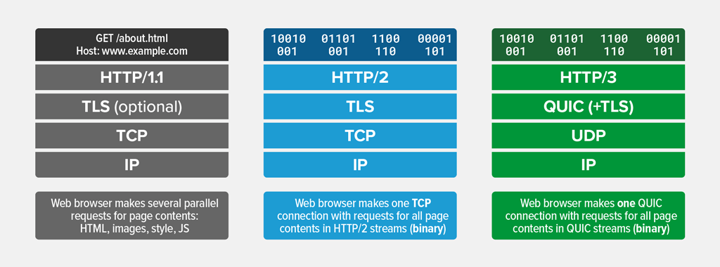
QUIC: Quick UDP Internet Connections A new transport layer protocol for web

Slide 108
HTTP/0.9
The one-line protocol
HTTP/1.0
Added extensibility
Initial version. Simple.
One-line request
Only the GET method works
Server sends HTML files
Status code included, helped
application caching and failure
management.
Metadata sent over HTTP header,
Helped extensibility.
Documents other than HTML files
can be sent.
HTTP/2.0
Performance
HTTP/1.1
Standardization
Connection reuse.
Pipeline
Content negotiation—Language,
encoding etc.
Binary protocol, not text
Multiplexed: Multiple requests
(streams) over the same
connection.
Header compression
Notes:
[Ref] https://developer.mozilla.org/en-US/docs/Web/HTTP/Guides/Evolution_of_HTTP

Slide 109
Transport layer (TCP) limitation for HTTP/2.0 streaming
Head-of-Line Blocking (HOLB): HTTP/2.0 resolves application layer
HOLB through multiplexing, but transport layer HOLB persists.
If a packet for a particular stream is lost or delayed (head-of-line), it can
block all other streams using that same TCP connection
TCP resolves order before sending to application layer.
HTTP/2.0
Performance
Binary protocol, not text
Multiplexed: Multiple requests
(streams) over the same
connection.
Header compression
Notes:
[Ref] https://developer.mozilla.org/en-US/docs/Web/HTTP/Guides/Evolution_of_HTTP

Slide 110
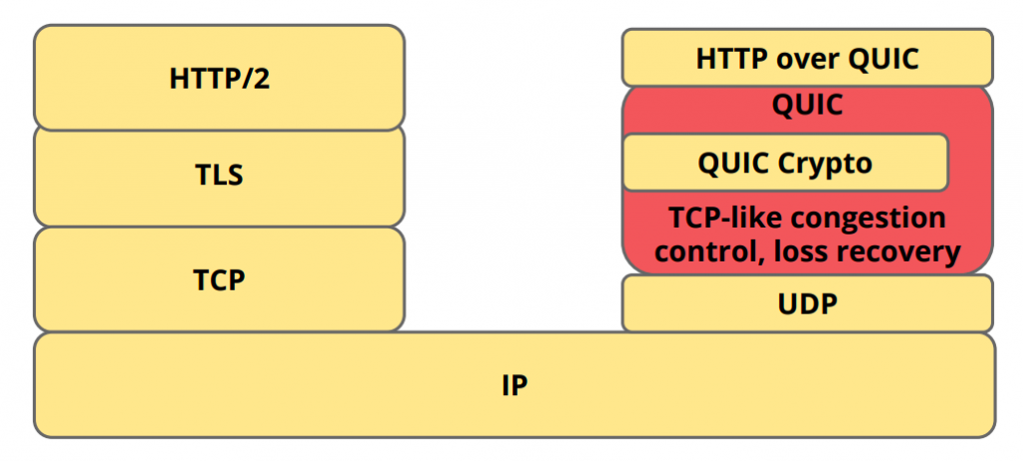
QUIC: A cross-layer approach
(+TLS 1.3)
QUIC can exist by itself, HTTP/3 can’t exist without QUIC.
Notes:
Image ref: https://medium.com/codavel-blog/quic-vs-tcp-tls-and-why-quic-is-not-the-next-big-thing-d4ef59143efd
[Ref] https://javascript-conference.com/blog/quic-and-http-3-the-next-step-in-web-performance/
QUIC is a general-purpose transport layer network protocol initially designed by Jim Roskind at Google. It was first implemented and deployed in 2012 and was publicly announced in 2013 as experimentation broadened.
[Ref] https://blog.apnic.net/2022/11/03/comparing-tcp-and-quic/
It is a grossly inaccurate simplification, but at its simplest level, QUIC is simply TCP encapsulated and encrypted in a User Datagram Protocol (UDP) payload. To the external network, QUIC has the appearance of a bidirectional UDP packet sequence where the UDP payload is concealed. To the endpoints, QUIC can be used as a reliable full duplex data flow protocol. Even at this level, QUIC has a number of advantages over TCP.

Slide 111
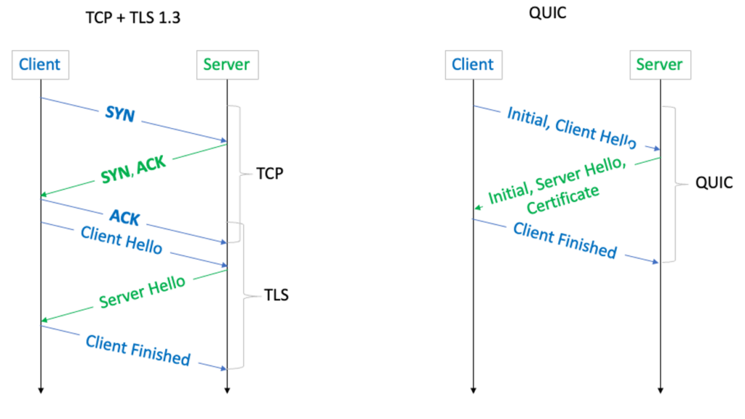
QUIC: A cross-layer approach
Notes:
Image ref: https://blog.apnic.net/2022/11/03/comparing-tcp-and-quic/

Slide 112
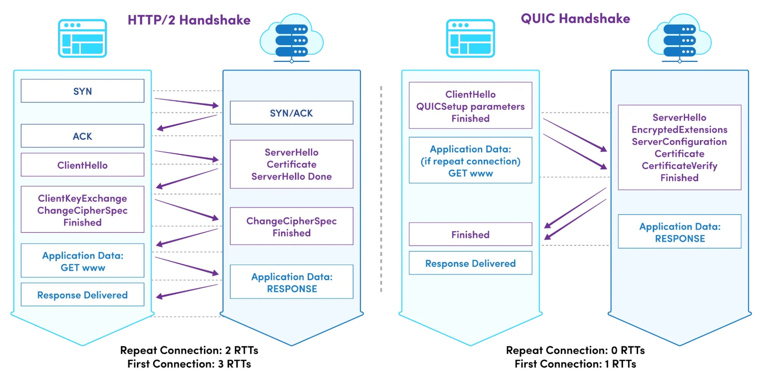
QUIC: Expedited secure handshake

Slide 113
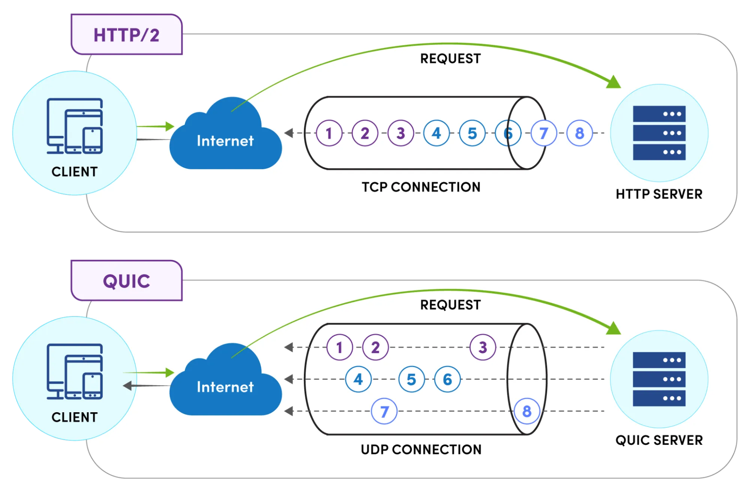
QUIC: Stream multiplexing
Notes:
[Ref] https://www.catchpoint.com/http3-vs-http2

Slide 114
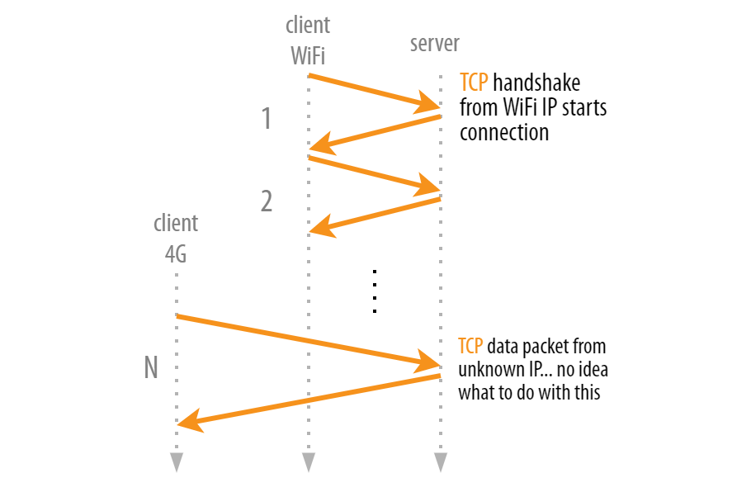
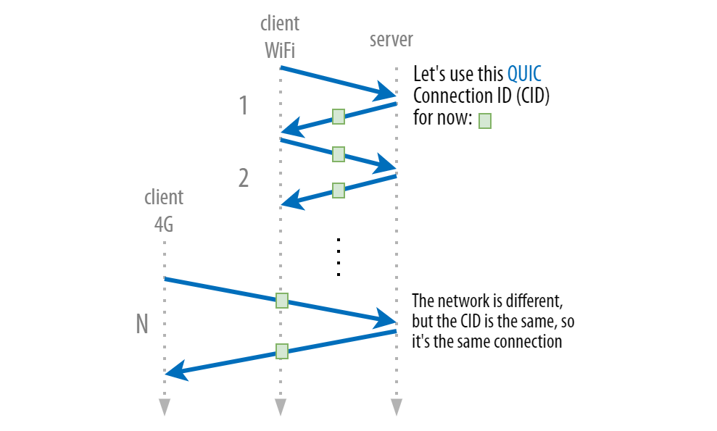
QUIC: A cross-layer approach
Seamless migration between multiple <IP, port>
Notes:
Image ref:
https://pulse.internetsociety.org/blog/how-quic-helps-you-seamlessly-connect-to-different-networks

Slide 115

Web caches (proxy server)
goal: satisfy client request without involving origin server
user sets browser: Web accesses via cache
browser sends all HTTP requests to cache
  object in cache: cache returns object
  else cache requests object from origin server, then returns object to client
proxy
server
HTTP request
HTTP request
client
origin
server
HTTP response
HTTP response
HTTP request
HTTP response
client
origin
server

Slide 116
More about Web caching
cache acts as both client and server
  server for original requesting client
  client to origin server
typically cache is installed by ISP (university, company, residential ISP)
why Web caching?
reduce response time for client request
reduce traffic on an institution’s access link
Internet dense with caches: enables “poor” content providers to effectively deliver content
Notes:
proxy

