Slide 1

Computer Networks
CMSC 417 : Spring 2026
Topic: Application Layer Protocols
(Textbook chapter 9)
Nirupam Roy
M-W 2:00-3:15pm
CSI 2117
May 6th, 2026

Slide 2


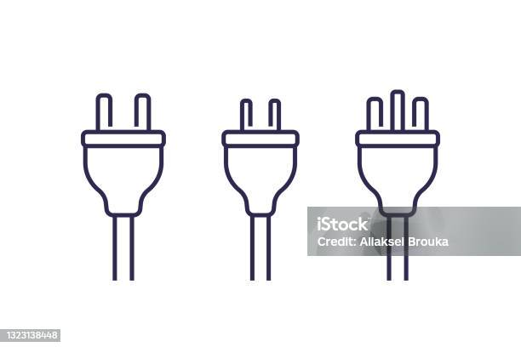
Applications
Internet as a Platform
Process to process: Transport layer
Network to network: Network layer
Device to device: Link/Physical layer

Slide 3
Applications
How do we address a host?
Internet as a Platform
Process to process: Transport layer
How did we address a host?
Network to network: Network layer
Device to device: Link/Physical layer

Slide 4
Applications
How do we address a host?
URLs, Email IDs
Internet as a Platform
Process to process: Transport layer
How did we address a host?
Network to network: Network layer
IP addresses
Device to device: Link/Physical layer

Slide 5
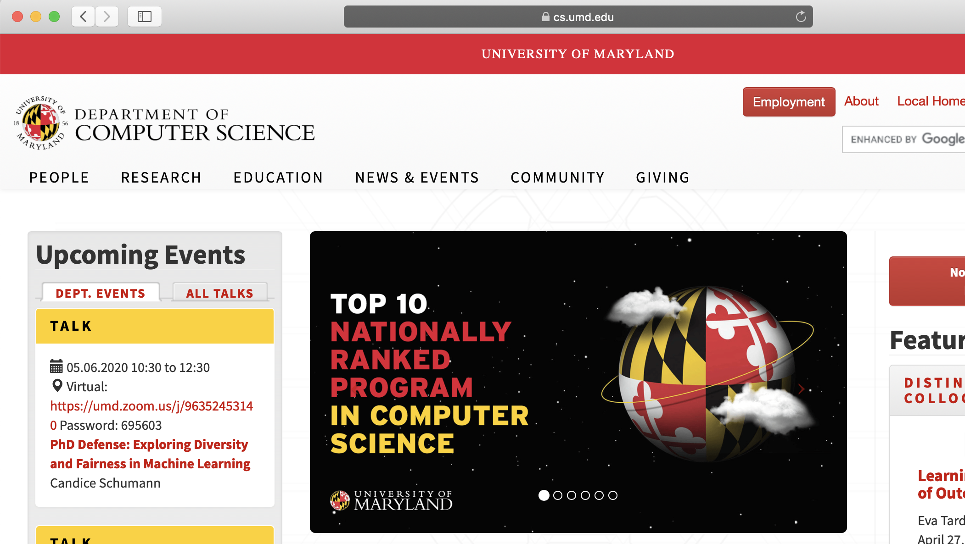
Applications (World wide web)
https://www.cs.umd.edu
Webserver
HTTP protocol responses
Internet as a Platform
Process to process: Transport layer
How did we address a host?
Network to network: Network layer
IP addresses
Device to device: Link/Physical layer

Slide 6
We need a database on the Internet
for
Human readable domain name → IP address mapping
Questions:
(1) Centralized or distributed?
(2) Hierarchical or flat?
(3) At the application layer or at a lower layer?

Slide 7
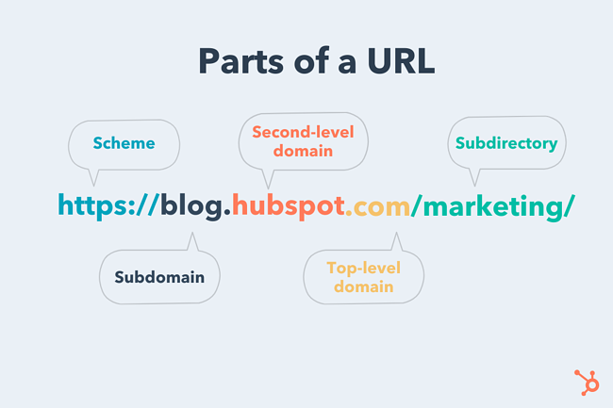
PC: https://blog.hubspot.com/marketing/parts-url

Slide 8
Anatomy of a domain name
https://www.cs.umd.edu
https://www.ece.umd.edu
ftp://ftp.example.com/Batch_File
nirupam@cs.umd.edu

Slide 9
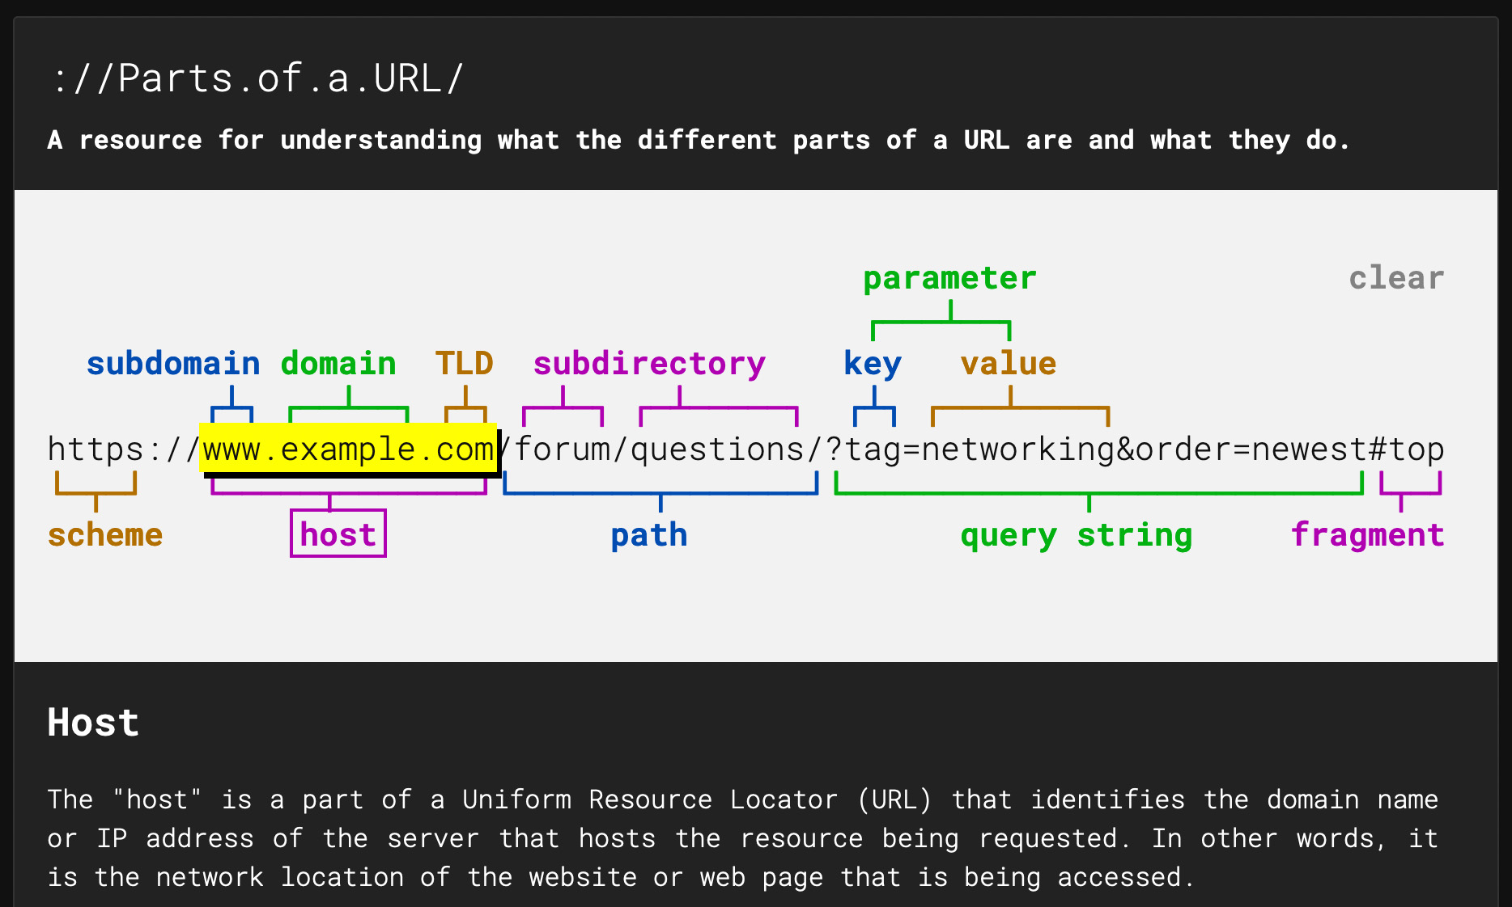
Anatomy of a domain name
https://www.cs.umd.edu
https://www.ece.umd.edu
ftp://ftp.example.com/Batch_File
nirupam@cs.umd.edu
[Picture] https://strategylab.ca/parts-of-a-url/

Slide 10
DNS: domain name system
people: many identifiers:
  SSN, name, passport #
Internet hosts, routers:
  IP address (32 bit) - used for addressing datagrams
  “name”, e.g., www.yahoo.com - used by humans
Q: how to map between IP address and name, and vice versa ?
Domain Name System:
distributed database implemented in hierarchy of many name servers
application-layer protocol: hosts, name servers communicate to resolve names (address/name translation)
  note: core Internet function, implemented as application-layer protocol
  complexity at network’s “edge”

Slide 11
DNS: a distributed, hierarchical database
Root DNS Servers
…
…
com DNS servers
org DNS servers
edu DNS servers
yahoo.com
DNS servers
pbs.org
DNS servers
poly.edu
DNS servers
umass.edu
DNS servers
amazon.com
DNS servers
client wants IP for www.amazon.com; 1st approximation:
client queries root server to find com DNS server
client queries .com DNS server to get amazon.com DNS server
client queries amazon.com DNS server to get IP address for www.amazon.com

Slide 12
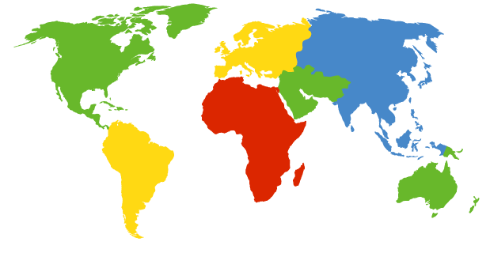
DNS: Root Name Servers
Contacted by local name server that cannot resolve name
Root name server:
  Contacts authoritative name server if name mapping not known
  Gets mapping
  Returns mapping to local name server
c. Cogent, Herndon, VA (5 other sites)
d. U Maryland College Park, MD
h. ARL Aberdeen, MD
j. Verisign, Dulles VA (69 other sites )
k. RIPE London (17 other sites)
i. Netnod, Stockholm (37 other sites)
e. NASA Mt View, CA
f. Internet Software C.
Palo Alto, CA (and 48 other sites)
m. WIDE Tokyo
(5 other sites)
13 logical root name “servers” worldwide
each “server” replicated many times
(BGP Anycast / GSLB)
a. Verisign, Los Angeles CA
(5 other sites)
b. USC-ISI Marina del Rey, CA
l. ICANN Los Angeles, CA
(41 other sites)
g. US DoD Columbus, OH (5 other sites)

Slide 13
TLD, Authoritative DNS Servers
Top-level domain (TLD) servers:
  responsible for com, org, net, edu, aero, jobs, museums, and all top-level country domains, e.g.: uk, fr, ca, jp
  Network Solutions maintains servers for .com TLD
  Educause for .edu TLD
Authoritative DNS servers:
Organization’s own DNS server(s), providing authoritative hostname to IP mappings for organization’s named hosts
  can be maintained by organization or service provider

Slide 14
Local DNS name server
does not strictly belong to hierarchy
each ISP (residential ISP, company, university) has one
  also called “default name server”
when host makes DNS query, query is sent to its local DNS server
  has local cache of recent name-to-address translation pairs (but may be out of date!)
  acts as proxy, forwards query into hierarchy

Slide 15

DNS name resolution example
root DNS server
2
host at cs.stanford.edu wants IP address for cs.umd.edu
3
TLD DNS server
4
5
iterated query:
contacted server replies with name of server to contact
“I don’t know this name, but ask this server”
local DNS server
dns.stanford.edu
7
6
1
8
authoritative DNS server
dns.cs.umd.edu
requesting host
cs.stanford.edu
cs.umd.edu

Slide 16
DNS name
resolution example
root DNS server
2
3
recursive query:
puts burden of name resolution on contacted name server
heavy load at upper levels of hierarchy?
7
6
TLD DNS
server
local DNS server
dns.stanford.edu
5
4
1
8
authoritative DNS server
dns.cs.umd.edu
requesting host
cs.stanford.edu
cs.umd.edu

Slide 17
DNS: caching, updating records
once (any) name server learns mapping, it caches mapping
  cache entries timeout (disappear) after some time (TTL)
  TLD servers typically cached in local name servers
    thus root name servers not often visited
cached entries may be out-of-date (best effort name-to-address translation!)
  if name host changes IP address, may not be known Internet-wide until all TTLs expire
update/notify mechanisms proposed IETF standard
  RFC 2136

Slide 18
DNS: services, structure
DNS services
hostname to IP address translation
host aliasing
  canonical, alias names
mail server aliasing
load distribution
  replicated Web servers: many IP addresses correspond to one name
why not centralize DNS?
single point of failure
traffic volume
distant centralized database
maintenance
Centralize DNS doesn‘t scale!

Slide 19
DNS records
DNS: distributed database storing resource records (RR)
RR format: (name, value, type, ttl)
type=A
  name is hostname
  value is IP address
type=CNAME
  name is alias name for some “canonical” (the real) name
  www.ibm.com is really
  servereast.backup2.ibm.com
  value is canonical name
type=NS
  name is domain (e.g., foo.com)
  value is hostname of authoritative name server for this domain
type=MX
  value is name of mail server associated with name

Slide 20
DNS protocol, messages
query and reply messages, both with same message format
2 bytes
2 bytes
message header
identification: 16 bit # for query, reply to query uses same #
flags:
  query or reply
  recursion desired
  recursion available
  reply is authoritative
identification
flags
# questions
# answer RRs
# authority RRs
# additional RRs
questions (variable # of questions)
answers (variable # of RRs)
authority (variable # of RRs)
additional info (variable # of RRs)

Slide 21
DNS protocol, messages
2 bytes
2 bytes
identification
flags
# questions
# answer RRs
# authority RRs
# additional RRs
name, type fields
for a query
questions (variable # of questions)
RRs in response
to query
answers (variable # of RRs)
records for
authoritative servers
authority (variable # of RRs)
additional “helpful”
info that may be used
additional info (variable # of RRs)
Notes:
Does DNS use TCP or UDP? Why?

Slide 22
Inserting records into DNS
example: new startup “Network Utopia”
register name networkuptopia.com at DNS registrar (e.g., Network Solutions)
  provide names, IP addresses of authoritative name server (primary and secondary)
  registrar inserts two RRs into .com TLD server:
  (networkutopia.com, dns1.networkutopia.com, NS)
  (dns1.networkutopia.com, 212.212.212.1, A)
create authoritative server type A record for www.networkuptopia.com; type NS record for networkutopia.com

Slide 23
HTTP
(Hyper-Text Transfer Protocol)

Slide 24
Web and HTTP
First, a review…
web page consists of objects
object can be HTML file, JPEG image, Java applet, audio file,…
web page consists of base HTML-file which includes several referenced objects
each object is addressable by a URL, e.g.,
www.someschool.edu/someDept/pic.gif
host name
path name

Slide 25

HTTP overview
HTTP: hypertext transfer protocol
Web’s application layer protocol
client/server model
  client: browser that requests, receives, (using HTTP protocol) and “displays” Web objects
  server: Web server sends (using HTTP protocol) objects in response to requests
HTTP request
PC running
Firefox browser
HTTP response
HTTP request
server
running
Apache Web
server
HTTP response
iPhone running
Safari browser

Slide 26
HTTP overview
Uses TCP:
client initiates TCP connection (creates socket) to server, port 80
server accepts TCP connection from client
HTTP messages (application-layer protocol messages) exchanged between browser (HTTP client) and Web server (HTTP server)
TCP connection closed
HTTP is “stateless”
server maintains no information about past client requests
aside
protocols that maintain “state” are complex!
past history (state) must be maintained
if server/client crashes, their views of “state” may be inconsistent, must be reconciled

Slide 27
HTTP connections
non-persistent HTTP
at most one object sent over TCP connection
  connection then closed
downloading multiple objects required multiple connections
persistent HTTP
multiple objects can be sent over single TCP connection between client, server

Slide 28
Non-persistent HTTP
(contains text, references to 10 jpeg images)
suppose user enters URL:
www.someSchool.edu/someDepartment/home.index
1a. HTTP client initiates TCP connection to HTTP server (process) at www.someSchool.edu on port 80
1b. HTTP server at host www.someSchool.edu waiting for TCP connection at port 80. “accepts” connection, notifying client
2. HTTP client sends HTTP request message (containing URL) into TCP connection socket. Message indicates that client wants object someDepartment/home.index
time
3. HTTP server receives request message, forms response message containing requested object, and sends message into its socket
5. HTTP client receives response message containing html file, displays html. Parsing html file, finds 10 referenced jpeg objects
4. HTTP server closes TCP connection.
6. Steps 1-5 repeated for each of 10 jpeg objects

Slide 29
Non-persistent HTTP: response time
RTT (Round Trip Time): time for a small packet to travel from client to server and back
HTTP response time:
one RTT to initiate TCP connection
one RTT for HTTP request and first few bytes of HTTP response to return
file transmission time
non-persistent HTTP response time
  = 2RTT+ file transmission time
initiate TCP
connection
RTT
request
file
RTT
time to
transmit
file
file
received
time
time

Slide 30
Persistent HTTP
Persistent HTTP:
server leaves connection open after sending response
subsequent HTTP messages between same client/server sent over open connection
client sends requests as soon as it encounters a referenced object
as little as one RTT for all the referenced objects
initiate TCP
connection
RTT
request
file
RTT
request
new file
time
time
Notes:
Breakdown of layering

Slide 31
Other optimizations
Pipelining
  Send several requests at once
initiate TCP
connection
RTT
request
file
RTT
request
new files
time
time

Slide 32
Other optimizations
Pipelining
  Send several requests at once
HTTP/2
  Push resources
initiate TCP
connection
RTT
request
file
RTT
send
file
push
objects
time
time

Slide 33
Other optimizations
Pipelining
  Send several requests at once
HTTP/2
  Push resources
QUIC
  Eliminate first RTT
initiate QUIC
connection
request
file
RTT
send
file
push
objects
time
time

Slide 34
HTTP request message
two types of HTTP messages: request, response
HTTP request message:
  ASCII (human-readable format)
carriage return character
request line
(GET, POST,
HEAD commands)
line-feed character
GET /index.html HTTP/1.1\r\n
Host: www-net.cs.umass.edu\r\n
User-Agent: Firefox/3.6.10\r\n
Accept: text/html,application/xhtml+xml\r\n
Accept-Language: en-us,en;q=0.5\r\n
Accept-Encoding: gzip,deflate\r\n
Accept-Charset: ISO-8859-1,utf-8;q=0.7\r\n
Keep-Alive: 115\r\n
Connection: keep-alive\r\n
\r\n
header
lines
carriage return,
line feed at start
of line indicates
end of header lines

Slide 35
HTTP request message: general format
method
sp
URL
sp
version
cr
lf
request
line
header field name
:
value
cr
lf
~
~
header
lines
~
~
header field name
:
value
cr
lf
cr
lf
~
entity body
~
body
~
~

Slide 36
Uploading form input
POST method:
web page often includes form input
input is uploaded to server in entity body
URL method:
uses GET method
input is uploaded in URL field of request line:
www.somesite.com/animalsearch?monkeys&banana

Slide 37
Method types
HTTP/1.0:
GET
POST
HEAD
  asks server to leave requested object out of response
HTTP/1.1:
GET, POST, HEAD
PUT
  uploads file in entity body to path specified in URL field
DELETE
  deletes file specified in the URL field

Slide 38
HTTP response message
status line
(protocol
status code
status phrase)
HTTP/1.1 200 OK\r\n
Date: Sun, 26 Sep 2010 20:09:20 GMT\r\n
Server: Apache/2.0.52 (CentOS)\r\n
Last-Modified: Tue, 30 Oct 2007 17:00:02 GMT\r\n
ETag: "17dc6-a5c-bf716880"\r\n
Accept-Ranges: bytes\r\n
Content-Length: 2652\r\n
Keep-Alive: timeout=10, max=100\r\n
Connection: Keep-Alive\r\n
Content-Type: text/html; charset=ISO-8859-1\r\n
\r\n
data data data data data ...
header
lines
data, e.g.,
requested
HTML file

Slide 39
HTTP response status codes
status code appears in 1st line in server-to-client response message.
some sample codes:
200 OK
  request succeeded, requested object later in this msg
301 Moved Permanently
  requested object moved, new location specified later in this msg (Location:)
400 Bad Request
  request msg not understood by server
404 Not Found
  requested document not found on this server
505 HTTP Version Not Supported
Notes:
cats

Slide 40
Trying out HTTP (client side) for yourself
1. Telnet to your favorite Web server:
telnet gaia.cs.umass.edu 80
opens TCP connection to port 80
(default HTTP server port)
at gaia.cs.umass. edu.
anything typed in will be sent
to port 80 at gaia.cs.umass.edu
2. type in a GET HTTP request:
GET /kurose_ross/interactive/index.php HTTP/1.1
Host: gaia.cs.umass.edu
by typing this in (hit carriage
return twice), you send
this minimal (but complete)
GET request to HTTP server
3. look at response message sent by HTTP server!
(or use Wireshark to look at captured HTTP request/response)

Slide 41
Trying out HTTP (client side) for yourself
1. Telnet to your favorite Web server:
telnet gaia.cs.umass.edu 80
opens TCP connection to port 80
(default HTTP server port)
at gaia.cs.umass. edu.
anything typed in will be sent
to port 80 at gaia.cs.umass.edu
2. type in a GET HTTP request:
GET /kurose_ross/interactive/index.php HTTP/1.1
Host: gaia.cs.umass.edu
by typing this in (hit carriage
return twice), you send
this minimal (but complete)
GET request to HTTP server
3. look at response message sent by HTTP server!
(or use Wireshark to look at captured HTTP request/response)

Slide 42
User-server state: cookies
Many Web sites use cookies
four components:
  1) Cookie header line of HTTP response message
  2) Cookie header line in next HTTP request message
  3) Cookie file kept on user’s host, managed by user’s browser
  4) Back-end database at Website
example:
Susan always access Internet from PC
visits specific e-commerce site for first time
when initial HTTP requests arrives at site, site creates:
  unique ID
  entry in backend database for ID

Slide 43
Cookies: keeping “state” (cont.)
client
server
ebay 8734
usual http request msg
Amazon server
creates ID
1678 for user
cookie file
usual http response
set-cookie: 1678
backend
database
create
entry
ebay 8734
amazon 1678
usual http request msg
cookie: 1678
cookie-
specific
action
access
usual http response msg
one week later:
access
ebay 8734
amazon 1678
usual http request msg
cookie: 1678
cookie-
specific
action
usual http response msg

Slide 44
Cookies (continued)
aside
what cookies can be used for:
authorization
shopping carts
recommendations
user session state (Web e-mail)
cookies and privacy:
cookies permit sites to learn a lot about you
you may supply name and e-mail to sites
how to keep “state”:
protocol endpoints: maintain state at sender/receiver over multiple transactions
cookies: http messages carry state
Notes:
tracking

Slide 45
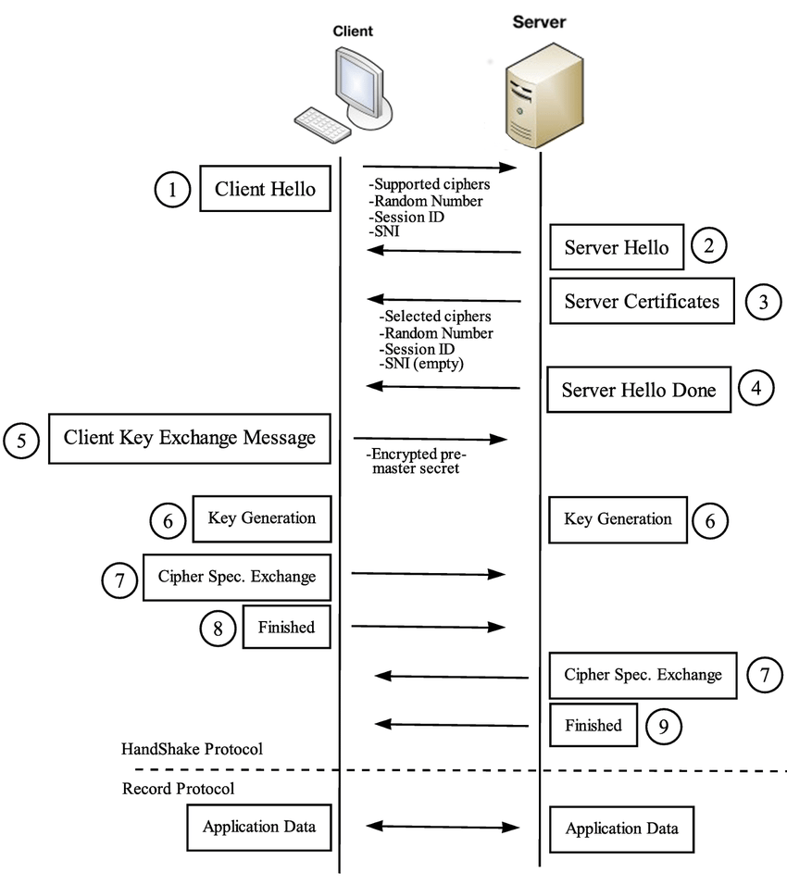
HTTPS: TLS handshake
Notes:
Image refs:
https://www.cloudflare.com/learning/ssl/what-happens-in-a-tls-handshake/
https://www.researchgate.net/figure/TLS-handshake-protocol_fig1_298065605

Slide 46
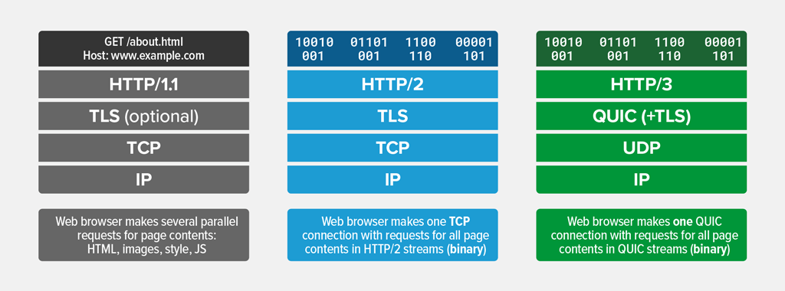
QUIC: Quick UDP Internet Connections A new transport layer protocol for web

Slide 47
HTTP/0.9
The one-line protocol
HTTP/1.0
Added extensibility
Initial version. Simple.
One-line request
Only the GET method works
Server sends HTML files
Status code included, helped
application caching and failure
management.
Metadata sent over HTTP header,
Helped extensibility.
Documents other than HTML files
can be sent.
HTTP/2.0
Performance
HTTP/1.1
Standardization
Connection reuse.
Pipeline
Content negotiation—Language,
encoding etc.
Binary protocol, not text
Multiplexed: Multiple requests
(streams) over the same
connection.
Header compression
Notes:
[Ref] https://developer.mozilla.org/en-US/docs/Web/HTTP/Guides/Evolution_of_HTTP

Slide 48
Transport layer (TCP) limitation for HTTP/2.0 streaming
Head-of-Line Blocking (HOLB): HTTP/2.0 resolves application layer
HOLB through multiplexing, but transport layer HOLB persists.
If a packet for a particular stream is lost or delayed (head-of-line), it can
block all other streams using that same TCP connection
TCP resolves order before sending to application layer.
HTTP/2.0
Performance
Binary protocol, not text
Multiplexed: Multiple requests
(streams) over the same
connection.
Header compression
Notes:
[Ref] https://developer.mozilla.org/en-US/docs/Web/HTTP/Guides/Evolution_of_HTTP

Slide 49
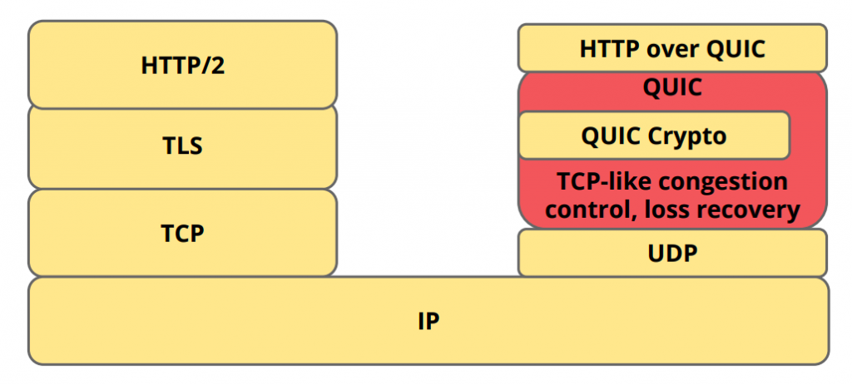
QUIC: A cross-layer approach
(+TLS 1.3)
QUIC can exist by itself, HTTP/3 can’t exist without QUIC.
Notes:
Image ref: https://medium.com/codavel-blog/quic-vs-tcp-tls-and-why-quic-is-not-the-next-big-thing-d4ef59143efd
[Ref] https://javascript-conference.com/blog/quic-and-http-3-the-next-step-in-web-performance/
QUIC is a general-purpose transport layer network protocol initially designed by Jim Roskind at Google. It was first implemented and deployed in 2012 and was publicly announced in 2013 as experimentation broadened.
[Ref] https://blog.apnic.net/2022/11/03/comparing-tcp-and-quic/
It is a grossly inaccurate simplification, but at its simplest level, QUIC is simply TCP encapsulated and encrypted in a User Datagram Protocol (UDP) payload. To the external network, QUIC has the appearance of a bidirectional UDP packet sequence where the UDP payload is concealed. To the endpoints, QUIC can be used as a reliable full duplex data flow protocol. Even at this level, QUIC has a number of advantages over TCP.

Slide 50
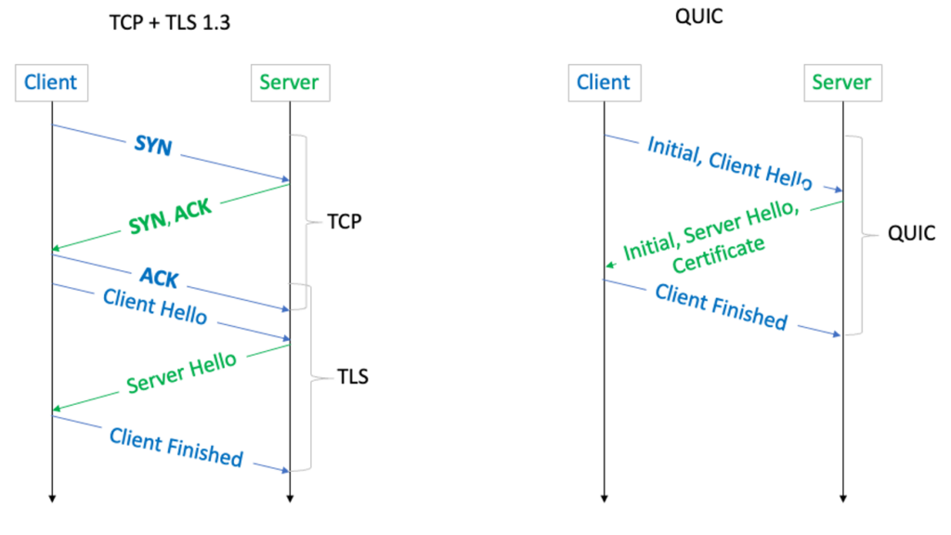
QUIC: A cross-layer approach
Notes:
Image ref: https://blog.apnic.net/2022/11/03/comparing-tcp-and-quic/

Slide 51
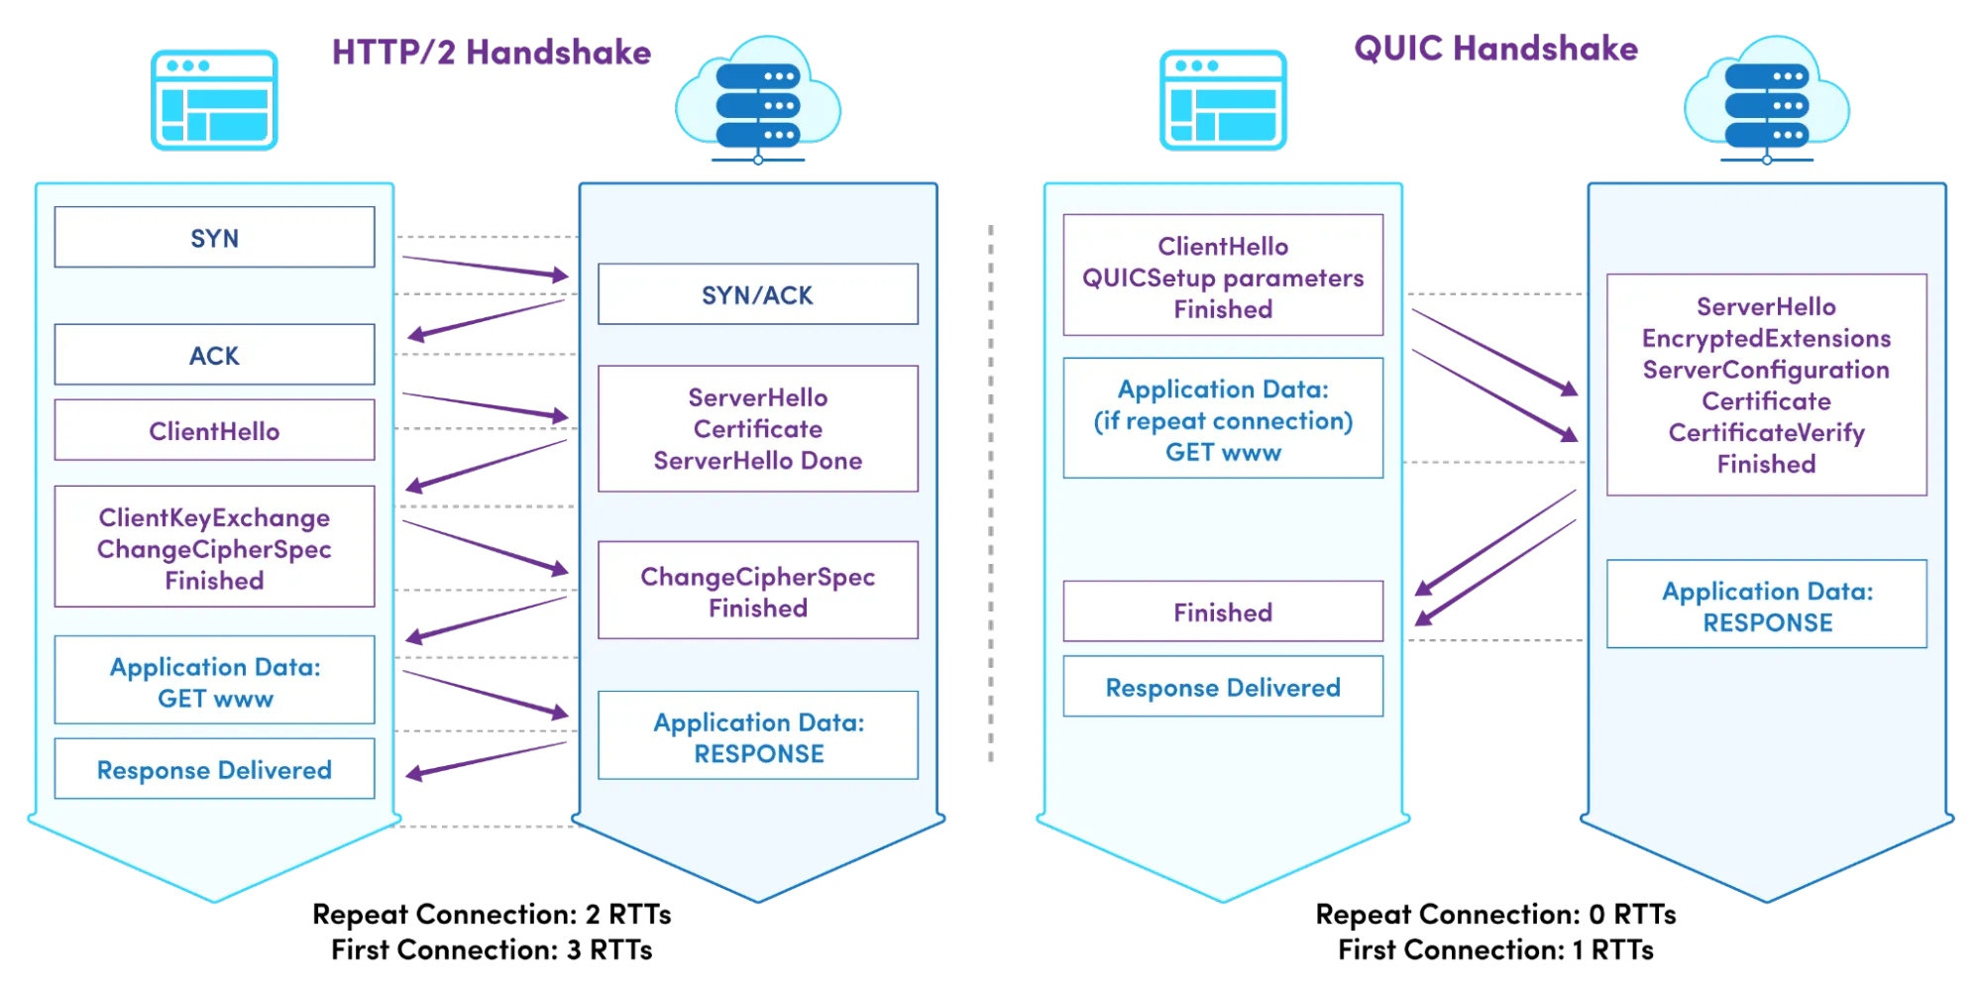
QUIC: Expedited secure handshake

Slide 52
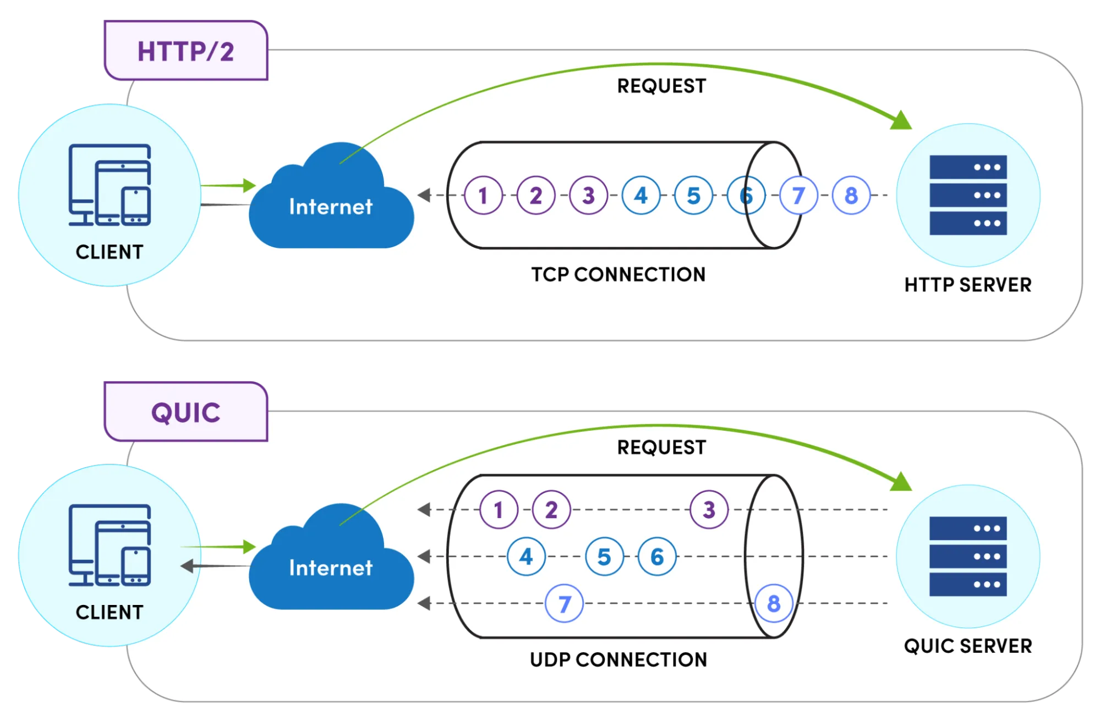
QUIC: Stream multiplexing
Notes:
[Ref] https://www.catchpoint.com/http3-vs-http2

Slide 53
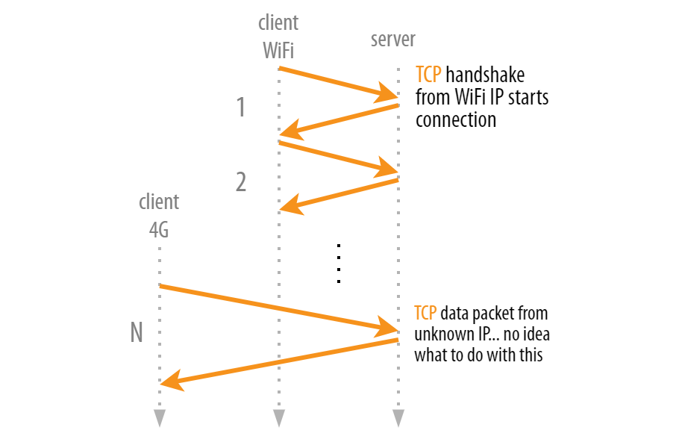
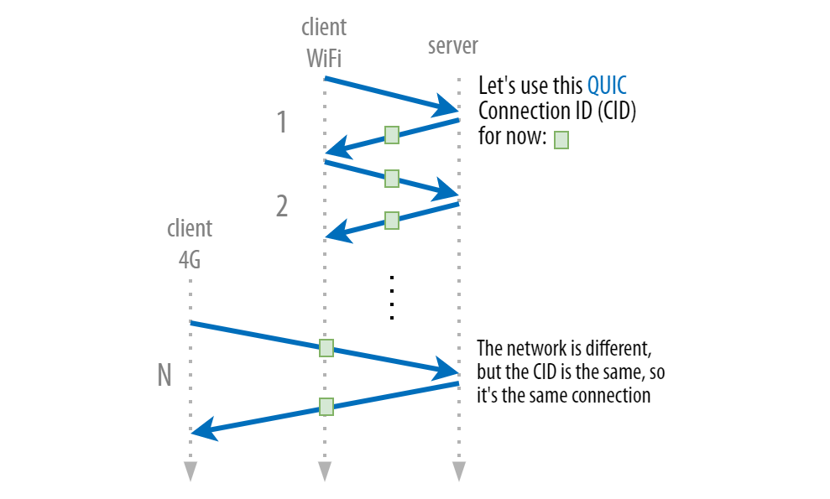
QUIC: A cross-layer approach
Seamless migration between multiple <IP, port>
Notes:
Image ref:
https://pulse.internetsociety.org/blog/how-quic-helps-you-seamlessly-connect-to-different-networks

Slide 54

Web caches (proxy server)
goal: satisfy client request without involving origin server
user sets browser: Web accesses via cache
browser sends all HTTP requests to cache
  object in cache: cache returns object
  else cache requests object from origin server, then returns object to client
proxy
server
HTTP request
HTTP request
client
origin
server
HTTP response
HTTP response
HTTP request
HTTP response
client
origin
server

Slide 55
More about Web caching
cache acts as both client and server
  server for original requesting client
  client to origin server
typically cache is installed by ISP (university, company, residential ISP)
why Web caching?
reduce response time for client request
reduce traffic on an institution’s access link
Internet dense with caches: enables “poor” content providers to effectively deliver content
Notes:
proxy

