Slide 1

CMSC 417: Computer Networks
Spring 2026
Topic: Internetworking/Routing Protocols
(Textbook chapter 3)
Nirupam Roy
M-W 2:00-3:15pm
CSI 2117
Feb 9th, 2026

Slide 2
Network architecture overview
What is the Internet?
Network edge
Network core
Delay, Loss, Throughput in networks
Protocol layers, service models

Slide 3
Internet protocol stack
application: supporting network applications
FTP, SMTP, HTTP
transport: process-process data transfer
TCP, UDP
network: routing of packets from source to destination
IP, routing protocols
link: data transfer between neighboring network elements
Ethernet, 802.11 (WiFi), PPP
physical: bits “on the wire”
application
transport
network
link
physical

Slide 4
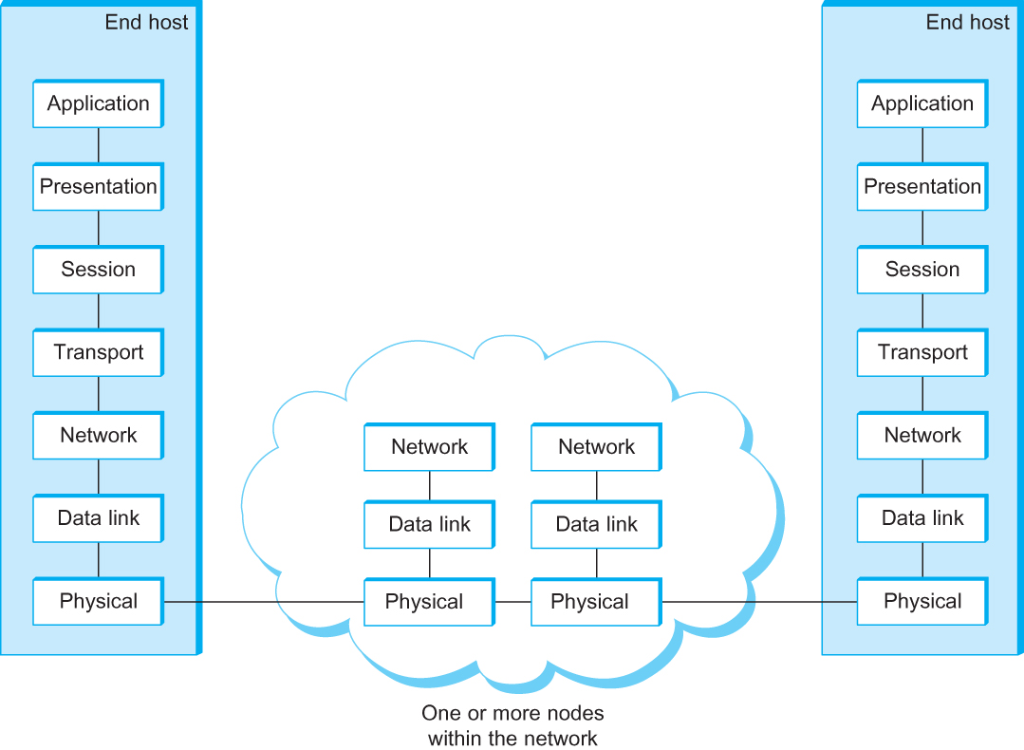
OSI Architecture
The OSI 7-layer Model
OSI – Open Systems Interconnection
(by International Organization for Standardization, ISO)

Slide 5
Description of Layers
Physical Layer
Handles the transmission of raw bits over a communication link
Data Link Layer
Collects a stream of bits into a larger aggregate called a frame
Network adaptor along with device driver in OS implement the protocol in this layer
Frames are actually delivered to hosts
Network Layer
Handles routing among nodes within a packet-switched network
Unit of data exchanged between nodes in this layer is called a packet
The lower three layers are implemented on all network nodes

Slide 6
Description of Layers
Transport Layer
Implements a process-to-process channel
Unit of data exchanges in this layer is called a message
Session Layer
Provides a name space that is used to tie together the potentially different transport streams that are part of a single application.
Presentation Layer
Concerned about the format of data exchanged between peers (data formats, data encryption)
Application Layer
Standardize common type of exchanges
The transport layer and the higher layers typically run only on end-hosts and not on the intermediate switches and routers

Slide 7

Encapsulation
source
message
M
application
transport
network
link
physical
segment
H_{t}
M
H_{t}
datagram
H_{n}
H_{n}
H_{t}
M
frame
H_{l}
H_{n}
H_{t}
M
link
physical
switch
destination
H_{n}
H_{t}
M
network
link
physical
M
application
transport
network
link
physical
H_{l}
H_{n}
H_{t}
M
H_{n}
H_{t}
M
H_{t}
M
H_{n}
H_{t}
M
H_{l}
H_{n}
H_{t}
M
router

Slide 8
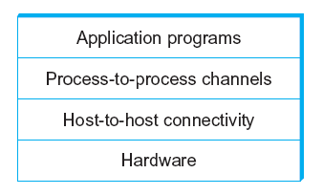
Network Architecture
Example of a layered network system

Slide 9
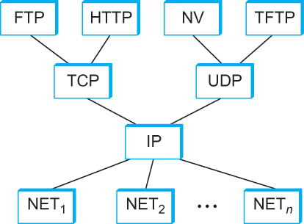
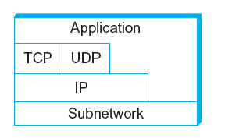
Internet Architecture
Alternative view of the Internet architecture. The “Network” layer shown here is sometimes referred to as the “sub-network” or “link” layer.
Internet Protocol Graph

Slide 10
This course: Top-Down or Bottom-up?

Slide 11
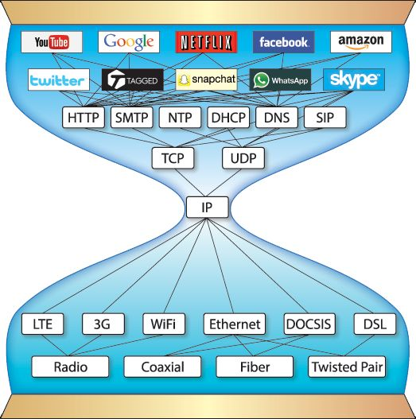

Slide 12
This course: Top-Down or Bottom-up?
3
2
1
4

Slide 13
Internetworking

Slide 14
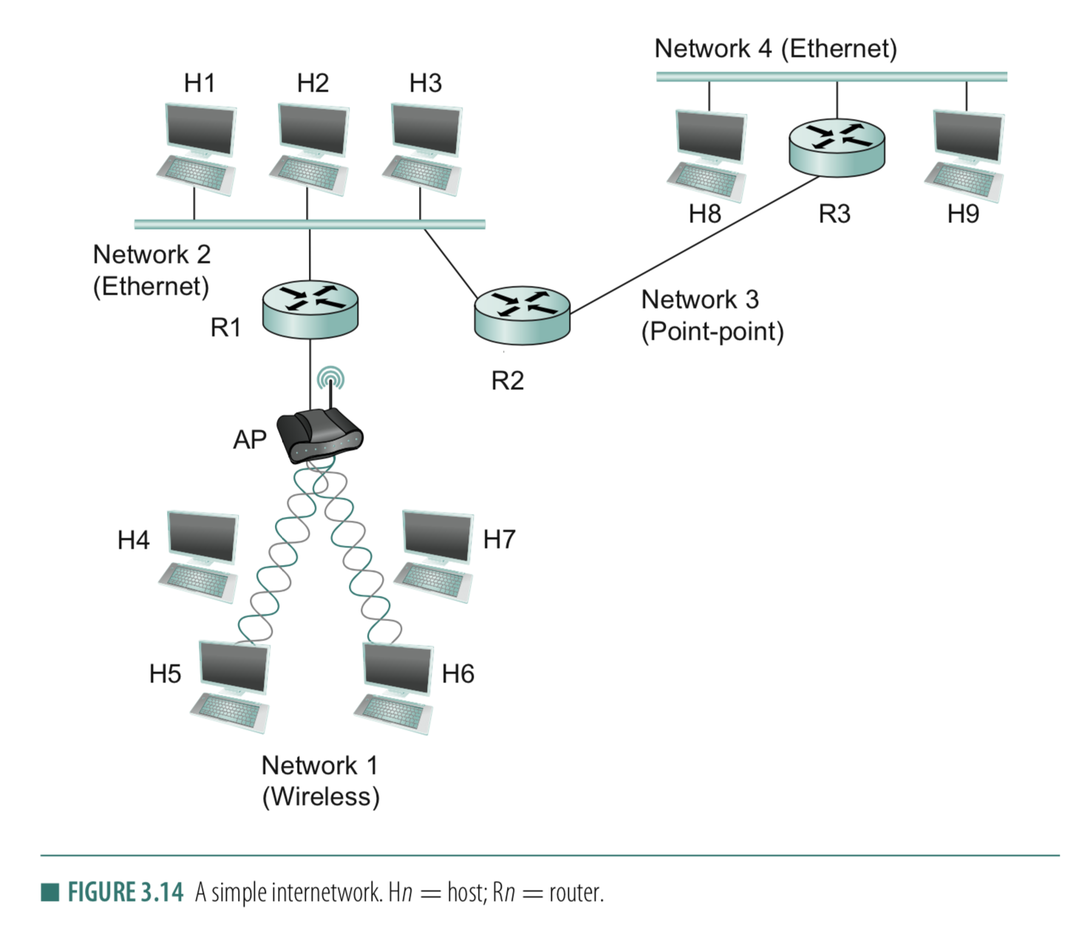
Connection between hosts
1. Addressing
– Unique identifier for global addressing
– Link name for neighbors
2. Forwarding
-- Switching packets between links
3. Routing
-- Determining paths between hosts

Slide 15
Internet Structure: Network of Networks
But if one global ISP is viable business, there will be competitors ….
…
Routers
access
net
access
net
…
access
net
access
net
access
net
access
net
ISP A
access
net
…
…
access
net
ISP B
access
net
ISP C
access
net
access
net
access
net
access
net
…
access
net
access
net
…
access
net

Slide 16
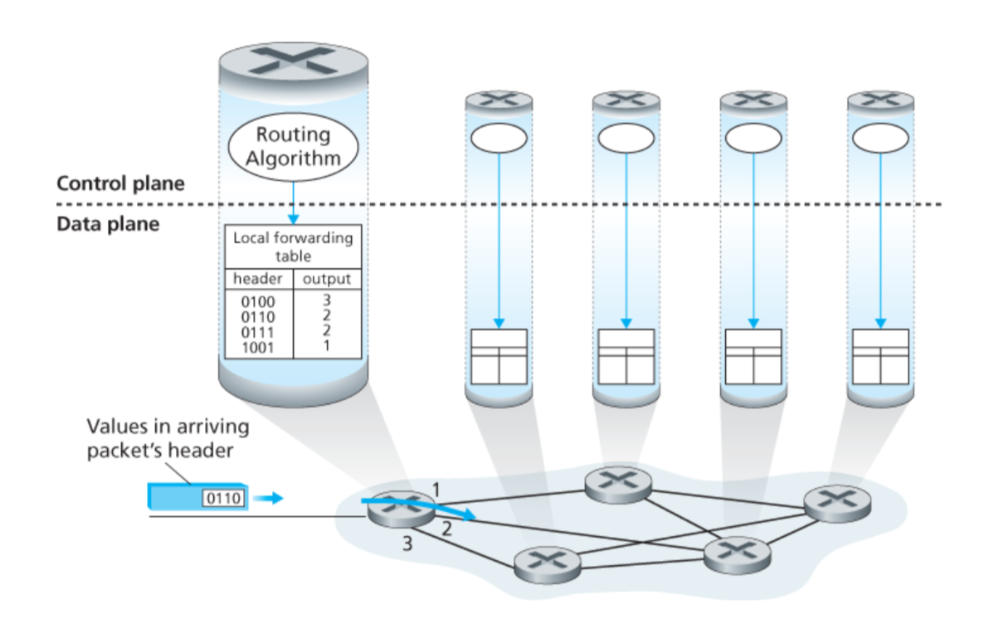
Connection between hosts

Slide 17
Connection between hosts
Using network to maintain network.
Behaves like Applications. Uses TCP/UDP packets

Slide 18
Connection between hosts
1. Addressing
– Unique identifier for global addressing
– Link name for neighbors
2. Forwarding
-- Switching packets between links
3. Routing
-- Determining paths between hosts

Slide 19
Routing protocols
Routing protocol goal: determine “good” paths (equivalently, routes), from sending hosts to receiving host, through network of routers
path: sequence of routers packets will traverse in going from given initial source host to given final destination host
“good”: least “cost”, “fastest”, “least congested”

Slide 20
Graph abstraction of the network
5
v
3
w
2
5
u
2
1
z
3
1
2
x
y
1
graph: G = (N,E)
N = set of routers = { u, v, w, x, y, z }
E = set of links ={ (u,v), (u,x), (v,x), (v,w), (x,w), (x,y), (w,y), (w,z), (y,z) }
aside: graph abstraction is useful in other network contexts, e.g.,
P2P, where N is set of peers and E is set of TCP connections

Slide 21
Graph abstraction: costs
5
c(x,x’) = cost of link (x,x’)
e.g., c(w,z) = 5
cost could always be 1, or
inversely related to bandwidth,
or related to congestion
v
3
w
2
5
u
2
1
z
3
1
2
x
y
1
cost of path (x₁, x₂, x₃,…, x_{p}) = c(x₁,x₂) + c(x₂,x₃) + … + c(x_{p-1},x_{p})
key question: what is the least-cost path between u and z ?
routing algorithm: algorithm that finds that least cost path

Slide 22
Routing
For a simple network, we can calculate all shortest paths and load them into some nonvolatile storage on each node.
Such a static approach has several shortcomings
It does not deal with node or link failures
It does not consider the addition of new nodes or links
It implies that edge costs cannot change
What is the solution?
Need a distributed and dynamic protocol
Two main classes of protocols
Distance Vector
Link State

Slide 23
Distance Vector Routing

Slide 24
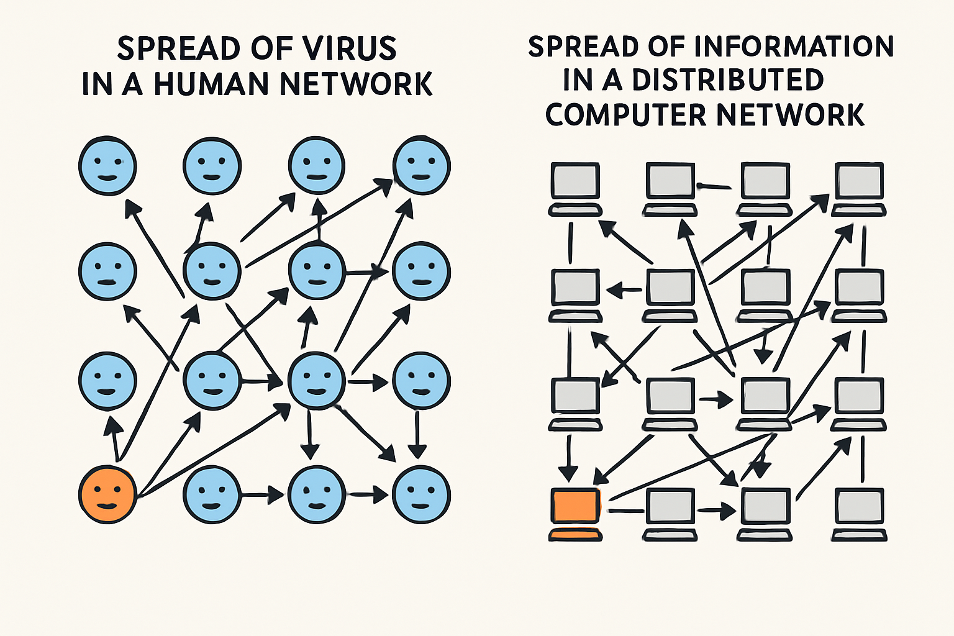
Gossip/Rumor/Epidemic distributed algorithm

Slide 25
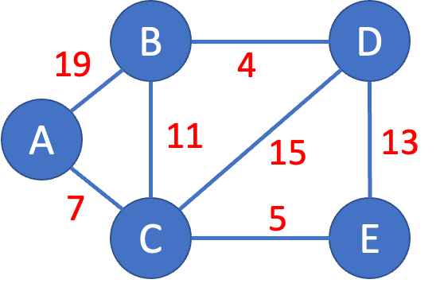
Distance Vector Routing: An example
Notes:
The key idea: How one node knows about its neighbors information, and then passes on this info to neighbors. Then neighbors knows new links. The information eventually makes all routes known to all routers.

Slide 26
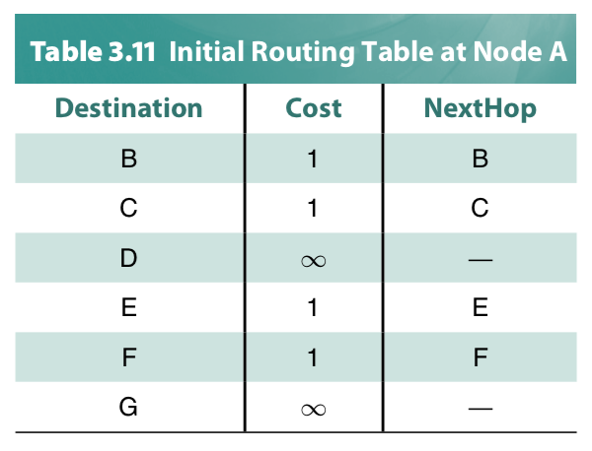
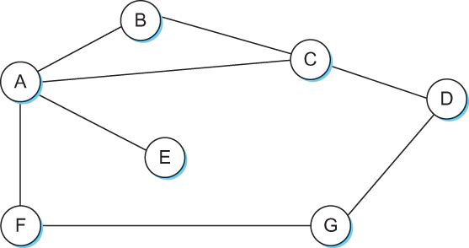
Distance Vector
Each node constructs a one-dimensional array (a vector) containing the “distances” (costs) to all other nodes and distributes that vector to its immediate neighbors
Starting assumption is that each node knows the cost of the link to each of its directly connected neighbors

Slide 27
Distance Vector Routing protocol
Advertise:
A router transmits its distance vector to each of its neighbors in a
routing packet.
2. Each router receives and saves the most recently received
distance vector from each of its neighbors.
3. Update:
A router recalculates its distance vector when:
It receives a distance vector from a neighbor containing
different information than before.
b) It discovers that a link to a neighbor has gone down
(or the cost has changed).

Slide 28
Distance Vector Routing: An example
B
D
19
4
A
11
13
15
7
5
C
E

Slide 29
Distance Vector Routing: An example
Routing table at Node A
Dest | Cost | N. Hop
B
D
19
4
A
11
13
15
7
5
C
E

Slide 30
Distance Vector Routing: An example
Routing table at Node A
Dest | Cost | N. Hop
A | 0 | A
B | 19 | B
C | 7 | C
D | ∞ | --
E | ∞ | --
B
D
19
4
A
11
13
15
7
5
C
E
Know thy neighbors !!
How?

Slide 31
Round: 0
Dest | Cost | N. Hop
A | 19 | A
B | 0 | B
C | 11 | C
D | 4 | D
E | ∞ | --
Dest | Cost | N. Hop
A | ∞ | --
B | 4 | B
C | 15 | C
D | 0 | D
E | 13 | E
Dest | Cost | N. Hop
A | 0 | A
B | 19 | B
C | 7 | C
D | ∞ | --
E | ∞ | --
B
D
19
4
A
11
13
15
7
5
C
E
Dest | Cost | N. Hop
A | 7 | A
B | 11 | B
C | 0 | C
D | 15 | D
E | 5 | E
Dest | Cost | N. Hop
A | ∞ | --
B | ∞ | --
C | 5 | C
D | 13 | D
E | 0 | E

Slide 32
Round: 0
Dest | Cost | N. Hop
A | 19 | A
B | 0 | B
C | 11 | C
D | 4 | D
E | ∞ | --
Dest | Cost | N. Hop
A | ∞ | --
B | 4 | B
C | 15 | C
D | 0 | D
E | 13 | E
Let your neighbors know what you know!!
Dest | Cost | N. Hop
A | 0 | A
B | 19 | B
C | 7 | C
D | ∞ | --
E | ∞ | --
B
D
19
4
A
11
13
15
7
5
C
E
Dest | Cost | N. Hop
A | 7 | A
B | 11 | B
C | 0 | C
D | 15 | D
E | 5 | E
Dest | Cost | N. Hop
A | ∞ | --
B | ∞ | --
C | 5 | C
D | 13 | D
E | 0 | E

Slide 33
Round: 1
Dest | Cost | N. Hop
A | 19 | A
B | 0 | B
C | 11 | C
D | 4 | D
E | ∞ | --
Dest | Cost | N. Hop
A | ∞ | --
B | 4 | B
C | 15 | C
D | 0 | D
E | 13 | E
Update your routing table, if required!!
Dest | Cost | N. Hop
A | 0 | A
B | 19 | B
C | 7 | C
D | ∞ | --
E | ∞ | --
B
D
19
4
A
11
13
15
7
5
C
E
Dest | Cost | N. Hop
A | 7 | A
B | 11 | B
C | 0 | C
D | 15 | D
E | 5 | E
Dest | Cost | N. Hop
A | ∞ | --
B | ∞ | --
C | 5 | C
D | 13 | D
E | 0 | E

Slide 34
Round: 1
Dest | Cost | N. Hop
A | 19 | A
B | 0 | B
C | 11 | C
D | 4 | D
E | ∞ | --
Let’s consider updates at node A
Dest | Cost | N. Hop
A | 0 | A
B | 19 | B
C | 7 | C
D | ∞ | --
E | ∞ | --
B
D
19
4
A
11
13
15
7
5
C
E
Dest | Cost | N. Hop
A | 7 | A
B | 11 | B
C | 0 | C
D | 15 | D
E | 5 | E

Slide 35
Round: 1
Dest | Cost | N. Hop
A | 19 | A
B | 0 | B
C | 11 | C
D | 4 | D
E | ∞ | --
Let’s consider updates at node A
Dest | Cost | N. Hop
A | 0 | A
B | 19 | B
C | 7 | C
D | ∞ | --
E | ∞ | --
B
D
19
4
A
11
13
15
7
5
C
E
Available Distance Vectors
A says <B, 19>
Dest | Cost | N. Hop
A | 7 | A
B | 11 | B
C | 0 | C
D | 15 | D
E | 5 | E
B says <B, 0>
C says <B, 11>

Slide 36
Round: 1
Dest | Cost | N. Hop
A | 19 | A
B | 0 | B
C | 11 | C
D | 4 | D
E | ∞ | --
Let’s consider updates at node A
Dest | Cost | N. Hop
A | 0 | A
B | 19 | B
C | 7 | C
D | ∞ | --
E | ∞ | --
B
D
19
4
A
11
13
15
7
5
C
E
Available Distance Vectors
A says <B, 19> + 0
Dest | Cost | N. Hop
A | 7 | A
B | 11 | B
C | 0 | C
D | 15 | D
E | 5 | E
B says <B, 0> + 19
C says <B, 11> + 7

Slide 37
Round: 1
Dest | Cost | N. Hop
A | 0 | A
B | 19 | B
C | 7 | C
D | ∞ | --
E | ∞ | --
B
D
19
4
A
11
13
15
7
5
C
E
Node A: Updates for B,D,E
Node B: Updates for A, E
Node C: No Updates
Node D: Updates for A
Node E: Updates for A, B
Dest | Cost | N. Hop
A | 7 | A
B | 11 | B
C | 0 | C
D | 15 | D
E | 5 | E

Slide 38
Round: 1
Dest | Cost | N. Hop
A | 19 | A
B | 0 | B
C | 11 | C
D | 4 | D
E | ∞ | --
Let’s consider updates at node A
Dest | Cost | N. Hop
A | 0 | A
B | 18 | C
C | 7 | C
D | ∞ | --
E | ∞ | --
B
D
19
4
A
11
13
15
7
5
C
E
Dest | Cost | N. Hop
A | 7 | A
B | 11 | B
C | 0 | C
D | 15 | D
E | 5 | E

Slide 39
Round: 1
Dest | Cost | N. Hop
A | 19 | A
B | 0 | B
C | 11 | C
D | 4 | D
E | ∞ | --
Let’s consider updates at node A
Dest | Cost | N. Hop
A | 0 | A
B | 18 | C
C | 7 | C
D | ∞ | --
E | ∞ | --
B
D
19
4
A
11
13
15
7
5
C
E
Dest | Cost | N. Hop
A | 7 | A
B | 11 | B
C | 0 | C
D | 15 | D
E | 5 | E

Slide 40
Round: 1
Dest | Cost | N. Hop
A | 19 | A
B | 0 | B
C | 11 | C
D | 4 | D
E | ∞ | --
Let’s consider updates at node A
Dest | Cost | N. Hop
A | 0 | A
B | 18 | C
C | 7 | C
D | 22 | C
E | ∞ | --
B
D
19
4
A
11
13
15
7
5
C
E
Dest | Cost | N. Hop
A | 7 | A
B | 11 | B
C | 0 | C
D | 15 | D
E | 5 | E

Slide 41
Round: 1
Dest | Cost | N. Hop
A | 18 | C
B | 0 | B
C | 11 | C
D | 4 | D
E | 16 | C
Dest | Cost | N. Hop
A | 22 | C
B | 4 | B
C | 15 | C
D | 0 | D
E | 13 | E
Dest | Cost | N. Hop
A | 0 | A
B | 18 | C
C | 7 | C
D | 22 | C
E | 12 | C
B
D
19
4
A
11
13
15
7
5
C
E
Node A: Updates for B,D,E
Node B: Updates for A, E
Node C: No Updates
Node D: Updates for A
Node E: Updates for A, B
Dest | Cost | N. Hop
A | 7 | A
B | 11 | B
C | 0 | C
D | 15 | D
E | 5 | E
Dest | Cost | N. Hop
A | 12 | C
B | 16 | C
C | 5 | C
D | 13 | D
E | 0 | E

Slide 42
Round: 1
Dest | Cost | N. Hop
A | 18 | C
B | 0 | B
C | 11 | C
D | 4 | D
E | 16 | C
Dest | Cost | N. Hop
A | 22 | C
B | 4 | B
C | 15 | C
D | 0 | D
E | 13 | E
When will a node send routing advertisements to its neighbors?
Dest | Cost | N. Hop
A | 0 | A
B | 18 | C
C | 7 | C
D | 22 | C
E | 12 | C
B
D
19
4
A
11
13
15
7
5
C
E
Node A: Updates for B,D,E
Node B: Updates for A, E
Node C: No Updates
Node D: Updates for A
Node E: Updates for A, B
Dest | Cost | N. Hop
A | 7 | A
B | 11 | B
C | 0 | C
D | 15 | D
E | 5 | E
Dest | Cost | N. Hop
A | 12 | C
B | 16 | C
C | 5 | C
D | 13 | D
E | 0 | E

Slide 43
Round: 1
Dest | Cost | N. Hop
A | 18 | C
B | 0 | B
C | 11 | C
D | 4 | D
E | 16 | C
Dest | Cost | N. Hop
A | 22 | C
B | 4 | B
C | 15 | C
D | 0 | D
E | 13 | E
When will a node send routing advertisements to its neighbors?
Dest | Cost | N. Hop
A | 0 | A
B | 18 | C
C | 7 | C
D | 22 | C
E | 12 | C
B
D
19
4
A
11
13
15
7
5
C
E
Node A: Updates for B,D,E
Node B: Updates for A, E
Node C: No Updates
Node D: Updates for A
Node E: Updates for A, B
Dest | Cost | N. Hop
A | 7 | A
B | 11 | B
C | 0 | C
D | 15 | D
E | 5 | E
Dest | Cost | N. Hop
A | 12 | C
B | 16 | C
C | 5 | C
D | 13 | D
E | 0 | E

Slide 44
Routing advertisements
Two circumstances when a node sends out routing advertisements:
Periodic: Automatically after some time. Why?
2) Triggered: Whenever an event makes a node to change its routing table (e.g., link fail or a new message from a neighbor).

Slide 45
Routing advertisements
Two circumstances when a node sends out routing advertisements:
Triggered: Whenever an event makes a node to change its routing table (e.g., link fail or cost change).

Slide 46
Routing advertisements
Two circumstances when a node sends out routing advertisements:
Triggered: Whenever an event makes a node to change its routing table (e.g., link fail or cost change).
Periodic: Automatically after some time . Why?

Slide 47
Routing advertisements
Two circumstances when a node sends out routing advertisements:
Triggered: Whenever an event makes a node to change its routing table (e.g., link fail or cost change).
Periodic: Automatically after some time . Why?
a) Failure detection without explicit signals
b) Recovery from lost messages
c) Self-stabilization
d) Handling silent failures
Notes:
Failure detection without explicit signals DV routers often infer failures implicitly. If periodic updates stop arriving, a route can be timed out and invalidated.
Recovery from lost messages Triggered updates can be dropped. Periodic refreshes eventually correct stale or inconsistent state.
Self-stabilization Even if transient inconsistencies or partial state corruption occur, periodic updates guarantee eventual convergence.
Handling silent failures Links or neighbors may fail without an explicit “down” event. Periodic updates are the only way to notice.

Slide 48
Round: 2
Dest | Cost | N. Hop
A | 18 | C
B | 0 | B
C | 11 | C
D | 4 | D
E | 16 | C
Dest | Cost | N. Hop
A | 22 | C
B | 4 | B
C | 15 | C
D | 0 | D
E | 13 | E
Dest | Cost | N. Hop
A | 0 | A
B | 18 | C
C | 7 | C
D | 22 | C
E | 12 | C
B
D
19
4
A
11
13
15
7
Convergence
C
5
E
Node A: No Updates
Node B: No Updates
Node C: No Updates
Node D: No Updates
Node E: No Updates
Dest | Cost | N. Hop
A | 7 | A
B | 11 | B
C | 0 | C
D | 15 | D
E | 5 | E
Dest | Cost | N. Hop
A | 12 | C
B | 16 | C
C | 5 | C
D | 13 | D
E | 0 | E

Slide 49
Distance vector algorithm
Bellman-Ford equation (dynamic programming)

Slide 50
Graph abstraction of the network
5
v
3
w
2
5
u
2
1
z
3
1
2
x
y
1
graph: G = (N,E)
N = set of routers = { u, v, w, x, y, z }
E = set of links ={ (u,v), (u,x), (v,x), (v,w), (x,w), (x,y), (w,y), (w,z), (y,z) }
aside: graph abstraction is useful in other network contexts, e.g.,
P2P, where N is set of peers and E is set of TCP connections

Slide 51
Graph abstraction: costs
5
c(x,x’) = cost of link (x,x’)
e.g., c(w,z) = 5
cost could always be 1, or
inversely related to bandwidth,
or related to congestion
v
3
w
2
5
u
2
1
z
3
1
2
x
y
1
cost of path (x₁, x₂, x₃,…, x_{p}) = c(x₁,x₂) + c(x₂,x₃) + … + c(x_{p-1},x_{p})
key question: what is the least-cost path between u and z ?
routing algorithm: algorithm that finds that least cost path

Slide 52
Distance vector algorithm
Bellman-Ford equation (dynamic programming)
let
d_{x}(y) := cost of least-cost path from x to y
then
d_{x}(y) = min {c(x,v) + d_{v}(y) }
v
cost from neighbor v to destination y
cost to neighbor v
min taken over all neighbors v of x

Slide 53
Bellman-Ford example
5
3 neighbors of u = v, x, w
clearly, d_{v}(z) = 5, d_{x}(z) = 3, d_{w}(z) = 3
v
3
w
2
5
u
z
B-F equation says:
2
1
3
1
2
d_{u}(z) = min { c(u,v) + d_{v}(z),
c(u,x) + d_{x}(z),
c(u,w) + d_{w}(z) }
= min {2 + 5,
1 + 3,
5 + 3} = 4
x
y
1
node achieving minimum is next
hop in shortest path, used in forwarding table
<dest, cost, next-hop> = <z, 4, x>

Slide 54
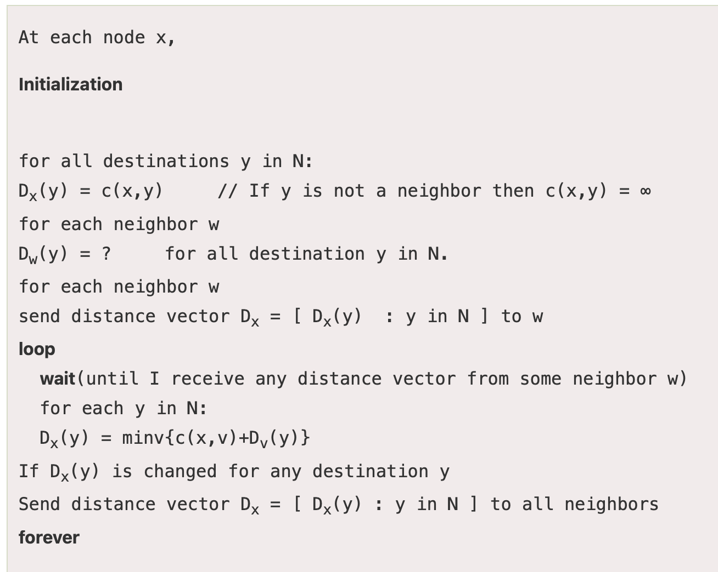
Distance vector algorithm
Putting together…
Notes:
The code is taken from: https://www.javatpoint.com/distance-vector-routing-algorithm

Slide 55
Distance vector algorithm
Putting together…
<Dest, cost> from N1
Database
<a1, 2> N1
…
<an, 1> Nn
Latest advertisements
Notes:
The code is taken from: https://www.javatpoint.com/distance-vector-routing-algorithm

Slide 56
Distance vector algorithm
Putting together…
Database
<a1, 2> N1
…
<an, 1> Nn
Latest advertisements
Notes:
The code is taken from: https://www.javatpoint.com/distance-vector-routing-algorithm

Slide 57
Distance vector algorithm
Putting together…
D_{x}(y) = estimate of least cost from x to y
x maintains distance vector D_{x} = [D_{x}(y): y є N ]
node x:
knows cost to each neighbor v: c(x,v)
maintains its neighbors’ distance vectors. For each neighbor v, x maintains D_{v} = [D_{v}(y): y є N ]

Slide 58
Distance vector algorithm
key idea:
from time-to-time, each node sends its own distance vector estimate to neighbors
when x receives new DV estimate from neighbor, it updates its own DV using B-F equation:
D_{x}(y) ← min_{v}{c(x,v) + D_{v}(y)} for each node y ∊ N
under minor, natural conditions, the estimate D_{x}(y) converge to the actual least cost d_{x}(y)

Slide 59
Distance vector algorithm
iterative, asynchronous: each local iteration caused by:
local link cost change
DV update message from neighbor
distributed:
each node notifies neighbors only when its DV changes
neighbors then notify their neighbors if necessary
each node:
wait for (change in local link cost or msg from neighbor)
recompute estimates
if DV to any dest has changed, notify neighbors

Slide 60
Distance Vector Routing protocol (Recap)
Advertise:
A router transmits its distance vector to each of its neighbors in a
routing packet.
2. Each router receives and saves the most recently received
distance vector from each of its neighbors.
3. Update:
A router recalculates its distance vector when:
It receives a distance vector from a neighbor containing
different information than before.
b) It discovers that a link to a neighbor has gone down
(or the cost has changed).

Slide 61
Routing updates (Recap)
Two circumstances when a node sends out routing advertisements:
Periodic: Automatically after some time. [typically 30 sec.]
2) Triggered: Whenever an event makes a node to change its routing table (e.g., link fail or a new message from a neighbor).

Slide 62
Distance Vector Routing: Link failure

Slide 63
Round: 2
Dest | Cost | N. Hop
A | 18 | C
B | 0 | B
C | 11 | C
D | 4 | D
E | 16 | C
Dest | Cost | N. Hop
A | 22 | C
B | 4 | B
C | 15 | C
D | 0 | D
E | 13 | E
Dest | Cost | N. Hop
A | 0 | A
B | 18 | C
C | 7 | C
D | 22 | C
E | 12 | C
B
D
19
4
A
11
13
15
7
5
C
E
Dest | Cost | N. Hop
A | 7 | A
B | 11 | B
C | 0 | C
D | 15 | D
E | 5 | E
Dest | Cost | N. Hop
A | 12 | C
B | 16 | C
C | 5 | C
D | 13 | D
E | 0 | E

Slide 64
Round: 3
Dest | Cost | N. Hop
A | ∞ | --
B | 0 | B
C | ∞ | --
D | 4 | D
E | ∞ | --
Dest | Cost | N. Hop
A | 22 | C
B | 4 | B
C | 15 | C
D | 0 | D
E | 13 | E
Dest | Cost | N. Hop
A | 0 | A
B | 18 | C
C | 7 | C
D | 22 | C
E | 12 | C
B
D
19
4
A
11
13
15
7
5
C
E
Node A: No Updates
Node B: No Updates
Node C: No Updates
Node D: No Updates
Node E: No Updates
Dest | Cost | N. Hop
A | 7 | A
B | ∞ | --
C | 0 | C
D | 15 | D
E | 5 | E
Dest | Cost | N. Hop
A | 12 | C
B | 16 | C
C | 5 | C
D | 13 | D
E | 0 | E

Slide 65
Round: 3
Dest | Cost | N. Hop
A | 19 | A
B | 0 | B
C | 19 | D
D | 4 | D
E | 17 | D
Dest | Cost | N. Hop
A | 22 | C
B | 4 | B
C | 15 | C
D | 0 | D
E | 13 | E
Dest | Cost | N. Hop
A | 0 | A
B | ∞ | C
C | 7 | C
D | 22 | C
E | 12 | C
Cost update
B
D
19
4
A
11
13
15
7
5
C
E
Node A: Updates for B
Node B: Updates for A,C,E
Node C: Updates for B
Node D: No Updates
Node E: Updates for B
Dest | Cost | N. Hop
A | 7 | A
B | 19 | D
C | 0 | C
D | 15 | D
E | 5 | E
Dest | Cost | N. Hop
A | 12 | C
B | 17 | D
C | 5 | C
D | 13 | D
E | 0 | E

Slide 66
Round: 4
Dest | Cost | N. Hop
A | 19 | A
B | 0 | B
C | 19 | D
D | 4 | D
E | 17 | D
Dest | Cost | N. Hop
A | 22 | C
B | 4 | B
C | 15 | C
D | 0 | D
E | 13 | E
Dest | Cost | N. Hop
A | 0 | A
B | ∞ | C
C | 7 | C
D | 22 | C
E | 12 | C
B
D
19
4
A
11
13
15
7
5
C
E
Node A: Updates for B
Node B: No Updates
Node C: No Updates
Node D: No Updates
Node E: No Updates
Dest | Cost | N. Hop
A | 7 | A
B | 19 | D
C | 0 | C
D | 15 | D
E | 5 | E
Dest | Cost | N. Hop
A | 12 | C
B | 17 | D
C | 5 | C
D | 13 | D
E | 0 | E

Slide 67
Round: 5
Dest | Cost | N. Hop
A | 19 | A
B | 0 | B
C | 19 | D
D | 4 | D
E | 17 | D
Dest | Cost | N. Hop
A | 22 | C
B | 4 | B
C | 15 | C
D | 0 | D
E | 13 | E
Dest | Cost | N. Hop
A | 0 | A
B | 19 | B
C | 7 | C
D | 22 | C
E | 12 | C
B
D
19
4
A
11
13
15
7
5
C
E
Dest | Cost | N. Hop
A | 7 | A
B | 19 | D
C | 0 | C
D | 15 | D
E | 5 | E
Dest | Cost | N. Hop
A | 12 | C
B | 17 | D
C | 5 | C
D | 13 | D
E | 0 | E

Slide 68
Distance vector: link cost changes
link cost changes:
node detects local link cost change
updates routing info, recalculates distance vector
if DV changes, notify neighbors
1
y
4
1
x
z
50

Slide 69
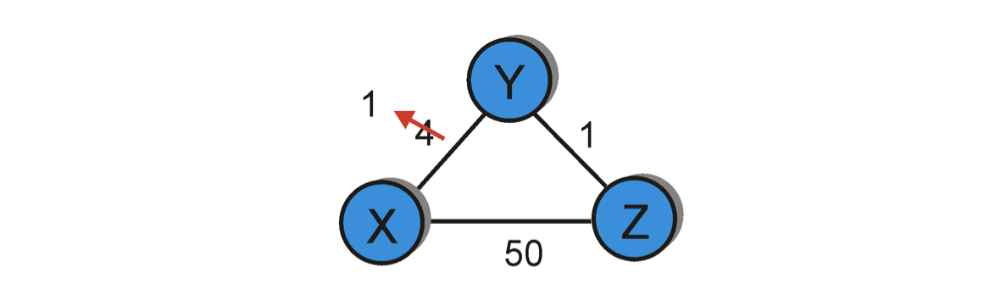
Distance vector: link cost “decreases”
Bellman-Ford algo.
considered the route
through Z (cost=51).
Dest | Cost | Hop
X | 4 | X
Y | 0 | Y
Z | 1 | Z
Dest | Cost | Hop
X | 1 | X
Y | 0 | Y
Z | 1 | Z
Dest | Cost | Hop
X | 1 | X
Y | 0 | Y
Z | 1 | Z
Dest | Cost | Hop
X | 1 | X
Y | 0 | Y
Z | 1 | Z
node Y
Dest | Cost | Hop
X | 5 | Y
Y | 1 | Y
Z | 0 | Z
Dest | Cost | Hop
X | 5 | Y
Y | 1 | Y
Z | 0 | Z
Dest | Cost | Hop
X | 2 | Y
Y | 1 | Y
Z | 0 | Z
Dest | Cost | Hop
X | 2 | Y
Y | 1 | Y
Z | 0 | Z
node Z
T1
T2
T3
T4
Cost change

Slide 70
Distance vector: link cost “increases”
Bellman-Ford algo.
considers two routes from the
saved advertisements.
<X, 60, X> -- direct link
<X, 5, Z> + d_{Z}(X) – Cost 6 link via Z
60
Dest | Cost | Hop
X | 4 | X
Y | 0 | Y
Z | 1 | Z
Dest | Cost | Hop
X | 6 | Z
Y | 0 | Y
Z | 1 | Z
Dest | Cost | Hop
X | 6 | Z
Y | 0 | Y
Z | 1 | Z
Dest | Cost | Hop
X | 8 | Z
Y | 0 | Y
Z | 1 | Z
node Y
Dest | Cost | Hop
X | 5 | Y
Y | 1 | Y
Z | 0 | Z
Dest | Cost | Hop
X | 5 | Y
Y | 1 | Y
Z | 0 | Z
Dest | Cost | Hop
X | 7 | Y
Y | 1 | Y
Z | 0 | Z
Dest | Cost | Hop
X | 7 | Y
Y | 1 | Y
Z | 0 | Z
node Z
T1
T2
T3
T4
Cost change

Slide 71
Distance vector: link cost “increases”
Bellman-Ford algo.
considers two routes from the
saved advertisements.
<X, 60, X> -- direct link
<X, 5, Z> + d_{Z}(X) – Cost 6 link via Z
60
When will this looped update stop (converge)?
Dest | Cost | Hop
X | 4 | X
Y | 0 | Y
Z | 1 | Z
Dest | Cost | Hop
X | 6 | Z
Y | 0 | Y
Z | 1 | Z
Dest | Cost | Hop
X | 6 | Z
Y | 0 | Y
Z | 1 | Z
Dest | Cost | Hop
X | 8 | X
Y | 0 | Y
Z | 1 | Z
node Y
Dest | Cost | Hop
X | 5 | Y
Y | 1 | Y
Z | 0 | Z
Dest | Cost | Hop
X | 5 | Y
Y | 1 | Y
Z | 0 | Z
Dest | Cost | Hop
X | 7 | Y
Y | 1 | Y
Z | 0 | Z
Dest | Cost | Hop
X | 7 | Y
Y | 1 | Y
Z | 0 | Z
node Z
T1
T2
T3
T4
Cost change

Slide 72
Distance vector: link cost “increases”
Bellman-Ford algo.
considers two routes from the
saved advertisements.
<X, 60, X> -- direct link
<X, 5, Z> + d_{Z}(X) – Cost 6 link via Z
60
“Count-to-infinity” problem
Dest | Cost | Hop
X | 4 | X
Y | 0 | Y
Z | 1 | Z
Dest | Cost | Hop
X | 6 | Z
Y | 0 | Y
Z | 1 | Z
Dest | Cost | Hop
X | 6 | Z
Y | 0 | Y
Z | 1 | Z
Dest | Cost | Hop
X | 8 | X
Y | 0 | Y
Z | 1 | Z
node Y
Dest | Cost | Hop
X | 5 | Y
Y | 1 | Y
Z | 0 | Z
Dest | Cost | Hop
X | 5 | Y
Y | 1 | Y
Z | 0 | Z
Dest | Cost | Hop
X | 7 | Y
Y | 1 | Y
Z | 0 | Z
Dest | Cost | Hop
X | 7 | Y
Y | 1 | Y
Z | 0 | Z
node Z
T1
T2
T3
T4
Cost change

Slide 73
When will this looped update stop (converge)?
Distance vector: link cost “increases”
Bellman-Ford algo.
considers two routes from the
saved advertisements.
<X, 60, X> -- direct link
<X, 5, Z> + d_{Z}(X) – Cost 6 link via Z
60
Dest | Cost | Hop
X | 4 | X
Y | 0 | Y
Z | 1 | Z
Dest | Cost | Hop
X | 6 | Z
Y | 0 | Y
Z | 1 | Z
Dest | Cost | Hop
X | 6 | Z
Y | 0 | Y
Z | 1 | Z
Dest | Cost | Hop
X | 8 | X
Y | 0 | Y
Z | 1 | Z
node Y
Dest | Cost | Hop
X | 5 | Y
Y | 1 | Y
Z | 0 | Z
Dest | Cost | Hop
X | 5 | Y
Y | 1 | Y
Z | 0 | Z
Dest | Cost | Hop
X | 7 | Y
Y | 1 | Y
Z | 0 | Z
Dest | Cost | Hop
X | 7 | Y
Y | 1 | Y
Z | 0 | Z
node Z
T1
T2
T3
T4
Cost change

Slide 74
“Count-to-infinity” problem: Another scenario
1
1
1
1
A
X
B
C
D
E
Small number for infinity
Triggered update and hold time
Avoiding loop while advertising

Slide 75
Count-to-infinity Problem: Solutions-1
Use some relatively small number as an approximation of infinity
For instance, in the Routing Information Protocol (RIP)—that implements DV routing-- the maximum number of hops is typically set to 15 with 16 hops considered as infinity. If a network destination is more than 15 hops away, it is considered unreachable.

Slide 76


Count-to-infinity Problem: Solutions-1
Use some relatively small number as an approximation of infinity
Maximum possible hops

Slide 77
Count-to-infinity Problem: Solutions-1
Use some relatively small number as an approximation of infinity
Maximum possible hops
“Thus, when considering even the most distant Facebook user in the Siberian tundra or the Peruvian rainforest, a friend of your friend probably knows a friend of their friend,” -- Facebook
(1) https://research.facebook.com/blog/2016/2/three-and-a-half-degrees-of-separation/
(2) Six degrees of separation: https://en.wikipedia.org/wiki/Six_degrees_of_separation

Slide 78
Count-to-infinity Problem: Solutions-2
Technique to improve the time to stabilize routing is called
split horizon
When a node sends a routing update to its neighbors, it does not send those routes it learned from each neighbor back to that neighbor
For example, if Z has the route (X, 5, Y) in its table, then it knows it must have learned this route from Y, and so whenever Z sends a routing update to Y, it does not include the route (X, 5) in that update

Slide 79
Distance vector: link cost “increases”
Bellman-Ford algo.
considers two routes from the
saved advertisements.
<X, 60, X> -- direct link
<X, 5, Z> + d_{Z}(X) – Cost 6 link via Z
60
Case: Split horizon
Dest | Cost | Hop
X | 4 | X
Y | 0 | Y
Z | 1 | Z
Dest | Cost | Hop
X | 6 | Z
Y | 0 | Y
Z | 1 | Z
Dest | Cost | Hop
X | 6 | Z
Y | 0 | Y
Z | 1 | Z
Dest | Cost | Hop
X | 8 | X
Y | 0 | Y
Z | 1 | Z
node Y
Dest | Cost | Hop
X | 5 | Y
Y | 1 | Y
Z | 0 | Z
Dest | Cost | Hop
X | 5 | Y
Y | 1 | Y
Z | 0 | Z
Dest | Cost | Hop
X | 7 | Y
Y | 1 | Y
Z | 0 | Z
Dest | Cost | Hop
X | 7 | Y
Y | 1 | Y
Z | 0 | Z
node Z
T1
T2
T3
T4
Cost change

Slide 80
Count-to-infinity Problem: Solutions-3
In a stronger version of split horizon, called split horizon with poison reverse
B actually sends that back route to A, but it puts negative information in the route to ensure that A will not eventually use B to get to E
For example, B sends the route (E, ∞) to A

Slide 81
Distance vector: link cost “increases”
Bellman-Ford algo.
considers two routes from the
saved advertisements.
<X, 60, X> -- direct link
<X, ♾, Z> + d_{Z}(X) – Cost 6 link via Z
60
Case: Split horizon
with poisoned reverse
Dest | Cost | Hop
X | 4 | X
Y | 0 | Y
Z | 1 | Z
Dest | Cost | Hop
X | 6 | Z
Y | 0 | Y
Z | 1 | Z
Dest | Cost | Hop
X | 6 | Z
Y | 0 | Y
Z | 1 | Z
Dest | Cost | Hop
X | 8 | X
Y | 0 | Y
Z | 1 | Z
node Y
Dest | Cost | Hop
X | 5 | Y
Y | 1 | Y
Z | 0 | Z
Dest | Cost | Hop
X | 5 | Y
Y | 1 | Y
Z | 0 | Z
Dest | Cost | Hop
X | 7 | Y
Y | 1 | Y
Z | 0 | Z
Dest | Cost | Hop
X | 7 | Y
Y | 1 | Y
Z | 0 | Z
node Z
T1
T2
T3
T4
Cost change

Slide 82
“Count-to-infinity” problem: Another scenario
1
1
1
1
A
X
B
C
D
E
Small number for infinity
Triggered update and hold time
Avoiding loop while advertising

Slide 83
Count-to-infinity Problem: Solutions-1
Use some relatively small number as an approximation of infinity
For instance, in the Routing Information Protocol (RIP)—that implements DV routing-- the maximum number of hops is typically set to 15 with 16 hops considered as infinity. If a network destination is more than 15 hops away, it is considered unreachable.

Slide 84
Count-to-infinity Problem: Solutions-2
Technique to improve the time to stabilize routing is called
split horizon
When a node sends a routing update to its neighbors, it does not send those routes it learned from each neighbor back to that neighbor
For example, if Z has the route (X, 5, Y) in its table, then it knows it must have learned this route from Y, and so whenever Z sends a routing update to Y, it does not include the route (X, 5) in that update

Slide 85
Distance vector: link cost “increases”
Bellman-Ford algo.
considers two routes from the
saved advertisements.
<X, 60, X> -- direct link
<X, 5, Z> + d_{Z}(X) – Cost 6 link via Z
60
Case: Split horizon
Dest | Cost | Hop
X | 4 | X
Y | 0 | Y
Z | 1 | Z
Dest | Cost | Hop
X | 6 | Z
Y | 0 | Y
Z | 1 | Z
Dest | Cost | Hop
X | 6 | Z
Y | 0 | Y
Z | 1 | Z
Dest | Cost | Hop
X | 8 | X
Y | 0 | Y
Z | 1 | Z
node Y
Dest | Cost | Hop
X | 5 | Y
Y | 1 | Y
Z | 0 | Z
Dest | Cost | Hop
X | 5 | Y
Y | 1 | Y
Z | 0 | Z
Dest | Cost | Hop
X | 7 | Y
Y | 1 | Y
Z | 0 | Z
Dest | Cost | Hop
X | 7 | Y
Y | 1 | Y
Z | 0 | Z
node Z
T1
T2
T3
T4
Cost change

Slide 86
Count-to-infinity Problem: Solutions-3
In a stronger version of split horizon, called split horizon with poison reverse
B actually sends that back route to A, but it puts negative information in the route to ensure that A will not eventually use B to get to E
For example, B sends the route (E, ∞) to A

Slide 87
Distance vector: link cost “increases”
Bellman-Ford algo.
considers two routes from the
saved advertisements.
<X, 60, X> -- direct link
<X, ♾, Z> + d_{Z}(X) – Cost 6 link via Z
60
Case: Split horizon
with poisoned reverse
Dest | Cost | Hop
X | 4 | X
Y | 0 | Y
Z | 1 | Z
Dest | Cost | Hop
X | 6 | Z
Y | 0 | Y
Z | 1 | Z
Dest | Cost | Hop
X | 6 | Z
Y | 0 | Y
Z | 1 | Z
Dest | Cost | Hop
X | 8 | X
Y | 0 | Y
Z | 1 | Z
node Y
Dest | Cost | Hop
X | 5 | Y
Y | 1 | Y
Z | 0 | Z
Dest | Cost | Hop
X | 5 | Y
Y | 1 | Y
Z | 0 | Z
Dest | Cost | Hop
X | 7 | Y
Y | 1 | Y
Z | 0 | Z
Dest | Cost | Hop
X | 7 | Y
Y | 1 | Y
Z | 0 | Z
node Z
T1
T2
T3
T4
Cost change

Slide 88

An example where split-horizon is not enough
DV format: <Destination, Path-cost, NextHop>
C
<A, 2, B>
Example: Let’s consider the routes
from (C to A) and (D to A).
1
A
B
1
1
1
<A, 2, B>
D
Event 1: Converged state

Slide 89
An example where split-horizon is not enough
DV format: <Destination, Path-cost, NextHop>
C
<A, 2, B>
1
X
A
B
1
1
X
X
X
1
<A, 2, B>
D
Event 2: Router B failed, i.e., both links (B,C) and (B,D) are down simultaneously.

Slide 90
An example where split-horizon is not enough
DV format: <Destination, Path-cost, NextHop>
C
<A, 2, B>
<A, 3, D>
Case A:
No split-horizon.
No poison reverse.
1
X
A
B
1
1
X
<A, 2, B>
X
1
<A, 4, C>
D
Event 3:
C updates the route from its old database (which contains an advertisement from D) to <A,3,D>.
C shares this route to D.
D updates its route with this recent advertisement from C.
D’s current route becomes <A,4,C>. D shares this route back to C and this starts the “count to infinity”.

Slide 91
An example where split-horizon is not enough
DV format: <Destination, Path-cost, NextHop>
C
<A, 2, B>
<A, 3, D>
Case B:
With split-horizon.
No poison reverse.
1
X
A
B
1
1
X
<A, 2, B>
X
1
<A, 3, C>
D
Event 3:
C updates the route from its old database (which contains an old advertisement from D) to <A,3,D>.
(Note that D’s old route <A,2,B> was not learnt from C, so it shared it with C even when split-horizon is applied.)
C DOES NOT advertise this route (i.e., <A,3,D>) to D due to the Split-horizon rule.
D also updates the route from its old database (which contains an old advertisement from C) to <A,3,C>.
D DOES NOT advertise this route to C due to the Split-horizon rule.
This prevents count to infinity, but does not stop routing loop as both C and D’s routes depend on each other.
In practical implementations, routers will time-out old database to eventually get rid of this inconsistency.

Slide 92
An example where split-horizon is not enough
DV format: <Destination, Path-cost, NextHop>
C
<A, 2, B>
<A, 3, D>
Case C:
With poison reverse.
(this means Split-horizon
with poisoned reverse)
1
X
A
B
1
1
X
<A, 2, B>
X
1
<No route to A>
D
Event 3:
C updates the route from its old database (which contains an old advertisement from D) to <A,3,D>.
C advertises the poisoned route <A, inf., D> to D due to Poisoned-reverse rule.
This advertisement from C changes D’s database indicating “cost to reach A via C is inf.”
D finds no path to A. D considers A unreachable (correct behavior). D may send this <A,inf,D> to C.
This prevents count to infinity, as well as prevents the routing loop.

Slide 93
Distance vector: Poisoned reverse
Does poison reverse solve the general count-to-infinity problem?
It does not. It may be possible that loops involving three or more nodes (rather than simply two immediately neighboring nodes, as we shown in last example) will not be detected by the poison reverse technique.

Slide 94
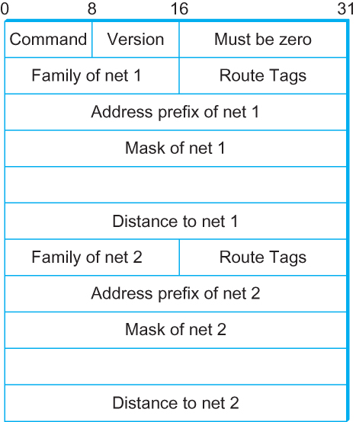
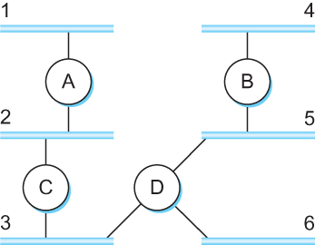
DV Implementation: Routing Information Protocol (RIP)
Example Network
running RIP RIPv2 Packet Format

Slide 95
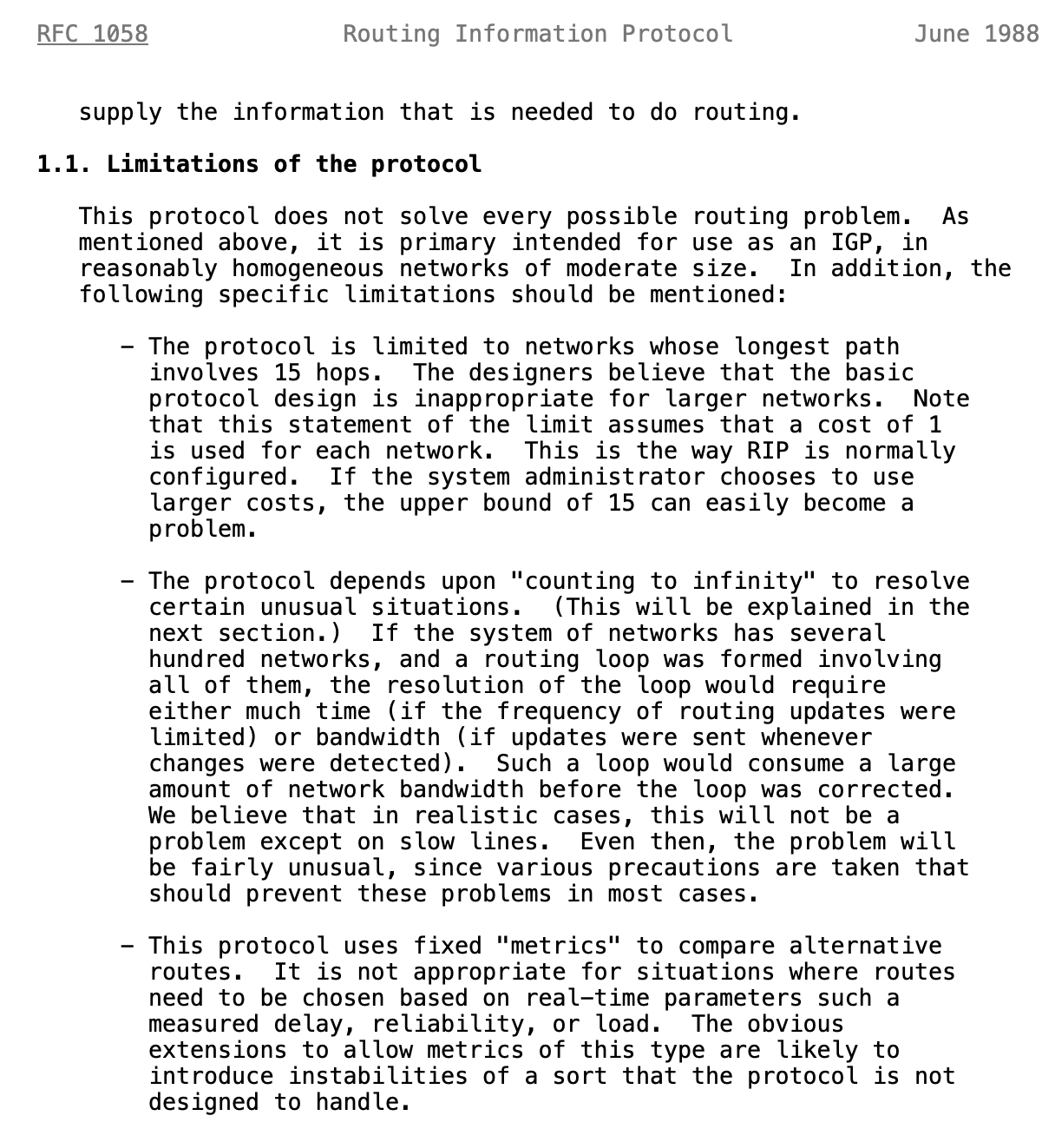
Limitations of DV routing
Small network assumption
Possibility of
routing loops
Static and
pre-determined
link costs
Notes:
What is RFC: https://www.techtarget.com/whatis/definition/Request-for-Comments-RFC

Slide 96
What is RFC?
Request for Comments (RFC):
A peer reviewed publication in a series from the
principal technical development and standards-setting
bodies for the Internet, most prominently
the Internet Engineering Task Force (IETF).
[ref] https://www.ietf.org/standards/rfcs/
How to Read an RFC: https://www.ietf.org/blog/how-read-rfc/

