Slide 1

CMSC 417: Computer Networks
Spring 2026
Topic: Internetworking – Routing protocols
(Textbook chapter 3)
Nirupam Roy
M-W 2:00-3:15pm
CSI 2117
Feb 11th, 2026

Slide 2
Distance Vector Routing (cont…)

Slide 3
Round: 1
Dest | Cost | N. Hop
A | 18 | C
B | 0 | B
C | 11 | C
D | 4 | D
E | 16 | C
Dest | Cost | N. Hop
A | 22 | C
B | 4 | B
C | 15 | C
D | 0 | D
E | 13 | E
When will a node send routing advertisements to its neighbors?
Dest | Cost | N. Hop
A | 0 | A
B | 18 | C
C | 7 | C
D | 22 | C
E | 12 | C
B
D
19
4
A
11
13
15
7
5
C
E
Node A: Updates for B,D,E
Node B: Updates for A, E
Node C: No Updates
Node D: Updates for A
Node E: Updates for A, B
Dest | Cost | N. Hop
A | 7 | A
B | 11 | B
C | 0 | C
D | 15 | D
E | 5 | E
Dest | Cost | N. Hop
A | 12 | C
B | 16 | C
C | 5 | C
D | 13 | D
E | 0 | E

Slide 4
Routing advertisements
Two circumstances when a node sends out routing advertisements:
Triggered: Whenever an event makes a node to change its routing table (e.g., link fail or cost change).

Slide 5
Routing advertisements
Two circumstances when a node sends out routing advertisements:
Triggered: Whenever an event makes a node to change its routing table (e.g., link fail or cost change).
Periodic: Automatically after some time (typically 30 secs). Why?

Slide 6
Routing advertisements
Two circumstances when a node sends out routing advertisements:
Triggered: Whenever an event makes a node to change its routing table (e.g., link fail or cost change).
Periodic: Automatically after some time (typically 30 secs). Why?
a) Failure detection without explicit signals
b) Recovery from lost messages
c) Self-stabilization
d) Handling silent failures
Notes:
Failure detection without explicit signals
DV routers often infer failures implicitly. If periodic updates stop arriving, a route can be timed out and invalidated.
Recovery from lost messages
Triggered updates can be dropped. Periodic refreshes eventually correct stale or inconsistent state.
Self-stabilization
Even if transient inconsistencies or partial state corruption occur, periodic updates guarantee eventual convergence.
Handling silent failures
Links or neighbors may fail without an explicit “down” event. Periodic updates are the only way to notice.

Slide 7
Round: 2
Dest | Cost | N. Hop
A | 18 | C
B | 0 | B
C | 11 | C
D | 4 | D
E | 16 | C
Dest | Cost | N. Hop
A | 22 | C
B | 4 | B
C | 15 | C
D | 0 | D
E | 13 | E
Dest | Cost | N. Hop
A | 0 | A
B | 18 | C
C | 7 | C
D | 22 | C
E | 12 | C
B
D
19
4
A
11
13
15
7
Convergence
C
5
E
Node A: No Updates
Node B: No Updates
Node C: No Updates
Node D: No Updates
Node E: No Updates
Dest | Cost | N. Hop
A | 7 | A
B | 11 | B
C | 0 | C
D | 15 | D
E | 5 | E
Dest | Cost | N. Hop
A | 12 | C
B | 16 | C
C | 5 | C
D | 13 | D
E | 0 | E

Slide 8
Distance vector algorithm
Bellman-Ford equation (dynamic programming)

Slide 9
Graph abstraction of the network
5
v
3
w
2
5
u
2
1
z
3
1
2
x
y
1
graph: G = (N,E)
N = set of routers = { u, v, w, x, y, z }
E = set of links ={ (u,v), (u,x), (v,x), (v,w), (x,w), (x,y), (w,y), (w,z), (y,z) }
aside: graph abstraction is useful in other network contexts, e.g.,
P2P, where N is set of peers and E is set of TCP connections

Slide 10
Graph abstraction: costs
5
c(x,x’) = cost of link (x,x’)
e.g., c(w,z) = 5
cost could always be 1, or
inversely related to bandwidth,
or related to congestion
v
3
w
2
5
u
2
1
z
3
1
2
x
y
1
cost of path (x₁, x₂, x₃,…, x_{p}) = c(x₁,x₂) + c(x₂,x₃) + … + c(x_{p-1},x_{p})
key question: what is the least-cost path between u and z ?
routing algorithm: algorithm that finds that least cost path

Slide 11
Distance vector algorithm
Bellman-Ford equation (dynamic programming)
let
d_{x}(y) := cost of least-cost path from x to y
then
d_{x}(y) = min {c(x,v) + d_{v}(y) }
v
cost from neighbor v to destination y
cost to neighbor v
min taken over all neighbors v of x

Slide 12
Bellman-Ford example
5
3 neighbors of u = v, x, w
clearly, d_{v}(z) = 5, d_{x}(z) = 3, d_{w}(z) = 3
v
3
w
2
5
u
z
B-F equation says:
2
1
3
1
2
d_{u}(z) = min { c(u,v) + d_{v}(z),
c(u,x) + d_{x}(z),
c(u,w) + d_{w}(z) }
= min {2 + 5,
1 + 3,
5 + 3} = 4
x
y
1
node achieving minimum is next
hop in shortest path, used in forwarding table
<dest, cost, next-hop> = <z, 4, x>

Slide 13
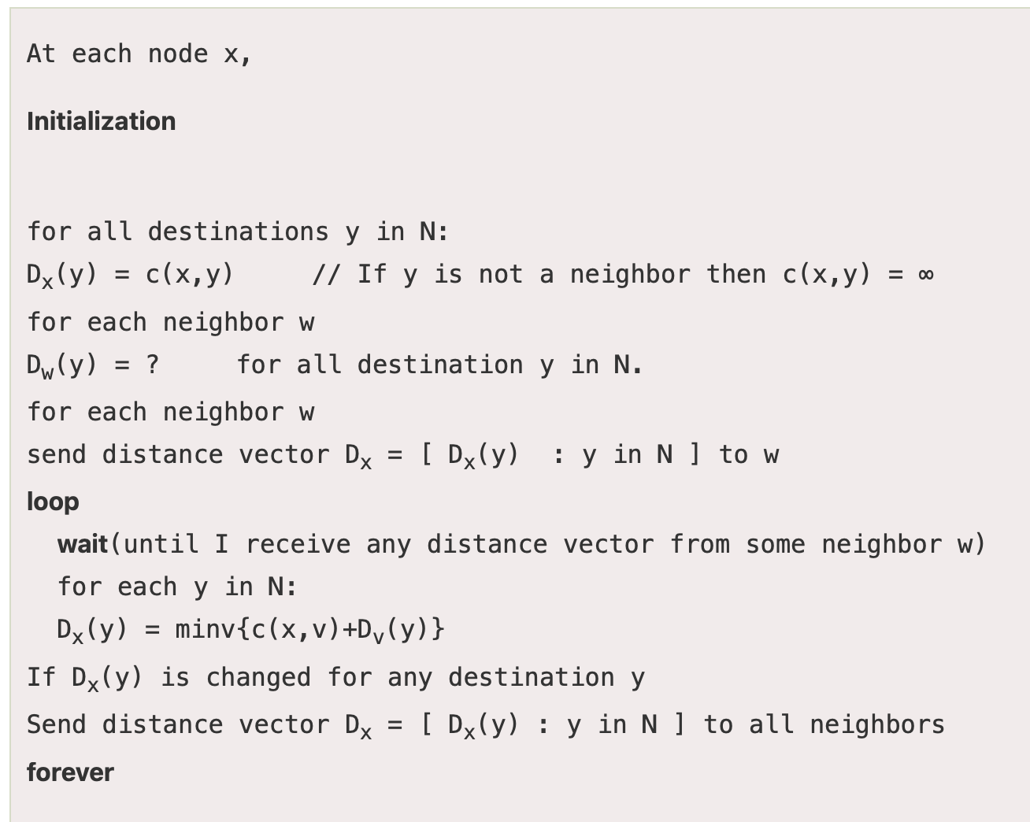
Distance vector algorithm
Putting together…
Notes:
The code is taken from: https://www.javatpoint.com/distance-vector-routing-algorithm

Slide 14
Distance vector algorithm
Putting together…
<Dest, cost> from N1
Database
<a1, 2> N1
…
<an, 1> Nn
Latest advertisements
from the neighbors
Notes:
The code is taken from: https://www.javatpoint.com/distance-vector-routing-algorithm

Slide 15
Distance vector algorithm
Putting together…
DV from the Routing table of A
<a1, 5>
…
<an, 3>
Own information
sent to neighbors
Notes:
The code is taken from: https://www.javatpoint.com/distance-vector-routing-algorithm

Slide 16
Distance vector algorithm
iterative, asynchronous: each local iteration caused by:
local link cost change
DV update message from neighbor
distributed:
each node notifies neighbors only when its DV changes
  neighbors then notify their neighbors if necessary
each node:
wait for (change in local link cost or msg from neighbor)
recompute estimates
if DV to any dest has changed, notify neighbors

Slide 17
Distance vector algorithm
iterative, asynchronous: each local iteration caused by:
local link cost change
DV update message from neighbor
distributed:
each node notifies neighbors only when its DV changes
  neighbors then notify their neighbors if necessary
each node:
wait for (change in local link cost or msg from neighbor)
recompute estimates
if DV to any dest has changed, notify neighbors

Slide 18
Implementation perspective
DV algorithm
Bellman-Ford algo.
d_{x}(y) = min {c(x,v) + d_{v}(y) }
Routing table
Dest | Cost | N. Hop
B | 7 | A
C | 11 | B
P | 0 | C

Slide 19
Implementation perspective
DV database
DV algorithm
Bellman-Ford algo.
d_{x}(y) = min {c(x,v) + d_{v}(y) }
Neighbor A’s--
Identity (IP/interface)
Timestamp of last update
+
Routing table
A’s DVs
Dest | Cost | N. Hop
B | 7 | A
C | 11 | B
P | 0 | C
A says <B, 19>
A says <C, 2>
A says <P, 6>
Neighbor B’s--
Identity (IP/interface)
Timestamp of last update
+
B’s DVs
B says <A, 5>
B says <C, 12>
B says <Q, 9>

Slide 20
Implementation perspective
DV database
DV algorithm
Bellman-Ford algo.
d_{x}(y) = min {c(x,v) + d_{v}(y) }
Neighbor A’s--
Identity (IP/interface)
Timestamp of last update
+
Routing table
A’s DVs
Dest | Cost | N. Hop
B | 7 | A
C | 11 | B
P | 0 | C
A says <B, 19>
A says <C, 2>
A says <P, 6>
Neighbor B’s--
Identity (IP/interface)
Timestamp of last update
Database maintenance
+
B’s DVs
Add new database entry
Update timestamp
Update a DV
Purge old information
B says <A, 5>
B says <C, 12>
B says <Q, 9>
Notes:
How are old vectors purged?
There are two levels of aging in RIP.
A. Neighbor-Level Aging
If a neighbor stops sending updates:
RIP expects updates every 30 seconds
If no update is heard within the invalid timer (~180 seconds):
All routes learned via that neighbor are marked invalid (metric = 16)
Triggered update may be sent
Eventually (after flush timer ~240 seconds):
Routes are removed from the table
The neighbor entry itself is also removed.
B. Route-Level Aging (More Important)
Each route has its own timers:
Update timer (~30 sec) — periodic advertisement
Invalid timer (~180 sec) — route considered dead
Flush timer (~240 sec) — route deleted
So routes are not stored indefinitely. They age out automatically.

Slide 21
Implementation perspective
DV database
DV algorithm
Bellman-Ford algo.
d_{x}(y) = min {c(x,v) + d_{v}(y) }
Neighbor A’s--
Identity (IP/interface)
Timestamp of last update
+
Routing table
A’s DVs
Dest | Cost | N. Hop
B | 7 | A
C | 11 | B
P | 0 | C
A says <B, 19>
A says <C, 2>
A says <P, 6>
Neighbor B’s--
Identity (IP/interface)
Timestamp of last update
Database maintenance
+
B’s DVs
Add new database entry
Update timestamp
Update a DV
Purge old information
B says <A, 5>
B says <C, 12>
B says <Q, 9>
X
Notes:
How are old vectors purged?
There are two levels of aging in RIP.
A. Neighbor-Level Aging
If a neighbor stops sending updates:
RIP expects updates every 30 seconds
If no update is heard within the invalid timer (~180 seconds):
All routes learned via that neighbor are marked invalid (metric = 16)
Triggered update may be sent
Eventually (after flush timer ~240 seconds):
Routes are removed from the table
The neighbor entry itself is also removed.
B. Route-Level Aging (More Important)
Each route has its own timers:
Update timer (~30 sec) — periodic advertisement
Invalid timer (~180 sec) — route considered dead
Flush timer (~240 sec) — route deleted
So routes are not stored indefinitely. They age out automatically.

Slide 22
Implementation perspective
DV database
DV algorithm
Bellman-Ford algo.
d_{x}(y) = min {c(x,v) + d_{v}(y) }
Neighbor A’s--
Identity (IP/interface)
Timestamp of last update
+
Routing table
A’s DVs
Dest | Cost | N. Hop
B | 7 | A
C | 11 | B
P | 0 | C
A says <B, 19>
A says <C, 2>
A says <P, 6>
Neighbor B’s--
Identity (IP/interface)
Timestamp of last update
Database maintenance
+
B’s DVs
Add new database entry
Update timestamp
Update a DV
Purge old information
B says <A, 5>
B says <C, 12>
B says <Q, 9>
X
Notes:
How are old vectors purged?
There are two levels of aging in RIP.
A. Neighbor-Level Aging
If a neighbor stops sending updates:
RIP expects updates every 30 seconds
If no update is heard within the invalid timer (~180 seconds):
All routes learned via that neighbor are marked invalid (metric = 16)
Triggered update may be sent
Eventually (after flush timer ~240 seconds):
Routes are removed from the table
The neighbor entry itself is also removed.
B. Route-Level Aging (More Important)
Each route has its own timers:
Update timer (~30 sec) — periodic advertisement
Invalid timer (~180 sec) — route considered dead
Flush timer (~240 sec) — route deleted
So routes are not stored indefinitely. They age out automatically.

Slide 23
Distance Vector Routing: Link failure

Slide 24
Round: 2
Dest | Cost | N. Hop
A | 18 | C
B | 0 | B
C | 11 | C
D | 4 | D
E | 16 | C
Dest | Cost | N. Hop
A | 22 | C
B | 4 | B
C | 15 | C
D | 0 | D
E | 13 | E
Dest | Cost | N. Hop
A | 0 | A
B | 18 | C
C | 7 | C
D | 22 | C
E | 12 | C
B
D
19
4
A
11
13
15
7
5
C
E
Dest | Cost | N. Hop
A | 7 | A
B | 11 | B
C | 0 | C
D | 15 | D
E | 5 | E
Dest | Cost | N. Hop
A | 12 | C
B | 16 | C
C | 5 | C
D | 13 | D
E | 0 | E

Slide 25
Round: 3
Dest | Cost | N. Hop
A | ∞ | --
B | 0 | B
C | ∞ | --
D | 4 | D
E | ∞ | --
Dest | Cost | N. Hop
A | 22 | C
B | 4 | B
C | 15 | C
D | 0 | D
E | 13 | E
Dest | Cost | N. Hop
A | 0 | A
B | 18 | C
C | 7 | C
D | 22 | C
E | 12 | C
B
D
19
4
A
11
13
15
7
5
C
E
Node A: No Updates
Node B: No Updates
Node C: No Updates
Node D: No Updates
Node E: No Updates
Dest | Cost | N. Hop
A | 7 | A
B | ∞ | --
C | 0 | C
D | 15 | D
E | 5 | E
Dest | Cost | N. Hop
A | 12 | C
B | 16 | C
C | 5 | C
D | 13 | D
E | 0 | E

Slide 26
Round: 3
Dest | Cost | N. Hop
A | 19 | A
B | 0 | B
C | 19 | D
D | 4 | D
E | 17 | D
Dest | Cost | N. Hop
A | 22 | C
B | 4 | B
C | 15 | C
D | 0 | D
E | 13 | E
Dest | Cost | N. Hop
A | 0 | A
B | ∞ | C
C | 7 | C
D | 22 | C
E | 12 | C
Cost update
B
D
19
4
A
11
13
15
7
5
C
E
Node A: Updates for B
Node B: Updates for A,C,E
Node C: Updates for B
Node D: No Updates
Node E: Updates for B
Dest | Cost | N. Hop
A | 7 | A
B | 19 | D
C | 0 | C
D | 15 | D
E | 5 | E
Dest | Cost | N. Hop
A | 12 | C
B | 17 | D
C | 5 | C
D | 13 | D
E | 0 | E

Slide 27
Round: 4
Dest | Cost | N. Hop
A | 19 | A
B | 0 | B
C | 19 | D
D | 4 | D
E | 17 | D
Dest | Cost | N. Hop
A | 22 | C
B | 4 | B
C | 15 | C
D | 0 | D
E | 13 | E
Dest | Cost | N. Hop
A | 0 | A
B | ∞ | C
C | 7 | C
D | 22 | C
E | 12 | C
B
D
19
4
A
11
13
15
7
5
C
E
Node A: Updates for B
Node B: No Updates
Node C: No Updates
Node D: No Updates
Node E: No Updates
Dest | Cost | N. Hop
A | 7 | A
B | 19 | D
C | 0 | C
D | 15 | D
E | 5 | E
Dest | Cost | N. Hop
A | 12 | C
B | 17 | D
C | 5 | C
D | 13 | D
E | 0 | E

Slide 28
Round: 5
Dest | Cost | N. Hop
A | 19 | A
B | 0 | B
C | 19 | D
D | 4 | D
E | 17 | D
Dest | Cost | N. Hop
A | 22 | C
B | 4 | B
C | 15 | C
D | 0 | D
E | 13 | E
Dest | Cost | N. Hop
A | 0 | A
B | 19 | B
C | 7 | C
D | 22 | C
E | 12 | C
B
D
19
4
A
11
13
15
7
5
C
E
Dest | Cost | N. Hop
A | 7 | A
B | 19 | D
C | 0 | C
D | 15 | D
E | 5 | E
Dest | Cost | N. Hop
A | 12 | C
B | 17 | D
C | 5 | C
D | 13 | D
E | 0 | E

Slide 29
Distance vector: link cost changes
link cost changes:
node detects local link cost change
updates routing info, recalculates
distance vector
if DV changes, notify neighbors
1
y
4
1
x
z
50

Slide 30
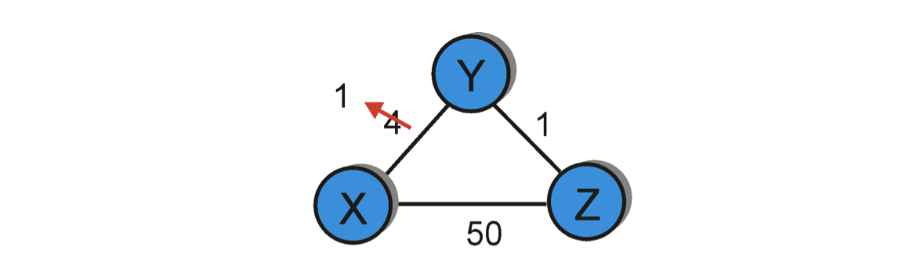
Distance vector: link cost “decreases”
Bellman-Ford algo.
considered the route
through Z (cost=51).
Dest | Cost | Hop
X | 4 | X
Y | 0 | Y
Z | 1 | Z
Dest | Cost | Hop
X | 1 | X
Y | 0 | Y
Z | 1 | Z
Dest | Cost | Hop
X | 1 | X
Y | 0 | Y
Z | 1 | Z
Dest | Cost | Hop
X | 1 | X
Y | 0 | Y
Z | 1 | Z
node Y
Dest | Cost | Hop
X | 5 | Y
Y | 1 | Y
Z | 0 | Z
Dest | Cost | Hop
X | 5 | Y
Y | 1 | Y
Z | 0 | Z
Dest | Cost | Hop
X | 2 | Y
Y | 1 | Y
Z | 0 | Z
Dest | Cost | Hop
X | 2 | Y
Y | 1 | Y
Z | 0 | Z
node Z
T1
T2
T3
T4
Cost change

Slide 31
Distance vector: link cost “increases”
Bellman-Ford algo.
considers two routes from the
saved advertisements.
<X, 60> -- direct link
<X, 5> says Z + C(Y,Z) – Cost 6 link via Z
60
Dest | Cost | Hop
X | 4 | X
Y | 0 | Y
Z | 1 | Z
Dest | Cost | Hop
X | 6 | Z
Y | 0 | Y
Z | 1 | Z
Dest | Cost | Hop
X | 6 | Z
Y | 0 | Y
Z | 1 | Z
Dest | Cost | Hop
X | 8 | Z
Y | 0 | Y
Z | 1 | Z
node Y
Dest | Cost | Hop
X | 5 | Y
Y | 1 | Y
Z | 0 | Z
Dest | Cost | Hop
X | 5 | Y
Y | 1 | Y
Z | 0 | Z
Dest | Cost | Hop
X | 7 | Y
Y | 1 | Y
Z | 0 | Z
Dest | Cost | Hop
X | 7 | Y
Y | 1 | Y
Z | 0 | Z
node Z
T1
T2
T3
T4
Cost change

Slide 32
Distance vector: link cost “increases”
Bellman-Ford algo.
considers two routes from the
saved advertisements.
<X, 60> -- direct link
<X, 5> says Z + C(Y,Z) – Cost 6 link via Z
60
When will this looped update stop (converge)?
Dest | Cost | Hop
X | 4 | X
Y | 0 | Y
Z | 1 | Z
Dest | Cost | Hop
X | 6 | Z
Y | 0 | Y
Z | 1 | Z
Dest | Cost | Hop
X | 6 | Z
Y | 0 | Y
Z | 1 | Z
Dest | Cost | Hop
X | 8 | X
Y | 0 | Y
Z | 1 | Z
node Y
Dest | Cost | Hop
X | 5 | Y
Y | 1 | Y
Z | 0 | Z
Dest | Cost | Hop
X | 5 | Y
Y | 1 | Y
Z | 0 | Z
Dest | Cost | Hop
X | 7 | Y
Y | 1 | Y
Z | 0 | Z
Dest | Cost | Hop
X | 7 | Y
Y | 1 | Y
Z | 0 | Z
node Z
T1
T2
T3
T4
Cost change

Slide 33
Distance vector: link cost “increases”
Bellman-Ford algo.
considers two routes from the
saved advertisements.
<X, 60> -- direct link
<X, 5> says Z + C(Y,Z) – Cost 6 link via Z
60
“Count-to-infinity” problem
Dest | Cost | Hop
X | 4 | X
Y | 0 | Y
Z | 1 | Z
Dest | Cost | Hop
X | 6 | Z
Y | 0 | Y
Z | 1 | Z
Dest | Cost | Hop
X | 6 | Z
Y | 0 | Y
Z | 1 | Z
Dest | Cost | Hop
X | 8 | X
Y | 0 | Y
Z | 1 | Z
node Y
Dest | Cost | Hop
X | 5 | Y
Y | 1 | Y
Z | 0 | Z
Dest | Cost | Hop
X | 5 | Y
Y | 1 | Y
Z | 0 | Z
Dest | Cost | Hop
X | 7 | Y
Y | 1 | Y
Z | 0 | Z
Dest | Cost | Hop
X | 7 | Y
Y | 1 | Y
Z | 0 | Z
node Z
T1
T2
T3
T4
Cost change

Slide 34
Why do we call it count to “infinity”?
Distance vector: link cost “increases”
Bellman-Ford algo.
considers two routes from the
saved advertisements.
<X, 60> -- direct link
<X, 5> says Z + C(Y,Z) – Cost 6 link via Z
Count to “infinity” for
link failure.
60
Dest | Cost | Hop
X | 4 | X
Y | 0 | Y
Z | 1 | Z
Dest | Cost | Hop
X | 6 | Z
Y | 0 | Y
Z | 1 | Z
Dest | Cost | Hop
X | 6 | Z
Y | 0 | Y
Z | 1 | Z
Dest | Cost | Hop
X | 8 | X
Y | 0 | Y
Z | 1 | Z
node Y
Dest | Cost | Hop
X | 5 | Y
Y | 1 | Y
Z | 0 | Z
Dest | Cost | Hop
X | 5 | Y
Y | 1 | Y
Z | 0 | Z
Dest | Cost | Hop
X | 7 | Y
Y | 1 | Y
Z | 0 | Z
Dest | Cost | Hop
X | 7 | Y
Y | 1 | Y
Z | 0 | Z
node Z
T1
T2
T3
T4
Cost change

Slide 35
“Count-to-infinity” problem: Another scenario
1
1
1
1
A
X
B
C
D
E
Small number for infinity
Triggered update and hold time
Avoiding loop while advertising

Slide 36
Count-to-infinity Problem: Solutions-1
Use some relatively small number as an approximation of infinity
For instance, in the Routing Information Protocol (RIP)—that implements DV routing-- the maximum number of hops is typically set to 15 with 16 hops considered as infinity. If a network destination is more than 15 hops away, it is considered unreachable.
Notes:
Up to 15 hop is valid.
16 = infinity
Why 16 Specifically?
Because:
4 bits can encode up to 15 cleanly
Small enough to bound convergence time
Large enough for intended deployment scale
It was a pragmatic engineering compromise.

Slide 37


Count-to-infinity Problem: Solutions-1
Use some relatively small number as an approximation of infinity
Maximum possible hops

Slide 38
Count-to-infinity Problem: Solutions-1
Use some relatively small number as an approximation of infinity
Maximum possible hops
“Thus, when considering even the most distant Facebook user in the Siberian tundra or the Peruvian rainforest, a friend of your friend probably knows a friend of their friend,” -- Facebook
(1) https://research.facebook.com/blog/2016/2/three-and-a-half-degrees-of-separation/
(2) Six degrees of separation: https://en.wikipedia.org/wiki/Six_degrees_of_separation

Slide 39

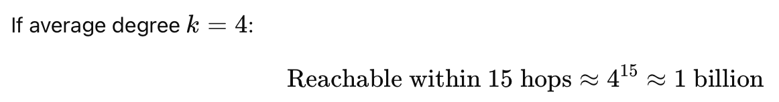
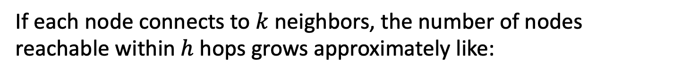
Network diameter (max hops) vs total nodes
If each node connects to $k$ neighbors, the number of nodes reachable within $h$ hops grows approximately like:

Slide 40
Count-to-infinity Problem: Solutions-2
Technique to improve the time to stabilize routing is called
split horizon
  When a node sends a routing update to its neighbors, it does not send those routes it learned from each neighbor back to that neighbor
  For example, if Z has the route (X, 5, Y) in its table, then it knows it must have learned this route from Y, and so whenever Z sends a routing update to Y, it does not include the route (X, 5) in that update

Slide 41
Distance vector: link cost “increases”
Bellman-Ford algo.
considers two routes from the
saved advertisements.
<X, 60, X> -- direct link
<X, 5, Z> + d_{Z}(X) – Cost 6 link via Z
60
Case: Split horizon
Dest | Cost | Hop
X | 4 | X
Y | 0 | Y
Z | 1 | Z
Dest | Cost | Hop
X | 6 | Z
Y | 0 | Y
Z | 1 | Z
Dest | Cost | Hop
X | 6 | Z
Y | 0 | Y
Z | 1 | Z
Dest | Cost | Hop
X | 8 | X
Y | 0 | Y
Z | 1 | Z
node Y
Dest | Cost | Hop
X | 5 | Y
Y | 1 | Y
Z | 0 | Z
Dest | Cost | Hop
X | 5 | Y
Y | 1 | Y
Z | 0 | Z
Dest | Cost | Hop
X | 7 | Y
Y | 1 | Y
Z | 0 | Z
Dest | Cost | Hop
X | 7 | Y
Y | 1 | Y
Z | 0 | Z
node Z
T1
T2
T3
T4
Cost change

Slide 42
Count-to-infinity Problem: Solutions-3
In a stronger version of split horizon, called split horizon with poison reverse
  B actually sends that back route to A, but it puts negative information in the route to ensure that A will not eventually use B to get to E
  For example, B sends the route (E, ∞) to A

Slide 43
Distance vector: link cost “increases”
Bellman-Ford algo.
considers two routes from the
saved advertisements.
<X, 60, X> -- direct link
<X, ♾, Z> + d_{Z}(X) – Cost 6 link via Z
60
Case: Split horizon
with poisoned reverse
Dest | Cost | Hop
X | 4 | X
Y | 0 | Y
Z | 1 | Z
Dest | Cost | Hop
X | 6 | Z
Y | 0 | Y
Z | 1 | Z
Dest | Cost | Hop
X | 6 | Z
Y | 0 | Y
Z | 1 | Z
Dest | Cost | Hop
X | 8 | X
Y | 0 | Y
Z | 1 | Z
node Y
Dest | Cost | Hop
X | 5 | Y
Y | 1 | Y
Z | 0 | Z
Dest | Cost | Hop
X | 5 | Y
Y | 1 | Y
Z | 0 | Z
Dest | Cost | Hop
X | 7 | Y
Y | 1 | Y
Z | 0 | Z
Dest | Cost | Hop
X | 7 | Y
Y | 1 | Y
Z | 0 | Z
node Z
T1
T2
T3
T4
Cost change

Slide 44

An example where split-horizon is not enough
C
<A, 2, B>
Example: Let’s consider the routes
from (C to A) and (D to A).
1
A
B
1
1
1
<A, 2, B>
D
Event 1: Converged state

Slide 45
An example where split-horizon is not enough
DV Database @ C
B says <A, 1>
D says <A, 2>
C
<A, 2, B>
Example: Let’s consider the routes
from (C to A) and (D to A).
1
A
B
1
1
DV Database @ D
1
<A, 2, B>
B says <A, 1>
D
C says <A, 2>
Event 1: Converged state

Slide 46
An example where split-horizon is not enough
DV Database @ C
B says <A, 1>
D says <A, 2>
C
<A, 2, B>
1
X
A
B
1
1
X
X
X
DV Database @ D
1
<A, 2, B>
B says <A, 1>
D
C says <A, 2>
Event 2: Router B failed, i.e., both links (B,C) and (B,D) are down simultaneously.

Slide 47
An example where split-horizon is not enough
DV Database @ C
B says <A, 1>
<A, 2, B>
Case A:
D says <A, 2>
C
<A, 3, D>
No split-horizon.
No poison reverse.
1
X
A
B
1
1
X
<A, 2, B>
X
DV Database @ D
1
B says <A, 1>
D
C says <A, 2>
C updates the route from its old database (which contains an advertisement from D) to <A,3,D>.
C shares this route to D.
D updates its route with this recent advertisement from C.
D’s current route becomes <A,4,C>. D shares this route back to C and this starts the “count to infinity”.

Slide 48
An example where split-horizon is not enough
DV Database @ C
B says <A, 1>
<A, 2, B>
Case A:
D says <A, 2>
C
<A, 3, D>
No split-horizon.
No poison reverse.
1
X
A
B
1
1
X
<A, 2, B>
X
DV Database @ D
1
B says <A, 1>
D
C says <A, 3>
C updates the route from its old database (which contains an advertisement from D) to <A,3,D>.
C shares this route to D.
D updates its route with this recent advertisement from C.
D’s current route becomes <A,4,C>. D shares this route back to C and this starts the “count to infinity”.

Slide 49
An example where split-horizon is not enough
DV Database @ C
B says <A, 1>
<A, 2, B>
Case A:
D says <A, 2>
C
<A, 3, D>
No split-horizon.
No poison reverse.
1
X
A
B
1
1
X
<A, 2, B>
X
DV Database @ D
1
<A, 4, C>
B says <A, 1>
D
C says <A, 3>
C updates the route from its old database (which contains an advertisement from D) to <A,3,D>.
C shares this route to D.
D updates its route with this recent advertisement from C.
D’s current route becomes <A,4,C>. D shares this route back to C and this starts the “count to infinity”.

Slide 50
An example where split-horizon is not enough
DV Database @ C
B says <A, 1>
<A, 2, B>
Case A:
D says <A, 4>
C
<A, 5, D>
No split-horizon.
No poison reverse.
1
X
A
B
1
1
X
<A, 2, B>
Issue:
X
DV Database @ D
1
Count to infinity
<A, 4, C>
B says <A, 1>
D
C says <A, 3>
C updates the route from its old database (which contains an advertisement from D) to <A,3,D>.
C shares this route to D.
D updates its route with this recent advertisement from C.
D’s current route becomes <A,4,C>. D shares this route back to C and this starts the “count to infinity”.

Slide 51
An example where split-horizon is not enough
DV Database @ C
B says <A, 1>
<A, 2, B>
Case B:
D says <A, 2>
C
<A, 3, D>
With split-horizon.
No poison reverse.
1
X
A
B
1
1
X
<A, 2, B>
X
DV Database @ D
1
<A, 3, C>
B says <A, 1>
D
C says <A, 2>
C updates the route from its old database (which contains an old advertisement from D) to <A,3,D>.
(Note that D’s old route <A,2> was not learnt from C, so it shared it with C even when split-horizon is applied.)
C DOES NOT advertise this route (i.e., <A,3>) to D due to the Split-horizon rule.
D also updates the route from its old database (which contains an old advertisement from C) to <A,3,C>.
D DOES NOT advertise this route to C due to the Split-horizon rule.
This prevents count to infinity, but does not stop routing loop as both C and D’s routes depend on each other.
In practical implementations, routers will time-out old database to eventually get rid of this inconsistency.

Slide 52
An example where split-horizon is not enough
DV Database @ C
B says <A, 1>
<A, 2, B>
Case B:
D says <A, 2>
C
<A, 3, D>
With split-horizon.
No poison reverse.
1
X
A
B
1
1
X
<A, 2, B>
Issue:
X
DV Database @ D
1
<A, 3, C>
Wrong route/routing loop
B says <A, 1>
D
C says <A, 2>
C updates the route from its old database (which contains an old advertisement from D) to <A,3,D>.
(Note that D’s old route <A,2> was not learnt from C, so it shared it with C even when split-horizon is applied.)
C DOES NOT advertise this route (i.e., <A,3>) to D due to the Split-horizon rule.
D also updates the route from its old database (which contains an old advertisement from C) to <A,3,C>.
D DOES NOT advertise this route to C due to the Split-horizon rule.
This prevents count to infinity, but does not stop routing loop as both C and D’s routes depend on each other.
In practical implementations, routers will time-out old database to eventually get rid of this inconsistency.

Slide 53
An example where split-horizon is not enough
DV Database @ C
DV format: <Destination, Path-cost, NextHop>
B says <A, 1>
<A, 2, B>
Case C:
D says <A, 2>
C
<A, 3, D>
With poison reverse.
(this means Split-horizon
with poisoned reverse)
1
X
A
B
1
1
X
<A, 2, B>
X
DV Database @ D
1
B says <A, 1>
D
C says <A, 2>
C updates the route from its old database (which contains an old advertisement from D) to <A,3,D>.
C advertises the poisoned route <A, inf.> to D due to Poisoned-reverse rule.
This advertisement from C changes D’s database indicating “cost to reach A via C is inf.”
D finds no path to A. D considers A unreachable (correct behavior). D may send this <A,inf> to C.
This prevents count to infinity, as well as prevents the routing loop.

Slide 54
An example where split-horizon is not enough
DV Database @ C
DV format: <Destination, Path-cost, NextHop>
B says <A, 1>
<A, 2, B>
Case C:
D says <A, 2>
C
<A, 3, D>
With poison reverse.
(this means Split-horizon
with poisoned reverse)
1
X
A
B
1
1
X
<A, 2, B>
X
DV Database @ D
1
B says <A, 1>
D
C says <A, Infinity>
C updates the route from its old database (which contains an old advertisement from D) to <A,3,D>.
C advertises the poisoned route <A, inf.> to D due to Poisoned-reverse rule.
This advertisement from C changes D’s database indicating “cost to reach A via C is inf.”
D finds no path to A. D considers A unreachable (correct behavior). D may send this <A,inf> to C.
This prevents count to infinity, as well as prevents the routing loop.

Slide 55
An example where split-horizon is not enough
DV Database @ C
DV format: <Destination, Path-cost, NextHop>
B says <A, 1>
<A, 2, B>
Case C:
D says <A, 2>
C
<A, 3, D>
With poison reverse.
(this means Split-horizon
with poisoned reverse)
1
X
A
B
1
1
X
<A, 2, B>
X
DV Database @ D
1
B says <A, 1>
<No route to A>
D
C says <A, Infinity>
C updates the route from its old database (which contains an old advertisement from D) to <A,3,D>.
C advertises the poisoned route <A, inf., D> to D due to Poisoned-reverse rule.
This advertisement from C changes D’s database indicating “cost to reach A via C is inf.”
D finds no path to A. D considers A unreachable (correct behavior). D may send this <A,inf,D> to C.
This prevents count to infinity, as well as prevents the routing loop.

Slide 56
An example where split-horizon is not enough
DV Database @ C
DV format: <Destination, Path-cost, NextHop>
B says <A, 1>
<A, 2, B>
Case C:
D says <A, Infinity>
C
With poison reverse.
(this means Split-horizon
with poisoned reverse)
1
X
<No route to A>
A
B
1
1
X
<A, 2, B>
X
DV Database @ D
1
B says <A, 1>
<No route to A>
D
C says <A, Infinity>
C updates the route from its old database (which contains an old advertisement from D) to <A,3,D>.
C advertises the poisoned route <A, inf.> to D due to Poisoned-reverse rule.
This advertisement from C changes D’s database indicating “cost to reach A via C is inf.”
D finds no path to A. D considers A unreachable (correct behavior). D may send this <A,inf> to C.
This prevents count to infinity, as well as prevents the routing loop.

Slide 57
Distance vector: Poisoned reverse
Does poison reverse solve the general count-to-infinity problem?
It does not. It may be possible that loops involving three or more nodes (rather than simply two immediately neighboring nodes, as we shown in last example) will not be detected by the poison reverse technique.

Slide 58
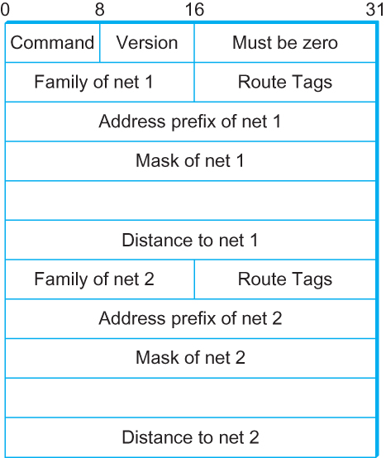
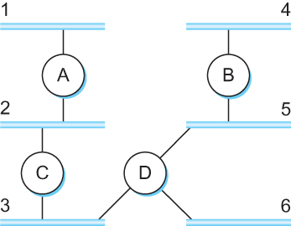
DV Implementation: Routing Information Protocol (RIP)
  Example Network
  running RIP RIPv2 Packet Format
RFC 1058 formally specifies the original Routing Information Protocol (RIP), which is a classic distance vector routing algorithm.

Slide 59
What is RFC?
Request for Comments (RFC):
A peer reviewed publication in a series from the
principal technical development and standards-setting
bodies for the Internet, most prominently
the Internet Engineering Task Force (IETF).
[ref] https://www.ietf.org/standards/rfcs/
How to Read an RFC: https://www.ietf.org/blog/how-read-rfc/

Slide 60
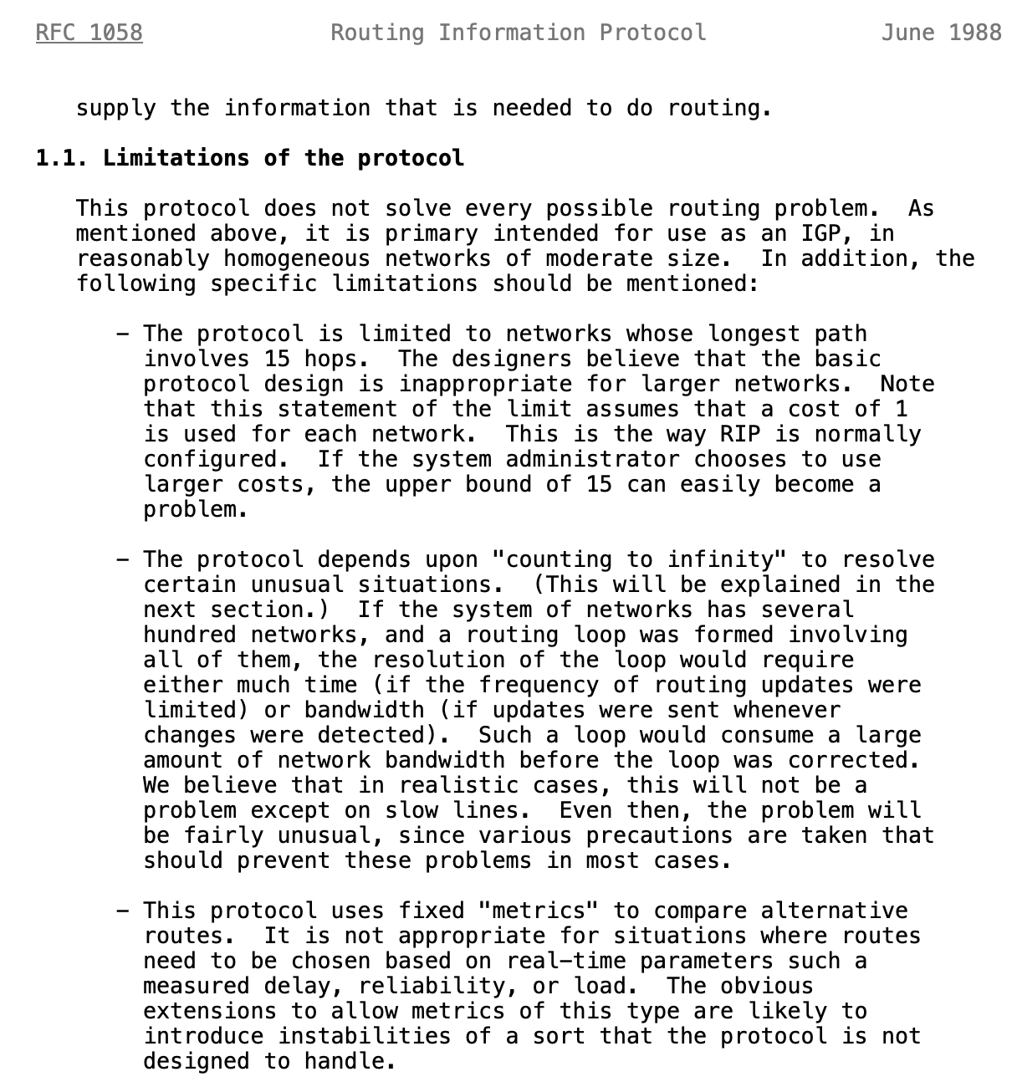
Limitations of DV routing
Small network assumption
Possibility of
routing loops
Static and
pre-determined
link costs
Notes:
What is RFC: https://www.techtarget.com/whatis/definition/Request-for-Comments-RFC

Slide 61
Routing by rumor
Consistent
view of topology
Link State Routing

Slide 62
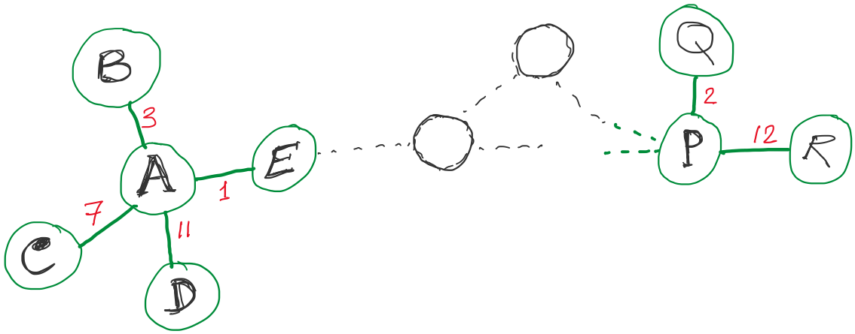
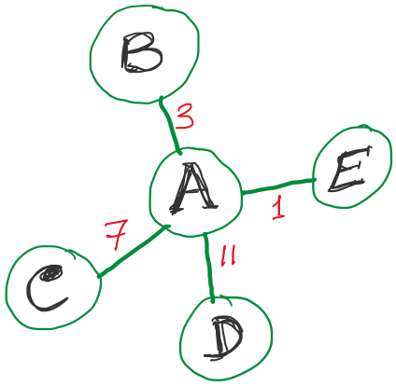
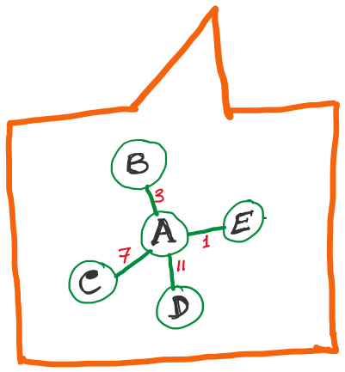
Link State Routing
Strategy:
Send to all nodes (not just neighbors) information about neighbors (not connection to all nodes).
All nodes will know the link-state information of all other nodes

Slide 63
Link State Routing
Strategy:
Send to all nodes (not just neighbors) information about neighbors (not connection to all nodes).
Link State Packet (LSP):
  The ID of the node that created the LSP
  (2) Costs of links to each directly connected neighbor
  (3) A sequence number (SEQNO)
  [To distinguish a newer LSP from the old ones]
  [Smaller number == older LSP]
  (4) A Time-To-Live (TTL) for this packet
  [To make sure old information is eventually removed
  from the network]
What is the unit of the “Time-to-Live”?

Slide 64
Thank you

