Slide 1

CMSC 417: Computer Networks
Spring 2026
Topic: Internetworking – Routing protocols
(Textbook chapter 3)
Nirupam Roy
M-W 2:00-3:15pm
CSI 2117
Feb 16th, 2026

Slide 2
Distance Vector Routing (cont…)

Slide 3
Implementation perspective
DV database
DV algorithm
Bellman-Ford algo.
d_{x}(y) = min {c(x,v) + d_{v}(y) }
Neighbor A’s--
Identity (IP/interface)
Timestamp of last update
+
Routing table
A’s DVs
Dest | Cost | N. Hop
B | 7 | A
C | 11 | B
P | 0 | C
A says <B, 19>
A says <C, 2>
A says <P, 6>
Neighbor B’s--
Identity (IP/interface)
Timestamp of last update
Database maintenance
+
B’s DVs
Add new database entry
Update timestamp
Update a DV
Purge old information
B says <A, 5>
B says <C, 12>
B says <Q, 9>
X
Notes:
How are old vectors purged?
There are two levels of aging in RIP.
A. Neighbor-Level Aging
If a neighbor stops sending updates:
RIP expects updates every 30 seconds
If no update is heard within the invalid timer (~180 seconds):
All routes learned via that neighbor are marked invalid (metric = 16)
Triggered update may be sent
Eventually (after flush timer ~240 seconds):
Routes are removed from the table
The neighbor entry itself is also removed.
B. Route-Level Aging (More Important)
Each route has its own timers:
Update timer (~30 sec) — periodic advertisement
Invalid timer (~180 sec) — route considered dead
Flush timer (~240 sec) — route deleted
So routes are not stored indefinitely. They age out automatically.

Slide 4

An example where split-horizon is not enough
DV Database @ C
B says <A, 1>
<A, 2, B>
Case C:
D says <A, Infinity>
C
With poison reverse.
(this means Split-horizon
with poisoned reverse)
1
X
<No route to A>
A
B
1
1
X
<A, 2, B>
X
DV Database @ D
1
B says <A, 1>
<No route to A>
D
C says <A, Infinity>
C updates the route from its old database (which contains an old advertisement from D) to <A,3,D>.
C advertises the poisoned route <A, inf.> to D due to Poisoned-reverse rule.
This advertisement from C changes D’s database indicating “cost to reach A via C is inf.”
D finds no path to A. D considers A unreachable (correct behavior). D may send this <A,inf> to C.
This prevents count to infinity, as well as prevents the routing loop.

Slide 5
Distance vector: Poisoned reverse
Does poison reverse solve the general count-to-infinity problem?
It does not. It may be possible that loops involving three or more nodes (rather than simply two immediately neighboring nodes, as we shown in last example) will not be detected by the poison reverse technique.

Slide 6
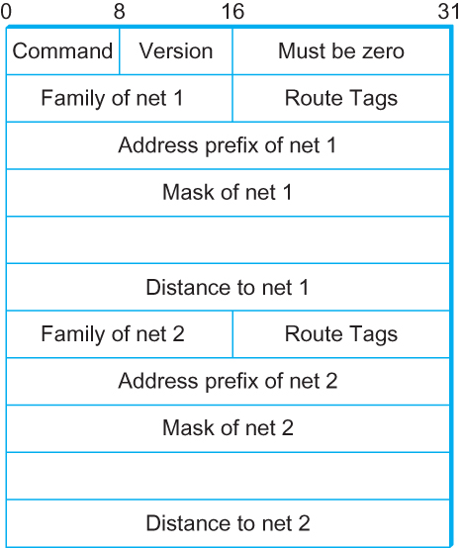
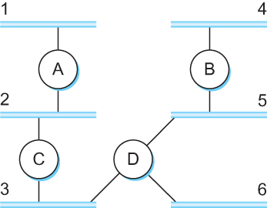
DV Implementation: Routing Information Protocol (RIP)
Example Network
running RIP RIPv2 Packet Format
RFC 1058 formally specifies the original Routing Information Protocol (RIP), which is a classic distance vector routing algorithm.

Slide 7
What is RFC?
Request for Comments (RFC):
A peer reviewed publication in a series from the
principal technical development and standards-setting
bodies for the Internet, most prominently
the Internet Engineering Task Force (IETF).
[ref] https://www.ietf.org/standards/rfcs/
How to Read an RFC: https://www.ietf.org/blog/how-read-rfc/

Slide 8
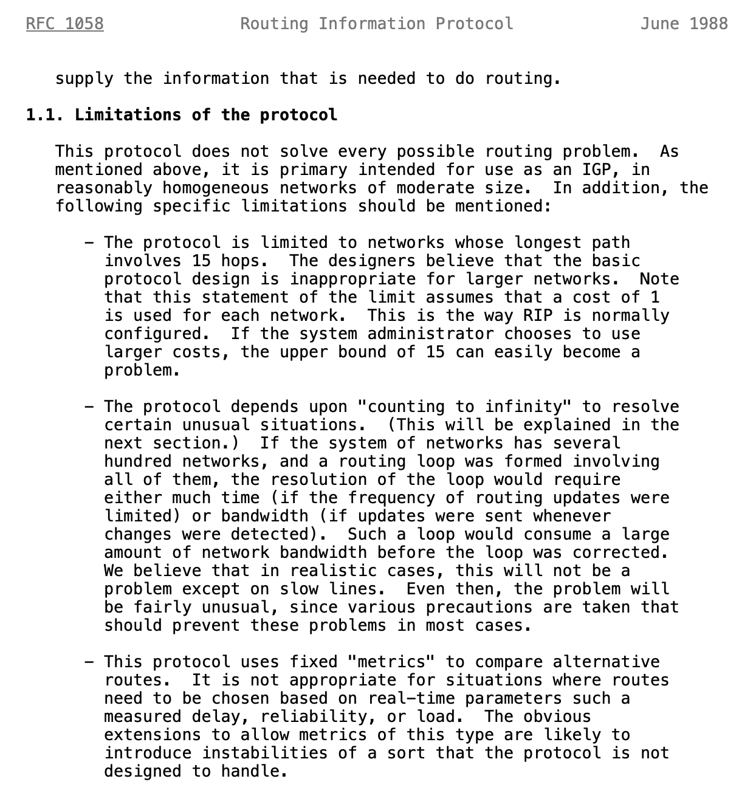
Limitations of DV routing
Small network assumption
Possibility of
routing loops
Static and
pre-determined
link costs
Notes:
What is RFC: https://www.techtarget.com/whatis/definition/Request-for-Comments-RFC

Slide 9
Routing by rumor
Consistent
view of topology
Link State Routing

Slide 10
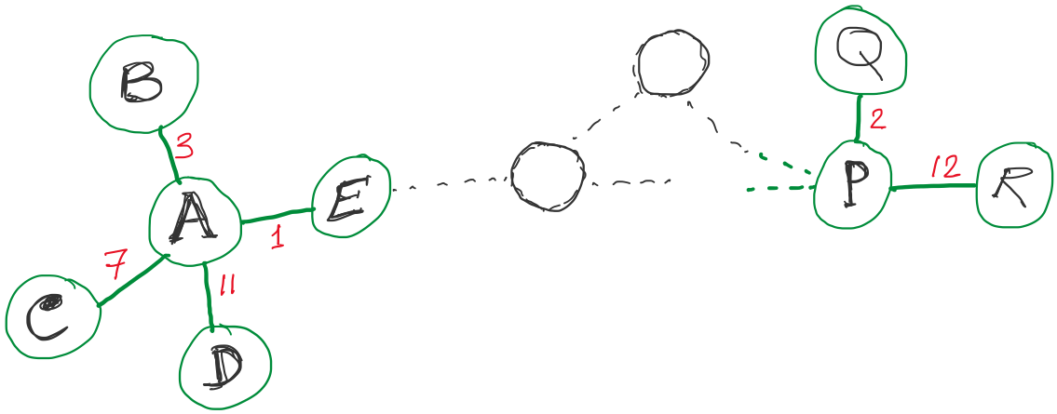
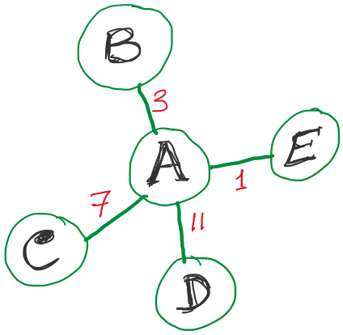
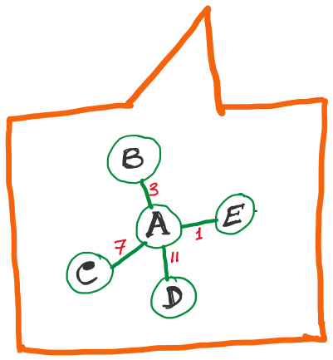
Link State Routing
Strategy:
Send to all nodes (not just neighbors) information about neighbors (not connection to all nodes).
All nodes will know the link-state information of all other nodes

Slide 11
Link State Routing
Strategy:
Send to all nodes (not just neighbors) information about neighbors (not connection to all nodes).
Link State Packet (LSP):
The ID of the node that created the LSP
(2) Costs of links to each directly connected neighbor
(3) A sequence number (SEQNO)
[To distinguish a newer LSP from the old ones]
[Smaller number == older LSP]
(4) A Time-To-Live (TTL) for this packet
[To make sure old information is eventually removed
from the network]
What is the unit of the “Time-to-Live”?

Slide 12
Link State Routing
Strategy:
Send to all nodes (not just neighbors) information about neighbors (not connection to all nodes).
“Aging” and removing a Link State Packet (LSP):
1. During control packet forwarding: “Time-to-Live” field (# of hops)
2. In the host’s database: Timer (seconds)

Slide 13
Link State Routing
(1) Reliable flooding
[Makes sure all nodes in the network get a copy of LSP from all other nodes]
(2) Route calculation
(Dijkstra’s shortest path algorithm)
[Calculates the shortest path from each node to all other nodes and the corresponding next-hop]

Slide 14
Link State Routing: Reliable flooding
Goals:
0) Ensure all nodes get LSPs from all other
Flood in minimum time
Minimize total routing traffic

Slide 15
Link State Routing: Reliable flooding
Goals:
0) Ensure all nodes get LSPs from all other
Flood in minimum time
Minimize total routing traffic
Basic rules:
Store most recent LSP from each node
Forward LSP to all nodes but one that sent it
Generate new LSP periodically; increment SEQNO
Start SEQNO at 0 when reboot
Decrement TTL before flooding it to neighbors.
Discard when TTL=0.
(Also age the stored LSP and discard when ‘expired’)

Slide 16
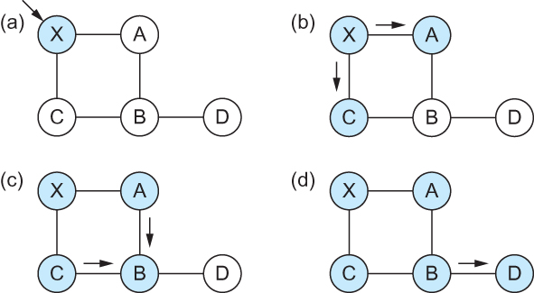
Link State
Gets two identical copies of LSP.
Accepts the one arrived first
Reliable Flooding
Flooding of link-state packets. (a) LSP arrives at node X; (b) X floods LSP to A and C; (c) A and C flood LSP to B (but not X); (d) flooding is complete

Slide 17
Link State
Reliable Flooding
Flooding of link-state packets. (a) LSP arrives at node X; (b) X floods LSP to A and C; (c) A and C flood LSP to B (but not X); (d) flooding is complete
This copy is not added to database.
But will ‘B’ flood it?
If B receives this LSP from A first, will B send the second copy received from C to A?

Slide 18
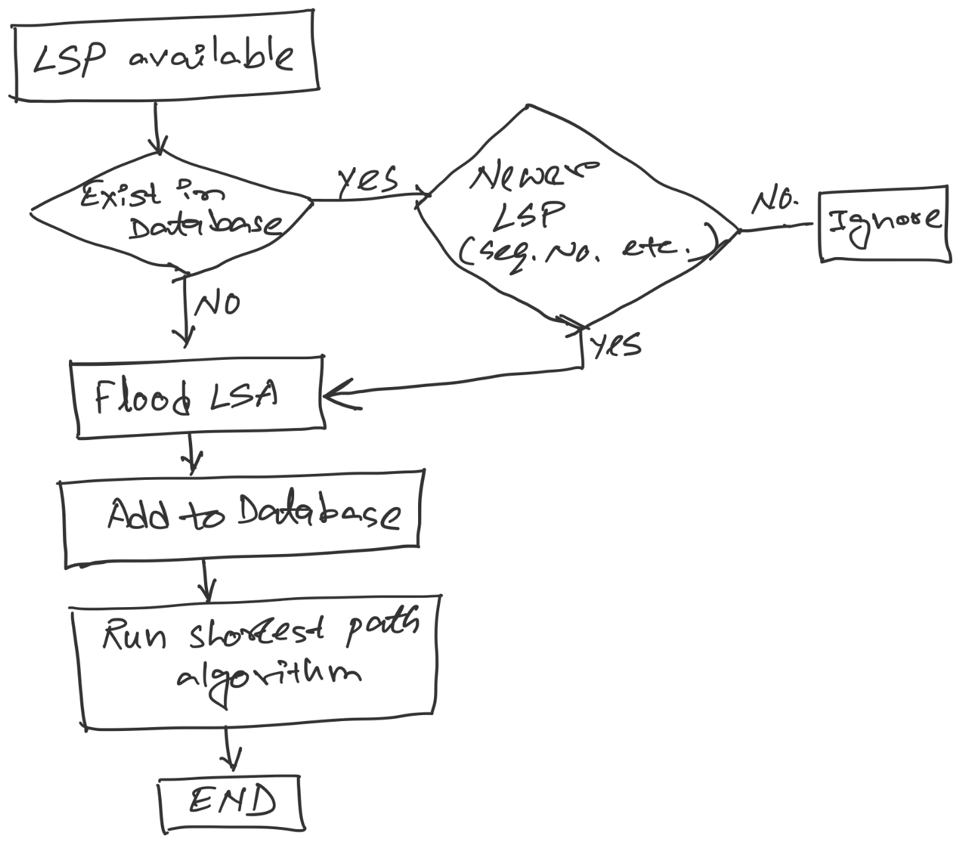
LSP processing

Slide 19
LSP processing flow
LSP available
Is it
a newer LSP?
(seq. #)
Exists in
Database?
Yes
No
Ignore
No
Yes
Flood LSP
Add to database
Run shortest path
algorithm
End

Slide 20
Consider this network:
B
D
19
4
A
11
13
15
7
5
C
E
After flooding every node will have the following information:
Each node has complete knowledge of the network topology
B
B
D
19
A
11
15
B
D
4
7
C
C
5
E
13
Apply shortest path algorithm to find routes
E
D
B
D
19
4
13
A
C
5
E

Slide 21
Consider this network:
B
D
19
4
A
11
13
15
7
5
C
E

Slide 22
Consider this network:
B
D
19
4
A
11
13
15
7
5
C
E
After flooding every node will have the following information:
B
B
D
19
A
11
15
B
D
A
4
7
C
C
5
E
7
15
13
E
D
C
B
D
19
4
13
11
C
5
A
E
C

Slide 23
Consider this network:
B
D
19
4
A
11
13
15
7
5
C
E
After flooding every node will have the following information:
Each node has complete knowledge of the network topology
B
B
D
19
A
11
15
B
D
A
4
7
C
C
5
E
7
15
13
Apply shortest path algorithm to find routes
E
D
C
B
D
19
4
13
11
C
5
A
E
C

Slide 24
Shortest Path Routing
Dijkstra’s Algorithm - Assume non-negative link weights
N: set of nodes in the graph
l((i, j): the non-negative cost associated with the edge between nodes i, j ∈N and l(i, j) = ∝ if no edge connects i and j
Let s ∈N be the starting node which executes the algorithm to find shortest paths to all other nodes in N
Two variables used by the algorithm
M: set of nodes incorporated so far by the algorithm
C(n) : the cost of the path from s to each node n
The algorithm
M = {s}
For each n in N – {s}
C(n) = l(s, n)
while ( N ≠ M)
M = M ∪ {w} such that C(w) is the minimum
for all w in (N-M)
For each n in (N-M)
C(n) = MIN (C(n), C(w) + l(w, n))

Slide 25
Shortest Path Routing
In practice, each switch computes its routing table directly from the LSP’s it has collected using a realization of Dijkstra’s algorithm called the forward search algorithm.
Specifically, each switch maintains two lists, known as Tentative and Confirmed
Each of these lists contains a set of entries of the form (Destination, Cost, NextHop)

Slide 26
Consider this network:
B
D
19
4
A
11
13
15
7
5
C
E
After flooding every node will have the following information:
B
B
D
19
A
11
15
B
D
A
4
7
C
C
5
E
7
15
13
E
D
C
B
D
19
4
13
11
C
5
A
E
C

Slide 27
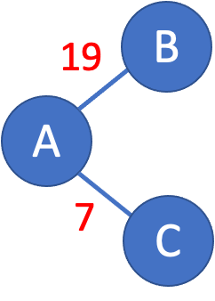
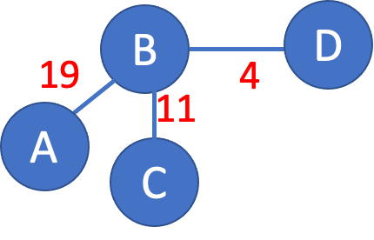
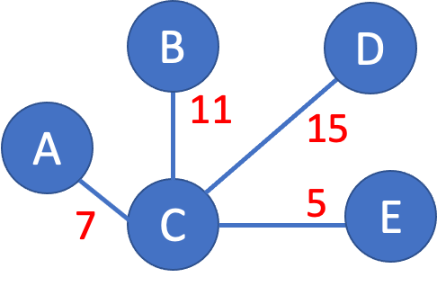
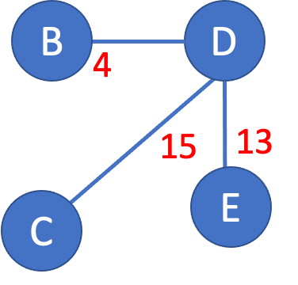
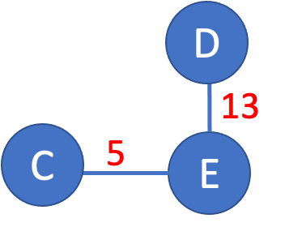
>

Slide 28
>
19
B
A
7
C

Slide 29
>
19
B
A
7
C

Slide 30
>
19
B
Unvisited nodes
A
Confirmed nodes
7
C
Tentative nodes

Slide 31
>
19
B
Unvisited nodes
A
Confirmed nodes
7
C
Tentative nodes

Slide 32
>
19
B
A
7
C
‘Confirm’ the lowest cost nodes
from the list of ‘tentative’ nodes.

Slide 33
>
B
B
D
19
A
11
15
A
7
C
X
C
5
E
7
‘Confirm’ the lowest cost nodes
from the list of ‘tentative’ nodes.
… and find out this newly ‘confirmed’
node’s LSP (i.e., C’s LSP).
X
= Ignore the confirmed nodes

Slide 34
>
B
B
D
19
A
11
15
Update costs
A
By adding the cost
to reach ‘C’.
7
C
X
C
5
E
7

Slide 35
>
B
B
D
19
A
18
22
Costs updated
A
7
C
X
C
12
E
7

Slide 36
>
Join with minimum link costs
D
B
B
D
A
18
22
18
Costs updated
22
A
7
C
12
E
X
C
12
E
7
Note that B’s link is updated.

Slide 37
>
D
B
A
18
22
7
C
12
E

Slide 38
>
D
D
B
13
A
18
22
C
5
E
7
C
12
E
‘Confirm’ the lowest cost nodes
from the list of ‘tentative’ nodes.
… and find out this newly ‘confirmed’
node’s LSP.

Slide 39
>
D
D
B
X
13
18
22
25
A
C
5
E
7
C
12
E
No addition to the topology as the links are already at minimum costs.

Slide 40
>
18
D
B
D
B
19
4
A
18
22
A
11
X
C
7
C
12
E
X
‘Confirm’ the lowest cost nodes
from the list of ‘tentative’ nodes.
… and find out this newly ‘confirmed’
node’s LSP (this time B’s LSP).

Slide 41
>
18
D
B
D
B
19
4
A
18
22
11
22
A
X
C
7
C
12
E
X
No addition to the topology as the links are already at minimum costs.

Slide 42
>
D
X
B
B
D
4
A
18
22
X
15
C
13
7
C
12
E
E
X
‘Confirm’ the lowest cost nodes
from the list of ‘tentative’ nodes.
… and find out this newly ‘confirmed’
node’s LSP (this time D’s LSP).
No addition to the topology as the links are already at minimum costs.

Slide 43
B
D
19
4
A
11
13
15
7
5
C
E
D
B
A
18
22
7
C
12
E
Notes:
Is this a minimum spanning tree?
No, it is a Shortest path tree.

Slide 44
Shortest Path Routing
Dijkstra’s Algorithm
M = {s}
For each n in N – {s}
C(n) = l(s, n)
while ( N ≠ M)
M = M ∪ {w} such that C(w) is the minimum
for all w in (N-M)
For each n in (N-M)
C(n) = MIN (C(n), C(w) + l(w, n))
Confirmed list
Newly added member to the confirmed list
Tentative list

Slide 45
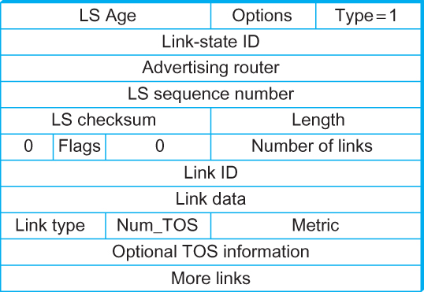
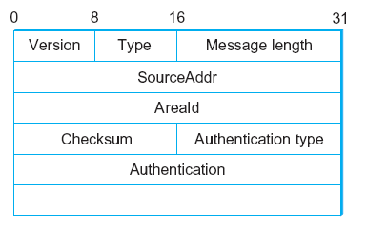
Open Shortest Path First (OSPF)
OSPF Header Format OSPF Link State Advertisement
OSPF runs over IPv4 and IPv6 (does not use a transport protocol such
as UDP or TCP).
It encapsulates its data directly in IP packets with protocol number 89.

Slide 46
Comparison of LS and DV algorithms
message complexity
LS: with n nodes, E links, O(nE) msgs sent
DV: exchange between neighbors only
convergence time varies
speed of convergence
LS: O(n²) algorithm requires O(nE) msgs
may have oscillations
DV: convergence time varies
may be routing loops
count-to-infinity problem
robustness: what happens if router malfunctions?
LS:
node can advertise incorrect link cost
each node computes only its own table
DV:
DV node can advertise incorrect path cost
each node’s table used by others
error propagate thru network

Slide 47
 | Distance Vector routing | Link State routing
Convergence time/Latency |  | ✅
Robustness to Loop |  | ✅
Processing overhead | ✅
Bandwidth requirement (for control plane) | ✅
Scalability (and robustness to complex topology and changes) |  | ✅

Slide 48
Internet Protocol

Slide 49
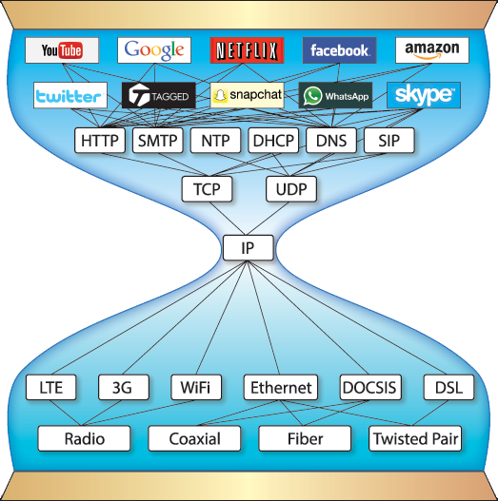
Pic courtesy: https://www.are.na/block/881873

Slide 50
The Internet network layer
host, router network layer functions:
transport layer: TCP, UDP
routing protocols
path selection
RIP, OSPF, BGP
IP protocol
addressing conventions
datagram format
packet handling conventions
network
layer
forwarding
table
ICMP protocol
error reporting
router “signaling”
link layer
physical layer

Slide 51
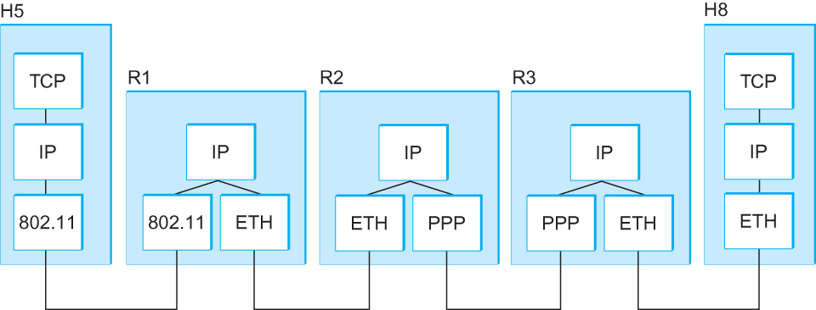
Internetworking
What is IP
IP stands for Internet Protocol
Key tool used today to build scalable, heterogeneous internetworks
It runs on all the nodes in a collection of networks and defines the infrastructure that allows these nodes and networks to function as a single logical internetwork
A simple internetwork showing the protocol layers

Slide 52
IP Service Model
Packet Delivery Model
Connectionless model for data delivery (packet switched)
Best-effort delivery (unreliable service)
packets are lost
packets are delivered out of order
duplicate copies of a packet are delivered
packets can be delayed for a long time
Global Addressing Scheme
Provides a way to identify all hosts in the network

Slide 53
IP datagram format (i.e., Packet format)
32 bits
ver
head.
len
type of
service
length
flgs
fragment
offset
16-bit identifier
Variable size header.
(20 bytes default
without options)
time to
live
upper
layer
header
checksum
32 bit source IP address
32 bit destination IP address
options (if any)
data
(variable length,
typically a TCP
or UDP segment)
Variable size data.
Data size =
(Datagram Len – Header Len)

Slide 54
IP datagram format
IP protocol version number
(4 bits)
32 bits
total datagram
length (bytes)
header length
in # of 4-bytes (4 bits)
head.
len
type of
service
ver
length
for
fragmentation/
reassembly
“type” of data
(real-time, non-real-time etc.)
fragment
offset
16-bit identifier
flgs
time to
live
upper
layer
header
checksum
max number remaining hops
(decremented at each router)
Why header only?
32 bit source IP address
32 bit destination IP address
upper layer protocol
to deliver payload to
options (if any)
e.g. timestamp,
record route
taken, specify
list of routers
to visit, Min-MTU
discovery
data
(variable length,
typically a TCP
or UDP segment)

Slide 55
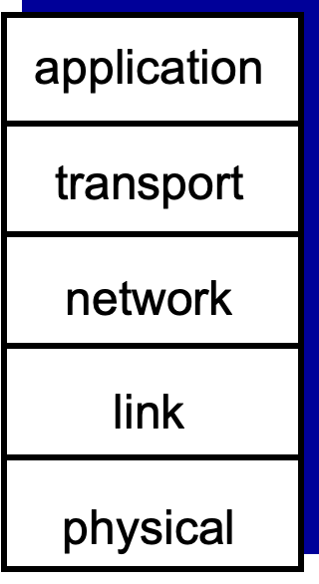

Slide 56
IP datagram format
32 bits
ver
head.
len
type of
service
length
for
fragmentation/
reassembly
flgs
fragment
offset
16-bit identifier
time to
live
upper
layer
header
checksum
32 bit source IP address
32 bit destination IP address
options (if any)
data
(variable length,
typically a TCP
or UDP segment)

Slide 57
IP Fragmentation and Reassembly

Slide 58



IP Fragmentation and Reassembly
R1
R2
R3
H5
H8
Maximum Transmission Unit (MTU)
[packet size limit for the network layer]

Slide 59
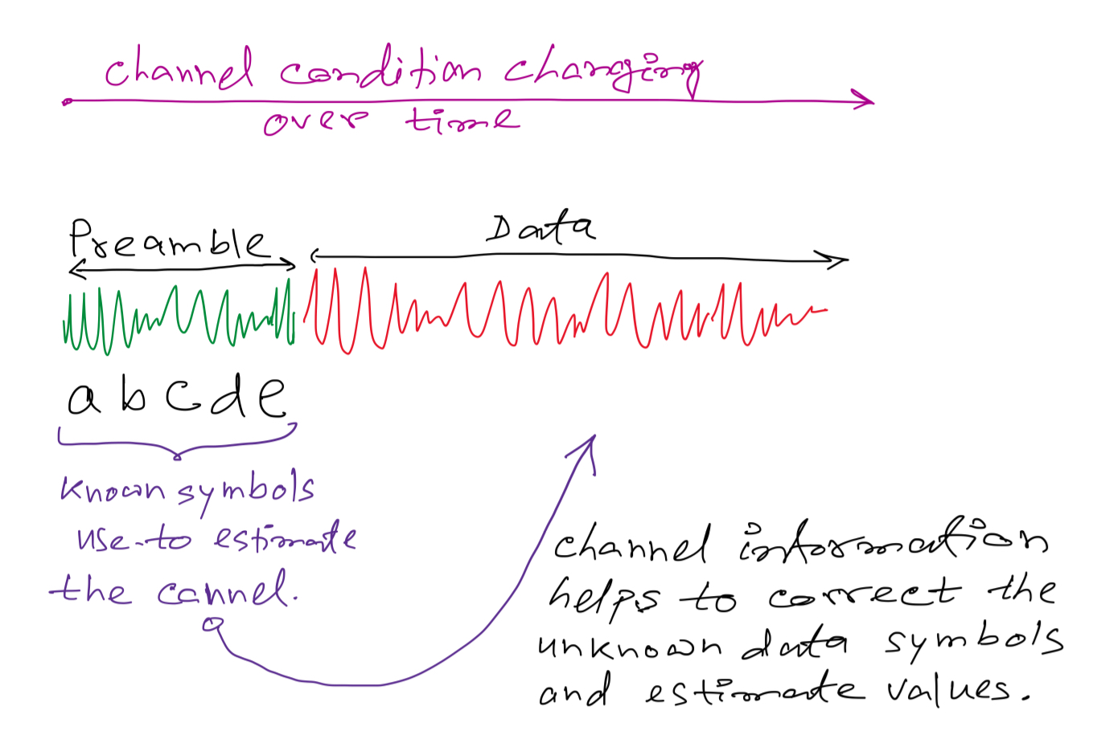
Rational behind the MTU limit:

Slide 60
Rational behind the MTU limit:

Slide 61
IP Fragmentation and Reassembly
Datagram Len=1500
?
MTU=1500
(bytes)
MTU=1500
MTU=532
R1
R2
R3
MTU=1500
Datagram Len=1500

Slide 62

Analogy:

Slide 63
Analogy:
Header
MTU
Data

Slide 64
Analogy:

Slide 65
Analogy:
Data index: 0

Slide 66
Analogy:
Data index: 0
Data index: 0

Slide 67
Analogy:
Data index: 0
Data index: 13
Data index: 0
Data index: 13

Slide 68
Analogy:
Data index: 0
Data index: 13
Data index: 0
Data index: 13
Data index: 26
Data index: 26

Slide 69
Analogy:
Data index: 0
Fragmented
Fragmented
Fragmented & last
Data index: 13
Data index: 0
Data index: 13
Data index: 26
Data index: 26

Slide 70
Analogy:
Data index: 0
Fragmented
1
2
Data index: 13
3
…
Fragmented
Data index: 0
Fragmented & last
Data index: 26
Virtually infinite buffer
for reassembly

Slide 71
Analogy:
Data index: 0
Fragmented
1
2
Data index: 13
…
Data index: 13
Fragmented
Data index: 0
Fragmented & last
Data index: 26
Virtually infinite buffer
for reassembly

Slide 72
Analogy:
Data index: 0
Fragmented
1
2
Data index: 13
…
Data index: 13
Fragmented
Data index: 0
Fragmented & last
Data index: 26
Virtually infinite buffer
for reassembly

Slide 73
Analogy:
Data index: 0
Fragmented
1
2
Data index: 13
…
Data index: 13
Data index: 26
Fragmented
Data index: 0
Fragmented & last
Data index: 26
Virtually infinite buffer
for reassembly

Slide 74
Analogy:
Data index: 0
1
2
…
Data index: 13
Data index: 26
Assembled packet
(The fragmentation and assembly process
Is transparent to the higher layers)
Virtually infinite buffer
for reassembly

Slide 75
IP Fragmentation and Reassembly
Datagram Len=1500
?
MTU=1500
(bytes)
MTU=1500
MTU=532
R1
R2
R3
MTU=1500
Datagram Len=1500

Slide 76
IP Fragmentation and Reassembly
Fragments
Dgram Len<=532
Dgram Len<=532
Datagram Len=1500
Dgram Len<=532
MTU=1500
(bytes)
MTU=1500
MTU=532
R1
R2
R3
MTU=1500
Datagram Len=1500
Where should reassembly take place?

Slide 77
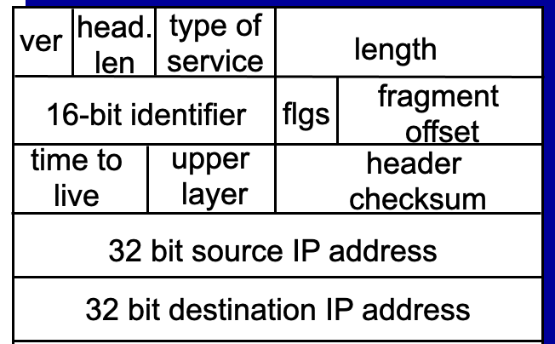
IP Fragmentation and Reassembly
Fragments
Dgram Len<=532
Dgram Len<=532
Datagram Len=1500
Dgram Len<=532
MTU=1500
(bytes)
MTU=1500
MTU=532
R1
R2
R3
MTU=1500
Datagram Len=1500
During assembly,
A. How can the destination identify all fragments of a packet?
Notes:
RFC page 24: https://www.rfc-editor.org/rfc/rfc791
The internet identification field (ID) is used together with the source and destination address, and the protocol fields, to identify datagram fragments for reassembly.
Comments of the limited ID:
https://www.rfc-editor.org/rfc/rfc6864
Introduction
In IPv4, the Identification (ID) field is a 16-bit value that is unique for every datagram for a given source address, destination address, and protocol, such that it does not repeat within the maximum datagram lifetime (MDL) [RFC791] [RFC1122]. As currently specified, all datagrams between a source and destination of a given protocol must have unique IPv4 ID values over a period of this MDL, which is typically interpreted as two minutes and is related to the recommended reassembly timeout [RFC1122]. This uniqueness is currently specified as for all datagrams, regardless of fragmentation settings.
Uniqueness of the IPv4 ID is commonly violated by high-speed devices; if strictly enforced, it would limit the speed of a single protocol between two IP endpoints to 6.4 Mbps for typical MTUs of 1500 bytes (assuming a 2-minute MDL, using the analysis presented in [RFC4963]). It is common for a single connection to operate far in excess of these rates, which strongly indicates that the uniqueness of the IPv4 ID as specified is already moot. Further, some sources have been generating non-varying IPv4 IDs for many years (e.g., cellphones), which resulted in support for such in RObust Header Compression (ROHC) [RFC5225].
And
4.1. IPv4 ID Used Only for Fragmentation
Although RFC 1122 suggests that the IPv4 ID field has other uses, including datagram de-duplication, such uses are already not interoperable with known implementations of sources that do not vary their ID. This document thus defines this field's value only for fragmentation and reassembly:
>> The IPv4 ID field MUST NOT be used for purposes other than fragmentation and reassembly.
Datagram de-duplication can still be accomplished using hash-based duplicate detection for cases where the ID field is absent (IPv6 unfragmented datagrams), which can also be applied to IPv4 atomic datagrams without utilizing the ID field [RFC6621].

Slide 78
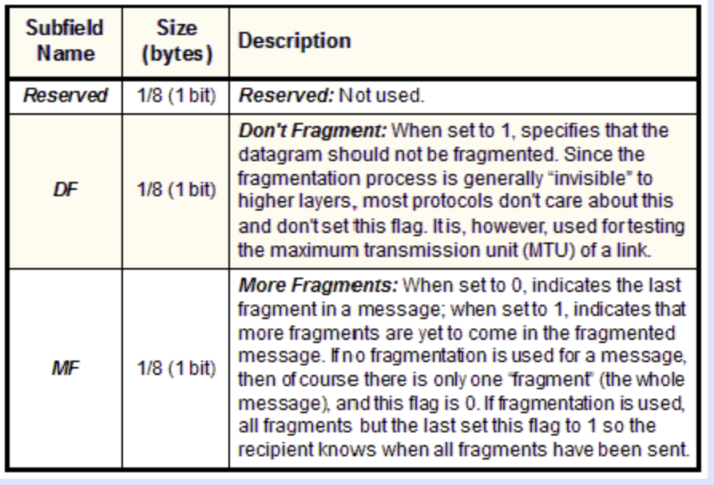
IP Fragmentation and Reassembly
Fragments
Dgram Len<=532
Dgram Len<=532
Datagram Len=1500
Dgram Len<=532
MTU=1500
(bytes)
MTU=1500
MTU=532
R1
R2
R3
MTU=1500
Datagram Len=1500
During assembly,
B. How will the destination know if the last fragment is received?
Notes:
RFC page 24: https://www.rfc-editor.org/rfc/rfc791
The internet identification field (ID) is used together with the source and destination address, and the protocol fields, to identify datagram fragments for reassembly.
If this is a whole datagram (that is both the fragment offset and the more fragments fields are zero), then it concludes that no fragmentation happened.

Slide 79
IP Fragmentation and Reassembly
Identifies the fragment location, relative to the beginning of the unfragmented data.
Fragments are counted in units of 8 octets (i.e., 8-bytes blocks).
Fragments
0
Data from fgmt offset: 2
2
Notes:
RFC page 24: https://www.rfc-editor.org/rfc/rfc791
The internet identification field (ID) is used together with the source and destination address, and the protocol fields, to identify datagram fragments for reassembly.
If this is a whole datagram (that is both the fragment offset and the more fragments fields are zero), then it concludes that no fragmentation happened.

Slide 80
IP Fragmentation and Reassembly
Identifies the fragment location, relative to the beginning of the unfragmented data.
Fragments are counted in units of 8 octets (i.e., 8-bytes blocks).
Fragments
0
2
Data from fgmt offset: 2
Note that this offset numbers are
in “8-octet” not bytes.
Notes:
RFC page 24: https://www.rfc-editor.org/rfc/rfc791
The internet identification field (ID) is used together with the source and destination address, and the protocol fields, to identify datagram fragments for reassembly.
If this is a whole datagram (that is both the fragment offset and the more fragments fields are zero), then it concludes that no fragmentation happened.

Slide 81
Bits
110100010001101101110001011000000111101001
Bytes
Byte-1
Byte-2
Byte-3
Byte-4
8-Octets == 8 Bytes
Byte-1
Byte-2
Byte-3
Byte-4
Byte-5
Byte-6
Byte-7
Byte-8
Byte-9
Byte-10
“8-octet” - 1
“8-octet” - 2

Slide 82
Analogy:
Data index: 0
Data index: 13
Data index: 0
Data index: 13
Data index: 26
Data index: 26
Data size should be integer multiple of
“8-octet” or “8 bytes”

Slide 83
Analogy:
Data index: 0
Data index: 13
Data index: 0
Data index: 13
Data index: 26
Data index: 26
Data size should be integer multiple of
“8-octet” or “8 bytes”
…the last one can be smaller.

Slide 84
IP Fragmentation and Reassembly
Identifies the fragment location, relative to the beginning of the unfragmented data.
Fragments are counted in units of 8 octets (i.e., 8-bytes blocks).
Fragments
Dgram Len<=532
Dgram Len<=532
Datagram Len=1500
Dgram Len<=532
MTU=1500
(bytes)
MTU=1500
MTU=532
R1
R2
R3
MTU=1500
Datagram Len=1500
During assembly,
C. How will the destination know how to rearrange the data?
D. How can the destination know if a packet is unfragmented/whole?
Notes:
RFC page 24: https://www.rfc-editor.org/rfc/rfc791
The internet identification field (ID) is used together with the source and destination address, and the protocol fields, to identify datagram fragments for reassembly.
If this is a whole datagram (that is both the fragment offset and the more fragments fields are zero), then it concludes that no fragmentation happened.

Slide 85
Example: IP Fragmentation
Fragments
Dgram Len<=532
Dgram Len<=532
Datagram Len=1500
Dgram Len<=532
MTU=1500
MTU=532
R2
Header field/<info> | Value
P. Identifier | XYZ
More Frag. bit | 0
Frag. offset | 0
Header Len. | 20 (bytes)
<Data Len.> | 1400
Packet Length | 1420
Fields | Val.
P. Id
MF bit
F. off.
H. Len.
<D Len.>
Pkt Len
Frag. Pkt #1
Original Packet

Slide 86
Example: IP Fragmentation
Fragments
Dgram Len<=532
Dgram Len<=532
Datagram Len=1500
Dgram Len<=532
MTU=1500
MTU=532
R2
Header field/<info> | Value
P. Identifier | XYZ
More Frag. bit | 0
Frag. offset | 0
Header Len. | 20 (bytes)
<Data Len.> | 1400
Packet Length | 1420
Fields | Val.
P. Id | XYZ
MF bit | 1
F. off.
H. Len. | 20
<D Len.>
Pkt Len | 532
Max. Data Len. =
Max. Packet Len. – Header Len
Calculate in integer multiple of 8-octets (8 bytes block)
Frag. Pkt #1
Original Packet

Slide 87
Example: IP Fragmentation
Fragments
Dgram Len<=532
Dgram Len<=532
Datagram Len=1500
Dgram Len<=532
MTU=1500
MTU=532
R2
Header field/<info> | Value
P. Identifier | XYZ
More Frag. bit | 0
Frag. offset | 0
Header Len. | 20 (bytes)
<Data Len.> | 1400
Packet Length | 1420
Fields | Val.
P. Id | XYZ
MF bit | 1
F. off.
H. Len. | 20
<D Len.> | 512
Pkt Len | 532
Max. Data Len. =
Max. Packet Len. – Header Len
Calculate in integer multiple of 8-octets (8 bytes block)
Frag. Pkt #1
(532-20) = 512
Original Packet

Slide 88
Example: IP Fragmentation
Fragments
Dgram Len<=532
Dgram Len<=532
Datagram Len=1500
Dgram Len<=532
MTU=1500
MTU=532
R2
Header field/<info> | Value
P. Identifier | XYZ
More Frag. bit | 0
Frag. offset | 0
Header Len. | 20 (bytes)
<Data Len.> | 1400
Packet Length | 1420
Fields | Val.
P. Id | XYZ
MF bit | 1
F. off.
H. Len. | 20
<D Len.> | 512
Pkt Len | 532
Max. Data Len. =
Max. Packet Len. – Header Len
Calculate in integer multiple of 8-octets (8 bytes block)
Frag. Pkt #1
(532-20) = 512
Original Packet

Slide 89
Example: IP Fragmentation
Fragments
Dgram Len<=532
Dgram Len<=532
Datagram Len=1500
Dgram Len<=532
MTU=1500
MTU=532
R2
Header field/<info> | Value
P. Identifier | XYZ
More Frag. bit | 0
Frag. offset | 0
Header Len. | 20 (bytes)
<Data Len.> | 1400
Packet Length | 1420
Fields | Val.
P. Id | XYZ
MF bit | 1
F. off. | 0
H. Len. | 20
<D Len.> | 512
Pkt Len | 532
Starting 8-octet number
Max. Data Len. =
Max. Packet Len. – Header Len
Calculate in integer multiple of 8-octets (8 bytes block)
Frag. Pkt #1
(532-20) = 512
Original Packet

Slide 90
Example: IP Fragmentation
Fragments
Dgram Len<=532
Dgram Len<=532
Datagram Len=1500
Dgram Len<=532
MTU=1500
MTU=532
R2
512 bytes/8 =
64 (in 8-octets)
Header field/<info> | Value
P. Identifier | XYZ
More Frag. bit | 0
Frag. offset | 0
Header Len. | 20 (bytes)
<Data Len.> | 1400
Packet Length | 1420
Fields | Val.
P. Id | XYZ
MF bit | 1
F. off. | 0
H. Len. | 20
<D Len.> | 512
Pkt Len | 532
Fields | Val.
P. Id | XYZ
MF bit | 1
F. off. | 64
H. Len. | 20
<D Len.> | 512
Pkt Len | 532
Frag. Pkt #1
Frag. Pkt #2
Original Packet

Slide 91
Example: IP Fragmentation
Fragments
Dgram Len<=532
Dgram Len<=532
Datagram Len=1500
Dgram Len<=532
MTU=1500
MTU=532
R2
Header field/<info> | Value
P. Identifier | XYZ
More Frag. bit | 0
Frag. offset | 0
Header Len. | 20 (bytes)
<Data Len.> | 1400
Packet Length | 1420
Fields | Val.
P. Id | XYZ
MF bit | 1
F. off. | 0
H. Len. | 20
<D Len.> | 512
Pkt Len | 532
Fields | Val.
P. Id | XYZ
MF bit | 1
F. off. | 64
H. Len. | 20
<D Len.> | 512
Pkt Len | 532
Fields | Val.
P. Id | XYZ
MF bit | 0
F. off. | 128
H. Len. | 20
<D Len.> | 376
Pkt Len | 396
Frag. Pkt #1
Frag. Pkt #2
Frag. Pkt #3
Original Packet

Slide 92
Example: IP Reassembly
Fields | Val.
P. Id | XYZ
MF bit | 1
F. off. | 0
H. Len. | 20
<D Len.> | 512
Pkt Len | 532
Fields | Val.
P. Id | XYZ
MF bit | 1
F. off. | 64
H. Len. | 20
<D Len.> | 512
Pkt Len | 532
Fields | Val.
P. Id | XYZ
MF bit | 0
F. off. | 128
H. Len. | 20
<D Len.> | 376
Pkt Len | 396
Header buffer
Data buffer

Slide 93
Example: IP Reassembly
Header from
fgmt 1
(updated later)
Fields | Val.
P. Id | XYZ
MF bit | 1
F. off. | 0
H. Len. | 20
<D Len.> | 512
Pkt Len | 532
Fields | Val.
P. Id | XYZ
MF bit | 1
F. off. | 64
H. Len. | 20
<D Len.> | 512
Pkt Len | 532
Fields | Val.
P. Id | XYZ
MF bit | 0
F. off. | 128
H. Len. | 20
<D Len.> | 376
Pkt Len | 396
Header buffer
Data buffer

Slide 94
Example: IP Reassembly
Header from
fgmt 1
(updated later)
Fields | Val.
P. Id | XYZ
MF bit | 1
F. off. | 0
H. Len. | 20
<D Len.> | 512
Pkt Len | 532
Fields | Val.
P. Id | XYZ
MF bit | 1
F. off. | 64
H. Len. | 20
<D Len.> | 512
Pkt Len | 532
Fields | Val.
P. Id | XYZ
MF bit | 0
F. off. | 128
H. Len. | 20
<D Len.> | 376
Pkt Len | 396
Header buffer
0
Data from fgmt 1
64
Data from fgmt 2
128
Data from fgmt 3
What if assembly is not possible?
Data buffer

Slide 95
Thank you

