Slide 1

CMSC 417: Computer Networks
Spring 2026
Topic: Internetworking
(Textbook chapter 3)
Nirupam Roy
M-W 2:00-3:15pm
CSI 2117
Feb 18th, 2026

Slide 2
The Internet “network layer”
host, router network layer functions:
transport layer: TCP, UDP
routing protocols
path selection
RIP, OSPF, BGP
IP protocol
addressing conventions
datagram format
packet handling conventions
network
layer
forwarding
table
ICMP protocol
error reporting
router “signaling”
link layer
physical layer

Slide 3
The Internet: How far we learned
…
…
Internet exchange point
access
net
access
net
access
net
access
net
access
net
IXP
access
net
access
net
ISP A
…
…
access
net
IXP
ISP B
access
net
ISP C
access
net
access
net
peering link
access
net
access
net
…
access
net
access
net
…
access
net

Slide 4
The Internet: How far we learned
Internet exchange point
IXP
ISP A
IXP
ISP B
ISP C
peering link
…

Slide 5
The Internet: How far we learned

Slide 6
The Internet: How far we learned
Router-B
To: Router-B
Router-A

Slide 7
The Internet: How far we learned
Router-B
To: Router-B
Router-A

Slide 8
The Internet: How far we learned
Router-B
To: Router-B
Router-A

Slide 9
The Internet “network layer”
host, router network layer functions:
transport layer: TCP, UDP
routing protocols
path selection
RIP, OSPF, BGP
IP protocol
addressing conventions
datagram format
packet handling conventions
network
layer
forwarding
table
ICMP protocol
error reporting
router “signaling”
link layer
physical layer

Slide 10
The Internet “network layer”
host, router network layer functions:
transport layer: TCP, UDP
routing protocols
path selection
RIP, OSPF, BGP
IP protocol
addressing conventions
datagram format
packet handling conventions
network
layer
forwarding
table
ICMP protocol
error reporting
router “signaling”
link layer
physical layer

Slide 11
IP: Internet Protocol

Slide 12
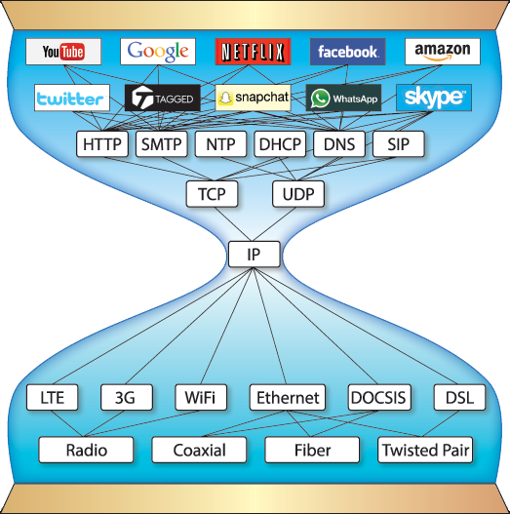
Network
Layer of
The Internet
Pic courtesy: https://www.are.na/block/881873
Notes:
IP is not the only protocol that makes the Network layer. There are other supporting protocols.

Slide 13
Network
Layer of
The Internet
Address resolution protocols,
Error messaging protocols
Routing protocols,
Pic courtesy: https://www.are.na/block/881873

Slide 14
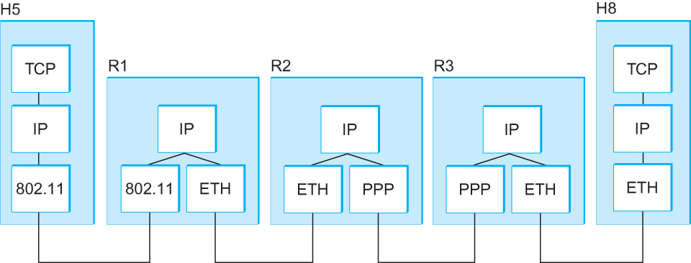
Internetworking
What is IP
IP stands for Internet Protocol
Key tool used today to build scalable, heterogeneous internetworks
It runs on all the nodes in a collection of networks and defines the infrastructure that allows these nodes and networks to function as a single logical internetwork
A simple internetwork showing the protocol layers

Slide 15
IP Service Model
Packet Delivery Model
Connectionless model for data delivery
Best-effort delivery (unreliable service)
packets are lost
packets are delivered out of order
duplicate copies of a packet are delivered
packets can be delayed for a long time
Global Addressing Scheme
Provides a way to identify all hosts in the network

Slide 16
IP datagram format (i.e., Packet format)
32 bits
ver
head.
len
type of
service
length
flgs
fragment
offset
16-bit identifier
Variable size header.
(20 bytes default
without options)
time to
live
upper
layer
header
checksum
32 bit source IP address
32 bit destination IP address
options (if any)
data
(variable length,
typically a TCP
or UDP segment)
Variable size data.
Data size =
(Datagram Len – Header Len)

Slide 17
IP datagram format
IP protocol version number
(4 bits)
32 bits
total datagram
length (bytes)
header length
in # of 4-bytes (4 bits)
head.
len
type of
service
ver
length
for
fragmentation/
reassembly
“type” of data
(real-time, non-real-time etc.)
fragment
offset
16-bit identifier
flgs
time to
live
upper
layer
header
checksum
max number remaining hops
(decremented at each router)
Why header only?
32 bit source IP address
32 bit destination IP address
upper layer protocol
to deliver payload to
options (if any)
e.g. timestamp,
record route
taken, specify
list of routers
to visit, Min-MTU
discovery
data
(variable length,
typically a TCP
or UDP segment)
Notes:
Header Fields (in order)
FieldSizePurposeVersion4 bitsIP version (4)IHL (Internet Header Length)4 bitsHeader length in 32-bit wordsDSCP/ECN (Type of Service)8 bitsQoS & congestion notificationTotal Length16 bitsEntire packet length (header + data)Identification16 bitsFragmentation reassemblyFlags3 bitsDF, MF control bitsFragment Offset13 bitsFragment positionTTL (Time To Live)8 bitsHop limitProtocol8 bitsUpper-layer protocol (TCP=6, UDP=17, ICMP=1)Header Checksum16 bitsHeader integrity checkSource Address32 bitsSender IPDestination Address32 bitsReceiver IPOptions + PaddingVariableOptional control information
In Internet Protocol version 4, the checksum:
Covers only the header (not payload)
Is 16 bits
Is recomputed at every router hop (because TTL changes)
It detects bit errors in the header.
Step-by-Step Calculation
Step 1: Set Checksum Field to Zero
Before computing, the checksum field is set to: 0x0000
Step 2: Divide Header into 16-bit Words
Step 3: Add Using One’s Complement Arithmetic
Step 4: Take One’s Complement
Why One’s Complement?
Properties:
Simple hardware implementation
Detects all 1-bit errors
Detects most multi-bit errors
Fast to compute

Slide 18
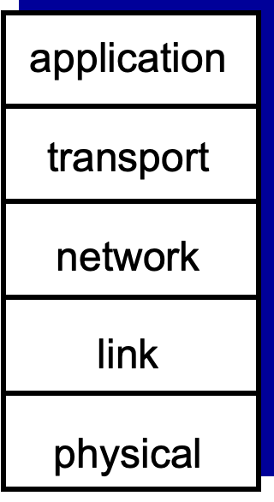

Slide 19
IP datagram format
32 bits
ver
head.
len
type of
service
length
for
fragmentation/
reassembly
flgs
fragment
offset
16-bit identifier
time to
live
upper
layer
header
checksum
32 bit source IP address
32 bit destination IP address
options (if any)
data
(variable length,
typically a TCP
or UDP segment)

Slide 20
IP Fragmentation and Reassembly

Slide 21



IP Fragmentation and Reassembly
R1
R2
R3
H5
H8
Maximum Transmission Unit (MTU)
[packet size limit for the network layer]

Slide 22
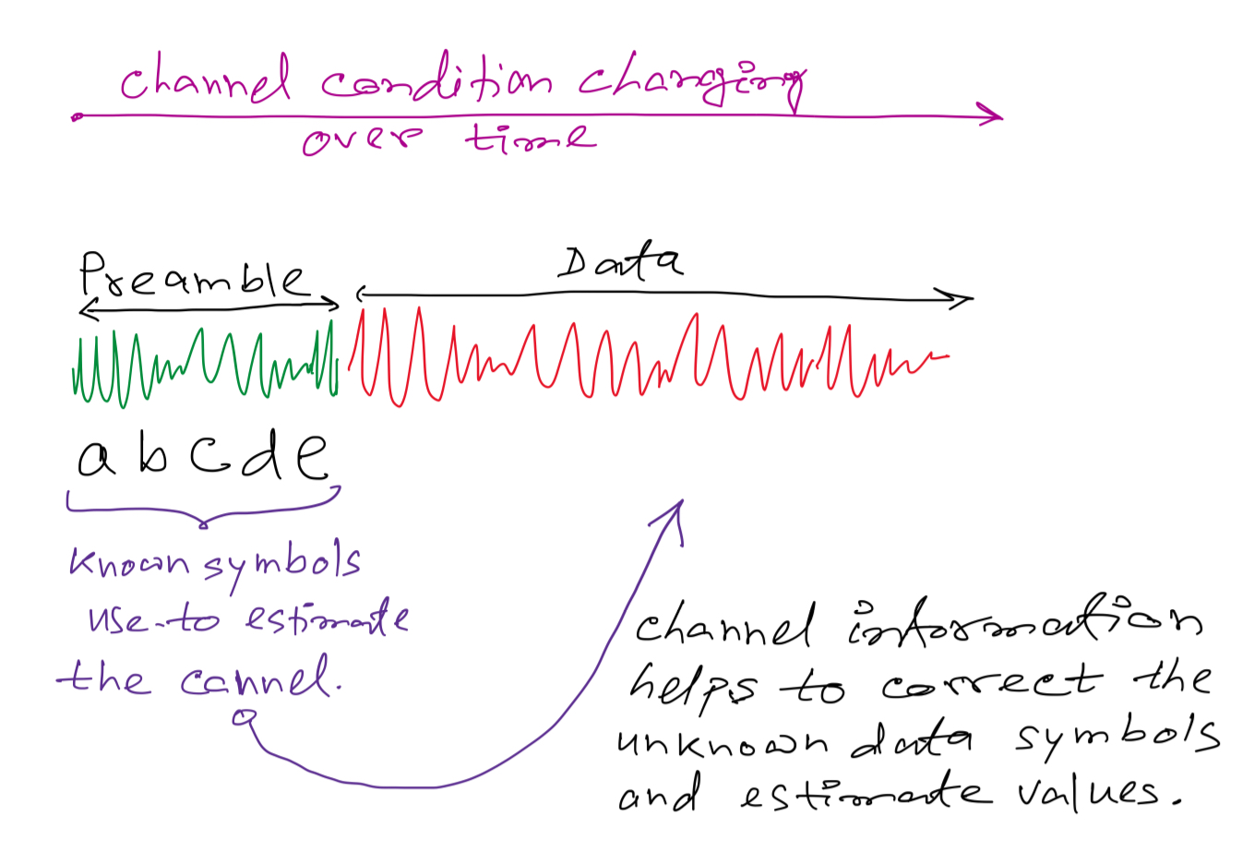
Rational behind the MTU limit:

Slide 23
Rational behind the MTU limit:

Slide 24
IP Fragmentation and Reassembly
Datagram Len=1500
?
MTU=1500
(bytes)
MTU=1500
MTU=532
R1
R2
R3
MTU=1500
Datagram Len=1500

Slide 25

Analogy:

Slide 26
Analogy:
Header
MTU
Data

Slide 27
Analogy:

Slide 28
Analogy:
Data index: 0

Slide 29
Analogy:
Data index: 0
Data index: 0

Slide 30
Analogy:
Data index: 0
Data index: 13
Data index: 0
Data index: 13

Slide 31
Analogy:
Data index: 0
Data index: 13
Data index: 0
Data index: 13
Data index: 26
Data index: 26

Slide 32
Analogy:
Data index: 0
Fragmented
Fragmented
Fragmented & last
Data index: 13
Data index: 0
Data index: 13
Data index: 26
Data index: 26

Slide 33
Analogy:
Data index: 0
Fragmented
1
2
Data index: 13
3
…
Fragmented
Data index: 0
Fragmented & last
Data index: 26
Virtually infinite buffer
for reassembly

Slide 34
Analogy:
Data index: 0
Fragmented
1
2
Data index: 13
…
Data index: 13
Fragmented
Data index: 0
Fragmented & last
Data index: 26
Virtually infinite buffer
for reassembly

Slide 35
Analogy:
Data index: 0
Fragmented
1
2
Data index: 13
…
Data index: 13
Fragmented
Data index: 0
Fragmented & last
Data index: 26
Virtually infinite buffer
for reassembly

Slide 36
Analogy:
Data index: 0
Fragmented
1
2
Data index: 13
…
Data index: 13
Data index: 26
Fragmented
Data index: 0
Fragmented & last
Data index: 26
Virtually infinite buffer
for reassembly

Slide 37
Analogy:
Data index: 0
1
2
…
Data index: 13
Data index: 26
Assembled packet
(The fragmentation and assembly process
Is transparent to the higher layers)
Virtually infinite buffer
for reassembly

Slide 38
IP Fragmentation and Reassembly
Datagram Len=1500
?
MTU=1500
(bytes)
MTU=1500
MTU=532
R1
R2
R3
MTU=1500
Datagram Len=1500

Slide 39
IP Fragmentation and Reassembly
Fragments
Dgram Len<=532
Dgram Len<=532
Datagram Len=1500
Dgram Len<=532
MTU=1500
(bytes)
MTU=1500
MTU=532
R1
R2
R3
MTU=1500
Datagram Len=1500
Where should reassembly take place?

Slide 40
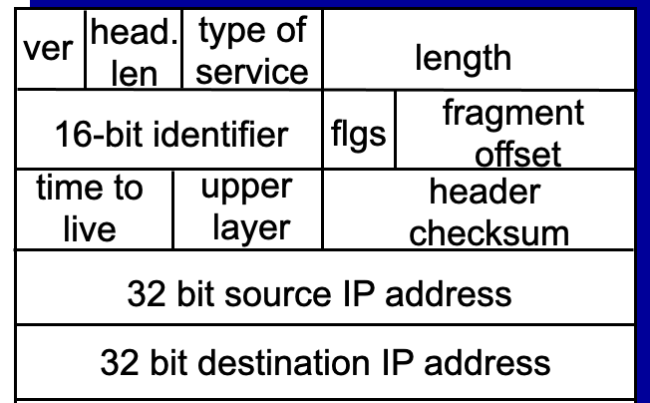
IP Fragmentation and Reassembly
Fragments
Dgram Len<=532
Dgram Len<=532
Datagram Len=1500
Dgram Len<=532
MTU=1500
(bytes)
MTU=1500
MTU=532
R1
R2
R3
MTU=1500
Datagram Len=1500
During assembly,
A. How can the destination identify all fragments of a packet?
Notes:
RFC page 24: https://www.rfc-editor.org/rfc/rfc791
The internet identification field (ID) is used together with the source and destination address, and the protocol fields, to identify datagram fragments for reassembly.
Comments of the limited ID:
https://www.rfc-editor.org/rfc/rfc6864
Introduction
In IPv4, the Identification (ID) field is a 16-bit value that is unique for every datagram for a given source address, destination address, and protocol, such that it does not repeat within the maximum datagram lifetime (MDL) [RFC791] [RFC1122]. As currently specified, all datagrams between a source and destination of a given protocol must have unique IPv4 ID values over a period of this MDL, which is typically interpreted as two minutes and is related to the recommended reassembly timeout [RFC1122]. This uniqueness is currently specified as for all datagrams, regardless of fragmentation settings.
Uniqueness of the IPv4 ID is commonly violated by high-speed devices; if strictly enforced, it would limit the speed of a single protocol between two IP endpoints to 6.4 Mbps for typical MTUs of 1500 bytes (assuming a 2-minute MDL, using the analysis presented in [RFC4963]). It is common for a single connection to operate far in excess of these rates, which strongly indicates that the uniqueness of the IPv4 ID as specified is already moot. Further, some sources have been generating non-varying IPv4 IDs for many years (e.g., cellphones), which resulted in support for such in RObust Header Compression (ROHC) [RFC5225].
And
4.1. IPv4 ID Used Only for Fragmentation
Although RFC 1122 suggests that the IPv4 ID field has other uses, including datagram de-duplication, such uses are already not interoperable with known implementations of sources that do not vary their ID. This document thus defines this field's value only for fragmentation and reassembly:
>> The IPv4 ID field MUST NOT be used for purposes other than fragmentation and reassembly.
Datagram de-duplication can still be accomplished using hash-based duplicate detection for cases where the ID field is absent (IPv6 unfragmented datagrams), which can also be applied to IPv4 atomic datagrams without utilizing the ID field [RFC6621].

Slide 41
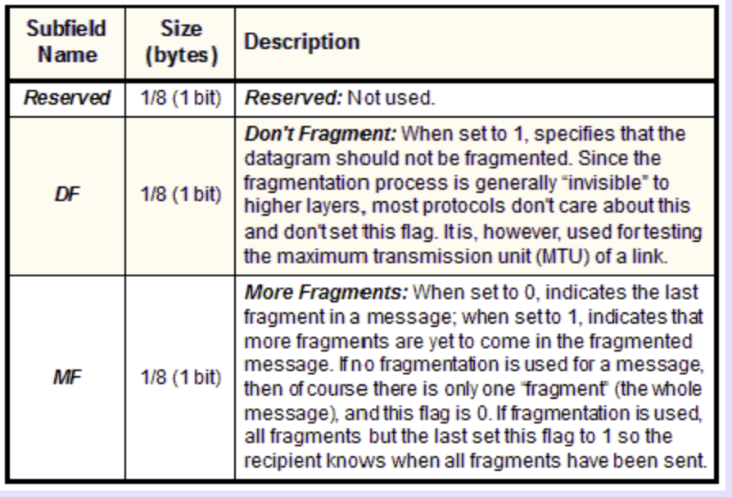
IP Fragmentation and Reassembly
Fragments
Dgram Len<=532
Dgram Len<=532
Datagram Len=1500
Dgram Len<=532
MTU=1500
(bytes)
MTU=1500
MTU=532
R1
R2
R3
MTU=1500
Datagram Len=1500
During assembly,
B. How will the destination know if the last fragment is received?
Notes:
RFC page 24: https://www.rfc-editor.org/rfc/rfc791
The internet identification field (ID) is used together with the source and destination address, and the protocol fields, to identify datagram fragments for reassembly.
If this is a whole datagram (that is both the fragment offset and the more fragments fields are zero), then it concludes that no fragmentation happened.

Slide 42
IP Fragmentation and Reassembly
Identifies the fragment location, relative to the beginning of the unfragmented data.
Fragments are counted in units of 8 octets (i.e., 8-bytes blocks).
Fragments
0
Data from fgmt offset: 2
2
Notes:
RFC page 24: https://www.rfc-editor.org/rfc/rfc791
The internet identification field (ID) is used together with the source and destination address, and the protocol fields, to identify datagram fragments for reassembly.
If this is a whole datagram (that is both the fragment offset and the more fragments fields are zero), then it concludes that no fragmentation happened.

Slide 43
IP Fragmentation and Reassembly
Identifies the fragment location, relative to the beginning of the unfragmented data.
Fragments are counted in units of 8 octets (i.e., 8-bytes blocks).
Fragments
0
2
Data from fgmt offset: 2
Note that this offset numbers are
in “8-octet” not bytes.
Notes:
RFC page 24: https://www.rfc-editor.org/rfc/rfc791
The internet identification field (ID) is used together with the source and destination address, and the protocol fields, to identify datagram fragments for reassembly.
If this is a whole datagram (that is both the fragment offset and the more fragments fields are zero), then it concludes that no fragmentation happened.

Slide 44
Bits
110100010001101101110001011000000111101001
Bytes
Byte-1
Byte-2
Byte-3
Byte-4
8-Octets == 8 Bytes
Byte-1
Byte-2
Byte-3
Byte-4
Byte-5
Byte-6
Byte-7
Byte-8
Byte-9
Byte-10
“8-octet” - 1
“8-octet” - 2

Slide 45
Analogy:
Data index: 0
Data index: 13
Data index: 0
Data index: 13
Data index: 26
Data index: 26
Data size should be integer multiple of
“8-octet” or “8 bytes”

Slide 46
Analogy:
Data index: 0
Data index: 13
Data index: 0
Data index: 13
Data index: 26
Data index: 26
Data size should be integer multiple of
“8-octet” or “8 bytes”
…the last one can be smaller.

Slide 47
IP Fragmentation and Reassembly
Identifies the fragment location, relative to the beginning of the unfragmented data.
Fragments are counted in units of 8 octets (i.e., 8-bytes blocks).
Fragments
Dgram Len<=532
Dgram Len<=532
Datagram Len=1500
Dgram Len<=532
MTU=1500
(bytes)
MTU=1500
MTU=532
R1
R2
R3
MTU=1500
Datagram Len=1500
During assembly,
C. How will the destination know how to rearrange the data?
D. How can the destination know if a packet is unfragmented/whole?
Notes:
RFC page 24: https://www.rfc-editor.org/rfc/rfc791
The internet identification field (ID) is used together with the source and destination address, and the protocol fields, to identify datagram fragments for reassembly.
If this is a whole datagram (that is both the fragment offset and the more fragments fields are zero), then it concludes that no fragmentation happened.

Slide 48
Example: IP Fragmentation
Fragments
Dgram Len<=532
Dgram Len<=532
Datagram Len=1500
Dgram Len<=532
MTU=1500
MTU=532
R2
Header field/<info> | Value
P. Identifier | XYZ
More Frag. bit | 0
Frag. offset | 0
Header Len. | 20 (bytes)
<Data Len.> | 1400
Packet Length | 1420
Fields | Val.
P. Id
MF bit
F. off.
H. Len.
<D Len.>
Pkt Len
Frag. Pkt #1
Original Packet

Slide 49
Example: IP Fragmentation
Fragments
Dgram Len<=532
Dgram Len<=532
Datagram Len=1500
Dgram Len<=532
MTU=1500
MTU=532
R2
Header field/<info> | Value
P. Identifier | XYZ
More Frag. bit | 0
Frag. offset | 0
Header Len. | 20 (bytes)
<Data Len.> | 1400
Packet Length | 1420
Fields | Val.
P. Id | XYZ
MF bit | 1
F. off.
H. Len. | 20
<D Len.>
Pkt Len | 532
Max. Data Len. =
Max. Packet Len. – Header Len
Calculate in integer multiple of 8-octets (8 bytes block)
Frag. Pkt #1
Original Packet

Slide 50
Example: IP Fragmentation
Fragments
Dgram Len<=532
Dgram Len<=532
Datagram Len=1500
Dgram Len<=532
MTU=1500
MTU=532
R2
Header field/<info> | Value
P. Identifier | XYZ
More Frag. bit | 0
Frag. offset | 0
Header Len. | 20 (bytes)
<Data Len.> | 1400
Packet Length | 1420
Fields | Val.
P. Id | XYZ
MF bit | 1
F. off.
H. Len. | 20
<D Len.> | 512
Pkt Len | 532
Max. Data Len. =
Max. Packet Len. – Header Len
Calculate in integer multiple of 8-octets (8 bytes block)
Frag. Pkt #1
(532-20) = 512
Original Packet

Slide 51
Example: IP Fragmentation
Fragments
Dgram Len<=532
Dgram Len<=532
Datagram Len=1500
Dgram Len<=532
MTU=1500
MTU=532
R2
Header field/<info> | Value
P. Identifier | XYZ
More Frag. bit | 0
Frag. offset | 0
Header Len. | 20 (bytes)
<Data Len.> | 1400
Packet Length | 1420
Fields | Val.
P. Id | XYZ
MF bit | 1
F. off.
H. Len. | 20
<D Len.> | 512
Pkt Len | 532
Max. Data Len. =
Max. Packet Len. – Header Len
Calculate in integer multiple of 8-octets (8 bytes block)
Frag. Pkt #1
(532-20) = 512
Original Packet

Slide 52
Example: IP Fragmentation
Fragments
Dgram Len<=532
Dgram Len<=532
Datagram Len=1500
Dgram Len<=532
MTU=1500
MTU=532
R2
Header field/<info> | Value
P. Identifier | XYZ
More Frag. bit | 0
Frag. offset | 0
Header Len. | 20 (bytes)
<Data Len.> | 1400
Packet Length | 1420
Fields | Val.
P. Id | XYZ
MF bit | 1
F. off. | 0
H. Len. | 20
<D Len.> | 512
Pkt Len | 532
Starting 8-octet number
Max. Data Len. =
Max. Packet Len. – Header Len
Calculate in integer multiple of 8-octets (8 bytes block)
Frag. Pkt #1
(532-20) = 512
Original Packet

Slide 53
Example: IP Fragmentation
Fragments
Dgram Len<=532
Dgram Len<=532
Datagram Len=1500
Dgram Len<=532
MTU=1500
MTU=532
R2
512 bytes/8 =
64 (in 8-octets)
Header field/<info> | Value
P. Identifier | XYZ
More Frag. bit | 0
Frag. offset | 0
Header Len. | 20 (bytes)
<Data Len.> | 1400
Packet Length | 1420
Fields | Val.
P. Id | XYZ
MF bit | 1
F. off. | 0
H. Len. | 20
<D Len.> | 512
Pkt Len | 532
Fields | Val.
P. Id | XYZ
MF bit | 1
F. off. | 64
H. Len. | 20
<D Len.> | 512
Pkt Len | 532
Frag. Pkt #1
Frag. Pkt #2
Original Packet

Slide 54
Example: IP Fragmentation
Fragments
Dgram Len<=532
Dgram Len<=532
Datagram Len=1500
Dgram Len<=532
MTU=1500
MTU=532
R2
Header field/<info> | Value
P. Identifier | XYZ
More Frag. bit | 0
Frag. offset | 0
Header Len. | 20 (bytes)
<Data Len.> | 1400
Packet Length | 1420
Fields | Val.
P. Id | XYZ
MF bit | 1
F. off. | 0
H. Len. | 20
<D Len.> | 512
Pkt Len | 532
Fields | Val.
P. Id | XYZ
MF bit | 1
F. off. | 64
H. Len. | 20
<D Len.> | 512
Pkt Len | 532
Fields | Val.
P. Id | XYZ
MF bit | 0
F. off. | 128
H. Len. | 20
<D Len.> | 376
Pkt Len | 396
Frag. Pkt #1
Frag. Pkt #2
Frag. Pkt #3
Original Packet

Slide 55
Example: IP Reassembly
Fields | Val.
P. Id | XYZ
MF bit | 1
F. off. | 0
H. Len. | 20
<D Len.> | 512
Pkt Len | 532
Fields | Val.
P. Id | XYZ
MF bit | 1
F. off. | 64
H. Len. | 20
<D Len.> | 512
Pkt Len | 532
Fields | Val.
P. Id | XYZ
MF bit | 0
F. off. | 128
H. Len. | 20
<D Len.> | 376
Pkt Len | 396
Header buffer
Data buffer

Slide 56
Example: IP Reassembly
Header from
fgmt 1
(updated later)
Fields | Val.
P. Id | XYZ
MF bit | 1
F. off. | 0
H. Len. | 20
<D Len.> | 512
Pkt Len | 532
Fields | Val.
P. Id | XYZ
MF bit | 1
F. off. | 64
H. Len. | 20
<D Len.> | 512
Pkt Len | 532
Fields | Val.
P. Id | XYZ
MF bit | 0
F. off. | 128
H. Len. | 20
<D Len.> | 376
Pkt Len | 396
Header buffer
Data buffer

Slide 57
Example: IP Reassembly
Header from
fgmt 1
(updated later)
Fields | Val.
P. Id | XYZ
MF bit | 1
F. off. | 0
H. Len. | 20
<D Len.> | 512
Pkt Len | 532
Fields | Val.
P. Id | XYZ
MF bit | 1
F. off. | 64
H. Len. | 20
<D Len.> | 512
Pkt Len | 532
Fields | Val.
P. Id | XYZ
MF bit | 0
F. off. | 128
H. Len. | 20
<D Len.> | 376
Pkt Len | 396
Header buffer
0
Data from fgmt 1
64
Data from fgmt 2
128
Data from fgmt 3
What if assembly is not possible?
Data buffer

Slide 58
Network Addresses

Slide 59
IP Address (IPv4)
A unique 32-bit number
Identifies an interface (on a host, on a router, …)
Represented in dotted-quad notation
12
34
158
5
00001100
00100010
10011110
00000101
12:34:158:5

Slide 60
Grouping Related Hosts
The Internet is an “inter-network”
Used to connect networks together, not hosts
Need to address a network (i.e., group of hosts)
host
host
...
host
host
host
...
host
LAN 1
LAN 2
router
router
router
WAN
WAN
LAN = Local Area Network
WAN = Wide Area Network

Slide 61
Scalability Challenge
Suppose hosts had arbitrary addresses
Then every router would need a lot of information
…to know how to direct packets toward every host
1.2.3.4
5.6.7.8
2.4.6.8
1.2.3.5
5.6.7.9
2.4.6.9
host
host
...
host
host
host
...
host
LAN 1
LAN 2
router
router
router
WAN
WAN
1.2.3.4
1.2.3.5
forwarding table

Slide 62
Hierarchical Addressing: IP Prefixes
Network and host portions (left and right)
12
34
158
5
00001100
00100010
10011110
00000101
Network (24 bits)
Host (8 bits)
(N bits)
(32-N bits)

Slide 63
Hierarchical Addressing in U.S. Mail
Addressing in the U.S. mail
Zip code: 08540
Building: 35 Olden Street
Room in building: 306
Name of occupant: Jennifer Rexford
Forwarding the U.S. mail
Deliver to the post office in the zip code
Assign to mailman covering the building
Drop letter into mailbox for building/room
Give letter to the appropriate person
???

Slide 64
Easy to Add New Hosts
No need to update the routers
E.g., adding a new host 5.6.7.213 on the right
Doesn’t require adding a new forwarding-table entry
1.2.3.4
1.2.3.7
1.2.3.156
5.6.7.8
5.6.7.9
5.6.7.212
host
host
...
host
host
host
...
host
LAN 1
LAN 2
router
router
router
host
WAN
WAN
5.6.7.213
1.2.3.0/24
5.6.7.0/24
forwarding table

Slide 65
Hierarchical Addressing: IP Prefixes
Network and host portions (left and right)
12
34
158
5
00001100
00100010
10011110
00000101
Network (24 bits)
Host (8 bits)
(N bits)
(32-N bits)

Slide 66
Hierarchical Addressing: IP Prefixes
Network and host portions (left and right)
12
34
158
5
00001100
00100010
10011110
00000101
Network (24 bits)
Host (8 bits)
(N bits)
(32-N bits)
N = ?

Slide 67
“Classes” of networks
The sizes of networks can be different
1.2.3.4
1.2.3.7
1.2.3.156
5.6.7.8
5.6.7.9
host
host
...
host
host
host
LAN 1
LAN 2
router
router
router
WAN
WAN
Large networks (many hosts)
Fewer such networks exist
Small networks (fewer hosts)
Many such networks exist
1.2.3.0/24
5.6.7.0/24
forwarding table

Slide 68
Class-full addressing

Slide 69
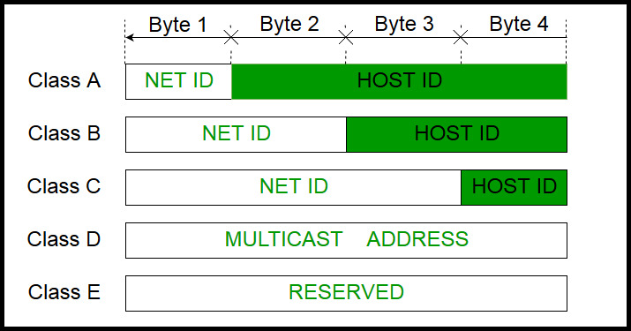
How can you tell network class from the IP address?
Picture courtesy: https://www.geeksforgeeks.org/introduction-of-classful-ip-addressing/

Slide 70
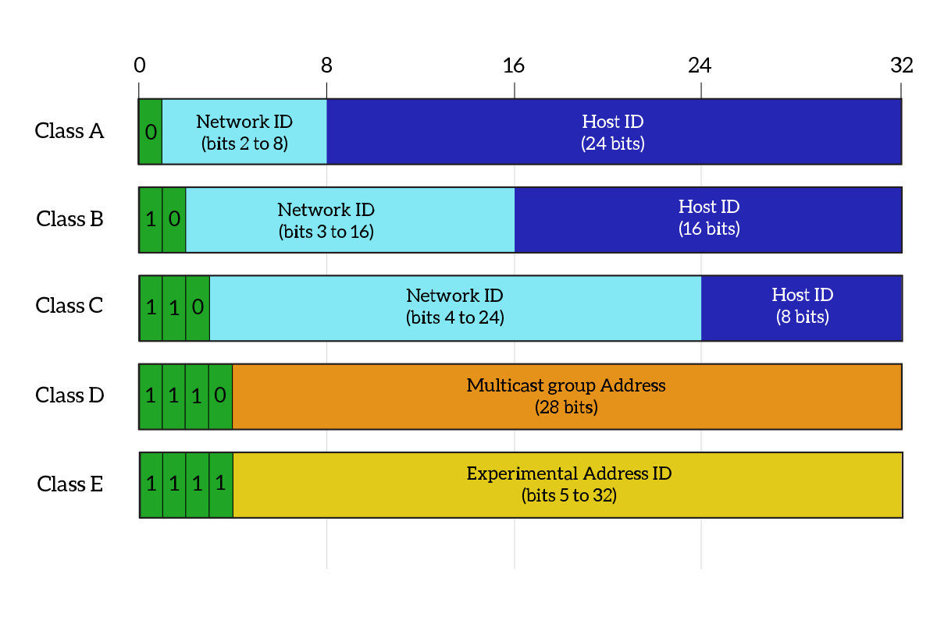
What percentage of addresses and allocated to each class?
Picture courtesy: https://www.ictshore.com/free-ccna-course/network-layer-ipv4-addressing/attachment/1013-05-classful_addressing/

Slide 71
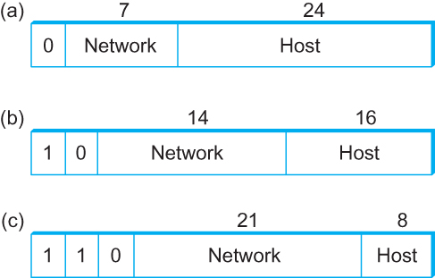
Global Addresses
Properties
globally unique
hierarchical: network + host
4 Billion IP address, half are A type, ¼ is B type, and 1/8 is C type
Format
Dot notation
10.3.2.4
128.96.33.81
192.12.69.77

Slide 72
Let’s assume we have 4-bit address (instead of 32 bit)
0000
0001
0010
0011
0100
0101
0110
0111
1000
1001
1010
1011
1100
1101
1110
1111
Class A (Half of all possible addresses)
Class B (1/4 of all possible addresses)
Class C (1/8 of all possible addresses)

Slide 73
Let’s assume we have 4-bit address (instead of 32 bit)
0000
0001
0010
0011
0100
0101
0110
0111
Class A (Half of all possible addresses)
Say, 1 bit for network part = 2 different networks
Say, 2 bits for host part = 4 hosts per network

Slide 74
Global Addresses
Properties
globally unique
hierarchical: network + host
4 Billion IP address, half are A type, ¼ is B type, and 1/8 is C type
Format
Dot notation
10.3.2.4
128.96.33.81
192.12.69.77

Slide 75
Classful Addressing
In the olden days, only fixed allocation sizes
Class A: 0*
Very large /8 blocks (e.g., MIT has 18.0.0.0/8)
There can be 126 different class A networks (0 and 127 values are reserved) and (2²⁴-2) different hosts (2 values are reserved)
Class B: 10*
Large /16 blocks (e.g,. Princeton has 128.112.0.0/16)
Class C: 110*
Small /24 blocks (e.g., AT&T Labs has 192.20.225.0/24)
2²¹ different networks possible, 254 hosts (255 is reserved for broadcast and 0 is reserved)
Class D: 1110* for multicast groups
Class E: 11110* reserved for future use
This is why folks use dotted-quad notation!

Slide 76
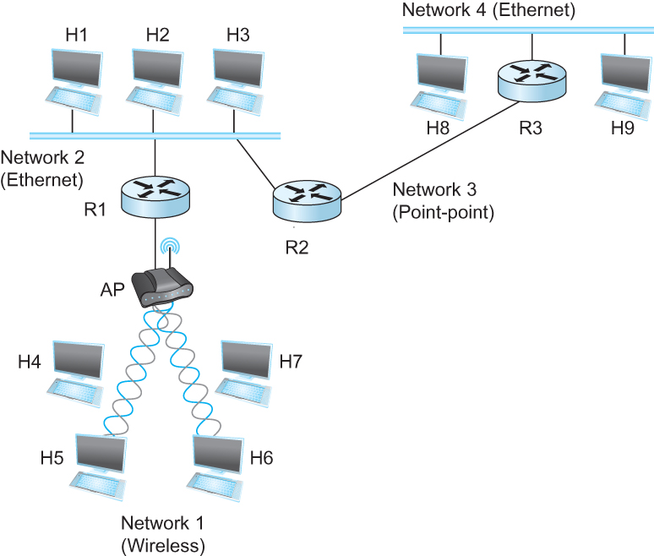
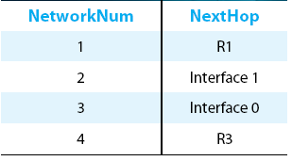
IP Datagram Forwarding
Strategy
every datagram contains destination's address
if directly connected to destination network, then forward to host
if not directly connected to destination network, then forward to some router
forwarding table maps network number into next hop
each host has a default router
each router maintains a forwarding table
Example (router R2)

Slide 77
IP Datagram Forwarding
Algorithm
if (NetworkNum of destination = NetworkNum of one of my interfaces) then
deliver packet to destination over that interface
else
if (NetworkNum of destination is in my forwarding table) then
deliver packet to NextHop router
else
deliver packet to default router
First: find the NetworkNum. How?

Slide 78
IP Datagram Forwarding
Algorithm
if (NetworkNum of destination = NetworkNum of one of my interfaces) then
deliver packet to destination over that interface
else
if (NetworkNum of destination is in my forwarding table) then
deliver packet to NextHop router
else
deliver packet to default router
For a host with only one interface and only a default router in its forwarding table, this simplifies to
if (NetworkNum of destination = my NetworkNum)then
deliver packet to destination directly
else
deliver packet to default router

Slide 79
Obtaining a Block of Addresses
Internet Corporation for Assigned Names and Numbers (ICANN)
Allocates large blocks to Regional Internet Registries
Regional Internet Registries (RIRs)
E.g., ARIN (American Registry for Internet Numbers)
Allocates to ISPs and large institutions
Internet Service Providers (ISPs)
Allocate address blocks to their customers
Who may, in turn, allocate to their customers…

Slide 80
Obtaining a Block of Addresses
Your organization: XYZ
Maximum # of hosts is estimated to be 10 millions.
What class of IP address will you request for?
Maximum # of hosts is estimated to be 64K ?
Maximum # of hosts is estimated to be 250?
Maximum # of hosts is estimated to be 100?
Maximum # of hosts is estimated to be 20?
Maximum # of hosts is estimated to be 300?
Maximum # of hosts is estimated to be 66K?
Notes:
Class A can have 16 millions (16777214 = 2^24-2)
Class B can have 65K (65534 = 2^16 - 2)
Class C can have 254 (2^8-2)

Slide 81
Problems with the classes of addresses
Wastage of addresses
Bigger tables to look up at routers

Slide 82
Thank you

