Slide 1

CMSC 417: Computer Networks
Spring 2026
Topic: Internetworking
(Textbook chapter 3)
Nirupam Roy
M-W 2:00-3:15pm
CSI 2117
Feb 23rd, 2026

Slide 2
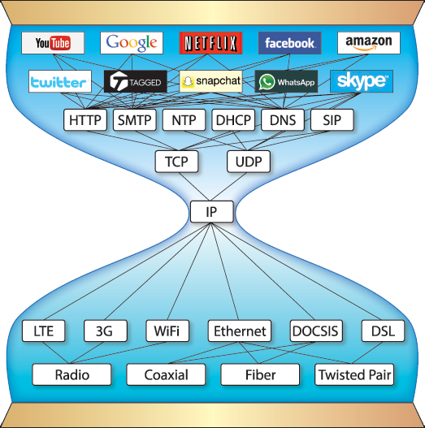
Network
Layer of
The Internet
Address resolution protocols,
Error messaging protocols
Routing protocols,
Pic courtesy: https://www.are.na/block/881873

Slide 3
IP datagram format
IP protocol version number
(4 bits)
32 bits
total datagram
length (bytes)
header length
in # of 4-bytes (4 bits)
head.
len
type of
service
ver
length
for
fragmentation/
reassembly
“type” of data
(real-time, non-real-time etc.)
fragment
offset
16-bit identifier
flgs
time to
live
upper
layer
header
checksum
max number remaining hops
(decremented at each router)
Why header only?
32 bit source IP address
32 bit destination IP address
upper layer protocol
to deliver payload to
options (if any)
e.g. timestamp,
record route
taken, specify
list of routers
to visit, Min-MTU
discovery
data
(variable length,
typically a TCP
or UDP segment)
Notes:
Header Fields (in order)
FieldSizePurposeVersion4 bitsIP version (4)IHL (Internet Header Length)4 bitsHeader length in 32-bit wordsDSCP/ECN (Type of Service)8 bitsQoS & congestion notificationTotal Length16 bitsEntire packet length (header + data)Identification16 bitsFragmentation reassemblyFlags3 bitsDF, MF control bitsFragment Offset13 bitsFragment positionTTL (Time To Live)8 bitsHop limitProtocol8 bitsUpper-layer protocol (TCP=6, UDP=17, ICMP=1)Header Checksum16 bitsHeader integrity checkSource Address32 bitsSender IPDestination Address32 bitsReceiver IPOptions + PaddingVariableOptional control information
In Internet Protocol version 4, the checksum:
Covers only the header (not payload)
Is 16 bits
Is recomputed at every router hop (because TTL changes)
It detects bit errors in the header.
Step-by-Step Calculation
Step 1: Set Checksum Field to Zero
Before computing, the checksum field is set to: 0x0000
Step 2: Divide Header into 16-bit Words
Step 3: Add Using One’s Complement Arithmetic
Step 4: Take One’s Complement
Why One’s Complement?
Properties:
Simple hardware implementation
Detects all 1-bit errors
Detects most multi-bit errors
Fast to compute

Slide 4

Example: IP Fragmentation
Fragments
Dgram Len<=532
Dgram Len<=532
Datagram Len=1500
Dgram Len<=532
MTU=1500
MTU=532
R2
512 bytes/8 =
64 (in 8-octets)
Header field/<info> | Value
P. Identifier | XYZ
More Frag. bit | 0
Frag. offset | 0
Header Len. | 20 (bytes)
<Data Len.> | 1400
Packet Length | 1420
Fields | Val.
P. Id | XYZ
MF bit | 1
F. off. | 0
H. Len. | 20
<D Len.> | 512
Pkt Len | 532
Fields | Val.
P. Id | XYZ
MF bit | 1
F. off. | 64
H. Len. | 20
<D Len.> | 512
Pkt Len | 532
Frag. Pkt #1
Frag. Pkt #2
Original Packet

Slide 5
Example: IP Fragmentation
Fragments
Dgram Len<=532
Dgram Len<=532
Datagram Len=1500
Dgram Len<=532
MTU=1500
MTU=532
R2
Header field/<info> | Value
P. Identifier | XYZ
More Frag. bit | 0
Frag. offset | 0
Header Len. | 20 (bytes)
<Data Len.> | 1400
Packet Length | 1420
Fields | Val.
P. Id | XYZ
MF bit | 1
F. off. | 0
H. Len. | 20
<D Len.> | 512
Pkt Len | 532
Fields | Val.
P. Id | XYZ
MF bit | 1
F. off. | 64
H. Len. | 20
<D Len.> | 512
Pkt Len | 532
Fields | Val.
P. Id | XYZ
MF bit | 0
F. off. | 128
H. Len. | 20
<D Len.> | 376
Pkt Len | 396
Frag. Pkt #1
Frag. Pkt #2
Frag. Pkt #3
Original Packet

Slide 6
Example: IP Reassembly
Fields | Val.
P. Id | XYZ
MF bit | 1
F. off. | 0
H. Len. | 20
<D Len.> | 512
Pkt Len | 532
Fields | Val.
P. Id | XYZ
MF bit | 1
F. off. | 64
H. Len. | 20
<D Len.> | 512
Pkt Len | 532
Fields | Val.
P. Id | XYZ
MF bit | 0
F. off. | 128
H. Len. | 20
<D Len.> | 376
Pkt Len | 396
Header buffer
Data buffer

Slide 7
Example: IP Reassembly
Header from
fgmt 1
(updated later)
Fields | Val.
P. Id | XYZ
MF bit | 1
F. off. | 0
H. Len. | 20
<D Len.> | 512
Pkt Len | 532
Fields | Val.
P. Id | XYZ
MF bit | 1
F. off. | 64
H. Len. | 20
<D Len.> | 512
Pkt Len | 532
Fields | Val.
P. Id | XYZ
MF bit | 0
F. off. | 128
H. Len. | 20
<D Len.> | 376
Pkt Len | 396
Header buffer
Data buffer

Slide 8
Example: IP Reassembly
Header from
fgmt 1
(updated later)
Fields | Val.
P. Id | XYZ
MF bit | 1
F. off. | 0
H. Len. | 20
<D Len.> | 512
Pkt Len | 532
Fields | Val.
P. Id | XYZ
MF bit | 1
F. off. | 64
H. Len. | 20
<D Len.> | 512
Pkt Len | 532
Fields | Val.
P. Id | XYZ
MF bit | 0
F. off. | 128
H. Len. | 20
<D Len.> | 376
Pkt Len | 396
Header buffer
0
Data from fgmt 1
64
Data from fgmt 2
128
Data from fgmt 3
What if assembly is not possible?
Data buffer

Slide 9
IP Fragmentation-Reassembly: Q&A
1. The packet “Identifier”
2. Does fragmentation and reassembly set a new limit on the total
packet size? Is it consistent with “packet length” header field?
3. Fragmentation of fragmentation
4. Assembly of mixed fragmentation of different size
(possibly from different paths)
RFC 791, page 24: https://www.rfc-editor.org/rfc/rfc791

Slide 10
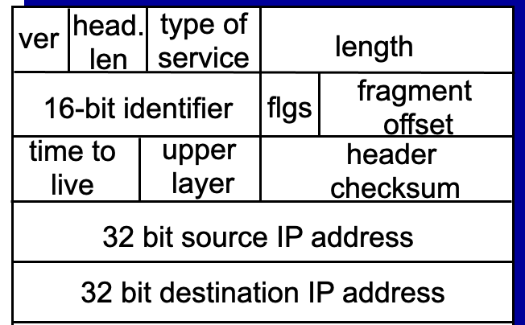
1. The packet “Identifier”
What can violate the uniqueness of the “identifier”?
In IPv4, the Identification (ID) field is a 16-bit value that is unique for every datagram for a given source address, destination address, and protocol, such that it does not repeat within the maximum datagram lifetime (MDL) [RFC791] [RFC1122]. As currently specified, all datagrams between a source and destination of a given protocol must have unique IPv4 ID values over a period of this MDL, which is typically interpreted as two minutes and is related to the
recommended reassembly timeout [RFC1122]. This uniqueness is currently specified as for all datagrams, regardless of fragmentation settings.

Slide 11
2. Does fragmentation and reassembly set a new limit on the total
packet size? Is it consistent with “packet length” header field?
Notes:
Packet length = 2^16
Fragment offet = 2^13 + 2^3 (because of 8 byte blocks, 8 = 2^3) = 16 bit of coverage.

Slide 12
3. Fragmentation of fragmentation
How “More Fragments (MF)” flag is decided?
How “fragment offset” is calculated?
Notes:
1)
All newly created sub-fragments except the last one get MF = 1.
The last sub-fragment inherits the MF value of the original fragment being split.
2) New fragment offset = original fragment offset + (local byte shift ÷ 8)

Slide 13
4. Assembly of mixed fragmentation of different size
(possibly from different paths)
“Fragment offsets” always represent the absolute position of a data-fragment relative to the original (unfragmented) packet.
The last fragment decides the total data size in the reassembly process.
Reassembly fails only if there are missing data before the timer goes off.
(Recommended initial value for the time is 15 seconds)

Slide 14
Network Addresses

Slide 15
IP Address (IPv4)
A unique 32-bit number
Identifies an interface (on a host, on a router, …)
Represented in dotted-quad notation
12
34
158
5
00001100
00100010
10011110
00000101
12:34:158:5

Slide 16
Grouping Related Hosts
The Internet is an “inter-network”
  Used to connect networks together, not hosts
  Need to address a network (i.e., group of hosts)
host
host
...
host
host
host
...
host
LAN 1
LAN 2
router
router
router
WAN
WAN
LAN = Local Area Network
WAN = Wide Area Network

Slide 17
Scalability Challenge
Suppose hosts had arbitrary addresses
  Then every router would need a lot of information
  …to know how to direct packets toward every host
1.2.3.4
5.6.7.8
2.4.6.8
1.2.3.5
5.6.7.9
2.4.6.9
host
host
...
host
host
host
...
host
LAN 1
LAN 2
router
router
router
WAN
WAN
1.2.3.4
1.2.3.5
forwarding table

Slide 18
Hierarchical Addressing: IP Prefixes
Network and host portions (left and right)
12
34
158
5
00001100
00100010
10011110
00000101
Network (24 bits)
Host (8 bits)
(N bits)
(32-N bits)

Slide 19
Hierarchical Addressing in U.S. Mail
Addressing in the U.S. mail
  Zip code: 08540
  Building: 35 Olden Street
  Room in building: 306
  Name of occupant: Jennifer Rexford
Forwarding the U.S. mail
  Deliver to the post office in the zip code
  Assign to mailman covering the building
  Drop letter into mailbox for building/room
  Give letter to the appropriate person
???

Slide 20
Easy to Add New Hosts
No need to update the routers
  E.g., adding a new host 5.6.7.213 on the right
  Doesn’t require adding a new forwarding-table entry
1.2.3.4
1.2.3.7
1.2.3.156
5.6.7.8
5.6.7.9
5.6.7.212
host
host
...
host
host
host
...
host
LAN 1
LAN 2
router
router
router
host
WAN
WAN
5.6.7.213
1.2.3.0/24
5.6.7.0/24
forwarding table

Slide 21
Hierarchical Addressing: IP Prefixes
Network and host portions (left and right)
12
34
158
5
00001100
00100010
10011110
00000101
Network (24 bits)
Host (8 bits)
(N bits)
(32-N bits)

Slide 22
Hierarchical Addressing: IP Prefixes
Network and host portions (left and right)
12
34
158
5
00001100
00100010
10011110
00000101
Network (24 bits)
Host (8 bits)
(N bits)
(32-N bits)
N = ?

Slide 23
“Classes” of networks
The sizes of networks can be different
1.2.3.4
1.2.3.7
1.2.3.156
5.6.7.8
5.6.7.9
host
host
...
host
host
host
LAN 1
LAN 2
router
router
router
WAN
WAN
Large networks (many hosts)
Fewer such networks exist
Small networks (fewer hosts)
Many such networks exist
1.2.3.0/24
5.6.7.0/24
forwarding table

Slide 24
Class-full addressing

Slide 25
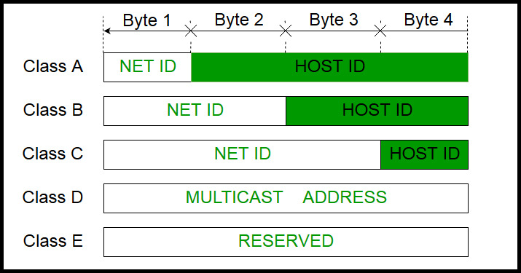
How can you tell network class from the IP address?
Picture courtesy: https://www.geeksforgeeks.org/introduction-of-classful-ip-addressing/

Slide 26
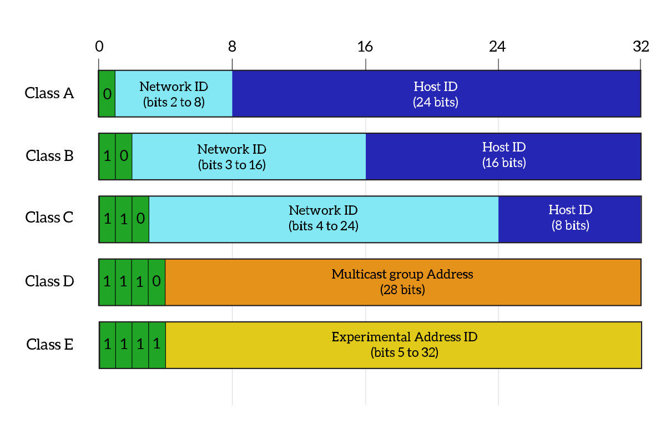
What percentage of addresses and allocated to each class?
Picture courtesy: https://www.ictshore.com/free-ccna-course/network-layer-ipv4-addressing/attachment/1013-05-classful_addressing/

Slide 27
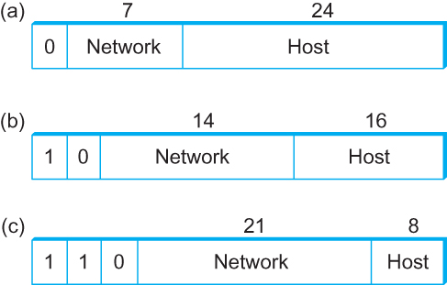
Global Addresses
Properties
  globally unique
  hierarchical: network + host
  4 Billion IP address, half are A type, ¼ is B type, and 1/8 is C type
Format
Dot notation
  10.3.2.4
  128.96.33.81
  192.12.69.77

Slide 28
Let’s assume we have 4-bit address (instead of 32 bit)
0000
0001
0010
0011
0100
0101
0110
0111
1000
1001
1010
1011
1100
1101
1110
1111
Class A (Half of all possible addresses)
Class B (1/4 of all possible addresses)
Class C (1/8 of all possible addresses)

Slide 29
Let’s assume we have 4-bit address (instead of 32 bit)
0000
0001
0010
0011
0100
0101
0110
0111
Class A (Half of all possible addresses)
Say, 1 bit for network part = 2 different networks
Say, 2 bits for host part = 4 hosts per network

Slide 30
Global Addresses
Properties
  globally unique
  hierarchical: network + host
  4 Billion IP address, half are A type, ¼ is B type, and 1/8 is C type
Format
Dot notation
  10.3.2.4
  128.96.33.81
  192.12.69.77

Slide 31
Classful Addressing
In the olden days, only fixed allocation sizes
  Class A: 0*
    Very large /8 blocks (e.g., MIT has 18.0.0.0/8)
    There can be 126 different class A networks (0 and 127 values are reserved) and (2²⁴-2) different hosts (2 values are reserved)
  Class B: 10*
    Large /16 blocks (e.g,. Princeton has 128.112.0.0/16)
  Class C: 110*
    Small /24 blocks (e.g., AT&T Labs has 192.20.225.0/24)
    2²¹ different networks possible, 254 hosts (255 is reserved for broadcast and 0 is reserved)
  Class D: 1110* for multicast groups
  Class E: 11110* reserved for future use
This is why folks use dotted-quad notation!

Slide 32
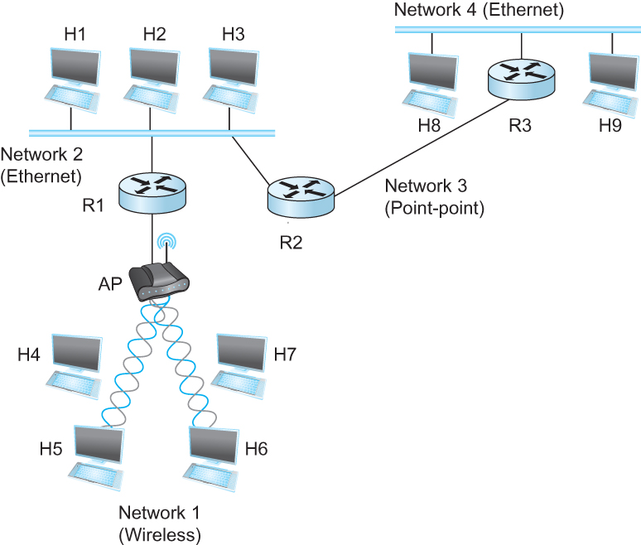
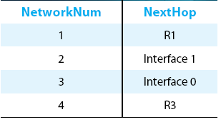
IP Datagram Forwarding
Strategy
  every datagram contains destination's address
  if directly connected to destination network, then forward to host
  if not directly connected to destination network, then forward to some router
  forwarding table maps network number into next hop
  each host has a default router
  each router maintains a forwarding table
Example (router R2)

Slide 33

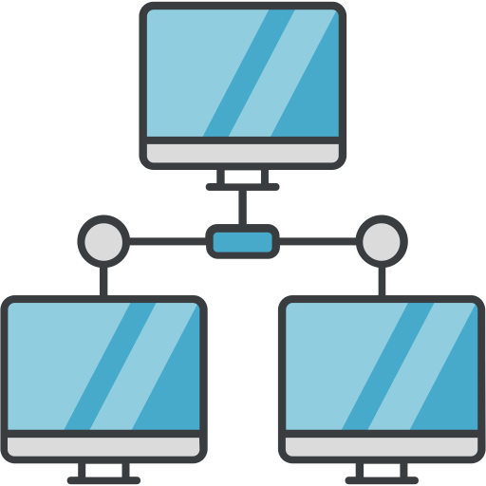
IP Datagram Forwarding
Forwarding table at R2
R2
I-0
I-1
R3
R1

Slide 34
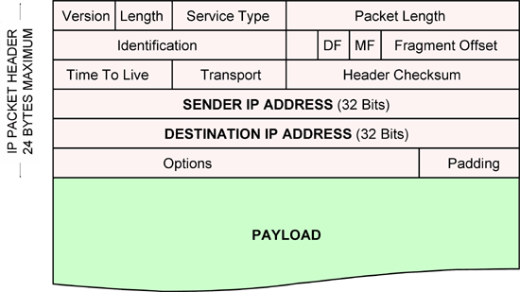
IP Datagram Forwarding
Forwarding table at R2
R2
I-0
I-1
R3
R1
IP data packet (datagram)

Slide 35
IP Datagram Forwarding
Forwarding table at R2
R2
I-0
I-1
R3
R1
Algorithm
if (NetworkNum of destination = NetworkNum of one of my interfaces) then
deliver packet to destination over that interface
else
if (NetworkNum of destination is in my forwarding table) then
deliver packet to NextHop router
else
deliver packet to default router
First: find the NetworkNum. How?

Slide 36
IP Datagram Forwarding
Algorithm
if (NetworkNum of destination = NetworkNum of one of my interfaces) then
deliver packet to destination over that interface
else
if (NetworkNum of destination is in my forwarding table) then
deliver packet to NextHop router
else
deliver packet to default router
First: find the NetworkNum. How?

Slide 37
IP Datagram Forwarding
Algorithm
if (NetworkNum of destination = NetworkNum of one of my interfaces) then
deliver packet to destination over that interface
else
if (NetworkNum of destination is in my forwarding table) then
deliver packet to NextHop router
else
deliver packet to default router
For a host with only one interface and only a default router in its forwarding table, this simplifies to
if (NetworkNum of destination = my NetworkNum)then
deliver packet to destination directly
else
deliver packet to default router

Slide 38
Obtaining a Block of Addresses
Internet Corporation for Assigned Names and Numbers (ICANN)
  Allocates large blocks to Regional Internet Registries
Regional Internet Registries (RIRs)
  E.g., ARIN (American Registry for Internet Numbers)
  Allocates to ISPs and large institutions
Internet Service Providers (ISPs)
  Allocate address blocks to their customers
  Who may, in turn, allocate to their customers…

Slide 39
Obtaining a Block of Addresses
Your organization: XYZ
Maximum # of hosts is estimated to be 10 millions.
What class of IP address will you request for?
Maximum # of hosts is estimated to be 64K ?
Maximum # of hosts is estimated to be 250?
Maximum # of hosts is estimated to be 100?
Maximum # of hosts is estimated to be 20?
Maximum # of hosts is estimated to be 300?
Maximum # of hosts is estimated to be 66K?
Notes:
Class A can have 16 millions (16777214 = 2^24-2)
Class B can have 65K (65534 = 2^16 - 2)
Class C can have 254 (2^8-2)

Slide 40
Problems with the classes of addresses
Wastage of addresses
Bigger tables to look up at routers

Slide 41
Subnetting

Slide 42


The ISP provided the network address space: 223.1.1.X
ISP
Router
223.1.1.1
223.1.1.2
223.1.1.3
223.1.1.4
223.1.1.5
223.1.1.6

Slide 43
The ISP provided the network address space: 223.1.1.X
ISP
223.1.2.X
Router
223.1.3.X
223.1.1.1
223.1.1.2
223.1.1.3
223.1.1.4
223.1.1.5
223.1.1.6

Slide 44
The ISP provided the network address space: 223.1.1.X
Router
Two separate networks are needed. How can we assign addresses to these “sub” networks?

Slide 45
The ISP provided the network address space: 223.1.1.X
Router

Slide 46
The ISP provided the network address space: 223.1.1.X
Router
Use subnetting

Slide 47
The ISP provided the network address space: 223.1.1.X
11011111.00000001.00000001.XXXXXXX
Router
Use part of the host bits to identify separate subnets.

Slide 48
The ISP provided the network address space: 223.1.1.X
11011111.00000001.00000001.XXXXXXX
Router
Use part of the host bits to identify separate subnets.
11011111.00000001.00000001.0XXXXXX
11011111.00000001.00000001.1XXXXXX
Subnet mask = 11111111. 11111111. 11111111.10000000

Slide 49
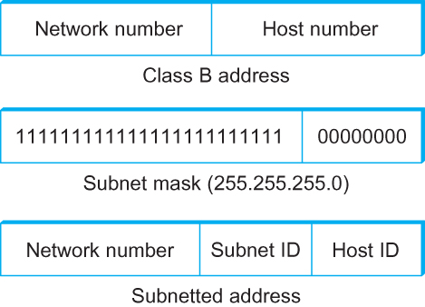
Subnetting
Add another level to address/routing hierarchy: subnet
Subnet masks define variable partition of host part of class A and B addresses
Subnets visible only within site
“Bitwise and”

Slide 50
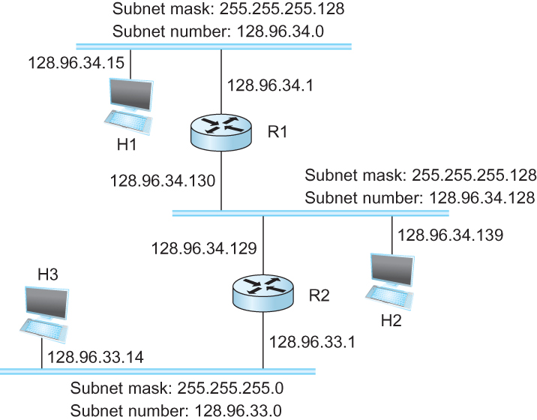
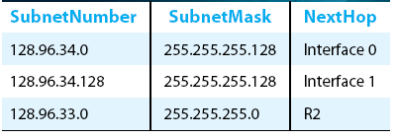
Subnetting
Forwarding Table at Router R1

Slide 51
Subnetting
Forwarding Table at Router R1
Forwarding Algorithm
D = destination IP address
for each entry < SubnetNum, SubnetMask, NextHop>
  D1 = SubnetMask & D
  if D1 = SubnetNum
    if NextHop is an interface
    deliver datagram directly to destination
    else
    deliver datagram to NextHop (a router)

Slide 52
Subnetting
Notes
Would use a default router if nothing matches
Not necessary for all ones in subnet mask to be contiguous
Can put multiple subnets on one physical network
Subnets not visible from the rest of the Internet

Slide 53
Subnets “toy” example

Slide 54


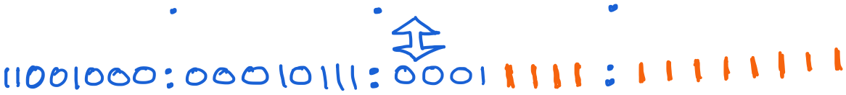
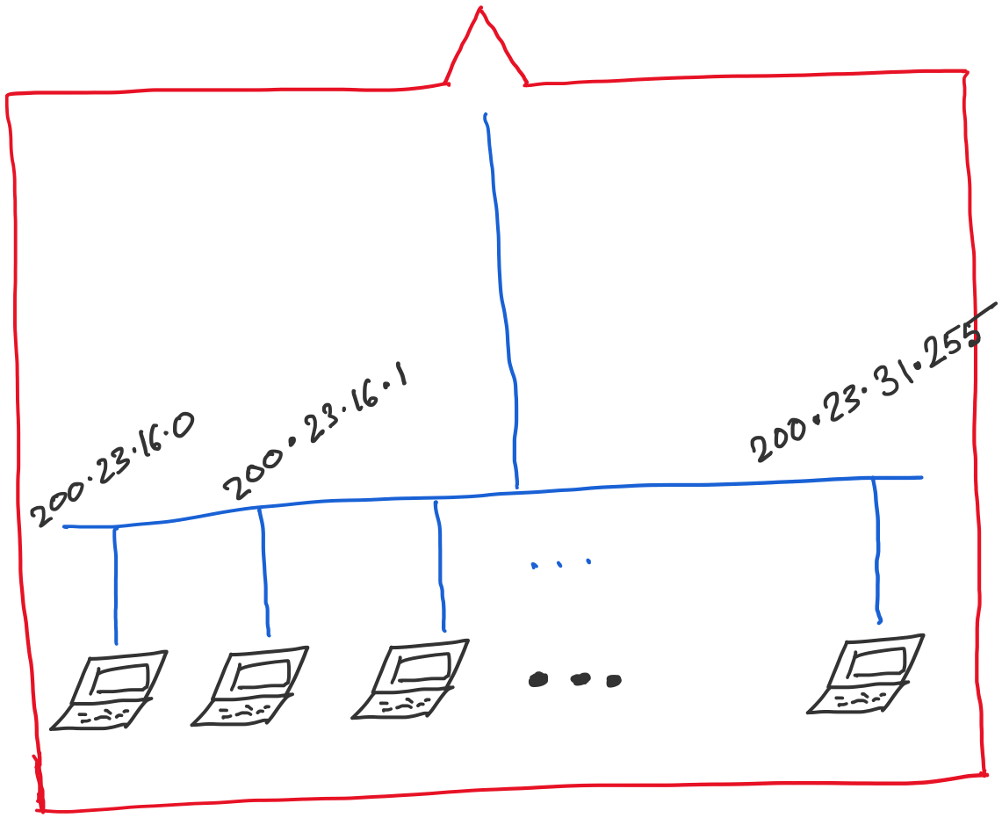
Address space assigned to you:

Slide 55
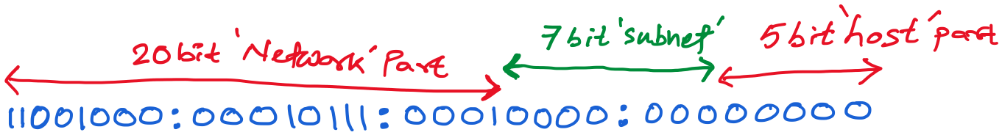
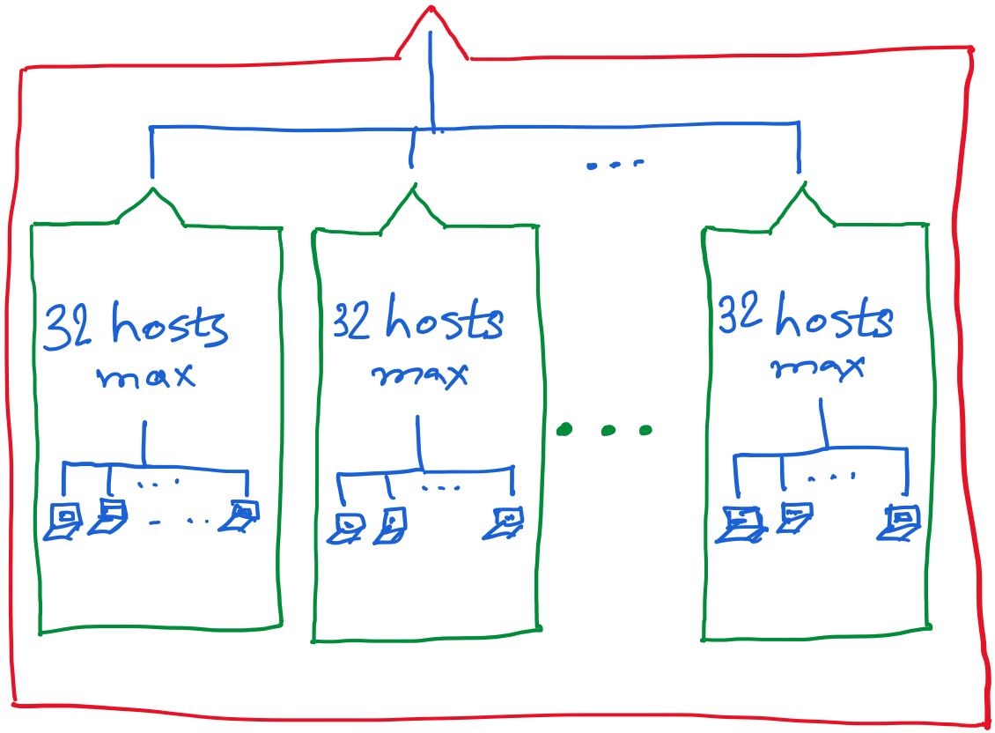
30 hosts max.
22 hosts max.
18 hosts max.

Slide 56
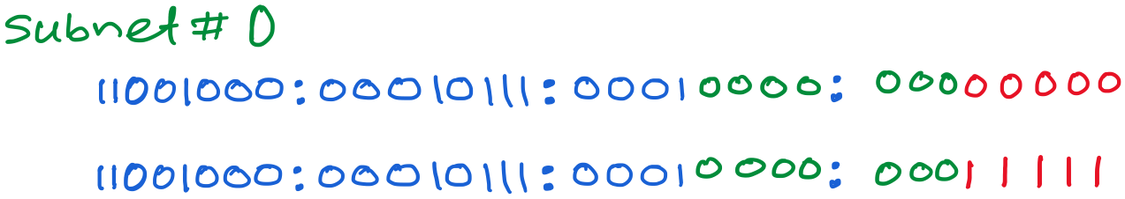
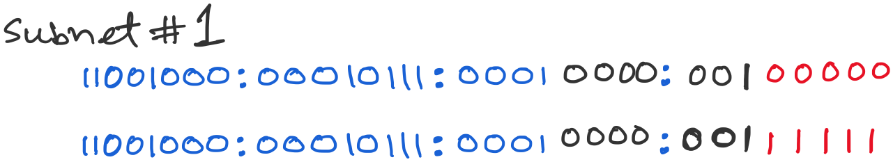
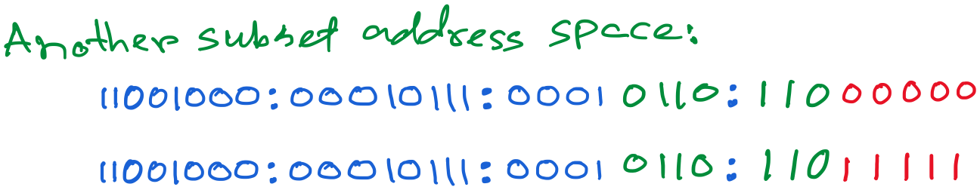

Slide 57
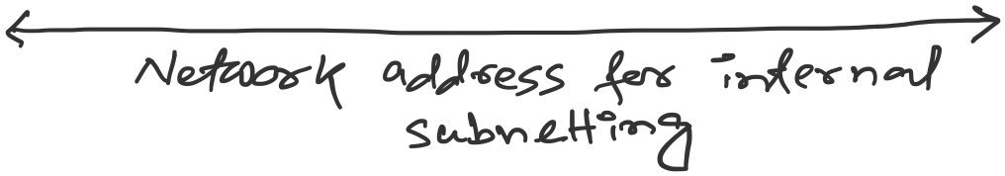

Slide 58
Class-less Interdomain Routing (CIDR)
Generalizes the ideas of subnetting

Slide 59
Lessons learned from subnetting
Forwarding tab.
Forwarding tab.
223.1.1.0
223.1.1.0
223.1.2.0
223.1.2.0
223.1.1.0
223.1.3.0
223.1.3.0
ISP
223.1.2.0
223.1.3.0

Slide 60
Lessons learned from subnetting
Forwarding tab.
Forwarding tab.
223.1.1.0
223.1.1.0
223.1.2.0
223.1.2.0
223.1.1.128
223.1.1.0
223.1.3.0
223.1.3.0
223.1.1.192
ISP
223.1.2.0
223.1.3.0

Slide 61
Lessons learned from subnetting
Forwarding tab.
Forwarding tab.
223.1.1.0
223.1.1.0
223.1.2.0
223.1.2.0
223.1.1.128
223.1.1.0
223.1.3.0
223.1.3.0
223.1.1.192
ISP
Lesson 1:
Address classes are not needed. Mask can define the number of bits for the network part.
Lesson 2:
Network hierarchies can be hidden from the outside world.
Network addresses can be aggregated/summarized/combined
223.1.2.0
223.1.3.0

Slide 62
CIDR: Classless address

Slide 63
IP addressing: CIDR
CIDR: Classless InterDomain Routing
  Network portion of address of arbitrary length
  address format: a.b.c.d/x, where x is # bits in subnet portion of address
subnet
part
host
part
11001000 00010111 00010000 00000000
200.23.16.0/23
200.23.16.0–200.23.17.255
This X bit network part is often called Prefix or Network-prefix

Slide 64
IP addressing: CIDR
CIDR: Classless InterDomain Routing
  subnet portion of address of arbitrary length
  address format: a.b.c.d/x, where x is # bits in subnet portion of address
forwarding table
4.0.0.0/8
4.83.128.0/17
201.10.0.0/21
201.10.6.0/23
126.255.103.0/24

Slide 65
CIDR: Super-netting/
Route aggregation

Slide 66
Lessons learned from subnetting
Forwarding tab.
Forwarding tab.
223.1.1.0/24
223.1.1.0/24
223.1.2.0/24
223.1.2.0/24
223.1.1.0
223.1.3.0/24
223.1.3.0/24
ISP
223.1.0.0/16
223.1.2.0
223.1.3.0

Slide 67
Lessons learned from subnetting
Forwarding tab.
Forwarding tab.
223.1.1.0/24
223.1.0.0/16
223.1.2.0/24
223.1.1.0
223.1.3.0/24
ISP
223.1.0.0/16
223.1.2.0
223.1.3.0

Slide 68
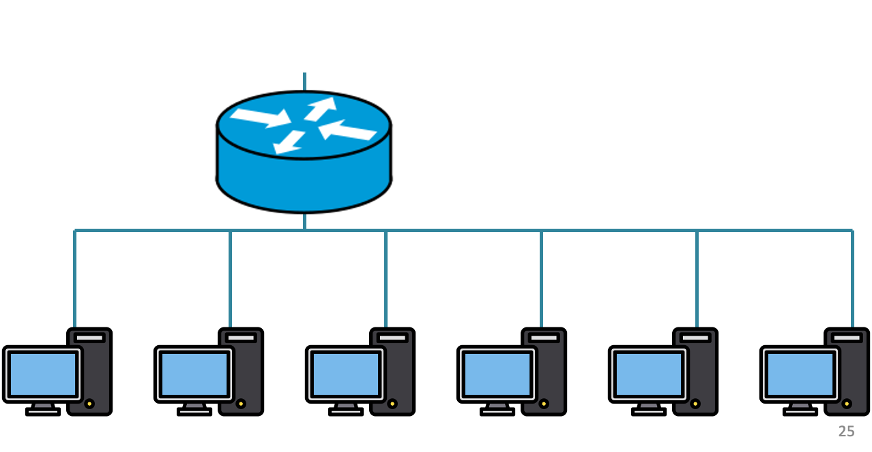
200.20.1.0/24
200.20.2.0/24
200.20.0.0/24

Slide 69
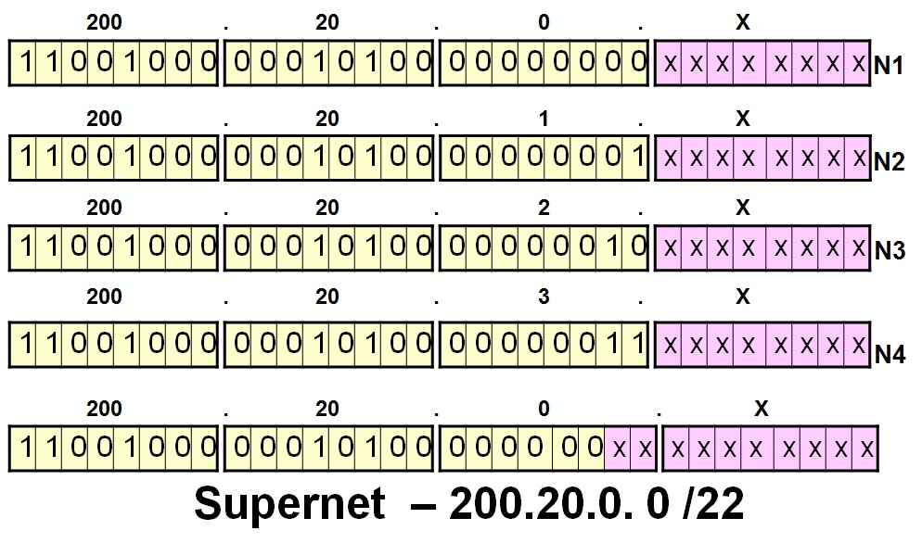
200.20.1.0/24
200.20.2.0/24
200.20.0.0/24

Slide 70
Route aggregation
200.20.1.0/24
200.20.2.0/24
200.20.0.0/24

Slide 71
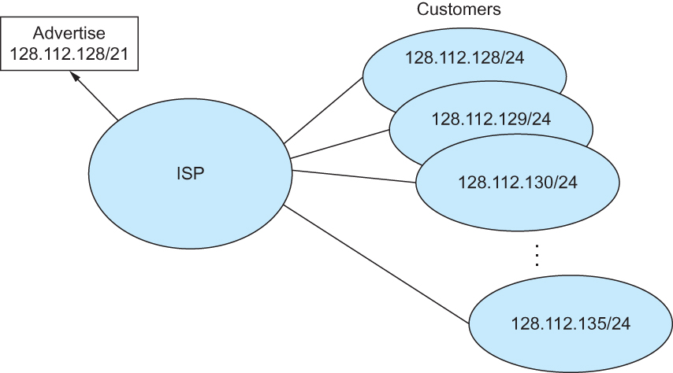
Route aggregation with CIDR

Slide 72
Classless Inter-Domain Routing (CIDR)
Use two 32-bit numbers to represent a network.
Network number = IP address + Mask
IP Address : 12.4.0.0 IP Mask: 255.254.0.0
Address
00001100
00000100
00000000
00000000
Mask
11111111
11111110
00000000
00000000
Network Prefix
for hosts
Written as 12.4.0.0/15

Slide 73
Hierarchical Address Allocation
Hierarchy is key to scalability
  Address allocated in contiguous chunks (prefixes)
  Today, the Internet has about 1,132,452 prefixes
  (March 4, 2025. Source: https://ipv4.bgp.he.net/report/netstats)
12.0.0.0/16
12.1.0.0/16
:
:
:
12.3.0.0/24
12.2.0.0/16
12.3.1.0/24
12.3.0.0/16
:
:
:
:
:
12.0.0.0/8
12.3.254.0/24
12.253.0.0/19
12.253.32.0/19
:
:
12.254.0.0/16
12.253.160.0/19

Slide 74
Separate Forwarding Entry Per Prefix
Prefix-based forwarding
  Map the destination address to matching prefix
  Forward to the outgoing interface
1.2.3.4
1.2.3.7
1.2.3.156
5.6.7.8
5.6.7.9
5.6.7.212
host
host
...
host
host
host
...
host
LAN 1
LAN
router
router
router
WAN
WAN
1.2.3.0/24
5.6.7.0/24
forwarding table

Slide 75
CIDR Makes Packet Forwarding Harder
201.10.0.0/21
Provider 1
201.10.0.0/22
201.10.4.0/24
201.10.5.0/24
201.10.6.0/23

Slide 76
CIDR Makes Packet Forwarding Harder
201.10.0.0/21
Provider 1
Provider 2
Multi-homing
201.10.0.0/22
201.10.4.0/24
201.10.5.0/24
201.10.6.0/23

Slide 77
CIDR Makes Packet Forwarding Harder
Forwarding tab.
201.10.0.0/21
Provider 1
Provider 2
Multi-homing
201.10.0.0/22
201.10.4.0/24
201.10.5.0/24
201.10.6.0/23

Slide 78
CIDR Makes Packet Forwarding Harder
Forwarding tab.
201.10.0.0/21
201.10.6.0/23
201.10.0.0/21
Provider 1
Provider 2
Multi-homing
201.10.0.0/22
201.10.4.0/24
201.10.5.0/24
201.10.6.0/23

Slide 79
CIDR Makes Packet Forwarding Harder
Forwarding table
201.10.0.0/21
11001001.00001010.00000000.00000000/21
201.10.6.0/23
11001001.00001010.00000110.00000000/23
A packet with dest. Addr.: 201.10.6.17
11001001.00001010.00000110.00010001

Slide 80
CIDR Makes Packet Forwarding Harder
Forwarding table may have many matches
  E.g., entries for 201.10.0.0/21 and 201.10.6.0/23
  The IP address 201.10.6.17 would match both!
201.10.0.0/21
Provider 1
Provider 2
201.10.0.0/22
201.10.4.0/24
201.10.5.0/24
201.10.6.0/23

Slide 81
Longest Prefix Match Forwarding
Destination-based forwarding
  Packet has a destination address
  Router identifies longest-matching prefix
  Cute algorithmic problem: very fast lookups
forwarding table
4.0.0.0/8
4.83.128.0/17
201.10.0.0/21
201.10.6.0/23
126.255.103.0/24
destination
201.10.6.17
outgoing link

Slide 82
Getting an IP address:
DHCP Protocol

Slide 83
Thank you

