Slide 1

CMSC 417: Computer Networks
Spring 2026
Topic: Internetworking
(Textbook chapter 3)
Nirupam Roy
M-W 2:00-3:15pm
CSI 2117
Feb 25th, 2026

Slide 2
Classful IP addressing

Slide 3
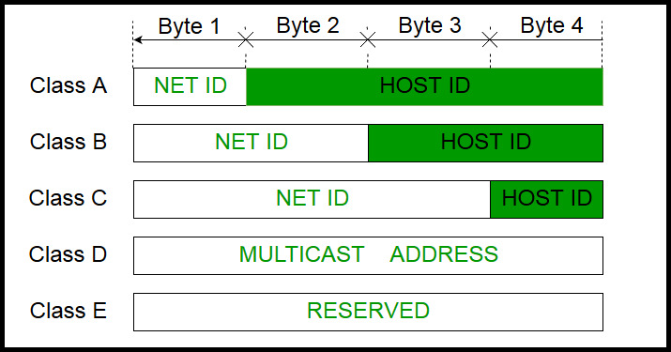
How can you tell network class from the IP address?
Picture courtesy: https://www.geeksforgeeks.org/introduction-of-classful-ip-addressing/

Slide 4
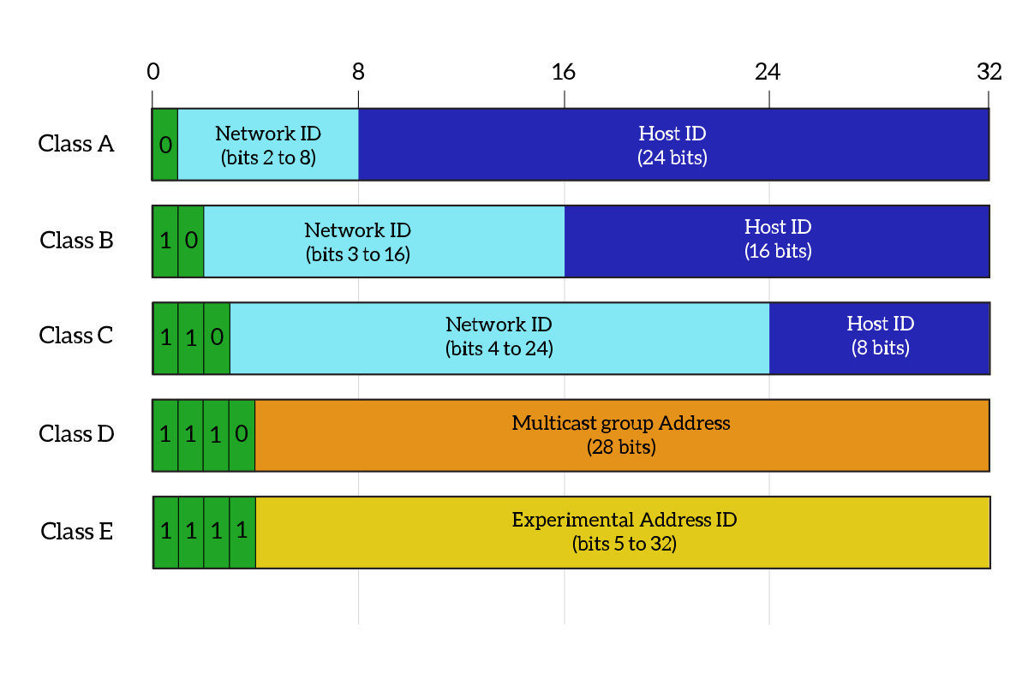
What percentage of addresses and allocated to each class?
Picture courtesy: https://www.ictshore.com/free-ccna-course/network-layer-ipv4-addressing/attachment/1013-05-classful_addressing/

Slide 5
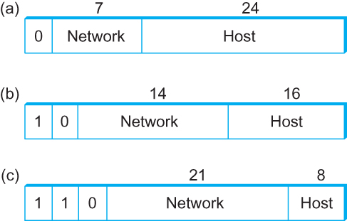
Global Addresses
Properties
globally unique
hierarchical: network + host
4 Billion IP address, half are A type, ¼ is B type, and 1/8 is C type
Format
Dot notation
10.3.2.4
128.96.33.81
192.12.69.77

Slide 6
Let’s assume we have 4-bit address (instead of 32 bit)
0000
0001
0010
0011
0100
0101
0110
0111
1000
1001
1010
1011
1100
1101
1110
1111
Class A (Half of all possible addresses)
Class B (1/4 of all possible addresses)
Class C (1/8 of all possible addresses)

Slide 7
Let’s assume we have 4-bit address (instead of 32 bit)
0000
0001
0010
0011
0100
0101
0110
0111
Class A (Half of all possible addresses)
Say, 1 bit for network part = 2 different networks
Say, 2 bits for host part = 4 hosts per network

Slide 8
Global Addresses
Properties
globally unique
hierarchical: network + host
4 Billion IP address, half are A type, ¼ is B type, and 1/8 is C type
Format
Dot notation
10.3.2.4
128.96.33.81
192.12.69.77

Slide 9
The “/X” notation
128.8.12.34/X means
the first X bits are the “Network part” or “Network prefix”

Slide 10
Classful Addressing
In the olden days, only fixed allocation sizes
Class A: 0*
Very large /8 blocks (e.g., MIT has 18.0.0.0/8)
There can be 126 different class A networks (0 and 127 values are reserved) and (2²⁴-2) different hosts (2 values are reserved)
Class B: 10*
Large /16 blocks (e.g,. Princeton has 128.112.0.0/16)
Class C: 110*
Small /24 blocks (e.g., AT&T Labs has 192.20.225.0/24)
2²¹ different networks possible, 254 hosts (255 is reserved for broadcast and 0 is reserved)
Class D: 1110* for multicast groups
Class E: 11110* reserved for future use
This is why folks use dotted-quad notation!

Slide 11
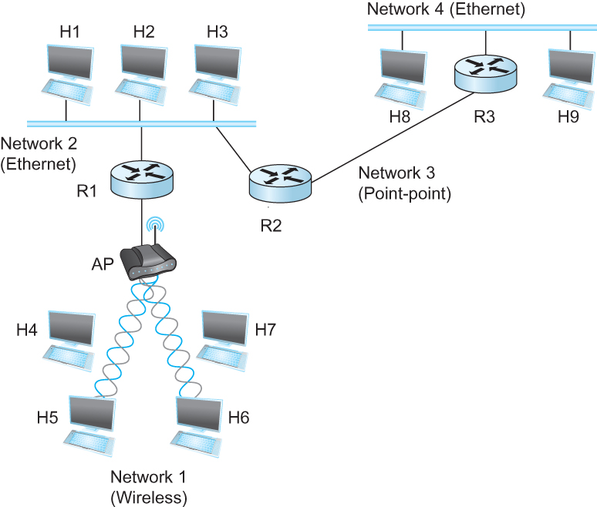
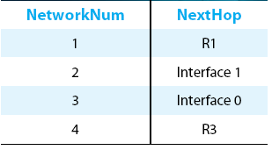
IP Datagram Forwarding
Strategy
every datagram contains destination's address
if directly connected to destination network, then forward to host
if not directly connected to destination network, then forward to some router
forwarding table maps network number into next hop
each host has a default router
each router maintains a forwarding table
Example (router R2)

Slide 12

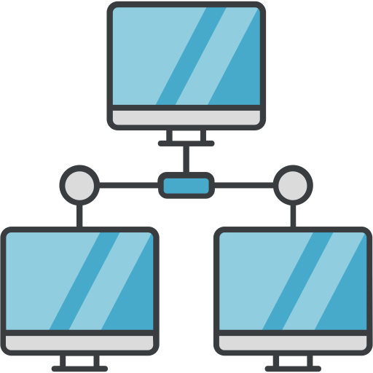
IP Datagram Forwarding
Forwarding table at R2
R2
I-0
I-1
R3
R1

Slide 13
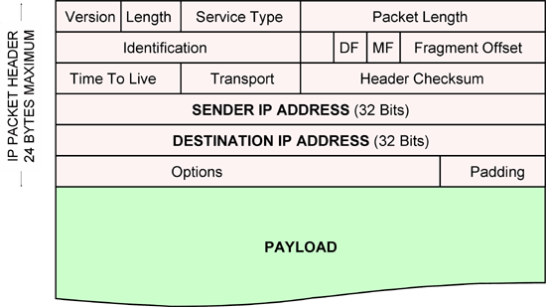
IP Datagram Forwarding
Forwarding table at R2
R2
I-0
I-1
R3
R1
IP data packet (datagram)

Slide 14
IP Datagram Forwarding
Forwarding table at R2
R2
I-0
I-1
R3
R1
Algorithm
if (NetworkNum of destination = NetworkNum of one of my interfaces) then
deliver packet to destination over that interface
else
if (NetworkNum of destination is in my forwarding table) then
deliver packet to NextHop router
else
deliver packet to default router
First: find the NetworkNum. How?

Slide 15
Obtaining a Block of Addresses
Internet Corporation for Assigned Names and Numbers (ICANN)
Allocates large blocks to Regional Internet Registries
Regional Internet Registries (RIRs)
E.g., ARIN (American Registry for Internet Numbers)
Allocates to ISPs and large institutions
Internet Service Providers (ISPs)
Allocate address blocks to their customers
Who may, in turn, allocate to their customers…

Slide 16
Obtaining a Block of Addresses
2^24 ~= 16 million
2^16 ~= 65K
2^8 = 256
Your organization: XYZ
Maximum # of hosts is estimated to be 10 millions.
What class of IP address will you request for?
Maximum # of hosts is estimated to be 64K ?
Maximum # of hosts is estimated to be 250?
Maximum # of hosts is estimated to be 100?
Maximum # of hosts is estimated to be 20?
Maximum # of hosts is estimated to be 300?
Maximum # of hosts is estimated to be 66K?
Notes:
Class A can have 16 millions (16777214 = 2^24-2)
Class B can have 65K (65534 = 2^16 - 2)
Class C can have 254 (2^8-2)

Slide 17
Problems with the classes of addresses
Wastage of addresses
Bigger tables to look up at routers

Slide 18
Subnetting: Splitting the network-prefix for smaller sub-networks

Slide 19


The ISP provided the network address space: 223.1.1.X/24
ISP
Router
223.1.1.1
223.1.1.2
223.1.1.3
223.1.1.4
223.1.1.5
223.1.1.6

Slide 20
The ISP provided the network address space: 223.1.1.X/24
ISP
223.1.2.X
Router
223.1.3.X
223.1.1.1
223.1.1.2
223.1.1.3
223.1.1.4
223.1.1.5
223.1.1.6

Slide 21
The ISP provided the network address space: 223.1.1.X/24
Router
Two separate networks are needed. How can we assign addresses to these “sub” networks?

Slide 22
The ISP provided the network address space: 223.1.1.X/24
Router

Slide 23
The ISP provided the network address space: 223.1.1.X/24
Router
Use subnetting

Slide 24
The ISP provided the network address space: 223.1.1.X/24
11011111.00000001.00000001.XXXXXXX
Router
Use part of the host bits to identify separate subnets.

Slide 25
The ISP provided the network address space: 223.1.1.X/24
11011111.00000001.00000001.XXXXXXX
Router
Use part of the host bits to identify separate subnets.
How will the router know the “subnet prefix” for a packet?
11011111.00000001.00000001.0XXXXXX
11011111.00000001.00000001.1XXXXXX

Slide 26
The ISP provided the network address space: 223.1.1.X/24
11011111.00000001.00000001.XXXXXXX
Router
Use part of the host bits to identify separate subnets.
11011111.00000001.00000001.0XXXXXX
11011111.00000001.00000001.1XXXXXX
Subnet mask = 11111111. 11111111. 11111111.10000000

Slide 27
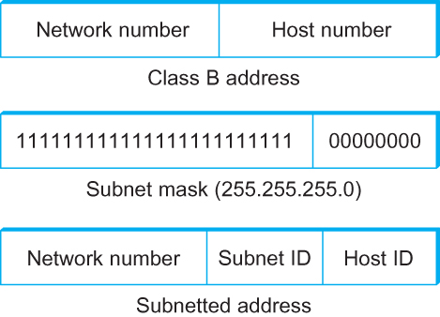
Subnetting
Add another level to address/routing hierarchy: subnet
Subnet masks define variable partition of host part of class A and B addresses
Subnets visible only within site
“Bitwise and”

Slide 28
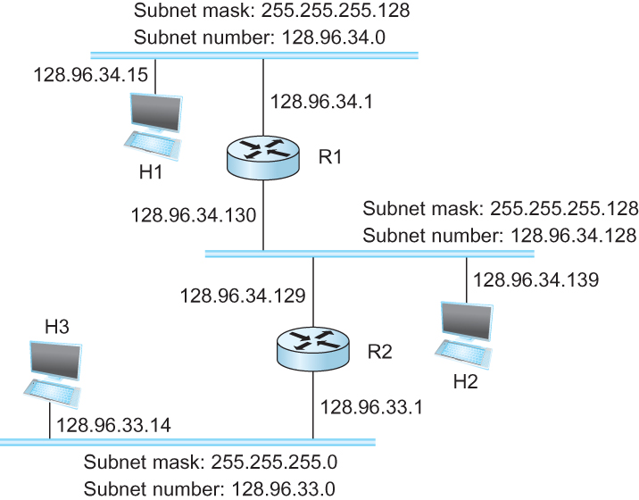
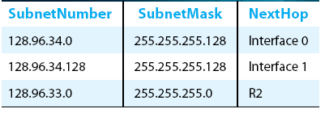
Subnetting
Forwarding Table at Router R1

Slide 29
Subnetting
Forwarding Table at Router R1
Forwarding Algorithm
D = destination IP address
for each entry < SubnetNum, SubnetMask, NextHop>
D1 = SubnetMask & D
if D1 = SubnetNum
if NextHop is an interface
deliver datagram directly to destination
else
deliver datagram to NextHop (a router)

Slide 30
Subnetting
Notes
Would use a default router if nothing matches
Not necessary for all ones in subnet mask to be contiguous
Can put multiple subnets on one physical network
Subnets not visible from the rest of the Internet

Slide 31
Subnets “toy” example

Slide 32


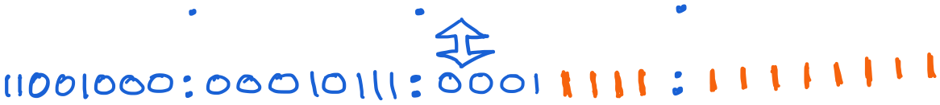
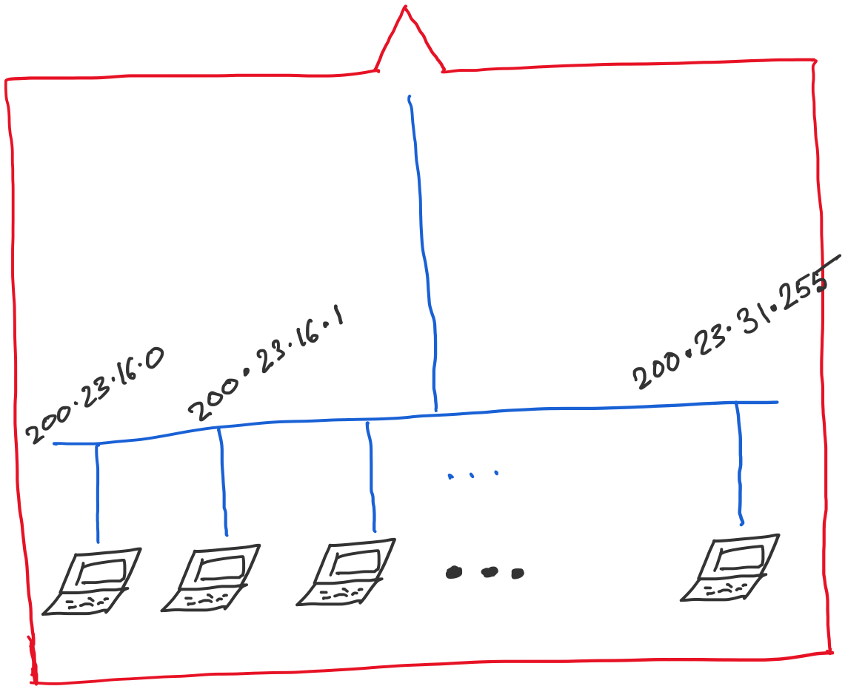
Address space assigned to you:

Slide 33
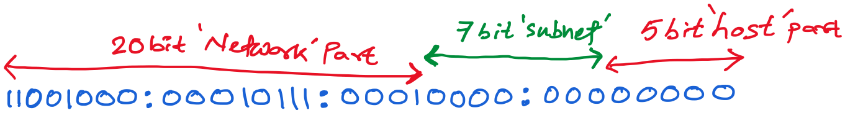
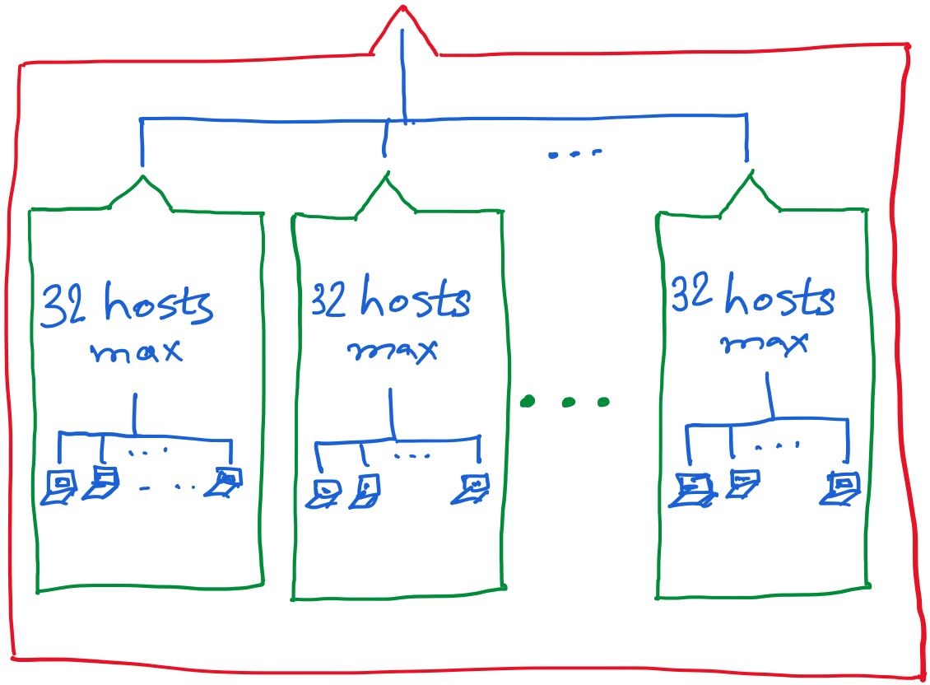
30 hosts max.
22 hosts max.
18 hosts max.

Slide 34
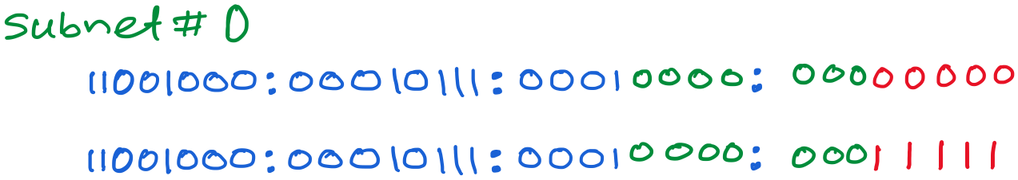
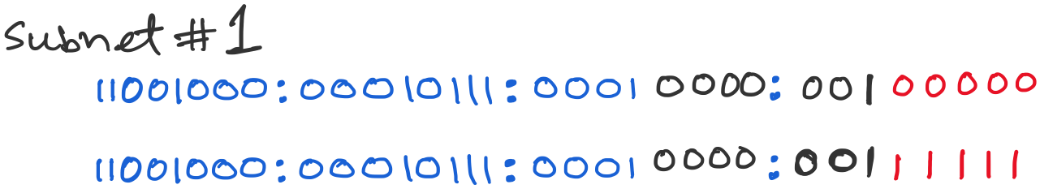
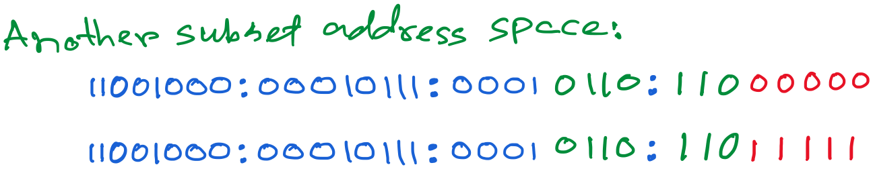

Slide 35
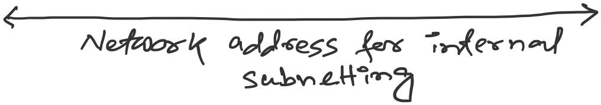

Slide 36
Classful address is dead.
Long live subnetting & prefix.
Notes:
Classful addressing is operationally dead
No routing protocol in active Internet use assumes class boundaries.
BGP is fully classless.
OSPF and RIP v2 carry explicit prefix lengths.
CIDR (RFC 4632) removed fixed /8, /16, /24 semantics.
Subnetting did not die — it evolved
Under CIDR, all addressing is subnetting.
Prefix allocation is hierarchical subdivision.
Route aggregation is simply reverse-subnetting (supernetting).

Slide 37
Class-less Interdomain Routing (CIDR)
Generalizes the ideas of subnetting
Notes:
OSPF includes the subnet mask in LSAs.
BGP advertises NLRI as prefix/length.
RIP v2 carries subnet mask fields (v1 did not).

Slide 38
Lessons learned from subnetting
Forwarding tab.
Forwarding tab.
223.1.1.0
223.1.1.0
223.1.2.0
223.1.2.0
223.1.1.0
223.1.3.0
223.1.3.0
ISP
223.1.2.0
223.1.3.0

Slide 39
Lessons learned from subnetting
Forwarding tab.
Forwarding tab.
223.1.1.0
223.1.1.0
223.1.2.0
223.1.2.0
223.1.1.128
223.1.1.0
223.1.3.0
223.1.3.0
223.1.1.192
ISP
223.1.2.0
223.1.3.0

Slide 40
Lessons learned from subnetting
Forwarding tab.
Forwarding tab.
223.1.1.0
223.1.1.0
223.1.2.0
223.1.2.0
223.1.1.128
223.1.1.0
223.1.3.0
223.1.3.0
223.1.1.192
ISP
Lesson 1:
Address classes are not needed. Mask can define the number of bits for the network part.
Lesson 2:
Network hierarchies can be hidden from the outside world.
Network addresses can be aggregated/summarized/combined
223.1.2.0
223.1.3.0

Slide 41
CIDR: Classless address

Slide 42
IP addressing: CIDR
CIDR: Classless InterDomain Routing
Network portion of address of arbitrary length
address format: a.b.c.d/x, where x is # bits in subnet portion of address
subnet
part
host
part
11001000 00010111 00010000 00000000
200.23.16.0/23
200.23.16.0–200.23.17.255
This X bit network part is often called Prefix or Network-prefix

Slide 43
IP addressing: CIDR
CIDR: Classless InterDomain Routing
subnet portion of address of arbitrary length
address format: a.b.c.d/x, where x is # bits in subnet portion of address
forwarding table
4.0.0.0/8
4.83.128.0/17
201.10.0.0/21
201.10.6.0/23
126.255.103.0/24

Slide 44
CIDR: Super-netting/ Route aggregation

Slide 45
Lessons learned from subnetting
Forwarding tab.
Forwarding tab.
223.1.1.0/24
223.1.1.0/24
223.1.2.0/24
223.1.2.0/24
223.1.1.0
223.1.3.0/24
223.1.3.0/24
ISP
223.1.0.0/16
223.1.2.0
223.1.3.0

Slide 46
Lessons learned from subnetting
Forwarding tab.
Forwarding tab.
223.1.1.0/24
223.1.0.0/16
223.1.2.0/24
223.1.1.0
223.1.3.0/24
ISP
223.1.0.0/16
223.1.2.0
223.1.3.0

Slide 47
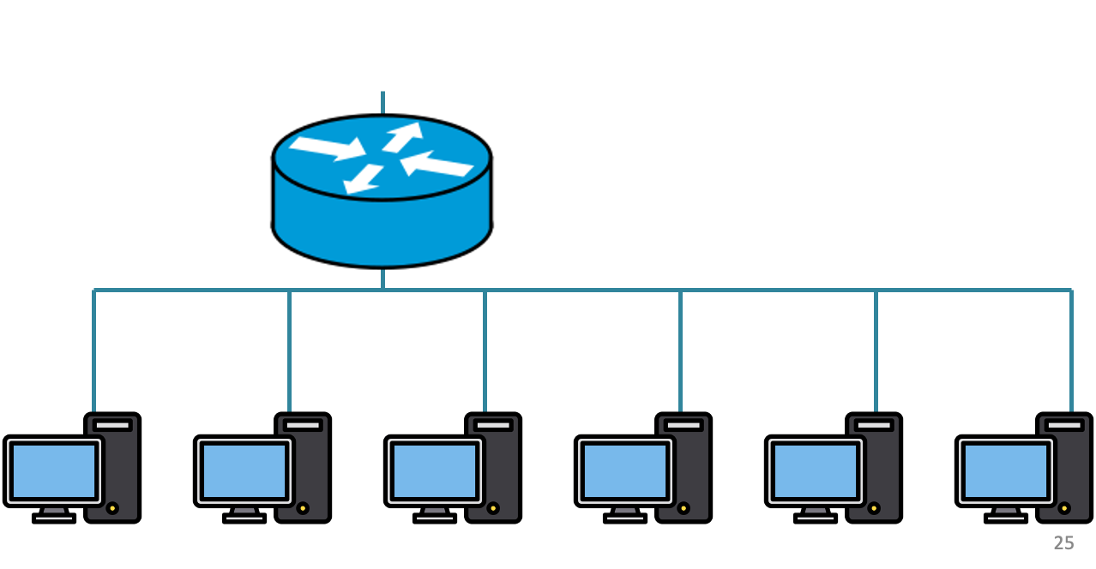
200.20.1.0/24
200.20.2.0/24
200.20.0.0/24

Slide 48
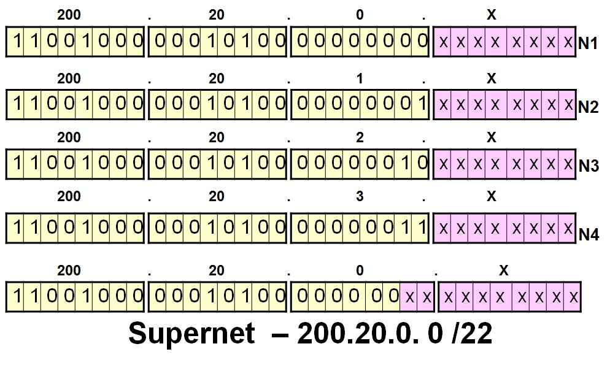
200.20.1.0/24
200.20.2.0/24
200.20.0.0/24

Slide 49
Route aggregation
200.20.1.0/24
200.20.2.0/24
200.20.0.0/24

Slide 50
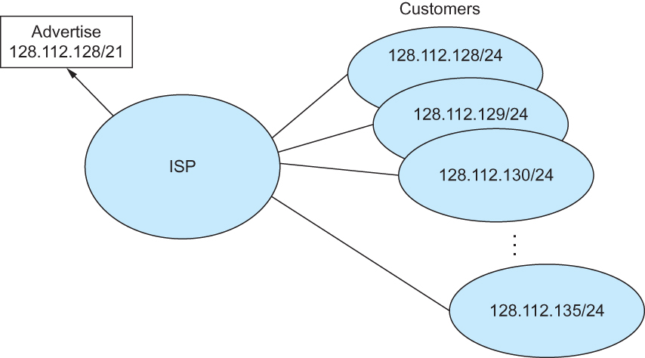
Route aggregation with CIDR

Slide 51
Classless Inter-Domain Routing (CIDR)
Use two 32-bit numbers to represent a network.
Network number = IP address + Mask
IP Address : 12.4.0.0 IP Mask: 255.254.0.0
Address
00001100
00000100
00000000
00000000
Mask
11111111
11111110
00000000
00000000
Network Prefix
for hosts
Written as 12.4.0.0/15

Slide 52
Hierarchical Address Allocation
Hierarchy is key to scalability
Address allocated in contiguous chunks (prefixes)
Today, the Internet has about 1,132,452 prefixes
(March 4, 2025. Source: https://ipv4.bgp.he.net/report/netstats)
12.0.0.0/16
12.1.0.0/16
:
:
:
12.3.0.0/24
12.2.0.0/16
12.3.1.0/24
12.3.0.0/16
:
:
:
:
:
12.0.0.0/8
12.3.254.0/24
12.253.0.0/19
12.253.32.0/19
:
:
12.254.0.0/16
12.253.160.0/19

Slide 53
Separate Forwarding Entry Per Prefix
Prefix-based forwarding
Map the destination address to matching prefix
Forward to the outgoing interface
1.2.3.4
1.2.3.7
1.2.3.156
5.6.7.8
5.6.7.9
5.6.7.212
host
host
...
host
host
host
...
host
LAN 1
LAN
router
router
router
WAN
WAN
1.2.3.0/24
5.6.7.0/24
forwarding table

Slide 54
CIDR Makes Packet Forwarding Harder
201.10.0.0/21
Provider 1
201.10.0.0/22
201.10.4.0/24
201.10.5.0/24
201.10.6.0/23

Slide 55
CIDR Makes Packet Forwarding Harder
201.10.0.0/21
Provider 1
Provider 2
Multi-homing
201.10.0.0/22
201.10.4.0/24
201.10.5.0/24
201.10.6.0/23

Slide 56
CIDR Makes Packet Forwarding Harder
Forwarding tab.
201.10.0.0/21
Provider 1
Provider 2
Multi-homing
201.10.0.0/22
201.10.4.0/24
201.10.5.0/24
201.10.6.0/23

Slide 57
CIDR Makes Packet Forwarding Harder
Forwarding tab.
201.10.0.0/21
201.10.6.0/23
201.10.0.0/21
Provider 1
Provider 2
Multi-homing
201.10.0.0/22
201.10.4.0/24
201.10.5.0/24
201.10.6.0/23

Slide 58
CIDR Makes Packet Forwarding Harder
Forwarding table
201.10.0.0/21
11001001.00001010.00000000.00000000/21
201.10.6.0/23
11001001.00001010.00000110.00000000/23
A packet with dest. Addr.: 201.10.6.17
11001001.00001010.00000110.00010001

Slide 59
CIDR Makes Packet Forwarding Harder
Forwarding table may have many matches
E.g., entries for 201.10.0.0/21 and 201.10.6.0/23
The IP address 201.10.6.17 would match both!
201.10.0.0/21
Provider 1
Provider 2
201.10.0.0/22
201.10.4.0/24
201.10.5.0/24
201.10.6.0/23

Slide 60
Longest Prefix Match Forwarding
Destination-based forwarding
Packet has a destination address
Router identifies longest-matching prefix
Cute algorithmic problem: very fast lookups
forwarding table
4.0.0.0/8
4.83.128.0/17
201.10.0.0/21
201.10.6.0/23
126.255.103.0/24
destination
201.10.6.17
outgoing link

Slide 61
Getting an IP address: DHCP Protocol

Slide 62
IP addresses: how to get one?
Q: How does a host get its IP address?
hard-coded by system admin in a file
Windows: control-panel->network->configuration->tcp/ip->properties
UNIX: /etc/…
DHCP: Dynamic Host Configuration Protocol: dynamically get address from a server
“plug-and-play”

Slide 63
DHCP: Dynamic Host Configuration Protocol
goal: allow host to dynamically obtain its IP address from network server when it joins network
can renew its lease on address in use
allows reuse of addresses (only hold address while connected/“on”)
support for mobile users who want to join network

Slide 64
DHCP: Dynamic Host Configuration Protocol
DHCP overview:
host broadcasts “DHCP discover” msg
DHCP server responds with “DHCP offer” msg
host requests IP address: “DHCP request” msg
DHCP server sends address: “DHCP ack” msg

Slide 65



DHCP client-server scenario
DHCP
server
223.1.1.0/24
223.1.1.1
223.1.2.1
223.1.1.2
arriving DHCP
client needs
address in this
network
223.1.1.4
223.1.2.9
223.1.3.27
223.1.2.2
223.1.1.3
223.1.2.0/24
223.1.3.1
223.1.3.2
223.1.3.0/24

Slide 66
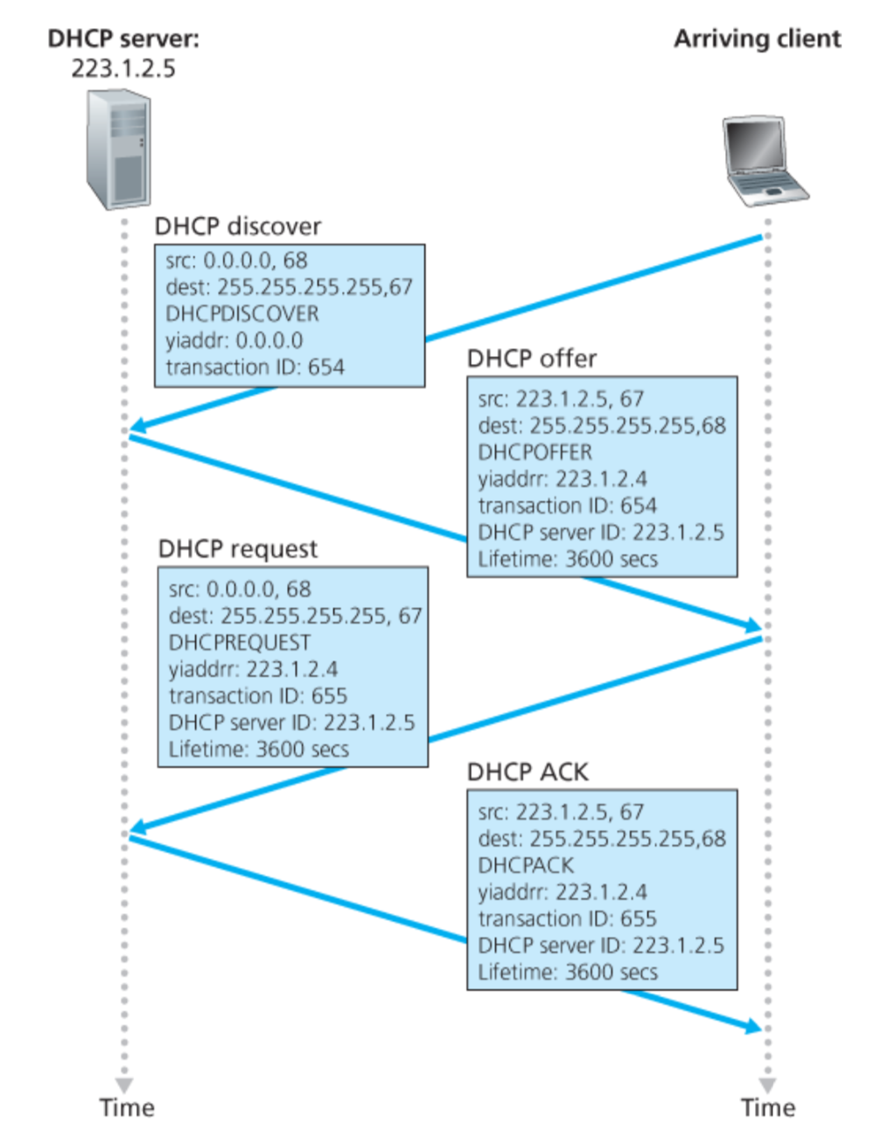
<Discover>
Broadcast: is there a DHCP server out there?

Slide 67
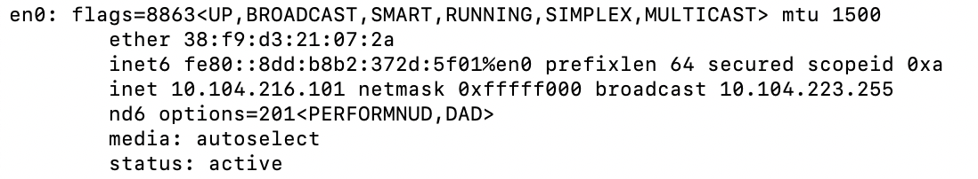
A note on the “broadcast address”

Slide 68
inet 10.104.216.101 ➔ 00001010.01101000.11011000.01100101
netmask ff:ff:f0:00 ➔ 11111111.11111111.11110000.00000000
broadcast 10.104.223.255 ➔
00001010.01101000.11011111.11111111

Slide 69
<Discover>
Broadcast: is there a DHCP server out there?
Which protocol would you use to exchange these DHCP protocol messages?
Notes:
It operates on UDP (User Datagram Protocol) and typically uses port 67 for DHCP servers and port 68 for DHCP clients.

Slide 70
<Discover>
Broadcast: is there a DHCP server out there?

Slide 71
<Discover>
Broadcast: is there a DHCP server out there?

Slide 72
<Discover>
Broadcast: is there a DHCP server out there?

Slide 73
<Discover>
Broadcast: is there a DHCP server out there?

Slide 74
<Discover>
Broadcast: is there a DHCP server out there?
yiaddr (“your” IP address)
Used by the server.

Slide 75
<Discover>
Broadcast: is there a DHCP server out there?
XId (transaction ID)
A random ID set by the client to keep track of the “question-answer” pair.

Slide 76
<Discover>
Broadcast: is there a DHCP server out there?
<Offer>
Broadcast: I’m a DHCP server! Here’s an IP address you can use

Slide 77
<Discover>
Broadcast: is there a DHCP server out there?
<Offer>
Broadcast: I’m a DHCP server! Here’s an IP address you can use

Slide 78
<Discover>
Broadcast: is there a DHCP server out there?
<Offer>
Broadcast: I’m a DHCP server! Here’s an IP address you can use

Slide 79
<Discover>
Broadcast: is there a DHCP server out there?
<Offer>
Broadcast: I’m a DHCP server! Here’s an IP address you can use

Slide 80
<Discover>
Broadcast: is there a DHCP server out there?
<Offer>
Broadcast: I’m a DHCP server! Here’s an IP address you can use

Slide 81
<Discover>
Broadcast: is there a DHCP server out there?
<Offer>
Broadcast: I’m a DHCP server! Here’s an IP address you can use
<Request>
Broadcast: OK. I’ll take that IP address! Can I ?

Slide 82
<Discover>
Broadcast: is there a DHCP server out there?
<Offer>
Broadcast: I’m a DHCP server! Here’s an IP address you can use
<Request>
Broadcast: OK. I’ll take that IP address! Can I ?
Notes:
It is broadcast so that other DHCP servers can get a notification. The behavior is different for first time aquiring address vs renewing the lease of the address.

Slide 83
<Discover>
Broadcast: is there a DHCP server out there?
<Offer>
Broadcast: I’m a DHCP server! Here’s an IP address you can use
<Request> Broadcast: OK. I’ll take that IP address! Can I ?

Slide 84
<Discover>
Broadcast: is there a DHCP server out there?
<Offer>
Broadcast: I’m a DHCP server! Here’s an IP address you can use
<Request> Broadcast: OK. I’ll take that IP address! Can I ?
<Ack>
Broadcast: OK. You’ve got that IP address!

Slide 85
<Discover>
Broadcast: is there a DHCP server out there?
<Offer>
Broadcast: I’m a DHCP server! Here’s an IP address you can use
<Request> Broadcast: OK. I’ll take that IP address! Can I ?
<Ack>
Broadcast: OK. You’ve got that IP address!
Discussion Point 1: The transaction ID (xid). RFC 2131
Discussion Point 2: Broadcast address. (Limited/Directed broadcast)
Notes:
RFC 2131, Page [39]: The DHCP client broadcasts DHCPDISCOVER, DHCPREQUEST and DHCPINFORM messages, unless the client knows the address of a DHCP server. The client unicasts DHCPRELEASE messages to the server.
DHCP is not intended for use in configuring routers.

Slide 86
Broadcast addresses: Limited and Directed broadcast
Broadcast traffic is sent to all stations on a LAN.
There are two types of IPv4 broadcast addresses:
Limited broadcast: The limited broadcast address is
255.255.255.255. It is “limited” because it is never forwarded across a router.
(b) Directed broadcast: The directed (also called net-directed) broadcast address of the 192.0.2.0/24 network is 192.0.2.255 (the host portion of the address is all “1”s in binary, or 255). It is called “directed” broadcast, because traffic to these addresses may be sent from remote networks (it may be “directed”).

Slide 87
DHCP: more than IP addresses
DHCP can return more than just allocated IP address on subnet:
address of first-hop router for client
name and IP address of DNS sever
network mask (indicating network versus host portion of address)

Slide 88
Dynamic Host Configuration Protocol (DHCP)
DHCP server is responsible for providing configuration information to hosts
DHCP server maintains a pool of available addresses
There is at least one DHCP server for an administrative domain (a server or a relay agent per subnet)

Slide 89
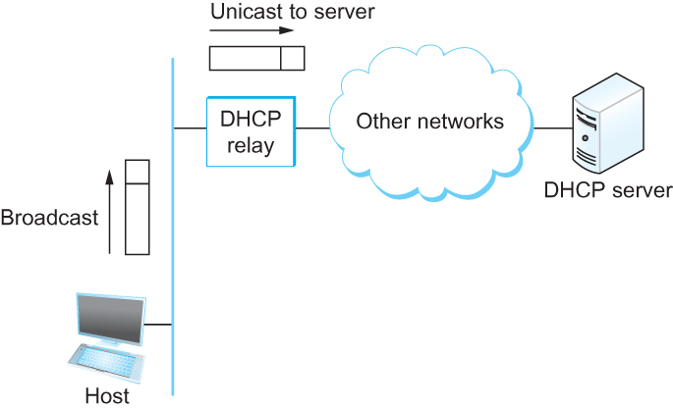
DHCP relay
Newly booted or attached host sends DHCPDISCOVER message to a special IP address (255.255.255.255)
DHCP relay agent unicasts the message to DHCP server and waits for the response

Slide 90
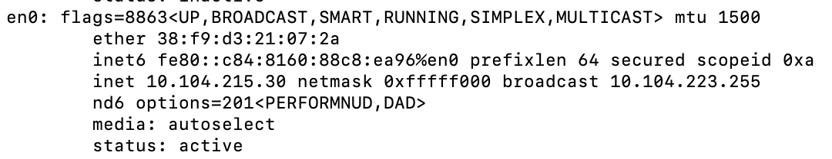
Check your IP addresses
ifconfig (linux/mac) / ipconfig (windows)

Slide 91
Check your IP addresses
(ifconfig/ipconfig)

Slide 92
Thank you

