Slide 1

CMSC 417: Computer Networks
Spring 2026
Topic: Internetworking
(Textbook chapter 3)
Nirupam Roy
M-W 2:00-3:15pm
CSI 2117
March 2nd, 2026

Slide 2
Classful Addressing Scheme is Inefficient
2^24 ~= 16 million
2^16 ~= 65K
2^8 = 256
Your organization: XYZ
Maximum # of hosts is estimated to be 10 millions.
What class of IP address will you request for?
Maximum # of hosts is estimated to be 64K ?
Maximum # of hosts is estimated to be 250?
Maximum # of hosts is estimated to be 100?
Maximum # of hosts is estimated to be 20?
Maximum # of hosts is estimated to be 300?
Maximum # of hosts is estimated to be 66K?
Notes:
Class A can have 16 millions (16777214 = 2^24-2)
Class B can have 65K (65534 = 2^16 - 2)
Class C can have 254 (2^8-2)

Slide 3


Subnetting:
Splitting the network-prefix for smaller sub-networks
The ISP provided the network address space: 223.1.1.X/24
11011111.00000001.00000001.XXXXXXX
Router
Use part of the host bits to identify separate subnets.
11011111.00000001.00000001.0XXXXXX
11011111.00000001.00000001.1XXXXXX
Subnet mask = 11111111. 11111111. 11111111.10000000

Slide 4



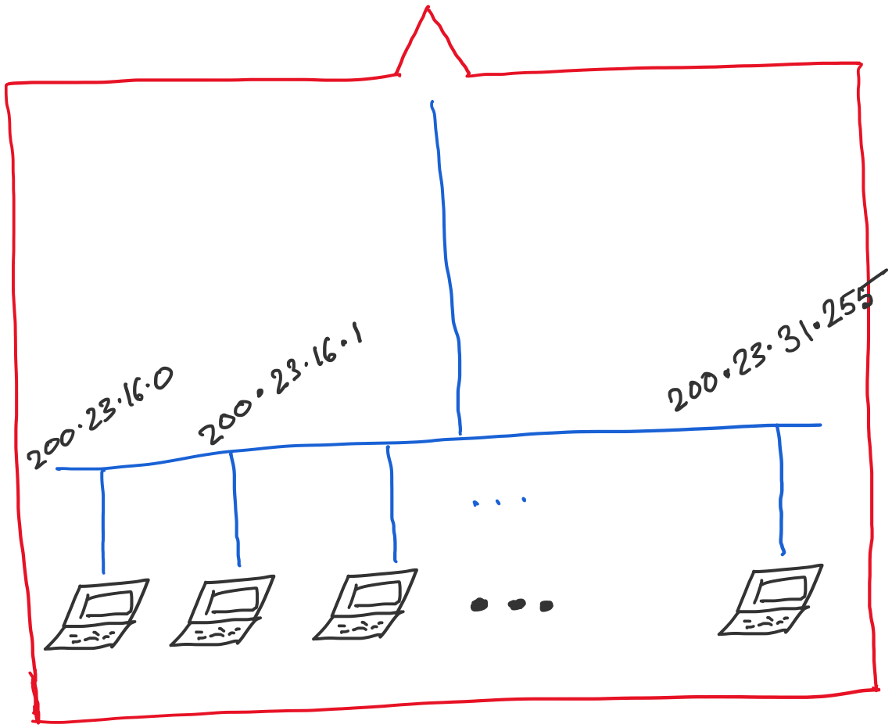
Address space assigned to you:

Slide 5
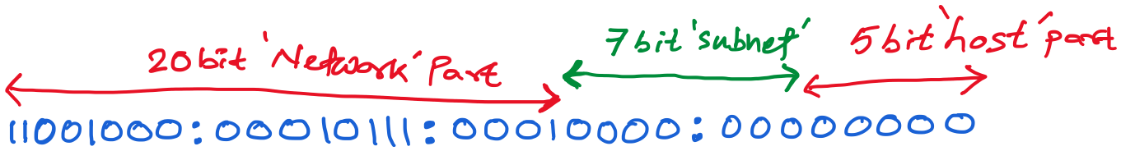
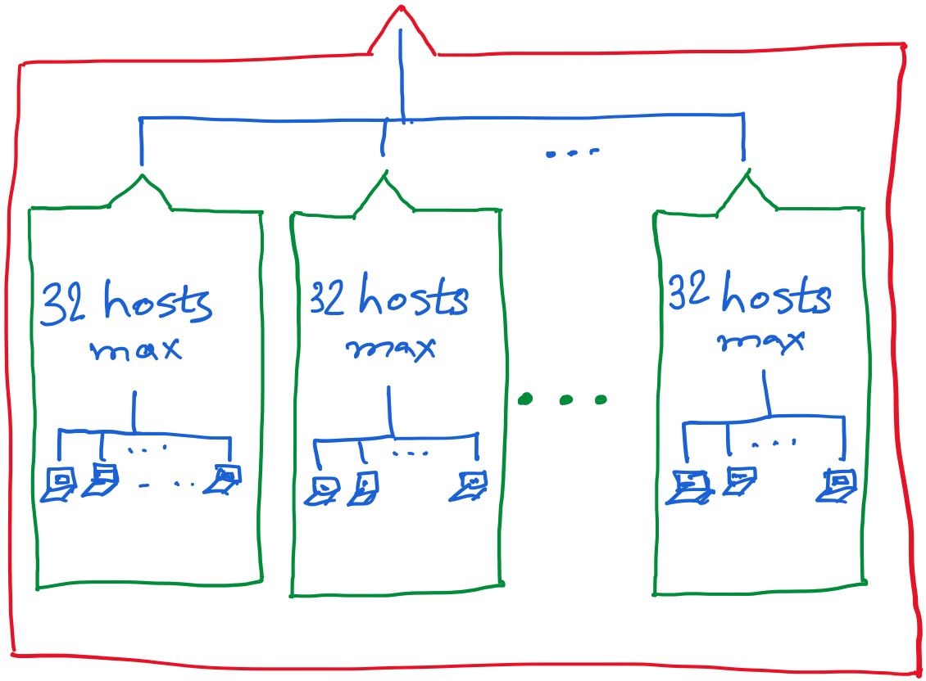
Fixed-Length Subnet Masks (FLSM)
30 hosts max.
22 hosts max.
18 hosts max.

Slide 6
Classful address is dead.
Long live subnetting & prefix.
Notes:
Classful addressing is operationally dead
No routing protocol in active Internet use assumes class boundaries.
BGP is fully classless.
OSPF and RIP v2 carry explicit prefix lengths.
CIDR (RFC 4632) removed fixed /8, /16, /24 semantics.
Subnetting did not die — it evolved
Under CIDR, all addressing is subnetting.
Prefix allocation is hierarchical subdivision.
Route aggregation is simply reverse-subnetting (supernetting).

Slide 7
Class-less Interdomain Routing (CIDR)
Generalizes the ideas of subnetting
Notes:
OSPF includes the subnet mask in LSAs.
BGP advertises NLRI as prefix/length.
RIP v2 carries subnet mask fields (v1 did not).

Slide 8
Lessons learned from subnetting
Forwarding tab.
Forwarding tab.
223.1.1.0
223.1.1.0
223.1.2.0
223.1.2.0
223.1.1.0
223.1.3.0
223.1.3.0
ISP
223.1.2.0
223.1.3.0

Slide 9
Lessons learned from subnetting
Forwarding tab.
Forwarding tab.
223.1.1.0
223.1.1.0
223.1.2.0
223.1.2.0
223.1.1.128
223.1.1.0
223.1.3.0
223.1.3.0
223.1.1.192
ISP
223.1.2.0
223.1.3.0

Slide 10
Lessons learned from subnetting
Forwarding tab.
Forwarding tab.
223.1.1.0
223.1.1.0
223.1.2.0
223.1.2.0
223.1.1.128
223.1.1.0
223.1.3.0
223.1.3.0
223.1.1.192
ISP
Lesson 1:
Address classes are not needed. Mask can define the number of bits for the network part.
Lesson 2:
Network hierarchies can be hidden from the outside world.
Network addresses can be aggregated/summarized/combined
223.1.2.0
223.1.3.0

Slide 11
CIDR: Classless address

Slide 12
CIDR: Classless address
- Standardized in 1993 in RFC 1519
- CIDR solved two major problems at the time:
1) IPv4 address exhaustion
2) Exploding global routing tables

Slide 13
CIDR features: (A) Elimination of Classful Addressing
CIDR: Classless InterDomain Routing
  Network portion of address of arbitrary length
  address format: a.b.c.d/x, where x is # bits in subnet portion of address
subnet
part
host
part
11001000 00010111 00010000 00000000
200.23.16.0/23
200.23.16.0–200.23.17.255
This X bit network part is often called Prefix or Network-prefix

Slide 14
CIDR features: (A) Elimination of Classful Addressing
CIDR: Classless InterDomain Routing
  subnet portion of address of arbitrary length
  address format: a.b.c.d/x, where x is # bits in subnet portion of address
forwarding table
4.0.0.0/8
4.83.128.0/17
201.10.0.0/21
201.10.6.0/23
126.255.103.0/24

Slide 15
CIDR features: (B) Variable-Length Subnet Masks (VLSM) Everywhere
CIDR made it standard to:
- Use arbitrary prefix lengths
- Subnet recursively
- Allocate address space efficiently
Without CIDR, VLSM was not deployable at Internet scale.

Slide 16
Fixed-Length Subnet Masks (FLSM)
30 hosts max.
22 hosts max.
18 hosts max.

Slide 17
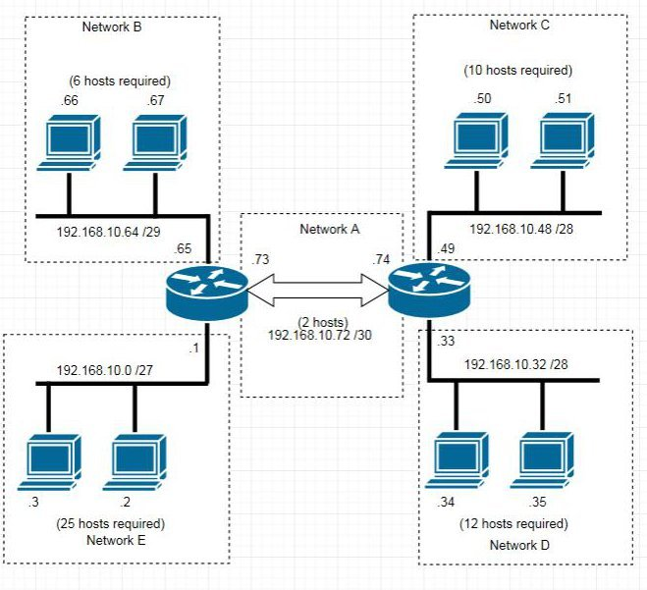
Variable-Length Subnet Masks (VLSM)

Slide 18
CIDR features: (C) Route Aggregation (Supernetting)

Slide 19
CIDR: Super-netting/
Route aggregation

Slide 20
Lessons learned from subnetting
Forwarding tab.
Forwarding tab.
223.1.1.0/24
223.1.1.0/24
223.1.2.0/24
223.1.2.0/24
223.1.1.0
223.1.3.0/24
223.1.3.0/24
ISP
223.1.0.0/16
223.1.2.0
223.1.3.0

Slide 21
Lessons learned from subnetting
Forwarding tab.
Forwarding tab.
223.1.1.0/24
223.1.0.0/16
223.1.2.0/24
223.1.1.0
223.1.3.0/24
ISP
223.1.0.0/16
223.1.2.0
223.1.3.0

Slide 22
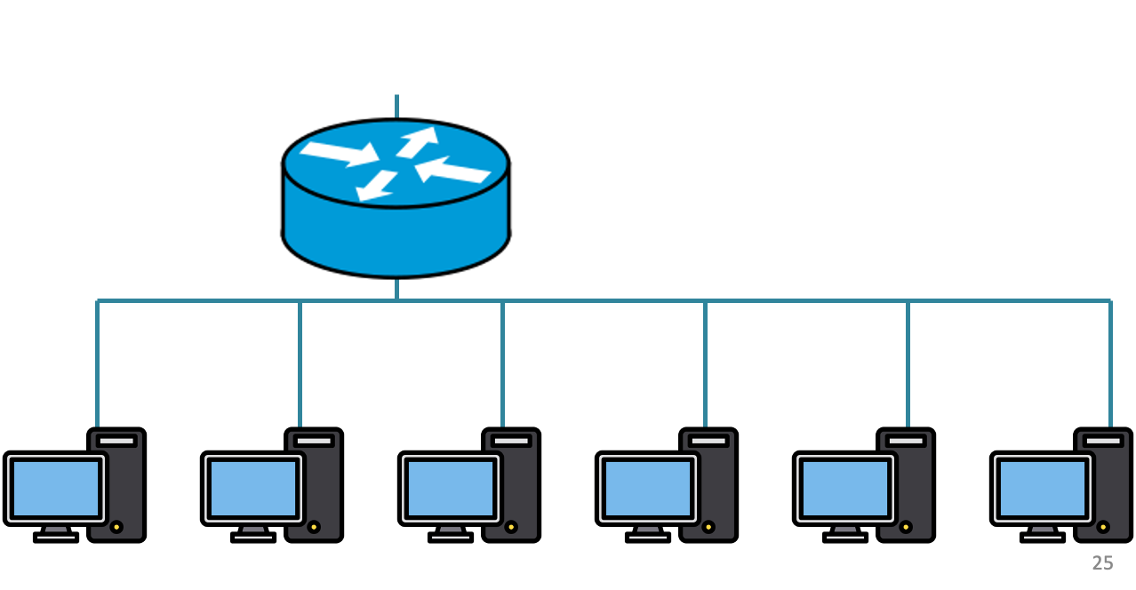
200.20.1.0/24
200.20.2.0/24
200.20.0.0/24

Slide 23
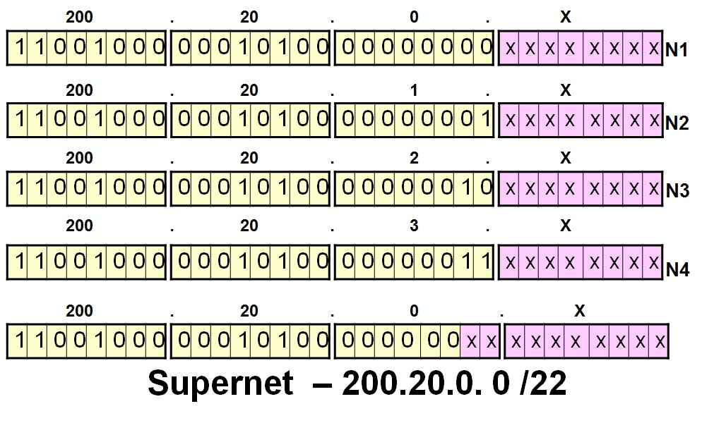
200.20.1.0/24
200.20.2.0/24
200.20.0.0/24

Slide 24
Route aggregation
200.20.1.0/24
200.20.2.0/24
200.20.0.0/24

Slide 25
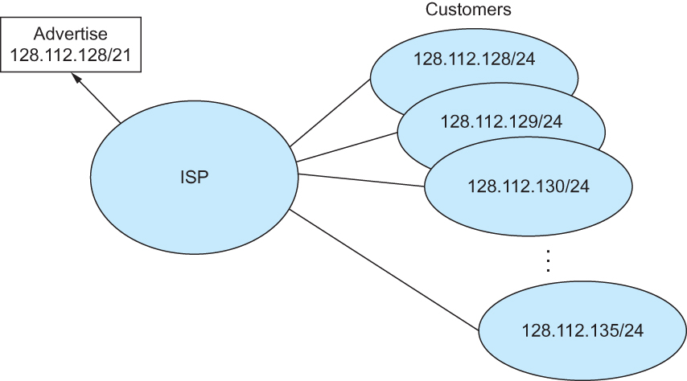
Route aggregation with CIDR

Slide 26
CIDR features: (D) Longest Prefix Match Requirement

Slide 27
CIDR Makes Packet Forwarding Harder
201.10.0.0/21
Provider 1
201.10.0.0/22
201.10.4.0/24
201.10.5.0/24
201.10.6.0/23

Slide 28
CIDR Makes Packet Forwarding Harder
201.10.0.0/21
Provider 1
Provider 2
Multi-homing
201.10.0.0/22
201.10.4.0/24
201.10.5.0/24
201.10.6.0/23

Slide 29
CIDR Makes Packet Forwarding Harder
Forwarding tab.
201.10.0.0/21
Provider 1
Provider 2
Multi-homing
201.10.0.0/22
201.10.4.0/24
201.10.5.0/24
201.10.6.0/23

Slide 30
CIDR Makes Packet Forwarding Harder
Forwarding tab.
201.10.0.0/21
201.10.6.0/23
201.10.0.0/21
Provider 1
Provider 2
Multi-homing
201.10.0.0/22
201.10.4.0/24
201.10.5.0/24
201.10.6.0/23

Slide 31
CIDR Makes Packet Forwarding Harder
Forwarding table
201.10.0.0/21
11001001.00001010.00000000.00000000/21
201.10.6.0/23
11001001.00001010.00000110.00000000/23
A packet with dest. Addr.: 201.10.6.17
11001001.00001010.00000110.00010001

Slide 32
Longest Prefix Match Forwarding
Destination-based forwarding
  Packet has a destination address
  Router identifies longest-matching prefix
  Cute algorithmic problem: very fast lookups
forwarding table
4.0.0.0/8
4.83.128.0/17
201.10.0.0/21
201.10.6.0/23
126.255.103.0/24
destination
201.10.6.17
outgoing link
Why “longest” prefix match and not shortest, random, or first match?

Slide 33
Why “longest” prefix match and not shortest, random, or first match?
Leads to
- Aggregates could override real subnets
- Traffic could leak
- Routing would be unstable
- First-match rule
- Shortest prefix rule
- Random match
CIDR can not safely advertise summarized routes.

Slide 34
CIDR features: (E) Classless Routing Protocols
Routing protocols have to:
1) Carry subnet mask in advertisements
2) Support arbitrary prefix lengths
This led to:
RIP v2 (not v1)
OSPF
IS-IS
BGP-4

Slide 35
CIDR features: (F) Allocation Based on Need and hierarchy
Address allocation shifted from:
“Here is a Class B”
to
“Here is exactly the block size you need”
Example:
Small ISP → /20
Medium ISP → /18
Large ISP → /14
This slowed IPv4 exhaustion significantly.

Slide 36
Hierarchical Address Allocation
Hierarchy is key to scalability
  Address allocated in contiguous chunks (prefixes)
  Today, the Internet has about 1,132,452 prefixes
  (March 4, 2025. Source: https://ipv4.bgp.he.net/report/netstats)
12.0.0.0/16
12.1.0.0/16
:
:
:
12.3.0.0/24
12.2.0.0/16
12.3.1.0/24
12.3.0.0/16
:
:
:
:
:
12.0.0.0/8
12.3.254.0/24
12.253.0.0/19
12.253.32.0/19
:
:
12.254.0.0/16
12.253.160.0/19

Slide 37
Getting an IP address:
DHCP Protocol

Slide 38
IP addresses: how to get one?
Q: How does a host get its IP address?
hard-coded by system admin in a file
  Windows: control-panel->network->configuration->tcp/ip->properties
  UNIX: /etc/…
DHCP: Dynamic Host Configuration Protocol: dynamically get address from a server
  “plug-and-play”

Slide 39
DHCP: Dynamic Host Configuration Protocol
goal: allow host to dynamically obtain its IP address from network server when it joins network
  can renew its lease on address in use
  allows reuse of addresses (only hold address while connected/“on”)
  support for mobile users who want to join network

Slide 40
DHCP: Dynamic Host Configuration Protocol
DHCP overview:
  host broadcasts “DHCP discover” msg
  DHCP server responds with “DHCP offer” msg
  host requests IP address: “DHCP request” msg
  DHCP server sends address: “DHCP ack” msg

Slide 41



DHCP client-server scenario
DHCP
server
223.1.1.0/24
223.1.1.1
223.1.2.1
223.1.1.2
arriving DHCP
client needs
address in this
network
223.1.1.4
223.1.2.9
223.1.3.27
223.1.2.2
223.1.1.3
223.1.2.0/24
223.1.3.1
223.1.3.2
223.1.3.0/24

Slide 42
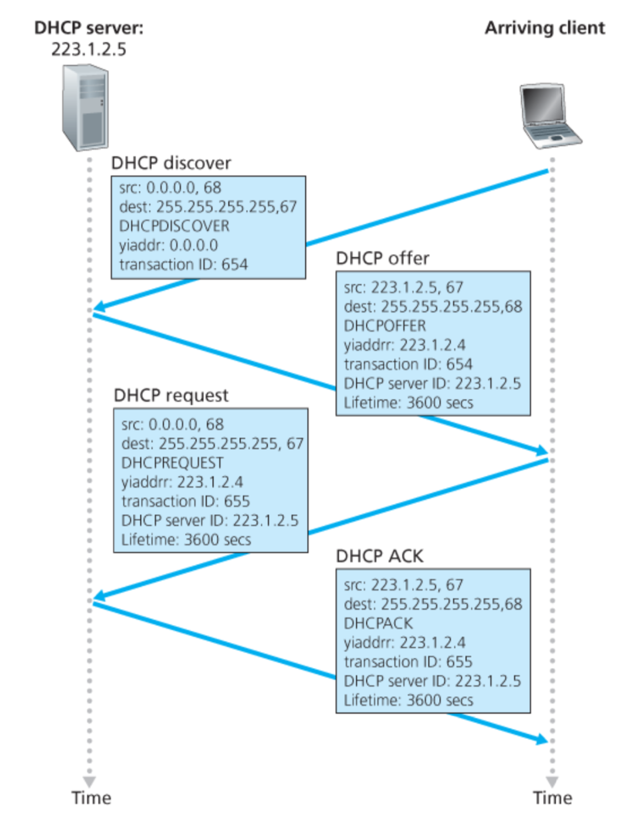
<Discover>
Broadcast: is there a DHCP server out there?

Slide 43
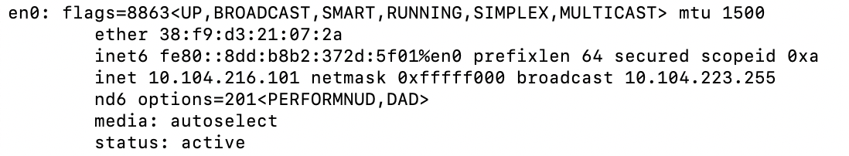
A note on the “broadcast address”

Slide 44
inet 10.104.216.101 ➔ 00001010.01101000.11011000.01100101
netmask ff:ff:f0:00 ➔ 11111111.11111111.11110000.00000000
broadcast 10.104.223.255 ➔
00001010.01101000.11011111.11111111

Slide 45
<Discover>
Broadcast: is there a DHCP server out there?
Which protocol would you use to exchange these DHCP protocol messages?
Notes:
It operates on UDP (User Datagram Protocol) and typically uses port 67 for DHCP servers and port 68 for DHCP clients.

Slide 46
<Discover>
Broadcast: is there a DHCP server out there?

Slide 47
<Discover>
Broadcast: is there a DHCP server out there?

Slide 48
<Discover>
Broadcast: is there a DHCP server out there?

Slide 49
<Discover>
Broadcast: is there a DHCP server out there?

Slide 50
<Discover>
Broadcast: is there a DHCP server out there?
yiaddr (“your” IP address)
Used by the server.

Slide 51
<Discover>
Broadcast: is there a DHCP server out there?
XId (transaction ID)
A random ID set by the client to keep track of the “question-answer” pair.

Slide 52
<Discover>
Broadcast: is there a DHCP server out there?
<Offer>
Broadcast: I’m a DHCP server! Here’s an IP address you can use

Slide 53
<Discover>
Broadcast: is there a DHCP server out there?
<Offer>
Broadcast: I’m a DHCP server! Here’s an IP address you can use

Slide 54
<Discover>
Broadcast: is there a DHCP server out there?
<Offer>
Broadcast: I’m a DHCP server! Here’s an IP address you can use

Slide 55
<Discover>
Broadcast: is there a DHCP server out there?
<Offer>
Broadcast: I’m a DHCP server! Here’s an IP address you can use

Slide 56
<Discover>
Broadcast: is there a DHCP server out there?
<Offer>
Broadcast: I’m a DHCP server! Here’s an IP address you can use

Slide 57
<Discover>
Broadcast: is there a DHCP server out there?
<Offer>
Broadcast: I’m a DHCP server! Here’s an IP address you can use
<Request>
Broadcast: OK. I’ll take that IP address! Can I ?

Slide 58
<Discover>
Broadcast: is there a DHCP server out there?
<Offer>
Broadcast: I’m a DHCP server! Here’s an IP address you can use
<Request>
Broadcast: OK. I’ll take that IP address! Can I ?
Notes:
It is broadcast so that other DHCP servers can get a notification. The behavior is different for first time aquiring address vs renewing the lease of the address.

Slide 59
<Discover>
Broadcast: is there a DHCP server out there?
<Offer>
Broadcast: I’m a DHCP server! Here’s an IP address you can use
<Request>
Broadcast: OK. I’ll take that IP address! Can I ?

Slide 60
<Discover>
Broadcast: is there a DHCP server out there?
<Offer>
Broadcast: I’m a DHCP server! Here’s an IP address you can use
<Request>
Broadcast: OK. I’ll take that IP address! Can I ?
<Ack>
Broadcast: OK. You’ve got that IP address!

Slide 61
<Discover>
Broadcast: is there a DHCP server out there?
<Offer>
Broadcast: I’m a DHCP server! Here’s an IP address you can use
<Request>
Broadcast: OK. I’ll take that IP address! Can I ?
<Ack>
Broadcast: OK. You’ve got that IP address!
Discussion Point 1: The transaction ID (xid). RFC 2131
Discussion Point 2: Broadcast address. (Limited/Directed broadcast)
Notes:
RFC 2131, Page [39]: The DHCP client broadcasts DHCPDISCOVER, DHCPREQUEST and DHCPINFORM messages, unless the client knows the address of a DHCP server. The client unicasts DHCPRELEASE messages to the server.
DHCP is not intended for use in configuring routers.

Slide 62
Broadcast addresses: Limited and Directed broadcast
Broadcast traffic is sent to all stations on a LAN.
There are two types of IPv4 broadcast addresses:
Limited broadcast: The limited broadcast address is
255.255.255.255. It is “limited” because it is never forwarded across a router.
(b) Directed broadcast: The directed (also called net-directed) broadcast address of the 192.0.2.0/24 network is 192.0.2.255 (the host portion of the address is all “1”s in binary, or 255). It is called “directed” broadcast, because traffic to these addresses may be sent from remote networks (it may be “directed”).

Slide 63
DHCP: more than IP addresses
DHCP can return more than just allocated IP address on subnet:
  address of first-hop router for client
  name and IP address of DNS sever
  network mask (indicating network versus host portion of address)

Slide 64
Dynamic Host Configuration Protocol (DHCP)
DHCP server is responsible for providing configuration information to hosts
DHCP server maintains a pool of available addresses
There is at least one DHCP server for an administrative domain (a server or a relay agent per subnet)

Slide 65
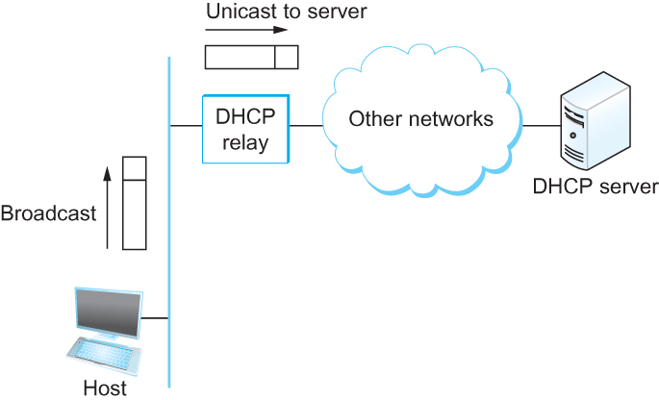
DHCP relay
Newly booted or attached host sends DHCPDISCOVER message to a special IP address (255.255.255.255)
DHCP relay agent unicasts the message to DHCP server and waits for the response

Slide 66
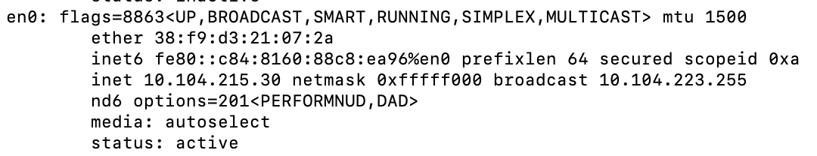
Check your IP addresses
ifconfig (linux/mac) / ipconfig (windows)

Slide 67
Check your IP addresses
(ifconfig/ipconfig)

