Slide 1
Red Black Tree

Slide 2
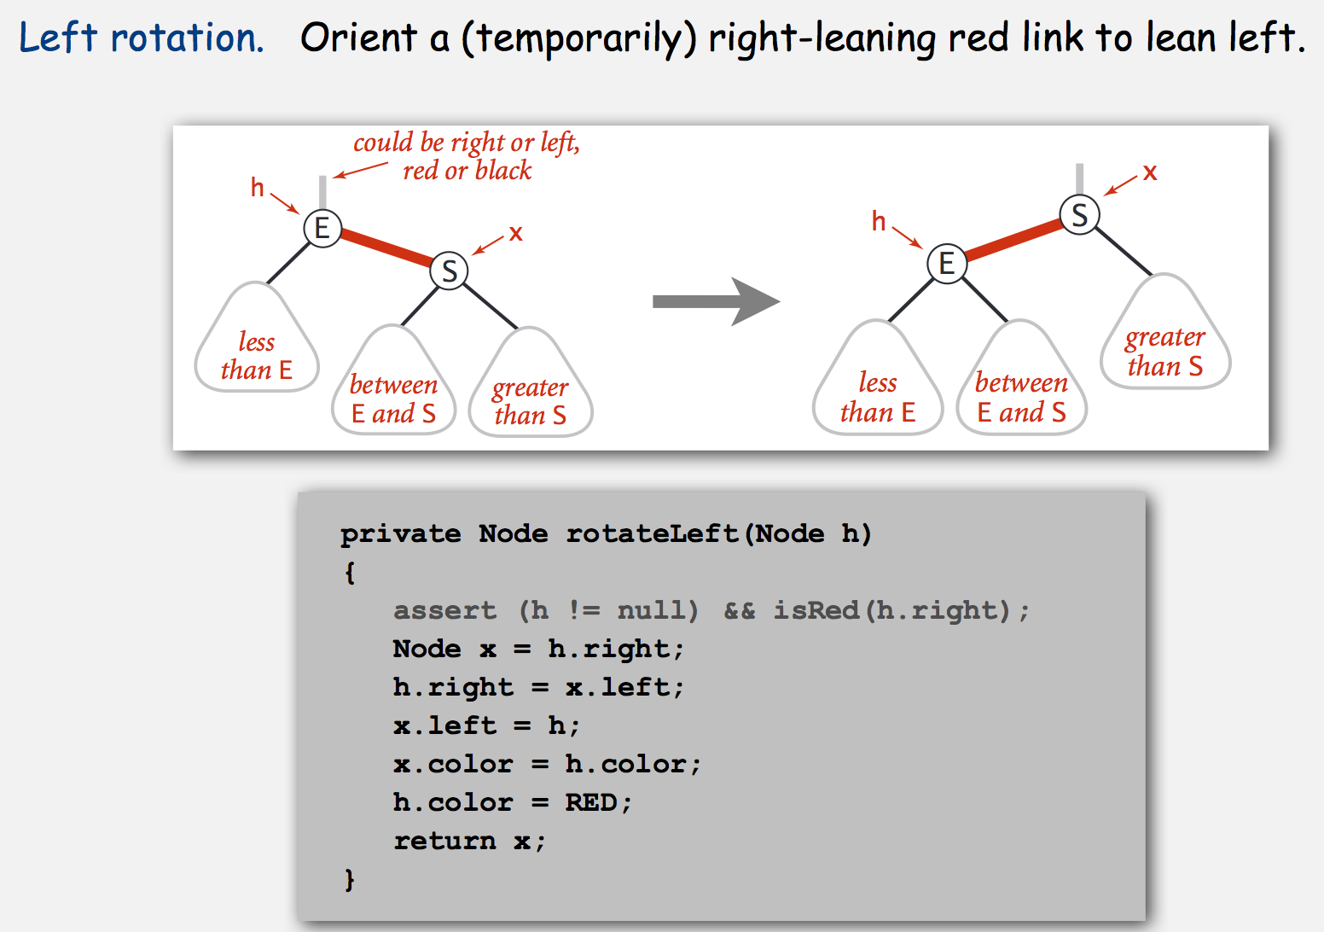
Left Rotate

Slide 3
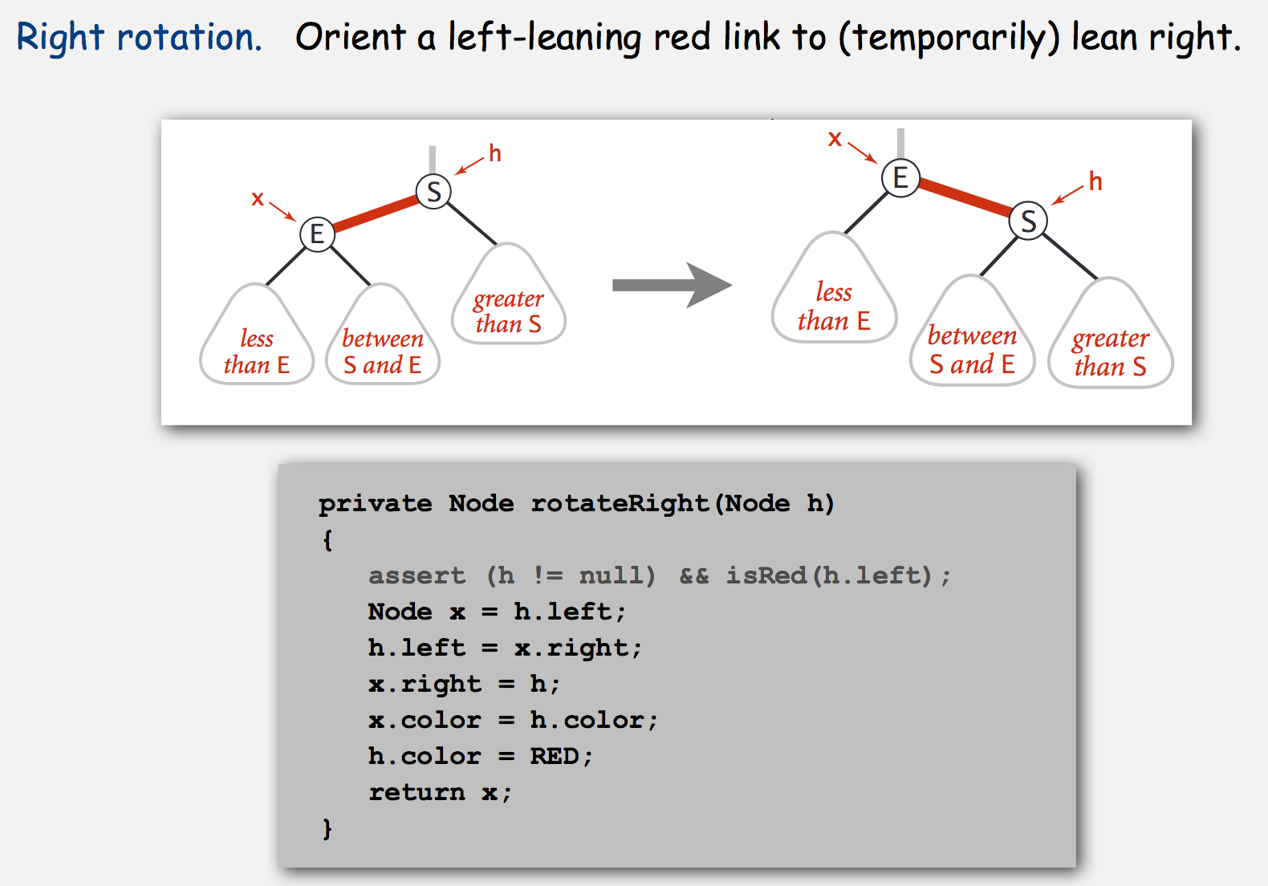
Right Rotate

Slide 4
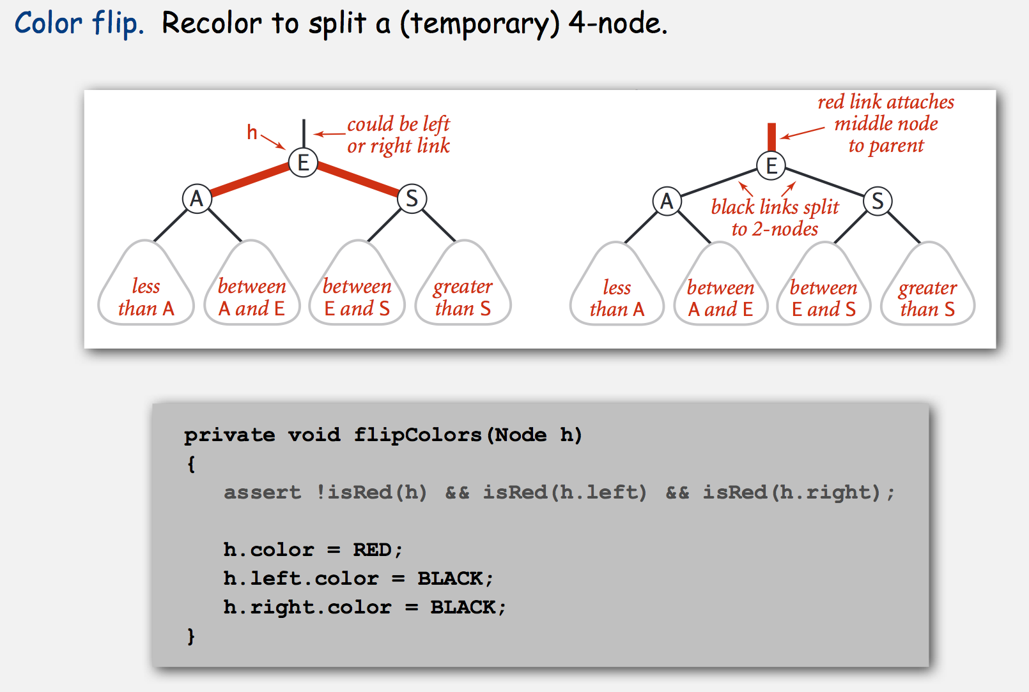
Flip Color

Slide 5
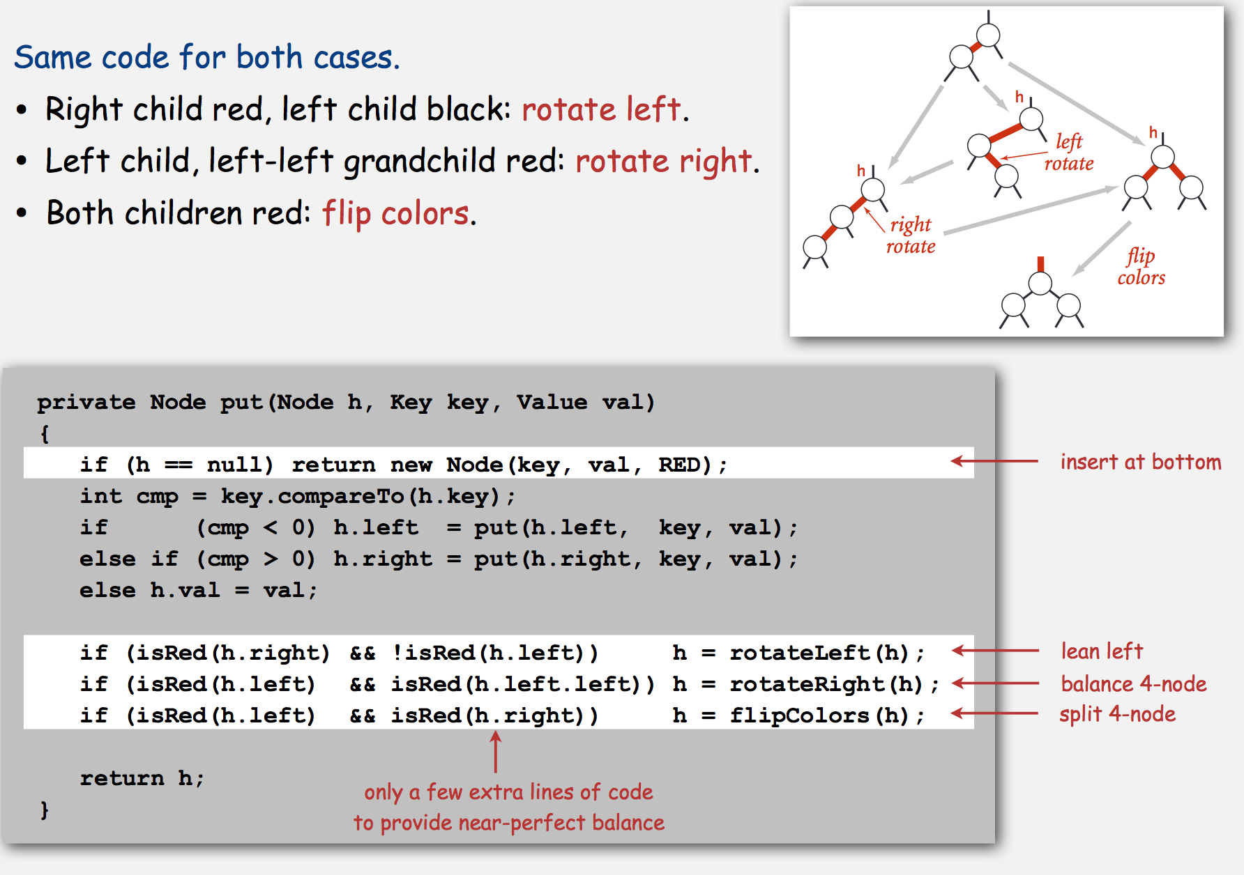
Put

