Slide 1
Merge Sort

Slide 2
What Is Sorting?
  To arrange a collection of items in some specified order.
    Numerical order
    Lexicographical order
  Input: sequence <a₁, a₂, …, a_{n}> of numbers.
  Output: permutation <a'₁, a'₂, …, a’_{n}> such that a'₁ ≤ a'₂ ≤ … ≤ a'_{n} .
  Example
    Start → 1 23 2 56 9 8 10 100
    End → 1 2 8 9 10 23 56 100

Slide 3
Why Sort?
A classic problem in computer science.
  Data requested in sorted order
    e.g., list students in increasing GPA order
Searching
  To find an element in an array of a million elements
    Linear search: average 500,000 comparisons
    Binary search: worst case 20 comparisons
  Database, Phone book
Eliminating duplicate copies in a collection of records
Finding a missing element, Max, Min

Slide 4
Sorting Algorithms
Selection Sort Bubble Sort
Insertion Sort Shell Sort
T(n)=O(n²) Quadratic growth
In clock time
Double input -> 4X time
  Feasible for small inputs, quickly unmanagable
Halve input -> 1/4 time
  Hmm... can recursion save the day?
  If have two sorted halves, how to produce sorted full result?
10,000 | 3 sec | 20,000 | 17 sec
50,000 | 77 sec | 100,000 | 5 min

Slide 5
Divide and Conquer
Base case: the problem is small enough, solve directly
Divide the problem into two or more similar and smaller subproblems
Recursively solve the subproblems
Combine solutions to the subproblems

Slide 6
Merge Sort
Divide and conquer algorithm
Worst case: O(nlogn)
Stable
  maintain the relative order of records with equal values
  Input: 12, 5, 8, 13, 8, 27
  Stable: 5, 8, 8, 12, 13, 27
  Not Stable:5, 8, 8, 12, 13, 27

Slide 7
Merge Sort: Idea
Divide into
two halves
A:
FirstPart
SecondPart
Recursively sort
FirstPart
SecondPart
Merge
A is sorted!
Notes:
Divide: if the initial array A has at least two elements (nothing needs to be done if A has zero or one elements), divide A into two subarrays each containing about half of the elements of A.
Conquer: sort the two subarrays using Merge Sort.
Combine: merging the two sorted subarray into one sorted array

Slide 8
Merge-Sort: Merge
Sorted
A:
merge
Sorted
Sorted
L:
R:

Slide 9
Merge Example
A:
L:
1
2
6
8
R:
3
4
5
7

Slide 10
Merge Example cont.
A:
1
2
3
4
5
6
7
8
k=8
L:
R:
3
1
5
2
15
6
28
8
6
3
10
4
14
5
22
7
i=4
j=4

Slide 11
Merge sort algorithm
MERGE-SORT A[1 . . n]
If n = 1, done.
Recursively sort A[ 1 . . ⎡n/2⎤ ] and A[ ⎡n/2⎤+1 . . n ] .
“Merge” the 2 sorted lists.
Key subroutine: MERGE

Slide 12
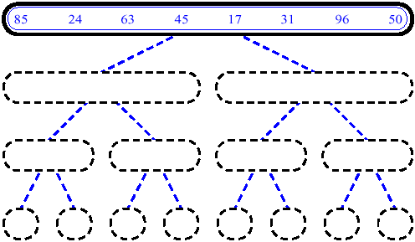
Merge sort (Example)

Slide 13
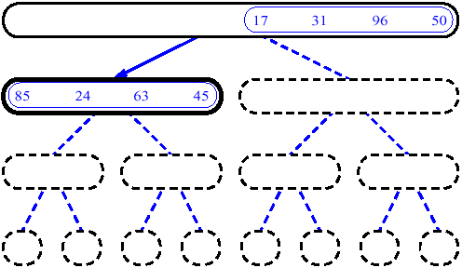
Merge sort (Example)

Slide 14
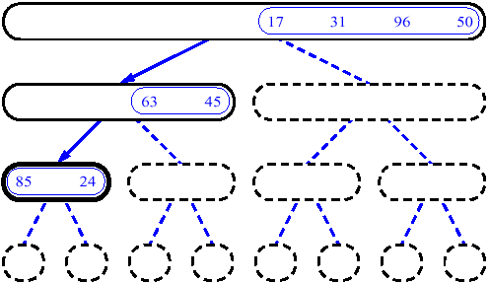
Merge sort (Example)

Slide 15
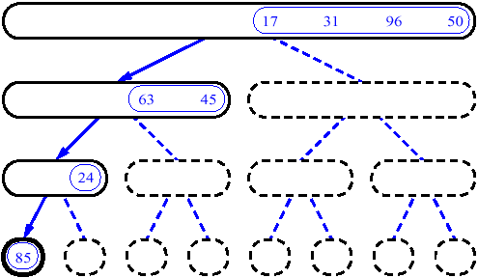
Merge sort (Example)

Slide 16
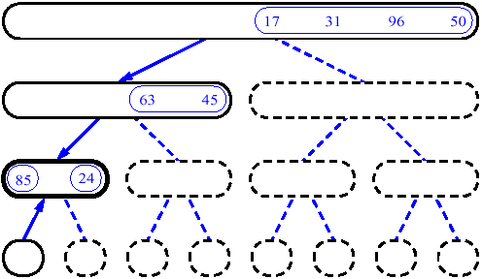
Merge sort (Example)

Slide 17
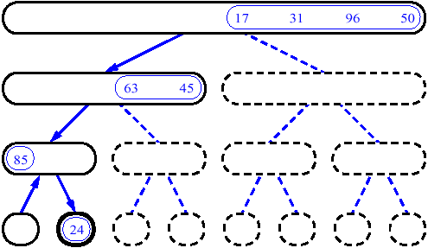
Merge sort (Example)

Slide 18
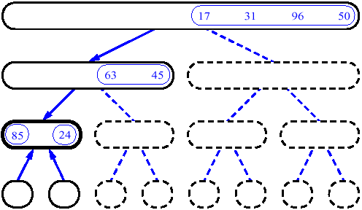
Merge sort (Example)

Slide 19
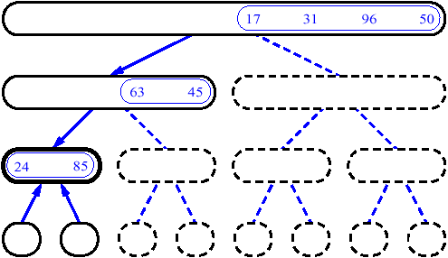
Merge sort (Example)

Slide 20
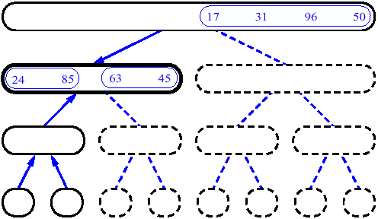
Merge sort (Example)

Slide 21
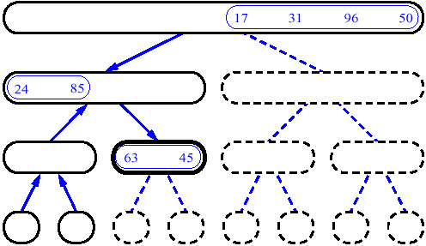
Merge sort (Example)

Slide 22
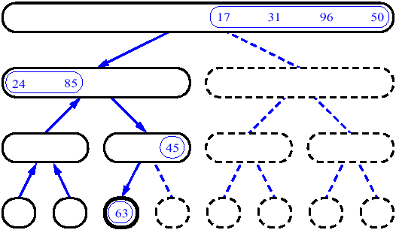
Merge sort (Example)

Slide 23
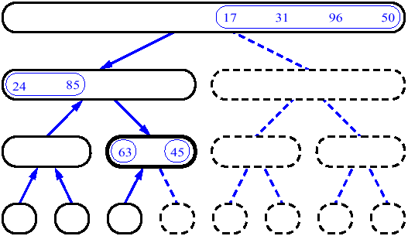
Merge sort (Example)

Slide 24
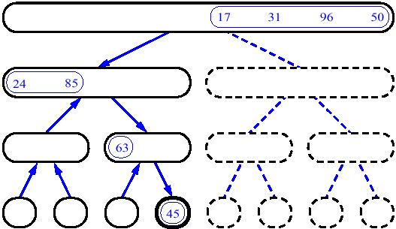
Merge sort (Example)

Slide 25
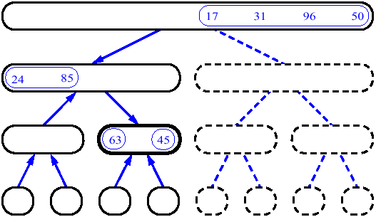
Merge sort (Example)

Slide 26
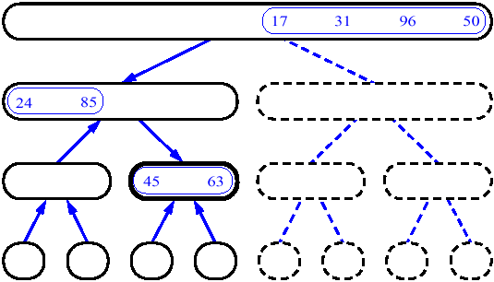
Merge sort (Example)

Slide 27
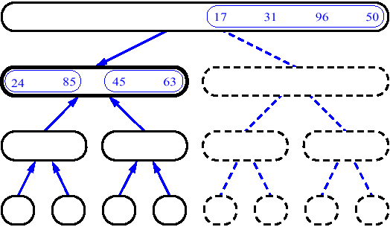
Merge sort (Example)

Slide 28
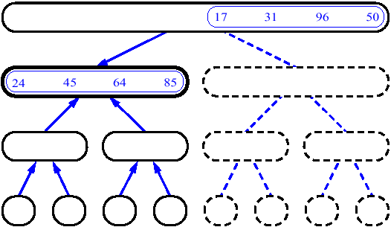
Merge sort (Example)

Slide 29
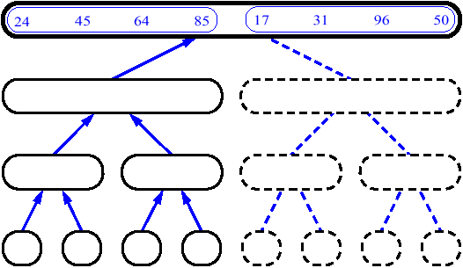
Merge sort (Example)

Slide 30
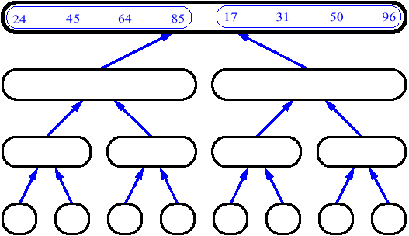
Merge sort (Example)

Slide 31
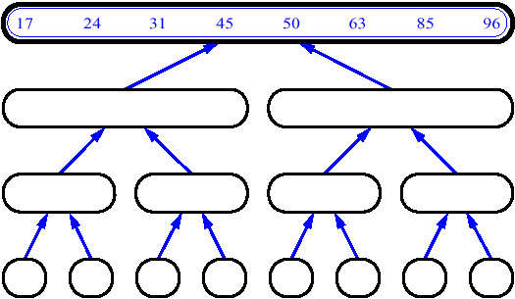
Merge sort (Example)

Slide 32
Analysis of merge sort
T(n)
Θ(1)
2T(n/2)
Θ(n)
MERGE-SORT A[1 . . n]
If n = 1, done.
Recursively sort A[ 1 . . ⎡n/2⎤ ] and A[ ⎡n/2⎤+1 . . n ] .
“Merge” the 2 sorted lists

Slide 33
Analyzing merge sort
Θ(1) if n = 1;
T(n) =
2T(n/2) + Θ(n) if n > 1.
T(n) = Θ(n lg n) (n > 1)

Slide 34
Recursion tree
Solve T(n) = 2T(n/2) + cn, where c > 0 is constant.
cn
cn
cn/2
cn/2
cn
h = log n
cn/4
cn/4
cn/4
cn/4
cn
…
…
Θ(1)
#leaves = n
Θ(n)
Total = Θ(n log n)

Slide 35
Memory Requirement
Needs additional n locations because it is difficult to merge two sorted sets in place
A:
L:
1
2
6
8
R:
3
4
5
7

Slide 36
Conclusion
Merge Sort: O(n log n)
  grows more slowly than Θ(n²)
  asymptotically beats insertion sort in the worst case
  In practice, merge sort beats insertion sort for n > 30 or so
Space requirement:
  O(n), not in-place

Slide 37
Heapsort

Slide 38
Heapsort
Merge sort time is O(n log n) but still requires, temporarily, n extra storage locations
Heapsort does not require any additional storage
As its name implies, heapsort uses a heap to store the array

Slide 39
First Version of a Heapsort Algorithm
When used as a priority queue, a heap maintains a smallest value at the top
The following algorithm
  places an array's data into a heap,
  then removes each heap item (O(n log n)) and moves it back into the array
This version of the algorithm requires n extra storage locations
Heapsort Algorithm: First Version
1. Insert each value from the array to be sorted into a priority queue (heap).
2. Set i to 0
3. while the priority queue is not empty
4. Remove an item from the queue and insert it back into the array at position i
5. Increment i

Slide 40
Revising the Heapsort Algorithm
In heaps we've used so far, each parent node value was not greater than the values of its children
We can build a heap so that each parent node value is not less than its children
Then,
  move the top item to the bottom of the heap
  reheap, ignoring the item moved to the bottom

Slide 41
Trace of Heapsort
89
76
74
37
32
39
66
20
26
18
28
29
6

Slide 42
Trace of Heapsort (cont.)
89
76
74
37
32
39
66
20
26
18
28
29
6

Slide 43
Trace of Heapsort (cont.)
89
76
74
37
32
39
66
20
26
18
28
29
6

Slide 44
Trace of Heapsort (cont.)
6
76
74
37
32
39
66
20
26
18
28
29
89

Slide 45
Trace of Heapsort (cont.)
76
6
74
37
32
39
66
20
26
18
28
29
89

Slide 46
Trace of Heapsort (cont.)
76
37
74
6
32
39
66
20
26
18
28
29
89

Slide 47
Trace of Heapsort (cont.)
76
37
74
26
32
39
66
20
6
18
28
29
89

Slide 48
Trace of Heapsort (cont.)
76
37
74
26
32
39
66
20
6
18
28
29
89

Slide 49
Trace of Heapsort (cont.)
76
37
74
26
32
39
66
20
6
18
28
29
89

Slide 50
Trace of Heapsort (cont.)
76
37
74
26
32
39
66
20
6
18
28
29
89

Slide 51
Trace of Heapsort (cont.)
29
37
74
26
32
39
66
20
6
18
28
76
89

Slide 52
Trace of Heapsort (cont.)
74
37
29
26
32
39
66
20
6
18
28
76
89

Slide 53
Trace of Heapsort (cont.)
74
37
66
26
32
39
29
20
6
18
28
76
89

Slide 54
Trace of Heapsort (cont.)
74
37
66
26
32
39
29
20
6
18
28
76
89

Slide 55
Trace of Heapsort (cont.)
74
37
66
26
32
39
29
20
6
18
28
76
89

Slide 56
Trace of Heapsort (cont.)
74
37
66
26
32
39
29
20
6
18
28
76
89

Slide 57
Trace of Heapsort (cont.)
28
37
66
26
32
39
29
20
6
18
74
76
89

Slide 58
Trace of Heapsort (cont.)
66
37
28
26
32
39
29
20
6
18
74
76
89

Slide 59
Trace of Heapsort (cont.)
66
37
39
26
32
28
29
20
6
18
74
76
89

Slide 60
Trace of Heapsort (cont.)
66
37
39
26
32
28
29
20
6
18
74
76
89

Slide 61
Trace of Heapsort (cont.)
66
37
39
26
32
28
29
20
6
18
74
76
89

Slide 62
Trace of Heapsort (cont.)
66
37
39
26
32
28
29
20
6
18
74
76
89

Slide 63
Trace of Heapsort (cont.)
18
37
39
26
32
28
29
20
6
66
74
76
89

Slide 64
Trace of Heapsort (cont.)
39
37
18
26
32
28
29
20
6
66
74
76
89

Slide 65
Trace of Heapsort (cont.)
39
37
29
26
32
28
18
20
6
66
74
76
89

Slide 66
Trace of Heapsort (cont.)
39
37
29
26
32
28
18
20
6
66
74
76
89

Slide 67
Trace of Heapsort (cont.)
39
37
29
26
32
28
18
20
6
66
74
76
89

Slide 68
Trace of Heapsort (cont.)
39
37
29
26
32
28
18
20
6
66
74
76
89

Slide 69
Trace of Heapsort (cont.)
6
37
29
26
32
28
18
20
39
66
74
76
89

Slide 70
Trace of Heapsort (cont.)
37
6
29
26
32
28
18
20
39
66
74
76
89

Slide 71
Trace of Heapsort (cont.)
37
32
29
26
6
28
18
20
39
66
74
76
89

Slide 72
Trace of Heapsort (cont.)
37
32
29
26
6
28
18
20
39
66
74
76
89

Slide 73
Trace of Heapsort (cont.)
37
32
29
26
6
28
18
20
39
66
74
76
89

Slide 74
Trace of Heapsort (cont.)
37
32
29
26
6
28
18
20
39
66
74
76
89

Slide 75
Trace of Heapsort (cont.)
20
32
29
26
6
28
18
37
39
66
74
76
89

Slide 76
Trace of Heapsort (cont.)
32
20
29
26
6
28
18
37
39
66
74
76
89

Slide 77
Trace of Heapsort (cont.)
32
26
29
20
6
28
18
37
39
66
74
76
89

Slide 78
Trace of Heapsort (cont.)
32
26
29
20
6
28
18
37
39
66
74
76
89

Slide 79
Trace of Heapsort (cont.)
32
26
29
20
6
28
18
37
39
66
74
76
89

Slide 80
Trace of Heapsort (cont.)
32
26
29
20
6
28
18
37
39
66
74
76
89

Slide 81
Trace of Heapsort (cont.)
18
26
29
20
6
28
32
37
39
66
74
76
89

Slide 82
Trace of Heapsort (cont.)
29
26
18
20
6
28
32
37
39
66
74
76
89

Slide 83
Trace of Heapsort (cont.)
29
26
28
20
6
18
32
37
39
66
74
76
89

Slide 84
Trace of Heapsort (cont.)
29
26
28
20
6
18
32
37
39
66
74
76
89

Slide 85
Trace of Heapsort (cont.)
29
26
28
20
6
18
32
37
39
66
74
76
89

Slide 86
Trace of Heapsort (cont.)
29
26
28
20
6
18
32
37
39
66
74
76
89

Slide 87
Trace of Heapsort (cont.)
18
26
28
20
6
29
32
37
39
66
74
76
89

Slide 88
Trace of Heapsort (cont.)
28
26
18
20
6
29
32
37
39
66
74
76
89

Slide 89
Trace of Heapsort (cont.)
28
26
18
20
6
29
32
37
39
66
74
76
89

Slide 90
Trace of Heapsort (cont.)
28
26
18
20
6
29
32
37
39
66
74
76
89

Slide 91
Trace of Heapsort (cont.)
28
26
18
20
6
29
32
37
39
66
74
76
89

Slide 92
Trace of Heapsort (cont.)
6
26
18
20
28
29
32
37
39
66
74
76
89

Slide 93
Trace of Heapsort (cont.)
26
6
18
20
28
29
32
37
39
66
74
76
89

Slide 94
Trace of Heapsort (cont.)
26
20
18
6
28
29
32
37
39
66
74
76
89

Slide 95
Trace of Heapsort (cont.)
26
20
18
6
28
29
32
37
39
66
74
76
89

Slide 96
Trace of Heapsort (cont.)
26
20
18
6
28
29
32
37
39
66
74
76
89

Slide 97
Trace of Heapsort (cont.)
26
20
18
6
28
29
32
37
39
66
74
76
89

Slide 98
Trace of Heapsort (cont.)
6
20
18
26
28
29
32
37
39
66
74
76
89

Slide 99
Trace of Heapsort (cont.)
20
6
18
26
28
29
32
37
39
66
74
76
89

Slide 100
Trace of Heapsort (cont.)
20
6
18
26
28
29
32
37
39
66
74
76
89

Slide 101
Trace of Heapsort (cont.)
20
6
18
26
28
29
32
37
39
66
74
76
89

Slide 102
Trace of Heapsort (cont.)
20
6
18
26
28
29
32
37
39
66
74
76
89

Slide 103
Trace of Heapsort (cont.)
18
6
20
26
28
29
32
37
39
66
74
76
89

Slide 104
Trace of Heapsort (cont.)
18
6
20
26
28
29
32
37
39
66
74
76
89

Slide 105
Trace of Heapsort (cont.)
18
6
20
26
28
29
32
37
39
66
74
76
89

Slide 106
Trace of Heapsort (cont.)
18
6
20
26
28
29
32
37
39
66
74
76
89

Slide 107
Trace of Heapsort (cont.)
6
18
20
26
28
29
32
37
39
66
74
76
89

Slide 108
Trace of Heapsort (cont.)
6
18
20
26
28
29
32
37
39
66
74
76
89

Slide 109
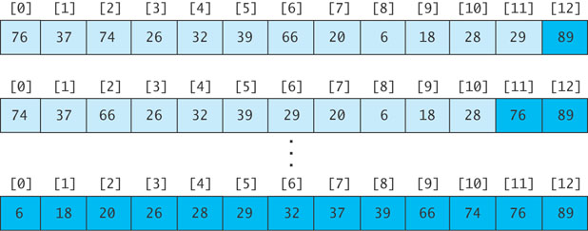
Revising the Heapsort Algorithm
If we implement the heap as an array
  each element removed will be placed at the end of the array, and
  the heap part of the array decreases by one element

Slide 110
Algorithm for In-Place Heapsort
Algorithm for In-Place Heapsort
1. Build a heap by rearranging the elements in an unsorted array
2. while the heap is not empty
3. Remove the first item from the heap by swapping it with the last item in the heap and restoring the heap property

Slide 111
Analysis of Heapsort
Because a heap is a complete binary tree, it has log n levels
Building a heap of size n requires finding the correct location for an item in a heap with log n levels
Each insert (or remove) is O(log n)
With n items, building a heap is O(n log n)
No extra storage is needed

Slide 112
Quicksort

Slide 113
Quicksort
Developed in 1962
Quicksort selects a specific value called a pivot and rearranges the array into two parts (called partioning)
  all the elements in the left subarray are less than or equal to the pivot
  all the elements in the right subarray are larger than the pivot
  The pivot is placed between the two subarrays
The process is repeated until the array is sorted

Slide 114
Trace of Quicksort
44
75
23
43
55
12
64
77
33

Slide 115
Trace of Quicksort (cont.)
44
75
23
43
55
12
64
77
33
Arbitrarily select the first element as the pivot

Slide 116
Trace of Quicksort (cont.)
55
75
23
43
44
12
64
77
33
Swap the pivot with the element in the middle

Slide 117
Trace of Quicksort (cont.)
55
75
23
43
44
12
64
77
33
Partition the elements so that all values less than or equal to the pivot are to the left, and all values greater than the pivot are to the right

Slide 118
Trace of Quicksort (cont.)
12
33
23
43
44
55
64
77
75
Partition the elements so that all values less than or equal to the pivot are to the left, and all values greater than the pivot are to the right

Slide 119
Quicksort Example(cont.)
44 is now in its correct position
12
33
23
43
44
55
64
77
75

Slide 120
Trace of Quicksort (cont.)
12
33
23
43
44
55
64
77
75
Now apply quicksort recursively to the two subarrays

Slide 121
Trace of Quicksort (cont.)
Pivot value = 12
12
33
23
43
44
55
64
77
75

Slide 122
Trace of Quicksort (cont.)
Pivot value = 12
12
33
23
43
44
55
64
77
75

Slide 123
Trace of Quicksort (cont.)
Pivot value = 33
12
33
23
43
44
55
64
77
75

Slide 124
Trace of Quicksort (cont.)
Pivot value = 33
12
23
33
43
44
55
64
77
75

Slide 125
Trace of Quicksort (cont.)
Pivot value = 33
12
23
33
43
44
55
64
77
75

Slide 126
Trace of Quicksort (cont.)
Pivot value = 33
12
23
33
43
44
55
64
77
75
Left and right subarrays have single values; they are sorted

Slide 127
Trace of Quicksort (cont.)
Pivot value = 33
12
23
33
43
44
55
64
77
75
Left and right subarrays have single values; they are sorted

Slide 128
Trace of Quicksort (cont.)
Pivot value = 55
12
23
33
43
44
55
64
77
75

Slide 129
Trace of Quicksort (cont.)
Pivot value = 64
12
23
33
43
44
55
64
77
75

Slide 130
Trace of Quicksort (cont.)
Pivot value = 77
12
23
33
43
44
55
64
77
75

Slide 131
Trace of Quicksort (cont.)
Pivot value = 77
12
23
33
43
44
55
64
75
77

Slide 132
Trace of Quicksort (cont.)
Pivot value = 77
12
23
33
43
44
55
64
75
77

Slide 133
Trace of Quicksort (cont.)
12
23
33
43
44
55
64
75
77
Left subarray has single value; it is sorted

Slide 134
Trace of Quicksort (cont.)
12
23
33
43
44
55
64
75
77

Slide 135
Algorithm for Quicksort
We describe how to do the partitioning later
The indexes first and last are the end points of the array being sorted
The index of the pivot after partitioning is pivIndex
Algorithm for Quicksort
1. if first < last then
2. Partition the elements in the subarray first . . . last so that the pivot value is in its correct place (subscript pivIndex)
3. Recursively apply quicksort to the subarray first . . . pivIndex - 1
4. Recursively apply quicksort to the subarray pivIndex + 1 . . . last

Slide 136
Analysis of Quicksort
If the pivot value is a random value selected from the current subarray,
  then statistically half of the items in the subarray will be less than the pivot and half will be greater
If both subarrays have the same number of elements (best case), there will be log n levels of recursion
At each recursion level, the partitioning process involves moving every element to its correct position—n moves
Quicksort is O(n log n), just like merge sort

Slide 137
Analysis of Quicksort (cont.)
The array split may not be the best case, i.e. 50-50
An exact analysis is difficult (and beyond the scope of this class), but, the running time will be bounded by a constant x n log n

Slide 138
Analysis of Quicksort (cont.)
A quicksort will give very poor behavior if, each time the array is partitioned, a subarray is empty.
In that case, the sort will be O(n²)
Under these circumstances, the overhead of recursive calls and the extra run-time stack storage required by these calls makes this version of quicksort a poor performer relative to the quadratic sorts
  We’ll discuss a solution later

Slide 139
Algorithm for Partitioning
44
75
23
43
55
12
64
77
33
If the array is randomly ordered, it does not matter which element is the pivot.
For simplicity we pick the element with subscript first

Slide 140
Trace of Partitioning (cont.)
44
75
23
43
55
12
64
77
33
If the array is randomly ordered, it does not matter which element is the pivot.
For simplicity we pick the element with subscript first

Slide 141
Trace of Partitioning (cont.)
44
75
23
43
55
12
64
77
33
For visualization purposes, items less than or equal to the pivot will be colored blue; items greater than the pivot will be colored light purple

Slide 142
Trace of Partitioning (cont.)
44
75
23
43
55
12
64
77
33
For visualization purposes, items less than or equal to the pivot will be colored blue; items greater than the pivot will be colored light purple

Slide 143
Trace of Partitioning (cont.)
44
75
23
43
55
12
64
77
33
Search for the first value at the left end of the array that is greater than the pivot value

Slide 144
Trace of Partitioning (cont.)
up
44
75
23
43
55
12
64
77
33
Search for the first value at the left end of the array that is greater than the pivot value

Slide 145
Trace of Partitioning (cont.)
up
44
75
23
43
55
12
64
77
33
Then search for the first value at the right end of the array that is less than or equal to the pivot value

Slide 146
Trace of Partitioning (cont.)
up
down
44
75
23
43
55
12
64
77
33
Then search for the first value at the right end of the array that is less than or equal to the pivot value

Slide 147
Trace of Partitioning (cont.)
up
down
44
75
23
43
55
12
64
77
33
Exchange these values

Slide 148
Trace of Partitioning (cont.)
44
33
23
43
55
12
64
77
75
Exchange these values

Slide 149
Trace of Partitioning (cont.)
44
33
23
43
55
12
64
77
75
Repeat

Slide 150
Trace of Partitioning (cont.)
up
44
33
23
43
55
12
64
77
75
Find first value at left end greater than pivot

Slide 151
Trace of Partitioning (cont.)
up
down
44
33
23
43
55
12
64
77
75
Find first value at right end less than or equal to pivot

Slide 152
Trace of Partitioning (cont.)
44
33
23
43
12
55
64
77
75
Exchange

Slide 153
Trace of Partitioning (cont.)
44
33
23
43
12
55
64
77
75
Repeat

Slide 154
Trace of Partitioning (cont.)
up
44
33
23
43
12
55
64
77
75
Find first element at left end greater than pivot

Slide 155
Trace of Partitioning (cont.)
down
up
44
33
23
43
12
55
64
77
75
Find first element at right end less than or equal to pivot

Slide 156
Trace of Partitioning (cont.)
down
up
44
33
23
43
12
55
64
77
75
Since down has "passed" up, do not exchange

Slide 157
Trace of Partitioning (cont.)
down
up
44
33
23
43
12
55
64
77
75
Exchange the pivot value with the value at down

Slide 158
Trace of Partitioning (cont.)
down
12
33
23
43
44
55
64
77
75
Exchange the pivot value with the value at down

Slide 159
Trace of Partitioning (cont.)
down
12
33
23
43
44
55
64
77
75
The pivot value is in the correct position; return the value of down and assign it to the pivot index pivIndex

Slide 160
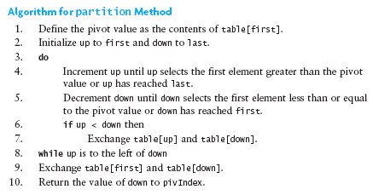
Algorithm for Partitioning

Slide 161
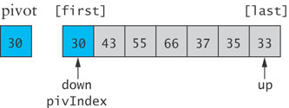
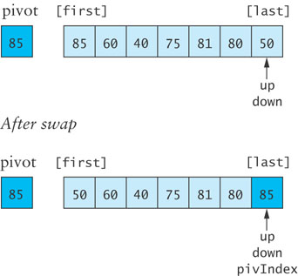
Code for partition when Pivot is the largest or smallest value

Slide 162
Revised Partition Algorithm
Quicksort is O(n²) when each split yields one empty subarray, which is the case when the array is presorted
A better solution is to pick the pivot value in a way that is less likely to lead to a bad split
  Use three references: first, middle, last
  Select the median of the these items as the pivot

Slide 163
Trace of Revised Partitioning
44
75
23
43
55
12
64
77
33

Slide 164
Trace of Revised Partitioning (cont.)
first
middle
last
44
75
23
43
55
12
64
77
33

Slide 165
Trace of Revised Partitioning (cont.)
first
middle
last
44
75
23
43
55
12
64
77
33
Sort these values

Slide 166
Trace of Revised Partitioning (cont.)
first
middle
last
33
75
23
43
44
12
64
77
55
Sort these values

Slide 167
Trace of Revised Partitioning (cont.)
first
middle
last
33
75
23
43
44
12
64
77
55
Exchange middle with first

Slide 168
Trace of Revised Partitioning (cont.)
first
middle
last
44
75
23
43
33
12
64
77
55
Exchange middle with first

Slide 169
Trace of Revised Partitioning (cont.)
44
75
23
43
33
12
64
77
55
Run the partition algorithm using the first element as the pivot

Slide 170
Algorithm for Revised partition Method
Algorithm for Revised partition Method
1. Sort table[first], table[middle], and table[last]
2. Move the median value to table[first] (the pivot value) by exchanging table[first] and table[middle].
3. Initialize up to first and down to last
4. do
5. Increment up until up selects the first element greater than the pivot value or up has reached last
6. Decrement down until down selects the first element less than or equal to the pivot value or down has reached first
7. if up < down then
8. Exchange table[up] and table[down]
9. while up is to the left of down
10. Exchange table[first] and table[down]
11. Return the value of down to pivIndex

Slide 171
Comparison of Sort Algorithms
Summary

Slide 172
Sorting Algorithm Comparison
Name | Best | Average | Worst | Memory | Stable
Bubble Sort | n | n² | n² | 1 | yes
Selection Sort | n² | n² | n² | 1 | no
Insertion Sort | n | n² | n² | 1 | yes
Merge Sort | nlogn | nlogn | nlogn | n | yes
Quick Sort | nlogn | nlogn | n² | log n | no
Heap Sort | nlogn | nlogn | nlogn | 1 | no

