Slide 1
Static member examples

Slide 2

Message Class
class MessagePad{
private String for;
private String from;
private Time time;
private Date date;
private boolean urgent;
private String Message;
}

Slide 3
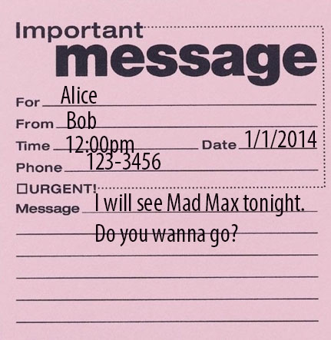
Message Class
Message msg = new Message(….);

Slide 4
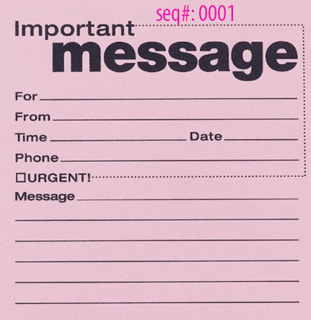
Message Class
class MessagePad{
private static int seq_id;
private String for;
private String from;
private Time time;
private Date date;
private boolean urgent;
private String Message;
}

Slide 5
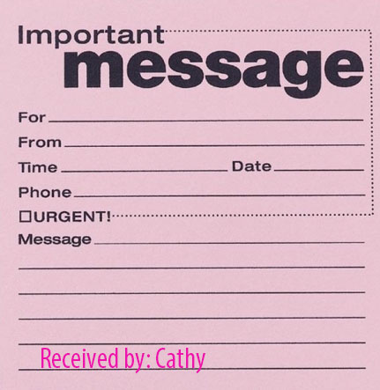
Message Class
class MessagePad{
private static String receivedby;
private String for;
private String from;
private Time time;
private Date date;
private boolean urgent;
private String Message;
}

