Slide 1
Mathematical Induction:
Introduction and basic problems
CMSC 250

Slide 2








The idea behind induction
Suppose that we want to prove that a proposition $P(n)$ is true for all natural numbers $n$.
$$0$$
$$1$$
$$2$$
$$…$$
$$…$$
$$n$$
$$n+1$$
$$…$$
$$…$$
$$…$$

Slide 3

The idea behind induction
Suppose that we want to prove that a proposition $P(n)$ is true for all natural numbers $n$.
We will prove two separate things:
$$0$$
$$1$$
$$2$$
$$…$$
$$…$$
$$n$$
$$n+1$$
$$…$$
$$…$$
$$…$$

Slide 4


The idea behind induction
Suppose that we want to prove that a proposition $P(n)$ is true for all natural numbers $n$.
We will prove two separate things:
  $P(0)$ is true
$$0$$
$$1$$
$$2$$
$$…$$
$$…$$
$$n$$
$$n+1$$
$$…$$
$$…$$
$$…$$

Slide 5


The idea behind induction
Suppose that we want to prove that a proposition $P(n)$ is true for all natural numbers $n$.
We will prove two separate things:
  $P(0)$ is true
  For any $n≥0$, if $P$ is true for $n$, it then must be true for $n+1$
$$0$$
$$1$$
$$2$$
$$…$$
$$…$$
$$n$$
$$⇒$$
$$n+1$$
$$…$$
$$…$$
$$…$$

Slide 6
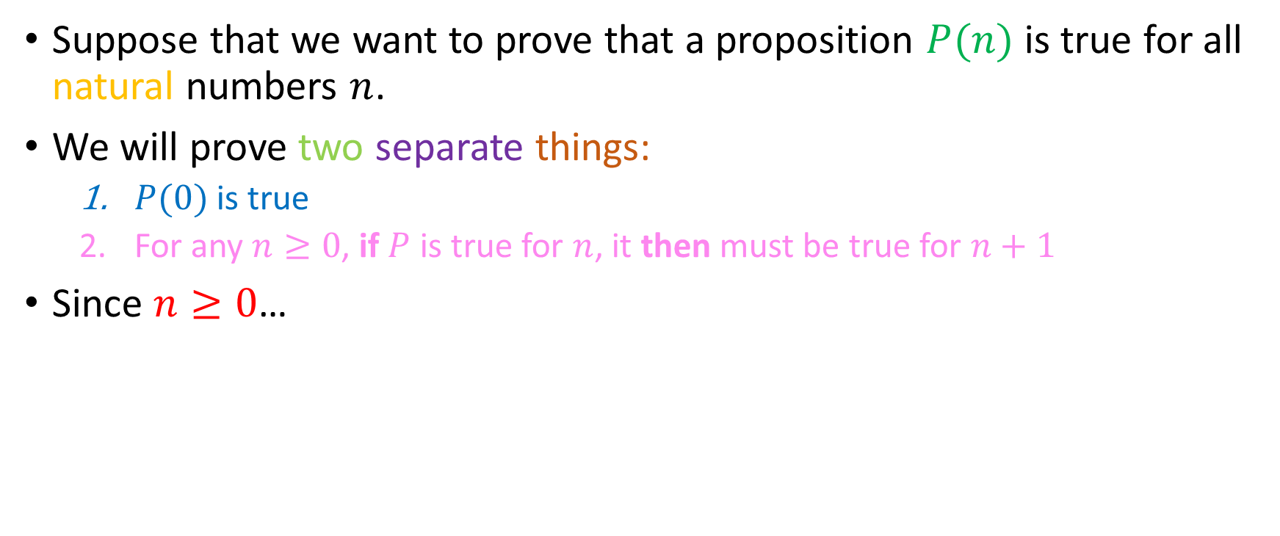
The idea behind induction
Suppose that we want to prove that a proposition $P(n)$ is true for all natural numbers $n$.
We will prove two separate things:
  $P(0)$ is true
  For any $n≥0$, if $P$ is true for $n$, it then must be true for $n+1$
Since $n≥0$…
$$0$$
$$1$$
$$2$$
$$…$$
$$…$$
$$n$$
$$⇒$$
$$n+1$$
$$…$$
$$…$$
$$…$$

Slide 7

The idea behind induction
Suppose that we want to prove that a proposition $P(n)$ is true for all natural numbers $n$.
We will prove two separate things:
  $P(0)$ is true
  For any $n≥0$, if $P$ is true for $n$, it then must be true for $n+1$
Since $n≥0$…
$$0$$
$$1$$
$$2$$
$$…$$
$$…$$
$$n$$
$$⇒$$
$$n+1$$
$$…$$
$$…$$
$$…$$

Slide 8
The idea behind induction
Suppose that we want to prove that a proposition $P(n)$ is true for all natural numbers $n$.
We will prove two separate things:
  $P(0)$ is true
  For any $n≥0$, if $P$ is true for $n$, it then must be true for $n+1$
Since $n≥0$…
$$0$$
$$1$$
$$2$$
$$…$$
$$…$$
$$n$$
$$⇒$$
$$n+1$$
$$…$$
$$…$$
$$…$$

Slide 9

The idea behind induction
Suppose that we want to prove that a proposition $P(n)$ is true for all natural numbers $n$.
We will prove two separate things:
  $P(0)$ is true
  For any $n≥0$, if $P$ is true for $n$, it then must be true for $n+1$
Since $n≥0$…
$$0$$
$$1$$
$$2$$
$$…$$
$$…$$
$$n$$
$$n+1$$
$$…$$
$$…$$
$$…$$

Slide 10
The idea behind induction
Suppose that we want to prove that a proposition $P(n)$ is true for all natural numbers $n$.
We will prove two separate things:
  $P(0)$ is true
  For any $n≥0$, if $P$ is true for $n$, it then must be true for $n+1$
Since $n≥0$…
$$0$$
$$1$$
$$2$$
$$…$$
$$…$$
$$n$$
$$⇒$$
$$n+1$$
$$…$$
$$…$$
$$…$$

Slide 11

The idea behind induction
Suppose that we want to prove that a proposition $P(n)$ is true for all natural numbers $n$.
We will prove two separate things:
  $P(0)$ is true
  For any $n≥0$, if $P$ is true for $n$, it then must be true for $n+1$
Since $n≥0$…
$$0$$
$$1$$
$$2$$
$$…$$
$$…$$
$$n$$
$$⇒$$
$$n+1$$
$$…$$
$$…$$
$$…$$

Slide 12
The idea behind induction
Suppose that we want to prove that a proposition $P(n)$ is true for all natural numbers $n$.
We will prove two separate things:
  $P(0)$ is true
  For any $n≥0$, if $P$ is true for $n$, it then must be true for $n+1$
Since $n≥0$…
$$0$$
$$1$$
$$2$$
$$…$$
$$…$$
$$n$$
$$⇒$$
$$n+1$$
$$…$$
$$…$$
$$…$$

Slide 13

The idea behind induction
Suppose that we want to prove that a proposition $P(n)$ is true for all natural numbers $n$.
We will prove two separate things:
  $P(0)$ is true
  For any $n≥0$, if $P$ is true for $n$, it then must be true for $n+1$
Since $n≥0$…
$$0$$
$$1$$
$$2$$
$$…$$
$$…$$
$$n$$
$$⇒$$
$$n+1$$
$$…$$
$$…$$
$$…$$

Slide 14
The idea behind induction
Suppose that we want to prove that a proposition $P(n)$ is true for all natural numbers $n$.
We will prove two separate things:
  $P(0)$ is true
  For any $n≥0$, if $P$ is true for $n$, it then must be true for $n+1$
Since $n≥0$…
$$0$$
$$1$$
$$2$$
$$…$$
$$…$$
$$n$$
$$n+1$$
$$…$$
$$…$$
$$…$$

Slide 15
The idea behind induction
Suppose that we want to prove that a proposition $P(n)$ is true for all natural numbers $n$.
We will prove two separate things:
  $P(0)$ is true
  For any $n≥0$, if $P$ is true for $n$, it then must be true for $n+1$
Since $n≥0$…
$$0$$
$$1$$
$$2$$
$$…$$
$$…$$
$$n$$
$$⇒$$
$$n+1$$
$$…$$
$$…$$
$$…$$

Slide 16

The idea behind induction
Suppose that we want to prove that a proposition $P(n)$ is true for all natural numbers $n$.
We will prove two separate things:
  $P(0)$ is true
  For any $n≥0$, if $P$ is true for $n$, it then must be true for $n+1$
Since $n≥0$…
$$0$$
$$1$$
$$2$$
$$…$$
$$…$$
$$n$$
$$⇒$$
$$n+1$$
$$…$$
$$…$$
$$…$$

Slide 17
The idea behind induction
Suppose that we want to prove that a proposition $P(n)$ is true for all natural numbers $n$.
We will prove two separate things:
  $P(0)$ is true
  For any $n≥0$, if $P$ is true for $n$, it then must be true for $n+1$
Since $n≥0$…
$$0$$
$$1$$
$$2$$
$$…$$
$$…$$
$$n$$
$$⇒$$
$$n+1$$
$$…$$
$$…$$
$$…$$

Slide 18
The idea behind induction
Suppose that we want to prove that a proposition $P(n)$ is true for all natural numbers $n$.
We will prove two separate things:
  $P(0)$ is true
  For any $n≥0$, if $P$ is true for $n$, it then must be true for $n+1$
Since $n≥0$…
$$0$$
$$1$$
$$2$$
$$…$$
$$…$$
$$n$$
$$⇒$$
$$n+1$$
$$…$$
$$…$$
$$…$$

Slide 19
The idea behind induction
Suppose that we want to prove that a proposition $P(n)$ is true for all natural numbers $n$.
We will prove two separate things:
  $P(0)$ is true
  For any $n≥0$, if $P$ is true for $n$, it then must be true for $n+1$
Since $n≥0$…
$$0$$
$$1$$
$$2$$
$$…$$
$$…$$
$$n$$
$$⇒$$
$$n+1$$
$$…$$
$$…$$
$$…$$

Slide 20
The idea behind induction
Suppose that we want to prove that a proposition $P(n)$ is true for all natural numbers $n$.
We will prove two separate things:
  $P(0)$ is true
  For any $n≥0$, if $P$ is true for $n$, it then must be true for $n+1$
Since $n≥0$…
$$0$$
$$1$$
$$2$$
$$…$$
$$…$$
$$n$$
$$⇒$$
$$n+1$$
$$…$$
$$…$$
$$…$$

Slide 21

The idea behind induction
Suppose that we want to prove that a proposition $P(n)$ is true for all natural numbers $n$.
We will prove two separate things:
  $P(0)$ is true
  For any $n≥0$, if $P$ is true for $n$, it then must be true for $n+1$
Since $n≥0$…
$$0$$
$$1$$
$$2$$
$$…$$
$$…$$
$$n$$
$$⇒$$
$$n+1$$
$$…$$
$$…$$
$$…$$

Slide 22
The idea behind induction
Suppose that we want to prove that a proposition $P(n)$ is true for all natural numbers $n$.
We will prove two separate things:
  $P(0)$ is true
  For any $n≥0$, if $P$ is true for $n$, it then must be true for $n+1$
Since $n≥0$…
$$0$$
$$1$$
$$2$$
$$…$$
$$…$$
$$n$$
$$⇒$$
$$n+1$$
$$…$$
$$…$$
$$…$$

Slide 23

The idea behind induction
Suppose that we want to prove that a proposition $P(n)$ is true for all natural numbers $n$.
We will prove two separate things:
  $P(0)$ is true
  For any $n≥0$, if $P$ is true for $n$, it then must be true for $n+1$
Since $n≥0$…
$$0$$
$$1$$
$$2$$
$$…$$
$$…$$
$$n$$
$$⇒$$
$$n+1$$
$$…$$
$$…$$
$$…$$

Slide 24

The idea behind induction
Suppose that we want to prove that a proposition $P(n)$ is true for all natural numbers $n$.
We will prove two separate things:
  $P(0)$ is true
  For any $n≥0$, if $P$ is true for $n$, it then must be true for $n+1$
Since $n≥0$…
$$0$$
$$1$$
$$2$$
$$…$$
$$…$$
$$n$$
$$⇒$$
$$n+1$$
$$…$$
$$…$$
$$…$$

Slide 25

How we’ll make it work
Inductive base: We will prove (explicitly, no matter how dumb it may sometimes seem) that $P(0)$ is true
0
$$1$$
$$2$$
$$…$$
$$…$$
$$n$$
$$n+1$$
$$…$$
$$…$$
$$…$$

Slide 26

How we’ll make it work
Inductive base: We will prove (explicitly, no matter how dumb it may sometimes seem) that $P(0)$ is true
$$0$$
$$1$$
$$2$$
$$…$$
$$…$$
$$n$$
$$n+1$$
$$…$$
$$…$$
$$…$$

Slide 27


How we’ll make it work
Inductive base: We will prove (explicitly, no matter how dumb it may sometimes seem) that $P(0)$ is true
Inductive hypothesis: We will assume that $P(n)$ for $n≥0$
Any $n$ at least $0$
$$0$$
$$1$$
$$2$$
$$…$$
$$…$$
$$n$$
$$n+1$$
$$…$$
$$…$$
$$…$$

Slide 28
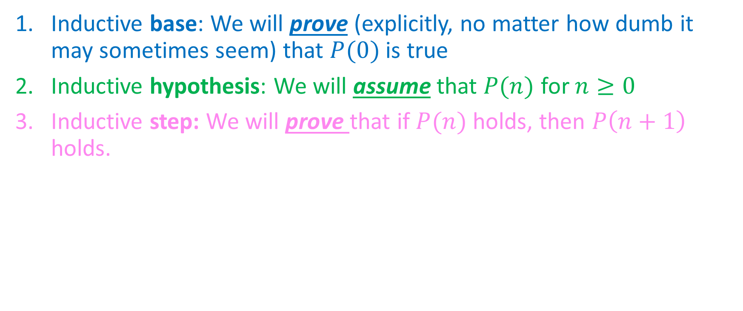
How we’ll make it work
Inductive base: We will prove (explicitly, no matter how dumb it may sometimes seem) that $P(0)$ is true
Inductive hypothesis: We will assume that $P(n)$ for $n≥0$
Inductive step: We will prove that if $P(n)$ holds, then $P\left(n+1\right)$ holds.
Any $n$ at least $0$
$$0$$
$$1$$
$$2$$
$$…$$
$$…$$
$$n$$
$$n+1$$
$$…$$
$$…$$
$$…$$

Slide 29
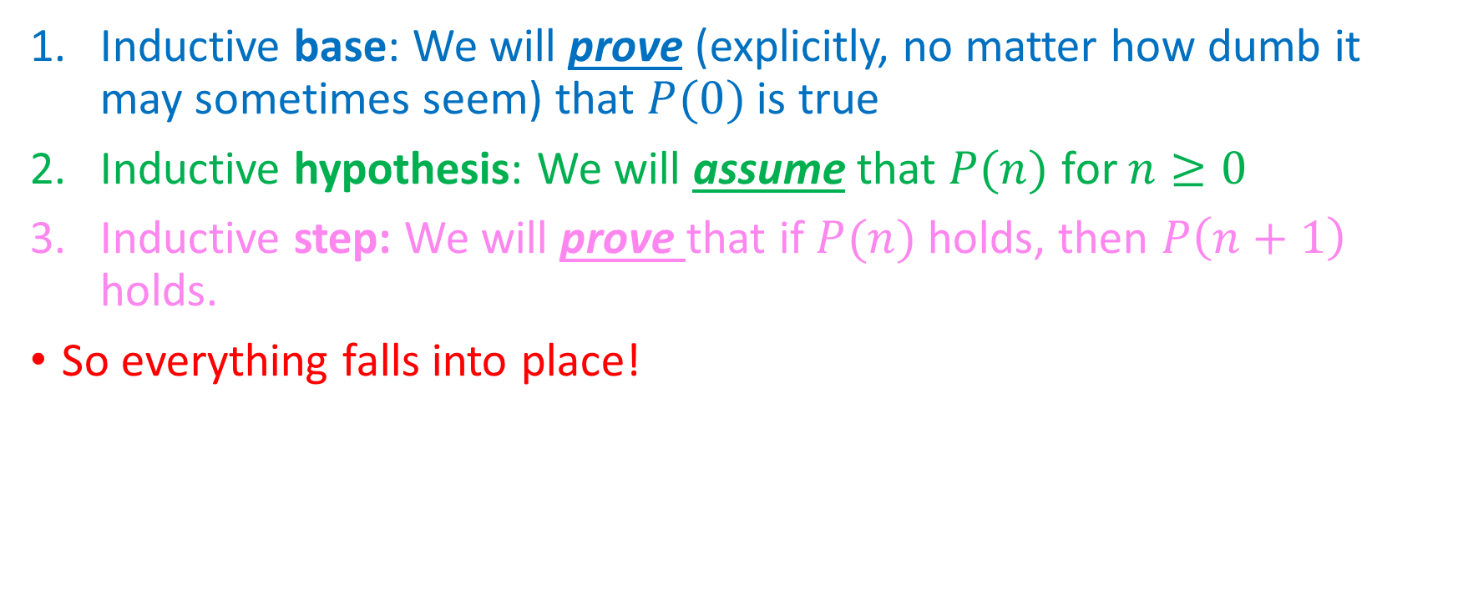
How we’ll make it work
Inductive base: We will prove (explicitly, no matter how dumb it may sometimes seem) that $P(0)$ is true
Inductive hypothesis: We will assume that $P(n)$ for $n≥0$
Inductive step: We will prove that if $P(n)$ holds, then $P\left(n+1\right)$ holds.
So everything falls into place!
Any $n$ at least $0$
$$0$$
$$1$$
$$2$$
$$…$$
$$…$$
$$n$$
$$n+1$$
$$…$$
$$…$$
$$…$$

Slide 30
How we’ll make it work
Inductive base: We will prove (explicitly, no matter how dumb it may sometimes seem) that $P(0)$ is true
Inductive hypothesis: We will assume that $P(n)$ for $n≥0$
Inductive step: We will prove that if $P(n)$ holds, then $P\left(n+1\right)$ holds.
So everything falls into place!
Any $n$ at least $0$
$$0$$
$$1$$
$$2$$
$$…$$
$$…$$
$$n$$
$$n+1$$
$$…$$
$$…$$
$$…$$

Slide 31
How we’ll make it work
Inductive base: We will prove (explicitly, no matter how dumb it may sometimes seem) that $P(0)$ is true
Inductive hypothesis: We will assume that $P(n)$ for $n≥0$
Inductive step: We will prove that if $P(n)$ holds, then $P\left(n+1\right)$ holds.
So everything falls into place!
Any $n$ at least $0$
$$0$$
$$1$$
$$2$$
$$…$$
$$…$$
$$n$$
$$n+1$$
$$…$$
$$…$$
$$…$$

Slide 32
How we’ll make it work
Inductive base: We will prove (explicitly, no matter how dumb it may sometimes seem) that $P(0)$ is true
Inductive hypothesis: We will assume that $P(n)$ for $n≥0$
Inductive step: We will prove that if $P(n)$ holds, then $P\left(n+1\right)$ holds.
So everything falls into place!
Any $n$ at least $0$
$$0$$
$$1$$
$$2$$
$$…$$
$$…$$
$$n$$
$$n+1$$
$$…$$
$$…$$
$$…$$

Slide 33
How we’ll make it work
Inductive base: We will prove (explicitly, no matter how dumb it may sometimes seem) that $P(0)$ is true
Inductive hypothesis: We will assume that $P(n)$ for $n≥0$
Inductive step: We will prove that if $P(n)$ holds, then $P\left(n+1\right)$ holds.
So everything falls into place!
Any $n$ at least $0$
(We fast-forwarded here; time is of the essence!)
$$0$$
$$1$$
$$2$$
$$…$$
$$…$$
$$n$$
$$n+1$$
$$…$$
$$…$$
$$…$$

Slide 34
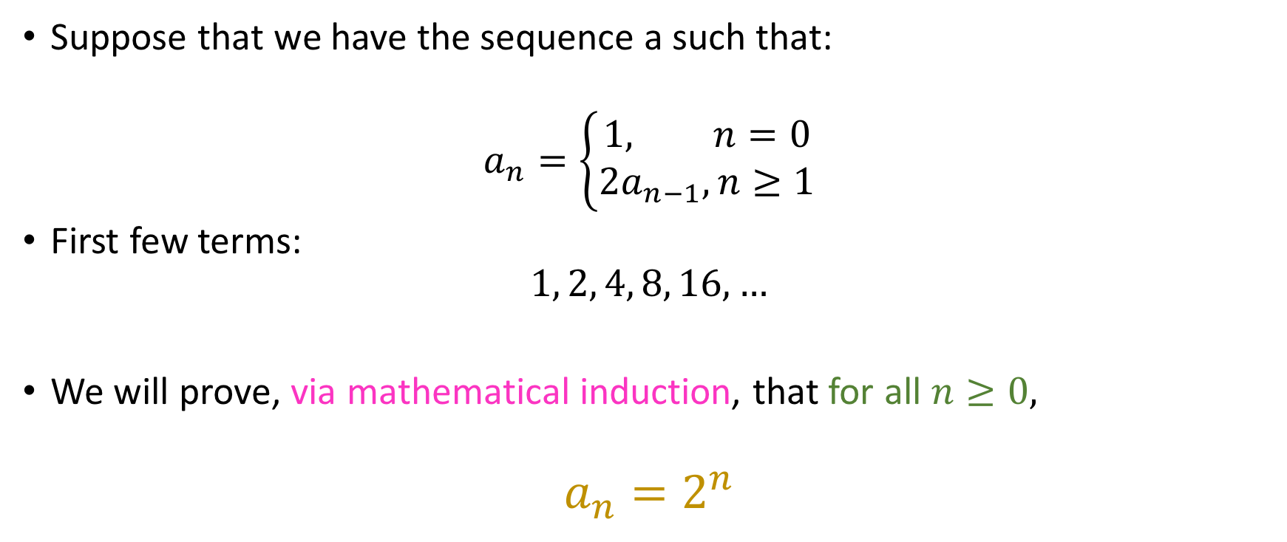
An introductory example
Suppose that we have the sequence a such that:
$$a_{n}=\left\{\begin{aligned}1, n=0 \\ 2a_{n−1}, n≥1\end{aligned}\right.$$
First few terms:
$$1, 2, 4, 8, 16, …$$
We will prove, via mathematical induction, that for all $n≥0,$
$$a_{n}=2^{n}$$

Slide 35
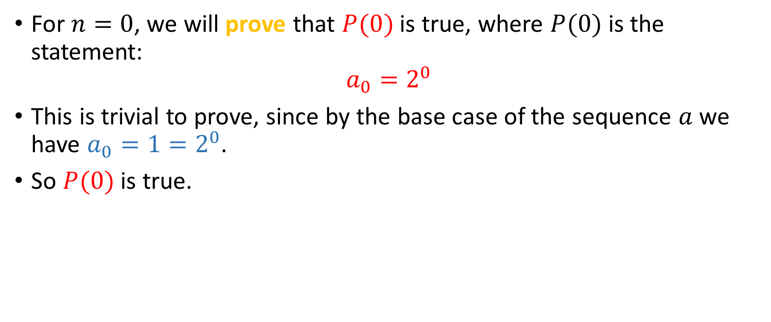
Inductive Base
For $n=0$, we will prove that $P(0)$ is true, where $P(0)$ is the statement:
$$a_{0}=2^{0}$$
This is trivial to prove, since by the base case of the sequence $a$ we have $a_{0}=1=2^{0}$.
So $P(0)$ is true.

Slide 36

Inductive Hypothesis
For $n≥0$, we assume that $P(n)$is true:
$$a_{n}=2^{n}$$

Slide 37

Inductive Step
Given that $P(n)$ is true, we will prove that $P(n+1)$ is true,where $P(n+1)$ is the statement:
$$a_{n+1}=2^{n+1}$$

Slide 38

Inductive Step
Given that $P(n)$ is true, we will prove that $P(n+1)$ is true,where $P(n+1)$ is the statement:
$$a_{n+1}=2^{n+1}$$
Since $n≥0, n+1≥1$.

Slide 39
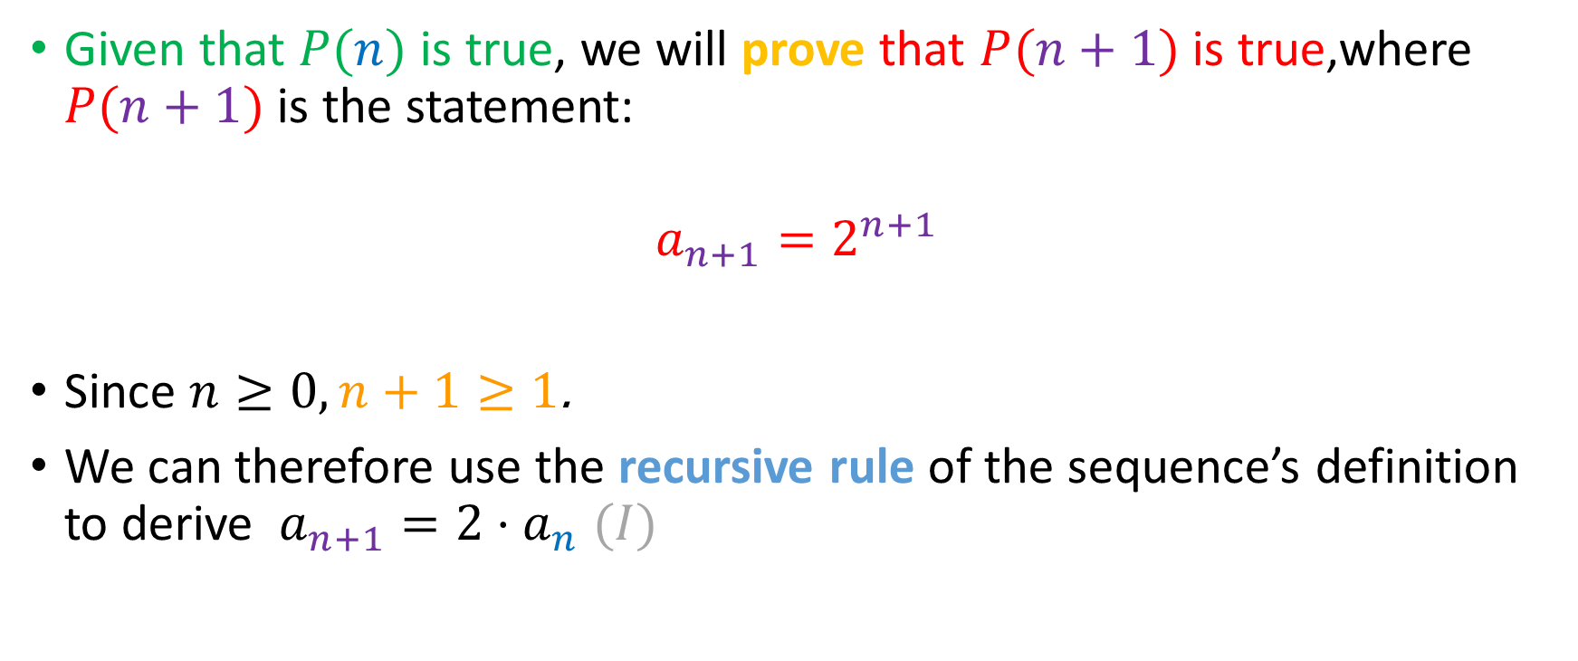
Inductive Step
Given that $P(n)$ is true, we will prove that $P(n+1)$ is true,where $P(n+1)$ is the statement:
$$a_{n+1}=2^{n+1}$$
Since $n≥0, n+1≥1$.
We can therefore use the recursive rule of the sequence’s definition to derive $a_{n+1}=2⋅a_{n}$ $(I)$

Slide 40
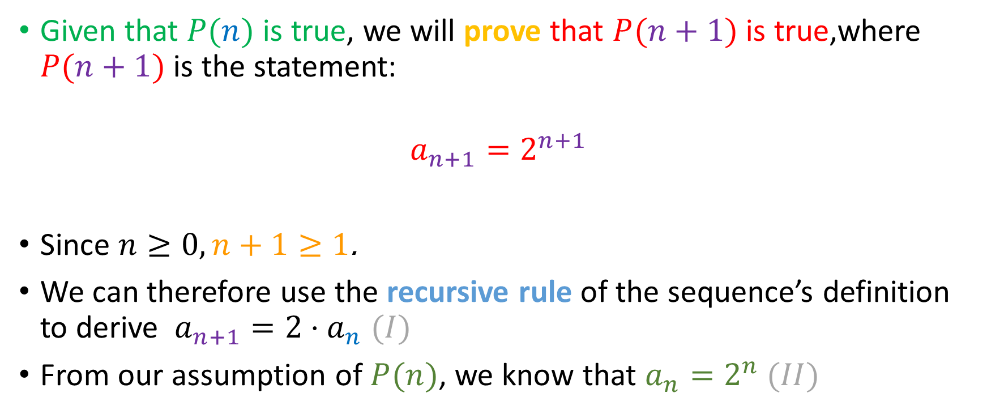
Inductive Step
Given that $P(n)$ is true, we will prove that $P(n+1)$ is true,where $P(n+1)$ is the statement:
$$a_{n+1}=2^{n+1}$$
Since $n≥0, n+1≥1$.
We can therefore use the recursive rule of the sequence’s definition to derive $a_{n+1}=2⋅a_{n}$ $(I)$
From our assumption of $P(n)$, we know that $a_{n}=2^{n}$ $(II)$

Slide 41
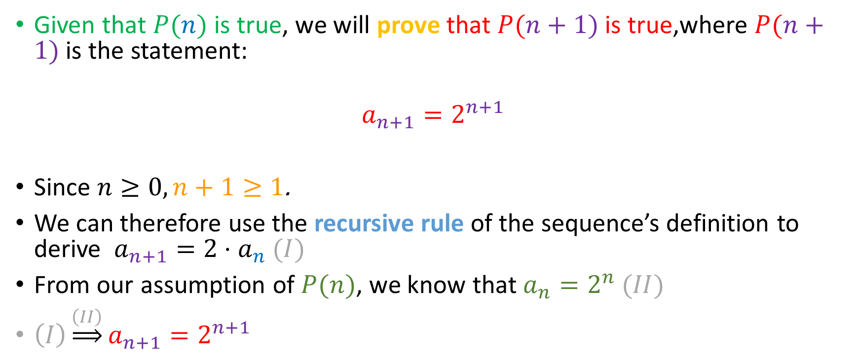
Inductive Step
Given that $P(n)$ is true, we will prove that $P(n+1)$ is true,where $P(n+1)$ is the statement:
$$a_{n+1}=2^{n+1}$$
Since $n≥0, n+1≥1$.
We can therefore use the recursive rule of the sequence’s definition to derive $a_{n+1}=2⋅a_{n}$ $(I)$
From our assumption of $P(n)$, we know that $a_{n}=2^{n}$ $(II)$
$\left(I\right)\underset{⇒}{\left(II\right)}a_{n+1}=2^{n+1}$

Slide 42
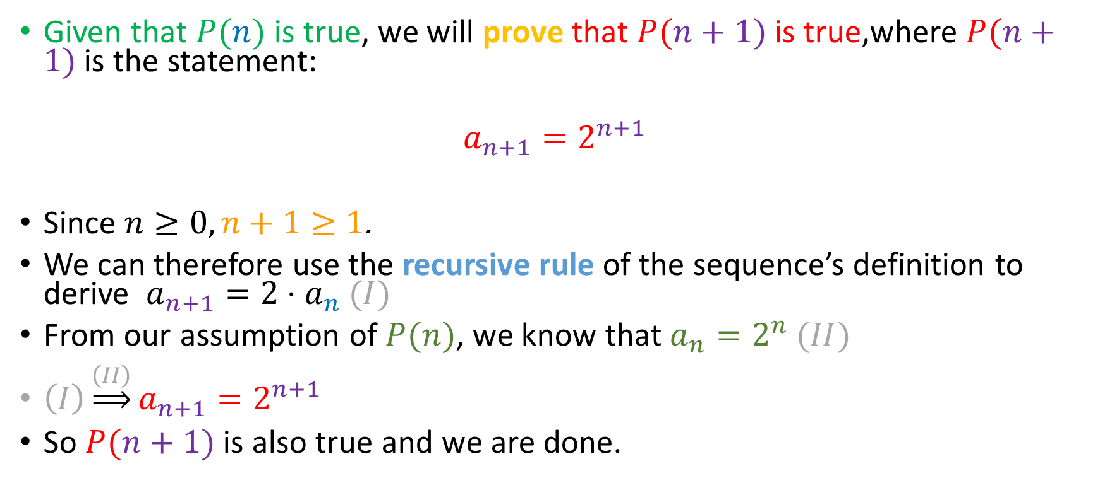
Inductive Step
Given that $P(n)$ is true, we will prove that $P(n+1)$ is true,where $P(n+1)$ is the statement:
$$a_{n+1}=2^{n+1}$$
Since $n≥0, n+1≥1$.
We can therefore use the recursive rule of the sequence’s definition to derive $a_{n+1}=2⋅a_{n}$ $(I)$
From our assumption of $P(n)$, we know that $a_{n}=2^{n}$ $(II)$
$\left(I\right)\underset{⇒}{\left(II\right)}a_{n+1}=2^{n+1}$
So $P(n+1)$ is also true and we are done.

Slide 43

Here’s another
Suppose that we have the sequence $s$ defined as follows:
$$s_{n}=\left\{\begin{aligned}0, n=0 \\ s_{n−1}+10, n≥1\end{aligned}\right.$$
Prove that $\left(∀n∈ℕ\right)\left[ 5 \right|{ s}_{n} ]$

Slide 44

Inductive Base
For $n=0,s_{0}=0 \left(I\right).$
Furthermore, it is the case that $5∣0 (II)$.
$\left(I, II\right)⇒5 | s_{0}⇒P\left(0\right) holds$

Slide 45

Inductive Hypothesis
Suppose that $n≥0$. We will assume that $P(n)$ holds, i.e:
$$(5 | s_{n})⇔(∃r∈ℤ)[s_{n}=5r]$$

Slide 46
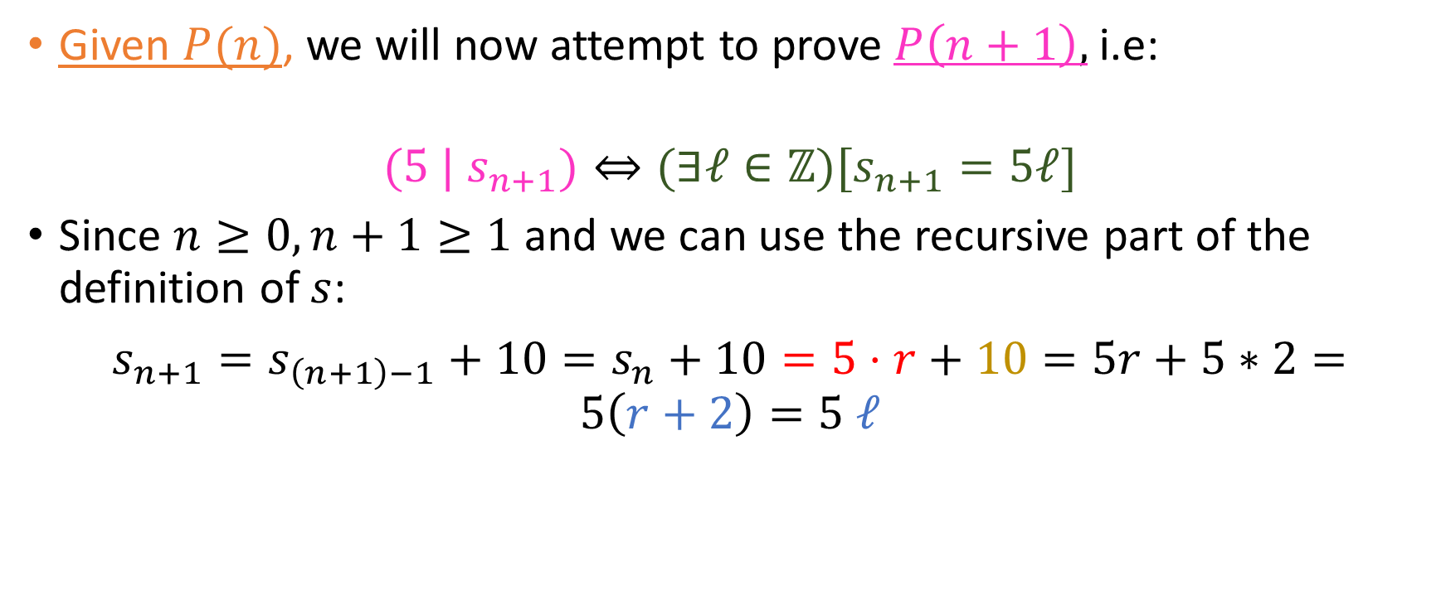
Inductive Step
Given $P(n)$, we will now attempt to prove $P\left(n+1\right),$ i.e:
$$(5 | s_{n+1})⇔(∃ℓ∈ℤ)[s_{n+1}=5ℓ]$$
Since $n≥0, n+1≥1$ and we can use the recursive part of the definition of $s$:
$s_{n+1}=s_{\left(n+1\right)−1}+10=s_{n}+10=5⋅r$ $+ 10=5r+5∗2=5\left(r+2\right)=5 ℓ$
(By I.H)

Slide 47

You do this!
The sequence $b$ is defined as:
$$b_{n}=\left\{\begin{aligned}1, n=0 \\ 4+b_{n−1}, n≥1\end{aligned}\right.$$
Prove that for all $n≥0$, $b_{n}$ is odd

Slide 48
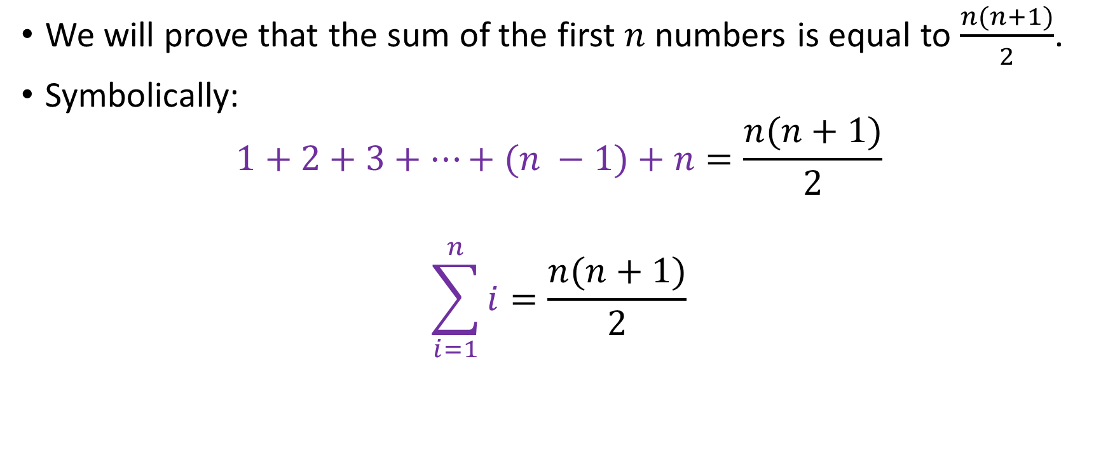
The Gaussian Sum
We will prove that the sum of the first $n$ numbers is equal to $\frac{n(n+1)}{2}$.
Symbolically:
$$1+2+3+…+(n −1)+n=\frac{n(n+1)}{2}$$
$$\sum_{i=1}^{n}{i}=\frac{n(n+1)}{2}$$

Slide 49
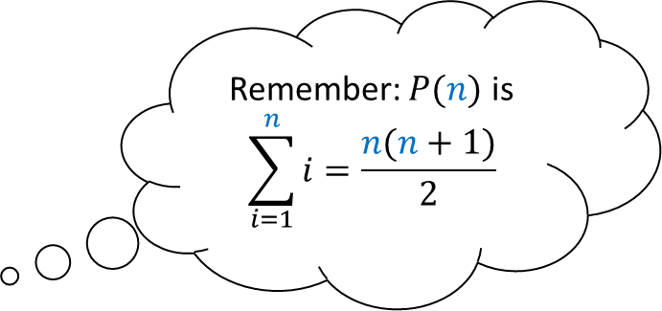
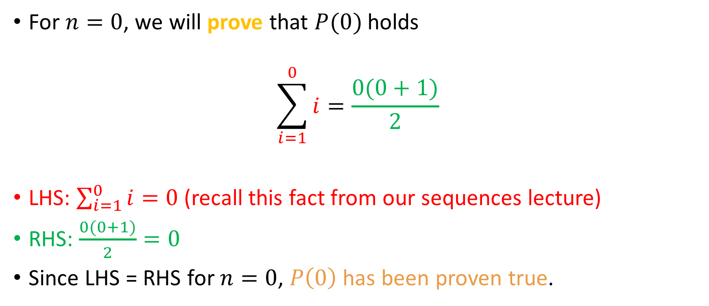
Inductive base
Remember: $P(n)$ is
$$\sum_{i=1}^{n}{i=\frac{n(n+1)}{2}}$$
For $n=0$, we will prove that $P(0)$ holds
$$\sum_{i=1}^{0}{i=\frac{0(0+1)}{2}}$$
LHS: $\sum_{i=1}^{0}{i}=0$ (recall this fact from our sequences lecture)
RHS: $\frac{0(0+1)}{2}=0$
Since LHS = RHS for $n=0$, $P\left(0\right)$has been proven true.
?

Slide 50
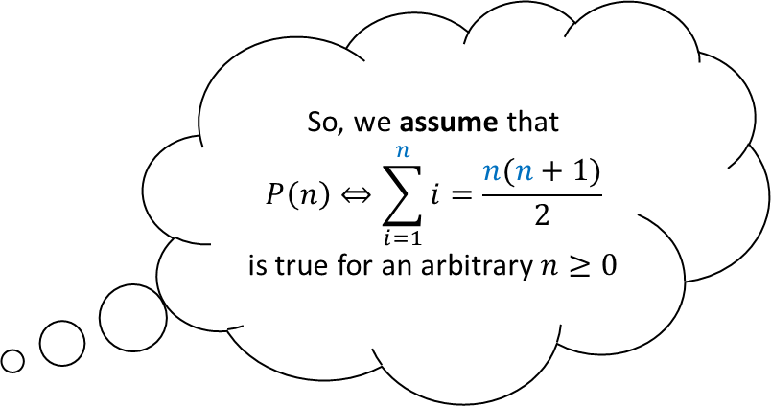

Inductive Hypothesis
So, we assume that
$$P\left(n\right)⇔\sum_{i=1}^{n}{i=\frac{n(n+1)}{2}}$$
is true for an arbitrary $n≥0$
For $n≥0$, we assume that $P(n)$is true:
$$\sum_{i=1}^{n}{i}=\frac{n(n+1)}{2}$$
Inductive Hypothesis done!

Slide 51

Inductive step
Given that $P(n)$ is true, we will prove that $P(n+1)$ is true.
$$\sum_{i=1}^{n}{i=\frac{n(n+1)}{2}}⇒\sum_{i=1}^{n+1}{i=\frac{(n+1)(n+2)}{2}}$$
This is our goal!

Slide 52


Inductive step
Given that $P(n)$ is true, we will prove that $P(n+1)$ is true.
$$\sum_{i=1}^{n}{i=\frac{n(n+1)}{2}}⇒\sum_{i=1}^{n+1}{i=\frac{(n+1)(n+2)}{2}}$$
Just adding 1 to $n$
Just adding 1 to $n+1$
This is our goal!

Slide 53

Inductive step
Given that $P(n)$ is true, we will prove that $P(n+1)$ is true.
$$\sum_{i=1}^{n}{i=\frac{n(n+1)}{2}}⇒\sum_{i=1}^{n+1}{i=\frac{(n+1)(n+2)}{2}}$$
Let’s prove it, then!
Just adding 1 to $n$
Just adding 1 to $n+1$
This is our goal!

Slide 54
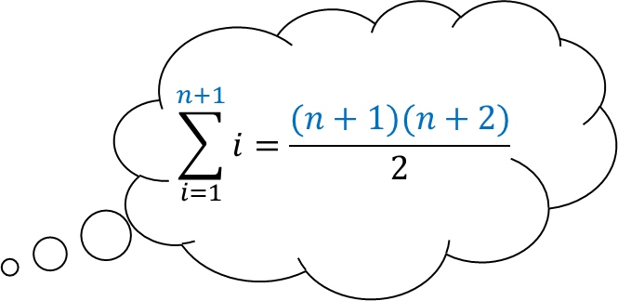

Inductive step, contd.
$$\sum_{i=1}^{n+1}{i=\frac{(n+1)(n+2)}{2}}$$
Starting from the LHS of the relation to prove, we have:
$$\sum_{i=1}^{n+1}{i}=1+2+…+n+(n+1)$$

Slide 55
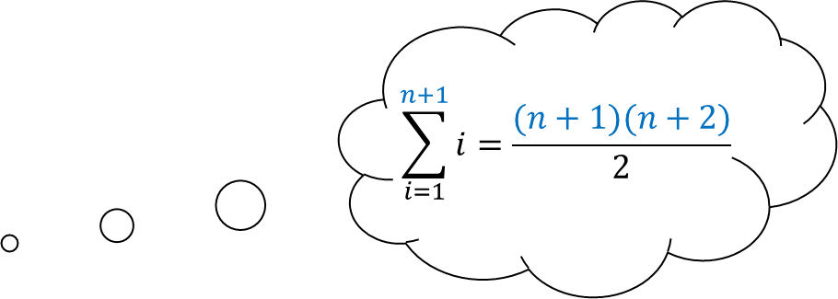

Inductive step, contd.
$$\sum_{i=1}^{n+1}{i=\frac{(n+1)(n+2)}{2}}$$
Starting from the LHS of the relation to prove, we have:
$$\sum_{i=1}^{n+1}{i}=1+2+…+n+\left(n+1\right)=\sum_{i=1}^{n}{i}+\left(n+1\right) (1)$$

Slide 56
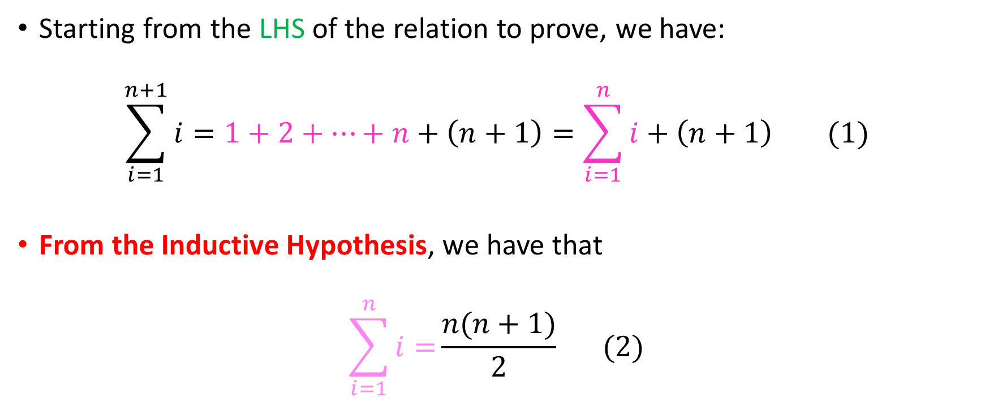
Inductive step, contd.
$$\sum_{i=1}^{n+1}{i=\frac{(n+1)(n+2)}{2}}$$
Starting from the LHS of the relation to prove, we have:
$$\sum_{i=1}^{n+1}{i}=1+2+…+n+\left(n+1\right)=\sum_{i=1}^{n}{i}+\left(n+1\right) (1)$$
From the Inductive Hypothesis, we have that
$$\sum_{i=1}^{n}{i=}\frac{n(n+1)}{2} (2)$$

Slide 57
Inductive step, contd.
$$\sum_{i=1}^{n+1}{i=\frac{(n+1)(n+2)}{2}}$$
Starting from the LHS of the relation to prove, we have:
$$\sum_{i=1}^{n+1}{i}=1+2+…+n+\left(n+1\right)=\sum_{i=1}^{n}{i}+\left(n+1\right) (1)$$
From the Inductive Hypothesis, we have that
$$\sum_{i=1}^{n}{i=}\frac{n(n+1)}{2} (2)$$

Slide 58
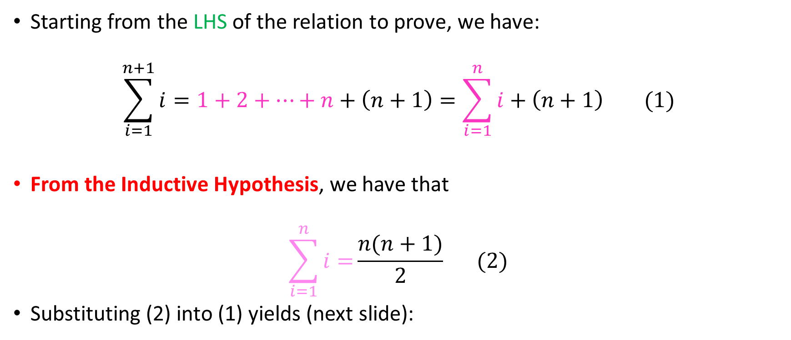
Inductive step, contd.
$$\sum_{i=1}^{n+1}{i=\frac{(n+1)(n+2)}{2}}$$
Starting from the LHS of the relation to prove, we have:
$$\sum_{i=1}^{n+1}{i}=1+2+…+n+\left(n+1\right)=\sum_{i=1}^{n}{i}+\left(n+1\right) (1)$$
From the Inductive Hypothesis, we have that
$$\sum_{i=1}^{n}{i=}\frac{n(n+1)}{2} (2)$$
Substituting (2) into (1) yields (next slide):

Slide 59
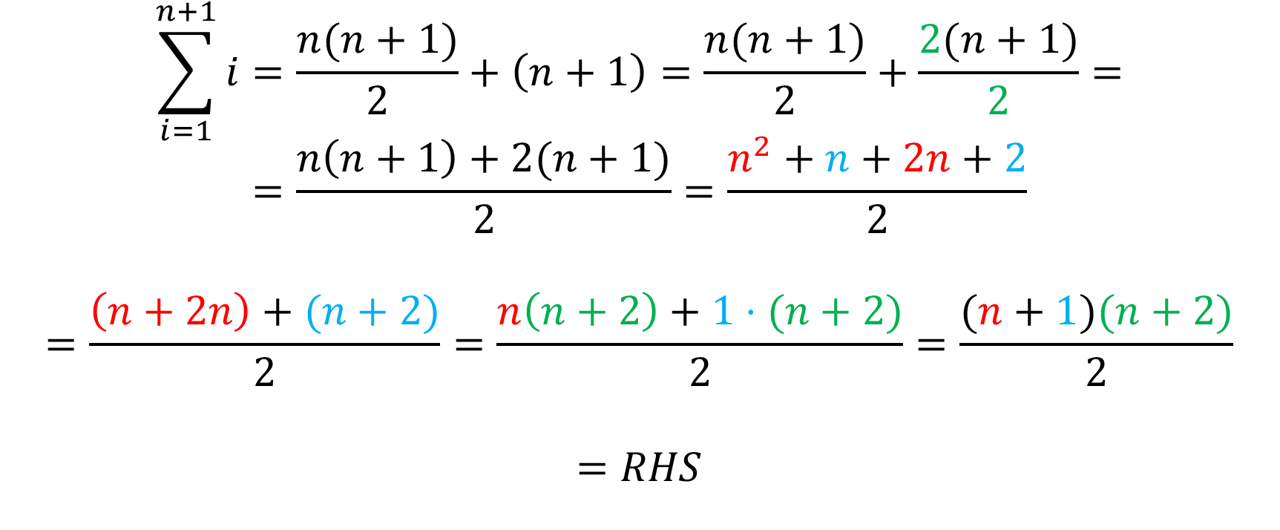
Inductive step, contd.
$$\sum_{i=1}^{n+1}{i}=\frac{n(n+1)}{2}+\left(n+1\right)=\frac{n(n+1)}{2}+\frac{2(n+1)}{2}=$$
$$=\frac{n\left(n+1\right)+2(n+1)}{2}=\frac{n^{2}+n+2n+2}{2}$$
$$=\frac{\left(n+2n\right)+(n+2)}{2}=\frac{n\left(n+2\right)+1⋅(n+2)}{2}=\frac{(n+1)(n+2)}{2}$$
$$=RHS$$

Slide 60
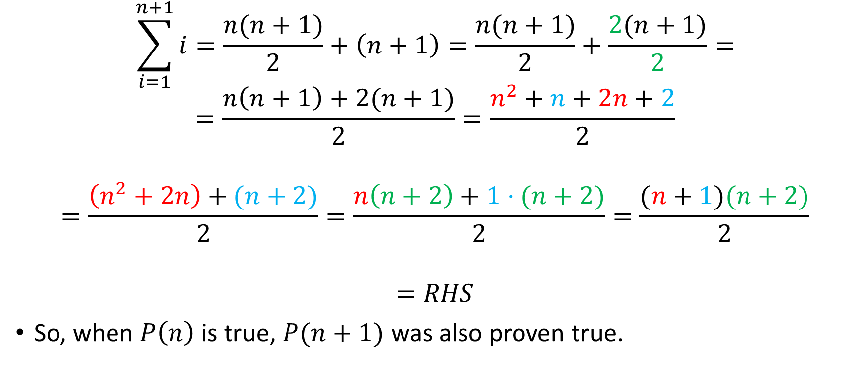
Inductive step, contd.
$$\sum_{i=1}^{n+1}{i}=\frac{n(n+1)}{2}+\left(n+1\right)=\frac{n(n+1)}{2}+\frac{2(n+1)}{2}=$$
$$=\frac{n\left(n+1\right)+2(n+1)}{2}=\frac{n^{2}+n+2n+2}{2}$$
$$=\frac{\left(n^{2}+2n\right)+(n+2)}{2}=\frac{n\left(n+2\right)+1⋅(n+2)}{2}=\frac{(n+1)(n+2)}{2}$$
$$=RHS$$
So, when $P\left(n\right)$ is true, $P(n+1)$ was also proven true.

Slide 61
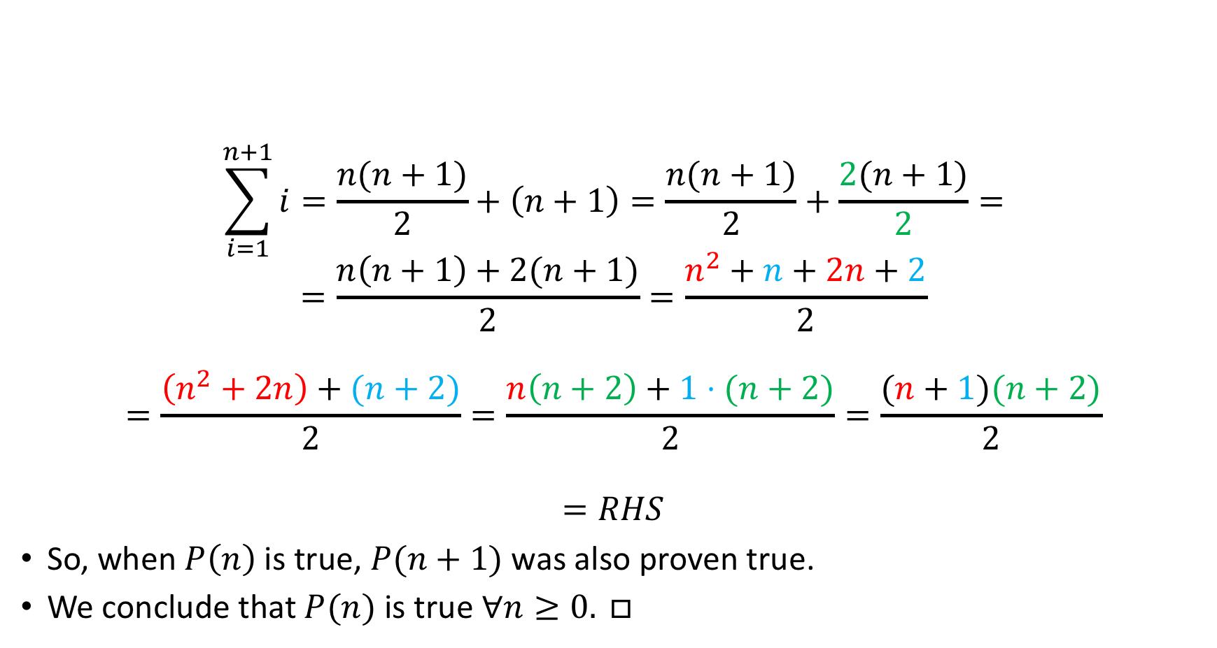
Inductive step, contd.
$$\sum_{i=1}^{n+1}{i}=\frac{n(n+1)}{2}+\left(n+1\right)=\frac{n(n+1)}{2}+\frac{2(n+1)}{2}=$$
$$=\frac{n\left(n+1\right)+2(n+1)}{2}=\frac{n^{2}+n+2n+2}{2}$$
$$=\frac{\left(n^{2}+2n\right)+(n+2)}{2}=\frac{n\left(n+2\right)+1⋅(n+2)}{2}=\frac{(n+1)(n+2)}{2}$$
$$=RHS$$
So, when $P\left(n\right)$ is true, $P(n+1)$ was also proven true.
We conclude that $P(n)$ is true $∀n≥0. □$

Slide 62


And one for you!
$$\sum_{i=1}^{n}{i^{2}}=\frac{n(n+1)(2n+1)}{6}$$

Slide 63
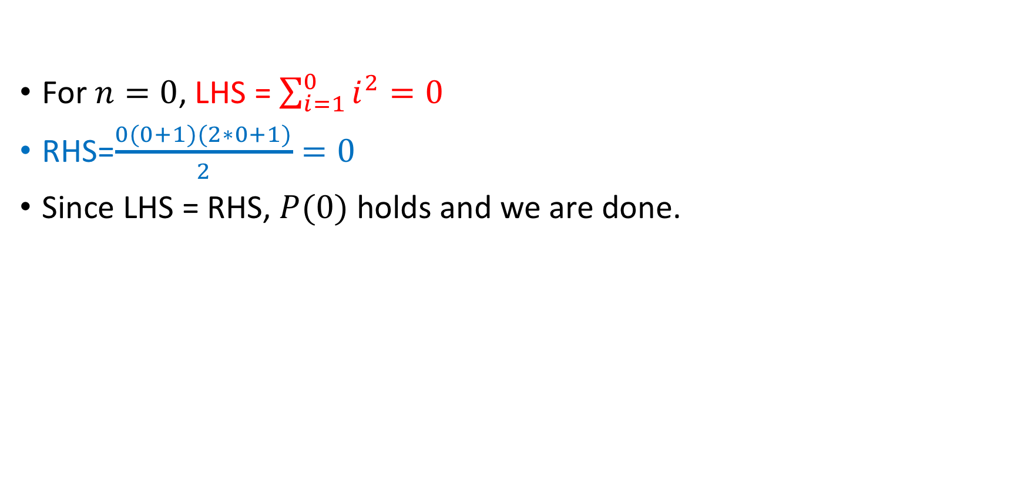
Inductive Base
For $n=0$, LHS = $\sum_{i=1}^{0}{i^{2}}=0$
RHS=$\frac{0(0+1)(2∗0+1)}{2}=0$
Since LHS = RHS, $P(0)$ holds and we are done.

Slide 64

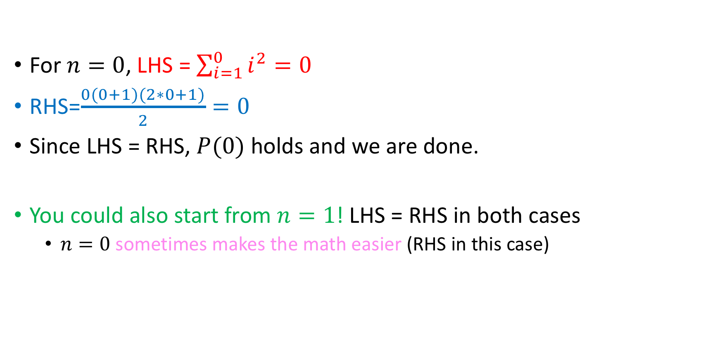
Inductive Base
For $n=0$, LHS = $\sum_{i=1}^{0}{i^{2}}=0$
RHS=$\frac{0(0+1)(2∗0+1)}{2}=0$
Since LHS = RHS, $P(0)$ holds and we are done.
You could also start from $n=1$! LHS = RHS in both cases
  $n=0$ sometimes makes the math easier (RHS in this case)

Slide 65
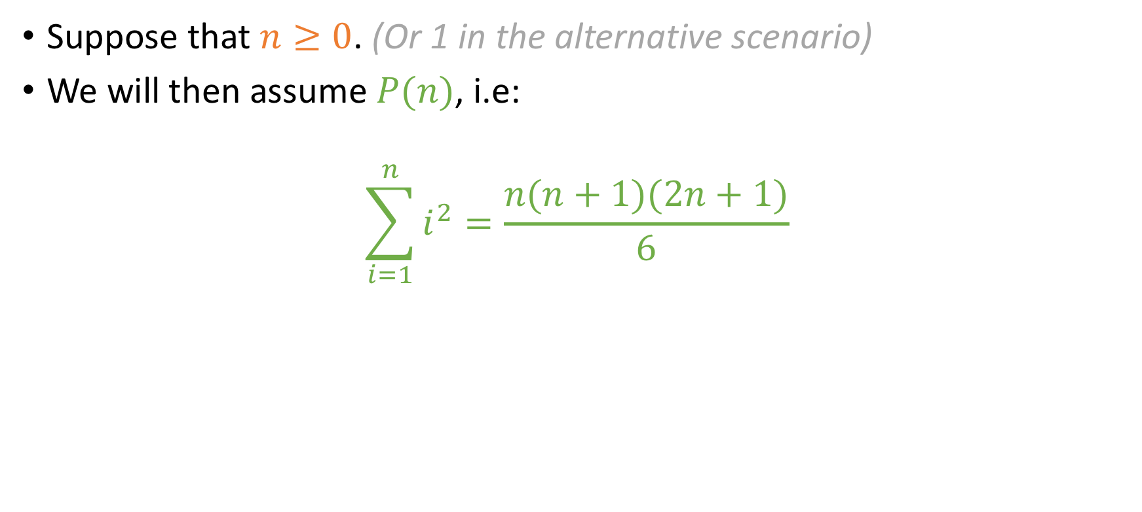
Inductive Hypothesis
Suppose that $n≥0$. (Or 1 in the alternative scenario)
We will then assume $P(n)$, i.e:
$$\sum_{i=1}^{n}{i^{2}}=\frac{n(n+1)(2n+1)}{6}$$

Slide 66
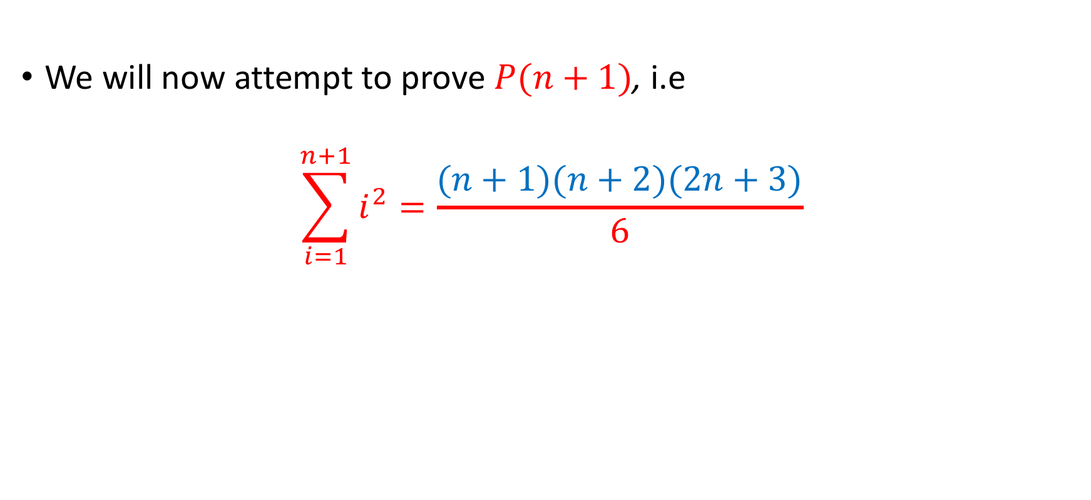
Inductive Step
Careful with factoring please!!!
We will now attempt to prove $P(n+1)$, i.e
$$\sum_{i=1}^{n+1}{i^{2}}=\frac{(n+1)(n+2)(2n+3)}{6}$$

Slide 67
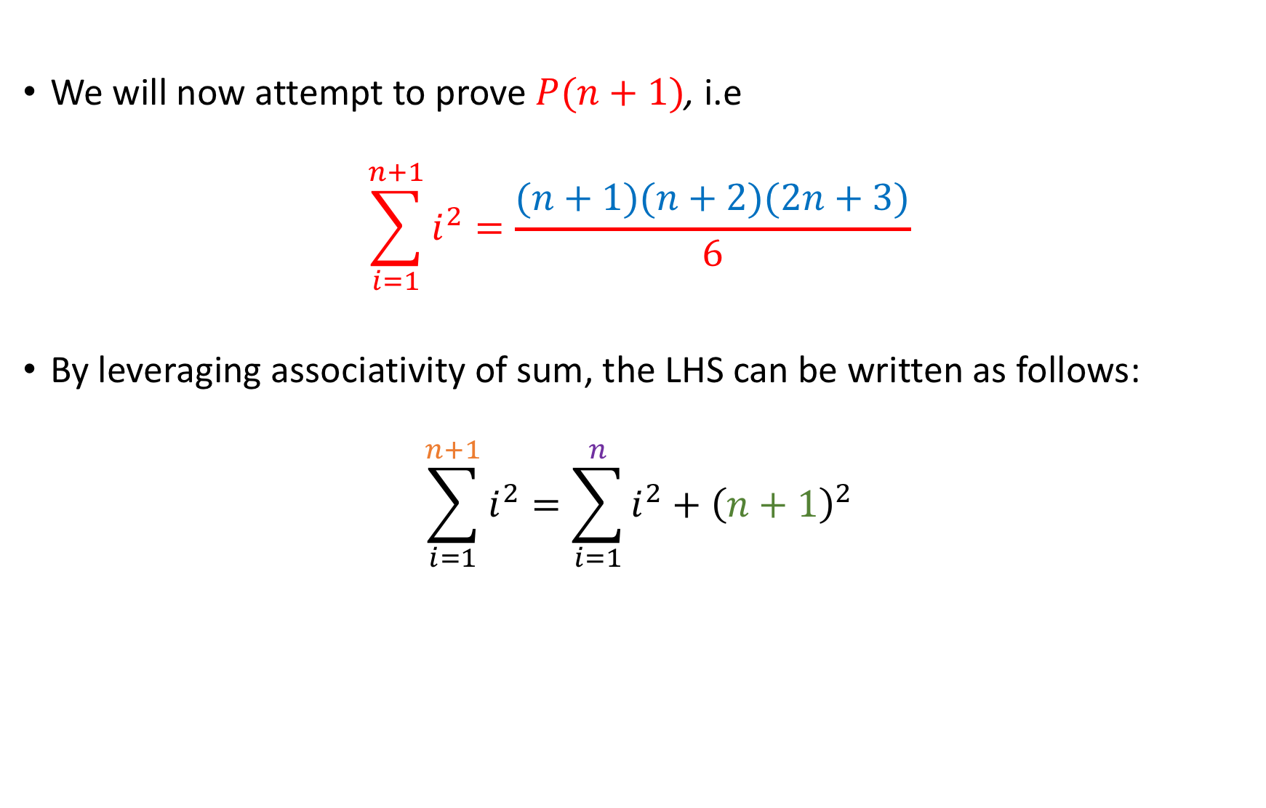
Inductive Step
Careful with factoring please!!!
We will now attempt to prove $P(n+1)$, i.e
$$\sum_{i=1}^{n+1}{i^{2}}=\frac{(n+1)(n+2)(2n+3)}{6}$$
By leveraging associativity of sum, the LHS can be written as follows:
$$\sum_{i=1}^{n+1}{i^{2}}=\sum_{i=1}^{n}{i^{2}+{\left(n+1\right)}^{2}}$$

Slide 68

Inductive Step
Careful with factoring please!!!
We will now attempt to prove $P(n+1)$, i.e
$$\sum_{i=1}^{n+1}{i^{2}}=\frac{(n+1)(n+2)(2n+3)}{6}$$
By leveraging associativity of sum, the LHS can be written as follows:
$$\sum_{i=1}^{n+1}{i^{2}}=\sum_{i=1}^{n}{i^{2}+{\left(n+1\right)}^{2}}$$
We can apply the I.H here!

Slide 69
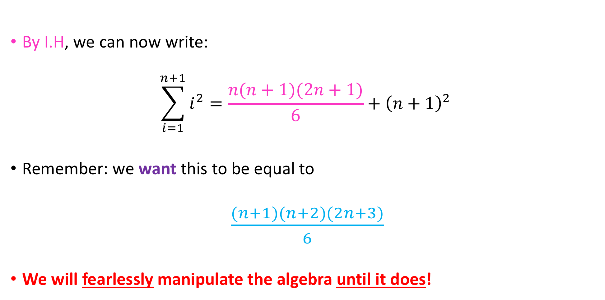
Inductive Step
By I.H, we can now write:
$$\sum_{i=1}^{n+1}{i^{2}}=\frac{n(n+1)(2n+1)}{6}+{\left(n+1\right)}^{2}$$
Remember: we want this to be equal to
$\frac{(n+1)(n+2)(2n+3)}{6}$
We will fearlessly manipulate the algebra until it does!

Slide 70
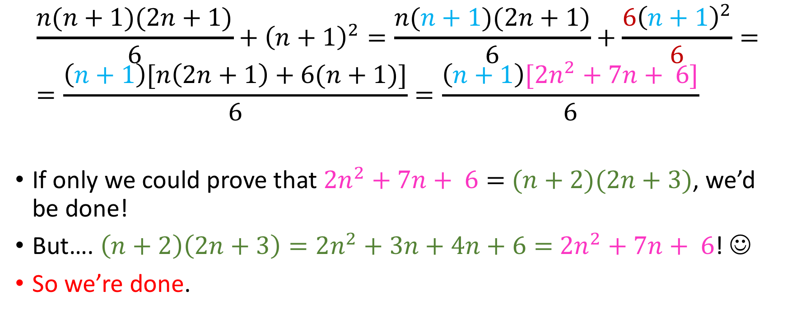
Inductive Step - Algebra
$$\frac{n(n+1)(2n+1)}{6}+{\left(n+1\right)}^{2}=\frac{n(n+1)(2n+1)}{6}+\frac{6{\left(n+1\right)}^{2}}{6}= \\ =\frac{\left(n+1\right)[n\left(2n+1\right)+6(n+1)]}{6}=\frac{\left(n+1\right)[2n^{2}+7n+ 6]}{6}$$
If only we could prove that $2n^{2}+7n+ 6=$ $(n+2)(2n+3)$, we’d be done!
But…. $\left(n+2\right)\left(2n+3\right)=2n^{2}+3n+4n+6=$ $2n^{2}+7n+ 6$! ☺
So we’re done.

Slide 71
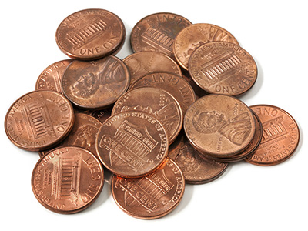

A coin problem
We will prove that every dollar amount $≥4$ cents can be exclusively paid for by 2 and/or 5 cent coins.

Slide 72


Theorem expressed in quantifiers
All quantifiers implicitly assumed over $ℕ$.
$$\left(∀n≥4\right)\left(∃n_{1},n_{2}\right)[n=2n_{1}+5n_{2}]$$

Slide 73

Inductive base
The least amount of money we are required to prove the statement for is 4¢, so we will attempt to prove $P(4)$.
For $n=4$, we have 4¢. Since $\text{4¢}=2×2\text{¢}$, we are done (we have shown that the amount of 4¢ can be exclusively paid for by using only 2 and/or 5 cent coins)

Slide 74

Inductive hypothesis
Let $n≥4.$
Assume $P\left(n\right)⇔\left(∃n_{1},n_{2}\right)[n=2n_{1}+5n_{2}]$

Slide 75

Inductive step
We will prove that $P\left(n\right)⇒P\left(n+1\right),$ i.e that we can pay an amount of money equal to $n+1$ cents using only 2¢ or 5¢ coins.
In terms of algebra, what we want to prove is:
$$(∃n_{3},n_{4}∈{ℕ)}^{ }[n+1=2n_{3}+5n_{4}]$$

Slide 76

Inductive Step (contd.)
From the Inductive Hypothesis (I.H), we have that for some specific positive integers $n_{1}$ and $n_{2}$:
$$n=2n_{1}+5n_{2}$$

Slide 77

Inductive Step (contd.)
From the Inductive Hypothesis (I.H), we have that for some specific positive integers $n_{1}$ and $n_{2}$:
$$n=2n_{1}+5n_{2}$$
Case #1: $n_{1}≥2$
I have at least 2 2¢ coins, so I can take away 2 2¢ coins and add one
5¢ coin

Slide 78



Inductive Step (contd.)
From the Inductive Hypothesis (I.H), we have that for some specific positive integers $n_{1}$ and $n_{2}$:
$$n=2n_{1}+5n_{2}$$
Case #1: $n_{1}≥2$
I have at least 2 2¢ coins, so I can take away two 2¢ coins and add one 5 ¢ coin
By adding 1 on both sides of the I.H we obtain:
$$n+1=2n_{1}+5n_{2}+1=2n_{1}+5n_{2}+\left(5 −2∗2\right)=$$
$$\text{=}\left(2n_{1}−4\right)+\left(5n_{2}+5\right)=2\underbrace{{(n}_{1}−2)}+5\underbrace{(n_{2}+1)}=2n_{3}+5n_{4}$$
$$n_{3}$$
$$n_{4}$$

Slide 79


Inductive Step (contd.)
From the Inductive Hypothesis (I.H), we have that for some specific positive integers $n_{1}$ and $n_{2}$:
$$n=2n_{1}+5n_{2}$$
Case #1: $n_{1}≥2$
I have at least 2 2¢ coins, so I can take away two 2¢ coins and add one 5 ¢ coin
By adding 1 on both sides of the I.H we obtain:
$$n+1=2n_{1}+5n_{2}+1=2n_{1}+5n_{2}+\left(5 −2∗2\right)=$$
$$\text{=}\left(2n_{1}−4\right)+\left(5n_{2}+5\right)=2\underbrace{{(n}_{1}−2)}+5\left(n_{2}+1\right)=2n_{3}+5n_{4}$$
$n_{1}−2≥0$ because
$$n_{1}≥2$$

Slide 80



Inductive step
Case #2: $n_{2}≥1$
I have at least one 5¢ coin so I can take away one 5¢ coin and add three 2¢ coins
By adding 1 on both sides of the I.H we obtain:
$$n+1=2n_{1}+5n_{2}+1=2n_{1}+5n_{2}+\left(3∗2−5\right)=$$
$=2\underbrace{{(n}_{1}+3)} +5\underbrace{(n_{2}−1)}=2n_{3}+5n_{4}$
$$n_{3}$$
$$n_{4}$$

Slide 81


Inductive step
Case #2: $n_{2}≥1$
I have at least one 5¢ coin so I can take away one 5¢ coin and add three 2¢ coins
By adding 1 on both sides of the I.H we obtain:
$$n+1=2n_{1}+5n_{2}+1=2n_{1}+5n_{2}+\left(3∗2−5\right)=$$
$=2(n_{1}+3) +5\underbrace{(n_{2}−1)}=2n_{3}+5n_{4}$
$$n_{2}−1≥0$$
because
$$n_{2}≥1$$

Slide 82

Inductive step
Case #3: ${(n}_{1}≤1)∧(n_{2}=0)$
This case means that we have either 0 or 2¢ at our disposal.
But this is not possible, since we want to prove the theorem only for values $≥4\text{¢}$
So we’re done. $□$

Slide 83

A note about the penny problem
Note that we proved the theorem for $n≥4$
Generally speaking, we can use induction to prove statements $P\left(n\right) ∀n≥n_{0}$, where $n_{0}∈ℕ$.
Most of the time $n_{0}$ will be small (0, 1, 2, …)

Slide 84












A note about the penny problem
Note that we proved the theorem for $n≥4$
Generally speaking, we can use induction to prove statements $P\left(n\right) ∀n≥n_{0}$, where $n_{0}∈ℕ$.
Most of the time $n_{0}$ will be small (0, 1, 2, …)
If $P\left(n_{0}\right)∧(∀k≥n_{0})[P\left(k\right)⇒P(k+1)]$ is true, then the inductive principle holds and we have the desired statement
$$\left(∀n≥n_{0}\right)[P\left(n\right)]$$
$$0$$
$$1$$
$$2$$
$$…$$
$$n_{0}$$
$$n_{0}+1$$
$$n_{0}+2$$
$$…$$
$$…$$
$$k$$
$$⇒$$
$$k+1$$
$$…$$
$$…$$
$$…$$

Slide 85


A coin problem for you!
Prove to me that every dollar amount $≥20$ cents can be exclusively paid for through combinations of 5-cent coins and 6-cent coins!

Slide 86

Here’s one with an inequality!
Prove that for all integers $n$ at least $4$, $2^{n}<n!$
I.B: We will prove $P\left(4\right)⇔2^{4}<4!$ Done.
I.H: For $n≥4$, we assume $P\left(n\right),$ i.e $2^{n}<n!$
I.S: We will prove $P\left(n\right)⇒P(n+1)$, i.e
$${(2}^{n}<n!)⇒{(2}^{n+1}<\left(n+1\right)!)$$

Slide 87

Inductive Step…
Prove that for all integers $n$ at least $4$, $2^{n}<n!$
I.B: We will prove $P\left(4\right): 2^{4}<4!$ Done.
I.H: For $n≥4$, we assume $P\left(n\right): 2^{n}<n!$
I.S: We will prove${ (2}^{n}<n!)⇒{(2}^{n+1}<\left(n+1\right)!)$

Slide 88

Inductive Step…
Prove that for all integers $n$ at least $4$, $2^{n}<n!$
I.B: We will prove $P\left(4\right): 2^{4}<4!$ Done.
I.H: For $n≥4$, we assume $P\left(n\right): 2^{n}<n!$
I.S: We will prove${ (2}^{n}<n!)⇒{(2}^{n+1}<\left(n+1\right)!)$
  From algebra, we have that $2^{n+1}=2^{n}⋅2 \text{(1)}$

Slide 89

Inductive Step…
Prove that for all integers $n$ at least $4$, $2^{n}<n!$
I.B: We will prove $P\left(4\right): 2^{4}<4!$ Done.
I.H: For $n≥4$, we assume $P\left(n\right): 2^{n}<n!$
I.S: We will prove${ (2}^{n}<n!)⇒{(2}^{n+1}<\left(n+1\right)!)$
  From algebra, we have that $2^{n+1}=2^{n}⋅2 \text{(1)}$
  From the I.H, we have that $2^{n}<n!\underset{⇔}{2>0}2^{n}⋅2<n!⋅2$ (2)

Slide 90

Inductive Step…
Prove that for all integers $n$ at least $4$, $2^{n}<n!$
I.B: We will prove $P\left(4\right): 2^{4}<4!$ Done.
I.H: For $n≥4$, we assume $P\left(n\right): 2^{n}<n!$
I.S: We will prove${ (2}^{n}<n!)⇒{(2}^{n+1}<\left(n+1\right)!)$
  From algebra, we have that $2^{n+1}=2^{n}⋅2 \text{(1)}$
  From the I.H, we have that $2^{n}<n!\underset{⇔}{2>0}2^{n}⋅2<n!⋅2$ (2)
  Since $n≥4$, we have that $2<n+1\underset{⇔}{n! > 0}n!⋅2<n!\left(n+1\right) (3)$

Slide 91

Inductive Step…
Prove that for all integers $n$ at least $4$, $2^{n}<n!$
I.B: We will prove $P\left(4\right): 2^{4}<4!$ Done.
I.H: For $n≥4$, we assume $P\left(n\right): 2^{n}<n!$
I.S: We will prove${ (2}^{n}<n!)⇒{(2}^{n+1}<\left(n+1\right)!)$
  From algebra, we have that $2^{n+1}=2^{n}⋅2 \text{(1)}$
  From the I.H, we have that $2^{n}<n!\underset{⇔}{2>0}2^{n}⋅2<n!⋅2$ (2)
  Since $n≥4$, we have that $2<n+1\underset{⇔}{n! > 0}n!⋅2<n!\left(n+1\right) (3)$
  $\left(2\right)\underset{⇒}{(3)} 2^{n}⋅2<\left(n+1\right)!\underset{⇔}{\left(1\right)}2^{n+1}<\left(n+1\right)!$

Slide 92

Inductive Step…
Prove that for all integers $n$ at least $4$, $2^{n}<n!$
I.B: We will prove $P\left(4\right): 2^{4}<4!$ Done.
I.H: For $n≥4$, we assume $P\left(n\right): 2^{n}<n!$
I.S: We will prove${ (2}^{n}<n!)⇒{(2}^{n+1}<\left(n+1\right)!)$
  From algebra, we have that $2^{n+1}=2^{n}⋅2 \text{(1)}$
  From the I.H, we have that $2^{n}<n!\underset{⇔}{2>0}2^{n}⋅2<n!⋅2$ (2)
  Since $n≥4$, we have that $2<n+1\underset{⇔}{n! > 0}n!⋅2<n!\left(n+1\right) (3)$
  $\left(2\right)\underset{⇒}{(3)} 2^{n}⋅2<\left(n+1\right)!\underset{⇔}{\left(1\right)}2^{n+1}<\left(n+1\right)!$

Slide 93

An inequality problem for you!
Using mathematical induction, prove that, for all naturals $n≥3$,
$$2n+1<2^{n}$$

Slide 94

And one with more than 1 variable!
Prove that the sum of the first $n$ terms of a geometric sequence with $m∈(ℝ−\left\{1\right\})$ and $a_{0}=1$ is equal to $\frac{m^{n} −1}{m −1}.$
Symbolically:
$$\sum_{i=0}^{n−1}{m^{i}=}\frac{m^{n} −1}{m −1}$$

Slide 95

And one with more than 1 variable!
Prove that the sum of the first $n$ terms of a geometric sequence with $m∈(ℝ−\left\{1\right\})$ and $a_{0}=1$ is equal to $\frac{m^{n} −1}{m −1}.$
Symbolically:
$$\sum_{i=0}^{n−1}{m^{i}=}\frac{m^{n} −1}{m −1}$$
In this instance, we have two variables, $m$ and $n$, and it’s spectacularly easy to confuse ourselves) about which variable we will be focusing on.
  So, we will explicitly say, at the beginning of our proof, that we will be performing a proof by induction on $n$.

Slide 96

Proof
Proof : We attempt to prove $P\left(n\right), ∀n∈ℕ^{ }$. We proceed via induction on $n.$
Inductive base: We attempt to prove $P\left(0\right).$
$P\left(0\right):$ $\sum_{i=0}^{0−1}{m^{i}=}\frac{m^{0} −1}{m −1}⇔\sum_{i=0}^{−1}{m^{i}=}\frac{m^{0} −1}{m −1}⇔0=0$
So $P(0)$ is true.
Inductive hypothesis: We assume $P(n)$ for some $n≥0$, i.e
$$\sum_{i=0}^{n−1}{m^{i}=\frac{m^{n} −1}{m −1}}$$

Slide 97

Proof (contd.)
Inductive step: We will attempt to prove $P\left(n+1\right),$ i.e
$$\sum_{i=0}^{n}{m^{i}=\frac{m^{n+1} −1}{m −1}}$$
From the LHS to the RHS:
$$LHS= \sum_{i=0}^{n}{m^{i}=\sum_{i=0}^{n−1}{m^{i}+m^{n}=\frac{m^{n}−1 }{m−1}+m^{n}=\frac{m−1 +m^{n}(m−1) }{m−1}=}}\frac{m^{n+1}−1}{m−1}\text{=} \text{RHS} □$$
By the I.H

Slide 98

Hey, wait a minute!
What about the sum of a geometric progression with $m=1$?
Since we proved that:
$$\sum_{i=0}^{n−1}{m^{i}=}\frac{m^{n} −1}{m −1}$$

Slide 99


Hey, wait a minute!
What about the sum of a geometric progression with $m=1$?
Since we proved that:
$$\sum_{i=0}^{n−1}{m^{i}=}\frac{m^{n} −1}{m −1}$$
So, what is the summation in the case of $m=1?$
Easy:
$\sum_{i=0}^{n−1}{1^{i}=}$ $\sum_{i=0}^{n−1}{1=n}$

Slide 100

Complete theorem
For $m∈ℝ:$
$$\sum_{i=0}^{n−1}{m^{i}=}\left\{\begin{aligned}\frac{m^{n}−1}{m−1}, m≠1 \\ \\ n ,m=1\end{aligned}\right.$$

Slide 101
Other ways to write down inductive proofs
Refer to Dr. Kruskal’s notes on ELMS.

